Slide 1
Version-2.0
User Management (Add/ Edit)

Slide 2
Background
RNTCP now has registered cumulatively over 35000 PHIs, 140000 Private HF, 15000Private labs, 31000Private Chemist, 700Districts, and 8000 TUs in Nikshay
Different Health Facilities have different profiles and may change over time.
This information needs to be recorded in Nikshay

Slide 3
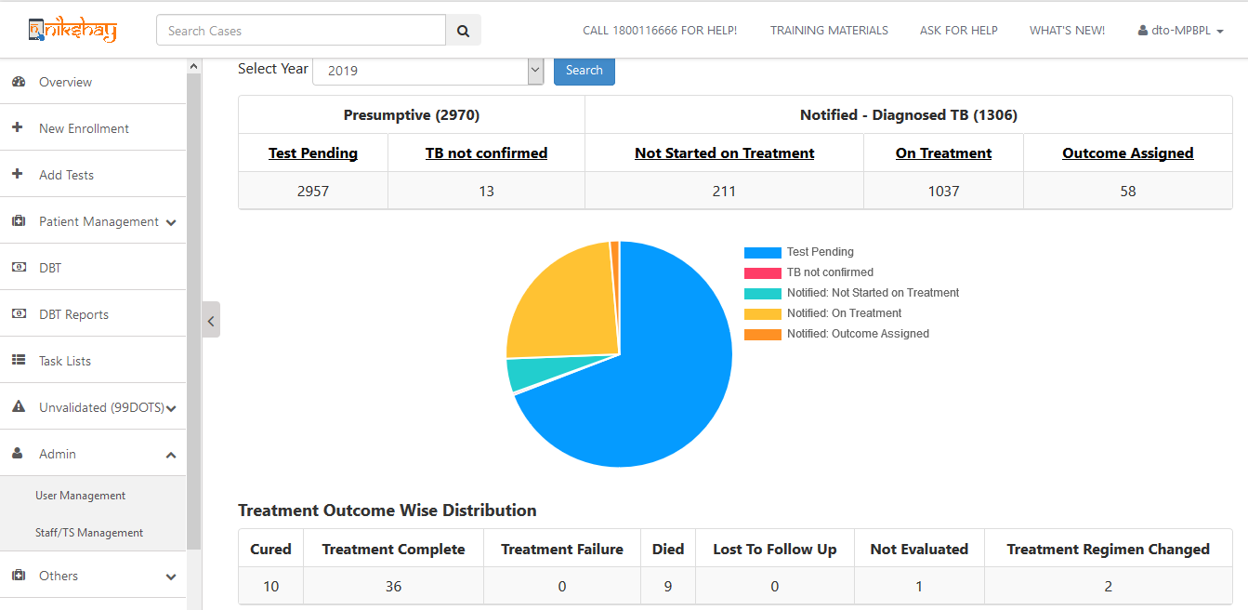
Menu Location
User Management option available under Admin Menu

Slide 4
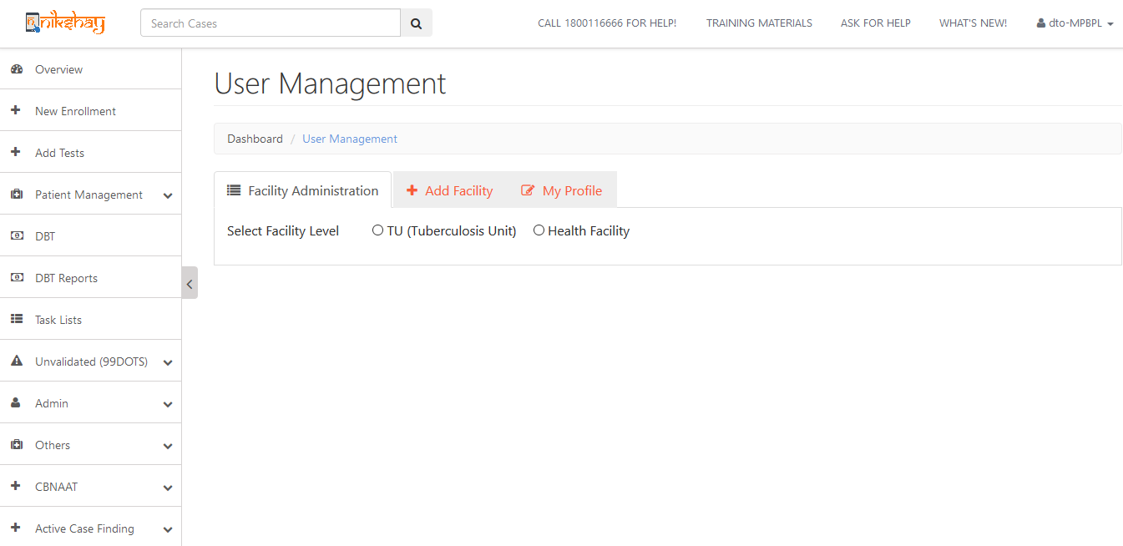
Select Operation
Modify Facilities
Create New Facilities
Modify Your own profile

Slide 5
Editing TU profile
Editing the name, address, MOTC/ STS/ STLS details

Slide 6
Select TU
Select TU

Slide 7
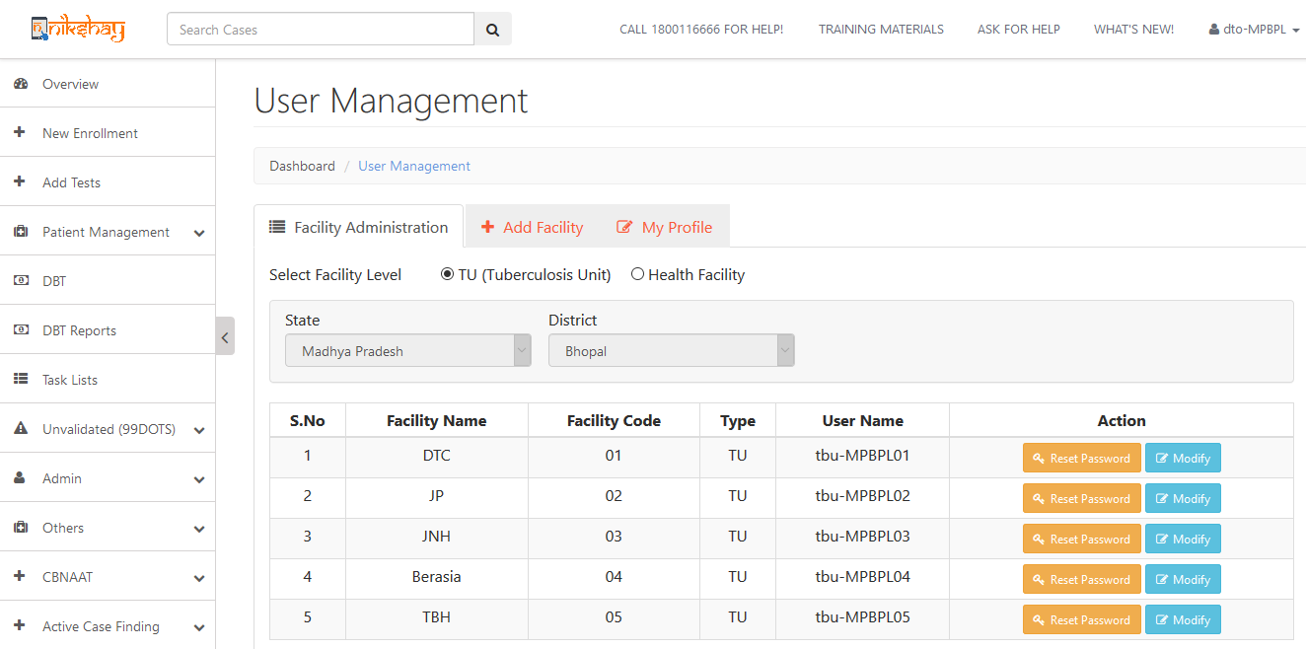
Select Action
Select Action to be performed for the TU

Slide 8
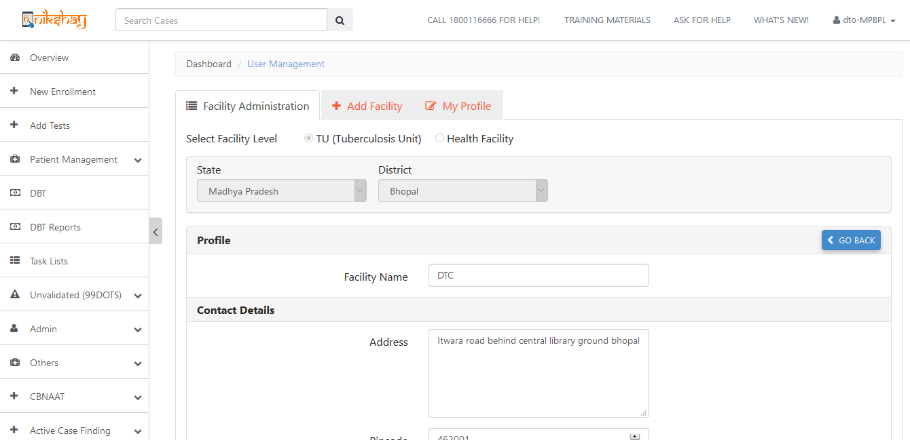
Edit necessary details -1
Wait for data to auto-populate
Edit as necessary

Slide 9
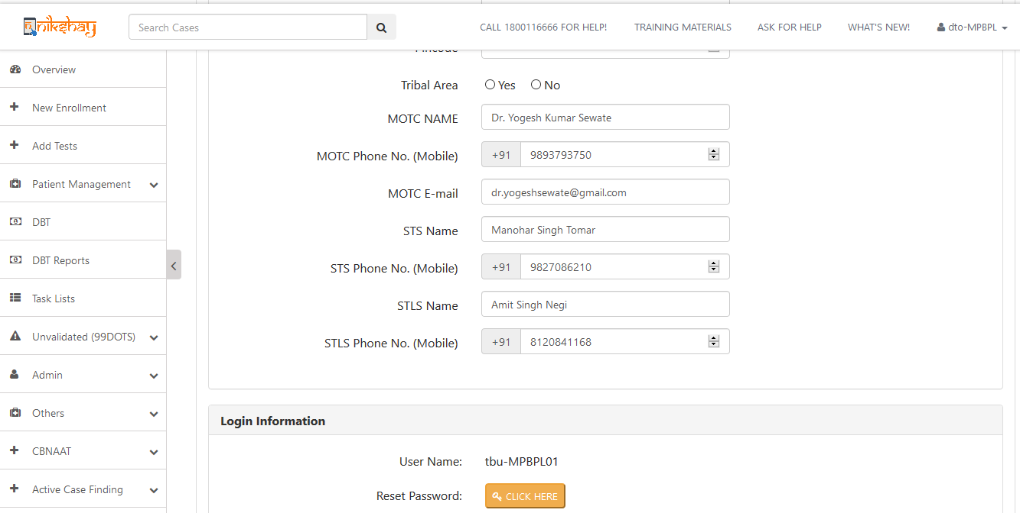
Edit necessary details -2
Any phone number updates may be done from here
Edit as necessary
View/ edit User Credentials

Slide 10
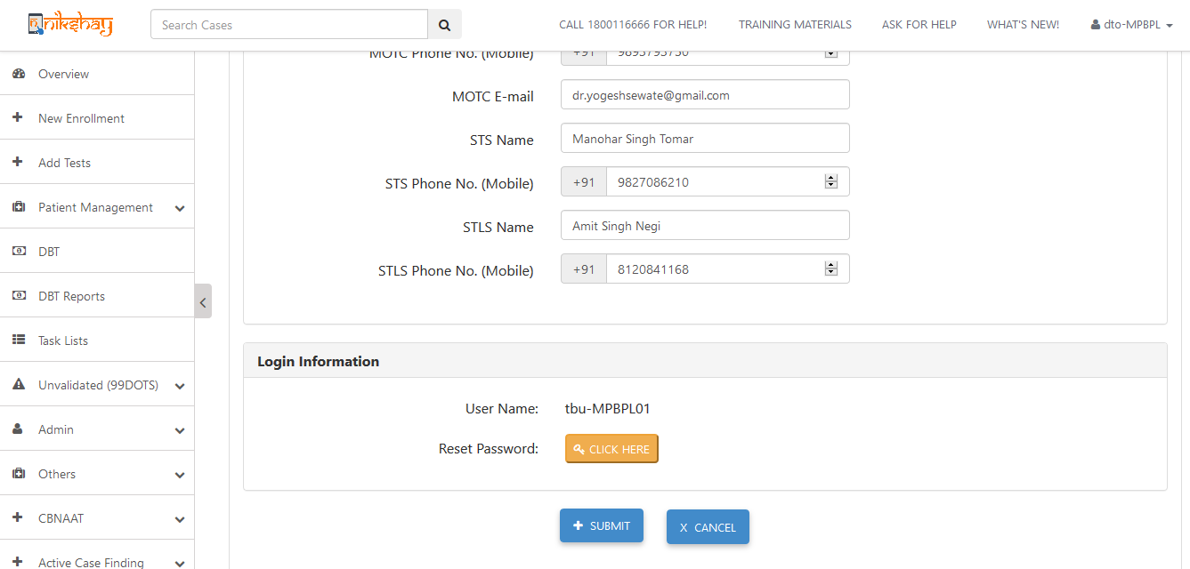
Submit
Click submit to save changes

Slide 11
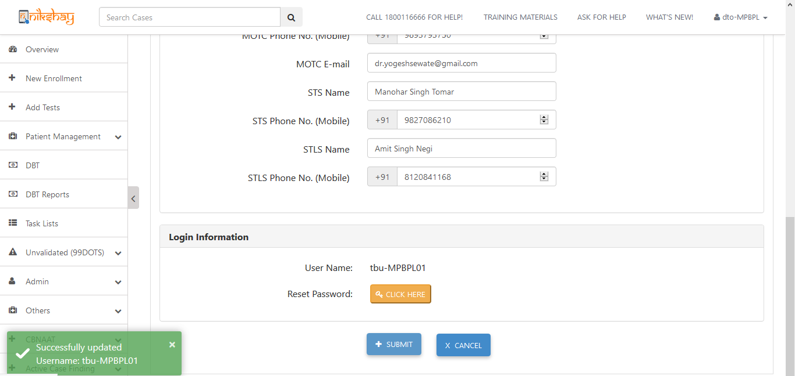
Wait for confirmation
Wait for confirmation message

Slide 12
Edit PHI/ Pvt HF Profile

Slide 13
Select Facility Type to be edited
Select Health Facility

Slide 14
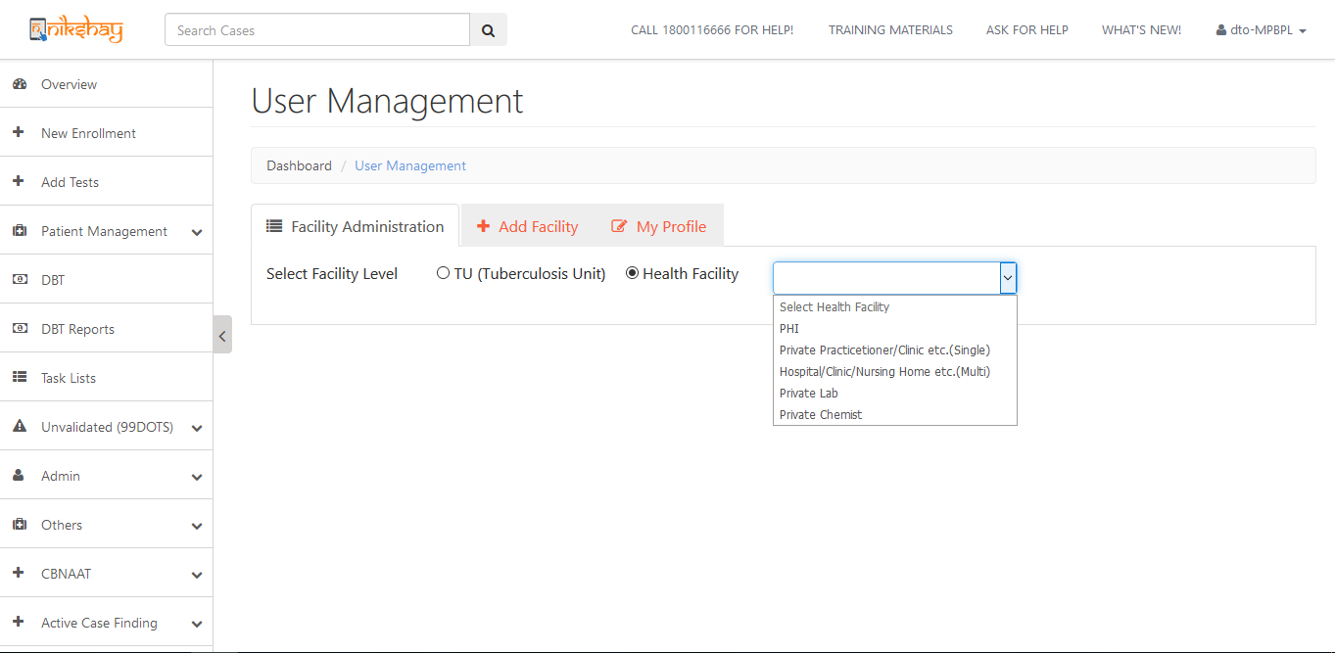
Select Facility Type to be edited
Select Health Facility type to be edited

Slide 15
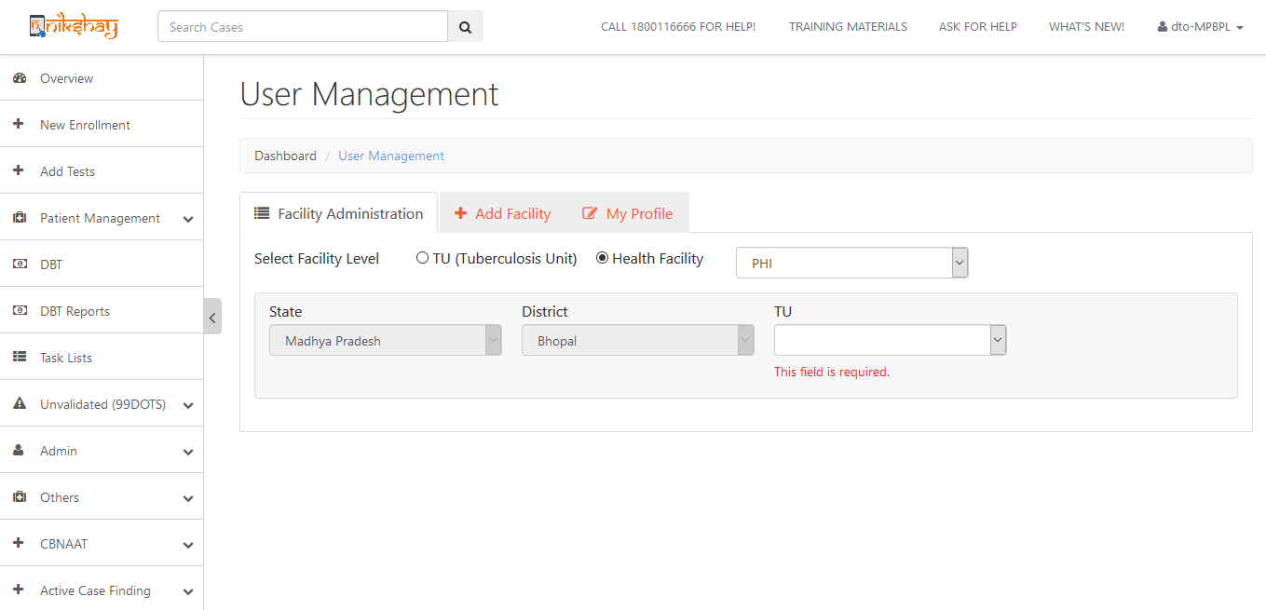
Select TU
Select State District & TU

Slide 16
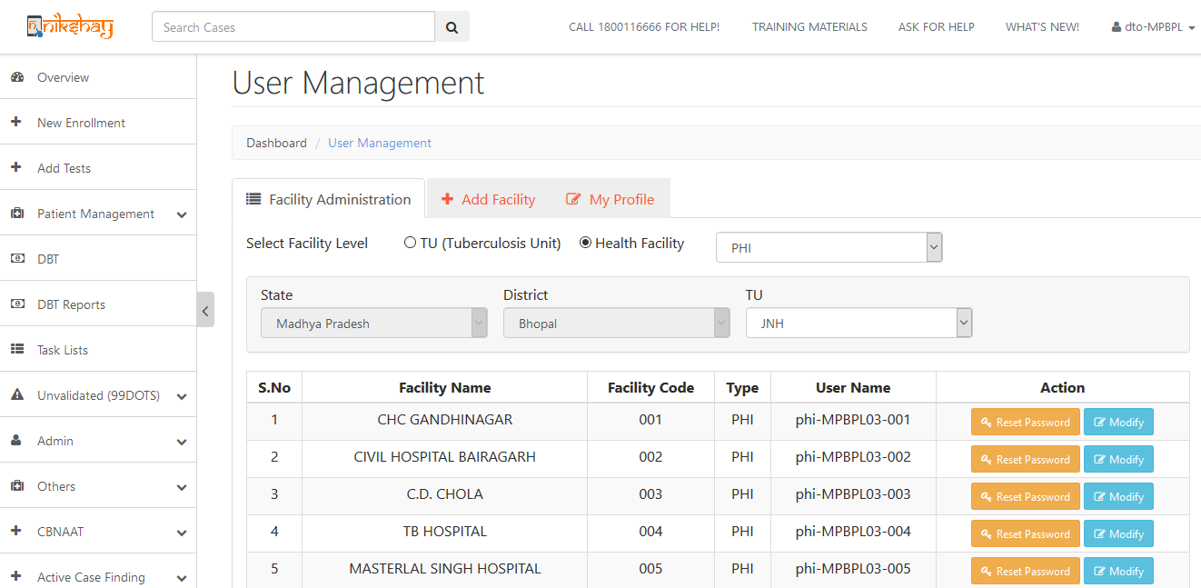
Click Modify to edit
Click Modify on the PHI for which profile need to be edited

Slide 17
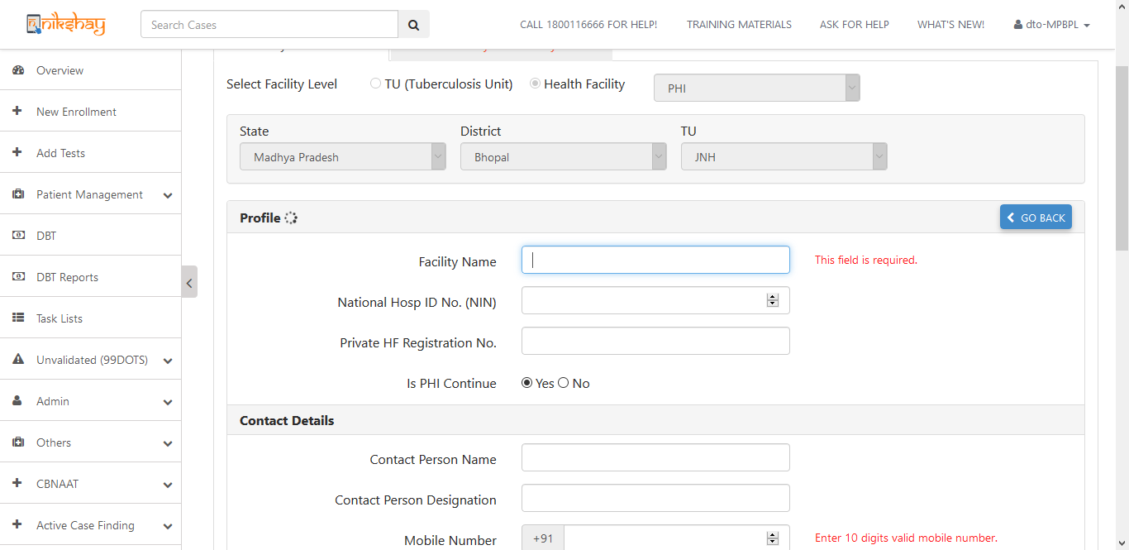
Edit as necessary -1
Wait for details to autofill

Slide 18
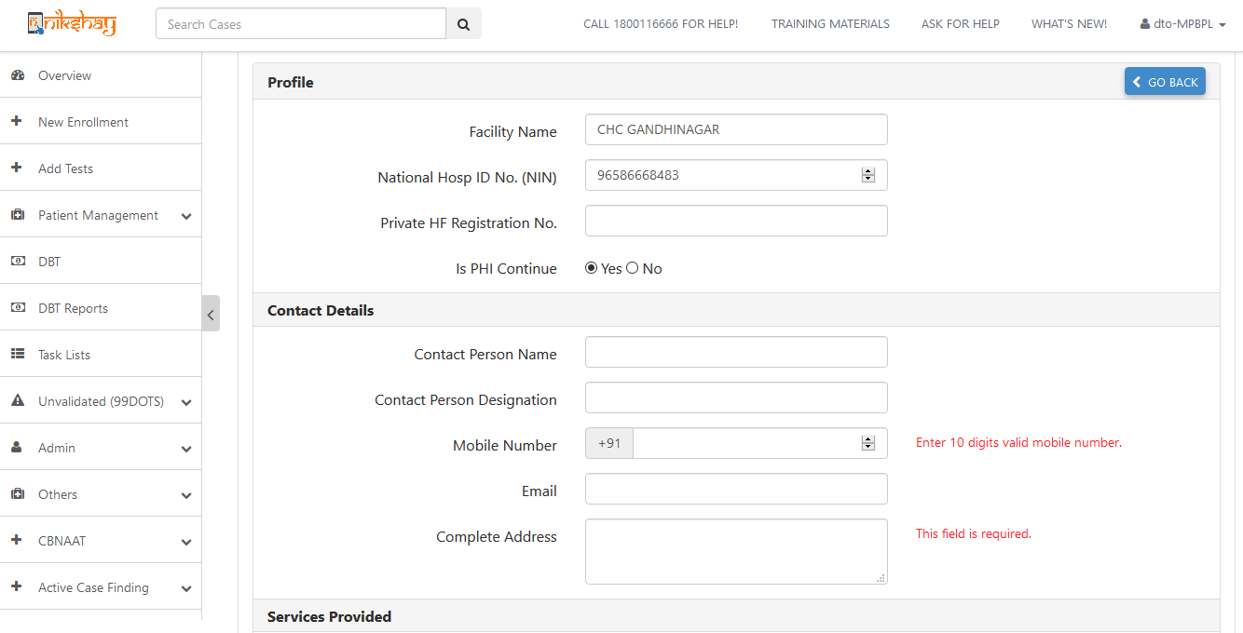
Edit as necessary -2
Edit Auto filled information

Slide 19
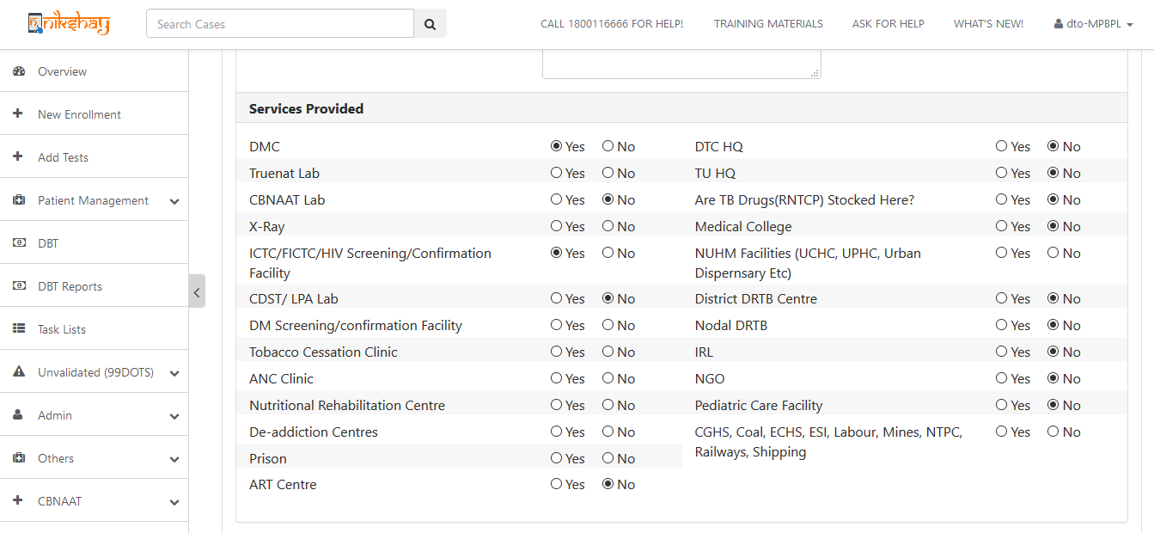
Edit as necessary -3
Edit the Services provided
Based on this selection various dropdown menus will be adjusted

Slide 20
Adding Facilities

Slide 21
Select Facility Type to add
Select TU/ Health Facility as required

Slide 22
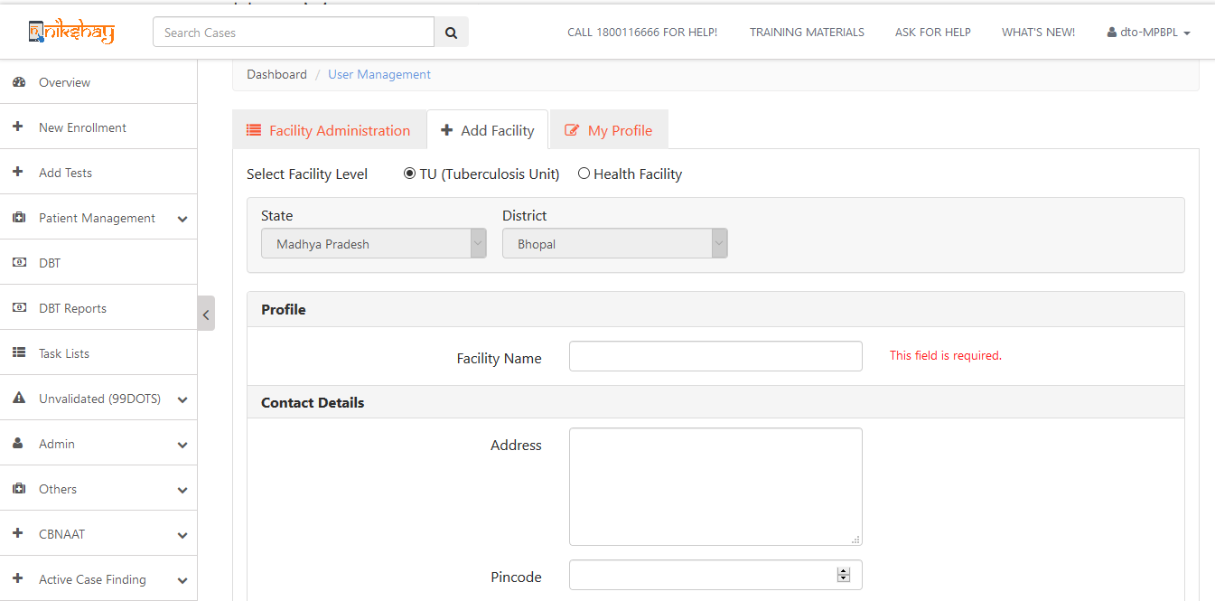
Enter profile details
Fill in the necessary details

Slide 23
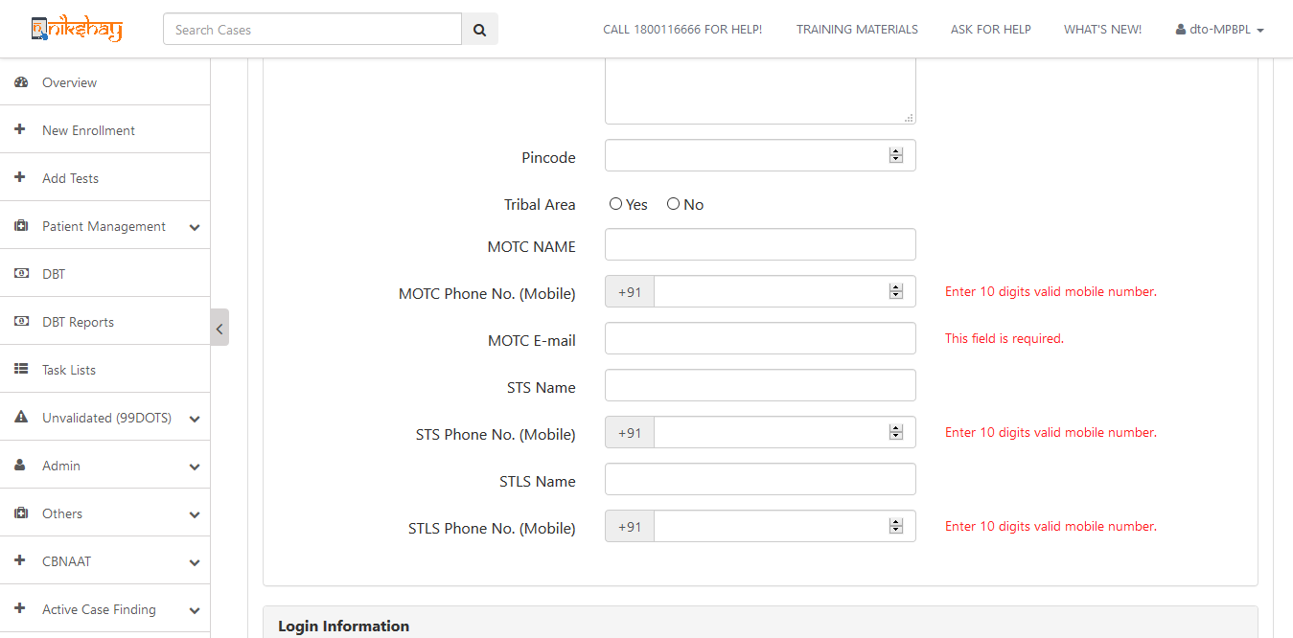
Enter profile details
Fill in the necessary details

Slide 24
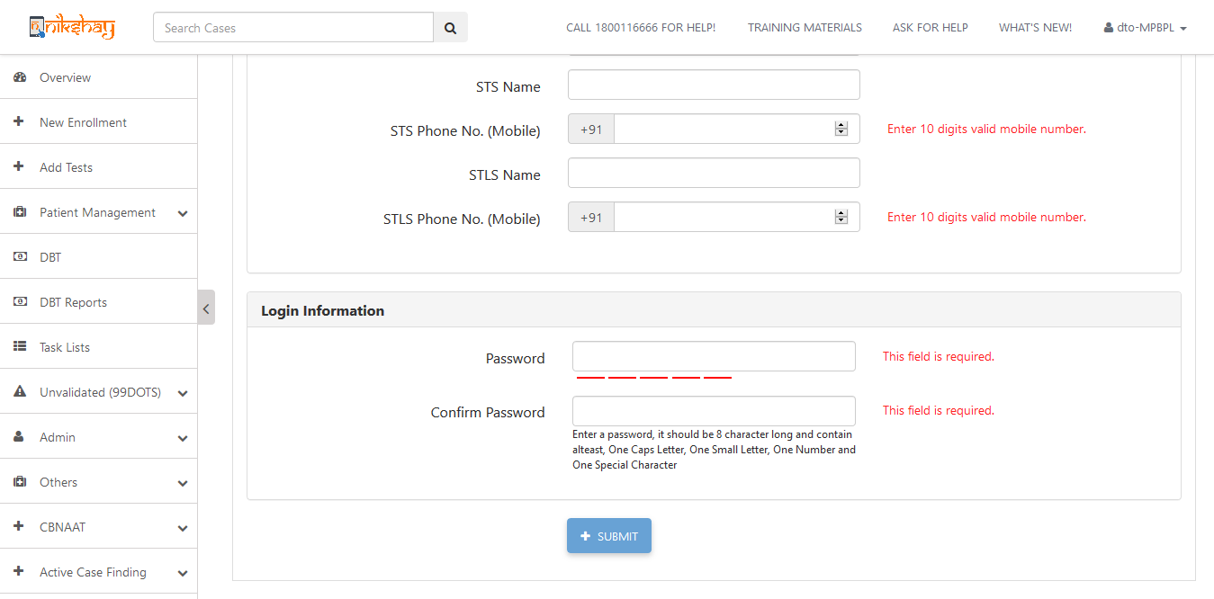
Enter password
Enter Password
Note the password being entered
Click Submit and wait for confirmation message

Slide 25
NOTE:
The designated in charge personnel of the facility is required to maintain their own usernames and passwords and of those below their level. in a secure manner.
If a password is created/changed it has to be maintained securely by the user changing it and communicated to the relevant authority.
Password reset for any facility should only be done with the concurrence of the competent authority.

Slide 26
Thankyou!

