Slide 1
User Management - Merge

Slide 2
Description of Changes
    Existing Problem:
    Currently in Nikshay there are Health Facility records duplicated for various reasons. These erroneous records need to be cleaned by merging all related patient notifications, lab records and users into the original Health facility.
    The new feature:
    Merge a duplicate Health Facility record into the original record that need to be maintained .
    User can select the type of Health Facilities that they choose to merge.
    When a Health Facility is merged, all linkages with patients, tests, staff, DBT records etc of the Merged Health Facility are relinked to the retained Health Facility. After merging the merged HF will no longer be visible in User Management.
    Whenever a Health facility gets merged, a notification is sent to the parent hierarchies (State, District, TU and concerned Health Facilities)

Slide 3
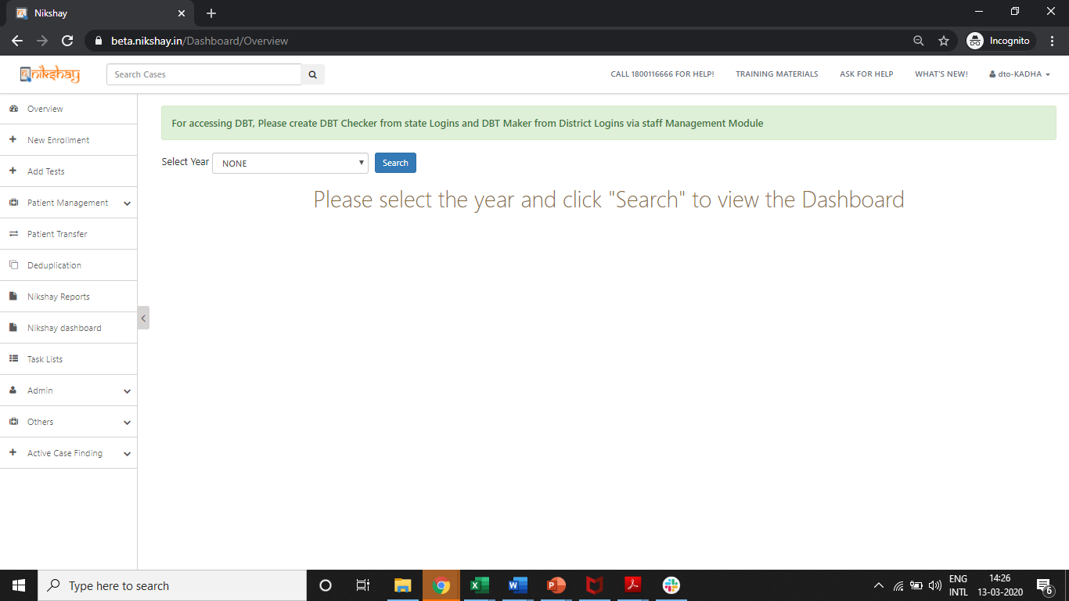
User Management – Merge Health Facility
Step 1
Click on Admin

Slide 4
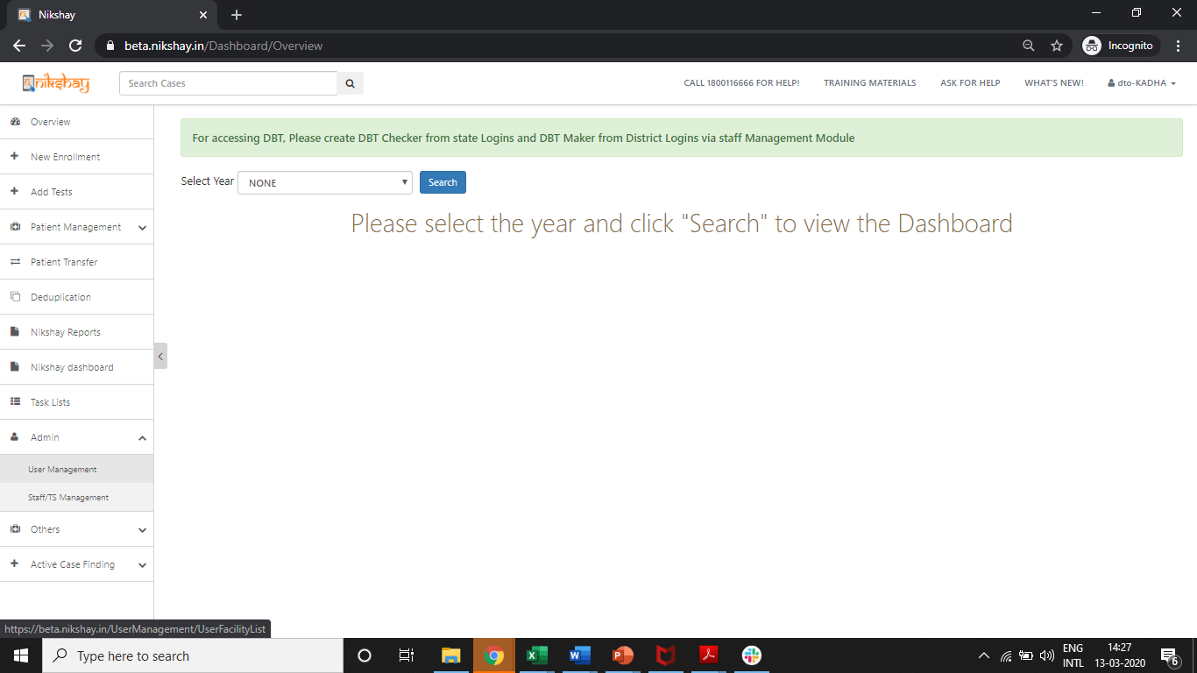
User Management – Merge Health Facility
Step 1
Step 2
Click on Admin
Click on User Management

Slide 5
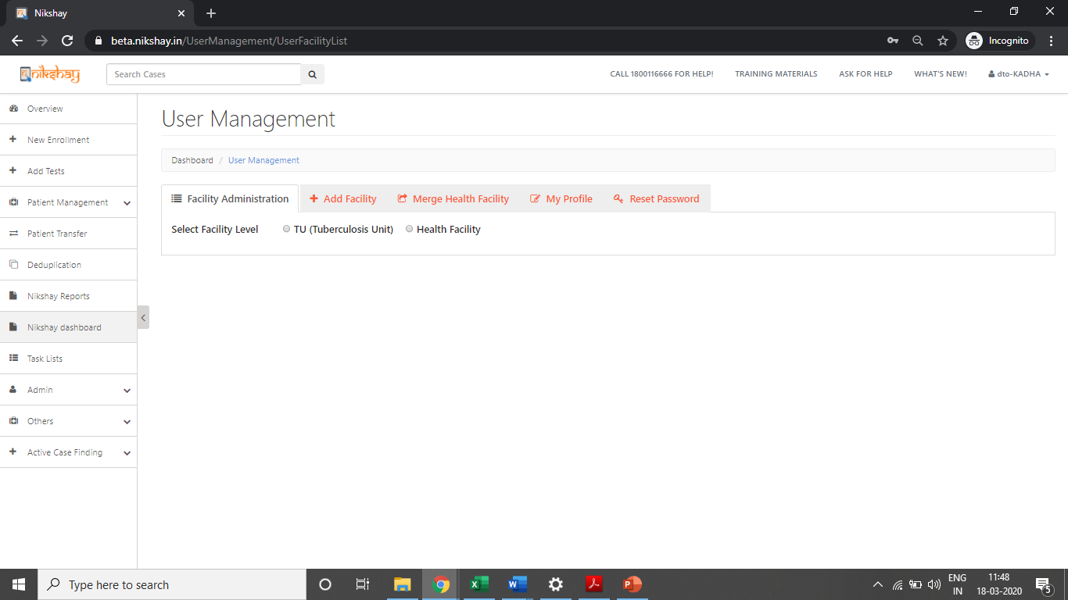
User Management – Merge Health Facility
Step 1
Step 2
Step 3
Click on Admin
Click on User Management
Click on Health Facility Merge

Slide 6
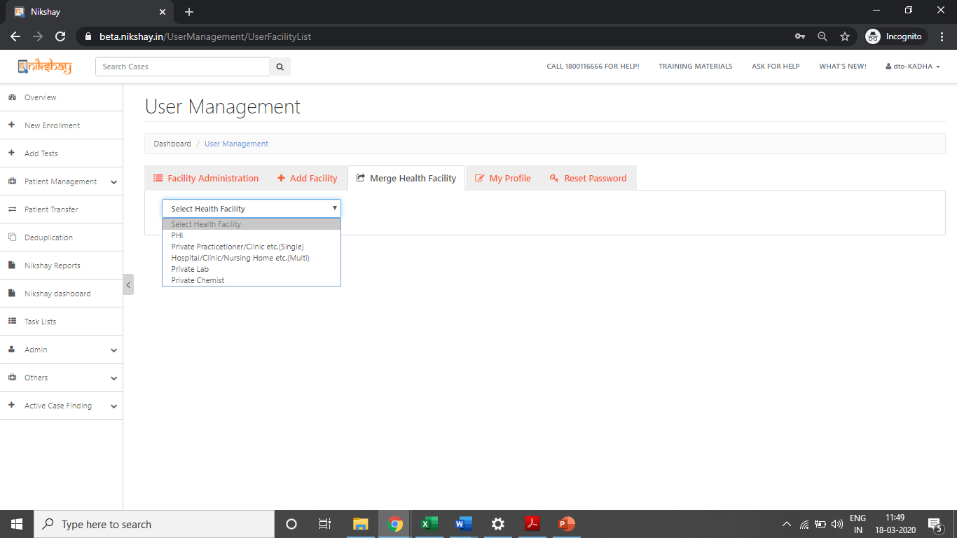
User Management – Merge Health Facility
Step 1
Step 2
Step 3
Step 4
Click on Admin
Click on User Management
Click on Health Facility Merge
Select the Type of Health Facility that is to be Merged

Slide 7
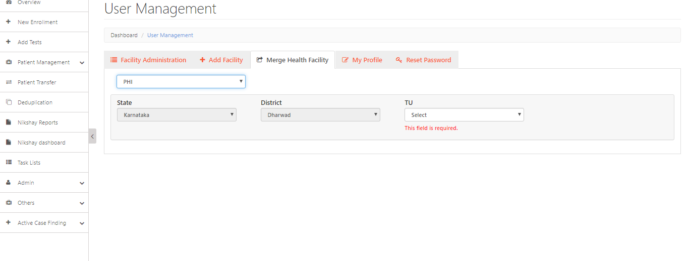
User Management – Merge Health Facility
Step 1
Step 2
Step 3
Step 4
Step 5
Click on Admin
Click on User Management
Click on Health Facility Merge
Select the Type of Health Facility that is to be Merged
Select the TU

Slide 8
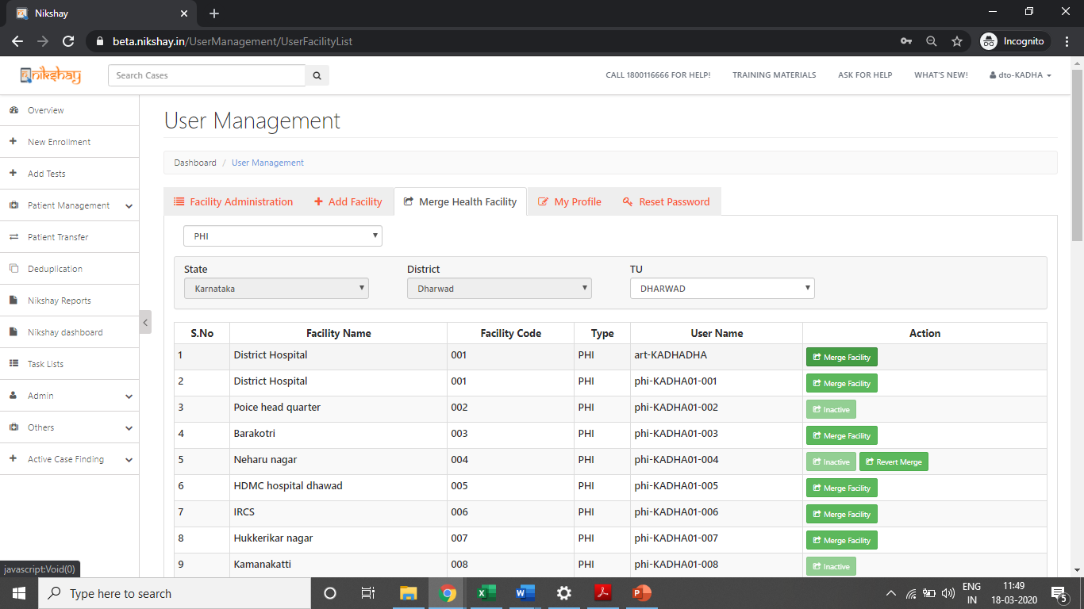
User Management – Merge Health Facility
Step 6
Click on Merge Facility
  Select the facility that needs to be merged with another facility. This facility will disappear after the merge is completed
Duplicated record
On Selecting the TU, the list of PHIs that are under the TU are displayed.

Slide 9
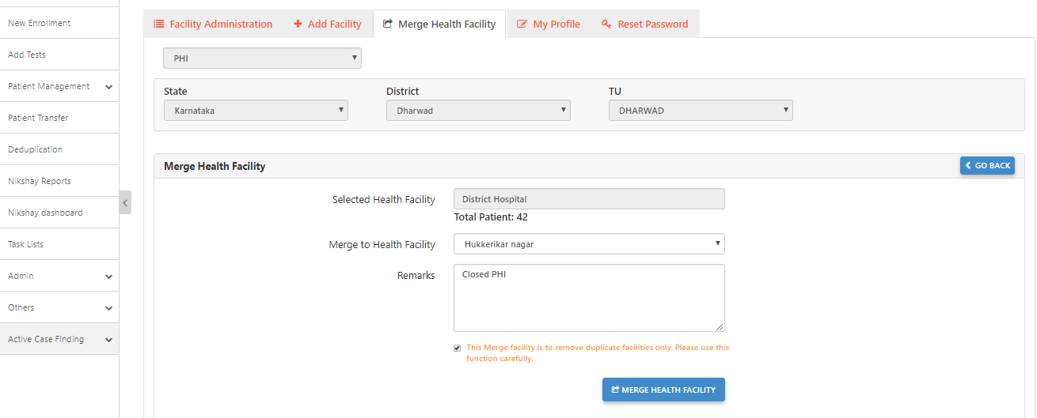
User Management – Merge Health Facility
Step 6
Step 7
Click on Merge Facility
Enter details required and click on Merge Health Facility
Note the number of patient records that this will affect
Select the Health Facility, Enter Remarks and tick the Check Box
Select the Health Facility where the previously selected PHI will be merged into.
This facility will be retained
Click here to process the Merge Request

Slide 10
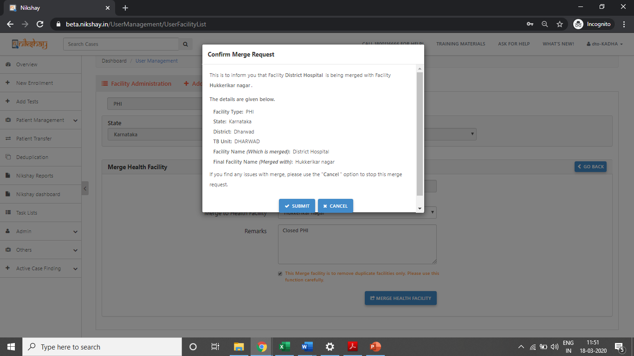
User Management – Merge Health Facility
Step 6
Step 7
Step 7
Click on Merge Facility
Enter details required and click on Merge Health Facility
Click on Submit Button
Review the information before submitting the Merge Request

Slide 11
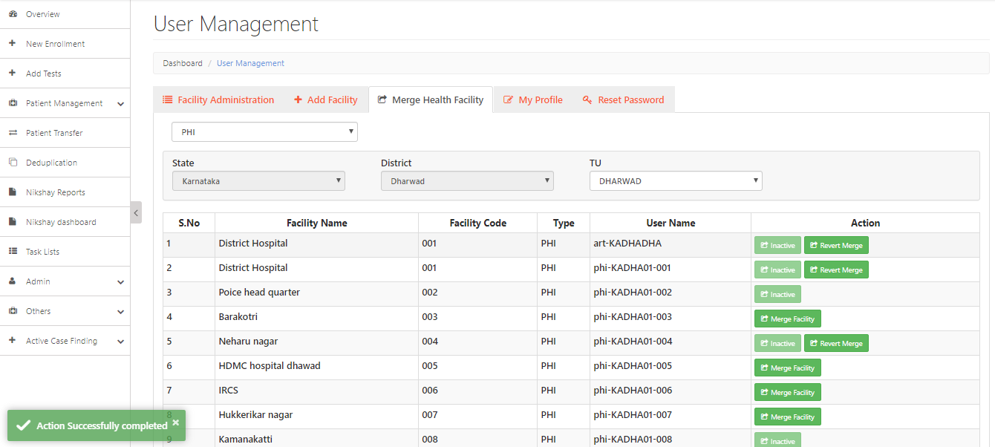
User Management – Merge Health Facility
  NOTE:
  - This is a time-consuming process and may take a few seconds to a few minutes to complete. Please do not refresh or close the page before the success message.
  - For merging PHI’s within a TU, with more than 500 patients, Please reach out to Nikshay Helpdesk by raising a service request via “Ask for Help” section.
  Message displayed after successful submission of Merge Request

Slide 12
User Management – Revert Merge Health Facility
Step 1
Click on Revert Merge
  NOTE: Please use this function sparingly and cautiously. This may result in errors in data.
  Facility to Revert Merge appears for 7 days after Merge

Slide 13
Merging Private Health Facilities
    In cases, where the Health Facility Type is different, then the base of the Health Facility Merge must be a “Hub”. Eg: If a Hub and Lab is being merged merge, then a Lab can merge into Hub, but a Hub cannot merge into a Lab.
    Implications on DBT:
  Beneficiary details will be retained, based on the beneficiary status of the merged and retained health facility.
  Beneficiary status of the retained health facility will be given a high priority and the corresponding merged health facility beneficiary status will be made inactive.
  If the beneficiary status is “Validated” for both the health facilities, then the beneficiary details of the Health Facility that is retained will be kept.

Slide 14
User Management – Merge Private Health Facility
Step 1
Click on Admin

Slide 15
User Management – Merge Private Health Facility
Step 1
Step 2
Click on Admin
Click on User Management

Slide 16
User Management – Merge Private Health Facility
Step 1
Step 2
Step 3
Click on Admin
Click on User Management
Click on Health Facility Merge

Slide 17
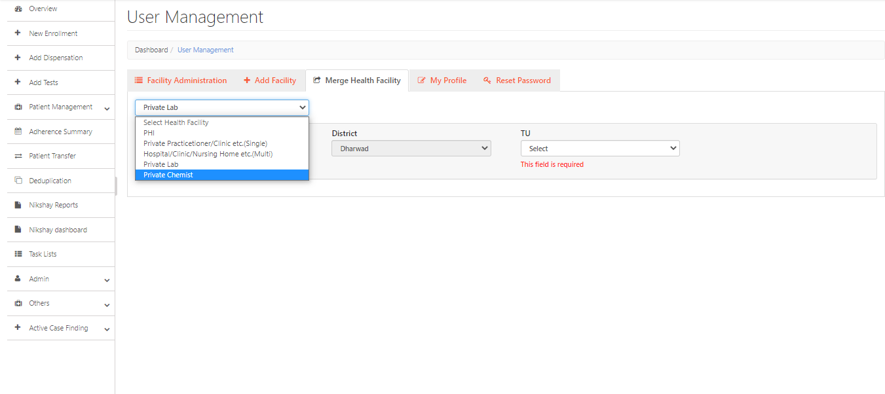
User Management – Merge Private Health Facility
Step 1
Step 2
Step 3
Step 4
Click on Admin
Click on User Management
Click on Health Facility Merge
Select the Type of Private Health Facility that is to be Merged

Slide 18
User Management – Merge Private Health Facility
Step 1
Step 2
Step 3
Step 4
Step 4
Click on Admin
Click on User Management
Click on Health Facility Merge
Select the Type of Private Health Facility that is to be Merged
Select the TU
  Note: In cases, where the Health Facility Type is different, then the base of the Health Facility Merge must be a “Hub”. Eg: If a Hub and Lab is being merged merge, then a Lab can merge into Hub, but a Hub cannot merge into a Lab.

Slide 19
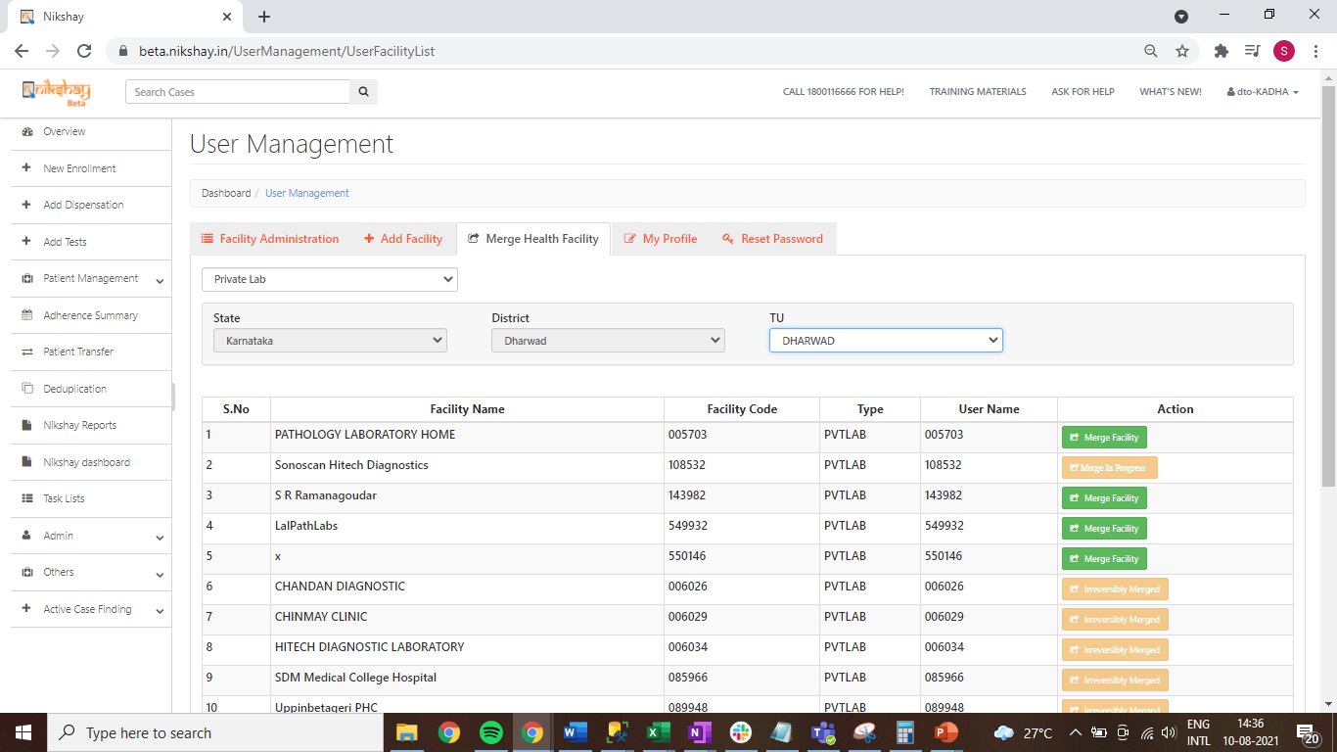
User Management – Merge Private Health Facility
Step 6
Click on Merge Facility
  Select the facility that needs to be merged with another facility. This facility will disappear after the merge is completed
On Selecting Private Lab, the list of Labs that are under the TU are displayed.

Slide 20
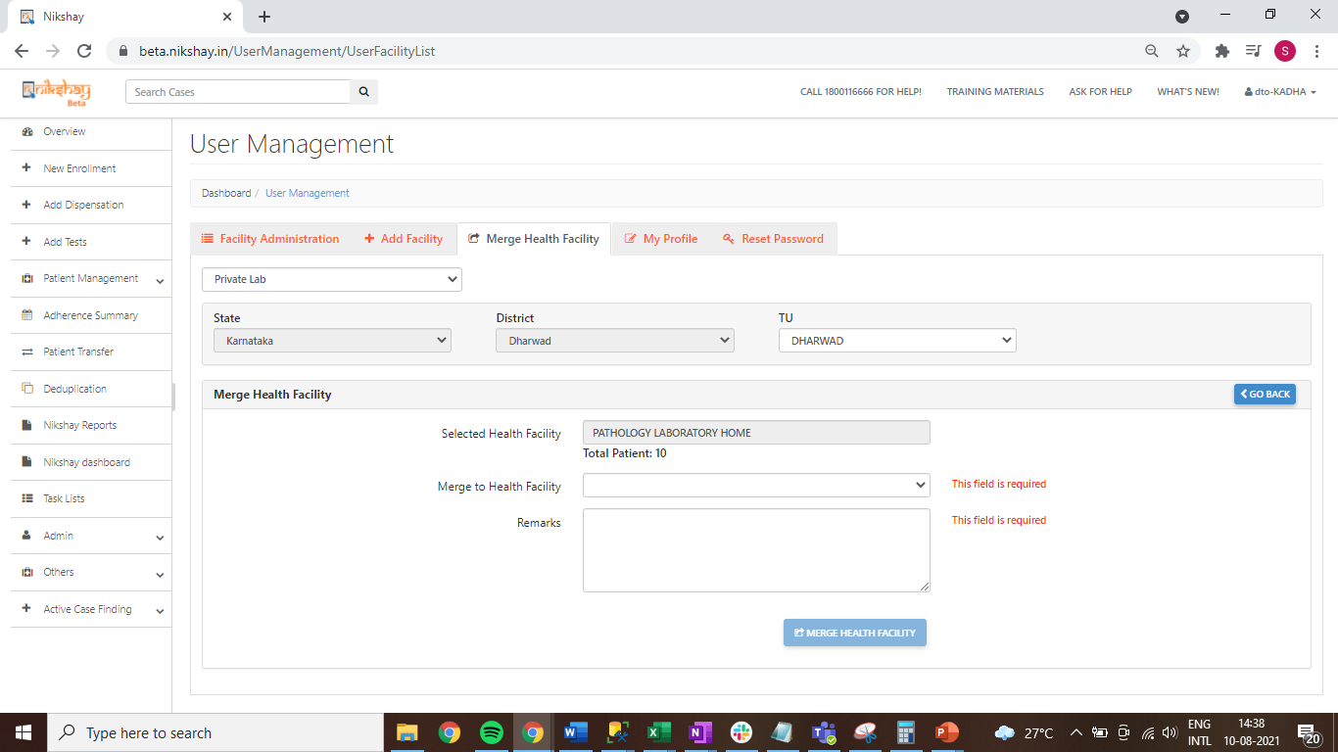
User Management – Merge Private Health Facility
Step 6
Step 7
Click on Merge Facility
Enter details required and click on Merge Health Facility
Note the number of patient records that this will affect
Select the Health Facility, Enter Remarks and tick the Check Box
Select the Health Facility where the previously selected Private facility will be merged into.
This facility will be retained
Click here to process the Merge Request

Slide 21
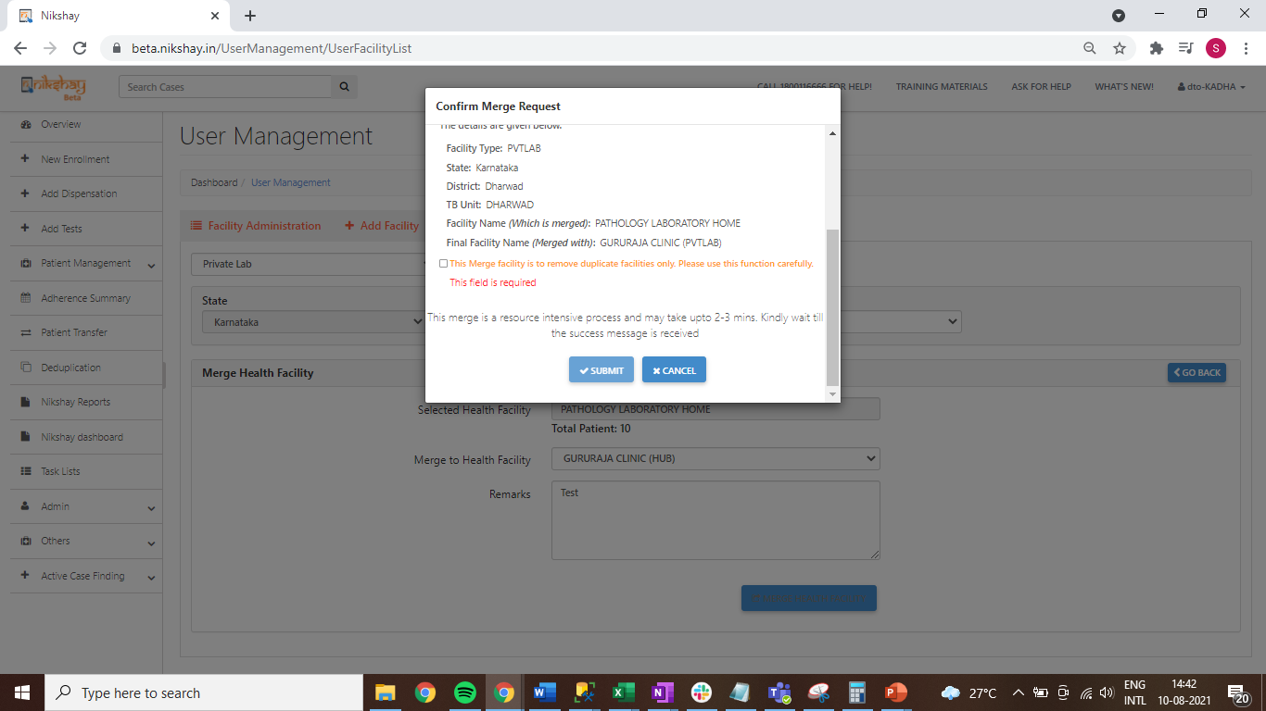
User Management – Merge Private Health Facility
Step 6
Step 7
Step 7
Click on Merge Facility
Enter details required and click on Merge Health Facility
Click on Submit Button
Review the information before submitting the Merge Request
Review the information and select the checkbox

Slide 22
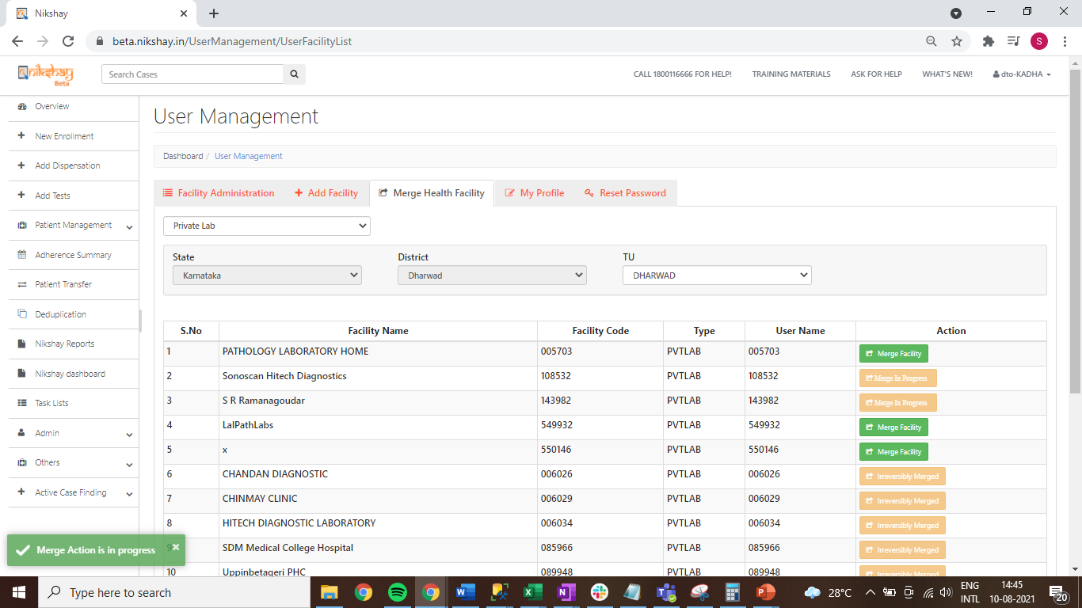
User Management – Merge Private Health Facility
  NOTE:
  - This is a time-consuming process and may take a few seconds to a few minutes to complete. Please do not refresh or close the page before the success message.
  - For merging health facilities within a TU, with more than 500 patients, Please reach out to Nikshay Helpdesk by raising a service request via “Ask for Help” section.
  Message displayed after successful submission of Merge Request

Slide 24
THANK YOU

