Slide 1
Module 5: Module 5: Nikshay Poshan Yojana and Tribal Support Scheme

Slide 2
Overview of Nutrional Support scheme
This scheme is aimed at providing financial support to TB patients for their nutrition. All TB patients notified in Ni-kshay (across India) are eligible to get the benefit under this scheme to mitigate catastrophic costs.
As per the scheme rules, Ni-kshay generates benefits for TB patients. The process that needs to be followed to make payments to the TB patients under this scheme.
The 1st incentive will generate with Rs. 1000 and alternate benefits will generate with Rs.500 after every 28 days till treatment completion for 1st April 2018 to till 31st December 2023
For all TB patient enrolled after 1st Jan’2024 date, Ni-kshay will generate benefits on the new logics automatically from their diagnosis date (Irrespective of the date of enrollment in Nikshay). The benefit generation schedule for the 1st and 2nd incentives will be every 84 days with Rs 1500. Subsequent incentives will be generated every 28 days if end date is extended with Rs 500.

Slide 3
How are NPY Benefits generated by Ni-kshay
All the incentives are being paid in the advance
Benefits are generated only till the end date has not passed.
Once the end date has passed, benefit generation will stop. To continue benefit generation, end date has to be updated
Benefits will get auto calculated, when an outcome is updated.
Once end date is updated then system will recalculate benefits as per treatment duration and rest unprocessed (Maker_pending & Approver_Pending) benefit will delete if any created.
If all benefits are under “Maker_Pending” process at the time of outcome then system will create a single benefits for whole amount.
If outcome is not updated on time and benefits via Ni-kshay has been processed. Then no benefits will be getting recalculated, if outcome is updated later in Ni-kshay.

Slide 4
How are NPY Benefits generated by Ni-kshay as per Nov’ 2024 logics
Date of diagnosis >= 1st of November 2024 ( New Logic on INR 1000/Month)
For all TB patient diagnosed after this date, Ni-kshay will generate benefits on the new logic automatically from their diagnosis date (Irrespective of the date of enrollment in Nikshay)
For all intents and purposes it will be the same as the flow above apart from the amount being increased from 500 to 100 per month
Incentive 1 and 2 will be generated in advance and 3rd will be generated if EndDate is extended for a 28-day time period.
The amount would remain 3000 INR for the First two benefits and INR 1000 of the duration for which the TB patient would remain on treatment (EndDate - benefit generation date) .
The amount would remain the same for both types of treatment - DSTB and DRTB.
Incentive Number | Amount | Logics | Dosing Days Range
1 | Rs. 3000 | on the midnight “Date of diagnosis”. | 0-84
2 | Rs. 3000 | on the midnight of 84 days from “Date of TB Treatment initiation” | 85-168
3rd Incentive( If Applicable) | Rs. 1000 | Treatment Initiation date + 169 days | 169-196
4th till Outcome will follow the logics same as 3rd Incentive | Rs. 1000 | if End Date is beyond the date and if the beneficiary is On Treatment. (3rd benefits + 28 days) | 197-224

Slide 5
Implementation plan and Arrears calculation
Patients Diagnosed After 1st November :
The benefit with revised DBT amount in Ni-kshay are generated for all patients diagnosed and on treatment on or after 1st November.
Patients Diagnosed Before 1st November:
For patients diagnosed and on treatment before 1st November, the concept of arrears has been introduced.
What are Arrears?:
Arrears represent the additional payment owed to patients due to the revised scheme amount applicable from 1st November.
Eligibility for Arrears:
Arrears apply to patients who were eligible for their second benefit or any recurring benefits post 1st November, based on the revised Direct Benefit Transfer (DBT) scheme amount.
Benefit Table Updates:
The additional payment, calculated as arrears, is included in the current benefit table for eligible patients.
Way forward
From January onwards - all benefits to be generated as per revised policy guidelines ir Rs 3000||3000||1000.

Slide 6
How are NPY Benefits generated by Ni-kshay as per Nov’ 2024 logics for arrears cases which are “On Treatment”
Benefit generation for arrears cases as per new logic with Rs. 1000 per month (28 Days)
Diagnosis | Treatment start date | Benefit Type | Expected Benefit Schedule as per new guidelines | Received so far | Arrears to be received
Aug’24- Nov’24 | Aug’24- Nov’24 | Second Benefit | ₹3000/- | ₹1500/- | ₹1500/-
Dec’23 onwards | Dec’23 onwards | Recurring Benefit | ₹1000/- | For Nov- ₹500/- | ₹500||₹500= 1000/-
 |  |  |  | For Dec ₹500/- | ₹500/-= ₹500/-

Slide 7
How are NPY Benefits generated by Ni-kshay as per Nov’ 2024 logics for arrears cases which are “On Treatment”
Episode Diagnosis Date | Episode Treatment Duration | Expected Benefit Schedule | Comments
1st January 2023 | 1st February - 20th July 2023 (171 days - 6 months) | INR 1000 | INR 500 | INR 500 | INR 500 | INR 500
1st December 2023 | 1st February - 1st December 2024 (305 days - 10 months) | INR 1000 | INR 500 | INR 500 | INR 500 | INR 500 | INR 500 | INR 500 | INR 500 | INR 500 | No treatment month started and completed after 1st November 2024
1st December 2023 | 26th January - 1st December 2024 (312 days - 10 months) | INR 1000 | INR 500 | INR 500 | INR 500 | INR 500 | INR 500 | INR 500 | INR 500 | INR 500 | INR 1000 (revised) | 1 treatment month started and completed after 1st November 2024
1st January 2024 | 1st February - 20th July 2024 (171 days - 6 months) | INR 1500 | INR 1500
1st January 2024 | 1st February - 1st December 2024 (305 days - 10 months) | INR 1500 | INR 1500 | INR 500 | INR 500 | INR 500 | INR 500 | No treatment month started and completed after 1st November 2024
1st January 2024 | 26th January - 1st December 2024 (312 days - 10 months) | INR 1500 | INR 1500 | INR 500 | INR 500 | INR 500 | INR 500 | INR 1000 | 1 treatment month started and completed after 1st November 2024
1st April 2024 | 1st April - 1st December 2024 (245 days - 8 months) | INR 1500 | INR 1500 | INR 500 | INR 500 | No treatment month started and completed after 1st November 2024

Slide 8
How are NPY Benefits generated by Ni-kshay as per Nov’ 2024 logics for arrears cases which are “On Treatment”
Episode Diagnosis Date | Episode Treatment Duration | Expected Benefit Schedule | Comments
1st July 2024 | 1st July - 16th December 2024 (169 days - 6 months) | INR 1500 | INR 1500 | INR 500 (arrear upon revision) | 2nd incentive already generated in advance hence arrear benefit for 1 revised month created
1st August 2024 | 1st August 2024 - 16th January 2025 (169 days - 6 months) | INR 1500 | INR 1500 | INR 1000 (arrear upon revision) | 2nd incentive already generated in advance hence arrear benefit for 2 revised month created
1st July 2024 | 1st July - 1st December 2024 (154 days - 5 months) | INR 1500 | INR 1500 / INR 1000 | As only 5 treatment months were completed hence if 2nd incentive was in unpaid status it would be deleted and new benefit of INR 1000 will be created as per existing system behavior
1st August 2024 | 1st August - 31st December 2024 (153 days - 5 months) | Case 1 - INR 1500 | INR 1500 | INR 500 (arrear upon revision) | INR 1000 (revised) (will be deleted on outcome assignment if unpaid) | The patient has completed 3 treatment months before revision and 2 treatment month post revision, as first and second incentive would have been created before revision date hence arrear benefit of INR 500 would be created upon the patient starting 5th month of treatment, The 4th incentive of INR 1000 would be advance incentive created upon starting of 6th treatment month which would be deleted if unpaid at the time of outcome assignment.

Slide 9
Steps to be taken in Ni-kshay at TU Level
Step 1
Login with DBT Maker – staff ID

Slide 10
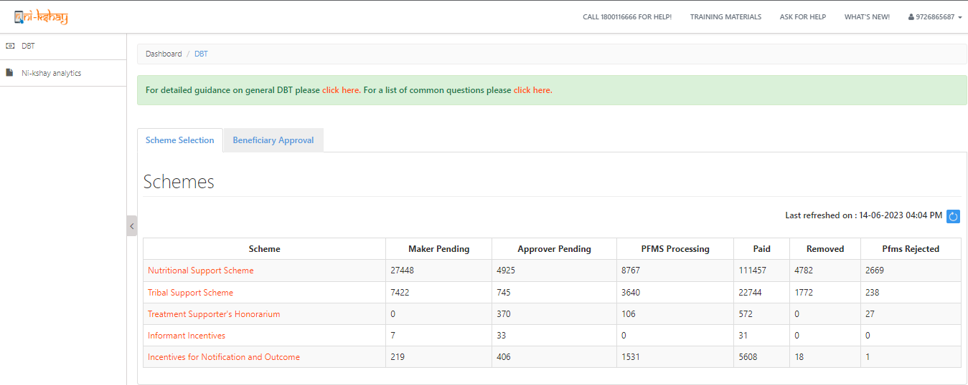
Steps to be taken in Ni-kshay at TU Level…
Step 1
Step 2
Login with DBT Maker – staff ID
Click on Scheme
Login from “DBT Maker – Staff ID”
Scheme wise, Benefit Payment status

Slide 11
Steps to be taken in Ni-kshay at TU Level…
Step 1
Step 2
Step 3
Login with DBT Maker – staff ID
Click on Scheme
Apply DBT Search Filter
Approved, under process at DTO or PFMS
Payments deferred
Approval Pending
Payments removed
Can Search using Patient ID
Payments made
Search filter to be applied based on the above parameter
For processing benefits, Click on Pending Tab and then apply search filter using the above options

Slide 12
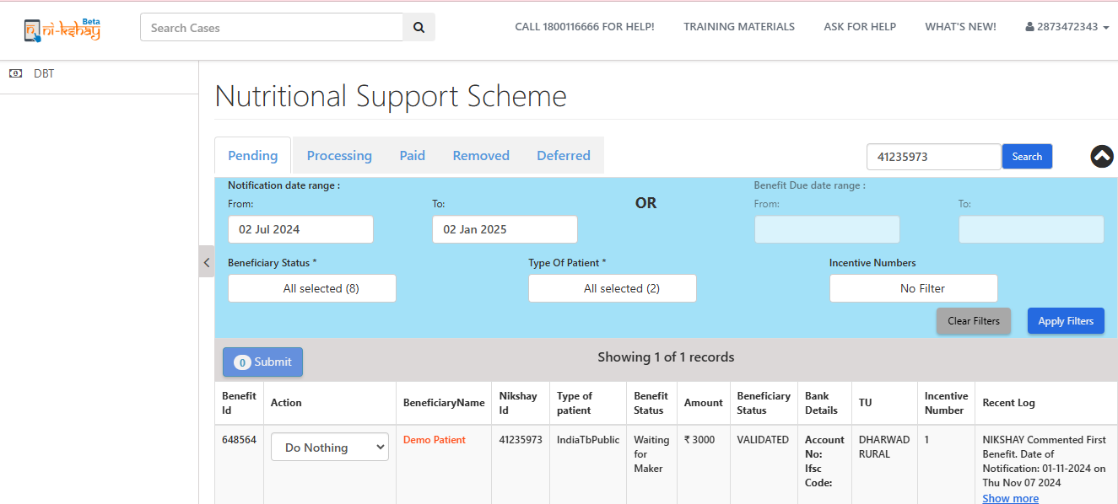
Steps to be taken in Ni-kshay at TU Level…
Step 1
Step 2
Step 3
Step 4
Login with DBT Maker – staff ID
Click on Scheme
Apply DBT Search Filter
View the List of Eligible Benefits
Bank details will not be allowed to edit from “DBT Maker” Login
Clicking on Patient name will allow user to view the patient data only

Slide 13
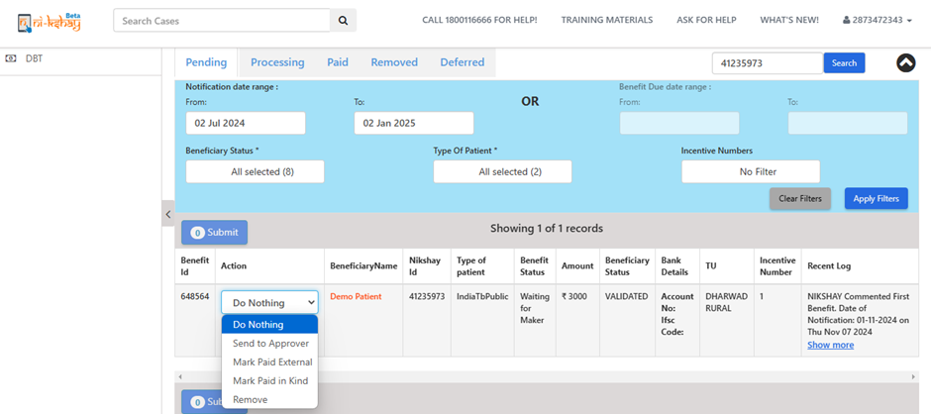
Steps to be taken in Ni-kshay at TU Level…
Step 1
Step 2
Step 3
Step 4
Login with DBT Maker – staff ID
Click on Scheme
Apply DBT Search Filter
View the List of Eligible Benefits
User can Approve only if Beneficiary is validated
“Remove” moves the Payment to “Removed” List
“Mark Paid External” allows user to tag in cases where patient is being paid outside Ni-kshay
Ni-kshay generates Beneficiary list to whom payment is due
Patient added to Pending list of Maker on next day of notification

Slide 14
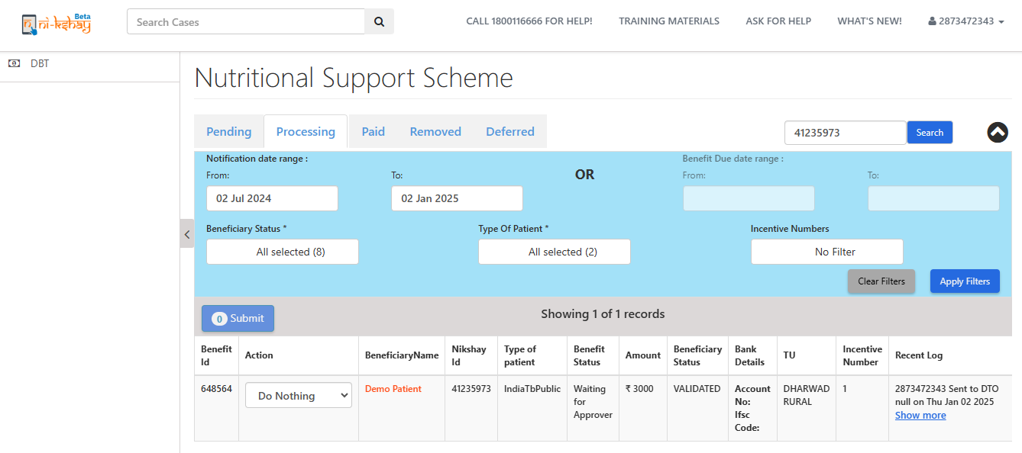
Steps to be taken in Ni-kshay at TU Level…
Step 1
Step 2
Step 3
Step 4
Login with DBT Maker – staff ID
Click on Scheme
Apply DBT Search Filter
View the List of Eligible Benefits

Slide 15
Steps to be taken in Ni-kshay at TU Level…
Step 1
Step 2
Step 3
Step 4
Step 5
Login with DBT Maker – staff ID
Click on Scheme
Apply DBT Search Filter
View the List of Eligible Benefits
Processing Benefits

Slide 16
Steps to be taken in Ni-kshay at DTO Level
Step 1
Login with DBT Checker– staff ID

Slide 17
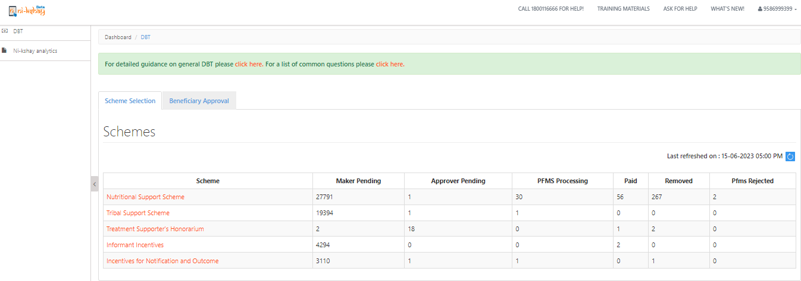
Steps to be taken in Ni-kshay at DTO Level
Step 1
Step 2
Login with DBT Checker – staff ID
Click on Scheme

Slide 18
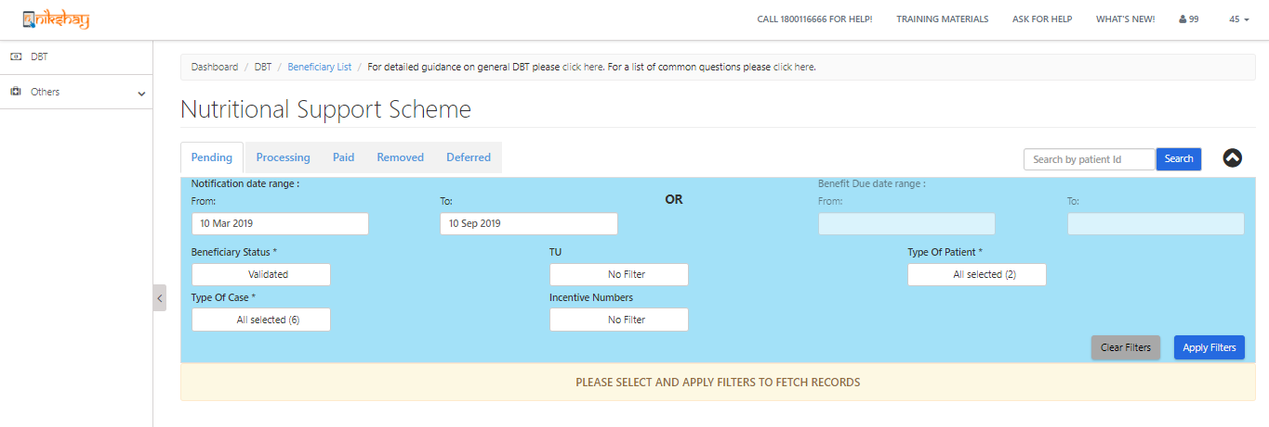
Steps to be taken in Ni-kshay at DTO Level
Step 1
Step 2
Step 3
Login with DBT Checker – staff ID
Click on Scheme
Apply DBT Search Filter
Can Search using Patient ID
Search filter to be applied based on the above parameter
For processing benefits, Click on Pending Tab and then apply search filter using the above options

Slide 19
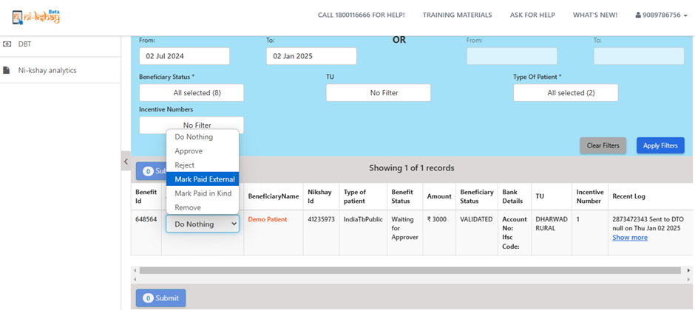
Steps to be taken in Ni-kshay at DTO Level
Step 1
Step 2
Step 3
Step 4
Login with DBT Checker – staff ID
Click on Scheme
Apply DBT Search Filter
View & Process Benefits
Now benefit approve the benefit which was approved DBT maker ID for payment
If you patient is not eligible for this benefit then you may reject/remove it.

Slide 20
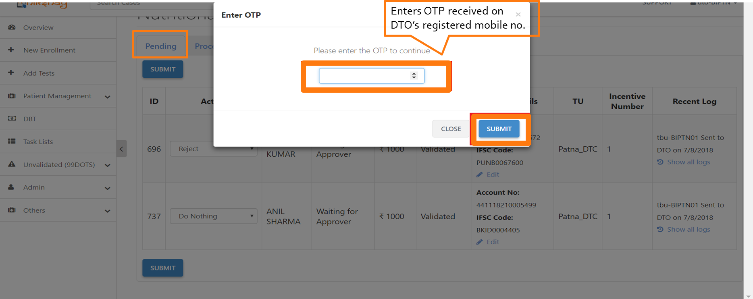
Steps to be taken in Ni-kshay at DTO Level
Step 1
Step 2
Step 3
Step 4
Login with DBT Checker – staff ID
Click on Scheme
Apply DBT Search Filter
View & Process Benefits

Slide 21
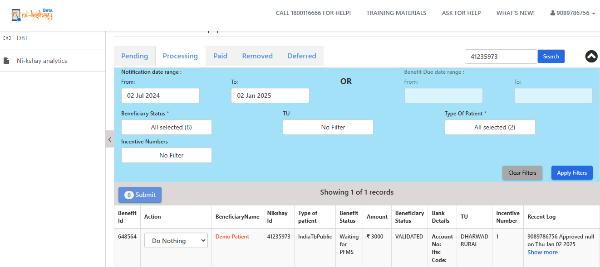
Steps to be taken in Ni-kshay at DTO Level
Step 1
Step 2
Step 3
Step 4
Step 5
Login with DBT Checker – staff ID
Click on Scheme
Apply DBT Search Filter
View & Process Benefits
View Benefit Status
The list of approved benefits will now be visible under “PROCESSING” tab with benefit status as “waiting for PFMS”. Once the PFMS accepts the benefit, the status will change to “PFMS accepted”. Once the payment is successfully processed from PFMS and amount is credited into beneficiary’s account, such benefits will show under the “PAID” tab.

Slide 22
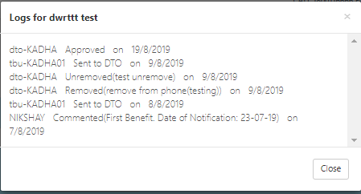
Steps to be taken in Ni-kshay at DTO Level
Step 1
Step 2
Step 3
Step 4
Step 5
Login with DBT Checker – staff ID
Click on Scheme
Apply DBT Search Filter
View & Process Benefits
View Benefit Status
Benefit status can also viewed by accessing the logs in DBT Page
By Clicking on “Show More” against each benefit will give you a complete overview on the benefit

Slide 23
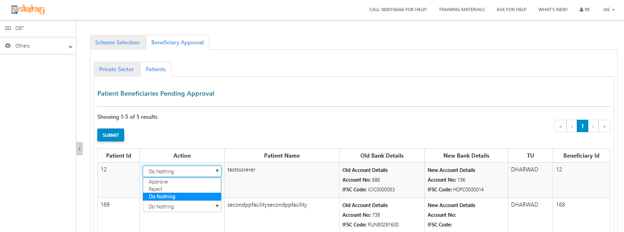
Steps to be taken in Ni-kshay at DTO Level
Step 1
Step 2
Step 3
Step 4
Step 5
Step 6
Login with DBT Checker – staff ID
Click on Scheme
Apply DBT Search Filter
View & Process Benefits
View Benefit Status
Beneficiary Approval by DBT Checker
Available at DBT Checker – Staff Logins
Any Edits made in the validated beneficiary will require DTO approval to Proceed
Beneficiary status at this stage will be “DTO Approval Pending”
Can view both the “Old” and “New” Bank Details entered
If approved, then beneficiary will be “Sent to PFMS”
If Rejected, then beneficiary status will be changed to “Entered” and user has to update the bank details

Slide 24
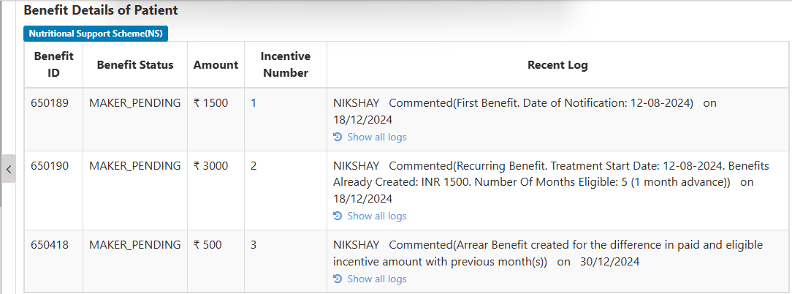
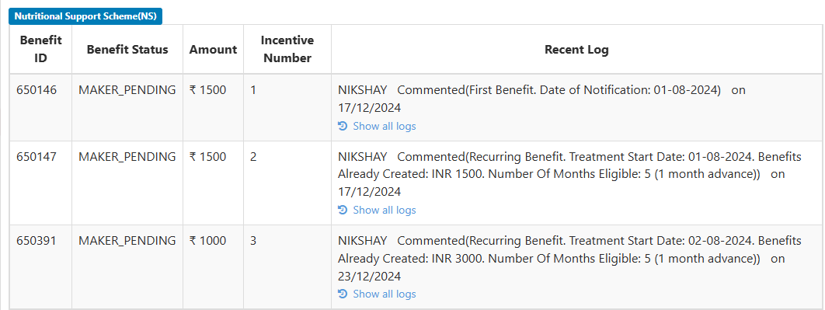
Arrears cases where benefit generated under 2 frequency
Here 1 incentives were created with older logic
2 incentives was created with new logic i.e. with Rs. 3000
Here 3rd incentives was created with Rs 500 for arrear amount for November month
Here 1 and 2 incentives were created with older logic
3 incentives was created with new logic i.e. with Rs. 1000 for arrear amount

Slide 25
Benefit Approval in PFMS
All such request payments accepted by PFMS now becomes visible in the DA ID of PFMS under “E-payment” for approval.
Payment advice may be generated for accepted Request Payments, attested by the authorised signatories and sent to the sponsor bank for payment into beneficiaries’ accounts.
Follow-up: Once payment has credited in the beneficiary account, status of the benefit is changed to ‘Paid’ along with relevant details. Else, if error/s occurred in transaction or if transaction was not possible, the payment request will get rejected. Status of all such failed payment requests along with reasons of failure are communicated back to Ni-kshay by PFMS. The user needs to rectify the failure reason/s and re-initiate the benefit.

Slide 26
Steps to be taken in PFMS
Step 1: Login with Data Approver ID

Slide 27
Step 2: Select Approve payment from E-Payment Module

Slide 28
Step 3: Select Updated Scheme, Beneficiary Type and Ref No of the list to be approved

Slide 29
Step – 4: Select the mode of payment and click on approve button to approve the payment.

Slide 30
Step – 5: For printing of PPA, go to e-payment module and select the print payment advice module.

Slide 31
Step – 6: Select updated scheme, bank account and ppa print status to see the list of approved beneficiaries.

Slide 32
Step – 7: Select the payment advice no.To view and print the PPA
Take a print out of the payment advice, get it signed from authorized signatories and deliver it to agency bank before the expiry date.

Slide 33
Tribal Support Scheme
A one-time benefit of Rs. 750 will be generated for a notified patient under Tribal Support Scheme
All notified patients from their "Current Facility" marked as Tribal are eligible for this benefit of Rs. 750 (Under External data, IsTribal=”Yes”)

Slide 34
Submission of beneficiary list using “Excel upload option” in PFMS
Login using the DO ID

Slide 35
Submission of beneficiary list using “Excel upload option” in PFMS…
Approve payment at DA level and generate PPA
Approval of payment batch:
Login with the DA id > Go to "E-Payment" module > Select "Approve Payment“ > select Beneficiary type and approve the Payment batch from the drop-down list
Printing of PPA:
Login with the DA id > Go to "E-Payment" module > Select "Print Payment Advice" and go for printing.

Slide 36
Patient Transfer Impact on DBT benefit and beneficiaries
Ni-kshay Poshan Yojana Scheme:-
Unprocessed benefits will transfer to the new hierarchy.
Processed benefit will not move to new hierarchy if benefit under PFMS processing.
User should be instructed to clear all backlogs benefits which are already under PFMS Process to avoid the rejection.
Beneficiary status will change if agency code is different and beneficiary status will Change from validated to entered mode, So user should wait for some time to validate the beneficiary to process the benefits which are coming on to new hierarchy.
Tribal Support Scheme:-
Unprocessed benefits will transfer to the new hierarchy if destination TU marked as Tribal area in Ni-kshay
Processed benefit will not move to new hierarchy if benefit under PFMS processing
User should be instructed to clear all backlogs benefits which are already under PFMS process to avoid the rejection.
Beneficiary status will change if agency code is different and beneficiary status will change from validated to enter mode, So user should wait for some time to validate the beneficiary to process the benefits which are coming on new hierarchy

Slide 37
Thank You

