Slide 1
Module 2: Enrolment and Notification
Changes in Patient management lists (March 2020):
The unified episode search page.

Slide 2
Description of Changes
Reason for change:
In the version of Nikshay prior to this change, to access a list of patients, one need to perform multiple clicks, drill down to a PHI/TU to access patient wise lists.
Apart from multiple clicks the user has to perform to generate a list of patients, at each click the page is rel0aded, resulting in multiple page loads significantly reducing system performance.
This view limits the user interface in such a way that the user can only access patients currently assigned under that District/TU/PHI.
The change made:
A single search page for patients assigned under health facility replaces the multiple stage wise hierarchical drill down.
User will be able to generate all lists and also make a specific filter based search to identify patients based on various criteria,
This page will also enable access to patients that are not currently under the PHI/TU/District, but those that are also assigned through the ART centre, DRTB Centre patient linkage as well.

Slide 3
Unified patient / episode search page

Slide 4
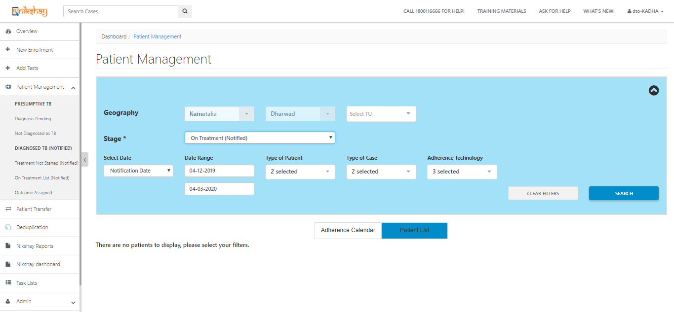
Accessing the page
The Geography will auto set based on your permission level.
Patient lists can be generated using the filters available
Click on patient management Sub links to access the unified search page
If the sub-links of Patient Management (eg. diagnosis pending, outcome assigned) are clicked, it will all direct to this page with the “Stage” filter auto selected based on the link clicked.

Slide 5
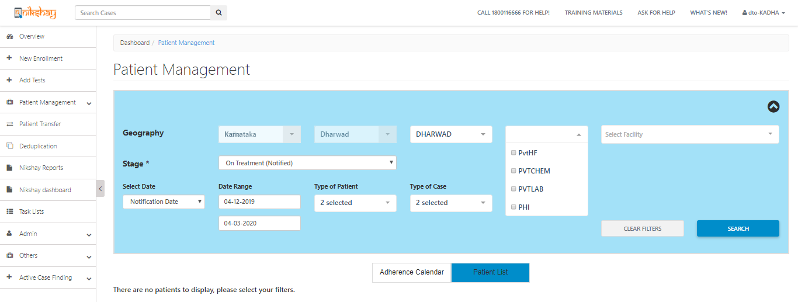
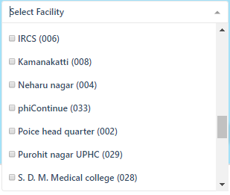
Filters: 1 - Geographic
Select Facility Type and Facility Name
NOTE: Users can select more than one option from all the drop downs (at the same time) and search. For e.g. multiple TUs or multiple PHIs can be selected at one go.

Slide 6
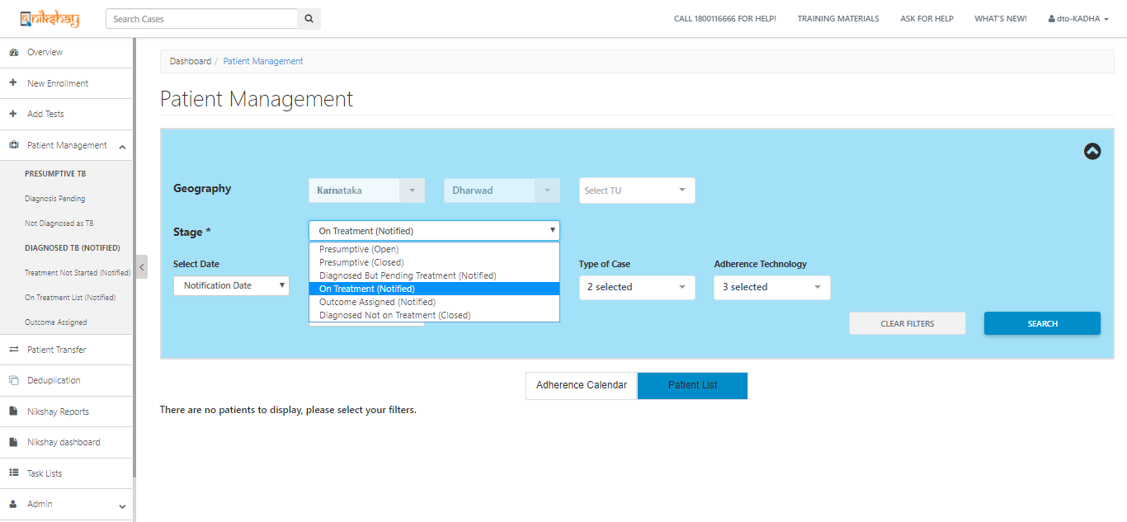
Filters: 2 - Stage
Select the ‘Stage’ of the Patient List that you would like to view
NOTE: Other filters are dependent on the on the choice of the Stage, for which patient lists are to be generated.
When ‘Presumptive Open’ and ‘Presumptive Closed’ Stages are selected, you will only be able to be able to filter by Enrolment date
When ‘Diagnosed but Pending Treatment (Notified)’ is selected as the Stage, you will be able to filter by Enrolment Date and Notification Date
For “On Treatment (Notified)” and “Outcome assigned (Notified)” cases, you will also be able to filter using Treatment Start Date. (in addition to Enrolment Date and Notification Date)

Slide 7
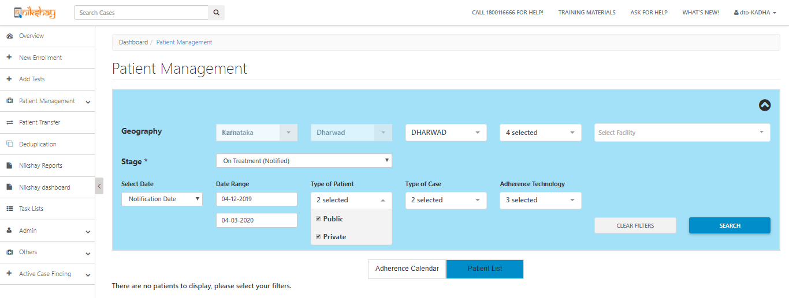
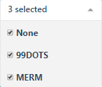
Filters: 3 - Others
Select Type of Case
Select Adherence Technology
Select type of date range
Select date range
Select Patient Type

Slide 8
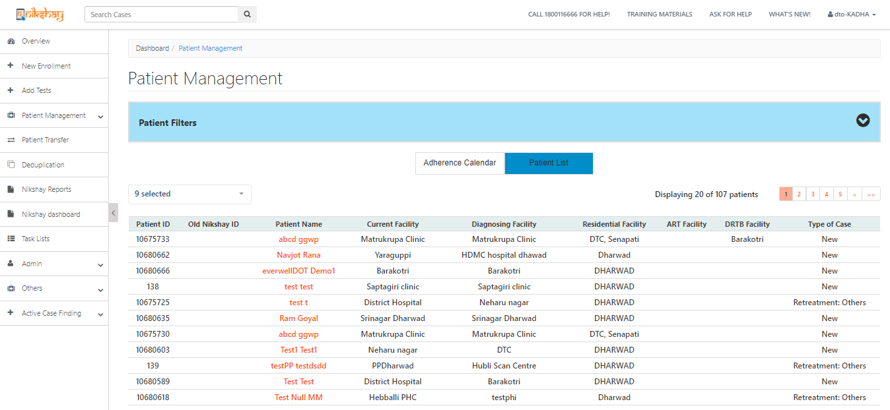
Patient lists: 1
Filters Minimised
Paginated list.

Slide 9
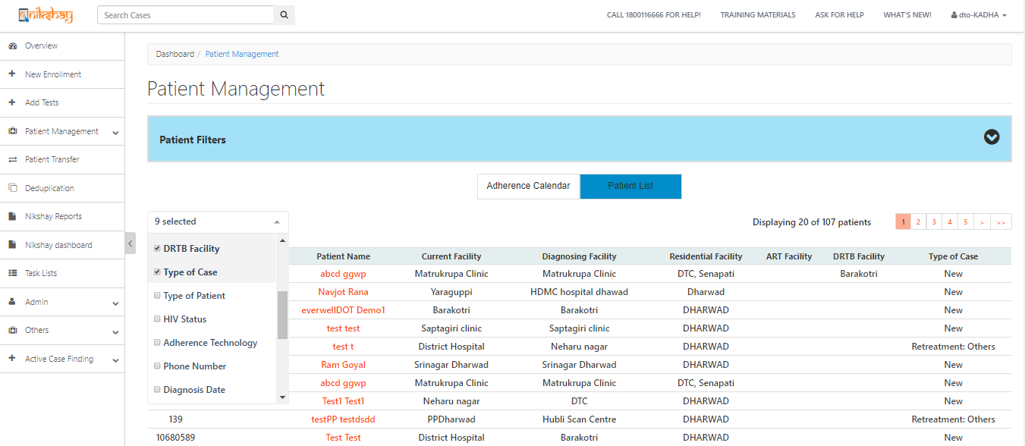
Patient Lists: 2 - Customisable columns
Select this if you want to view the adherece calendar of all these paients
User may select the columns that he/she wants to view

Slide 10
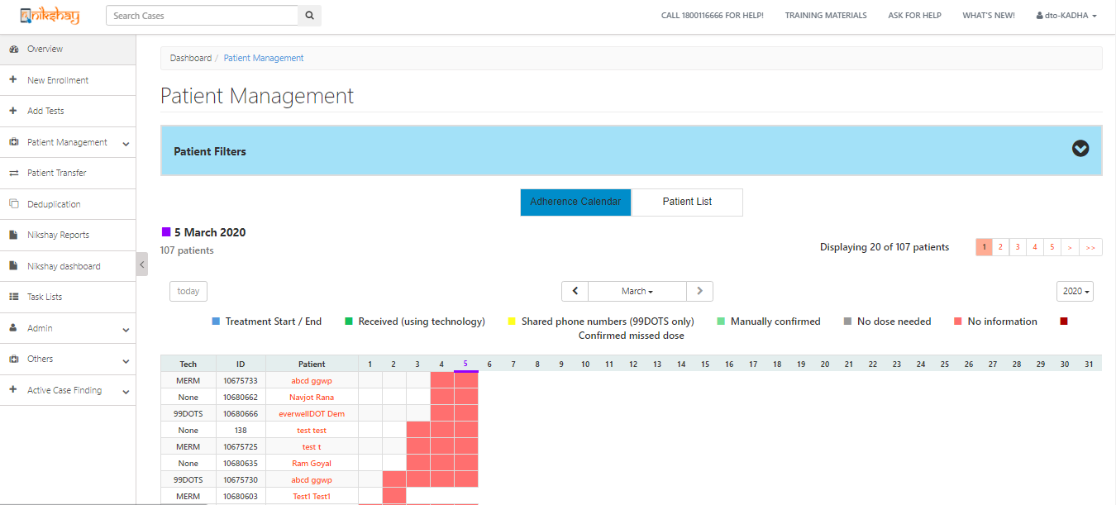
Patient List: 3 - Adherence Calendar view
“Adherence for last month displayed by default” of patients displayed here. User can see adherence of other months by Clicking <.>.
“Adherence Calendar” of patients displayed here

Slide 11
Additional view for PHI that are ART or DRTB Centre
Patients can now be assigned to an “ART” or “DRTB” Centers in addition to current PHI.
This will enable ART and DRTB Centers to view patient based outside their PHIs.
The Unified episode search page will also enable these PHIs to access the above linked patients, in addition to their currently assigned patients.
Currently to view patient list based on ART and DRTB centres is only available in PHI Logins. Gradually access to view patient based on Current Health Facility, ART and DRTB Facility will be given to TU and District Logins

Slide 12
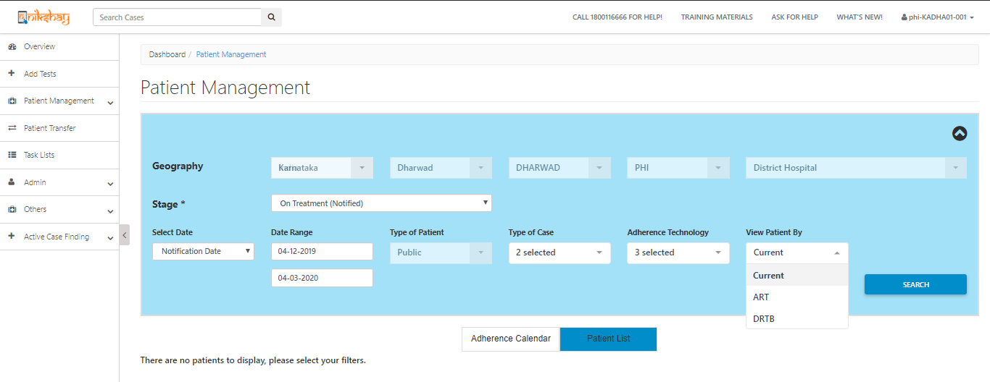
Patient List: 4 – View Patient List by ART / DRTB
Only PHI Login can view patient by “Current Health Facility” / “ART” and “DRTB”
PHI and Patient assignment as “ART” and “DRTB” centre is explained in training material – ‘PHI and Patient assignment as “ART” and “DRTB” Centre (March 2020)’

Slide 13
THANK YOU

