Slide 1
Updation of Triggers for TB Preventive Therapy (TPT) workflows

Slide 2
Background
Earlier, TB Preventive Therapy (TPT) workflows on Ni-kshay were triggered by six specific risk factors, which were 'Contact of TB Patients', 'Patient on immunosuppressants', 'Silicosis', 'Anti-TNF treatment', 'Dialysis', and 'Transplantation'.
In 2023-24, the program priority for TPT is institution-based mapping of other risk groups for TPT by districts. To ensure that all eligible individuals receive preventive treatment, the list of triggers for TPT workflows has been updated on Ni-kshay to include all risk factors, including HIV status to be either positive or reactive.

Slide 3
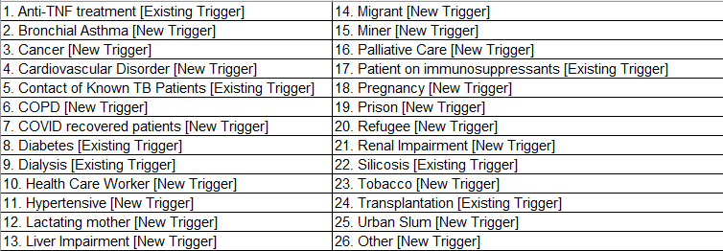
Updated Risk Factors
The list of Key Population/Risk Factors that can trigger TPT workflows are as follows:
In Addition to this the following HIV status trigger TPT workflows

Slide 4
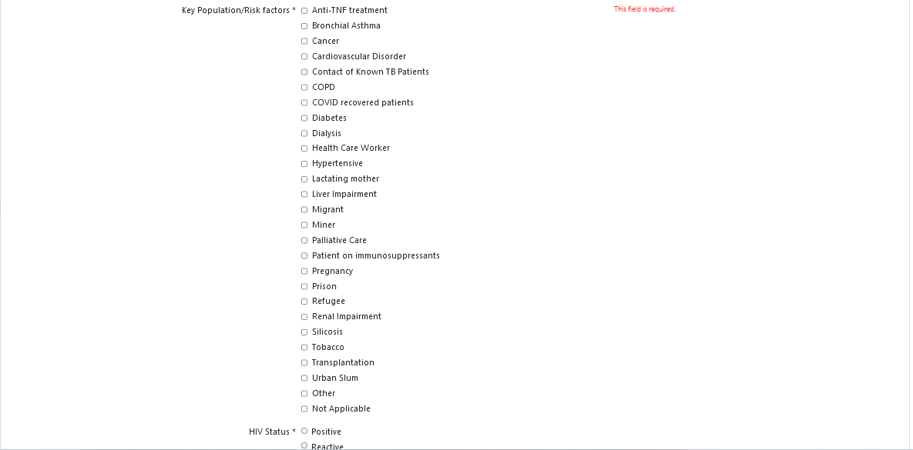
Step 1
Complete Enrolment of TPT beneficiary
During Enrolment, If any of highlighted Key Population options are selected, then the case registered will be allowed to initiate treatment even without the addition of a positive diagnostic test.

Slide 5
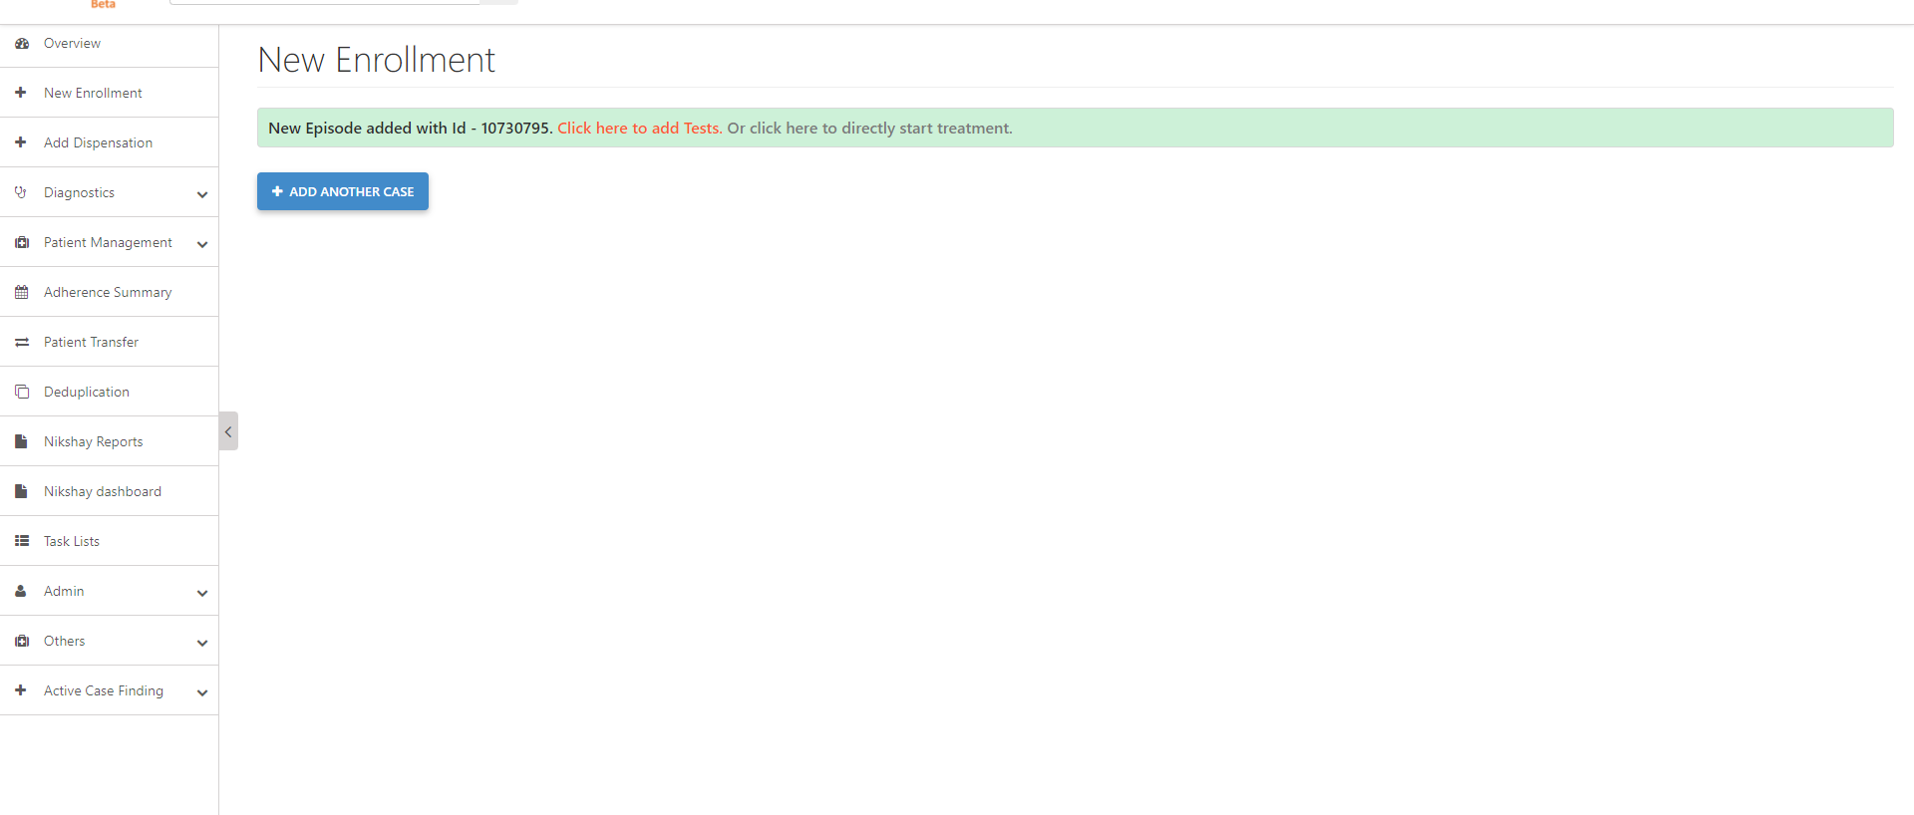
Step 1
Step 2
Complete Enrolment of TPT beneficiary
Initiate Treatment or Add Tests
Adding Test Details is Optional and can be added as per test being done on TPT beneficiaries

