Slide 1
Tasklist Metrics

Slide 2
Task List Metrics
Task list metrics in landing page would provide a snapshot of following activities which are pending at the particular hierarchy:
Treatment outcome due
Bank details required
HIV status unknown
Contact tracing due
Transfer In Approval Pending
Transfer Out Approval Pending
Deduplication Pending
DBT Maker Pending
DBT Checker Pending
Beneficiary Approval Pending
The metrics would be depicted from the beginning of hierarchy till date
Enabled at District, TB Unit, and PHI level
This feature is available for both Web and App

Slide 3
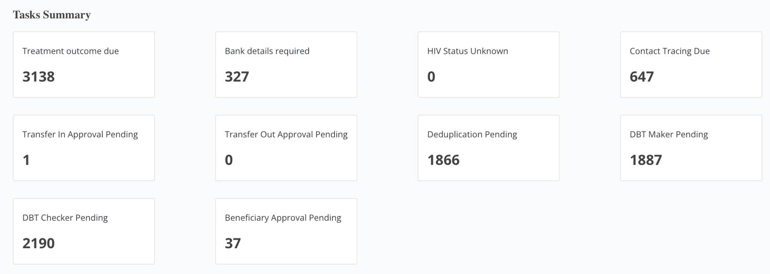
Step 1
Step 2
Login into ‘Ni-kshay’: (with District, TBU or PHI logins)
Check the landing page for Task Summary

Slide 4
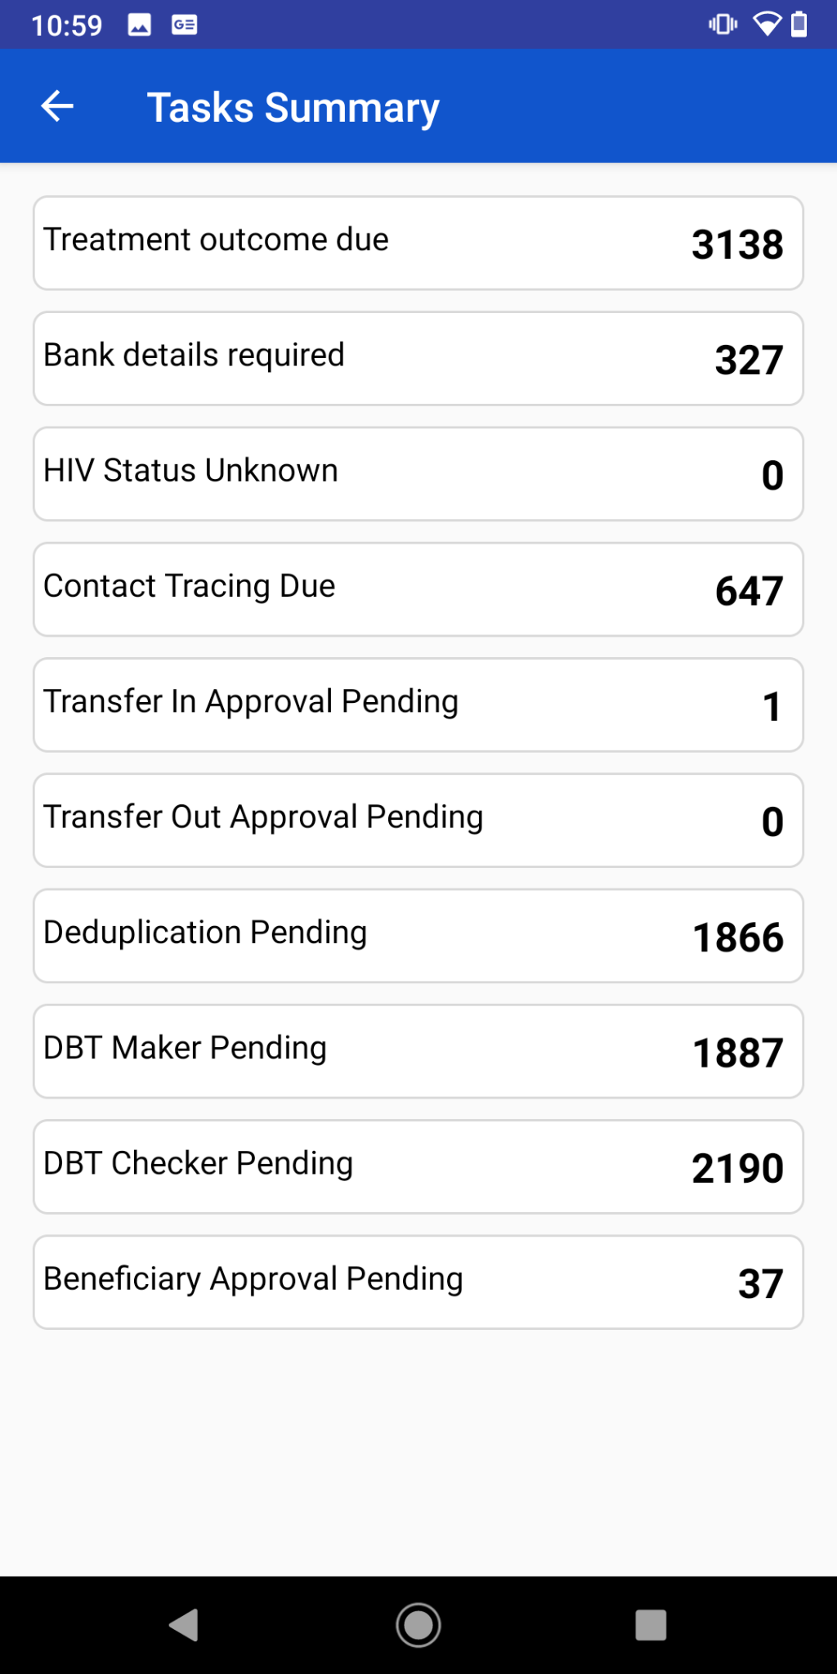
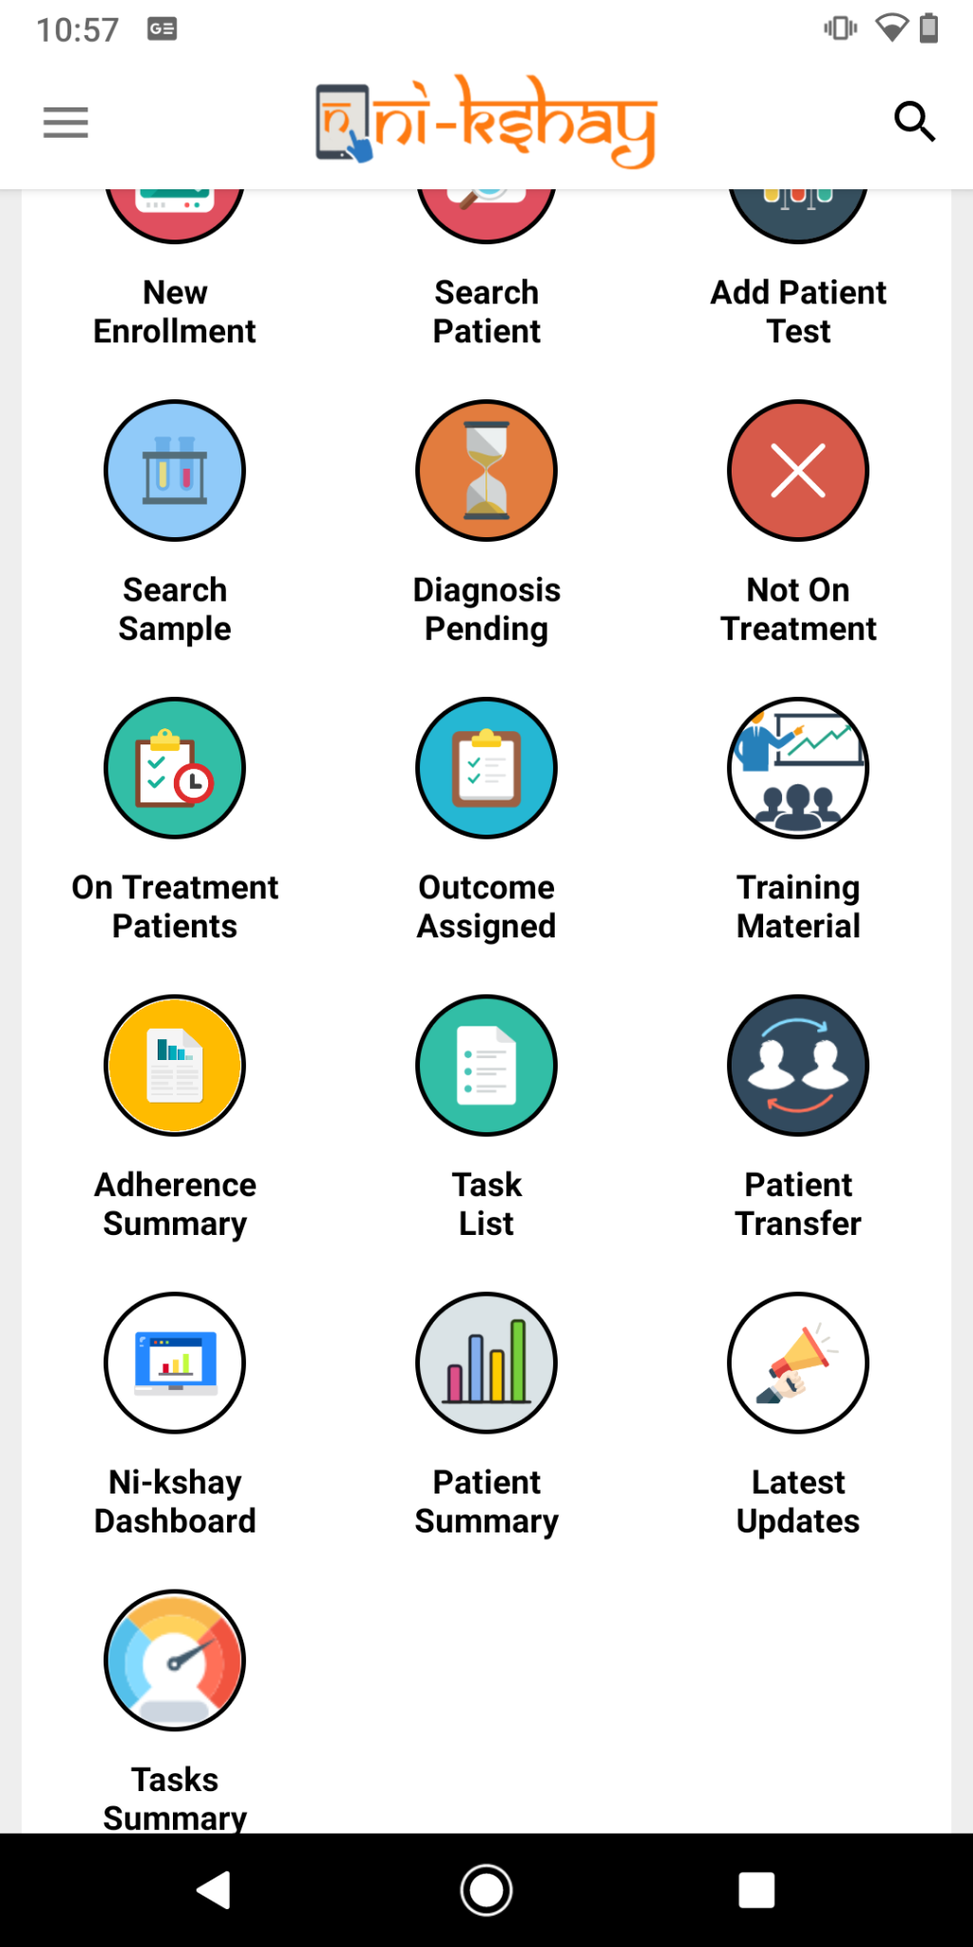
Step 1
Step 2
Login into ‘Ni-kshay App’ and click on ‘Tasks Summary’
The Tasks Summary indicators details shall be available

Slide 5
Key points
To be Noted
Task list metrics include all pending tasks for patients diagnosed with TB.
Once the task is completed, the relevant number would be deducted from the respective indicator.
The DBT related metrics include all type of beneficiaries -TB patients, Treatment Supporters, Private providers/Private Health facilities.

Slide 6
THANK YOU

