Slide 1
TB Preventive Therapy (TPT) –Other Risk Group Register

Slide 2
Introduction
Earlier, TB Preventive Therapy (TPT) workflows on Ni-kshay were triggered by six specific risk factors, which were 'Contact of TB Patients', 'Patient on immunosuppressants', 'Silicosis', 'Anti-TNF treatment', 'Dialysis', and 'Transplantation'. In 2023-24, the program prioritized institution-based mapping of other risk groups for TPT by districts. To ensure that all eligible individuals receive preventive treatment, the list of triggers for TPT workflows has been updated on Ni-kshay to include all risk factors, including HIV status to be either positive or reactive.
This has necessitated a ‘Other Risk Group Register’ that includes all the beneficiaries who have been allocated to any of the high-risk groups mentioned exclusively without a tag of contact of known TB patients. The register would also exclude all beneficiaries who have been added through the Contact Tracing Module/directly enrolled as Contact of Known TB patient.
Staff and Treatment Supporters

Slide 3
Introduction
The list of additional 21 risk factors is enlisted below, beyond the existing 6 risk factors -
Bronchial Asthma
Cancer
Cardiovascular Disorder
COPD
COVID recovered patients
Diabetes
Health Care Worker
HIV positive/reactive
Hypertensive [New Trigger]
Lactating mother
Liver Impairment
Migrant
Miner
Palliative Care
Pregnancy
Prison
Refugee
Renal Impairment
Tobacco
Urban Slum
Other
Staff and Treatment Supporters

Slide 4
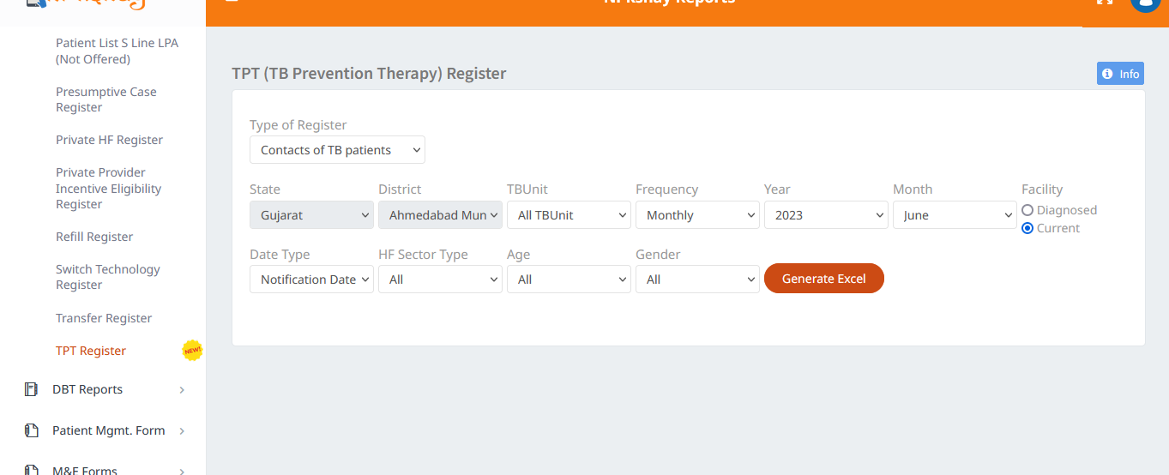
TPT – Other Risk Groups Register
Step 1
Click on TPT Register

Slide 5
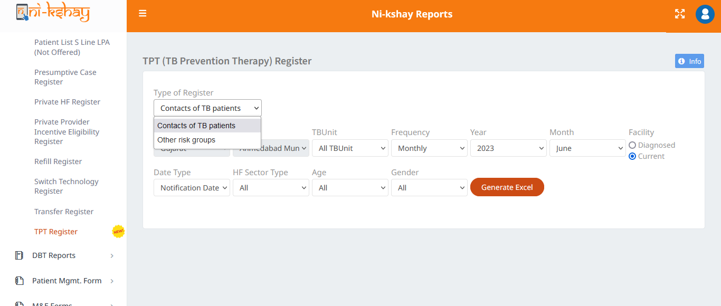
TPT – Other Risk Groups Register
Step 1
Step 2
Click on TPT Register
Select Other risk groups

Slide 6
TPT – Other Risk Groups Register
Step 1
Step 2
Step 3
Click on TPT Register
Select Other risk groups
Click on ‘Generate Excel’
Select relevant filters and click on ‘Generate Excel’ button

Slide 7
Fields Available in the Register
Current Facility State | Fathers Name
Current Facility District | Address
Current Facility TBUnit | Taluka
Current Health Facility | Town
Current Health Facility Type | Ward
Diagnosing Facility State | Landmark
Diagnosing Facility District | Pincode
Diagnosing Facility TBUnit | ResidentialState
Diagnosing Health Facility | ResidentialDistrict
Diagnosing Health Facility Type | ResidentialTBU
Enrollment Facility State | KeyPopulation
Enrollment Facility District | HIV TestStatus
Enrollment Facility TBUnit | Diabetes Status
Enrollment Health Facility | Diagnosis Basis
Enrollment Health Facility Type | TPT Treatment Start Date
Diagnosis Date | Treatment Outcome
Enrollment Date | End Date
Episode ID | Latitude
Stage | Longitude
Person Name | Monitoring Method
Age | Type of Case
Gender | Regimen Type
Occupation | Type of Patient
Weight | Episode ID Index
Height | Basis Of Diagnosis Final Interpretation Index
Primary Phone | Microbiological Confirmation Index
Staff and Treatment Supporters

Slide 8
THANK YOU

