Slide 1


Citizen and Patient App: TB Aarogya Sathi
Training Material

Slide 2
1. Overview of the App
2. Symptom Checker Workflow
3. Self Reporting Adherence Functionality
4. DBT Bank Edit Functionality
5. TB Champion
6. Reports
Contents

Slide 3
Overview of TB Aarogya Sathi
TB Aarogya Sathi is for Citizens as well as Patients registered under Ni-kshay
Citizen
Patient
  Informative content available for all Citizens using the App (no login required to access this content)
  Patients registered under Ni-kshay get access to additional information (after login)
  Adherence Details
  Treatment Progress Details
  DBT Details
  Basic Details
  Information on TB
  Symptoms of TB
  Side Effects of TB
  Health Facility Search
  BMI Assessment
  Ni-kshay Sampark Helpline
  Motivational Videos
  Nutritional Advice

Slide 4
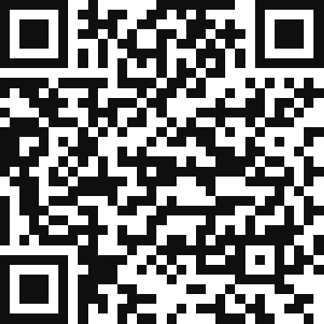

Download the “TB Aarogya Sathi” App
This App is available only for Android devices. Below are the steps to download the application
Open Google Play Store on your android Device
Make sure you have internet connectivity.
Search for “TB Aarogya Sathi” on Google Play Store or Scan QR Code
Download the App and Install the App on your device.
SCAN QR CODE

Slide 5
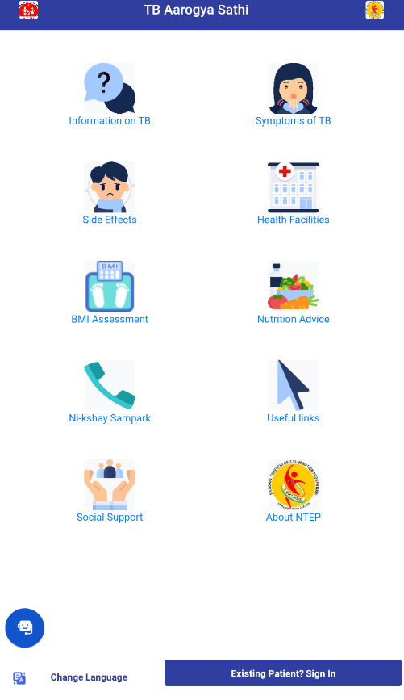
Informative Page
After Installing the App, all users will have access to the static content of the App which includes useful information around TB and its diagnosis. It covers the following sections.
Frequently Asked Question on TB
Common Symptoms of TB
Common Side Effects of TB
Health Facility Search
Nutrition Advice for TB Patients
BMI Assessment
Call Ni-kshay Sampark for Queries
Useful Video Links
Snapshot of Govt DBT Schemes
About NTEP Program
Ni-kshay Sahyogi
View App in Local Languages
Click to Login

Slide 6
Informative Page…
It covers the following sections.
  Information on TB - Provides basic information on TB. Useful to create awareness of TB and remove misconceptions/ stigma around the general public
  Symptoms - Provides information on the common symptoms of TB
  Side Effects - Provides basic information on side effects due to Anti TB treatment detailed to remove misconception
  Health Facilities - Provides details of the health facilities which are providing TB Services
  BMI Assessment - Provides Nutritional Assessment of the user based on Body Mass Index (BMI)
  Ni-kshay Sampark - The toll-free TB Helpline is accessed directly from the application.

Slide 7
Informative Page…
It covers the following sections.
  Nutrition Advice - Guides the user on the importance of good nutrition for prevention of TB and risk of TB due to malnutrition
  Useful Links - Awareness materials on various aspects of TB, including nutritional support, mitigating stigma, incentives etc
  Social Support - Provides information on various Direct Benefit Transfer Schemes available under NTEP.
  About NTEP - Provides a brief history of the National TB Program in the country along with its aims and objectives.

Slide 8
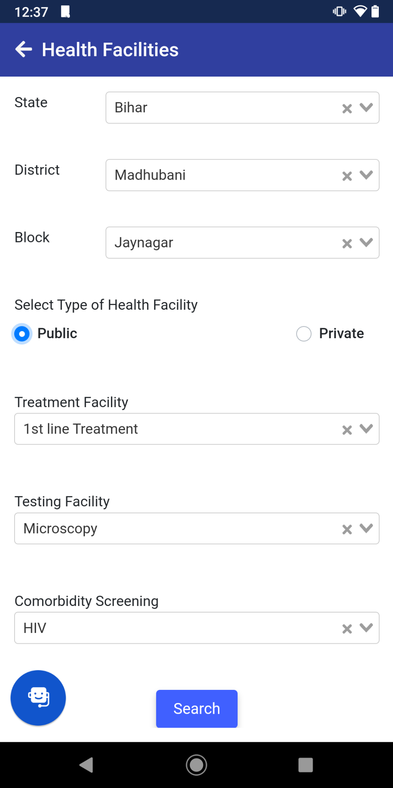
Health Facilities
Select State
On clicking on Search, the following details will be shown
Name of Health facility
Contact Person Name as per Ni-kshay
Phone number as per Ni-kshay
Address of the Health Facility as per Ni-kshay
Select NTEP District
Select TU (Block)
Select Public / Private Type of patient
Additional filters only while Public is selected
Click on Search to proceed

Slide 9
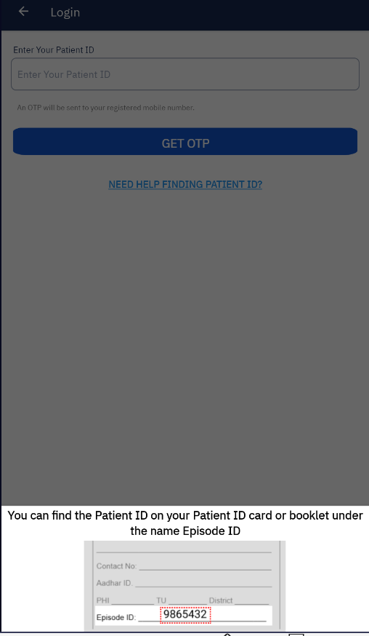
Steps to Login
In order to login in the app, the user needs to use the Ni-kshay ID.
If the patients mobile number is linked to more than 4 users(Ni-kshay IDs) then they will not be able to login to the app
In case the Patient does not have the Ni-kshay ID, the patient needs to refer to the treatment card or SMS that is sent on their registered phone number or take the help of NTEP staff to identify the Ni-kshay ID.
On entering the Ni-kshay ID, an OTP will be sent to the registered Primary Phone Number of the patient. OTP is valid for 300 seconds
In case patient wants to change the contact number, the NTEP staff needs to assist in updating the contact number of the patient.
Resend OTP is allowed only after 60 seconds. This is allowed only one time, after which the requester needs to request for an OTP after one hour.

Slide 10
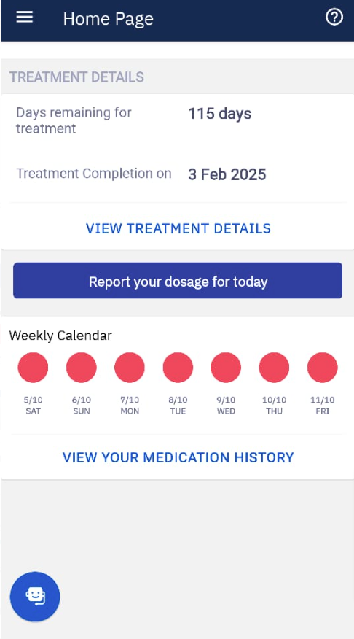
Summary Page
For those patient registered under Ni-kshay, this serves as a portal to access digital health records on TB, including
Treatment Progress - The patients can see their current treatment details along with the treatment progress and diagnostic details.
Adherence - This shows the adherence of the particular patient for the entire treatment period.

Slide 11
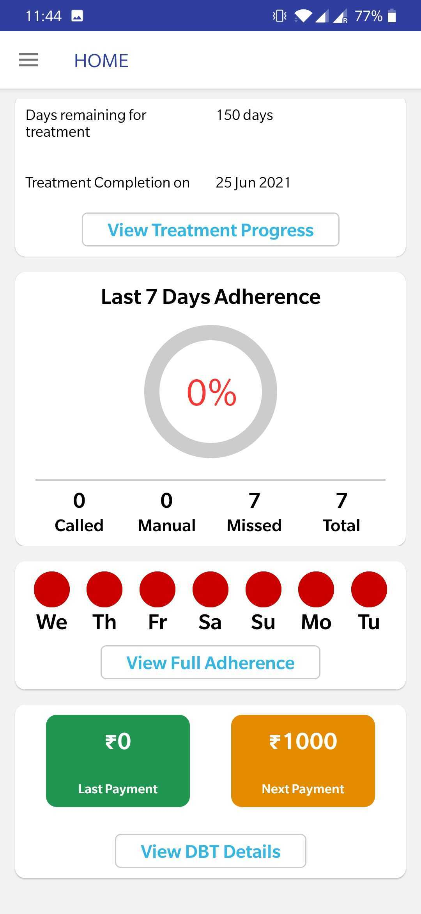
Summary Page…
Sidebar Menu
Click to View Treatment Progress and Treatment Details
Last 7 days Adherence Percentage
Digitally Reported Dose
Total Dose for the week
Manual Reported Dose
Missed Dose / Unreported Doses
Last Payment made
Upcoming Payments (Payments in process)

Slide 12
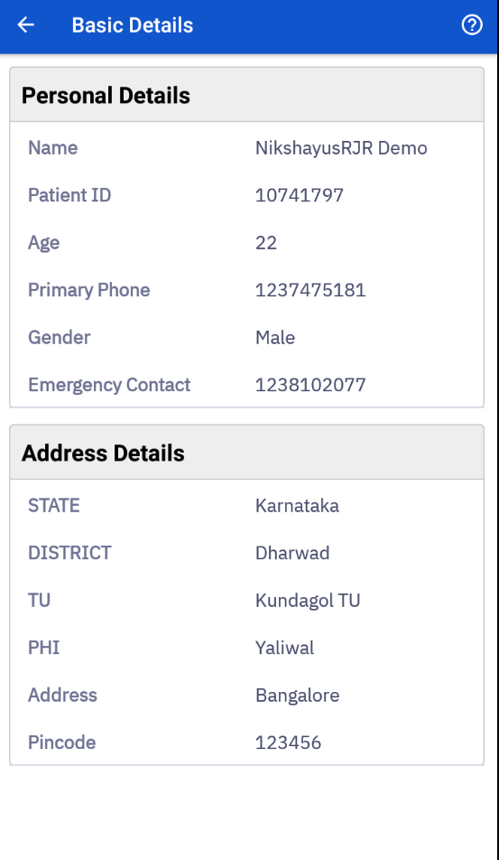
Basic Details
Displays the Personal and Address Details of the user (if they have logged in using their Patient ID) as available on Ni-kshay.

Slide 13
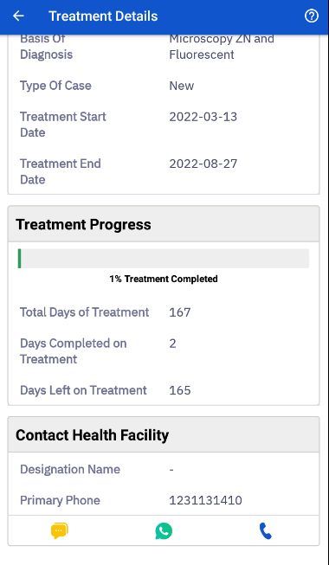
Treatment Progress Page
User can check his/her Treatment Details along with the Treatment Progress.
From this page, user gets access to the Treatment Supporter or the Current Health Facilities contact number. If the user wishes to call the provider, they can simply press on the call button.
Treatment Progress Bar
Click to contact treatment supporter / treatment provider through Call/Message/Whatsapp

Slide 14
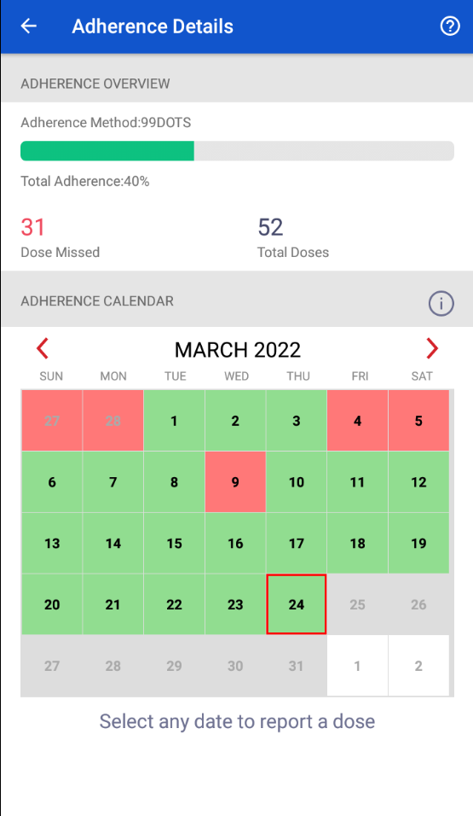
Adherence Details Page
User can check the reported adherence using this page. In case of any unreported doses, user can inform the treatment coordinator of the same.
Adherence Monitoring Method and Statistics
Light Green - Manually Reported Dose
Dark Green - Digitally Reported Dose
Adherence Calendar
Light Red - Unreported Dose
Dark Red - Reported Missed Dose

Slide 15
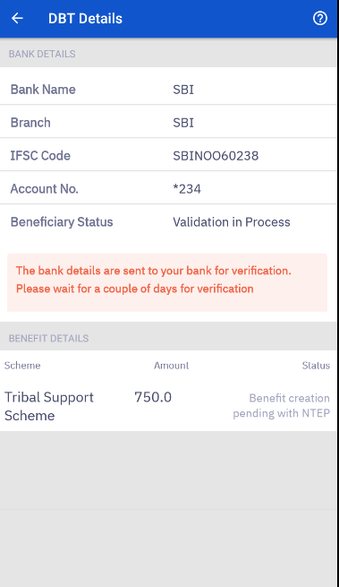
DBT Details Page
The user can check his/her Bank details along with their Benefit status. In case, if no bank details are updated in Ni-kshay, then user has to inform the treatment coordinator to update the bank details.
MAKER_PENDING - Benefit creation pending with NTEP
APPROVER_PENDING - Approval pending with NTEP
DEFERRED - Payment deferred by NTEP
DELETED - Benefit deleted by NTEP
REMOVED - Payment removed by NTEP
PFMS_ACCEPTED - Payment accepted by PFMS
PFMS_PENDING - Payment pending with PFMS
PFMS_REJECTED - Payment rejected by PFMS
PFMS_SENT - Payment sent to PFMS
PAID - Paid
PAID_EXTERNAL – Paid
PAID_IN_KIND - Paid
Bank Details Updated as per Ni-kshay
Benefit Details in process/paid

Slide 16
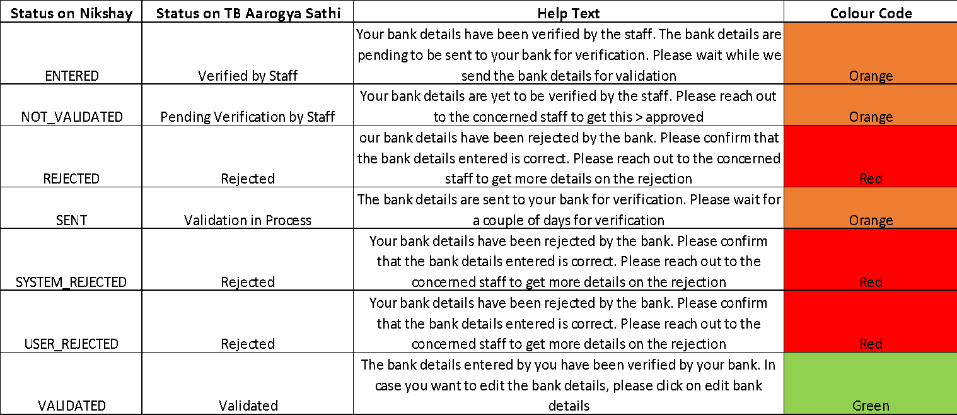
DBT Details Page
Detailed description of the DBT Beneficiary status will be shown to the user depending on his current status. The description will also be colour coded.

Slide 17
FAQs
Below is a small list of Frequently Asked Questions
Question: An error “Failed to send SMS, Please retry again”, occurs every time I try to login using my Ni-kshay ID. What does it mean?
Reason: The user is getting the above error since there are multiple patients id linked to the same primary number. A phone number can be linked to up to 4 patient records. If more than 5 users are linked to a mobile number, then the error message will be displayed.
Resolution: The user should get in touch with any NTEP Staff, and get his primary number changed so that the number is a unique number.
Question: I do not have my Ni-kshay ID, what do I do?
Reason: Multiple reasons for this like not sure about the Ni-kshay id, not comfortable sharing the id, have not got a Ni-kshay id yet.
Resolution: In case the user does not have the Ni-kshay ID, the patient needs to refer to the treatment card or take the help of NTEP staff to identify the Ni-kshay ID or check the SMS that was sent to the registered phone number.

Slide 18
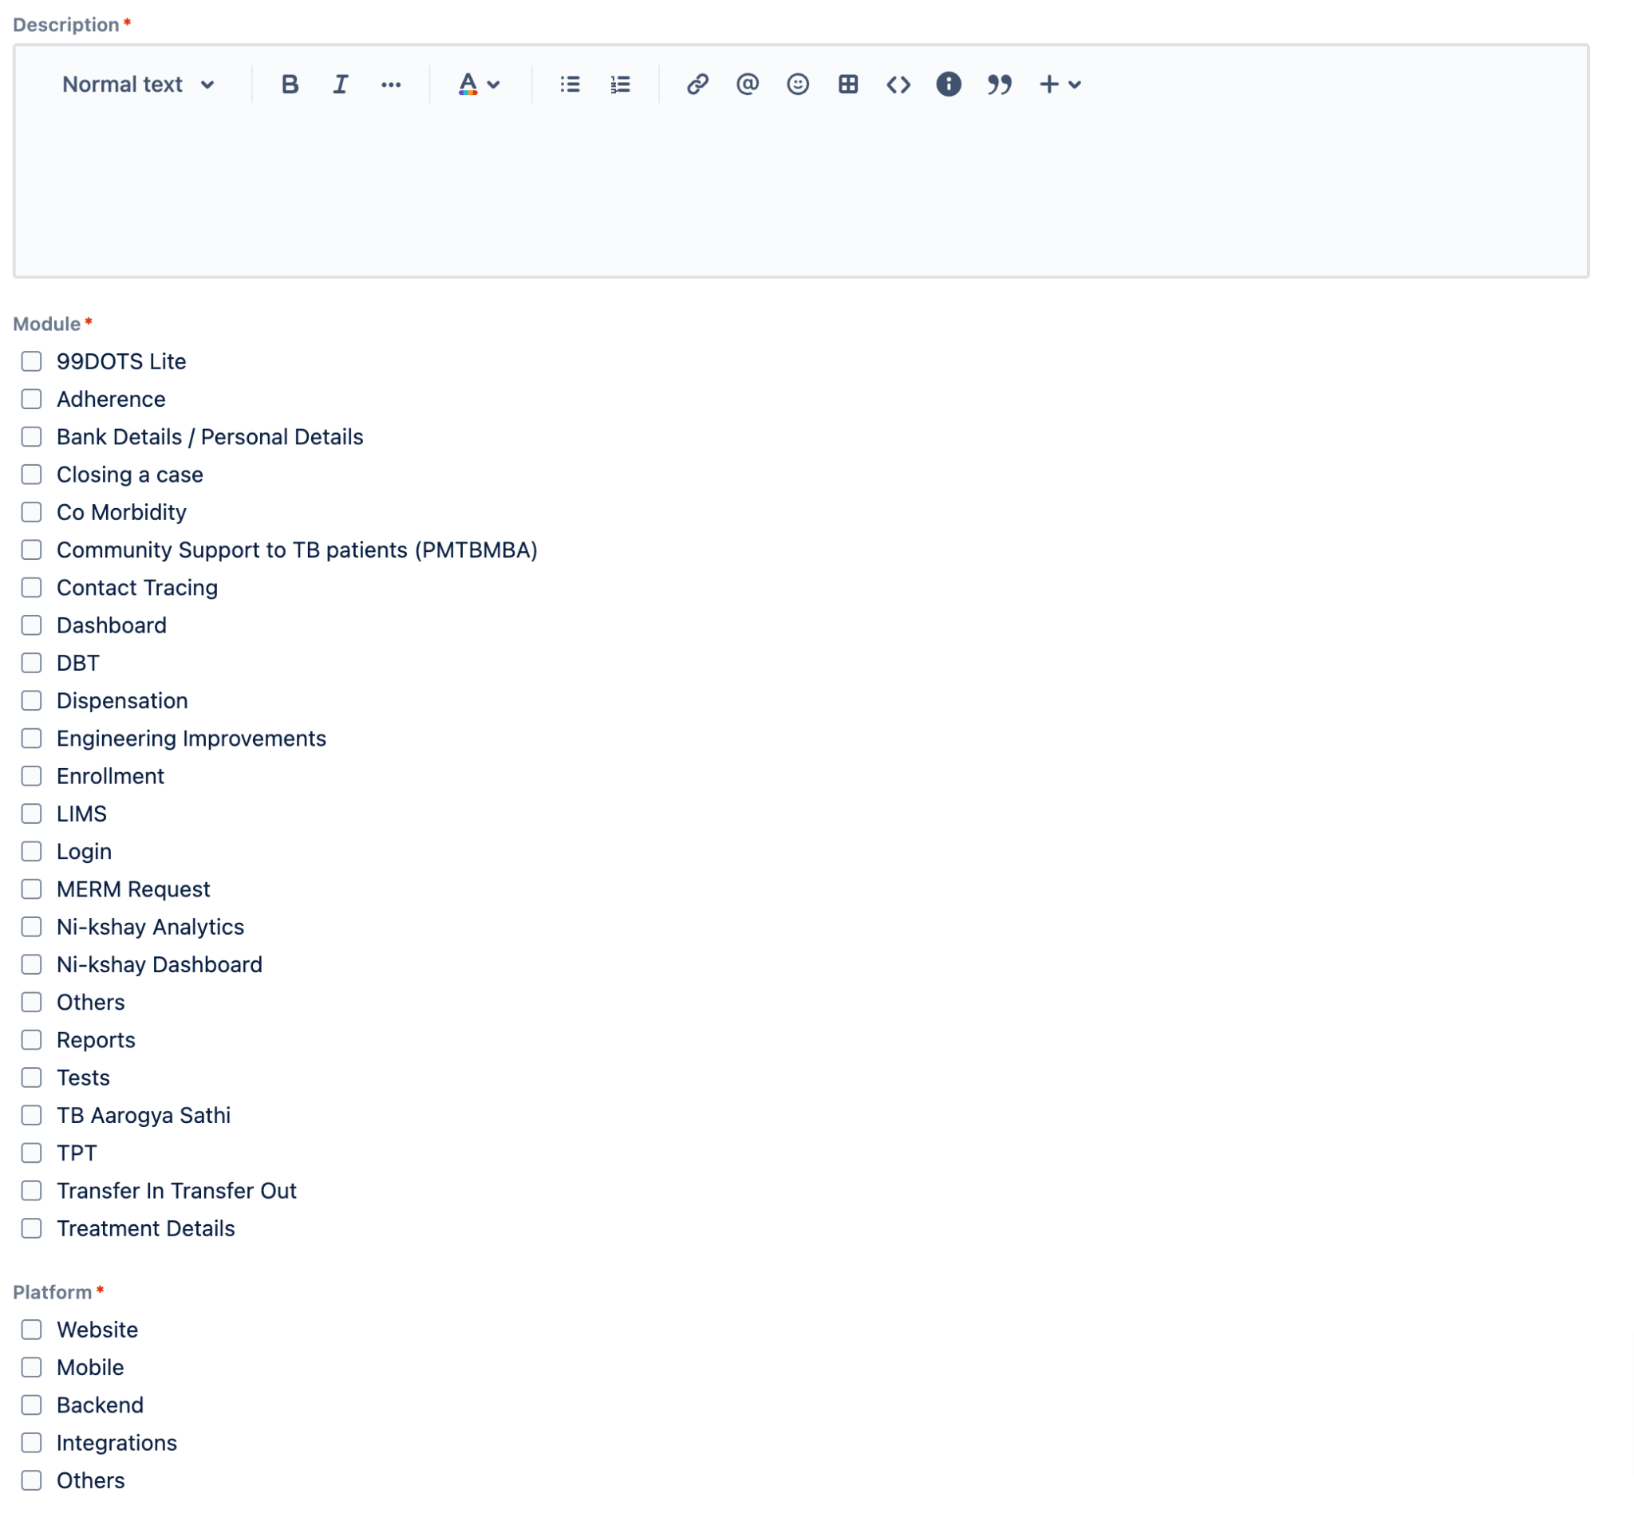
Reporting a Bug/Feature Request via JIRA

Slide 19
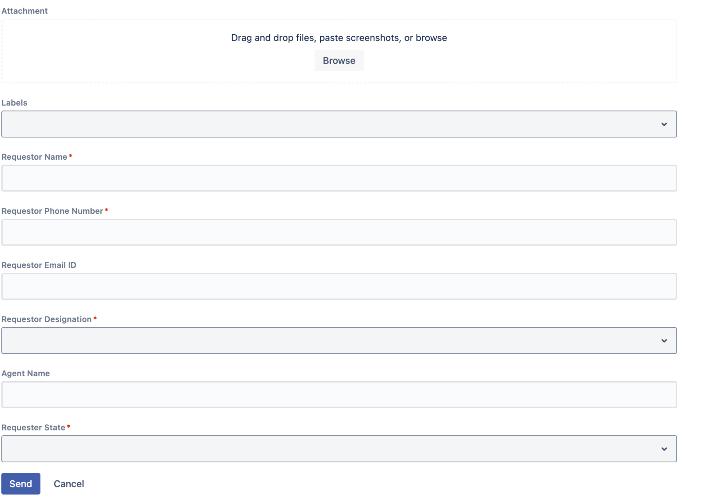
Reporting a Bug/Feature Request via JIRA

Slide 20
Tuberculosis Screening Tool

Slide 21
1. Overview
2. Screening for Self and Others
3. Post enrolment follow-up cycle in Ni-kshay
Contents

Slide 22
Overview on TB Screening Module
This is a screening tool for citizens to help them understand if the existing symptoms require them to take a TB test or not.
Using this tool citizens can find out the nearest health facilities where they can take get the tests done.
It can also be used by volunteers and staff to screen the patient for symptoms of TB and enroll them on Ni-kshay.

Slide 23
Screening for Self and Others

Slide 24
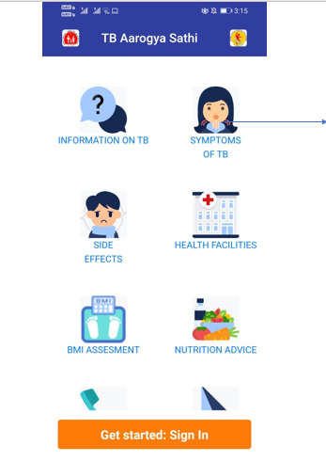
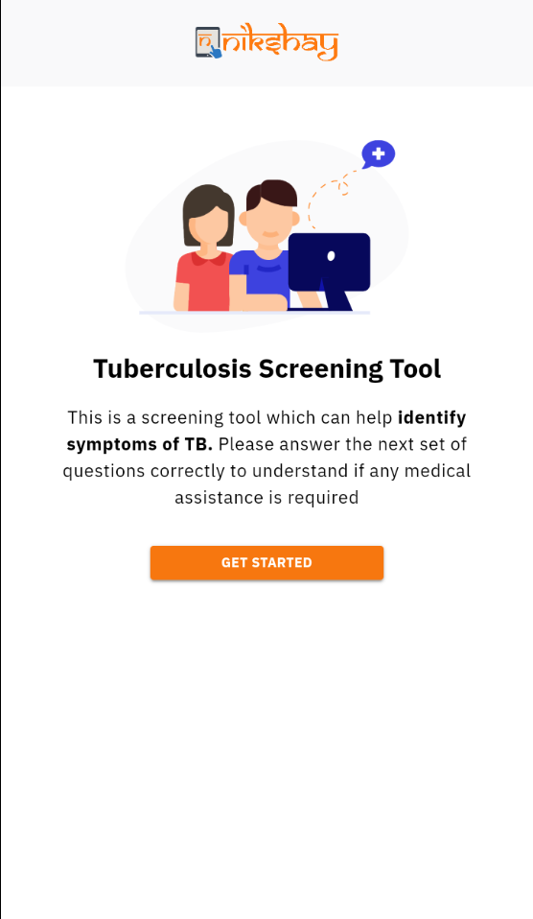
Where can you find the screening tool?
The screening tool can be accessed clicking this link.
The tool can also be directly accessed using https://tbscreeningtool.Ni-kshay.in
Click to Get Started

Slide 25
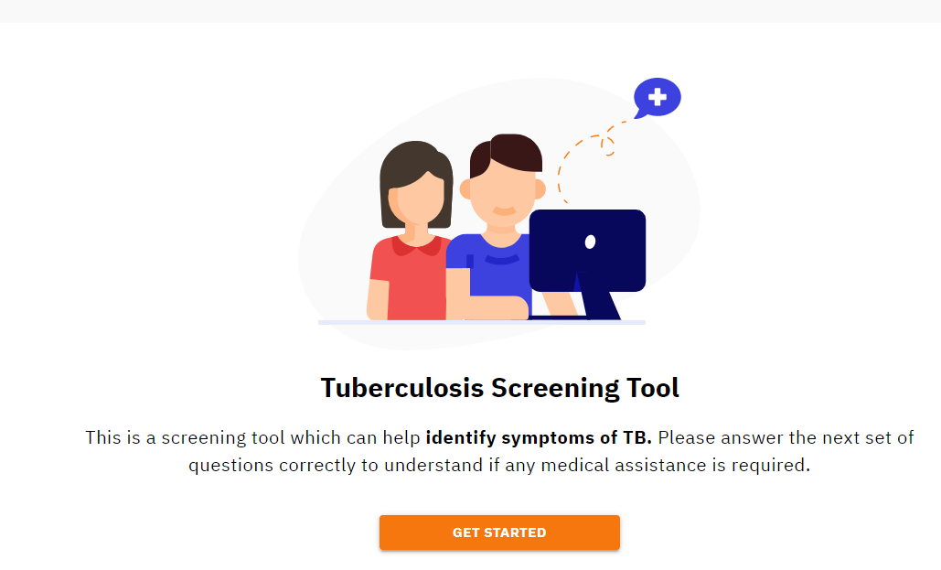
Click on the module to start screening
Click on Get Started

Slide 26
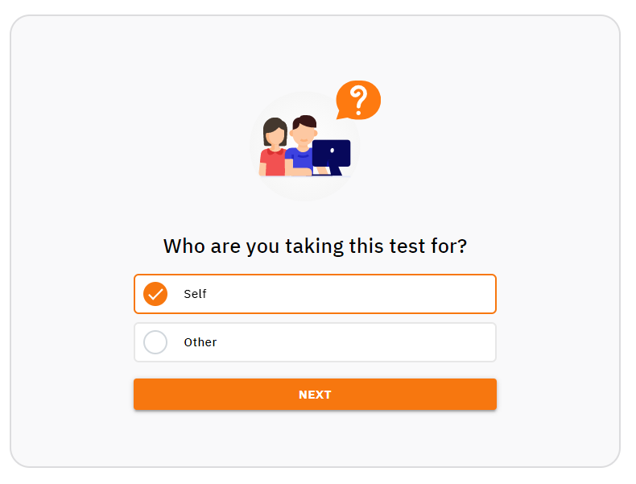
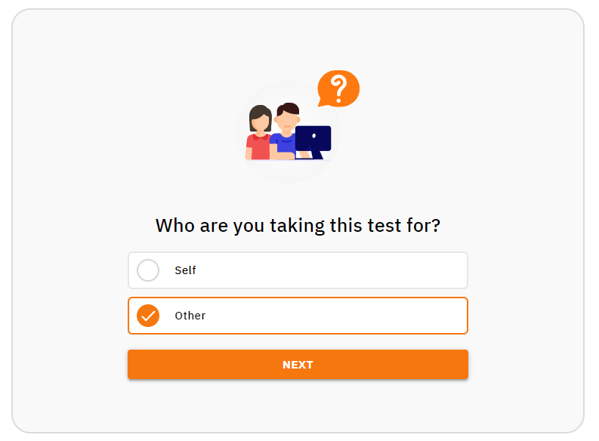
Click on Self (Image 1) or Others (Image 2) and press Next…
Image 1 – for Self
Image 1 – for Self
Image 2 – for Others
Image 2 – for Others
1. Click on Self
1. Click on Self
1. Click on Other
2. Click on Next
2. Click on Next
2. Click on Next

Slide 27
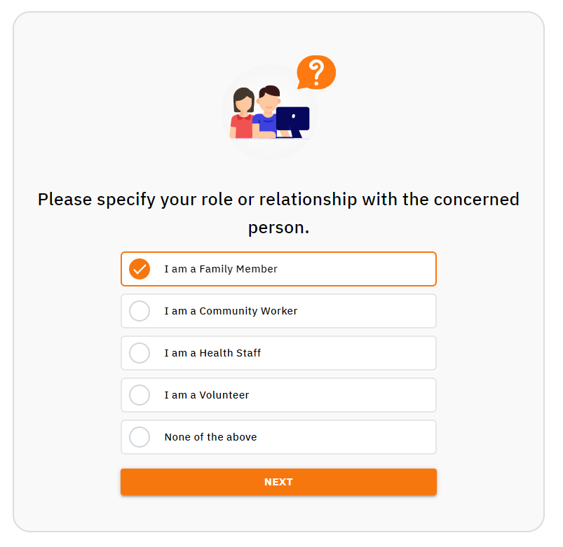
For Others, select the relationship
1. Select an appropriate option, when you are checking the symptoms for Other
2. Click on Next

Slide 28
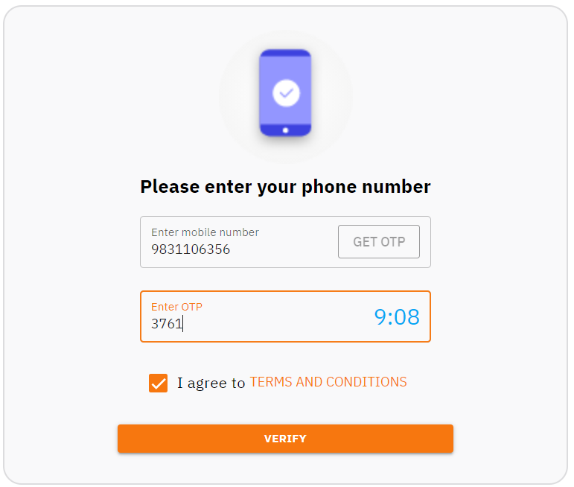
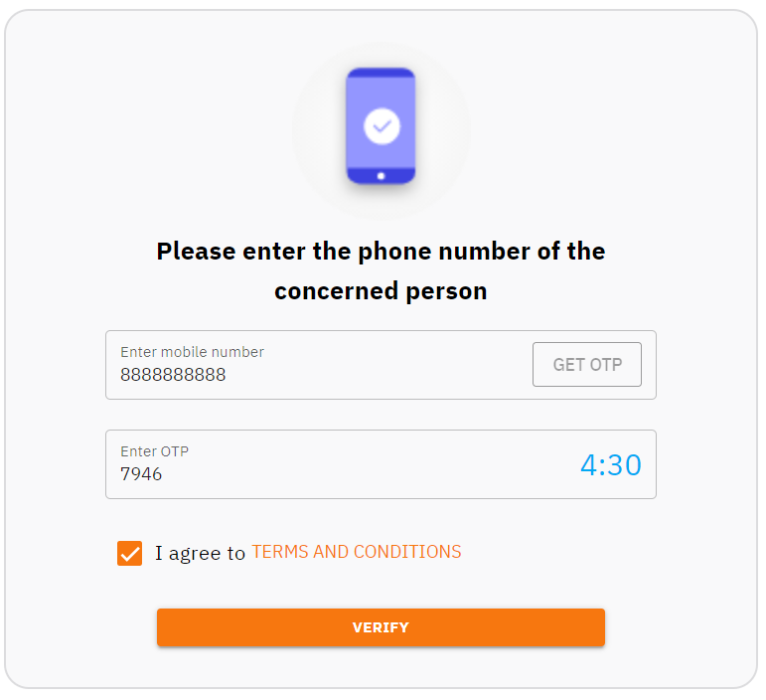
Enter mobile number to get the OTP and initiate the Verification
Image 1 – for Self
Image 2 – for Others
1. Enter your valid mobile number
1. Enter your valid mobile number
2. Click to get the OTP
2. Click to get the OTP
XXXXXXX
XXXXXXX
XXXX
3. Click on the Box to agree with the T&C
3. Click on the Box to agree with the T&C
4. Click to Check Symptoms
4. Click to Verify

Slide 29
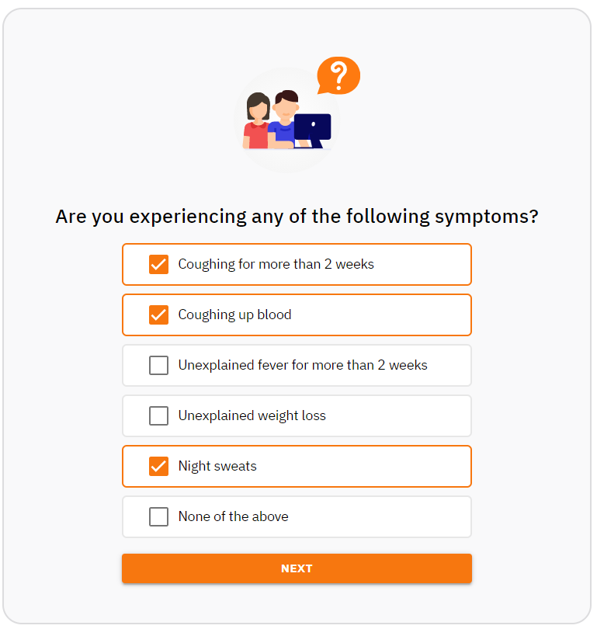
Select the symptoms which you or the concerned person suffering from
1. Select the symptoms from the listed options, otherwise, select “None of the above”
2. Click on Next

Slide 30
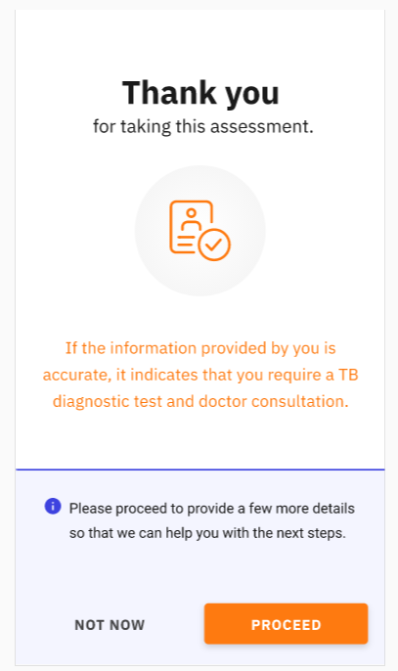
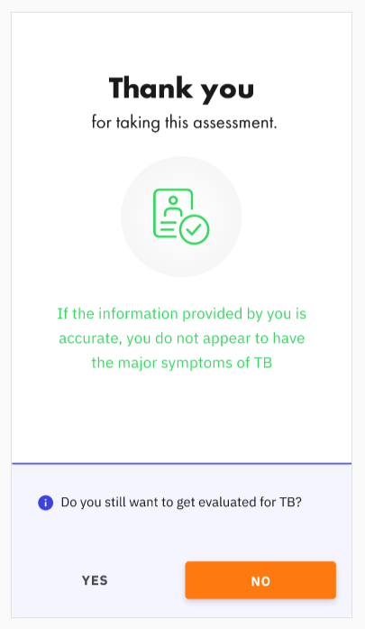
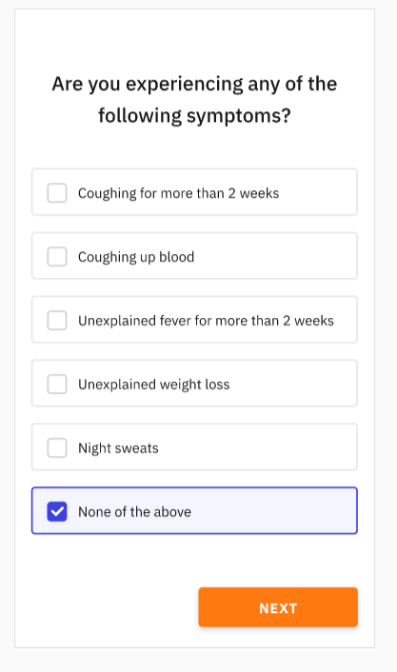
Basic assessment completed, now proceed to next steps as applicable-
Case 1:
When any of the listed symptom(s) get selected and the assessment directs the user towards the TB Diagnostic Tests
Case 2:
When “None of the Symptoms” gets selected by the user and primary assessment does not indicate TB
2. Click No, to exit the Symptom Checker tool
Click to Proceed
1. Click to Next

Slide 31
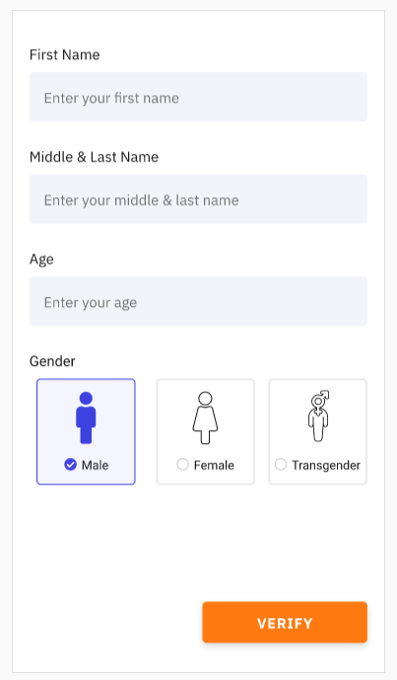
Enter all the required details to initiate the enrolment in Ni-kshay
1. Enter your details –
    First name,
    Middle & Last name
    Age
    Select your gender
2. Click on Verify to initiate the Enrolment process in Ni-kshay

Slide 32
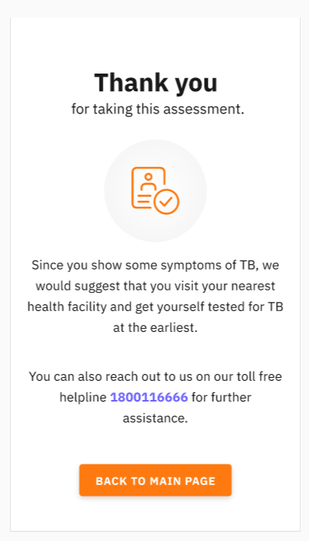
If skipped enrolment process, then it is redirecting to the Main page
Image 1
Image 2
If the person choose to select “Not now” , then next screen takes back to the Main page as shown in - Image 2
If the person skips enrollment he would be left with the information that he needs a test for which he can reach out to the helpline number.

Slide 33
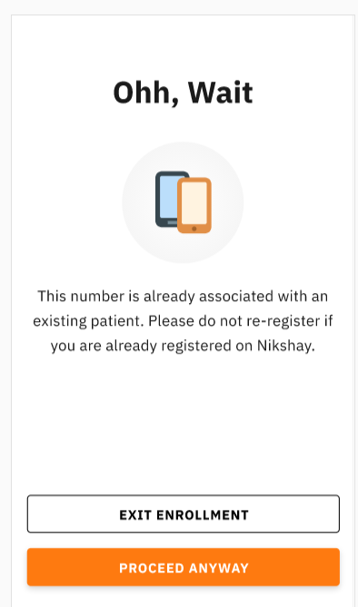
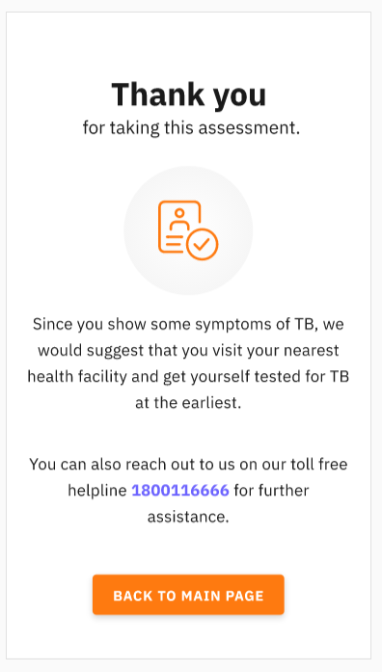
Once you entered your number, you need to select Next button
Enrolment process in Ni-kshay shall follow as per Option a & b as below -
Option a.
if the entered number is already linked to a patient in Ni-kshay, an alert would be shown to avoid any duplicate entries, the concerned person can skip this if this is a new entry or exit the enrollment process.
Option b.
If it is a new data, then the registration shall be completed in Ni-kshay as per the current functionality.
In this case, you required to proceed to the next steps
Click here to proceed anyway to the next steps
Click here for the next steps

Slide 34
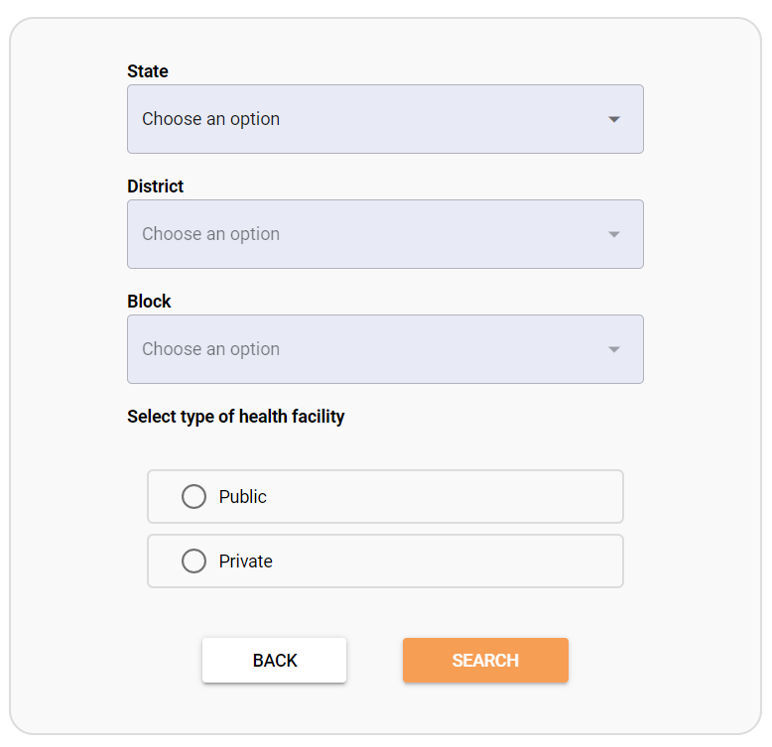
Find the health facilities
Select your intended State, District and Block from the respective drop down menu
Select the type of health facility
3. Click on Search

Slide 35
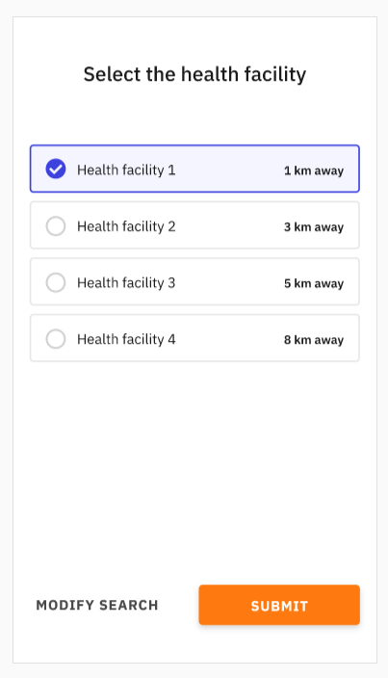
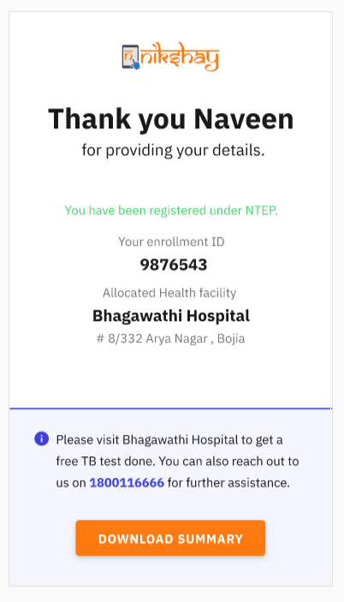

Select the health facility of your choice and submit
Your registration has now been completed and your enrolment ID is provided, you are allocated to the selected healthcare facility to get the TB tests conducted
XXXXXXX
5. Click on your nearest / intended Health Facility
4. Click on your nearest / intended Health Facility
Health Facility 1
5. Click to Proceed
6. Click on Submit
You may click here and download the summary for future records, if required

Slide 36
Post enrolment - follow-up cycle in Ni-kshay

Slide 37
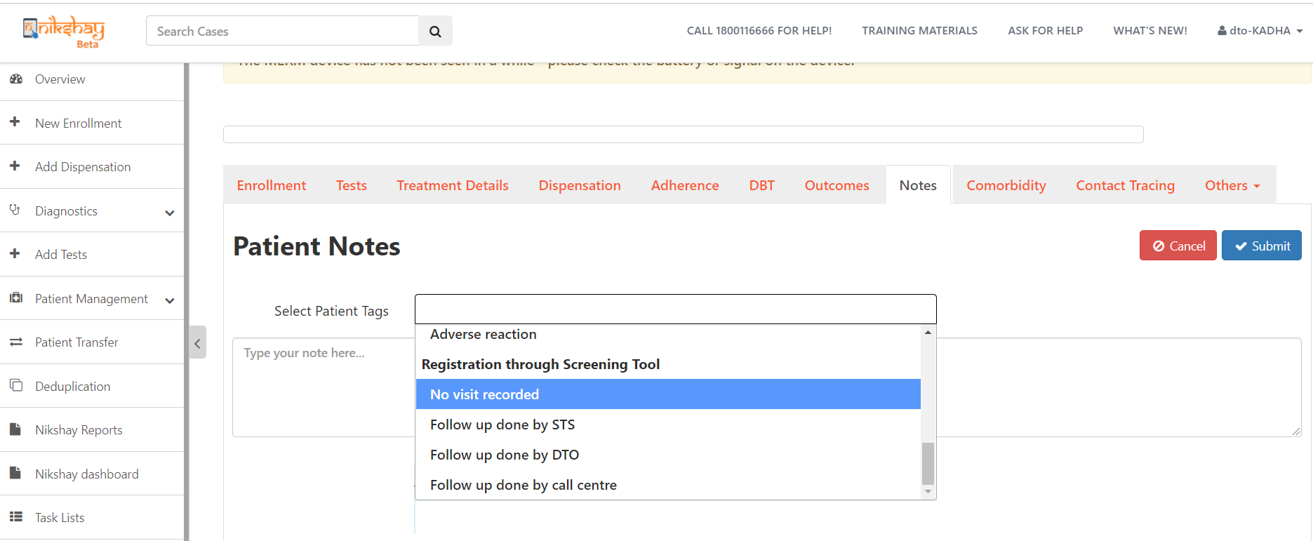
Click on Notes > Patient Management to initiate the treatment / follow up on enrolments made from Symptom Checker
Once registered through the Symptom Checker , patients’ information are linked to Ni-kshay as Presumptive open cases and can be checked with-
“Patient Management > Notes >
Patient Notes > Registration Through Screening Tool”
Unless any tests / visit recorded in Ni-kshay, such patients are tagged as
“No visit recorded”
Follow up cycle starts in Ni-kshay with this step and all the enrolments are shown in the system until they are closed in Ni-kshay after due follow up visits or with any other appropriate reasons

Slide 38
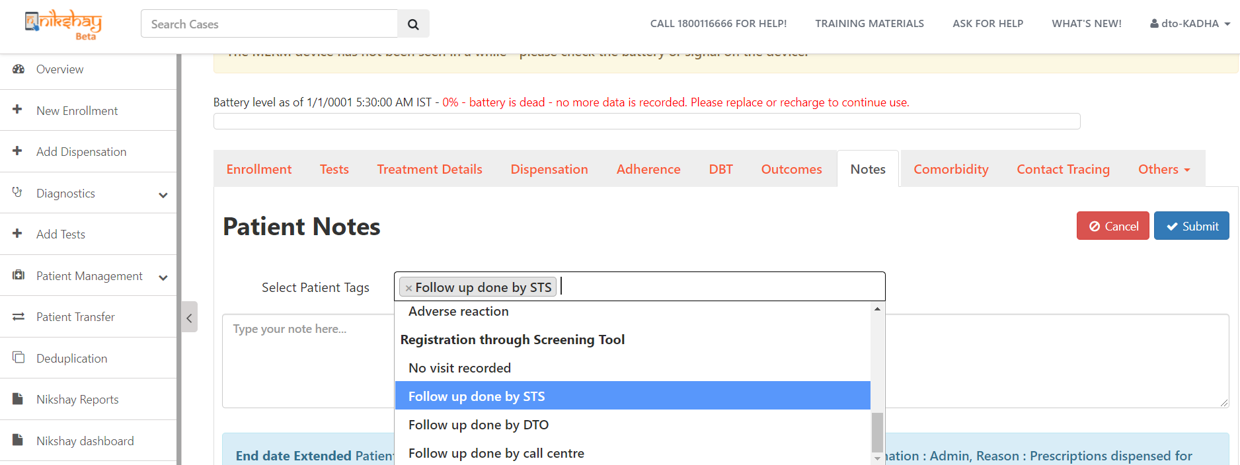
1st stage Follow-up: Click on > Patient Notes > Follow up done by STS, once the call is made by the STS level
Where patient’s visit is not observed in the system for 3-13 days from the date of enrolment in the screening tool,
That list shall be notified to the STS level and 1st level follow up is to be made and appropriate tags to be selected in Ni-kshay
1st level follow up to be made by STS and system tag to be changed as -
“Patient Management > Notes >
Patient Notes > Follow up done by STS” and
STS would require to modify the patient tag/status based on the patient's response as:
1. If the patient says he would visit, STS to update the tag from ‘No visit Recorded’ to ‘Follow up done by STS’
2. If the patient denies further treatment or needs no further intervention, the case can be closed after giving suitable reasons.

Slide 39
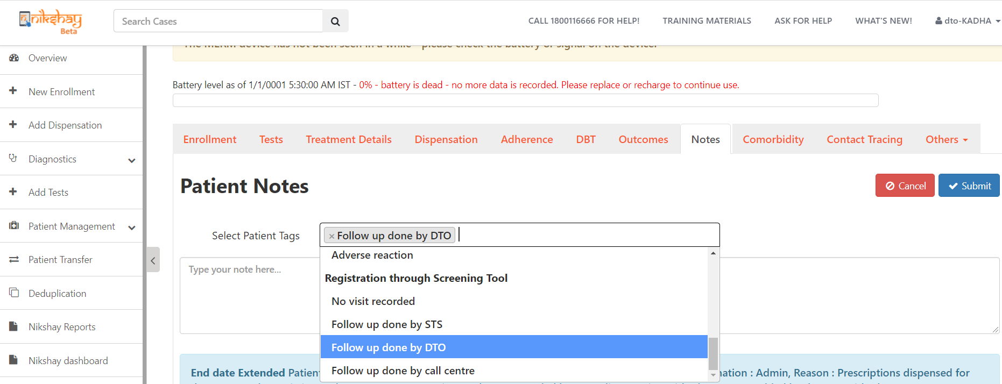
2nd stage Follow-up: Click on > Patient Notes > Follow up done by DTO, once the call is made by the DTO level
Cases enrolled from 14-20 days in the screening tool or where no action observed after follow up is made by the STS level, shall be notified to the DTO level, on which 2nd level follow up is to be made and appropriate tags to be selected in Ni-kshay
2nd level follow up to be made by DTO and system tag to be changed as -
“Patient Management > Notes >
Patient Notes > Follow up done by DTO” and DTO would require to modify the patient tag/status based on the patient's response as:
If the patient says he would visit, DTO to update the tag from ‘No visit Recorded’ or ‘Follow up done by STS’ to ‘Follow up done by DTO’
If the patient denies further treatment or needs no further intervention, the case can be closed after giving suitable reasons.

Slide 40
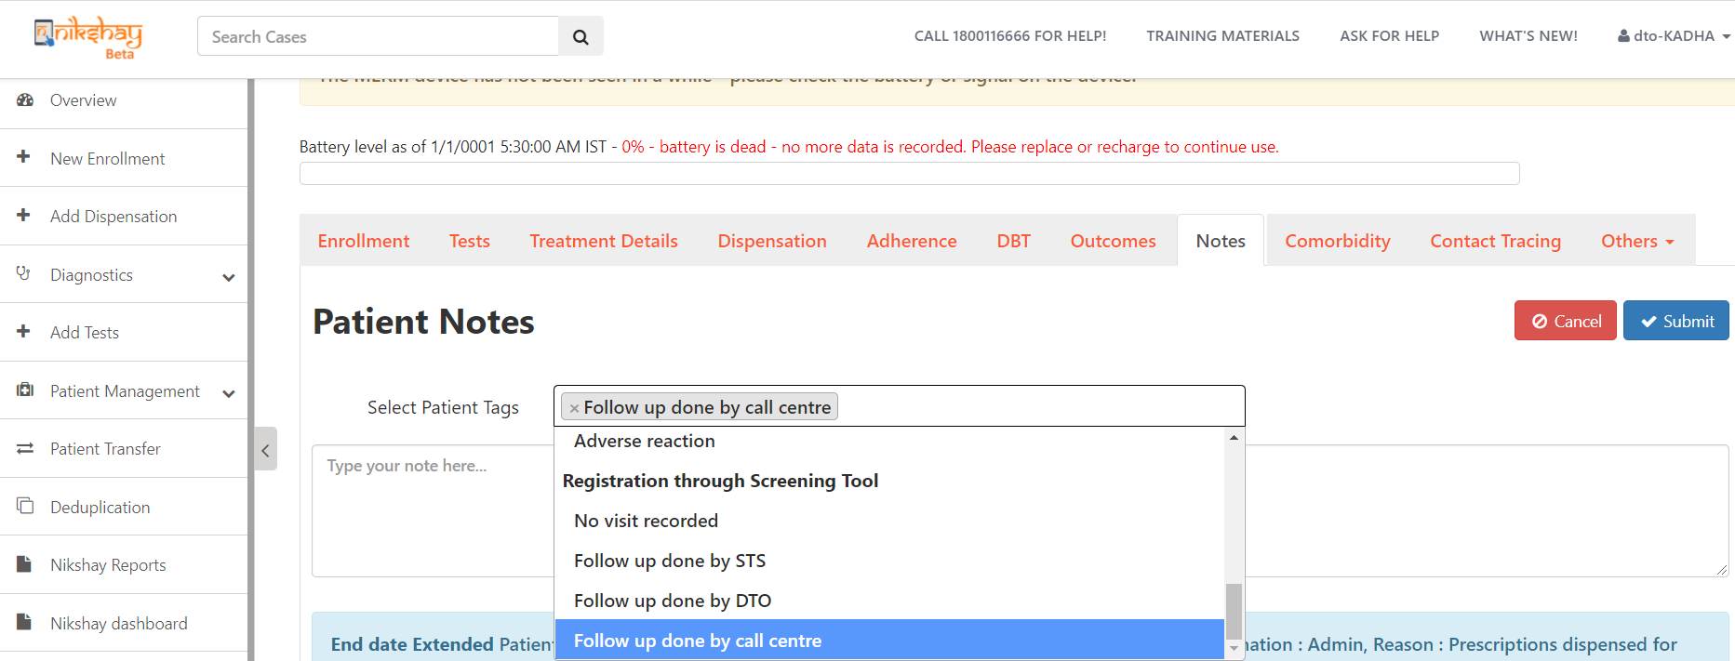
3rd stage Follow-up: Click on > Patient Notes > Follow up done by Call Centre, once the call is made by the Call Centre level
Cases enrolled from 14-20 days in the screening tool or where no action observed after follow up is made by the DTO and STS level, shall be notified to the Call Centre level, on which 3rd level follow up is to be made and appropriate tags to be selected in Ni-kshay
3rd level follow up is directed to the Call Centre level and system tag to be changed as -
“Patient Management > Notes >
Patient Notes > Follow up done by Call Centre” and the call centre agent requires to follow up and modify the patient tag/status based on the patient response as:
If the patient says he would visit, call centre to update the tag from ‘No visit Recorded’ or ‘Follow up done by STS’ or ‘Follow up done by DTO’ to ‘Follow up done by call centre’
If the patient denies further treatment or needs no further intervention, the case can be closed after giving suitable reasons.

Slide 41
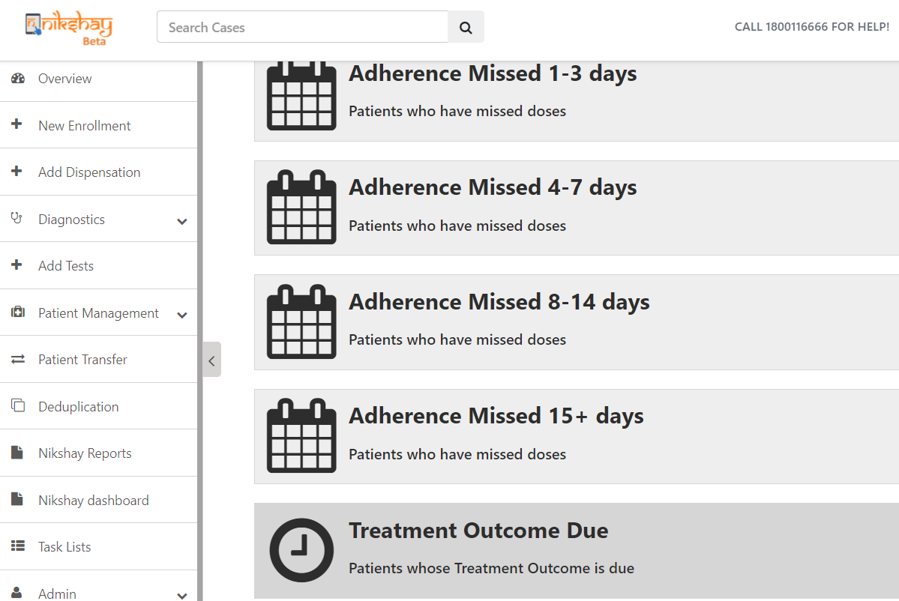
Click on Patients registered through screening tool – to check patients’ record who never visited for tests/ treatments even after follow up stages
Click on “Patients registered through Screening tool” - to get the details of the patients who got registered through the screening tool but have never visited for any tests/ treatments, even after 3 stage follow- up by STS, DTO and Call Centre agents

Slide 42
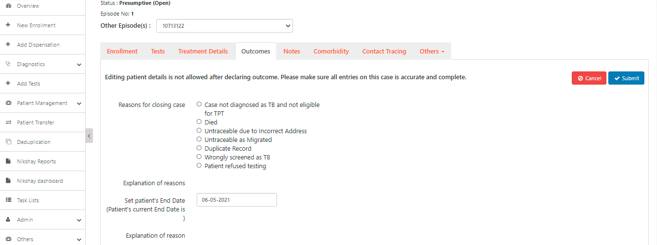
Click on Outcomes > Reason for closing Case, where applicable
On day 28th if the patient continues to remain in the same state and no visit is recorded up to week 4, the case would be auto closed with option ‘Untraceable’ and remarks ‘No information on patient visit recorded 4 weeks after registration.’
New options are added under ‘Reasons for closing case’ for Presumptive cases:
a) Died
b) Untraceable (Incomplete/ Wrong address/Migrated/Others)
c) Duplicate record (Repeat diagnosis/ already on treatment)
d) Wrongly screened as TB
e) Patient refused testing
f) Case not diagnosed as TB and not eligible for TPT
Follow up cycle closes with this step in Ni-kshay
Note: For any re-open cases, it can linked to previous records in Ni-kshay

Slide 43
Self Reporting Adherence
Patients can mark a manually taken dose or a manually missed dose from the TB Aarogya Sathi App
Patients can mark manual doses for the last 28 days
The doses marked from the app immediately show up on the Patient Calendar as manually marked (light green) or manually missed (dark red) legends.
Notes that are added from the Patient app are also visible under the ‘Notes’ section
Notes section also documents the time and the days for which manual doses were marked from the Patient App.

Slide 44
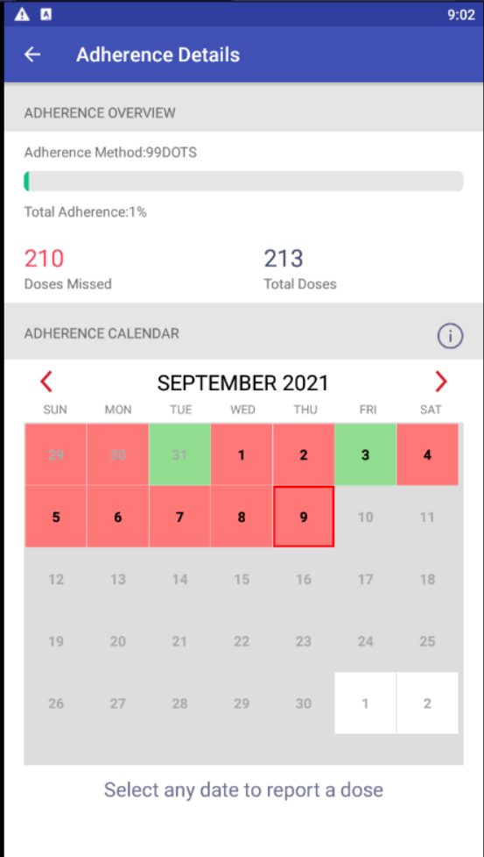
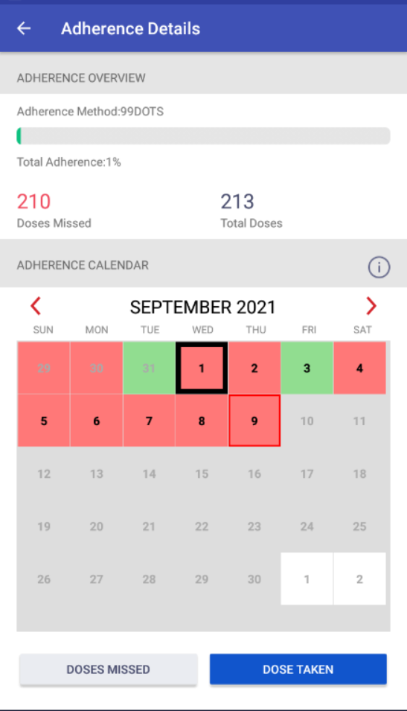
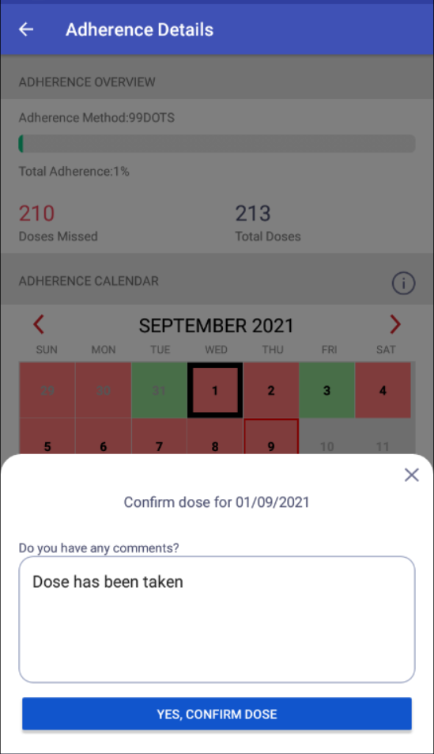
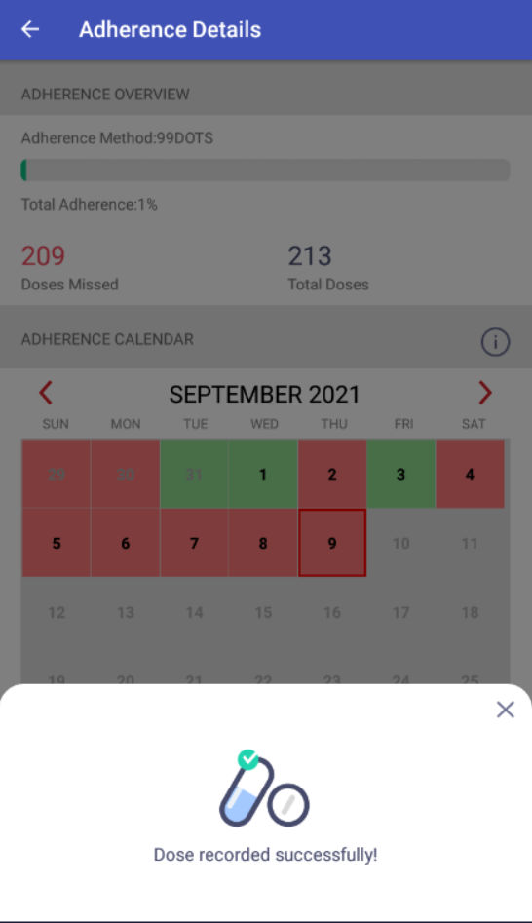
Self Reporting Adherence
Step 1
Step 2
Step 3
Select the Date
Mark Dose taken or Missed
Add comments and confirm Dose

Slide 45
Bank Edit Functionality

Slide 46
Bank Edit Functionality
Users who have logged in to the app with their Ni-kshay IDs will now be able to add and edit their bank details.
Users will be required to upload a photo of their passbook/bank statement/proof
Once the users upload the Bank details, the same will be available in the Patient page on the Ni-kshay Mobile and Web app and the staff will be able to view the photo proof uploaded.
If a beneficiary enters duplicate bank details, then an error message is displayed saying "A beneficiary with these account details already exists. Currently we do not allow multiple beneficiaries to have the same bank account"”
The Bank Details uploaded by the user will need to be approved by the DBT Maker. Also, if a validated beneficiary is edited, the DBT Checker will have to verify the bank details.

Slide 47
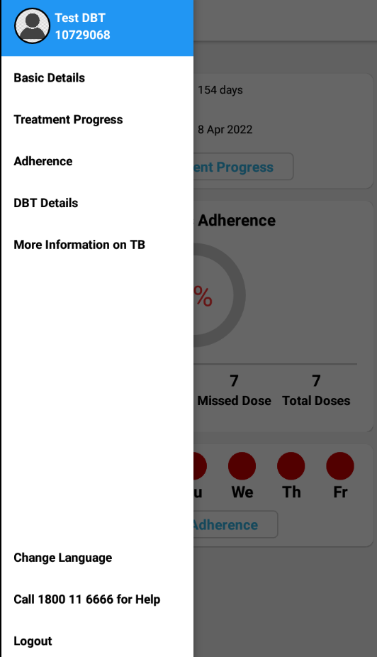
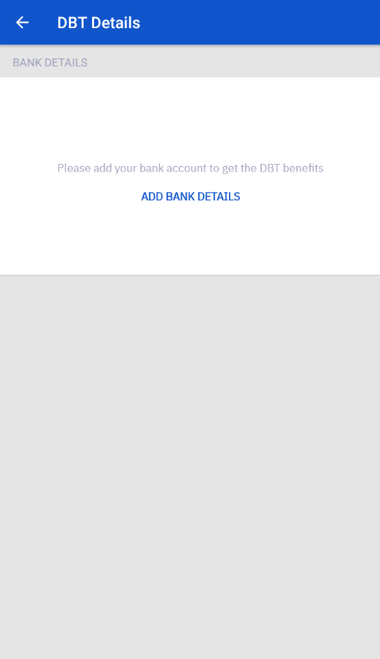
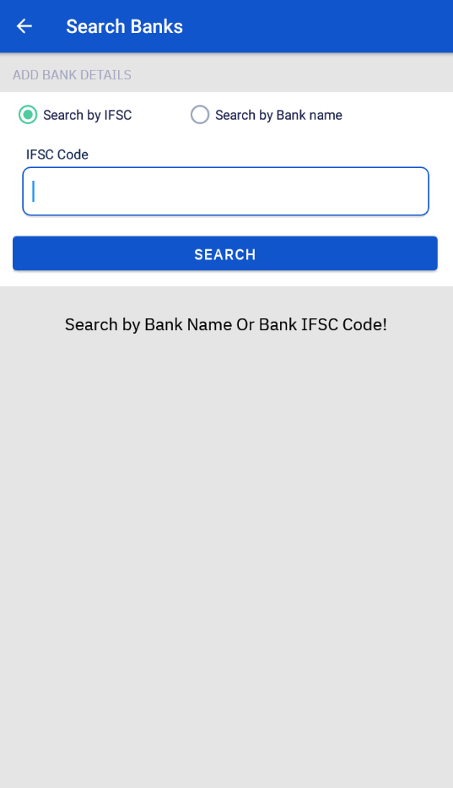
Bank Edit Functionality
Step 1
Step 2
Step 3
Click on DBT Details
Click on Add Bank Details
Select the Bank
Users can either search for the Bank by the IFSC Code or search using the Bank and Branch Name

Slide 48
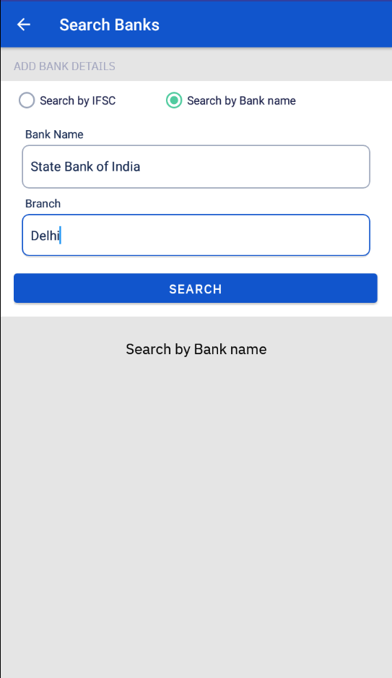
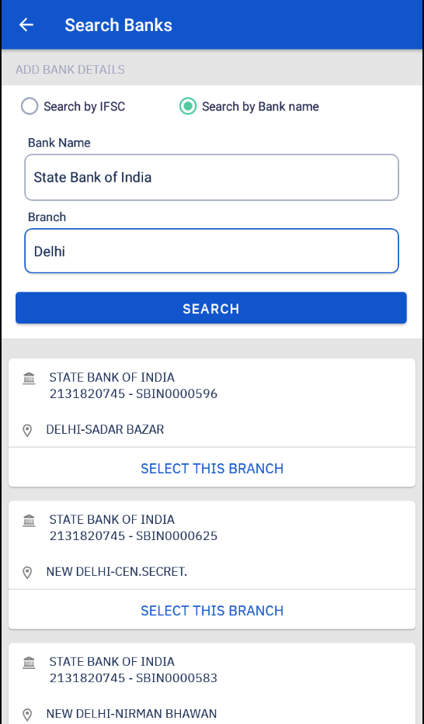
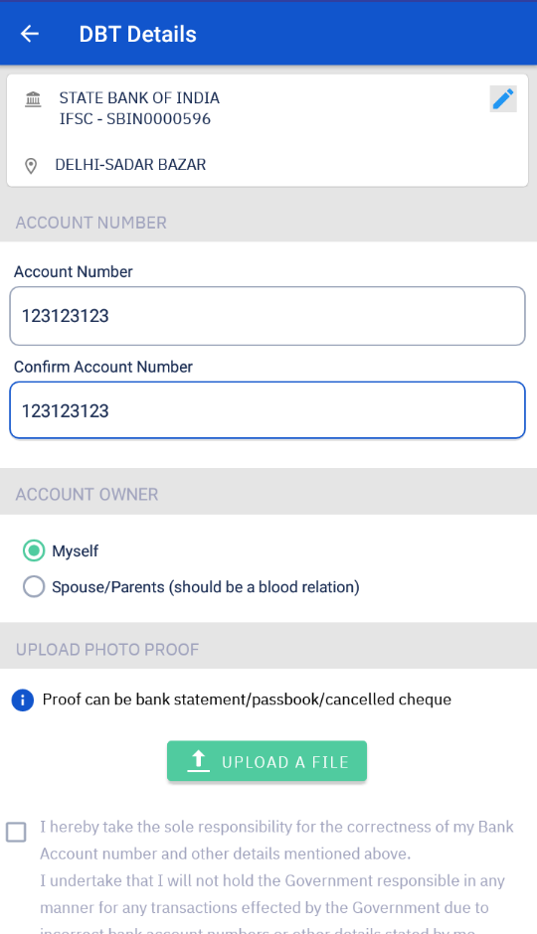
Bank Edit Functionality
Step 4
Step 5
Step 6
Click on the ‘Search’ button
Select the right branch
Enter the Bank Details
Enter and re-confirm the account number
Confirm if the account belongs to you or to a blood relation

Slide 49
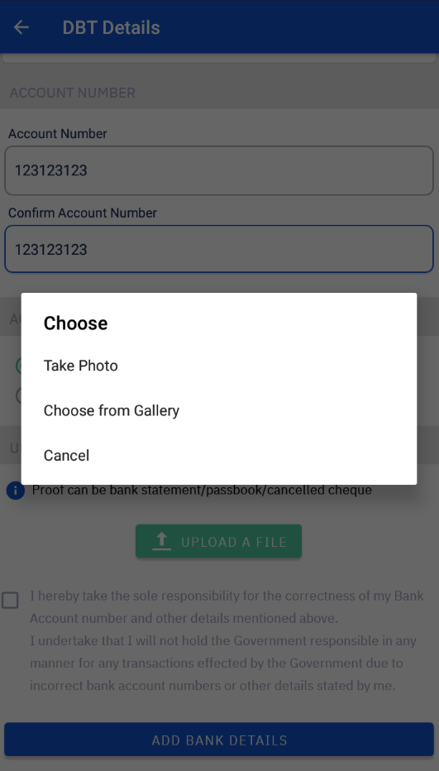
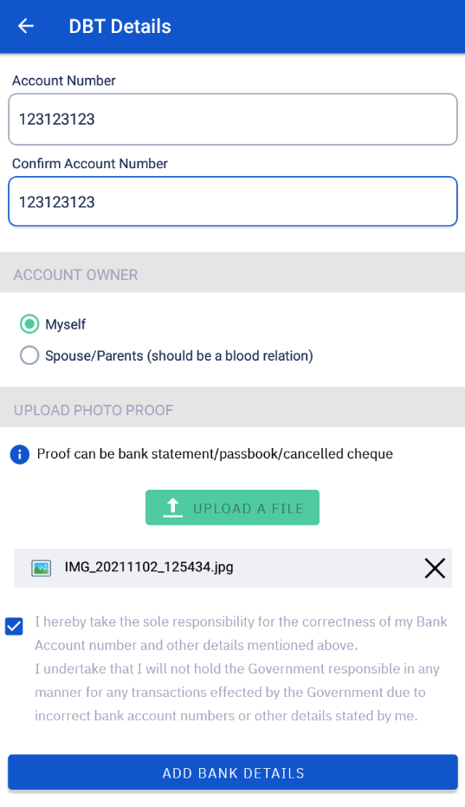

Bank Edit Functionality
Step 7
Step 8
Step 9
Upload Proof of the Bank Account
Select the Checkbox and click on Add Bank Details
View the uploaded details

Slide 50


Bank Edit Functionality

Slide 51

Entering Duplicate Bank Details
When a duplicate bank account is added then the following error message is shown - "A beneficiary with these account details already exists. Currently we do not allow multiple beneficiaries to have the same bank account“

Slide 52

DBT Details Page
The details along with the photo proof entered by the user from the TB Aarogya Sathi App are visible to staff in the DBT Tab of the Patient Page.

Slide 53

Approving beneficiary details by DBT Maker
Step 1
Click on Patient Approval Tab

Slide 54
Approving beneficiary details by DBT Maker
Step 1
Step 2
Click on Patient Approval Tab
Verify the details entered
Confirm if the details entered are accurate by checking the picture of the passbook/cancelled cheque uploaded by the user

Slide 55

Approving beneficiary details by DBT Maker
Step 1
Step 2
Step 3
Click on Patient Approval Tab
Verify the details entered
Act on the entered details
If the entered details are accurate, approve the beneficiary.

Slide 56

Approving beneficiary details by DBT Maker
Message displayed on successful approval of the beneficiary

Slide 57
Self-Learning Course for TB Survivors as TB Champions

Slide 58
Introduction
Central TB Division aims to reach out to TB survivors across the country and facilitate their participation in the mission to end TB as TB champions
As part of this activity, TB Survivors will be trained in the basics of TB and services under NTEP and briefed on how they can contribute to ending TB
The TB Aarogya Sathi app will contain links for each of the 7 courses on iGoT portal/DIKSHA platform that are available in Hindi and English.
Once trained as TB survivors, they are expected to support NTEP in the following
  Make people aware about TB & need for seeking care
  Support people with TB to undergo treatment & get back to good health
  Advocate for unaddressed challenges/barriers related to Tuberculosis
  Provide inputs/feedback to improve the quality of TB services.

Slide 59
Content of Self Learning Course
Content of the course on the Diksha Platform:
1. Introduction to TB
2. TB Diagnosis and Treatment
3. Stigma, Myths and Misconceptions related to TB
4. NTEP programme and services
5. Role of TB Champions
6. Training of TB Champions: Communication skills
7. Training of TB Champions: Advocacy and Way Forward

Slide 60

Access TB Champion Course
Step 1
Click on ‘Learn More’

Slide 61

Access TB Champion Course
Step 1
Step 2
Click on ‘Learn More’
Select the Language of your choice

Slide 62

Access TB Champion Course
Step 1
Step 2
Step 3
Click on ‘Learn More’
Select the Language of your choice
Click on the ‘+’ icon and then click on ‘Go to the Course’

Slide 63


Access TB Champion Course
Step 1
Step 2
Step 3
Step 4
Click on ‘Learn More’
Select the Language of your choice
Click on the ‘+’ icon and then click on ‘Go to the Course’
Click on ‘Continue’ Button

Slide 64


Access to TB Champion Course
The User can view the course from the web browser or can also view it through the DIKSHA app which is available on the playstore
If the Diksha app is not installed, the user will be redirected to the Diksha platform on the web browser.

Slide 65

Mark Course as Complete
Click on ‘Mark Completed’ after the course has been completed by the user
The course is indicated by a checkmark icon to indicate that the course has been completed by the user.

Slide 66

Report Activities
Report Activity Button will be visible after the user has completed all the courses and updated the courses as “Mark Complete”

Slide 67




Report Activities
Step 1
Step 2
Step 3
Step 4
Click on Report Activity’
Click on the ‘+’ icon to add activities
Enter the details of the activities
Click on ‘Save’ Button

Slide 68
Expectations from the State
Preparation of the identified TB Survivors for the training. States to brief them on the processes and ensure that TB survivors having access to smartphone install the TB Aarogya Saathi App in their phone.
Ensure the completion of the course by the identified TB Survivors within a month after national launch of the same.
Facilitate reporting of the activities undertaken by TB champions on the TB Aarogya Saathi app.
Provide feedback to CTD on the self-learning training initiative, if any.
Support from partner organizations (REACH/JHPIEGO/KHPT and any other partner organization working with community) shall be utilized for facilitating the self learning of TB Survivors as well as their engagement post the training.

Slide 69
FAQs
1. Who will be able to access the course?
The TB Champion course will be visible to a user(TB Patient) who has completed treatment successfully.
(stage=”DIAGNOSED_OUTCOME_ASSIGNED” and Treatment Outcome is either CURED or TREATMENT_COMPLETE)
2. Will the user be able to directly access courses on the IGOT/Diksha Platform?
No, the user will have to register separately on the iGOT/Diksha platform to enroll in the course.
3. How will the user be able to update that the course has been completed?
Currently the user does not have an option to mark a course as completed on the TB Aarogya Sathi platform, but this will soon be available.

Slide 70
Future Changes
Users will be able to mark a lesson as completed on the TB Aarogya Sathi App once they have successfully completed the lesson on the Diksha Portal.
Upon completion of all lessons, the User Summary Page will have an option through which they will be able to report all activities (patient visits, meetings) performed by the TB Champion. The user will be able to view all previously added activities as well.

Slide 71
Reports
TB Aarogya Sathi Patient Access Report - A new report which provides the users with an overview of the number of users who have logged in to the TB Arogya Sathi (TAS) App is now available.
The Notification and Enrolment Register has been enhanced with a new column - Logged Into TAS - indicating if the patient has logged into the TB Aarogya Sathi app.
TB Screening Tool Access Report: This report provides a summary view of patients who have accessed the TB Screening tool and enrolled on Ni-kshay.

Slide 72
Ni-kshay Sahyogi (TB Chatbot)

Slide 73
Features
Ni-kshay Sahyogi will be available for Citizens and Patients.
Users can ask general questions related to TB, its symptoms, diagnosis, facility details, etc.
This feature is currently available in English, but will be available in multiple local languages in the future release of the app.

Slide 74

Ni-kshay Sahyogi
Step 1
Click on the Icon
Click here to launch Ni-kshay Sahyogi

Slide 75

Ni-kshay Sahyogi
Step 1
Step 2
Click on the Icon
Enter the question
Press the enter button after writing the questions

Slide 76

Ni-kshay Sahyogi
Step 1
Step 2
Click on the Icon
Enter the question
Answer to the question is displayed here.

Slide 77
Thank You

