Slide 1
Statement of Expenditure (SoE) form in Ni-kshay
(State and District level)

Slide 2
Background
Statement of Expenditure (SoE) form (State & District level) & Edit functionality
Reports
Form Fill Summary
Form Data
Contents

Slide 3
Background
National TB Elimination Programme (NTEP) is a centrally sponsored scheme under NHM to implement the programme activities as envisaged under NSP 2017-25 as per NTEP guidelines.
The procedures for financial management are being followed as per the manuals and guidelines available on the programme website (Financial Manual for NTEP).
The fund flow remains within the existing financial management system of the MoHFW, which operates through the centralized Pay and Accounts office. The release of funds to States is done in installments through State Treasury.
The expenditure report are presently being manually compiled at State/District levels and shared with CTD on a quarterly basis over email.

Slide 4
Statement of Expenditure (SoE) form
(State & District levels)

Slide 5
Statement of Expenditure (SoE) forms
The Statement of Expenditure (SoE) forms shall be accessible from the State level, CTD-3, India-all, Regional WHO Consultants, STDC, RTPMU, CTO, WHO Consultant, MD-NHM, PS-Health, and District level logins.
The form can be submitted with the option to select the ‘Reporting Year’ (2023-24, 2024-25) and ‘Reporting Quarter’ (Apr-Mar).
The user can edit/modified the records for the specific Reporting Year & Quarter entered in the form.
Major KPIs captured in the reporting form:
Receipts
SPIP Approvals (As per RoP)
Expenditure

Slide 6
Statement of Expenditure (SoE) forms
Step 1
Step 2
Step 3
Go to https://www.nikshay.in
Click on ‘Ni-kshay Reports’
Select ‘SoE Form’ under M&E Forms
Select the Reporting Year and Quarter and click on ‘Search’

Slide 7
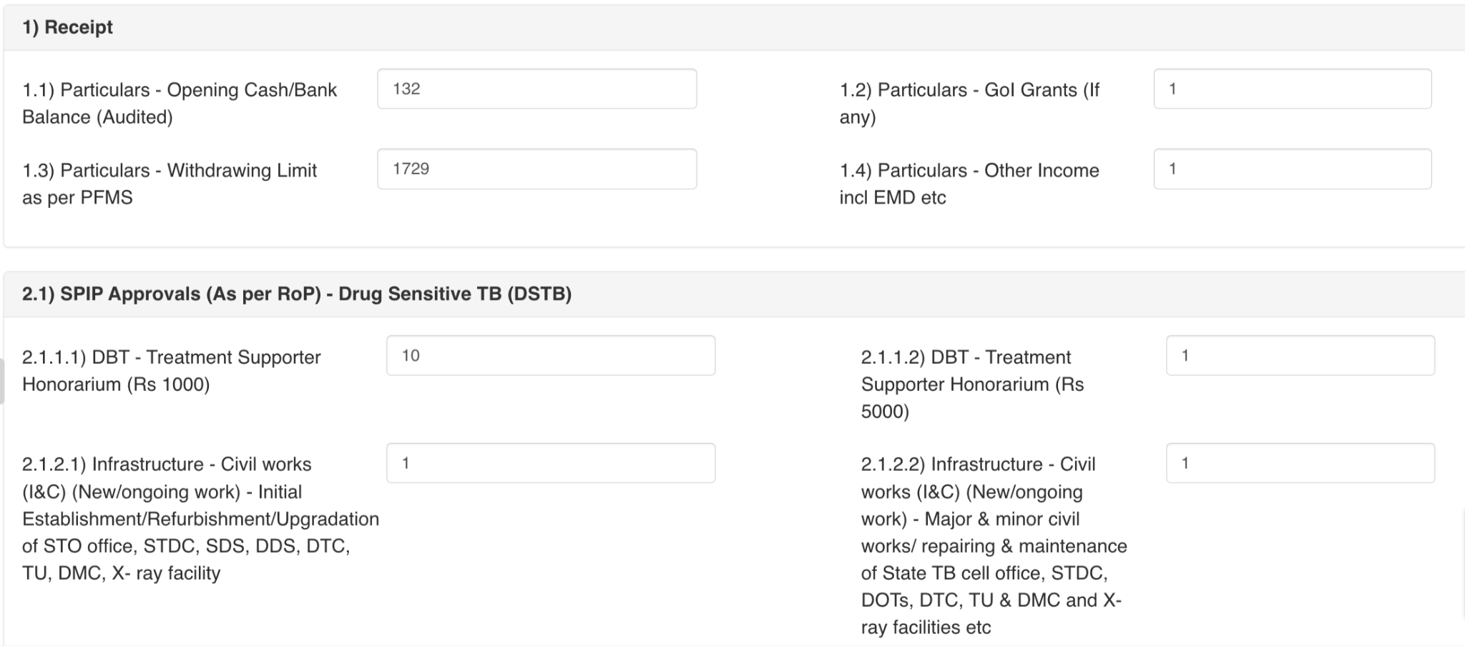
Statement of Expenditure (SoE) forms
Step 1
Step 2
Step 3
Go to https://www.nikshay.in
Click on ‘Ni-kshay Reports’
Select ‘SoE Form’ under M&E Forms

Slide 8
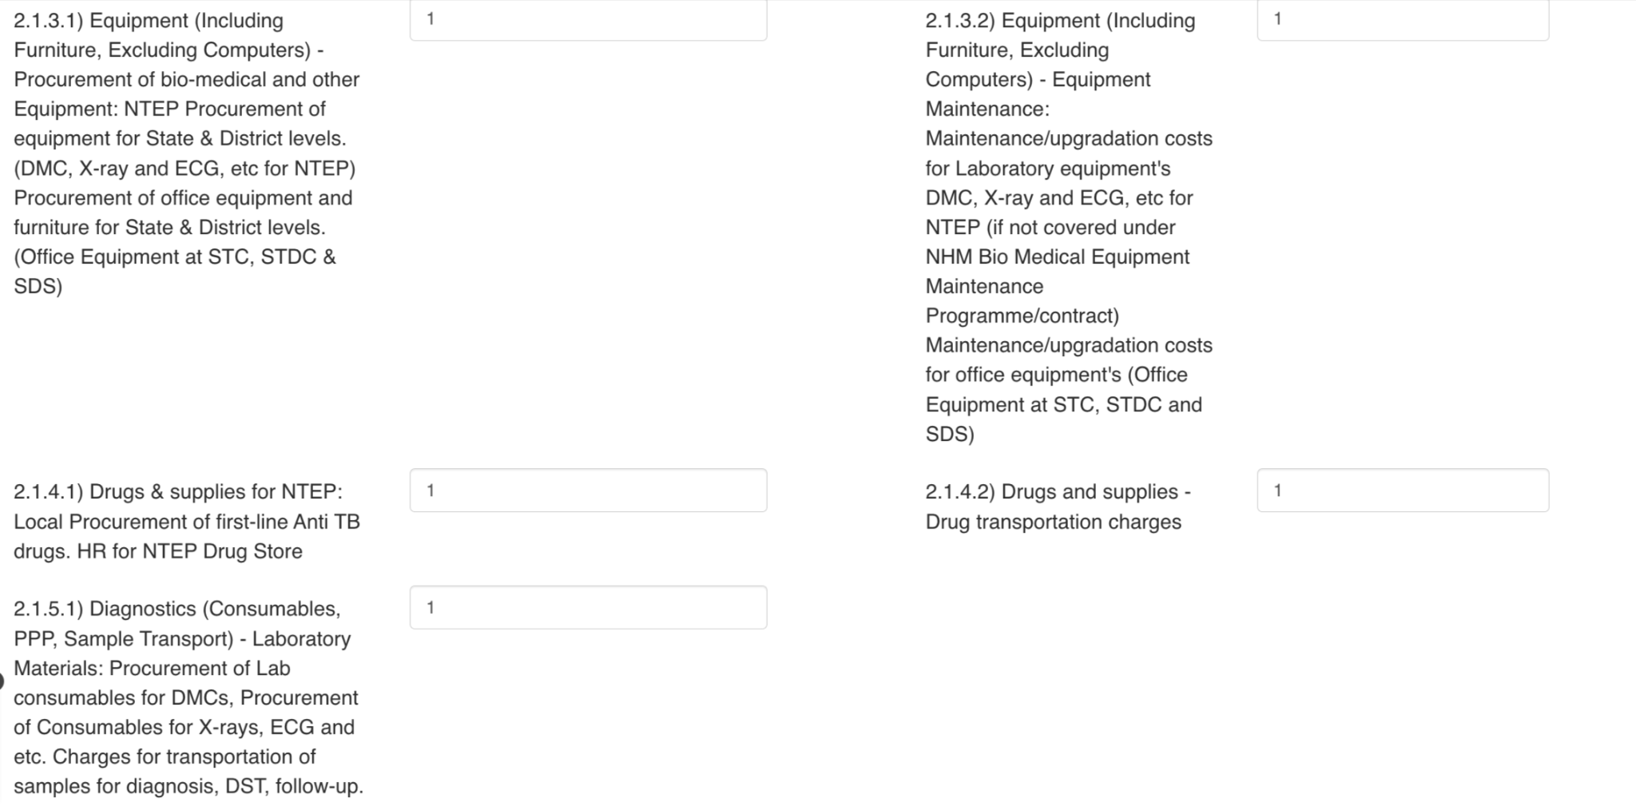
Statement of Expenditure (SoE) forms
Step 1
Step 2
Step 3
Go to https://www.nikshay.in
Click on ‘Ni-kshay Reports’
Select ‘SoE Form’ under M&E Forms

Slide 9
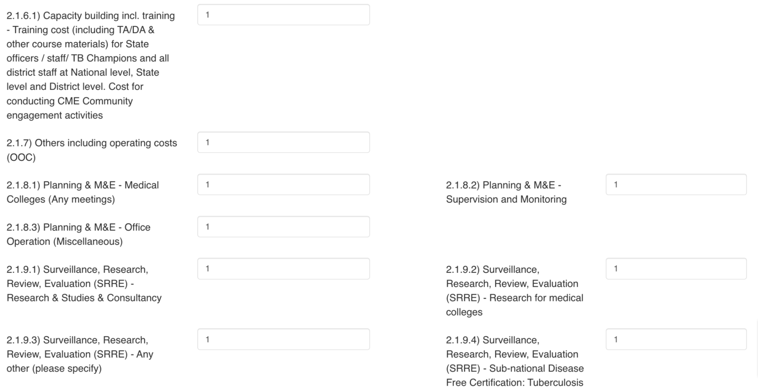
Statement of Expenditure (SoE) forms
Step 1
Step 2
Step 3
Go to https://www.nikshay.in
Click on ‘Ni-kshay Reports’
Select ‘SoE Form’ under M&E Forms

Slide 10
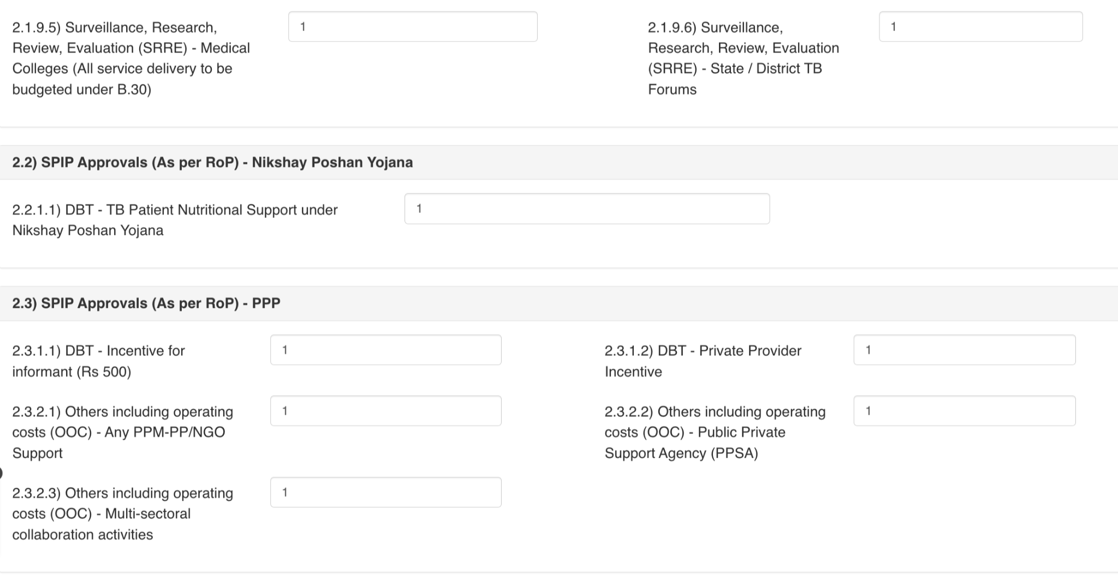
Statement of Expenditure (SoE) forms
Step 1
Step 2
Step 3
Go to https://www.nikshay.in
Click on ‘Ni-kshay Reports’
Select ‘SoE Form’ under M&E Forms

Slide 11
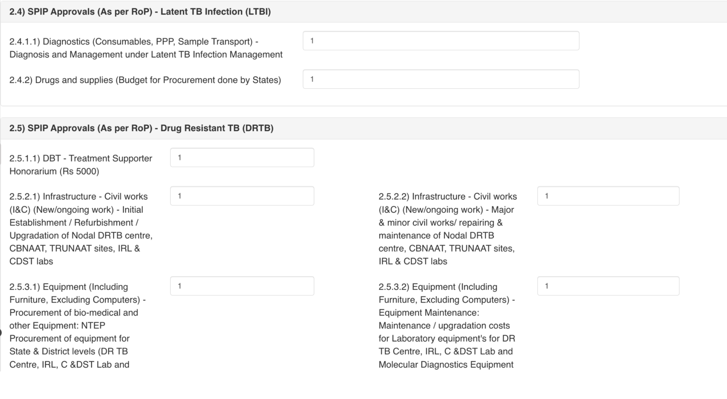
Statement of Expenditure (SoE) forms
Step 1
Step 2
Step 3
Go to https://www.nikshay.in
Click on ‘Ni-kshay Reports’
Select ‘SoE Form’ under M&E Forms

Slide 12
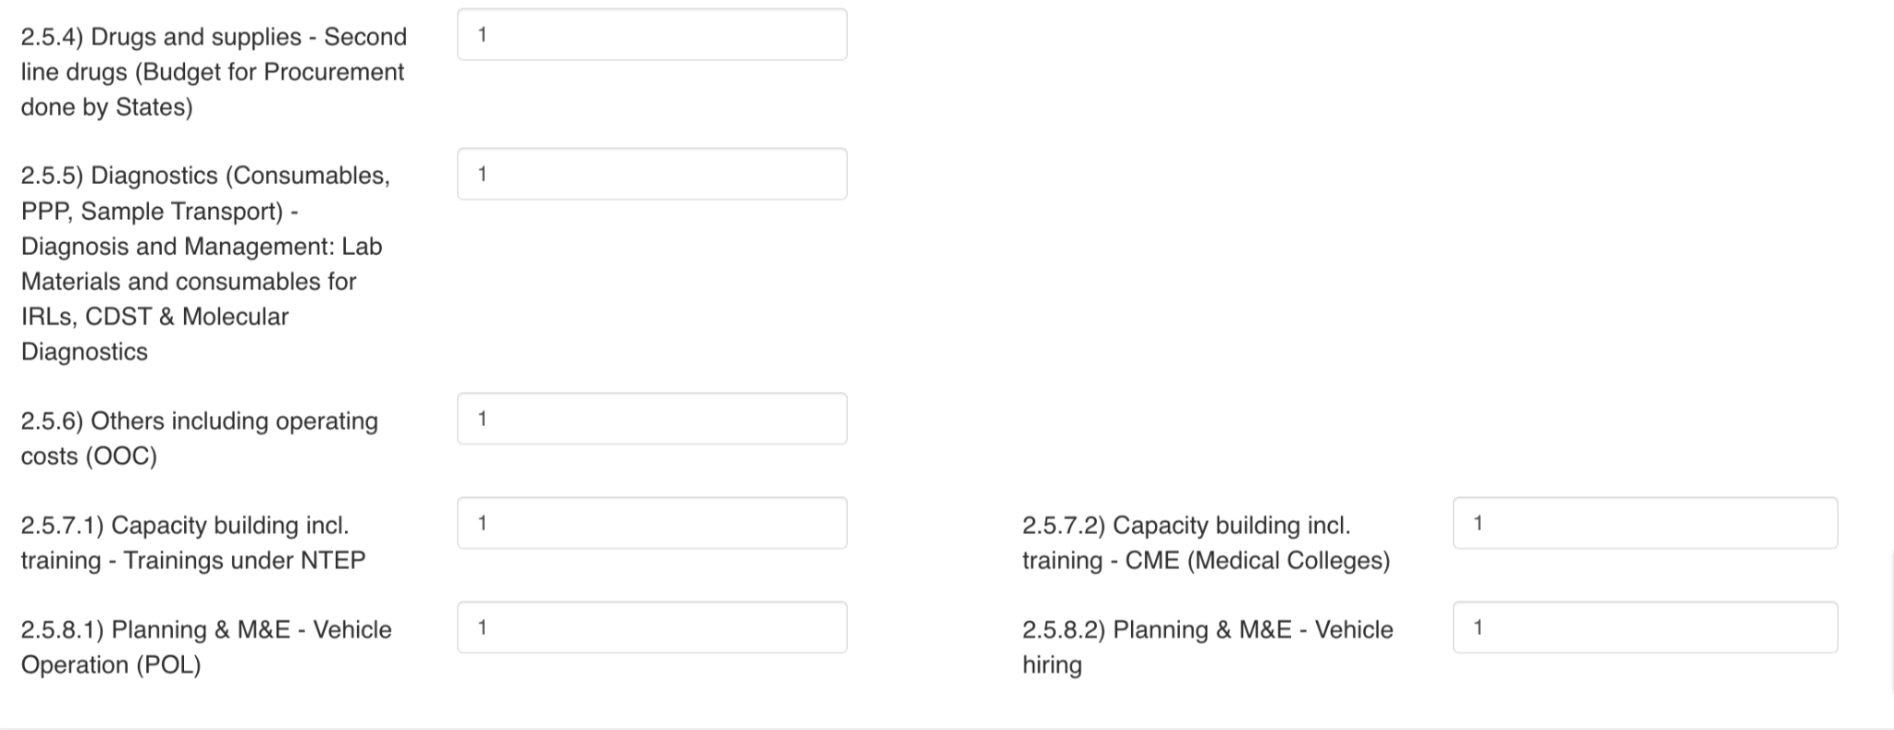
Statement of Expenditure (SoE) forms
Step 1
Step 2
Step 3
Go to https://www.nikshay.in
Click on ‘Ni-kshay Reports’
Select ‘SoE Form’ under M&E Forms

Slide 13
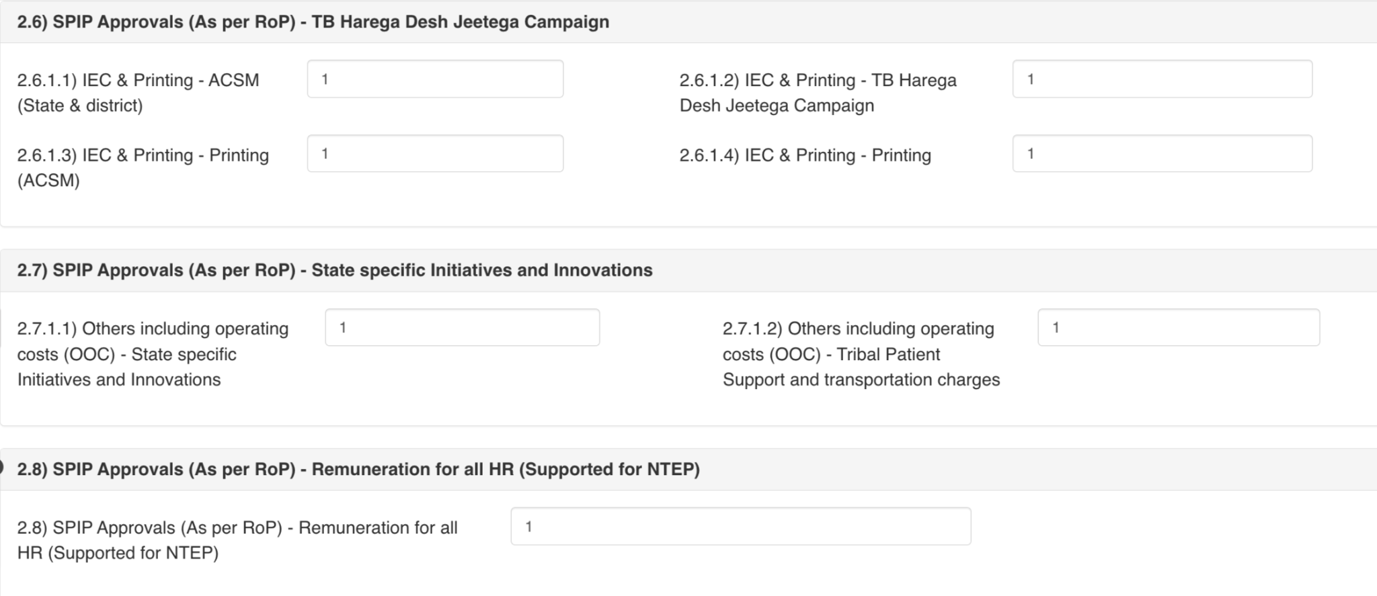
Statement of Expenditure (SoE) forms
Step 1
Step 2
Step 3
Go to https://www.nikshay.in
Click on ‘Ni-kshay Reports’
Select ‘SoE Form’ under M&E Forms

Slide 14
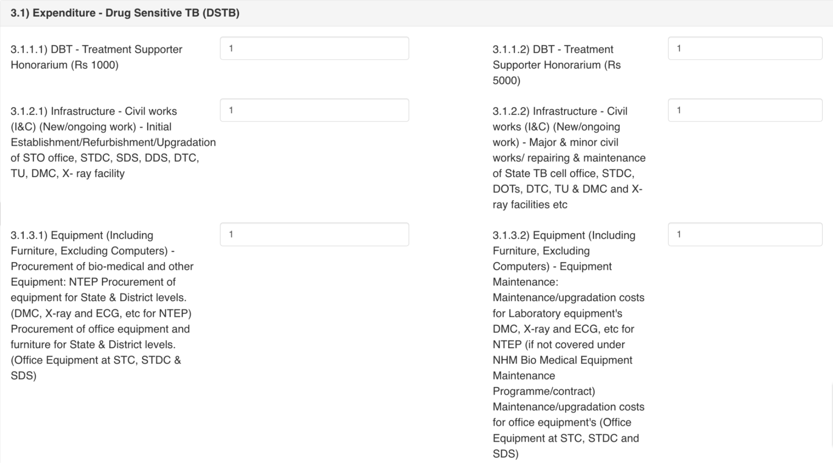
Statement of Expenditure (SoE) forms
Step 1
Step 2
Step 3
Go to https://www.nikshay.in
Click on ‘Ni-kshay Reports’
Select ‘SoE Form’ under M&E Forms

Slide 15
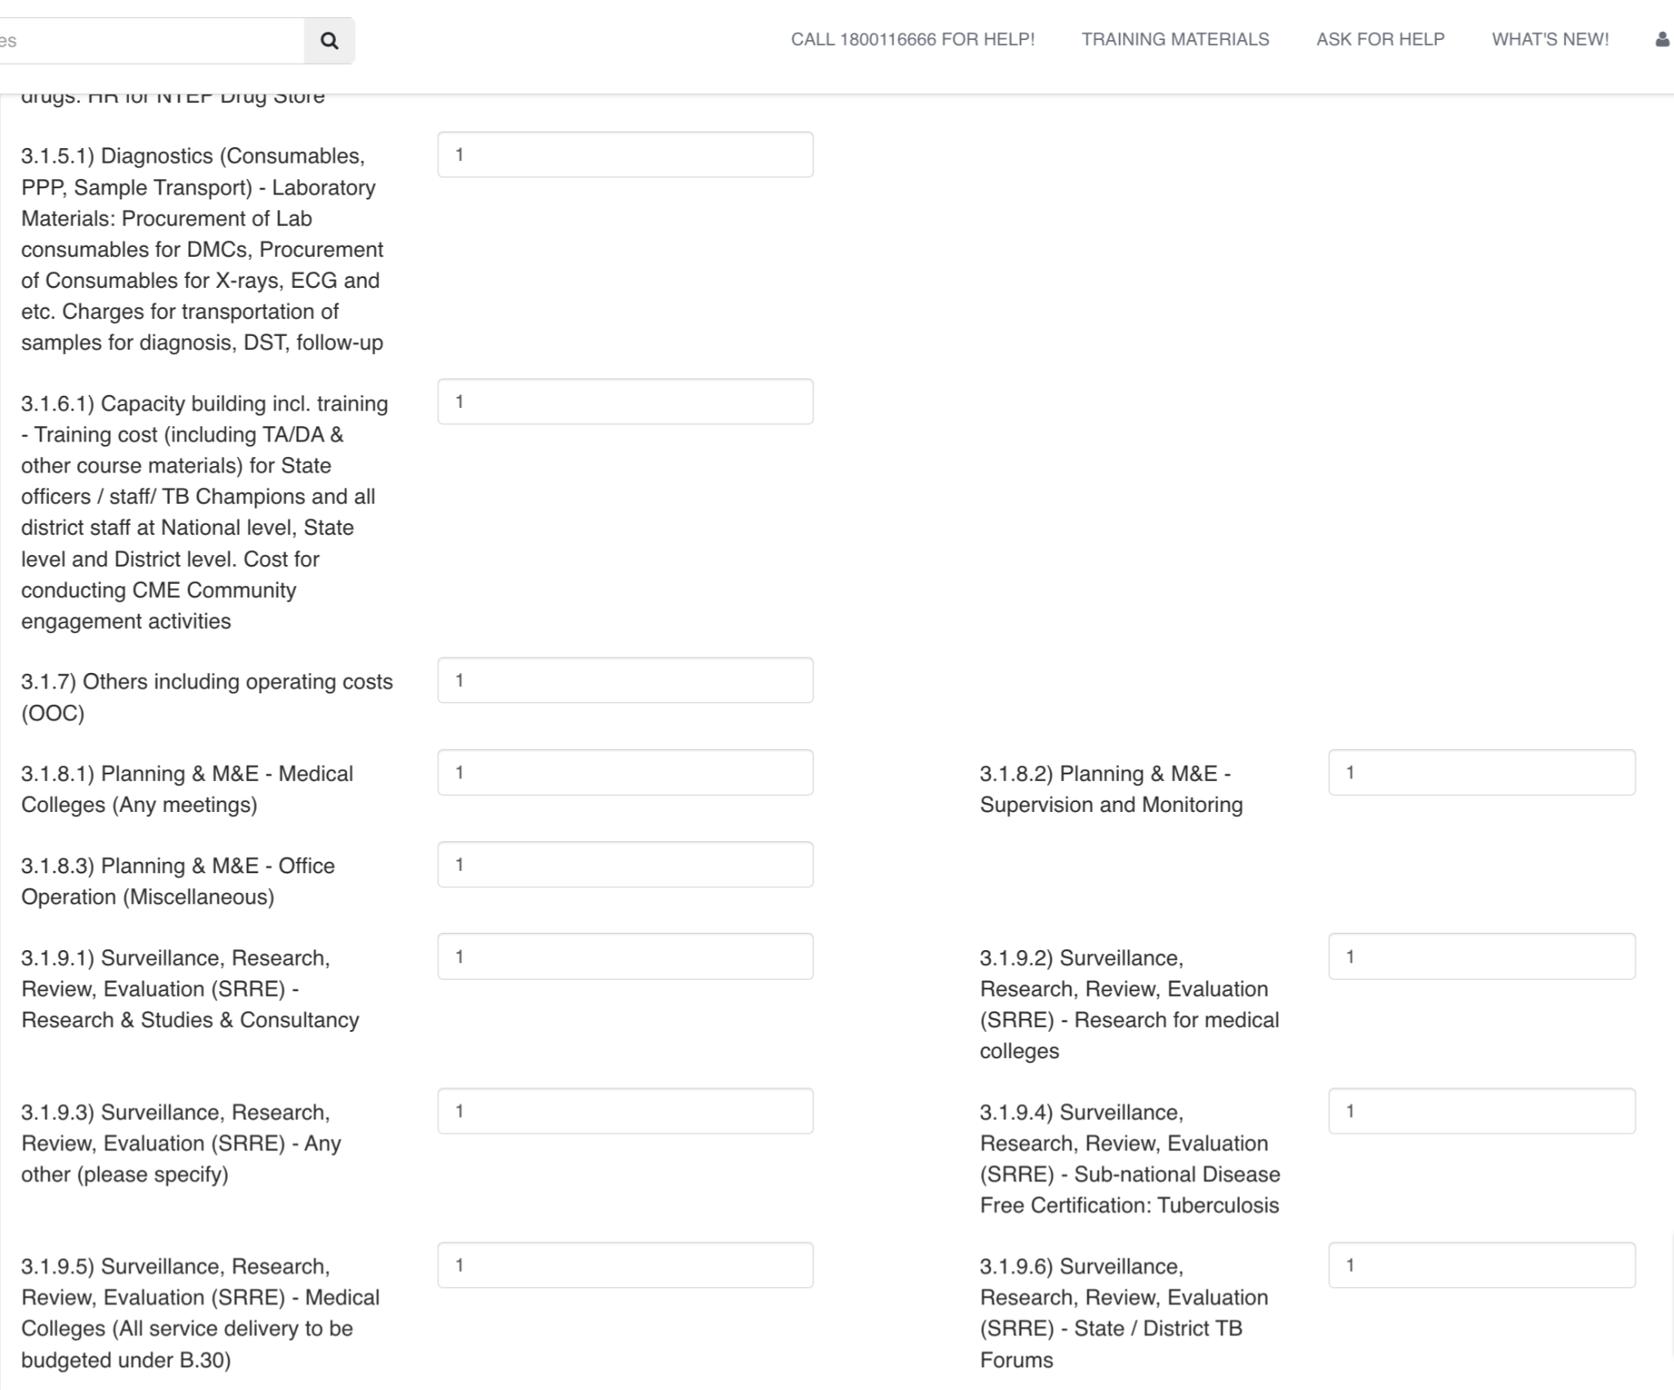
Statement of Expenditure (SoE) forms
Step 1
Step 2
Step 3
Go to https://www.nikshay.in
Click on ‘Ni-kshay Reports’
Select ‘SoE Form’ under M&E Forms

Slide 16
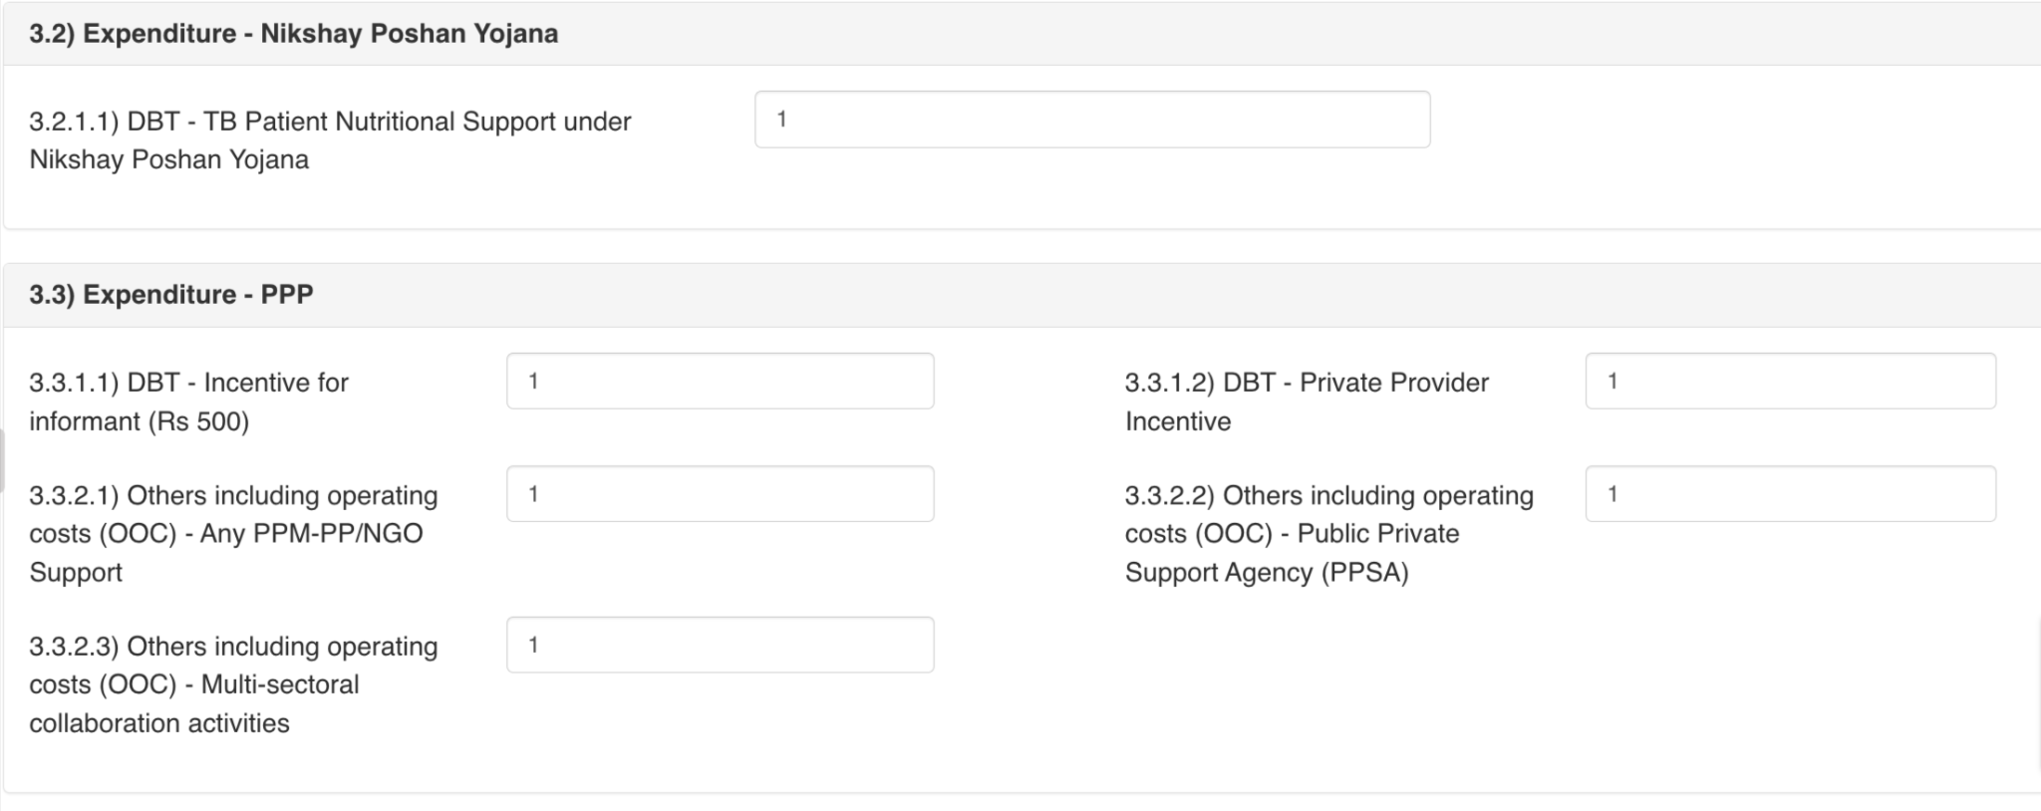
Statement of Expenditure (SoE) forms
Step 1
Step 2
Step 3
Go to https://www.nikshay.in
Click on ‘Ni-kshay Reports’
Select ‘SoE Form’ under M&E Forms

Slide 17
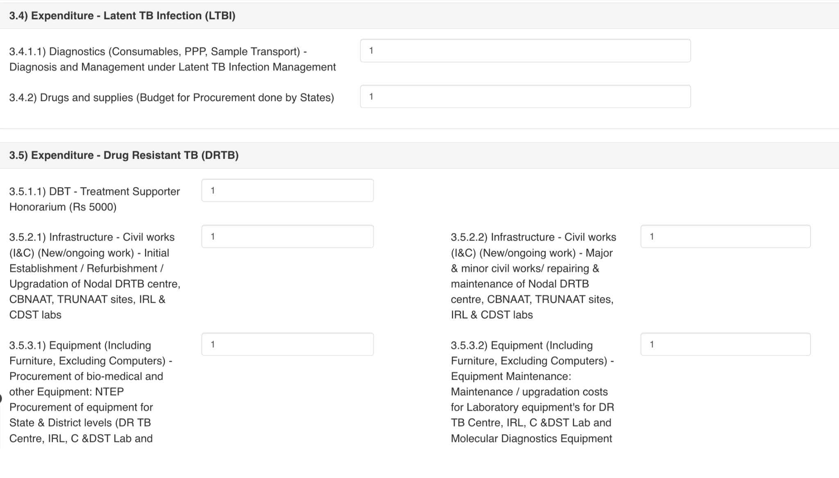
Statement of Expenditure (SoE) forms
Step 1
Step 2
Step 3
Go to https://www.nikshay.in
Click on ‘Ni-kshay Reports’
Select ‘SoE Form’ under M&E Forms

Slide 18
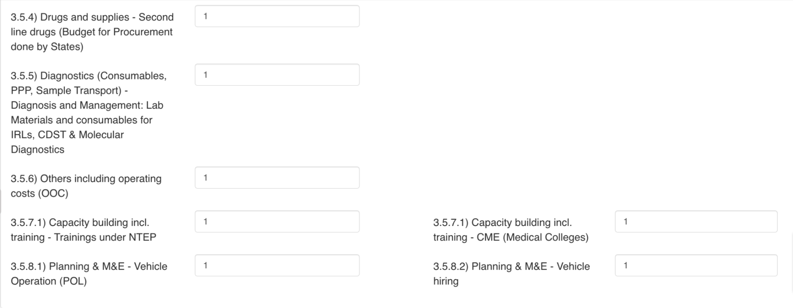
Statement of Expenditure (SoE) forms
Step 1
Step 2
Step 3
Go to https://www.nikshay.in
Click on ‘Ni-kshay Reports’
Select ‘SoE Form’ under M&E Forms

Slide 19
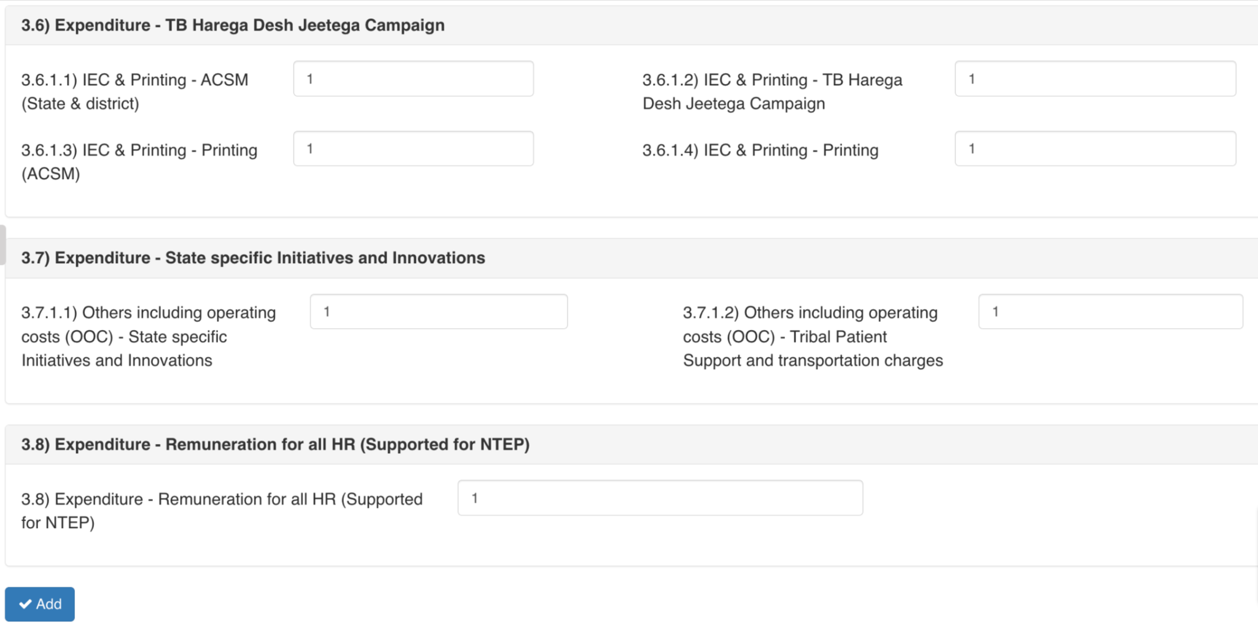
Statement of Expenditure (SoE) forms
Step 1
Step 2
Step 3
Step 4
Go to https://www.nikshay.in
Click on ‘Ni-kshay Reports’
Select ‘SoE Form’ under M&E Forms
Click on ‘Add’ button to add the record
Click on ‘Add’ to add the record in the database.

Slide 20
Statement of Expenditure (SoE) form: State & District levels
(edit functionality)

Slide 21
Statement of Expenditure (SoE) forms - Edit functionality
Step 1
Step 2
Step 3
Go to https://www.nikshay.in
Click on ‘Ni-kshay Reports’
Select ‘SoE Form’ under M&E Forms
Select the Reporting Year and Quarter for the record that needs to be modified and then click on ‘Search’

Slide 22
Statement of Expenditure (SoE) forms
Step 1
Step 2
Step 3
Step 4
Go to https://www.nikshay.in
Click on ‘Ni-kshay Reports’
Select ‘SoE Form’ under M&E Forms
Click on ‘Add’ button to update the record
After check/verify or modified the entered records; click on ‘Add’ button to update the record in the database.

Slide 23
SoE Form - Reports
(Form Fill Summary & Form Data)

Slide 24
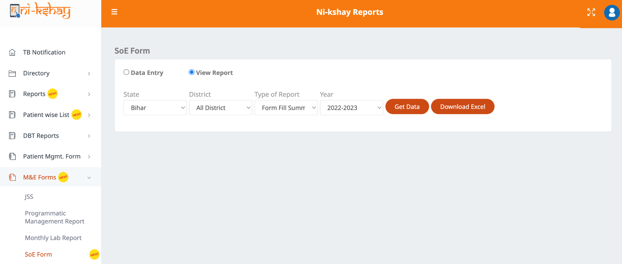
Statement of Expenditure (SoE) forms - Reports (Form Fill Summary)
Step 1
Step 2
Step 3
Step 4
Step 5
Go to https://www.nikshay.in
Click on ‘Ni-kshay Reports’
Select ‘SoE Form’ under M&E Forms
Select ‘SoE Form’
Select ‘View Report’

Slide 25
Statement of Expenditure (SoE) forms - Reports (Form Fill Summary)
Step 5
Step 6
Step 7
Select ‘View Report’
Select ‘State/District and Year’
Click on ‘Get Data’

Slide 26
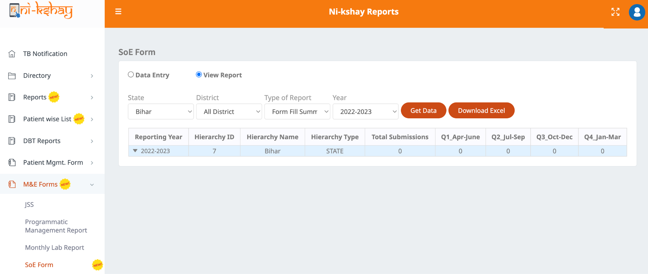
Statement of Expenditure (SoE) forms - Reports (Form Fill Summary)
Step 5
Step 6
Step 7
Select ‘View Report’
Select ‘State/District and Year’
Click on ‘Get Data’

Slide 27
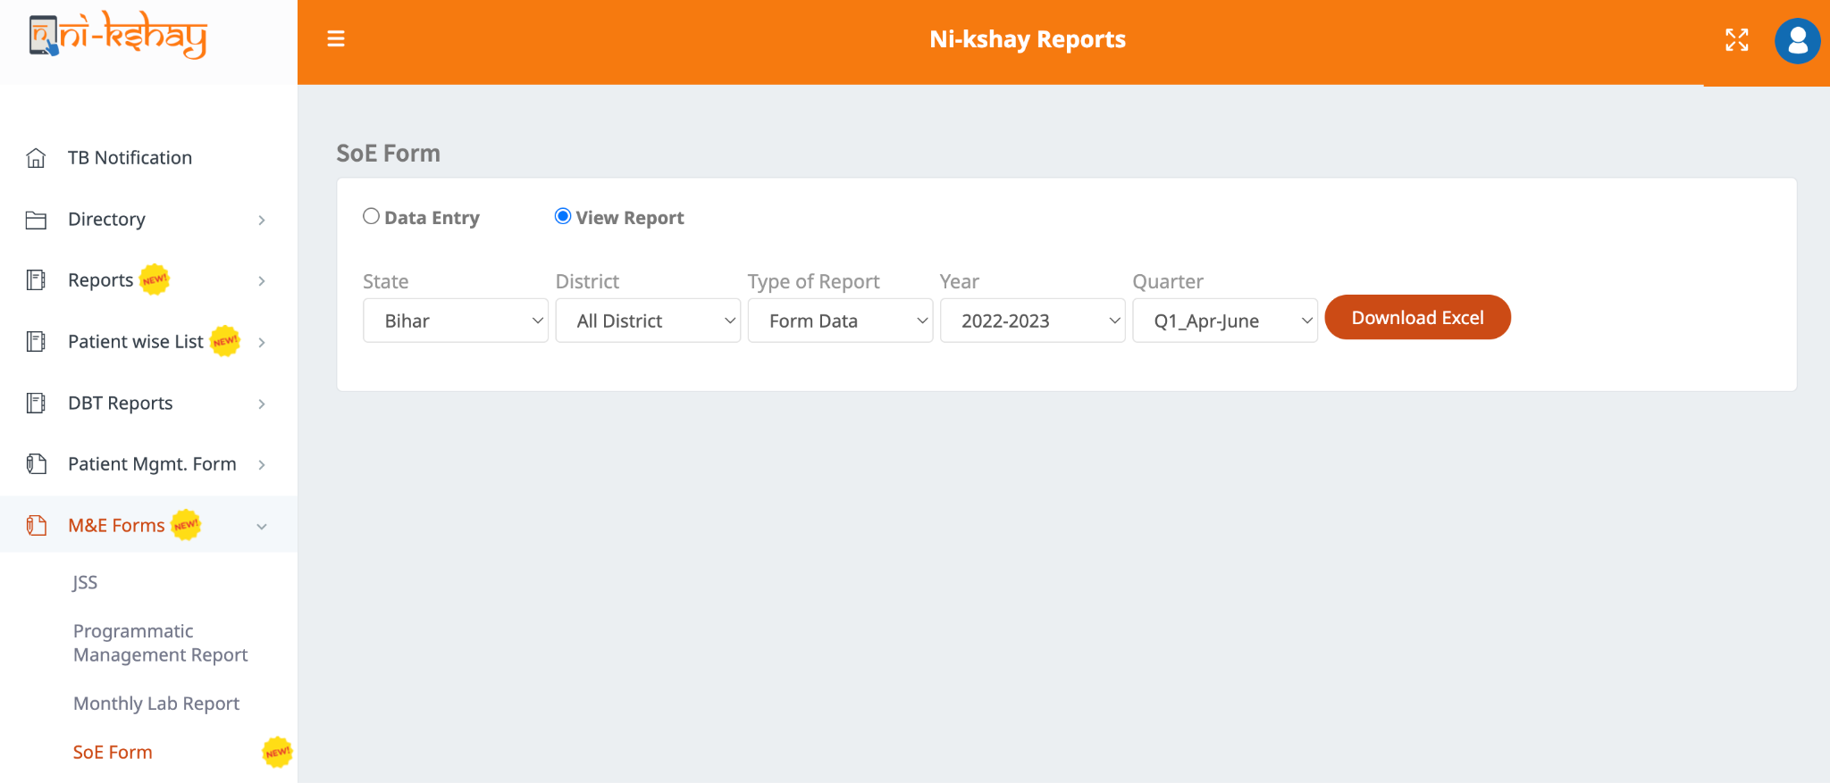
Statement of Expenditure (SoE) forms - Reports (Form Data)
Step 1
Step 2
Step 3
Step 4
Step 5
Go to https://www.nikshay.in
Click on ‘Ni-kshay Reports’
Select ‘SoE Form’ under M&E Forms
Select ‘SoE Form’
Select ‘View Report’

Slide 28
Statement of Expenditure (SoE) forms - Reports (Form Data)
Step 5
Step 6
Step 7
Select ‘View Report’
Select ‘State/District and Year/Quarter’
Click on ‘Download Excel’

Slide 29
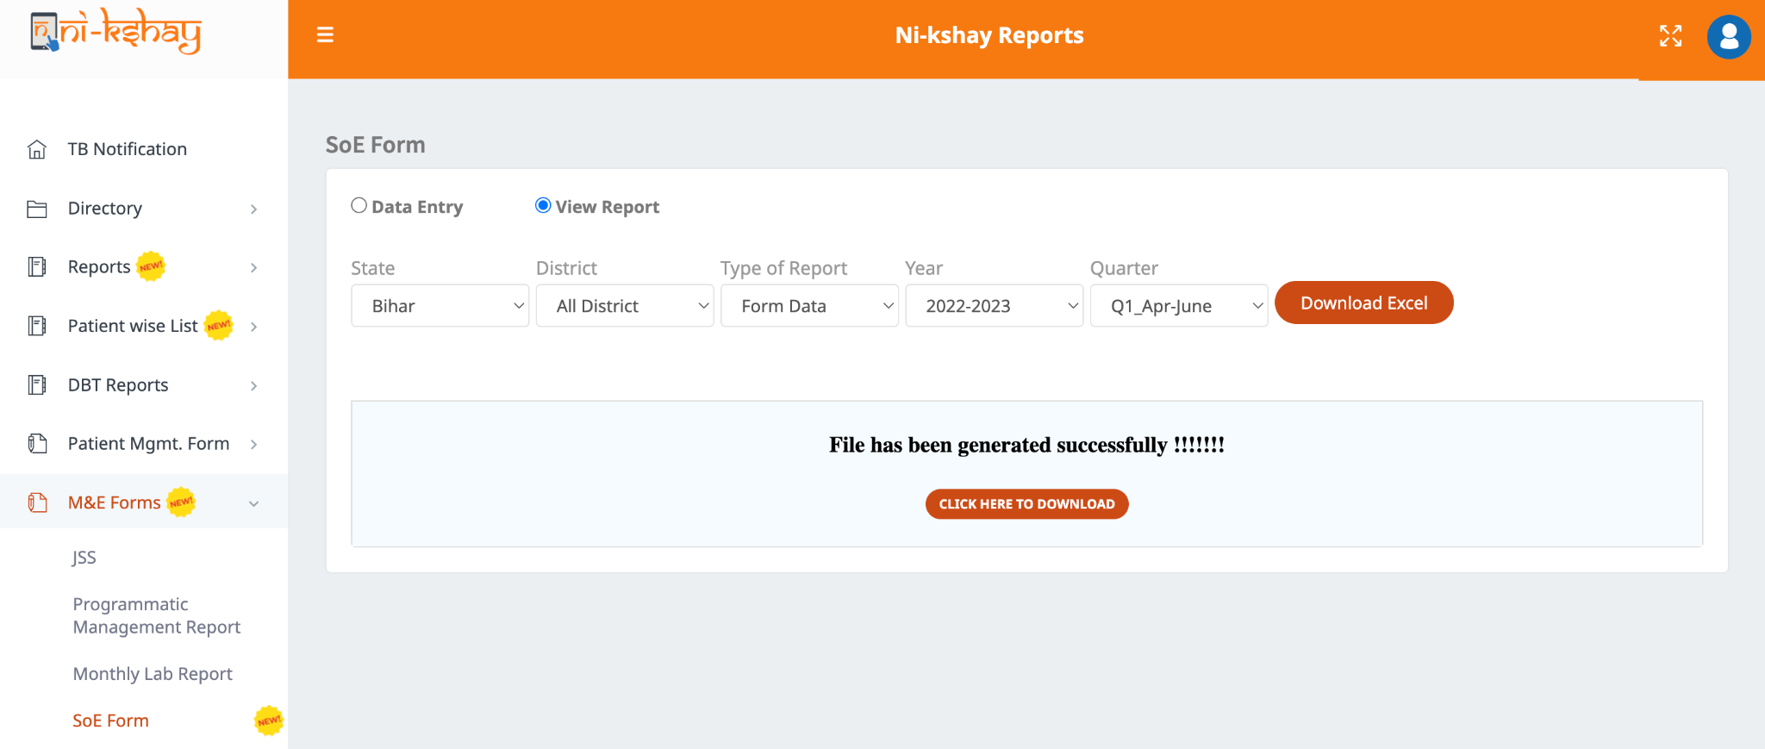
Statement of Expenditure (SoE) forms - Reports (Form Data)
Step 5
Step 6
Step 7
Select ‘View Report’
Select ‘State/District and Year/Quarter’
Click on ‘Download Excel’

Slide 30
THANK YOU

