Slide 1
Post Treatment Follow Up Form, Report and Register

Slide 2

Table of Contents
Introduction
Post Treatment Follow up register
Post Treatment Follow Up Form
Post Treatment Follow up report
Staff and Treatment Supporters

Slide 3
Introduction
As part of TOG 2016 guidance, all DSTB, DRTB and TPT beneficiaries successfully completing treatment are eligible for follow-up for a 2-year period at regular intervals to reduce relapse, death and ensure recurrence-free survival
Nikshay would enable the user to identify the beneficiaries eligible for follow-up, have provision for capturing details of the follow-up and adding tests/management details as appropriate
Line list of eligible cases for whom follow-up is to be done in a particular month as per Treatment outcome date are made available to user to download on app and web
Staff and Treatment Supporters

Slide 4

Post Treatment Follow Up Register - Overview
Line list of eligible cases for whom follow-up is to be done in a particular month as per Treatment outcome date available to user to download on app and web
Available for post-treatment interval periods (All, 6 M, 12 M, 18 M, 24 M)
Hierarchy, demography and clinical details are included
Additional contact details made available are
  Secondary phone number
  Treatment supporter
  Contact person
  Staff

Slide 5
Eligible Patient Cohort Selection
TB Patients who have successful treatment outcome i.e “cured” or “treatment complete” and who have completed 6, 12, 18, 24 months post successful treatment are eligible for post treatment follow up.
6 month cohort: 180 days completed post treatment outcome date
12 month cohort: 365 days completed post treatment outcome date
18 month cohort 545 days completed post treatment outcome date
24 month cohort: 725 days should be completed from treatment outcome date
Example:
Month of Post-treatment Follow up | 6 month Rx. outcome | 12 month Rx. outcome | 18 month Rx. outcome | 24 month Rx. outcome
November 2021 | May 2021 | November 2020 | May 2020 | November 2019
December 2021 | June 2021 | December 2020 | June 2020 | December 2019
January 2022 | July 2021 | January 2021 | July 2020 | January 2020
February 2022 | August 2021 | February 2021 | August 2020 | February 2020
March 2022 | September 2021 | March 2021 | September 2020 | March 2020
April 2022 | October 2021 | April 2021 | October 2020 | April 2020
May 2022 | November 2021 | May 2021 | November 2020 | May 2020

Slide 6
PTFU Register

Slide 7
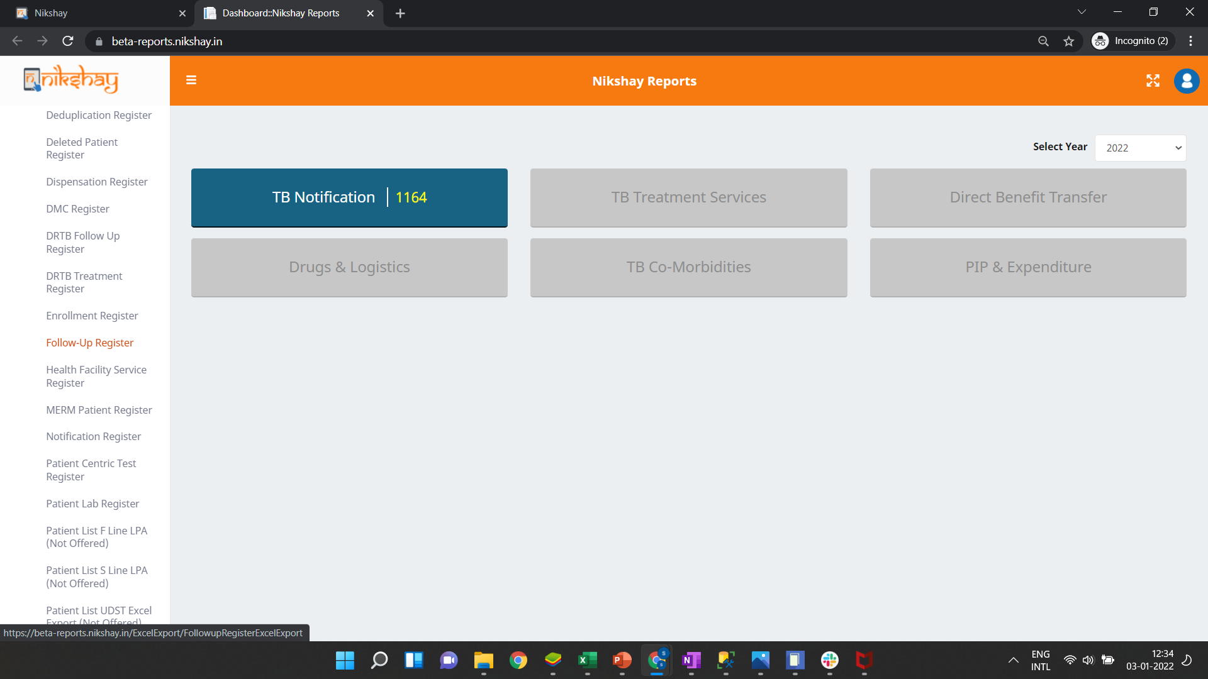
Post Treatment Follow Up –Register
Step 1
Click on Follow Up Register

Slide 8
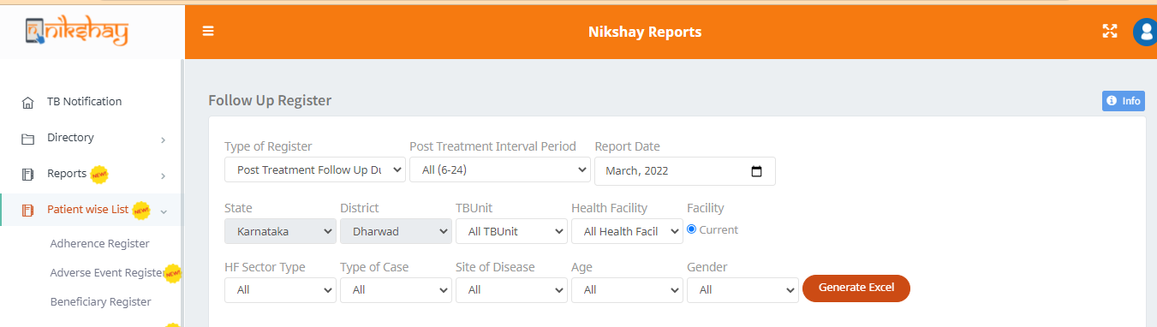
Post Treatment Follow Up –Register
Step 1
Step 2
Under patient wise list Click on Follow Up Register
Select Post Treatment Follow Up Due

Slide 9
Post Treatment Follow Up – Register
Step 1
Step 2
Step 3
Click on Follow Up Register
Select Post Treatment Follow Up Due
Select the Post Treatment Interval Period
Select relevant filters and click on ‘Generate Excel’ button

Slide 10
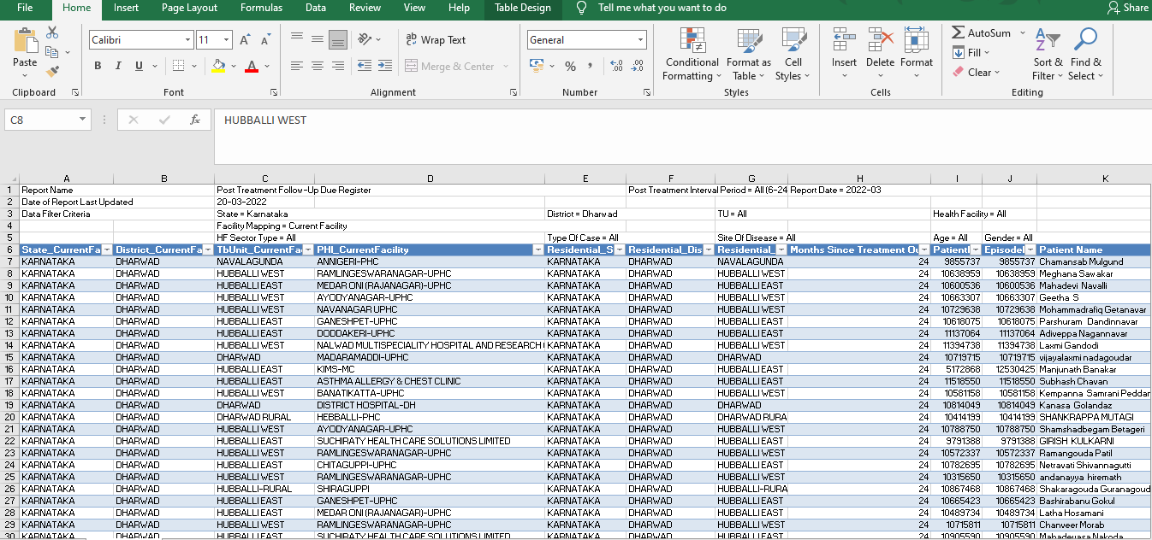
Post Treatment Follow Up –Register..1

Slide 11
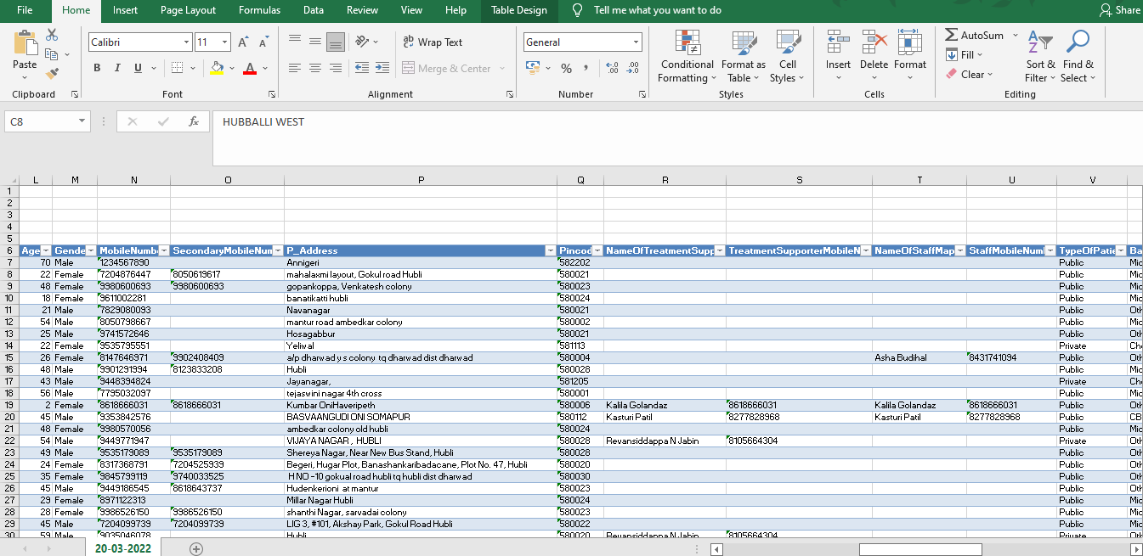
Post Treatment Follow Up –Register..2

Slide 12
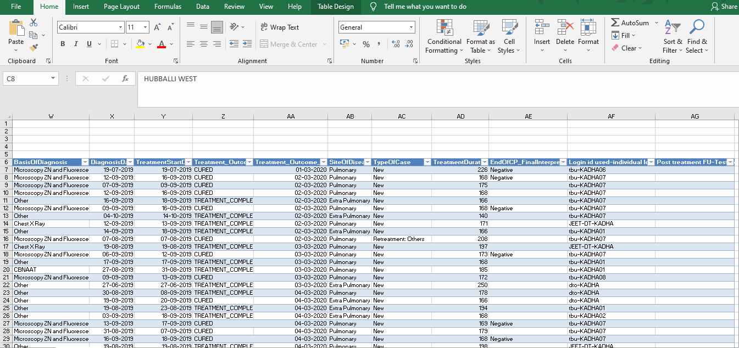
Post Treatment Follow Up –Register..3

Slide 13
Post Treatment Follow Up – Fields

Slide 14
PTFU Form

Slide 15
Post Treatment Follow Up – Screening Form
A form is made available to users on Web and App in “Patient Management forms” tab in Nikshay Reports portal using existing Nikshay credentials
This form captures details of the activity, present status of the patient/beneficiary and screening for TB symptoms
The form is linked to Diagnostic module in scenario where test is required to be added
The data being entered would be made available as reports for users

Slide 16

Post Treatment Follow Up – Report
Step 1
Click on Patient Management Form

Slide 17
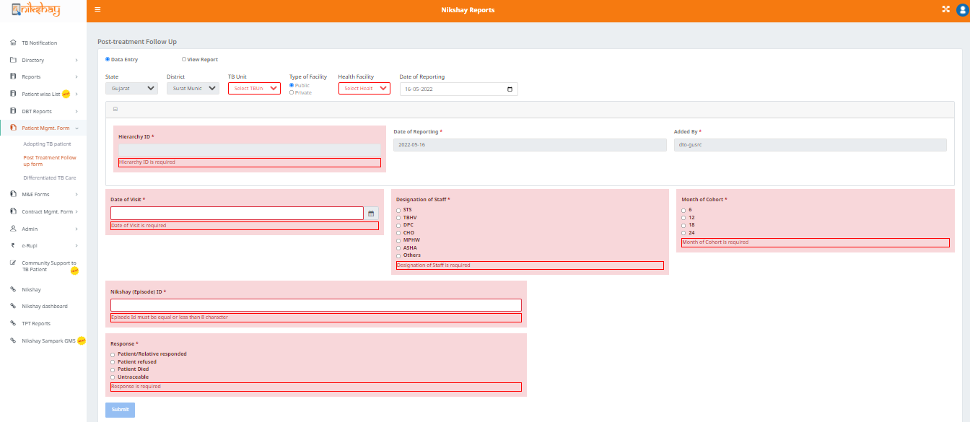
Post Treatment Follow Up – Screening Form
Step 1
Step 2
Click on Patient Management Form
Click on Post Treatment Follow Up Form

Slide 18
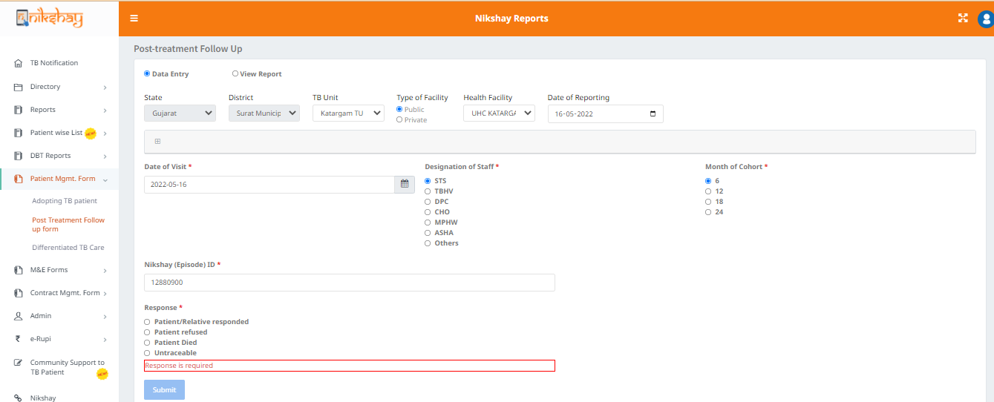
Post Treatment Follow Up – Screening Form
Step 1
Step 2
Step 3.a
Click on Patient Management Form
Click on Post Treatment Follow Up Form
Fill the form
Enter TU and Health Facility
Enter the
-Date of Visit
-Designation of Staff
-Month of Cohort
-Nikshay Episode Id

Slide 19
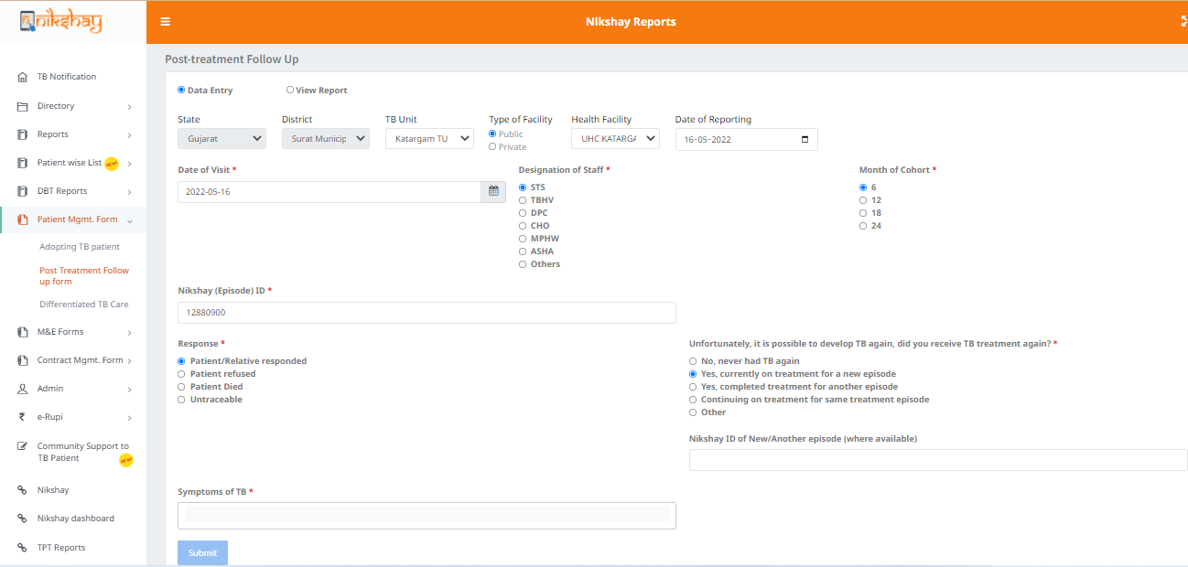
Post Treatment Follow Up – Screening Form
Step 1
Step 2
Step 3.b
Click on Patient Management Form
Click on Post Treatment Follow Up Form
Fill the form
This set of questions appear when response is selected as- “Patient/Relative responded”
Enter response received by Patient
Enter the symptoms of TB
Enter the Nikshay Id of patient if the patient is on/ completed treatment for a new episode

Slide 20
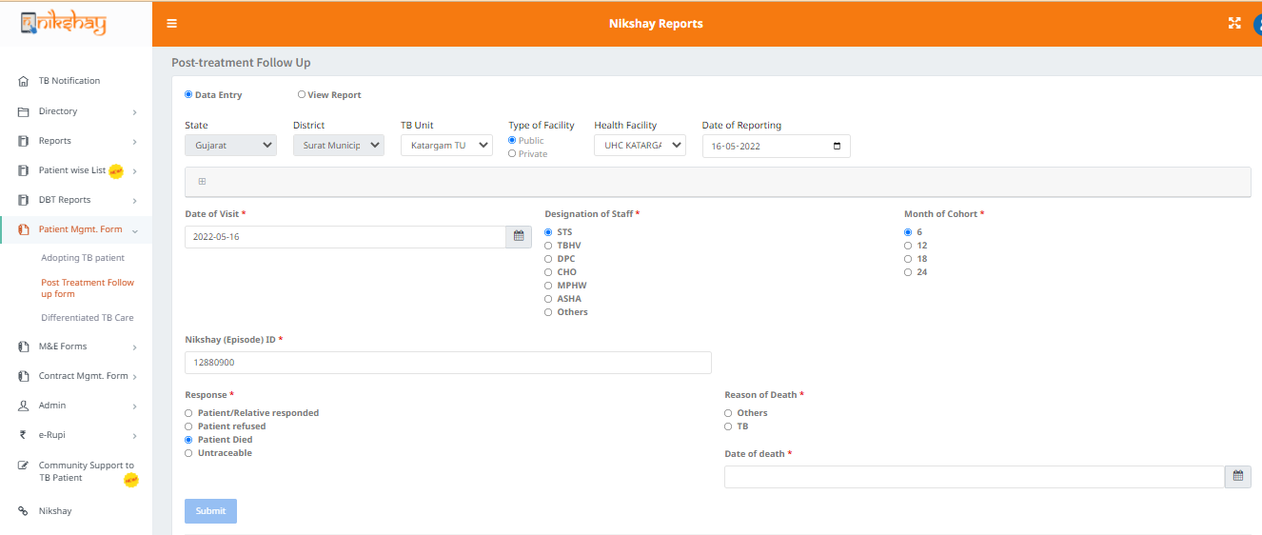
Post Treatment Follow Up – Screening Form
Step 1
Step 2
Step 3.b
Click on Patient Management Form
Click on Post Treatment Follow Up Form
Fill the form
This question appears when response is selected as- “Patient Dead”.
Select the reason for death
Enter response received by Patient
Enter the Date of death

Slide 21
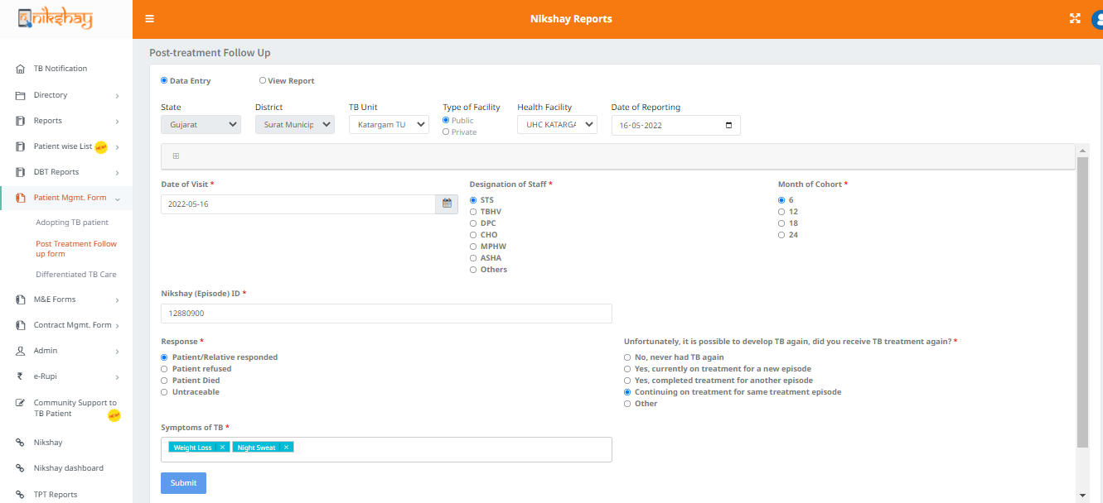
Post Treatment Follow Up – Screening Form
Step 1
Step 2
Step 3
Step 3
Click on Patient Management Form
Click on Post Treatment Follow Up Form
Fill up the form
Click Submit

Slide 22
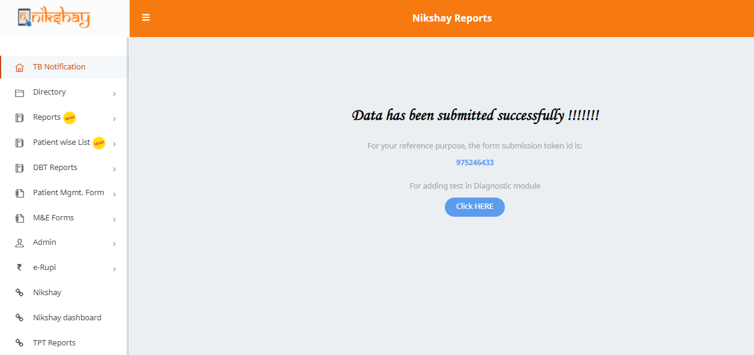
Post Treatment Follow Up – Screening Form
Message Displayed after successful submission of the form
To Add Tests through the Nikshay Diagnostic Module click here.

Slide 23
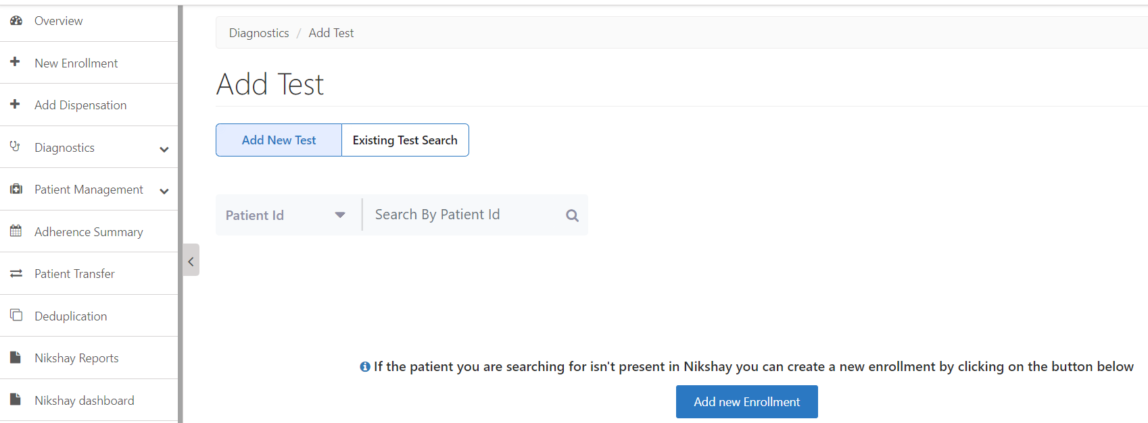
Diagnostic – Add Test>Step1>Add Test tab
Users are redirected to the ‘Add Test’ page on Nikshay to add test details for the followed-up patients.
  1. Click on
Diagnostic> Add Test to add any new Test or
Search any existing Patients’ test data
  2. Search for patient details through any of the following –
Patient ID
Patient Name
Phone no. (through which enrolment is done)
And click on Search
  Click to add new enrollment directly from this module, where required

Slide 24
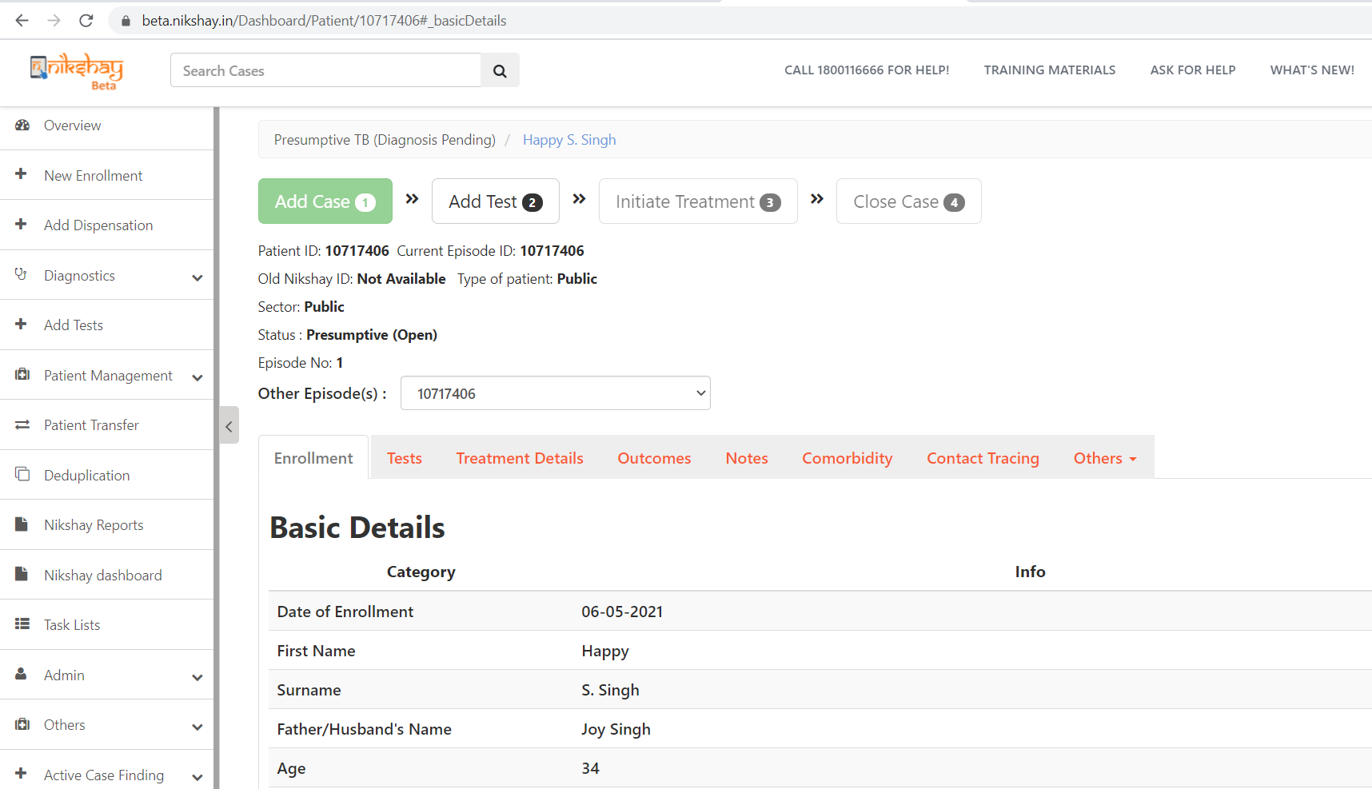
Diagnostic – Add Test >Step3>Checking Patient’s details
  Any new enrolment shall show under Presumptive TB (Diagnosis Pending ) status
  Patient details can be checked here
  Test(s) can also be added from here

Slide 25
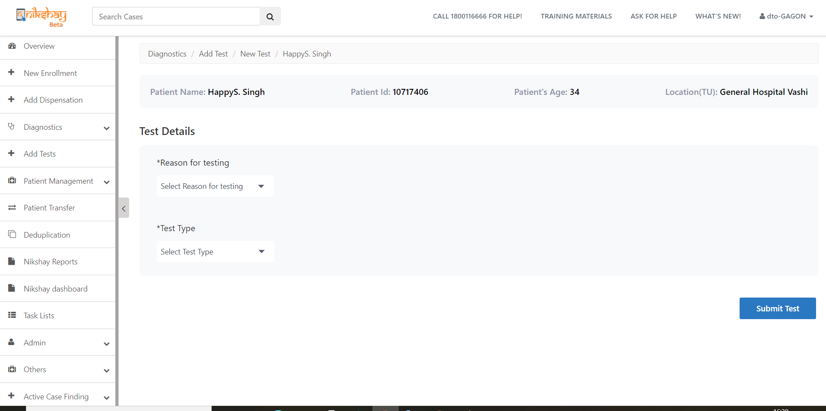
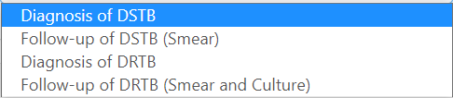
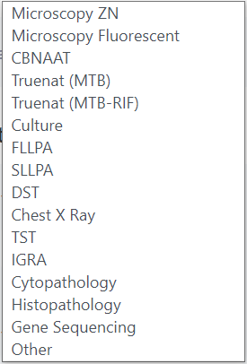
Diagnostic – Add Test>Step4>Add Test >All required fields
  Enter an appropriate Reason for Testing from the dropdown options shown below-
  Click to select Test Type from the dropdown options shown here-
  Click on Submit test to add the test(s)

Slide 26
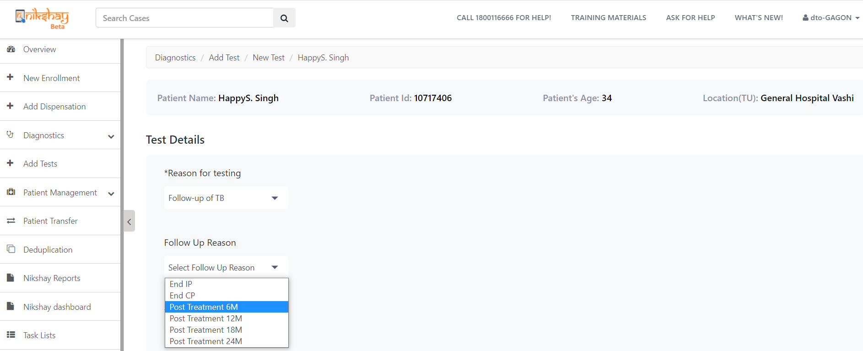
Diagnostic – Add Test>Step5c>Reason for Testing> Follow-up of TB
  When selected reason for Testing as-Follow-up of TB
  Select the Follow up Reason from the drop down option as shown here-

Slide 27
PTFU Cascade Report

Slide 28
Post Treatment Follow Up – Report
Step 1
Step 2
Click on Patient Management Form
Click on Post Treatment Follow Up Form

Slide 29
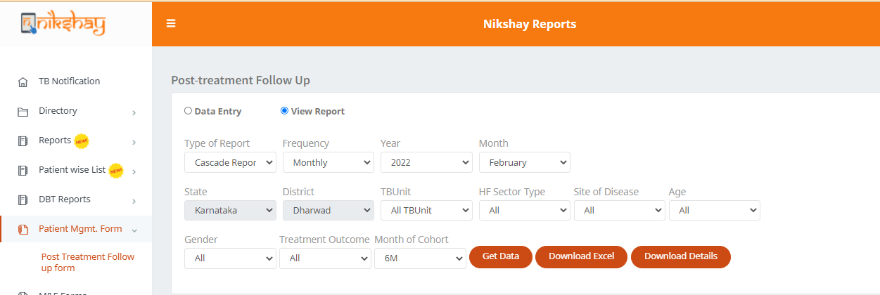
Post Treatment Follow Up – Screening Form
Step 1
Step 2
Step 3
Click on Patient Management Form
Click on Post Treatment Follow Up Form
Click on View Report
Select the report type as Cascade Report
Select relevant filters and click on ‘Generate Excel’ button

Slide 30
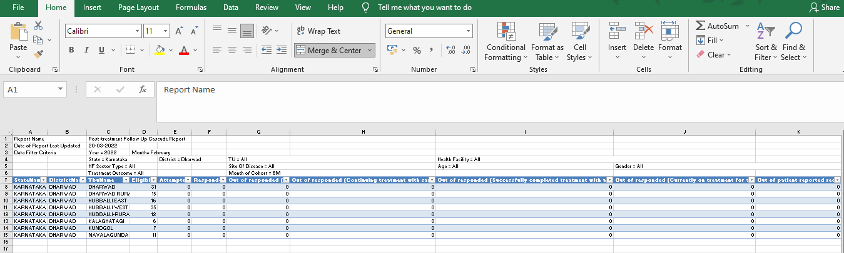
Post Treatment Follow Up –Report..1

Slide 31
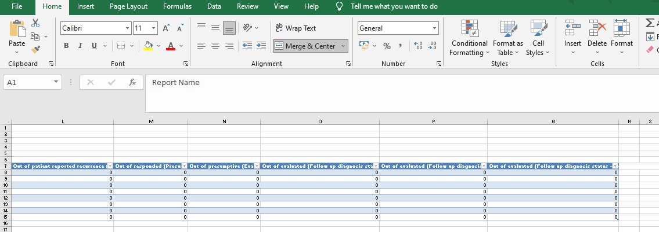
Post Treatment Follow Up –Report..2

Slide 32
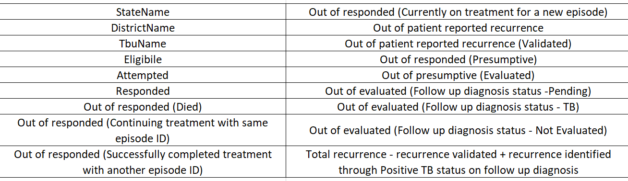
Post Treatment Follow Up – Fields

Slide 33
THANK YOU

