Slide 1
Addition of Pathodetect - MTB, Rif & Inh test in the list of diagnostic tests in Ni-kshay

Slide 2
Pathodetect - MTB, Rif & Inh
A new test type Pathodetect - MTB, Rif & Inh test has been approved by CDSCO and is being used in the TB Diagnostic laboratories in the States. To enable the labs to report the tests being performed with this test type, this test type has been enabled in the dropdown of the Ni-kshay Diagnostic module.

Slide 3
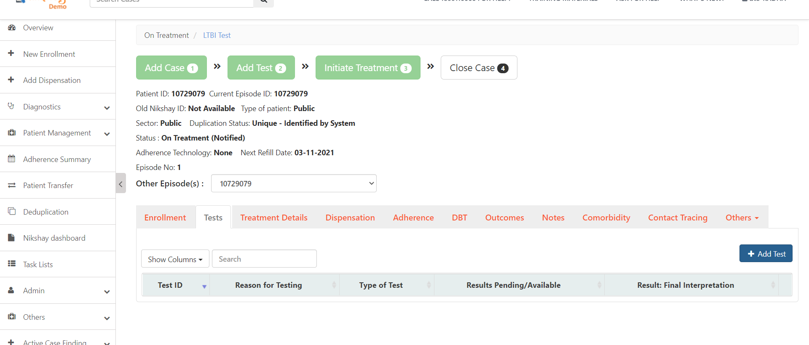
Adding Test ..1
Step 1
Click on Tests Tab and click on the ‘Add Test’ Button

Slide 4
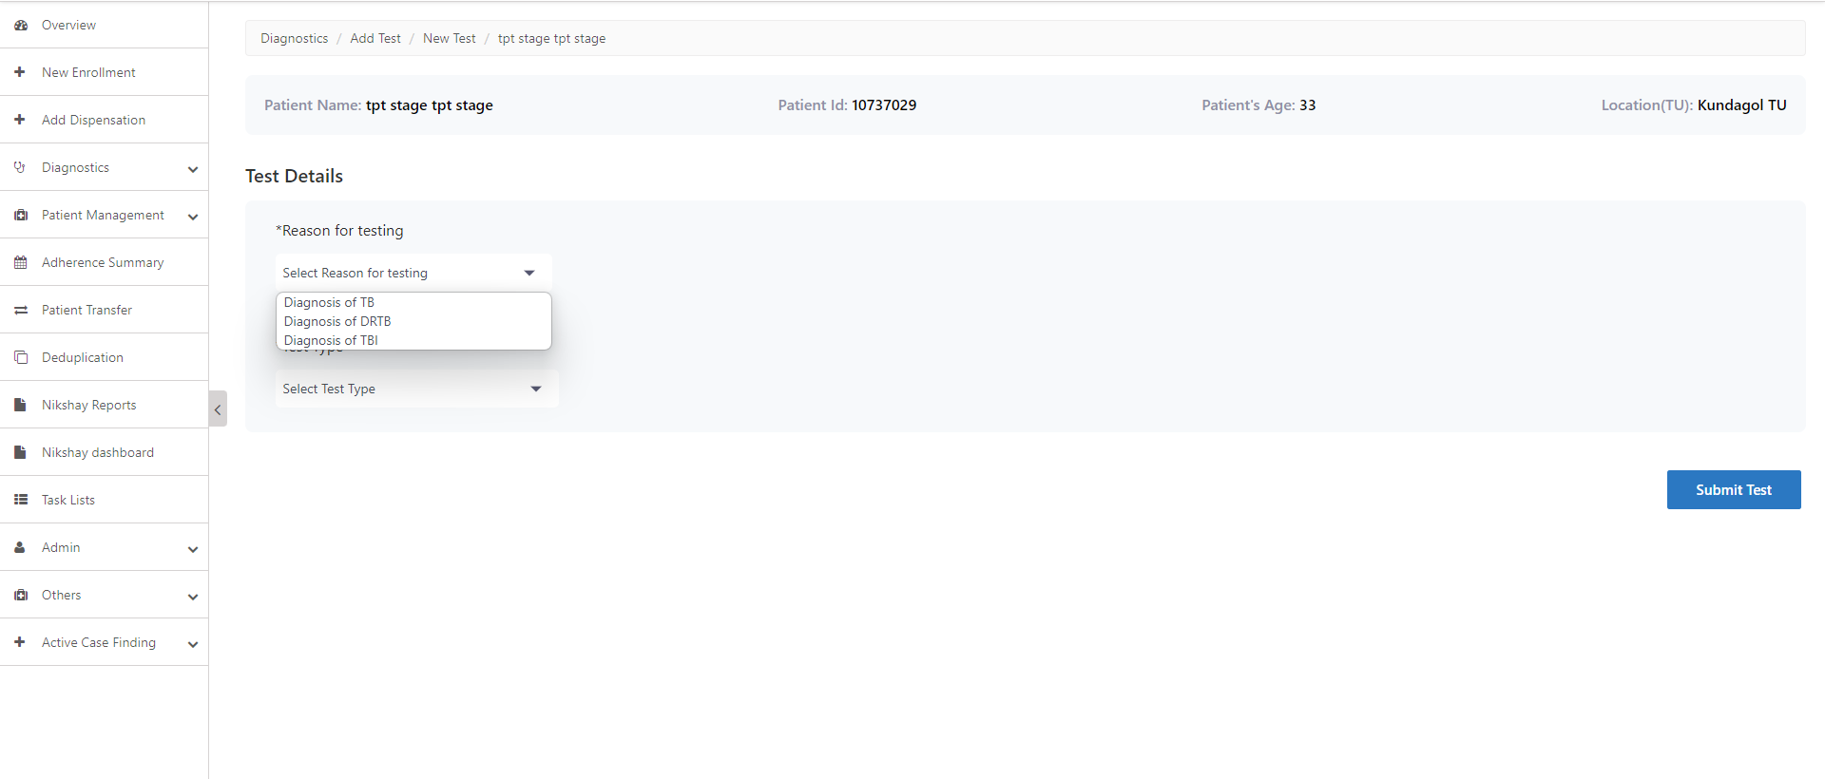
Adding Test..2
Step 1
Step 2
Click on Tests Tab and click on the ‘Add Test’ Button
Select Reason for Testing

Slide 5
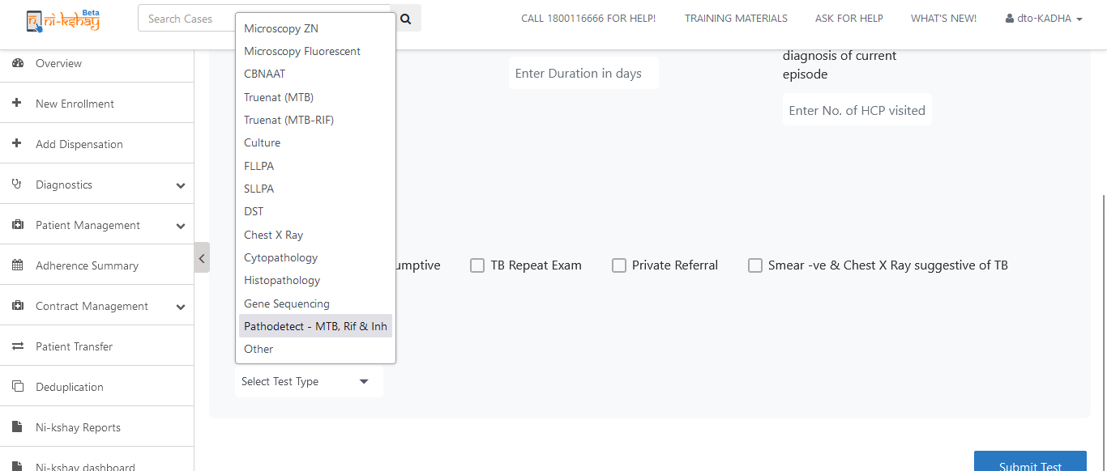
Adding Test..3
Step 1
Step 2
Step 3
Click on Tests Tab and click on the ‘Add Test’ Button
Select Reason for Testing
Select Pathodetect

Slide 6
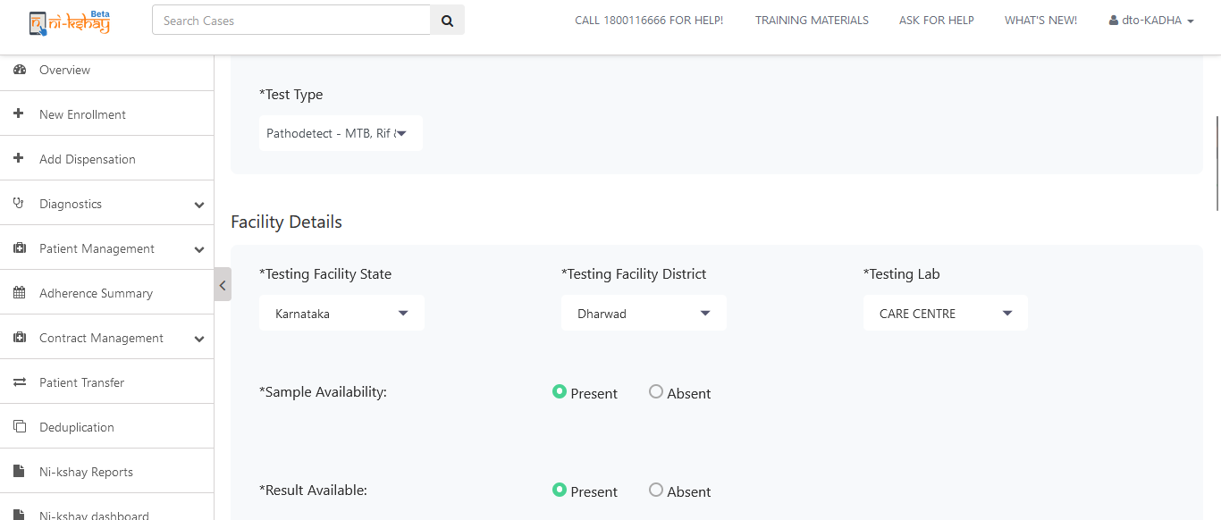
Adding Test..4
Step 1
Step 2
Step 3
Step 4
Click on Tests Tab and click on the ‘Add Test’ Button
Select Reason for Testing
Select Test Type
Select Facility Details
If results are available , select ‘Present’

Slide 7
Adding Test..5
Step 5
Enter Test Results
Click here after entering the test details

Slide 8
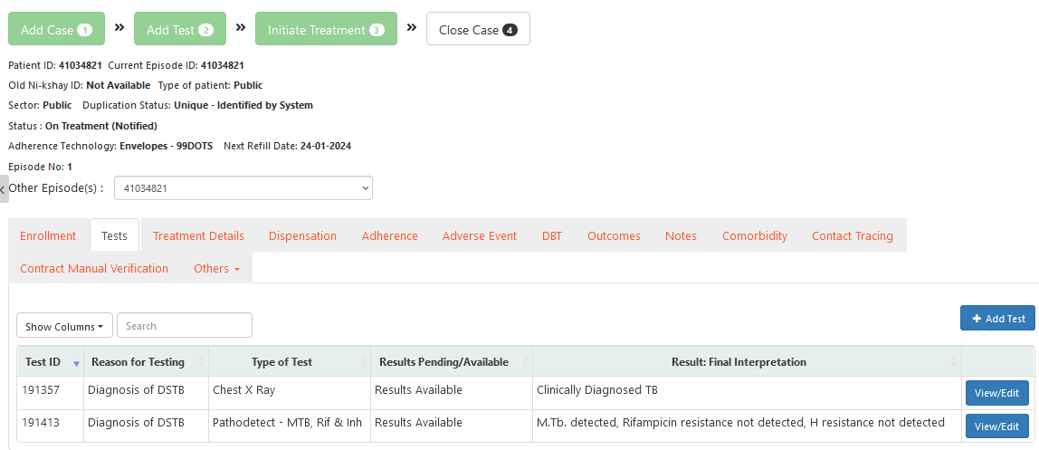
Adding Test ..6
Test details are visible in the Tests Tab

Slide 9
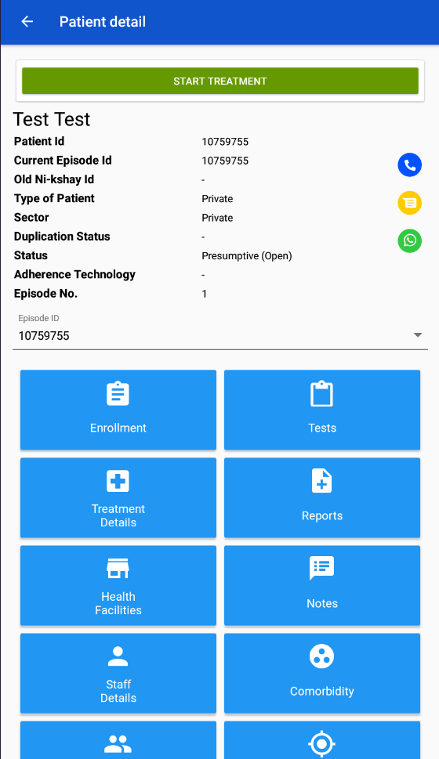
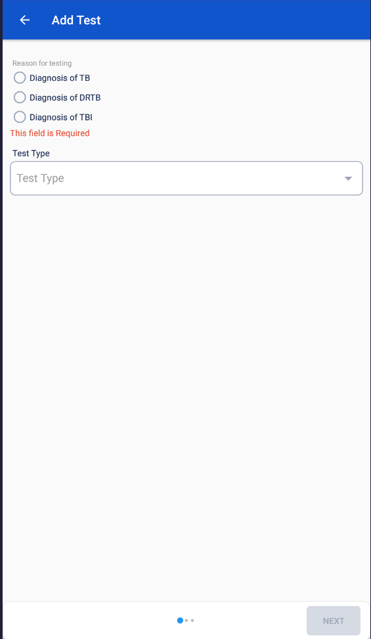
Adding Test - App
Step 1
Step 2
Step 3
Click on the ‘Tests’ button
Click on ‘+’ Button
Select ‘Reason for testing’

Slide 10
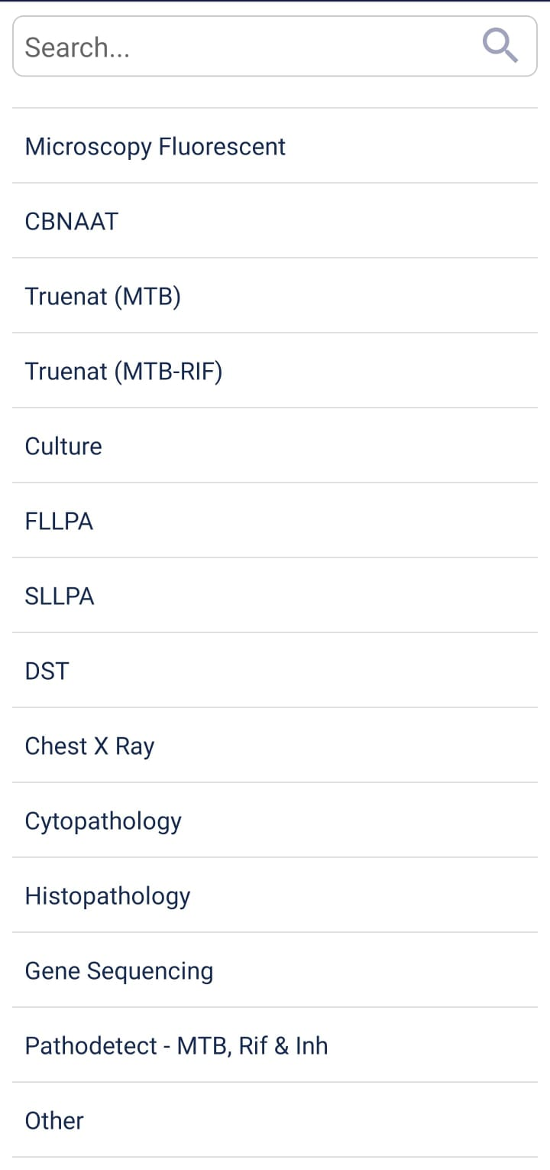
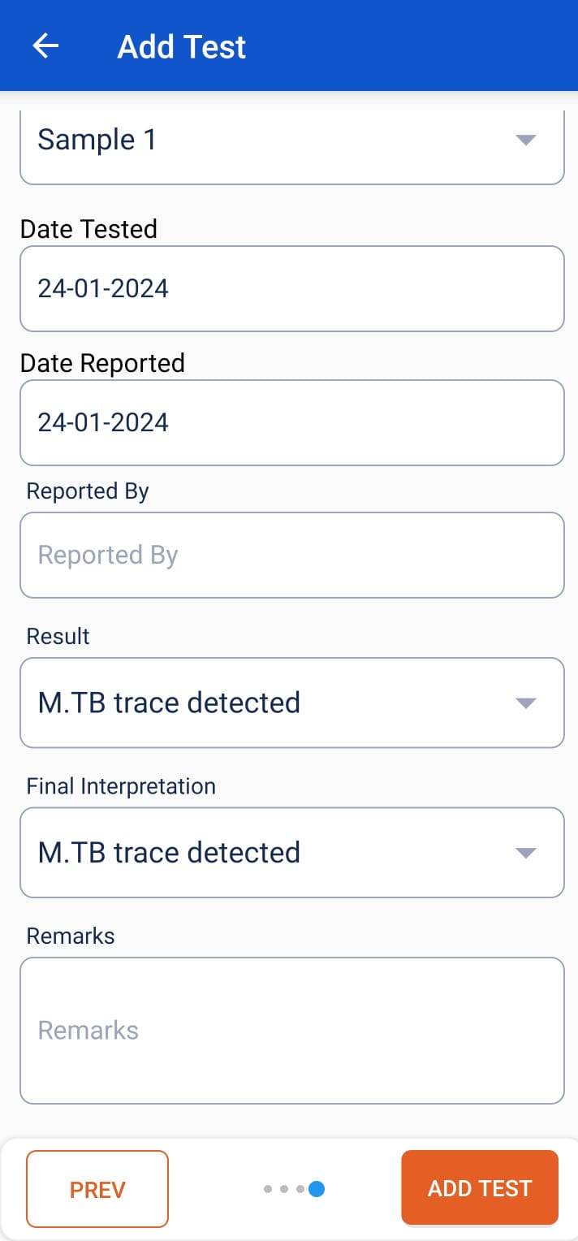
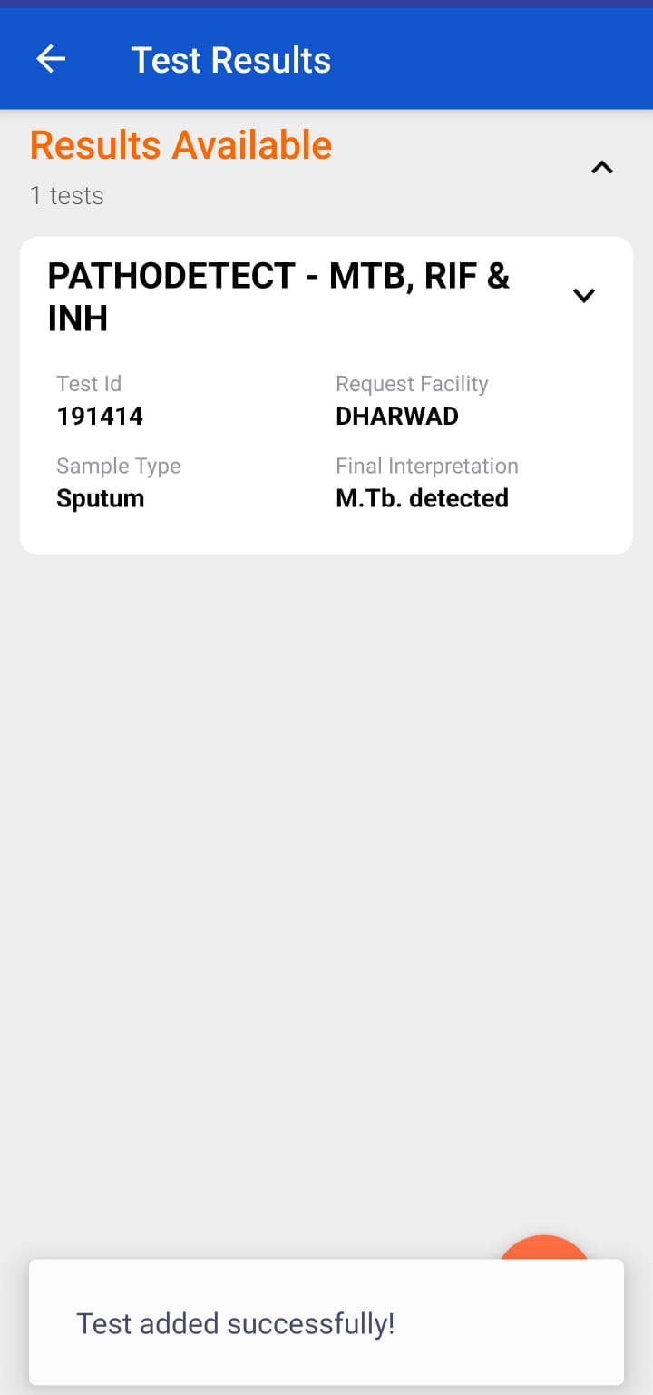
Adding Test - App
Step 4
Step 5
Select ‘Pathotdetect’ as Test Type
Enter the Test Facility Details
Test details added are visible in the Test Tab
Click here after entering facility details

Slide 11
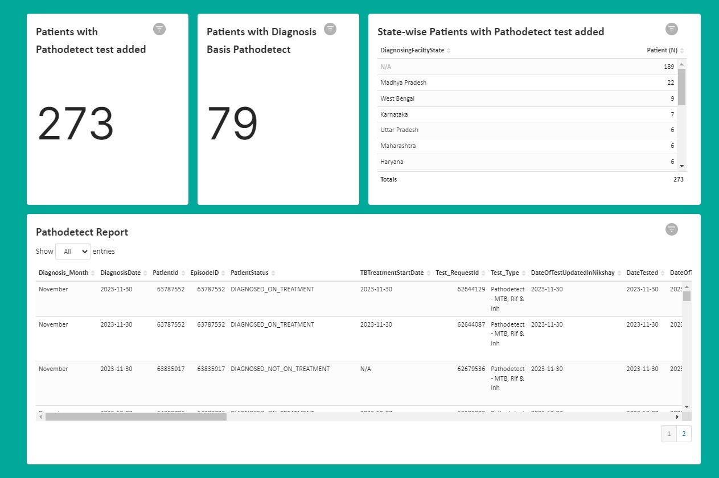
Analytics
Relevant metrics related to the Pathodetect test are made available at the state and district level logins at Ni-kshay Analytics

