Slide 1



Guidelines on Engagement of Family Caregivers for Persons with TB
Dr. Raghuram Rao
Asst. Director General(TB)
CTD, MOHFW

Slide 2
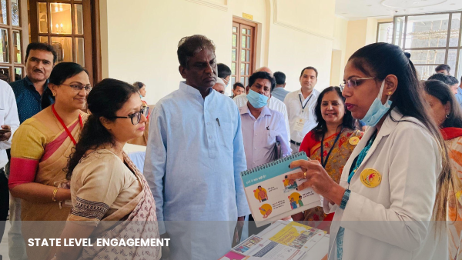
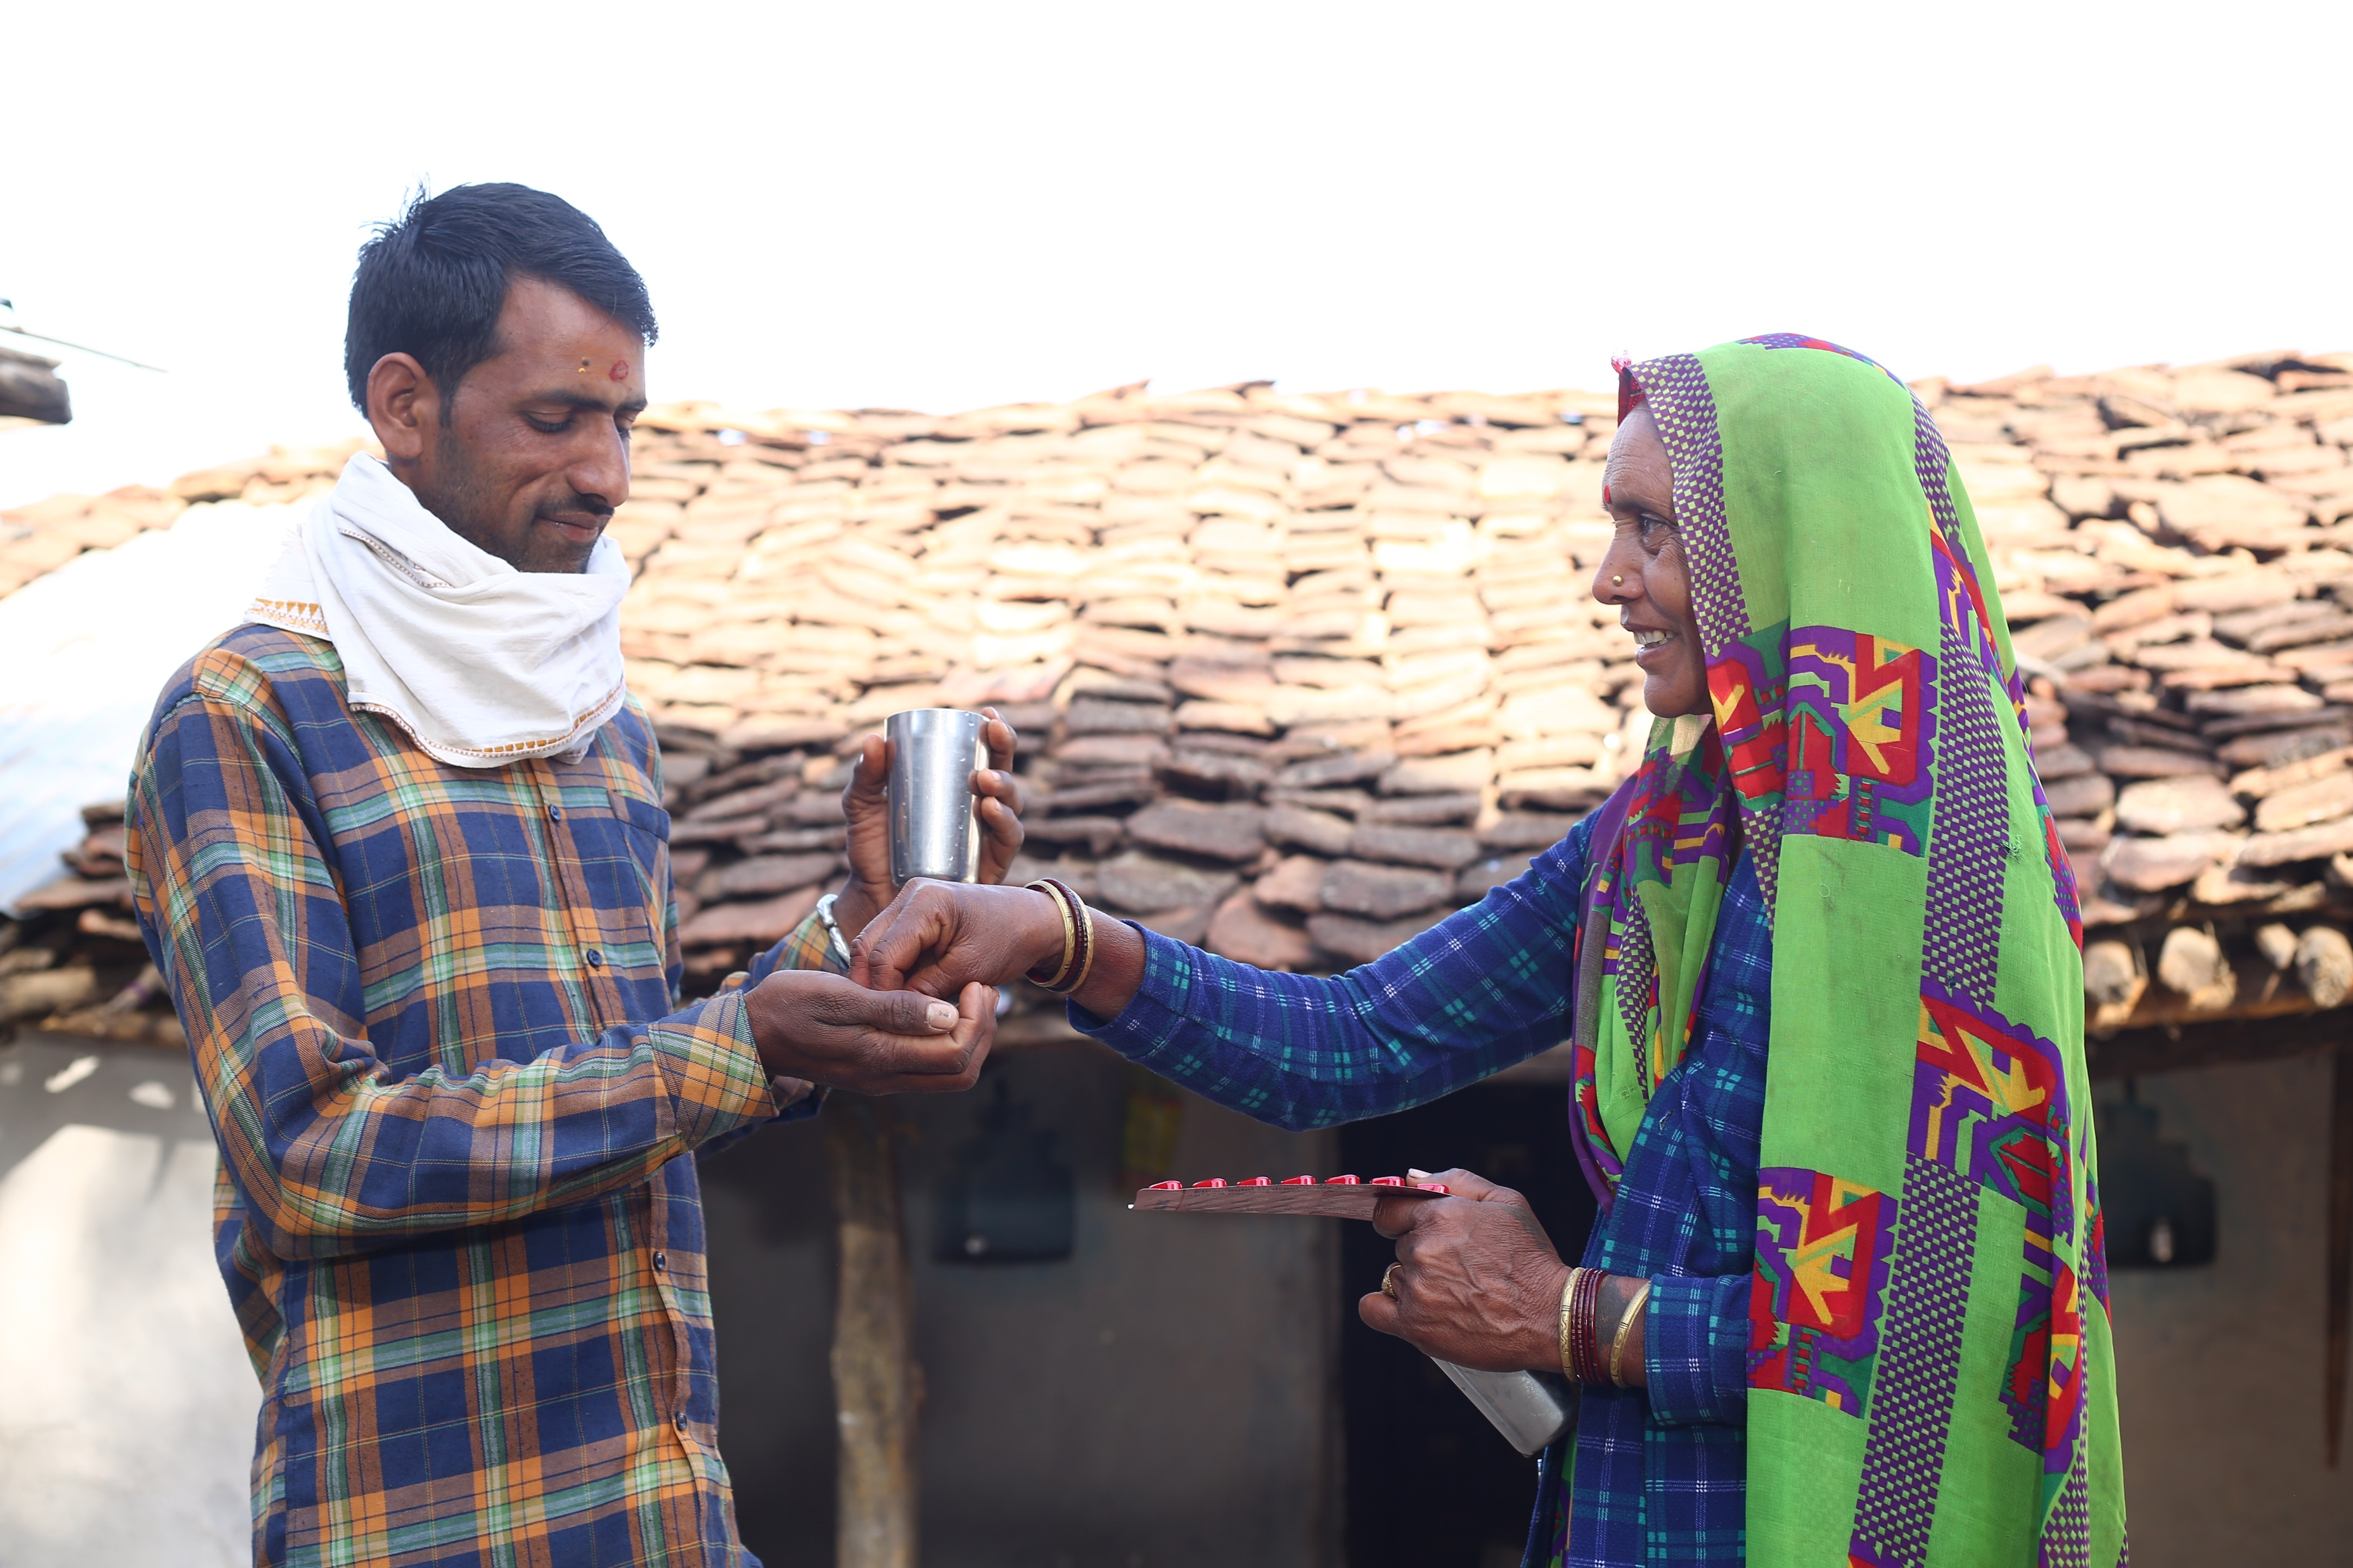
Rationale for Family Care Giver Model for TB
  Social support -Family members can provide practical and emotional support to TB patients, which can improve their quality of life and mental health.
  Empowerment of the Family: Training family members to provide care for TB patients can empower them to take control of their health and the health of their loved ones.
  Reduced Stigma: By training family members as primary caregivers, the program can improve equity in TB care, as it provides care and support to patients who may not have access to healthcare services.
  Cost-effective -Family members can provide care and support for patients within their homes, reducing the burden on health facilities and minimizing the cost of hospitalization
  Improved Equity: By training family members as primary caregivers, the program can improve equity in TB care, as it provides care and support to patients who may not have access to healthcare services.
Piloted in two districts of Madhya Pradesh

Slide 3
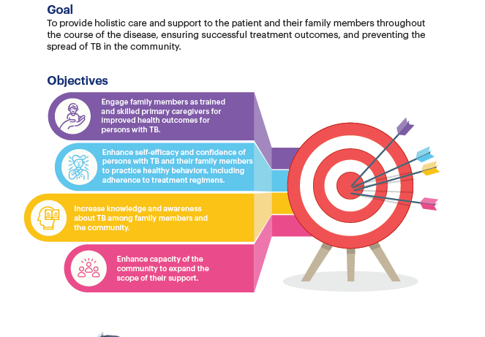
Objectives
Goal:
To provide holistic care and support to the patient and their family members throughout the course of the disease, ensuring successful treatment outcomes, and preventing the spread of TB in the community
Objectives:

Slide 4


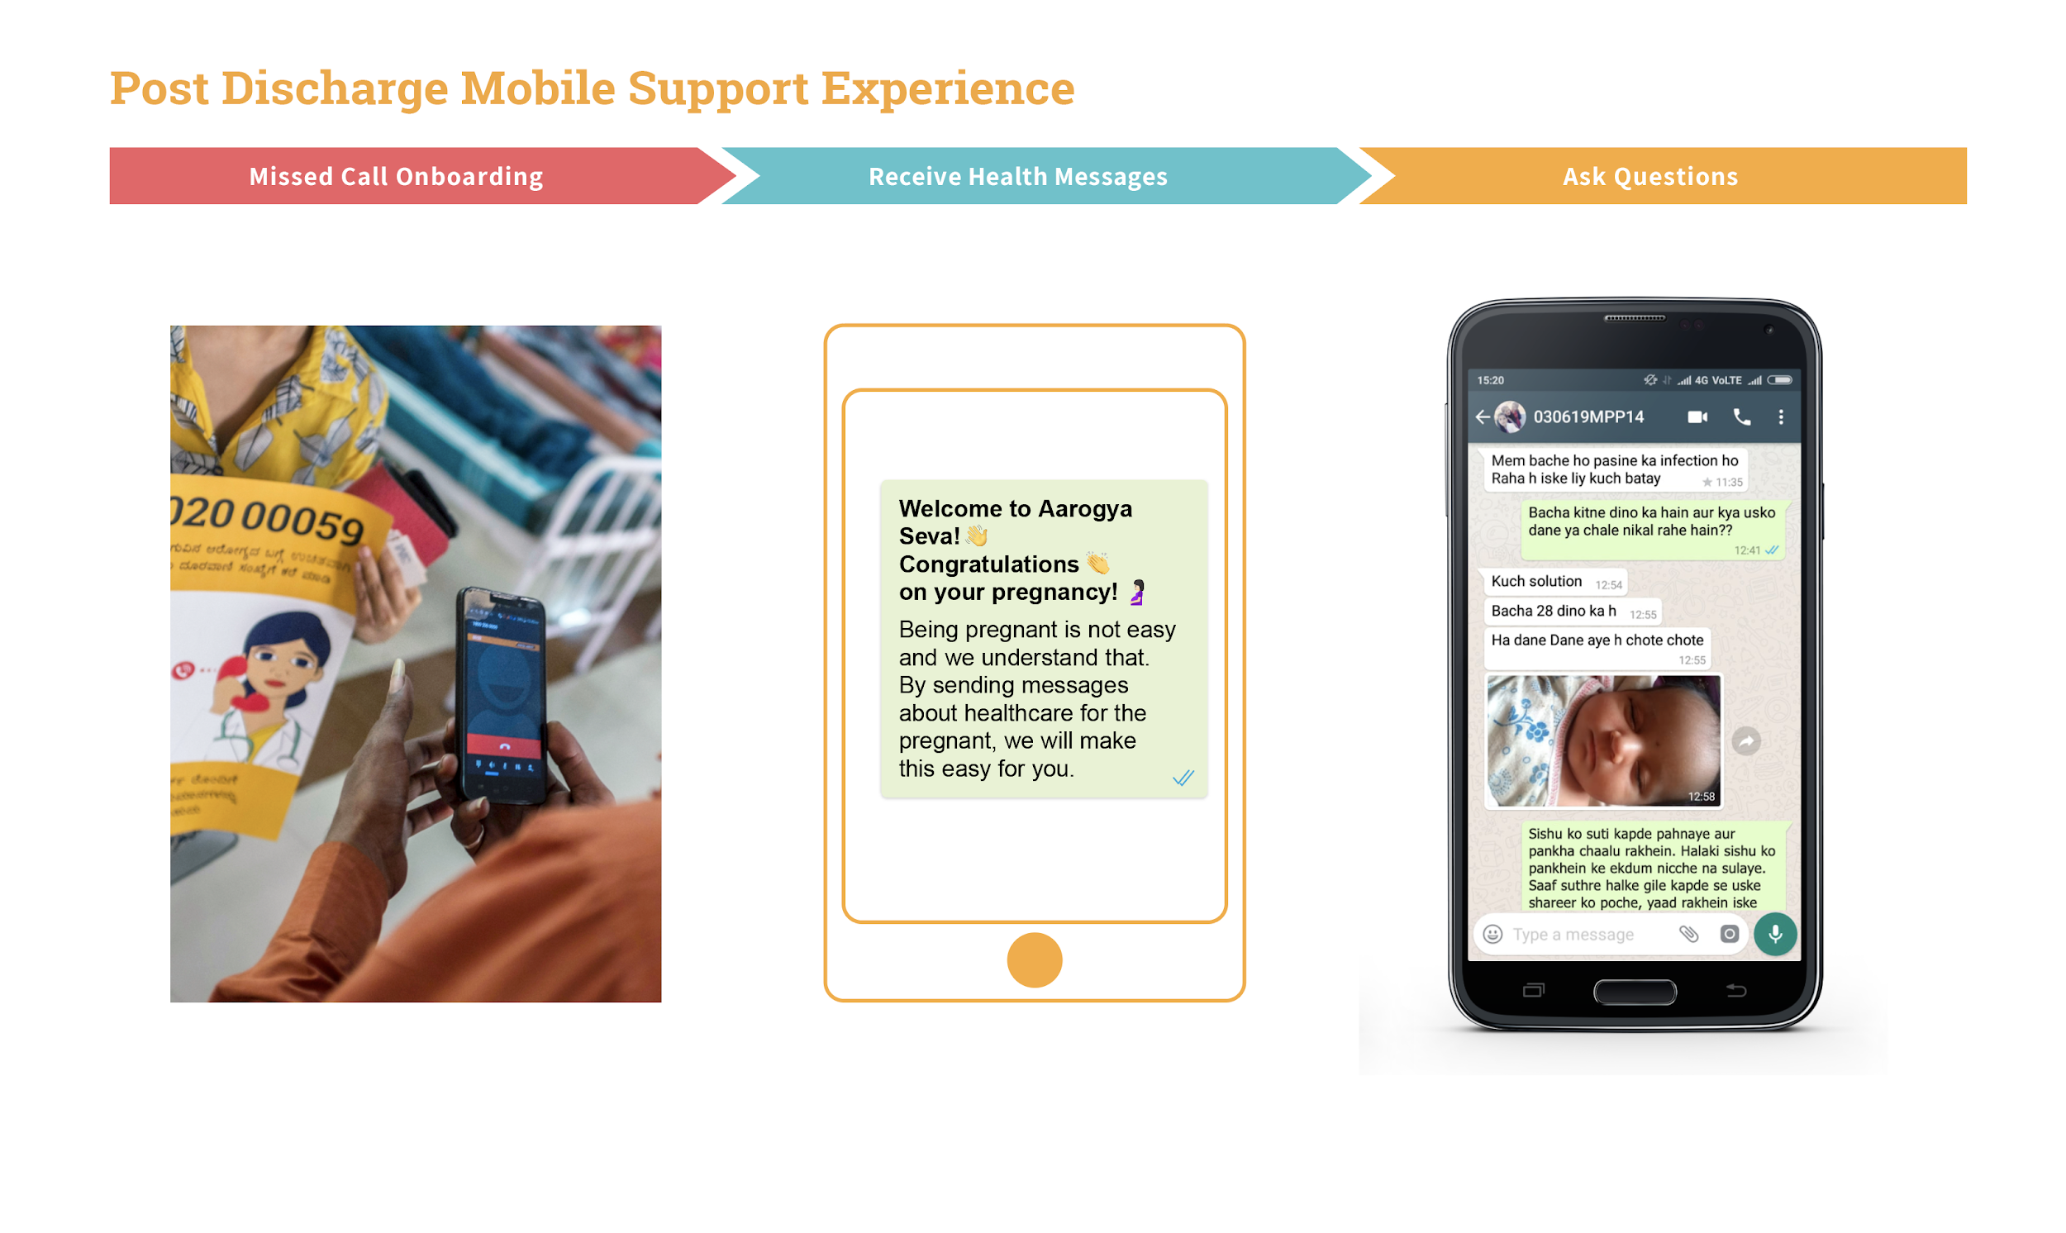
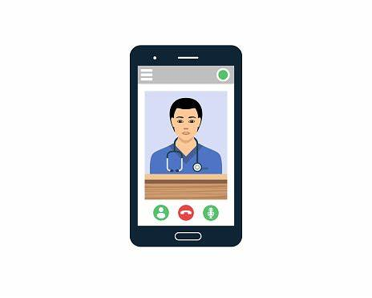




Model Overview
Enrollment of Family Members/Care Givers
Post training support and Follow up
1
Follow-up tools
IVR platform for ADR reporting and query resolution
Push messages through IVR for medication reminder/contact tracing and TPT etc
Training of Trainers
5
Nudge Messages thru WhatsApp, IVR
TB patients from HF/TU/HWC
2
3
Identification & Enrollment of Care Giver/Family Member of TB patients
7
Interactive visual aids for community awareness/Stigma reduction
4
Training of Family caregivers using Interactive AV tools on key aspects of Patient care, Treatment, Treatment adherence
At
Home visits of TB champions/ASHA/CHOs/PPSAs/TBHV/ANMs for follow-up with patients and to train caregivers once a month through the treatment period and after treatment completion on agreed frequency
8
Multiple Touchpoints/Monthly
Home visits
5
Immediately after diagnosis
Dispensing
of drugs
Treatment adherence support
Home visits

Slide 5
Key Components
Community awareness at health facility about disease and family caregiver
Capacity building of MO/CHO/TBHV/STS/ANMs as master trainers to implement the program
Capacity building of family caregivers by MO/CHO/TBHV/STS/ANMs/TB Champion/ASHA
Mobile-based follow-up for patients and caregivers through Ni-kshay Sampark
Monthly follow-up & training of caregiver on providing home-based care from CHO/TB Champions/ANMs
Counseling tools, job aids, and for service provider
Adherence monitoring and reference tools for caregiver

Slide 6
Package of Services
For Family Care giver
For Health Staff
Specially designed training tools for health staff for training of the caregiver
Training tool/FAQ-cards having identified various topics on which caregiver has to be trained during different touchpoints
Job aid & training manual to be kept at the facility for ready reference
IEC material for HF to generate awareness on Family caregiving
IVR service – reminder messages for treatment adherence twice a week
Impart training using audio capsules through IVR on different aspects of home-based care
Ready reckoner for caregiver
Pragati Register for tracking adherence of patients
Monthly in person training/counselling to caregiver on various aspects of caregiving

Slide 7
Technical Approach
Training of Health Staff
Identification & enrollment of caregiver at the time treatment initiation
Training and follow-up of Patients & caregivers using IVR and household visits
Improved Treatment Outcome of TB & DRTB Patients
Recording & reporting in NI-KSHAY
Providing handholding & support to family caregiver for providing homebased care using tailored tools & collaterals

Slide 8
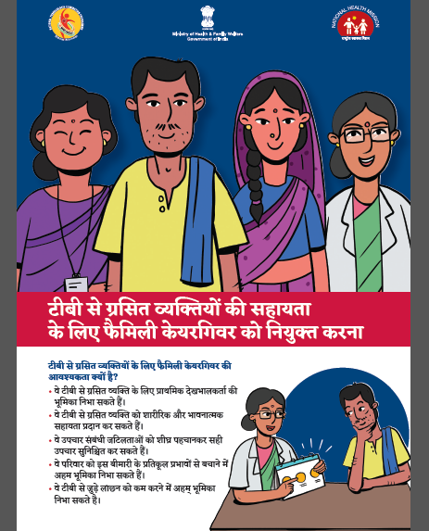
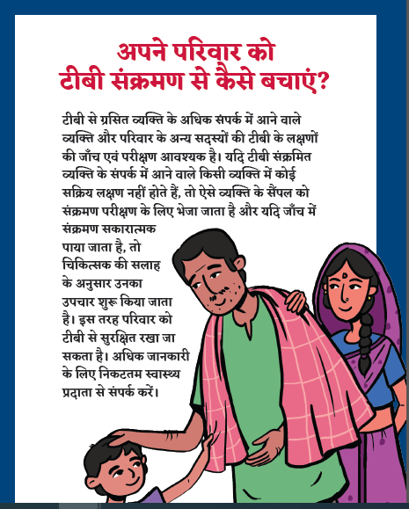
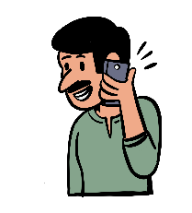
Communication Tools
Communication tools:
IEC/Standee for Health Facility
FAQ Cards
Handbook with Progress Tracker
IVR Service for care givers
Reference Manual
Visual cards/tools for caregivers
Patient Progress Tracker
Standee for HF
IVR service for Care Givers
FAQ Cards for Counselling of patients and care givers
Job Aid
Visual Cards for Caregiver

Slide 9
NI-KSHAY Sampark for Caregivers
Central TB Division (CTD) is intending to launch a new auto outbound audio message project for the Family Care givers of the TB patients.
Under this activity following will be done:
Scope of project is include only those TB patients who are under treatment and are registered with a Family Care giver with valid mobile number.
Recorded audio messages will be send to family care giver
Start date of message would be treatment start date of the patient.
Total 49 Audio Messages would be send in 6 months
Audio message length: 30 sec to 1 min
Frequency: Welcome message on registration + 2 messages per week for 6 months (24 weeks).
Total Tenure of blast would be 6 months (24 weeks)
Content Overview:
Periodic information when subscribed to
All TB-related information to the caregiver
Addressing myths and stigma
Acceptance/ Mental health
Connect to helplines/support systems
Intended Outcome:
Adherence to treatment protocol by TB patients
Capacity building of Family Caregivers
Readily available information → More informed decisions
National Call Centre no. – 1800-11- 6666

Slide 10
Who can be a Family Caregiver?
Criteria to choose a family caregiver
  Who is willing to take the responsibility of caring for the patient and consented to become a family caregiver
  Family Caregiver will be chosen by the patient only
  The caregiver need not necessarily be a blood relative of the patient
  Who is above 14 years of age
  Who stays with the patient most of the time
  Who is acceptable to the patients and patients should feel comfortable with the caregiver

Slide 11
Training Schedule of Caregivers
Sr. No. | Stages | Touchpoints | Topics to be covered during interaction
1 | Post Diagnosis | Immediately after Confirmation of diagnosis or Within one week of treatment initiation | General awareness about disease To counsel other family members/household for contact tracing & TPT For treatment literacy including treatment duration, treatment adherence Nutrition, Ni-kshay Poshan Yojana and other incentives About myths & misconception about disease Prevention of disease at household and Airborne Infection Control (AIC) at home Sputum disposal and disposal of waste of Persons with TB About services/community support platforms/social protection schemes available for Persons with TB and families

Slide 12
Training Schedule of Caregivers
Sr. No. | Stages | Touchpoints | Topics to be covered during interaction
2 | Post Diagnosis | Monthly(till treatment completion) | Treatment adherence support Early identification of adverse drug reactions and management Screening of other family members for symptom identification Importance of nutrition Psychosocial Counseling About myths & misconception about disease Prevention of disease at households and Airborne Infection Control (AIC) at home Sputum disposal and disposal of waste About services/community support platforms/social protection schemes available for Persons with TB and families Stigma reduction and any other issues Differentiated TB Care Assessments and its importance

Slide 13
Training Schedule of Caregivers
Sr. No. | Stages | Touchpoints | Topics to be covered during interaction
3 | Post Treatment Completion | At the end of 6 months | For symptom screening To counsel them for vocational and physical rehabilitation Post treatment care Getting back to routine life Psychosocial counseling
 |  | At the end of 12 Months
 |  | At the end of 18 months
 |  | At the end of 24 months

Slide 14
Points to Remember for Private Sector patients
The idea of implementation of the guidelines would remain unchanged for Private sector patients, operationally it would differ in the following manner:
  Sensitize the private healthcare provider about the model
    For districts where there are PPSAs: Sensitization of the providers can be done through the existing PPSA staff
    For districts where there are no PPSAs: The providers may be sensitized by DTO/MO/PPM Co-ordinator/ Programme coordinator and by engagement with professional bodies like IMA, IAP FOGSI, consortiums, etc.
  Training of the PPSA staff will be done in addition to the existing NTEP on the family caregiver model.
  Enrollment of family caregiver- family caregivers and persons with TB will be enrolled in NI-KSHAY by either the provider himself/his staff/PPSA/CHOs/MO/MO Urban PHC/MO urban HWC/STS/TBHV/MPW
  In case the private providers volunteer, they may continue further support in training and follow-up of caregiver and patient at the facility. They may be assisted by their own staff or PPSA.

Slide 15
For Patient Taking Treatment from Private Sector
  If they do not volunteer, the provider may also transfer that case in NI-KSHAY to designated and nearest AB-HWC for further support and training
  In urban areas or where there are no AB-HWCs, PPSA staff/MO urban PHC/MO urban PHC/ TBHV/STS/ANM of the current treatment facility/current private health facility will be responsible for monthly training of the family caregiver and follow-up of PwTB
  PwTB along with the designated family caregiver will visit the current treatment facility/AB-HWC every month for adherence monitoring, during this visit MO/CHO/STS/TBHV/ANM will conduct training sessions for family caregivers using various interactive training tools available in the program.
  If PwTB is not able to come to the health facility, PPSA staff/ CHO/TB Champions (TB Vijeta)/STS/TBHV/ANM are supposed to reach out to all persons with TB to train family caregivers on monthly basis.

Slide 16
Roles & Responsibilities
Position | Roles & Responsibilities
Caregiver | Take care of persons with TB as instructed by Doctor/CHO/TB Champions (TB Vijeta) Support patients for treatment compliance Marking treatment adherence in pragati register. Facilitate patients for regular follow-ups/checkups at HWCs/health facilities. Provide nutritional support/dietary monitoring of patients. Facilitate TB Champions (TB Vijeta) for contact tracing activities Ensure initiation and adherence to TB preventive treatment for other eligible household contacts Identify and monitor adverse drug reactions and report Ensure AIC in house to keep others safe

Slide 17
Roles & Responsibilities
Position | Roles & Responsibilities
TB Champions/ ASHA/ANMs | Identify and refer Presumptive cases from the community and their potential caregivers Visit persons with TB and their families at least once a month for preparing families as caregivers, Train caregivers at multiple touchpoints during household visits. Identify contacts of index TB cases with symptoms of TB and refer them to HWCs for sample collection/testing Personally, accompany people to facilities to ensure they get tested promptly Provide psychological support to Persons with TB and their caregivers Motivate persons with TB who dropped out of treatment to resume taking their medication and complete treatment successfully Update CHOs/MOs about the status of the implementation of initiative

Slide 18
Roles & Responsibilities
Position | Roles & Responsibilities
Community Health Officers | Identify and train TB champions at their facility (if not identified/trained yet) Orient HWC team including ANMs, ASHAs and TB Champions (TB Vijeta) about family caregiver initiative Generate list of all on-treatment Persons with TB from NI-KSHAY Screen individuals for symptoms of TB in family and ensure they all eligible family member started on TPT Identify potential family caregivers for all presumptive and confirmed cases Train & counsel family caregivers at different touchpoints Plan and ensure follow-up/training of all Persons with TB and family members along with TB Champions(TB Vijeta)Ensure all logistics including recording & reporting formats, consumables, IEC etc. are available at AB-HWCs Ensure enrollment of Persons with TB and family caregivers in NI-KSHAY platform Overall monitoring of family caregiver initiative at AB-HWCs

Slide 19
Roles & Responsibilities
Position | Roles & Responsibilities
Medical Officers (MO) | Identify and facilitate training of TB Champions (TB Vijeta) at their facility (if not identified/trained yet) Orient team including ANMs, ASHAs and TB Champions (TB Vijeta) about family caregiving Initiative Screen individuals for symptoms of TB Identify potential family caregivers for all patients Train & counsel family caregivers at different touchpoints Plan and monitor awareness and community mobilization activities Plan and ensure follow-up/training of all Persons with TB in consultation with STS and TB Champions (TB Vijeta) Ensure all logistics including recording & reporting formats, consumables, IEC etc. are available at facility Ensure enrollment of TB patients and family caregivers in NI-KSHAY platform Overall monitoring of initiative at the facility level Provide need-based support to linked SHC-HWCs for implementing family caregiving initiative

Slide 20
Roles & Responsibilities
Position | Roles & Responsibilities
STSs/TBHVs | Overall coordination and monitoring of activities at the SHC-HWC level Conduct monthly supportive supervisory visits to AB-HWCs Mentor linked SHC-HWC staff for family caregiver initiative Generate list of current Persons with TB from NI-KSHAY and share it with SHC-HWC Facilitate training of CHOs/TB Champions (TB Vijeta) Conduct follow-up training for all family caregivers and patients Handhold HWC team for implementing family caregiving initiative Ensure all caregivers are enrolled a in NI-KSHAY

Slide 21
Roles & Responsibilities
Position | Roles & Responsibilities
PPSA | Identify potential family caregivers for all presumptive and confirmed cases Train & counsel family caregivers at different touchpoints Plan and ensure follow-up/training of all Persons with TB and family members along with TB Champions (TB Vijeta) Ensure all logistics including recording & reporting formats, consumables, IEC etc. are available for private providers Screen individuals for symptoms of TB in family and ensure they all eligible family member started on TPT Overall coordination and monitoring of activities at the private provider level Conduct monthly supportive supervisory visits to Private providers Advocate and brief private provider for implementing family caregiving initiative Ensure all caregivers of private sector patients are enrolled a in NI-KSHAY

Slide 22
Roles & Responsibilities
Position | Roles & Responsibilities
DTOs | Issue guidance to the district for implementation of family care giver initiative Ensure training of NTEP, NHM staff, and TB Champions (TB Vijeta) on NTEP and Family Caregiver initiative Ensure availability of all tools and collaterals at AB-HWCs Overall monitoring and supportive supervision of the district for effective implementation of the initiative Ensure data reporting and recording in NI-KSHAY
STOs | Issuance of necessary guidance to districts for effective implementation of initiatives in field Ensure availability of IEC documents, tools & collaterals Overall guidance and support districts on the implementation Create pool of master trainers at state and district level for cascade training of CHOs and TB Champions (TB Vijeta)

Slide 23
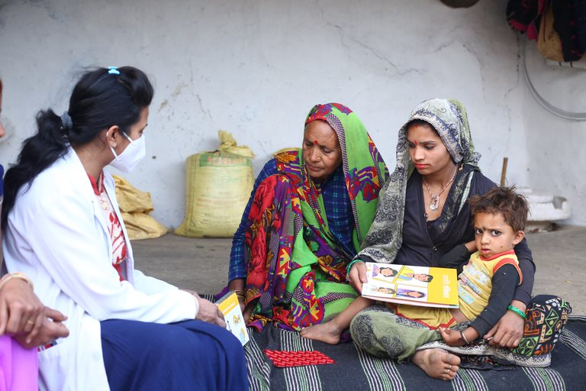
Expected Outcomes
Improvement in treatment adherence and overall health outcomes of TB patients
Improved knowledge and practice of healthy behaviors to prevent TB-related complications and hospitalizations
Reduced stress and anxiety among family caregivers and patients

Slide 24
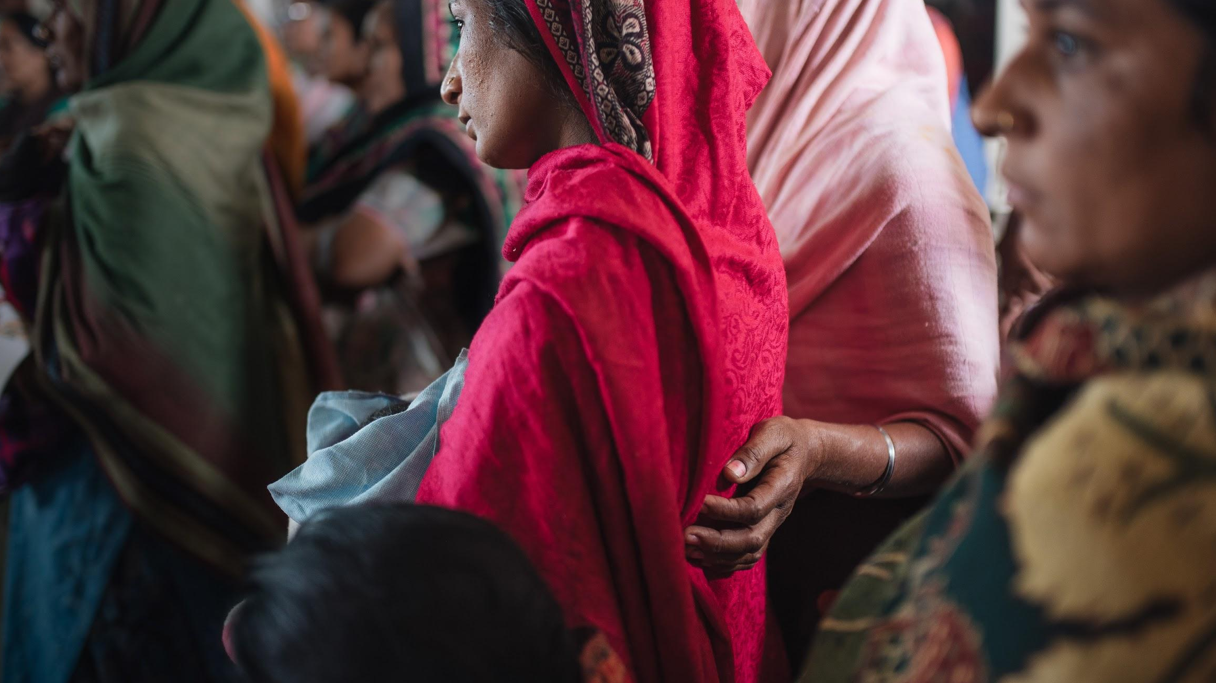
We believe in the
power of family
to heal.
THANK YOU

