Slide 1
TB Preventive Therapy Module

Slide 2
Contents
Add Contacts of TB Patients and High-risk populations eligible for TB Preventive Therapy (TPT) as TPT beneficiaries/persons
Enrollment of TPT Beneficiaries
Add Tests for TB Infection (TBI) Beneficiaries
Initiate TPT Beneficiaries
Add Outcomes for TPT Beneficiaries

Slide 3
Overview
This Module will enable users to register and track the management of TPT Beneficiaries. Users would also be able to add Dispensation, Adherence, and Comorbidity details for the TPT beneficiaries.
In the Contact Tracing Module, users can add contacts of the primary beneficiaries. On Clicking on Add Contacts, users will directly be redirected to the Add Enrollment Page.
For Cases that are added through the Contact Tracing Module, In the ‘Key Population’ section, 'contact of known TB patient' will be selected by default and will be non-editable.
During Enrolment, TPT Workflows will be enabled based on the selection of any of the following triggers
Selection of any of the Key Population/Risk factors except ‘Not Applicable
HIV Status values are either "Positive" or "Reactive"
Users can add Tests specific for TBI Beneficiaries from the Tests Tab (Diagnosis of TBI) - TST and IGRA. For TBI Beneficiaries, adding Test Results is optional. They can be initiated on treatment even without test results being added.
Treatment regimen and Outcome options relevant to TPT Beneficiaries are made available

Slide 4
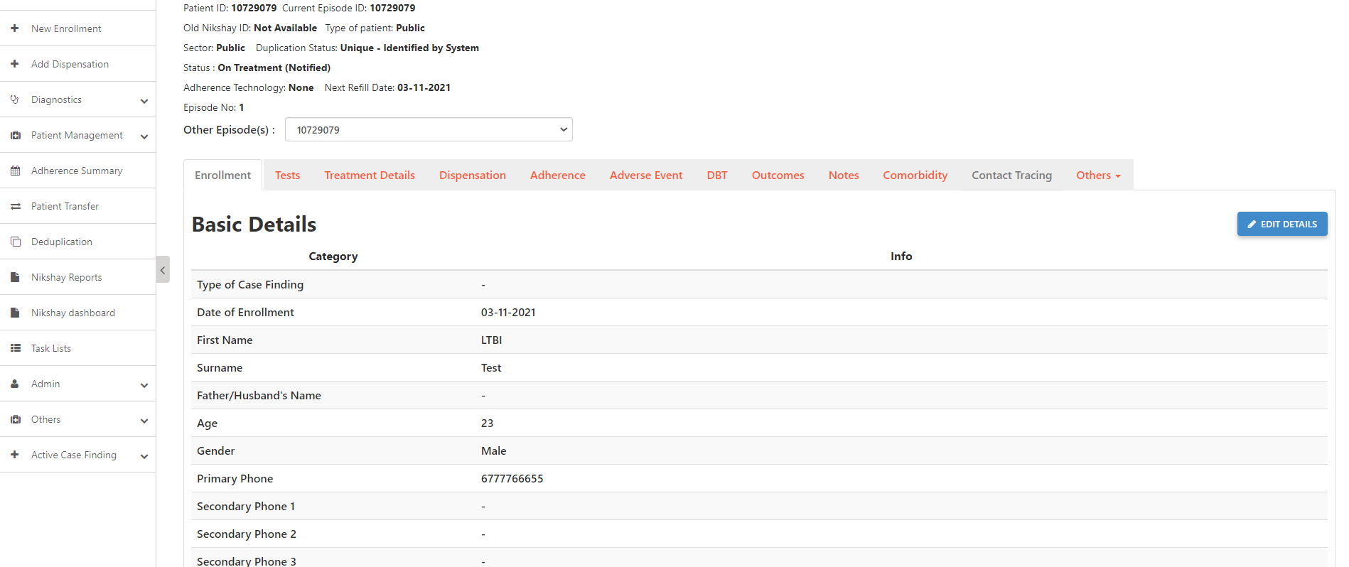
Add Contacts
Step 1
Click on ‘Contact Tracing’

Slide 5
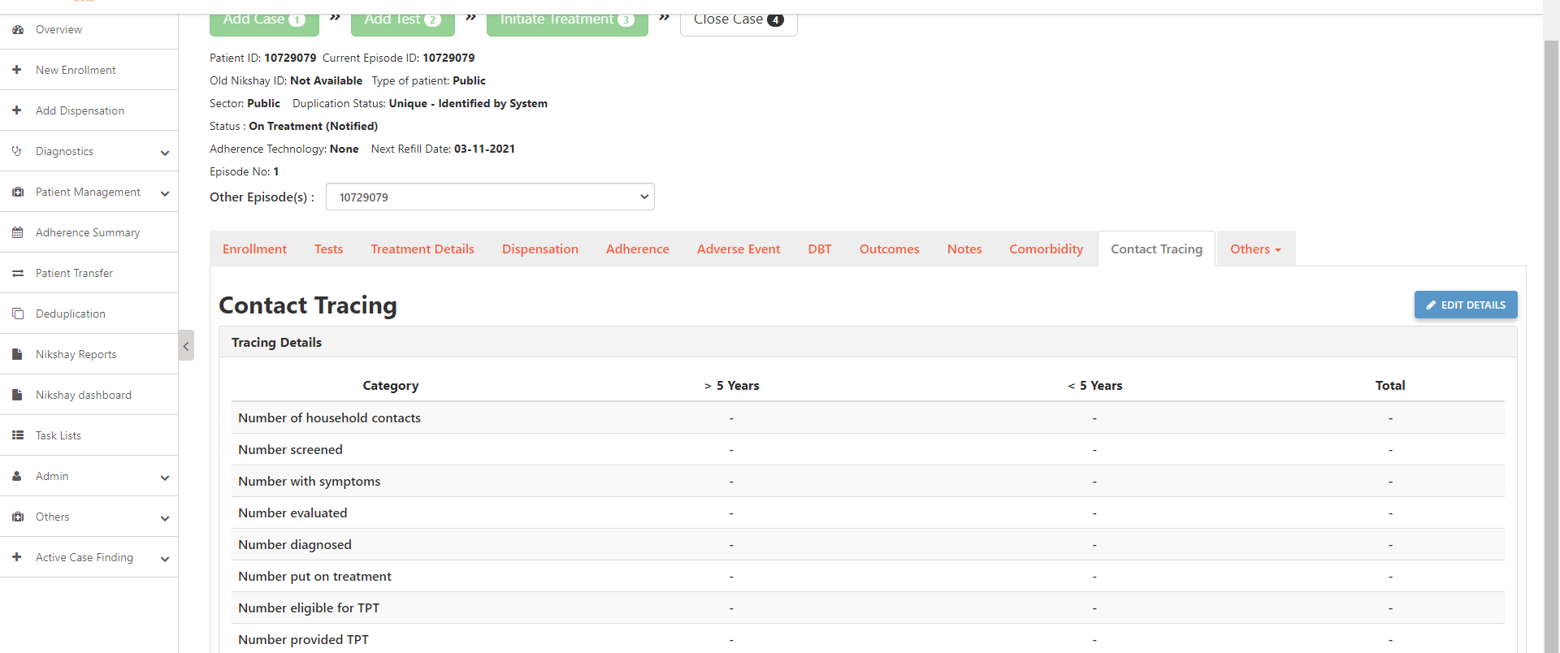
Add Contacts
Step 1
Step 2
Click on ‘Contact Tracing’
Click on ‘Edit Details’

Slide 6
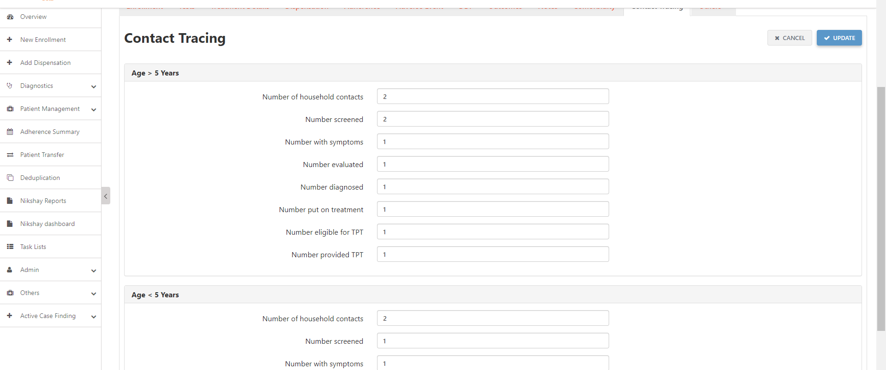
Add Contacts
Step 1
Step 2
Step 3
Click on ‘Contact Tracing’
Click on ‘Edit Details’
Enter Contacts of TB Patients
Click on Update after entering details of household contacts.

Slide 7
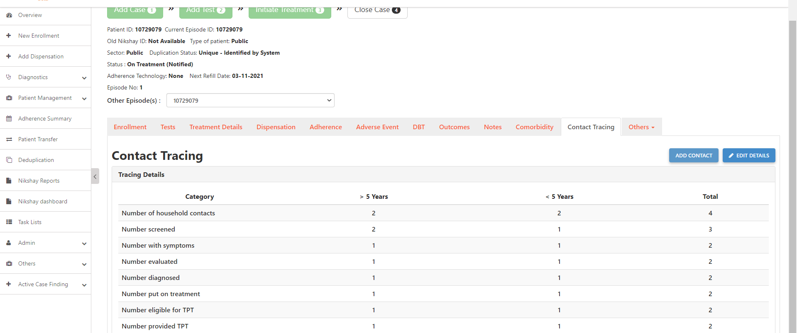
Add Contacts
Step 1
Step 2
Step 3
Step 4
Click on ‘Contact Tracing’
Click on ‘Edit Details’
Enter Contacts of TB Patients
Click on ‘Add Contact’

Slide 8
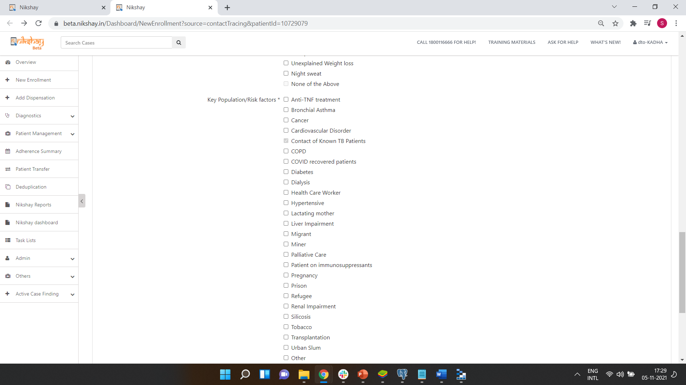
Add Contacts of TB Patients
Step 1
Complete Enrolment of TPT beneficiary
In the Enrolment form, Key Population option “Contact of Known TB Patients” will be auto selected and will be non-editable

Slide 9
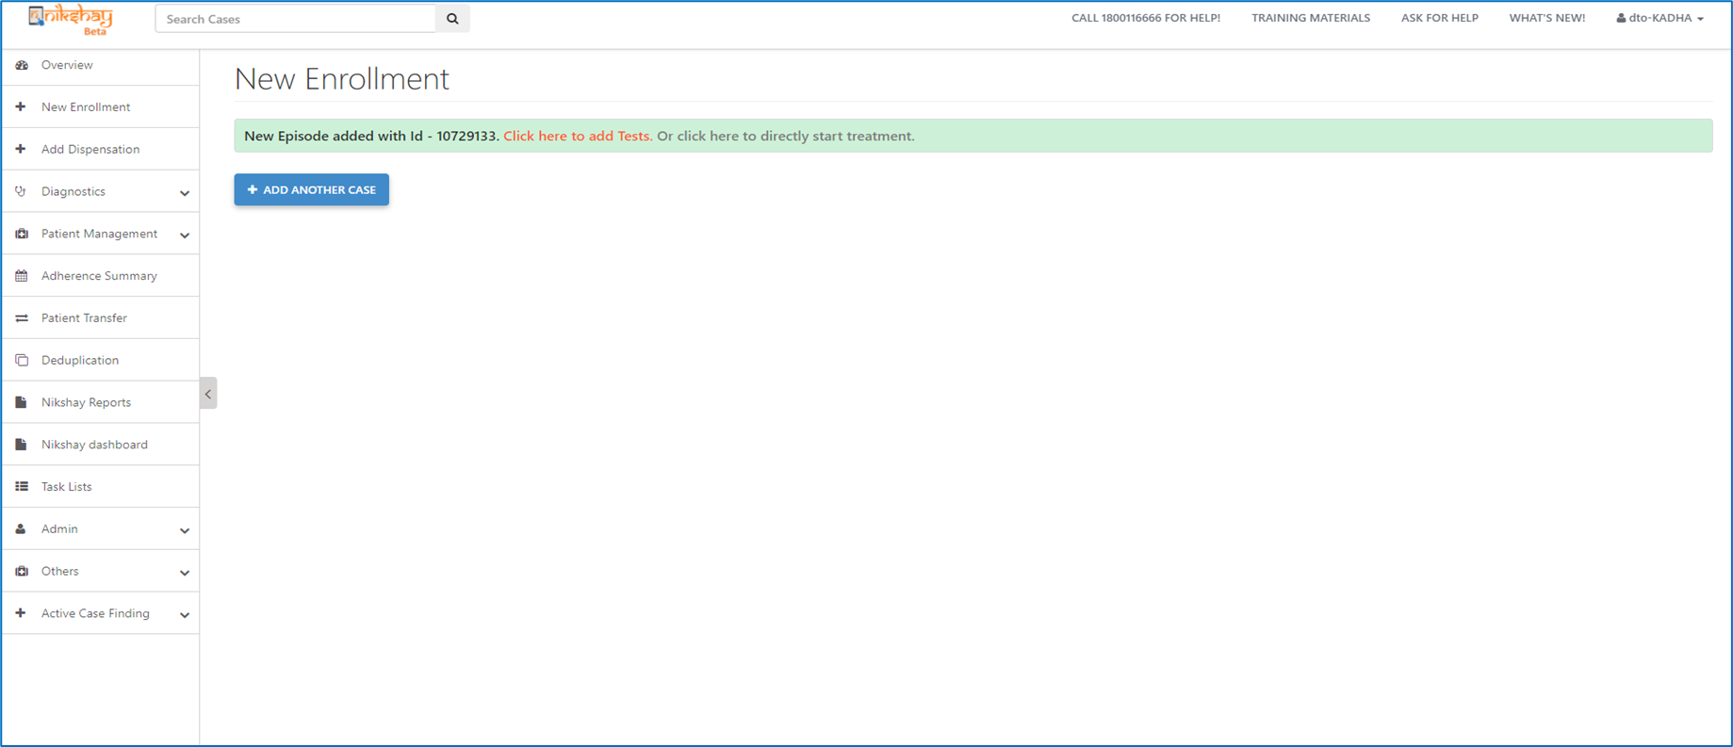
Add Contacts of TB Patients
Step 1
Step 2
Complete Enrolment of TPT beneficiary
Add Tests or Start Treatment
Adding Test Details is Optional and can be added as per test being done on beneficiaries

Slide 10
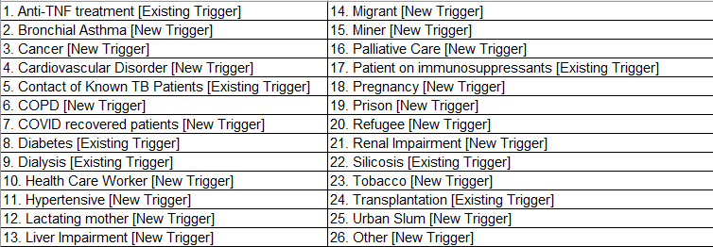
Enrollment of High-Risk Beneficiaries
The list of Key Population/Risk Factors that can trigger TPT workflows are as follows:
In Addition to this the following HIV status trigger TPT workflows
In Addition to this the following HIV status trigger TPT workflows

Slide 11
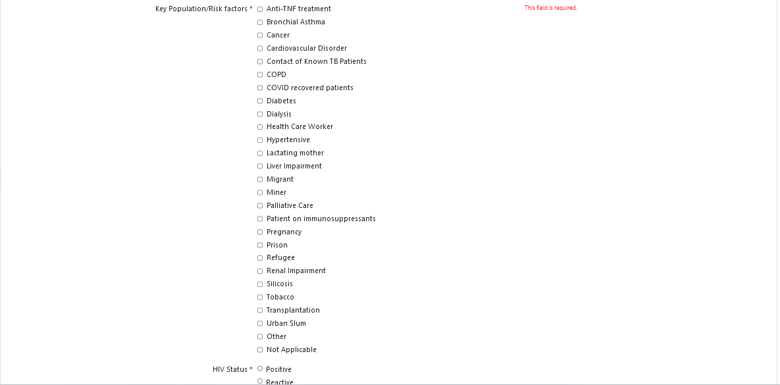
Enrollment of High-Risk Beneficiaries
Step 1.a
Complete Enrolment of TPT beneficiary
During Enrolment, If any of the Key Population options are selected except for Not Applicate, then the case registered will be allowed to initiated on treatment even without the addition of a positive diagnostic test.

Slide 12
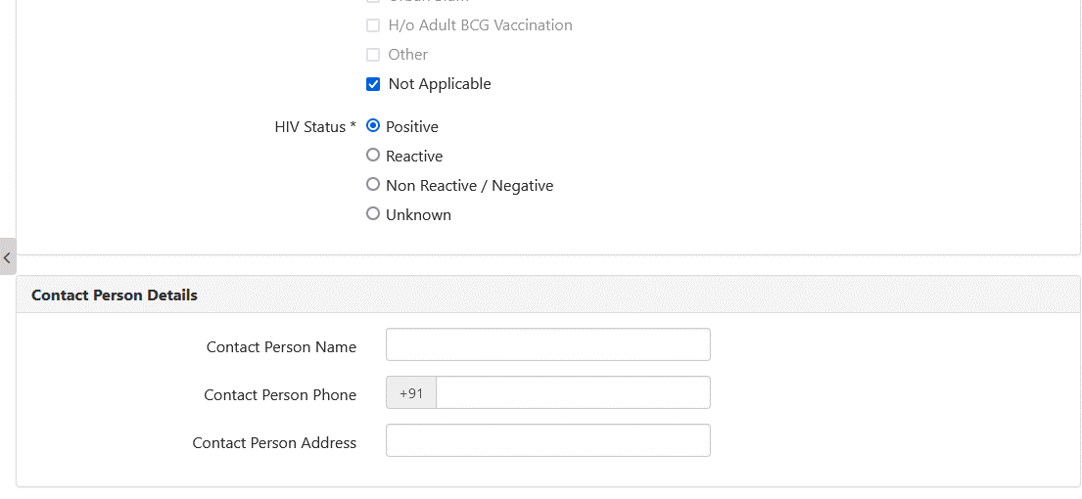
Enrollment of High-Risk Beneficiaries
Step 1.b
Complete Enrolment of TPT beneficiary
If the HIV options are Positive or Reactive, then the case registered will be allowed to be initiated on treatment even without the addition of a positive diagnostic test.

Slide 13
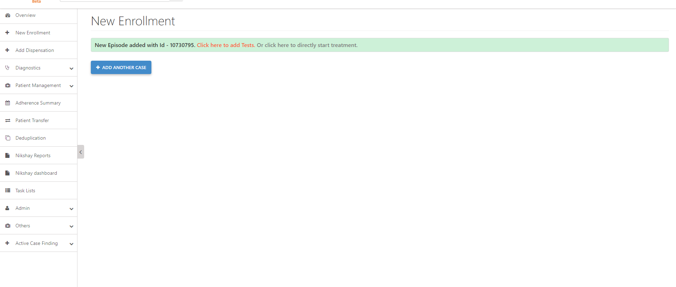
Enrollment of High-Risk Beneficiaries
Step 1
Step 2
Complete Enrolment of TPT beneficiary
Initiate Treatment or Add Tests
Adding Test Details is Optional and can be added as per test being done on TPT beneficiaries

Slide 14
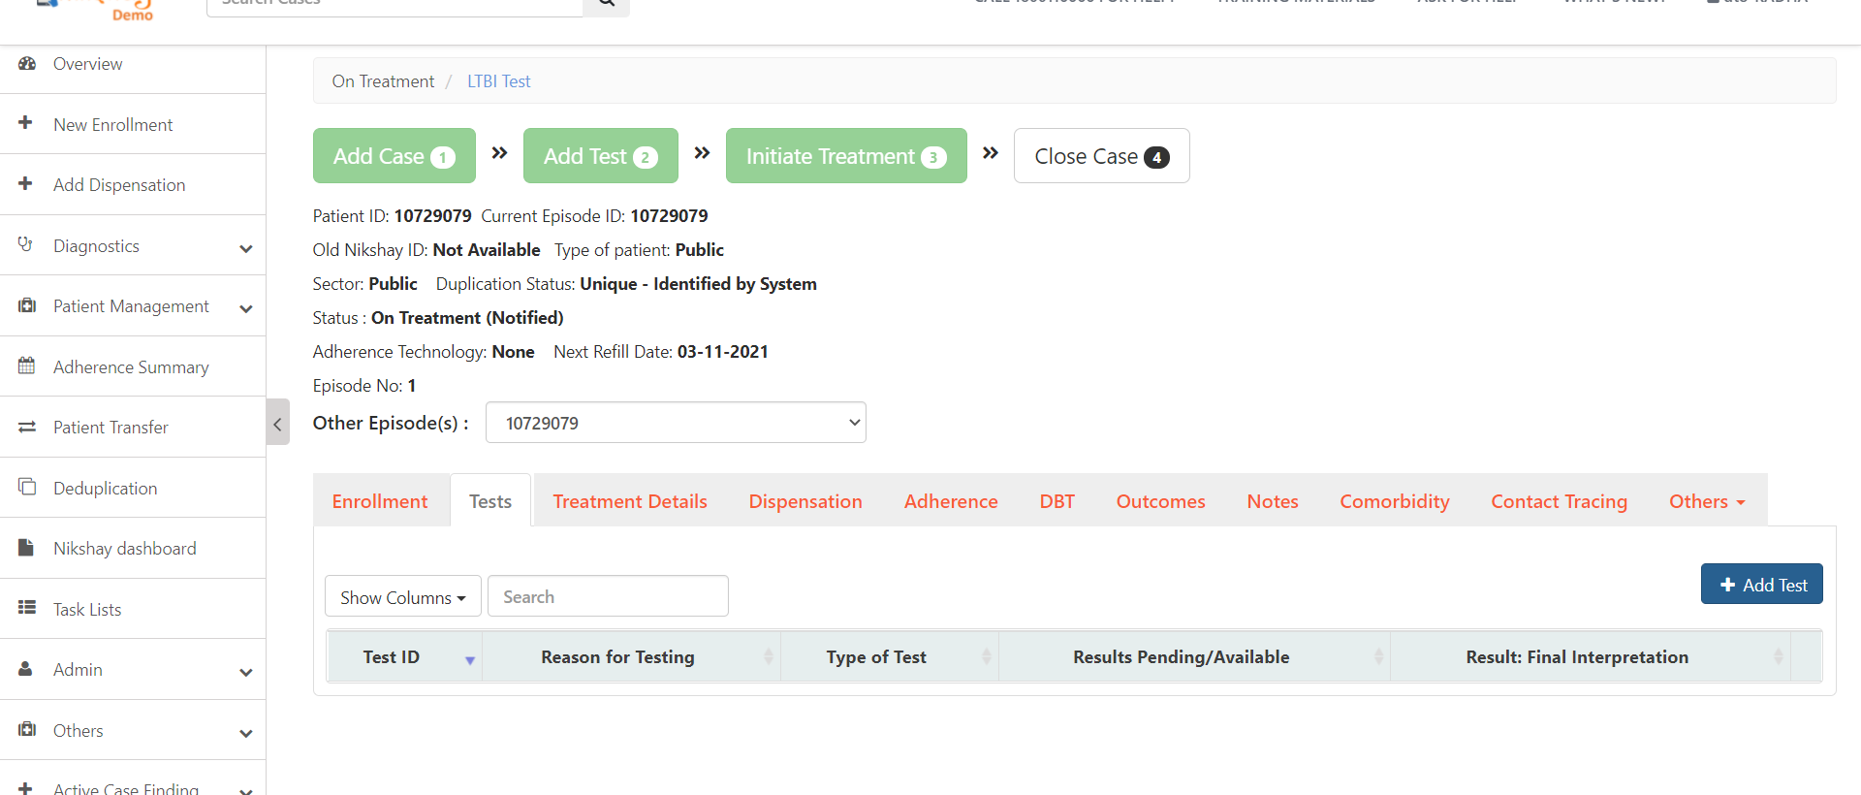
Adding Test for TBI Beneficiary ..1
Step 1
Click on Tests Tab and click on the ‘Add Test’ Button

Slide 15
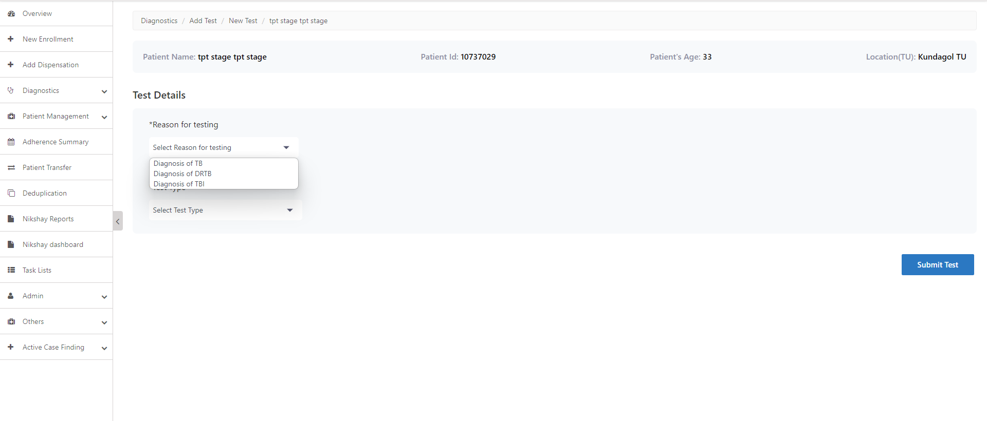
Adding Test for TBI Beneficiary..2
Step 1
Step 2
Click on Tests Tab and click on the ‘Add Test’ Button
Select Reason for Testing

Slide 16
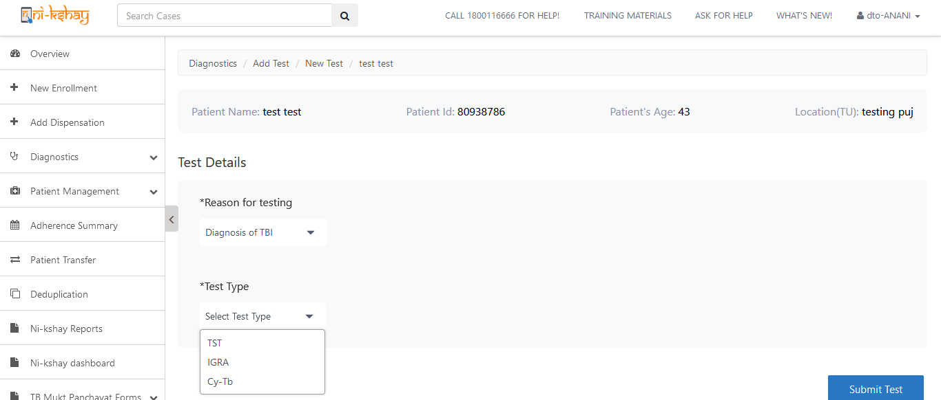
Adding Test for TBI Beneficiary..3
Step 1
Step 2
Step 3
Click on Tests Tab and click on the ‘Add Test’ Button
Select Reason for Testing
Select Test Type

Slide 17
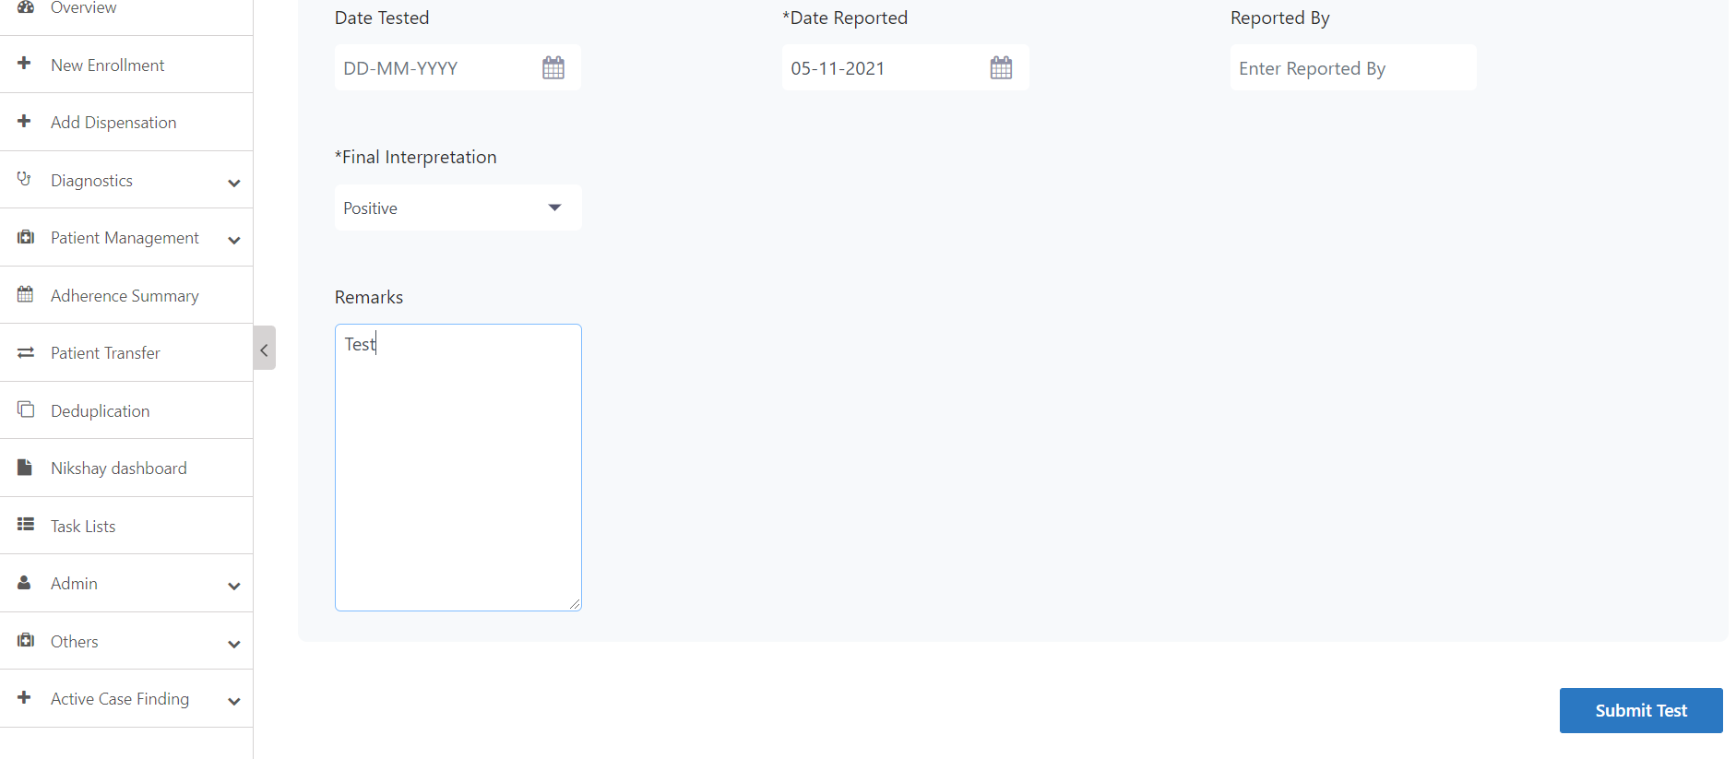
Adding Test for TBI Beneficiary..4
Step 1
Step 2
Step 3
Step 4
Click on Tests Tab and click on the ‘Add Test’ Button
Select Reason for Testing
Select Test Type
Click on Submit Test

Slide 18
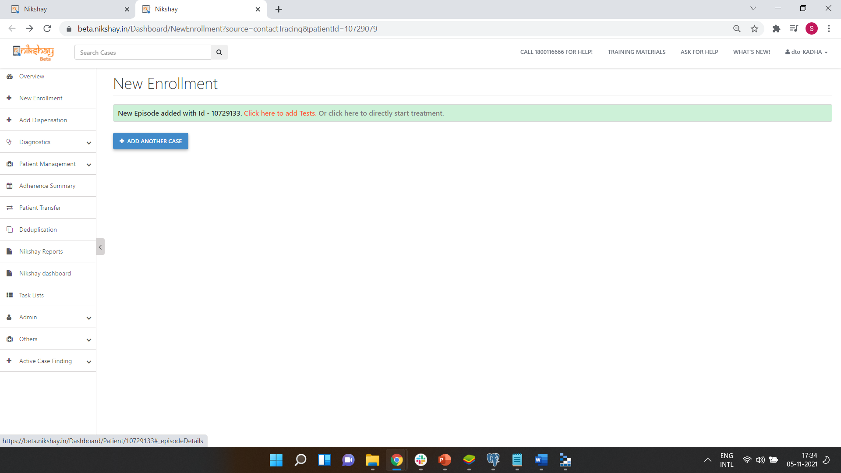
Initiating Treatment of Contacts..1
Step 1
Step 2
Complete Enrolment of TPT beneficiary
Initiate Treatment
Adding Test Details is Optional. The contact added can be initiated on treatment without test details being added.

Slide 19
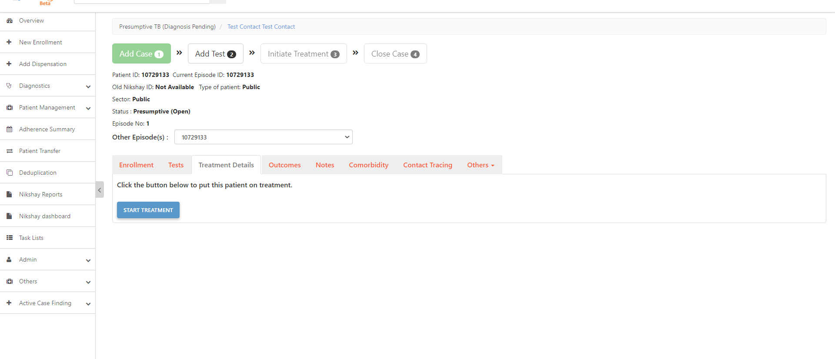
Initiating Treatment of Contacts..2
Step 1
Step 2
Step 3
Complete Enrolment of TPT beneficiary
Initiate Treatment
Click on Treatment Details Tab and then click on ‘Start Treatment’
Adding Test Details is Optional. The contact added can be initiated on treatment without test details being added.

Slide 20
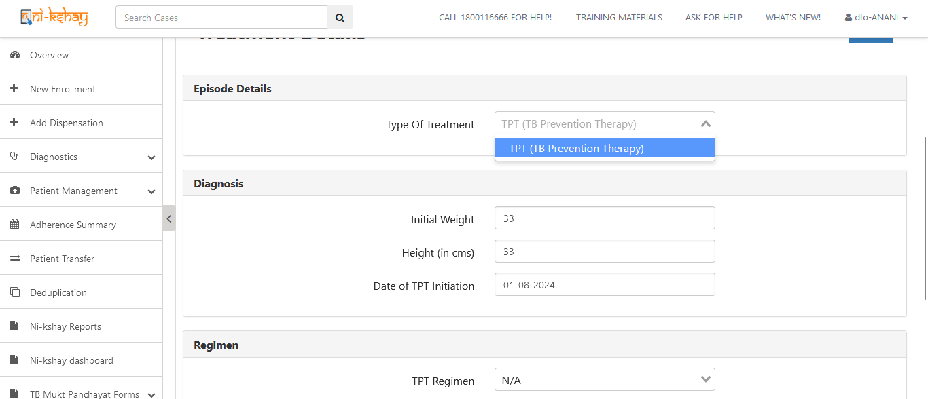
Initiating Treatment of Contacts..3
Step 1
Step 2
Step 3
Step 4
Complete Enrolment of TPT beneficiary
Initiate Treatment
Click on Treatment Details Tab and then click on ‘Start Treatment’
Select the ‘Type of Case’

Slide 21
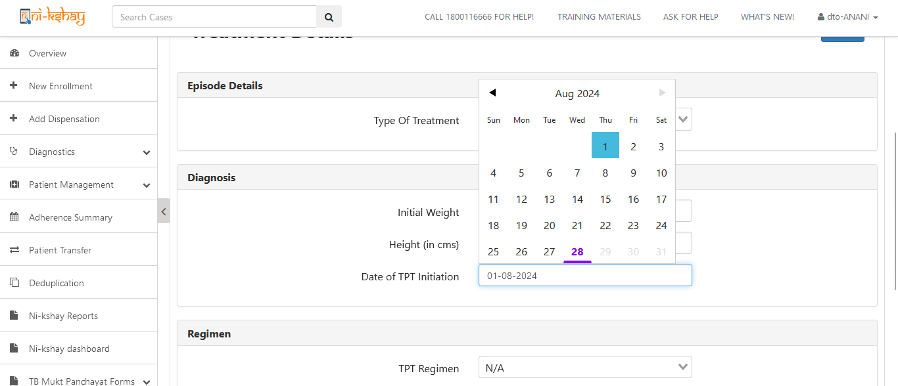
Initiating Treatment of Contacts..5
Step 5
Select date of TPT Initiation

Slide 22
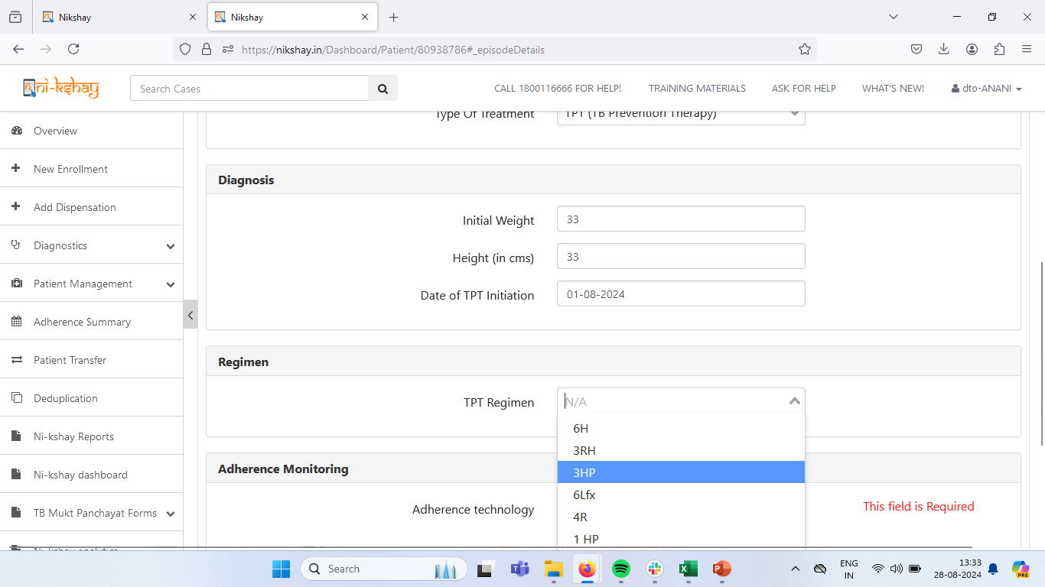
Initiating Treatment of Contacts..6
Step 5
Step 6
Select date of TPT Initiation
Select TPT Regimen

Slide 23
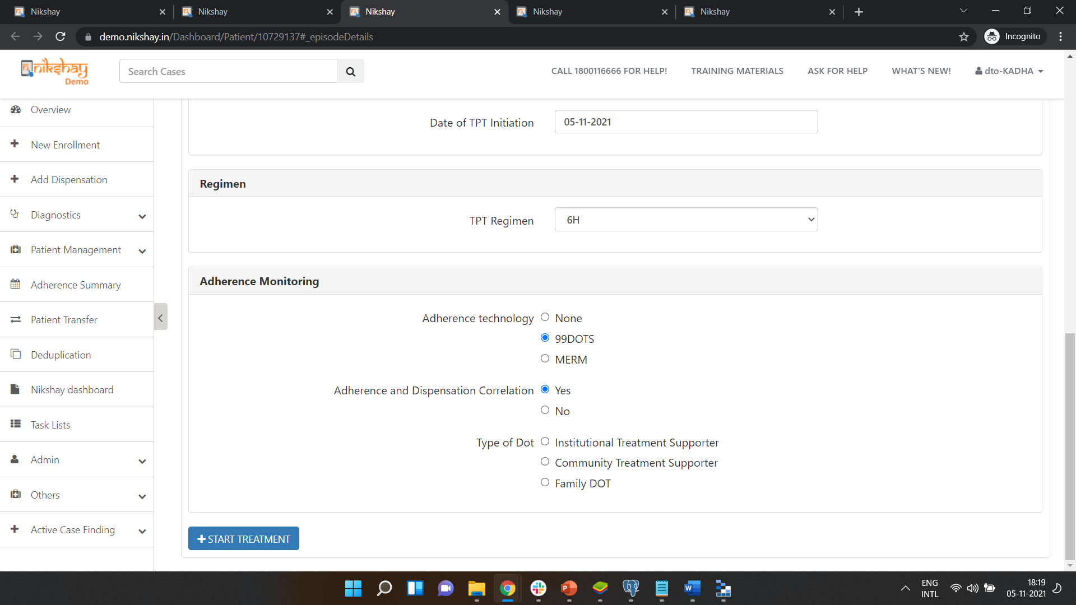
Initiating Treatment of Contacts..7
Step 5
Step 6
Step 7
Select date of TPT Initiation
Select TPT Regimen
Click on ‘Start Treatment’

Slide 24
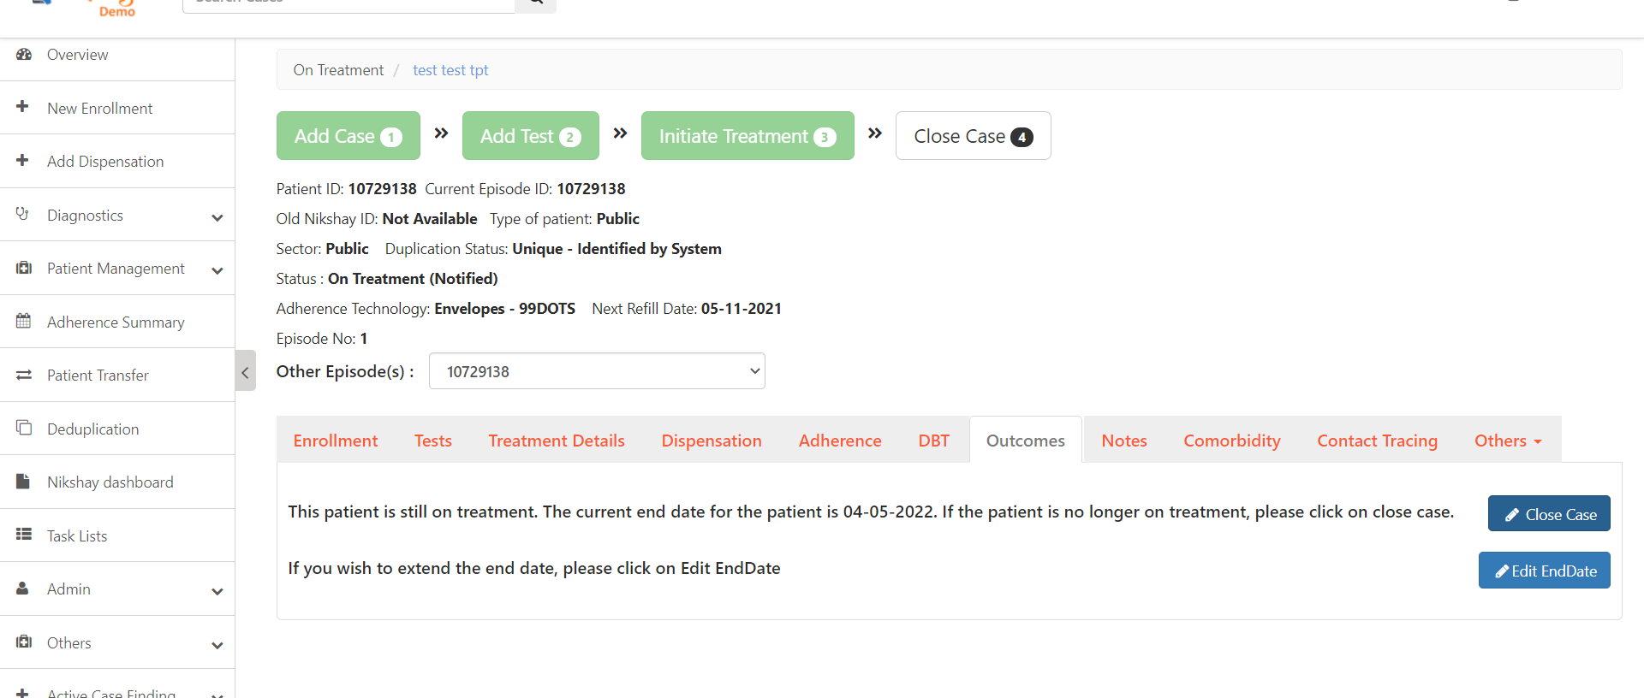
Adding Outcomes
Step 1
Click on Outcomes Tab and click on the ‘Close Case’ Button

Slide 25
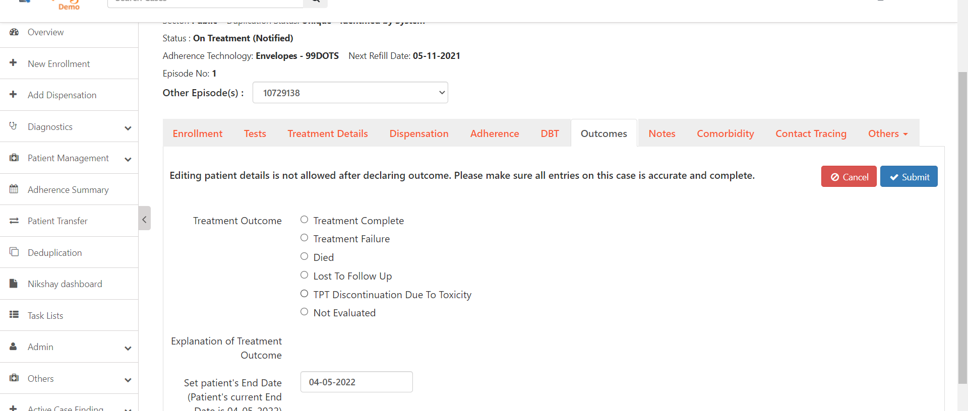
Adding Outcomes
Step 1
Step 2
Click on Outcomes Tab and click on the ‘Close Case’ Button
Select Outcomes relevant for TPT Patients
Click here to Submit

Slide 26
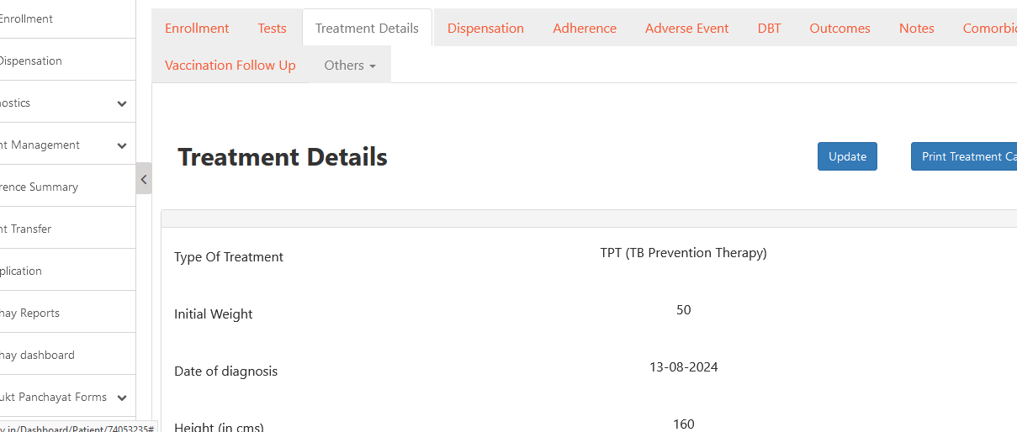
Print TPT Treatment Card
Step 1
Step 2
Click on Treatment Details Tab
Click on Print Treatment Card

Slide 27
Print TPT Treatment Card – Page 1

Slide 28
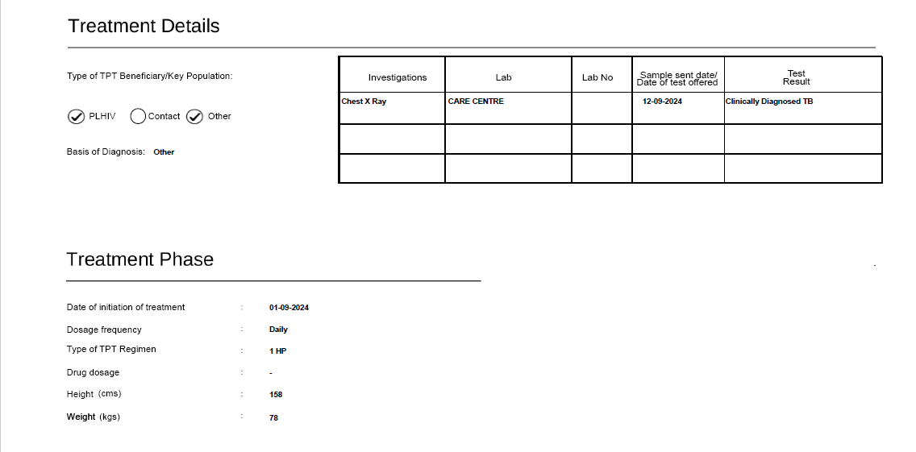
Print TPT Treatment Card – Page 1

Slide 29
Print TPT Treatment Card – Page 1

Slide 30
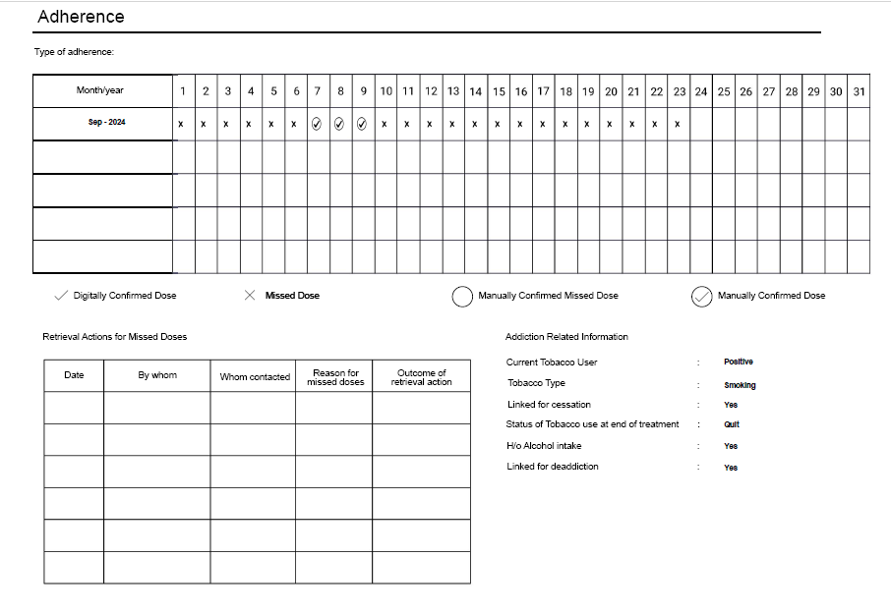
Print TPT Treatment Card – Page 2

Slide 31
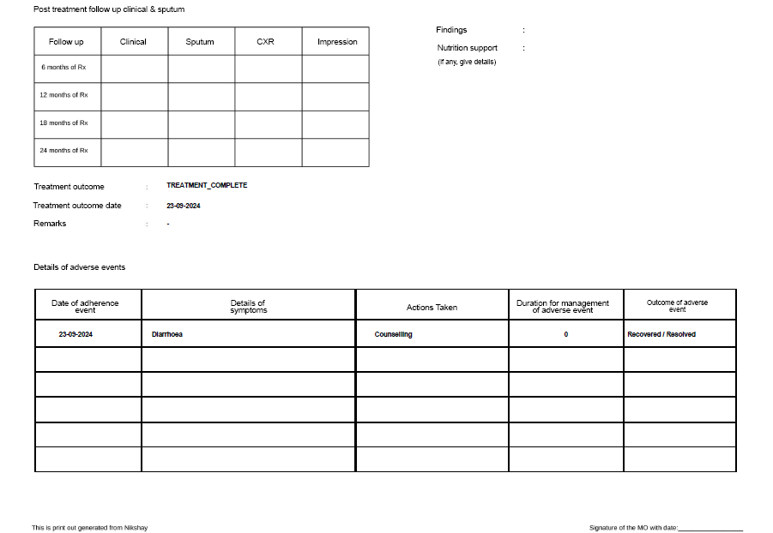
Print TPT Treatment Card – Page 2

Slide 32
TPT Beneficiary Notification and Post-Treatment Follow-up SMS
The following SMS notifications for TPT beneficiaries have been enabled:
1. TPT Beneficiary Notification: Sent upon successful registration as a TB preventive treatment beneficiary.
Trigger: When Patient Status changes from Presumptive (Open) to "Diagnosed On Treatment (Notified)" for TPT Beneficiaries
SMS Content: "Dear {#var#}: {#var#}, You have successfully registered under NTEP as a TB preventive treatment beneficiary. Please ensure you complete treatment for the entire duration as prescribed. For any queries or support during treatment, you can contact your treatment supporter or our Toll-Free number 1800-11-6666 (National TB Call Centre) or download the TB Aarogya Sathi app - Click {#var#} and Login using your Ni-kshay ID. CTD
-MoHFW".
2. Post-Treatment Follow-up Reminder: Sent at 6, 12, 18, and 24 months after treatment completion.
Trigger: For TPT beneficiaries whose outcomes have been assigned, SMS to be sent on Date of Treatment Outcome + 6 M/ 12 M/ 18 M & 24 M".
SMS Content: "Dear {#var#}: {#var#}, Congratulations! You have completed your TB Preventive Treatment. The next thing to do is get your post-treatment follow-up, which is due on {#var#}. Please visit your doctor or contact your treatment supporter. For more information contact Toll-Free 1800-11-6666 (National TB Call Centre). CTD -MoHFW".

Slide 33
FAQs
1. What is the protocol to follow if a beneficiary who has completed treatment must be put on TPT, as per PMTPT guidelines ?
Incase the beneficiary has already completed TB treatment previously and is now eligible for TPT as per PMTPT guidelines, a new episode needs to be created in Nikshay for the patient with same primary Nikshay ID (mobile number)

Slide 34
Task Lists
The Tasklist logic in Ni-kshay has been updated, incorporating the TPT beneficiary logic as per the list shared below
HIV status Unknown – TPT Beneficiaries excluded
Contact tracing due – TPT Beneficiaries excluded
Bank Details Required – TPT Beneficiaries excluded
DBT maker pending - TPT Beneficiaries excluded
DBT Checker pending - TPT Beneficiaries excluded
Beneficiary approval pending - TPT Beneficiaries excluded
Patients registered through screening tool – No change
Adherence Missed 1-3 Days – TPT Beneficiaries included
Adherence Missed 4-7 Days – TPT Beneficiaries included
Adherence Missed 8-14 Days – TPT Beneficiaries included
Adherence Missed - 15+ Days – TPT Beneficiaries included
Dose not reported today – TPT Beneficiaries included
MERM Device Battery Level – TPT Beneficiaries included
Treatment Outcome Due – TPT Beneficiaries included
Refill Due – TPT Beneficiaries included
Transfer in approval pending - TPT Beneficiaries included
Transfer out approval pending - TPT Beneficiaries included
Deduplication pending - TPT Beneficiaries included

Slide 35
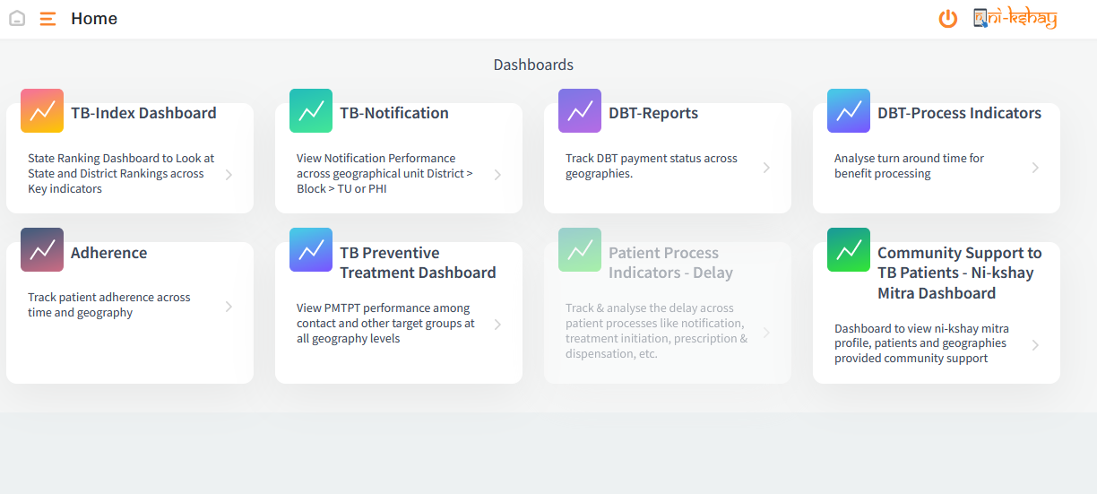
TB Preventive Therapy Dashboard
TB Preventive Therapy Dashboard has been made available with the following set of features included.
Enables cascade monitoring of contacts and other target beneficiaries at all geography levels.
Overview tab provides visualizations on the TPT Pathway, Contact tracing, Source of Identification, TPT Outcome, Symptoms Prevalence, Latency Indicators, and Map & Demographic Breakdown view
Diagnosis and Treatment tab provides visualizations on Test Administered, Dispensation Status, ADR (Reported at least once), TPT Regimen, TST Induration, and Map & Demographic Breakdown view.

Slide 36
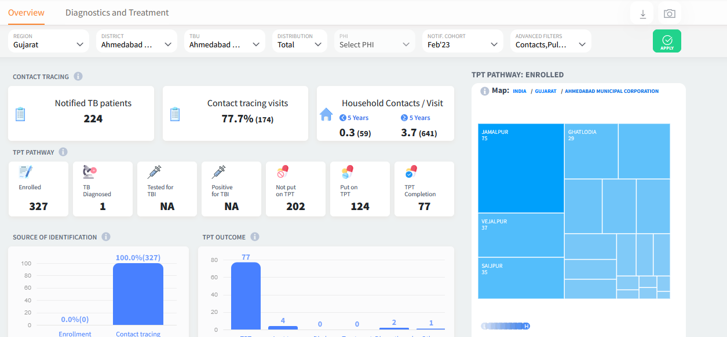
TB Preventive Therapy Dashboard
Click on the ‘i’ icon for explanation of the tiles.

Slide 37
THANK YOU

