Slide 1
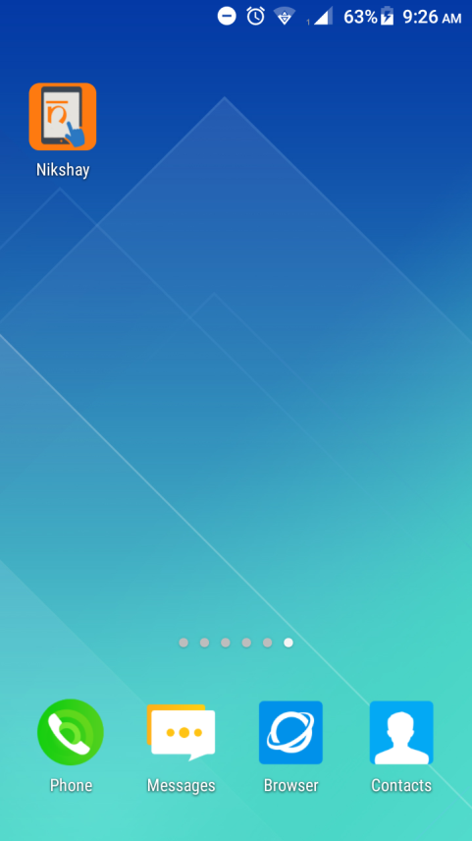



Version-2.0
App User Guide
14th Dec 2018

Slide 2
Introduction

Slide 3
Nikshay version 2:
Intro
Nikshay is an Integrated ICT system for TB patient management and care in India. Consolidating various improvements since 2012, Version 2 makes the following upgrades:
Unified interface for public and private sector health care providers
Integrates all adherence technologies such as 99DOTS and MERM
Unified DSTB and DRTB data entry forms
PHI level users
Mobile friendly website with mobile app

Slide 4
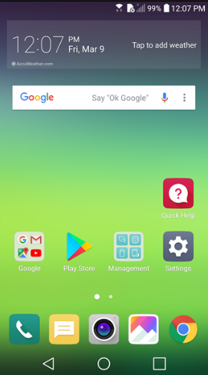
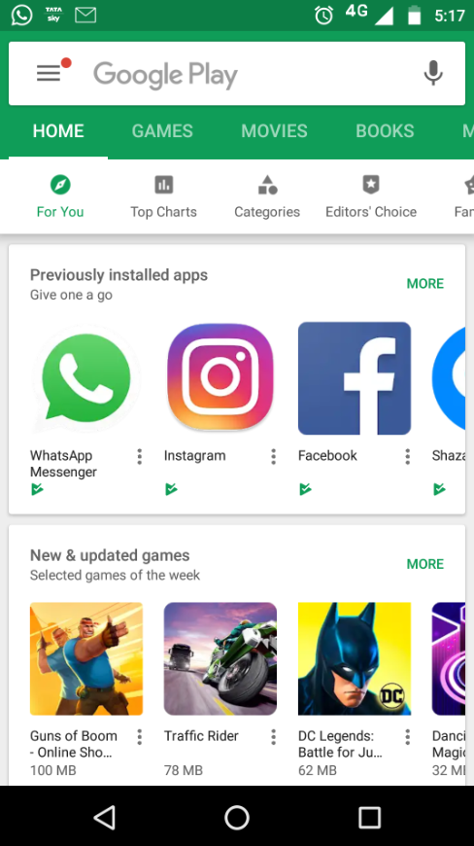
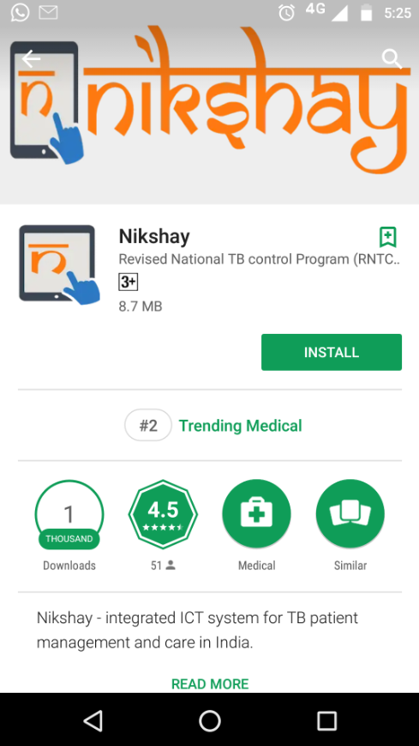
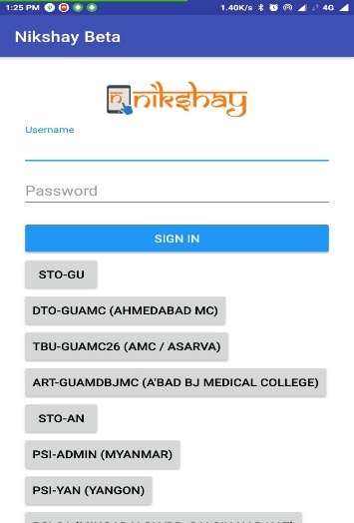

Mobile App installation procedure
Step 1
Step 2
Step 3
Go to Google Play Store on your Tablet or Mobile device
In Google Play Store, search for Nikshay App
Click on “Install”
Notes
Step 5
Step 4
To use Nikshay App, user should have Internet connectivity on the Tablet or Mobile device. If a tablet is no connectivity, the App will not open or work.
Users should avoid using the Web application of Nikshay (https://Nikshay.in) on a tablet and use the Mobile App as it will give a better user experience
The mobile App is designed to work fast. If you find that the app is slow, kindly check internet connectivity before reporting the issue
For any queries or issues while using the App, please contact Nikshay Sampark at 1800116666
Enter your Log in ID and Password start using the Application
After installation, a shortcut of Nikshay App, gets created on Home Page
Nikshay

Slide 5
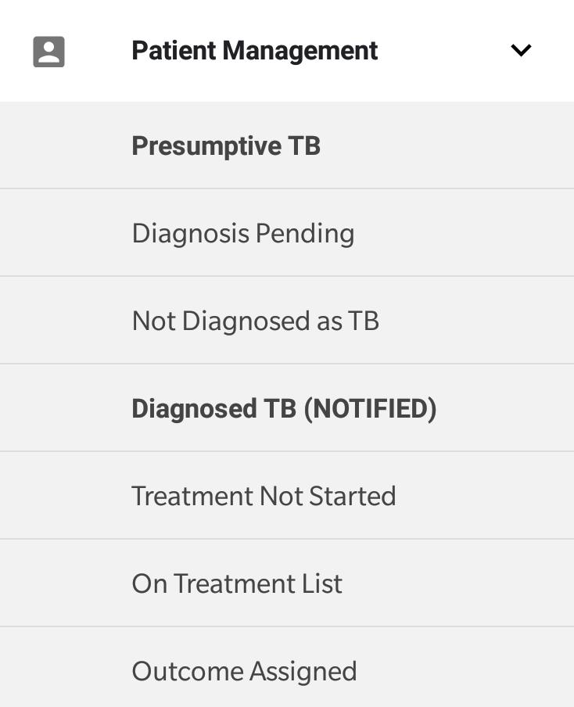
Viewing patients at various stages?
PRESUMPTIVE TB
Diagnosis Pending- List of patients who are just enrolled and test results not added.
Not Diagnosed as TB- List of presumptive patients where after enrolment it has been decided that this person is not a case of TB.

Slide 6
Viewing patients at various stages?
DIAGNOSED TB (NOTIFIED)
Treatment Not Started-List of patients diagnosed with TB but treatment not started.
On Treatment List- List of patients diagnosed with TB and are on treatment.
  On Treatment Calendar-Month wise adherence calendar of patients diagnosed with TB.
Outcome Assigned- List of all patients who are no longer on treatment.

Slide 7
New Enrolment
  This module enables registration of ALL kinds of new cases
    Presumptive Case or Confirmed Patient
    Taking treatment from Public or Private Sector
    DS TB and DR TB
  On enrolment, a unique 7 digit numeric Patient ID gets generated.
  Before enrolment of a new case, users should search (by Patient Name) to see if the patient is already registered, to avoid duplicates registrations

Slide 8

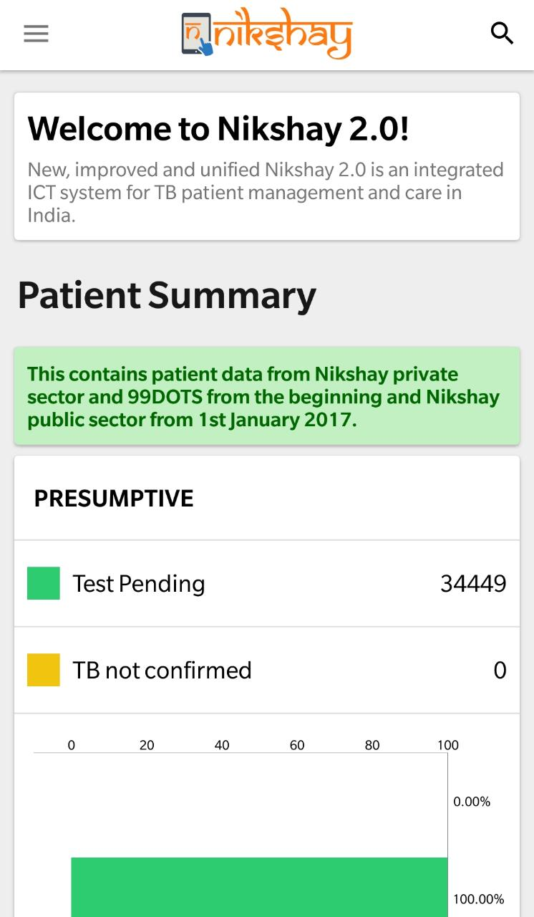
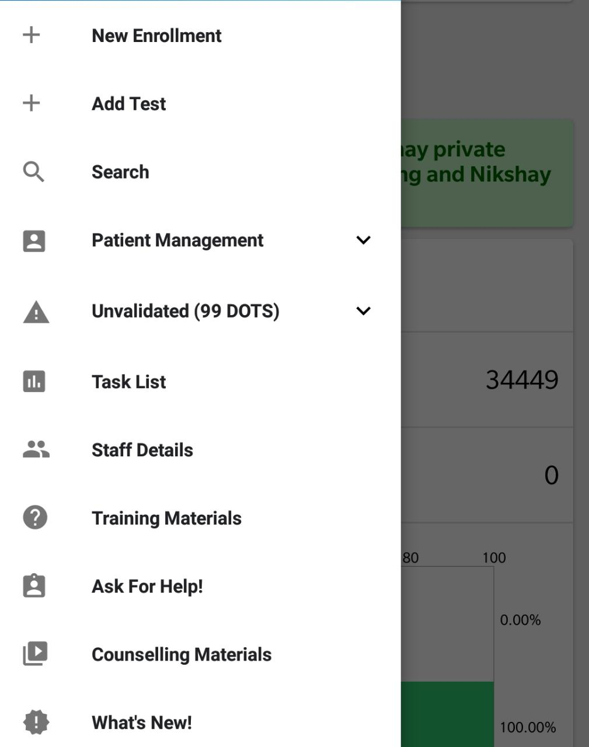
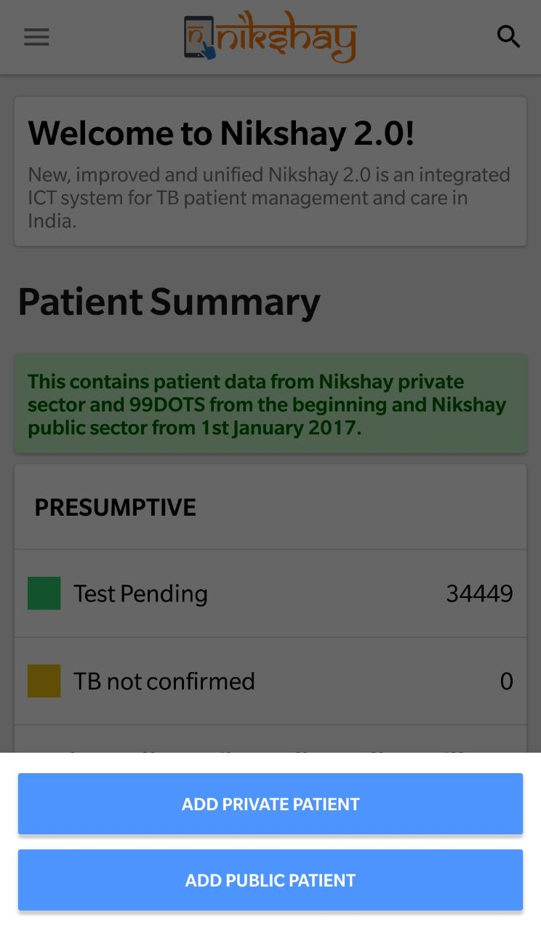
New Enrolment
Step 1
Step 2
Step 3
Click on the Icon
Click on “New Enrollment”
Select Patient Type

Slide 9
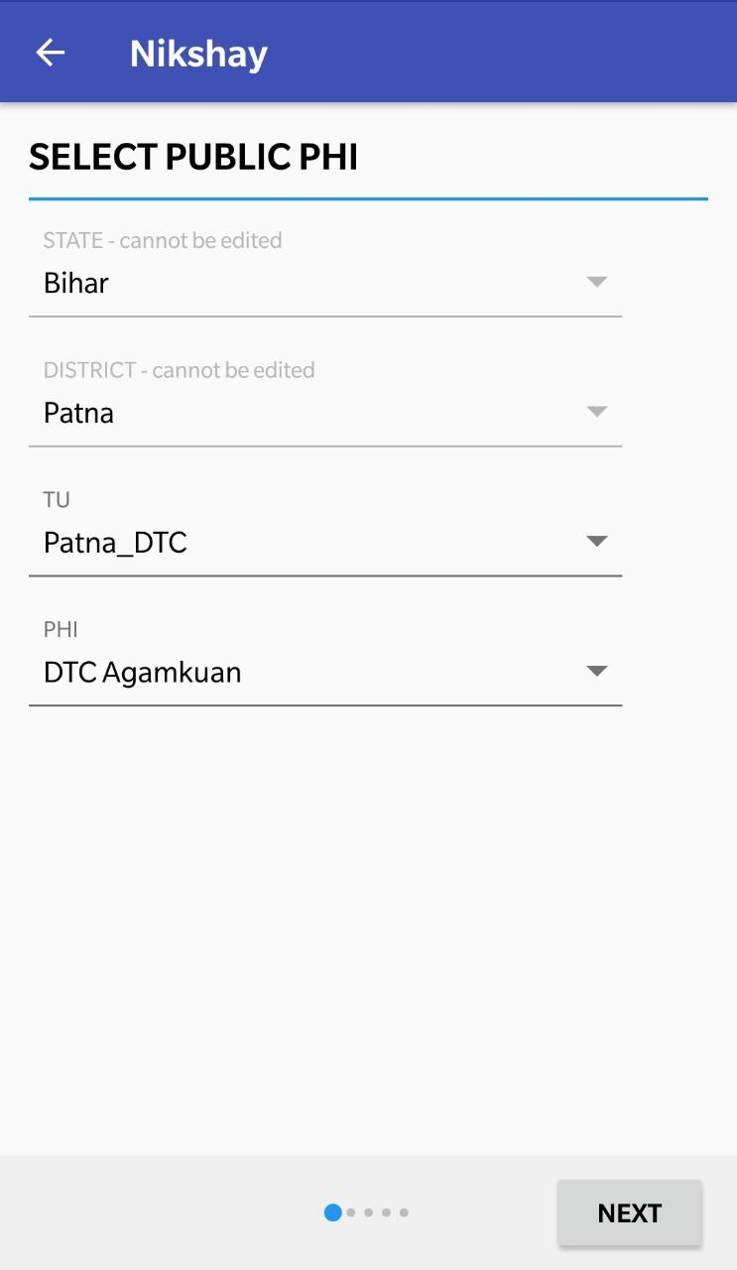
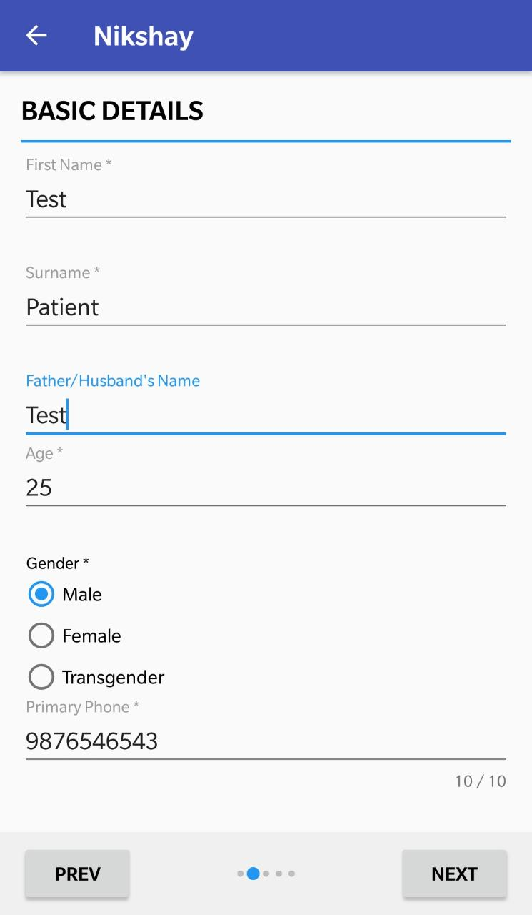
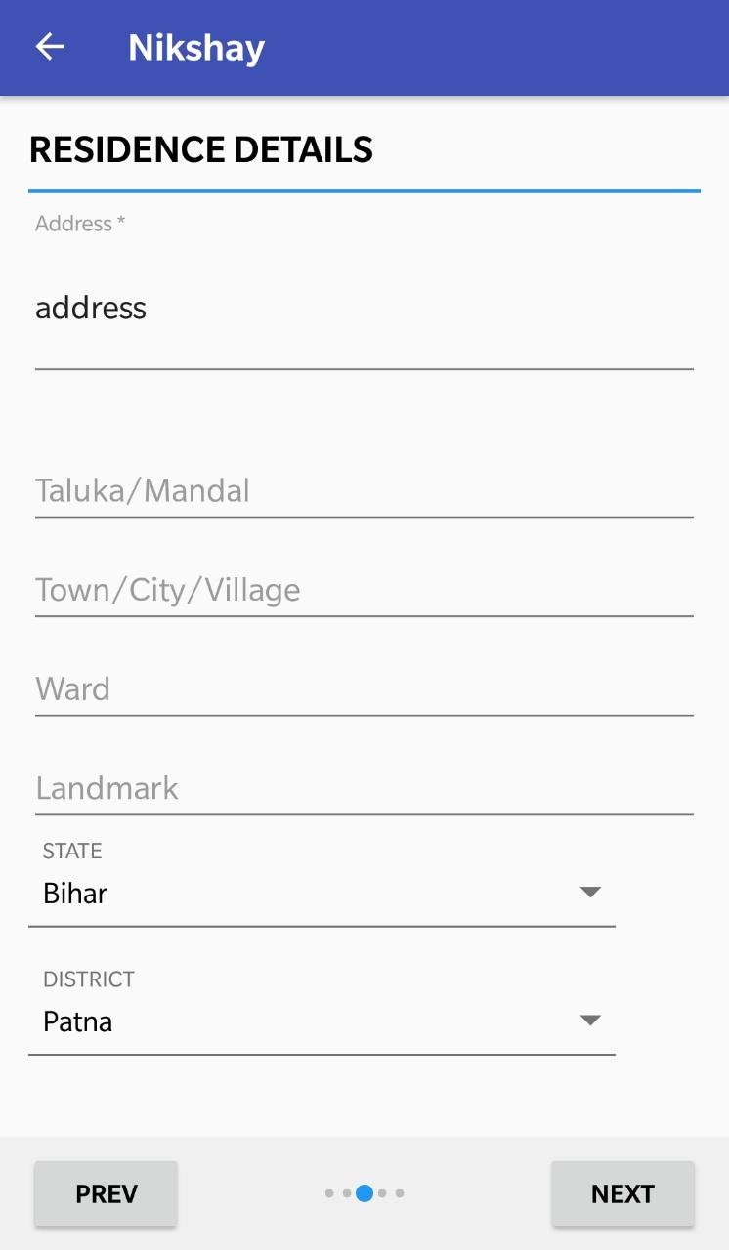
New Enrolment
Step 4
Step 5
Step 6
Select the Enrollment TU/PHI details and click on “Next” button
Enter Residence Details
Enter Basic Details
Click here proceed
Click here proceed
Click here proceed

Slide 10
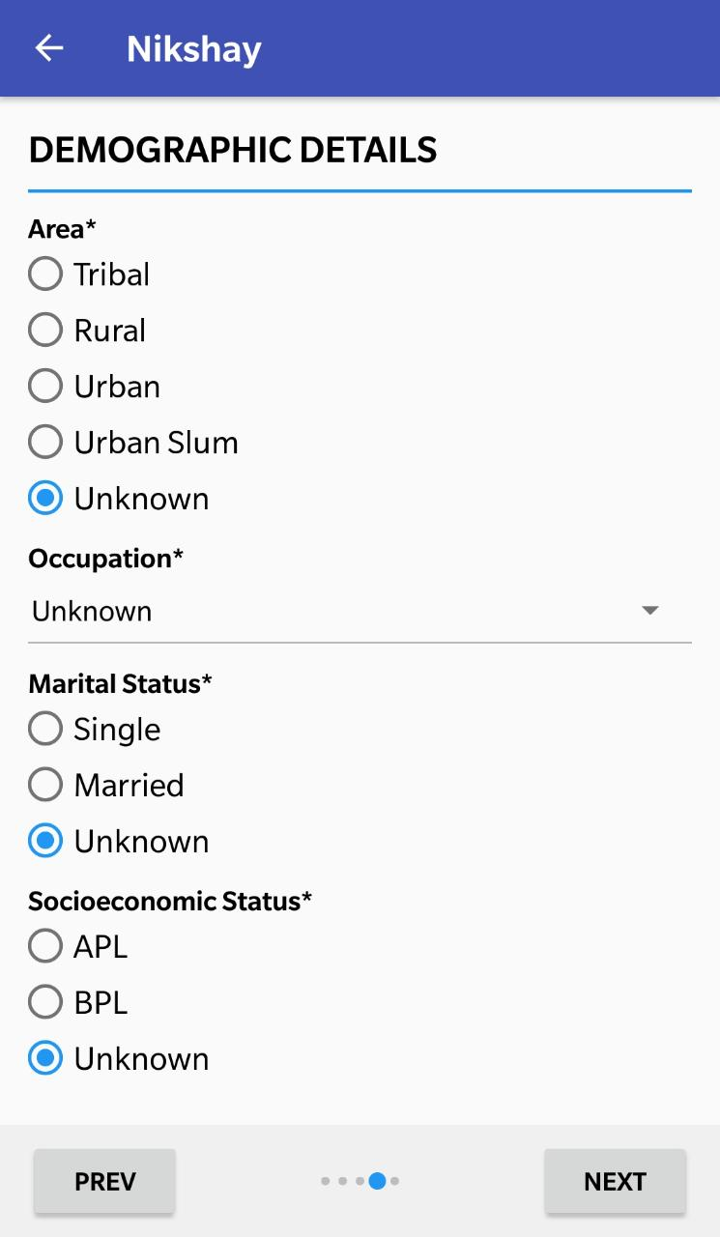
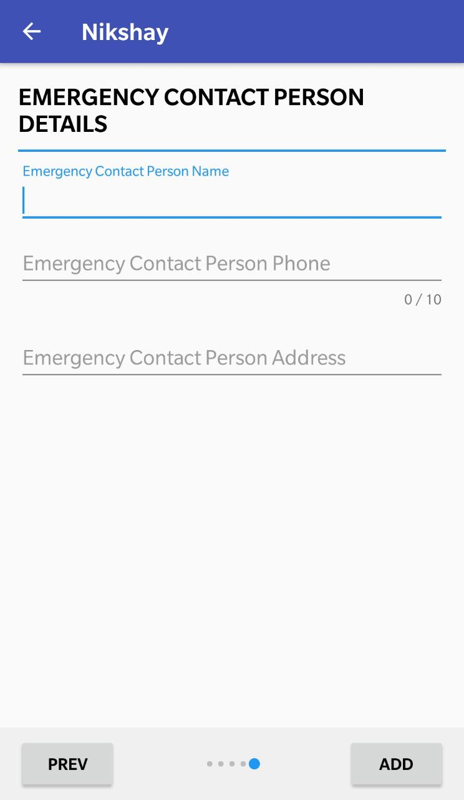
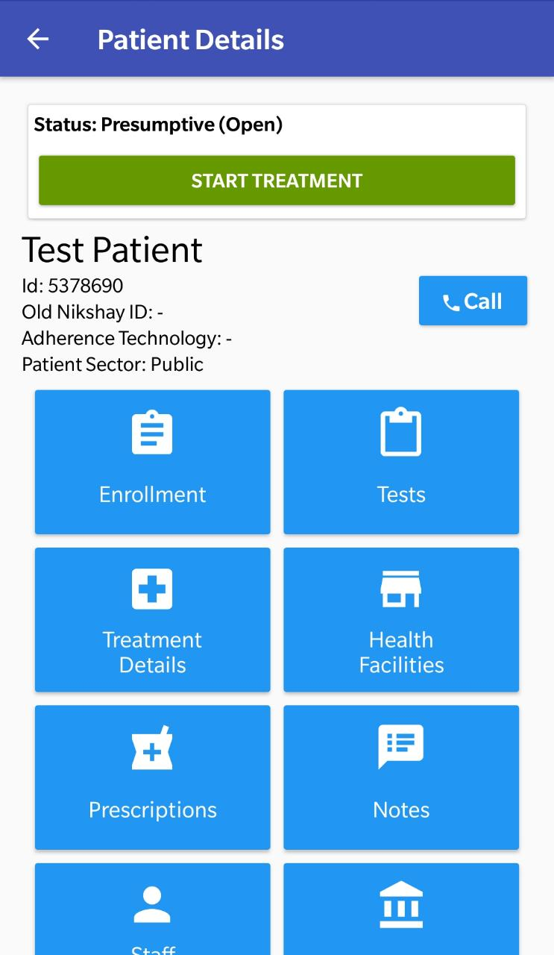
New Enrolment
Step 7
Step 8
Enter Demographic Details
Enter Emergency Contact Person Details
Patient will be assigned status: Presumptive (Open)
Note the ID generated for the case
Click here proceed
Click here to complete enrolment

Slide 11
Edit Patient details
  Users can easily Edit patient details such as Name, Age, Contact Details , Residence Details, Demographic Details and Emergency Contact Details.
  As User clicks on Edit, fields of the Form become editable
  The changes made are visible immediately.
  After closure of a Patient record (by update of Treatment Outcome), the patient record will not be editable.

Slide 12
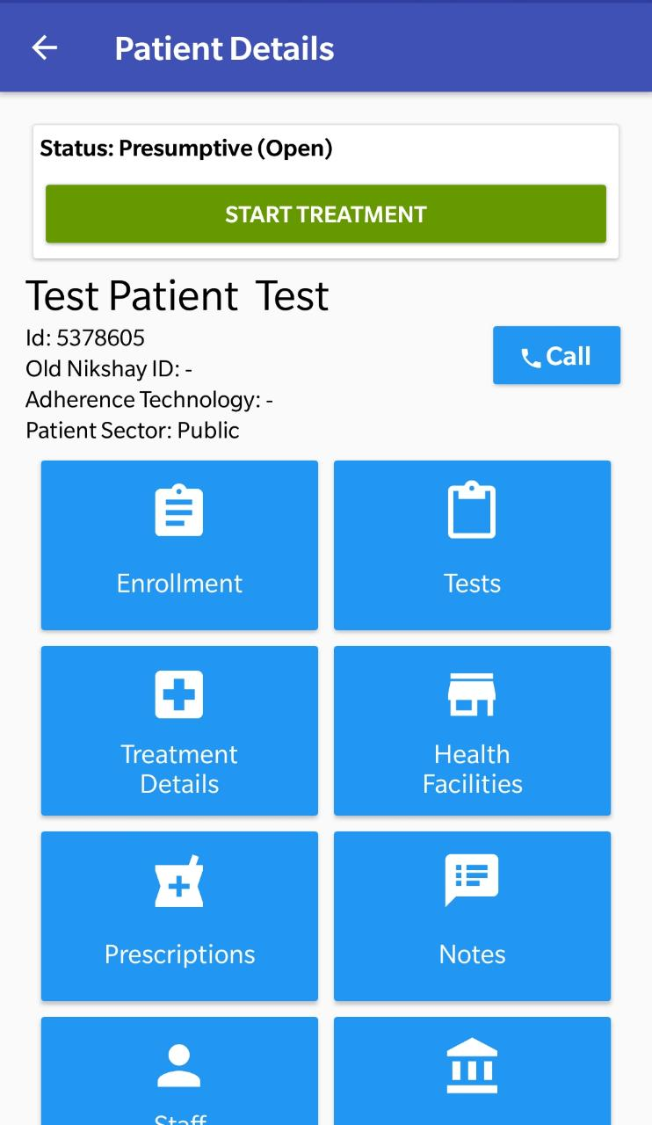
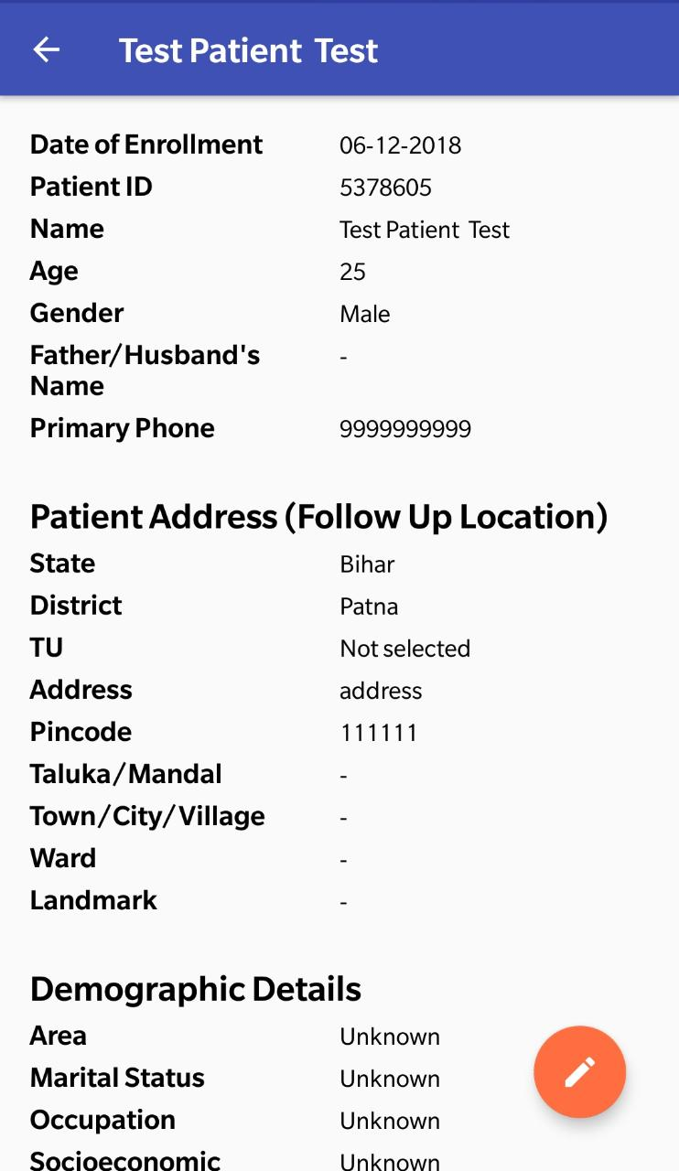
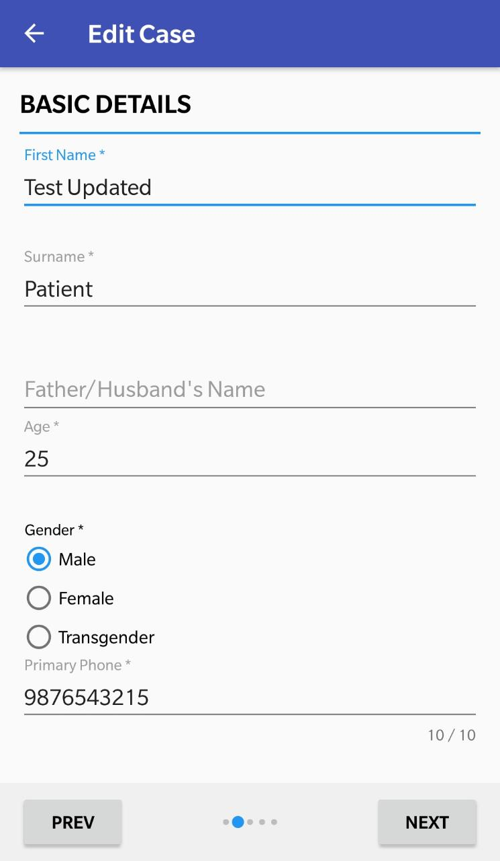
Edit Patient details
Step 1
Step 2
Step 3
Select the Enrollment Tab
Click on the Edit Button
Make Necessary Changes
  This section is now editable and changes can be made
Click here proceed

Slide 13
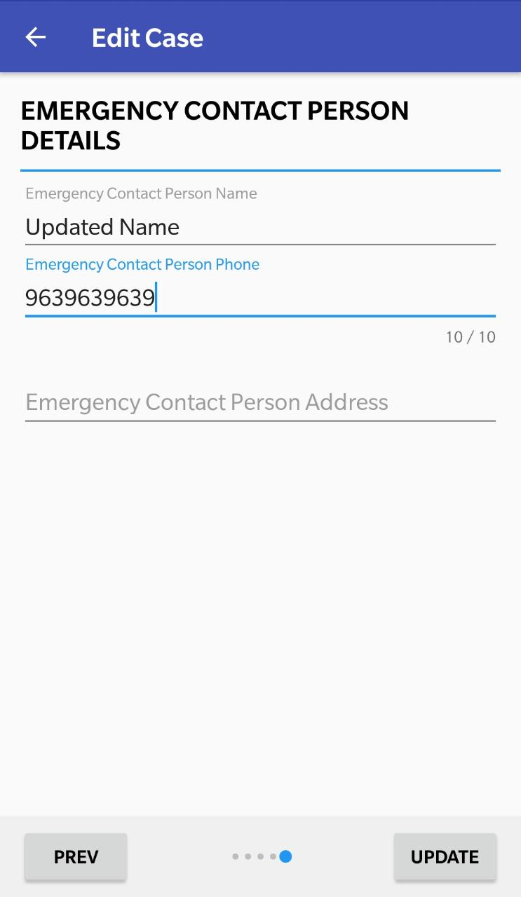
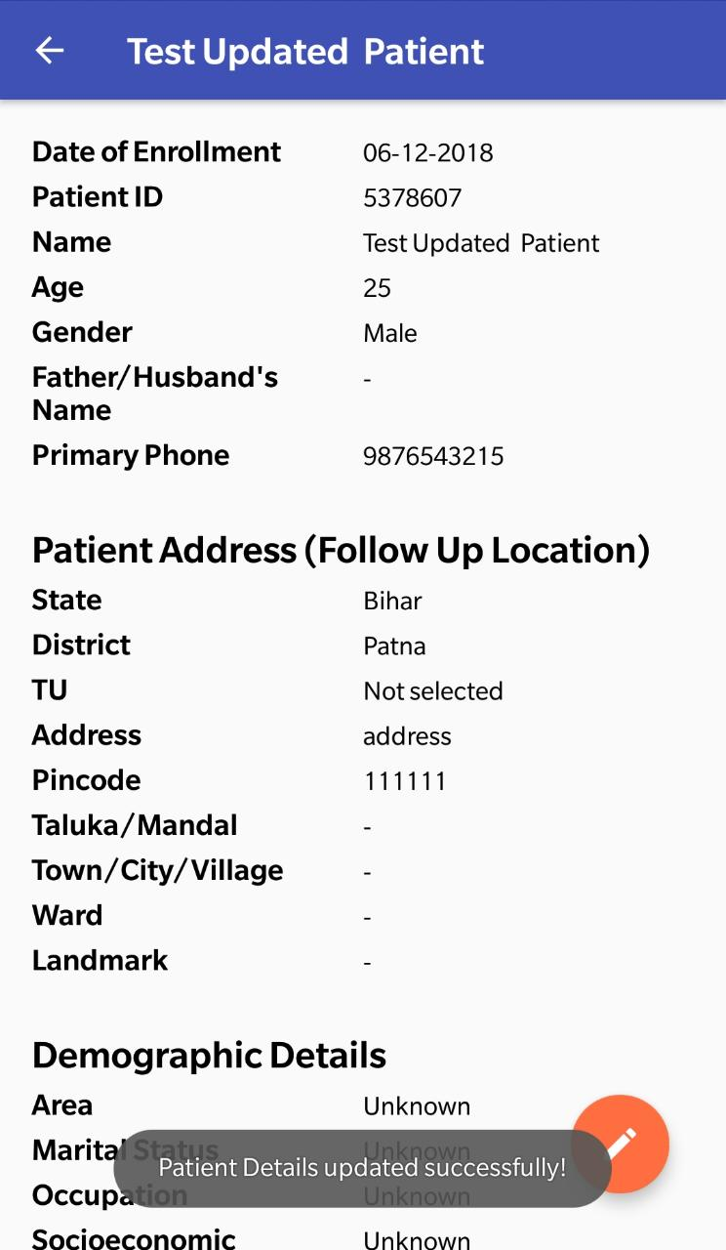
Edit Patient details
Step 4
Click Update
  Message displayed after successful update

Slide 14
Patient Management
  Once enrolled, complete case information is visible and actionable from a single screen.
  For simplicity, information is divided into subsections or tabs.
  Users can take the following actions from here:
    Add test details (Diagnostic or follow up)
    Add or update Treatment/ Prescription/ Bank/ Adherence details
    Update any patient details
    Declare patient outcome

Slide 15
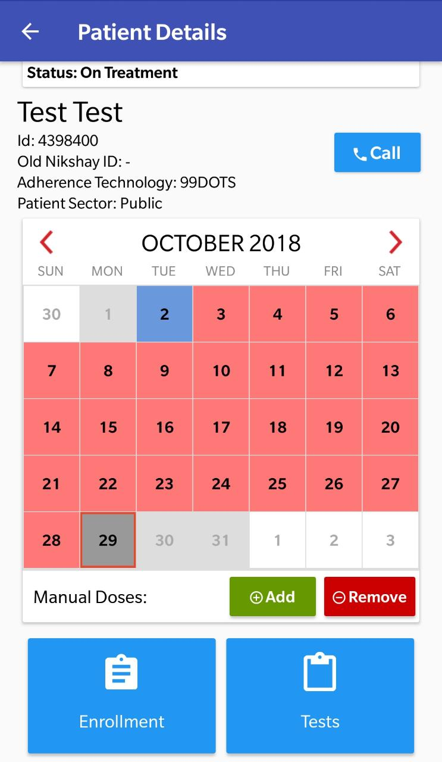
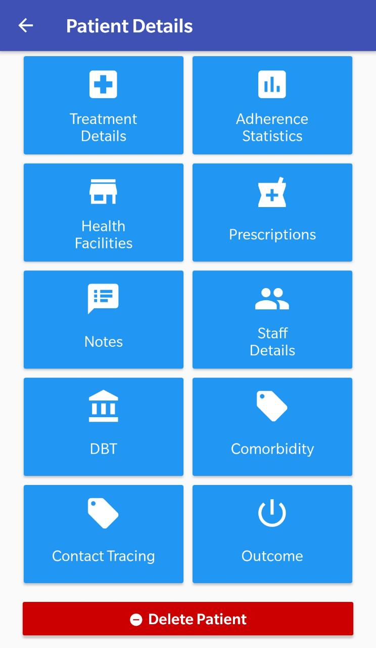
Patient Management Screen
Patient Management screen
  All patient details are visible on a single screen
  Critical information such as Patient ID and treatment status shown here
  For simplicity, patient information is distributed in various sections (tabs)
  Adherence calendar of the patient will be visible after initiating treatment.

Slide 16
Various sections (tabs) in Patient Management Screen
Module Name
Adherence
Enrolment
Tests
Treatment Details
DBT
Close Case
Notes
Health Facilities
Prescriptions
Engagement
Staff
Comorbidity
Contact Tracing
Delete Case
Description / Details captured
Adherence Calendar view/update (Dose taken or missed - Manually/ 99DOTS/MERM)
Basic details of the presumptive Case or Patient (Name, Mobile No, Address, Area, Key Population etc.)
Request Test & Update/view Result (Diagnostic /Follow up) (Type of Test, Facility, etc.)
Record /view Treatment Details (Type of Case, Site of Disease, Date of Rx Initiation etc.)
Direct Benefit Transfer (Bank Name, IFSC Code, Account Number, Branch Name)
Record Treatment Outcome for Case (Rx Outcome, Date, Remarks)
To record any remarks or additional details of the patient
Update Health Facility for Patient (Enrolment Facility, Diagnostic Facility, Current Facility)
Prescription/ Regimen (Product Name, Weight Band, No of Days etc.)
Update engagement assistance (via SMS, Call Centre, Household Visits)
Update / edit health care staff information (Staff name, Designation & Phone No.)
HIV & Diabetes
Record Contact Tracing
Enables deletion of duplicate or incorrect patient records (Reason for deletion, Remarks)
1
2
3
4
5
6
7
8
9
10
11
12
13
14

Slide 17
Add Test
  Single screen to add Diagnostic or Follow Up tests for Public or Private sector patients
  To register a PATIENT, it is compulsory to add a POSITIVE DIAGNOSTIC test
  Add Test is a 2-step process, 1) Test Request and 2) Result Update.
  These steps can be done by a user at once or by two different users.
    Eg. 1: TB HV (enrols case + Requests Test) → LT (enters result)
    Eg.2: TB HV or LT (enrols case+ Request Test+ Enter Result)
  As soon as a positive test result is entered, the patient gets notified

Slide 18
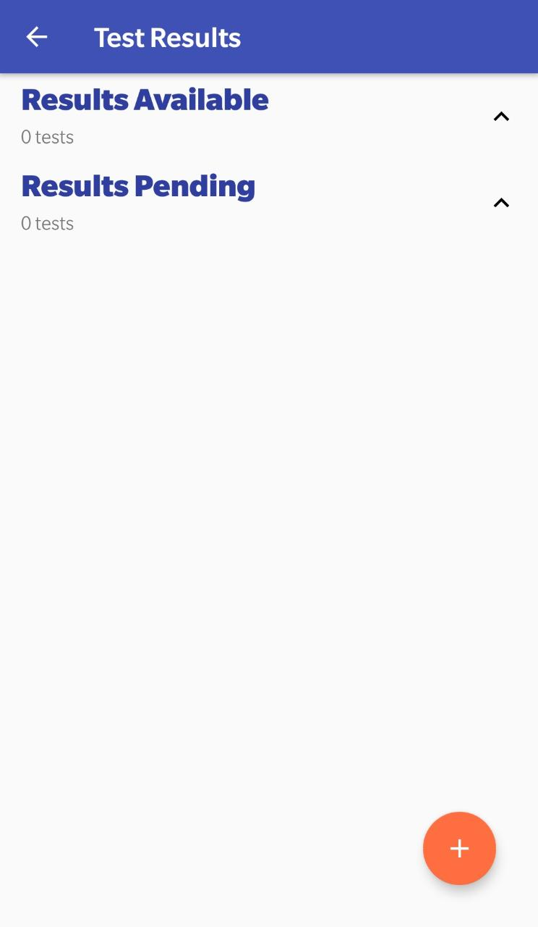
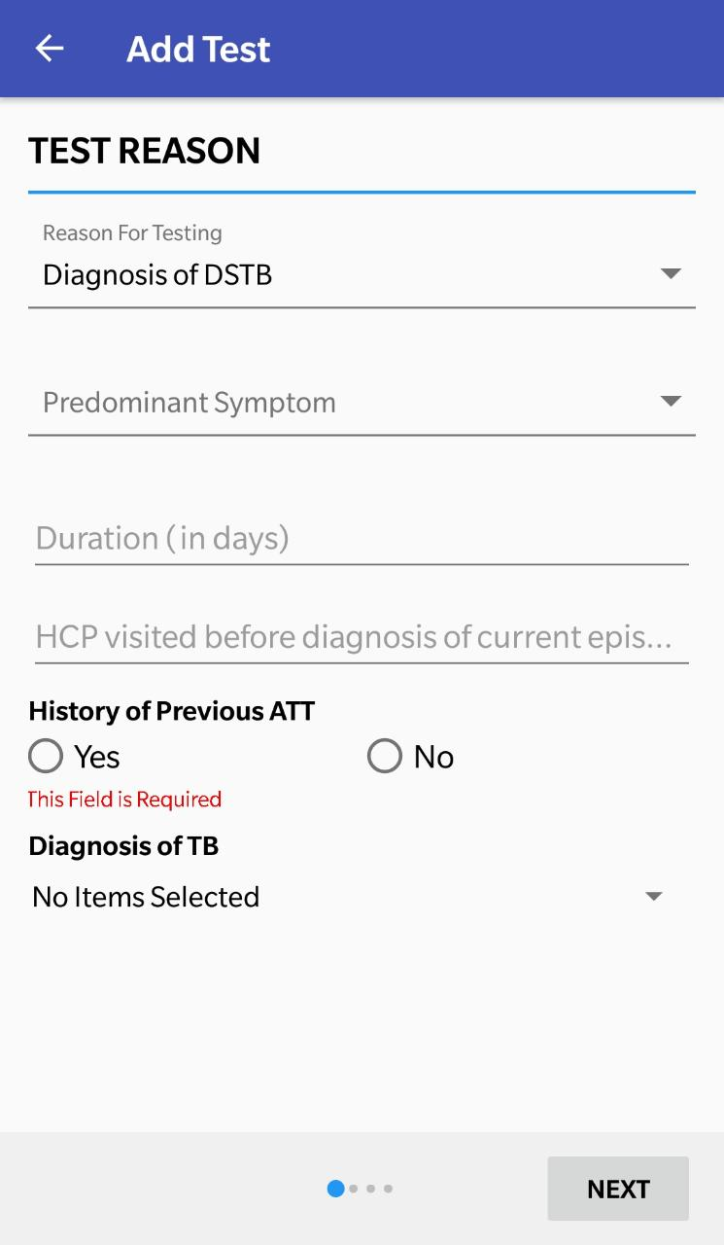
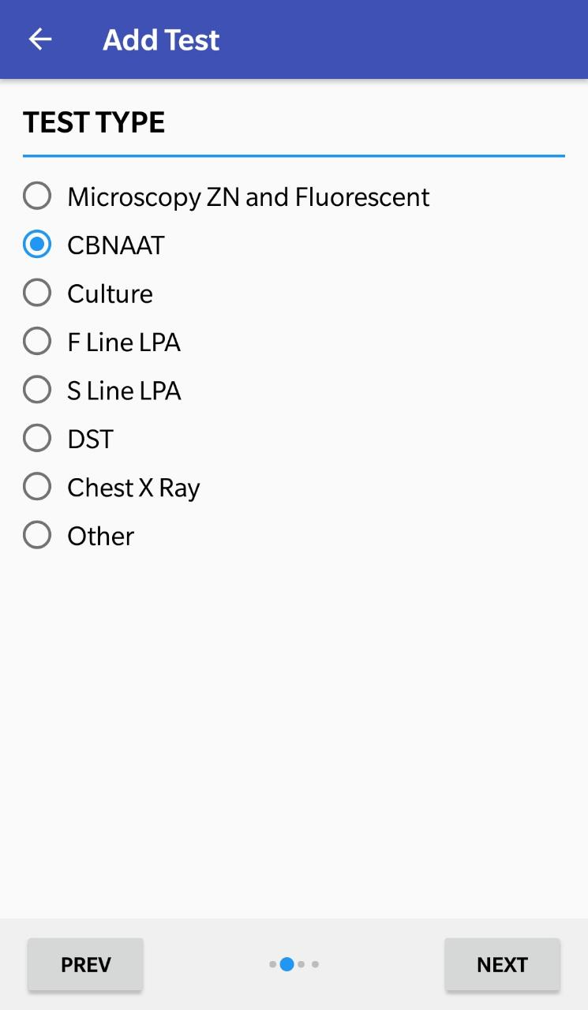
Add Test Details
Step 1
Step 2
Step 3
Step 4
Click on the Tests Tab
Click on the “+” button to add test results
Enter Test Reason and then click “Next”
Enter the Test Type
Click here proceed
Click here proceed

Slide 19
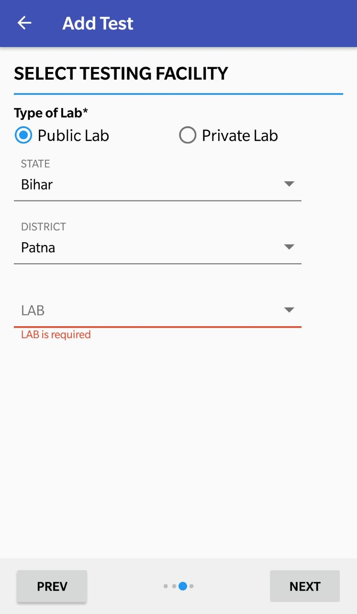
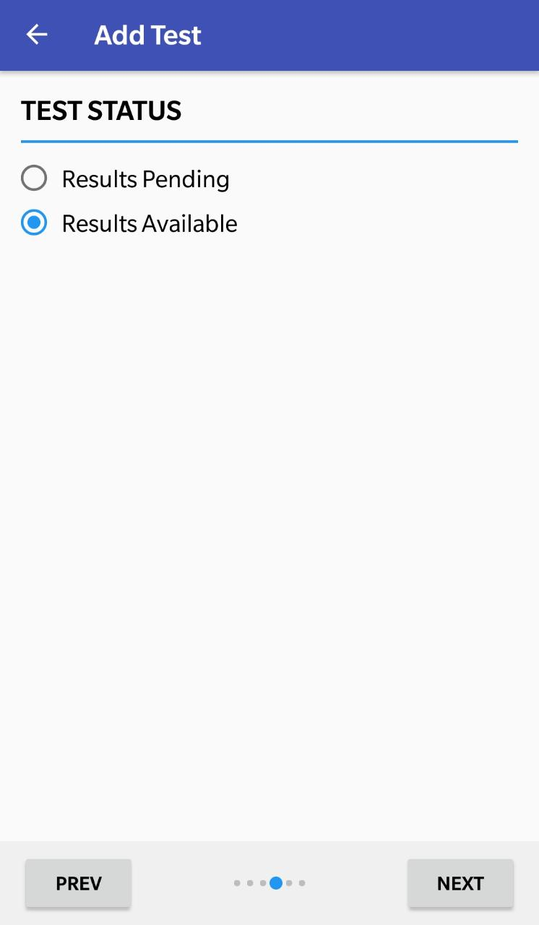
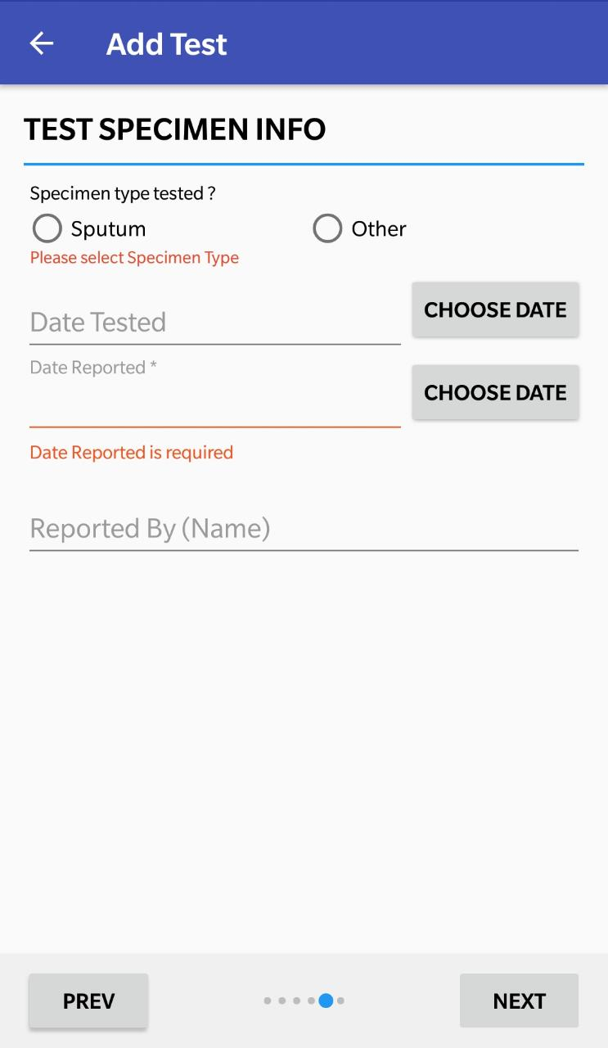
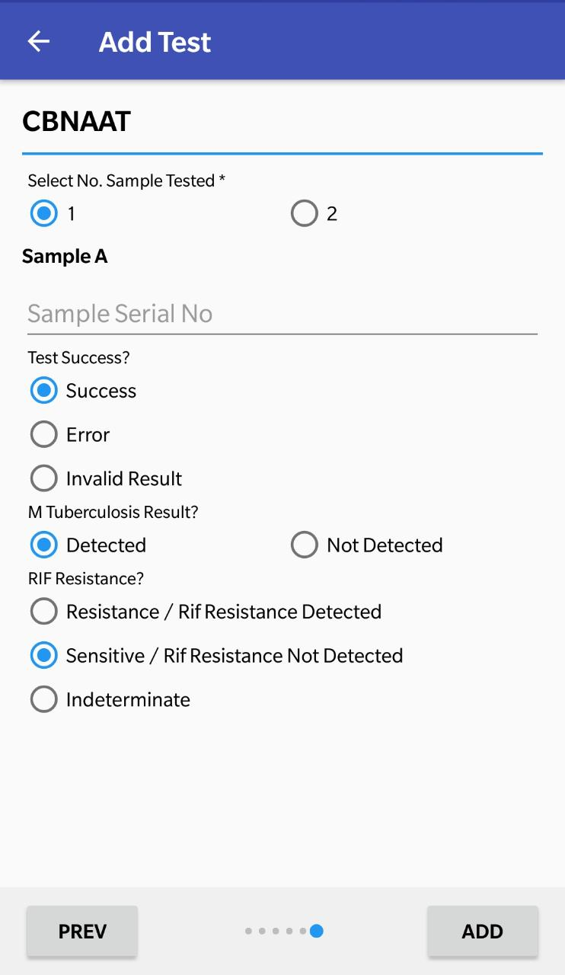
Add Test Details
Step 5
Step 6
Step 7
Select the Testing Facility
Click “Ok” on the alert message displayed.
Step 8
Request Test and enter Result at the same time, or later
Click on the “Update Location” Button
Both Public or Private Sector labs can be selected
Click here to complete the form
Click here proceed
Click here proceed
Click here proceed

Slide 20
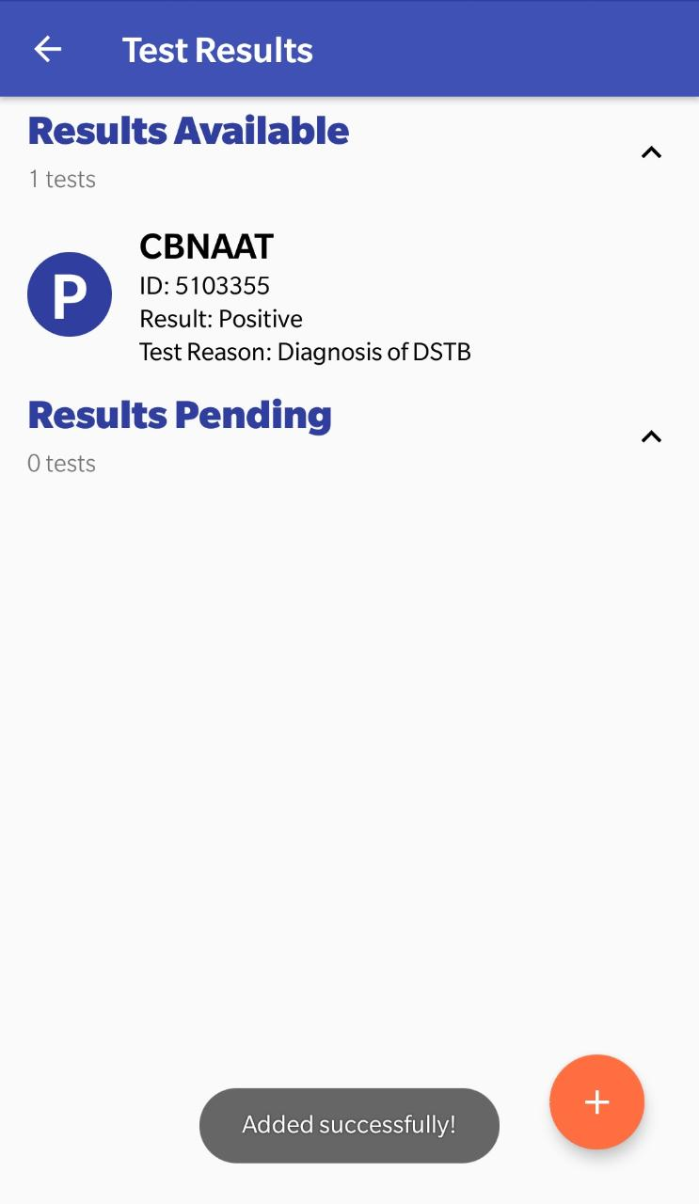
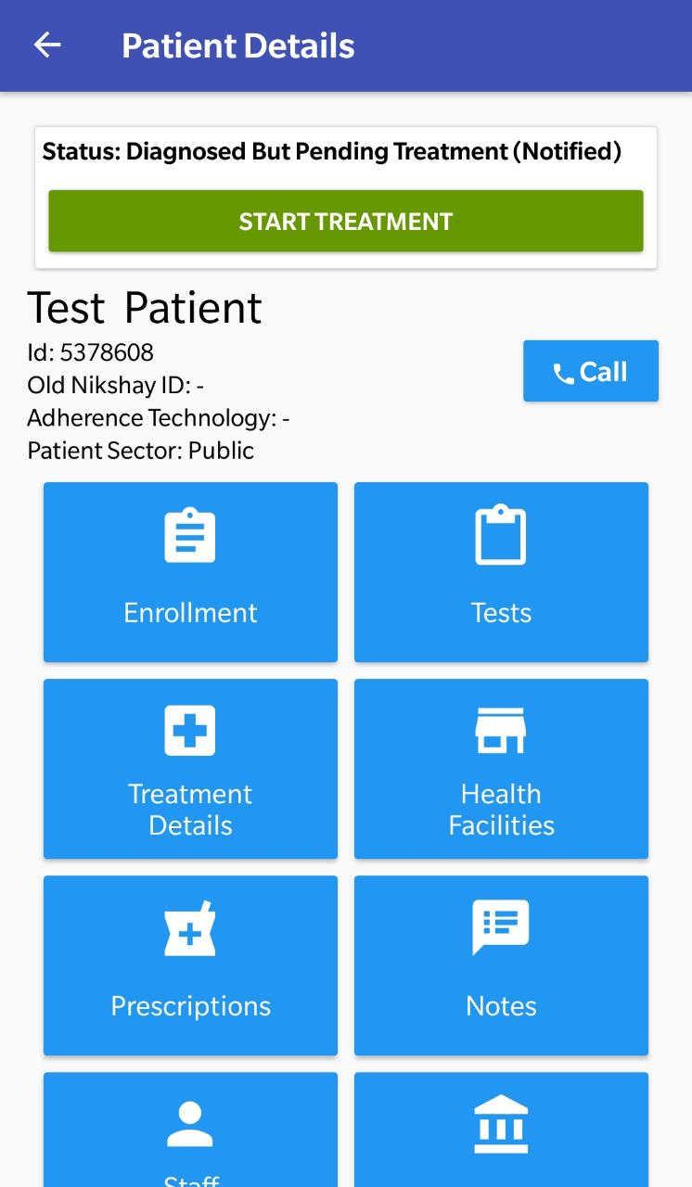
Add Test Details
On entering a +ve diagnostic test, case status changes to Diagnosed But Pending Treatment(Notified)
Tests added are shown here
  Message displayed after successful update

Slide 21
  Test Results for any Patient across the country can be entered now in Nikshay App.
  Users can search any patient across any location in the country using “+Add Test” button
  In the +Add Test section, patients can be searched using only the numeric patient ID and not by any other fields.
Adding Test Results for Patients across any Location

Slide 22
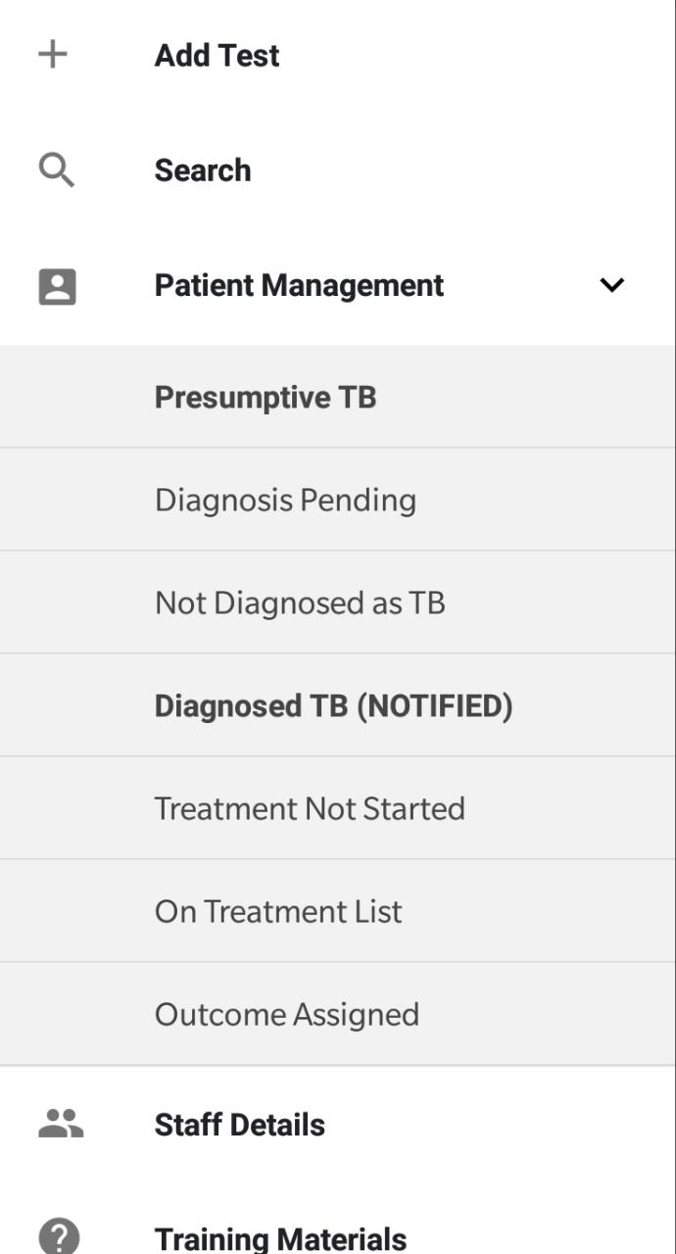
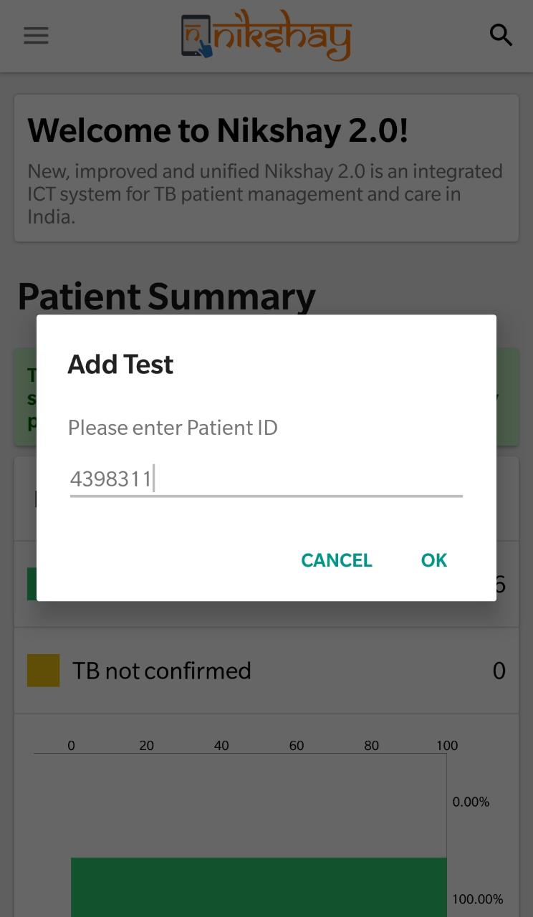
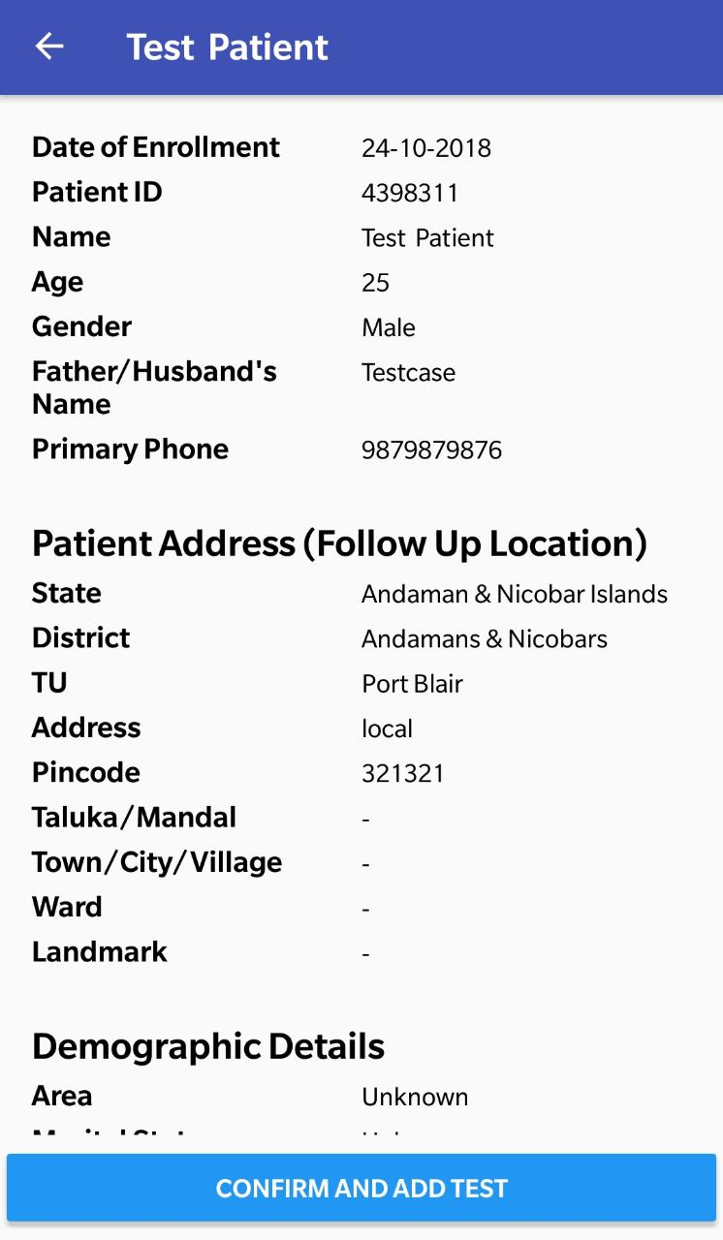
Adding Test Results for Patients across any Location
Step 1
Step 2
Step 3
Click +Add Tests to search any patient across the country
Search Patients Nikshay ID to enter Test Results
Verify patient details and confirm to add test
Click here to complete the form

Slide 23
Start Treatment
  Initiation of Treatment is the third step in the Patient Management Lifecycle in Nikshay (After Enrolment and Enter Test Details).
  In Treatment Details section, “Date of Diagnosis” and “Basis of Diagnosis” gets populated based on the Diagnosis test details.
  Once Treatment details are updated, the Adherence Calendar is made available for view and update.
  The Start Treatment Screen is common for DS TB and DR TB Patients

Slide 24
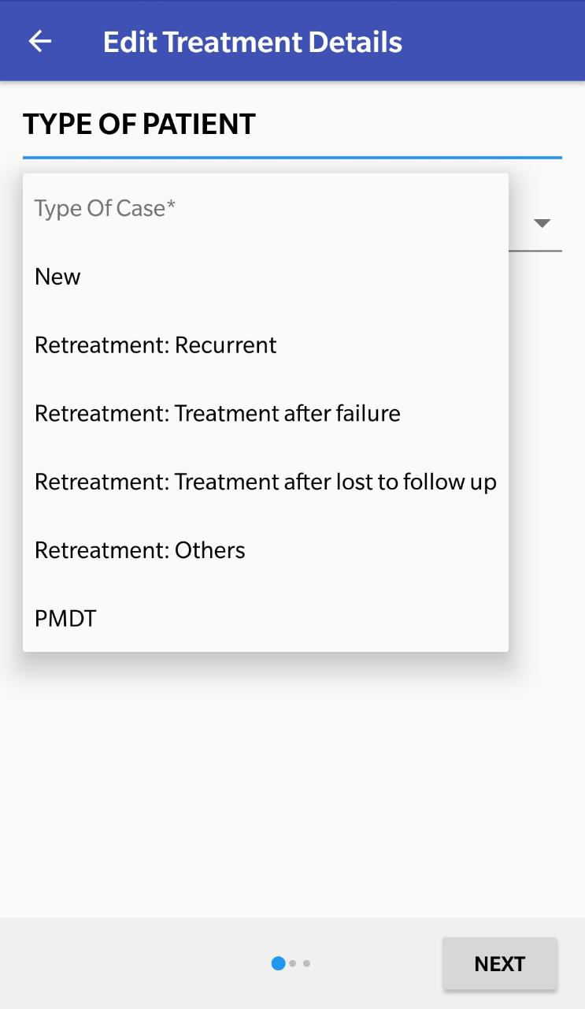
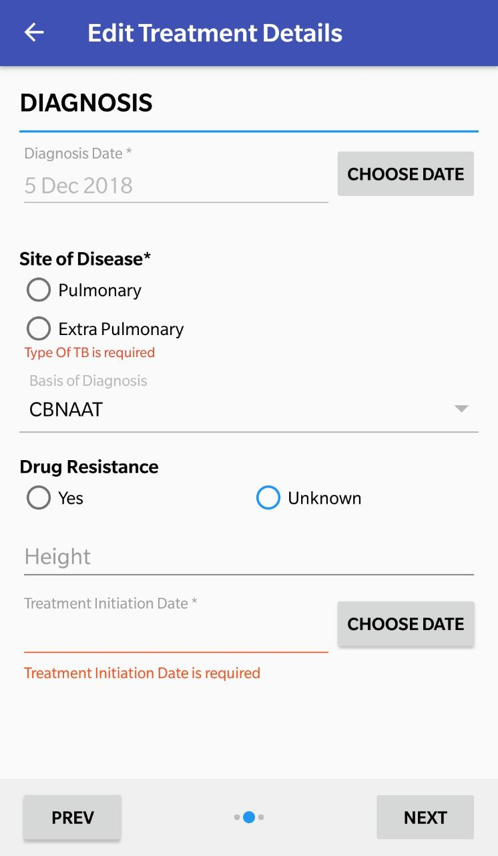
Starting Treatment
Step 1
Step 2
Step 3
Enter Type of Patient
Enter Diagnosis Details
Select Patients from the “Treatment Not Started” List
Click here to Start treatment
Auto-populated based on test result and is non editable

Slide 25
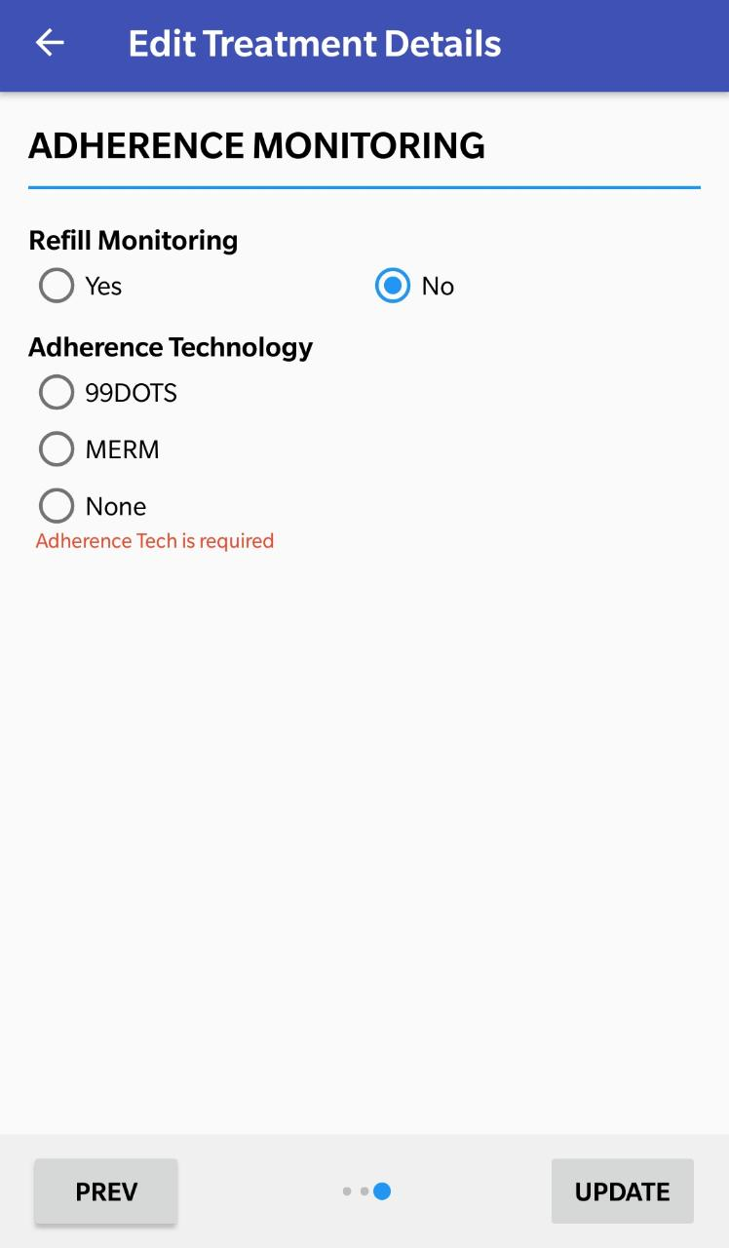
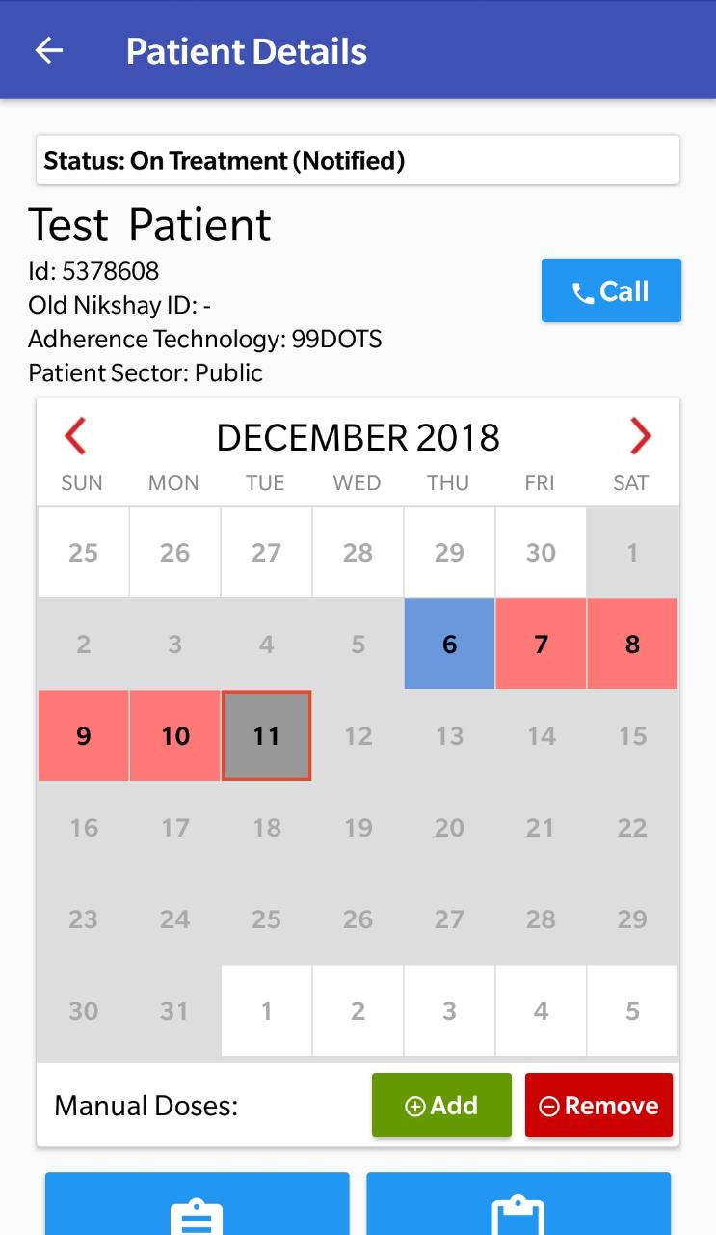
Starting Treatment
Step 4
Enter Adherence Details
  Select the Adherence Technology through which patient will be monitored.
Status of case gets updated
Adherence calendar of the patient will now be visible.
Click here to complete the form

Slide 26
Allocating MERM Devices

Slide 27
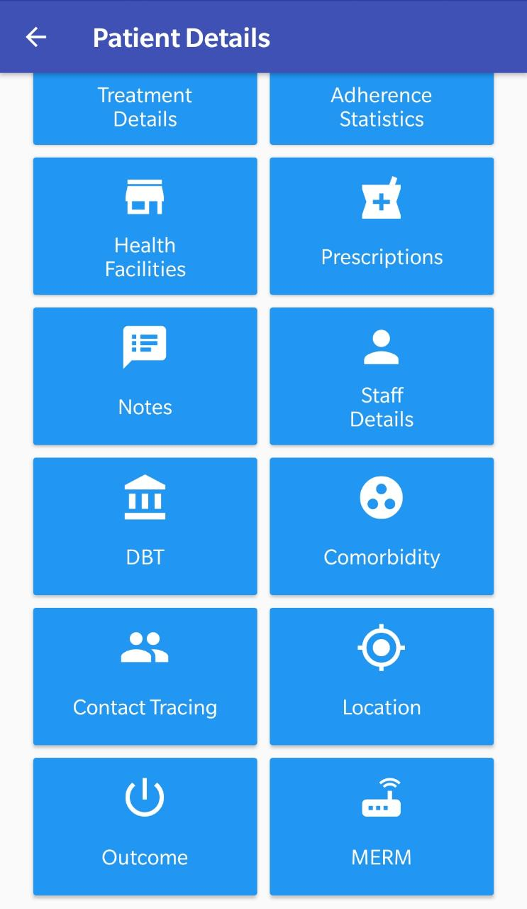
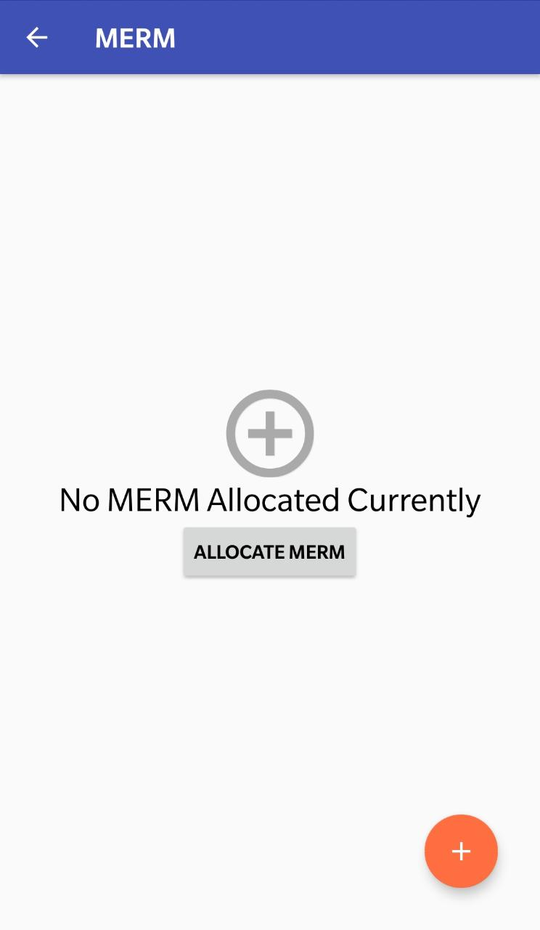
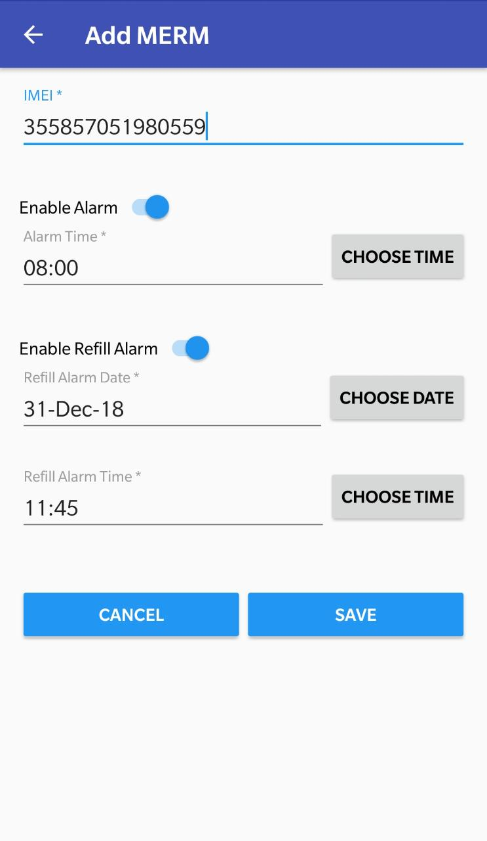
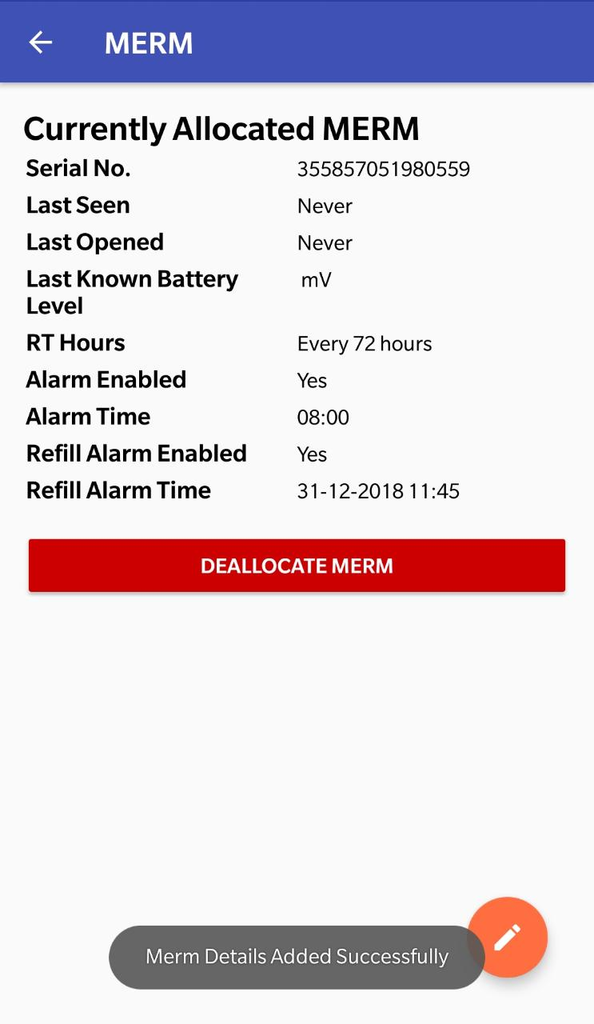
Allocating MERM Boxes
Step 1
Step 2
Click on the “MERM” Tab
Step 3
Click on the “Allocate MERM” or “+” Button
Click “Save” after entering necessary details.
  Message displayed that MERM has been allocated successfully

Slide 28
Adherence Tracking
  As soon as the Patient’s treatment details are entered and, Patient’s status changes to “On treatment”, the ”Adherence” section is displayed
  Nikshay 2.0 is integrated with ICT Based adherence technologies of 99DOTS and MERM.
  If a 99 DOTS patient makes a call or if a MERM Patient opens his Medicine box to indicate dose taken, Adherence calendar gets updated.
  The Adherence Calendar can also be manually updated for Missed dose or Dose taken
  Adherence details for a date range can be updated by selecting multiple dates
  Tags (Remarks) can also be added for later reference

Slide 29
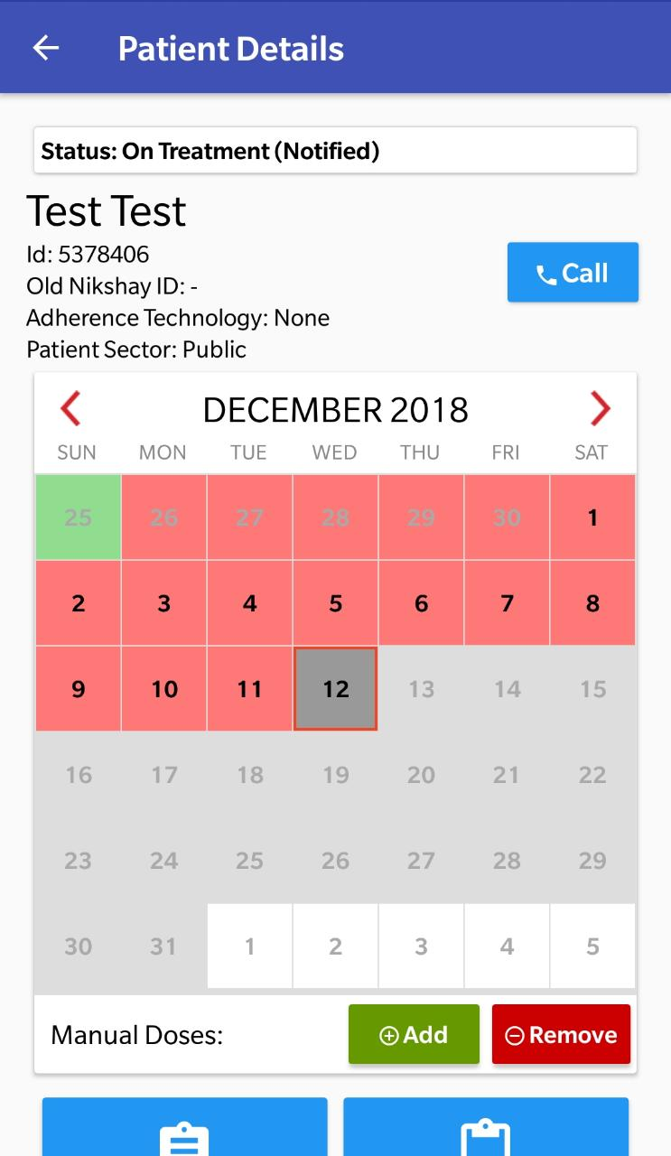
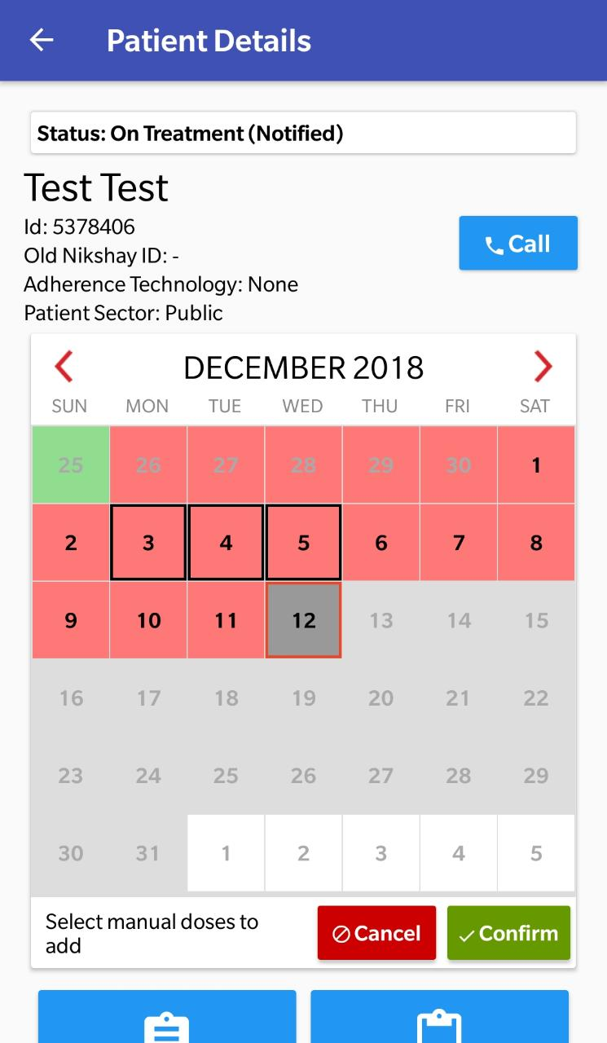
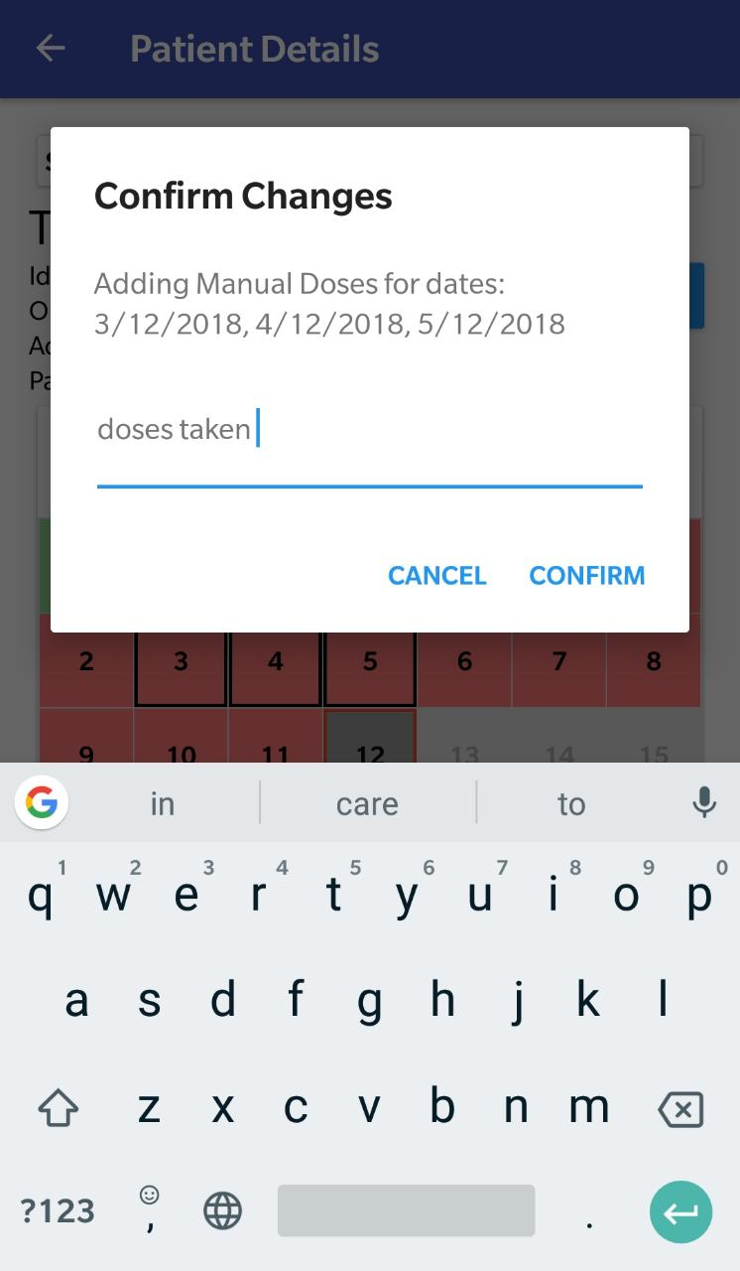
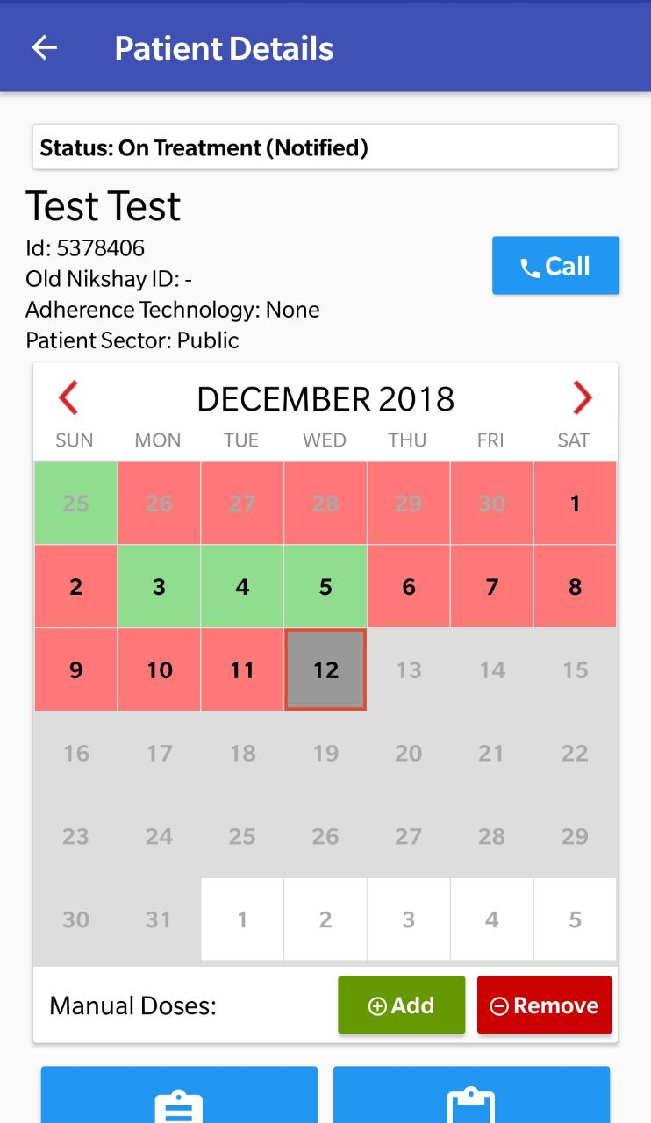
Manual Adherence Update
Step 1
Step 2
Step 3
Click “Add” to Mark doses manually
Select Dates to be tagged
Click “Confirm to mark manual doses
Calendar updated with light green color as manually updated as dose taken
Click here to cancel
After selecting dates, click here to confirm
In confirmation window, dates for which adherence is being updated is displayed

Slide 30
Assign Treatment Outcome
  DTO or TU or PHI level user can update Treatment Outcome.
  Users can update Treatment Outcome (or any other details) of only those patients who are enrolled or taking treatment under their own District or TU or PHI
  Outcome can be declared for a Public or Private Sector Patient
  After update of Outcome, the patient record moves to “Outcome Assigned” list under “Patient Management”.
  If Outcome of a case is updated incorrectly, it can be corrected using the “Reopen” case option

Slide 31
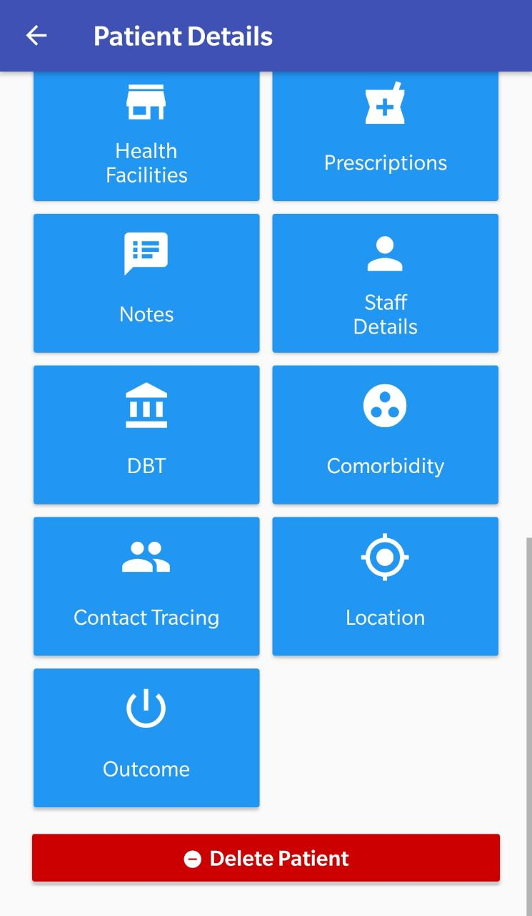
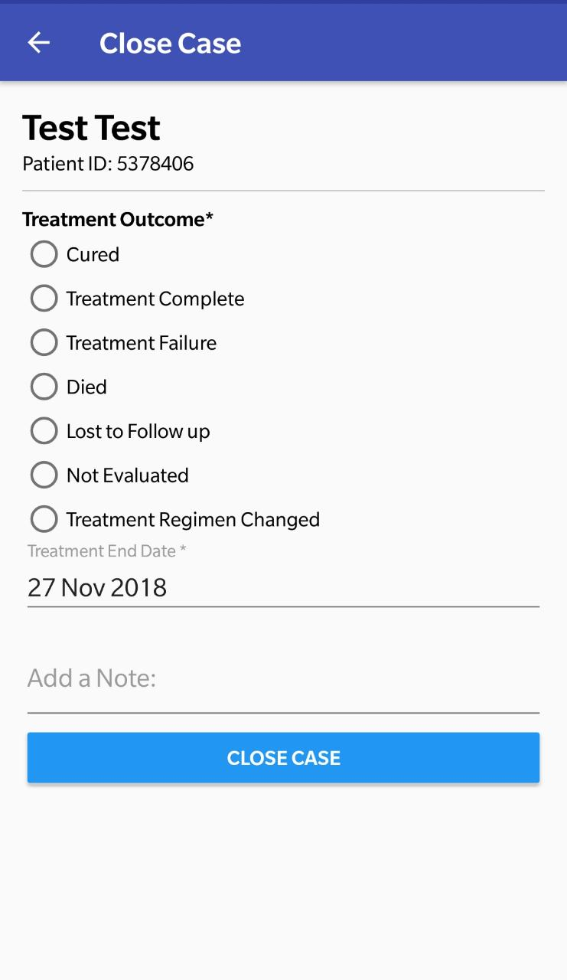
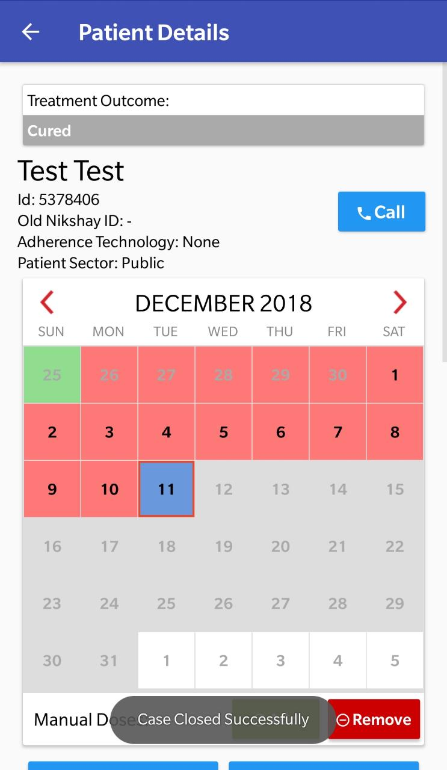
Assign Treatment Outcome
Step 1
Step 2
Click on “Outcome” Button
Assign Treatment Outcome
Select Outcome
Enter Outcome Date
Click on Close Case
Click here to assign outcomes
  Message displayed as Case closed successfully

Slide 32
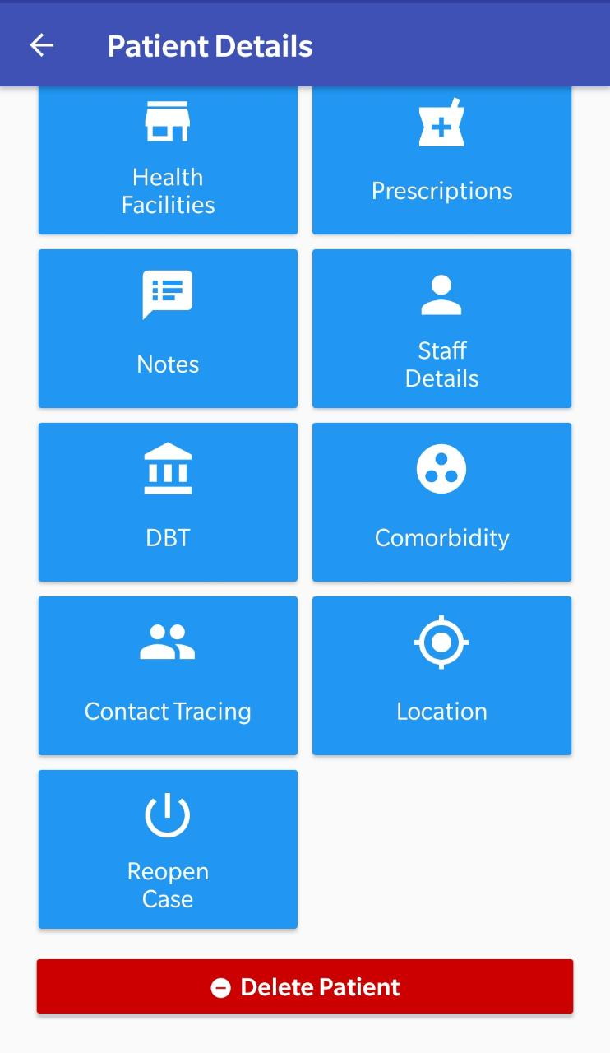


Edit Treatment Outcomes (Reopen Case)
Step 1
Step 2
Click on “Reopen Case”
Enter Date
Click here to Reopen Case
This section is visible after Treatment Outcome is updated for a case
  Message displayed as Case Reopened successfully

Slide 33
Delete a Case
  Before deleting a case, users should be careful because, “deletion” can not be undone.
  While deleting, the user needs to select the reason for deletion
  The Audit Trail of deleted cases will be available with Nikshay Technical Team and can be extracted and shared with CTD if required.
  The deleted case will not be visible to users ( in the Application or in the Reports/Registers)

Slide 34




Delete Case
Step 1
Step 2
Step 3
Click on “Reopen Case”
Select Reason for Deletion
Confirm Deletion of patient record
Click here to Delete Patient Record
  Message displayed as Patient Record deleted successfully

Slide 35
Direct Benefit Transfer
  Nikshay enables Direct Benefit Transfer of incentives into Bank Account of Beneficiaries under various schemes
  The various schemes under which benefits can be processed are:
    Nikshay Poshan Yojana / TB Patient Incentive to TB Patients for nutrition support (FEATURE AVAILABLE)
    Treatment supporters incentive (COMING SOON)
    Tribal TB patients (COMING SOON)
    Private Practitioners incentives for Notification (COMING SOON)

Slide 36
Process Overview
STEP | DETAILS
1 | Update Beneficiary’s Bank Account details (Bank Name, Account Number and IFSC Code) in Nikshay
2 | Beneficiary’s Bank details (entered in Nikshay), are sent to Public Finance Management System (PFMS) for validation/ registration. This is a one time activity for each beneficiary (provided account details do not change).
3 | Based on scheme eligibility criteria, every time a beneficiary is eligible for DBT a Benefit is created in the system. Each benefit is tracked till a DBT transaction is successful for the beneficiary.
4 | DBT can be made to validated/Registered beneficiaries. For every payment, double check at TU & DTO is required (Checker /TU – Approver/DTO). The DTOs approval will initiate payment process after OTP Authentication via registered mobile No.
5 | If there is a failure in beneficiary Validation / payment, the reason will be displayed to the users. On rectification of the said errors, the payment process can be re-triggered.
6 | Nikshay reflects the Beneficiary status (status of registration) and Benefit Status(status of payment) in DBT Module (explained below)

Slide 37



Adding Bank Details for DBT
Step 1
Step 2
Step 4
Search Patients by their Name, Old or new Nikshay ID
Step 3
Click on the Edit button at the bottom of the screen
Click Search to search any patient across the country
Click on the DBT Tab in the Patient Details Page

Slide 38




Adding Bank Details for DBT
Step 1
Step 2
Step 3
Step 4
Click on the “Click to Select Bank” Button
Enter the Bank and Branch Details and click on the “Search” Button
Select the correct Bank detail.
Enter the Account Number details
Click here to save the details.

Slide 39
Comorbidity
  Comorbidity refers to the presence of one or more additional diseases or disorders co-occurring with a primary disease or disorder.
  In this section, HIV Information, Diabetes Information and Additional Information like Tobocco user or not, Alcohol intake etc can be added for a patient.
  All the comorbidity details added for a given patient are visible to the User

Slide 40



Add Comorbidity
Co-Morbidity
Step 1
Step 2
Step 3
Click on Comorbidity
Click on the Edit Button
Enter Relevant HIV information
Click here to proceed further

Slide 41



Co-Morbidity
Step 4
Step 5
Enter relevant information and click “Next” to proceed
Enter relevant information and click “Update” to submit data
  Message displayed that details added successfully

Slide 42
Contact Tracing
  Contact Tracing is a process of screening all household members in contact with the TB patients including Children less than the age of six.
  Contact tracing is very necessary to establish the primary source of the TB disease and to detect all those who are secondary infected for proper diagnosis and prompt treatment
  Under Contact Tracing tab, the details of other household members of the patient could be added.
  All the Contact Tracing details added for a given patient are visible to the User

Slide 43


Contact Tracing
Step 1
Step 2
Step 3
Click on “Contact Tracing”
Click on the Edit Button
Enter Relevant information
  Click this button to proceed further.

Slide 44


Step 4
Enter relevant information and click “Update” to submit data
  Message displayed that details added successfully

Slide 45
Location

Slide 46




Updating Patient Location
Step 1
Step 2
Click on the “Location” Tab
Step 3
  Click here to Update Location or view the location on the map.
Click on the “Update Location” Button
Click “Ok” on the alert message displayed.
  Message displayed that location has been updated successfully

Slide 47
Patients can now be transferred by editing the Current Facility
Transfers

Slide 48



Updating Current Facility
Step 1
Step 2
Step 4
Click on the “Health Facilities” Tab
Step 3
Click “Edit Facility”
Click “Ok” on the alert message displayed.
Update the location where the patient will be transferred to
  Click here to Update Hierarchy

Slide 49
Searching for Patient Records

Slide 50


Searching for Patient Records
Click on the Search Icon located at the top right corner of the screen.
Patient records can be searched by Name, Patient ID or Old Nikshay ID

Slide 51
Thank You!

