Slide 1
Monthly Lab Report

Slide 2
Contents
Introduction
Monthly Lab report Overview
Monthly Lab forms in Ni-kshay Web:
Annexure M
CBNAAT
TrueNat
Monthly Lab forms in Ni-kshay App:
Annexure M
CBNAAT
TrueNat
Monthly Lab reports in Ni-kshay Web:
Annexure M
CBNAAT
TrueNat

Slide 3
Introduction
The monthly lab report is created to gather the monthly Microscopy, CBNAAT, and TrueNat details of the lab.
The Monthly Lab report contains the following three reports-
1. Annexure M
2. CBNAAT Monthly report
3. TrueNat Monthly report
The report would be accessible using the SSO login in Ni-kshay at District, TU, and PHI levels.

Slide 4
Monthly Lab report Overview
A form accessible by users on Web and App in “M&E forms” tab in Ni-kshay Reports portal using existing Ni-kshay credentials.
Captures the monthly microscopy , CBNAAT and TrueNat details of the lab at district , TU and PHI level for each month.
The state and district in the form are captured based on the login hierarchy. The user can select the TU and PHI in the defaulted state/district.
The date of reporting is defaulted to the current date and can be modified.
The other details in the form are to be entered by the user.

Slide 5
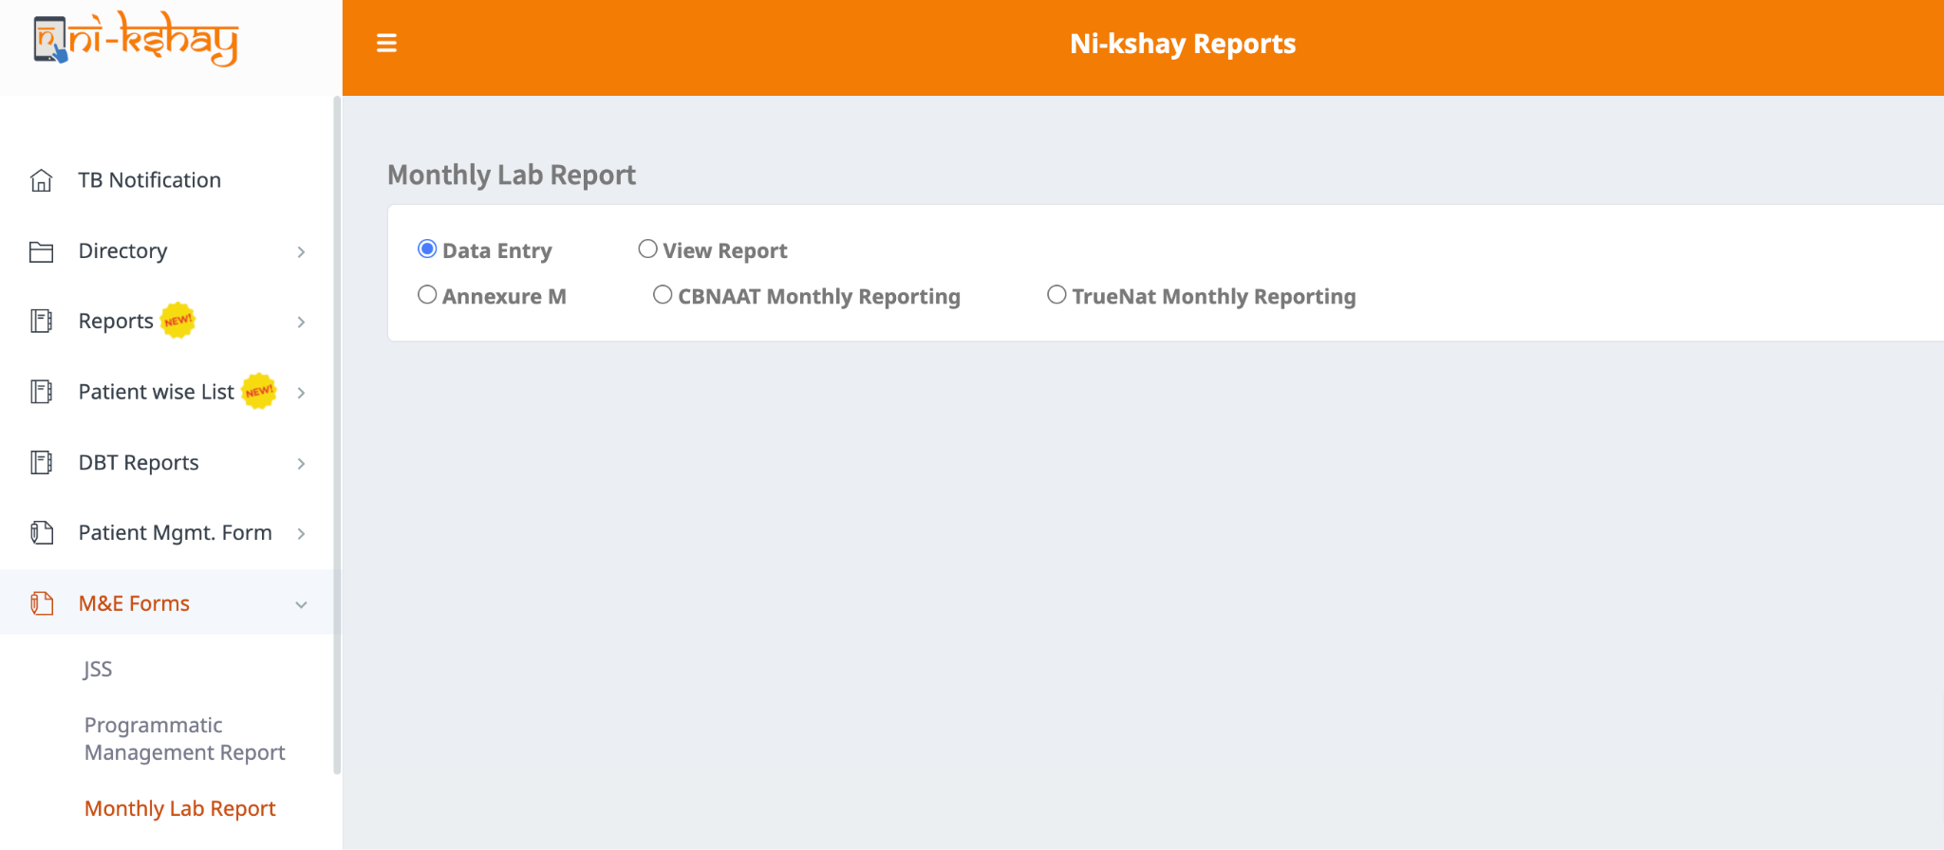
Monthly Lab Report in Ni-kshay : Web

Slide 6
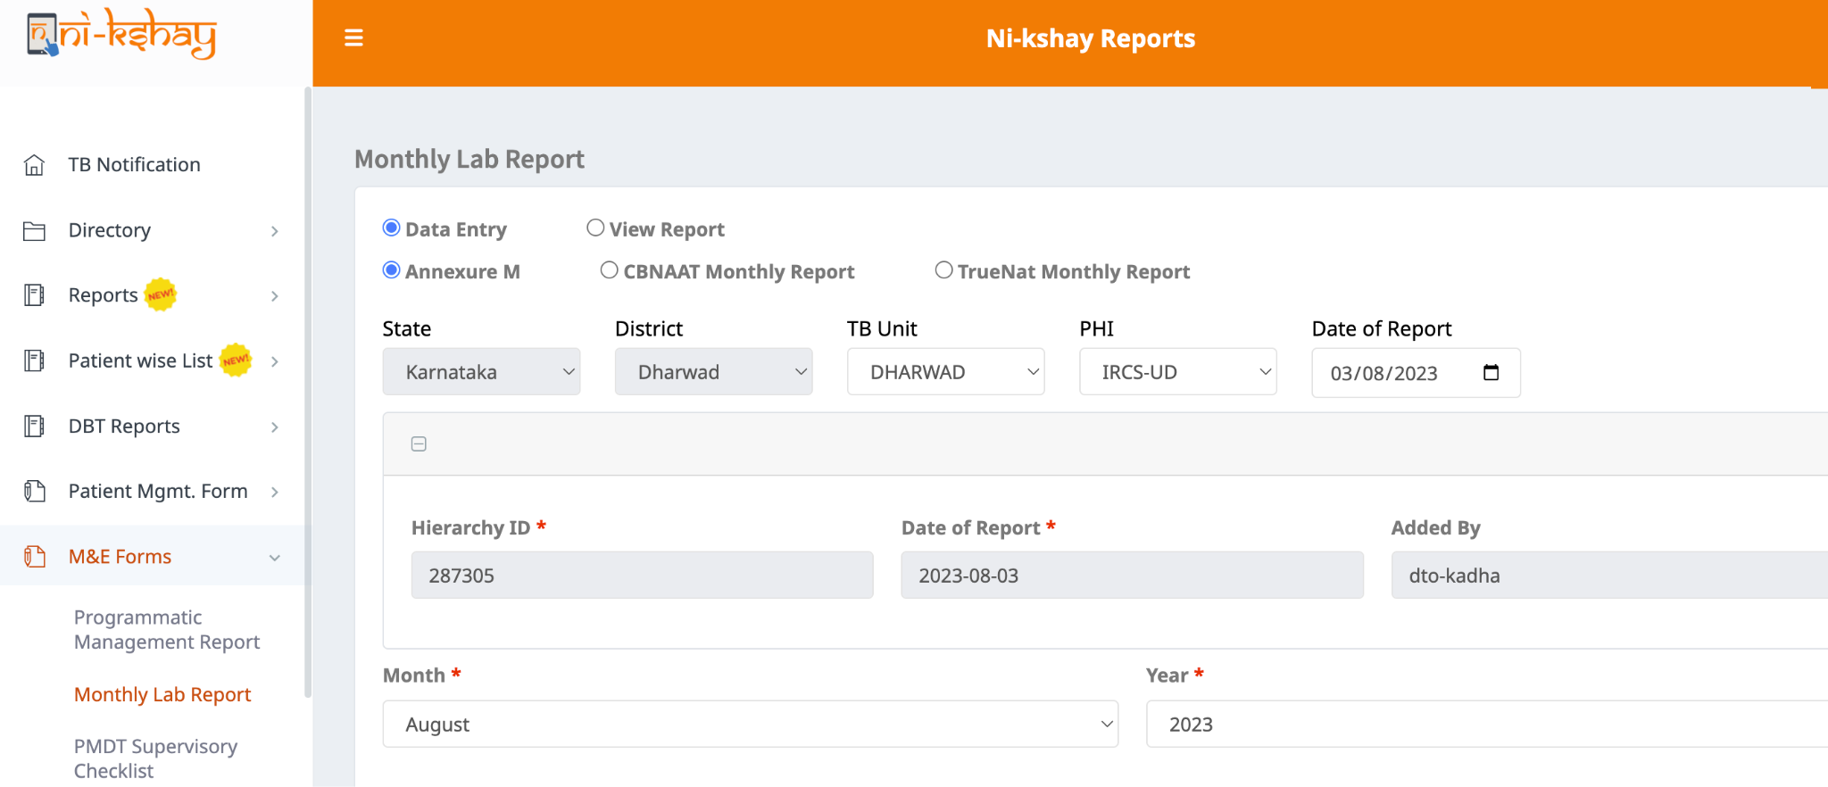
1.Monthly Lab Report : Annexure M (web)

Slide 7
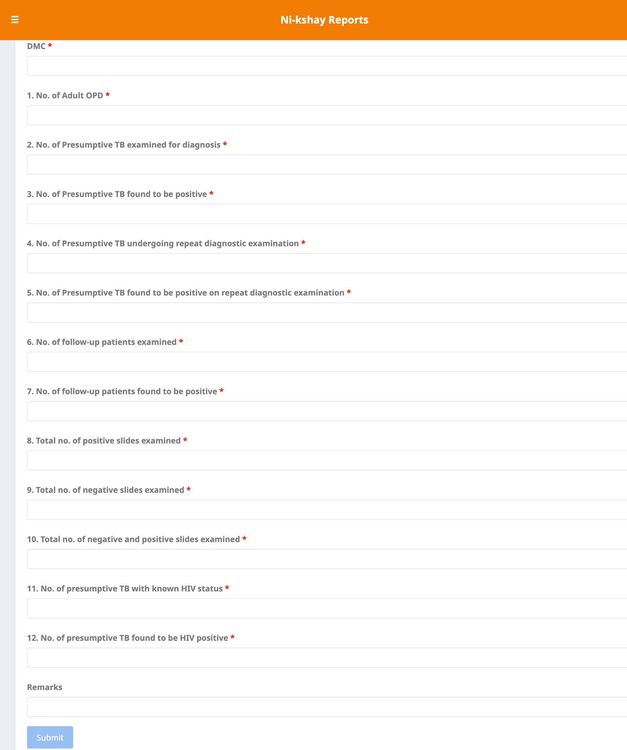
1.a. Monthly Lab Report : Annexure M (web)

Slide 8
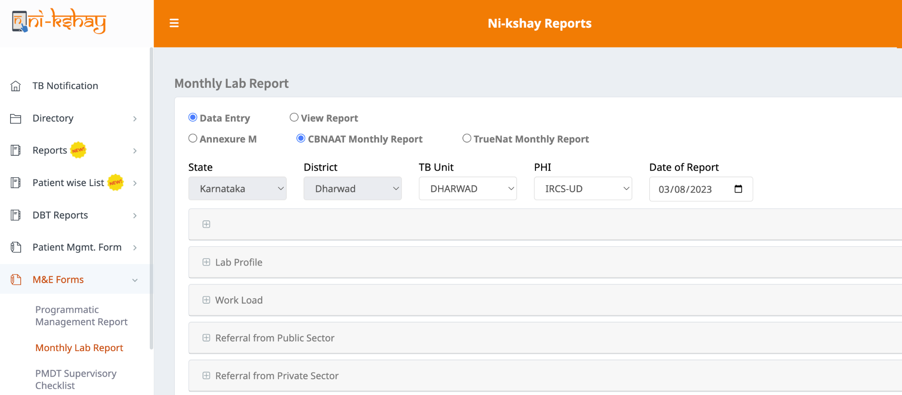
2.Monthly Lab Report : CBNAAT Monthly Report (web)

Slide 9
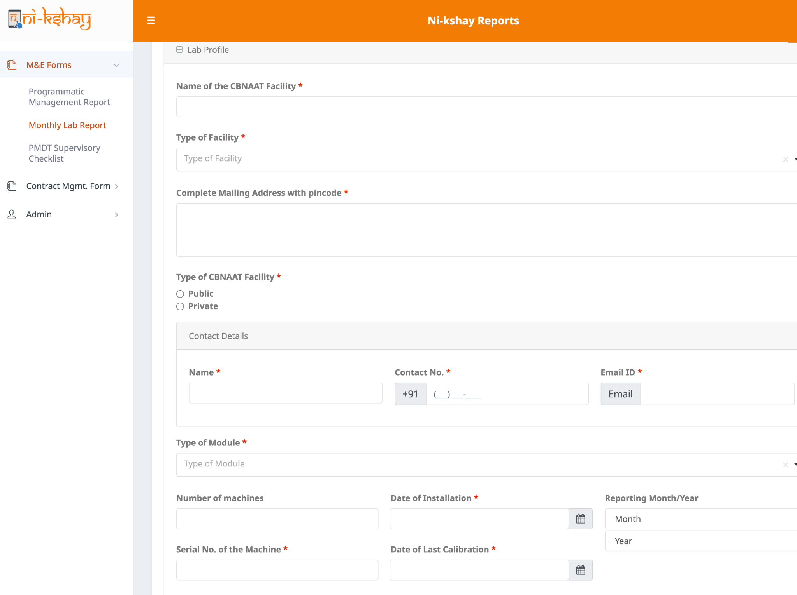
2.a. Lab Profile Section
The CBNAAT form should be filled for each machine.
The number of CBNAAT machines in a facility is a non mandatory field.
Only one serial number should be filled in one form.

Slide 10
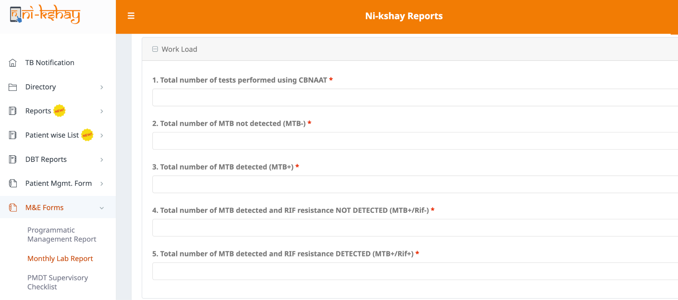
2.b Work Load Section

Slide 11
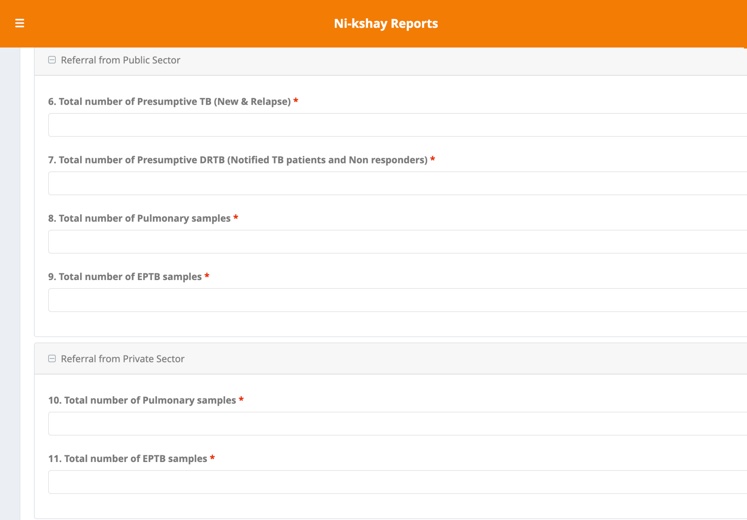
2.c Referral from Public and Private sectors

Slide 12
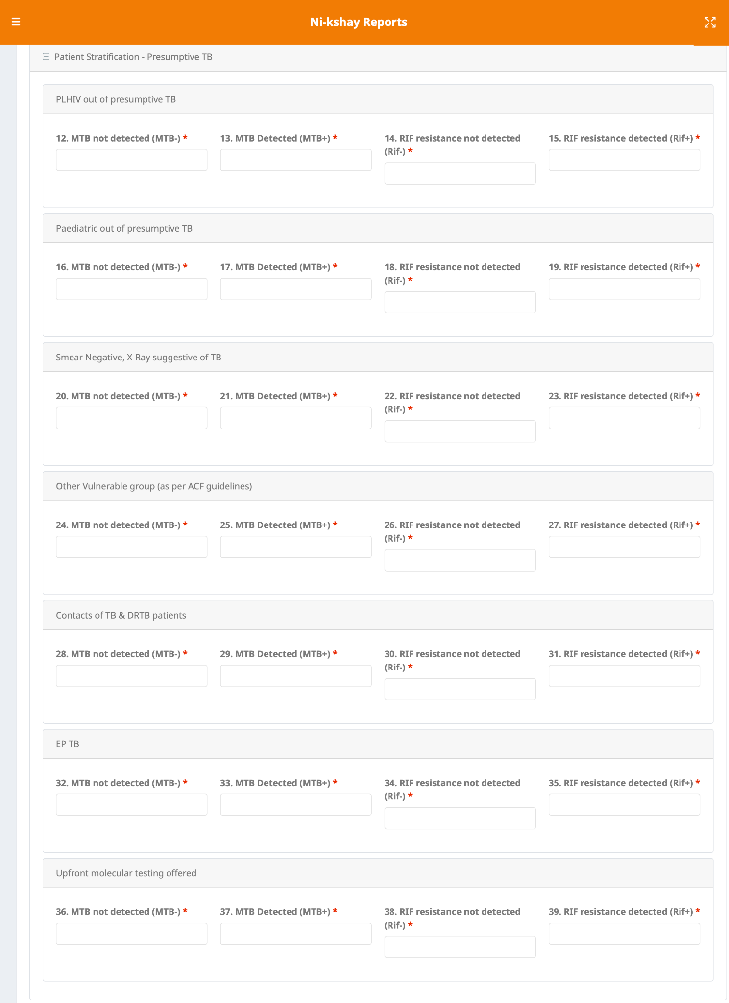
2.d Patient Stratification - Presumptive TB section

Slide 13
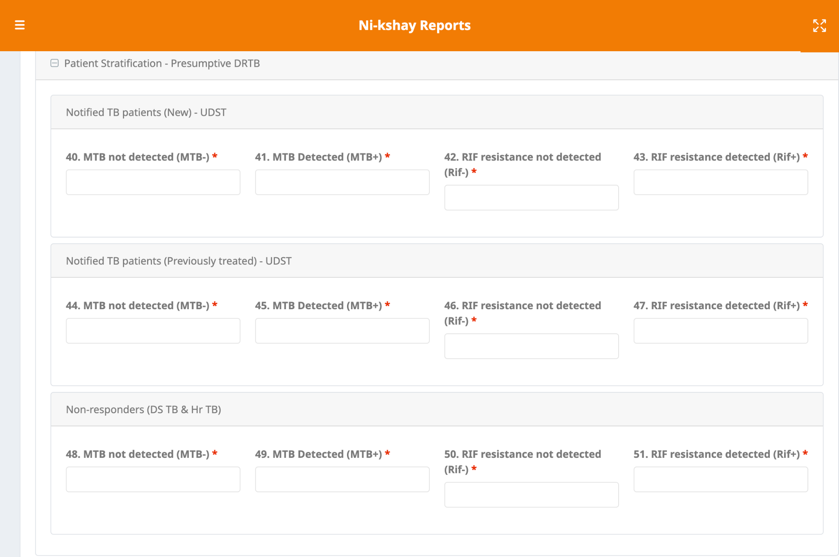
2.e Patient Stratification - Presumptive DRTB section

Slide 14
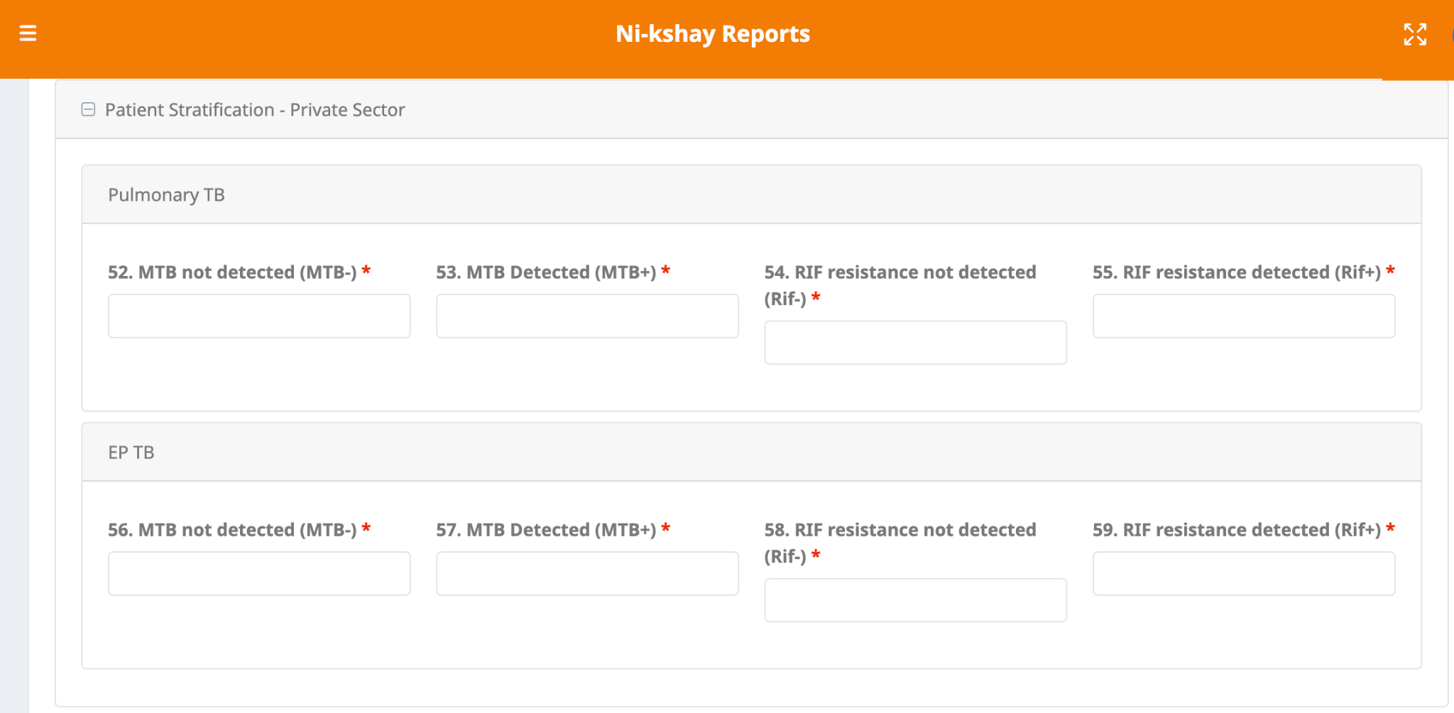
2.f Patient Stratification - Private Sector

Slide 15
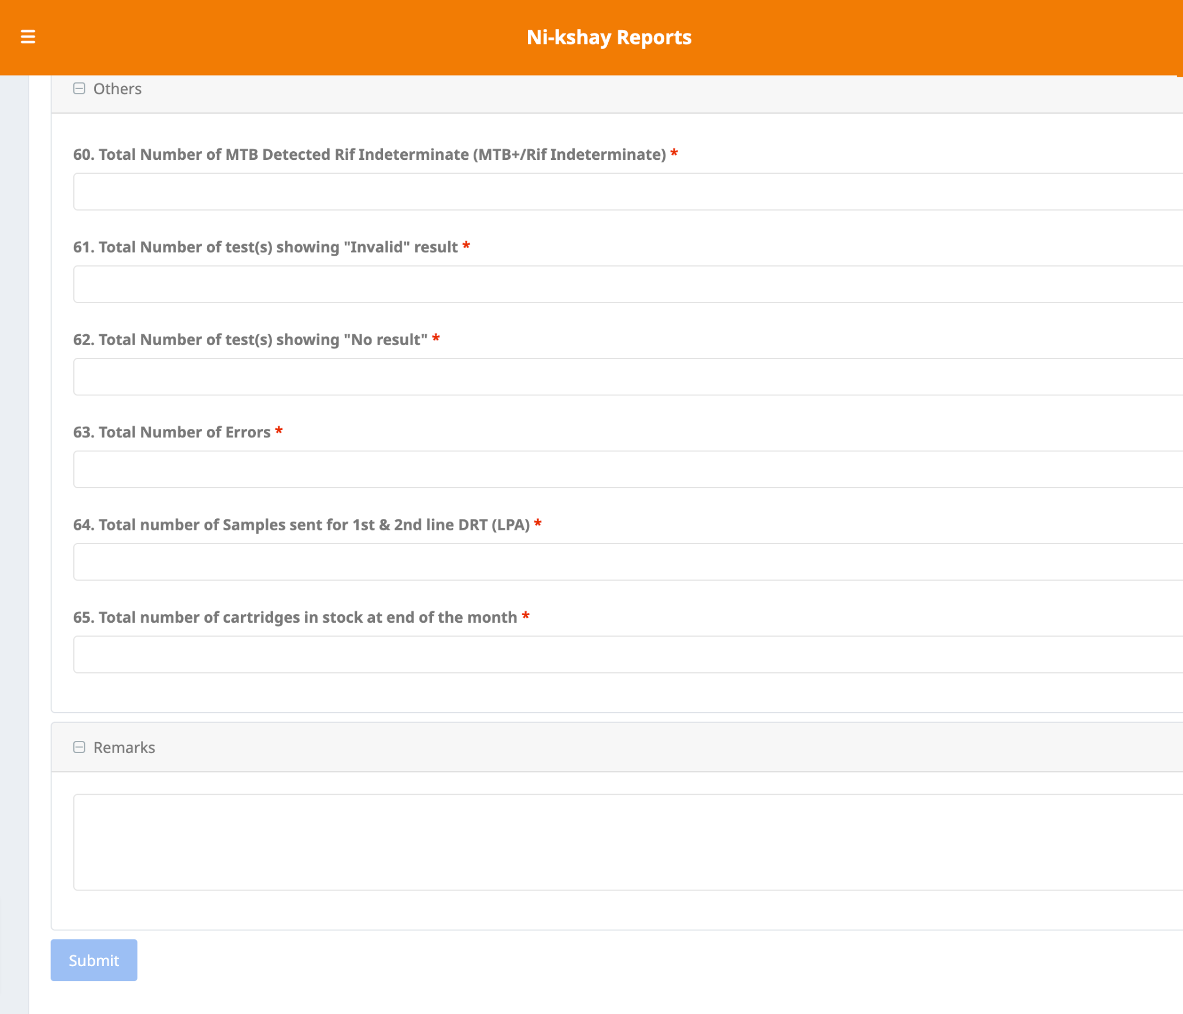
2.g Others and Remarks sections

Slide 16
3.Monthly Lab Report : TrueNat Monthly Report (web)

Slide 17
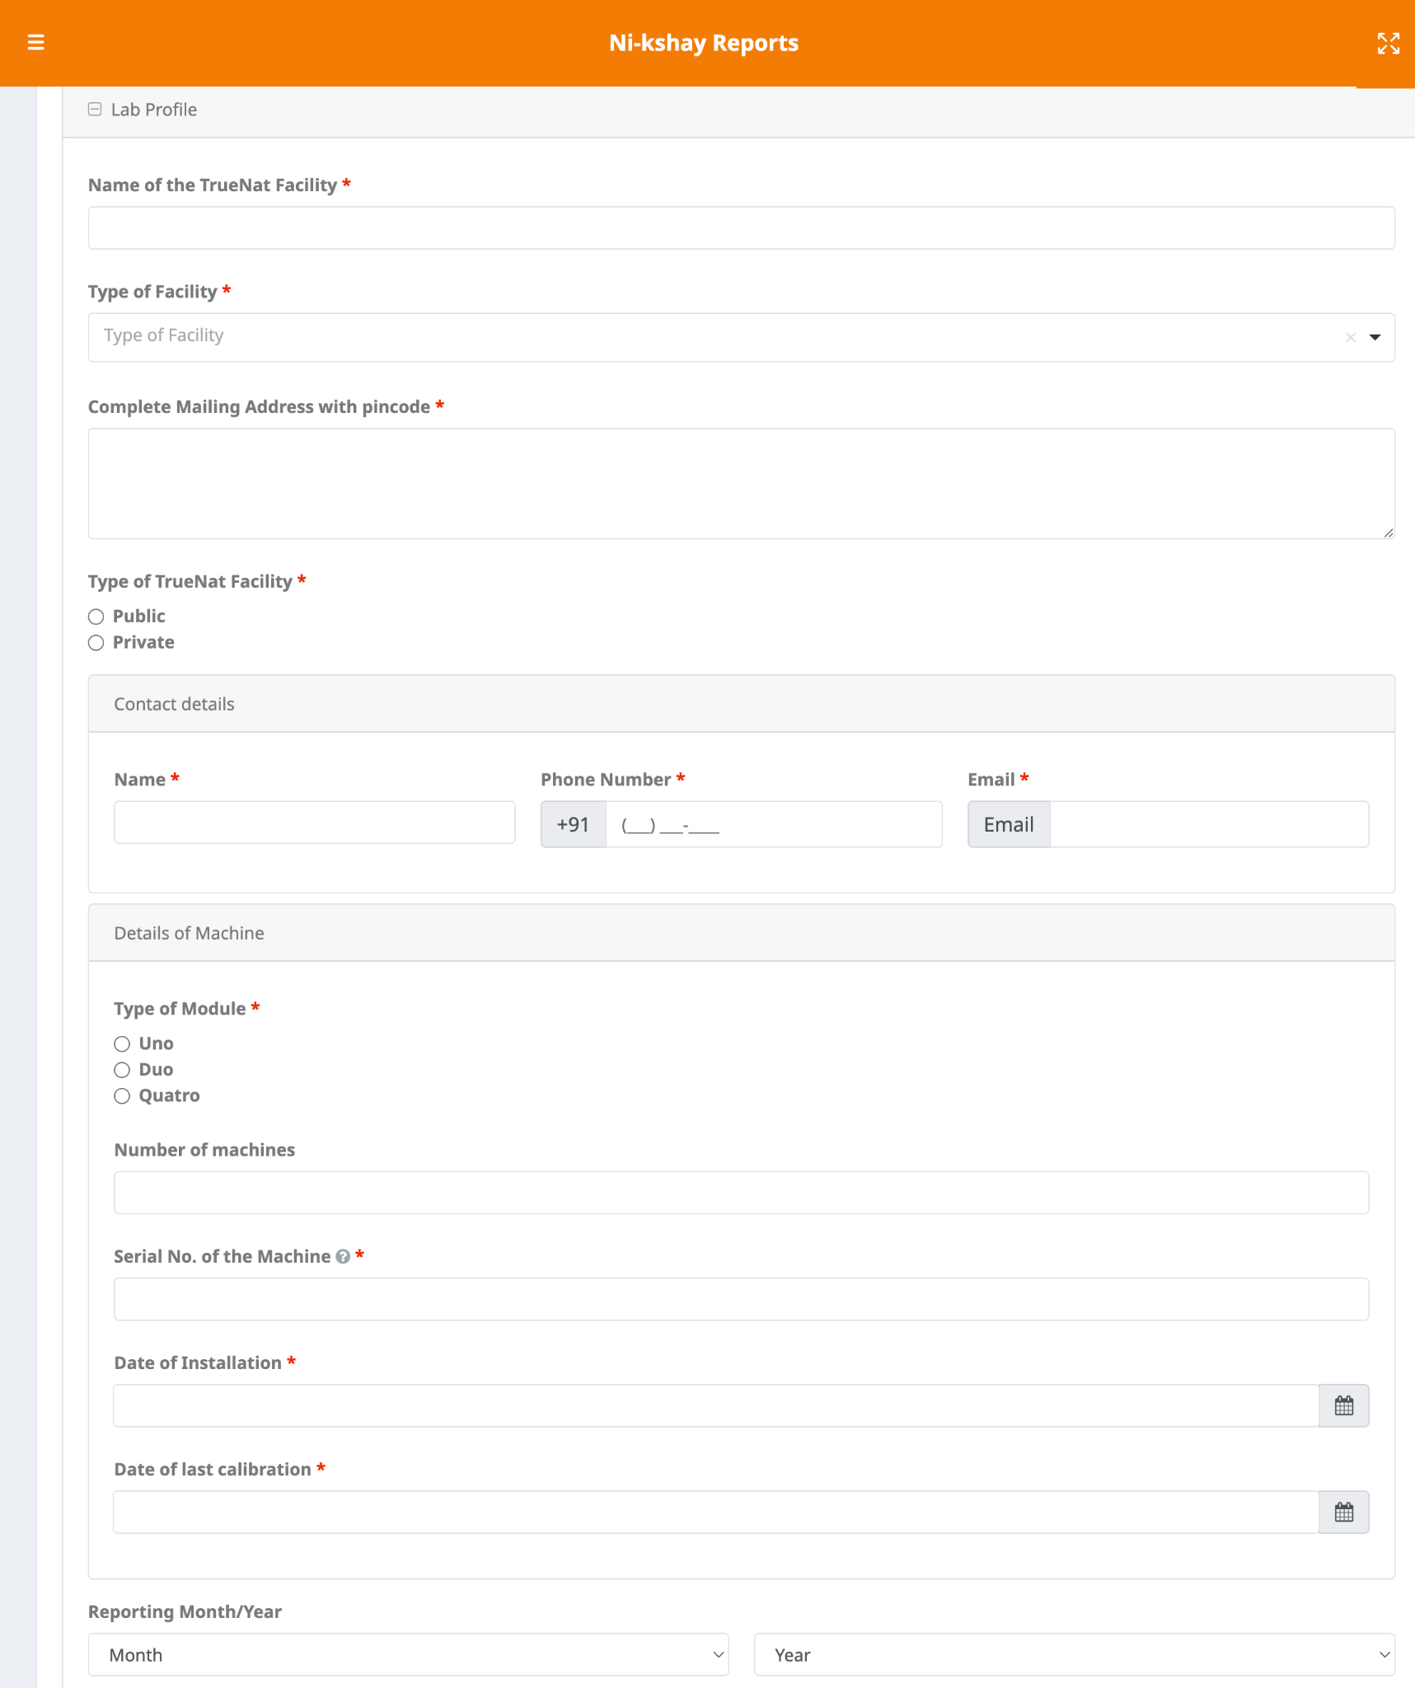
3.a Lab Profile section
The TrueNat form should be filled for each machine.
The number of TruNat machines in a facility is a non mandatory field.
Only one serial number should be filled in one form.

Slide 18
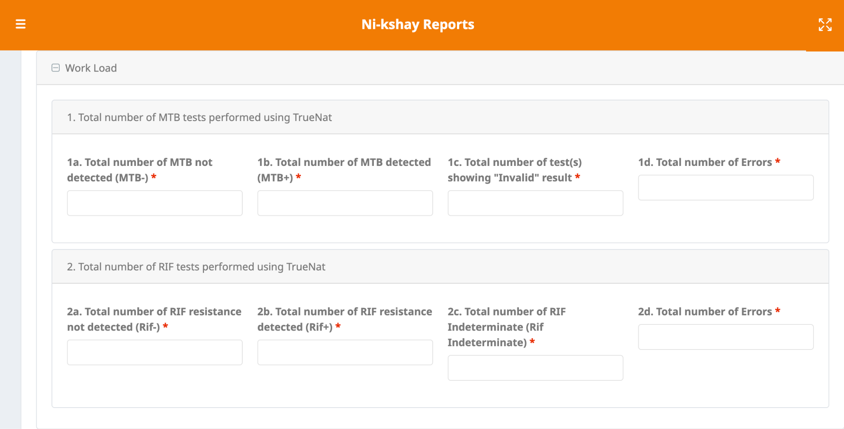
3.b Work Load section

Slide 19
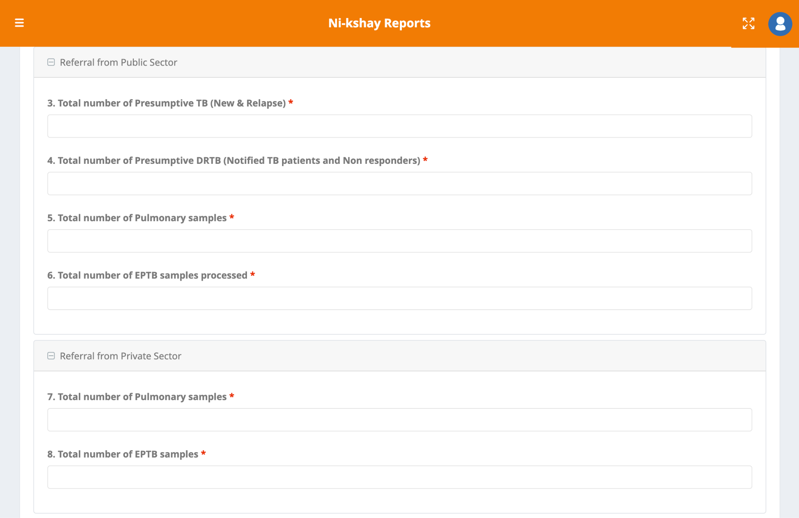
3.c Referral from Public and Private sectors

Slide 20
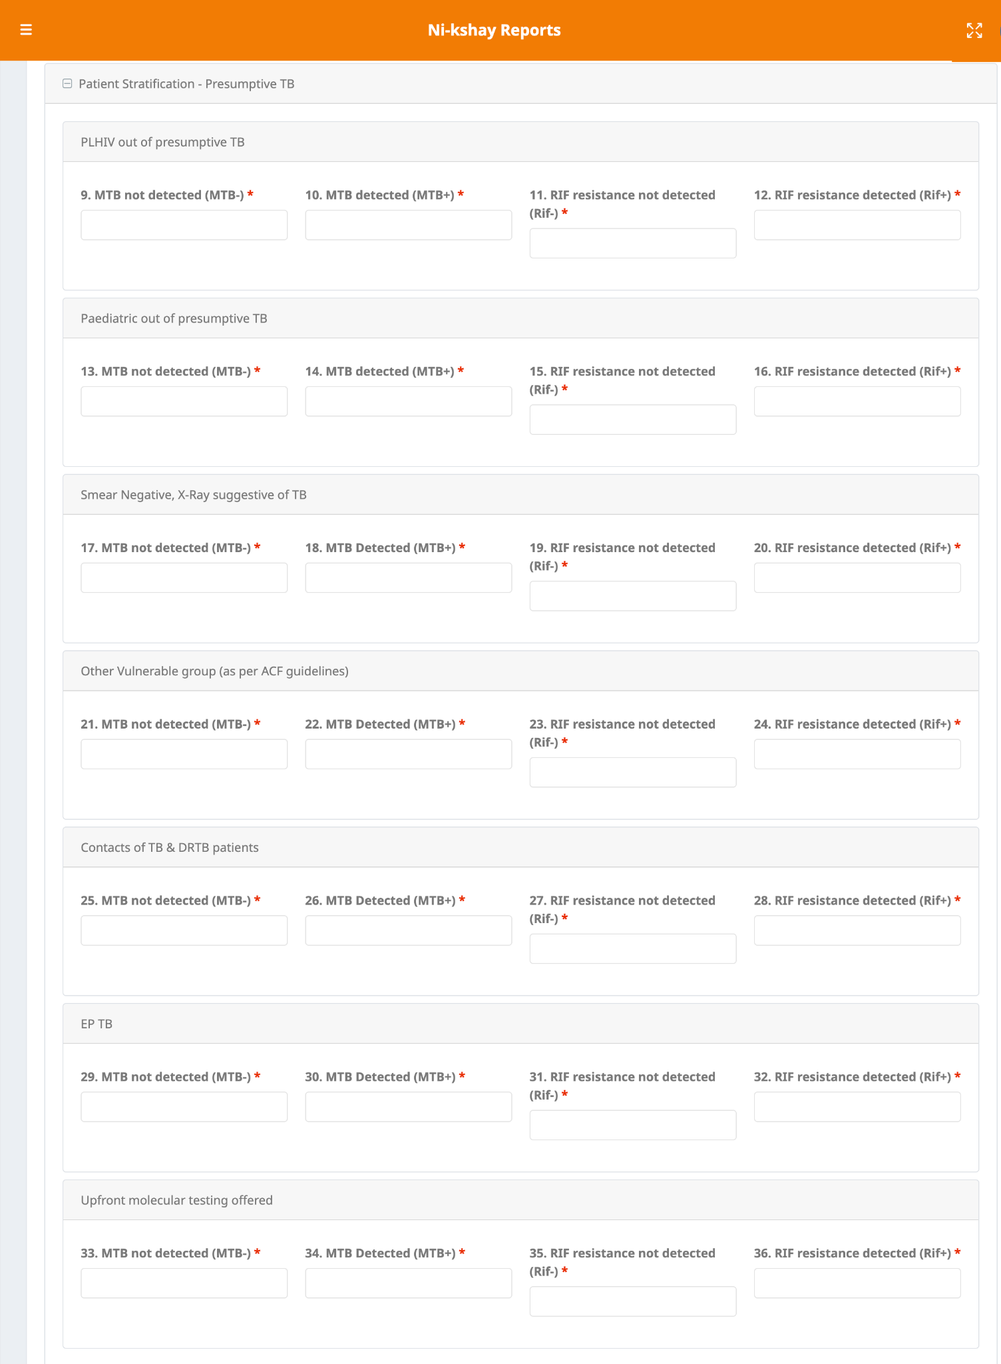
3.d Patient Stratification - Presumptive TB section

Slide 21
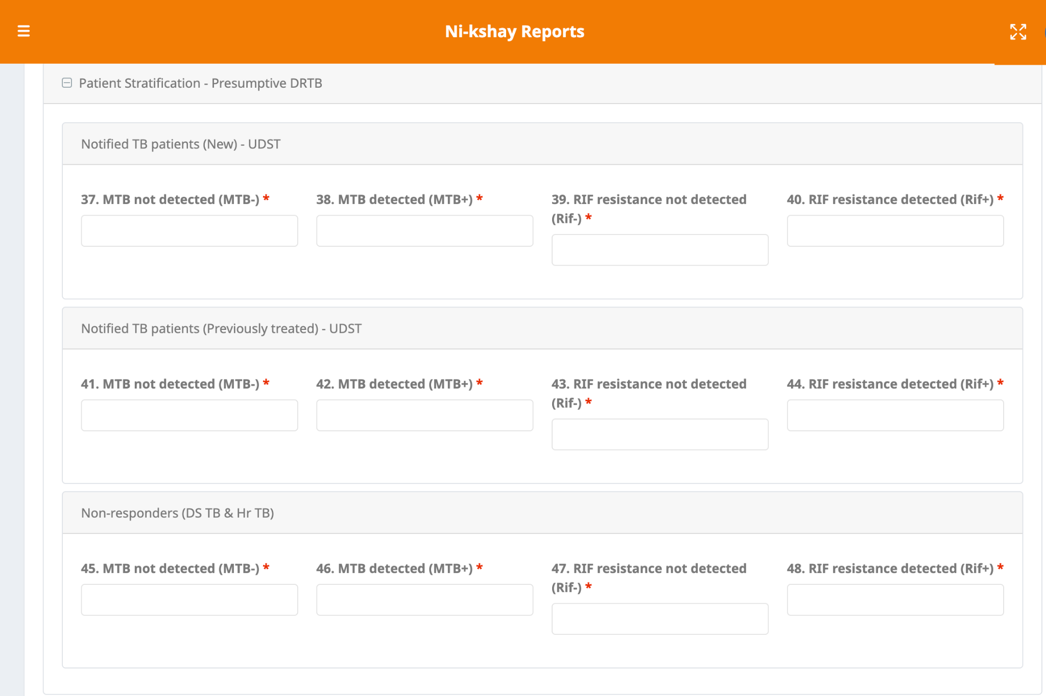
3.e Patient Stratification - Presumptive TB section

Slide 22
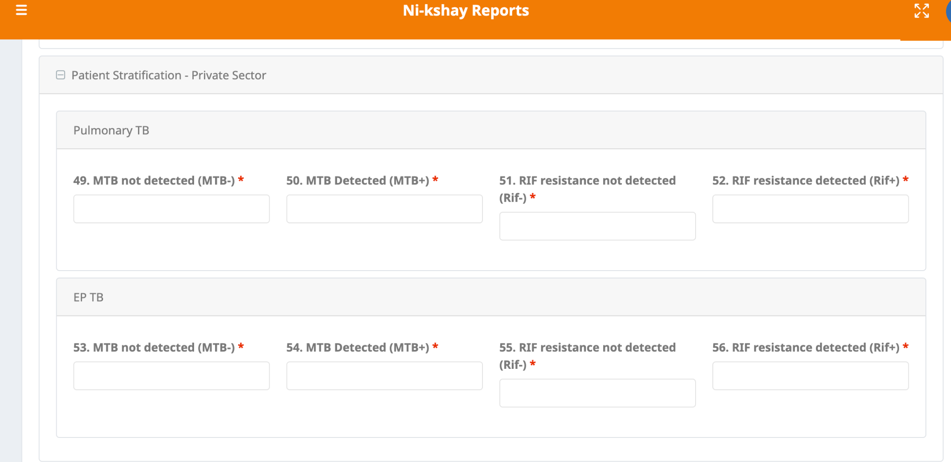
3.f Patient Stratification - Private Sector

Slide 23
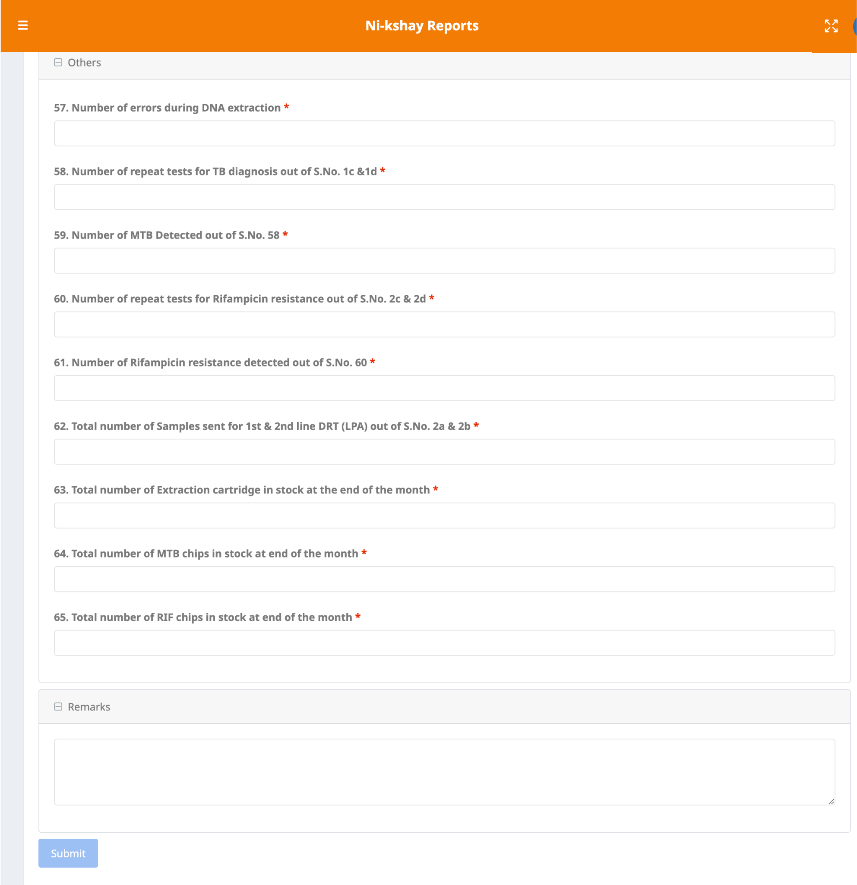
3.g Others and Remarks sections

Slide 24
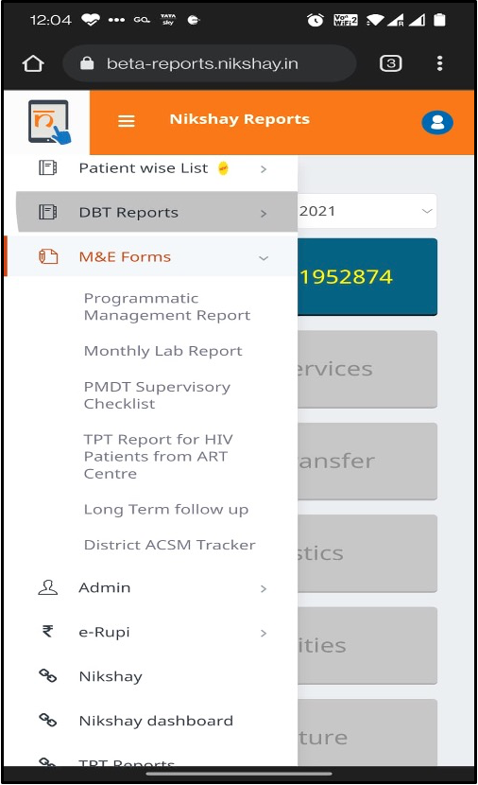
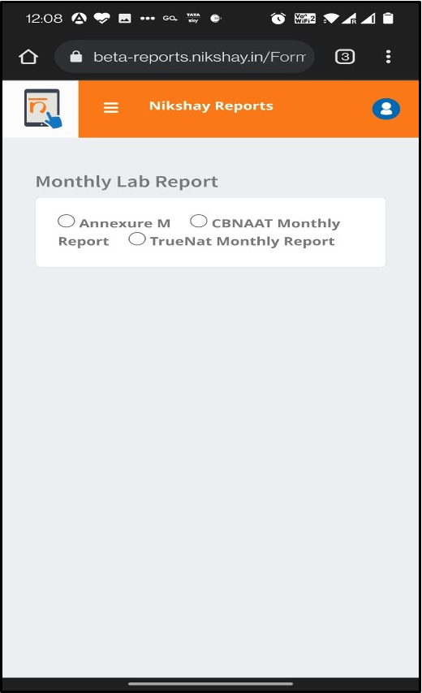
Monthly Lab Report in Ni-kshay: App

Slide 25
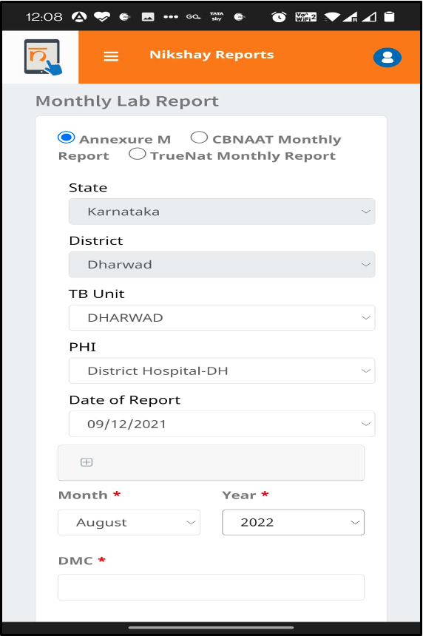
Monthly Lab Report: Annexure M: App

Slide 26
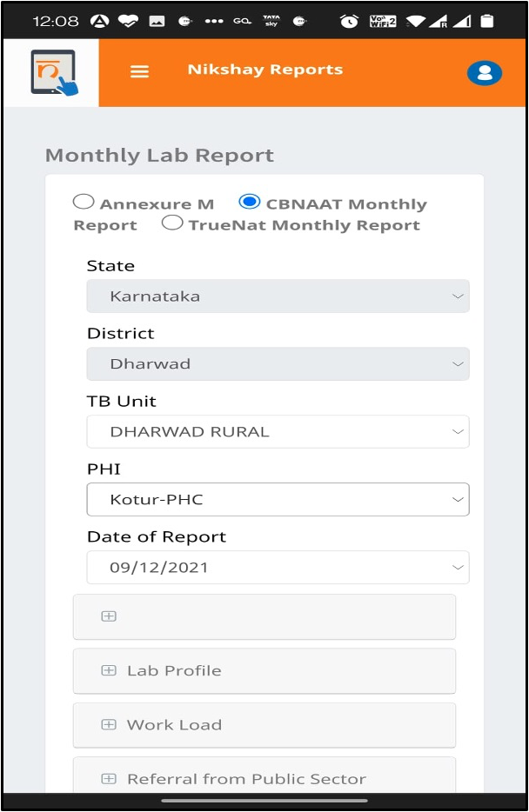
Monthly Lab Report-CBNAAT Monthly Report: App

Slide 27
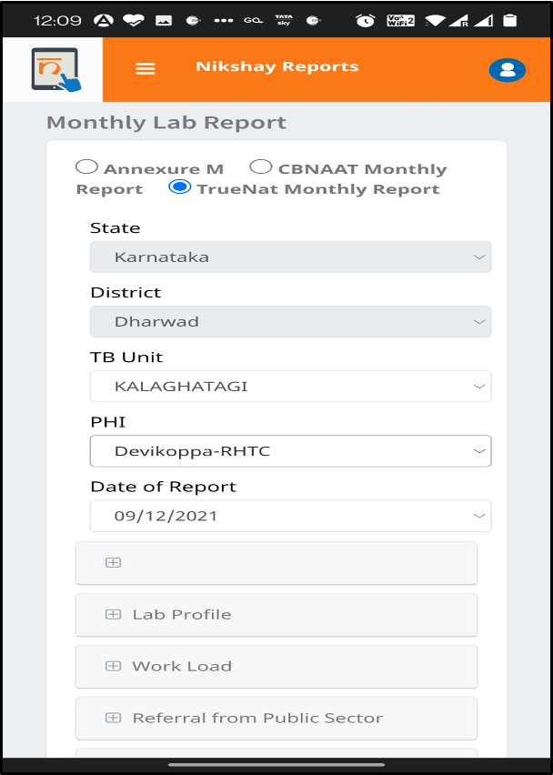
Monthly Lab Report-TruNat Monthly Report: App

Slide 28
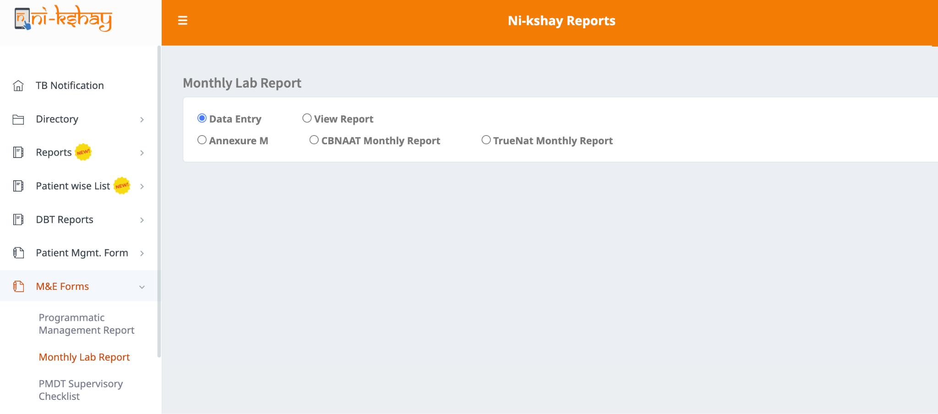
Monthly Lab Report for Annexure M

Slide 29
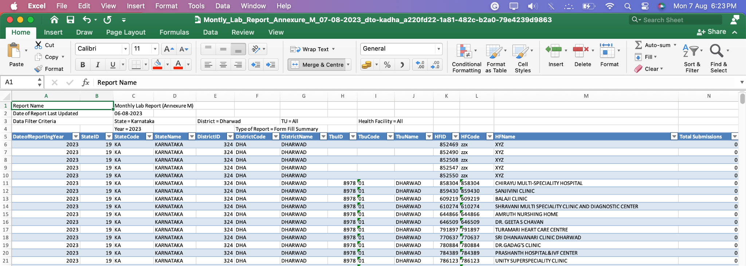
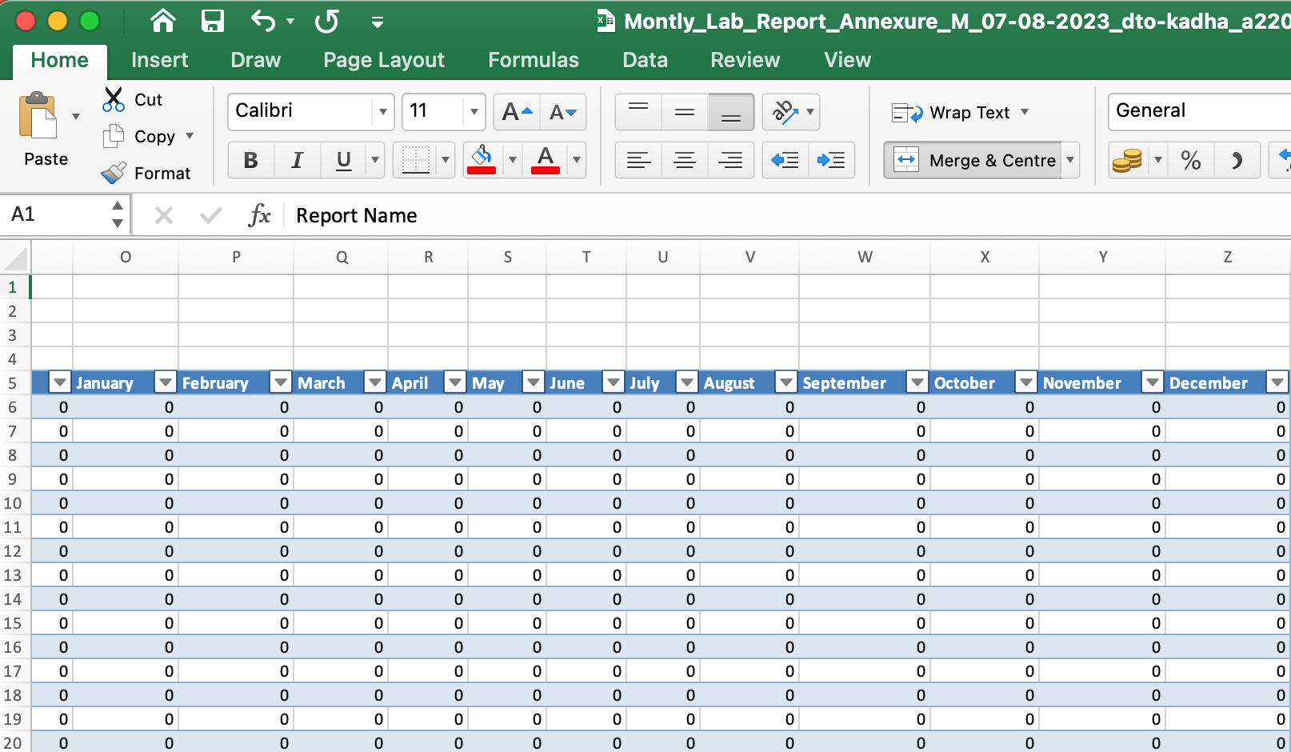
Monthly Lab Report for Annexure M

Slide 30
Monthly Lab Report for CBNAAT Monthly Reporting

Slide 31
Monthly Lab Report for TruNat Monthly Reporting

Slide 32
THANK YOU

