Slide 1
Module 9: Treatment Supporter Scheme for TPT beneficiary

Slide 2
Who can be a Treatment Supporter
A Treatment Supporter can be any person such as a Medical Officer, MPWs, community volunteers working with the program etc.. Even a beneficiaries relative can be a Treatment Supporter.
As per NTEP guidelines, salaried NTEP/ General Health System staff may also be assigned as treatment supporters for a beneficiary. However, they will not be eligible for any honorarium.
A TPT beneficiary can only be linked to one treatment supporter at a time.
Staff and Treatment Supporters

Slide 3
Role of a Treatment Supporter
The Treatment Supporter is a person who helps a TPT beneficiary to complete his treatment
They explain the beneficiary about TPT treatment and inform them about the treatment facilities provided by the government
They encourage beneficiary to take the prescribed TPT medication regularly, on schedule, for the full duration of the treatment
They help the beneficiary to visit nearest health facility for regular health check ups and conduct the follow-up tests on time
If the beneficiary faces any health issues such as ADR, refers the beneficiary to the health facility
Staff and Treatment Supporters

Slide 4
About the TPT Treatment Supporter Honorarium Scheme
Eligibility: Honorarium to be disbursed upon completion of treatment for TPT patient as below
For TPT beneficiary , Rs. 250
System will generate the manual benefit only for those TPT beneficiaries who are recorded on or after 1 st October 2022 are eligible for incentive under this scheme
Treatment Supporter’s Honorarium

Slide 5
DBT processing via Ni-kshay
Following are the 5 steps to be followed for processing payments under this scheme. This is the 2nd scheme in Ni-kshay in which the benefits must be generated manually by TU User.
1
Registration of Treatment Supporter
(Once per treatment supporter)
2
Update Bank details of Treatment Supporter
3
Assign Treatment Supporter to a TPT Beneficiary
(Once per benefit)
4
Manually create Benefits
(Once per benefit)
5
Approval of Benefit by DBT Checker
(Once per benefit)

Slide 6
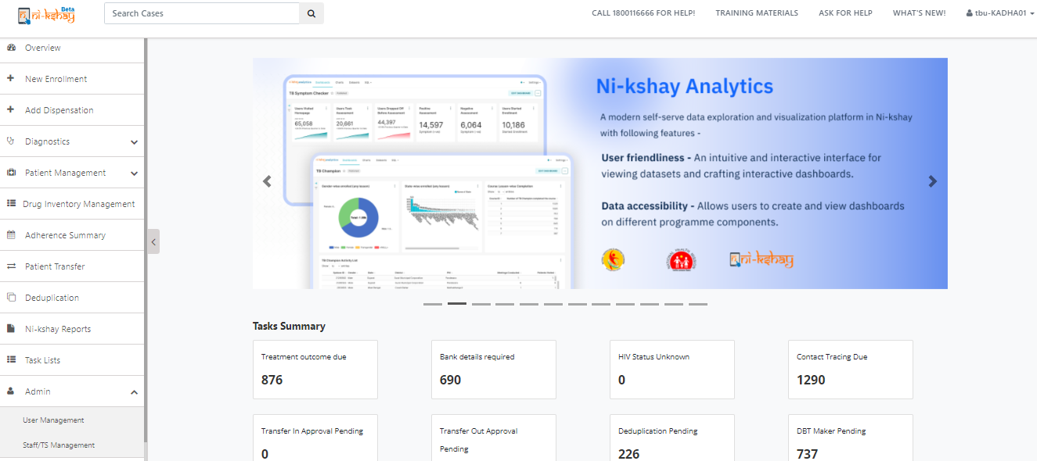
Step 1: Registration of Treatment Supporter in Ni-kshay
Go to Admin 🡪 Staff/TS Management

Slide 7
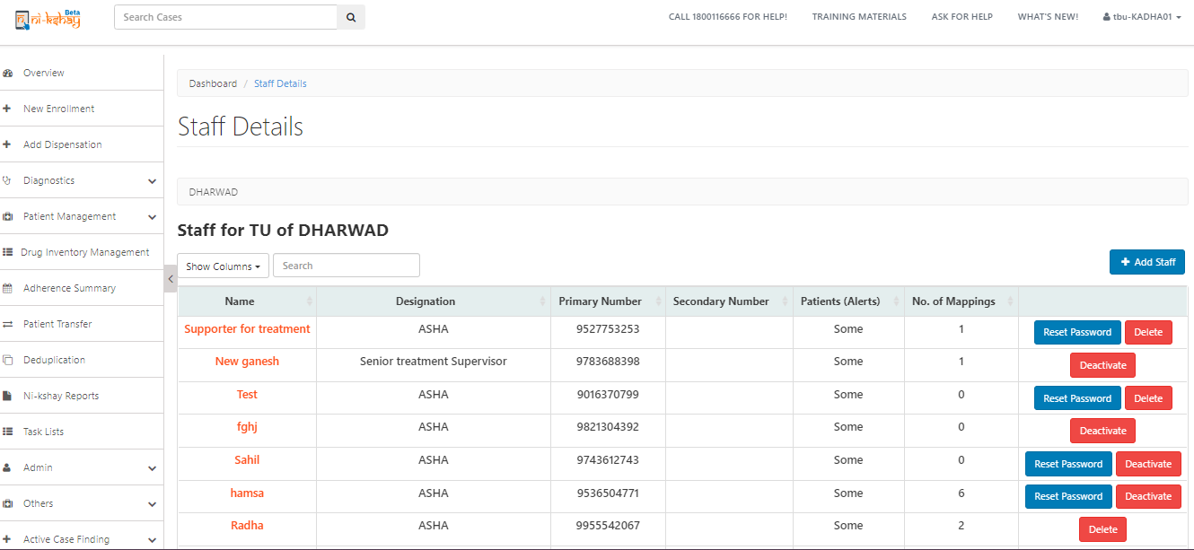
Step 1: Registration of Treatment Supporter in Ni-kshay
Go to Admin 🡪 Staff/TS Management > Staff Details page

Slide 8
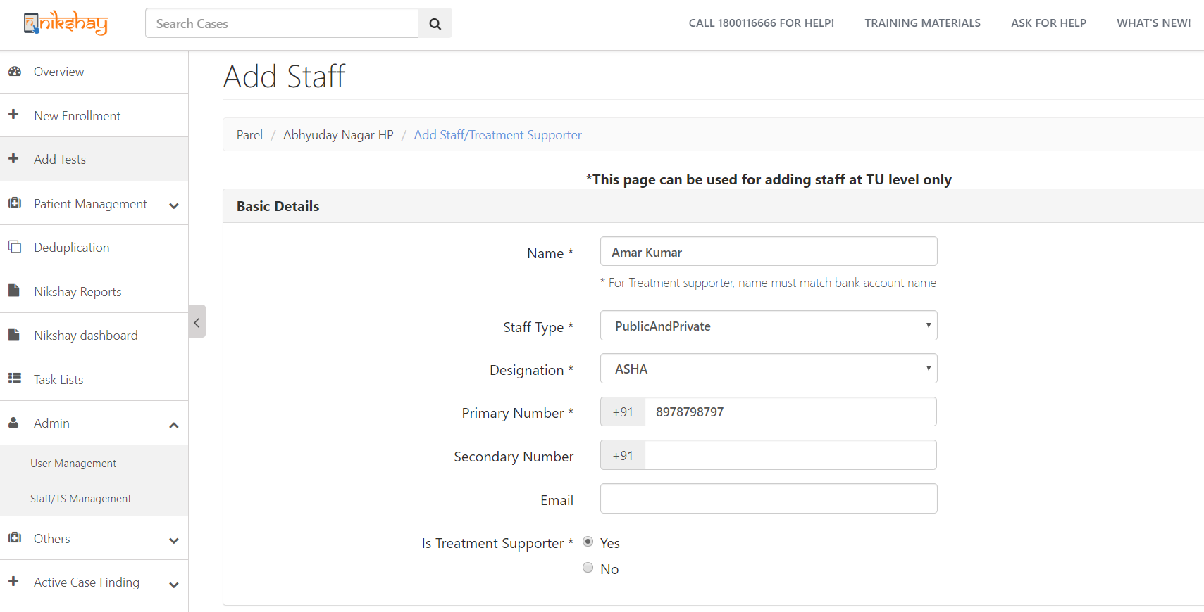
Step 1: Registration of Treatment Supporter in Ni-kshay
Go to Admin 🡪 Staff/TS Management
Note: Treatment Supporters can be created only at TU and PHI levels
Select “PublicAndPrivate”
Mobile No. must be unique
Select “Yes”

Slide 9
Step 2: Update Bank details of Treatment Supporter
Treatment Supporter can login into Ni-kshay and view /edit details of patients assigned
Select ‘Yes’
Enter Bank details
As Bank details are entered, its sent to PFMS for validation

Slide 10
Step 3: Assign Treatment Supporter to TPT beneficiary
Open the TPT beneficiary record, Go to “Others” 🡪 “Staff/Treatment Supporter”
Click here to Add

Slide 11
Step 3: Assign Treatment Supporter to TPT beneficiary
Select Treatment Supporter’s Name
Note: The Treatment Supporters of TPT beneficiary current TUs will appear in this drop down

Slide 12
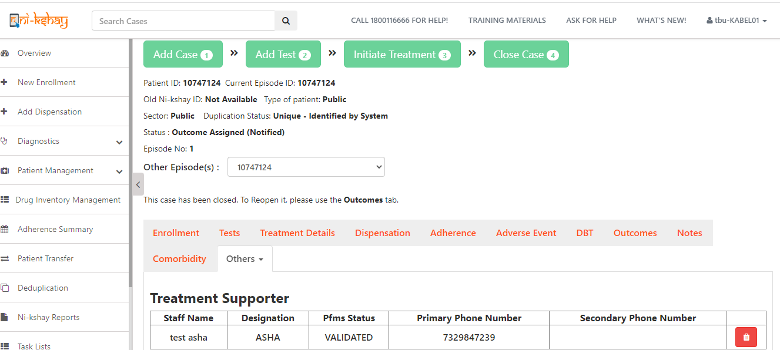
2. Assigning a Treatment Supporter to a Patient
Step 3: Assign Treatment Supporter to TPT beneficiary
Treatment Supporter cannot be unassigned if a benefit has been sent to PFMS or paid
A Treatment Supporter can be unassigned by clicking the delete button

Slide 13
Step 4: Manually create Benefits
Benefit can be created only if the following conditions are met:
A staff (Treatment supporter = Yes) is assigned as Treatment supporter to the beneficiary
The assigned staff has Eligible for Honorarium = Yes
Treatment Supporter’s Bank details are validated by PFMS
Treatment Status of beneficiary:
For TPT beneficiary , one benefit of maximum amount of Rs. 2,50 can be created if outcome is updated as “Treatment Completed
If all the above conditions are met, TU user can create Benefit for Treatment Supporter

Slide 14
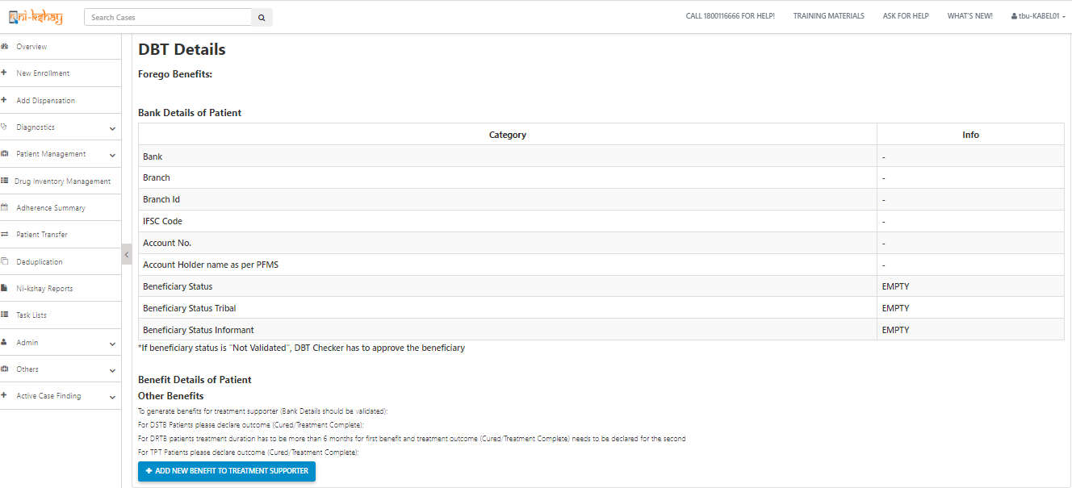
3. Creation of Benefits by TU
Step 4: Manually create Benefits
Login as TU User, open Patient’s Record for which Treatment Supporter Honorarium is to be paid, and Go to ‘DBT’ Tab
If eligibility conditions are met, benefit can be generated by clicking here

Slide 15
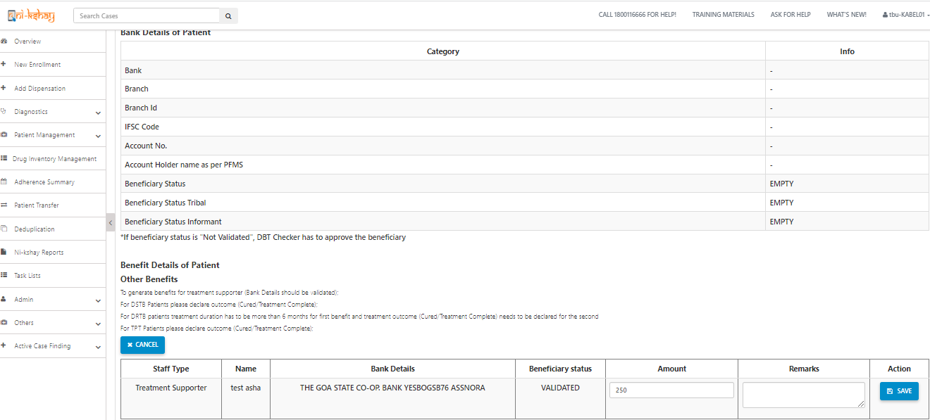
Step 4: Manually create Benefits
Enter amount and click on Save

Slide 16
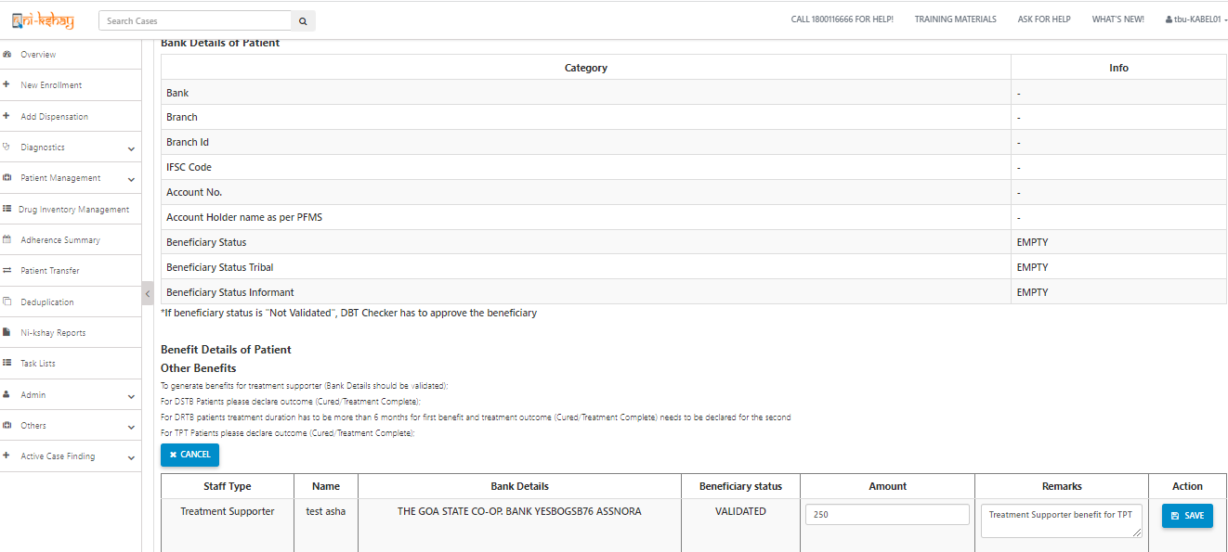
3. Creation of Benefits by TU
Step 4: Manually create Benefits
As user clicks on Save, Benefit will get created and notification displayed
Note: 1. A TPT beneficiary episode record cannot be deleted if benefit to the Treatment Supporter has already been sent to PFMS or paid 2. Edit of Case type (DSTB to DRTB/ DRTB to DSTB/ TPT to DSTB/ TPT to DRTB) will not be possible once benefit is generated under this scheme

Slide 17
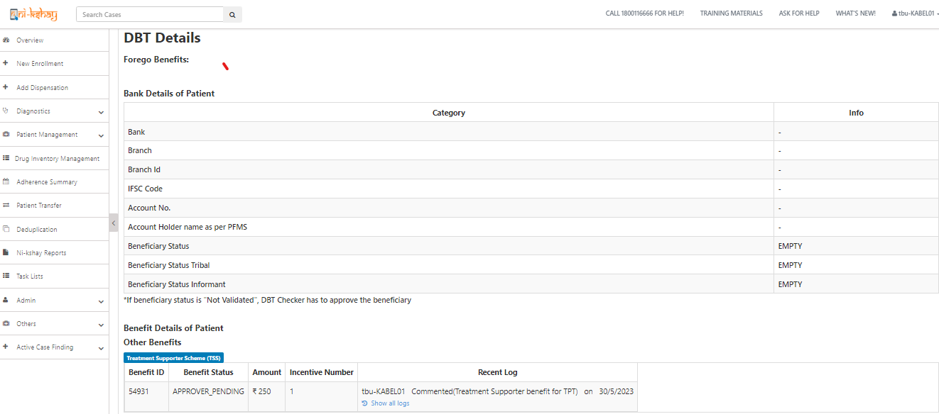
Step 5: Approval of Benefit by DBT Checker
Benefit will be available at DBT Checker login for approval.
Benefit Status can be seen here

Slide 18
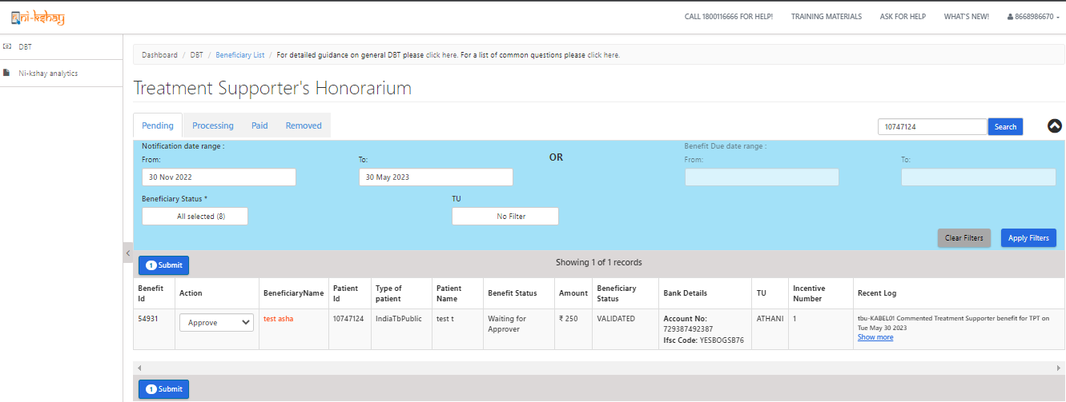
Step 5: Approval of Benefit by DBT Checker
The DBT Checker User will be able to process the Benefits

Slide 19
Handling of DBT benefits upon transfer of TPT beneficiary
Upon transfer of a TPT beneficiary to a hierarchy outside the existing TBU, all unprocessed benefits would be transferred along with the beneficiary to new hierarchy
All processed DBT benefits would not be transferred and status of payment need to be monitored from parent hierarchy itself

Slide 20
SOP for moving Treatment supporter to different hierarchy
Treatment Supporter Scheme for TPT cases:-
1. Users can register a staff with new bank details and generate a TSS benefit
2. We will delete all beneficiary bank account number in database which are in old hierarchy to avoid the duplicate pop message while entering bank account details in new hierarchy to same staffs
3. Processed & Unprocessed benefit will not move with patient to new hierarchy
4. Users have the option to pay the old hierarchy benefits which are in status “Approver_Pening”.
5. Kindly follow below steps for payment where benefit under “Approver_Pening” in old hierarchy.
a. users can remove the treatment supporter from other tab where benefits is not processed
b. After removing the treatment supporter system will delete the TSS benefit which are under “Approver_pending” in backend
c. User need re-register same treatment supporter with bank details in new hierarchy
d. User can use the same bank details for payment since we have deleted old beneficiary (Isdeleted= 1)
e. Once beneficiary is validated by PFMS for new staff then you can assign the treatment supporter and create a TSS benefit by TU logins
f. After all this process, user can reassign the same Treatment supporter to patient for further process
g. Create a TSS benefit manually from patient DBT page by TU logins
h. Clear all backlogs benefits which are already under PFMS process to avoid the future rejection.

Slide 21
Thank you

