Slide 1
Basic concepts of DBT
Module 4:

Slide 2
What is DBT?
D
Direct: to identified beneficiary
B
Benefits: Cash or In - Kind
T
Transfers (Electronic)
Nikshay enables DBT of incentives into Bank Account of Beneficiaries under various schemes
Beneficiary is a person or entity who receives benefits under an incentive scheme of the Government
Benefit: A payment transaction to Beneficiary

Slide 3
DBT schemes in Nikshay
Schemes | Beneficiary | Benefit Amount
Nikshay Poshan Yojana (NPY) | Confirmed TB Patients DSTB & DRTB Public + Private Sector Patients | Rs 500 per month
Tribal Support Scheme | Confirmed TB Patients residing in Tribal TU | Rs 750 (one time)
Treatment supporter’s Honorarium | Treatment Supporter | Rs 1,000 for DS TB patients Rs 5,000 for DR TB patients
Incentive for Notification and Outcomes | Private Health Facilities: Practitioner / Clinic etc. (Single) Hospital/ Clinic/ Nursing Home etc. (Multi) Laboratories Chemists | Rs 500 as Informant or Notification Incentive Rs. 500 for Outcome declaration

Slide 4
Bank details of Beneficiary
Each beneficiary can be linked to unique bank account belonging to him/her.
Beneficiaries without bank accounts need to be facilitated to open bank accounts in any bank as convenient
If a Beneficiary does not have a bank account and is unable to open a new bank account, his/her relative’s bank account may be used (immediate family member such as parents, spouse, siblings).
If a relative’s bank account is used, written consent should be taken from beneficiary.
If a bank account has already been used for another beneficiary, it can not be re-used for another beneficiary
If a new Bank account needs to be opened, its easy to open a zero-balance account with Indian Post Payments Bank.
Notes:
IPB requires only Aadhar Card

Slide 5
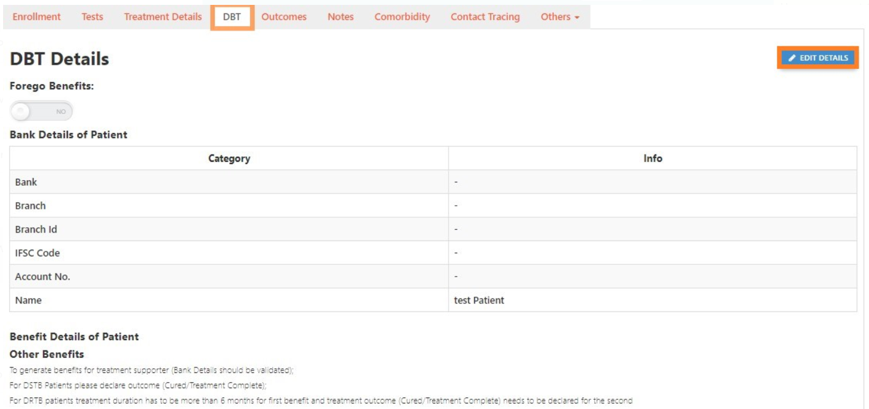
How to enter Bank Details in Nikshay

Slide 6
Beneficiary Status
Not Validated
5
Edit in validated beneficiaries require DTO Approval
If Approved, status changes to Entered
4a
Validated
1
Empty
Entered
2
3
Sent to PFMS
Bank details successfully validated by PFMS
Bank details not yet entered in Nikshay
Bank details entered in Nikshay, pending to be sent to PFMS
Bank details sent to PFMS for validation; response awaited
4b
Rejected
Bank details rejected by PFMS; Check rejection reason & take corrective action

Slide 7
Beneficiary Validation
To process benefit via Nikshay, “Beneficiary” should be “validated” by PFMS.
This is a one-time activity. Successful Validation indicates that Beneficiary’s Bank account details are valid
Nikshay automatically sends Beneficiary Bank Account details to PFMS on the same day on which they are entered into Nikshay (End of day at 12 AM)
PFMS sends the bank account details of the beneficiary to the respective Banks for validation.
If PFMS rejects a Beneficiary for any reason such as, incorrect Bank Account No. or IFSC Code, User has to correct the details in Nikshay so that it can be re-sent to PFMS
“Sent to PFMS” beneficiaries bank details will not be allowed to edit unless and until a response is received from PFMS
DTO’s approval is only required when any edit is being made in the “validated” beneficiaries

Slide 8
Benefits
Definition: A payment transaction to someone entitled to receive it
Nikshay generates benefits automatically (except for treatment Supporter scheme)
These benefits are displayed in the TU level user (DBT Maker) login
Processing a Benefit in Nikshay is a 2-step process:.
Step 1: Review and ‘send for Approval’ by DBT Maker
Step 2: Approval by DTO (DBT Checker)
As DBT Checker approves, the benefit is sent to PFMS for payment. If DBT Checker rejects, the benefit is sent back to DBT Maker
If PFMS processes the benefit, the amount gets credited to the Beneficiary’s Bank Account. However, if PFMS rejects the benefit, it returns to DBT Maker for re-processing.

Slide 9
Benefit Status
4b
Rejected
1
Pending at Maker
2
Waiting for Approver
3
Sent to PFMS
PFMS rejected payment request. User to check rejection reason for corrective action
Benefit pending approval by TU
Benefit pending approval by DTO
Benefit sent to PFMS for processing
4b
PFMS Validated
2a
Removed
3a
Rejected by DBT Checker
5
Benefit Credited
2b
Deferred
2c
Paid External
Notes:
As DBT Maker processes a benefit, s of the Benefit Payment is “Pending at Maker”
As TU User approves, the Benefit record is visible in “Pending” list of DTO (Approver) & its status is “Pending for Approver”

Slide 10
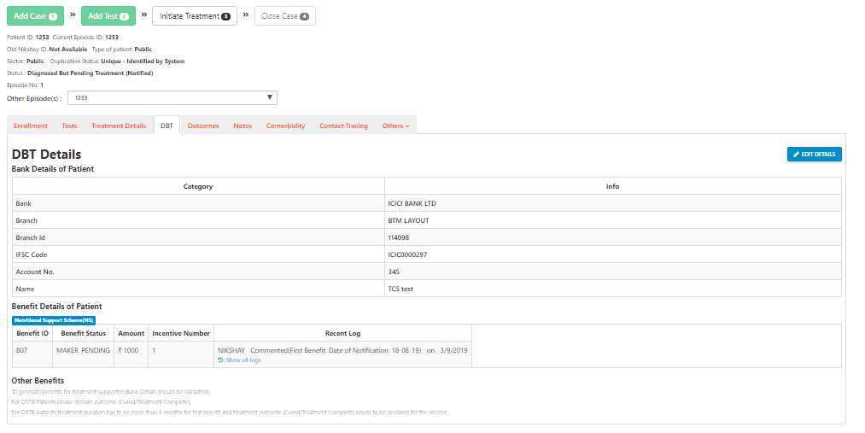
View Benefit details of patient

Slide 11
Roles and Responsibility
Features | General Roles (DTO / TU / PHI / JEET) | DBT Specific Roles (DBT Maker/ DBT Checker)
View DBT details (Patient Record → DBT) | √ | √
Add/ Edit DBT details (Patient Record → DBT) | √ | X
Beneficiary Approval – Patient/ Private Health Facility | X | √
Available only at DBT Checker Logins
Processing Benefits | X | √
While processing benefits from DBT Checker Logins, OTP is triggered to registered mobile number of DTO

