Slide 1
Module 3: Treatment Initiation and Patient Management

Slide 2
Contents
Start Treatment
Add Prescription
Add Co morbidity
Contact Tracing
Adherence Tracking
Closing case
Reinitiating case
Update/view health facilities
Transferring a patient
Patient notes
CBNAAT Test to Ni-kshay
ACF
Tasklist
Followup module

Slide 3
Contents
Start Treatment
Add Prescription
Add Co morbidity
Contact Tracing
Adherence Tracking
Closing case
Reinitiating case
Update/view health facilities
Transferring a patient
Patient notes
CBNAAT Test to Ni-kshay
ACF
Tasklist
Followup module

Slide 4
Start Treatment
Initiation of Treatment is the third step in the Patient Management Lifecycle in Ni-kshay (After Enrolment and Enter Test Details).
In Treatment Details section, “Date of Diagnosis” and “Basis of Diagnosis” gets populated based on the Diagnosis test details.
Once Treatment details are updated, the Adherence Calendar is made available for view and update.
The Start Treatment Screen is common for DS TB,DR TB and TPT beneficiaries.

Slide 5
Enhancement of Type of Treatment (Treatment page)
Type of Case would be added to the ‘Treatment Details’ tab of the patient management page.
The following options would be visible in the dropdown option
DS-TB
PMDT
TPT
If any of the relevant triggers for TPT workflows have been selected and no positive test has been added, then only the TPT option would be displayed in the list of options.
If any of the relevant triggers have been selected and a positive test has been added, then the options visible would be DS-TB, PMDT and TPT.

Slide 6
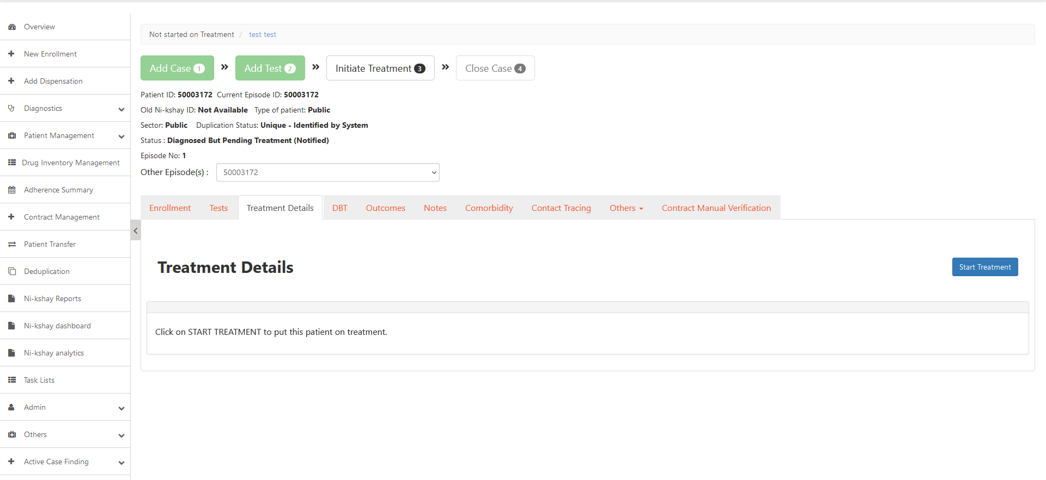
Enter Treatment Details
Step 1
Click on ‘Start Treatment’
As Test is added but treatment details not added, status is “Diagnosed But Pending Treatment (Notified)
White color box indicates “Initiate Treatment” is pending
Click here to Start treatment

Slide 7
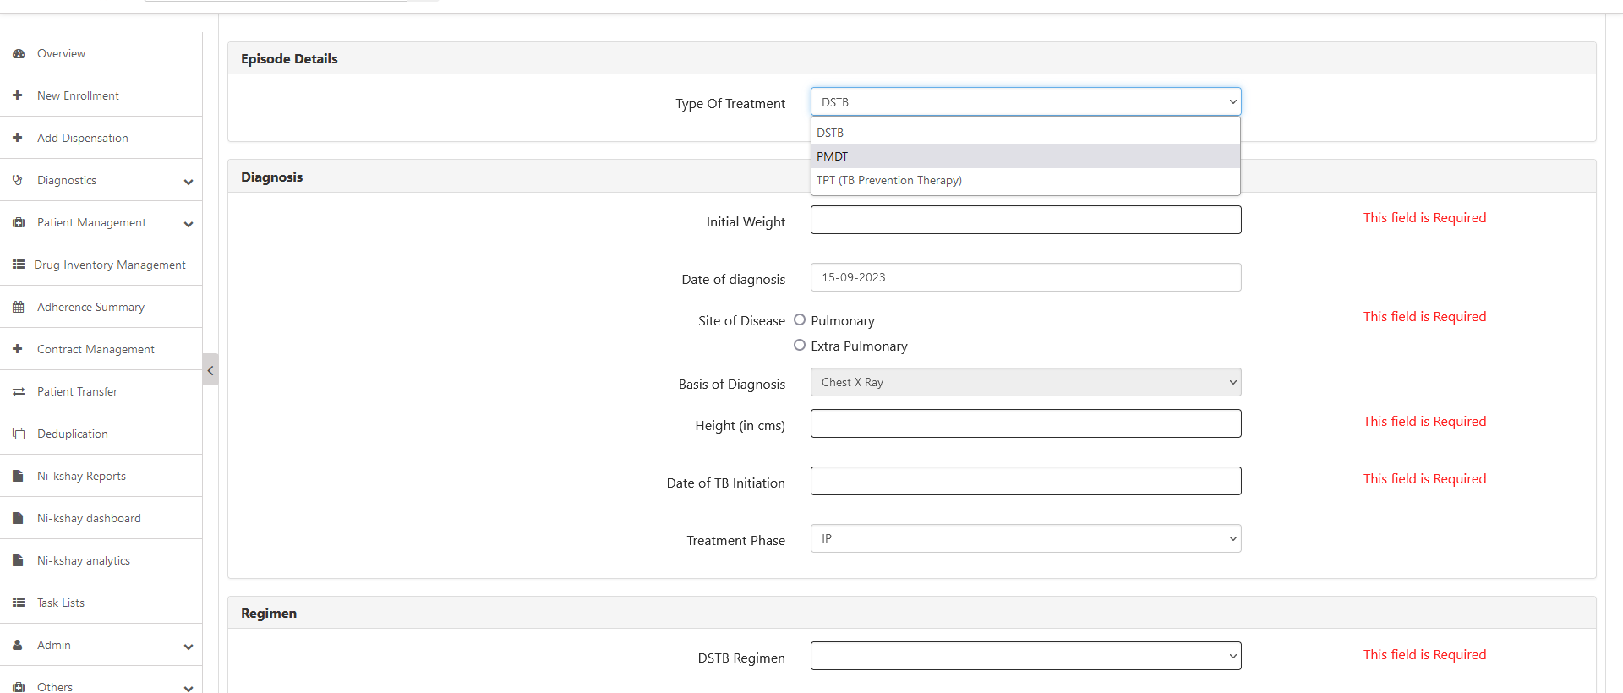
Enter Treatment Details
Step 1
Step 2
Click on ‘Start Treatment’
Select the ‘Type of Treatment’
Can initiate case on DSTB, DRTB & TPT

Slide 8
Enter Treatment Details
Step 1
Step 2
Step 3
Click on ‘Start Treatment’
Select the ‘Type of Treatment’
Select the relevant Regimen and other details

Slide 9
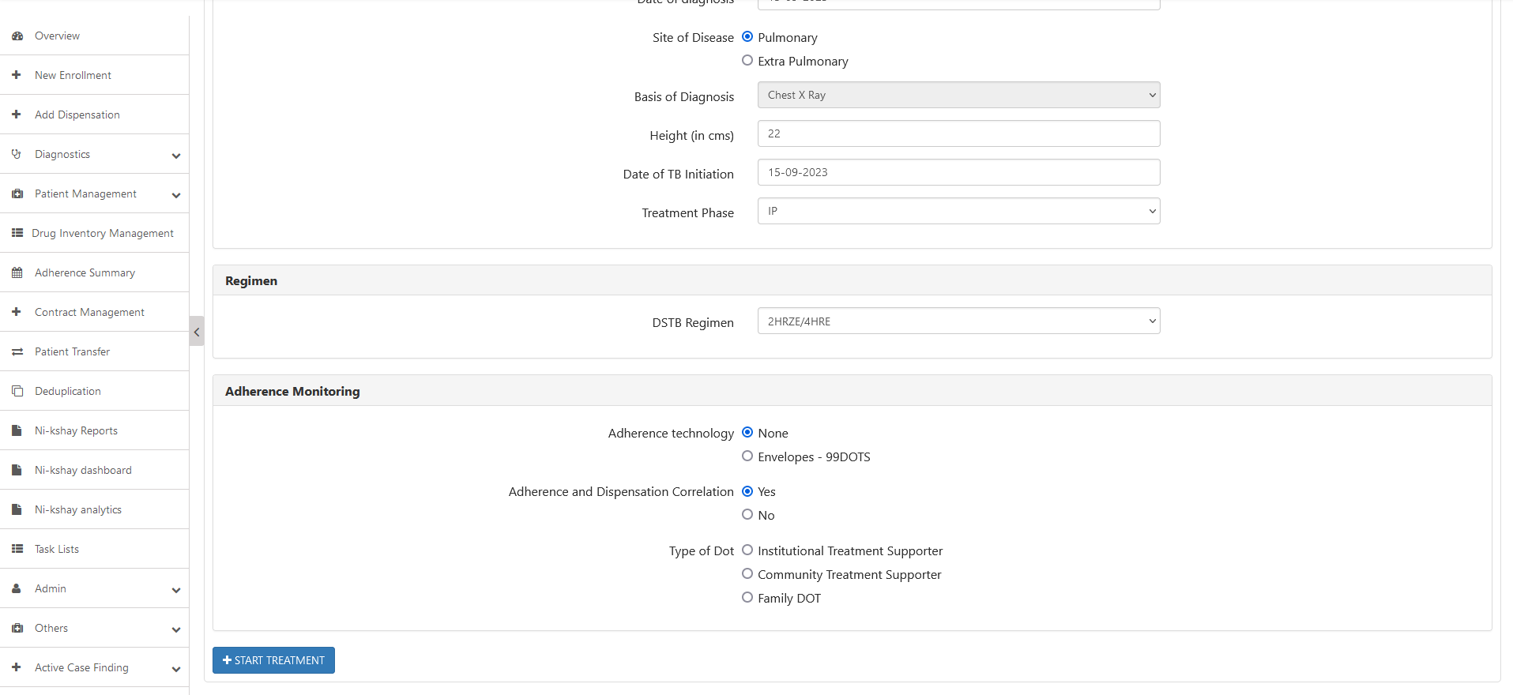
Enter Treatment Details
Step 1
Step 2
Step 3
Step 4
Click on ‘Start Treatment’
Select the ‘Type of Treatment’
Select the relevant Regimen
Click on ‘Start Treatment’
Click here after entering the required details

Slide 10
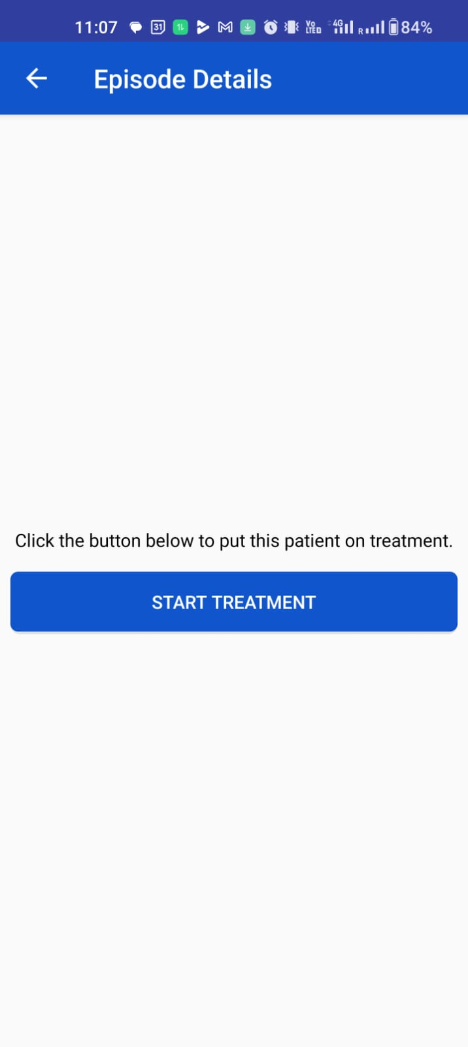
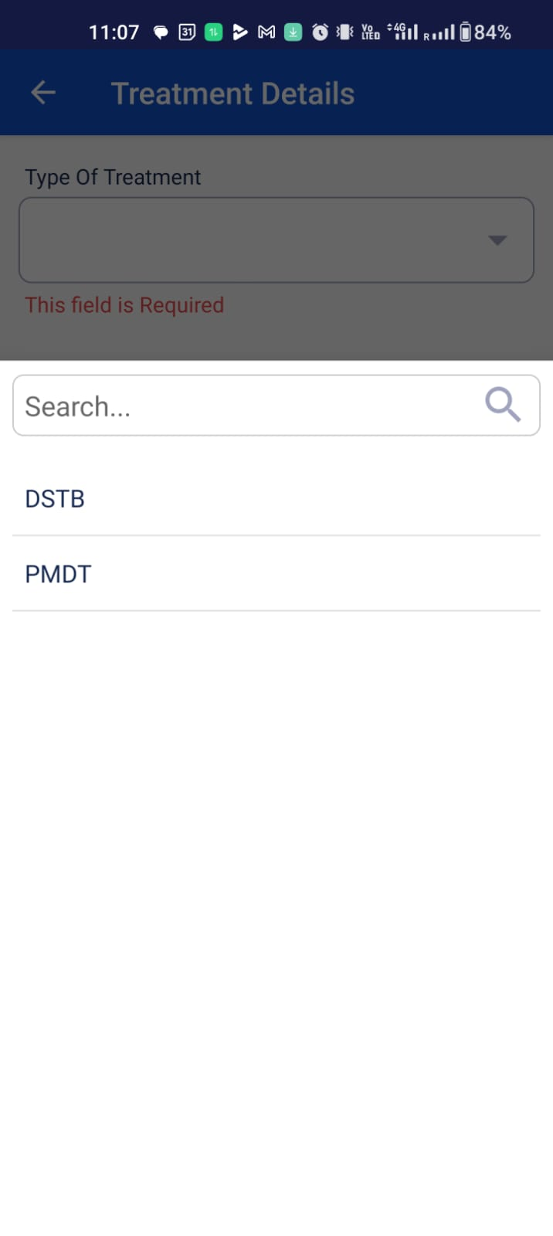
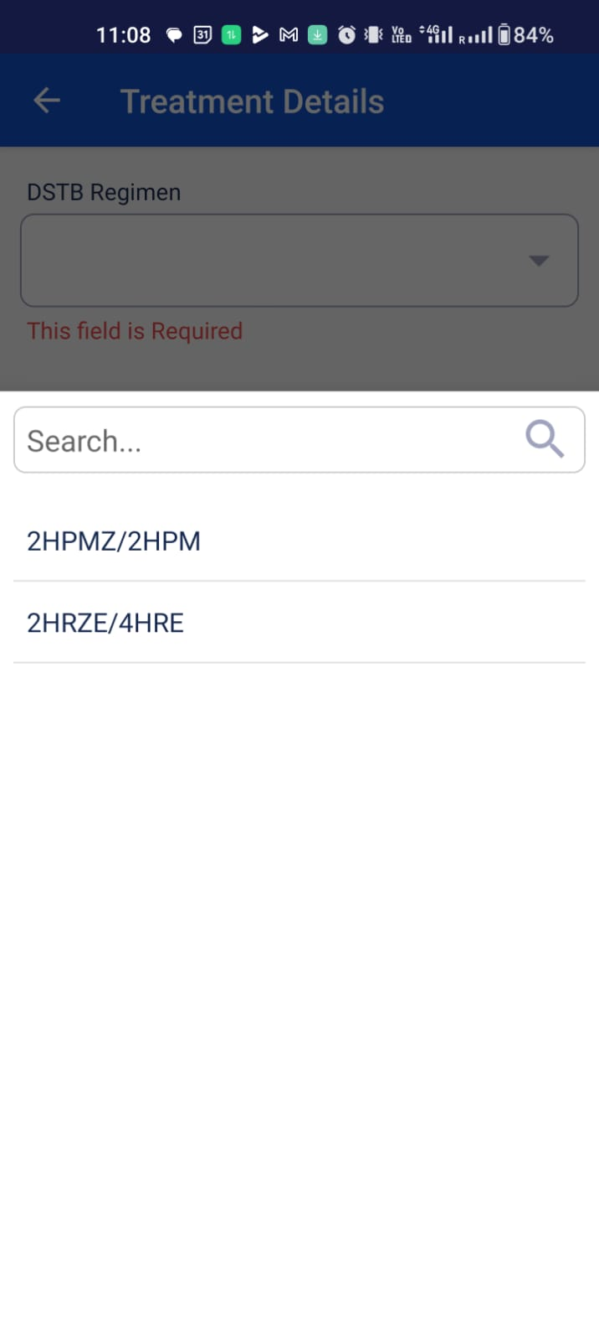
Enter Treatment Details - App
Step 1
Step 2
Step 3
Click on Start Treatment
Select Type of Treatment
Select the relevant regimen

Slide 11
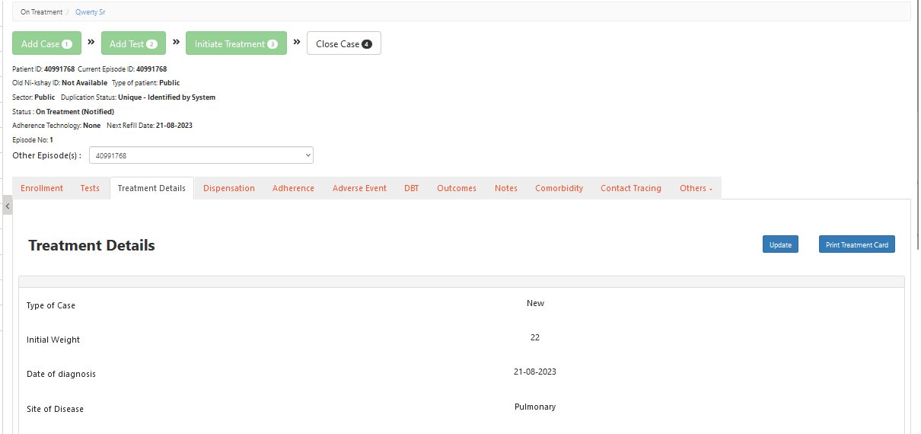
Enter Treatment details
Step 1
Step 2
Step 3
Step 4
Step 4
Click on Treatment Details
Enter Type of Patient
Enter Diagnosis details
Enter Adherence details
View Treatment details
Green color box Indicates Test updated
Status of case gets updated

Slide 12
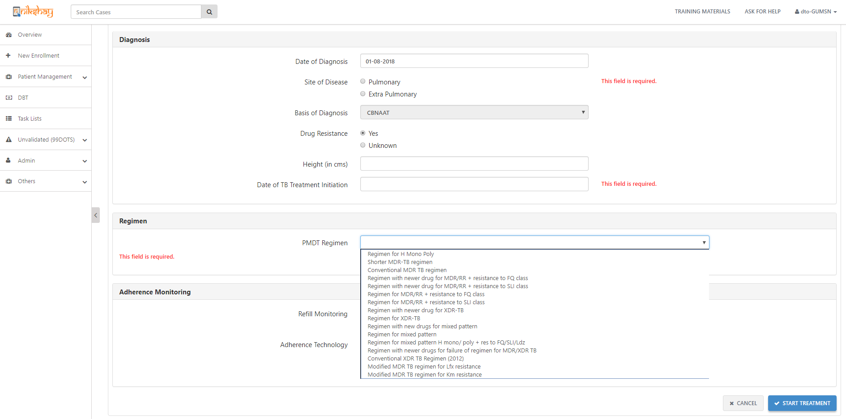
Enter treatment details of DRTB patient
Step 1
Step 2
Step 2
Click on Treatment Details
Enter Type of case
Enter Regimen Details
Select regimen

Slide 13
Contents
Start Treatment
Add Dispensation
Add Co morbidity
Contact Tracing
Adherence Tracking
Closing case
Reinitiating case
Delete a case
Update/view health facilities
Transferring a patient
Patient notes
CBNAAT Test to Ni-kshay
ACF
Tasklist
Followup module

Slide 14
Dispensation
Features:
Add details of the product and quantity of drugs issued to patients
Print and download the details of drug dispensed in a pdf form and share with patients
Save time spent in repetitive data entry by copying previous dispensation details.
Log details of drugs that are returned by patients.
Ensure timely dispensation of drugs to patients by accessing list of patients whose refill is due through the ‘Refill Due Task List’
Update the stock level from Drug Inventory Management
Outcome Validations & Adherence Linkages:
Auto Extension of End Date if the “Next Refill Due Date’ is greater than the Treatment End Date.
Adherence-Dispensation correlation restricts manual doses from being added if no active dispensation is available.
Adherence-Dispensation correlation is defaulted to ‘Yes’ for DSTB patients and ‘No’ for DRTB Patients with the ability to switch on or off as required.

Slide 15
Contents
Reason why Prescription Module is getting replaced with Dispensation Module
Navigation to Dispensation module
Add Dispensation
Print Dispensation
Return Dispensation
Copy Dispensation
Refill Due Task-list
Outcome Assignment Changes
Adherence Dispensation Correlation
Drug Inventory Management

Slide 16
Prescription Module replaced with Dispensation Module
We are replacing the Prescription module with the new “Dispensation” module for following reasons:
The fields that were part of the current Prescription module was not always relevant
No linkage to when Drug Refills were due for patients
No option to Print and Copy Products from previous prescriptions
No differentiation between when the drugs were prescribed, when the drugs were provided and when the dosage starts
No option to return the drugs issued to patients
No Linkage between Drugs Prescribed to Adherence
This module will be available for all patients in the following stages:
On Treatment
Outcome Assigned

Slide 17
Workflow for Add Dispensation

Slide 18
Workflow for Return Dispensation

Slide 19
How to navigate to Dispensation Module
Step 1
Click on ‘Add Dispensation’ Button
Click here for Dispensation Module

Slide 20
How to navigate to Dispensation Module
Step 1
Step 2
Click on ‘Add Dispensation’ Button
Search by Episode ID or Dispensation ID
Search can also be initiated with the Dispensation ID
Enter the Episode ID to initiate the search on any Patient’s details
Click here to
Start the search
Dispensation Details can also be added from the Patient Page

Slide 21
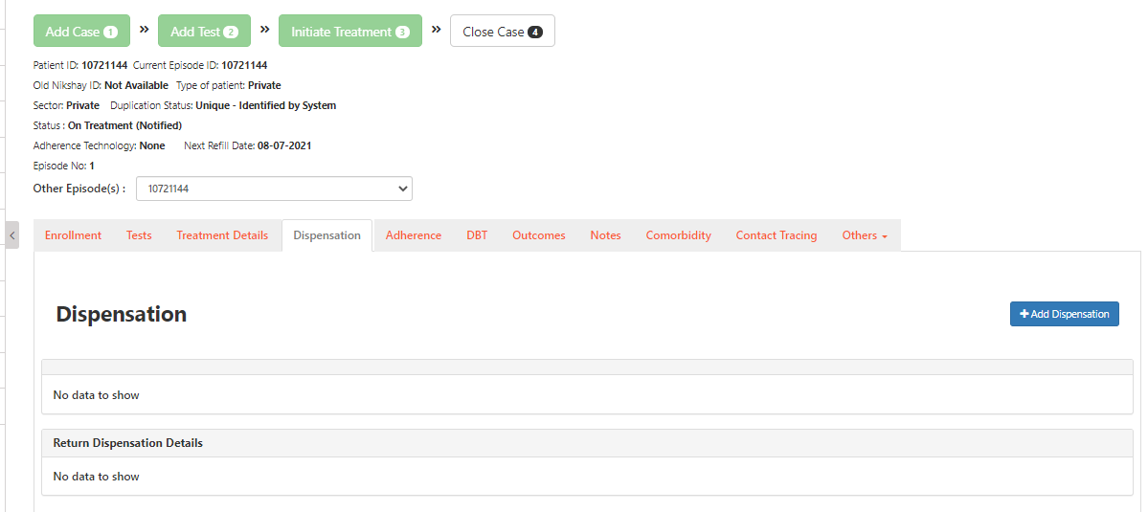
Add Dispensation
Step 1
Step 1
Step 1
Click on Dispensation Tab
Click here to add Dispensations

Slide 22
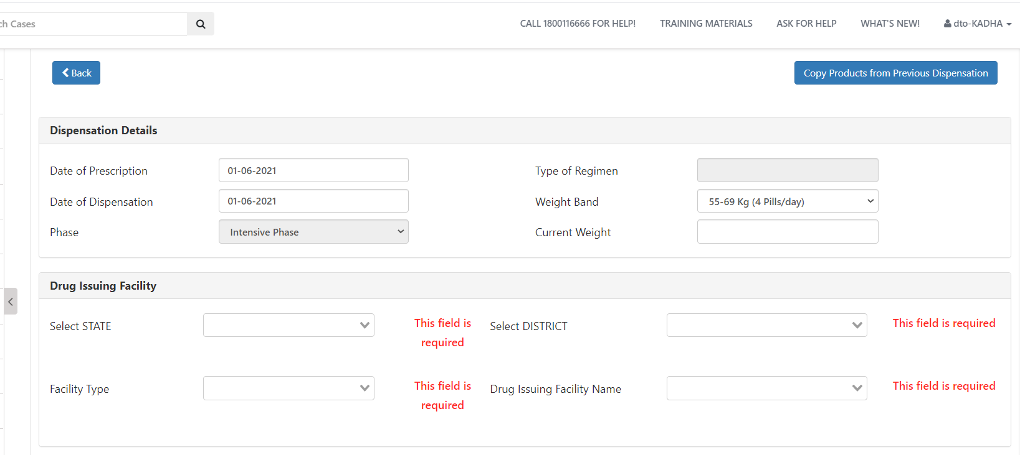
Add Dispensation
Step 1
Step 1
Step 2
Step 1
Click on Dispensation
Enter Dispensation Details
Enter the “Date of Prescription”
Type of Regimen gets auto-populated based on the Test Results
Enter the “Date of Dispensation”
“Weight Band” is getting auto-populated based on the patients’ primary data
Click here to copy medicine / products from the previous Dispensation
1
2
3
4
5. Phase also gets auto-populated based on the Test Results
6. Enter the “Current Weight”

Slide 23
Add Dispensation
Step 1
Step 2
Step 3
Step 1
Step 1
Click on Dispensation
Enter Dispensation Details
Enter Drug Issuing Facility Details
The weight band is auto populated and is editable with the other weight band options available in the dropdown
7. Select the State
8. Select the District
10. Select the “Drug Issuing Facility Name” from the drop down option
9. Select the “Drug Issuing Facility Type” from these three options

Slide 24
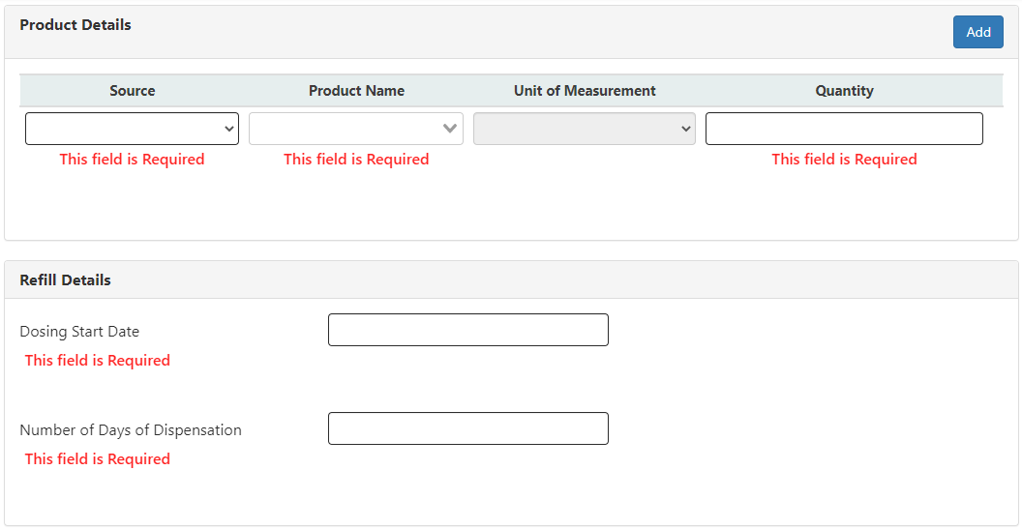
Add Dispensation
Step 1
Step 2
Step 3
Step 4
Step 1
Step 1
Click on Dispensation
Enter Dispensation Details
Enter Drug Issuing Facility Details
Enter Product Details
1
*2
3
4
5
Click on “Add” if required to add more product(s)
Select the “Source” from the list
Select the prescribed product name from the drop down option, it is a mandatory field.
It is an auto-populated field based on the chosen product
Enter the “Quantity” as per the prescription, it is a mandatory field.

Slide 25
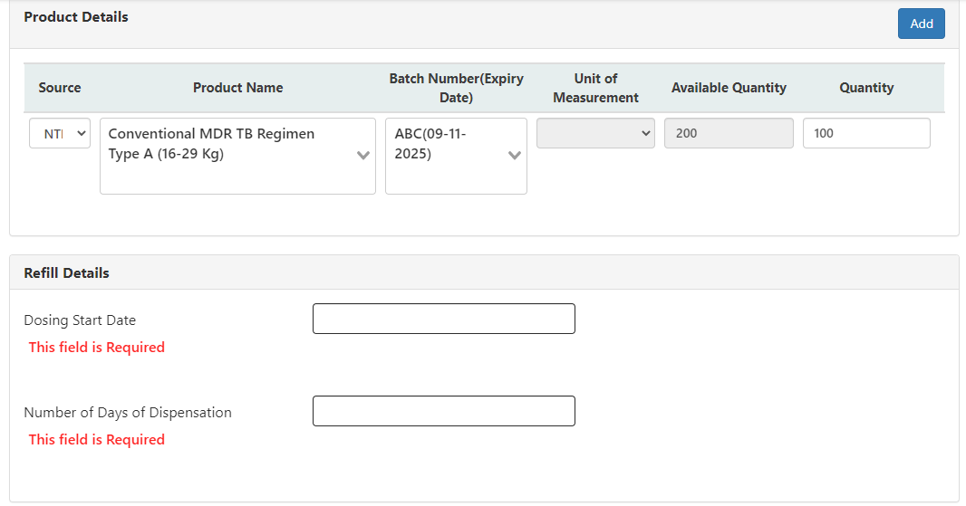
Add Dispensation- NTEP Product addition
Step 1
Step 2
Step 3
Step 4
Step 1
Step 1
Click on Dispensation
Enter Dispensation Details
Enter Drug Issuing Facility Details
Enter Product Details
1
2
3
4
5
6
Click on “Add” if required to add more product(s)
Selected the “Source” as NTEP from the list
Select the prescribed product name from the drop down option, it is a mandatory field.
Select the batch number from the drop down option, it is a mandatory field.
The Available quantity of the product is shown as a display only field
Select the quantity less than or equal to the available quantity.
Please Note- Products with zero quantities would not get listed in the “Product name” dropdown

Slide 26
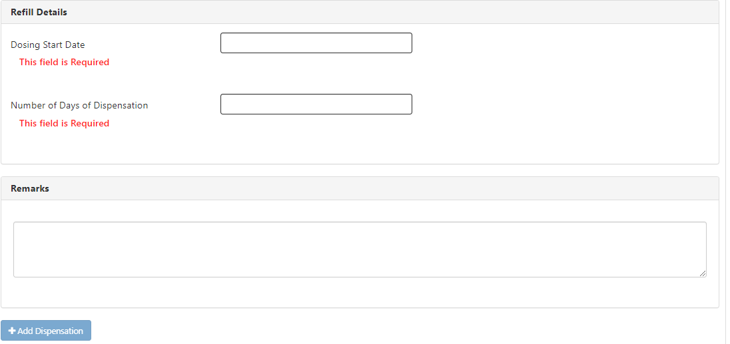
Add Dispensation
Step 1
Step 2
Step 3
Step 4
Step 1
Step 1
Step 5
Click on Dispensation
Enter Dispensation Details
Enter Drug Issuing Facility Details
Enter Product Details
Enter Refill Details
Enter the dosing start date as per the prescription, it is a mandatory field
Enter number of days of dispensation as per the prescription, it is a mandatory field
Enter remarks, if any
10. Click here to add the dispensation
Note: If the Facility type is selected as ‘PHI’ then only ‘NTEP’ option is visible in the ‘Source’ field. If ‘Chemist’ or ‘Private HF’ are selected both ‘NTEP’ and ‘Private’ will be visible in the source.

Slide 27
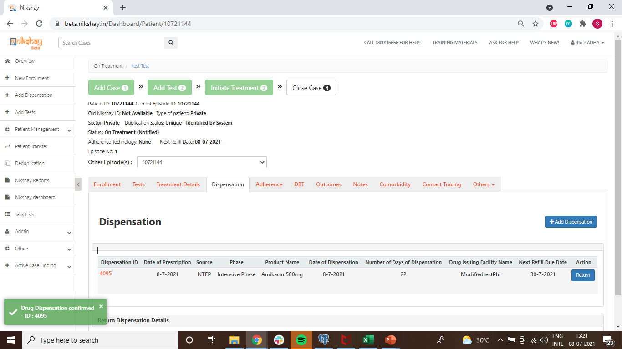
Add Dispensation
Details of the Dispensation added are displayed here.

Slide 28
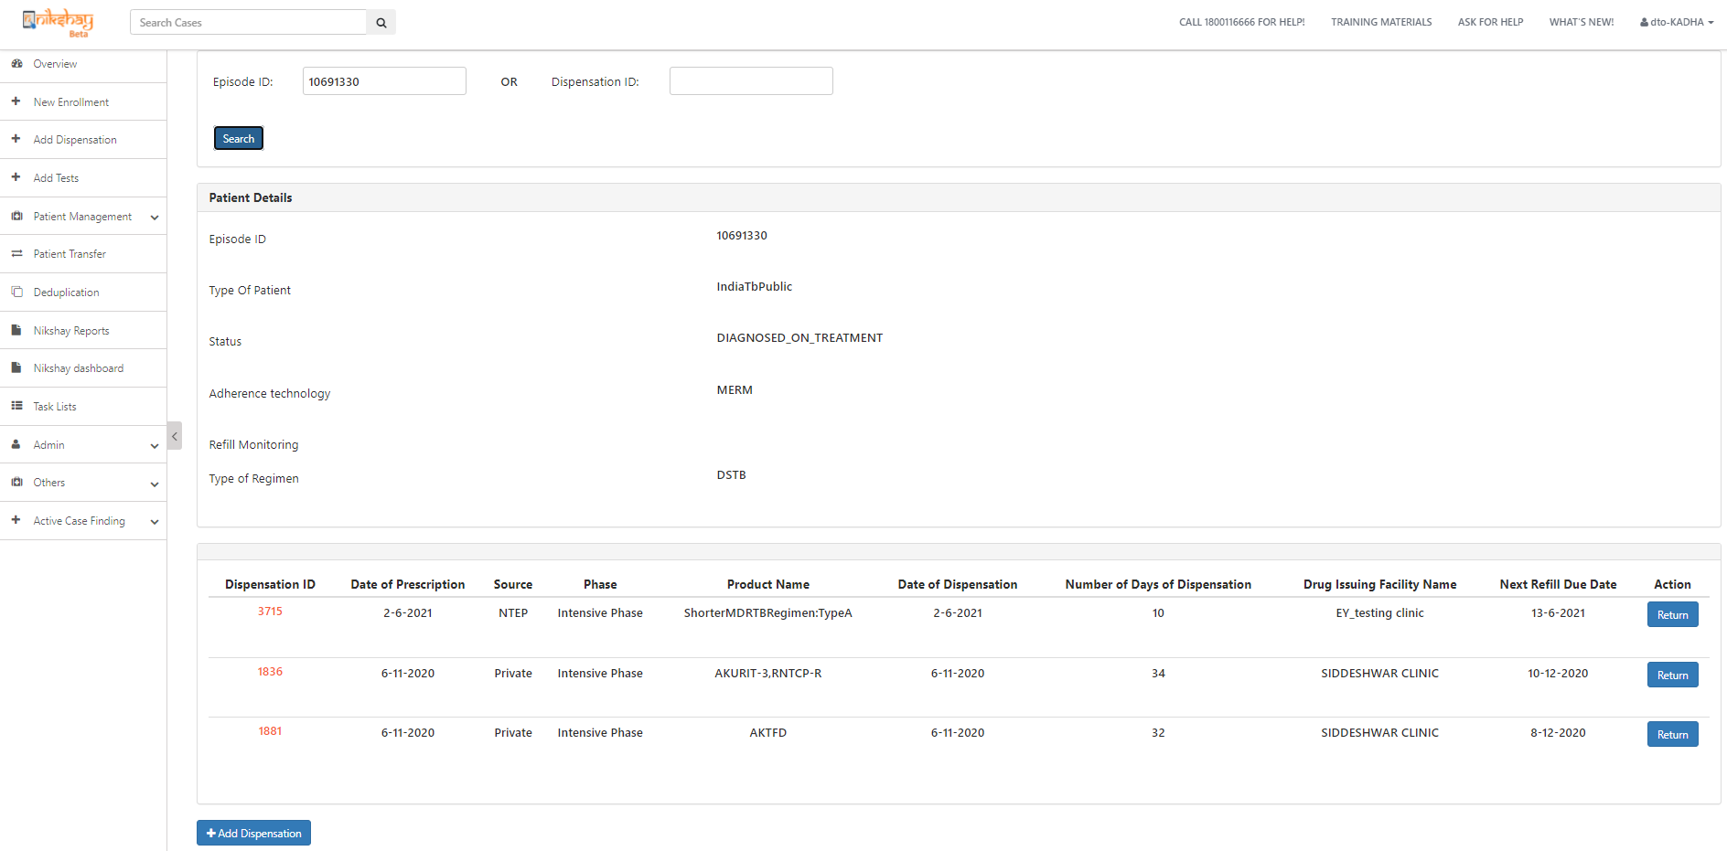
Print Dispensation Details
Dispensation details can be viewed/added by entering the Episode or Dispensation ID of the patients
Click on the Dispensation ID to view the dispensation details and to a print a copy of the selected dispensation.

Slide 29
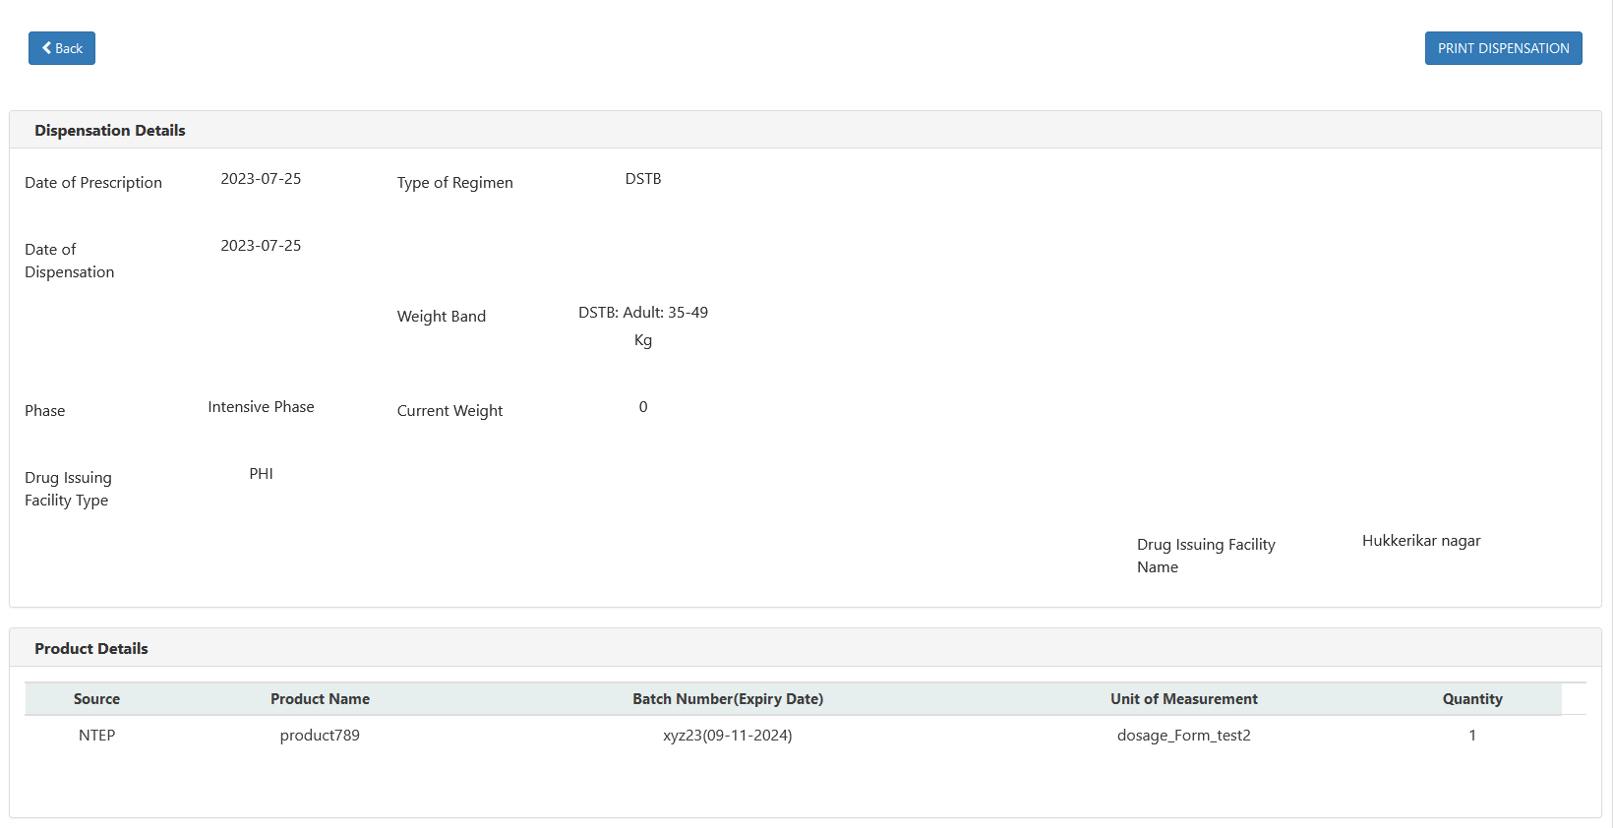
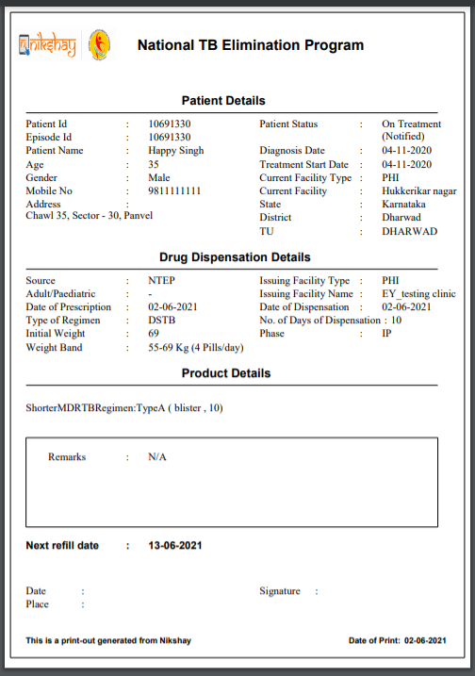
Print Dispensation Details
Print Preview
Click here to go back to the list of the dispensation
Click here to print a copy of the dispensation

Slide 30
Return Dispensation
Dispensation details can be viewed/added by entering the Episode or Dispensation ID of the patients
Click here to return any of the prescribed medicines, if required

Slide 31
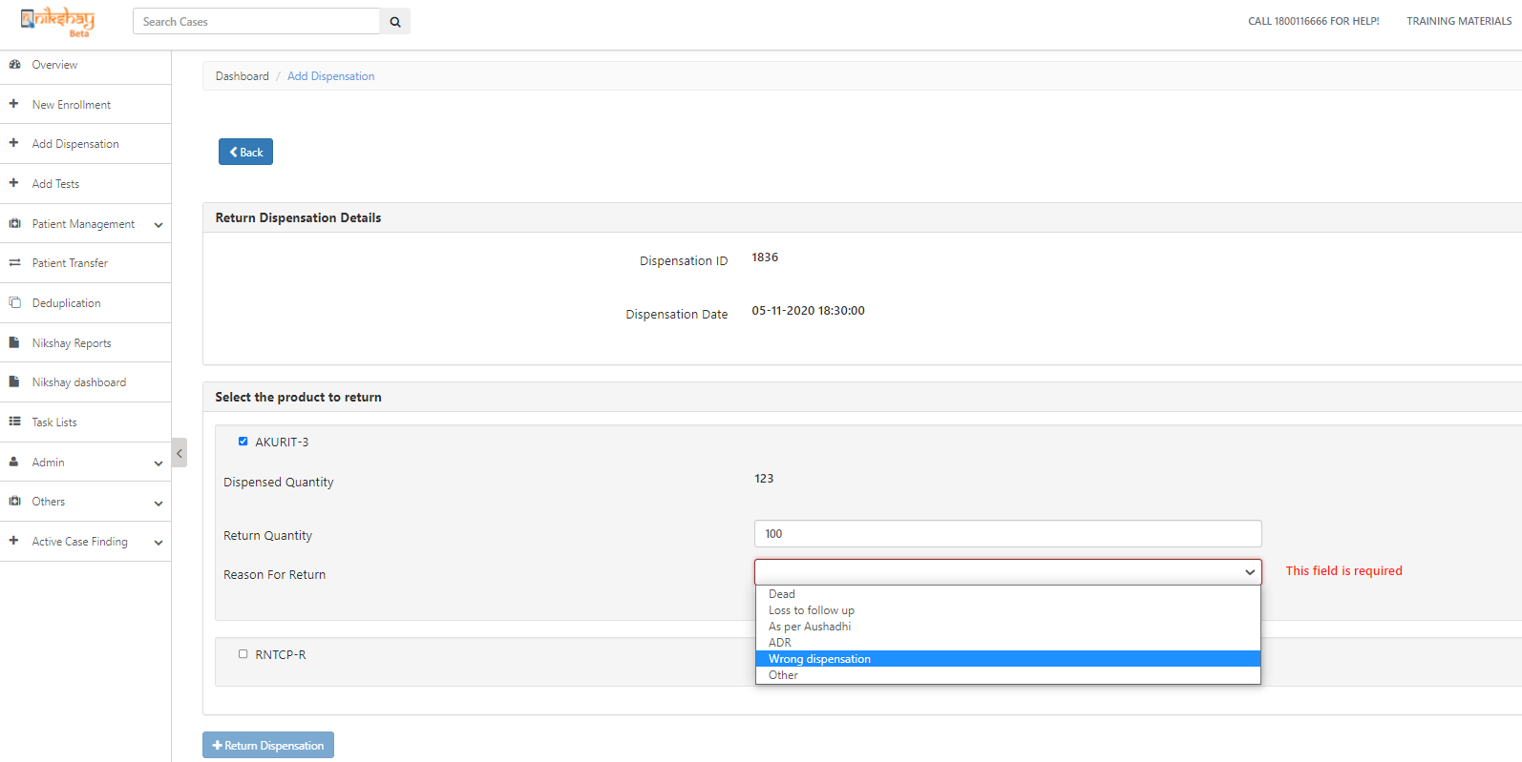
Return Dispensation
click here to go to list of dispensations
Return Dispensation Details
This message pops up after successful return of a dispensation
Enter the quantity of the medicines which is to be returned
Select a reason of the return from the drop down options, a mandatory field for return dispensations
Click here to complete the return of the Dispensation

Slide 32
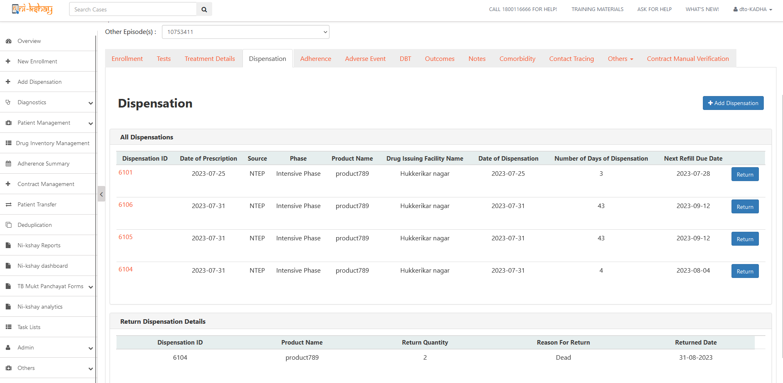
Return Dispensation
History of return dispensation can be seen under patient’s page , which can be navigated through patient’s name or the patient’s ID from Patient management or direct from the Search cases
Details of Returned Dispensations

Slide 33
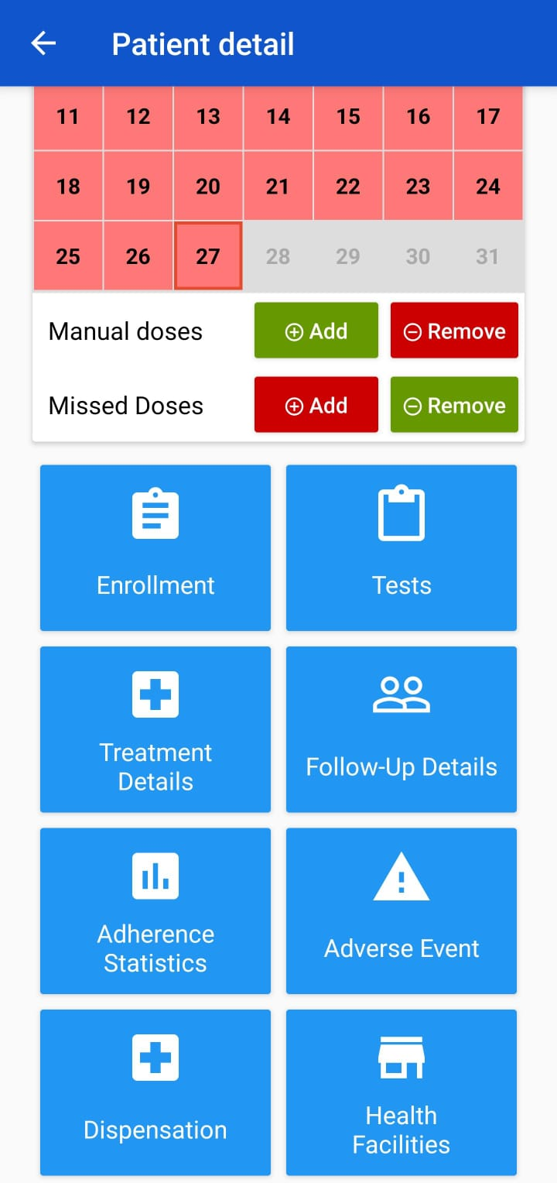
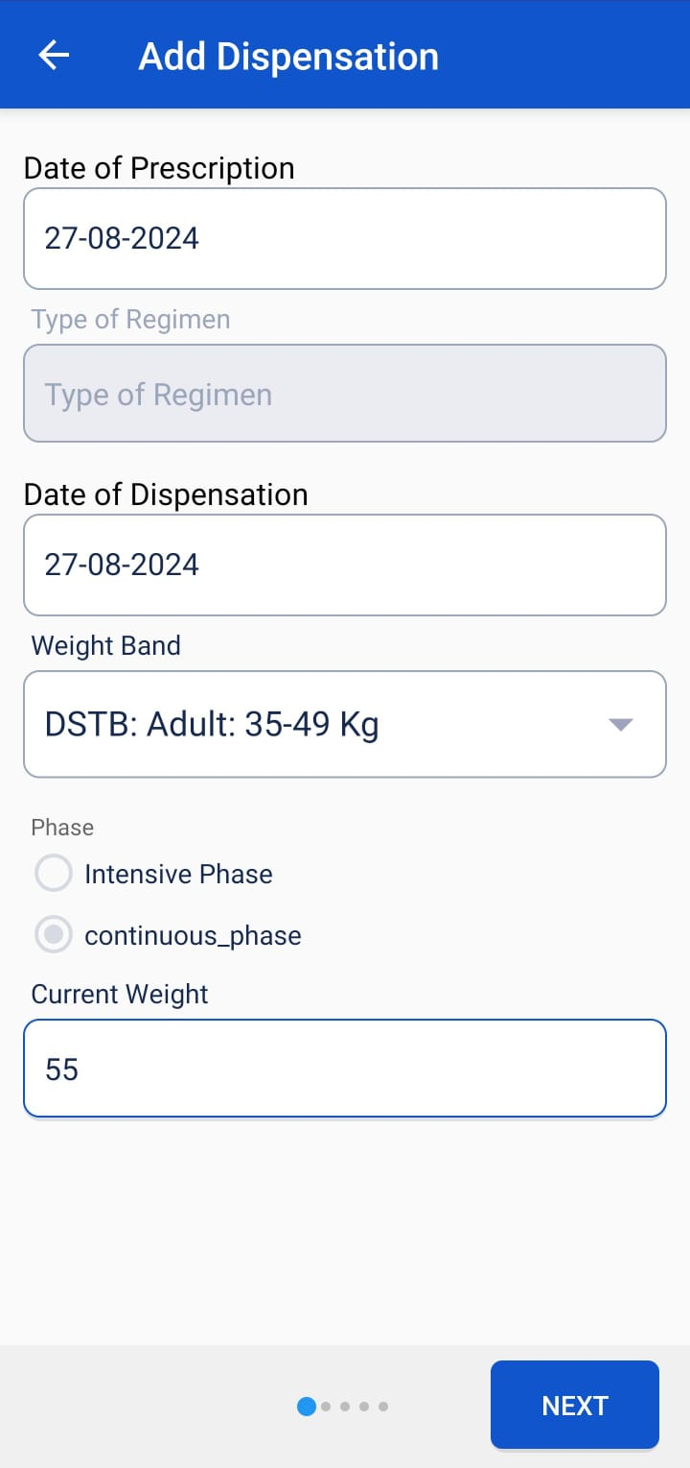
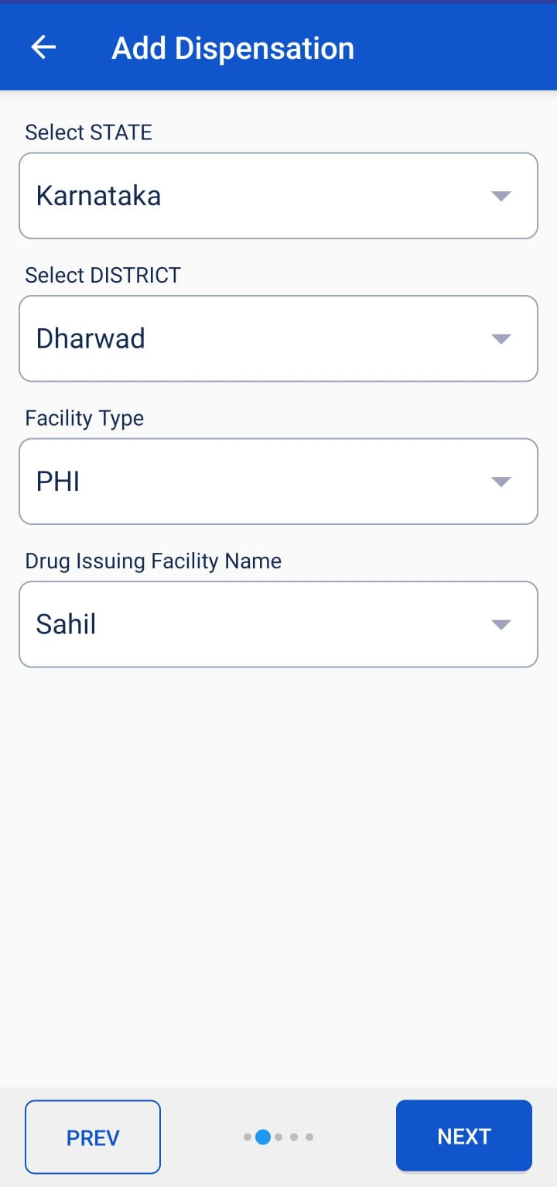
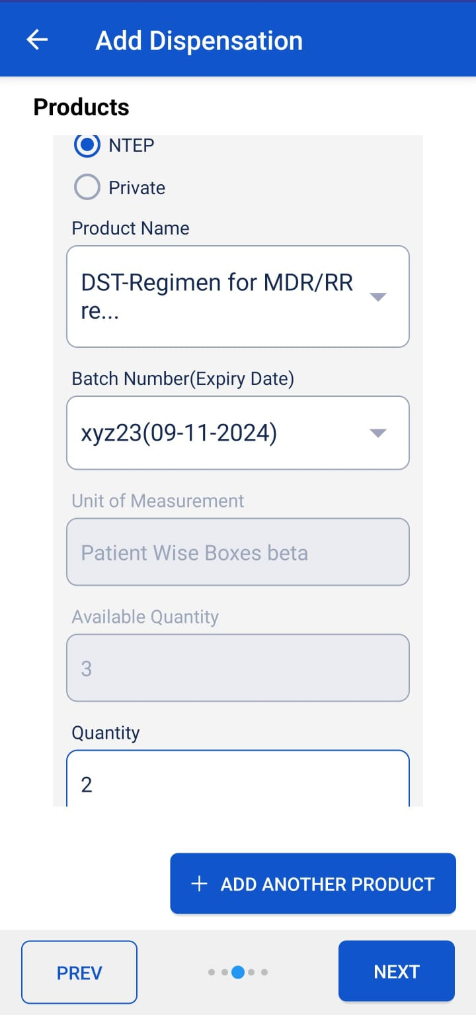
Add Dispensation - App
Step 1
Step 2
Step 3
Step 4
Step 5
Step 1
Step 1
Click on Dispensation
Click on Add Button
Enter Dispensation Details
Enter dispensing facility details
Enter Product details

Slide 34
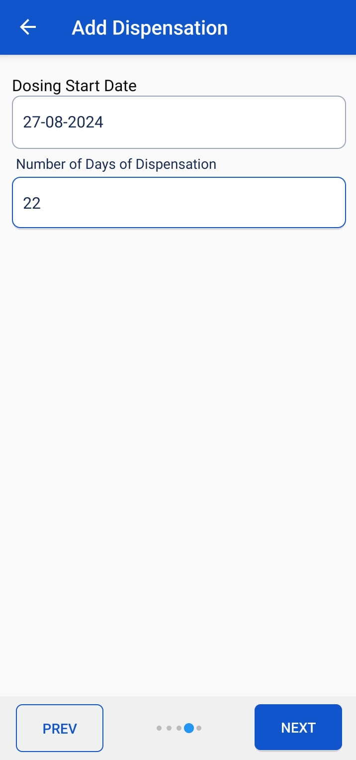
Add Dispensation - App
Step 1
Step 7
Step 1
Step 6
Enter refill details
Click on Add Dispensation

Slide 35
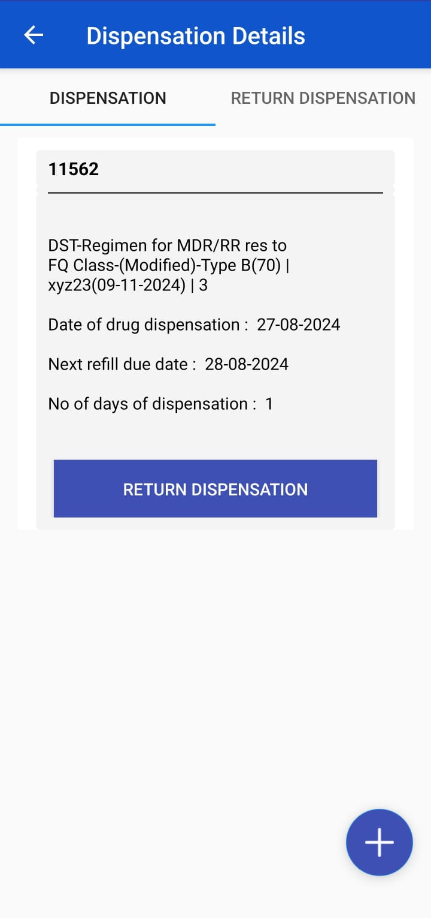
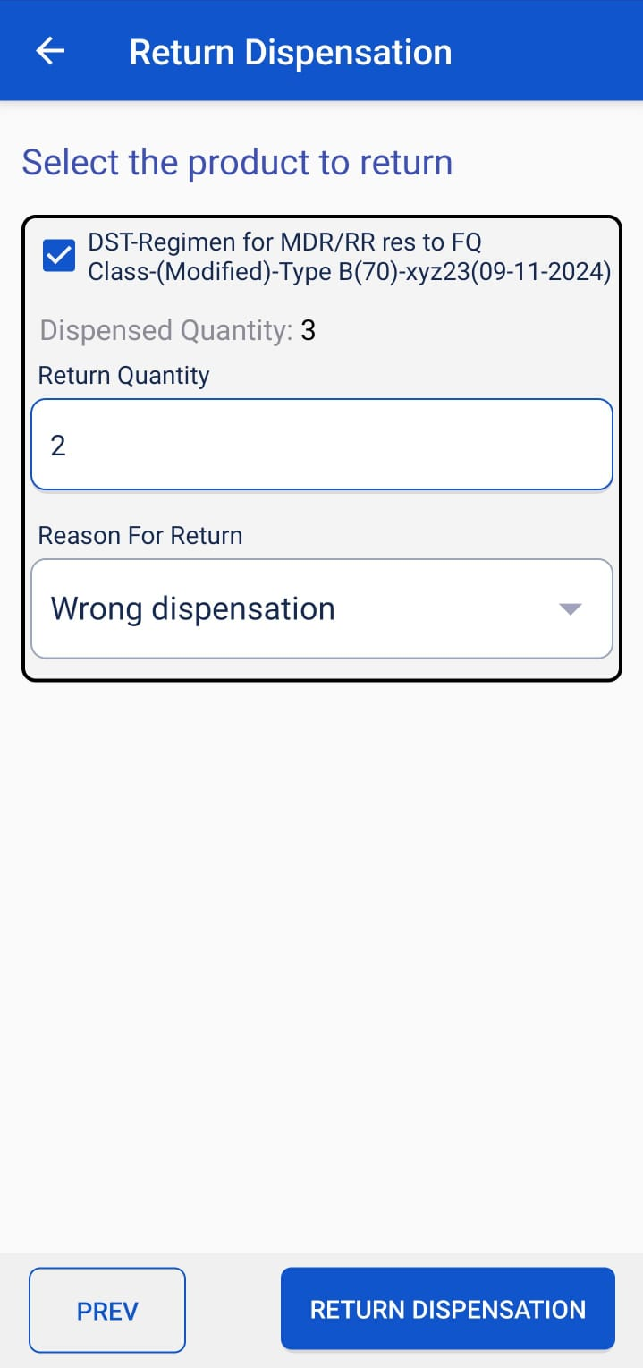
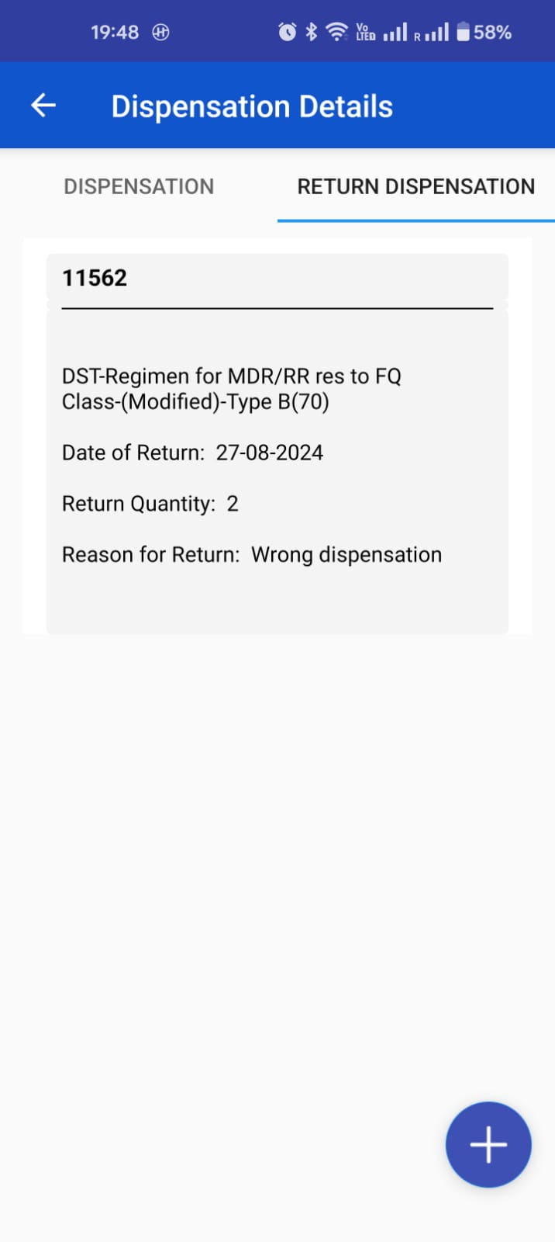
Return Dispensation - App
Step 1
Step 2
Step 3
Step 4
Step 1
Step 1
Click on return Dispensation
Click on Next Button
Enter Details of product to be returned
View return details

Slide 36
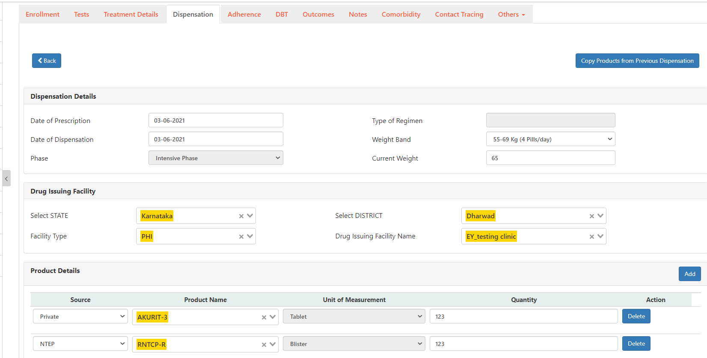
Copy products from previous Dispensation
Click here to copy medicine / products from the previous Dispensation,
this facility is available from the second dispensation record
Product details are getting copied from the previous dispensation including source, product name and quantities

Slide 37
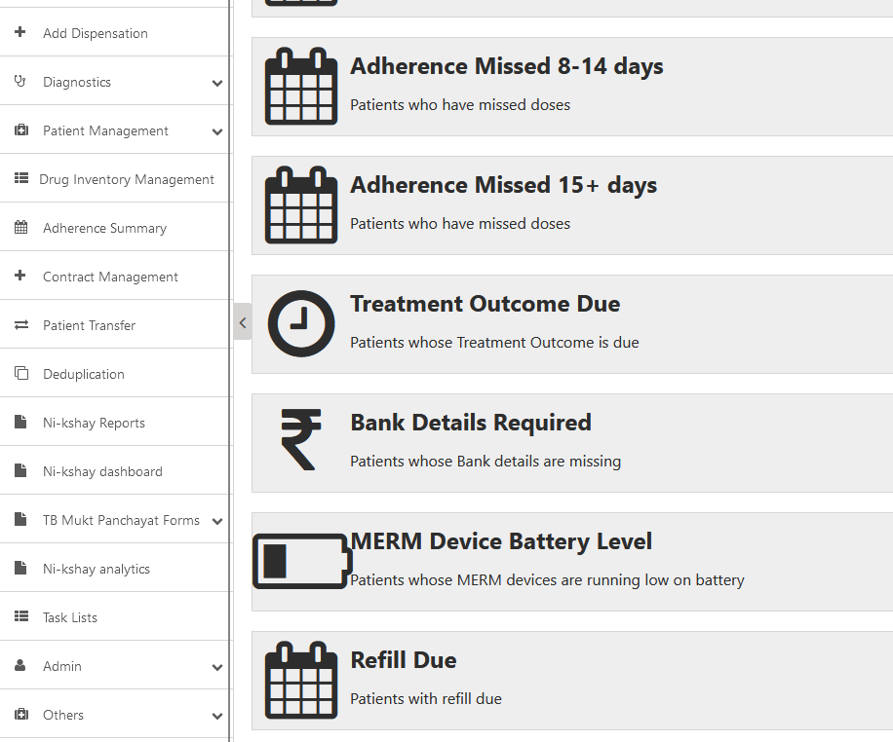
Refill Due Tasklist
The Next Refill Due Date is calculated based on the number of days for which Dispensation is Issued.
Click here to view the list of patients for whom refill is due.

Slide 38
Refill Due Tasklist
If patients have no dispensation details entered, their Date of Diagnosis will be considered as the default ‘Next Refill Date ’
Patient record enters the task list 2 days before their ‘Next Refill Date’.
The patient remains in the task list until his dispensation details are updated.

Slide 39
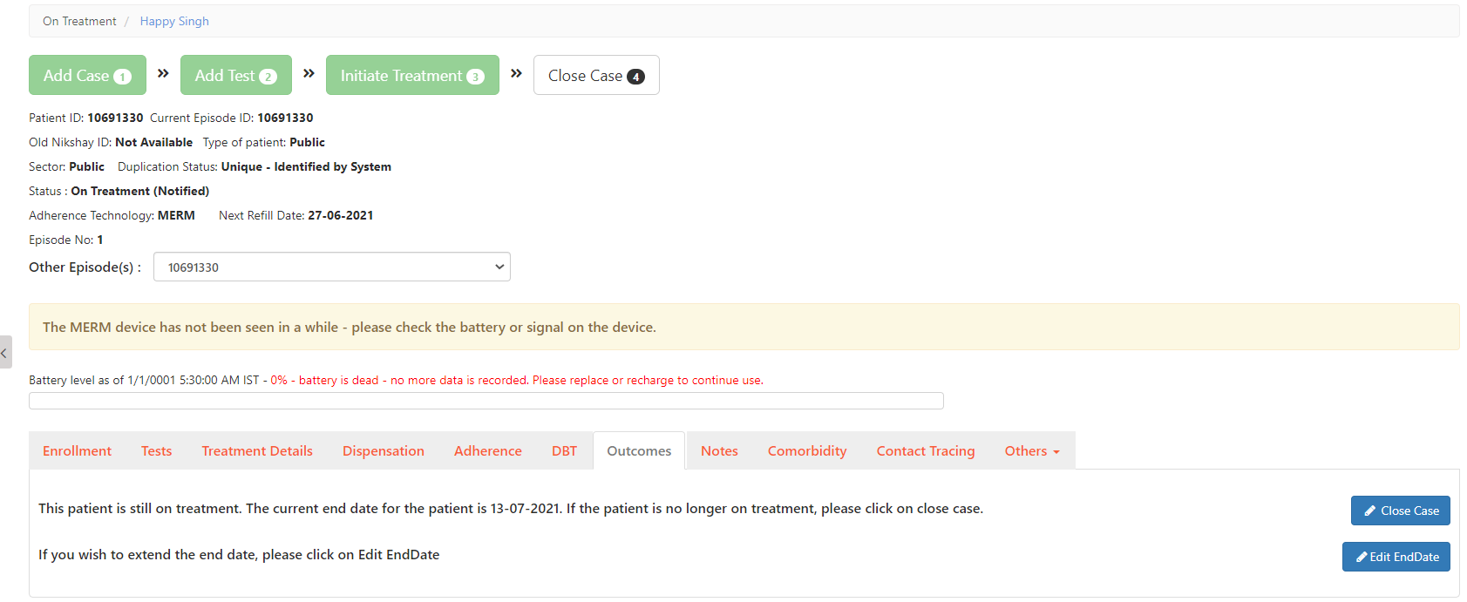
Outcome assignment changes
In the cases where the “Next Refill Due Date” is greater than the treatment end date, the “Treatment End date” is extended.

Slide 40
Outcome assignment changes
Patient Notes also get added with the changes made in the outcome end date I.e. it got extended from 4/20/2021 to 7/13/2021 based on the entry made against the patient ID
Notes:
Note: Patient’s End Date will be increased if the refill due date for the added Dispensation is greater than End date for the patient. If the Patients End date is increased due to a Dispensation there is also a corresponding Note for the same.

Slide 41
Adherence and Dispensation Correlation
Adherence and Dispensation Correlation is defaulted as ‘Yes’ for all notified DSTB Patients and defaulted to ‘No’ for all notified DRTB Patients, but this can be manually turned On/Off by the staff through the ‘Treatment Details Tab’
If Adherence and Dispensation Correlation is selected as ‘Yes’ then staff will be unable to mark manual doses if an active dispensation is not available for the days on which manual doses are being marked.
If Adherence-Dispensation is selected as ‘No’ then staff will be able to mark manual doses irrespective of whether dispensation details are available or not.

Slide 42
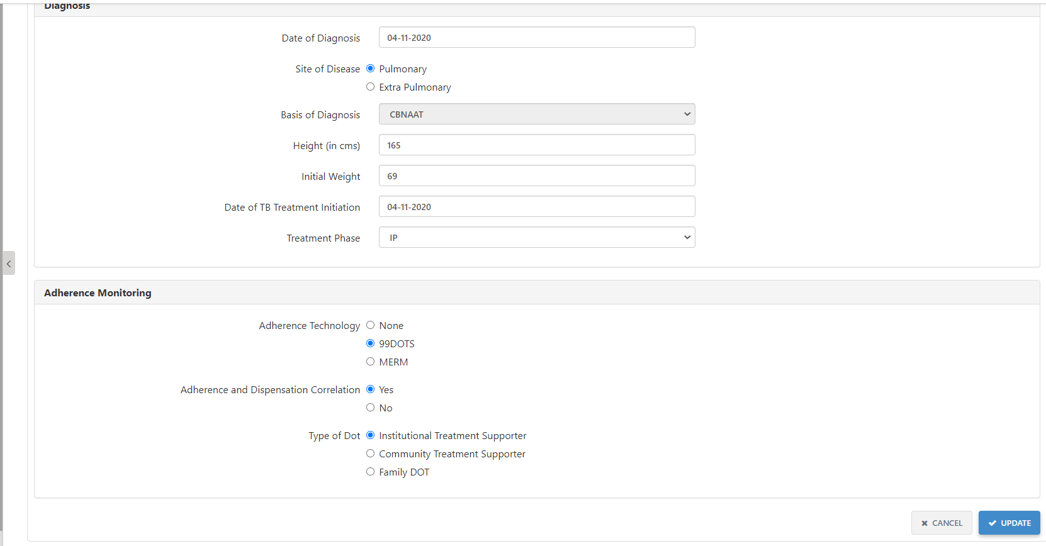
Adherence and Dispensation Correlation
1. Go to Treatment Details>Adherence Monitoring
2. Click on “Yes” in order to enable the “Adherence and Dispensation Correlation” feature. And, once it is marked as “Yes”, it shall not allow manual doses to be marked unless there is an active dispensation
3. Click on Update to save the revised settings

Slide 43
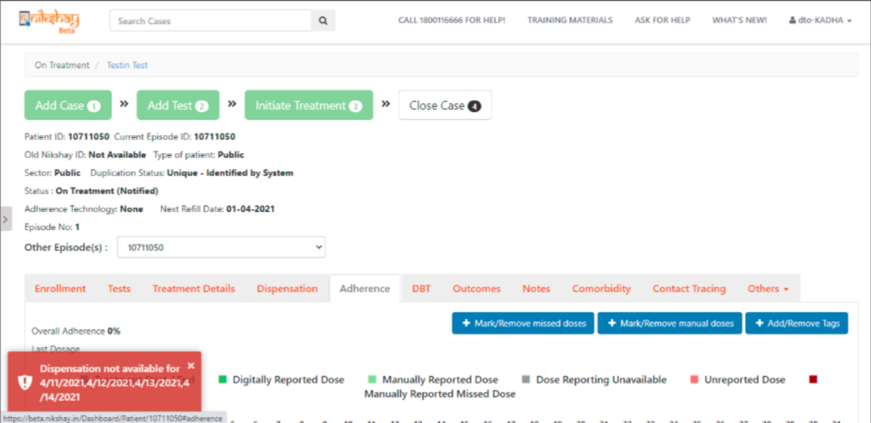
Adherence and Dispensation Correlation
If Adherence and Dispensation Correlation is marked as ‘Yes’ and if manual doses are added if no active dispensation details are available for those dates, then the user will be unable to add manual doses and an error message will be displayed.

Slide 44
Drug Inventory Management
This feature consists with following key points-
In situations wherein users observe a discrepancy in the drug stock mentioned in Ni-kshay and the stock obtained from physical verification, Inventory management feature would enable user to update stock of the drug
The user must update the stock immediately upon observing discrepancy, before proceeding to dispense the drug to patients
Users can update stock of different drugs or multiple batches of same drug using the feature by using the "Add" button at the top
The feature allows updation of stock details at PHI level only
The updated stock is immediately reflected in the Dispensation module for the respective PHI
The feature is available in web and app

Slide 45
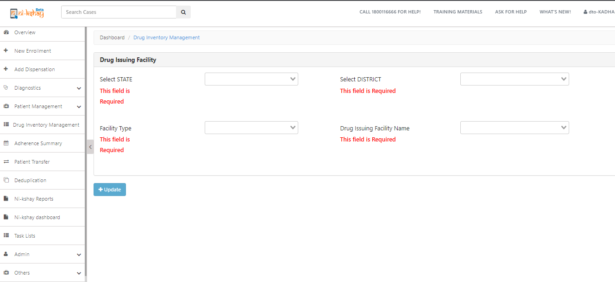
Drug Inventory Management
Step 1
Step 1
Step 1
Click on Drug Inventory Management Tab

Slide 46
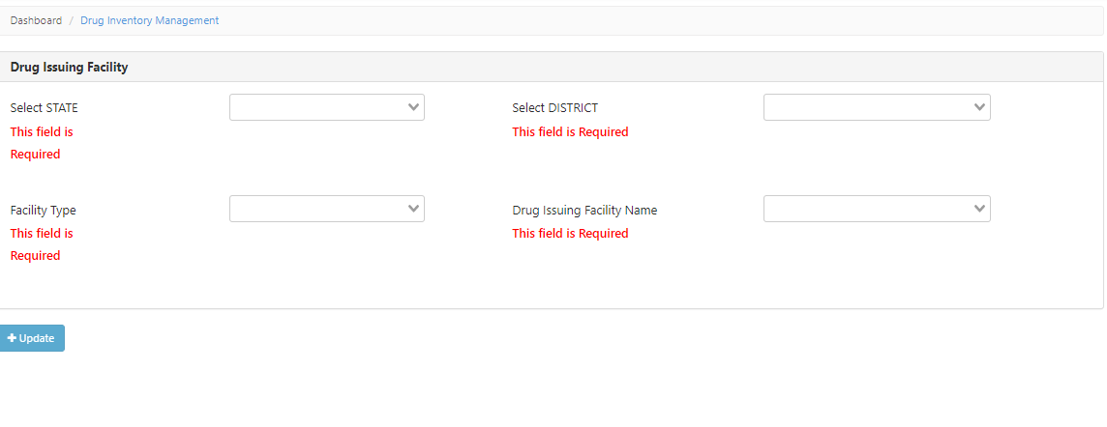
Drug Inventory Management
Step 2
Fill all mandatory hierarchy details
Select State, District, Health facility type (PHI,Chemist & Labs) and Drug Issuing Facility Name

Slide 47
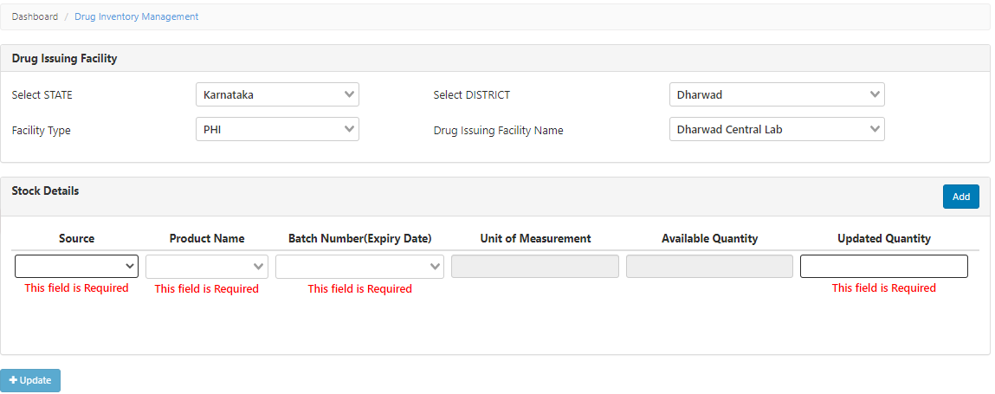
Drug Inventory Management
Step 3
Fill all mandatory details of product
Select the “Source” from the list
Select the prescribed product name from the drop down option, it is a mandatory field.
Select batch number from the dropdown
It is an auto-populated field based on the chosen product
Check available quantity
Enter the updated “Quantity”

Slide 48
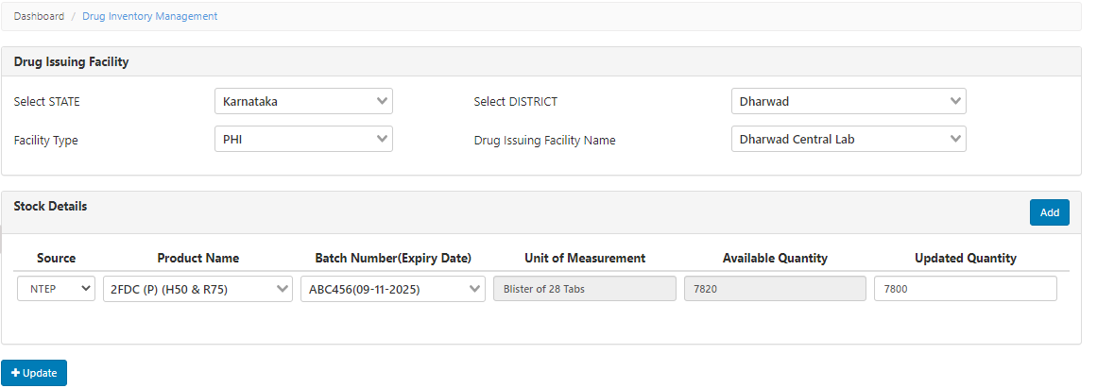
Drug Inventory Management
Step 1
Step 1
Step 4
Select all mandatory field to select product details
Click on add tab for update the quantity of multiple products
Click on Update tab for updating the product quantity
Select Drug source,Product Name,Batch Number and Enter correct available quantity and click on Update tab

Slide 49
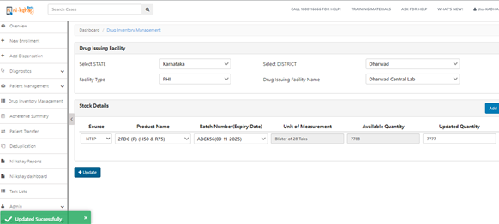
Drug Inventory Management
Step 1
Step 1
Step 5
CLick on update tab to update the latest quantity

Slide 50
Dispensation Register and Report
The below reports and register are created for the Dispensation module-
Dispensation Patient wise register- This report contains the details of the product dispensed (Batch number, expiry date) added to the Patient wise dispensation register
Stock In Hand report- This is an Aggregate reporting of drug consumption levels, including opening stock, closing stock and consumption.
Dispensation Report: This report gives information on the number of notified patients as per their dispensation status (complete details, incomplete details or no details) for the selected time period based on their regimen type.

Slide 51
Dispensation Patient wise register
CurrentFacilityState | DateOfDispensation
CurrentFacilityDistrict | TreatmentPhase
CurrentFacilityTBU | WeightBand
CurrentFacilityPHI | DrugIssuingFacilityState
CurrentFacilityPHIType | DrugIssuingFacilityDistrict
CurrentFacilityPHI_ID | DrugIssuingFacilityTBU
PatientId | DrugIssuingHealthFacility
EpisodeID | TypeOfRegimen
PatientName | DosingStartDate
Age | NumberOfDaysOfDispensation
Gender | RefillDueDate
DiagnosisDate | DispensationId
DateOfTBTreatmentInitiation | ProductSource
CurrentHealthFacilitySector | ProductName
SiteOfDisease | UnitofMeasurement
BasisOfDiagnosis | ProductQuantity
TypeOfCase | NumberOfIssuesProduct
TreatmentStatus | BatchNumber
DateOfPrescription | ExpiryDate
The following fields are available in the dispensation register

Slide 52
Dispensation Patient wise register

Slide 53
Stock In Hand report
The fields available in the Stock In Hand Report are
Drug Issuing Facility State | hierarchy_mapping_id
Drug Issuing Facility District | Product_Source
Drug Issuing Facility TBU | ProductName
Drug Issuing Health Facility | Batch Number
inventory_id | Unit of Measurement
p_inventory_id | Opening Stock
product_id | Closing Stock
 | Patient Consumption

Slide 54
Stock In Hand report
If the report is downloaded for the current month/ quarter then the report shows the stock available at the beginning of the month, the amount consumed during the time duration and the closing stock at the end of the month/quarter.

Slide 55
Dispensation report
The following fields are available in the dispensation report
State Name
State Code
District Name
District Code
TB Unit
Notified Patient
Treatment Phase IP
Treatment Phase CP
Patients With Adherence And Refill Correlation
Patients With Incomplete Dispensation Details
Patients With Complete Dispensation Details
Patients With NTEP Drugs
Patients With Private Drugs
Patients With No Dispensation Details
Patients with Complete dispensation Details => Number of patients on treatment who have dispensation details added for entire duration of treatment. For example, if patient has been on treatment for 100 days, while dispensation information is available for 100 days
Patients with Incomplete dispensation Details => Number of patients on treatment who have dispensation details added for partial duration of treatment. For example, if patient has been on treatment for 100 days, while dispensation information is available for 50 days.

Slide 56
Q1. Where can the user view the stock of all the medicines at their facility (District, TU, and PHI) without open patient’s profile. The stock can be viewed only by the Aushadhi team by using the stock search API. A report would also be made available in Ni-kshay portal on stock and consumption. Q2. How to distribute medicines on the portal from District to TU and TU to PHI? The stock management up to TU level including transfer to PHI would be handled by Aushadhi software, while PHI to patient would be handled by Ni-kshay. Q3. Can we dispense drugs to patients outside the logged in hierarchy? The drugs can be dispensed to patients belonging to any hierarchy even if the patient belongs to a hierarchy other than the logged in hierarchy. The dispensation can be done through the ‘Add dispensation’ module in Ni-kshay.
FAQs..1

Slide 57
Q4. The drugs transferred from TB unit to PHI are not visible in dispensation module PHI stock. The Drugs transferred from TBU to PHI would be visible in the Ni-kshay Aushadhi system. The transfer of drugs from TU to PHI would happen using the stock credit API. A report would be made available in Ni-kshay portal on the PHI stock and consumption. Q5. What is the process of consumption of CBNAAT and Truenat Cartridges, with inactivation of PHI login? Ni-kshay Aushadhi would reopen the PHI Module only for NAAT stores. The CBNAAT and TrueNat consumables would be reported in the NAAT consumable module of Ni-kshay Aushadhi.
Q6. Box preparation of Modified regimen of AOL regimen is not available in Ni-kshay aushadhi. Ni-kshayAushadi team to convert the existing stock of DRTB boxes into loose drugs and the stock to be updated on the system. The updated stock would then be consumed by Ni-kshay using API and available for users to dispense.
FAQs..2

Slide 58
Q4. Districts are not able to view PHI drug stock as a whole, It can only be viewed while dispensing to every patient. Which makes it difficult to assess the requirement of PHI Since Ni-kshay is handling the dispensation of drugs from PHI to patient, the available quantity of a particular product will be available only while dispensing the product. A report would be made available in Ni-kshay portal on the PHI stock and consumption that can be used to check the stock levels of the products. Q5. Dispensation module is not allowing to directly dispense drugs of Continuation Phase. For patients whom drugs have already been issued from Ni-kshay aushadhi, if we issue drugs in back date the current drug stock of PHI is getting deducted leading to imbalance in stock. All the TB patients are registered in Ni-kshay and undergo Intensive and Continuous phases of treatment. The drugs can be dispensed from Ni-kshay for current or future dispensation date. For dispensing drugs for Continuous Phase for a patient currently on IP, follow the below steps- 1. In the Patient management module, go to Treatment details tab of the patient. 2. Click the ‘Update’ button to update the Treatment Phase to CP 3. Add the End of IP date as a back date or a future date. 4. Go to Dispensation tab of the patient, where the Phase would be changed to CP 5. Dispense the drugs for CP phase.
FAQs..3

Slide 59
Q6. Currently Drug can be dispensed for any no. of days with patient’s Id. The limit should be fixed to maximum 60 days. This would help in buffer stock management, monitoring and minimizing the retrieval/wastage. This requirement will be discussed with the ministry and upon approval, this can be added in the future changes for Dispensation module.
Q7. Users unable to dispense NTEP drugs from private chemist and private health facility. Private Health facilities and chemists which are presently registered as third-parties will be registered as Health facilities in Ni-kshay Aushadhi and the NTEP drug stock will be updated for the same. Ni-kshay will consume the stock status of these facilities from Ni-kshay Aushadhi and make it available to users for dispensation Q8. The district alert dashboards shows acknowledgement pending in Ni-kshay Aushadhi . How can phi acknowledge without login to PHI module? Ni-kshay Aushadhi will disable the feature of acknowledging the drugs from PHI module from backend
FAQs..4

Slide 60
Q9. How will the drugs be indented from PHI to TU? The PHIs would submit their drug request to their parent stores (TU) through Offline indenting i.e. via email, Phone, or any other method. On receipt of Offline Indent, the respective TU would release the drugs to the PHI through the TU login in Ni-kshay Aushadhi using : Dispatch without drug request” under Issue / Dispatch Module.
Q10. how to return drug from DRTB/ PHI to DDS/ TU? The return from PHI to TU would be handled by Ni-kshay Aushadhi using the backend stock debit API. Q10. Should the PHI dispense lab consumables like head covers, shoe covers etc through Patient login in Ni-kshay? The PHI dispense lab consumables like head covers, shoe covers etc should not be dispensed through Patient login in Ni-kshay . These products are for PHI use and should be consumed only at PHI level.
FAQs..5

Slide 61
Contents
Start Treatment
Add Prescription
Add Co morbidity
Contact Tracing
Adherence Tracking
Closing case
Reinitiating case
Update/view health facilities
Transferring a patient
Patient notes
CBNAAT Test to Ni-kshay
ACF
Tasklist
Followup module

Slide 62
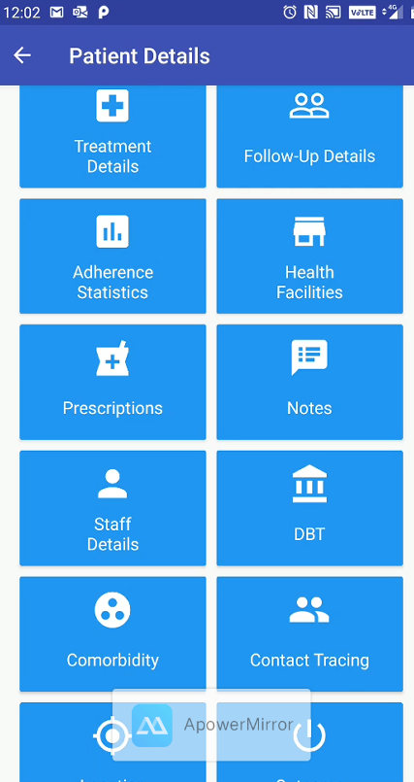
Add Comorbidity
Comorbidity refers to the presence of one or more additional diseases or disorders co-occurring with a primary disease or disorder.
In this section, HIV Information, Diabetes Information and Additional Information like Tobacco user or not, Alcohol intake etc can be added for a patient.
All the comorbidity details added for a given patient are visible to the User

Slide 63
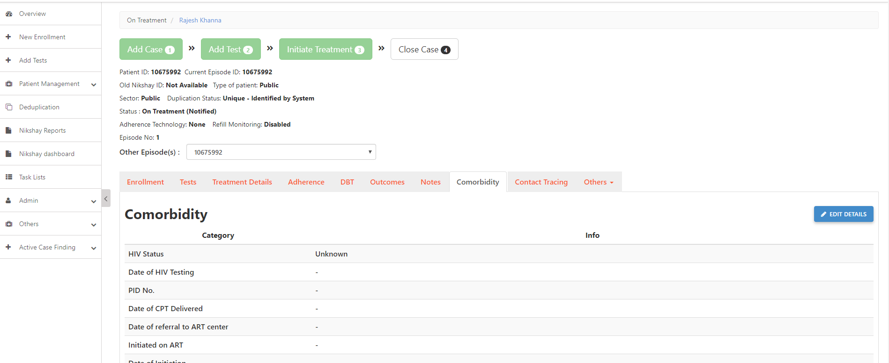
Add Comorbidity
Step 1
Click on Comorbidity

Slide 64
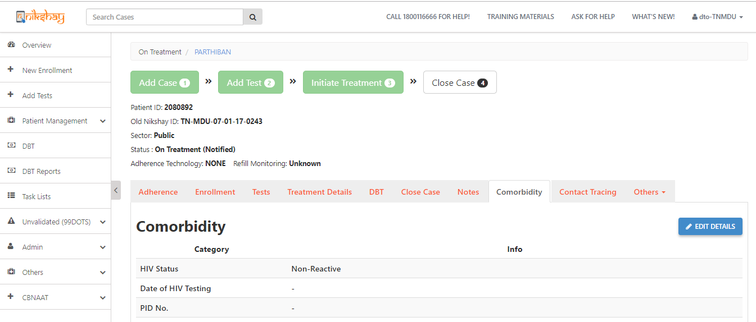
Add Comorbidity
Step 1
Step 2
Click on Comorbidity
Click Edit Details
Click here to add Comorbidity Details
Please Note that all fields are not Mandatory in Comorbidity section. The Staffs can fill the fields whichever they know

Slide 65
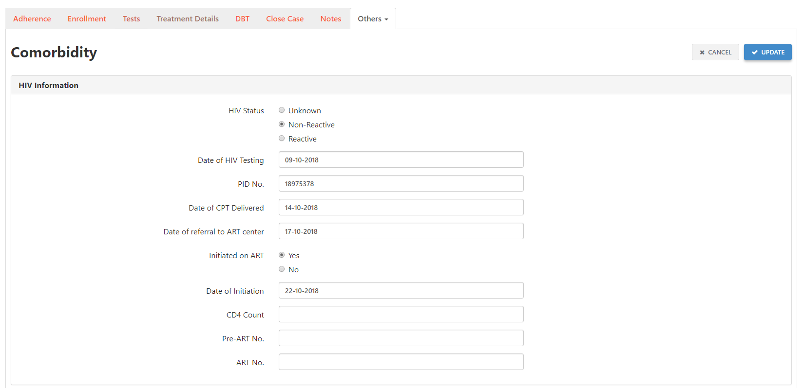
Add Comorbidity
Step 1
Step 2
Step 3
Click on Comorbidity
Click Edit Details
Add Comorbidity Details
Select HIV Status
Click here to Update Comorbidity Details
Fill HIV Related details for that Patient
Select the Date of Initiation at ART Centre
Select whether the Patient is Initiated in ART centre or not
Enter the Latest CD4 Count
Please Note that all fields are not Mandatory in Comorbidity section. The Staffs can fill the fields whichever they know

Slide 66
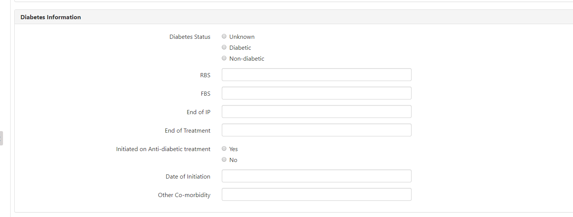
Add Comorbidity
Step 1
Step 2
Step 3
Click on Comorbidity
Click Edit Details
Add Comorbidity Details
Select the Diabetes Status for the Patient
Fill Diabetes Related details for the Patient
Select whether the Patient is initiated for Anti-Diabetic Treatment
Select the date of Initiation of Anti-Diabetic Treatment
Enter any other Co-Morbidity
Please Note that all fields are not Mandatory in Comorbidity section. The Staffs can fill the fields whichever they know

Slide 67
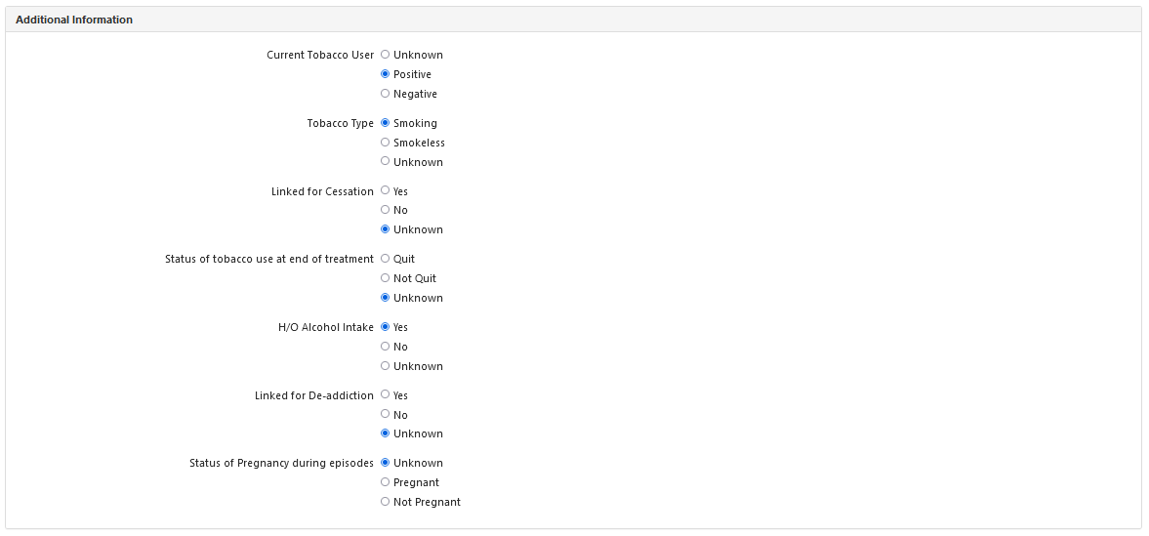
Add Comorbidity
Step 1
Step 2
Step 3
Click on Comorbidity
Click Edit Details
Add Comorbidity Details
Please Note that all fields are not Mandatory in Comorbidity section. The Staffs can fill the fields whichever they know

Slide 68
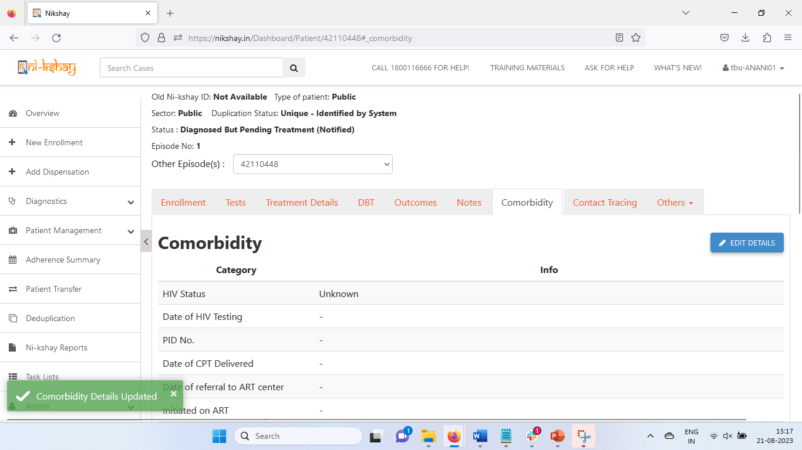
Add Comorbidity
Step 1
Step 2
Step 3
Click on Comorbidity
Click Edit Details
Add Comorbidity Details
One can Edit the Comorbidity Details at any time by clicking this button
Message Displayed After Successfully updating Comorbidity Details
Please Note that all fields are not Mandatory in Comorbidity section. The Staffs can fill the fields whichever they know

Slide 69
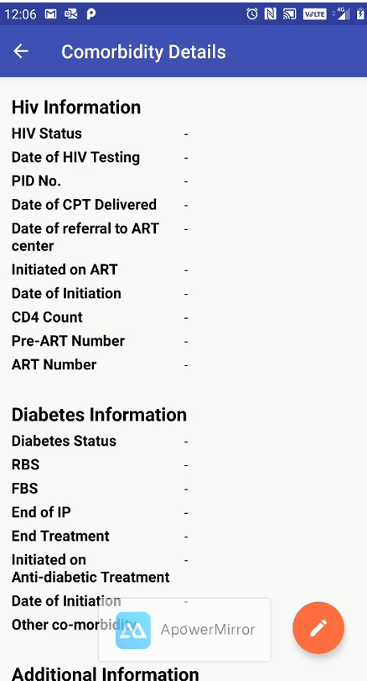
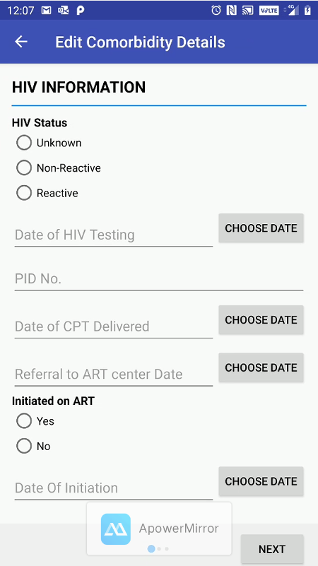
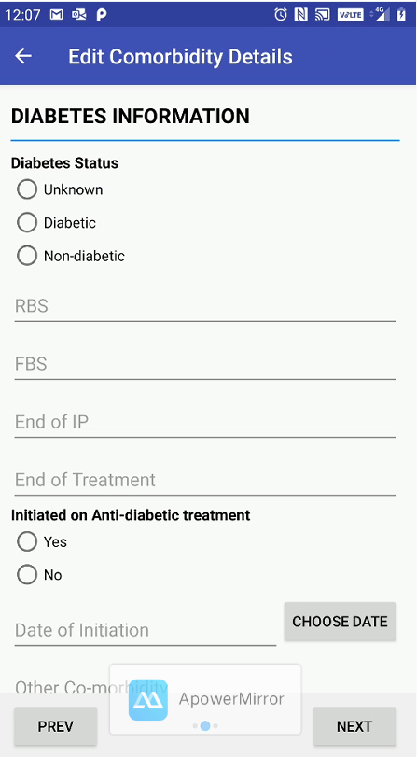
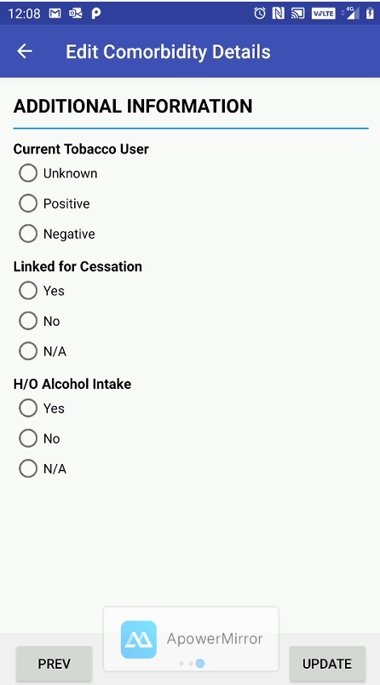
Add Comorbidity- Mobile version
Step 1
Step 2
Step 3
Click on Comorbidity
Click Edit Details
Add Comorbidity Details
Please Note that all fields are not Mandatory in Comorbidity section. The Staffs can fill the fields whichever they know

Slide 70
Contents
Start Treatment
Add Prescription
Add Co morbidity
Contact Tracing
Adherence Tracking
Closing case
Reinitiating case
Update/view health facilities
Transferring a patient
Patient notes
CBNAAT Test to Ni-kshay
ACF
Tasklist
Followup module

Slide 71
Contact Tracing
Contact Tracing
Contact Tracing is a process of screening all household members in contact with the TB patients including Children less than the age of six.
Contact tracing is very necessary to establish the primary source of the TB disease and to detect all those who are secondary infected for proper diagnosis and prompt treatment
Under Contact Tracing tab, the details of other household members of the patient could be added.
All the Contact Tracing details added for a given patient are visible to the User

Slide 72
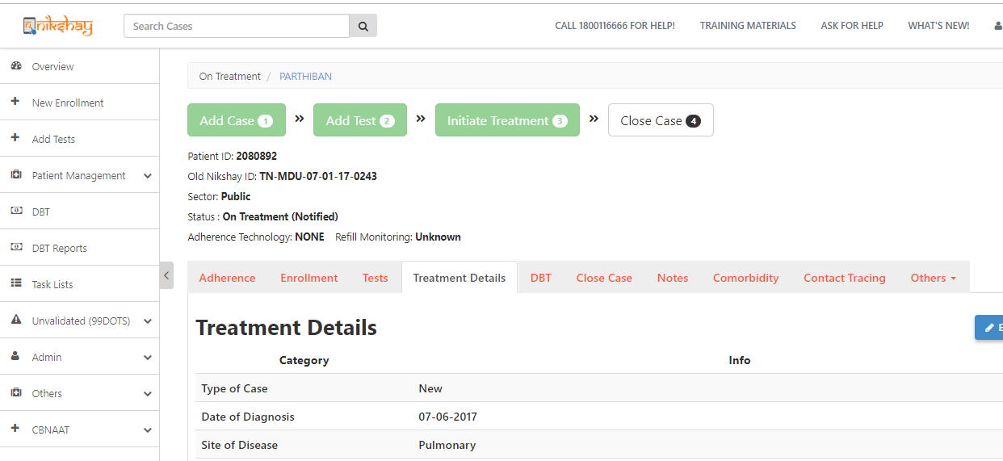
Contact Tracing
Step 1
Click on Contact Tracing

Slide 73
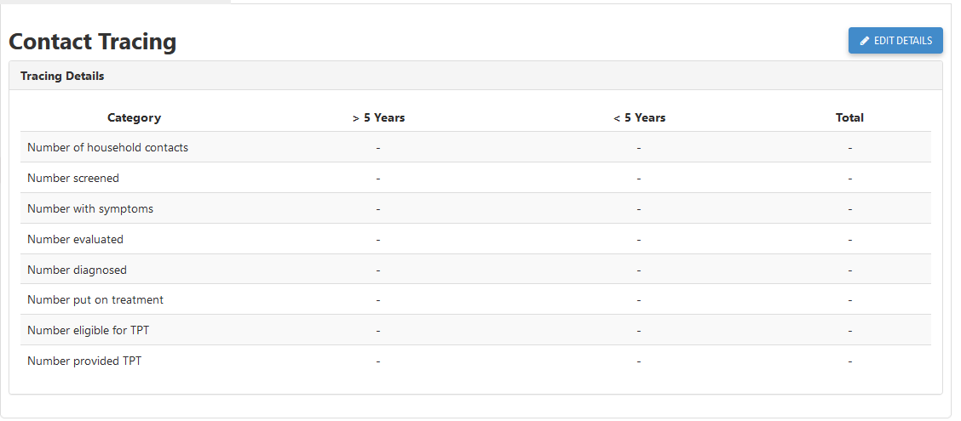
Contact Tracing
Step 1
Step 2
Click on Contact Tracing
Click Edit Details
Click here to add Contact Tracing Details
Please Note that all fields are not Mandatory in Contact Tracing section. The Staffs can fill the fields whichever they know

Slide 74
Contact Tracing
Step 1
Step 2
Step 3
Click on Contact Tracing
Click Edit Details
Add Contact Tracing Details
Click here to update Contact Tracing Details
Fill the Contact Tracing Details of members aged above 5 years old
Fill the Contact Tracing Details of members aged below 5 years old
Please Note that all fields are not Mandatory in Contact Tracing section. The Staffs can fill the fields whichever they know

Slide 75
Contact Tracing
Step 1
Step 2
Step 3
Click on Contact Tracing
Click Edit Details
Add Contact Tracing Details
Click here to edit the submittedd details.
Click here to enrol contacts

Slide 76
Contact Tracing- mobile version
Step 2
Step 3
Step 4
Step 1
Click Edit Details
Click on Contact Tracing
Add Contact Tracing Details
Click on Update

Slide 77
Contents
Start Treatment
Add Prescription
Add Co morbidity
Contact Tracing
Adherence Tracking and management
Closing case
Reinitiating case
Update/view health facilities
Transferring a patient
Patient notes
CBNAAT Test to Ni-kshay
ACF
Tasklist
Followup module

Slide 78
Adherence Tracking
As soon as the Patient’s treatment details are entered and, Patient’s status changes to “On treatment”, the ”Adherence” section is displayed
Ni-kshay 2.0 is integrated with ICT Based adherence technologies of 99DOTS and MERM.
If a 99 DOTS patient makes a call or if a MERM Patient opens his Medicine box to indicate dose taken, Adherence calendar gets updated.
The Adherence Calendar can also be manually updated for Missed dose or Dose taken
Adherence details for a date range can be updated by selecting multiple dates
Tags (Remarks) can also be added for later reference

Slide 79
Manual Adherence update
Step 1
Step 2
Click on Adherence
Record Manual Dose
Section is visible as Treatment details are entered
Click here to mark doses manually
Not available in mobile version

Slide 80
Manual Adherence update
Step 1
Step 2
Click on Adherence
Record Manual Dose
After selecting dates, click here to confirm
Click here to cancel
Select dates

Slide 81
Manual Adherence update
Step 1
Step 2
Click on Adherence
Record Manual Dose
In confirmation window, dates for which adherence is being updated is displayed
Enter remarks here (if required)
Click here to submit

Slide 82
Manual Adherence update
Step 1
Step 2
Step 2
Click on Adherence
Record Manual Dose
View Calendar
Calendar updated with light green colour as manually updated as dose taken)

Slide 83
Manual Adherence update
Step 1
Step 2
Step 2
Click on Adherence
Record Manual Dose
View Calendar
Calendar updated with maroon colour as manually updated as missed dose)

Slide 84
Manual Adherence update
Step 1
Step 2
Step 2
Step 4
Click on Adherence
Record Manual Dose
View Calendar
Add Tags
Select dates to be tagged

Slide 85
Manual Adherence update
Step 1
Step 2
Step 2
Step 4
Click on Adherence
Record Manual Dose
View Calendar
Add Tags
Can select multiple tags

Slide 86
Manual Adherence update
Step 1
Step 2
Step 2
Step 4
Step 4
Click on Adherence
Record Manual Dose
View Calendar
Add Tags (optional)
View Tags
On hovering mouse tags are displayed

Slide 87
Adherence Monitoring in Ni-kshay Version 2.0
In Ni-kshay Version 2.0, one can monitor adherence in the following ways:
Using On Treatment List (Notified) in Web Dashboard (NOT AVAILABLE IN MOBILE)
Using Patient Page in Web Dashboard
Using Notification Report in Web Dashboard

Slide 88
Adherence Monitoring - Using On Treatment Calendar in Web Dashboard
Step 1 – From Patient Management meu select On Treatment List (Notified) option
Step 2 – Select from Calendar/ List

Slide 89
Adherence Monitoring - Using On Treatment Calendar in Web Dashboard
Step 1 – From Patient Management meu select On Treatment List (Notified) option
Step 2 – Select from Calendar/ List

Slide 90
Adherence Monitoring - Using On Treatment Calendar in Web Dashboard
Step 3 – From the calendar view, click on the Tech column to sort the list as per adherence technology. Once you click sort the list will group patients on 99D, MERM and No technology options
Step 4 – Here you can view adherence calendar of all patients in that hierarchy. You can right-click on the patient name to open the individual patient calendar in a new window.

Slide 91
Adherence Monitoring - Using Patient Page in Web Dashboard
From the patient page in web dashboard, you can view the adherence calendar and also see overall adherence, technology only adherence, the type of adherence technology the patient is using, and you can also mark manual and missed doses.

Slide 92
Contents
Start Treatment
Add Prescription
Add Co morbidity
Contact Tracing
Adherence Tracking and management
Closing case
Reinitiating case
Update/view health facilities
Transferring a patient
Patient notes
CBNAAT Test to Ni-kshay
ACF
Tasklist
Followup module

Slide 93
Closing Cases / Assigning Outcomes
Closing Cases/ Assigning Outcomes
A case record submitted to Ni-kshay is tracked till a logical end point.
The type of logical end will depend on whether the case is Diagnosed/Notified and whether treatment was initiated or not
For Cases that are Test Pending → convert to TB Not Confirmed
For Cases Treatment has not been started → Assign Notification Outcome or the reason for not initiating on treatment
For cases that have stopped/ completed treatment→ Assign Treatment outcome.
Moving a case to its logical end is called Closing a case.
A patient’s record may be closed by going to the Close Case tab in the patient management interface.

Slide 94
Closing Test Pending cases
Step 1
Click on Diagnosis Pending

Slide 95
Closing Test Pending cases
Step 1
Step 2
Click on Test Pending
Select Patient

Slide 96
Closing Test Pending cases
Step 1
Step 2
Step 3
Click on Test Pending
Select Patients
Click on outcomes tab in Patient’s Page
Click on Outcomes
Click on close case

Slide 97
Closing Test Pending cases
Step 1
Step 2
Step 3
Step 4
Click on Test Pending
Select patient
Click on the Patient Name to assign outcome
Select the reason for closing case and click Submit
Confirm by selecting case not diagnosed as TB
Click Submit

Slide 98
Closing Test Pending cases
Verify that the status is changed to Presumptive(Closed)
Confirm Status change to Presumptive (Closed)

Slide 99
Closing Notified (Treatment Not started) Cases
Step 1
Step 1
Click on Treatment Not Started
Click on Treatment not started

Slide 100
Closing Notified (Treatment Not started) Cases
Step 1
Step 2
Click on Treatment not started
Select Patient
Click to get list of patients

Slide 101
Closing Notified (Treatment Not started) Cases
Step 1
Step 2
Step 3
Click on Test Pending
Select Patient
Click on outcomes tab in Patient’s Page
Click on Outcomes
Click on close case

Slide 102
Closing Notified (Treatment Not started) Cases
Step 1
Step 2
Step 3
Step 4
Click on Test Pending
Select Patient
Click on outcomes tab in Patient’s Page
Select reason for closing
Reason for closing
Click here to complete assigning outcome.
Patients current end date

Slide 103
Assign Treatment Outcome
Step 1
Step 2
Step 3
Open the Patient’s Page
Click on the Close Case Tab
Click Close Case Button
White color box indicates that case is Open
Status of patient is “On Treatment”
Click here to Close Case

Slide 104
Assign Treatment Outcome
Step 1
Step 2
Step 3
Step 4
Open the Patient’s Page
Click on the Close Case Tab
Click Close Case Button
Select the reason for closing case and click Submit
Click on Submit
Select outcome
Enter Outcome date

Slide 105
Assign Treatment Outcome
Verify that the status is changed to Outcome Assigned(Notified)
Green color box Indicates Outcome has been updated
Status of patient is “Outcome Assigned”

Slide 106
Edit Treatment Outcome date
Click on Edit End Date button to change the end date of the beneficiary record .

Slide 107
Contents
Start Treatment
Add Prescription
Add Co morbidity
Contact Tracing
Adherence Tracking and management
Closing case
Reinitiating case
Update/view health facilities
Transferring a patient
Patient notes
CBNAAT Test to Ni-kshay
ACF
Tasklist
Followup module

Slide 108
Reopening case
Step 1
Step 2
Step 3
Open the Patient’s Page
Click on the Reopen Case Tab
Click Reopen Case Button
Shows Treatment outcome updated earlier
Click here to edit treatment outcome details

Slide 109
Reopening case
Step 1
Step 2
Step 3
Step 4
Open the Patient’s Page
Click on the Reopen Case Tab
Click Reopen Case Button
Select the End Date for that Patient and click Submit
Click on Submit
Edit date and click on Submit

Slide 110
Re-initiating a case on new episode
Re-Initiating a Case on New Episodes
This feature allows to add multiple episodes for a patient. User can re-initiate an outcome assigned case.
Using this option, we can retain the enrolment details for the same patient.
Using this option we can view previous episodes for the same patient in the Patient Management Page.

Slide 111
Re-initiating a Case on New Episode
Step 2
Step 3
Step 1
Open the Patient’s Page
Click on the Reopen Case Tab
Click “CLICK HERE TO REINITIATE CASE ON NEW EPISODE”
Click here

Slide 112
Re-initiating a Case on New Episode
Step 2
Step 3
Step 4
Step 5
Step 1
Click “+ADD CASE AND PROCEED TO ADD TEST”
Open the Patient’s Page
Click on the Reopen Case Tab
Click “CLICK HERE TO REINITIATE CASE ON NEW EPISODE”
Fill the Enrolment form with required fields
Fill the Enrolment form with required fields.
A New Patient/Episode ID is generated once enrolment form is filled and case is added
Click here

Slide 113
Re-initiating a Case on New Episode
Step 1
Step 2
Click “+New Enrollment”
Click “IS THIS CASE ALREADY ENROLLED?”
Enter the Episode or Patient ID for the existing patient
One can also add a new episode to the patient by using the “+New Enrollment” tab in the home page, once you click that tab in the right corner click “IS THIS CASE ALREADY ENROLLED?”
After Entering the Patient or Episode ID, the enrolment form will open and the user can enter required fields and can click Add Case to generate a new Patient or Episode ID

Slide 114
Re-initiating a Case on New Episode
Once a new episode is created then, the status for that episode is changed to Presumptive Open
One can select the other episodes for that patient in the Patient Management Page.
In a Patient Management Page an user can toggle between the various episodes added for that patient.

Slide 115
Contents
Start Treatment
Add Prescription
Add Co morbidity
Contact Tracing
Adherence Tracking and management
Closing case
Reinitiating case
Update/view health facilities
Transferring a patient
Patient notes
CBNAAT Test to Ni-kshay
ACF
Tasklist
Followup module

Slide 116
Update / View patient Health Facility details
The following Health Facilitates associated with the patient are visible in this section:
Enrolment Facility- The facility that enrols a Patient.
Diagnosing Facility- The facility that adds a positive test result.
Current Facility (can be edited)- The current facility where the patient takes treatment.
Residence Facility (Coming soon)
ART Facility (if any)
DR TB Facility (if any)

Slide 117
Update / View patient Health Facility details
Step 1
Click on Health Facilities

Slide 118
Update / View patient Health Facility details
Step 1
Click on Health Facilities
The Health Facilitates associated with the patient are displayed here

Slide 119
Contents
Start Treatment
Add Prescription
Add Co morbidity
Contact Tracing
Adherence Tracking and management
Closing case
Reinitiating case
Delete a case
Update/view health facilities
Transferring a patient
Patient notes
CBNAAT Test to Ni-kshay
ACF
Tasklist
Followup module

Slide 120
Introduction
This module enables transfer request of patients between health facilities across the country. Users make requests of two types - “Transfer In” and “Transfer Out”.
These request are made visible in the Transfer page with 3 tabs -
“Transfer In” - View list of all patients where requests for Transfer In are pending (with either the user logged in or someone else).
“Transfer Out” - View list of all patients where requests for Transfer out are pending. (The option to request transfer out is available in Patient Page>Health Facilities)
Request for Transfer In - In this tab, you can search a patient currently in any other geography or PHI using “Patient ID”/ “Episode Id” or “Patient Mobile Number” and initiate a request transfer in.
NOTE:
All transfer requests needs to be accepted by “District/TU/PHI” to where the transfer request is made to, in order for it to take effect.
Transfer requests can be made to even the District/TU level. However, it can be completed only once the “Transferred To PHI” has been assigned.

Slide 121
Transfer Management
Click on ‘Patient Transfer’ to view the Transfer Module

Slide 122
Transfer Management
List of Patients Transferred out from your district to another district that are pending acceptance
Summary to alert users of pending Transfer Requests with either you or others
Initiate a transfer in request for patients who are currently in another District / TU / PHI.
List of Patients Transferred in from other District /TU/ PHI to your district that are pending acceptance
Transfer approval is pending with other users
Transfer approval is pending with me

Slide 123
Contents
Request Transfer Out
Initiate the Transfer out Request (by Source PHI/TU/District)
Accept Transfer in (by receiving PHI/TU/District)
Reject Transfer in (by receiving PHI/TU/District)
Request Transfer in
Initiate the Transfer in Request
Accept Transfer out (by Source PHI/TU/District)
Reject Transfer out (by Source PHI/TU/District)
Cancel the transfer in request (By receiving PHI/TU/District)

Slide 124
1a. Request Transfer Out
Initiate move of patients to a PHI outside your geography

Slide 125
Initiate Transfer Out request-1
Step 1
Click on ‘Others’

Slide 126
Initiate Transfer Out request-2
Step 1
Step 2
Click on ‘Others’
Click on Health Facilities

Slide 127
Initiate Transfer Out request-3
Step 1
Step 2
Step 3
Click on ‘Others’
Click on Health Facilities
Click on Transfer

Slide 128
Initiate Transfer Out request-4
Step 1
Step 2
Step 3
Step 4
Click on ‘Others’
Click on Health Facilities
Click on Transfer
Enter the Details of the Hierarchy where the patient is being transferred

Slide 129
Initiate Transfer Out request-5
Step 1
Step 2
Step 3
Step 4
Step 5
Click on ‘Others’
Click on Health Facilities
Click on Transfer
Enter the Details of the Hierarchy where the patient is being transferred
Click on Done
Enter all the details required
Click here to complete the Transfer
If you are unaware of the destination PHI/ TU, you may still transfer to the district/TU who can then assign the required PHI

Slide 130
Initiate Transfer Out request-6
If required the user initiating the request can “Cancel Transfer”.
The patient now appears in the “Transfer In” tab where the patient has been transferred to .
Message displayed that Transfer Out request has been completed. Transfer ID is mentioned.
You can also access the transfer details via “Transfer Out” tab of your “Transfer Management” Page

Slide 131
Initiate Transfer Out request-7
When the transfer out request has been accepted by the receiving District / TU/ PHI, then the current facility of the patient will be updated.

Slide 132
1b. Accept Transfer In
Take action where Transfer Out requests made by someone else, and transfer in are pending with you.

Slide 133
Accept Transfer In-1
Step 1
Select “Accept” in the Dropdown option

Slide 134
Accept Transfer In-2
Step 1
Step 2
Select “Accept” in the Dropdown option
Click on Submit

Slide 135
Accept Transfer In-3
Transfer In
Transfer details are displayed in the Notes tab of patient
Message displayed after successful Transfer

Slide 136
Accept Transfer In-4 (If PHI not assigned)
Step 1
Select ’Edit Facility’

Slide 137
Accept Transfer In-4 (If PHI not assigned)
Step 1
Step 2
Select ’Assign PHI’
Enter the TU/PHI details (if not selected while patient transfer) and click on Done
To accept a patient, user will have to Click Edit Facility and select TU and PHI (if those details were not already entered by referring district). The users will also be able to change the TU/ PHI selected by the referring facility

Slide 138
Accept Transfer In-5 (If PHI not assigned)
Step 1
Step 2
Step 3
Select ’Assign PHI’
Enter the TU/PHI details (if not selected while patient transfer) and click on Done
Follow normal accept transfer in process

Slide 139
1c. Reject Transfer In
Take action where Transfer In requests made by someone else, are pending with you.

Slide 140
Reject Transfer In-1
Step 1
Select “Reject” in the Dropdown option

Slide 141
Reject Transfer In-2
Step 1
Step 2
Select “Reject” in the Dropdown option
Enter the reason for Rejection
Mandatory field, if transfer is rejected

Slide 142
Reject Transfer In-3
Step 1
Step 2
Step 3
Select “Reject” in the Dropdown option
Enter the reason for Rejection
Click on Done

Slide 143
Reject Transfer In-4
Step 1
Step 2
Step 3
Step 4
Select “Reject” in the Dropdown option
Enter the reason for Rejection
Click on Done
Click on Submit

Slide 144
2a. Request Transfer In
In this tab, you can search a patient currently in any other geography or PHI using “Patient ID”/ “Episode Id” or “Patient Mobile Number” and request a transfer in.

Slide 145
Request Transfer In-1
Step 1
Search for the Patient using his Patient ID or Mobile Number
Patients can be searched, and basic details will be visible to help users select the correct record

Slide 146
Request Transfer In-2
Step 1
Step 2
Search for the Patient using his Patient ID or Mobile Number
Click on ‘Request Transfer In’

Slide 147
Request Transfer In-3
Step 1
Step 1
Step 2
Step 3
Search for the Patient using his Patient ID or Mobile Number
Search for the Patient using his Patient ID or Mobile Number
Click on ‘Request Transfer In’
Enter Mandatory Information

Slide 148
Request Transfer In-4
Step 1
Step 4
Step 1
Step 2
Step 3
Search for the Patient using his Patient ID or Mobile Number
Click on Done
Search for the Patient using his Patient ID or Mobile Number
Click on ‘Request Transfer In’
Enter Mandatory Information

Slide 149
Request Transfer In-5
Step 1
Step 4
Step 1
Step 2
Step 3
Search for the Patient using his Patient ID or Mobile Number
Click on Done
Search for the Patient using his Patient ID or Mobile Number
Click on ‘Request Transfer In’
Enter Mandatory Information
Only Initiated PHI / TU / District can “Cancel Transfer”
Action updated after successful Transfer
Message displayed after successful Request for Transfer IN

Slide 150
2b.Accept Transfer Out Request
A Transfer in Request initiated by you can be cancelled

Slide 151
Accept Transfer Out Request-1
Step 1
Step 1
Search for the Patient using his Patient ID or Mobile Number
Click on Patient Transfer → Transfer Out
Click here to view those request that are pending with you

Slide 152
Accept Transfer Out Request-2
Step 1
Step 1
Step 2
Search for the Patient using his Patient ID or Mobile Number
Click on Patient Transfer → Transfer Out
Click on ‘Accept’
Message displayed after Transfer is accepted

Slide 153
2c.Reject Transfer Out Request
A Transfer in Request initiated by you can be cancelled

Slide 154
Reject Transfer Out Request-1
Step 1
Step 1
Search for the Patient using his Patient ID or Mobile Number
Click on Patient Transfer → Transfer Out
Click here to view those request that are pending with you

Slide 155
Reject Transfer Out Request-2
Step 1
Step 1
Step 2
Search for the Patient using his Patient ID or Mobile Number
Click on Patient Transfer → Transfer Out
Click on ‘Reject’

Slide 156
Reject Transfer Out Request-3
Step 1
Step 1
Step 2
Step 3
Search for the Patient using his Patient ID or Mobile Number
Click on Patient Transfer → Transfer Out
Click on ‘Reject’
Enter Mandatory Information
Mandatory field, if transfer is rejected

Slide 157
Reject Transfer Out Request-4
Step 1
Step 4
Step 1
Step 2
Step 3
Search for the Patient using his Patient ID or Mobile Number
Click on “Submit”
Click on Patient Transfer → Transfer Out
Click on ‘Reject’
Enter Mandatory Information
Message displayed after Transfer Request is Rejected

Slide 158
2d.Cancel Request Transfer In
A Transfer in Request initiated by you can be cancelled

Slide 159
Cancel Transfer In Request
Step 1
Click on “Transfer In” Option

Slide 160
Cancel Transfer In Request
Step 1
Step 2
Click on “Transfer In” Option
Select ‘Cancel’

Slide 161
Cancel Transfer In Request
Step 1
Step 2
Step 3
Click on “Transfer In” Option
Select ‘Cancel’
Click on Submit Button
Message displayed after Cancellation of Transfer IN request

Slide 162
Contents
Start Treatment
Add Prescription
Add Co morbidity
Contact Tracing
Adherence Tracking and management
Closing case
Reinitiating case
Delete a case
Update/view health facilities
Transferring a patient
Patient notes
CBNAAT Test to Ni-kshay
ACF
Tasklist
Followup module

Slide 163
Add or view Patient Notes
Ni-kshay enables adding Notes to a Patient’s record so that users can refer to it in future.
Since multiple people (such as LT, TB HV, STS, SDPS etc.) interact with a patient and access a patient’s records, this is a useful feature to record Notes (Remarks) so that everyone can view

Slide 164
Add/View Patient Notes
Step 1
Click on Notes
Click here to add Notes on any matter. E.g.
Patient’s Phone issues
Health issues like Adverse Drug Reaction

Slide 165
Add/View Patient Notes
Step 1
Step 2
Click on Notes
Enter Note Details
User can enter any note here
Few Frequently used tags are predefined and available

Slide 166
Add/View Patient Notes
Step 1
Step 2
Step 3
Click on Notes
Enter Note Details
View Note Details
Multiple Notes/ Tags can be added
Notes/ Tags added are displayed here

Slide 167
Contents
Start Treatment
Add Prescription
Add Co morbidity
Contact Tracing
Adherence Tracking and management
Closing case
Reinitiating case
Delete a case
Update/view health facilities
Transferring a patient
Patient notes
CBNAAT Test to Ni-kshay
ACF
Tasklist
Followup module

Slide 168
Uploading CBNAAT Test Results to Ni-kshay
Uploading CBNAAT Test Results to Ni-kshay
Central TB division has now provided the function in Ni-kshay to directly upload CBNAAT results to Ni-kshay.
PHIs with CBNAAT facilities will be provided with the ability to upload CBNAAT test details to Ni-kshay.
The results need to be exported in bulk from the CBNAAT machine and uploaded to Ni-kshay on a daily basis by the Lab Technician.
The test details and the performance of the site are visible through a calendar based report with the details on number of tests performed, MTB detected/not detected and Rif sensitive/resistant patients
For more information on Uploading CBNAAT Test Results to Ni-kshay, please refer to the document in this link:
https://Ni-kshayeverwell.blob.core.windows.net/training-materials-Ni-kshay/Ni-kshay%20Documents/Uploading%20CBNAAT%20Test%20Results%20in%20Ni-kshay.pdf

Slide 169
Uploading Genxpert Report to Ni-kshay
Select the PHI and click Choose file and upload the CSV file exported from Genexpert.
Note:
1. All tests done after 1st of December 2018 are to be uploaded.
2. Tests are to be uploaded daily to Ni-kshay. Preferably after the last test has been done for the day.

Slide 170
Report Module as Non Functional
1.Select the PHI and the instrument and the module serial number.
2. Select the from and to date for the status
3. Select the status of the module.
4. Click on Submit
If no tests are done, because modules are not functional, then this detail need to be updated in Ni-kshay.
This facility is only available for TU and PHIs.

Slide 171
Viewing Reports based on the Data Uploaded
All the tests uploaded can be viewed on a calendar based on the date of test. Each day a summary based on the type of result is provided

Slide 172
Contents
Start Treatment
Add Prescription
Add Co morbidity
Contact Tracing
Adherence Tracking and management
Closing case
Reinitiating case
Delete a case
Update/view health facilities
Transferring a patient
Patient notes
CBNAAT Test to Ni-kshay
ACF
Tasklist
Followup module

Slide 173
Active Case Finding (ACF)
Active Case Finding (ACF)
The Active Case Finding (ACF) of Tuberculosis programme, a national campaign, has been launched to prevent new infections and new cases and thus reduce TB transmission in the community.
The feature of ACF mapping details addition in Ni-kshay is active now

Slide 174
Active Case Finding (ACF)
Step 1
Step 2
Click Mapping Details/Activity
Select the TU & PHI
Select the TU & PHI

Slide 175
Active Case Finding (ACF)
Step 1
Step 2
Step 3
Click Mapping Details/Activity
Select the TU & PHI
Fill the Form and click SAVE DATA
Select the type of Area
Fill the Details
Click SAVE DATA

Slide 176
Active Case Finding (ACF)
Step 1
Step 2
Step 3
Step 4
Click Mapping Details/Activity
Select the TU & PHI
Fill the Form and click SAVE DATA
Select the appropriate facility and click Add Activity Report
Select the TU & PHI to see the ACF details below
Click Add Activity Report to enter ACF results

Slide 177
Active Case Finding (ACF)
Step 1
Step 2
Step 3
Step 4
Step 5
Click Mapping Details/Activity
Select the TU & PHI
Fill the Form and click SAVE DATA
Select the appropriate facility and click Add Activity Report
Fill the Activity Report Details and click Submit
Fill the Details
Click Submit

Slide 178
Contents
Start Treatment
Add Prescription
Add Co morbidity
Contact Tracing
Adherence Tracking and management
Closing case
Reinitiating case
Delete a case
Update/view health facilities
Transferring a patient
Patient notes
CBNAAT Test to Ni-kshay
ACF
Tasklist
Followup module

Slide 179
Task List
Task List
Now, we have Task list in Ni-kshay which helps staffs to view patients based on main parameters to take action like Adherence, Outcome date passed patients and Bank details patients.
Task List are available at District, TU and PHI level users.

Slide 180
Task List (Web)

Slide 181
Task List (Web)
S No | Tasklist metric | Description | Exclusion's
1 | Treatment Outcome Due | Contains details of beneficiaries whose outcomes are due | None
2 | Bank Details Required | Contains details of beneficiaries whose bank details are required | TPT Beneficiaries excluded
3 | HIV status Unknown | Contains details of beneficiaries whose HIV Status is unknown | TPT Beneficiaries excluded
4 | Contact tracing due | Contains details of beneficiaries who are due for contact tracing. | TPT Beneficiaries excluded
5 | Transfer in approval pending | Contains details of beneficiaries pending transfer-in approval. | None
6 | Transfer out approval pending | Contains details of beneficiaries pending transfer-out approval. | None
7 | Deduplication pending | Contains details of beneficiaries with pending deduplication. | None
8 | DBT maker pending | Contains details of beneficiaries pending approval with DBT Maker | TPT Beneficiaries excluded
9 | DBT checker pending | Contains details of beneficiaries with pending approval with DBT Checker | TPT Beneficiaries excluded
10 | Beneficiary approval pending | Contains details of beneficiaries pending approval. | TPT Beneficiaries excluded
11 | Adherence Missed 1-3 Days | Contains details of beneficiaries who missed adherence for 1-3 days. | None
12 | Adherence Missed 4-7 Days | Contains details of beneficiaries who missed adherence for 4-7 days. | None
13 | Adherence Missed 8-14 Days | Contains details of beneficiaries who missed adherence for 8-14 days. | None
14 | Adherence Missed - 15+ Days | Contains details of beneficiaries who missed adherence for 15+ days. | None
15 | Treatment Outcome Due | Contains details of beneficiaries due for treatment outcome assessment. | None
16 | Bank details required | Contains details of beneficiaries who have not updated bank details. | TPT Beneficiaries excluded
17 | Refill Due | Contains details of beneficiaries due for a refill. | None
18 | Dose not reported today | Contains details of beneficiaries who did not report today's dose. | None

