Slide 1
Module 2: Enrolment and Notification

Slide 2
Contents
New Enrolment
De-duplication
Search and View patients
Patient Management
Add Test
Adding Test Results for Patients across any Location

Slide 3
Contents
New Enrolment
De-duplication
Search and View patients
Patient Management
Add Test
Adding Test Results for Patients across any Location

Slide 4
New Enrolment
This module enables registration of ALL kinds of new cases
Presumptive Case or Confirmed Patient
Taking treatment from Public or Private Sector
DS TB and DR TB
On enrolment, a unique numeric Patient ID is generated by Nikshay
While enrolment, Nikshay shows duplicate records based on Gender and mobile number. Users should review the possible duplicates carefully before enrolling a new case

Slide 5
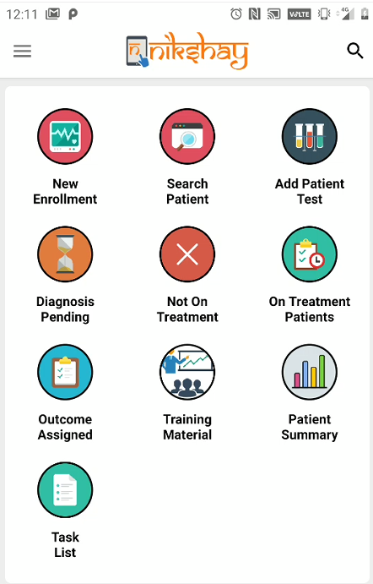
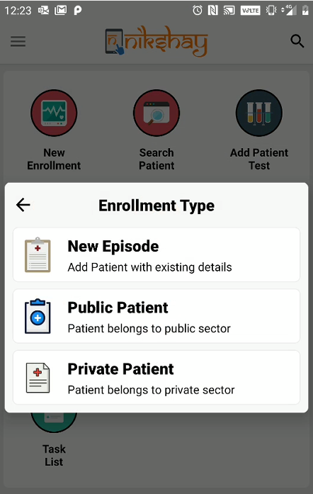
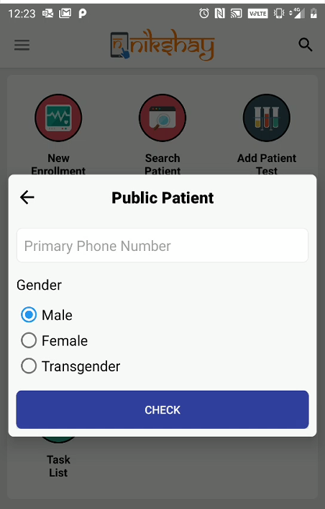
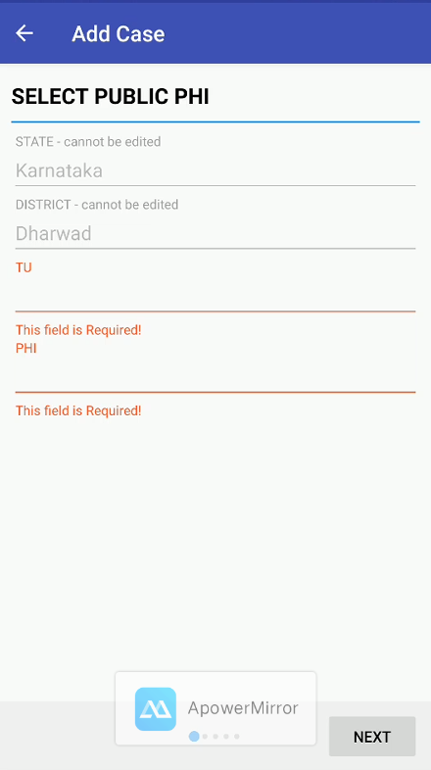
New Enrolment - Mobile App
Step 1
Step 2
Step 3
Step 4
Click on New Enrolment
Select Patient Type
Check for Deduplication. Enter Phone number and gender
If no duplication Select TU and PHI details

Slide 6
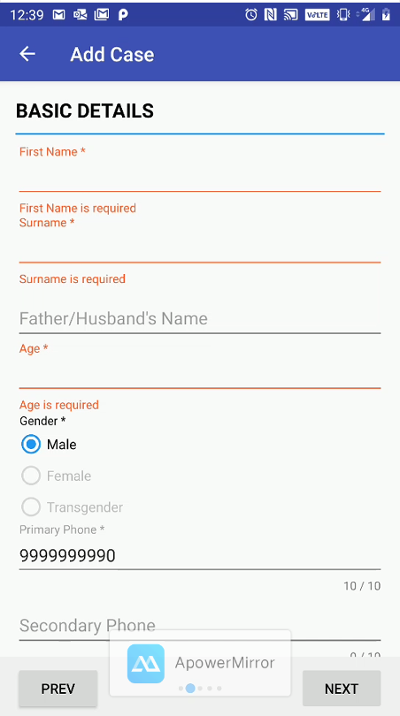
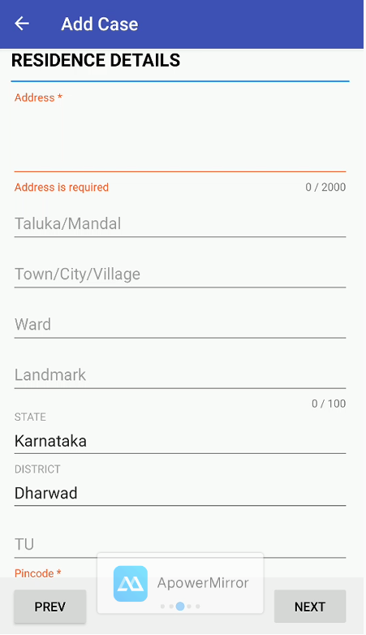
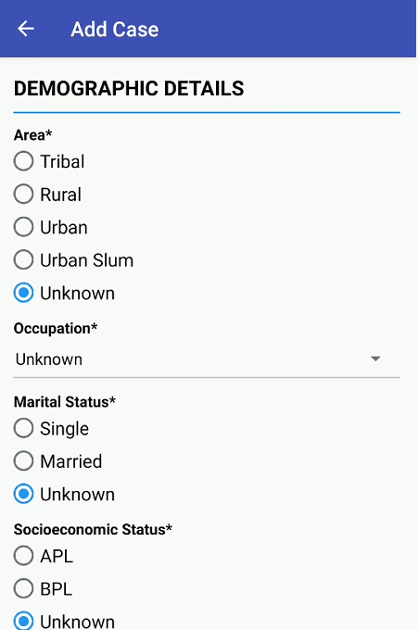
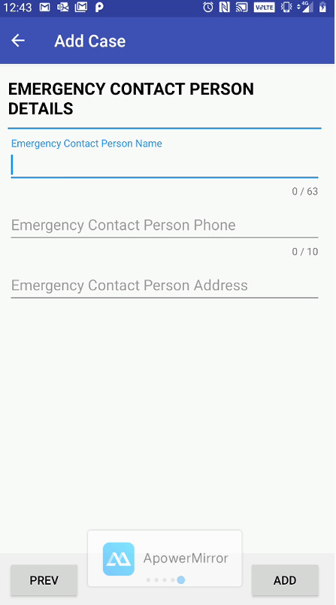
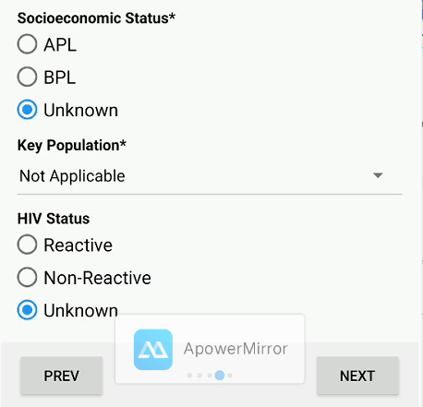
New Enrolment - Mobile App
Step 5
Step 6
Step 7
Step 8
Add basic Details
Add Residence details
Add demographic details
Add Emergency contact details
Click on “ADD” to enrol patient

Slide 7
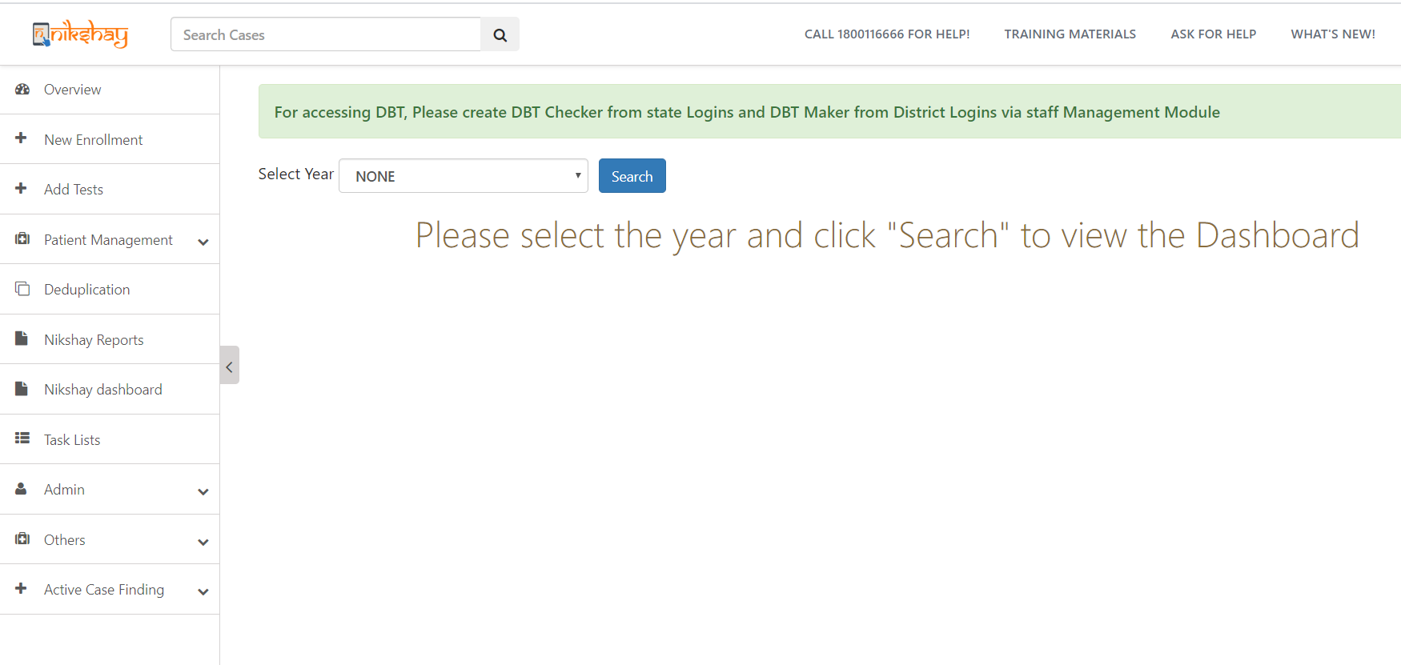
New Enrolment - Web
Step 1
Click on New Enrolment

Slide 8
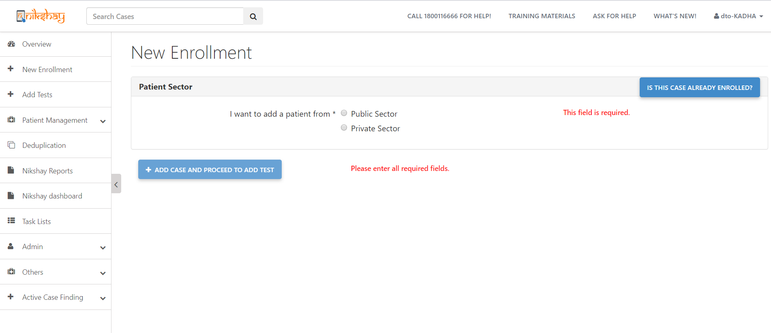
New Enrolment - Web
Step 1
Step 2
Click on New Enrolment
Select Patient Type

Slide 9
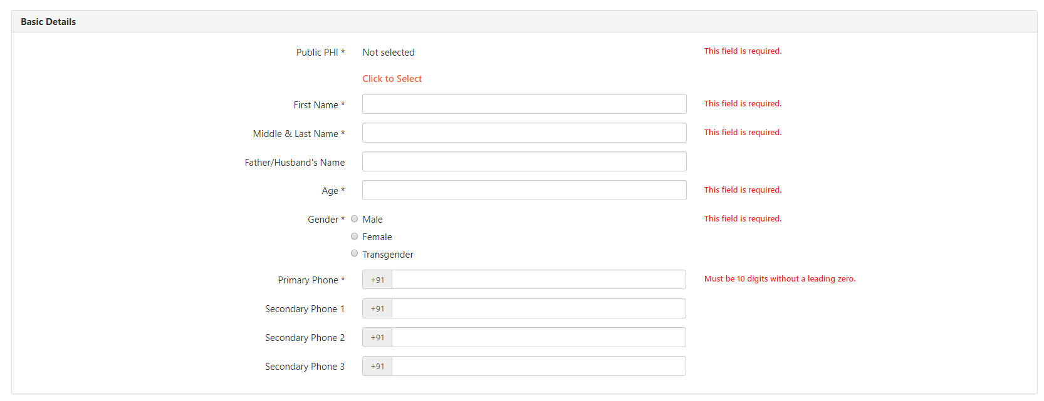
New Enrolment- Web
Step 3
Step 4
Step 5
Add Basic Details
Check for Deduplication. Enter Phone No. & gender
Select TU and PHI details
Deduplication is based on Gender and Primary Phone Number

Slide 10
New Enrolment- Web
Step 6
Add Residence details

Slide 11
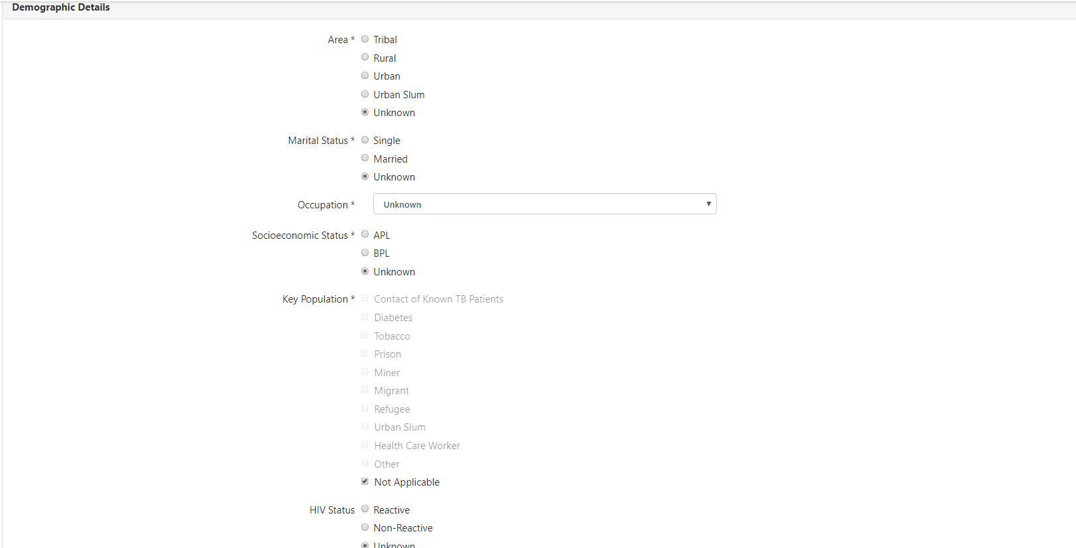
New Enrolment- Web
Step 7
Add demographic details

Slide 12
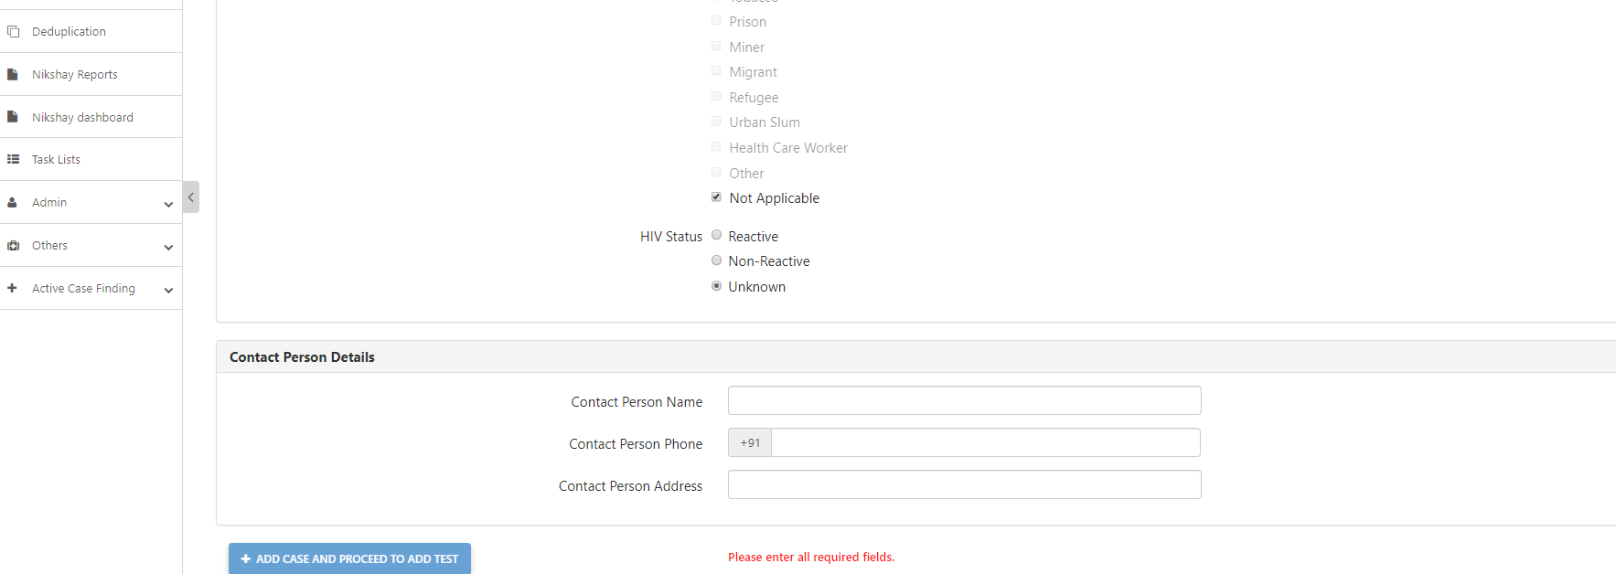
New Enrolment- Web
Step 8
Add Emergency contact details
Note: On Enrolment, the Status of the case would be “Presumptive(Open)

Slide 13
Contents
New Enrolment
De-duplication
Search and View patients
Patient Management
Add Test
Adding Test Results for Patients across any Location

Slide 14
Deduplication
Deduplication check is done based on “Primary Phone” number and “Gender” of the patient.
In Nikshay, Deduplication is implemented in two parts:
New enrolment - De-duplication alert message is displayed to the users while enrolment
After Notification - List of possible duplicates are displayed in ‘De-duplication’ Module which enables users to review and approve notifications as ‘unique‘ or ‘mark them as duplicates’. This module is available only in the Web application of Nikshay

Slide 15
Deduplication in New Enrolment
While enrolment, as User enters Patient’s ‘Primary’ Phone Number and Gender, Nikshay searches and displays potential duplicates
Several details of the potential duplicate records are displayed so that user can take a decision.
User can choose to “Exit Enrolment” or “Proceed Anyway”
If the user selects “Proceed Anyway”, and continues with enrolment, such records are marked as duplicate when notified.
If the user selects “Exit Enrolment” then the enrolment form will be closed.
If invalid mobile numbers are entered (such as 1111111111,9999999999,1234567890 etc) Nikshay will not check for deduplication. Thus, it is very important to enter the correct mobile number

Slide 16
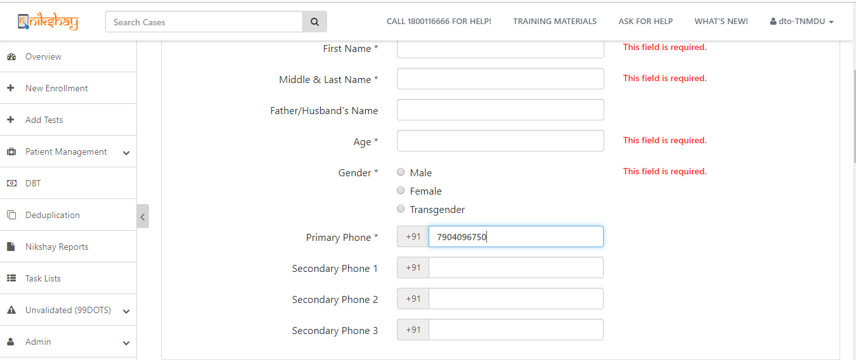
Deduplication While Enrolling- Web
Deduplication is based on Gender and Primary Phone Number

Slide 17
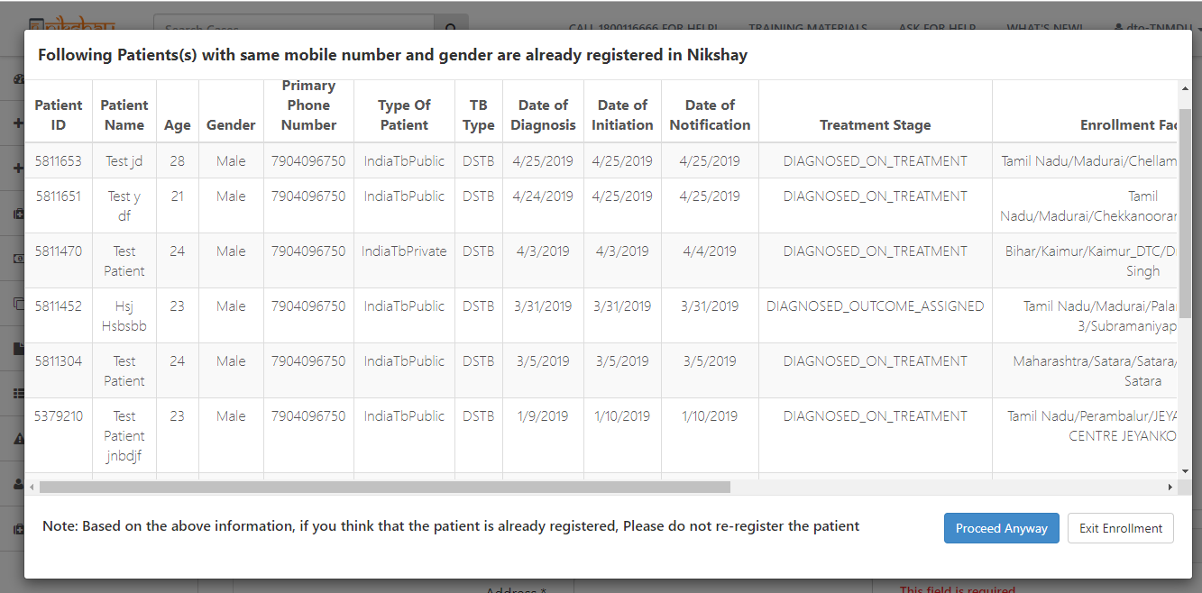
Deduplication While Enrolling- Web
Details of matching records are displayed. Note: while enrolment, potential duplicates which are Presumptive are also displayed
If user thinks it is a unique case, “Proceed Anyway” to continue with enrolment.
If user thinks that it is a duplicate, can exit enrolment and either request for transfer in or create a new episode for existing patient

Slide 18
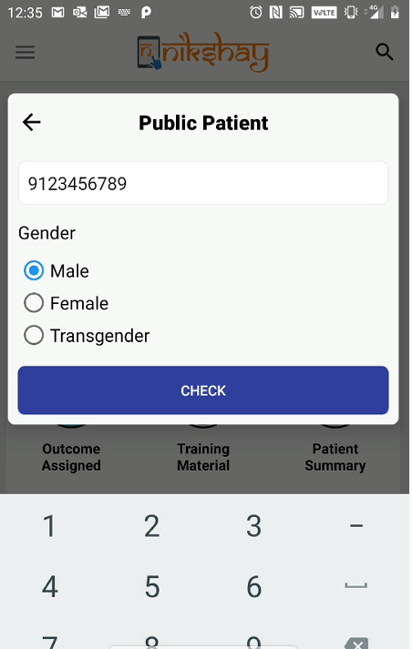
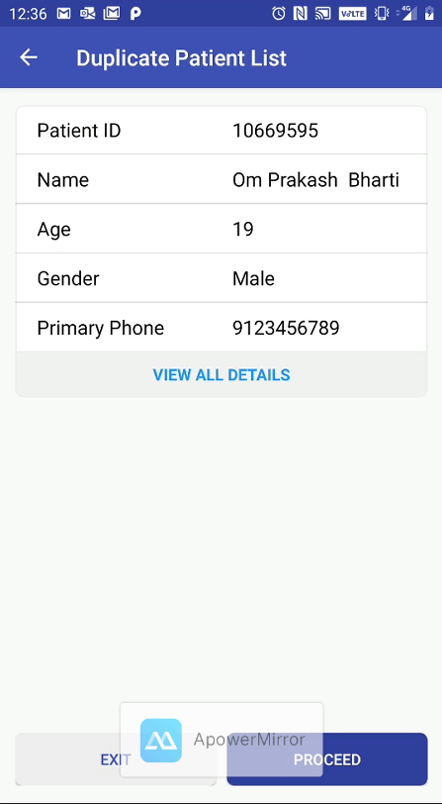
Deduplication While Enrolling- Mobile
EXIT
PROCEED

Slide 19
Deduplication Module
In the Deduplication tab, list of patients notified in the user’s jurisdiction and marked as duplicates are displayed.
Duplication status of a notification can be:
System identified Unique
System identified Duplicate
User marked Unique
User marked Duplicate
There could be 1 or more duplicates for a patient record. All the possible duplicates are displayed
From this module, action can be taken only for records with duplicate status “System Identified Duplicate
Duplicates can be either - Notified by Public or Private sector, anywhere in India and against an open or closed patient record
User will be able to take action on a notification from a provider under his/her jurisdiction and not beyond
For notifications identified as Duplicate, benefits under any DBT scheme will be generated only if user marks them as Unique
Private sector users can see the possible duplicates in Public sector but they can’t take any actions for Public sector records.

Slide 20
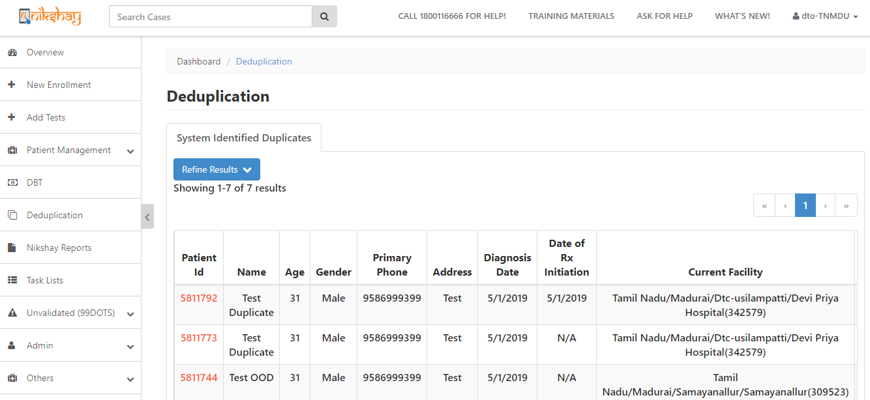
Deduplication Tab- Only in Web
Click on Patient ID to view potential duplicate records for this patient

Slide 21
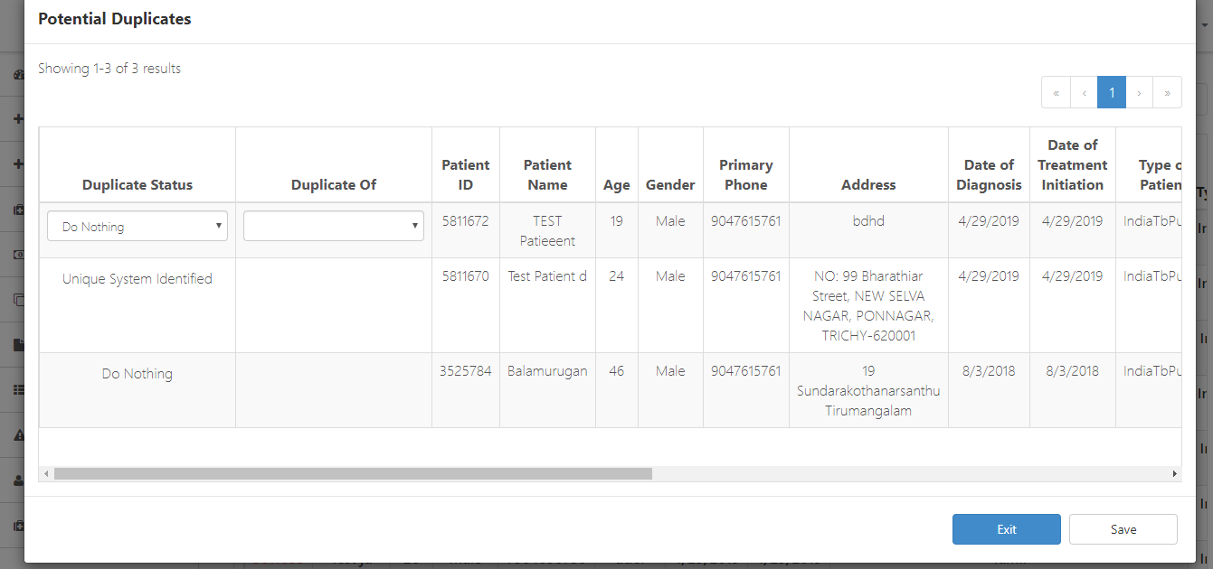
Deduplication Tab- Only in Web
Various details of potential duplicate records displayed so that user can take decision and either accept notification or mark as duplicate

Slide 22
Deduplication Tab
To mark a record as “Duplicate”, user should select “Duplicate of” and select the patient ID against which this notification is being marked as Duplicate and click “Save”

Slide 23
Contents
New Enrolment
De-duplication
Search and View patients
Patient Management
Add Test
Adding Test Results for Patients across any Location

Slide 24
Search and view patient lists
A Patient /Presumptive record can be searched by Name or Patient ID, by a user from the patient’s ‘current facility’ hierarchy
To view details of patients or presumptive cases whose “Current Facility” is not in the user’s hierarchy, “Add Test” module can be used.
However, to be able to view, patient ID is mandatory. However, users can not edit any details of such patients; They can only Add new tests.

Slide 25
Search and view patient details
Users can search presumptive cases and Patient records, registered by both public and private sector registered under their PHI or TU or District
Nikshay also enables search if Patient ID is not available or if the record is not searchable by Name (due to spelling mismatch); via the Patient Management Module.
In the Patient Management Module, patient lists are provided which enables drill down to PHI level and manually select the patient’s record.
For simplicity, patients are divided into lists and sub-lists based on treatment status 1) Presumptive, 2) Diagnosed TB (Notified)
Note: Presently users cannot search for records not enrolled by them or are not under treatment with them. This Global search facility will be made available shortly.

Slide 26
Search and view patient lists
To search by Name or Patient ID
To view Patient lists, click on the Patient Management link
Diagnosis Pending………………(Presumptive cases enrolled but test results not updated)
Not diagnosed as TB…….….(Presumptive cases enrolled with negative test results)
Treatment Not Started (Notified)…(Confirmed TB cases enrolled, diagnosed but not initiated on treatment)
On Treatment List (Notified)………..(Confirmed TB cases currently seeking treatment)
On Treatment Calendar…(Confirmed TB cases for whom adherence has been recorded)
Outcome Assigned……… (List of Confirmed TB cases for which outcome has been assigned)

Slide 27
Contents
New Enrolment
De-duplication
Search and View patients
Patient Management
Add Test
Adding Test Results for Patients across any Location

Slide 28
Patient Management Page
Once enrolled, complete case information is visible and actionable from a single screen.
For simplicity, information is divided into subsections or tabs.
Users can take the following actions from here:
Add test details (Diagnostic or follow up)
Add or update Treatment/ Prescription/ Bank/ Adherence details
Update any patient details
Update Staff/Patient engagement details
Declare patient outcome

Slide 29
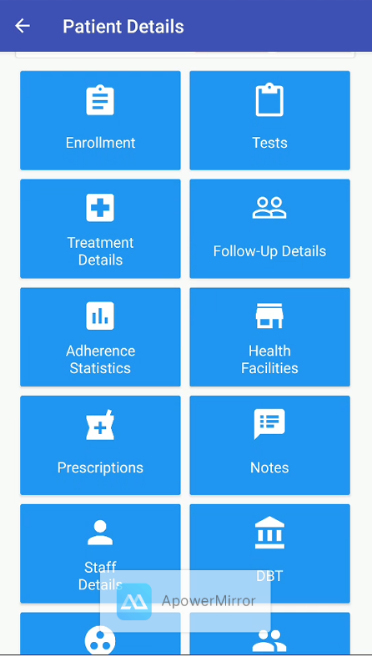
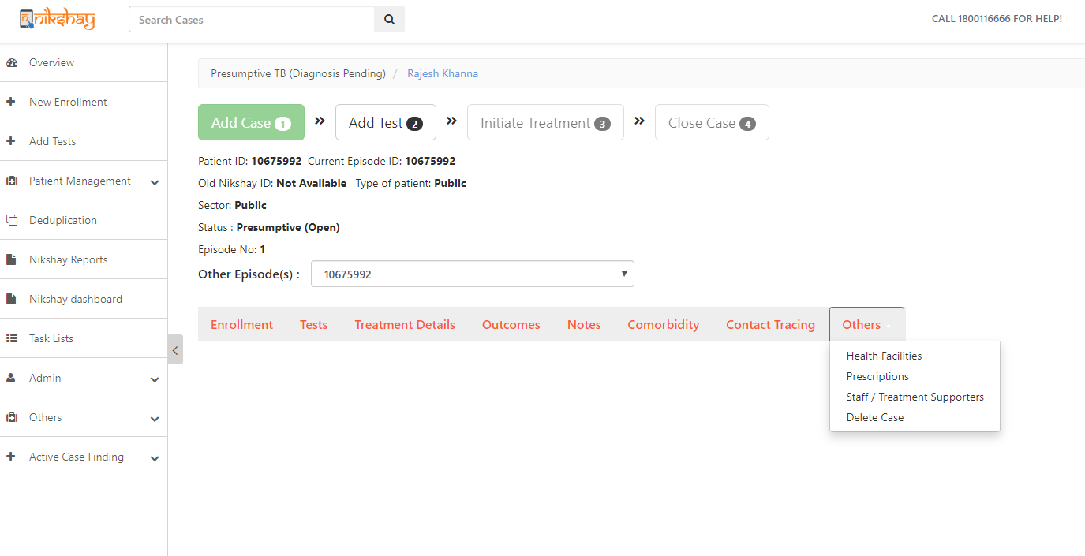
Patient Management screen
Status bar indicates activities completed for a case.
Critical information such as Patient ID and treatment status shown here
For simplicity, patient information is displayed in various sections (tabs)

Slide 30
Various sections (tabs) in Patient Management Screen
Module Name
Adherence
Enrolment
Tests
Treatment Details
DBT
Close Case
Notes
Health Facilities
Prescriptions
Engagement
Staff
Comorbidity
Contact Tracing
Delete Case
Description / Details captured
Adherence Calendar view/update (Dose taken or missed - Manually/ 99DOTS/MERM)
Basic details of the presumptive Case or Patient (Name, Mobile No, Address, Area, Key Population etc.)
Request Test & Update/view Result (Diagnostic /Follow up) (Type of Test, Facility, etc.)
Record /view Treatment Details (Type of Case, Site of Disease, Date of Rx Initiation etc.)
Direct Benefit Transfer (Bank Name, IFSC Code, Account Number, Branch Name)
Record Treatment Outcome for Case (Rx Outcome, Date, Remarks)
To record any remarks or additional details of the patient
Update Health Facility for Patient (Enrolment Facility, Diagnostic Facility, Current Facility)
Prescription/ Regimen (Product Name, Weight Band, No of Days etc.)
Update engagement assistance (via SMS, Call Centre, Household Visits)
Update / edit health care staff information (Staff name, Designation & Phone No.)
HIV, Diabetes and Tobacco
Record Contact Tracing
Enables deletion of duplicate or incorrect patient records (Reason for deletion, Remarks)
1
2
3
4
5
6
7
8
9
10
11
12
13
14

Slide 31
Edit Patient details
Users can easily Edit patient details
Edit option will be visible each of the sections.
As User clicks on Edit, fields of the Form become editable
The changes made are visible immediately.
After closure of a Patient record (by update of Treatment Outcome), the patient record will not be editable.

Slide 32
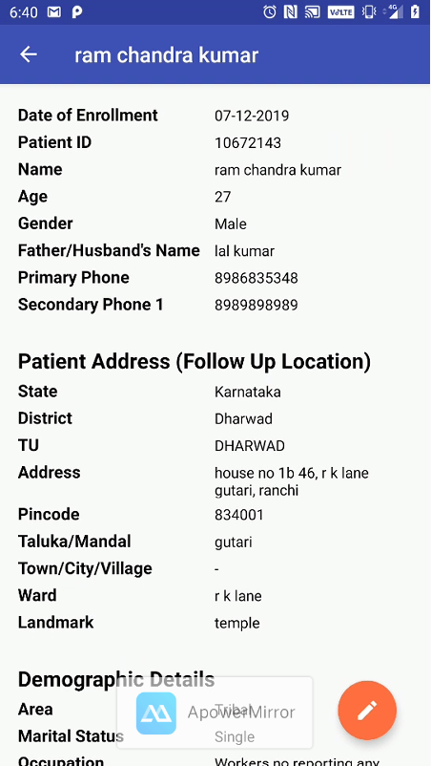
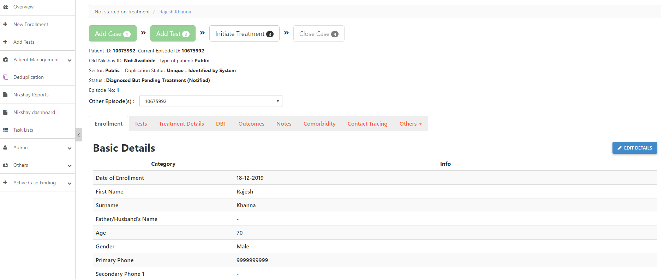
Edit Patient details
Step 1
Step 2
Select the section that needs to be edited
Click on Edit Details

Slide 33
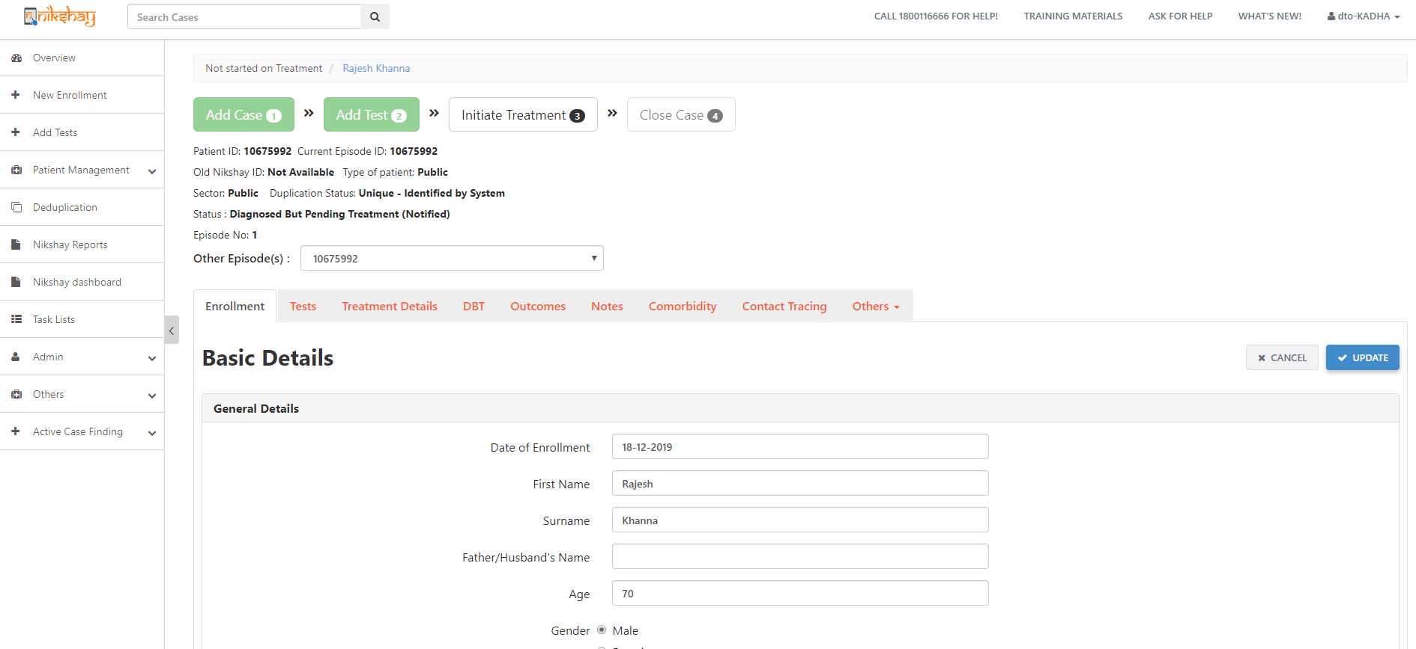
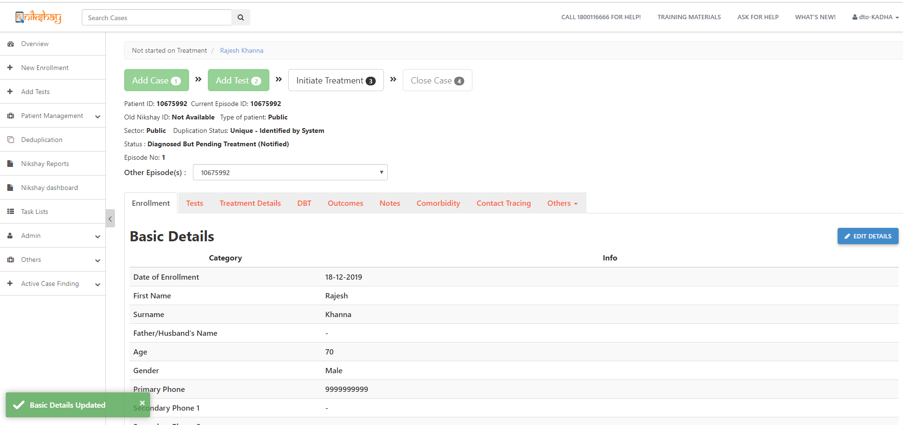
Edit Patient details
Step 1
Step 2
Step 3
Select the section that needs to be edited
Click on Edit Details
Make changes and click on Update
Date of Enrolment is a non-editable field
This section is now editable and changes can be made
Message displayed after successful update

Slide 34
Contents
New Enrolment
De-duplication
Search and View patients
Patient Management
Add Test
Adding Test Results for Patients across any Location

Slide 35
Add Test
Single screen to add Diagnostic or Follow Up tests for Public or Private sector patients
To register a PATIENT, it is compulsory to add a POSITIVE DIAGNOSTIC test
Add Test is a 2-step process, 1) Test Request and 2) Result Update.
These steps can be done by a user at once or by two different users.
Eg. 1: TB HV (enrols case + Requests Test) → LT (enters result)
Eg.2: TB HV or LT (enrols case+ Request Test+ Enter Result)
As soon as a positive test result is entered, the patient gets notified

Slide 36
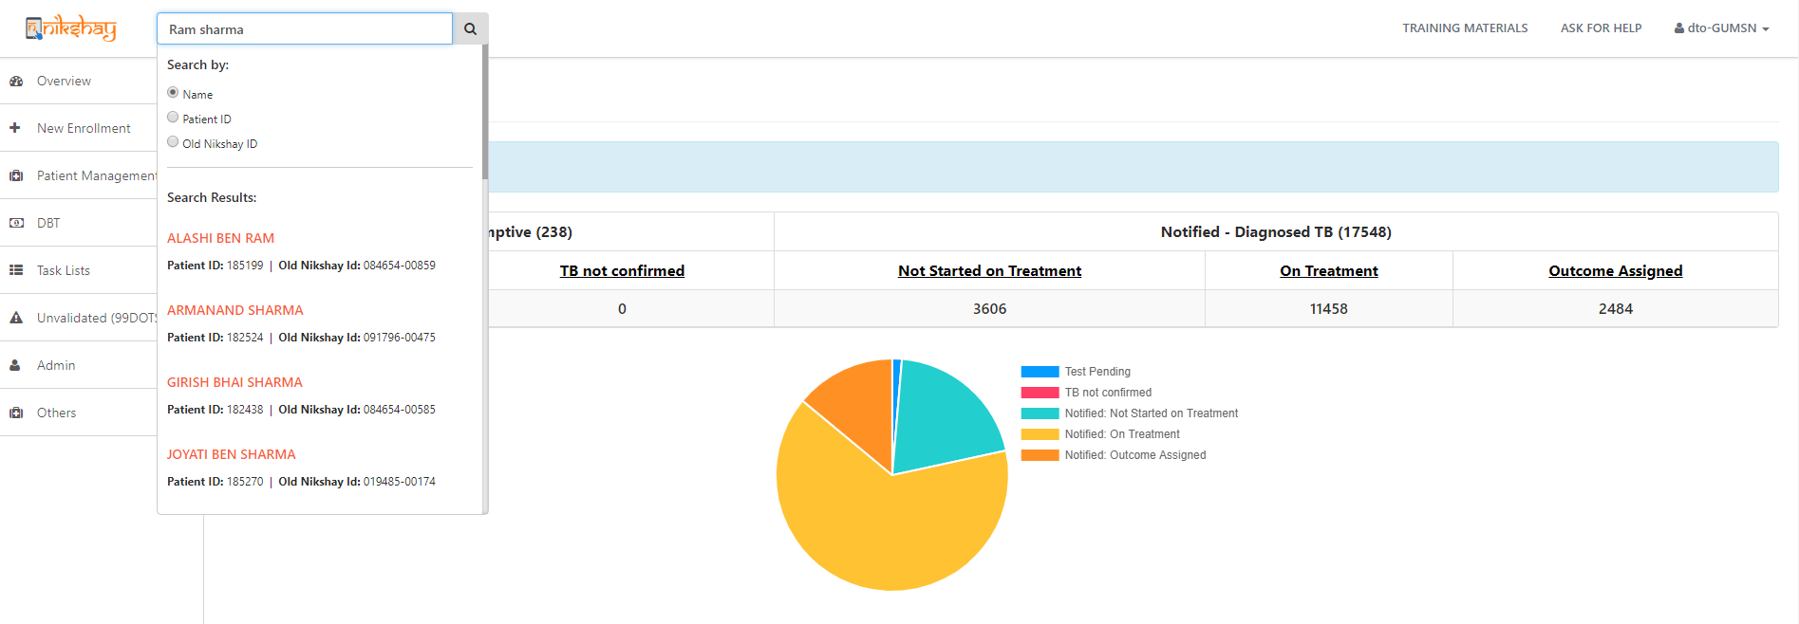
Add Test details
Step 1
Search case for which Test to be updated
Armanand
Select the correct record

Slide 37
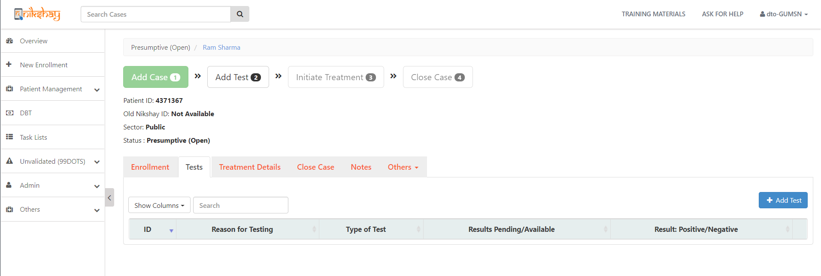
Add Test details
Step 1
Step 2
Step 3
Search case for which Test to be updated
Open Patient record and select Tests section
Click on Add Test
White color box indicates “Add Test” is pending
As no test is added, status is “Presumptive(Open)”
Details of tests added earlier (if any) are shown here

Slide 38
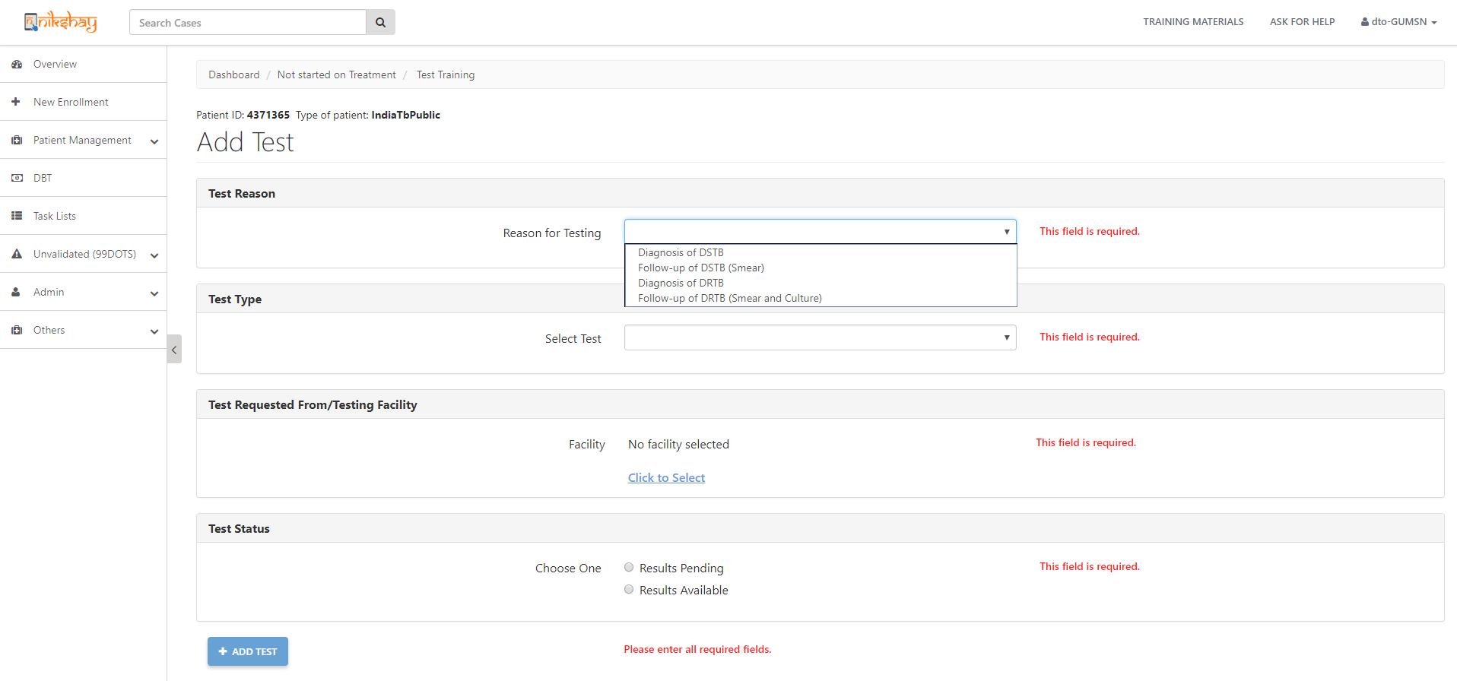
Add Test details
Step 1
Step 2
Step 3
Step 4
Search case for which Test to be updated
Open Patient record and select Tests section
Click on Add Test
Enter Test Details
Both Public or Private Sector labs can be selected
User can Request Test and enter Result either at the same time, or later

Slide 39
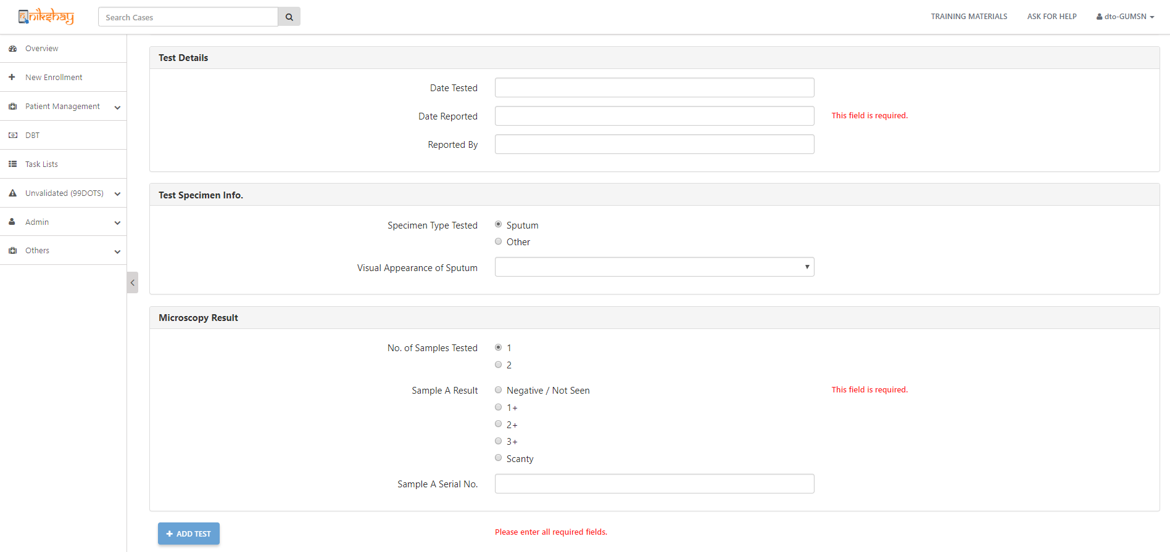
Add Test details
Step 1
Step 2
Step 3
Step 4
Search case for which Test to be updated
Open Patient record and select Tests section
Click on Add Test
Enter Test Details
Enter all the other test details
Click here to complete the form

Slide 40
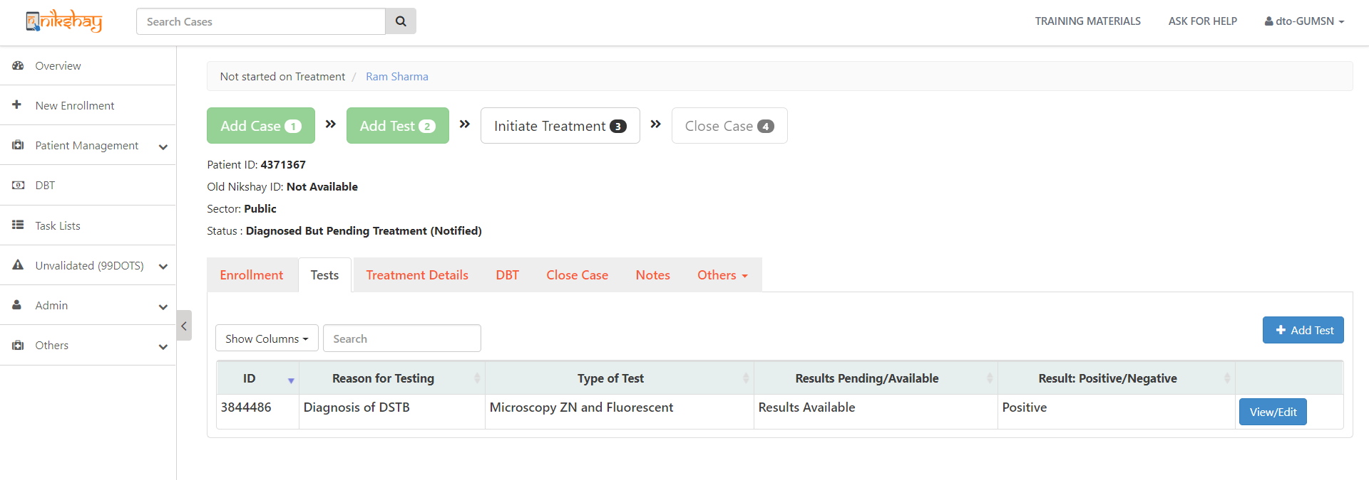
Add Test details
Step 1
Step 2
Step 3
Step 4
Step 4
Search case for which Test to be updated
Open Patient record and select Tests section
Click on Add Test
Enter Test Details
View Test Details
Green color box Indicates Test updated
On entering a +ve diagnostic test, case status changes to Patient
Tests added are shown here

Slide 41
Contents
New Enrolment
De-duplication
Search and View patients
Patient Management
Add Test
Adding Test Results for Patients across any Location

Slide 42
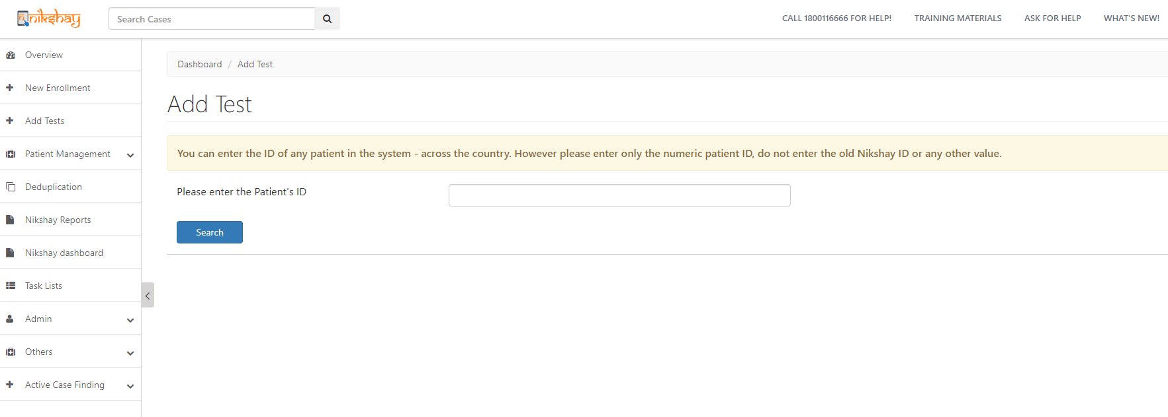
Adding Test Results for Patients across any Location
Step 1
Step 2
Click +Add Tests to search any patient across the country
Search Patients Nikshay ID to enter Test Results
To search and Add test, Patient’s Nikshay ID should be known.
Thus, the Nikshay ID of the patient or presumptive case should be mentioned in the Lab Request form which sent to the Labs along with the sample

Slide 43
Adding Test Results for Patients across any Location
Step 1
Step 2
Step 3
Click +Add Tests to search any patient across the country
Search Patients Nikshay ID to enter Test Results
Enter Test Details
Both Public or Private Sector labs can be selected
User can Request Test and enter Result either at the same time, or later

Slide 44
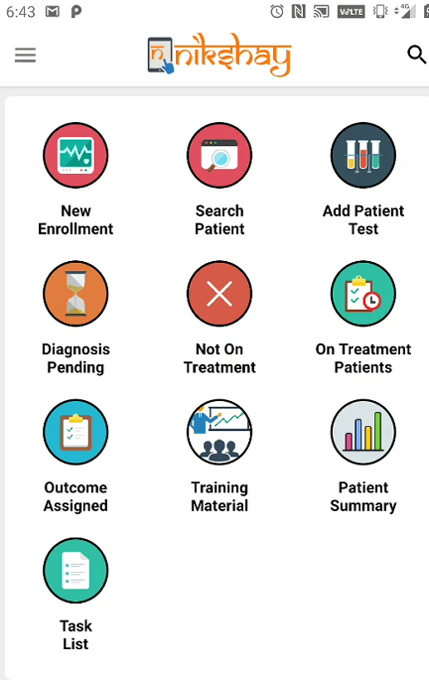
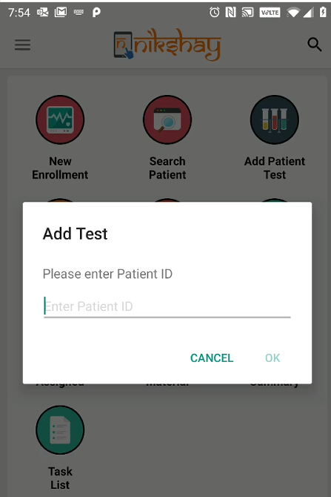
Adding Test Results for Patients across any Location
Step 1
Step 2
Step 3
Click +Add Tests to search any patient across the country
Search Patients Nikshay ID to enter Test Results
Enter Test Details

Slide 45
THANK YOU

