Slide 1
Joint Supportive Supervision (JSS) Forms in Ni-kshay

Slide 2
Contents
The following Forms have been made available
Serial | Field Visit-Checklist
A | Policy & Planning
B | Capacity building
C | Human Resource
D | Case Finding
E | TB Comorbidities
F | Laboratory & Diagnostics
G | Management & Maintenance of Laboratory Equipment's & BSL-3
H | ACSM/IEC Activities
I | Private Sector Engagement
J | TB Preventive Therapy
K | Drug-Resistant Tuberculosis
L | Supply Chain Management
M | Inter-sectoral Collaboration
Serial | Field Visit-Checklist
N | Supervision and Monitoring
O | Community Engagement
P | Finance
Q | DBT
R | Medical College
S | National Urban Health Mission
T | Facility-wise Checklist- HWC/PHC
U | Onsite Field Visit Report
Serial | Patient Interview
A | Drug-Sensitive TB Patient
B | Drug-Resistant TB Patient
C | Private Sector TB Patient
D | Contact Tracing and TPT Initiation

Slide 3
Overview
The Forms are available on Ni-kshay Web and App.
Forms for Patient Interviews and Field Visits are available at https://reports.nikshay.in/FormIO/JSSFormLoad
Entries would require an internet connection.
Users may access the reports using the JSS-NTEP login.
Reports for the entries made would initially be available from the backend.

Slide 4
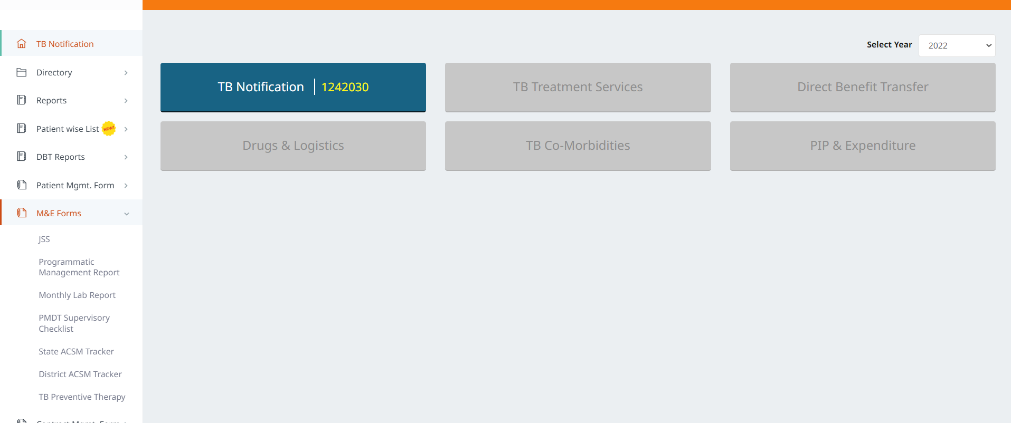
JSS Forms
Step 1
Step 2
Step 3
Go to ‘Ni-kshay Reports’
Click on ‘M&E Forms’
Click on ‘JSS’

Slide 5
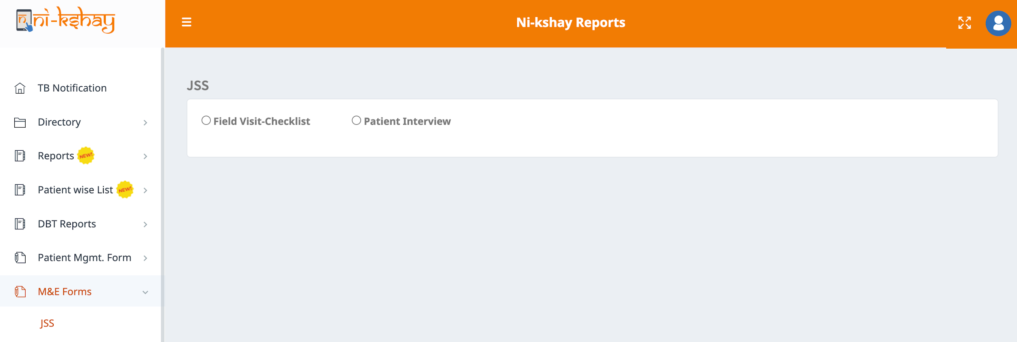
JSS Forms
Step 1
Step 2
Step 3
Step 4
Go to ‘Ni-kshay Reports’
Click on ‘M&E Forms’
Click on ‘JSS’
Select the type of checklist to be filled

Slide 6
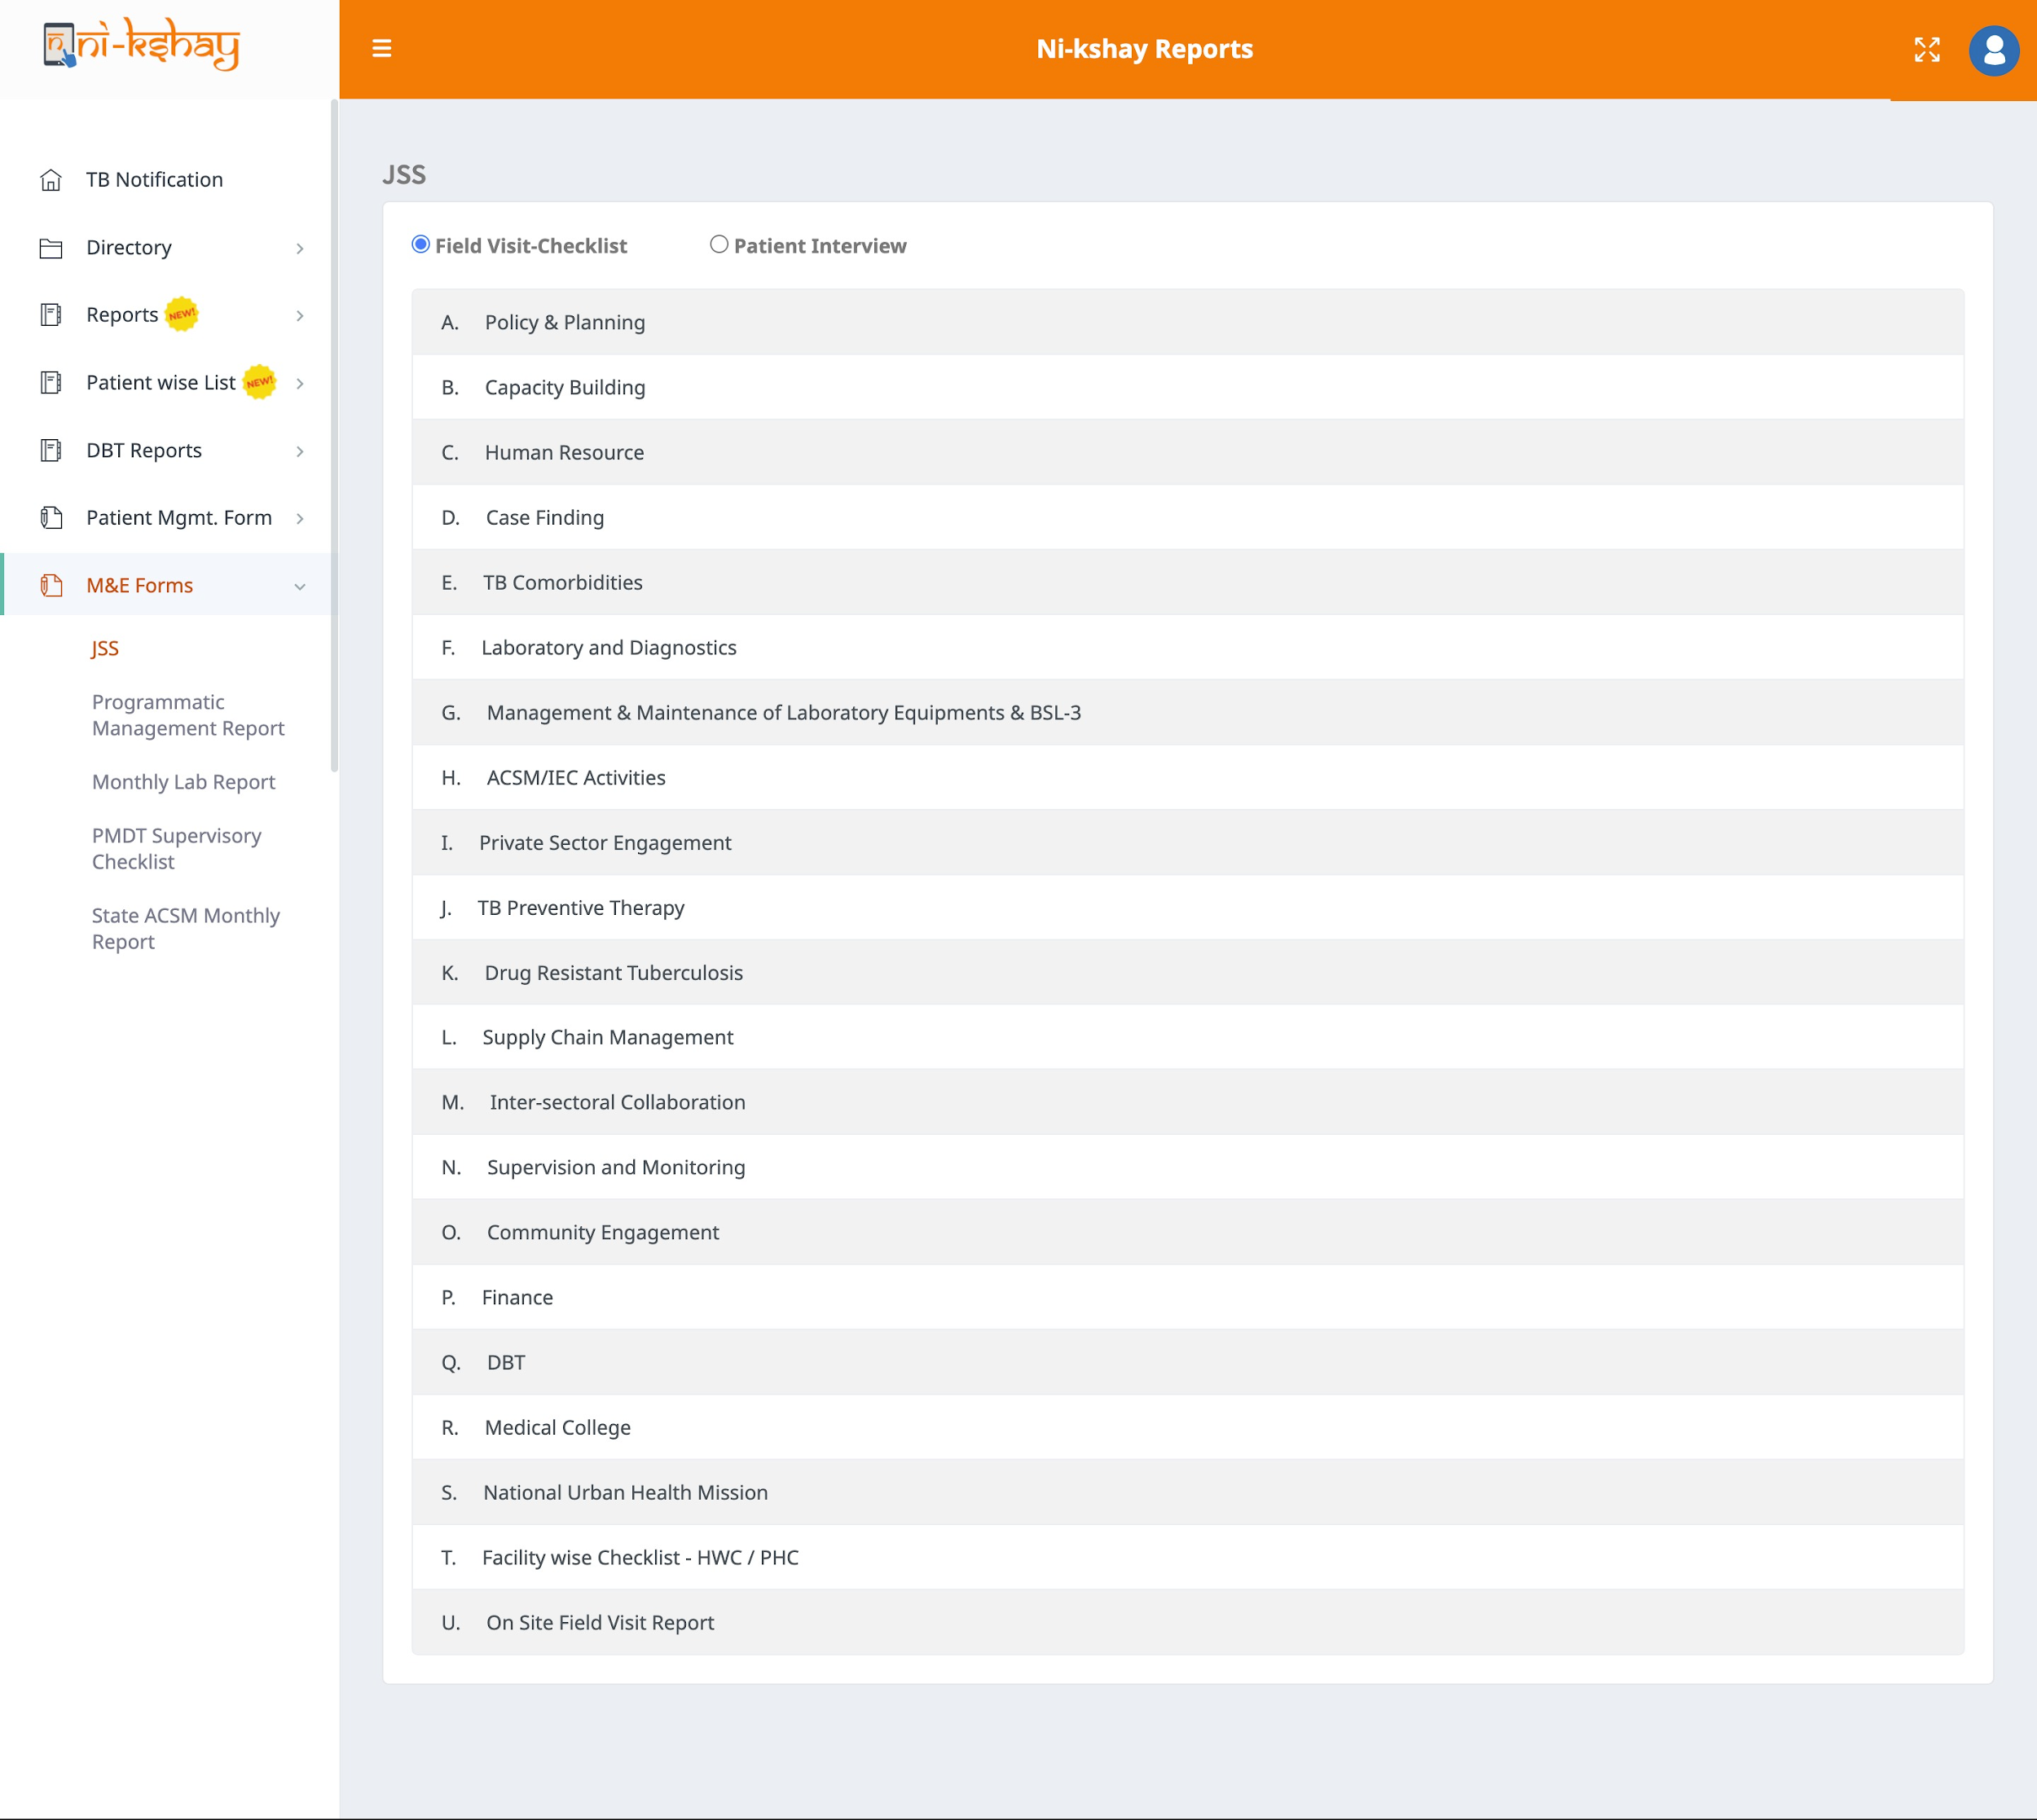
JSS Forms
Step 5
Click on the name to open the form

Slide 7
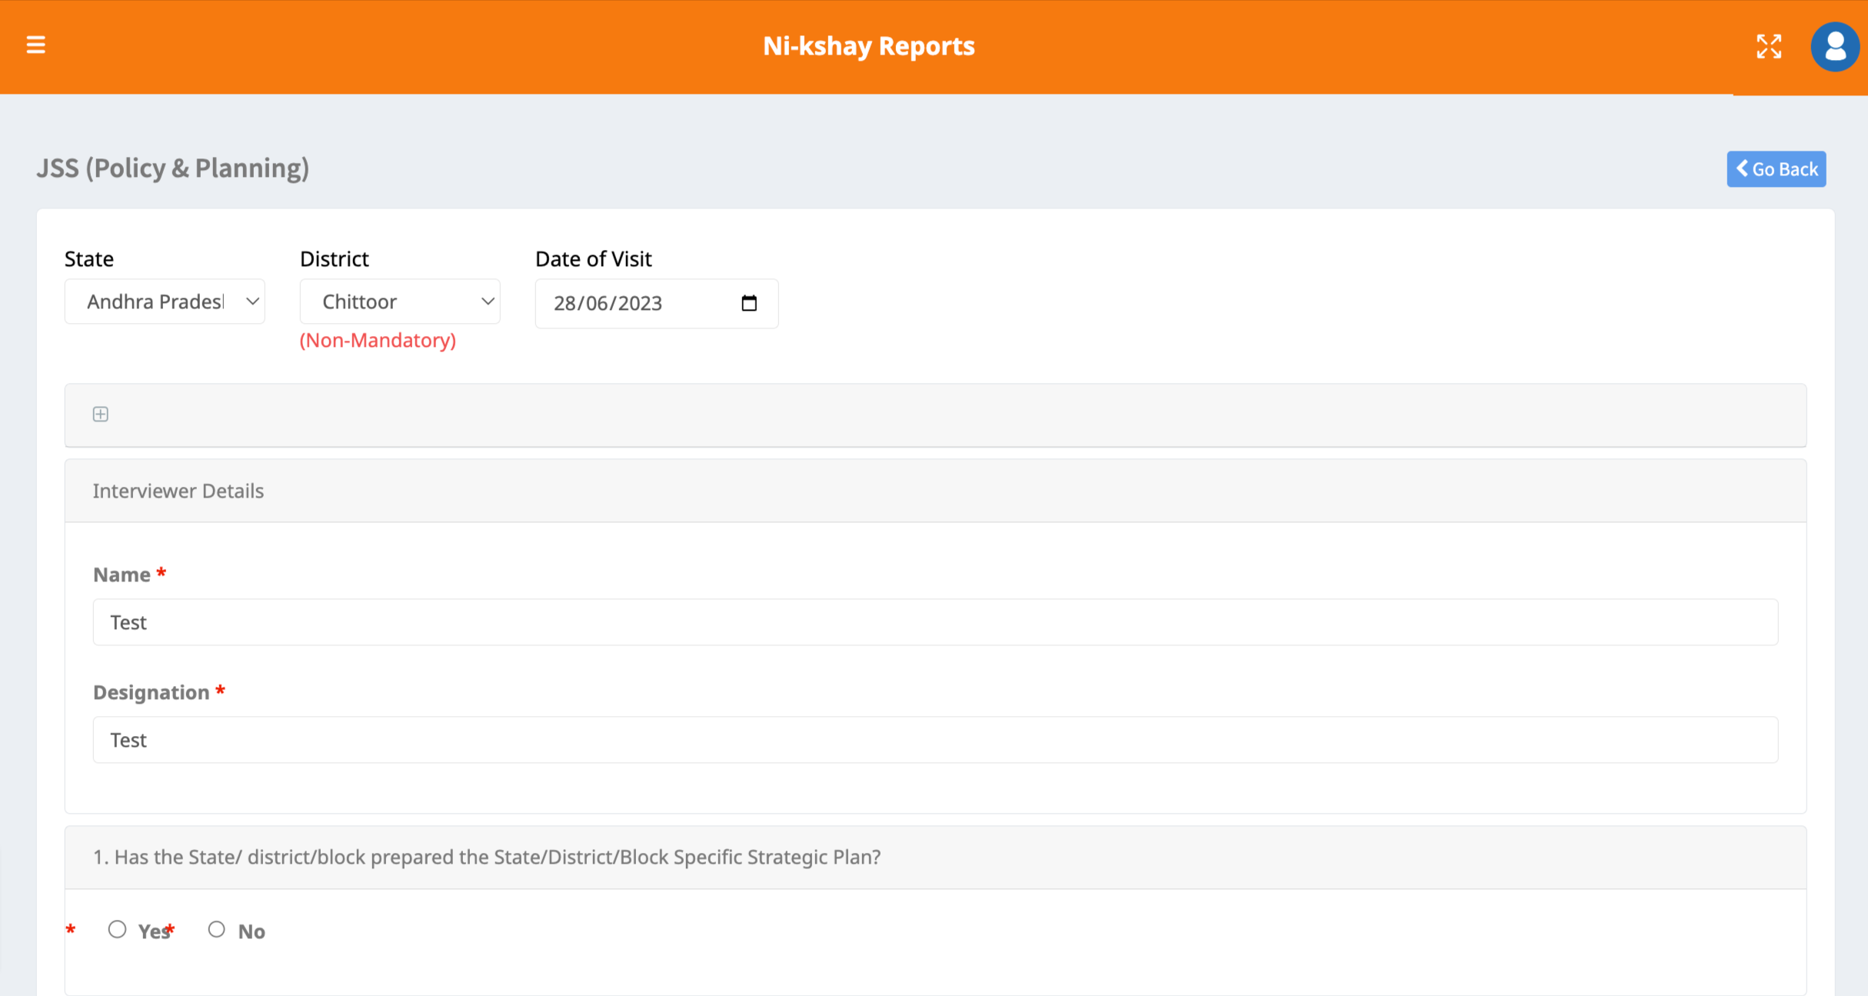
JSS Forms
Step 6
Enter relevant details

Slide 8
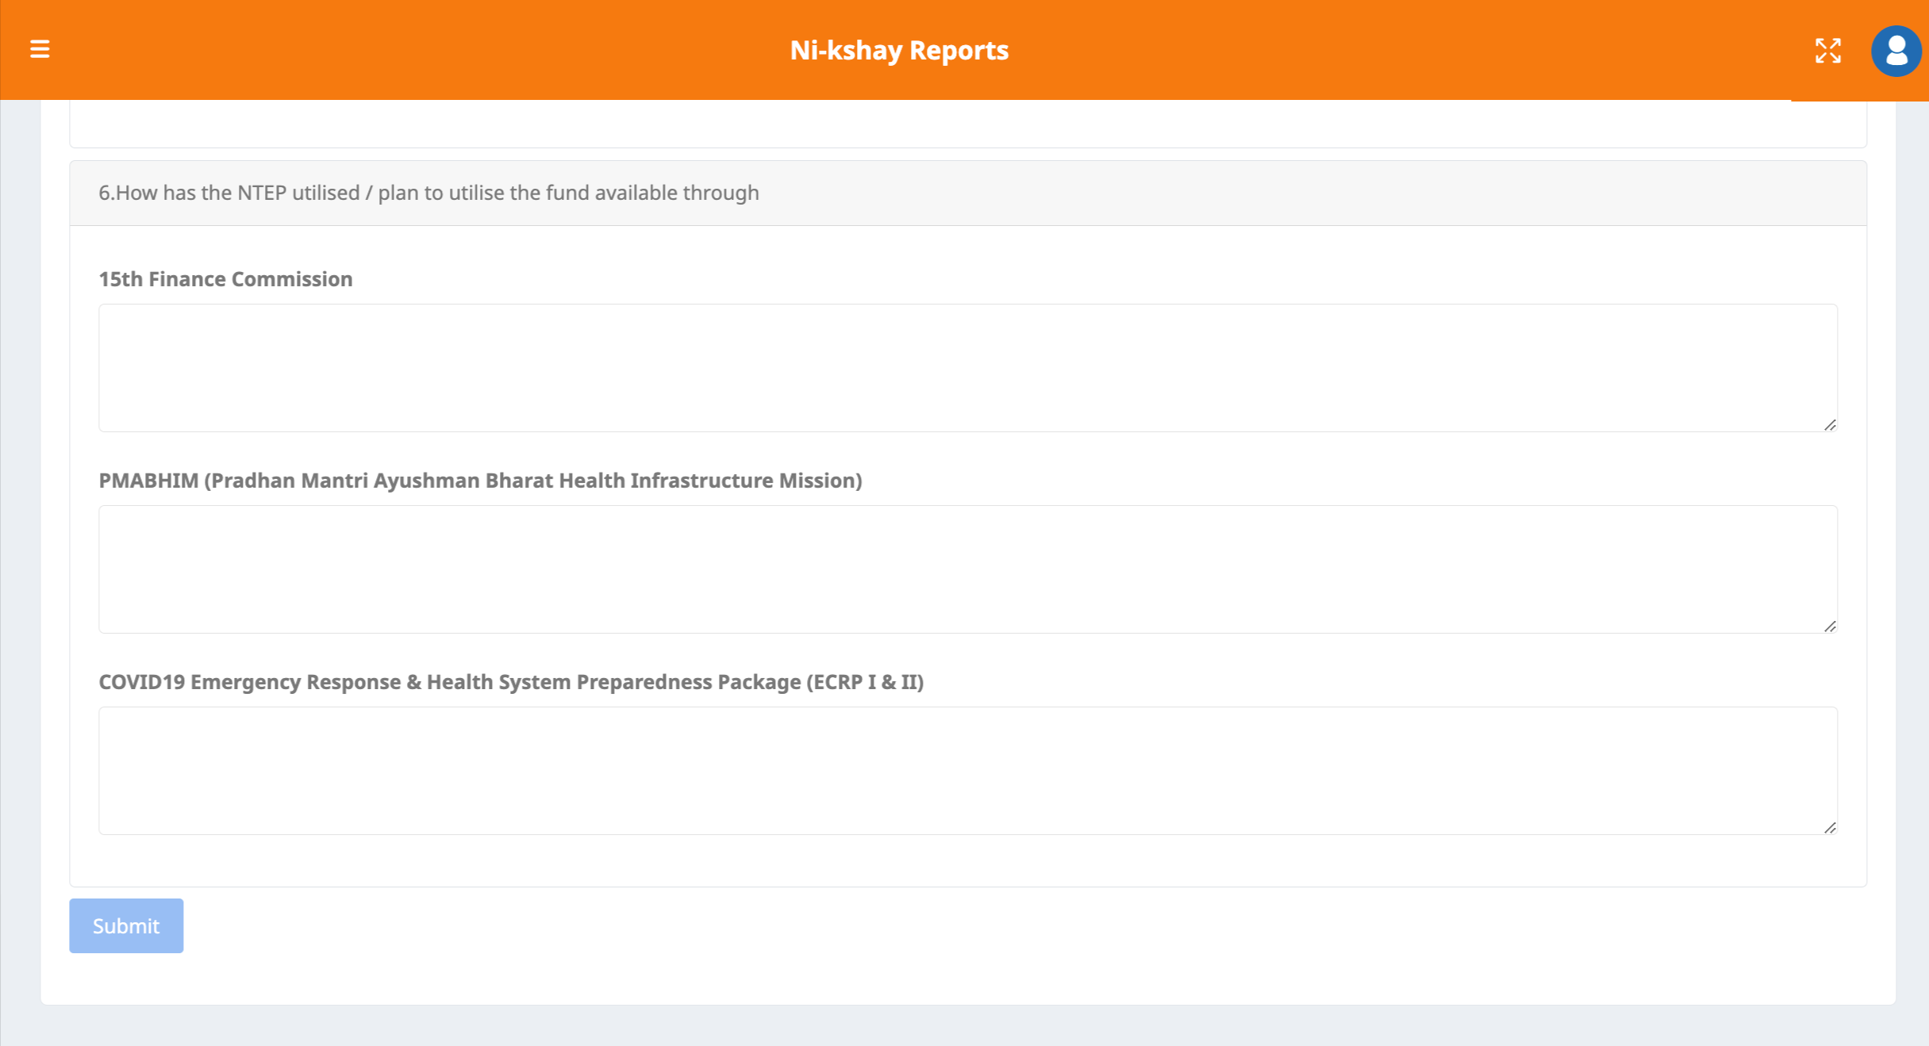
JSS Forms
Step 6
Step 7
Enter relevant details
Click on the Submit Button

Slide 9
Field Visit Checklist

Slide 10
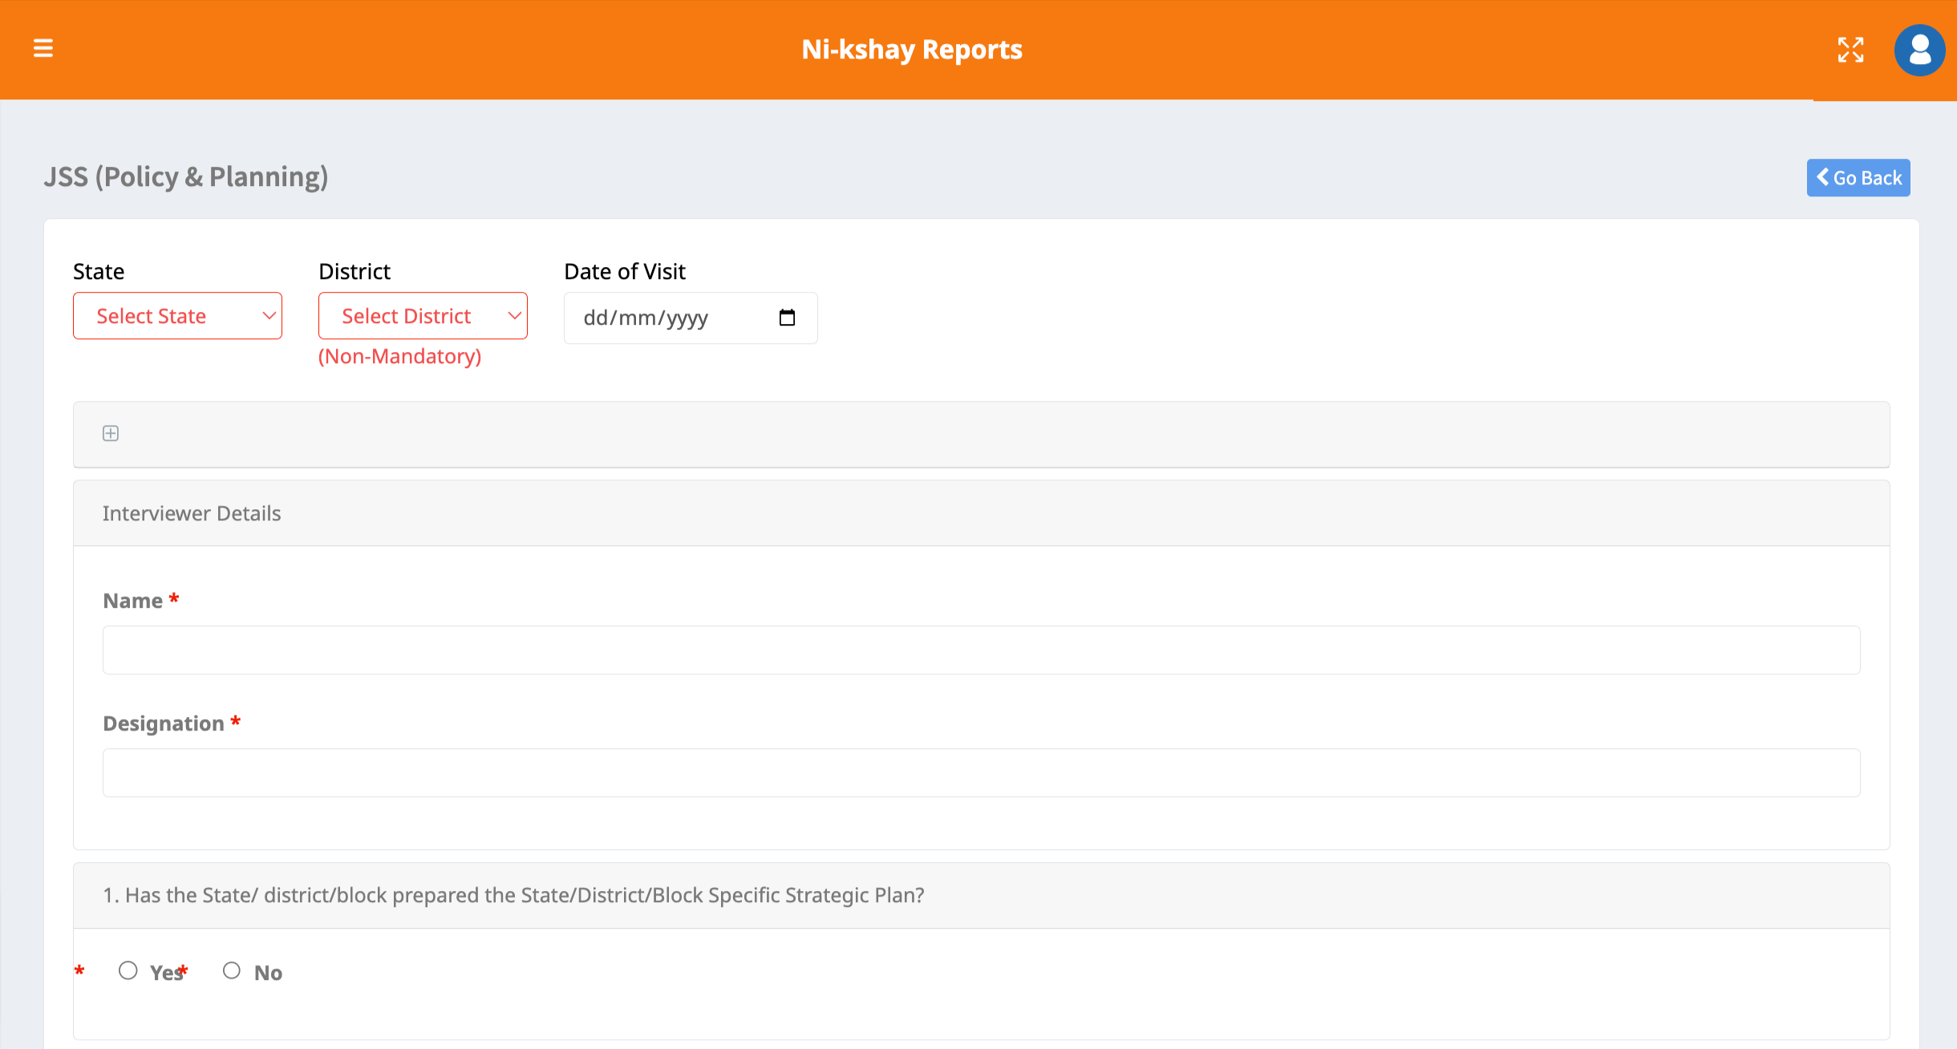
JSS Form – Policy & Planning

Slide 11
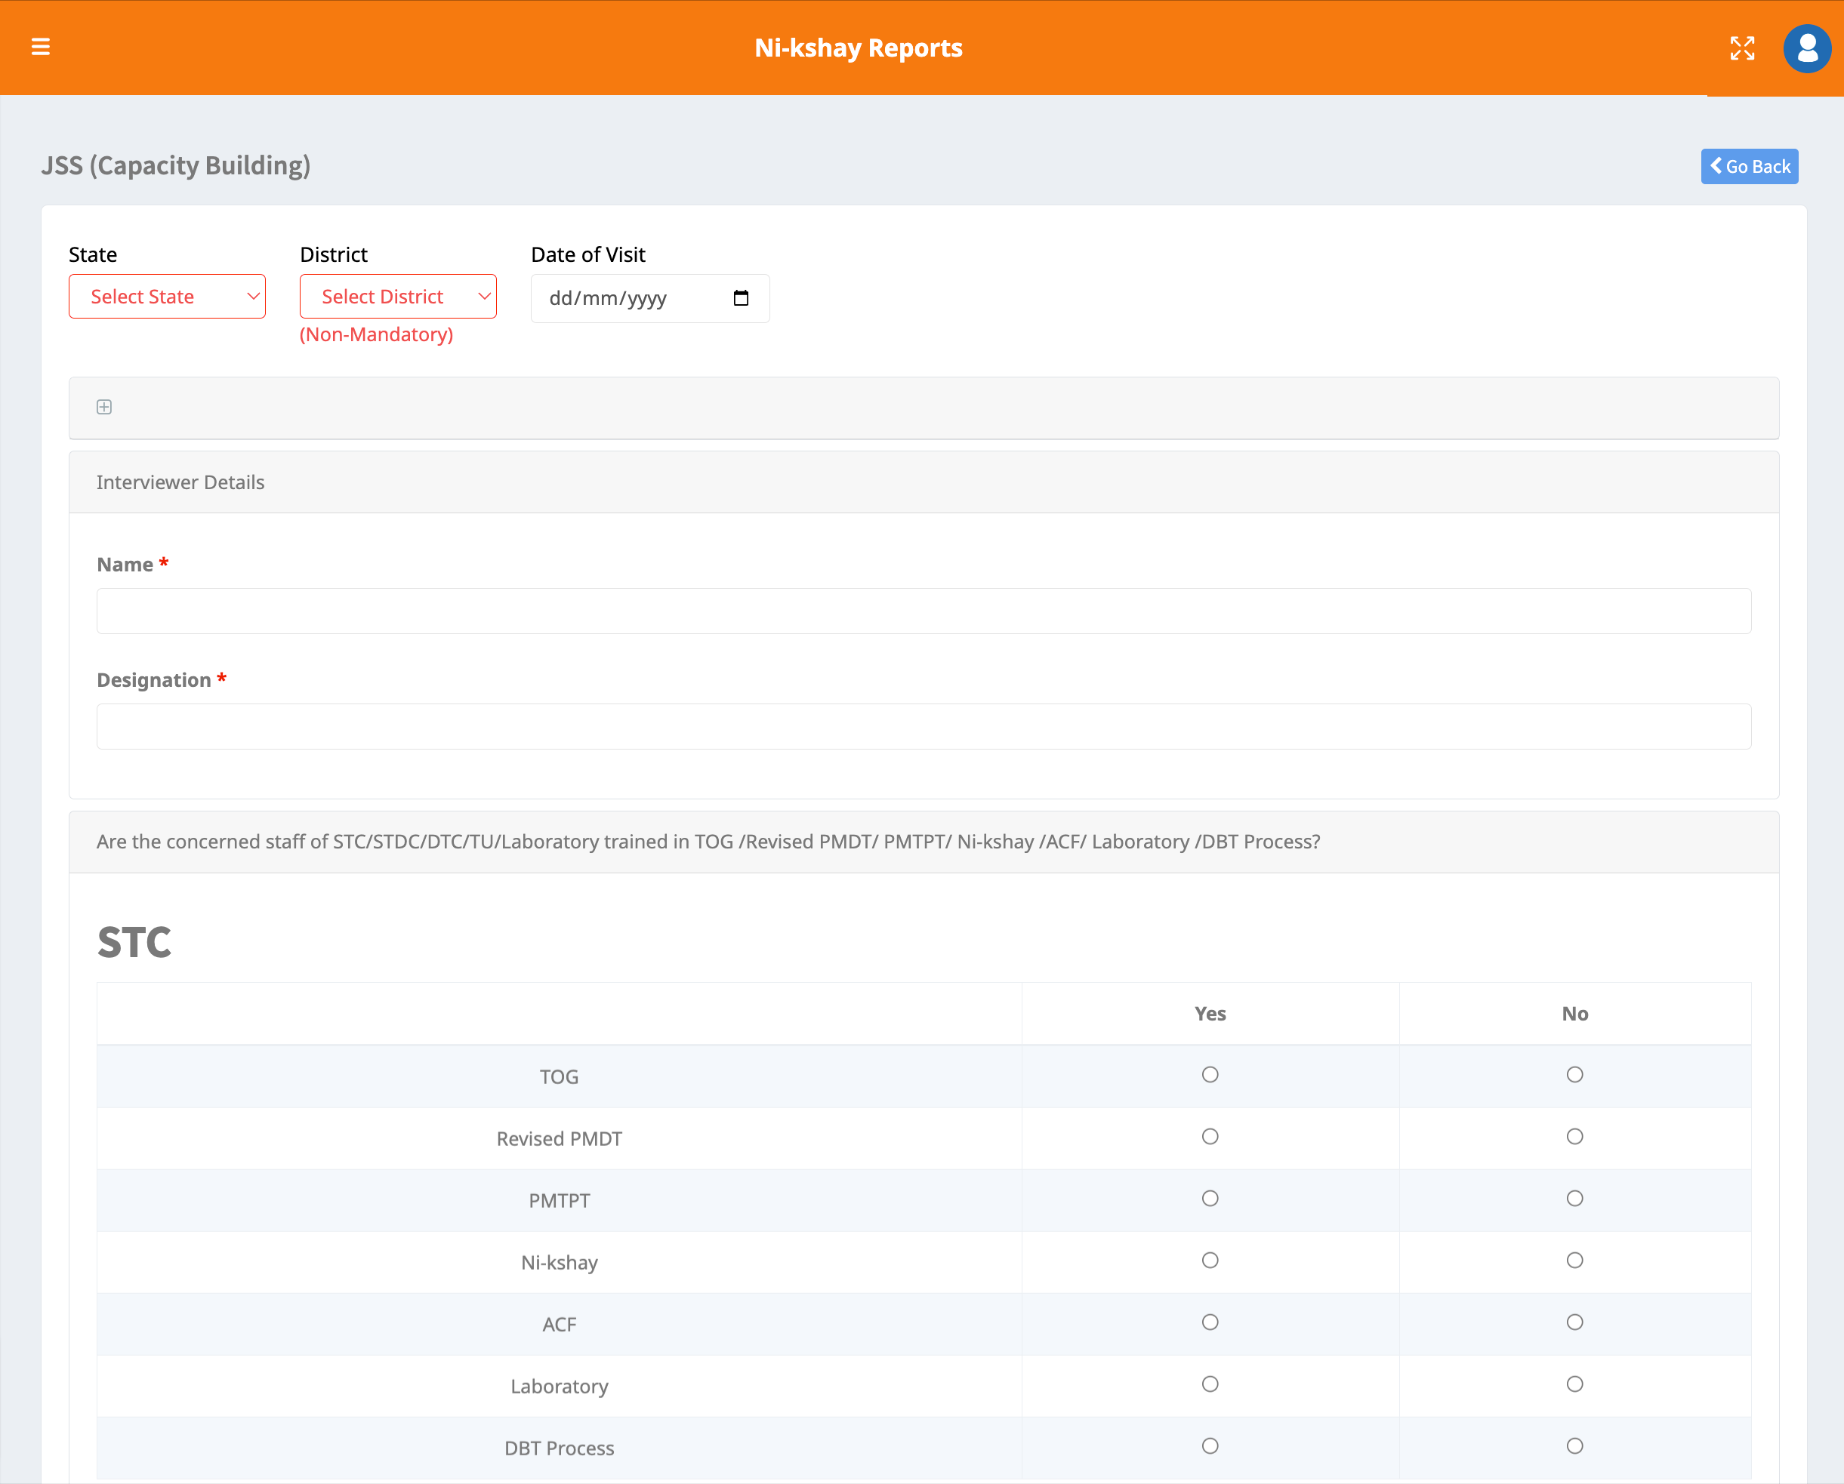
JSS Form – Capacity Building

Slide 12
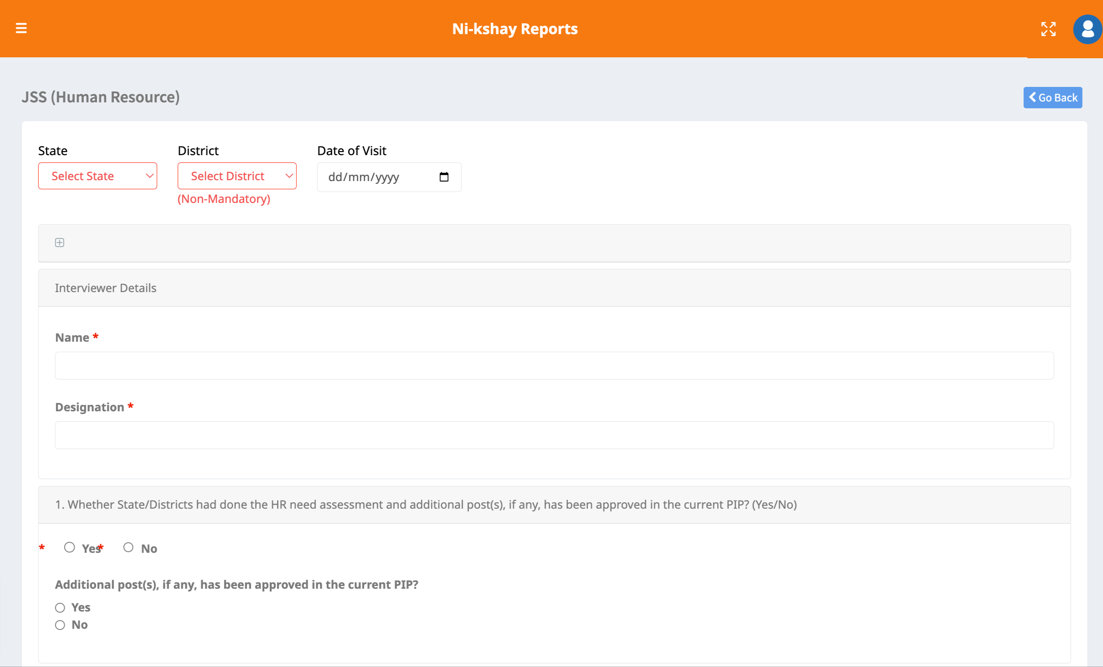
JSS Form – Human Resource

Slide 13
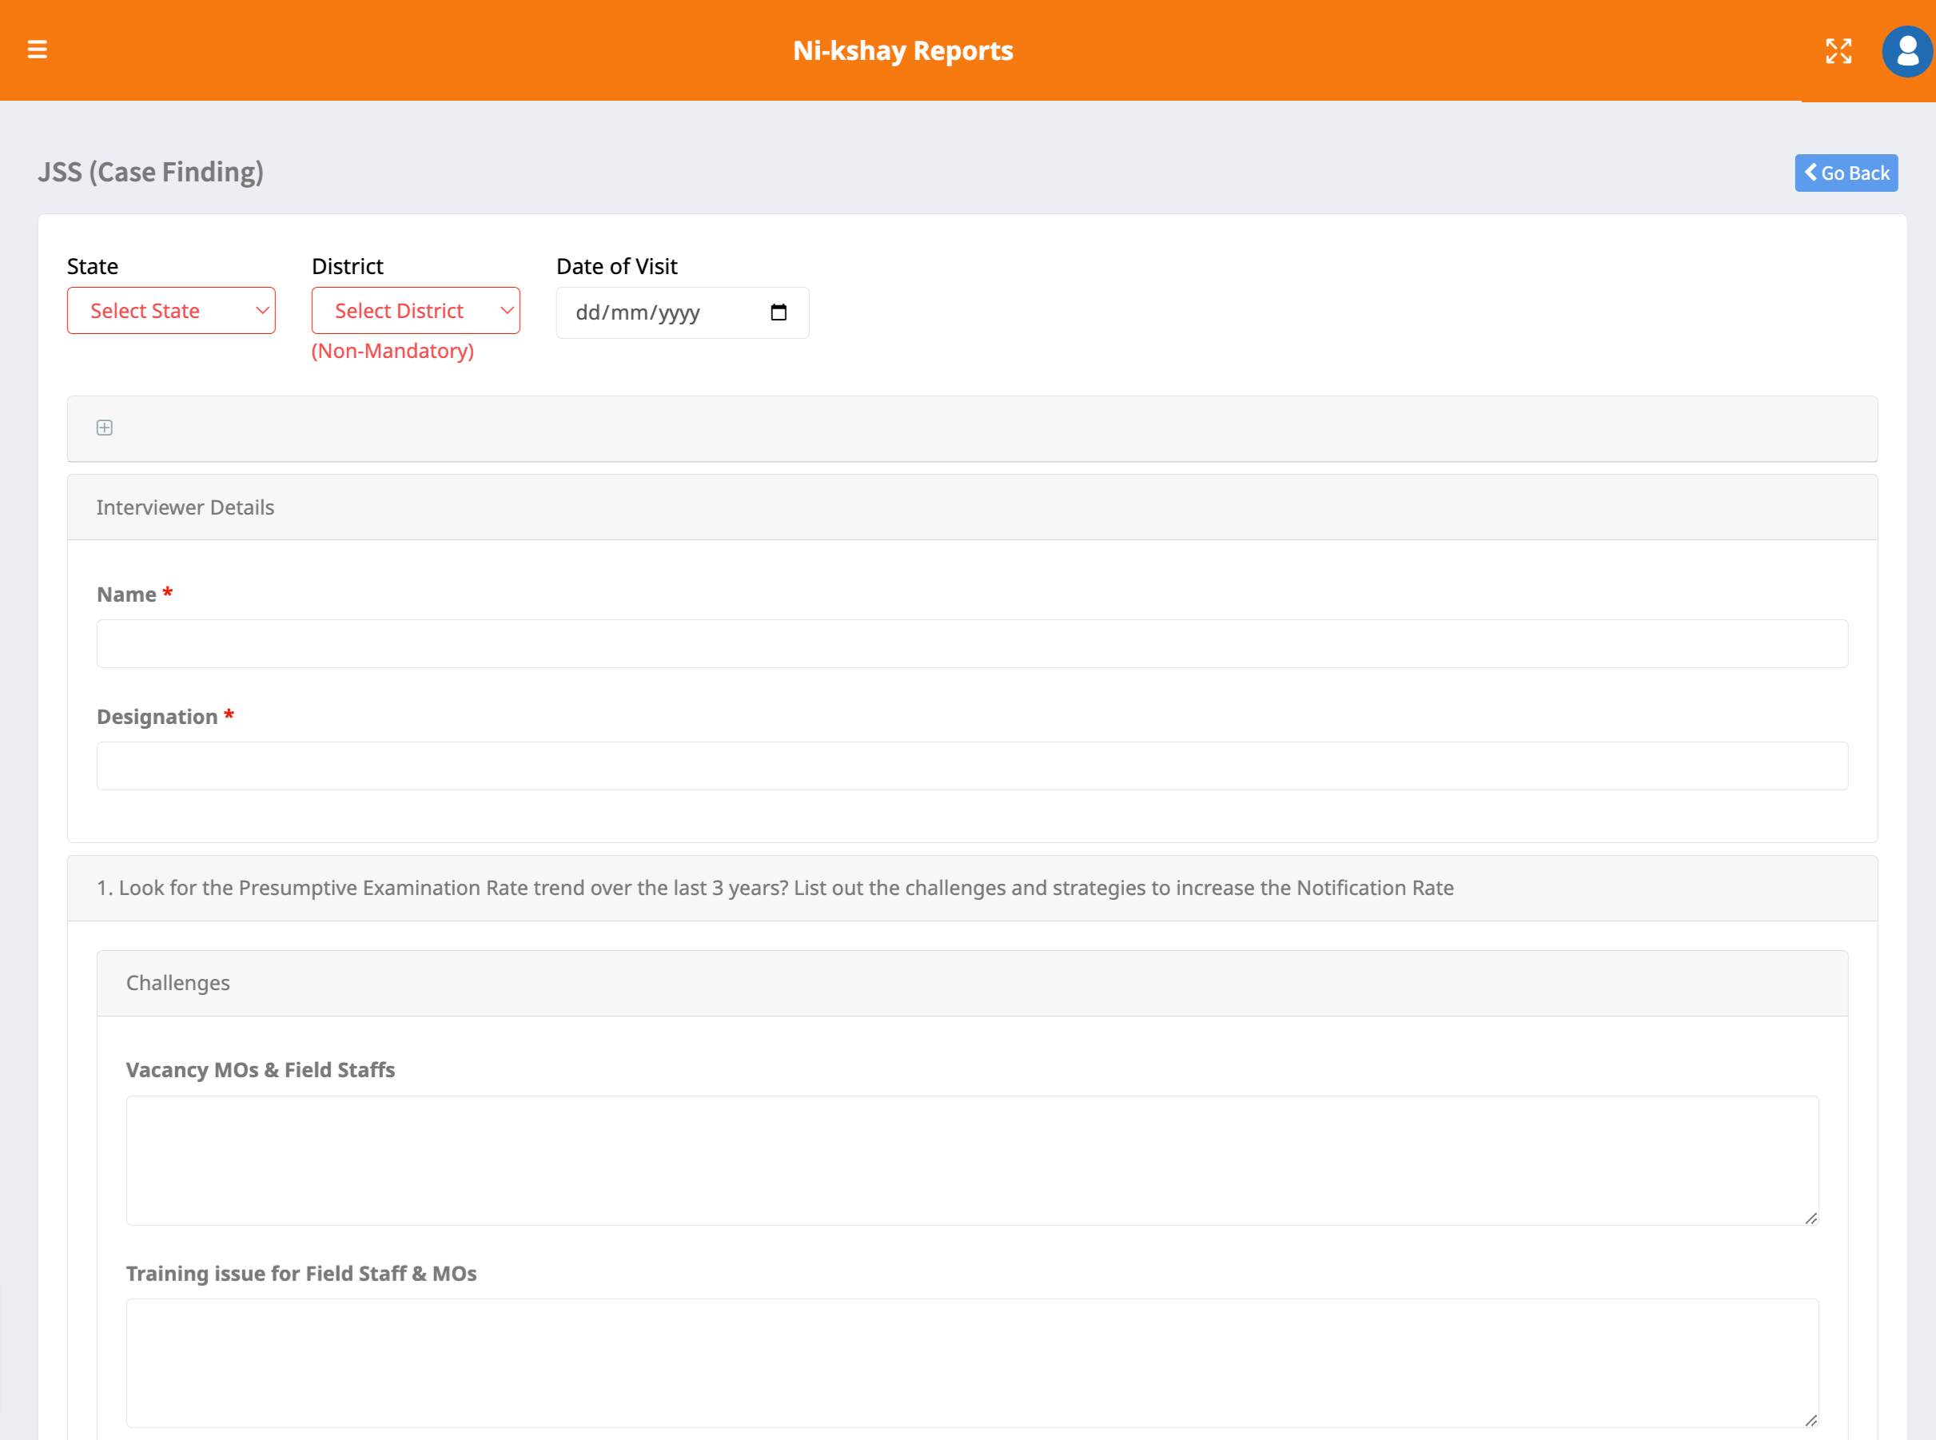
JSS Form – Case Finding

Slide 14
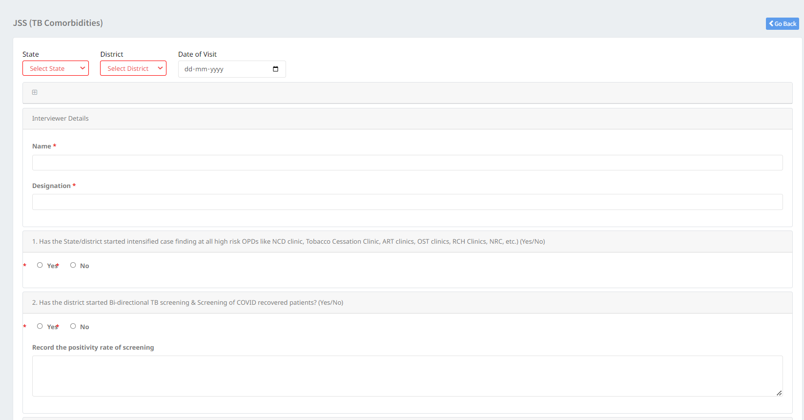
JSS Form – TB Comorbidities

Slide 15
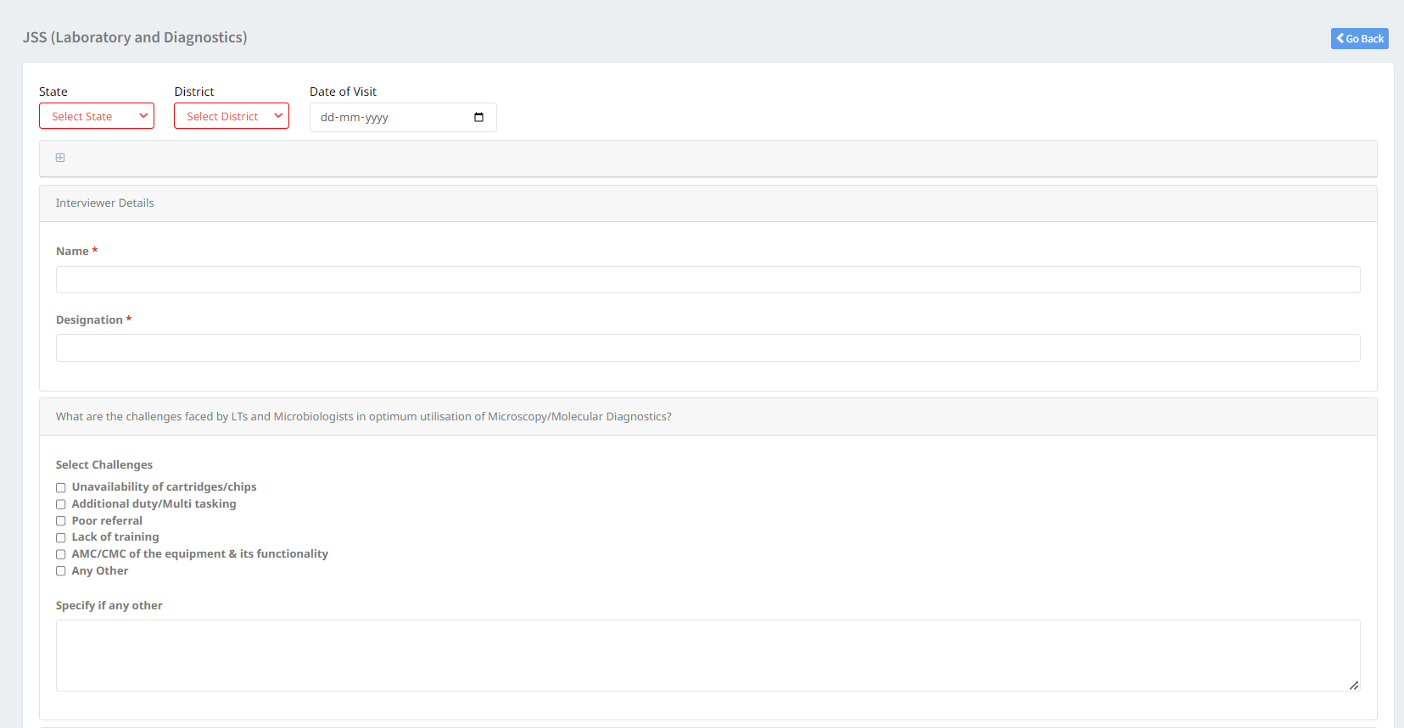
JSS Form – Laboratory and Diagnostics

Slide 16
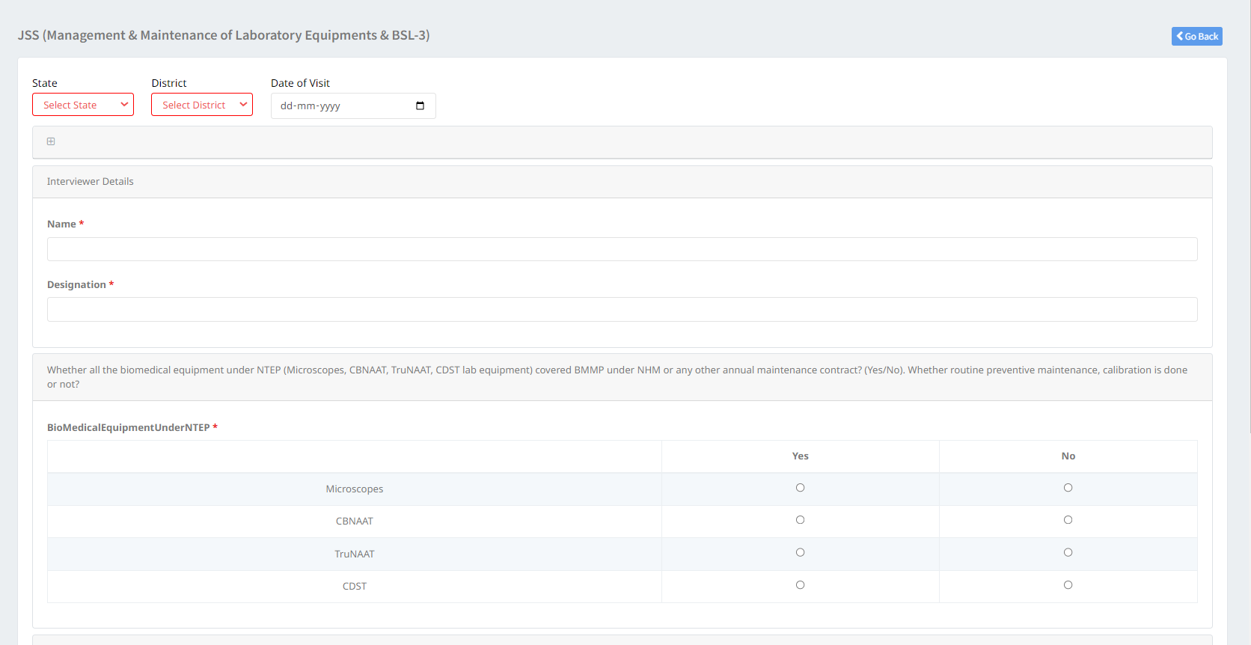
JSS Form – Management & Maintenance of Laboratory Equipment & BSL-3

Slide 17
JSS Form – ACSM/IEC Activities

Slide 18
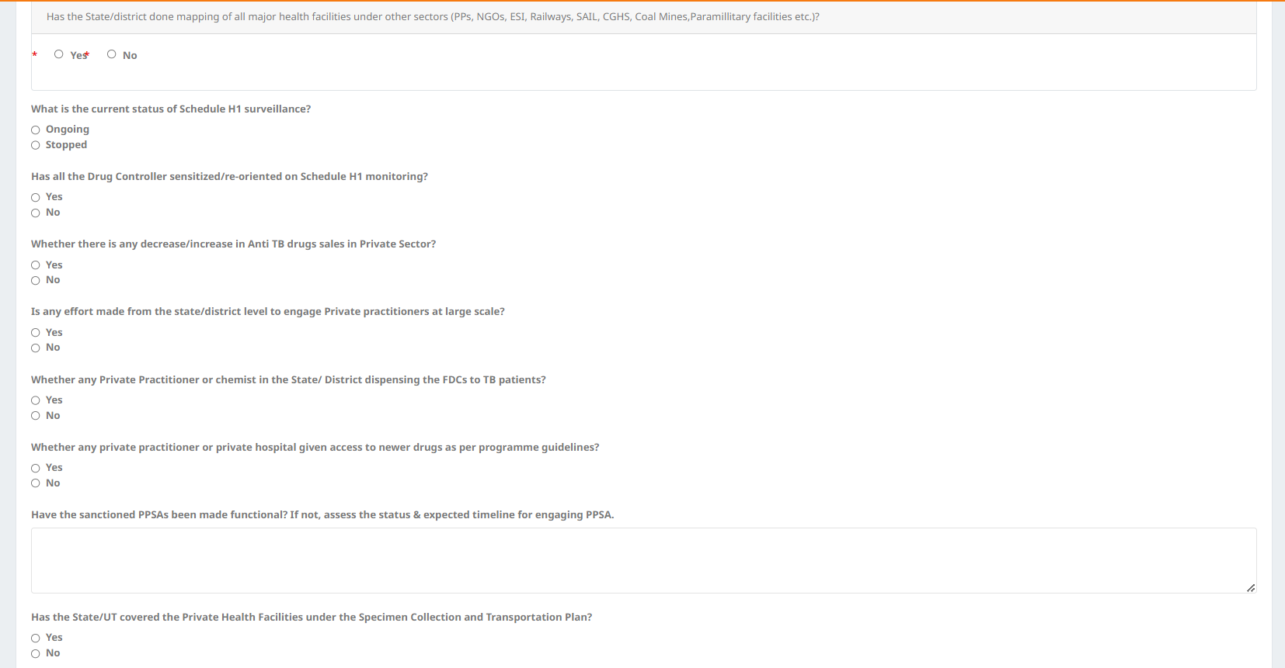
JSS Form – Private Sector Engagement

Slide 19
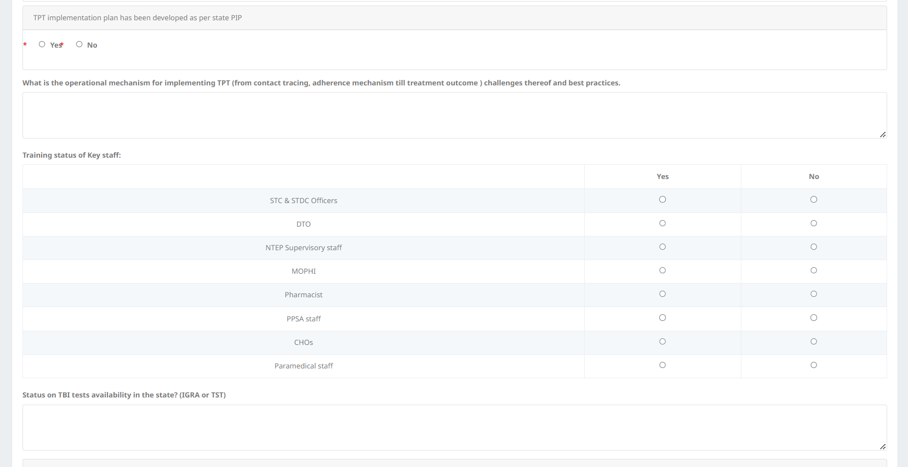
JSS Form – TB Preventive Therapy

Slide 20
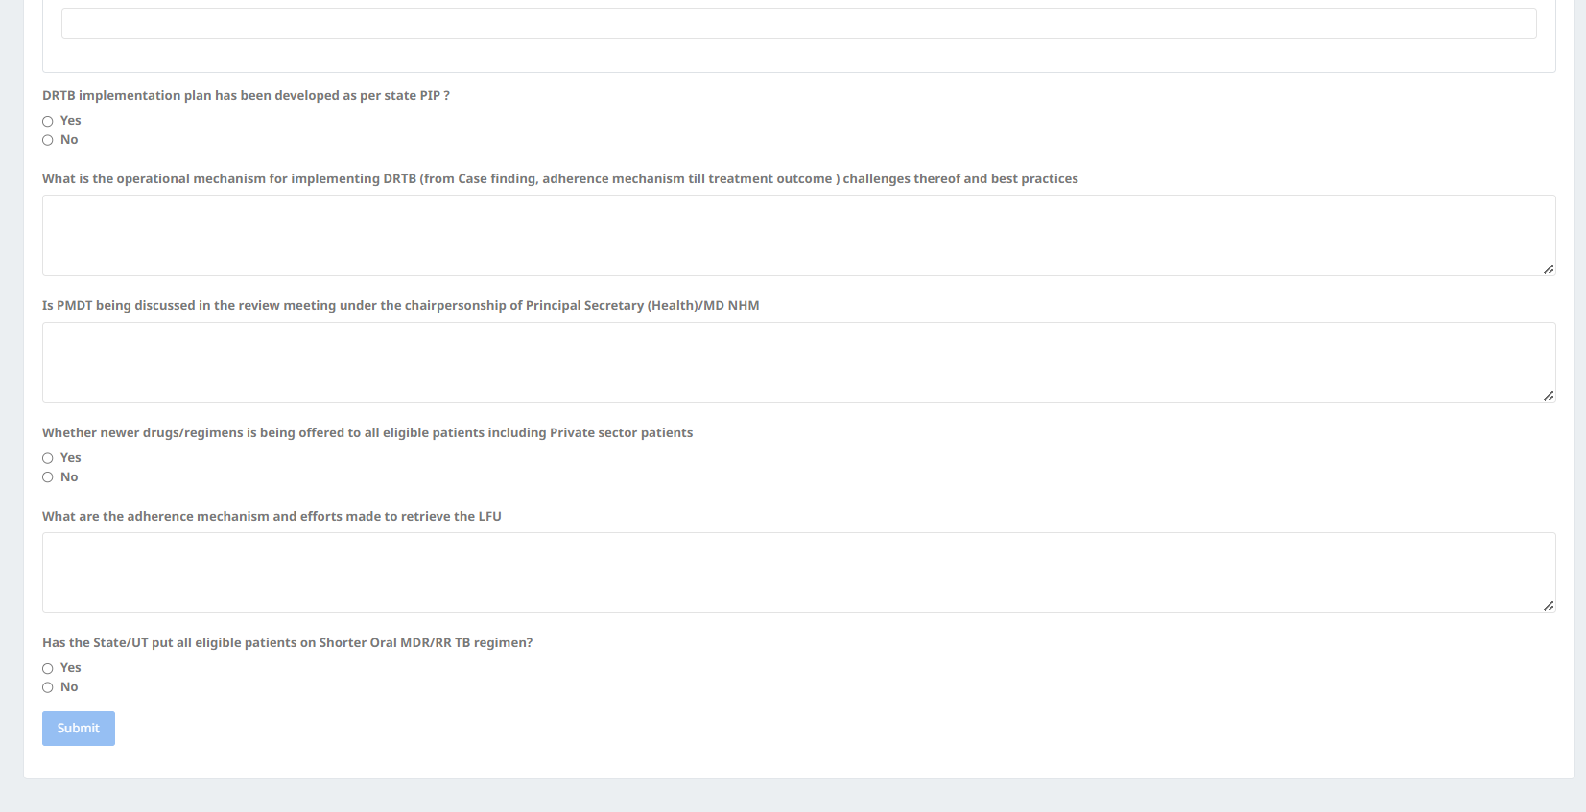
JSS Form – DRTB

Slide 21
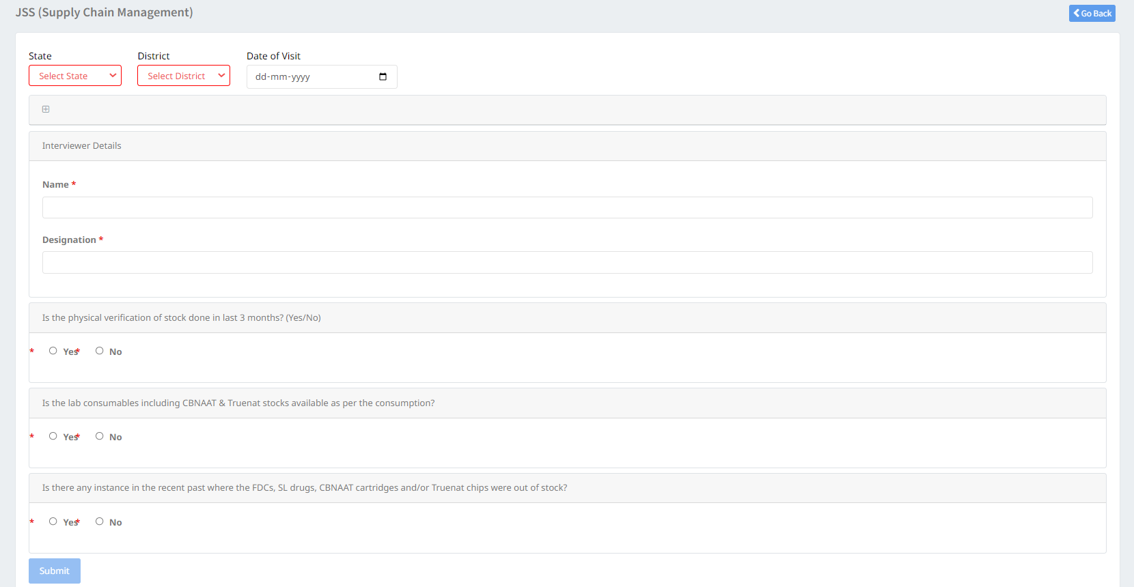
JSS Form – Supply Chain Management

Slide 22
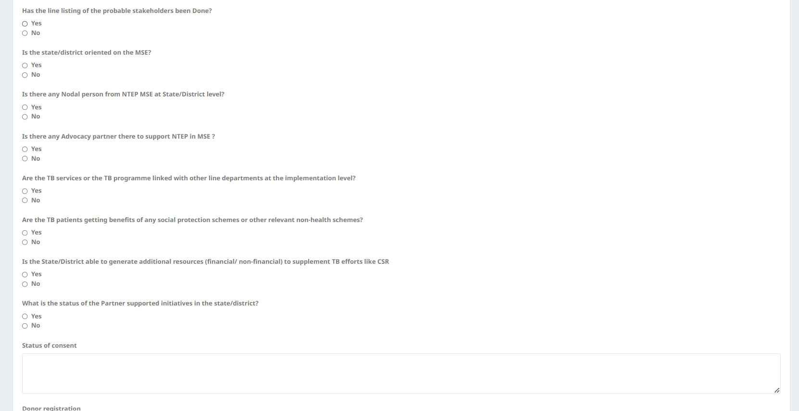
JSS Form – Intersectoral Collaboration

Slide 23
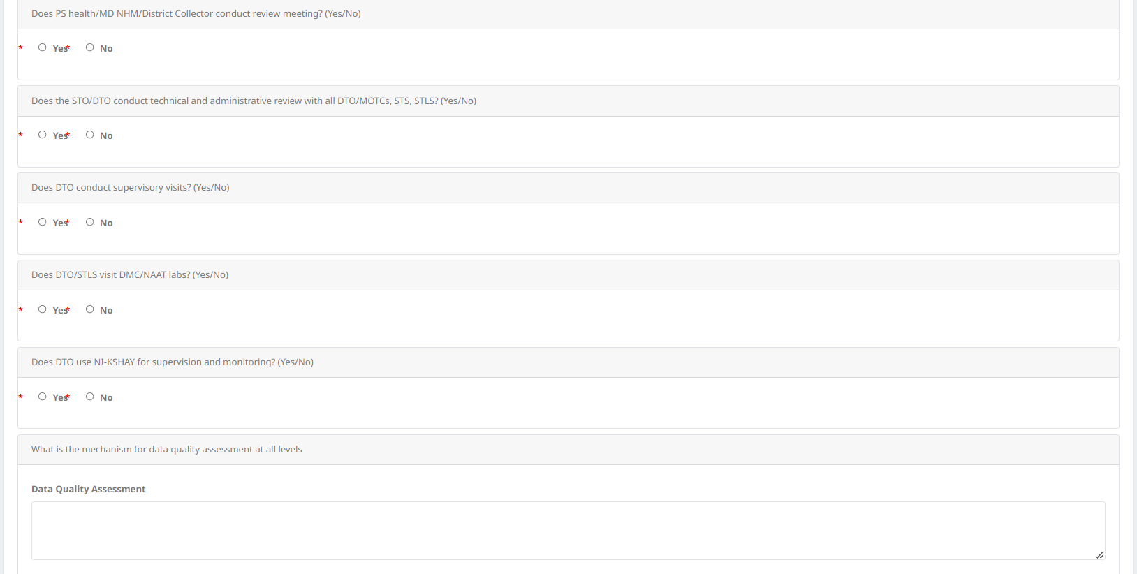
JSS Form – Supervision and Monitoring

Slide 24
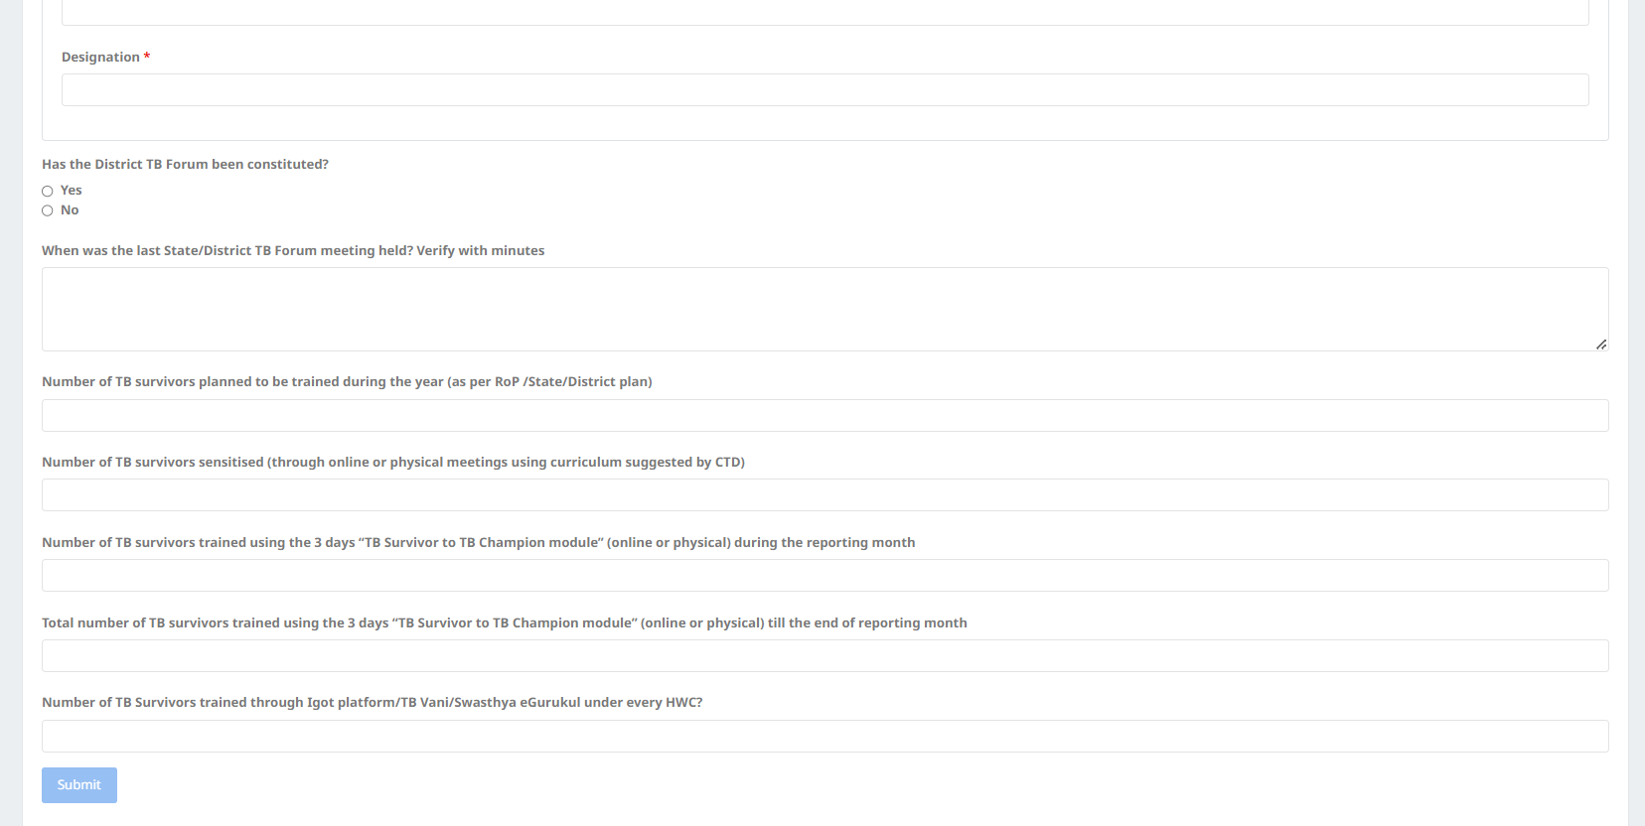
JSS Form – Community Engagement

Slide 25
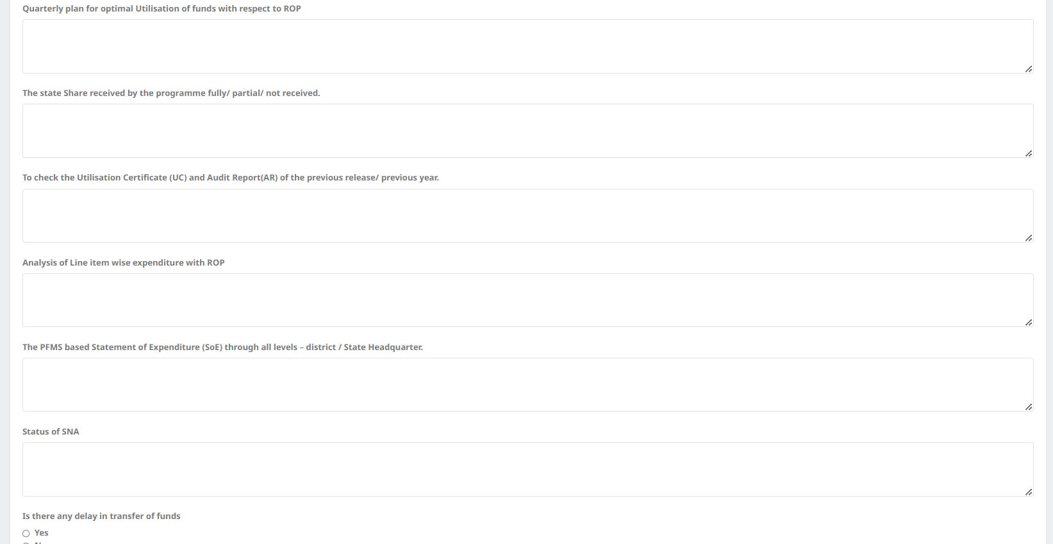
JSS Form – Finance

Slide 26
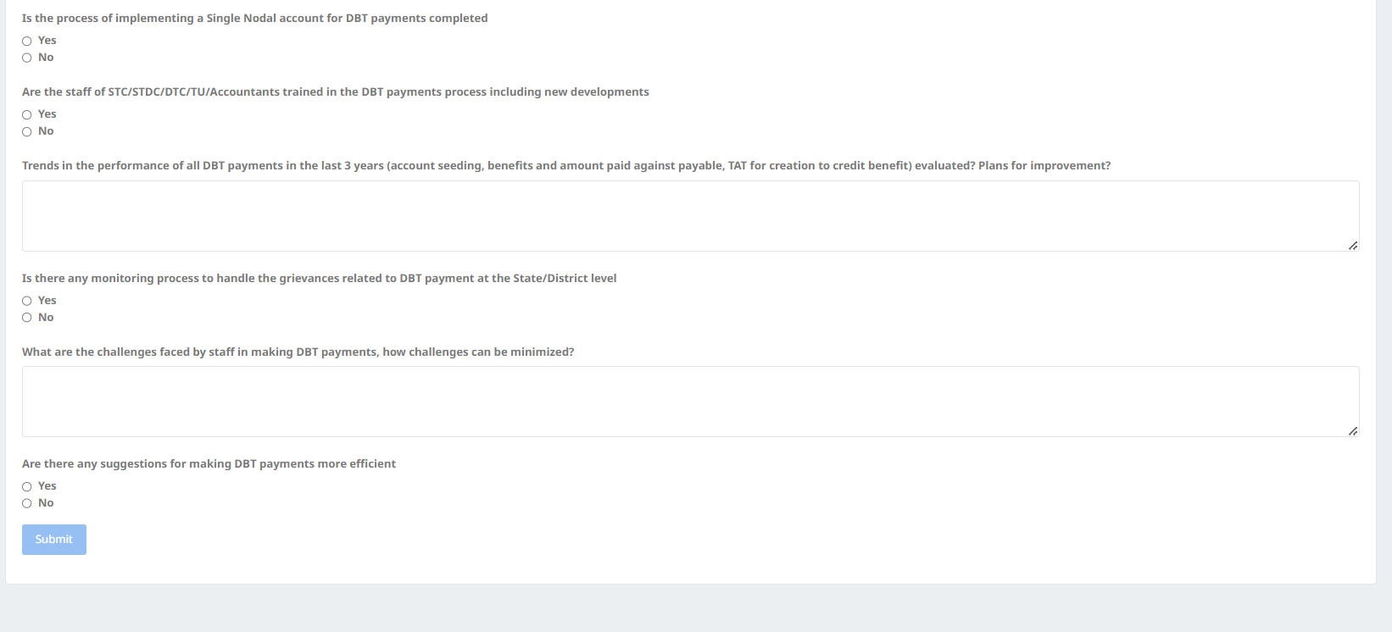
JSS Form – DBT

Slide 27
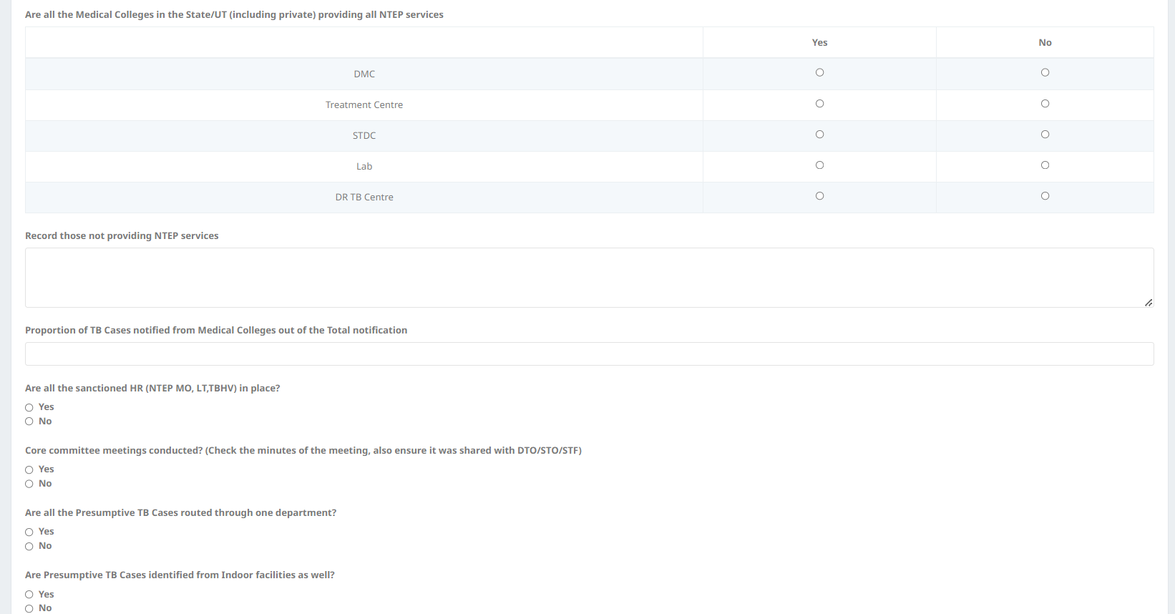
JSS Form – Medical College

Slide 28
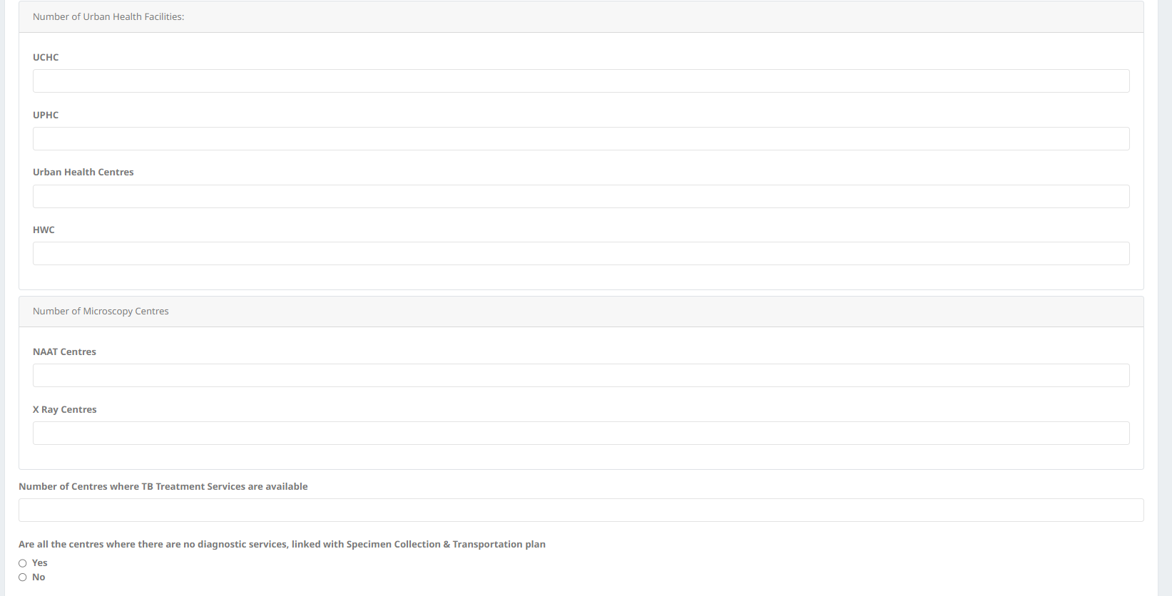
JSS Form – National Urban Health Mission

Slide 29
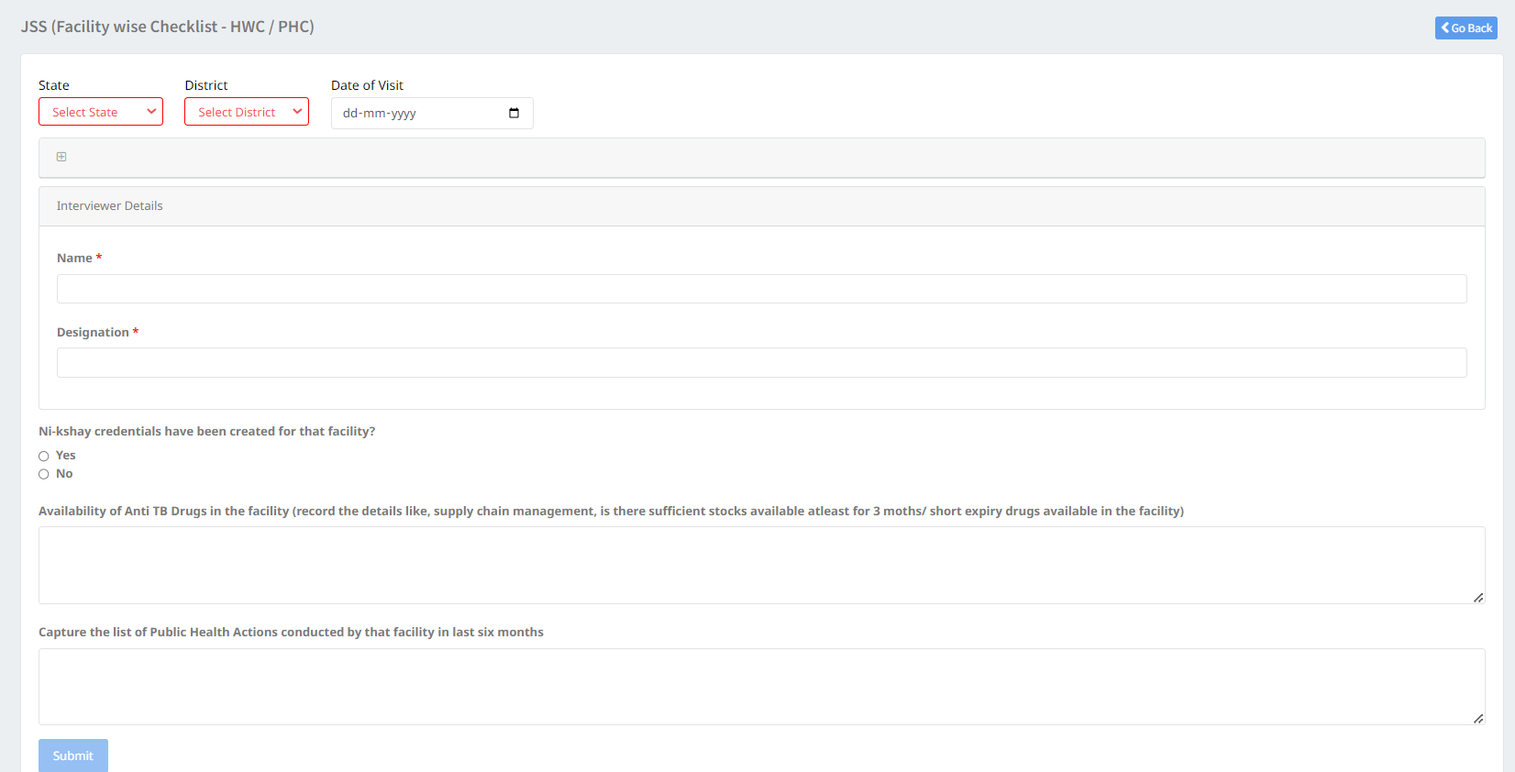
JSS Form – Facility wise checklist – HWC/PHC

Slide 30
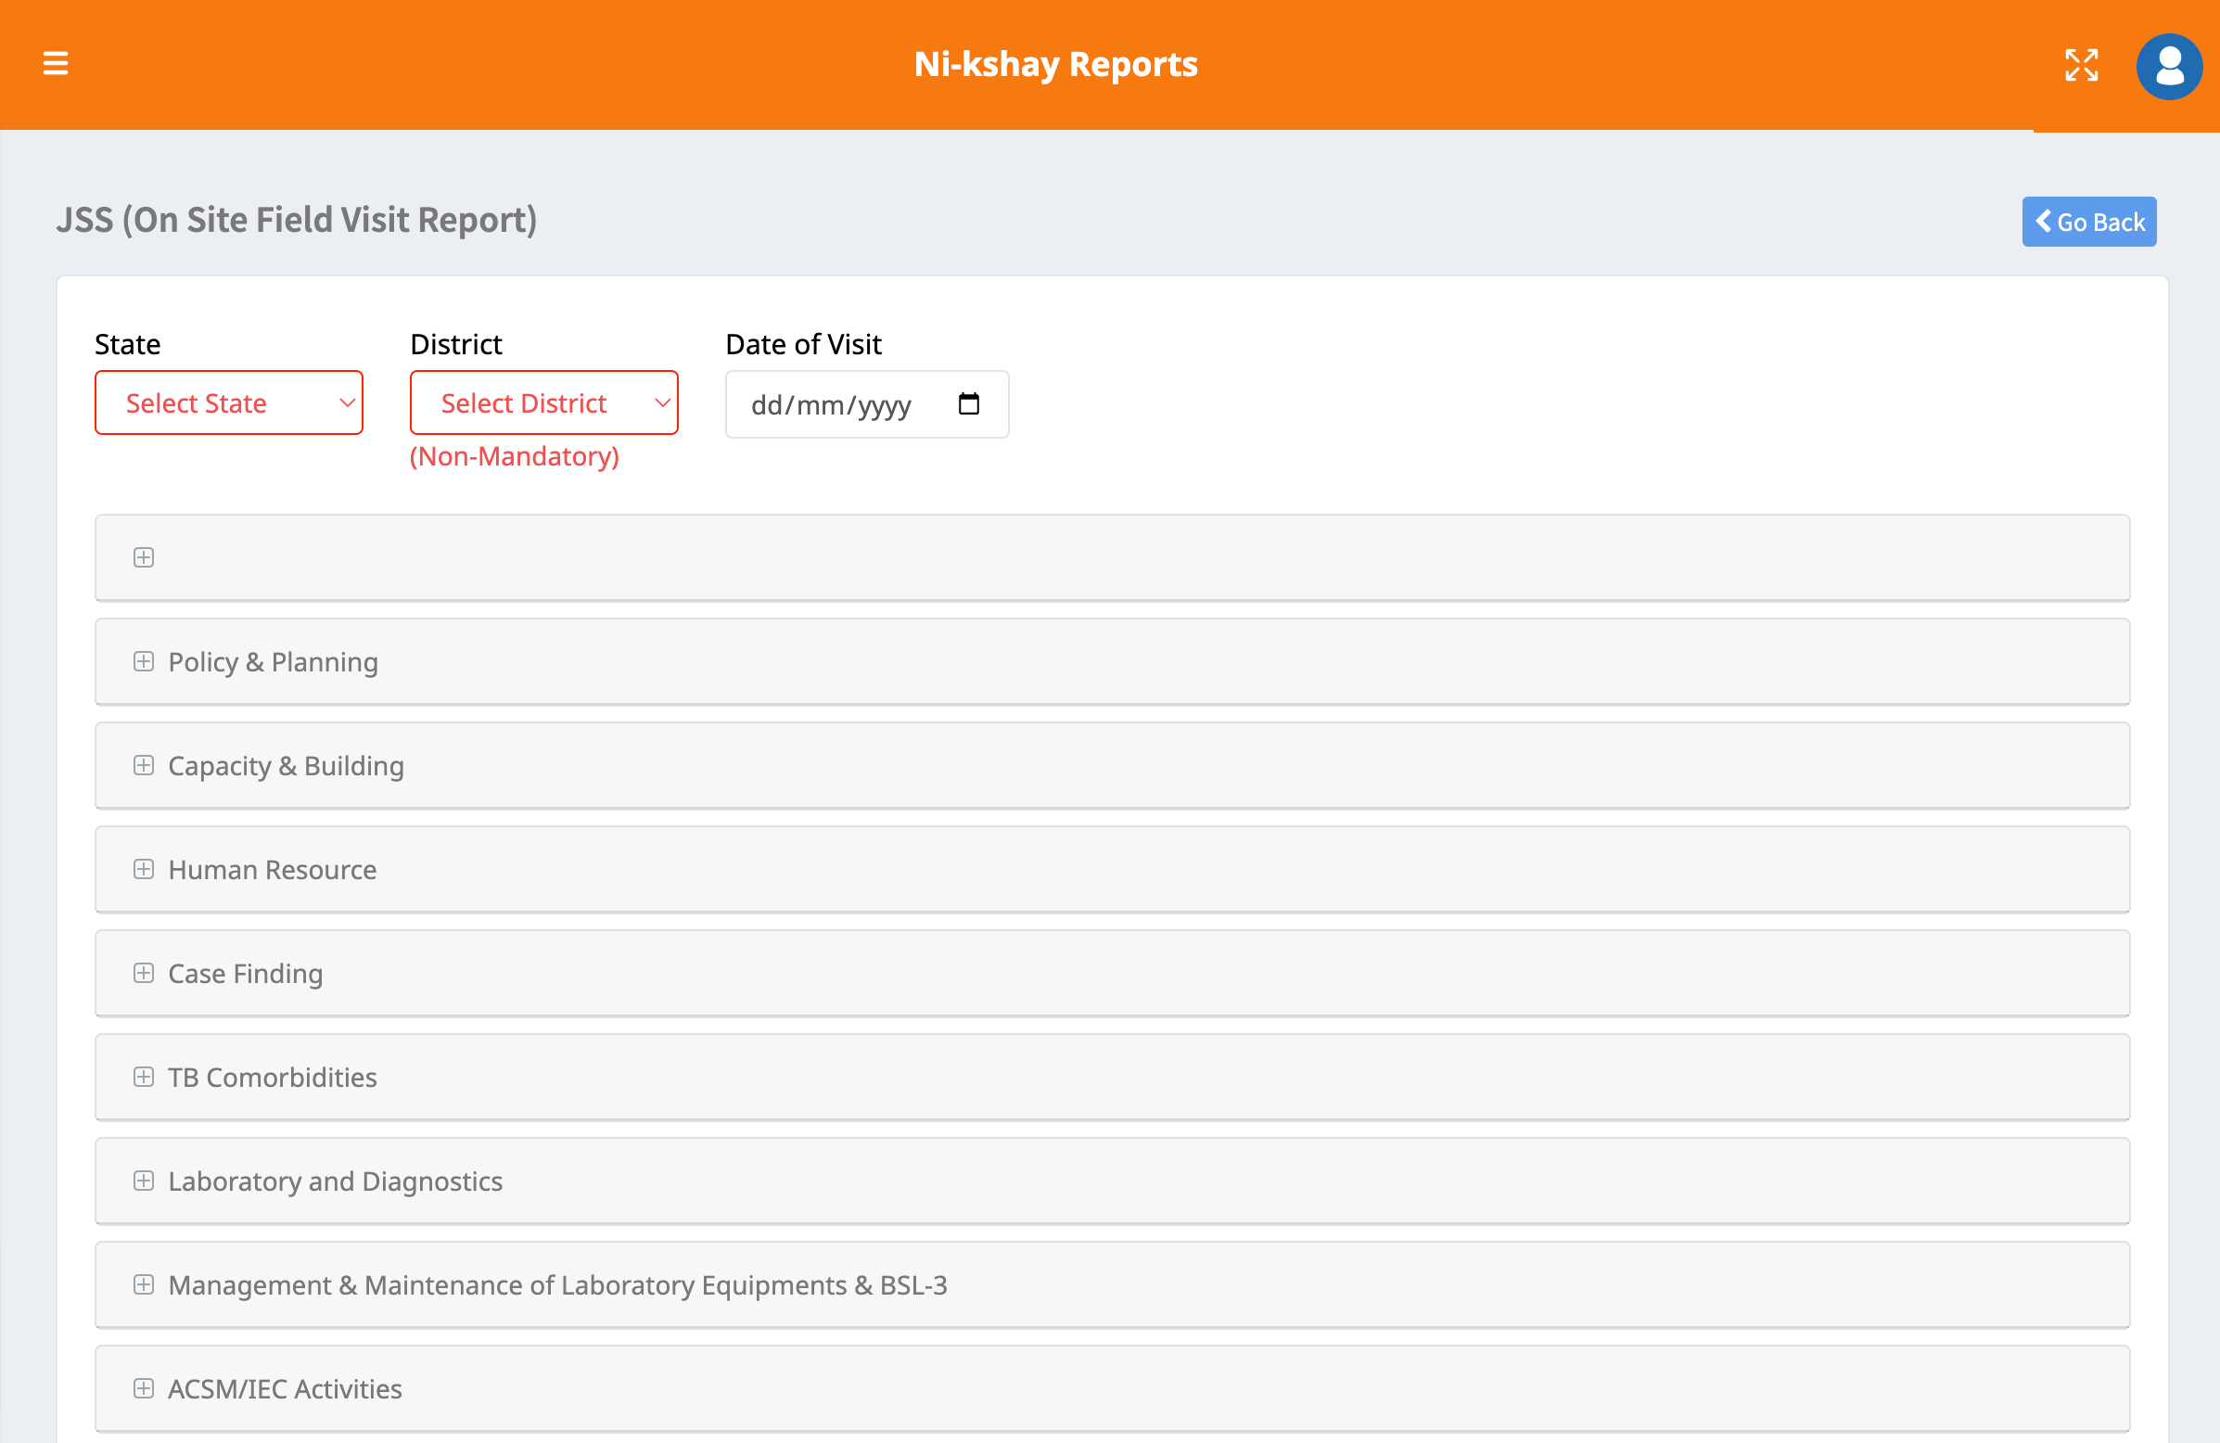
JSS Form - On Site Field Visit Report

Slide 31
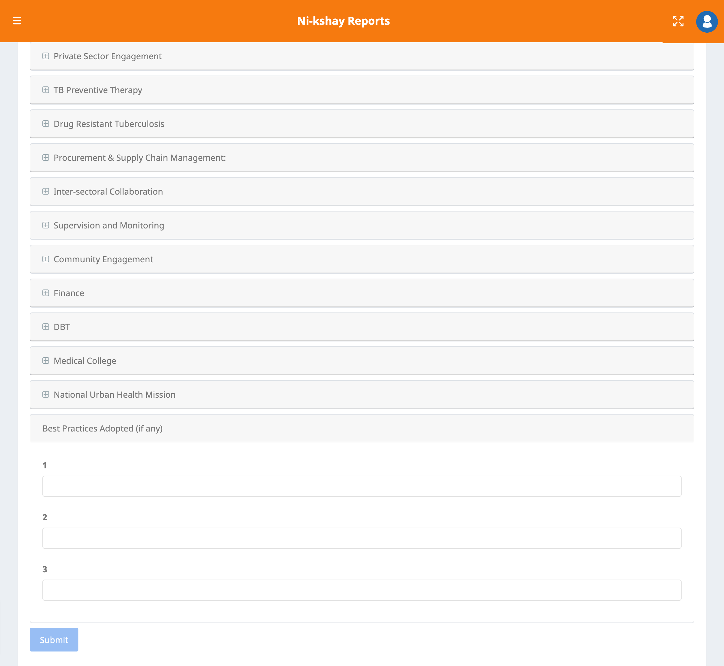
JSS Form - On Site Field Visit Report

Slide 32
Patient Interviews

Slide 33
JSS Form – Drug Sensitive TB Patient

Slide 34
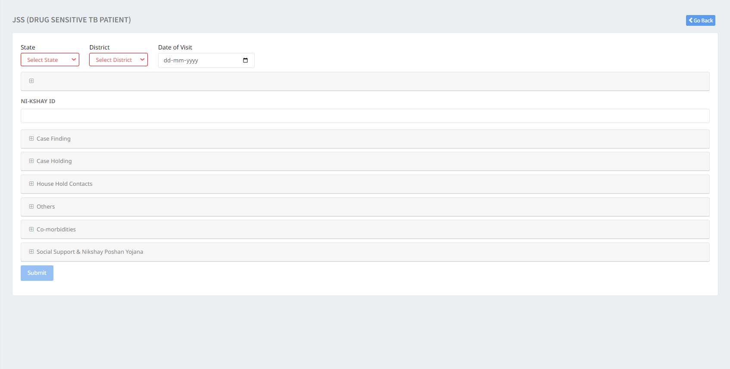
JSS Form – Drug Sensitive TB Patient

Slide 35
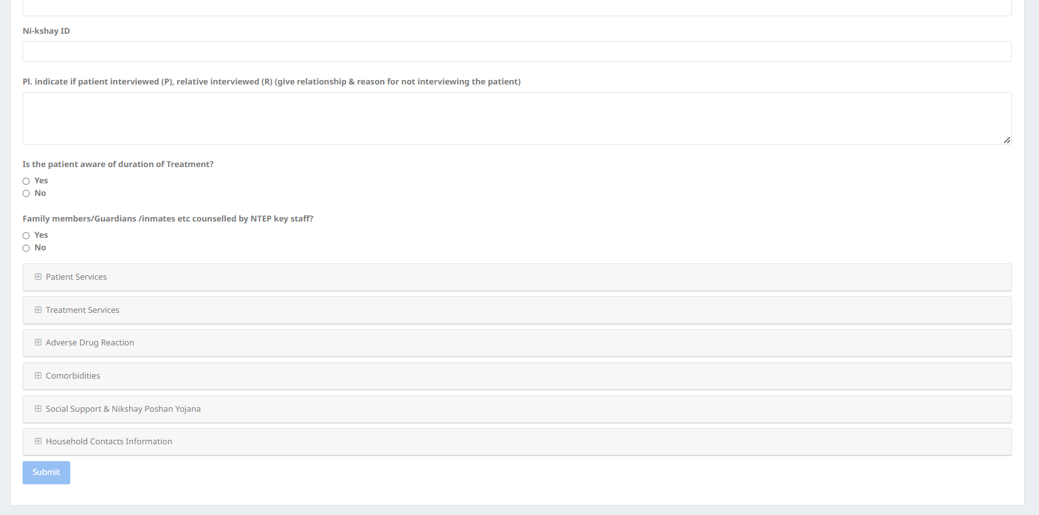
JSS Form – Drug Resistant TB Patient

Slide 36
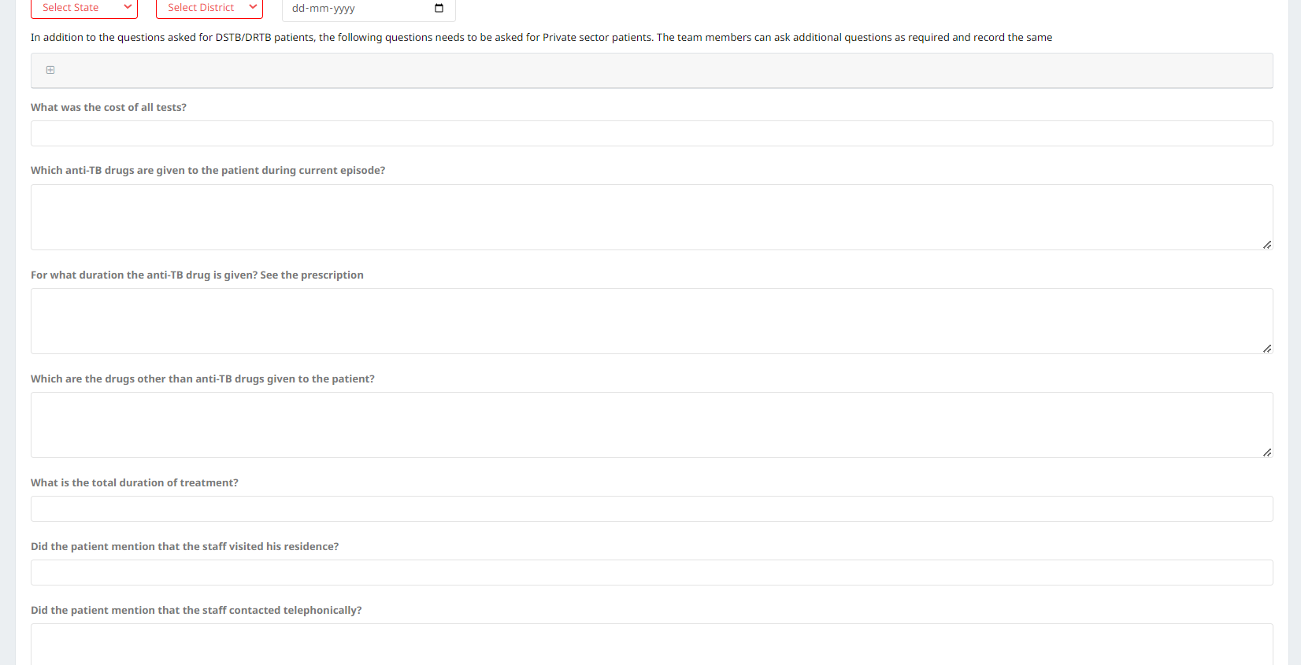
JSS Form – Private Sector TB Patient

Slide 37
JSS Form – Contact Tracing and TPT Initiation

