Slide 1
Module 1: Introduction to Ni-kshay

Slide 2
Salient Features of Ni-kshay 2.0
How to access Ni-kshay
Overview of Patient Management workflow and auto update of patient status
Ni-kshay 2.0 technical support (Ask for help)
How to access Training Materials
Contents

Slide 3
Ni-kshay is an Integrated ICT system for TB patient management and care in India.
Ni-kshay was launched in 2012 and since then, various improvements have been made to the system.
Ni-kshay Version 2 has been launched in September 2018. Ni-kshay provides-
A Unified Interface for Public and Private Sector Health Care Providers.
Different types of Logins like State, District, TU, PHI, Staff logins, Private providers, Chemist, Labs, and PPSA Logins
Integrates all adherence technologies such as 99DOTS MERM, and VOT.
Unified DSTB, DRTB, and TPT data entry forms.
A mobile-friendly website with a mobile app.
Salient Features of Ni-kshay 2.0

Slide 4
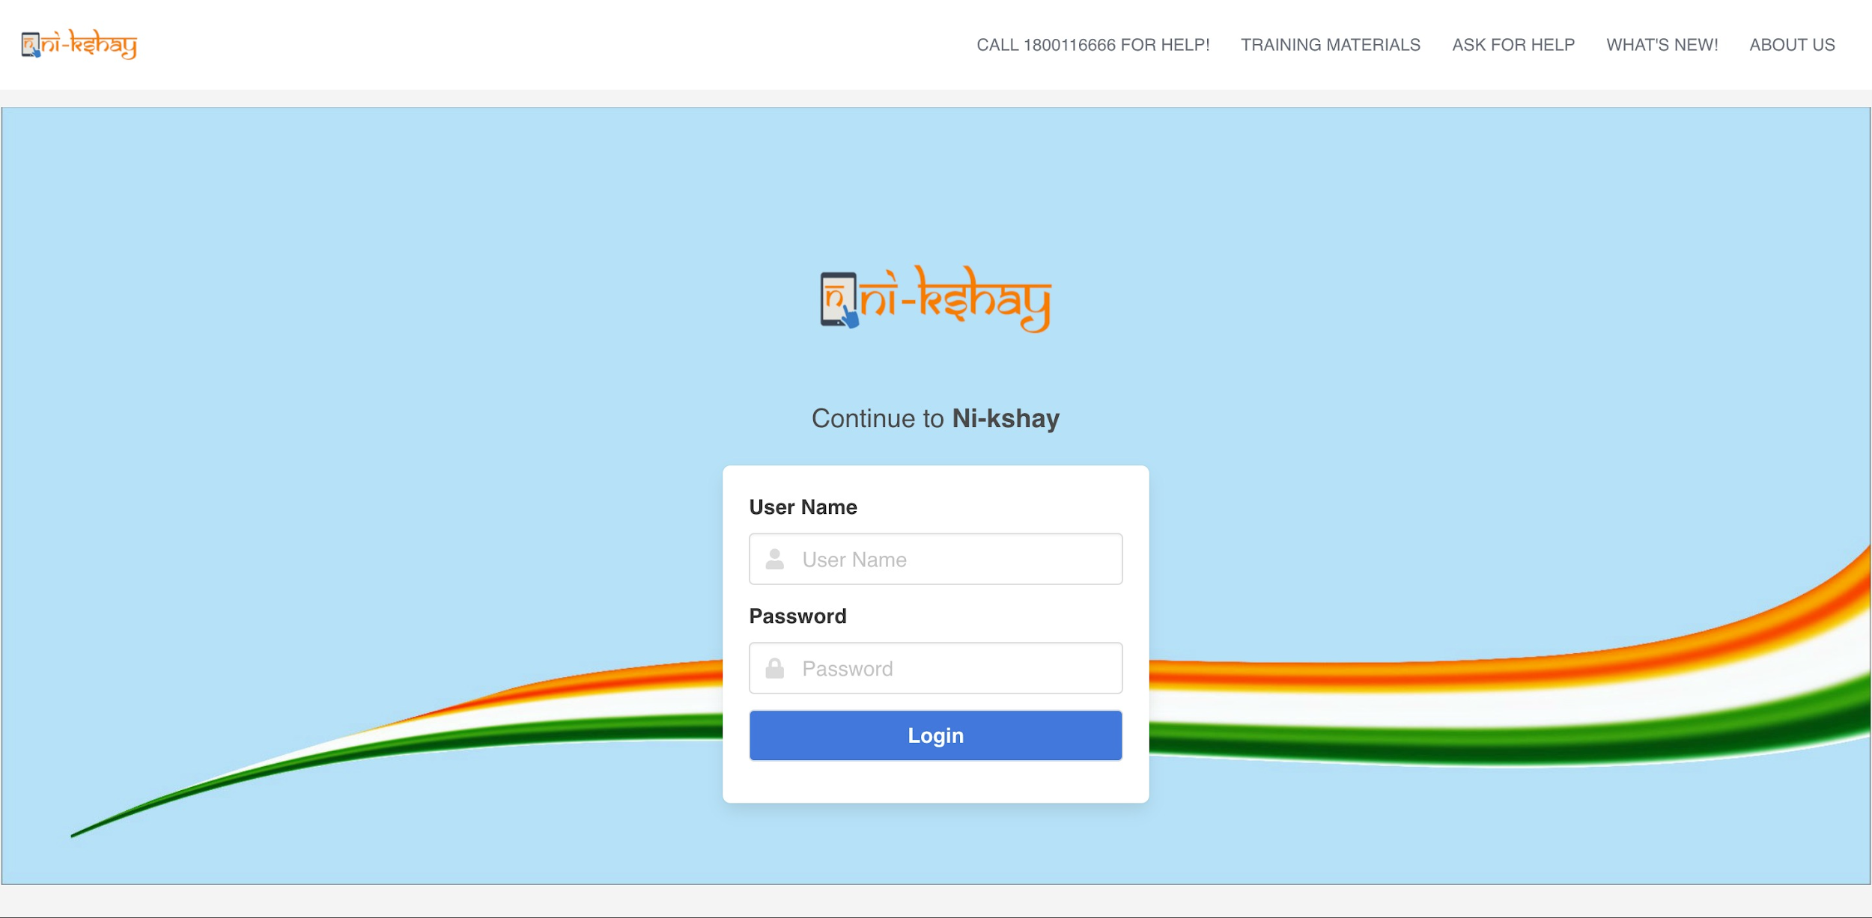
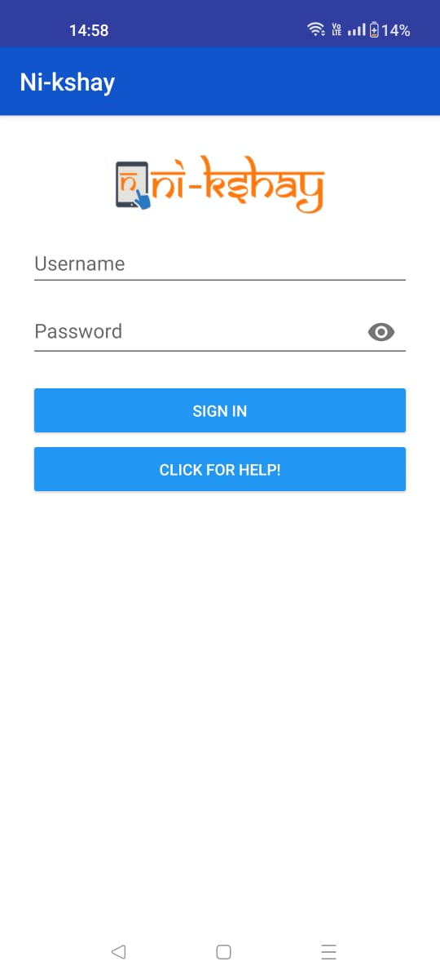
How to access Ni-kshay
Ni-kshay 2.0 is accessible either via a web browser (https://ni-kshay.mohfw.gov.in/) or a mobile App called ‘Nikshay’ that can be downloaded from Google Play Store.
( login page in a web browser)
( login page in mobile App)

Slide 5
Patient Management Workflow
1
2
3
4
5
6
7
Identify a Presumptive or Confirmed case <One time>
New Enrolment
PHI
Diagnosis <One time>
Test
DMC or TrueNat or CBNAAT or C&DST Lab
Adherence Monitoring <Continuous>
Adherence
PHI
Treatment initiation <One time>
Treatment Dispensation Contact Tracing Comorbidity Adverse Event Health Facilities Engagement Staff
PHI
Follow up tests <Multiple>
Test
PHI
Declare Outcome One time
Close case
PHI
Update Patient details <As required>
Treatment Dispensation Health Facilities Engagement Staff Notes
PHI
Activity
Module to be used
User

Slide 6
Auto calculation of patient status during patient lifecycle
Action
Status
Step 1
New Enrollment
Presumptive (Open)
Step 2a
Negative diagnostic test result
TB Not Diagnosed
Step 2b
Diagnosed but pending Treatment (Notified)
Positive diagnostic test result
Patient treatment life cycle
Step 3
Treatment Initiation
On Treatment (Notified)
Note: For Private Patients one can directly start treatment without adding tests.
Step 4
Outcome Assigned
Outcome Assigned (Notified)

Slide 7
Ni-kshay 2.0 technical support
If users have a query or face any issue while using the Application, they can either Call Ni-kshay Sampark at 1800 11 6666.
Users can also log a SERVICE Request using the “Ask for Help” option on the Ni-kshay Website.
To resolve your queries, please review the latest training material on the Ni-kshay Website.

Slide 8
Categories in “Ask for Help”
Subcategory | Definition | Example
Help with application Training | Queries on Ni-kshay arising out of knowledge gaps. A user is not requesting a new feature nor is raising a defect in the system | How do I check patient data? Where can I monitor adherence?
System Issues/Bug | Any issue that refrains a user from using the system or its function in accordance with the current requirements | Workflows not working Dashboard showing incorrect data
Feature Request | Any change to an existing functionality or an additional of a new functionality when compared to current requirements | Ability to customize notifications on the system Add additional data fields

Slide 9
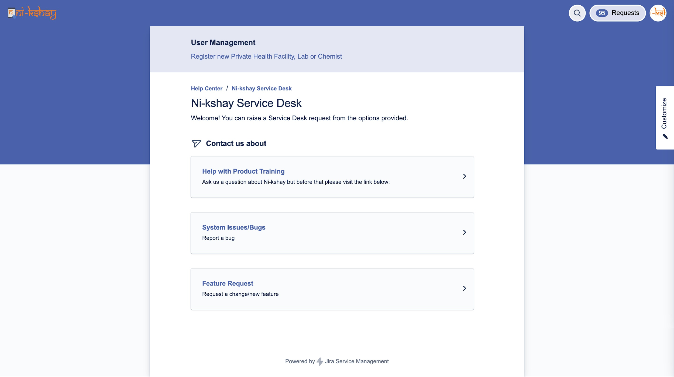
Log in into Service Request Portal
Sub categories of Service Request

Slide 10
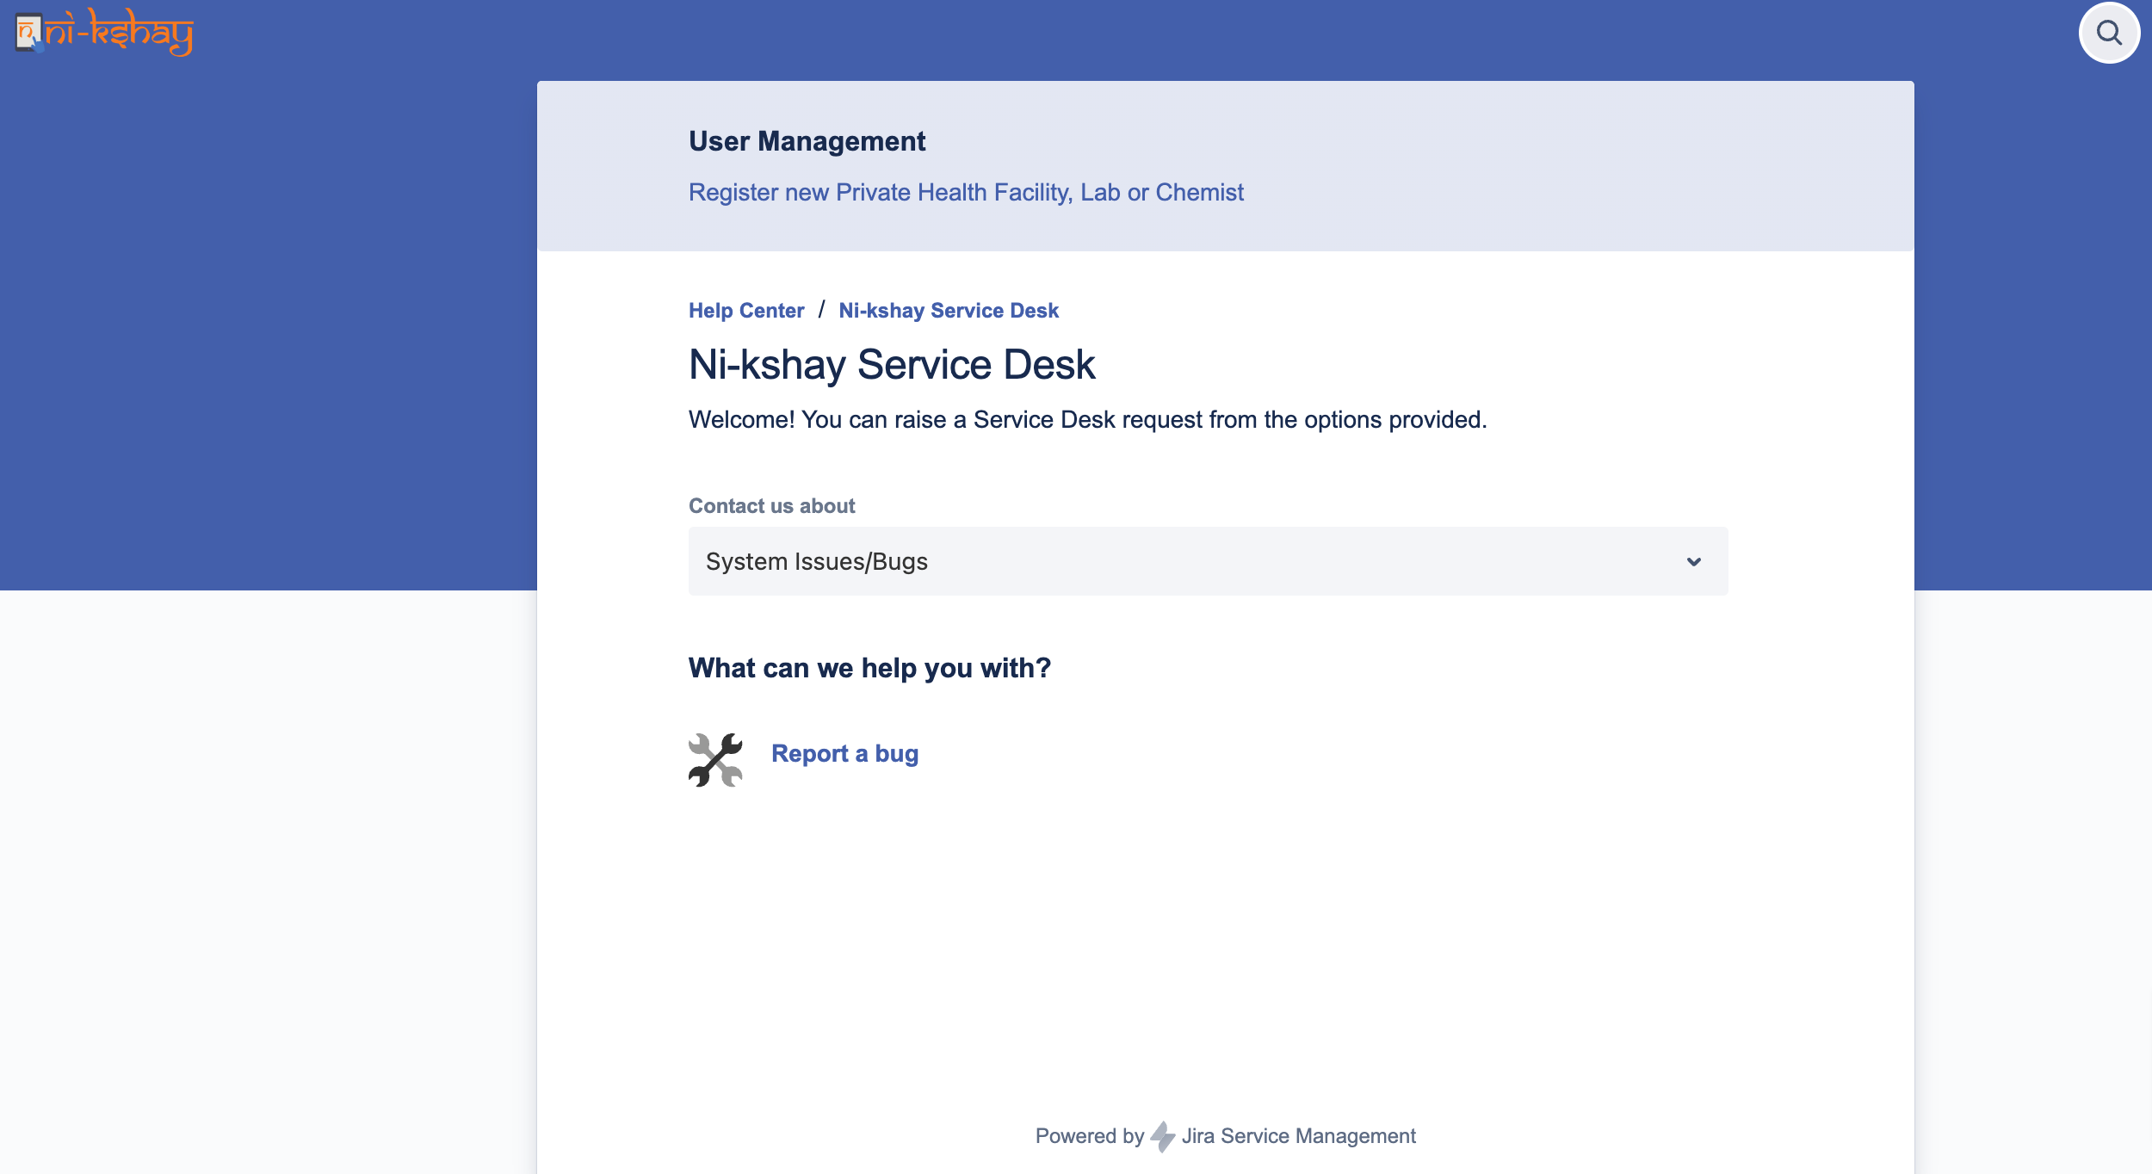
Raise a Bug / Defect
Any issue that refrains a user from using the system or its function in accordance with the current requirements. Eg

Slide 11
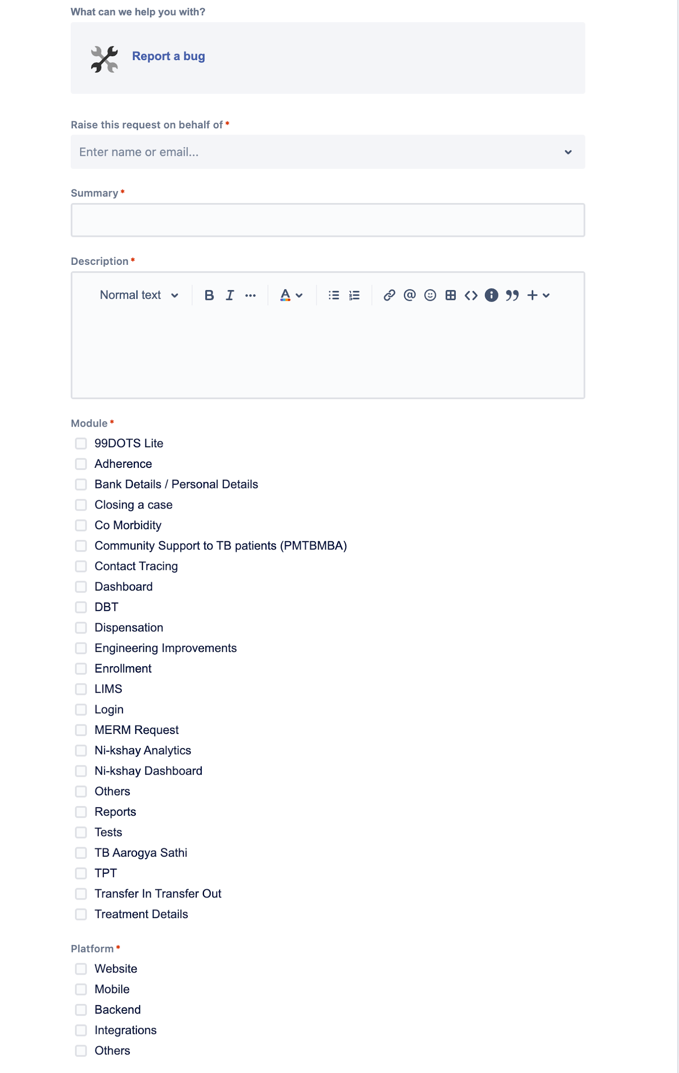
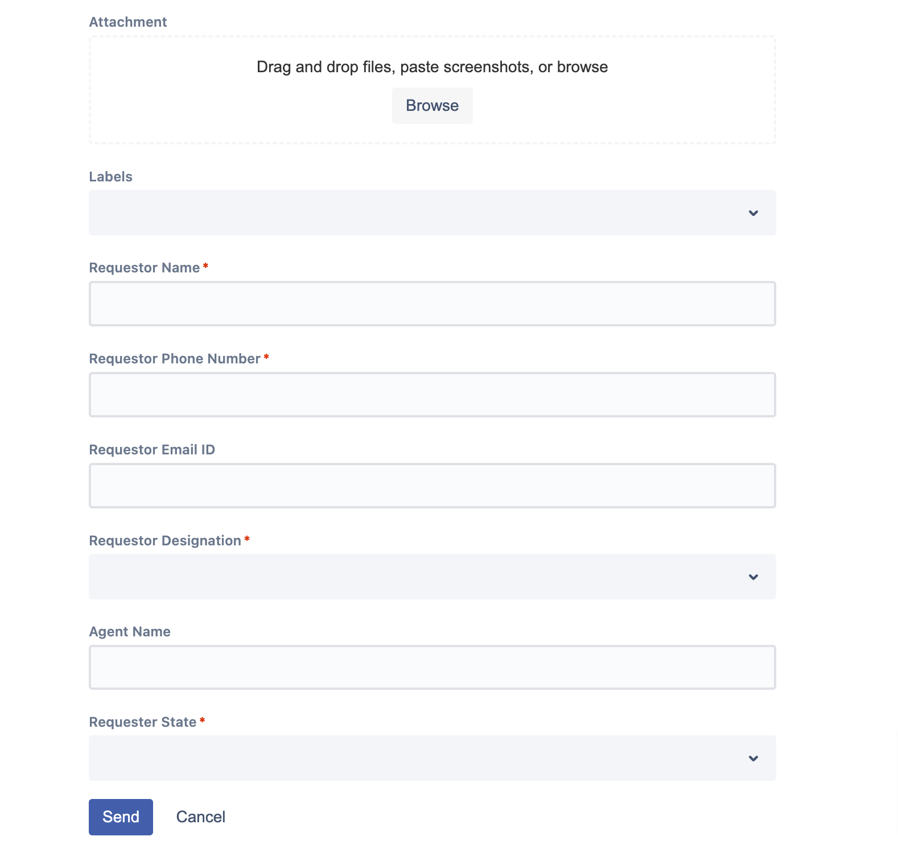
Raise a Bug / Defect
While raising a Service Request, user should try to explain the issue in detail and attach screen shots if possible, so that the support team can get all the requisite details

Slide 12
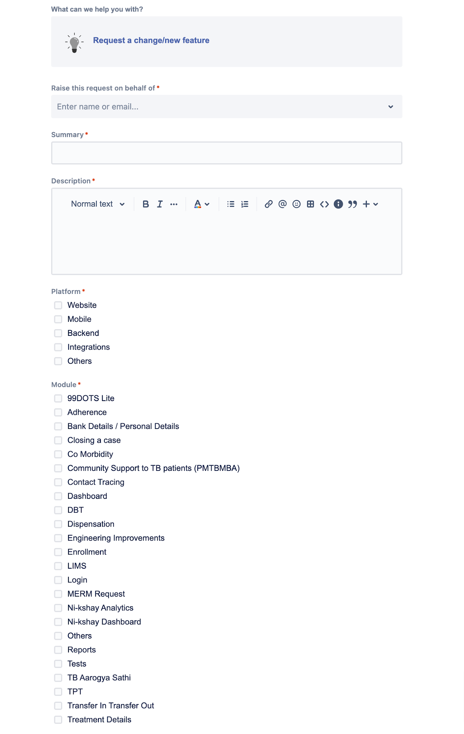
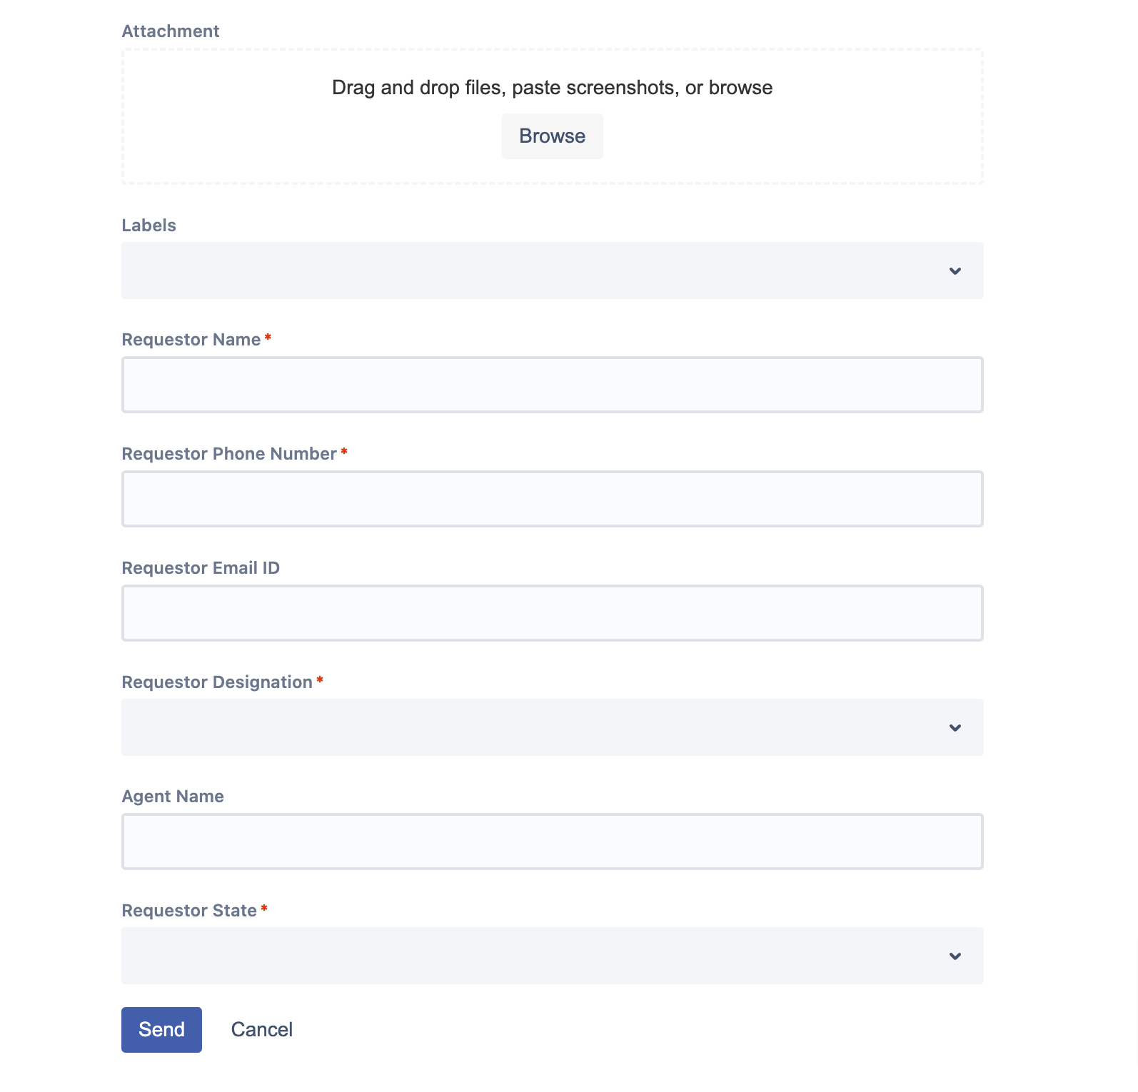
Raise a Request for a new feature

Slide 13
How the Support team works in the back end
Resolve the issue
Service Request Portal
(Ask for Help)
Option 2: User calls Ni-kshay Sampark to log an issue
User
Call Centre Agent
(L1 Support )
Issues assigned to L2 support Team
L2 Agents
Option 1: User can log a Service Request directly
(L1 = Level 1, L2 = Level 2, L3 = Level 3)
L3 Engineers

Slide 14
As we continuously upgrade our training material, kindly ensure you refer to the updates provided in the section called “What’s new” on the home page of Ni-kshay.
Also, kindly make sure that you refer to the latest version of the training Material. The Training Materials are available on the Home Page of Ni-kshay 2.0.
What’s new section & Training Materials

Slide 15
Access latest version of Training Material

