Slide 1




Slide 2
Patient Follow Up Module
(App Only)
Patient Follow Up Module (App Only)
In Nikshay App, whenever a staff does follow-up those details now can be recorded in Patient Page.
This feature is exclusively for field staffs using Nikshay App to monitor patients.

Slide 3
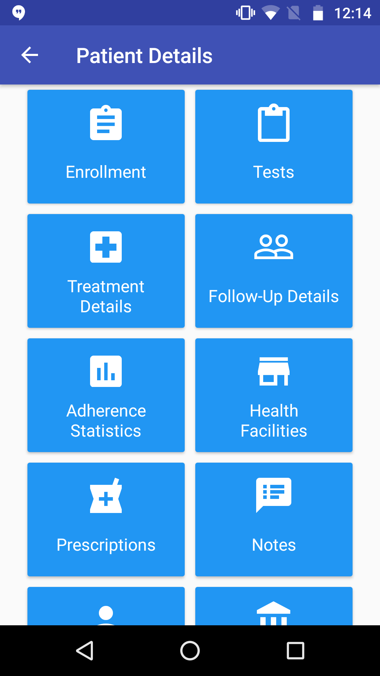
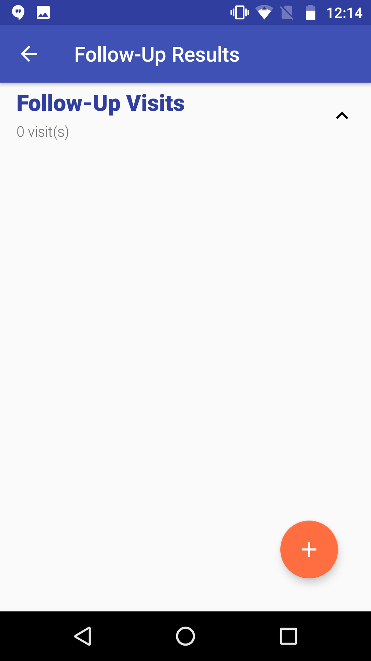
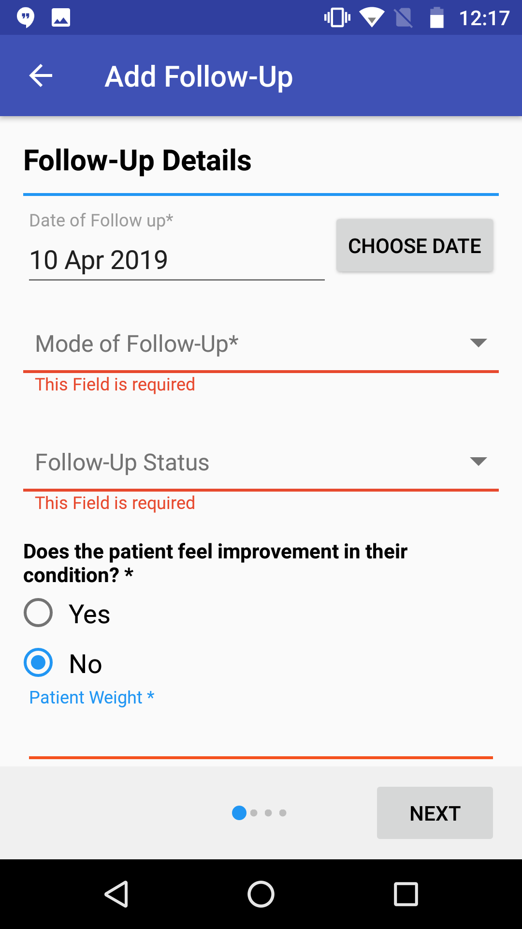
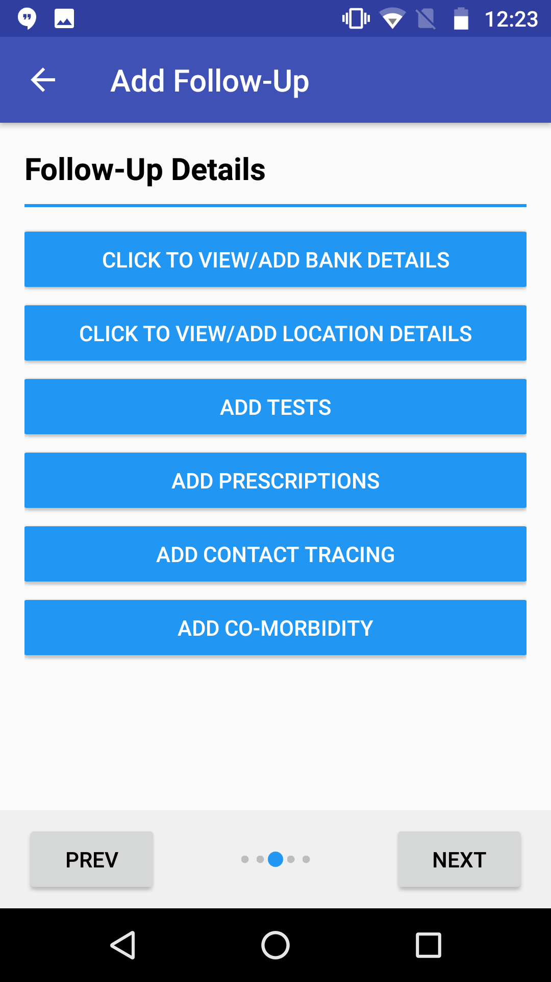
Patient Follow Up Module (App Only)
In the Patient’s Page click “Follow-Up Details”
Click + To Add a Follow-Up Visit
User can add Bank Details, Location Details, Test etc.
Fill The form

Slide 4
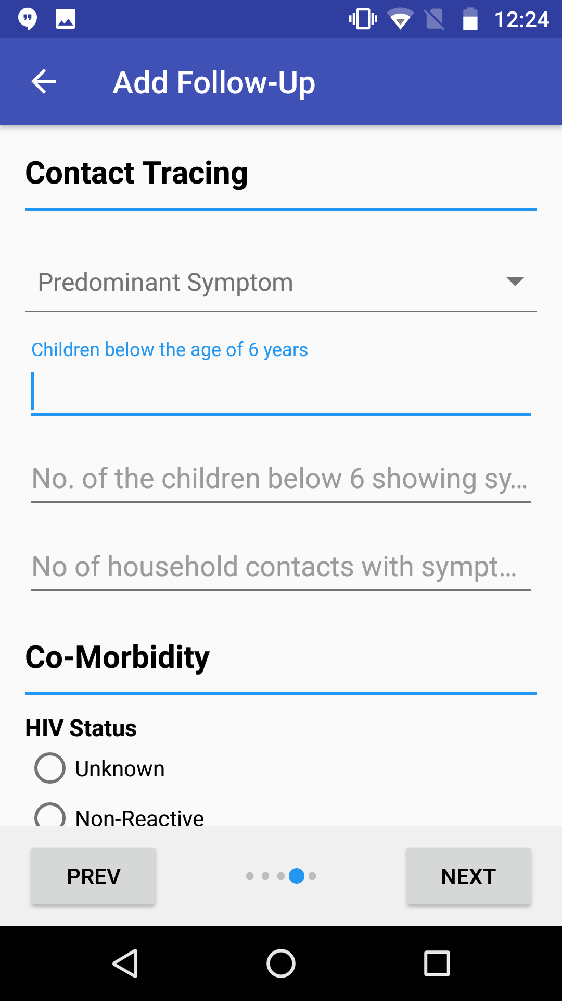
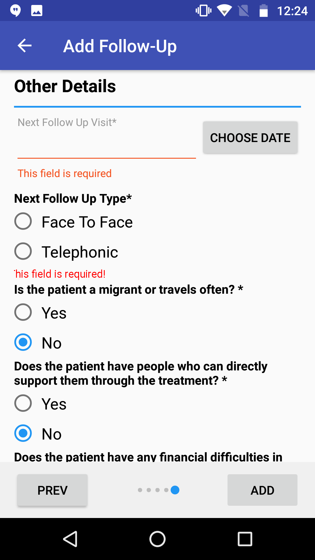
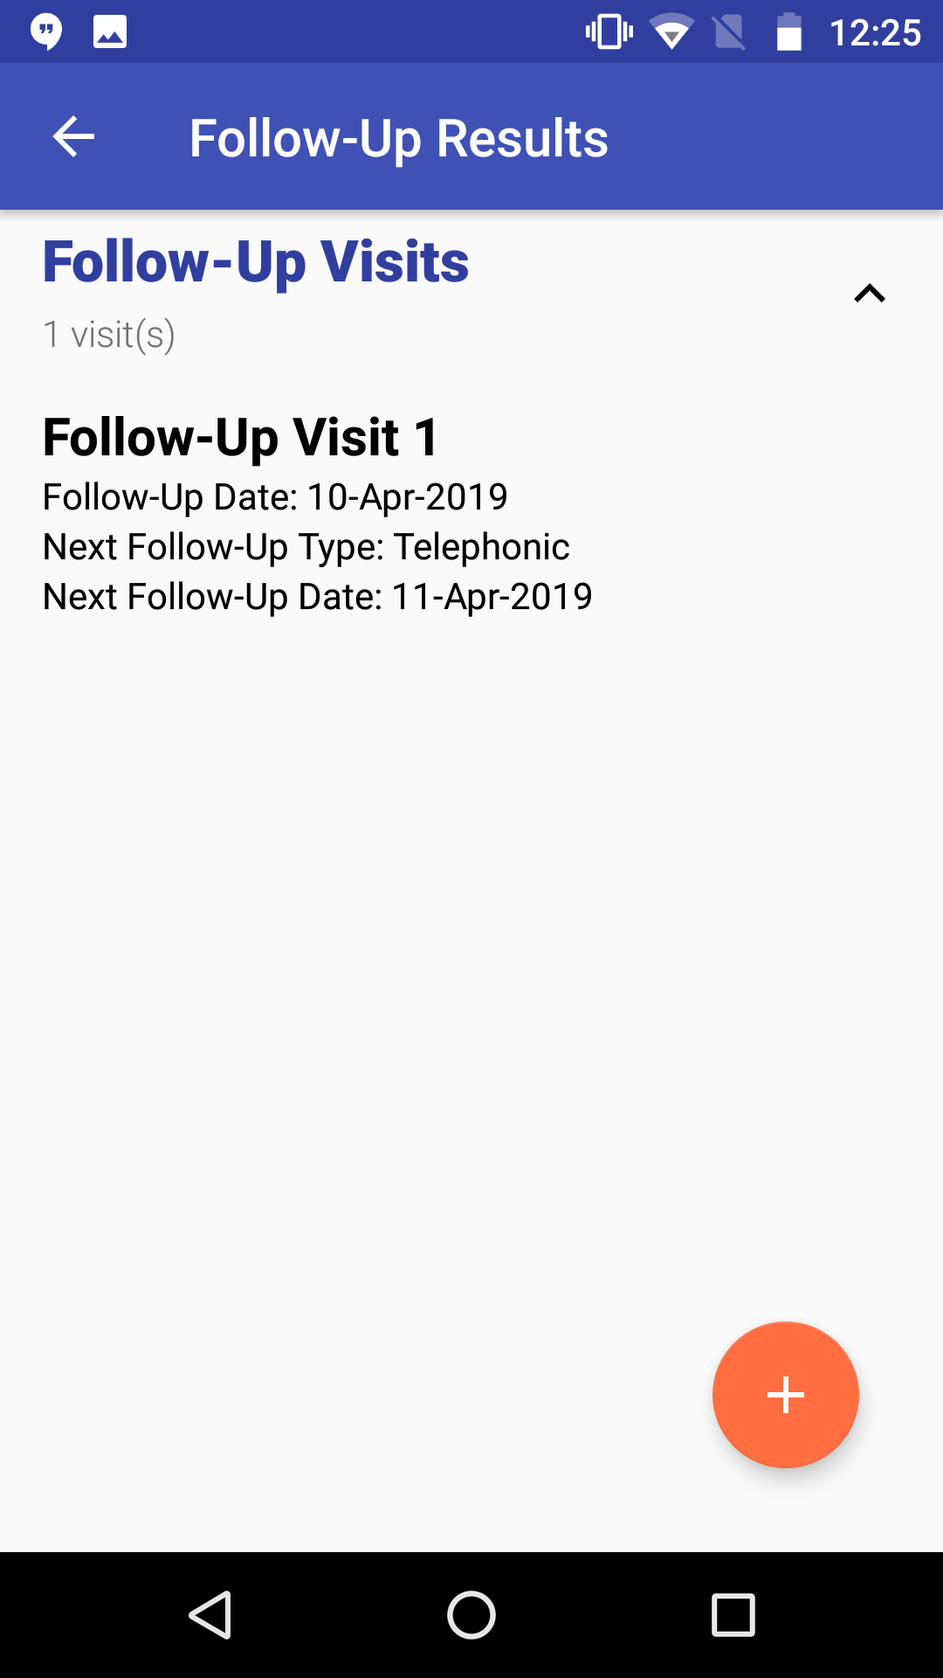
Patient Follow Up Module (App Only)
User can add Contact Tracing and Co-Morbidity Details
After filling Other Details click “ADD”
Follow up Details can be viewed here

Slide 5
Health Facility Visit Module
(App Only)
Health Facility Visit Module (App Only)
In Nikshay App, whenever a field officer visits a provider they can record their purpose of visit using their logins using this Module.

Slide 6
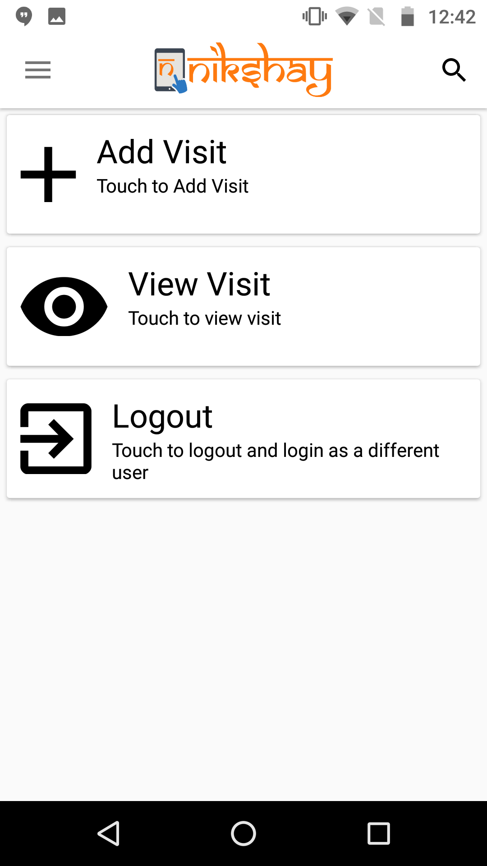
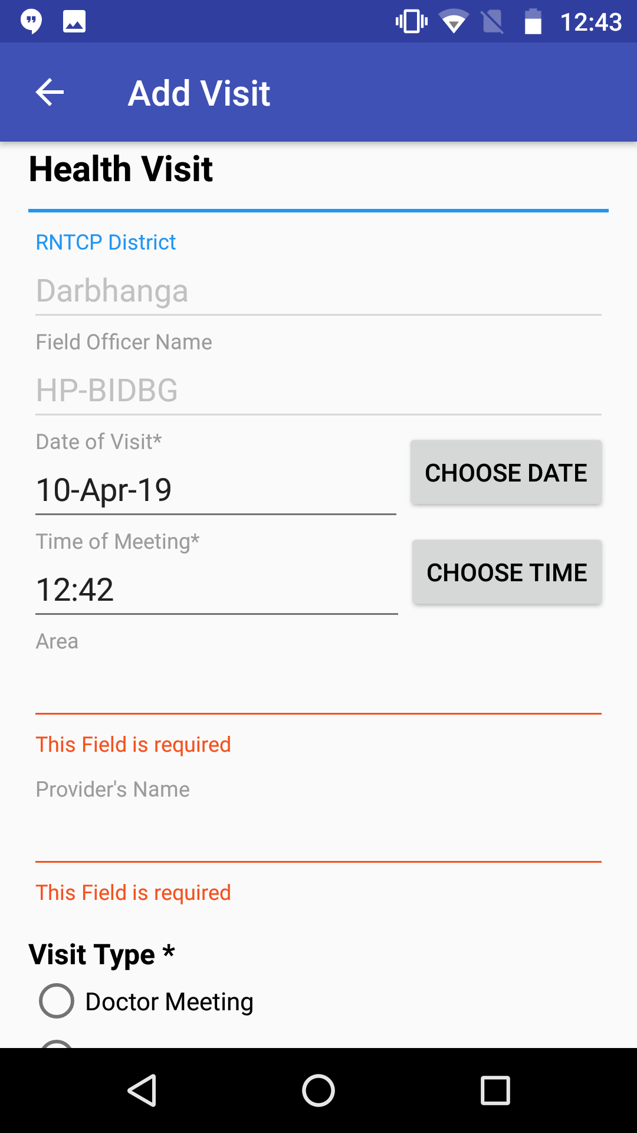
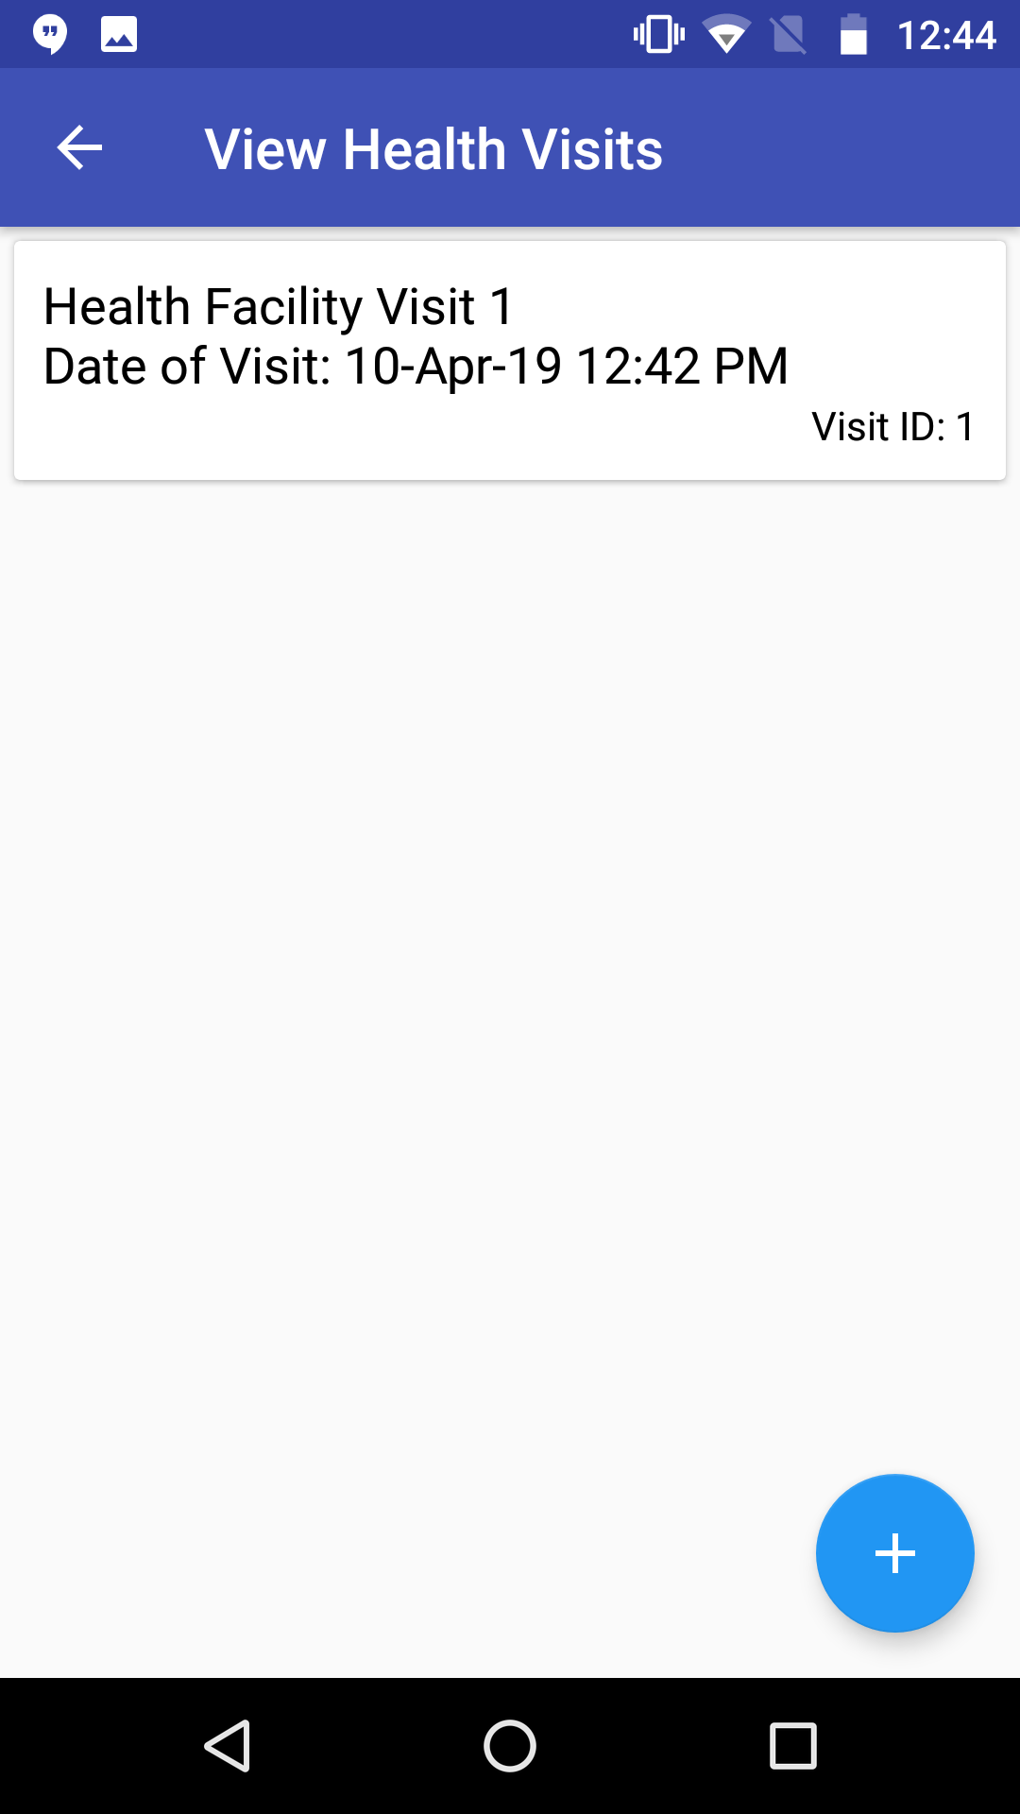
Health Facility Visit Module (App Only)
After Login one can Add and View Visits
The form for adding Visits
One can view Visits by clicking “View Visit” and the selecting the Provider

Slide 7
Thank you

