Slide 1
Feature to capture HWC/Home-based service delivery under PMTBMBA module in Ni-kshay

Slide 2
About
Requirement Overview
Enhancement in Ni-kshay Mitra Follow-up Confirmation Form
Enhancements in Reports/Registers:
Follow-up Confirmation Report
Consented TB Patients Report/Dashboard
TB Notification Register
PMTBMBA Monitoring Report
(Ni-kshay Mitra view & Geography-based view)
Contents

Slide 3
India is among the list of high-burden countries as per the World Health Organisation (WHO) which accounts for a quarter of the global burden of Tuberculosis. The economic burden of TB in terms of lives, income, and workdays is also substantial.
TB usually affects the most economically productive age group of society resulting in a significant loss of working days and pushing TB patients further into poverty.
The challenge of tuberculosis requires a multi-sectoral response to address the social determinants like undernutrition, living and working conditions, and an increase in access to diagnostic and treatment services.
In this regard it becomes imperative to strengthen collaboration with the community and the existing institutions in the society which can play a critical role in filling gaps and addressing social determinants, thereby contributing to achieving the national goal of TB Mukt Bharat.
About

Slide 4
To further enhanced the PMTBMBA module, a feature is developed to capture patient-wise Ayushman Bharat Health & Wellness Centres (HWCs)/Home-based service delivery in Ni-kshay Mitra Follow-up Confirmation.
Requirement Overview

Slide 5
Ni-kshay Mitra Follow-up Confirmation Form
The below indicators have been replaced and new indicators have been added to the Ni-kshay Mitra Follow-up Confirmation Form:
Name of Ni-kshay Mitra
Mobile Number of Ni-kshay Mitra
Email ID of Ni-kshay Mitra
Type of Support Agreed
Duration of Support (In Years)
Geographies Agreed to Support

Slide 6
Ni-kshay Mitra Follow-up Confirmation Form
Based on the requirements the form has been redesigned and simplified with the addition of the below new indicators:
Validation of Ni-kshay Mitra ID: The Ni-kshay Mitra ID is extracted from the Support Linkage form upon validation.
Reporting Period:
Year of Reporting
Month of Reporting
Patient-wise details are captured in the Ni-kshay Poshan kits Delivery for the below indicators:
Poshan kits distributed at AB-HWC/PHI
Poshan kits delivered at Home

Slide 7
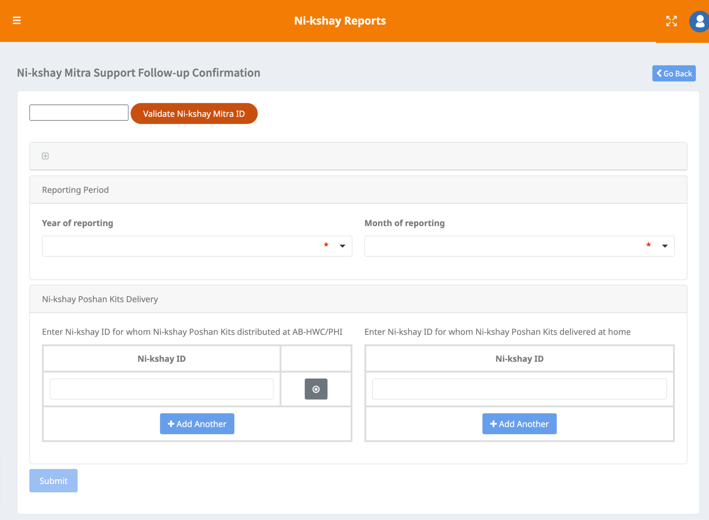
Ni-kshay Mitra Follow-up Confirmation Form
Step 1
Step 2
Step 3
Click on Ni-kshay Reports
Click on ‘Community Support to TB patients - Ni-kshay Mitra’
Click on ‘Ni-kshay Mitra Support Follow-up Confirmation’

Slide 8
Ni-kshay Mitra Follow-up Confirmation Report
A separate view is available in addition to the existing report. The existing view is labeled “April-October 2022” and the New view is labeled “November 2022 onwards”. The patient-supported count would be based on the Current Health facility of the patient, irrespective of the Stage of the patient (On Treatment and Outcome assigned) and deduplicated. In this new report, new indicators have been added and the Ni-kshay Mitra Registration and Linkage report data shall be available. Such as:
Ni-kshay Mitra ID, Added By, Duration for Support (In Years): These details shall be extracted from the NM Support Linkage form upon validation.
Name, Mobile Number, Email ID: As per the details available in the NM registration form.
Two new columns were added "TB patient actually supported at HWC/PHI (Oct 2022 onwards)", and "TB patient actually supported at Home (Oct 2022 onwards)".

Slide 9
Ni-kshay Mitra Follow-up Confirmation Report
Step 1
Step 2
Step 3
Click on Ni-kshay Reports
Click on ‘Community Support to TB patients - Ni-kshay Mitra’
Click on ‘Ni-kshay Mitra Support Follow-up Confirmation Report’

Slide 10
Consented TB Patients Report/Dashboard
A new column ‘Total TB patients received support (kits provided)’ has been introduced.
The count shall be displayed on the UI on the basis of the patient hierarchy till the TU level and the same shall be available as the downloaded report till the PHI level.

Slide 11
Consented TB Patients Report/Dashboard
Step 1
Step 2
Step 3
Step 4
Click on Ni-kshay Reports
Click on ‘Community Support to TB patients - Ni-kshay Mitra’
Click on ‘Consented TB Patients for Community Support- Dashboard’
Click on ‘View Data’ or ‘Download Excel’

Slide 12
TB Notification Register
Step 1
Step 2
Step 3
Step 4
Click on Ni-kshay Reports
Click on ‘Patient wise list’
Click on ‘Notification Register’
Click on ‘Generate Excel’
New columns have been added in the Notification Register for ‘TB patients provided support (Yes/No)’ and the Ni-kshay Mitra ID (who has provided the support).

Slide 13
PMTBMBA- Monitoring Report (Ni-kshay Mitra & Geography View)
Step 1
Step 2
Step 3
Step 4
Click on Ni-kshay Reports
Click on ‘Community Support to TB patients - Ni-kshay Mitra’
Click on ‘Consented TB Patients for Community Support- Dashboard’
Click on ‘PMTBMBA Monitoring- Report’
The existing columns of "TB patient actually supported" have been renamed to "Total kits distributed by Ni-kshay Mitra (Apr-Oct 2022). Additionally, three new columns have been added "Total kits distributed at HWC/PHI (Oct 2022 onwards), "Total kits distributed at Home (Oct 2022 onwards)” and "Total kits distributed (all time period)".

