Slide 1
Family Caregiver

Slide 2
Introduction
Ni-kshay will enable health staff to enroll a family caregiver and tag linked patients to them. While the enrollment of family caregiver is accessible through the Staff/TS Management Module, tagging patients is accessible either through Staff/TS Management Module or through the ‘Staff/TS/Family Caregiver' tab in the patient management module.
Family Caregivers will be allowed to be added in TU and PHI Logins.
Staff and Treatment Supporters

Slide 3
STEPS TO ENROLL FAMILY CAREGIVER AND LINK PATIENTS VIA STAFF/TS MANAGEMENT MODULE

Slide 4
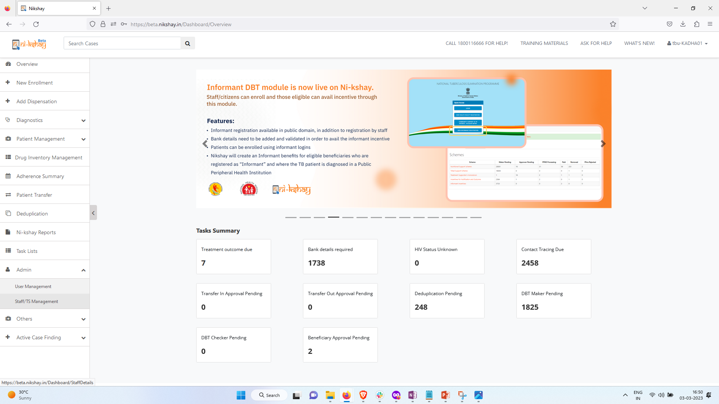
Family Caregiver (Adding Family Caregiver)
Step 1
Click on ‘Staff/TS Management’

Slide 5
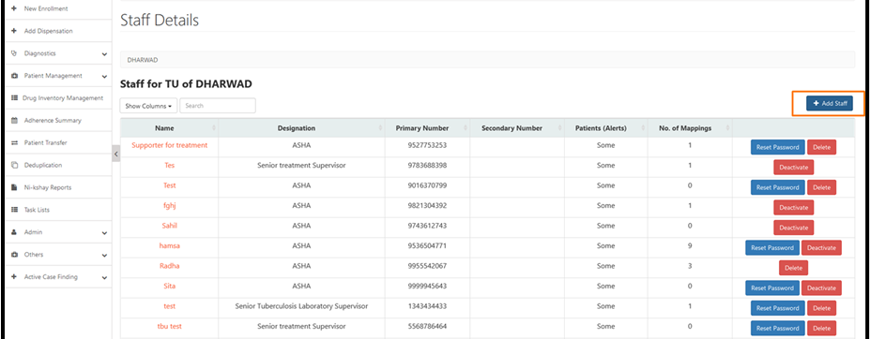
Family Caregiver (Adding Family Caregiver)
Step 1
Step 2
Click on ‘Staff/TS Management’
Click on Add Staff

Slide 6
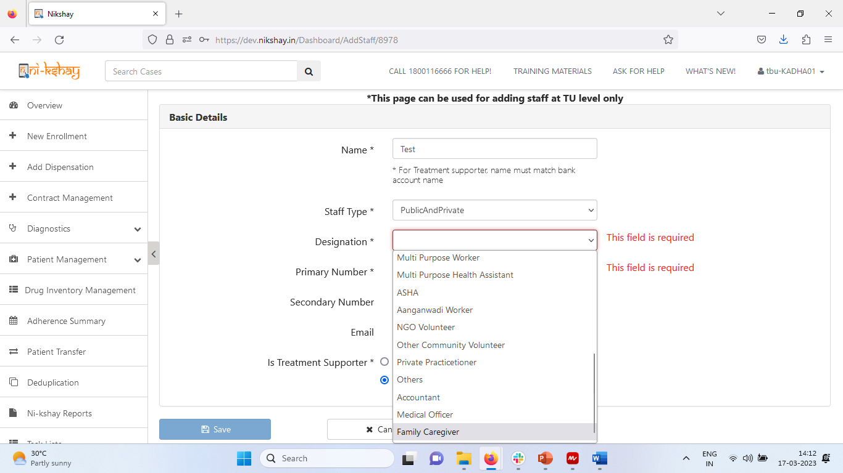
Family Caregiver (Adding Family Caregiver)
Step 1
Step 2
Step 3
Click on ‘Staff/TS Management’
Click on Add Staff
Select Designation as ‘Family Caregiver’
Enter the name of the Family Giver and select ‘Family Caregiver’ from the ‘Designation’ dropdown option. [Data fields that are not relevant to the Family Caregiver will have defaulted values]
Enter other relevant information such as Mobile Number, Email

Slide 7
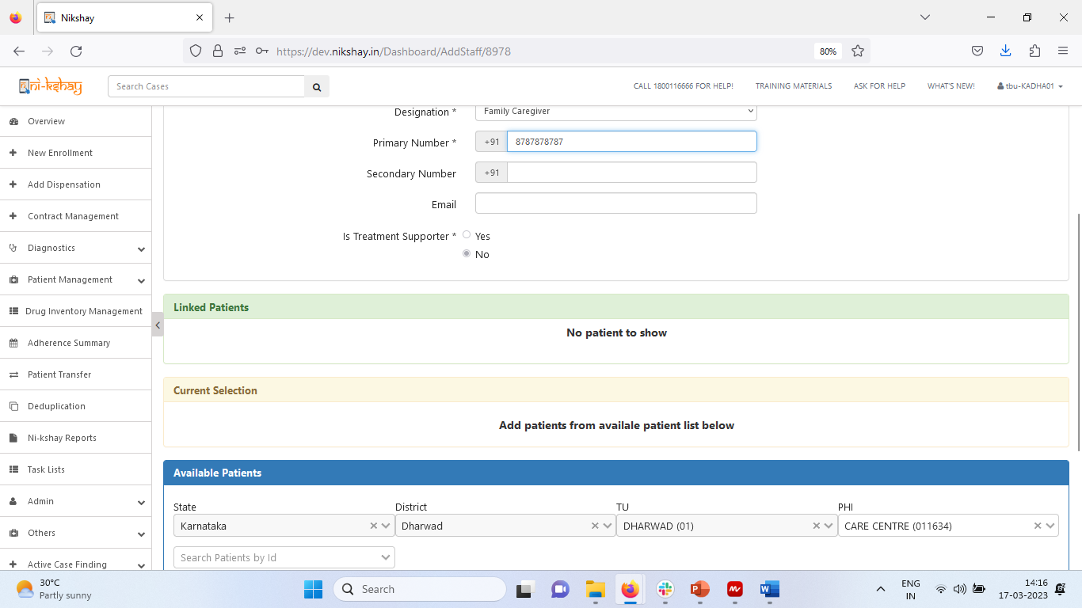
Family Caregiver (Adding Family Caregiver)
Step 1
Step 2
Step 3
Step 4
Click on ‘Staff/TS Management’
Click on Add Staff
Select Designation as ‘Family Caregiver’
Link Patient to the Family Caregiver
If the patient has been registered, the newly added Family Caregiver can be tagged to the patient by entering the Ni-kshay ID of the patient in the ‘Available Patients’ section. [If the patient ID has not been added, you can click ‘Save’ to complete addition of the Family Caregiver and tag the patient either through the patient page or through the Staff Module]

Slide 8
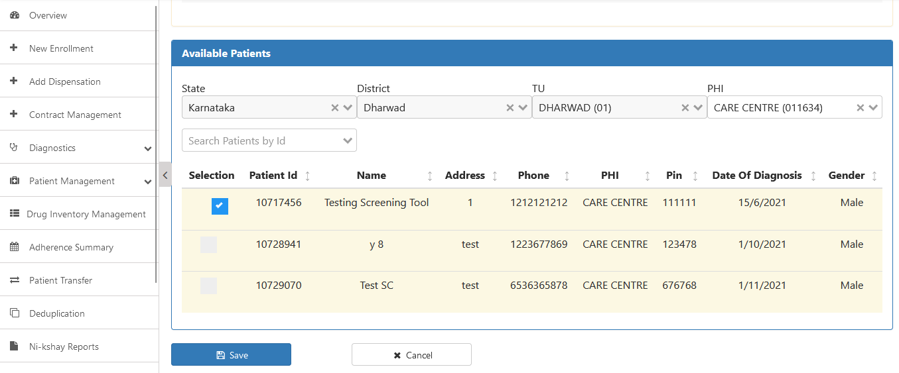
Family Caregiver (Adding Family Caregiver)
Step 5
Click on Save
Upon finding the patient record, click the checkbox selection and the ‘Save’ button

Slide 9
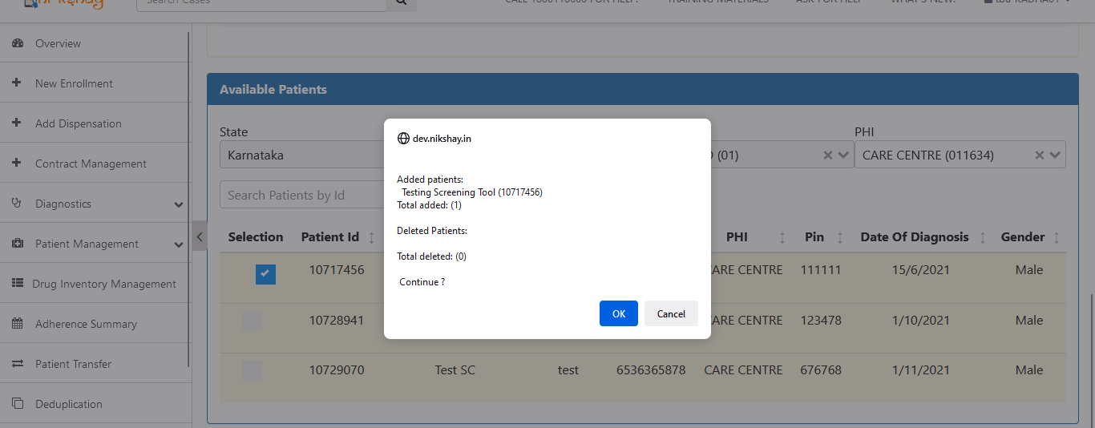
Family Caregiver (Adding Family Caregiver)
Step 5
Step 6
Click on Save
Click on ‘OK’

Slide 10
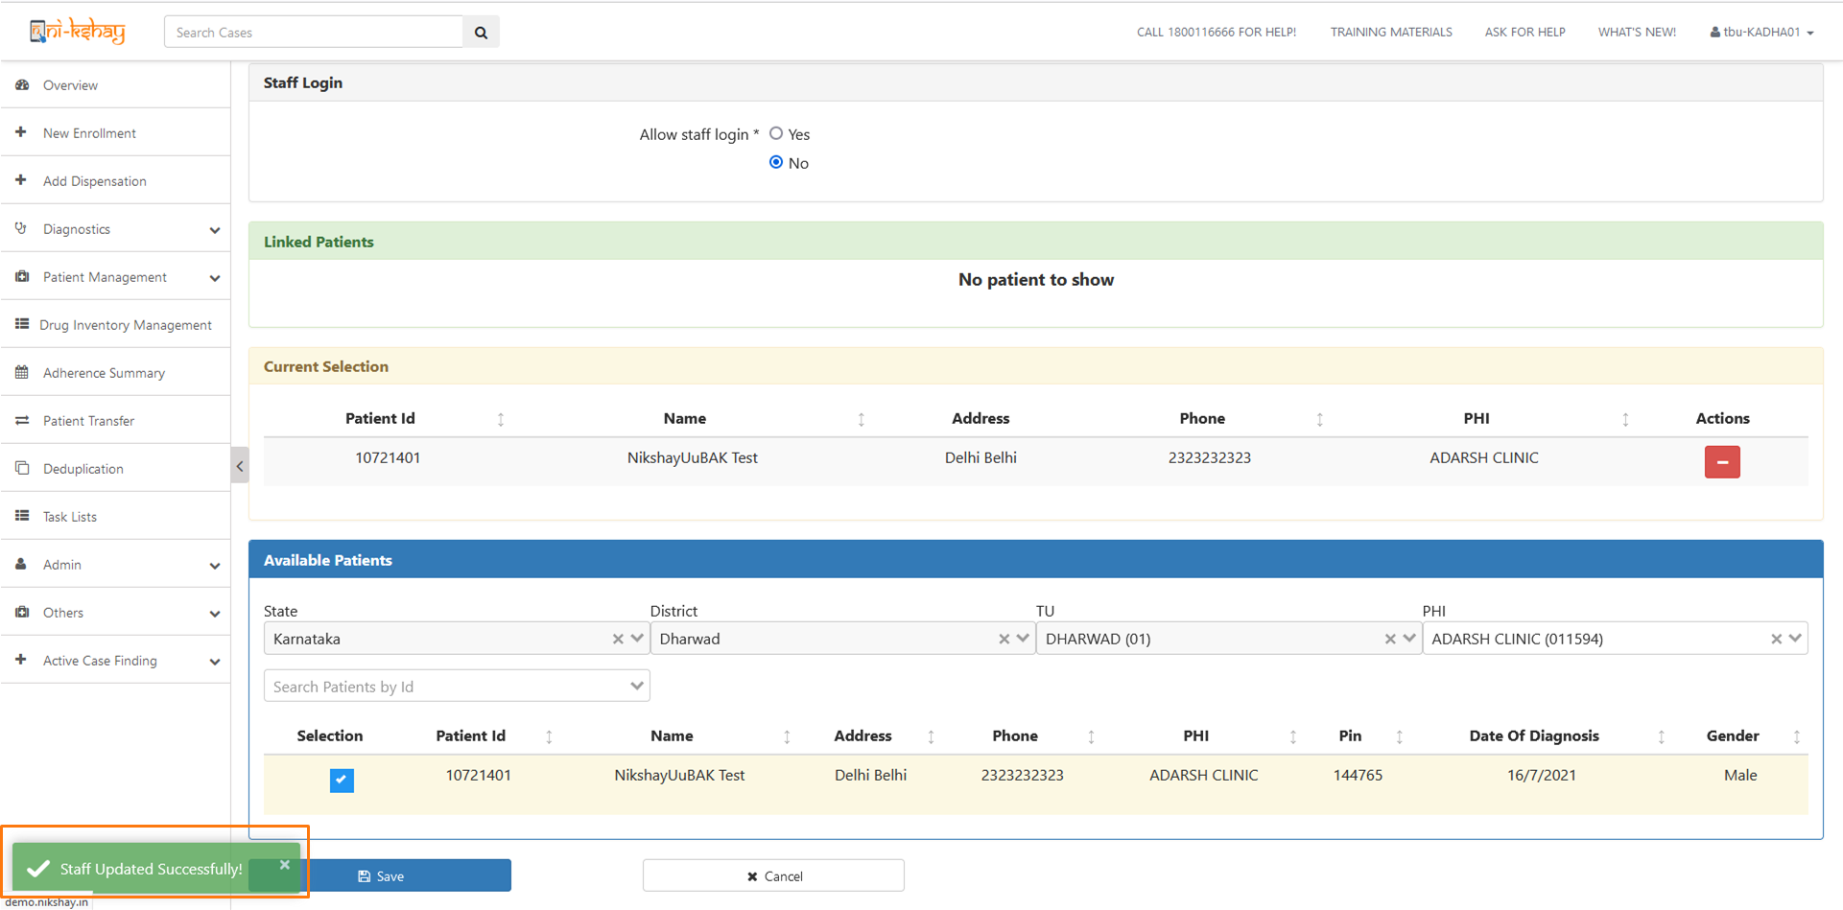
Family Caregiver (Adding Family Caregiver)
Upon successful addition of the Family Caregiver, a success message is displayed on the screen.

Slide 11
STEPS TO LINK PATIENTS IN PATIENT MANAGEMENT MODULE

Slide 12
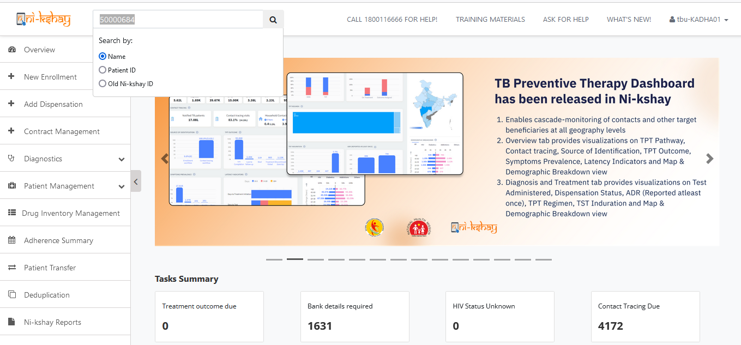
Family Caregiver (Link Patients)
Step 1
Search for the Patient
Login to Ni-kshay and search for the Patient who is to be tagged to an already enrolled Family Caregiver.

Slide 13
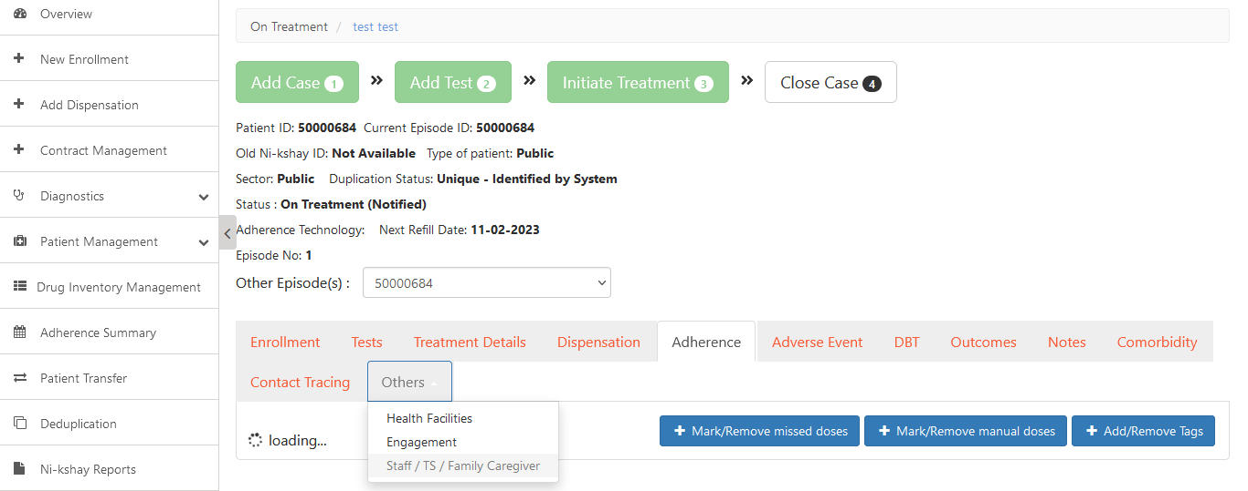
Family Caregiver (Link Patients)
Step 1
Step 2
Search for the Patient
Click on ‘Staff/TS/Family Caregiver’ under Others Tab
Login to Ni-kshay and search for the Patient who is to be tagged to an already enrolled Family Caregiver.

Slide 14
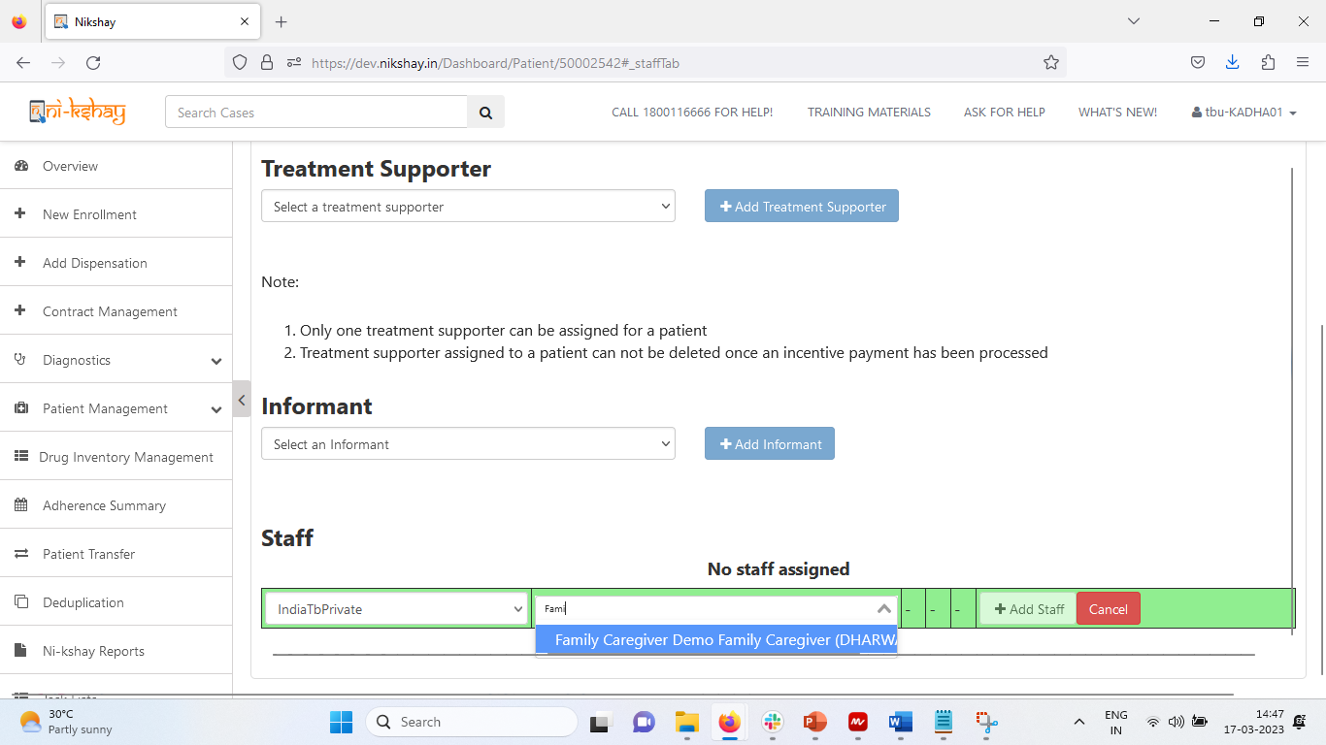
Family Caregiver (Link Patients)
Step 1
Step 2
Step 3
Search for the Patient
Click on ‘Staff/TS/Family Caregiver’ under Others Tab
Search for the Family Caregiver that is to be tagged

Slide 15
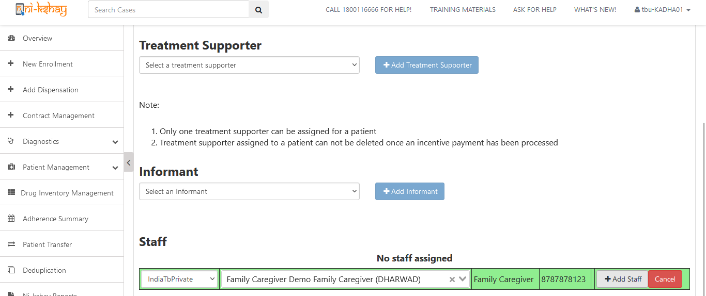
Family Caregiver (Link Patients)
Step 1
Step 2
Step 3
Step 4
Search for the Patient
Click on ‘Staff/TS/Family Caregiver’ under Others Tab
Search for the Family Caregiver that is to be tagged
Click on ‘Add Staff’

Slide 16
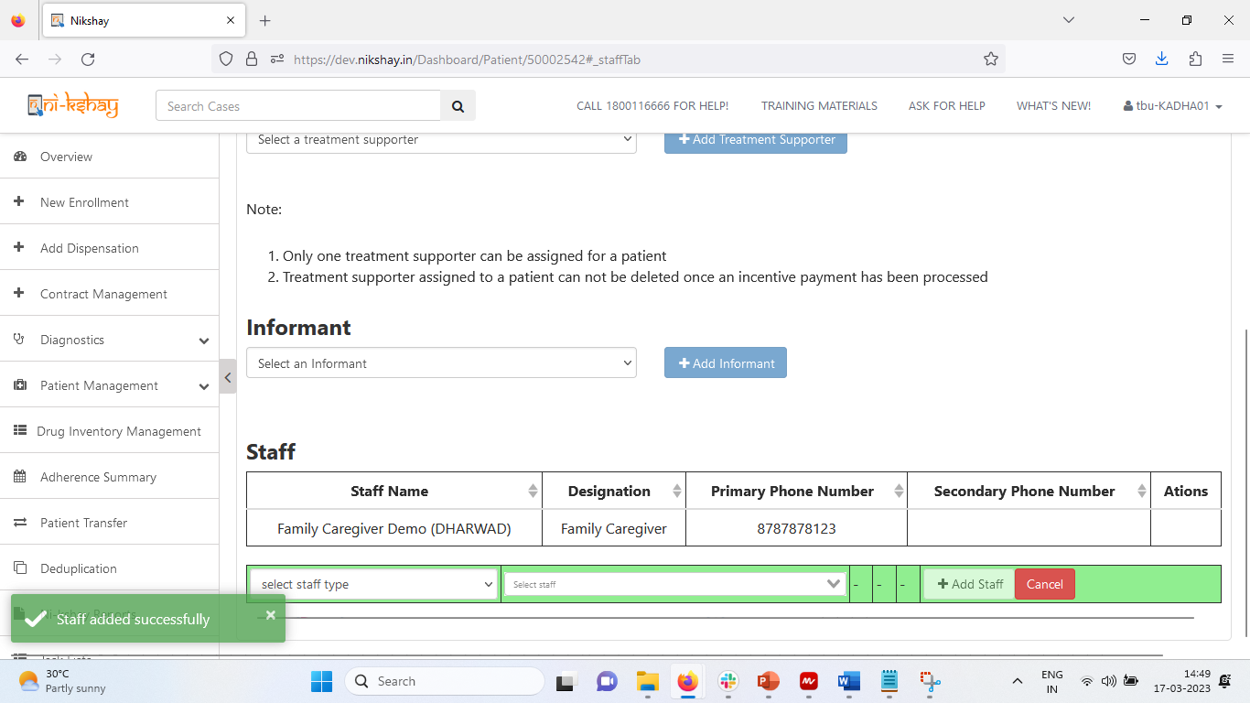
Family Caregiver (Link Patients)
The Family Caregiver who is linked to the Patient is now visible the Staff/TS/Family Caregiver Tab

Slide 17
THANK YOU

