Slide 1
Module 5: Module 5: Staff Management

Slide 2
Overview on Staff Management Module
This module allows user to either “Add New staff”, “View & Edit staff details” and can also “Delete staff” depending upon the access assigned to the user
In addition, user can also assign patients to the staff for regular monitoring of patient treatment
Patients can be assigned to all staff except to “DBT Checker” and “DBT maker” staff logins

Slide 3
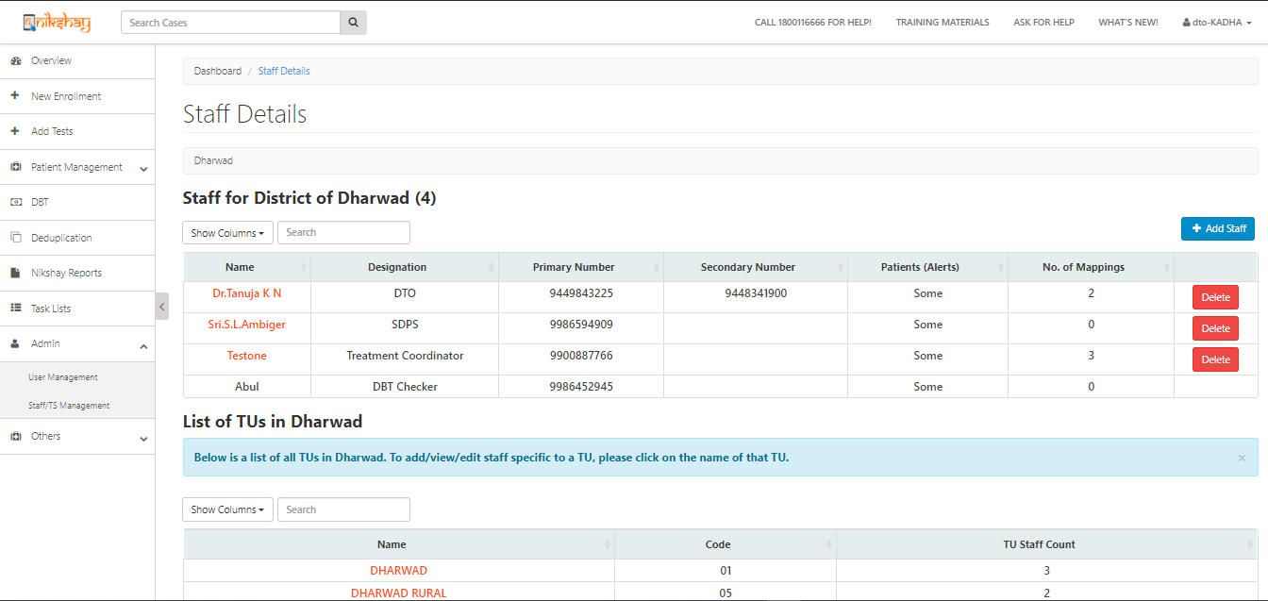
Add, View, Edit & Delete Staff Details…
Can “Add”/ “View”/ “Delete” staff either at your or below your hierarchy
Overview of Staff at District Level
Overview of Staff at TU Level

Slide 4
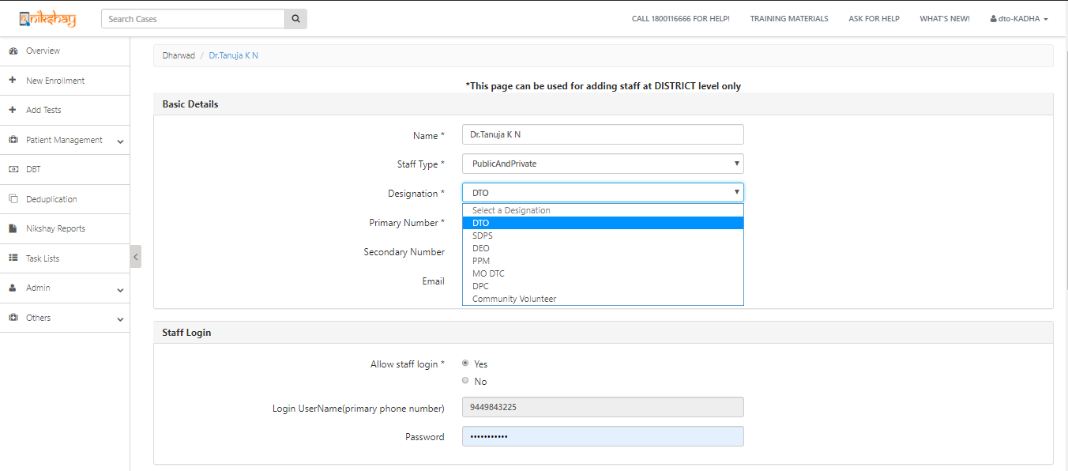
Manage Staff
Use this feature to allow staff to login into Ni-kshay and access patients assigned to the staff
Username will be defaulted to primary phone number
Enter Password

Slide 5
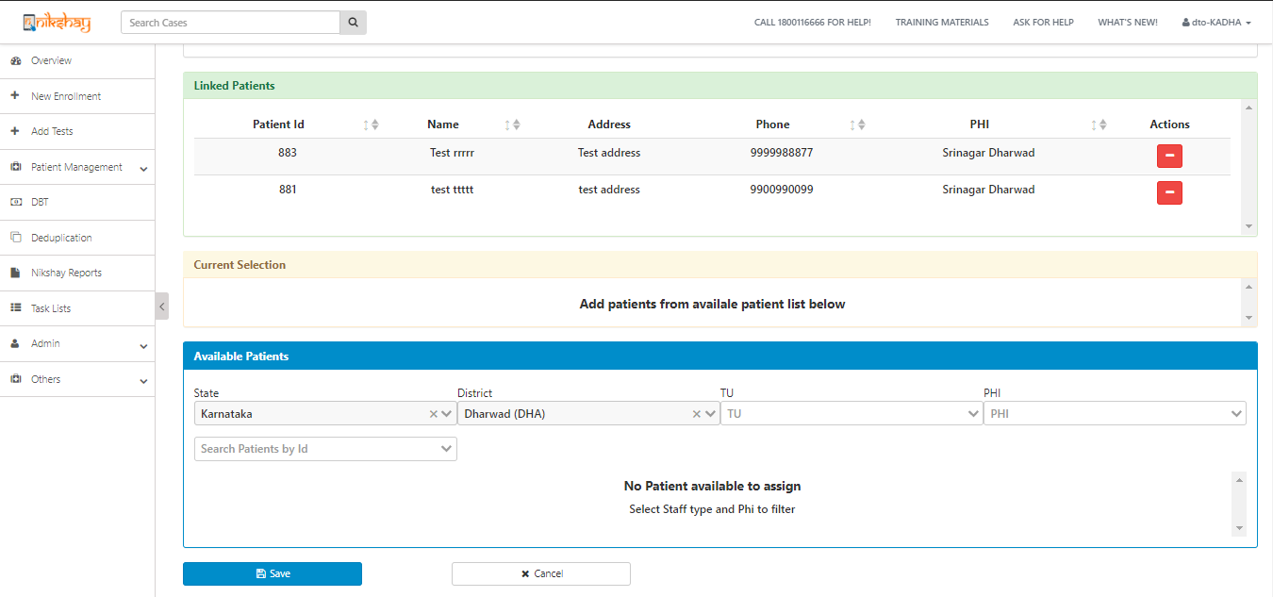
Add, View, Edit & Delete Staff Details…
Shows the list of all patients that are linked to the staff
Can assign more patients if required by using the search filter

Slide 6
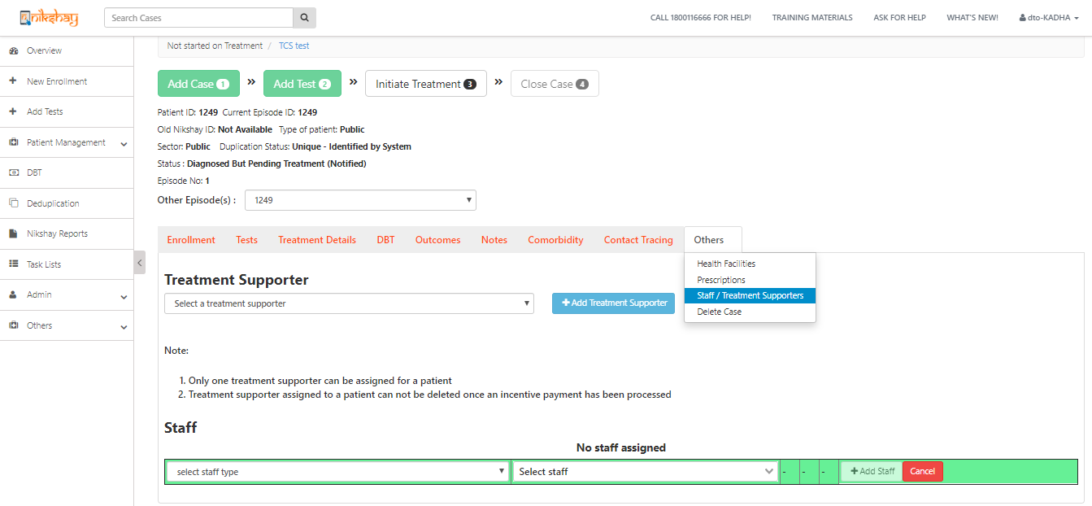
Assigning staff from Patient page
Can assign Multiple staff to same patient

Slide 7
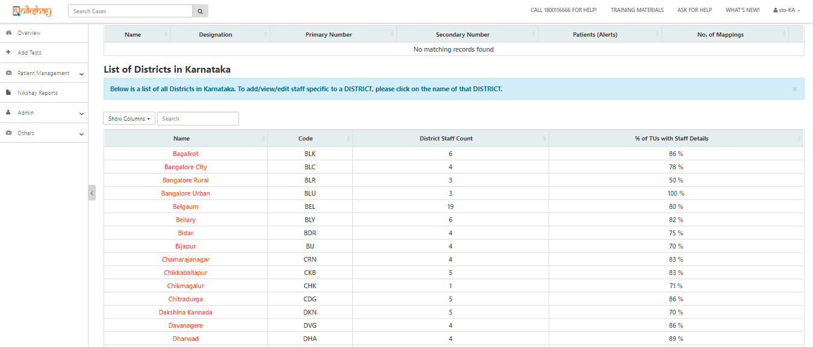
Creating DBT Checker for Processing DBT
Only State can create DBT Checker for District
Click on the District Name to proceed with the creation of DBT Checker

Slide 8
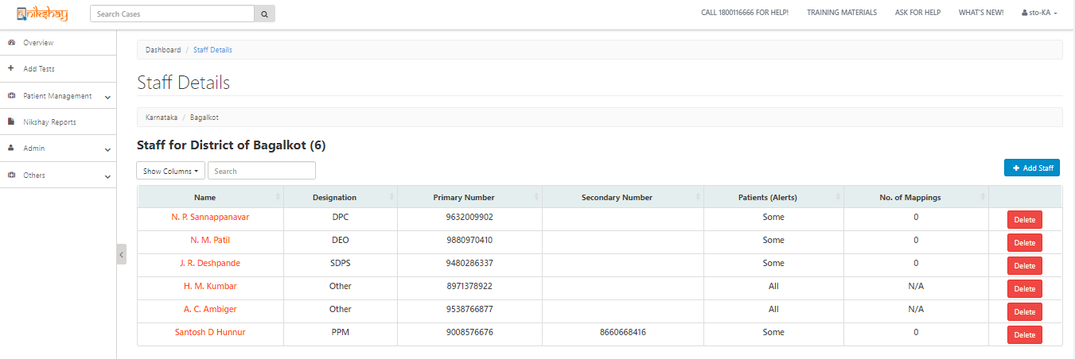
Creating DBT Checker for Processing DBT…

Slide 9
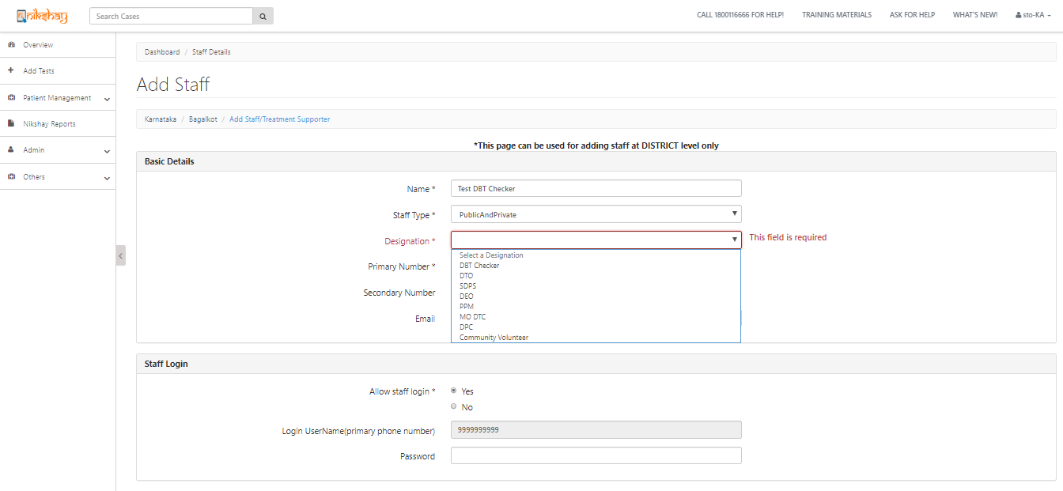
Creating DBT Checker for Processing DBT…
Enter Primary Phone Number, which will be defaulted to username
Click on Save to Proceed
Enter Password

Slide 10
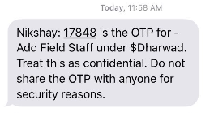
Creating DBT Checker for Processing DBT…
After submitting, 2 OTPs will be sent
1st OTP to “DBT Checker” Primary Phone Number
2nd OTP to default facility login primary phone number i.e Primary phone number of the login from where DBT checker is being created
On submission of both these OTPs, then DBT Checker Staff Logins will be created
Thereafter, DBT Checker registered phone number will receive an sms with login credentials
After login using the credential, another OTP will be sent to the registered phone number of DBT Checker.
User then has to enter the OTP and reset the password to proceed.
OTP SMS Tempelate
Login Credential SMS

Slide 11
Creating DBT Checker for Processing DBT…
After completing the login process, following activities can be performed from this login
DBT Processing
Beneficiary Approval
Private Sector:
First time approval for all private health facilities whose bank details are entered in Ni-kshay
Patients:
Approving / Rejecting the beneficiaries, where any edit has been made in validated beneficiaries
Can view the Old and New Bank account details entered for a beneficiaries
Can only view patient details via DBT Page
Cannot edit any patient details
Cannot edit the bank details of a patient

Slide 12
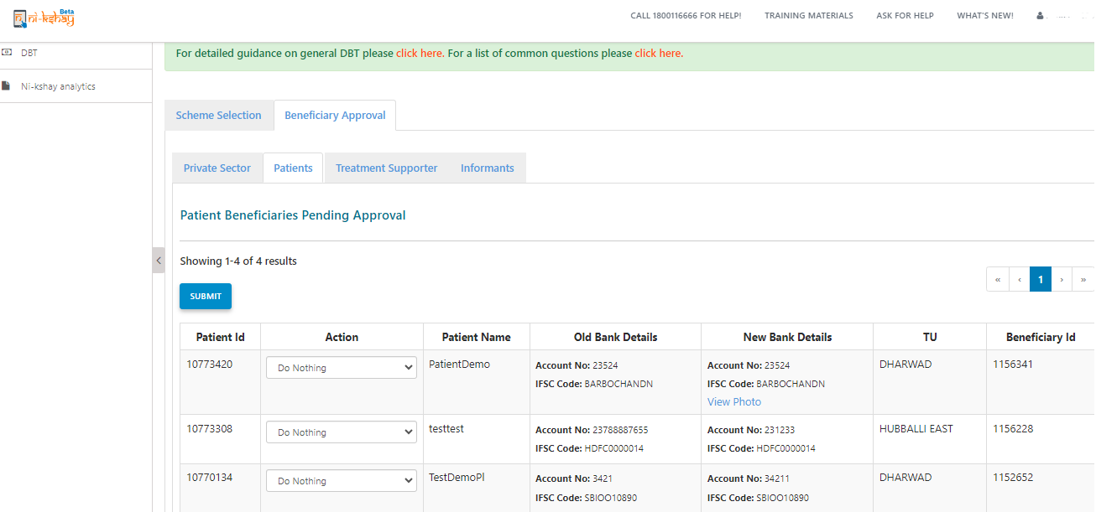
Creating DBT Checker for Processing DBT…
Access to “Beneficiary approval” will only be available from DBT Checker Staff Logins

Slide 13
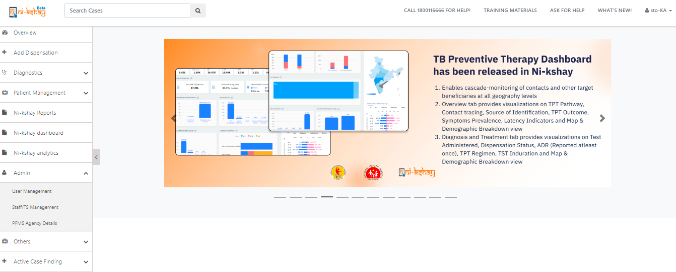
Process of Reset Password for DBT Checker ID
Login with STO ID>>Go To Staff Management Page

Slide 14
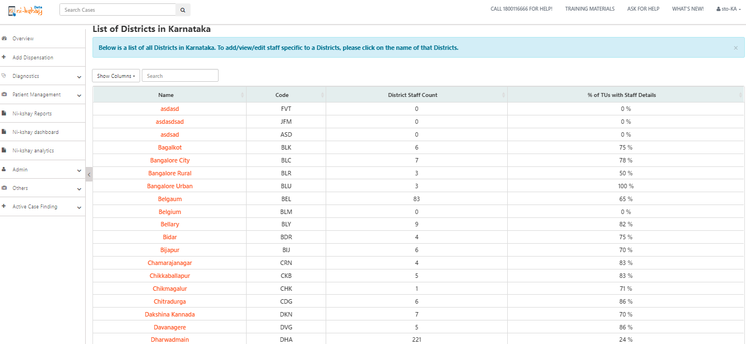
Process of Reset Password for DBT Checker ID
Select District
Click on Hyperlink of District name

Slide 15
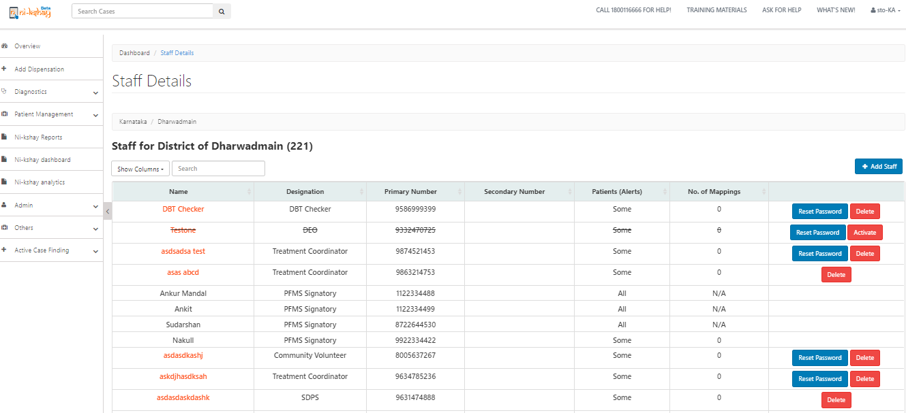
Process of Reset Password for DBT Checker ID
Select District >> Select DBT checker>> Click on Reset Password
Click on Reset Password

Slide 16
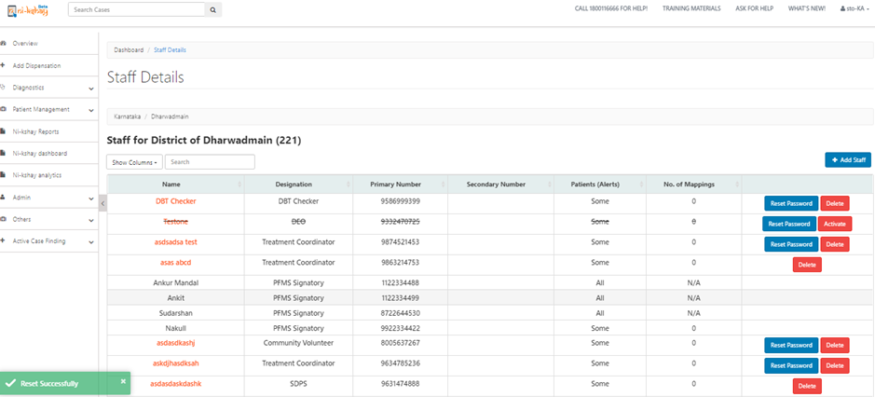
Process of Reset Password for DBT Checker ID
Select District >> Select DBT checker>> Click on Reset Password>> Reset Successfully
Wait for confirmation message
Note
New Password sent on DBT checker mobile number and use that password for login

Slide 17
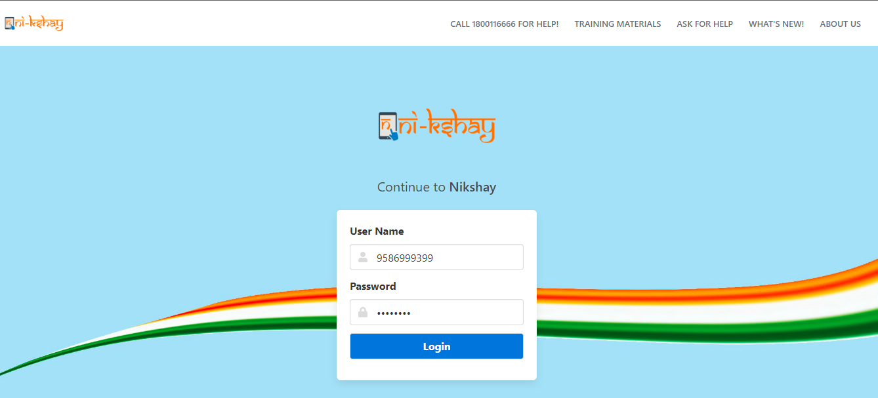
Process of Reset Password for DBT Checker ID
Re-login again on Ni-kshay >> Enter ID>> Enter Password (Received on DBT checker mobile number)
Enter DBT checker ID/Mobile number
Enter Password which is received on Primary mobile number
Click on Login

Slide 18
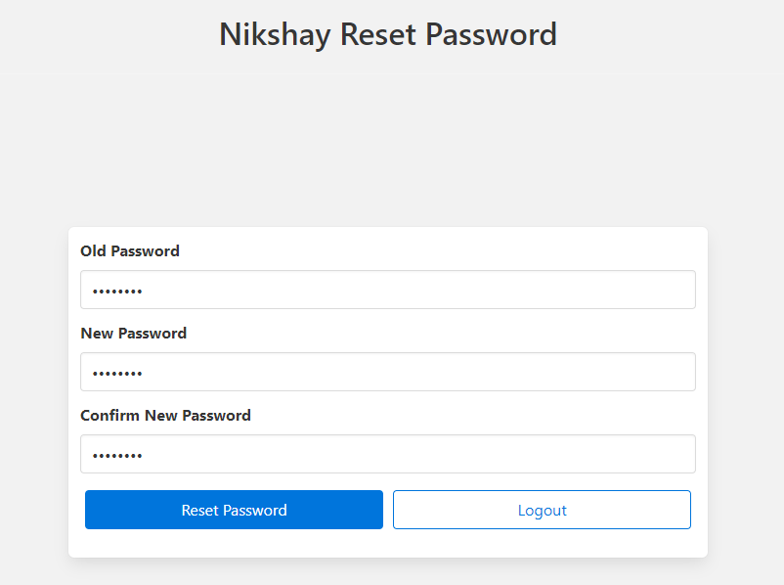
Process of Reset Password for DBT Checker ID
Enter Old Password >> Enter New Password >> Re-Enter Password >> Click on Reset Password
Enter old password means which is received on registered mobile number
Enter Strong New password
Re-Enter New password
Click on Reset Password

Slide 19
Process of Reset Password for DBT Checker ID
Now Password reset Process successfully done for DBT Checker ID

Slide 20
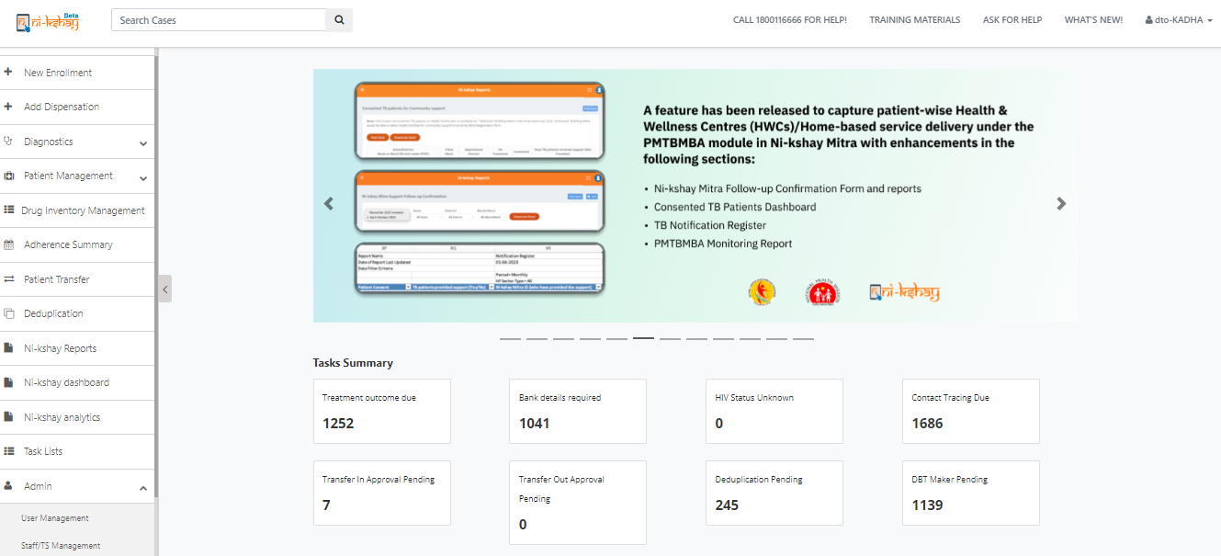
Process of Reset Password for DBT Maker ID
Login with DTO ID>>Go To Staff Management Page

Slide 21
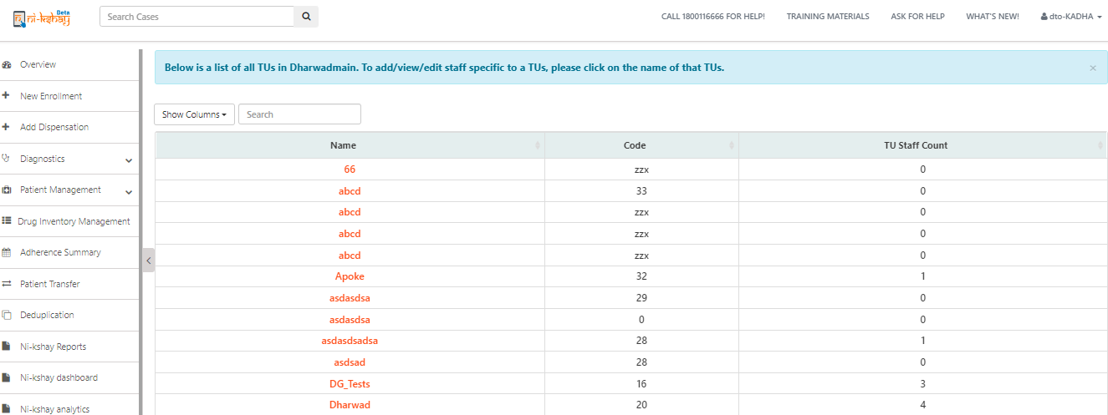
Process of Reset Password for DBT Maker ID
Login with DTO ID>>Go To Staff Management Page>> Select District
Click on Hyperlink of TU name

Slide 22
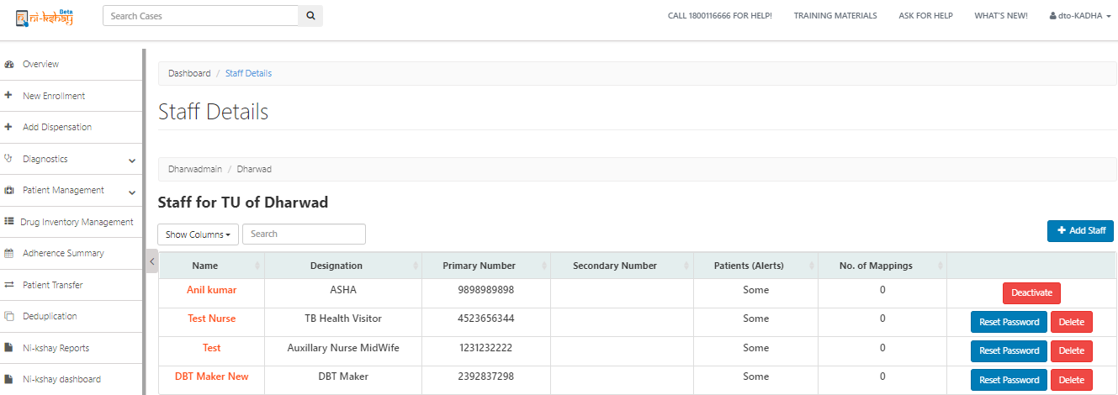
Process of Reset Password for DBT Maker ID
Select District >> Select DBT Maker >> Click on Reset Password
Click on Reset Password

Slide 23
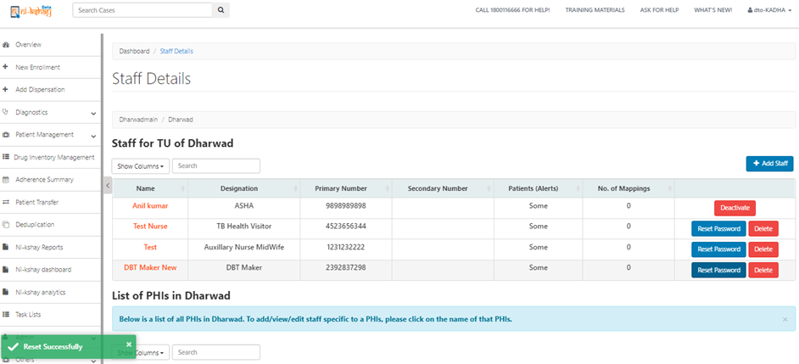
Process of Reset Password for DBT Maker ID
Select District >> Select DBT Maker >> Click on Reset Password
Wait for confirmation message
Note
New Password sent on DBT checker mobile number and use that password for login

Slide 24
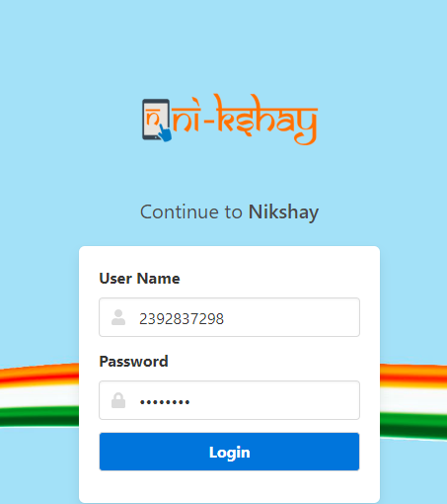
Process of Reset Password for DBT Maker ID
Re-login again on Ni-kshay >> Enter ID>> Enter Password (Received on DBT Maker mobile number)
Enter DBT Maker ID/Mobile number
Enter Password which is received on Primary mobile number
Click on Login

Slide 25
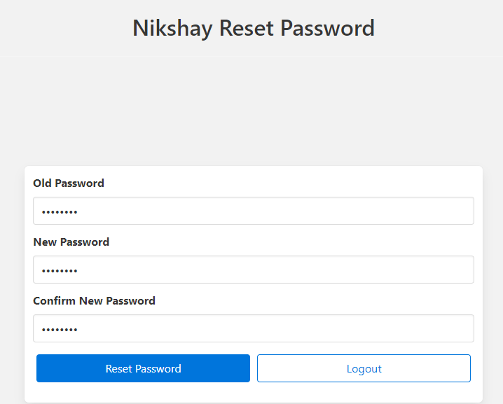
Process of Reset Password for DBT Maker ID
Enter Old Password >> Enter New Password >> Re-Enter Password >> Click on Reset Password
Enter old password means which is received on DBT Maker mobile number
Enter Strong New password
Re-Enter Strong New password

Slide 26
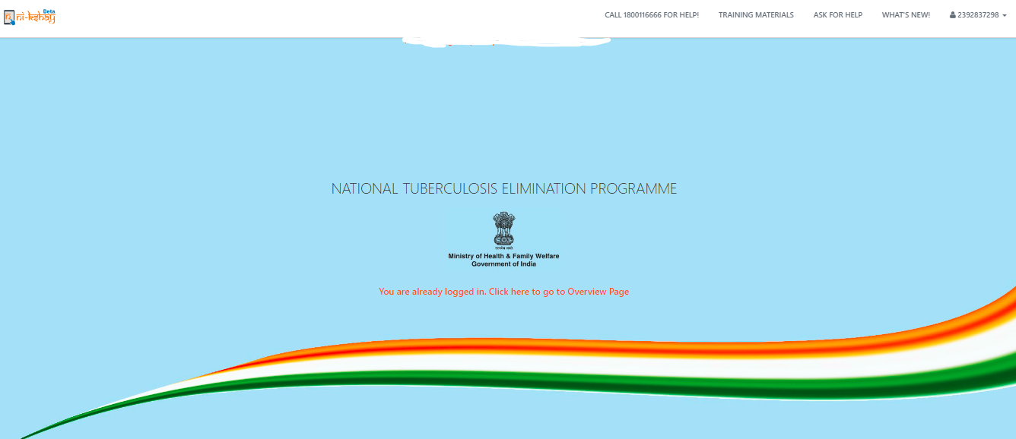
Process of Reset Password for DBT Maker ID
Now Password reset Process successfully done for DBT Maker ID

Slide 27
Note
Similarly, DTO Facility Logins can create DBT Maker at TU Level
While creating DBT Maker or DBT Checker, 2 OTPs will be sent
One OTP for validating the primary phone number of DBT Maker & DBT Checker
Second OTP to the registered primary phone number of STO (while creating DBT Checker) or DTO (While creating DBT Maker)
An sms will be sent to the registered primary phone number of “DBT Maker” and “DBT Checker” texting that “You have been registered as "DBT Maker/ Checker" and your username is ABC & password is 789 and please reset your password“.
After login using the credential, the user has to reset the password with OTP being sent to the registered primary phone number of DBT Maker & DBT Checker

Slide 28
Note
Staff Phone number once entered & validated in Nikshay, cannot be re-entered again
Any edit in the Primary Phone Number of DBT Checker & DBT Maker will require an OTP validation with next higher official. Please note that OTP for validation will be sent to State & District Facility Logins Primary Phone number
Edits in bank details of patients is available from all other logins apart from “DBT Maker” and “DBT Checker”
No “Patient” and “Treatment Supporter” can be assigned from “DBT Maker” and “DBT Checker” staff logins.

Slide 29
Staff List
Type of Staff | Levels | Designation | Informant Eligibility
Private | 2,3 | Treatment Coordinator
Public and Private | 3 | DBT Checker
Public and Private | 3 | DTO
Public and Private | 3 | SDPS
Public and Private | 3 | DEO
Public and Private | 3 | PPM
Public and Private | 3 | MO DTC
Public and Private | 3 | DPC
Public and Private | 3 | Community Volunteer | Yes
Public and Private | 3,4,5 | Accountant
Public and Private | 3,4,5 | Medical Officer
Public and Private | 4 | STS
Public and Private | 4 | STLS
Public and Private | 4,5 | Medical Officer

Slide 30
Staff List
Type of Staff | Levels | Designation | Informant Eligibility
Public and Private | 4,5 | Senior Treatment Supervisor
Public and Private | 4,5 | Senior Tuberculosis Laboratory Supervisor
Public and Private | 4,5 | TB Health Visitor
Public and Private | 4,5 | Laboratory Technician
Public and Private | 4,5 | Pharmacist/Storekeeper
Public and Private | 4,5 | Auxiliary Nurse Midwife
Public and Private | 4,5 | Multi Purpose Worker
Public and Private | 4,5 | Multi Purpose Health Assistant
Public and Private | 4,5 | ASHA | Yes
Public and Private | 4,5 | Anganwadi Worker
Public and Private | 4,5 | NGO Volunteer | Yes
Public and Private | 4,5 | Other Community Volunteer | Yes
Public and Private | 4,5 | Senior Treatment Supervisor

Slide 31
Staff List
Type of Staff | Levels | Designation | Informant Eligibility
Public and Private | 4,5 | Private Practitioner | Yes
Public and Private | 4,5 | Others
Public and Private | 5 | TBHV
Public and Private | 5 | DMC LT
Public and Private | 5 | CBNAAT LT
Public and Private | 5 | CDST LT
Private | 5 | Physician | Yes
Private | 5 | Nurse | Yes
Private | 5 | Other Paramedical Staff | Yes
Private | 5 | Attendant | Yes
Public and Private | 4,5 | Private Practitioner | Yes
Public and Private | 4,5 | Others
Public and Private | 5 | TBHV

Slide 32
Staff List
Type of Staff | Levels | Designation | Informant Eligibility
Public and Private | 5 | Microbiologist
Public and Private | 5 | Statistical Assistant
Public and Private | 5 | DRTB Counselor
Public and Private | 5 | Community Health Officer
Public and Private | 5 | Citizen | Yes
Public and Private | 5 | Informal Provider | Yes

Slide 33
Family Caregiver
Ni-kshay will enable health staff to enroll a family caregiver and tag linked patients to them. While the enrollment of family caregiver is accessible through the Staff/TS Management Module, tagging patients is accessible either through Staff/TS Management Module or through the ‘Staff/TS/Family Caregiver' tab in the patient management module.
Family Caregivers will be allowed to be added in TU and PHI Logins
You can refer below link for training deck of Family Caregiver
https://nikshay.zendesk.com/hc/en-us/articles/16792342874777-Family-Caregiver

Slide 34
Thank You

