Slide 1
Version-2.0
Patients and Episodes

Slide 2
Concept of Episode
Notes:
Test

Slide 3
Concept
A patient can be notified and complete one treatment cycle (Diagnosis to outcome) and continue to have TB or have TB again at a later point in time.
This effectively is recorded as a second notification and becomes the second Episode of TB.
An episode(subsequently) need to be created in following situations
A patient’s treatment outcome is declared and patient later reappeared with symptoms of TB at a later point in time.
While on treatment, any additional resistance is detected or the patient clinical condition warrant for introduction of the new regimen (where outcome is “Regimen changed”)

Slide 4
When should you create a new episode
Episodes can be created only once outcome is declared for existing episode.
You can access this function in Nikshay from
Route 1 >Close Case tab> After declaring outcomes
Route 2 > Enrolment> By searching for a patient
One patient can have many episodes (many notification for one patient)

Slide 5
Adding an Episode
Route 1 : From Close case/ Outcomes tab
Notes:
Test

Slide 6
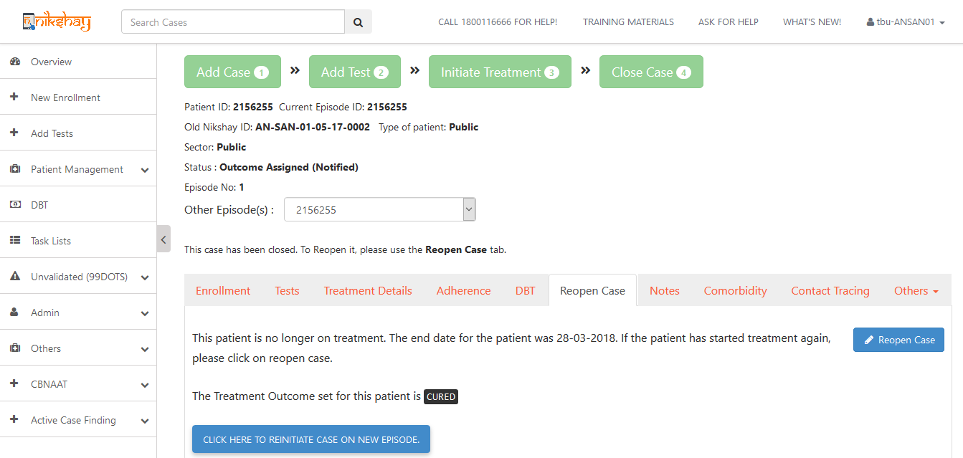
Adding Episodes – Route:1.1 (After outcome)
Do NOT click here, this will open the last episode for which the treatment outcome was declared
Click after outcome is declared

Slide 7
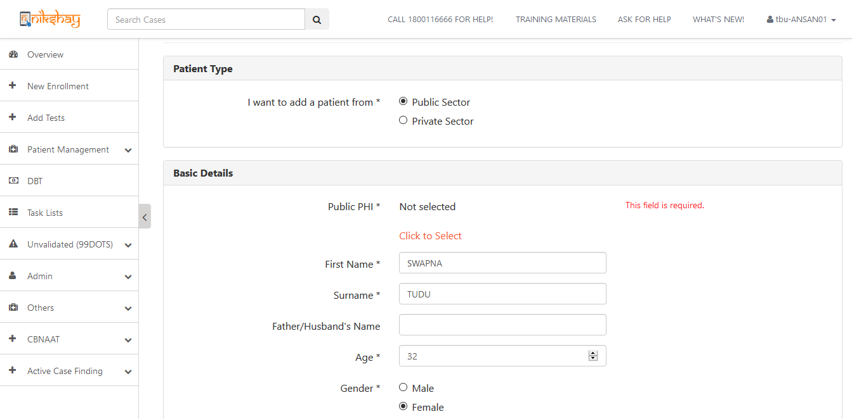
Adding Episodes – Route:1.2 (After outcome)
Ability to re-classify patients
Existing data pre-filled
Check for the details and update if required

Slide 8
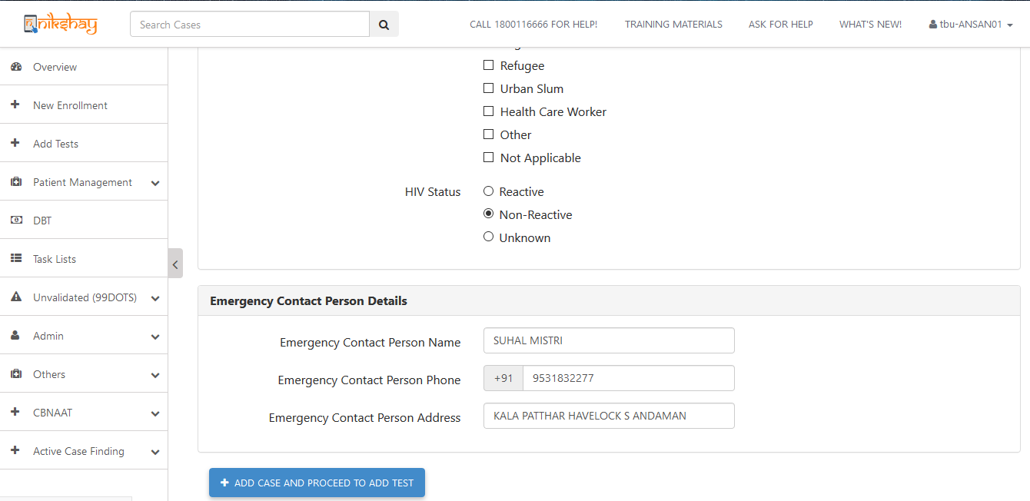
Adding Episodes – Route:1.3 (After outcome)
Check and update the contact numbers
Click add case to create a new episode

Slide 9
Adding an Episode
Route 2 : From Enrolment
Notes:
Test

Slide 10
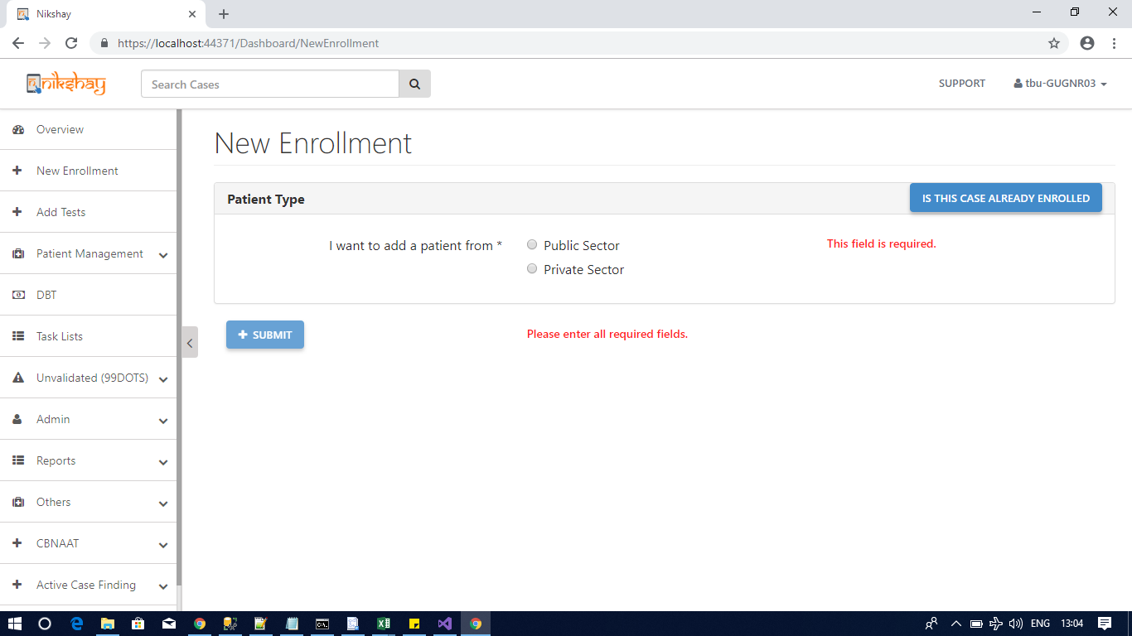
Adding Episodes – Route:2.1 (from enrolment)
Click if case is already enrolled and you want to initiate a case on new episode

Slide 11
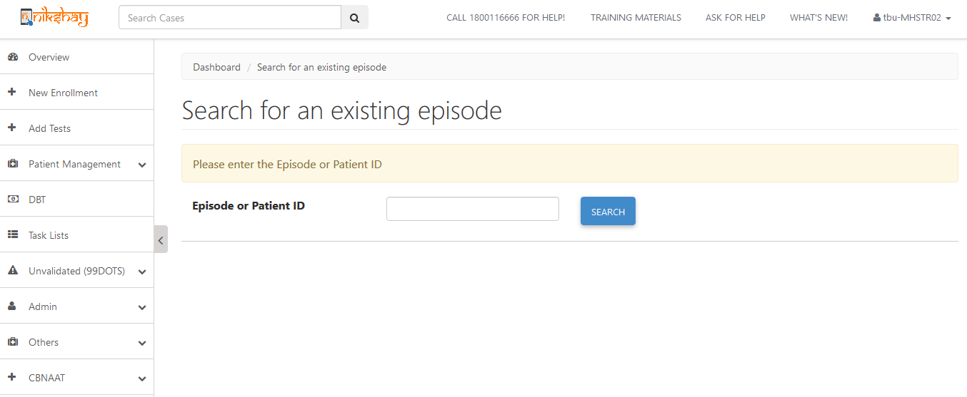
Adding Episodes – Route:2.2 (from enrolment)
Global search using both patient or episode ID
Global Search using Episode ID OR patient ID

Slide 12
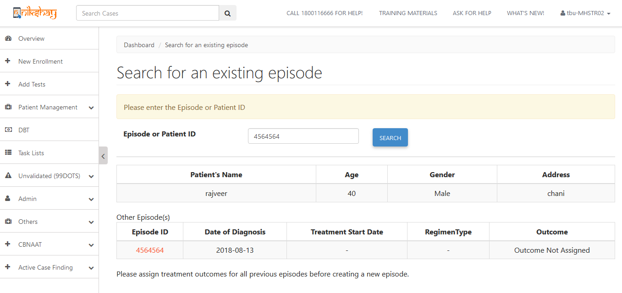
Adding Episodes – Route:2.3 (from enrolment)
Patient & existing episode details shown
Click on episode ID to declare outcomes
Explanation of why You cannot initiate another episode

Slide 13
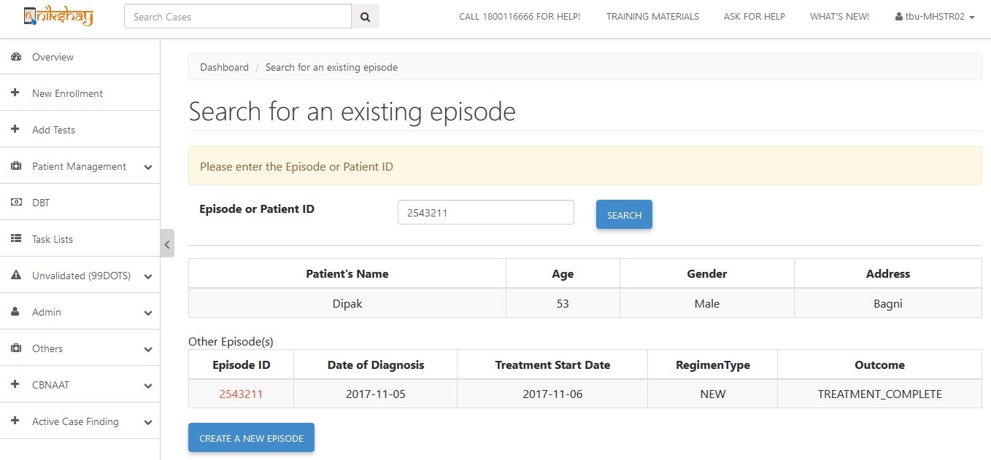
Adding Episodes – Route:2.4 (from enrolment)
Create episode option is available
If all outcomes have been declared

Slide 14
Things to keep in mind
Notes:
Test

Slide 15
Important Notes:
In the Life cycle approach a person needs to be tracked across episodes
Each patient → First episode Nikshay ID (Patient ID)
Each subsequent episode →(Episode ID)
Subsequent episodes cannot be re-initiated in cases that have never been notified in Nikshay(no existing record).
In the first episode the Patient ID = EpisodeID (will be numerically equal)
You may do global searched by both Episode ID and Patient ID.
In the physical Notification register
in the Notification ID column record episode ID. Mention Patient ID in remarks
In DR TB notification register column for both Episode ID and Patient ID is separate
Notes:
Test

Slide 16
When not to create an episode?
Whenever there is a mere change in the composition of regimen, as in the case of H mono/poly or all oral longer regimen, without change of regimen itself does NOT require a new episode creation.
In these cases only the composition of regimen need to be updated in prescription module and continue with the existing episode.

Slide 17
Scenarios
Create an Episode
Ramu was diagnosed with TB in January 2017 and notified in Nikshay. He completes 6months of treatment and outcome is declared. In March 2019 he has prolonged cough and weight loss, and MTB detected, Rif sensitive. He has not been initiated on treatment.
Create a new episode?? → Yes
Sanu was diagnosed with TB on February 1st on microscopy and with Rif Resistance on 2nd February. He was initiated on Shorter MDRTB regimen on 7th of February.
How many episodes of TB need to be created in Nikshay→ 1
Consider Sanu was initiated on First Line treatment on 2nd Feb and later changed on 7th February, how many episodes should be created→ 2.
Sanu was later diagnosed with FQ resistance on the followup on 17 June and regimen needs to be changed.
Does a new episode need to be created → Yes

Slide 18
Who can create the next episode
Episodes can be created at
Current PHI or
Treatment initiating PHI of subsequent episode eg. Nodal DRTB Centre . (Precondition: treatment outcome has to be declared by the current PHI)

