Slide 1
Diagnostic Module

Slide 2
Contents
(Web version)
Overview of Diagnostic Phase 1 adoption
Demo of Diagnostic Phase 2 feature
Diagnostic Sample availability & Turn-Around time Reports
Sample Tracking

Slide 3
Diagnostic Module Phase 2 adoption
New User-friendly Diagnostics Module with additional test types and new final interpretation values.
Sample Information System - Addition of a new Sample Registration process, capturing extensive Sample related details - both programmatic and operational.
MyTest and Workbench view - Enhancing user experience by creating simpler workflows to update tests. Now this feature is made available with the DTO level users, to have a comprehensive and transparent view of the patients’ status as well as the Samples’ journey and current status
Integration of the Lab Information Management System (LIMS) system with the new Diagnostics Module in Nikshay

Slide 4
Overview on New Diagnostic Module
A simplified user workflow for adding and updating Test Requests and Results
Tests can be added and all the added tests’ history is available
A new module for Sample Registration allowing for the collection of additional Sample Related Details such as Site and Date of Sample Collection
A new and powerful feature is introduced as Sample tracking to ensure that the Sample reaches its desired destination
Ability to map Samples to one or more Tests within Nikshay
A New “MyTest” Page containing the summary view of all the tests within a hierarchy is available. Users can search for specific tests and patients, or choose to view those tests matching pre-defined criteria such as Results Available, Sample to be collected or Waiting for Results, all on one page.
A “Workbench” view is available. This provides a single interface to View/Print/Copy the Test Summary, Add/View Sample Details and Update/View Result details.

Slide 5
Add Test

Slide 6
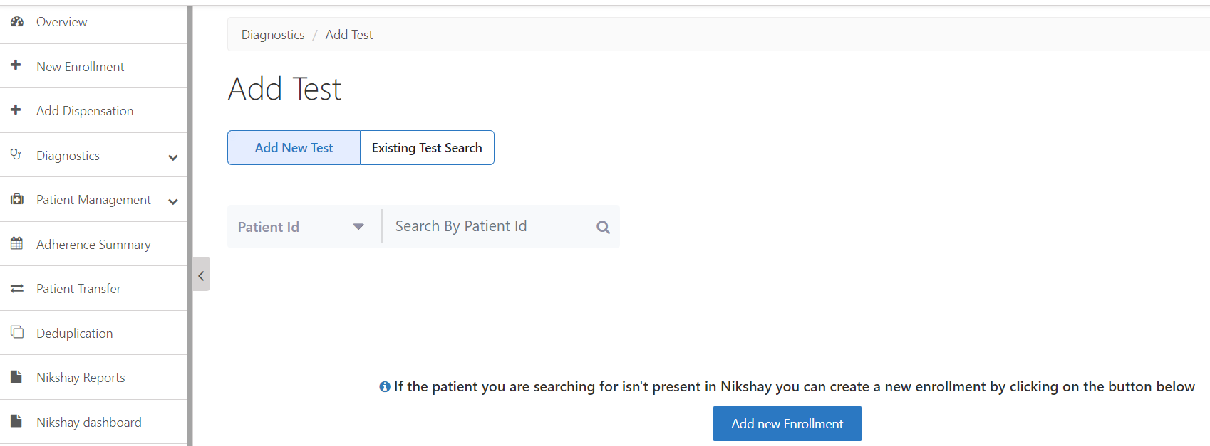
Diagnostic – Add Test>Step 1>Add Test tab
1. Click on
Diagnostic> Add Test to add any new Test or
Search any existing Patients’ test data
2. Search for patient details through any of the following –
Patient ID
Patient Name
Phone no. (through which enrolment is done)
And click on Search
Click to add new enrollment directly from this module, where required

Slide 7
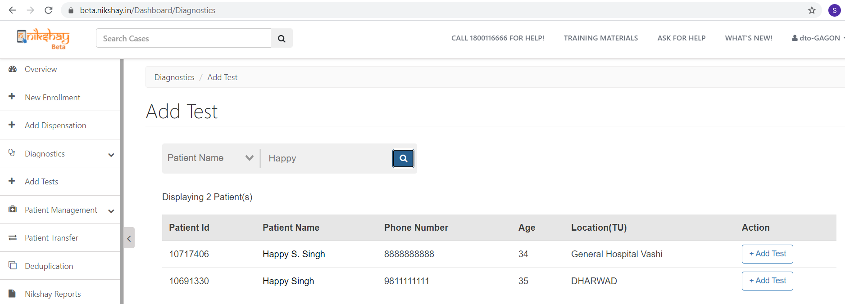
Diagnostic – Add Test>Step 2>Searching patient
Search for patient details through any of the following –
Patient ID
Patient Name
Phone no. (through which enrolment is done)
Click here to select the patient’s details
Click to add new Test(s)

Slide 8
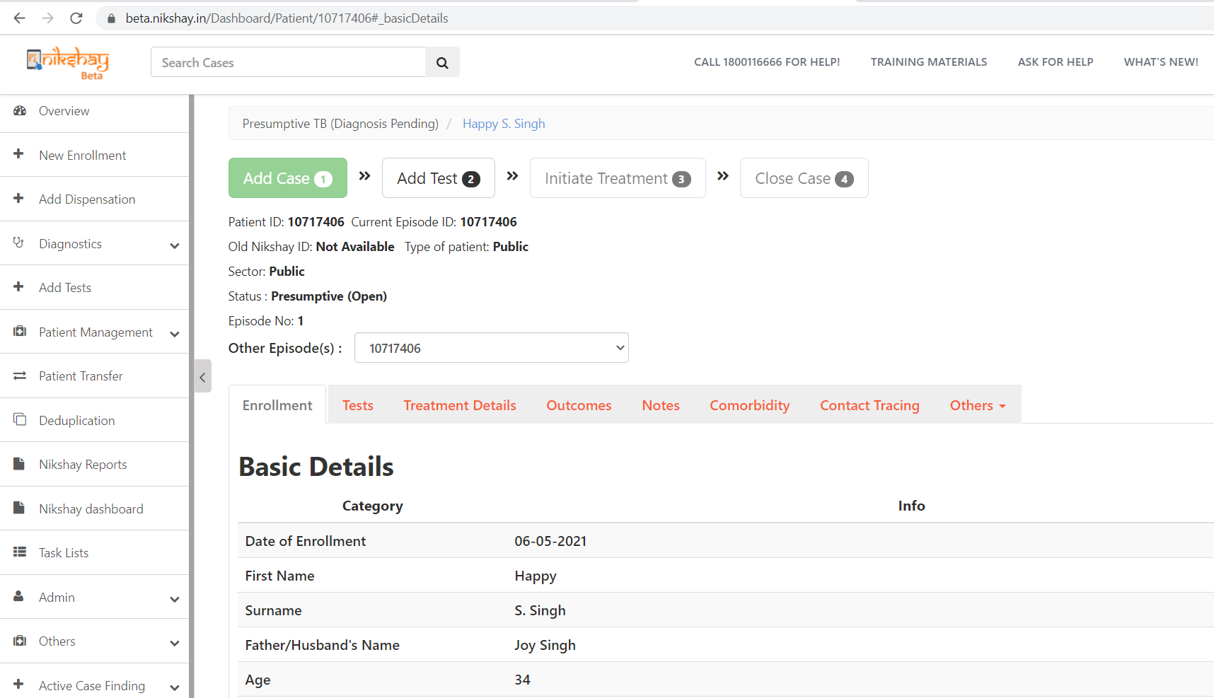
Diagnostic – Add Test >Step 3>Checking Patient’s details
Any new enrolment shall show under Presumptive TB (Diagnosis Pending ) status
Patient details can be checked here
Test(s) can also be added from here

Slide 9
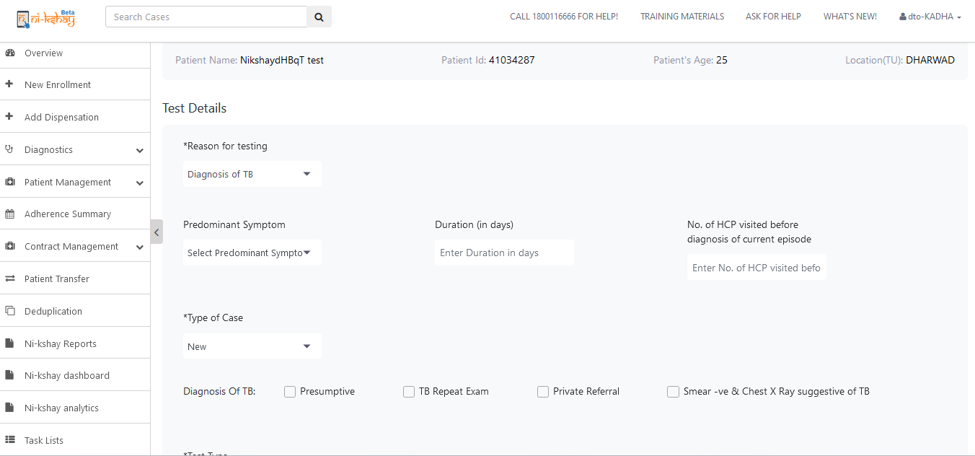
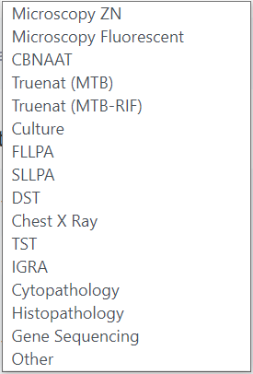
Diagnostic – Add Test>Step 4>Add Test >All required fields
Enter an appropriate Reason for Testing from the dropdown options shown below-
Click to select Test Type from the dropdown options shown here-

Slide 10
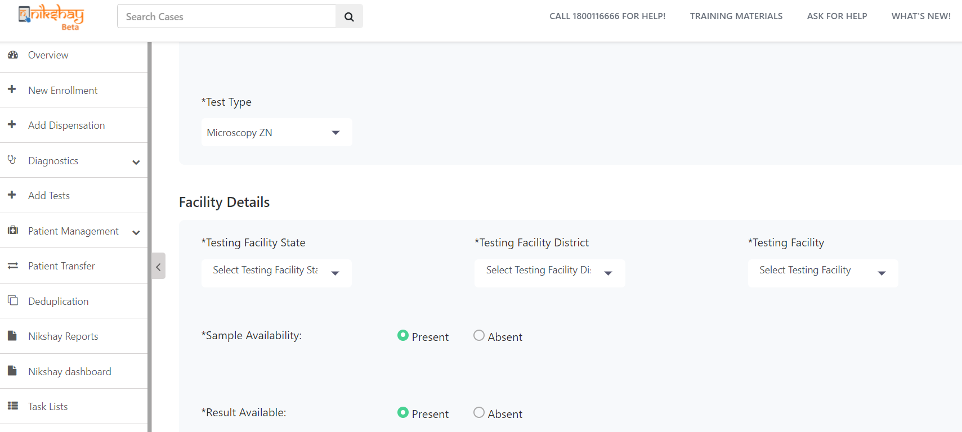
Diagnostic – Add Test>Step 5> Test Type and Facility Details
Click to select Test Type from the dropdown options shown here for “Diagnosis of TB” -
Select the Testing Facility from the Dropdown options
Select the Testing Facility State from the Dropdown options
Select the Testing Facility District from the Dropdown options
Select the Sample availability option – Present / Absent
Select the Result availability option – Present / Absent
Note:
Either of the Sample / Result to be selected as “Present”, to continue to the next process (i.e. adding Sample or Result), otherwise the test can be submitted on this point itself
Test Type options and fields for Facility details are uniform to all the four reasons for testing TB
Testing facility details are mandatory for all patients - Public and Private

Slide 11
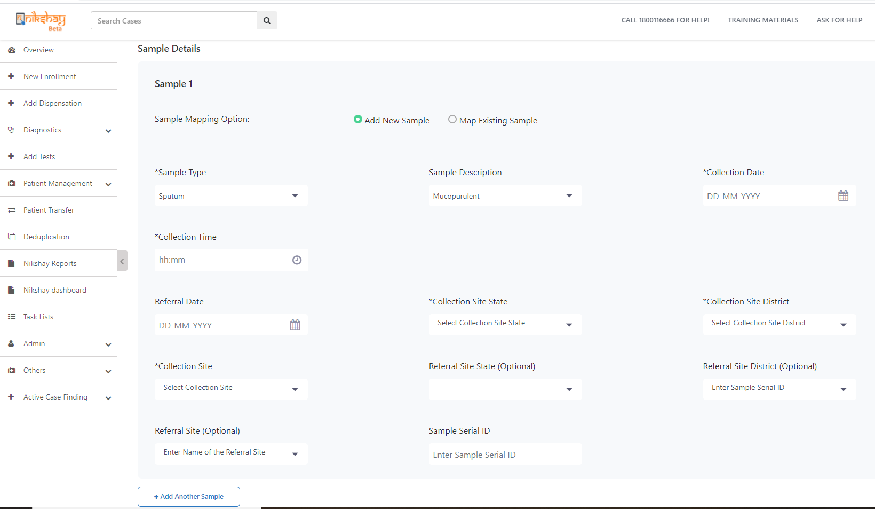
Diagnostic – Add Test>Step 6a> Sample Details - New
When selecting Sample mapping options as – New Sample
Select Sample Type from the dropdown options
Select Sample description from the dropdown options
Enter Collection Date
Enter Collection Time
Enter Referral Date, if any
Select the Collection Site State
Select the Collection Site District
Select the Collection Facility
Select the Referral Site State, if any
Select the Referral Site District, if any
Enter Sample serial ID, if any
Select the name of the Referral Site, if any
Add to another sample, when required
Note: Sample (New ) collection process and information fields are uniform to all four reasons for testing TB. Sample details would not be visible for X-Ray, HPE, CPE, Gene Sequencing, Others

Slide 12
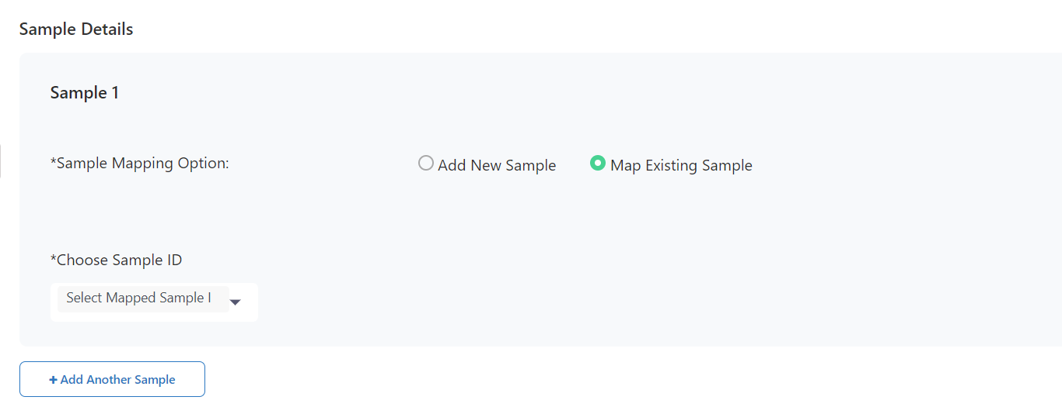
Diagnostic – Add Test>Step 6b>Sample Details - Existing
When selected Sample mapping Option as “Mapping existing Sample”
Choose Sample ID from the dropdown options (it will show previously collected samples) –
Add to another sample, as required
Note: Sample ( Existing) collection process and information fields are uniform to all four of the reasons for testing TB
Notes:
The screen has been changed. Mockup to be updated.

Slide 13
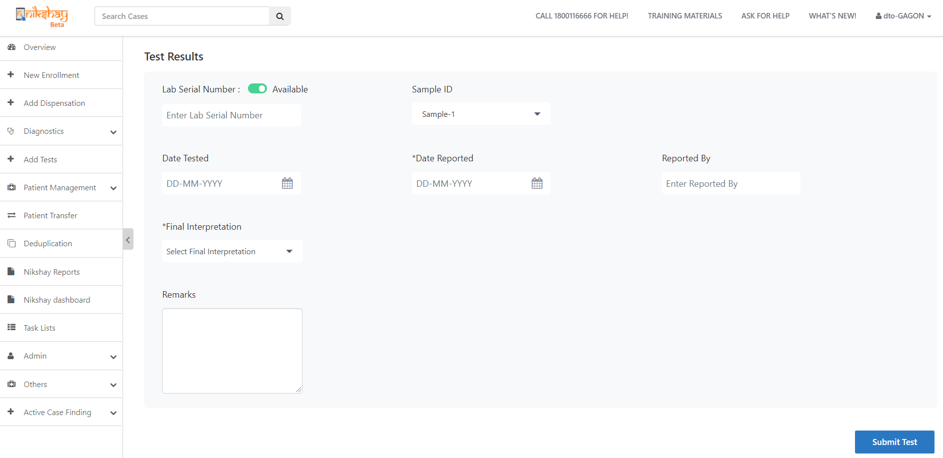
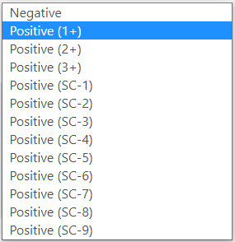
Diagnostic – Add Test>Step 7 Diagnosis of TB>Test Result
Enter the lab serial no., if available
Enter the sample number (eg Sample-1, Sample-2) by choosing from the drop down option from samples entered for the patient
Select the test date
Select the reported date
Enter the name
Select the final interpretation result from the below drop down options
Enter remarks, if any
Click to submit the Test
Notes:
Mockup to be updated from Beta

Slide 14
Diagnostic – Add Test>Step 7 Diagnosis of TB>Test Result
Enter the lab serial no., if available
Enter the sample number (eg Sample-1, Sample-2) by choosing from the drop down option from samples entered for the patient
Select the test date
Select the reported date
Enter the name
Select the final interpretation result from the below drop down options
Enter remarks, if any
Click to submit the Test
Notes:
Mockup to be updated from Beta

Slide 15
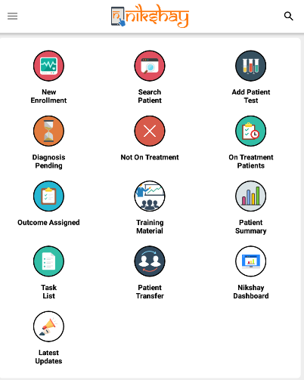
Diagnostic – Add Test> APP
Notes:
Mockup to be updated from Beta

Slide 16
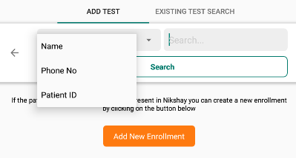
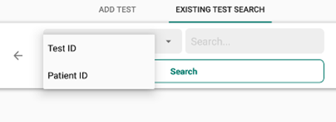
Diagnostic – Add Test> APP
Click on Add Test and to add a new test existing patients can be searched through -
a.Name
b.Phone No.
c.Patient ID
Notes:
Mockup to be updated from Beta

Slide 17
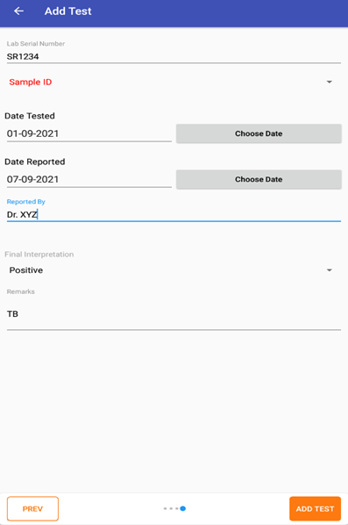
Diagnostic – Add Test> APP
Notes:
Mockup to be updated from Beta

Slide 18
Diagnostic – Add Test> APP
Click here to search any existing Test Details for an existing patient, search can e made through-
a.Test ID
b.Patient ID
Notes:
Mockup to be updated from Beta

Slide 19
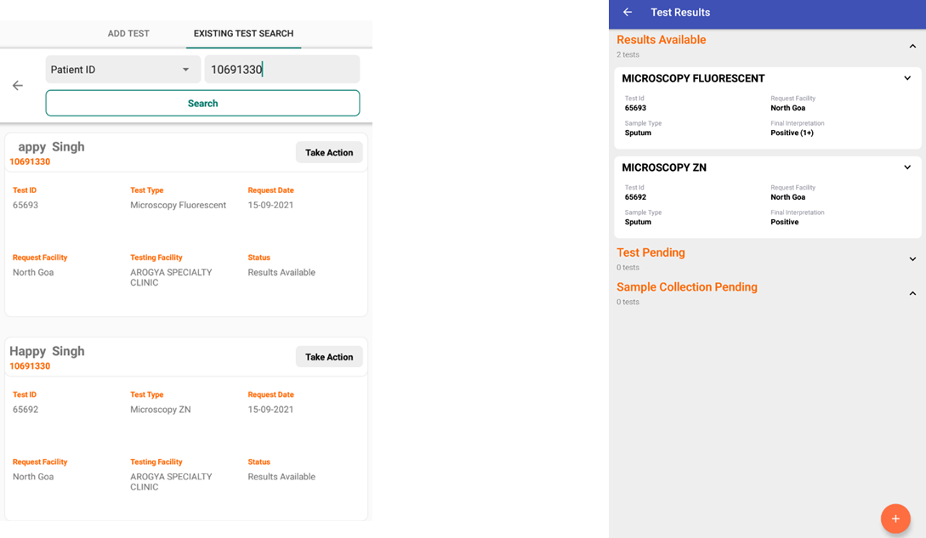
Diagnostic – Add Test> APP
Click here to check any test is pending for the patient
Click here to check any sample collection is pending
Click here to Add Test
Notes:
Mockup to be updated from Beta

Slide 20
Sample Registration and Journey Tracking

Slide 21
Overview of Sample Registration and Journey Tracking
For many Diagnostic Tests, the facility collecting sample is not the same facility where the tests are actually taking place. Previously, samples were not getting tracked within Nikshay, as a result, there were often delays with these samples, some samples getting lost or spoilt on the way as well
To ensure that the Sample collected are tested appropriately and reaches its correct facility centre, Nikshay has introduced a new & useful feature called Sample Tracking (with/without QR Codes). Through this feature the journey of a collected Sample shall be recorded in Nikshay vide Sample specific transactions.
These new workflows are for those users who works on adding Samples and Tests related information in Nikshay, specifically for those Samples, which are collected and transported at different facilities for tests
All samples that are collected and tested in the same facility need not perform these additional transactions, unless the Sample is to be rejected for any reason.

Slide 22
Overview of Sample Registration and Journey Tracking
5. This feature would be available for users at District, TB Unit and PHI/Pvt. Health facility level
6. All Samples that are getting tracked in Nikshay are being tracked through Sample IDs, hence Samples require to be registered in Nikshay while “Adding Test(s)”, Sample IDs are auto-generated and how to get / view the Sample ID is detailed in the following slides.

Slide 23
Overview of Sample tracking through QR Code Scanning
1. New Diagnostic module has the facility to scan the QR code as well. STO, DTO and PPSA Logins can generate the QR codes within Nikshay.
2. Once the QR codes reached out to the field level i.e. at the sample collection / sample testing centres, then the QR stickers required to be installed / sticked to each of the sample collected.
3. Once every sample got it’s QR stickers, then sample can be tracked with the help of QR codes instead of manual sample IDs. These QR codes / numbers can be added manually while Adding any tests in the web version of Nikshay, or can be scanned and get added with the Test details in the Nikshay - Mobile app version
4. QR stickers, samples can be tracked and monitored with the help of Sample IDs as well, which also got generated within Nikshay and unique in nature.

Slide 24
Process 1: Sample Tracking through QR Code scanning

Slide 25
Diagnostic – QR Code Generation>Generating QR Code Page
Step 1: Go to Diagnostic> Click on Generate QR Codes > Put desired no. of Pages > Enter Submit
2. Put desired no. of page, max. limit: 99 at one go;
1 Page = 121 QR Stickers
3. Click on Submit
5. Click on Download QR Codes for print / saving the PDF version
1. Diagnostic > Click on Generate QR Codes
4. Once submitted, QR codes generated in Nikshay and PDF link is updated for download / print

Slide 26
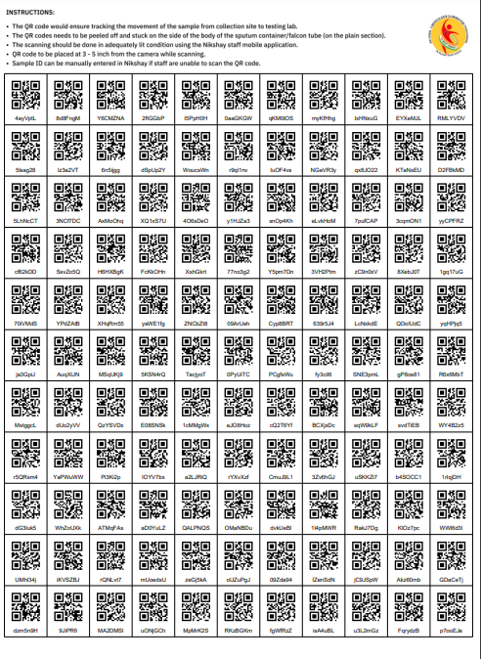
Diagnostic – QR Code Generation>Generating QR Code Page
Step 2: Go to Diagnostic> Click on Generate QR Codes > Sample QR Code booklet in PDF version > Click on Print to have physical version
Sample QR code Booklet (in PDF)

Slide 27
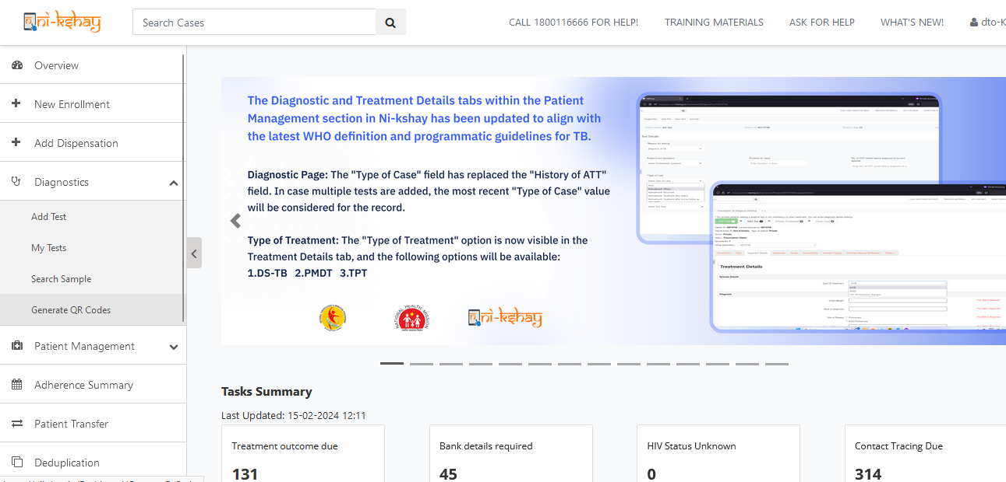
Generate QR Code – District Login

Slide 28
Generate QR Code – PPSA Login

Slide 29
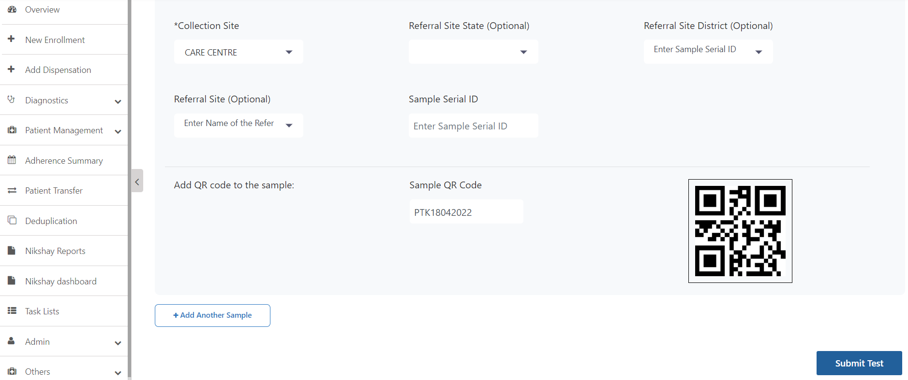
Diagnostic – QR Code Incorporation for New Test >Enter / Scan the QR code
Add New Test for Selected Patients> Add QR Code Number for Web Version and can be scanned in App version
1:
Enter the Sample’s respective QR Number if using Nikshay Web Version and Scanner is not available
Scan the QR Code on Sample if using App version or Scanner available with the Facility
Once QR Number is entered / Scanned QR Code is generated and tagged with the Test
2. Click on Submit

Slide 30
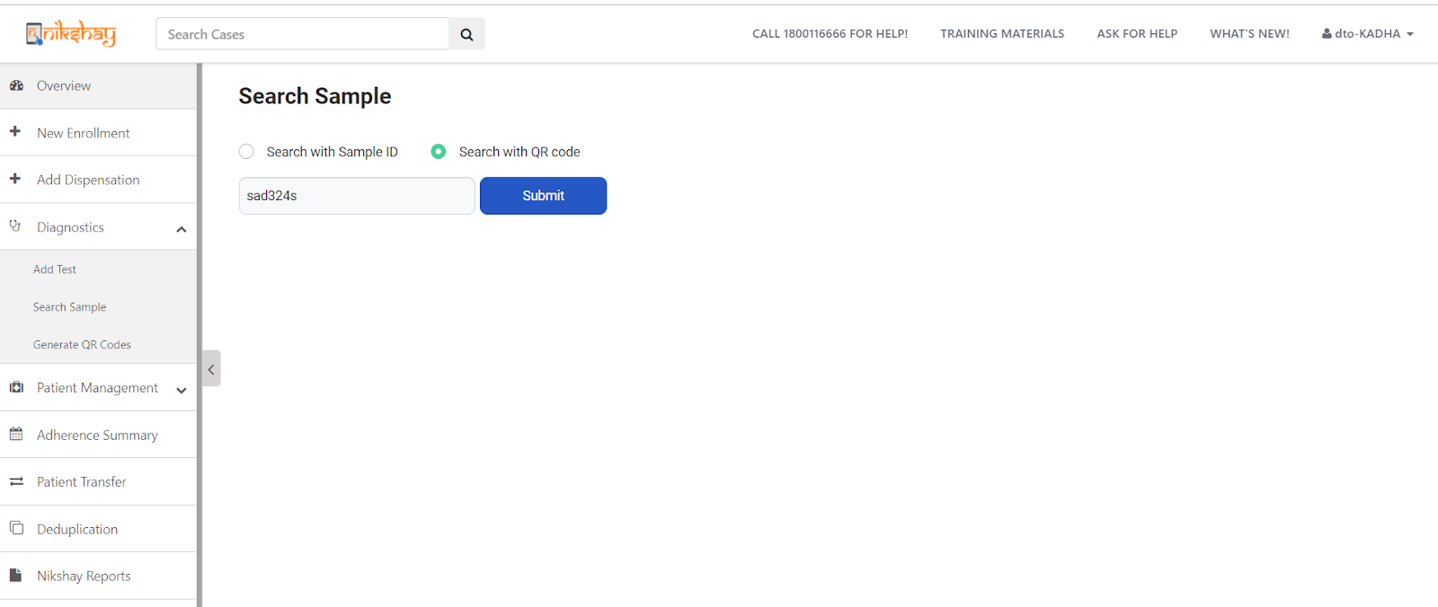
Diagnostic – QR Code as a Sample Identifier (in Web) > Search Sample
Go to Diagnostic> Click on Search Sample> Search with QR Code for an Existing Test
1. Click here> to Search with QR Code
2. Once Code appears here , click on Submit

Slide 31
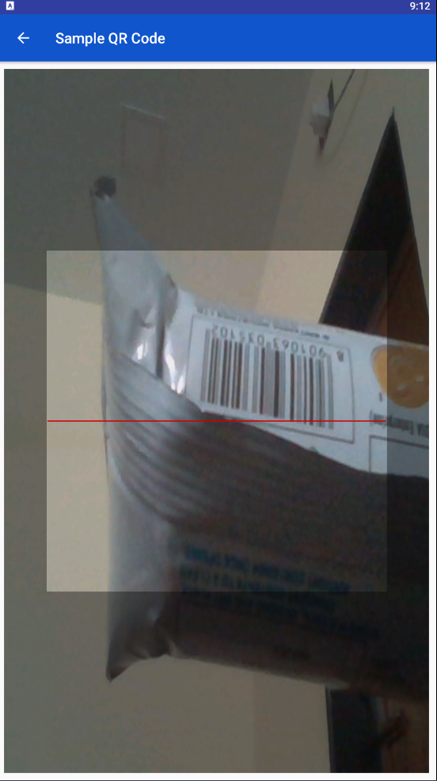
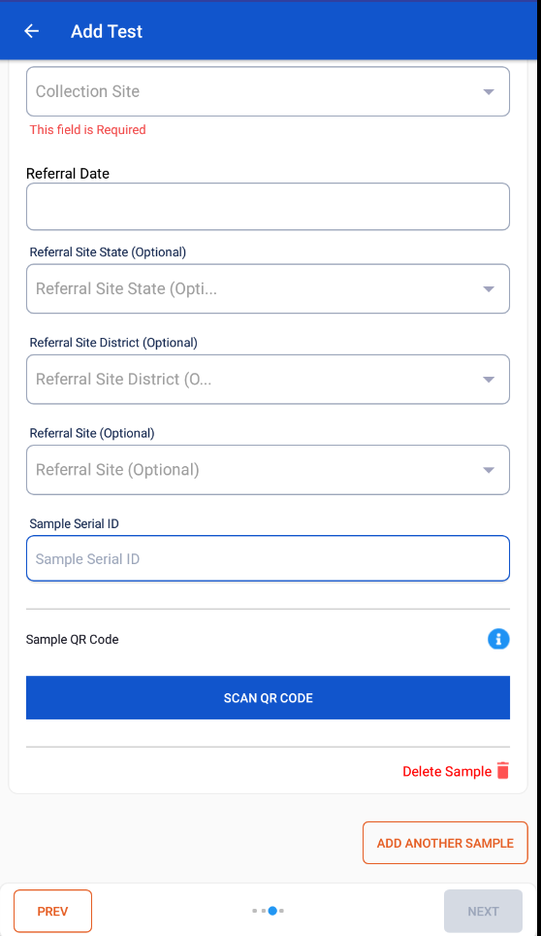
Diagnostic – QR Code as a Sample Identifier > Linking QR Code with Sample [APP]
Go to Diagnostic> Search Sample for an Existing Test> Linking QR code with a Sample
`
1. Select the information as r required
2. Click here to scan the QR code to link a Sample
3.Click here to add / link another sample

Slide 32
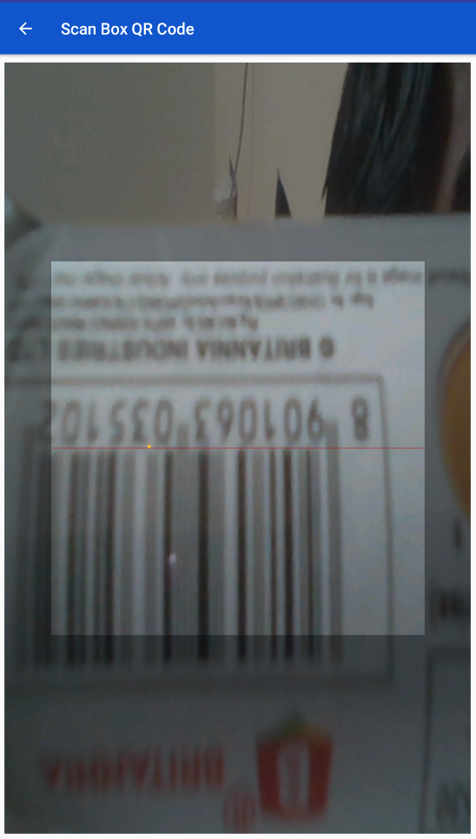
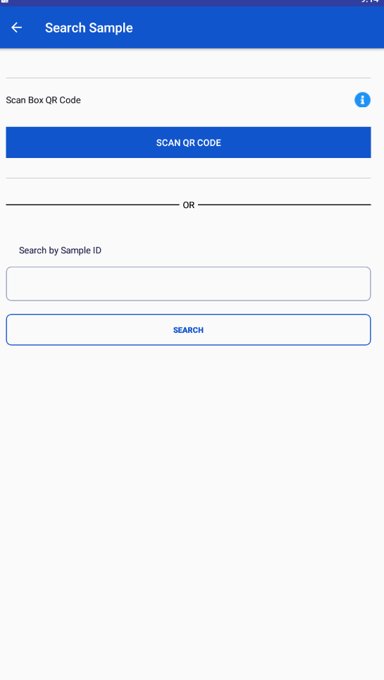
Diagnostic – Scanning QR Code to ID Samples [APP]
Go to Diagnostic> Search Sample> Scanning QR Code to ID Samples
1. Scan QR Code here
2. Click here to Search with Sample ID

Slide 33
Process 2: Sample Tracking through Sample ID Generation

Slide 34
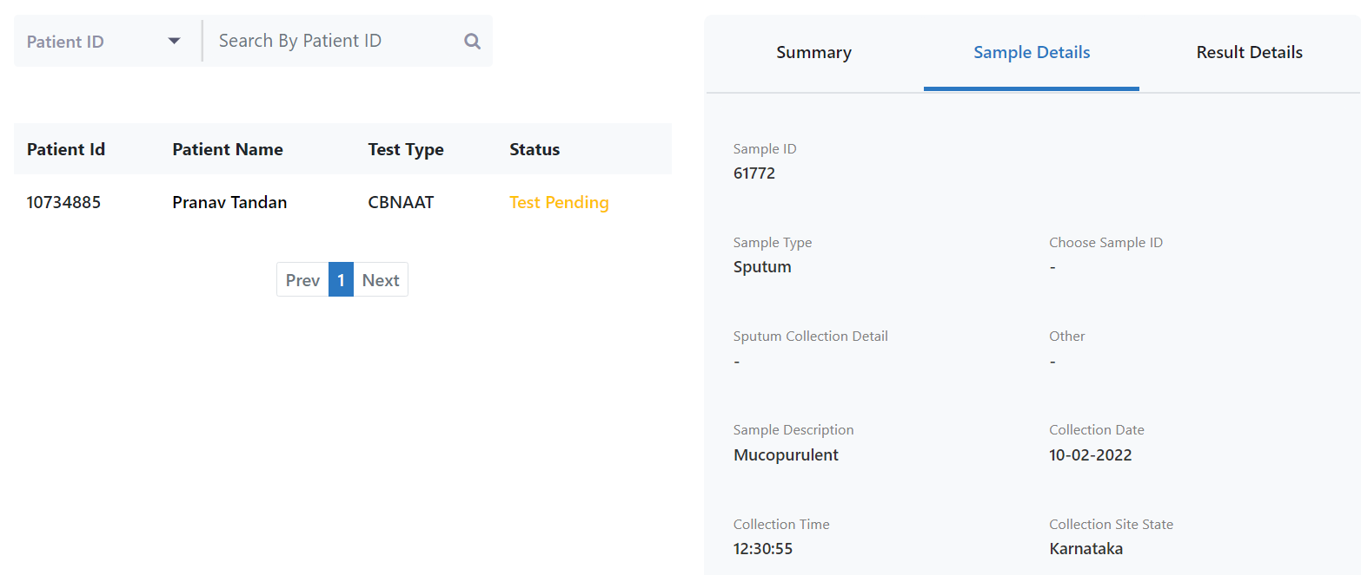
Diagnostic – Sample Registration>Step4>getting Sample ID
Click on the Sample Details to get the Sample ID, through which Sample is getting tracked in Nikshay
Click on the Test
1. Click on the Patient Details to view the Sample details

Slide 35
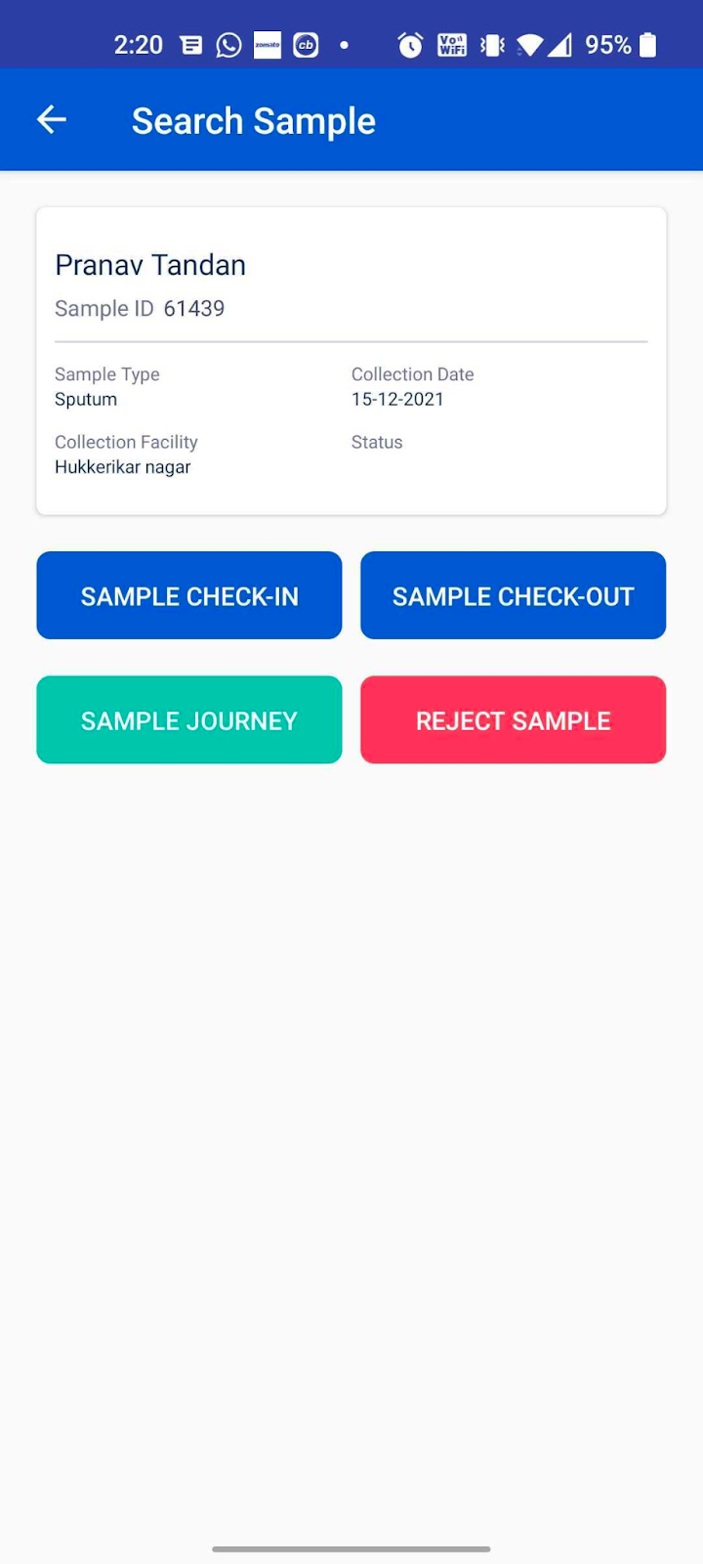
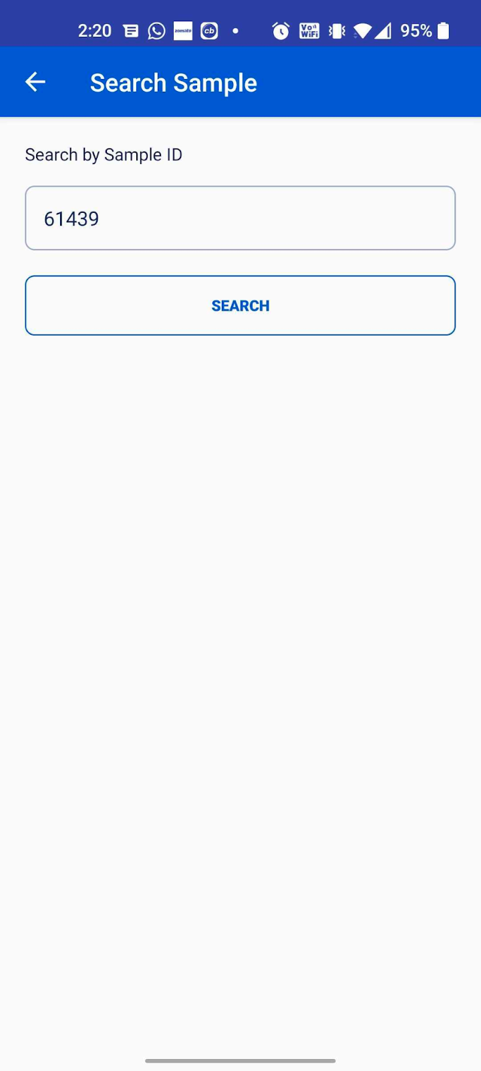
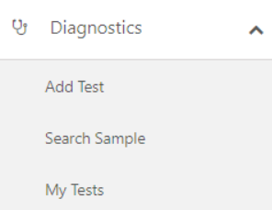
Diagnostic – Sample Registration>Step5> Sample Journey Tracking
Search Sample : Click on Diagnostic> Click on Search Sample
Sample can be searched through Sample ID or QR Code
Enter Sample ID and Click on Submit
Enter Sample ID and Click on Submit
Sample Check in / Check out or rejection can be done through this screen
Sample Check in / Check out or rejection can be done through this screen`
Web Version
Mobile App Screenshot

Slide 36
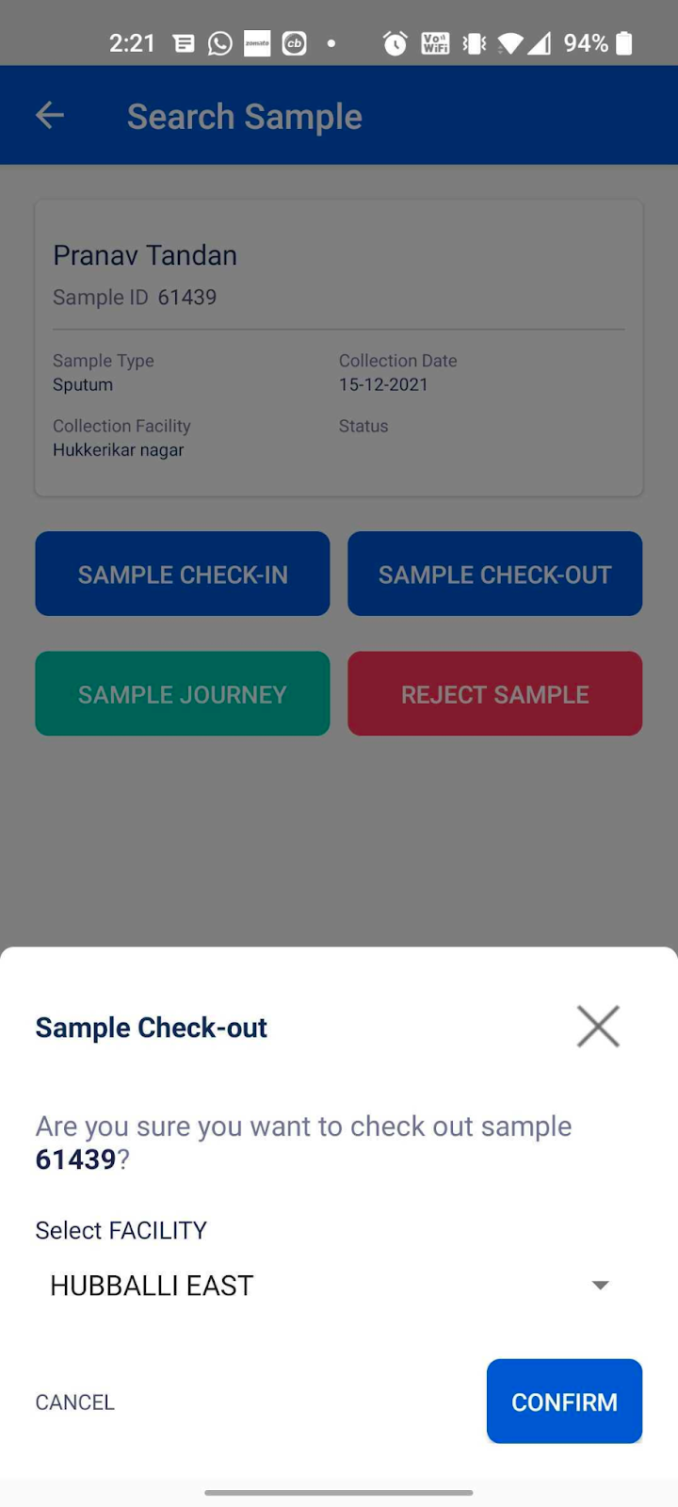
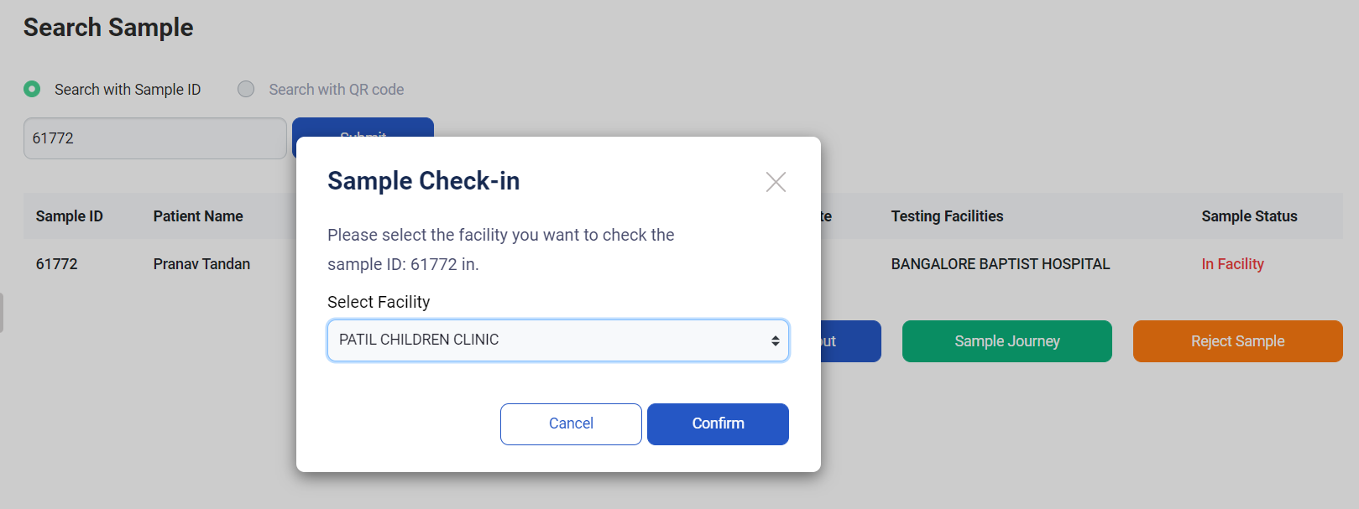
Diagnostic – Sample Registration> Sample Journey Tracking
Step 6: Sample* Check-in / out
Click on Sample Check –in/out
Click Select Facility from the Drop down menu
Click on confirm to complete the Check-in/out process
Click on Sample Check –in/out
Click Select Facility from the Drop down menu
Click on confirm to complete the Check-in/out process
Web Version
*Sample that are registered within Nikshay can only be Checked in / out
Mobile App Screenshot

Slide 37
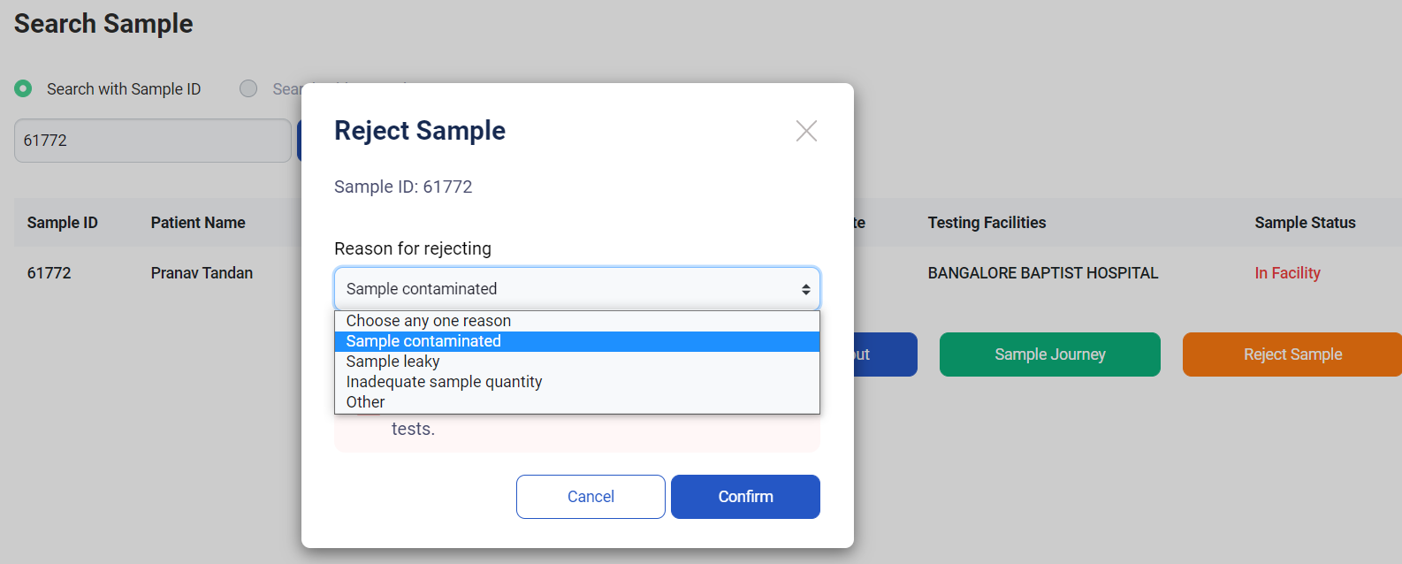
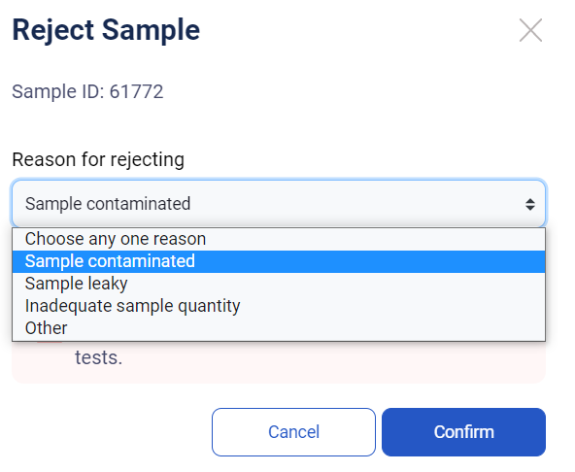
Diagnostic – Sample Registration> Sample Journey Tracking
Step 7: Reject Sample*
Click on Reject Sample
Select the reason for rejection from the dropdown list
Click on confirm to complete the Sample Rejection process
Web Version
*Rejecting a sample is a irreversible action. Once a sample is rejected, it cannot be used for any further tests.`
Mobile App Screenshot

Slide 38
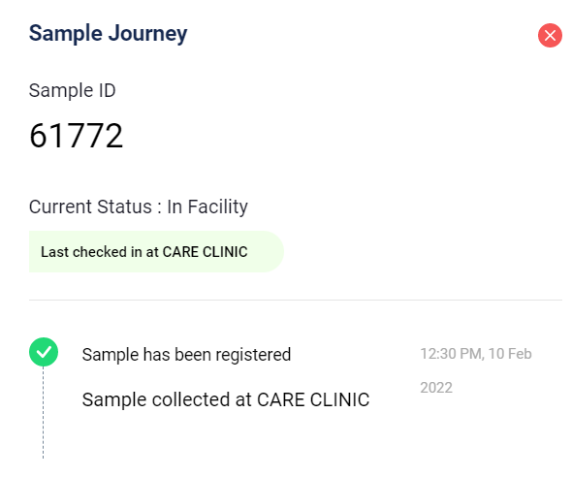
Diagnostic – Sample Registration> Sample Journey Tracking
Step 7: Sample Journey
Click on Sample Journey to check the Sample transaction History

Slide 39
My Test Workbench

Slide 40
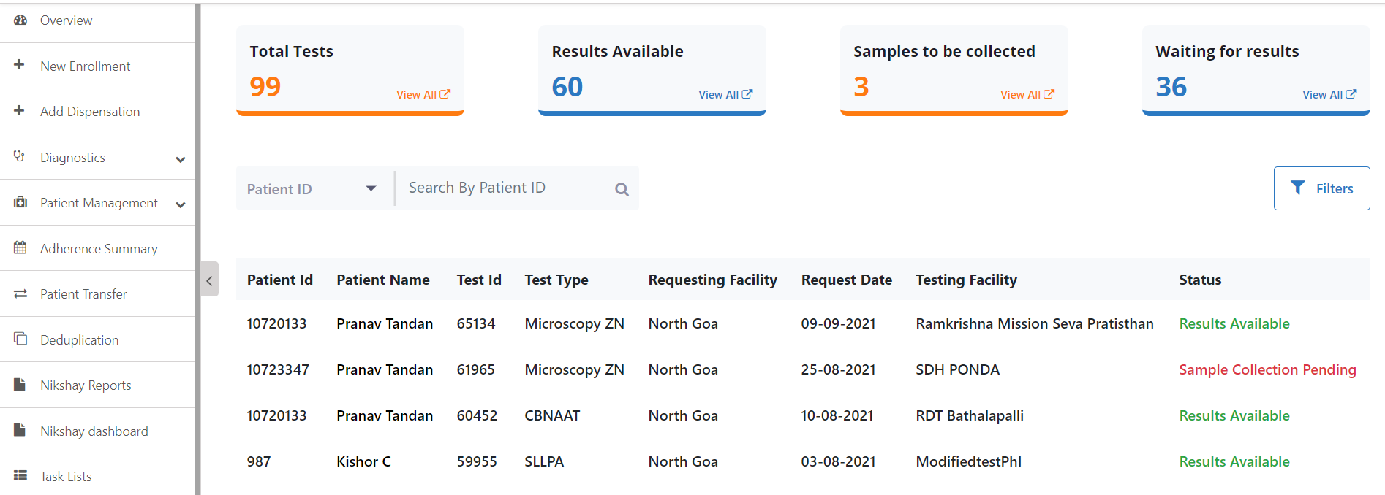
Diagnostic > My Test > Workbench Option #1
Summary view of the Patients data as Workbench and additional filters as workbench filters are added now in the Diagnostic Module -
Sample Workbench:
1. Patient details can be searched from here, as shown in Slide # 5
2. Filters options shown in next slide i.e. Slide # 20
3. Please double click on the patient’s data to get more details and to apply Filter options

Slide 41
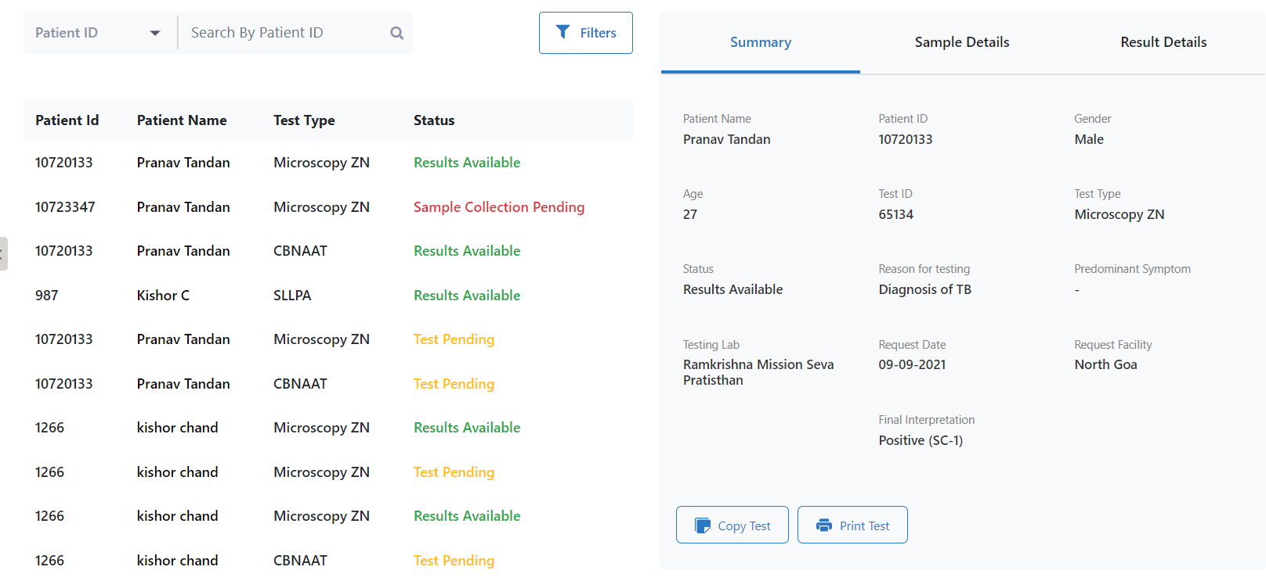
Diagnostic > My Test > Workbench Option # 2
Detailed view of the Patients data with the copy and print facility
Sample Workbench:
When clicked on any Individual patient data, following details are shown -
2. Tests now can be Copied and Printed (in PDF), sample print file is attached

Slide 42
Diagnostic > My Test > Workbench Filter Option
Workbench Filter options:
1. Patient details can be searched from here, details shown in Slide # 5
a
b
c
2. Following Filters can be applied to check patient’ details and click on Apply Filter-
Test Type
Status
Request Date
Requesting Facility
Testing Facility be
d
e

Slide 43
Sample availability & Turn-Around time Reports

Slide 44
Reports : Sample Collection Distribution Report

Slide 45
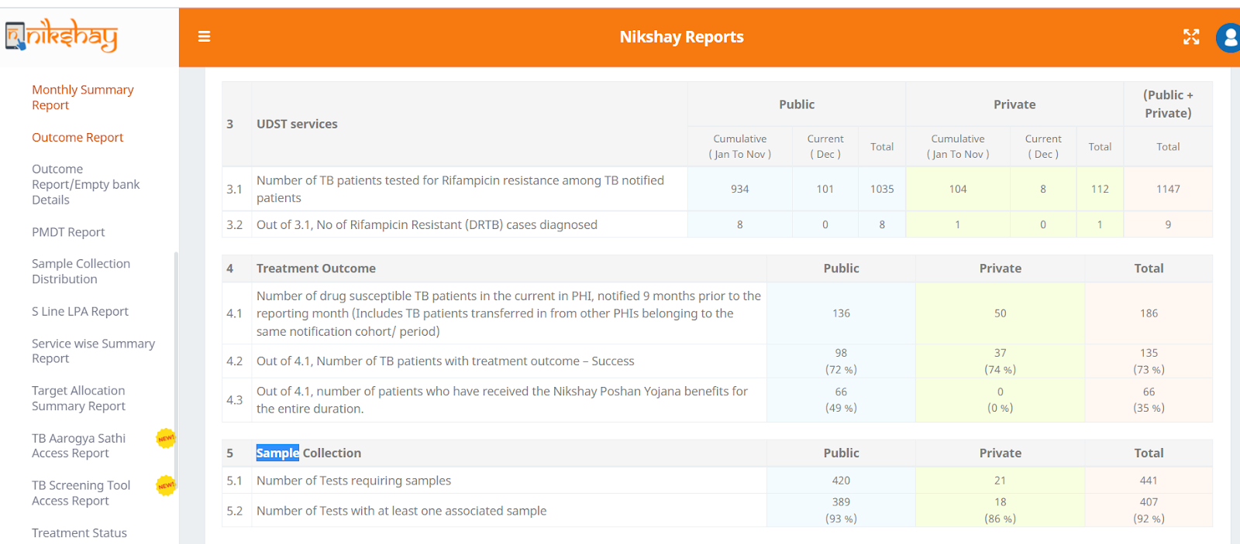
Monthly Summary Report – Sample Collection

Slide 46
Can I add the test request initially and Sample details and Result details later?
ANS: Yes, you can add Sample and Result details subsequently if they are not available yet.
Can I edit a test with a positive test result?
ANS: Unfortunately, a positive test result cannot be edited. Please raise a service
Request with the Nikshay Support Team or submit another test request.
Can I update a test only from the patient’s profile?
ANS: No, you need not go to the patient’s profile to update the tests. You can access your facility’s test at the MyTest Workbench.
How can I look for tests not part of my hierarchy?
ANS: To search for tests outside your hierarchy, please use the Existing Tests Search option. You will be able to search by Test Id or Patient Id, but will not be able to edit these tests.
NIkshay App > FAQs

Slide 47
Can a test have multiple samples?
ANS: Yes, more than one sample can be added to a test, via the Sample Registration module.
Can one sample be mapped to multiple tests?
ANS: Yes, the same sample can be mapped to multiple tests of the same patient.
Choose the Map Existing Sample option in the Sample Registration Module.
Would my old records / data be migrated in this current version?
ANS: Yes, all old records will be migrated and visible in the new module
For Private sector clients , will this be mandatory to select the Test facility centres?
ANS: Yes, it is mandatory to provide testing facility for both public and private sector so that monitoring of the patients can be optimized
NIkshay App > FAQs

Slide 48
Sample/Test Status

Slide 49
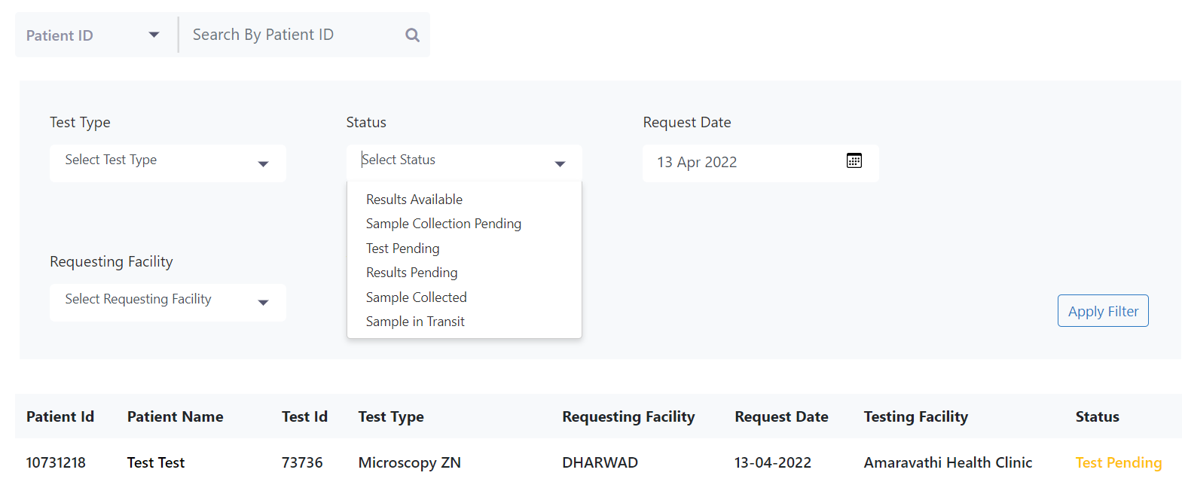
New Statuses in Workbench Filter for Web
Web version : Workbench View

Slide 50
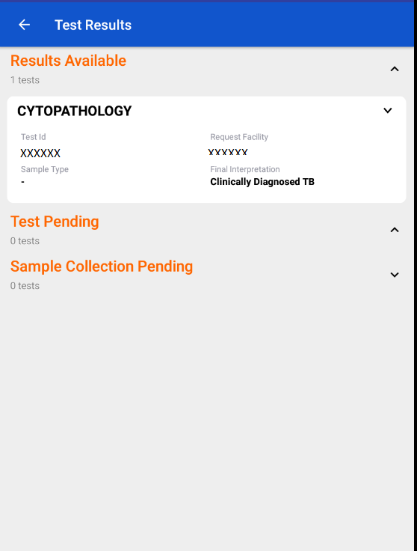
New Statuses in App Version
Mobile App version View

Slide 51
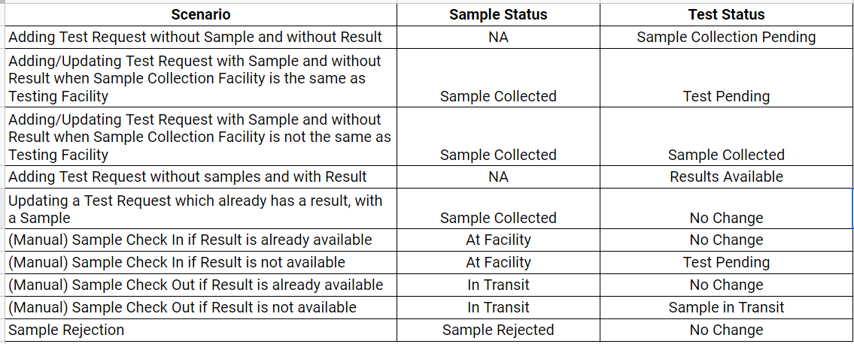
Sample and test status relationship feature

Slide 52
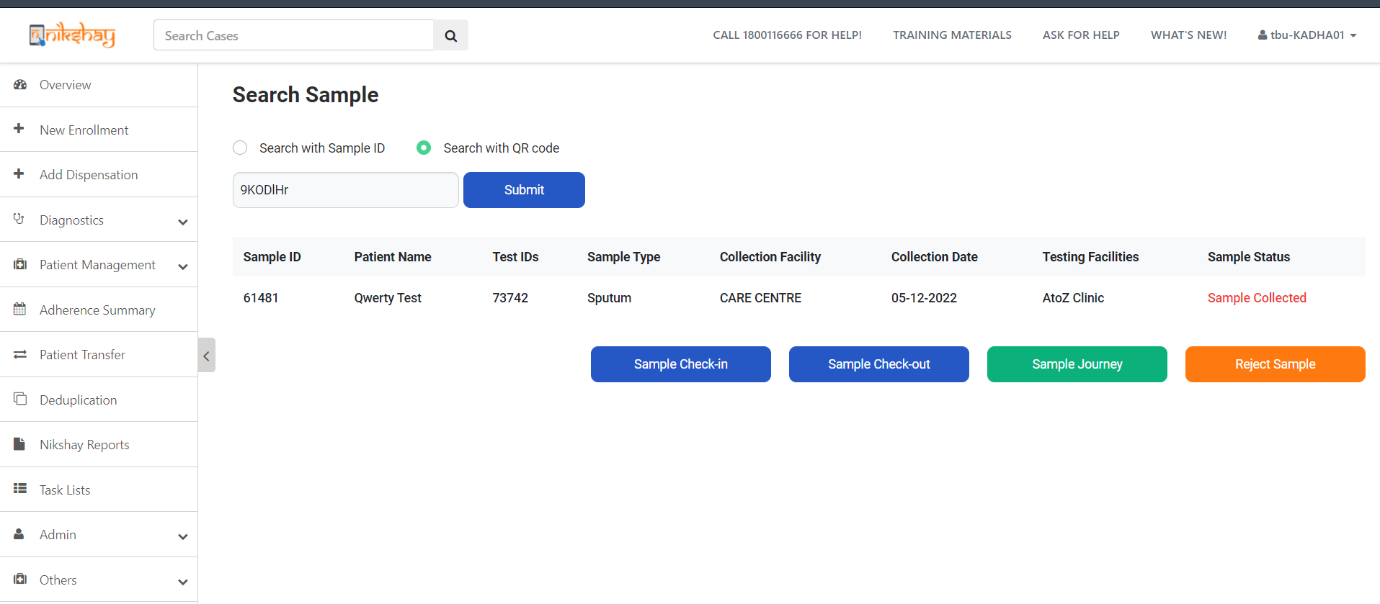
Sample status in “Search sample” page linked with test status

Slide 53
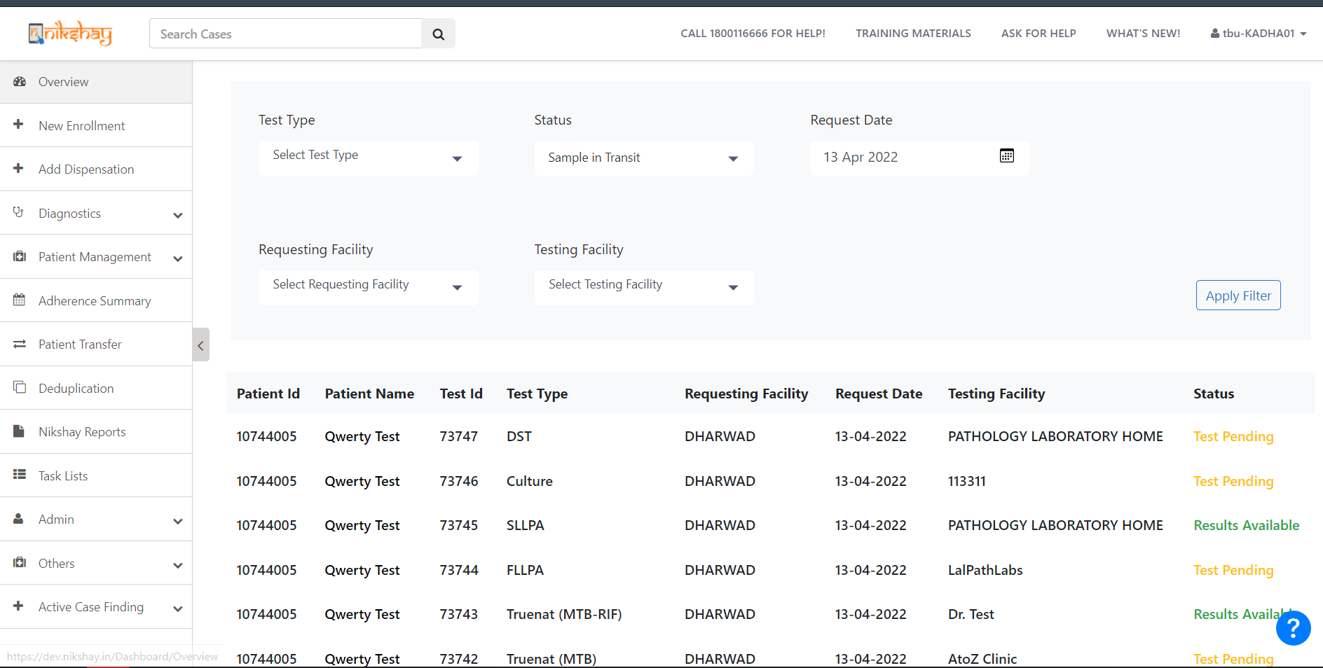
Test Status in “My Test” page linked with Sample Status

Slide 54
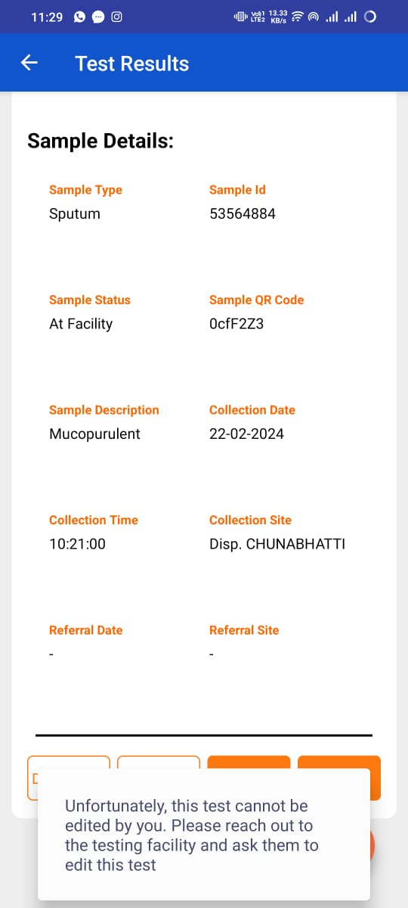
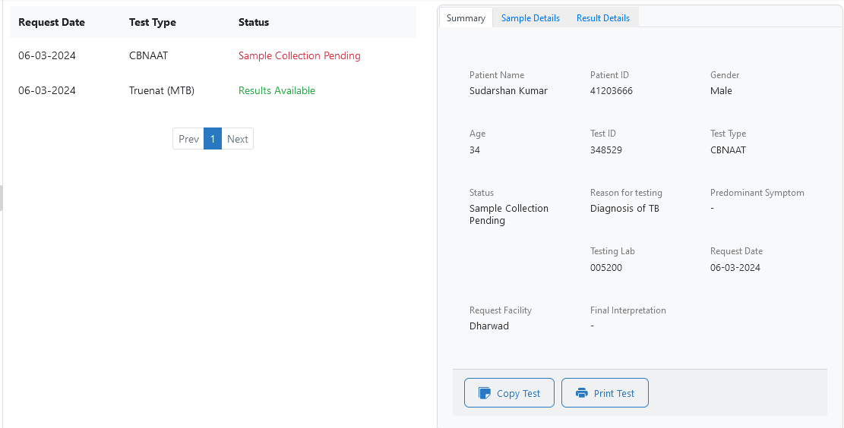
A test in Ni-kshay can be edited only by the following facilities
Testing Lab - that is selected under the Facility Details section
Request Facility - the facility from which the test is added
If a test has been added from Facility A (Request Facility), and the Facility B is selected as the Testing Facility, then Facility C will be unable to add the result for the test.
While editing the test added, an error will be displayed
If the Sample is at Facility C, then facility C can add a new test to the patient and link the existing sample to the newly created test.
Mapping an existing Sample to a test
Testing Lab
Request Facility

Slide 55
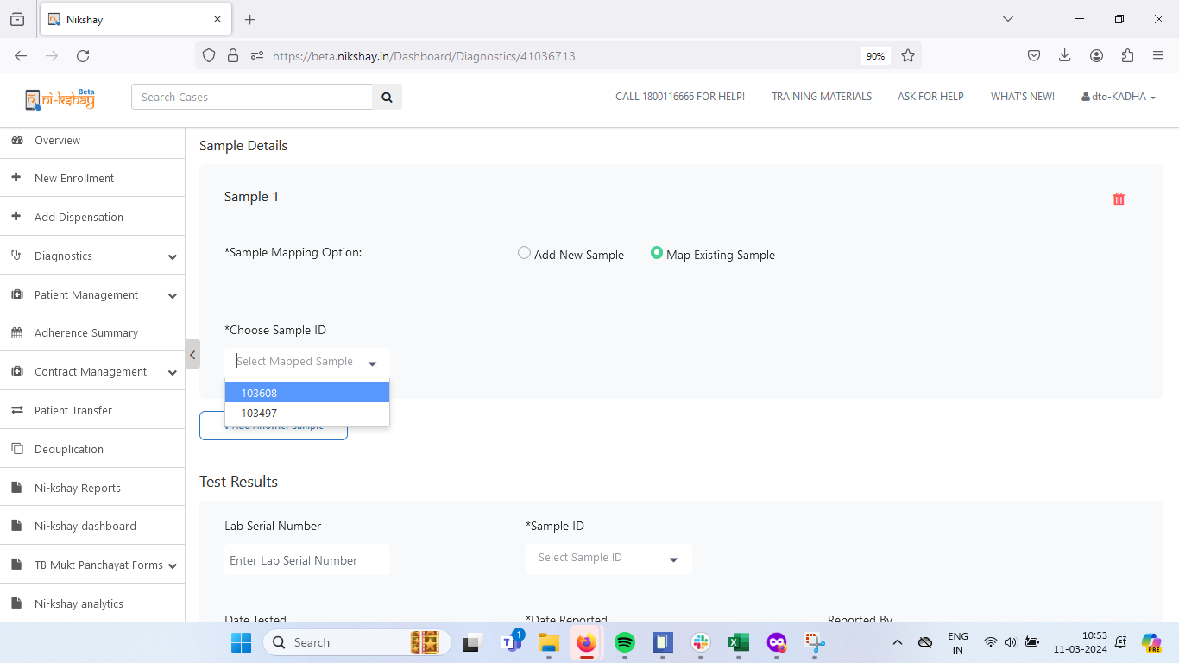
Mapping an existing Sample to a test (Web)
Click on Map Existing Sample
Select the Sample from the list of existing samples linked to the patient

Slide 56
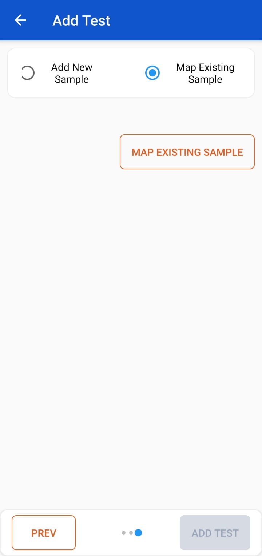
Mapping an existing Sample to a test (App)
Click on Map Existing Sample
Click here to search for the list of existing samples

Slide 57
Thank You

