Slide 1
Disbursing DBT using Digital Signature Certificates (DSCs) in PFMS platform

Slide 2
Agenda
What is Digital Signature Certificate (DSC)?
Why is DSC required?
Who issues DSC and Process of DSC procurement?
How to enable DSC based authentication and Approval process to make the DBT payments in PFMS?
DSC Based payment approval process in PFMS
Steps to Activate Second level DSC in PFMS and Approval process with Two level DSCs

Slide 3
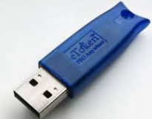
1. What is Digital Signature Certificate (DSC)
Digital Signature Certificates (DSC) are the digital equivalent (that is electronic format) of physical or paper certificates.
Few Examples of physical certificates are drivers' licenses, passports or membership cards. Certificates serve as proof of identity of an individual for a certain purpose; for example, a driver's license identifies someone who can legally drive in a particular country.
Likewise, a digital certificate can be presented electronically to prove one’s identity, to access information or services on the Internet or to sign certain documents digitally.
Sample token of DSC looks like the image herewith. But, it could be different based on the type and version of a DSC. It has to be inserted with PC/ Laptop to enable the DSC application and authorisation.
Sample Token of DSC

Slide 4
2. Why is DSC required
Physical documents are signed manually and electronic documents, for example e-forms are required to be signed digitally using a Digital Signature Certificate. Similarly, we shall use DSC to sign / approve payment process through PFMS portal for benefit transfer payment.
As using DSC for approval of payment transactions, simplifies and fast tracks the payment process to a very large extent because of the following reasons:
The lengthy and time consuming manual process of printing PPA, getting signatures of two authorised signatories and submission to Bank can be avoided
Rejections due to PPA Expiry / R98 etc.. can be minimised and higher success rate can be achieved
The payment gets credited to the beneficiary within hours of DSC based approval in PFMS which considerably reduces the Turnaround time of payments

Slide 5
3. Who issues DSCs and Process of Procurement
DSC Issuing authorities:
A licensed Certifying Authority (CA) issues the digital signature. Certifying Authority (CA) means a person who has been granted a license to issue a digital signature certificate under Section 24 of the Indian IT-Act 2000.
The list of licensed CAs along with their contact information is available on the MCA portal. Certifying Authorities
Directive has been issued by Central TB Division, all STOs and DTOs to procure the DSCs from their respective NIC units.
Process of Procuring DSCs
Digital Signature Certificate (DSC) Applicants can directly approach Certifying Authorities (CAs) with original supporting documents, and self-attested copies. DSCs can also be obtained, wherever offered by CA, using Aadhar eKYC based authentication, and supporting documents are not required in this case
DSC form can be downloaded from NIC websites i.e. https://vpn.nic.in/resources/application_forms/DSC-Request-Form.pdf
Else, Form attachment (PDF) is given herewith too
NIC form to be filled up and to be submitted to your local NIC unit, upon verification the respective NIC units shall issue the DSCs
A letter/certificate issued by a Bank containing the DSC applicant’s information as retained in the Bank database can be accepted. Such letter/certificate should be certified by the Bank Manager .

Slide 6
4. How to enable DSC based authentication and Approval process to make the DBT payments?
To enable DSC based authentication and Approval process in PFMS, following steps to be adhered:
a. DSC Enrolment
(One time activity from DA Login)
b. Account Activation for e-Payment vide DSC
(One time activity from Admin Login)
c. Signatory Configuration – One time activity for each PFMS Agency (Admin Login)
d. Sign Enrolment File – One time activity for each PFMS Agency (DA Login)
e. Opening Balance to be added – One time activity (DO Login)
f. Opening Balance to be Approved – One time activity (DA Login)
(Note: These steps are one time activities)

Slide 7
4a. DSC enrolment
For DSC Enrolment following is a summary of the steps to be followed
S.No | Description | Actions to be completed for DSC Enrolment
1 | Install Java on the PC | Confirm that Java Is installed on to your Machine
2 | PFMS Website Entry in Java | Go to Security Tab of Java and in Edit Site List enter https://pfms.nic.in.
3 | Show Console Enabled in Advance Tab | Go to Advance Tab of Java And under Java Console option Enable Show Console
4 | Close Browser | Close the Java and the Browser and login again to Enrol DSC

Slide 8
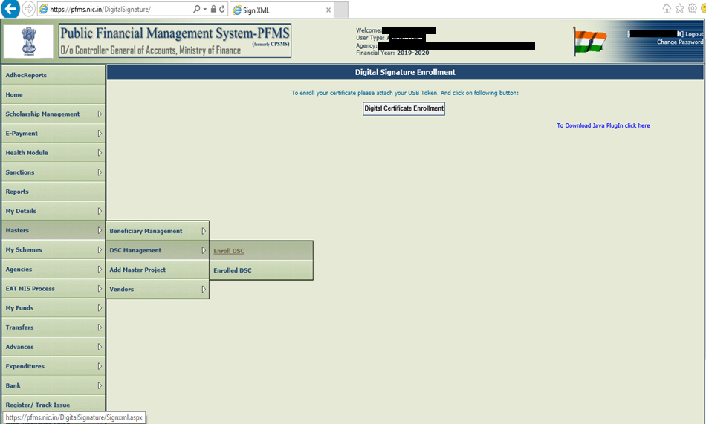
4a. DSC Enrolment
Step – 1 : Log in as DA, Click on “Masters → “DSC Management” → “Enrol DSC”

Slide 9
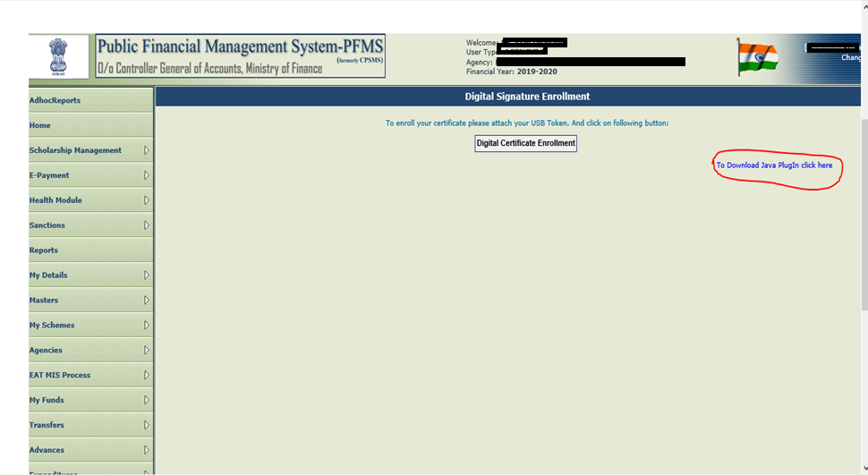
4a. DSC Enrolment (DA Login)
Step – 2 : Download Java by clicking on link. If link is not working, download from https://www.java.com/en/download/ and download the latest version.

Slide 10
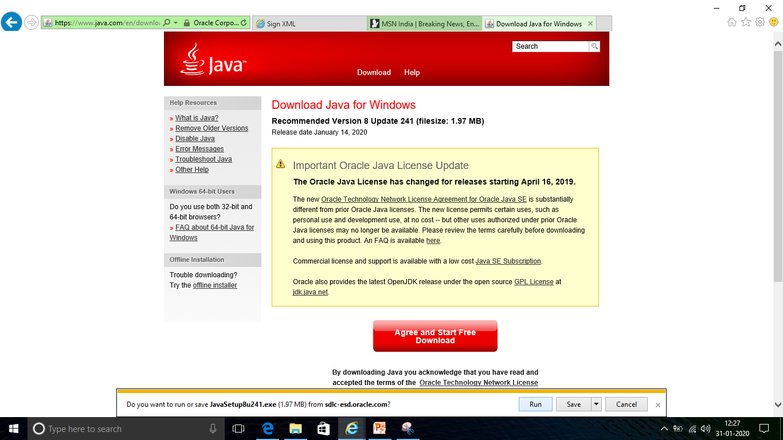
4a. DSC Enrolment (DA Login)
Step – 3 : Click on “Agree and Start Free Download” and Save
1
2

Slide 11
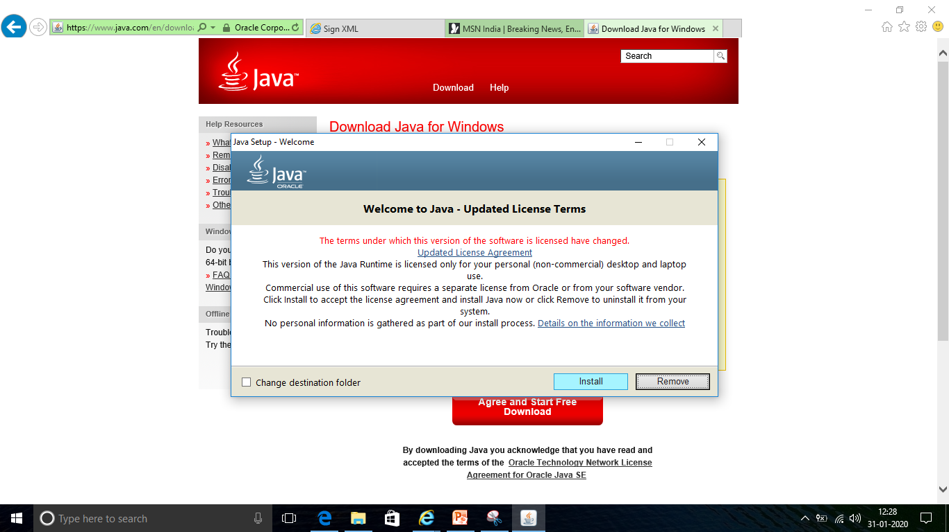
4a. DSC Enrolment (DA Login)
Step – 4 : Click on ‘Install’

Slide 12
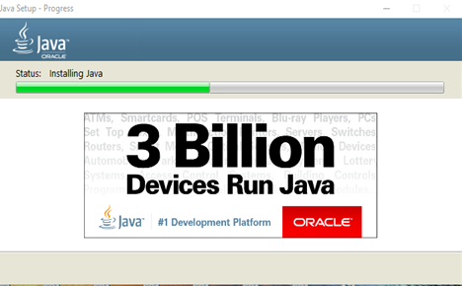
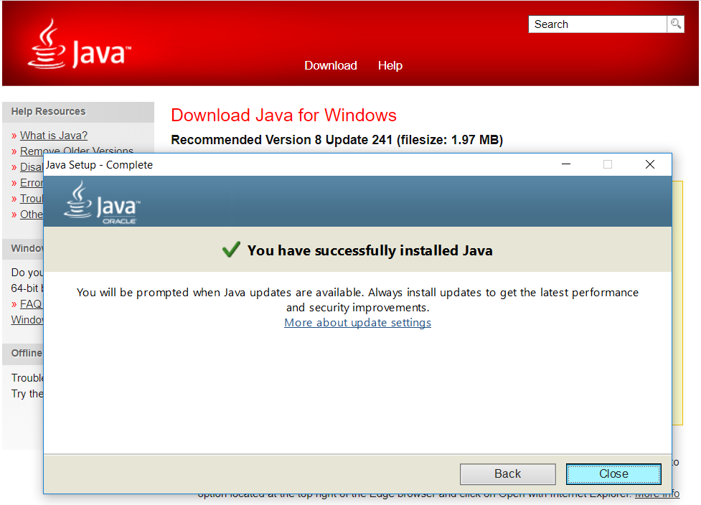
4a. DSC Enrolment (DA Login)
Step – 5 : Screen 1 shall appear as Java is getting installed (do not interrupt the Java Installation). Once the installation is complete, Screen 2 shall appear saying “You have successfully installed Java”, then click on “Close” to finish the Java Installation
Screen 1
Screen 2

Slide 13
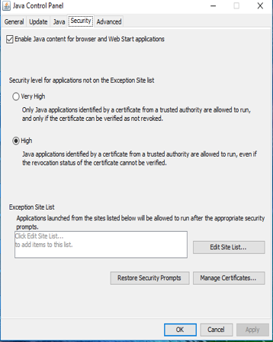
4a. DSC Enrolment (DA Login)
Step – 6 : As Java is successfully installed, Press right click on Java Application icon, go to Java Control Panel - Security Tab – Edit Site List
1
2

Slide 14
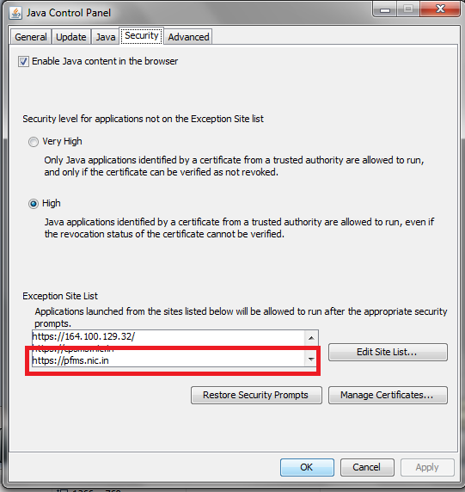
4a. DSC Enrolment (DA Login)
Step – 7 : Add “https://pfms.nic.in/” under Exception Site list and Click on OK
1

Slide 15
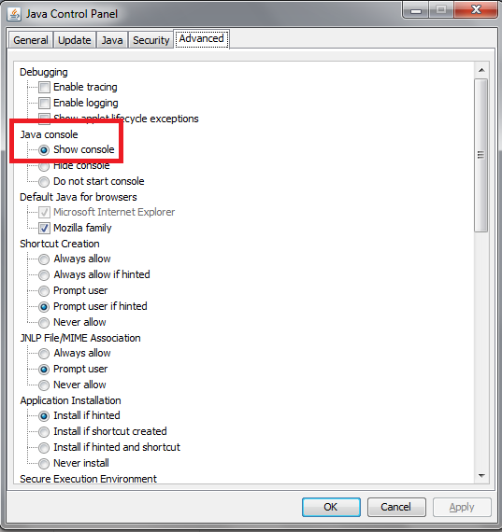
4a. DSC Enrolment (DA Login)
Step – 8 : Go to “Advanced”, Select “Show console” and Click on OK
1
2

Slide 16
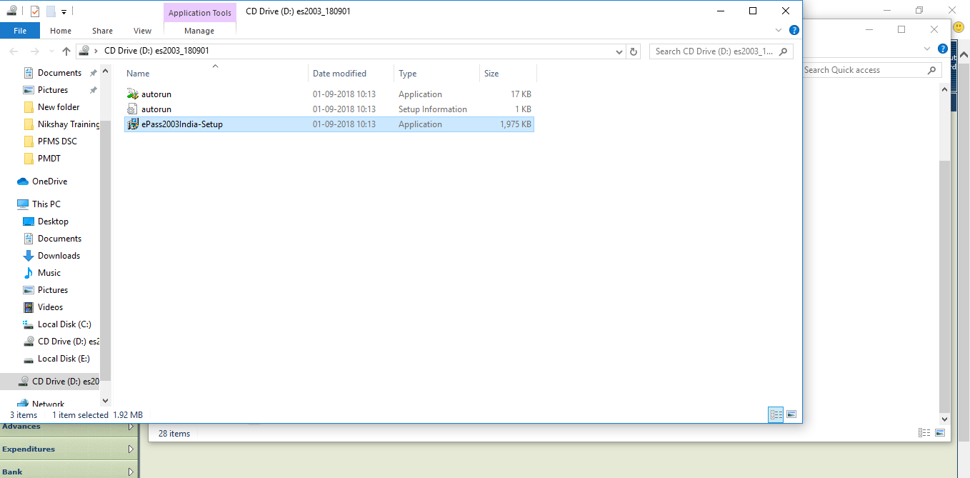
4a. DSC Enrolment (DA Login)
Step – 9 : Attach DSC USB token to your computer. Setup will run automatically. (If Setup does not run automatically, open USB Drive folder and Run the Setup)

Slide 17
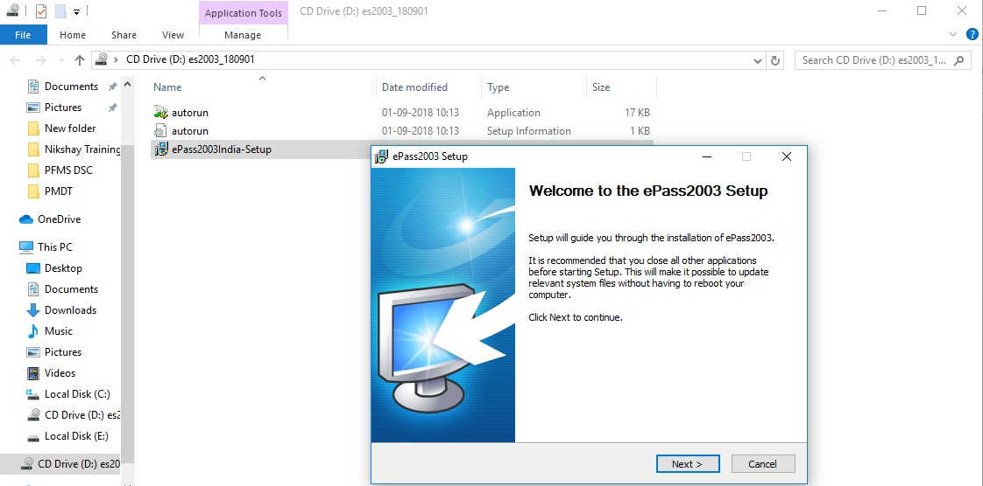
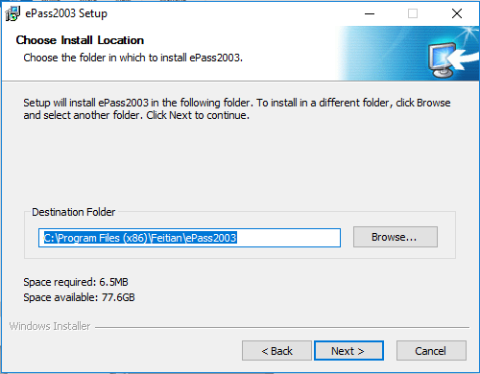
4a. DSC Enrolment (DA Login)
Step – 10 : As Setup runs, click with “Next” & Continue with default settings
1
2

Slide 18
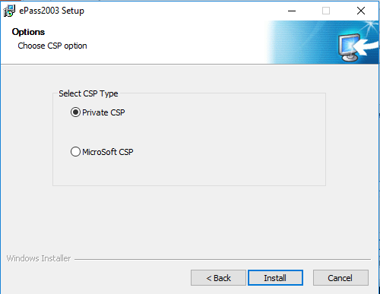
4a. DSC Enrolment (DA Login)
Step – 11 : Select “Private CSP” and Click on Install
1
2

Slide 19
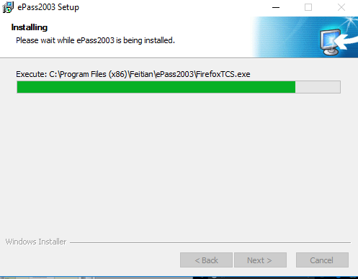
4a. DSC Enrolment (DA Login)
Following screens shall appear when DSC Token Drive is successfully installed

Slide 20
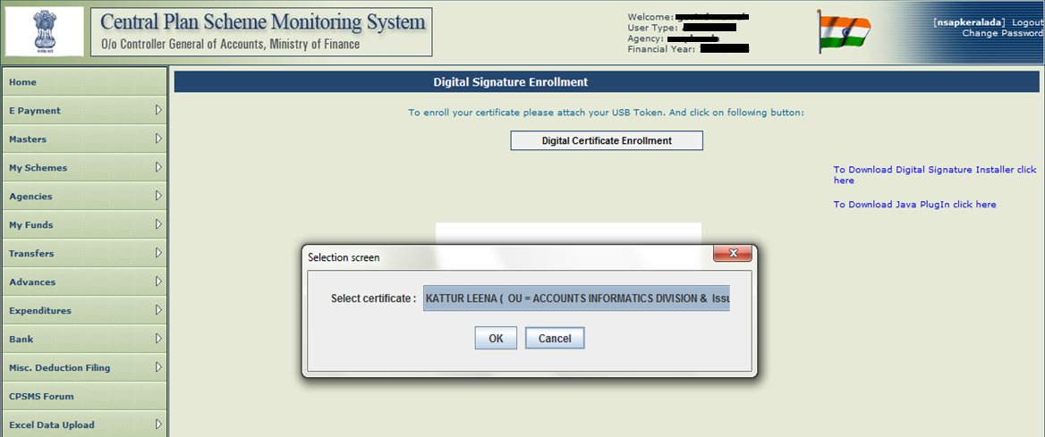
4a. DSC Enrolment (DA Login)
Step – 12 : From DA Login, Click on “Digital Certificate Enrolment” & “Click on “OK”
1
2

Slide 21
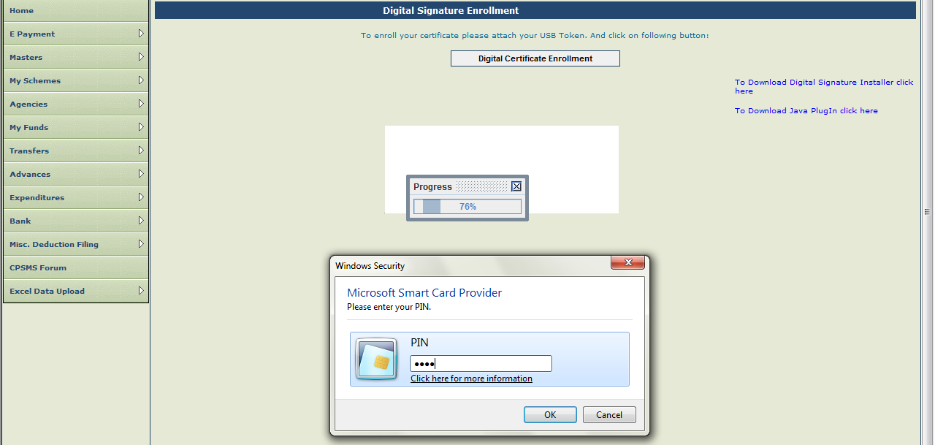
4a. DSC Enrolment (DA Login)
Step – 13 : Enter “Pin / Password” and Click OK
1
2
Note: PIN is the security code received along with the DSC from the issuing authority

Slide 22
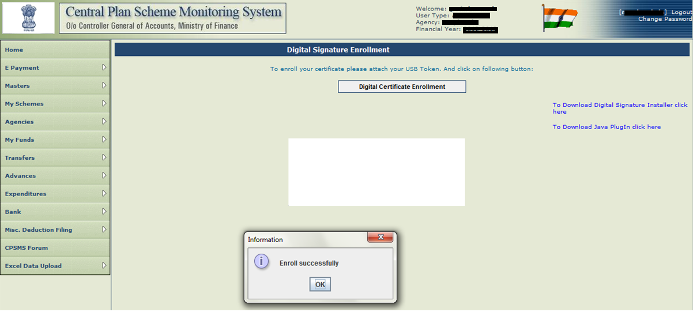
4a. DSC Enrolment (DA Login)
Step – 14 : Now account credentials are verified, “Click on “OK”

Slide 23
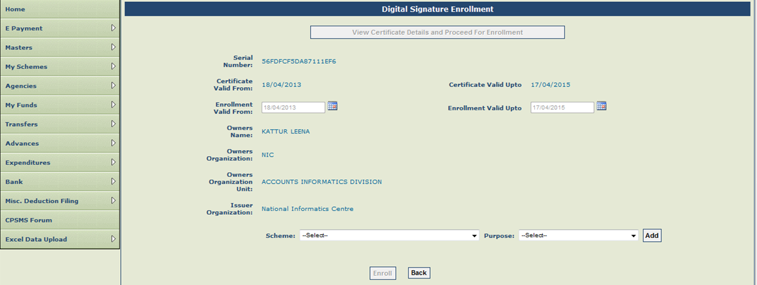
4a. DSC Enrolment (DA Login)
Step – 15 : Click on “View Certificate Details and Proceed for Enrolment”, then choose “Scheme” & “Purpose” and Click on “Enrol”
1
2
3
4

Slide 24
4a. DSC Enrolment (DA Login)
Step – 16 : Digital Signature Enrolled Successfully at 1st user and below screen shall appear

Slide 25
4 b. Account Activation for e-Payment using DSC
To complete the Account activation for e-payment using DSC, the steps to be followed as-

Slide 26
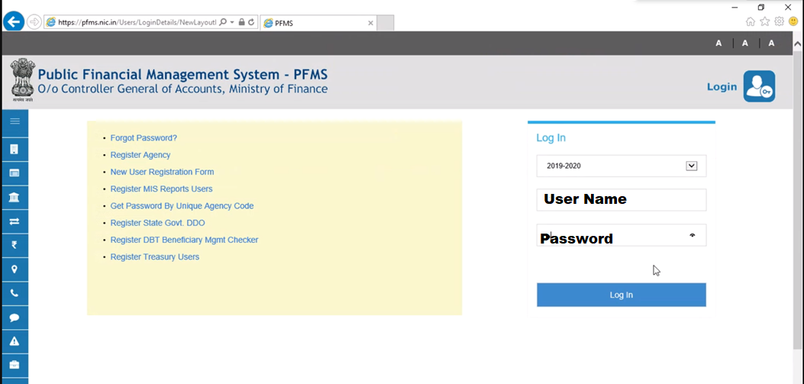
4b. Account Activation for e-Payment using DSC
Step – 1 : Login with Admin id

Slide 27
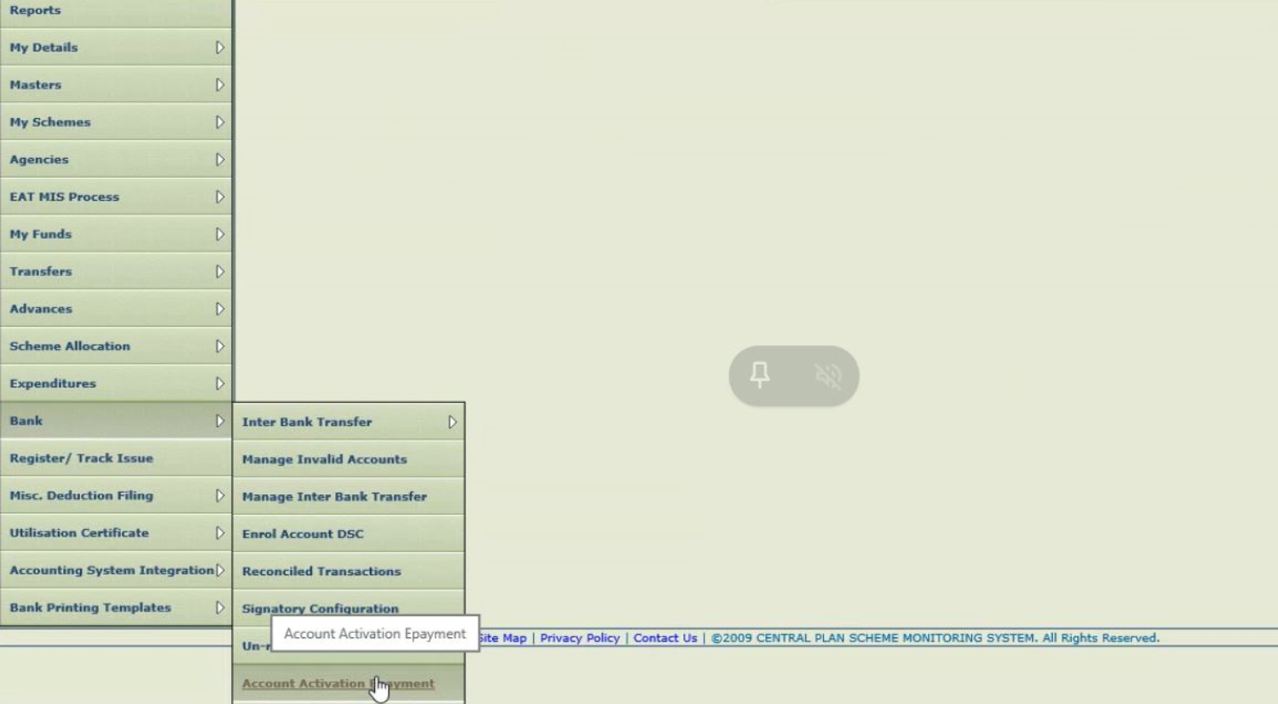
4b. Account Activation for e-Payment using DSC
Step – 2 : Go to Bank module and click on “Account Activation Epayment”

Slide 28
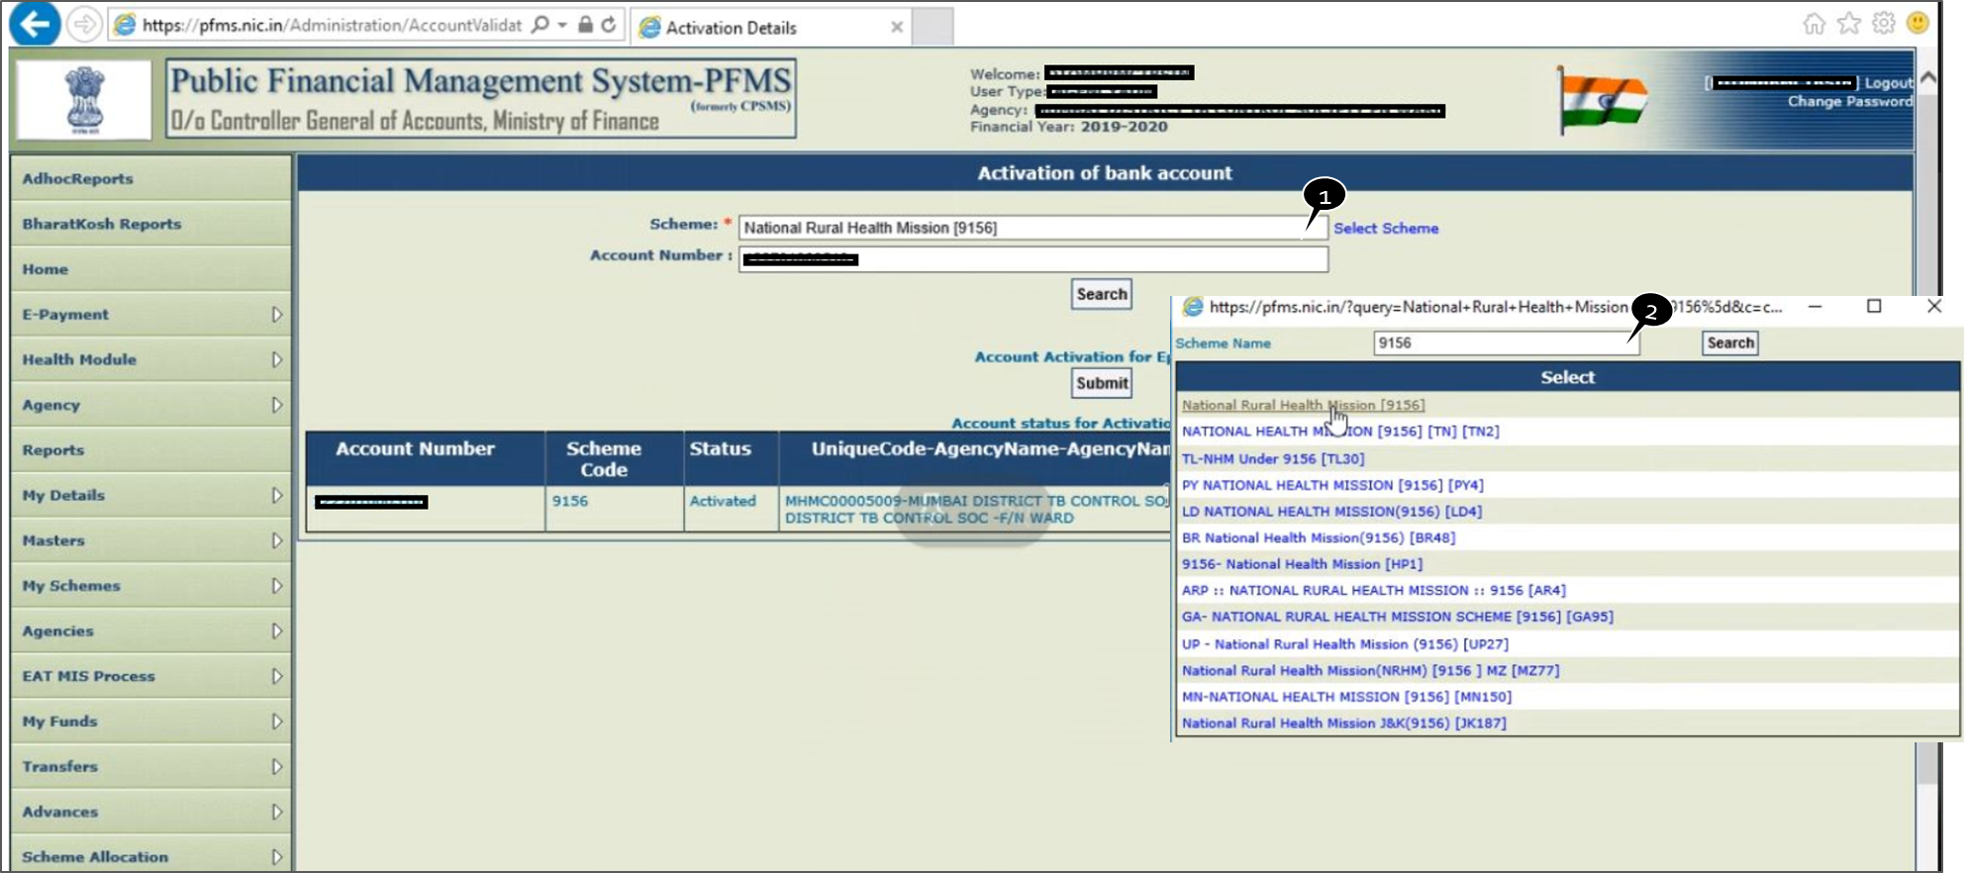
4b. Account Activation for e-Payment using DSC
Step – 3 : Go to “Select Scheme” and select ”9156”

Slide 29
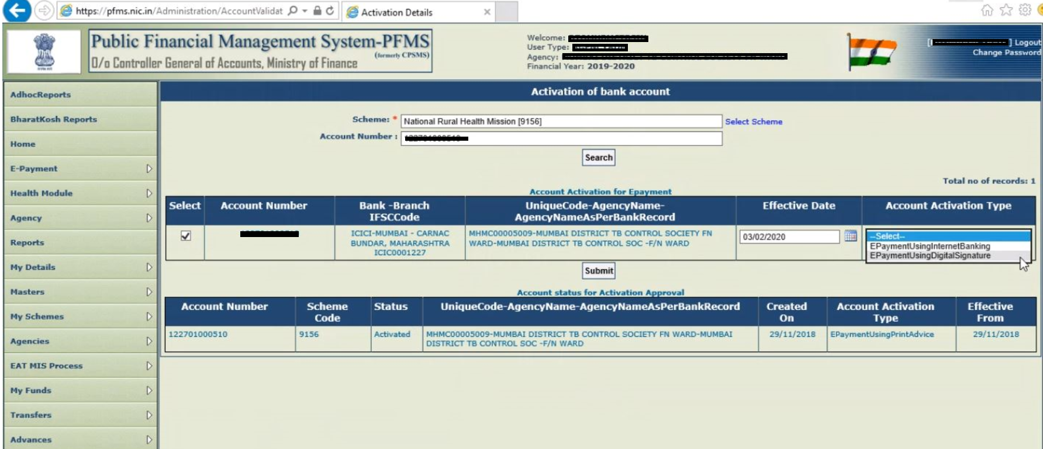
4b. Account Activation for e-Payment using DSC
Step – 5 : Click on “Select” enter “Effective Date”, select “EpaymentusingDigital Signature” and Submit
2
1
3

Slide 30
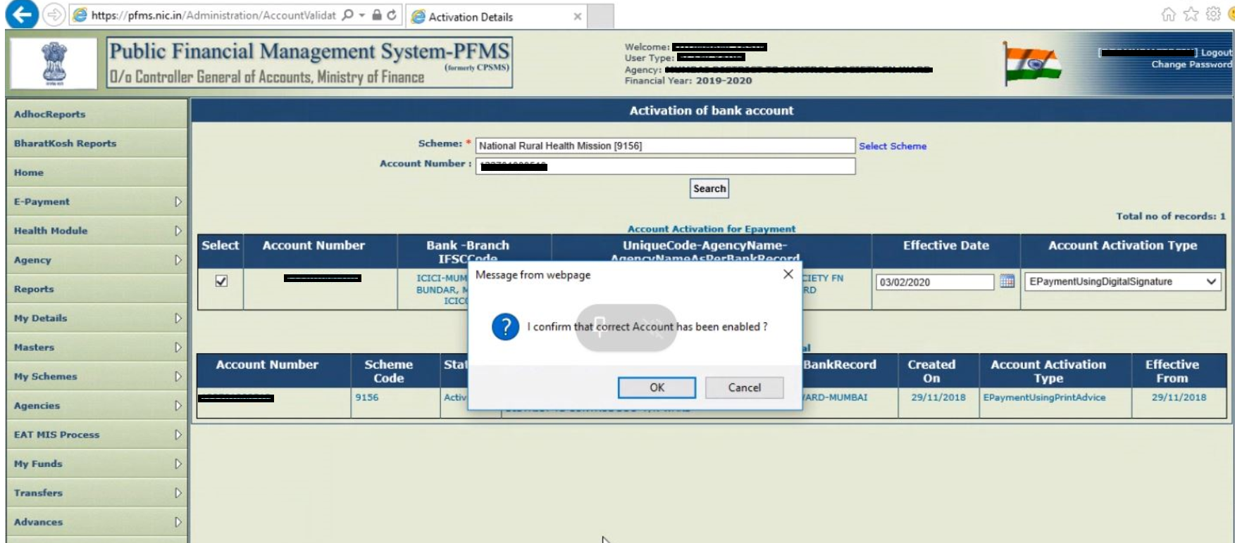
4b. Account Activation for e-Payment using DSC
Step – 6 : Select OK and confirm

Slide 31
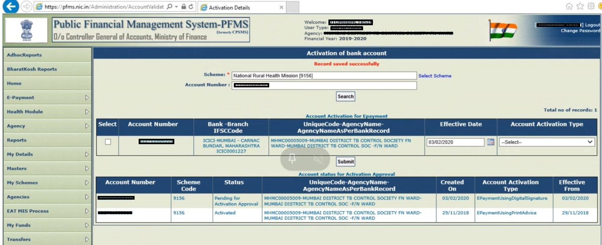
4b. Account Activation for e-Payment using DSC
Step – 4 : Select “Bank Account Number” which you need to activate for Epayment

Slide 32
4.c Signatory Configuration
Signatory Configuration is an one time activity for each DSC user and steps to be followed as -

Slide 33
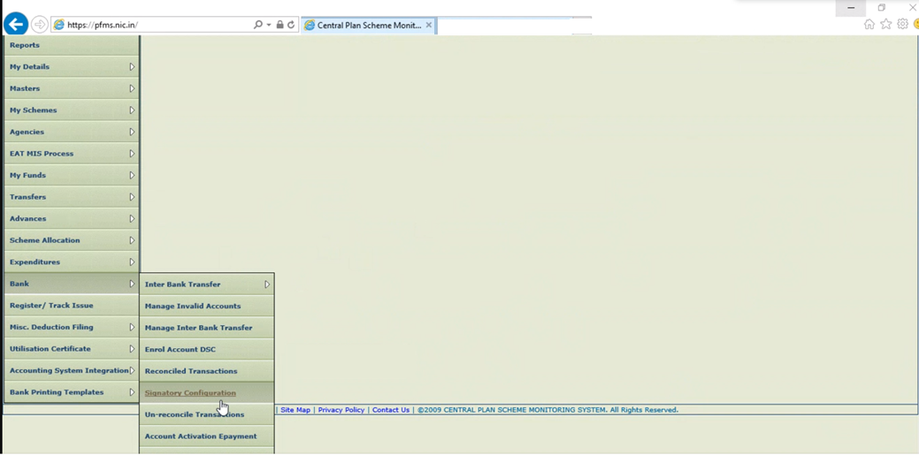
4c. Signatory Configuration
Step 1 : Login as Admin user, Go to Bank → Signatory Configuration

Slide 34
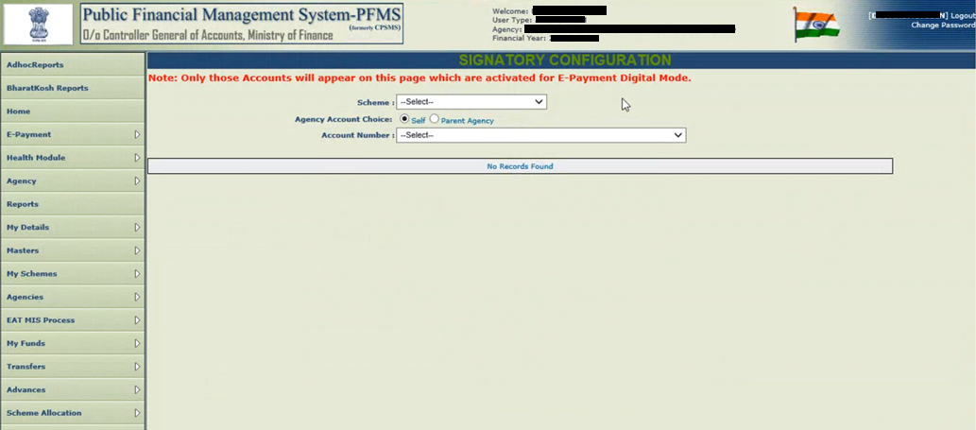
4c. Signatory Configuration
Step 2 : Select “Scheme” and respective “Account Number”
1
2

Slide 35
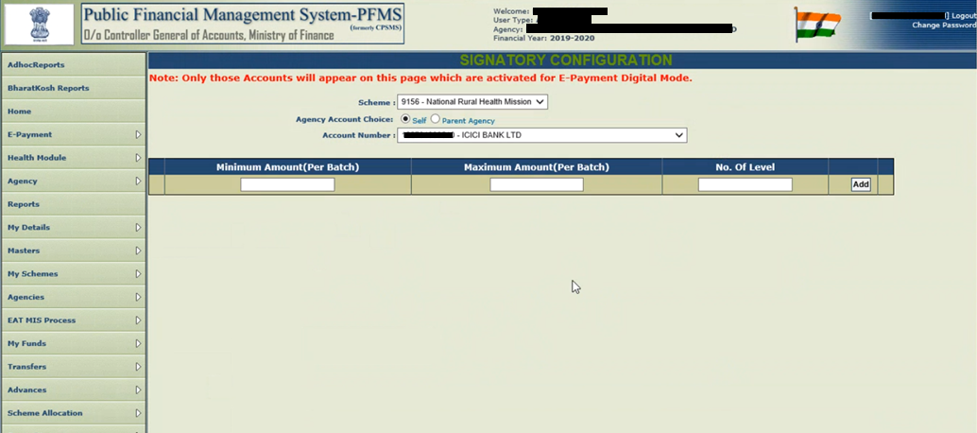
4c. Signatory Configuration
Step 3 : Enter “Minimum “ & “Maximum” Balance and No. of level; click on “Add”
Amount can be changed or edited any time. You have to repeat “Sign Enrollment File” step every time you change amount.
1
2
3
4

Slide 36
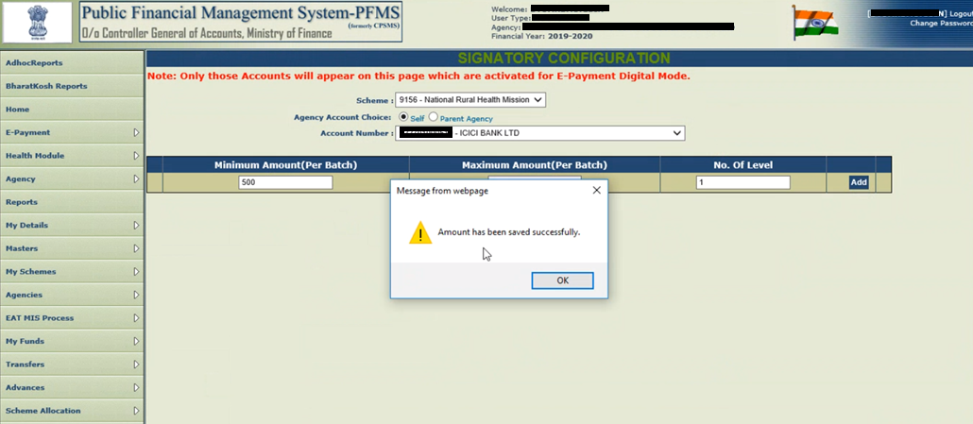
4c. Signatory Configuration
Step 4 : Click on OK at “Amount has been saved successfully”

Slide 37
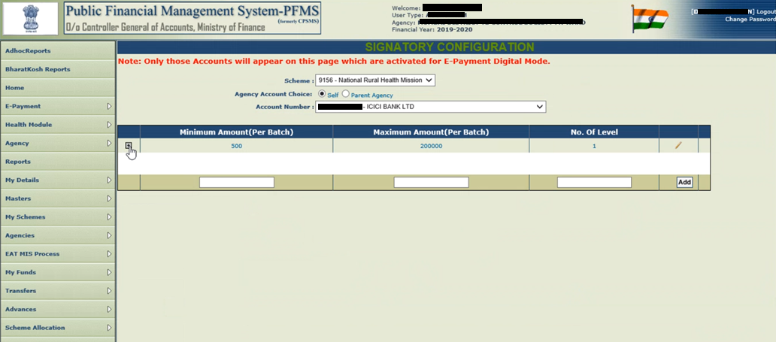
4c. Signatory Configuration
Step 5 : Click on (+) to add details of Authorised Signatory for whom configuration is being done

Slide 38
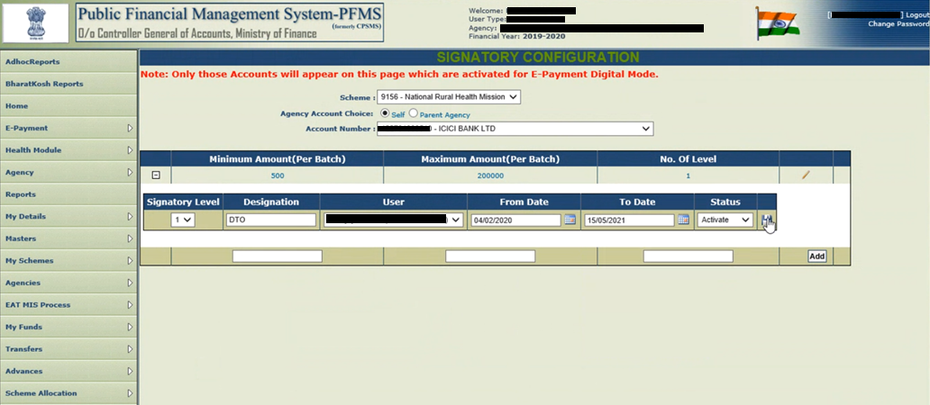
4c. Signatory Configuration
Step 6 : Enter “Designation”, select “User” from dropdown, Enter “From Date” & “To Date” and click on ‘Save’
1
2
3
4
5

Slide 39
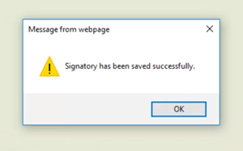
4c. Signatory Configuration
Step 7: Click “OK” on “Signatory has been saved successfully”

Slide 40
4d. Sign Enrolment File
Sign Enrolment File is an one time activity for each DSC user and steps to be followed as -

Slide 41
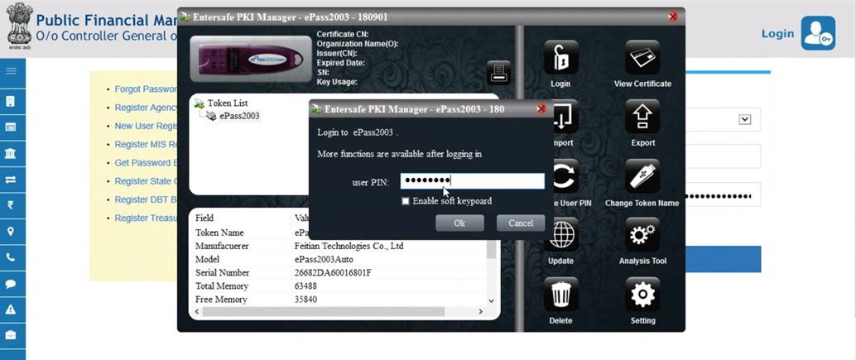
4d. Sign Enrolment File
Step 1: Log in as DA User. Attach DSC USB token to your computer. Enter “DSC PIN” and Click “OK”
1
2

Slide 42
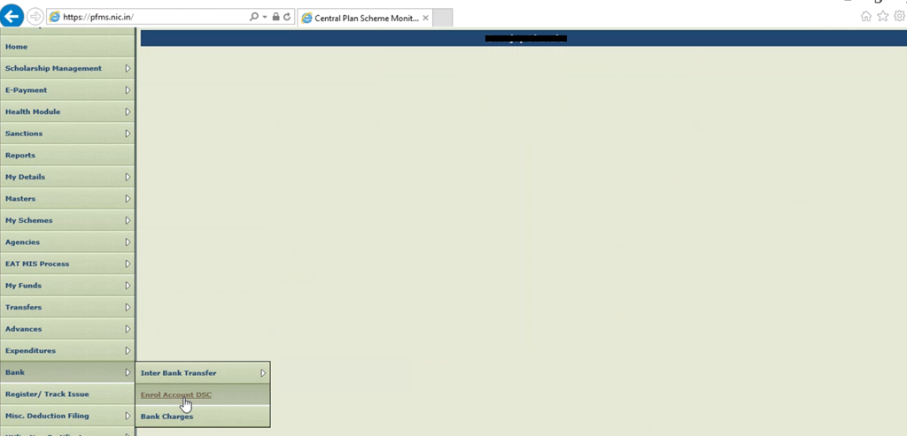
4d. Sign Enrolment File
Step 2: Go to “Bank” Module and Click on ”Enrol Account DSC”

Slide 43
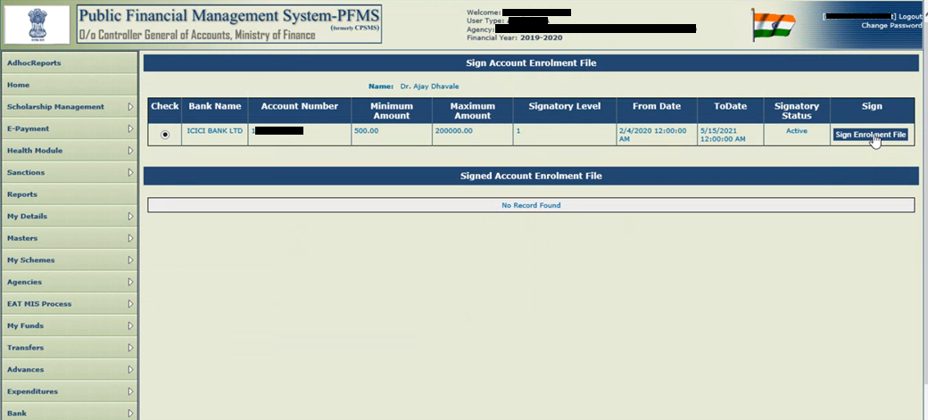
4d. Sign Enrolment File
Step 3: Click on “Check” and then Click on “Sign Enrolment File”
2
1

Slide 44
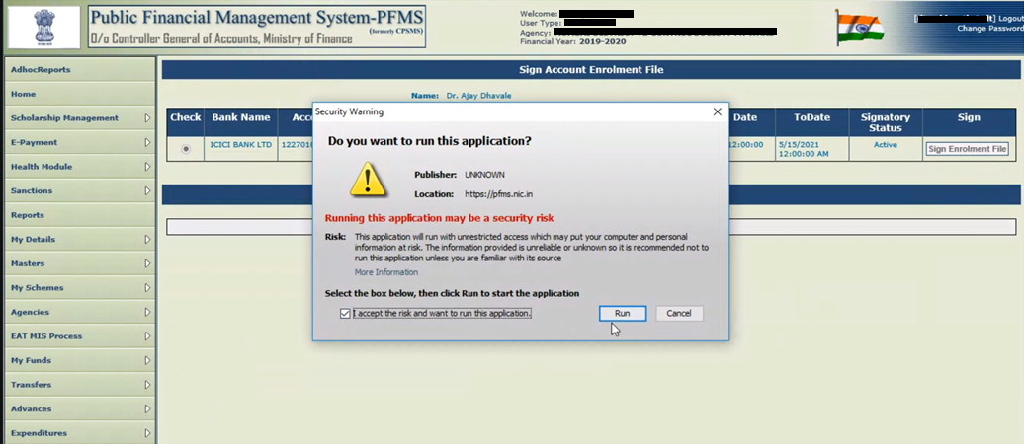
4d. Sign Enrolment File
Step 4: Click on ”Run”

Slide 45
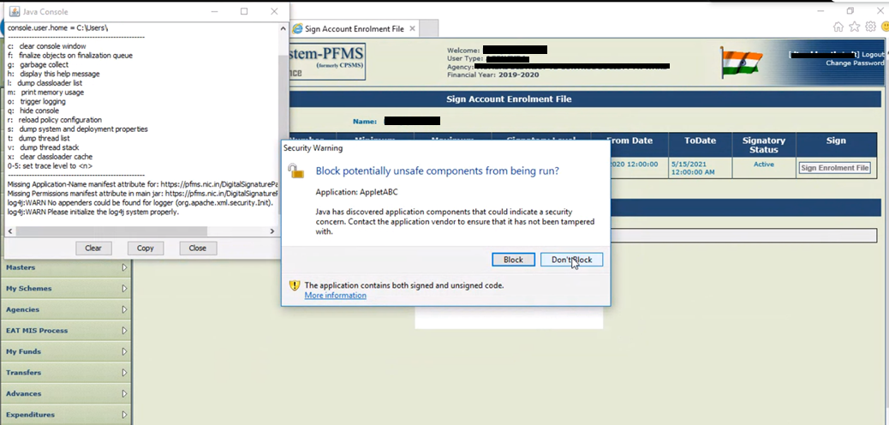
4d. Sign Enrolment File
Step 5: Click on ”Don’t Block” and wait for next screen

Slide 46
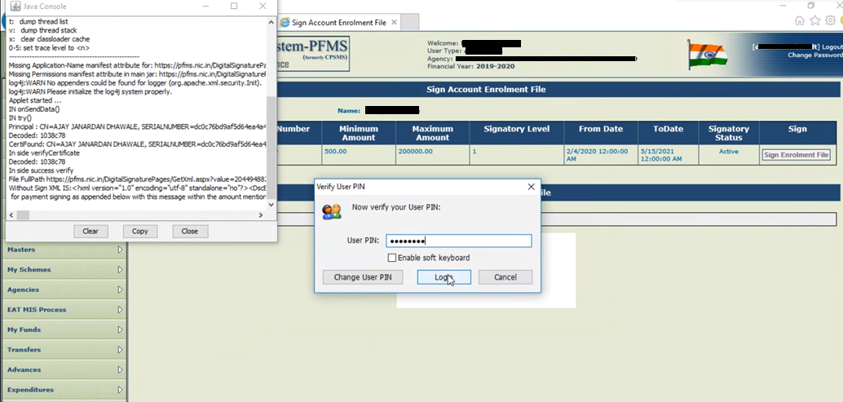
4d. Sign Enrolment File
Step 6: Enter ”PIN” and Click on “Login”
1
2

Slide 47
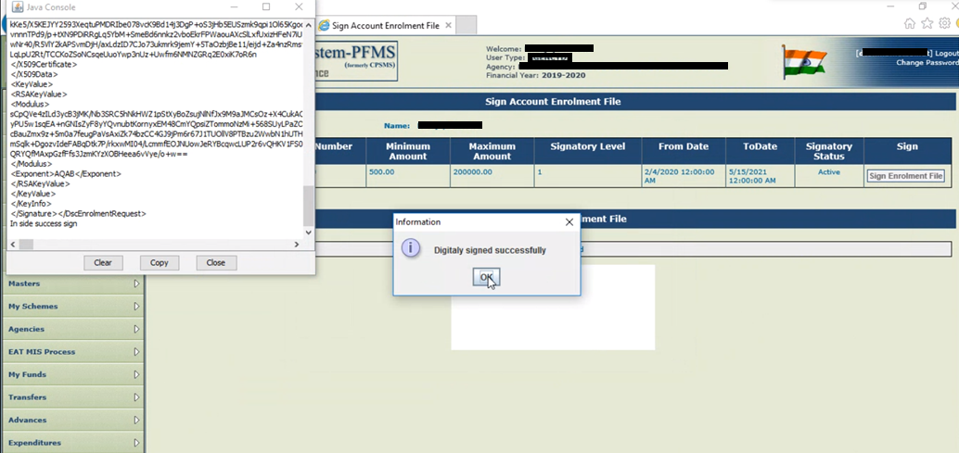
4d. Sign Enrolment File
Step 7: Click OK on “Digitally Signed Successfully”

Slide 48
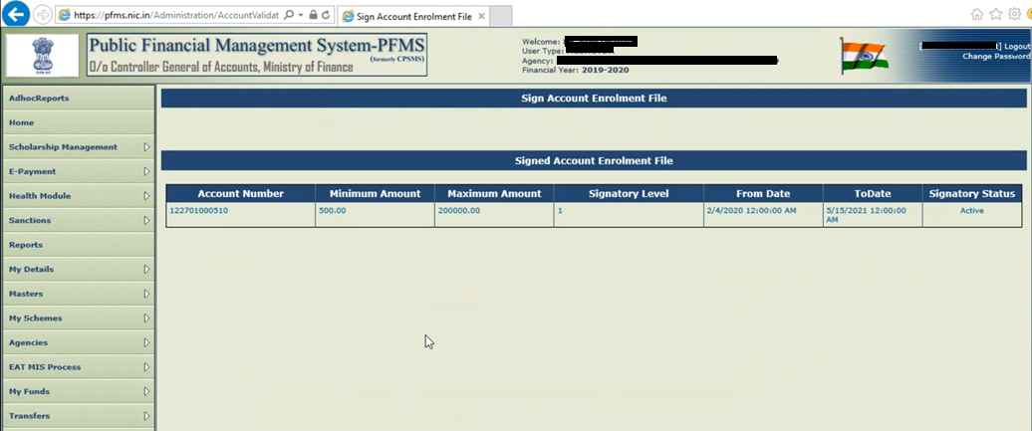
4d. Sign Enrolment File
After successful enrolment, following screen would be shown

Slide 49
4e. Adding Opening Balance
Adding Opening Balance from DO Login. This an one time activity and steps to be followed as -

Slide 50
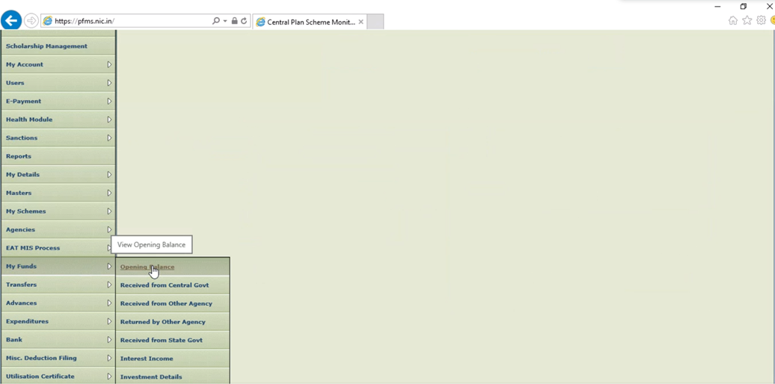
4e. Adding Opening Balance
Step 1: Login as DO User, Go to “My Funds” → “Opening Balance”

Slide 51
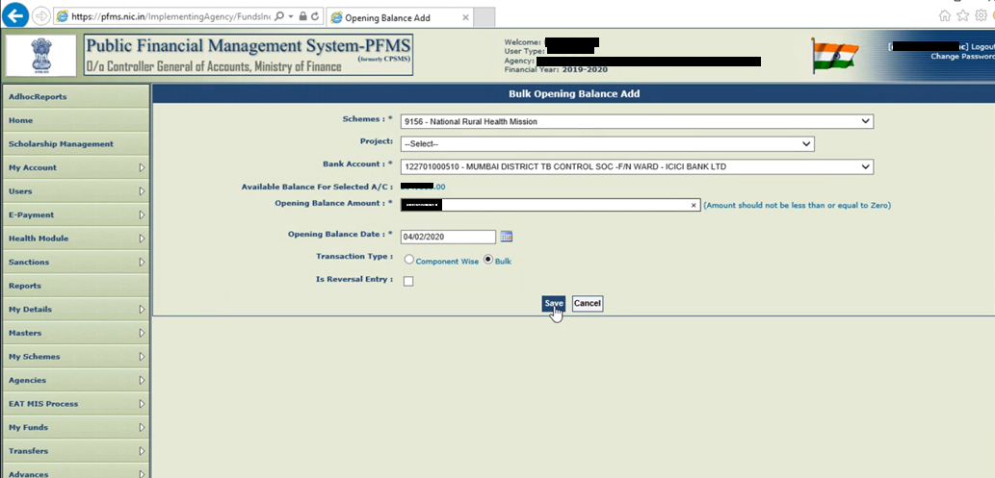
4e. Adding Opening Balance
Step 2: Select “Schemes”, Select “Bank Account”, Enter “Opening Balance Amount”, Check on “Bulk” and “Save”
1
2
3
4
5

Slide 52
4e. Adding Opening Balance
Below message shall appear as Opening Balance is saved

Slide 53
4 f. Approving Opening Balance
Approving Opening Balance from DA Login. This is an one time activity and steps to be followed as-

Slide 54
4f. Approving Opening Balance
Step 1: Login as DA User and Go to “My Funds” → “Opening Balance”

Slide 55
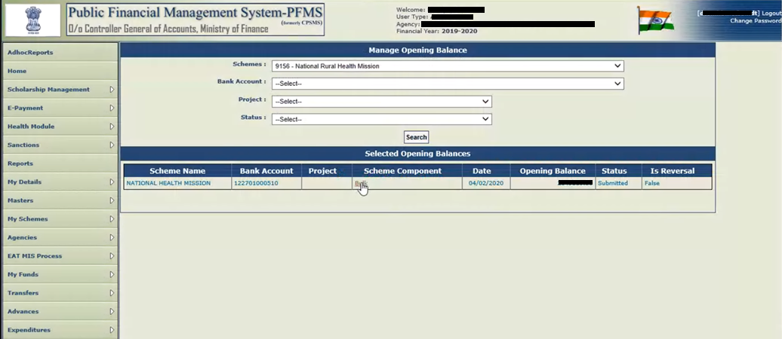
4f. Approving Opening Balance
Step 2: Select “Schemes” and Click on “Bulk”
1
2

Slide 56
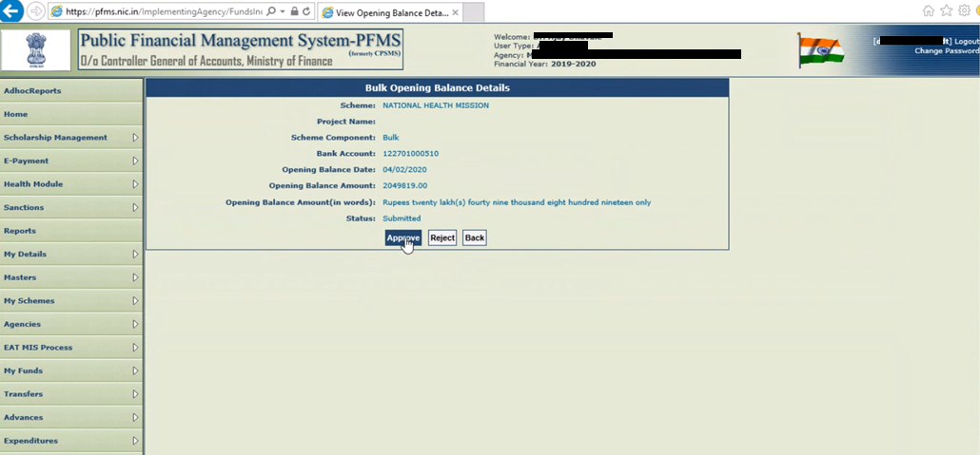
4f. Approving Opening Balance
Step 3: Click on “Approve” and then Click on “Confirm”
1
2

Slide 57
4f. Approving Opening Balance
On confirmation, the following screen appears

Slide 58
5 DSC based payment approval process in PFMS
This section explains the payment approval process in PFMS using DSC.
This is the regular activity for approval of each payment batch in PFMS (after they are available in PFMS received from Nikshay).

Slide 59
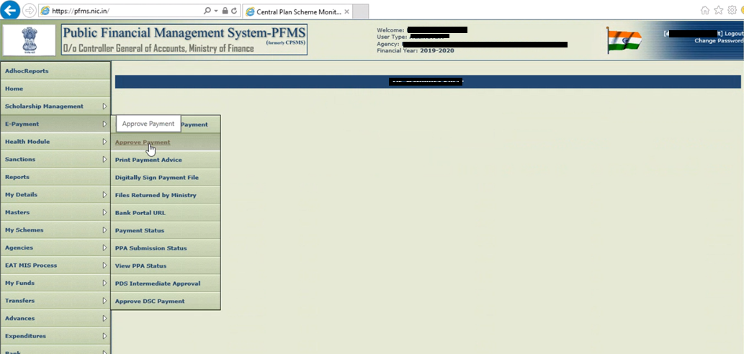
5. DSC based payment approval process in PFMS
Step 1: Login as DA User and Go to “E-payment” → “Approve Payment”

Slide 60
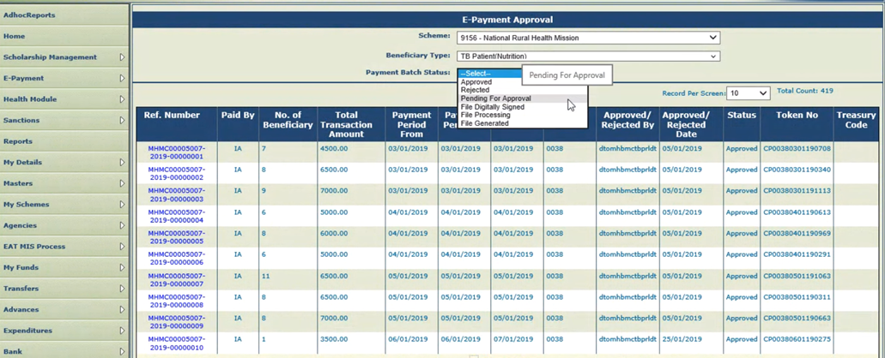
5. DSC based payment approval process in PFMS
Step 2: Select “Schemes”, “Beneficiary Type (TB Patient …)” and “Payment Batch Status (Pending for Approval)”
1
2
3

Slide 61
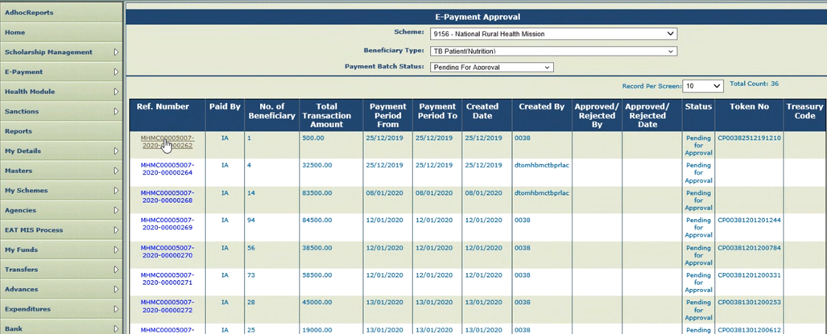
5. DSC based payment approval process in PFMS
Step 3: Click on “Batch No.” (under Ref. Number) to be Approved

Slide 62
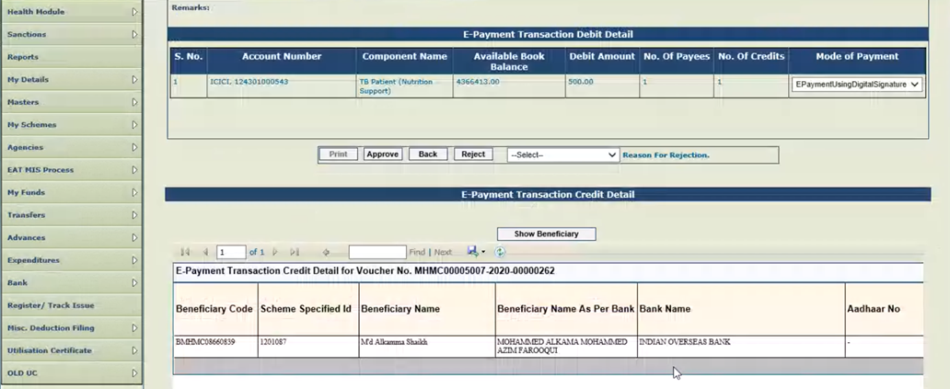
5. DSC based payment approval process in PFMS
Step 4: View details, select “Mode of Payment” as “EpaymentUsingDigitalSignature” and click on “Approve”
Note:
a. Beneficiary Details can also be seen from this screen by Clicking on “Show Beneficiary” and the list/ data can be saved
b. The file can also be rejected by selecting the “Reject” option, by providing a reason. On Rejection, all the benefits of this batch are returned to ‘DBT Maker’ in Nikshay for further processing.

Slide 63
5. DSC based payment approval process in PFMS
As the Batch is “Approved”, Payment file is processed for “Digital Signature”

Slide 64
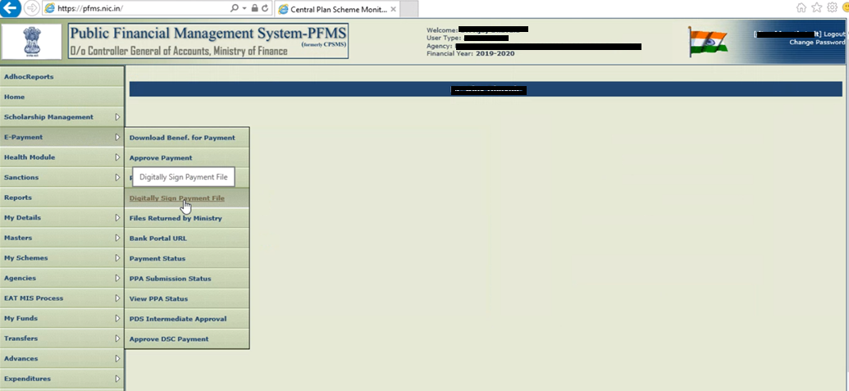
5. DSC based payment approval process in PFMS
Step 5: Go to “E-payment” → “Digitally Sign Payment File”

Slide 65
5. DSC based payment approval process in PFMS
Step 6: Select “Scheme” and Click on “Select a file”
1
2
Note:
a. You may see “File under processing..” under “Payment File Name “ column. One cannot apply digital signature until file is processed and file name is seen in this column. This usually takes few seconds. One can Refresh the PFMS by clicking by Home menu and going to “E-payment” and “Digitally Sign Payment File” again.

Slide 66
5. DSC based payment approval process in PFMS
Step 7: Click on “Apply Digital Signature”, if to be Approved,
Note:
a. The file can also be rejected by selecting the “Reject” option, by providing a reason.
b. On Rejection, all the benefits of this batch are returned to ‘DBT Maker’ in Nikshay for further processing.

Slide 67
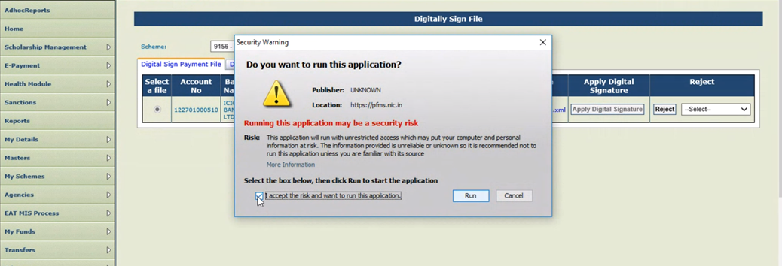
5. DSC based payment approval process in PFMS
Step 8: Click on “I accept the risk and want to run the application” and on “Run”
1
2

Slide 68
5. DSC based payment approval process in PFMS
Step 9: Click on “Don’t Block”

Slide 69
5. DSC based payment approval process in PFMS
Step 10: Enter “PIN” and Click on “Login”
1
2

Slide 70
5. DSC based payment approval process in PFMS
Step 11: Click “OK” on “Digital signed successfully”

Slide 71
5. DSC based payment approval process in PFMS
Click on “Payment Advice No.” to view save the details
As the batch file is Digital signed successfully, file now can be seen under “Digital Signed Payment File”. The rejected files can also be viewed under the “Reject payment file”

Slide 72
6. Steps to Activate Second level DSC in PFMS and Approval process with Two level DSCs
To enable Second level DSC based authentication and Approval process in PFMS, following steps to be adhered:
a. Creating Second DA User - One time activity from Admin Login
b. Signatory Updation – One time activity from Admin Login
c. DSC Enrolment
- One time activity from Second DA Login
d. Approval process for e-Payment with Two level DSCs
(Note: First Three steps [a to c] are one time activities)

Slide 73
6 a. Creating Second DA User
Creating Second DA User to be done from Admin User. This is an one time activity and following steps to be adhered

Slide 74
6a. Creating Second DA User
Step – 1 : Login as Admin User > Go to Master > Users > and Click on Add User
Note: User name should exactly match with the DSC name, which can be cross checked from:
“Browser Setting > Internet option > Content > Certificates > Issued To”

Slide 75
6a. Creating Second DA User (Admin Login)
Note: User name should exactly match with the DSC name, which can be checked from -
“Browser Setting > Internet option > Certificate> Issued To”, Screenshots are as follows:
Screen 1
Screen 3
Screen 2

Slide 76
6a. Creating Second DA User (Admin Login)
Step – 2 : Fill all the required field details as per Screen 1 and Click on Submit, upon submission of the User details, Screen 2 shall appear and password shall be sent to the registered email id, which requires to be “Reset”, as per User choice to make the login secured and confidential.
Screen 1
Screen 2
1
2

Slide 77
6a. Creating Second DA User (Admin Login)
Step – 3 : On “Reset Password” following screen shall appear, where all the required fields to be filled and Click on “Change Password”
Note: Passwords must contain minimum 6 characters and maximum 15 characters, Password should contain alpha numeric combination and at least one special character (@, #, %, &, *, -)

Slide 78
6 b. Signatory Updation
Signatory Updation for the Second DA User to be done from Admin User. This is an one time activity and steps to be followed as-

Slide 79
6b. Signatory Updation (Admin Login)
Different Types of Configuration
Scenario 1: DA1 and DA2 both have to sign all files (Setting Type 1):
Where, DA1 and DA2 both are required to sign all the payment files, then its is required to be - Enter “2” at “No. of Level” (Please refer
Next Slide i.e. no. - 81) and add two signatories by clicking on “+” sign
Scenario 2: DA1 will be signing files upto a certain limit and above that set maximum limit DA2 will sign the file (Setting Type 2):
Where, DA1 will be signing files upto a certain limit and above that set maximum limit DA2 will sign the file, there below mentioned steps requires to be followed:
Create one more Signatory Level, by clicking Add button > enter minimum amount and maximum amount > Enter 2 in “No. of Levels”
Click on + sign
a) Select 1 in “Signatory Level” dropdown > select sign of DA1 from dropdown > select “Status” Activate > Click on save button
b) Select 2 in “Signatory Level” dropdown > select sign of DA2 from dropdown > select status Activate > click on save button.
3) Here files only ABOVE the set maximum limit for DA1 will be seen in DA2 login for Digital signs. Files below this limit DO NOT require DA2 sign and will be sent to bank directly after Digital Sign of DA1.
Note:
In any of the above setting when DA2 is created, both DA ids can approve or reject PFMS files. Any number of DA users can be added in the PFMS.
Where, amount limit is set for signing by the DA1 and DA2 has been added, steps for “Sign Enrolment File” (Slide 40 to 48)has to be repeated. Those step are required to notify the Enrolled Bank about the changes of set limit against one DA user

Slide 80
6b. Signatory Updation (Admin Login)
Step – 1 : Login as Admin User > Go to Bank > and Click on Signatory Configuration

Slide 81
6b. Signatory Updation (Admin Login)
Step – 2 : Select “Scheme (1)” , Select “Self (2)”, Select “Account Number (3)”, Click on “+ (4)” sign, Enter “Minimum Amount (5)”, Enter “Maximum Amount (6), Enter 2 as “No. of Level (7)” and Save (8)
2
1
3
4
5
6
7
8
Note: Minimum and Maximum balance requires to be entered / maintained as per the Agency’s Budget and set guidelines.

Slide 82
6b. Signatory Updation (Admin Login)
Step – 3 : Select “Scheme (1)” , Select “Self (2)”, Select “Account Number (3)”, Click on “+ (4)” sign, Select “Signatory Level as 2 (5)”, Enter “Designation (6)”, Enter name of the “User (7)”, Enter “From Date (8)” , Enter “ To Date (9)”, Select “Activate (10)” under Status and Save (11)
1
2
3
4
7
9
10
11
5
6
8

Slide 83
6b. Signatory Updation (Admin Login)
Step – 3 : Click Ok at “Signatory has been updated Successfully”

Slide 84
6b. Signatory Updation (Admin Login)
Setting 2 : DA1 signatory for all files and DA2 signatory for files above Rs 300000/-

Slide 85
6 c. DSC Enrolment
DSC Enrolment for the Second DA User to be done from Second DA Login. This is an one time activity.
Steps are similar to Slide no. 7 to 24, which were configured for DA1
If you are doing in same PC where Java is alrady configured, follow only steps in Slide no. 20 to 24.

Slide 86
6 d. Approval process for e-Payment with Two level DSCs
This section explains the payment approval process in PFMS using Two level of DSCs.
This is the regular activity for approval of each payment batch in PFMS (after they are available in PFMS received from Nikshay).

Slide 87
6d. Two Levels of E-Payment Approval ( 1st DA Login)
Step – 1 : Login as 1st DA User > Go to E-Payment > and Click on “Digitally Sign Payment File”

Slide 88
6d. Two Levels of E-Payment Approval ( 1st DA Login)
Step - 2: Select “Scheme” and Click on “Select a file”
1
2

Slide 89
6d. Two Levels of E-Payment Approval ( 1st DA Login)
Step – 3 : Click on “Apply Digital Signature”, if to be Approved,
Note:
a. The file can also be rejected by selecting the “Reject” option, by providing a reason.
b. On Rejection, all the benefits of this batch are returned to ‘DBT Maker’ in Nikshay for further processing.

Slide 90
6d. Two Levels of E-Payment Approval ( 1st DA Login)
Step – 4 : Click on “I accept the risk and want to run the application” and on “Run”
1
2

Slide 91
6d. Two Levels of E-Payment Approval ( 1st DA Login)
Step – 5 : Click on “Don’t Block”

Slide 92
6d. Two Levels of E-Payment Approval ( 1st DA Login)
Step – 6 : Enter “PIN” and Click on “Login”
1
2

Slide 93
6d. Two Levels of E-Payment Approval ( 1st DA Login)
Step – 7 : Click “OK” on “Digital signed successfully”

Slide 94
6d. Two Levels of E-Payment Approval ( 1st DA Login)
Click on “Payment Advice No.” to view save the details
As the batch file is Digital signed successfully, file now can be seen under “Digital Signed Payment File”. The rejected files can also be viewed under the “Reject payment file”

Slide 95
6d. Two Levels of E-Payment Approval ( 2nd DA Login)
Step – 8 : Login as 2nd DA User > Go to E-Payment > and Click on “Digitally Sign Payment File”

Slide 96
6d. Two Levels of E-Payment Approval ( 2nd DA Login)
Step – 9 : Click on “Check” and then Click on “ Sign Enrolment File”, if to be approved by the 2nd DA User (You will get alert in Red Font while applying DSC, if this step is not done earlier just after adding amount limits for DA2 in “Signatory configuration”. Alert will be “Please sign enrollment file from menu (Bank-> Enroll Account DSC))
1
2

Slide 97
6d. Two Levels of E-Payment Approval ( 2nd DA Login)
Step – 10 : Enter user Pin and Continue with DSC Login

Slide 98
6d. Two Levels of E-Payment Approval ( 2nd DA Login)
Step – 11 : Select “Scheme”, Select “a File” and Click on “Apply Digital Signature
1
2
3

Slide 99
6d. Two Levels of E-Payment Approval ( 2nd DA Login)
Step – 12 : Click OK on “Digitally signed Successfully”, and it completes the E-Payment process with Two level of DSC authentication in PFMS

Slide 100
6d. Two Levels of E-Payment Approval ( 2nd DA Login)
Digitally Signed Payment File can be seen in the below screen
As the batch file is Digital signed successfully, file now can be seen under “Digital Signed Payment File”. The rejected files can also be viewed under the “Reject payment file”

