Slide 1
DBT on App

Slide 2
DBT on App
The DBT Module is now available in Nikshay Mobile App.
Only DBT Checker at District Level and DBT Maker at TU level only can access this DBT Processing module.
DBT Checker and DBT Maker can use their same web login to use this feature in App.

Slide 3
Introduction
To streamline the DBT process in Nikshay and to improve its security features and to eliminate the possibility of inadvertent errors & malpractices, the following changes for Nikshay Poshan Yojana are put in with effect from September 13th, 2019 (Ref: DO letter: Z-28015/230/2018-11th Sep 2019)
I. DBT specific users (Staff) to be created. Only these users will have access to the DBT Processing interfaces.
1. by STO at District (DBT Checker)
2. by DTO at TBU (DBT Maker)
II. One bank account one beneficiary. Nikshay will not allow seeding the same bank account against another patient.
III. Beneficiary Approval workflow: If PFMS validated bank account of any beneficiary is changed, DTO approval will be required before the change is applied.

Slide 4
1.Rationale and principles
DBT (Benefits and Beneficiary) Processing had to be compartmentalized to specific users to improve co-ordination and accountability. Compartmentalization will be done by two types of DBT specific users. DBTMaker for each TBU and DBTChecker for each RNTCP District
The DTO and MO-TBunit (MOTC) need to designate a staff to be responsible for beneficiary and benefit processing at their respective level.
After designating the staff, the DBTChecker will have to be created by the STO and DBTMaker will have to be created by the DTO upon request from the DTO and MOTC. The user credentials will be sent to the registered mobile numbers of these staff.
Only one DBT user can be created for each District & TBU unit and any changes in these logins will require approval from the STO or DTO via an OTP to their registered phone number in Nikshay.
The phone number of all staff registered in Nikshay will be critical to the operations of this user and care has to be taken while entering the phone number to these user credentials.

Slide 5
2.Permissions at DBT Checker & Maker Logins
Functionality | DTO Login | TBU/PHI Login | DBT Maker | DBT Checker
Access to DBT Module |  |  | √ | √
Approve/ Reject/ Remove/ Defer/ Paid External Benefit |  |  | √ | √
View Patient Management Details | √ | √ | √ | √
Edit Patient Management Details | √ | √
Add Bank details | √ | √
Beneficiary Approval(Bank detail Change ) |  |  |  | √
OTP for processing benefits from DBT Checker to PFMS | √
DBT Maker & DBT Checker will be jointly responsible for
verifying correctness of bank account details of all beneficiaries,
updating any existing externally made payments on Nikshay
for generating and processing benefits for each beneficiary promptly

Slide 6
3.Process to create DBT Checker Login (In Web)
Login using the
Username as Primary Phone Number and auto generated password
STO user - Go to Staff Management module and click on district name
1
4
STO
DBT
Checker
2
Add staff for each district Choose Designation - DBTChecker. Enter necessary details. OTP validation by STO necessary
5
User is forced to Reset the password Keep this new password safe and secure.
It should not be shared.
STO
DBT
Checker
An SMS will be sent to the registered primary phone number of “DBT Checker” with an auto generated credentials
DBTChecker may Login again with new credentials to access DBT Functions
3
6
DBT
Checker
DBT
Checker
Nikshay will resets the password every month

Slide 7
4. Process to create DBT Maker Login (In Web)
Login using the
Username as Primary Phone Number and auto generated password
DTO User - Go to Staff Management module and click add staff
1
4
DTO
DBT
Maker
2
Add staff for each district Choose Designation - DBTMaker. Enter necessary details. OTP validation by DTO necessary
5
User is forced to Reset the password Keep this new password safe and secure.
It should not be shared.
DTO
DBT
Maker
An SMS will be sent to the registered primary phone number of “DBT Maker” with auto generated credentials
DBTMaker may Login again with new credentials to access DBT Functions
3
6
DBT
Maker
DBT
Maker
Nikshay will resets the password every month

Slide 8
Actions that a DBT Maker/ Checeker can take from various Lists
List Type | TU Level: DBT Maker | DTO Level: DBT Checker
Pending | List of benefits pending to be checked and submitted to DTO for approval, or to be removed or deferred by the TU, as generated by Nikshay TU user has to take action on each record in this list & may either send to approver or Remove or perform No action | List of benefit submitted by the TU and pending at DTO for approval, or to be removed or deferred by the DTO DTO has to take action on each record in this list and, may either Approve or Reject Remove or Do Nothing
Processing | List of benefits sent to DTO for approval and its status TU User can only view but not take any action on the records in this list | List of benefits approved by DTO and sent to PFMS for processing DTO can only view but can not take any action on the records in this list
Paid | List of benefits that were approved and paid by PFMS to the beneficiary TU User can only view but not take any action on the records in this list | List of benefits that were approved and paid by PFMS to the beneficiary. DTO can view but can not take any action on the records in this list
Removed | List of beneficiary payments removed from the “Pending” list/ TU user will be visible here TU User can “Unremove” records upon which, they will move to “Pending” list for approval | List of beneficiary payments removed from the “Pending” list/ TU & DTO user will be visible here DTO can “Unremove” records upon which, they will move to “Pending” list for approval
Deferred | List of beneficiary payments which have been postponed to be paid along with the benefit next month. | List of beneficiary payments that have been postponed to be paid along with benefit of next month by TU & DTO user.

Slide 9
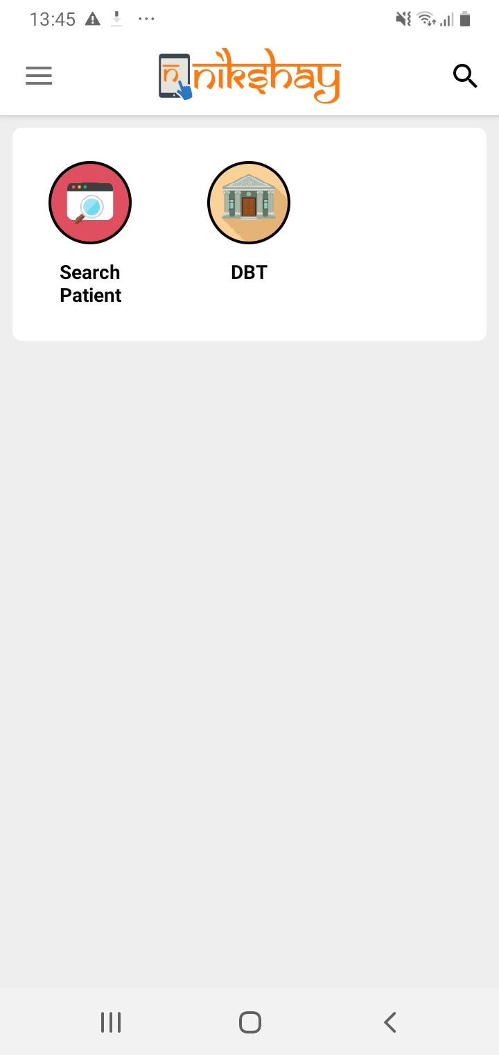
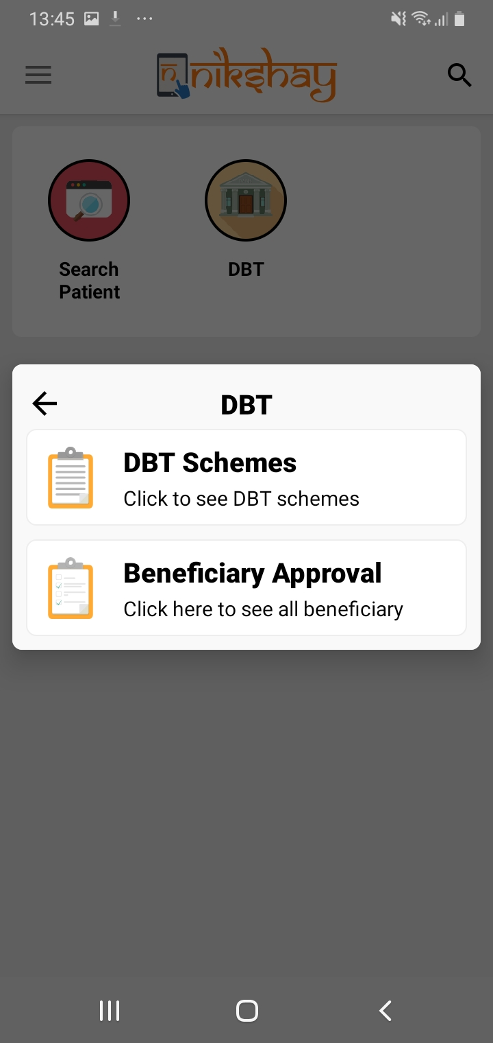
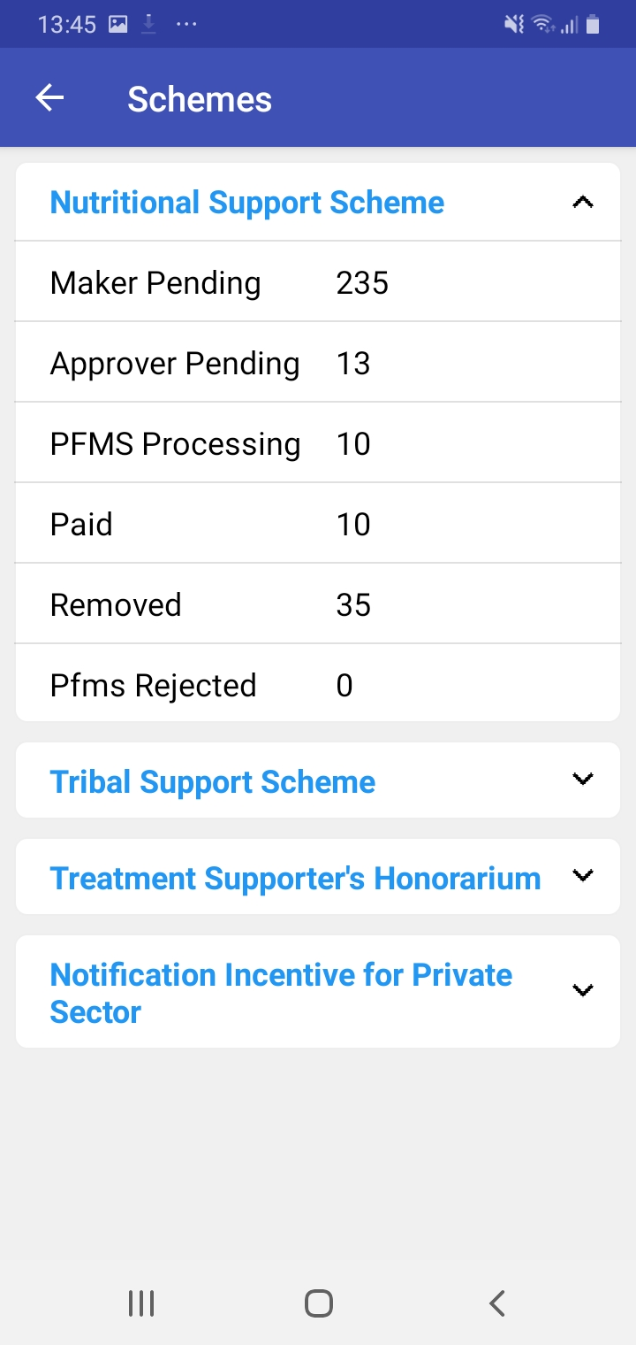
DBT on App
Click DBT option
Similar to web for DBT Checker, you have DBT Schemes and Beneficiary Approval module
Under the Schemes, you have all schemes

Slide 10
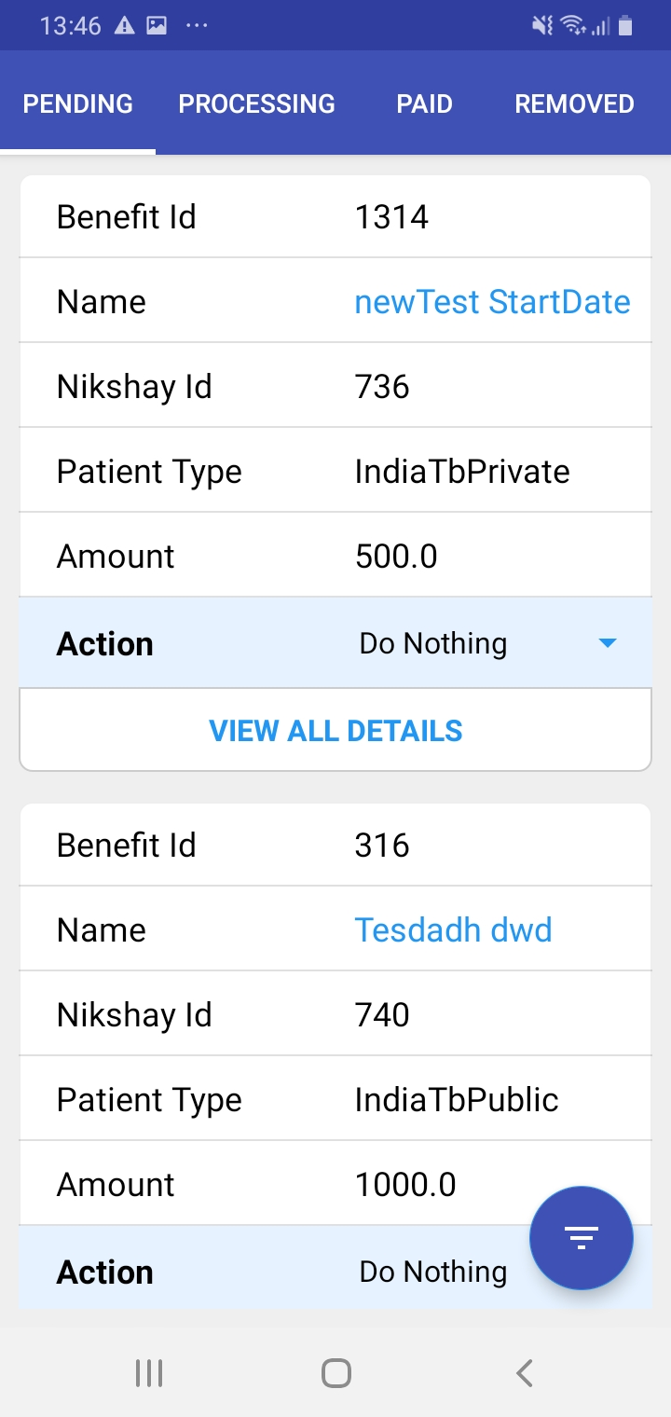
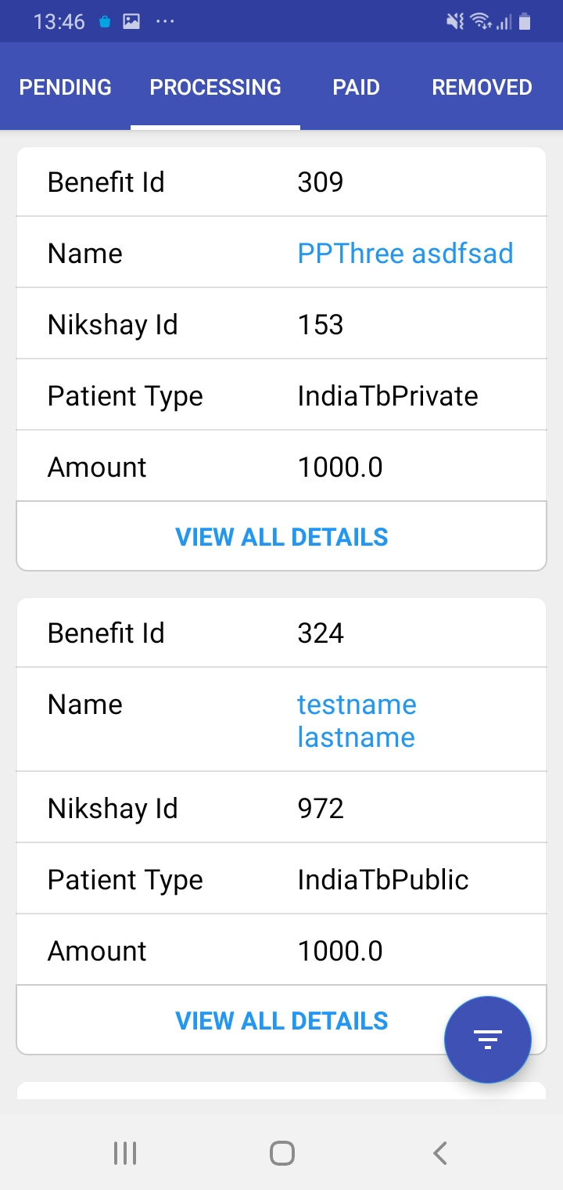
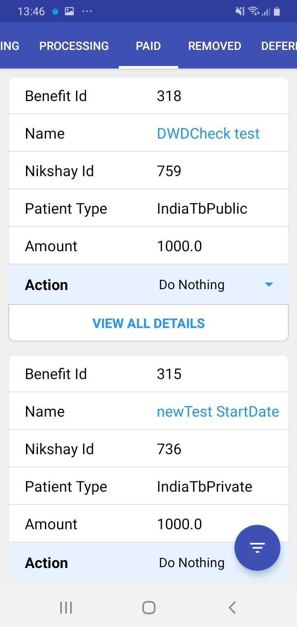
DBT on App- Various Stages
Similar to web we have Pending, Processing, Paid, Removed and Deferred stages.

Slide 11
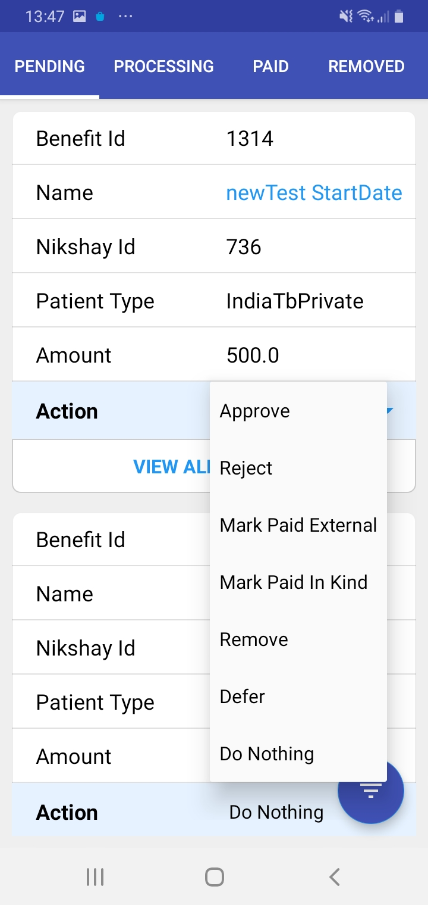
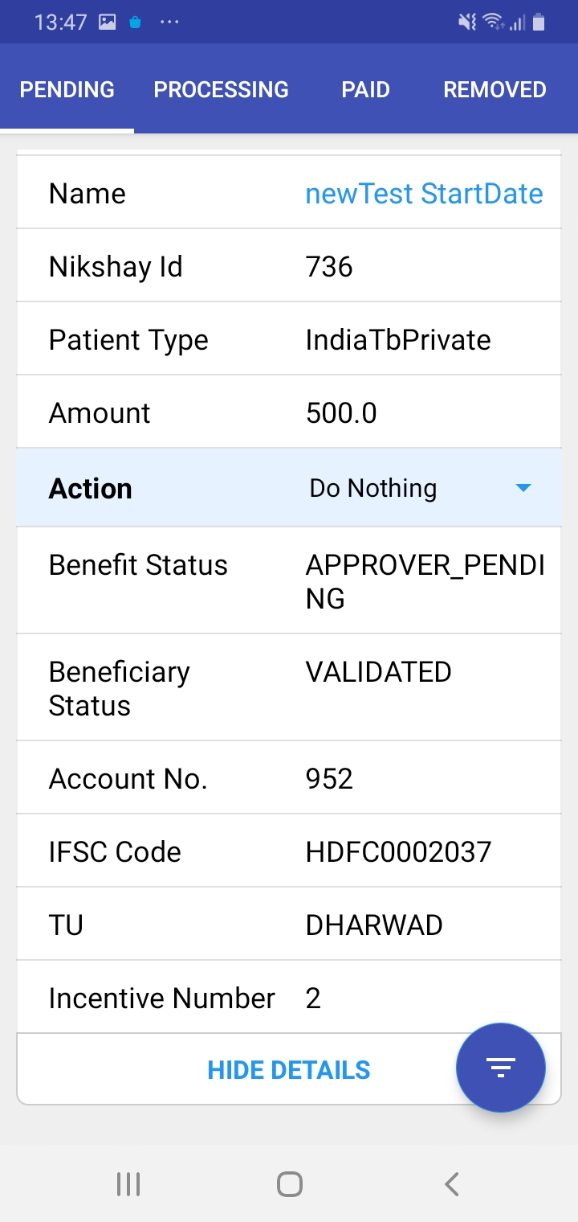
DBT on App
If you click, 'View All Details ’ then details related to that Patient and Benefit can be viewed
Similar to web one can take action for the benefits

Slide 12
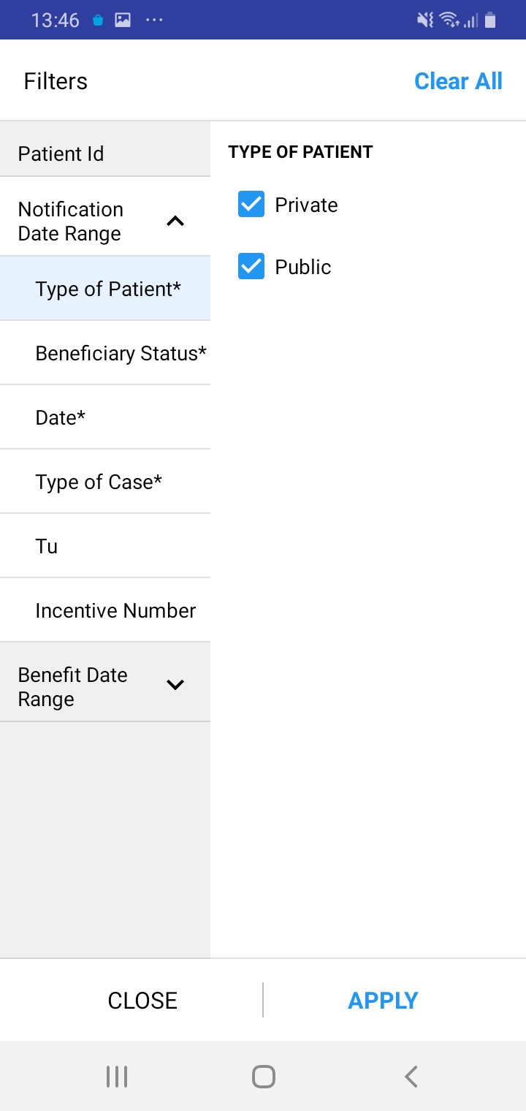
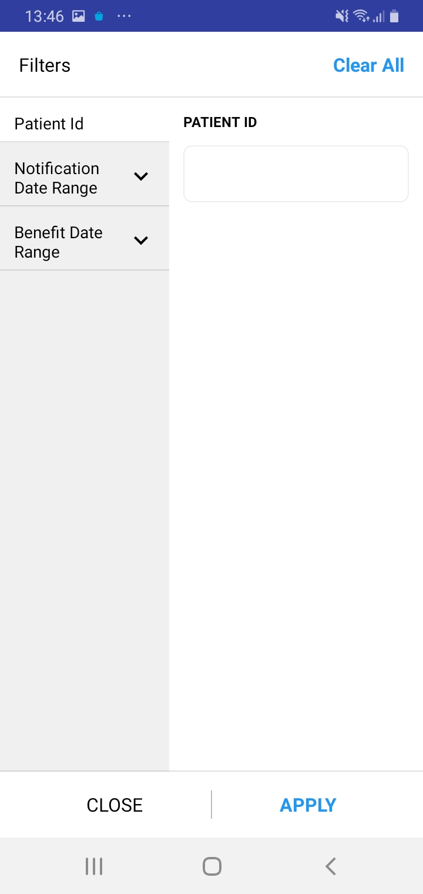
DBT on App-Filters
Click this button to filter the benefits
There are many filters which are defaulted. The user can change
User can search using Patient ID to find the benefits

Slide 13
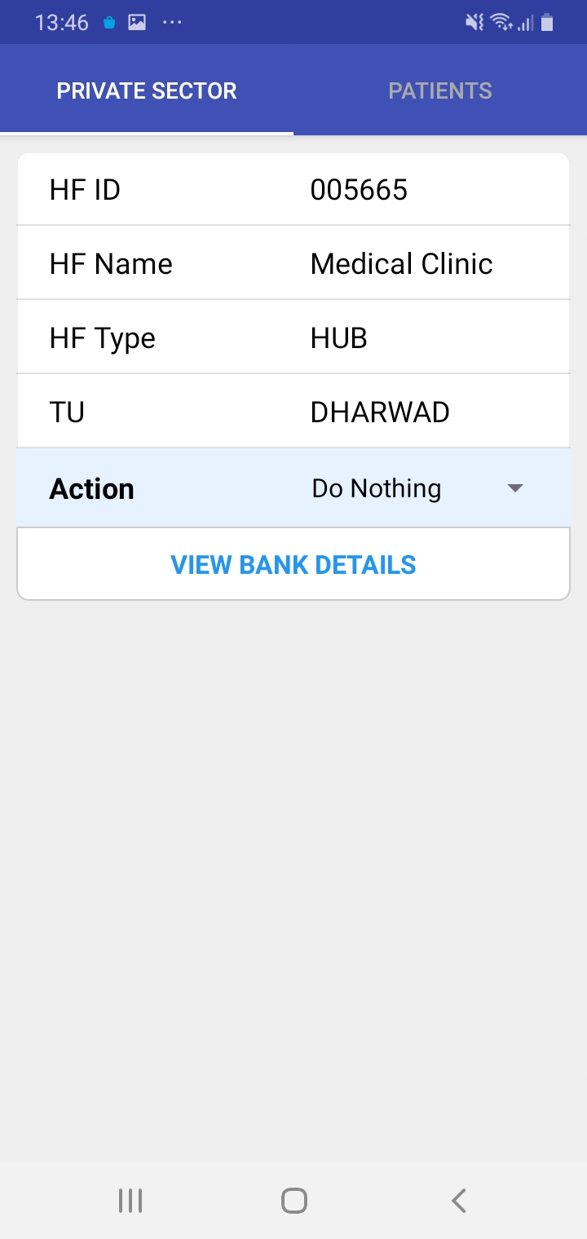
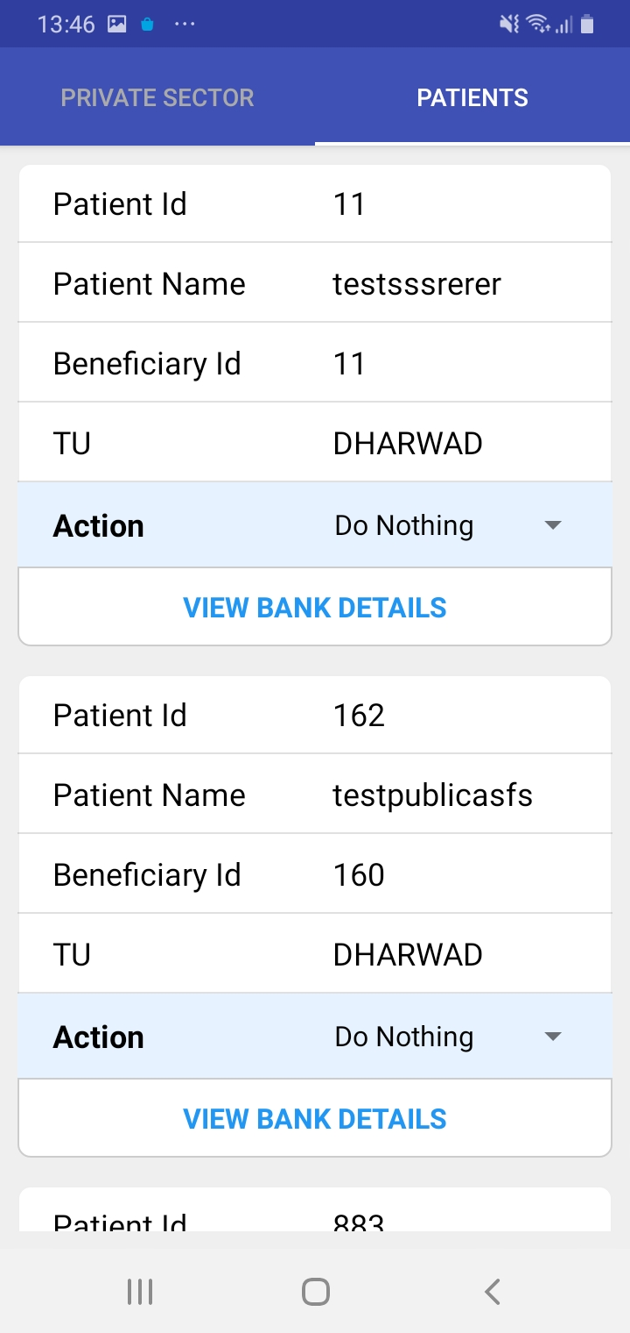
DBT on App-Beneficiary Approval
Click this button to filter the benefits
Beneficiary Approval for Private Provider Scheme
Beneficiary Approval for Patients whose Bank Acc Number is Duplicate or any edits made

Slide 14
Thank you

