Slide 1
Reporting DBT Scheme performance & DBT Bharat

Slide 2
Background
RNTCP is required to monitor monthly performance of DBT Schemes
Currently in RNTCP 4 Schemes are registered
TB Patient Nutrition (Nikshay Poshan Yojana)
Tribal TB patients support
Incentives to Private Practitioners
Honorarium for Treatment supporters
Each months reporting is required to be completed before 6th of the next month. Data entry forms will be open between 1st and 5th of the month
This is a consolidated and cumulative report of performance based on expenditure made through all modes of payments
Once filled data is sent to Ministry of Health and to the DBT Bharat portal

Slide 3
Accessing the reporting form
The reporting of performance in any of the DBT schemes may be accessed through the state login for the respective states or at the National level for all states.
Step 1: Log into the reports platform
Option 1: Click the Nikshay reports link within Nikshay
Option 2: go to URL: https://reports.Nikshay.in/nikshayreports
Step 2: Access the data entry form on → DBT Reports>DBT Bharat reporting
Step 3: Fill in Data
State level FY data : filled once each FY
State level monthly performance data: Filled each F Month
Step 4: Save data

Slide 4
Step 1: logging in

Slide 5
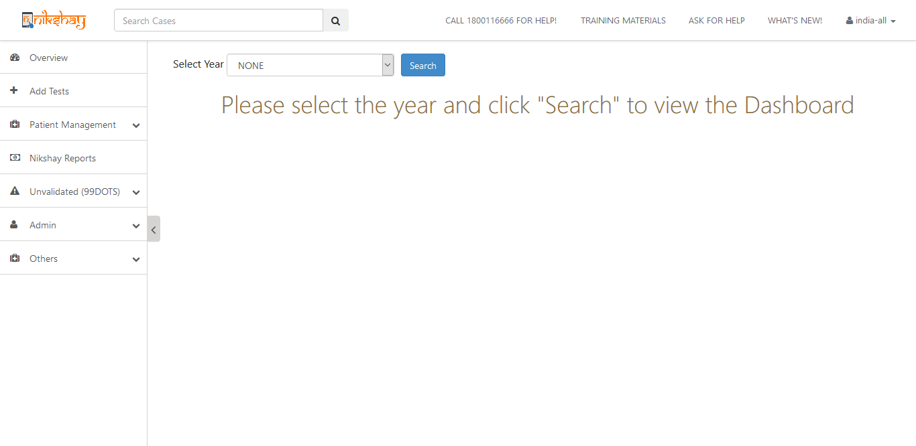
Step 1: Log into the reports platform (Option 1)
Click on Nikshay Reports
Option 1:Login to Nikshay (www.nikshay.in)

Slide 6
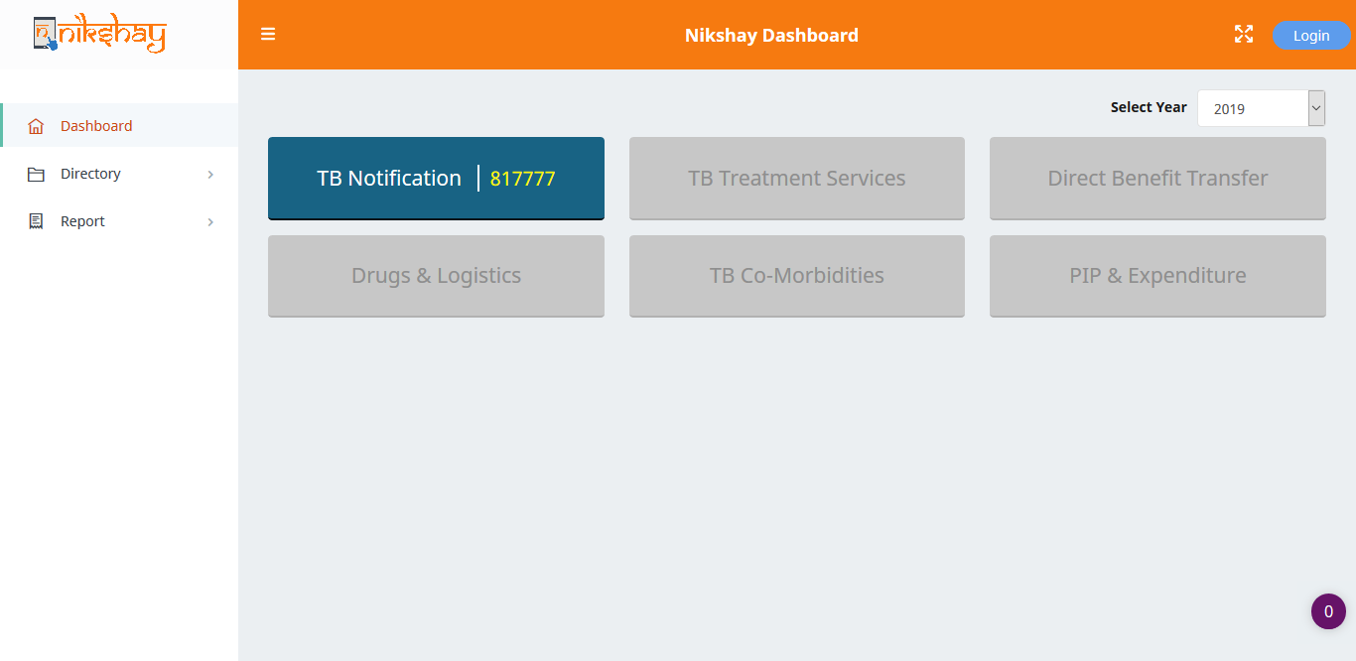
Step 1: Log into the reports platform (Option 2)
Login by clicking on login
Option 2:Go to Nikshay Reports. http://nikshay.in/nikshayreports

Slide 7
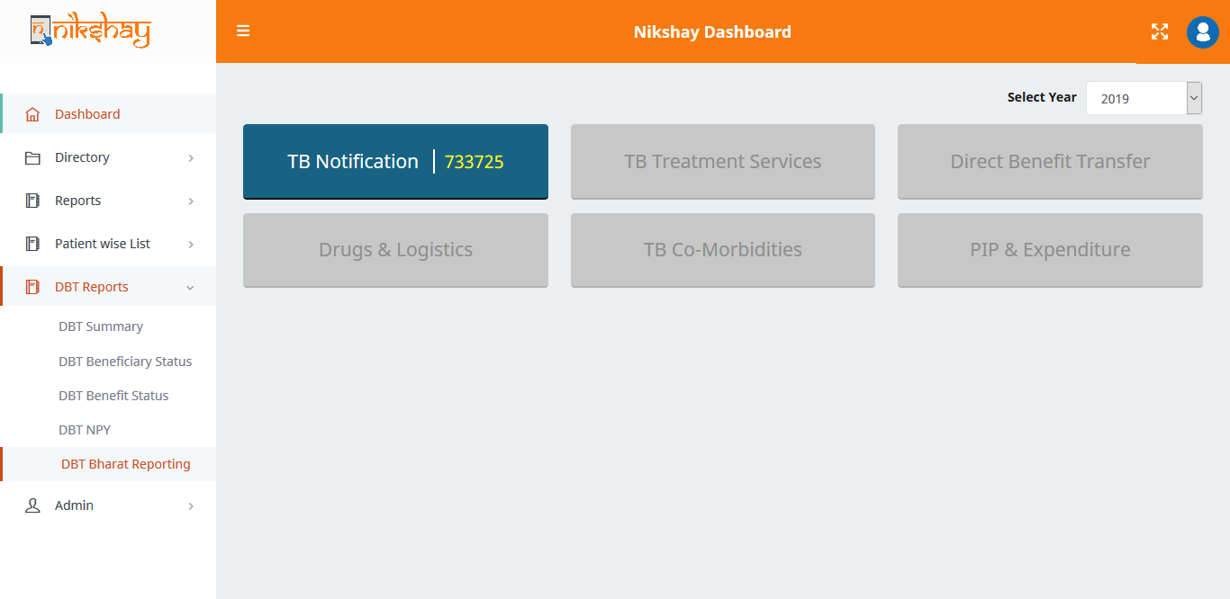
Step 2: Data entry form: DBT Reports>DBT Bharat reporting
Click on DBT Bharat Reporting
Once logged in

Slide 8
Step 2: Filling in data
State level:Annual Budget data

Slide 9
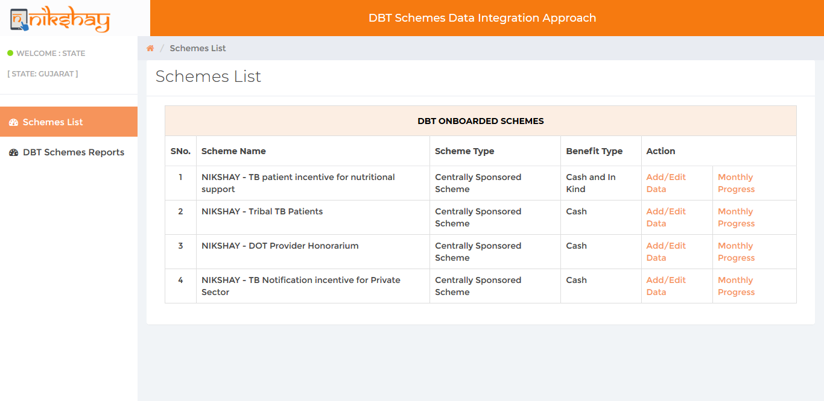
Step 2: Filling in Data
Verify the state
Update monthly progress data during the first week of the next month (1st to 1th )
Add data scheme wise
Click Add/edit Data to fill in Annual Budget for each financial year (Once a year activity)

Slide 10
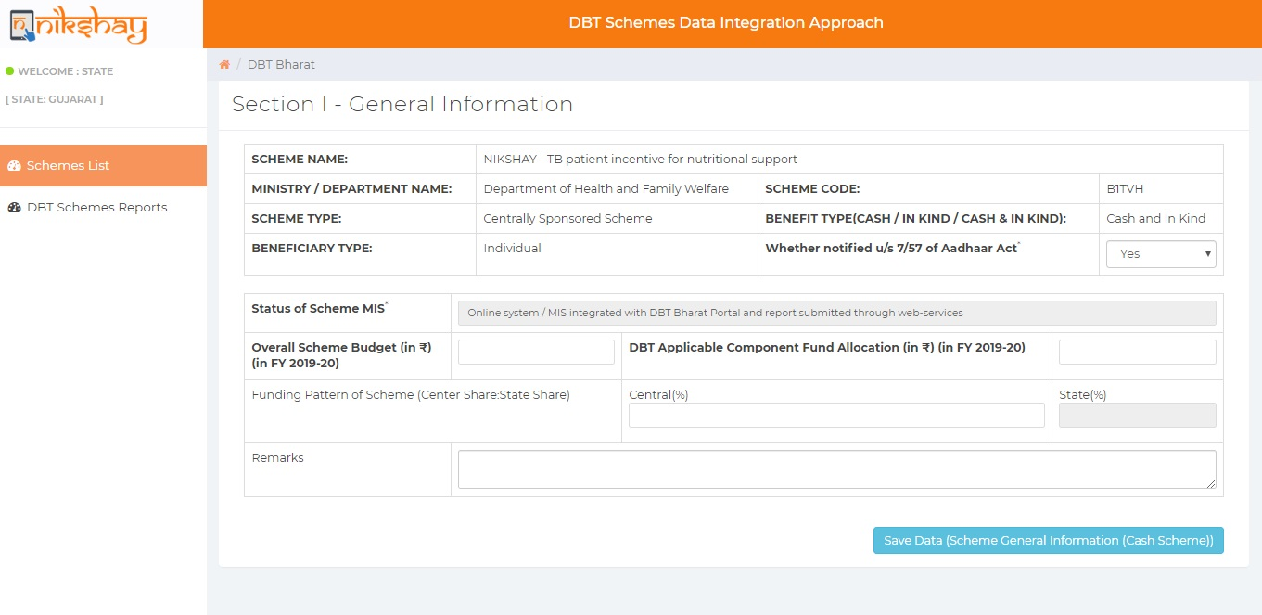
Step 2: Filling in State level Budget Data
Fill in Annual Budget for each financial year (Once a year activity)
Click save

Slide 11
Step 2: Filling in State level Budget Data
Wait for confirmation
Click Go Back to go to previous screen

Slide 12
Step 2: Filling in data
State level: Monthly Progress

Slide 13
Step 2: Monthly progress data
Add data scheme wise
Click monthly progress to fill monthly progress data

Slide 14
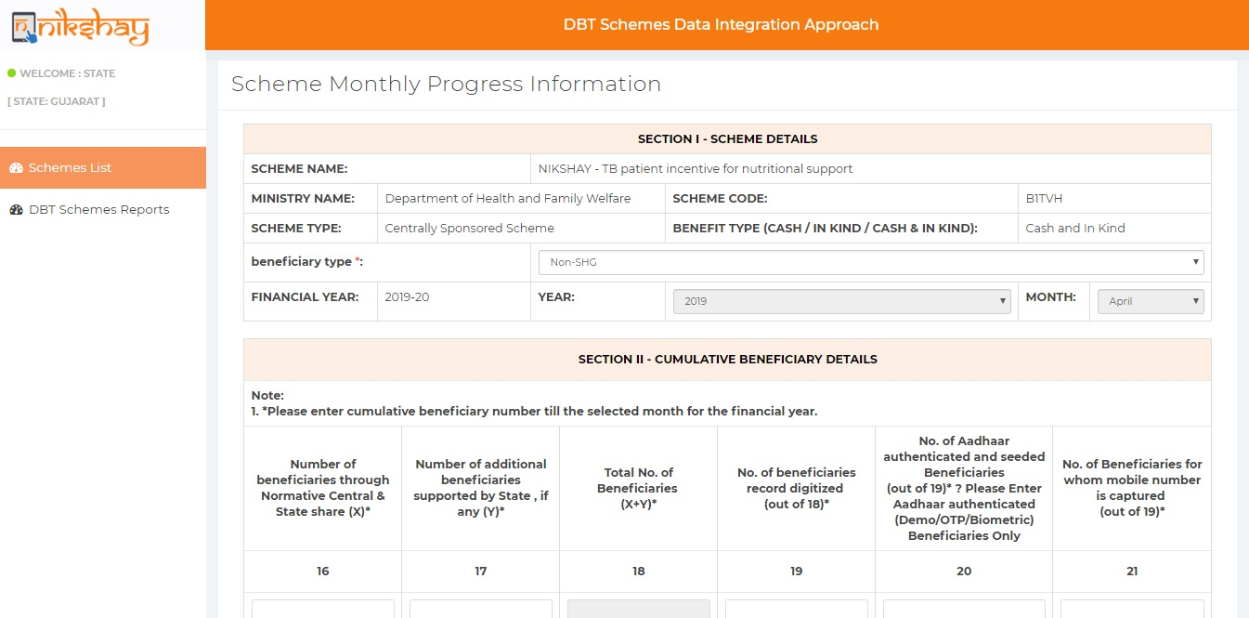
Step 2: Monthly progress data
Fill in each parameter from 16 onwards

Slide 15
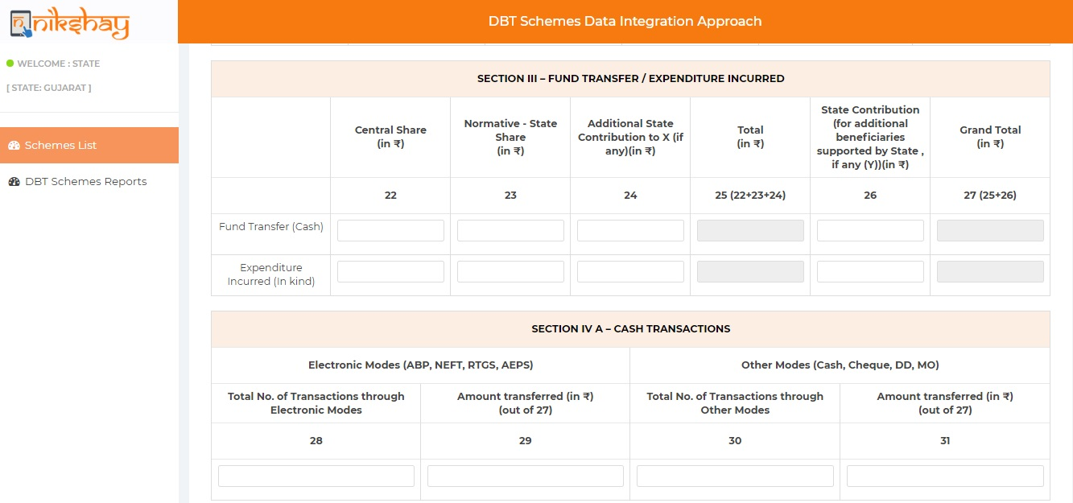
Step
Fill in each parameter from 22 onwards.

Slide 16
Step
Fill in each parameter till 39
Click Save

Slide 17
Step
Wait for confirmation

Slide 18
Notes:
This activity is to be done at state level
Data needs to include all modes of payment including
Paid through Nikshay
Paid through PFMS
paid in Kind
Any other means directly to beneficiary
Data has to be filled in each month between the 1st to the 5th of the month.
Data entered should be cumulative for the entire financial year.

Slide 19
Thank you!

Slide 20
Thank you!

