Slide 1
Contract Management & Tracking Tool
Training Material

Slide 2
Contract Management & Tracking Tool
NSP lays specific emphasis on engaging the private sector to achieve the ambitious goal to end TB in India by 2025.
To engage the private sector, States have MoU with Patient Provider Support Agency (PPSA), private labs/NGOs/ agencies under various partnership options.
Furthermore, regular payment of these partners and financial management are of utmost importance.
Objectives: 1. Streamline the invoices submitted and disbursement data 2. Analyse and garner insights against Key indicators for programmatic actions for the state officials. 3. Use the insights to course correct and streamline the payment cycle in the State.

Slide 3
Contract Management & Tracking Tool- Overview
Forms are available in both web and app
Data entry would be possible for the Contracted agencies through the Ni-kshay logins provided to them.
Reports would be visible to the District, State and National team via the respective Ni-kshay logins.
Report would provide a Summary of the forms filled and details of the information filled in.
Additional details made available on the dashboard include:
Overall payment done
Contract finance cascade
Payment cycle
Contract wise payment
Payment TAT analysis

Slide 4
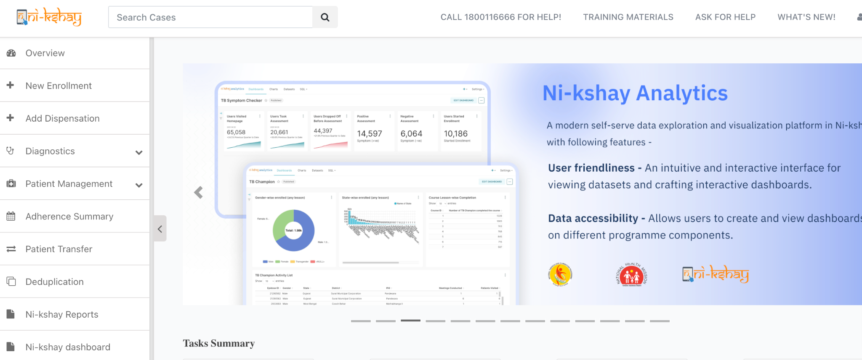
Contract Management & Tracking Tool
Step 1
Click on Ni-kshay Reports

Slide 5
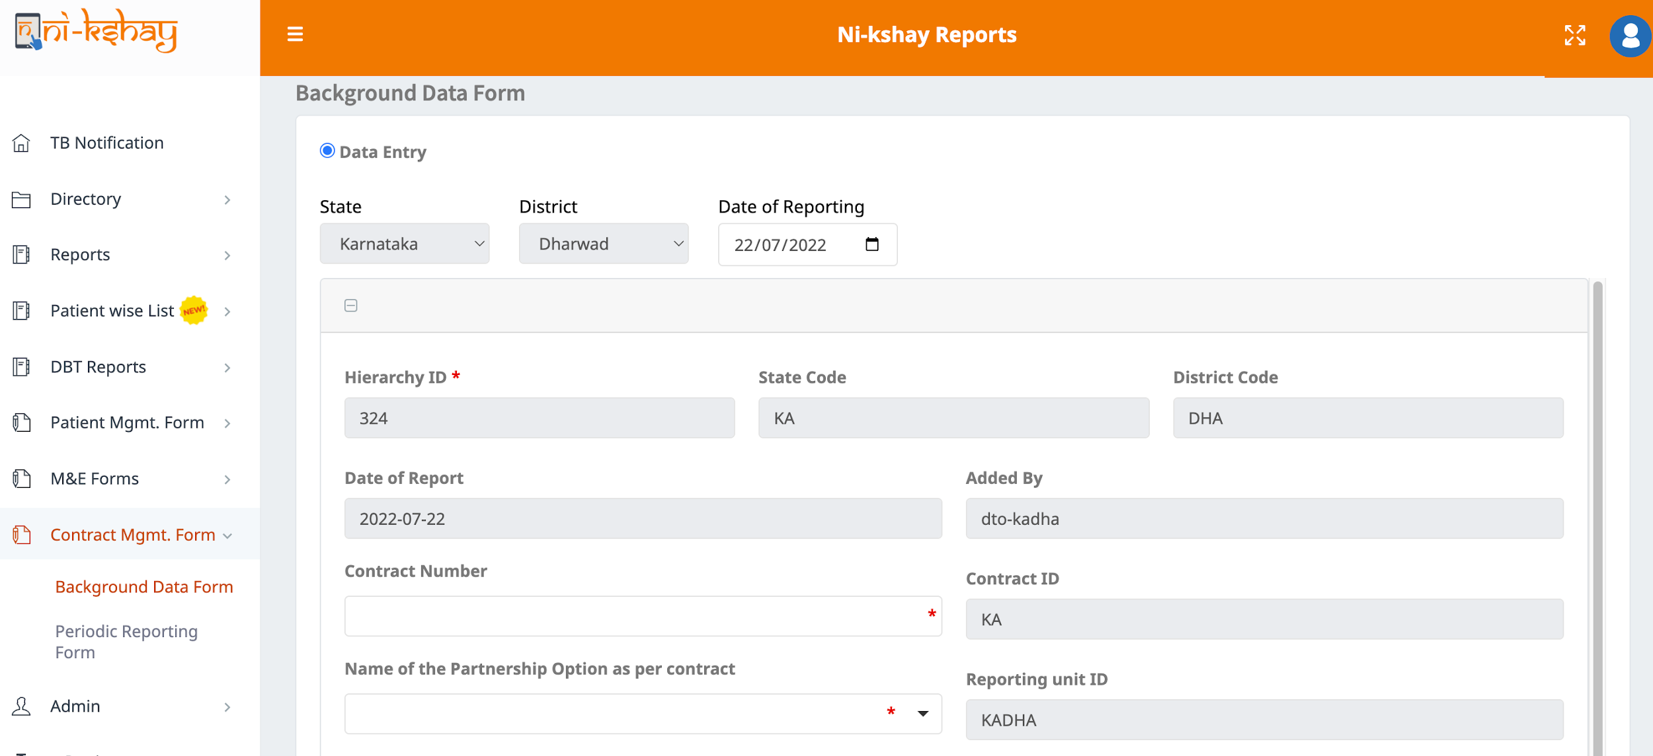
Contract Management & Tracking Tool- Form
Step 1
Step 2
Click on Ni-kshay Reports
Select Contract Management Forms

Slide 6
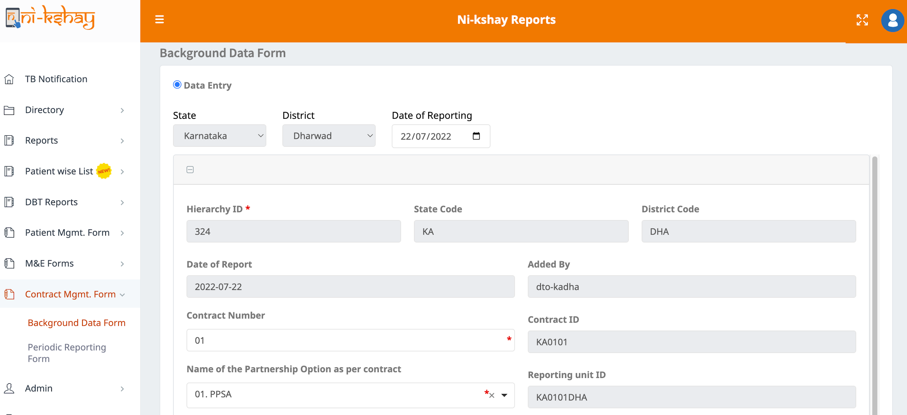
Contract Management & Tracking Tool– Background Data
Step 1
Step 2
Step 3
Click on Ni-kshay Reports
Select Contract Management Forms
Select the Background Data Form
Enter contract number
Contract ID and Reporting Unit ID will be auto populated on basis of Contract Number and Partnership Option
Select relevant partnership option from the available list

Slide 7
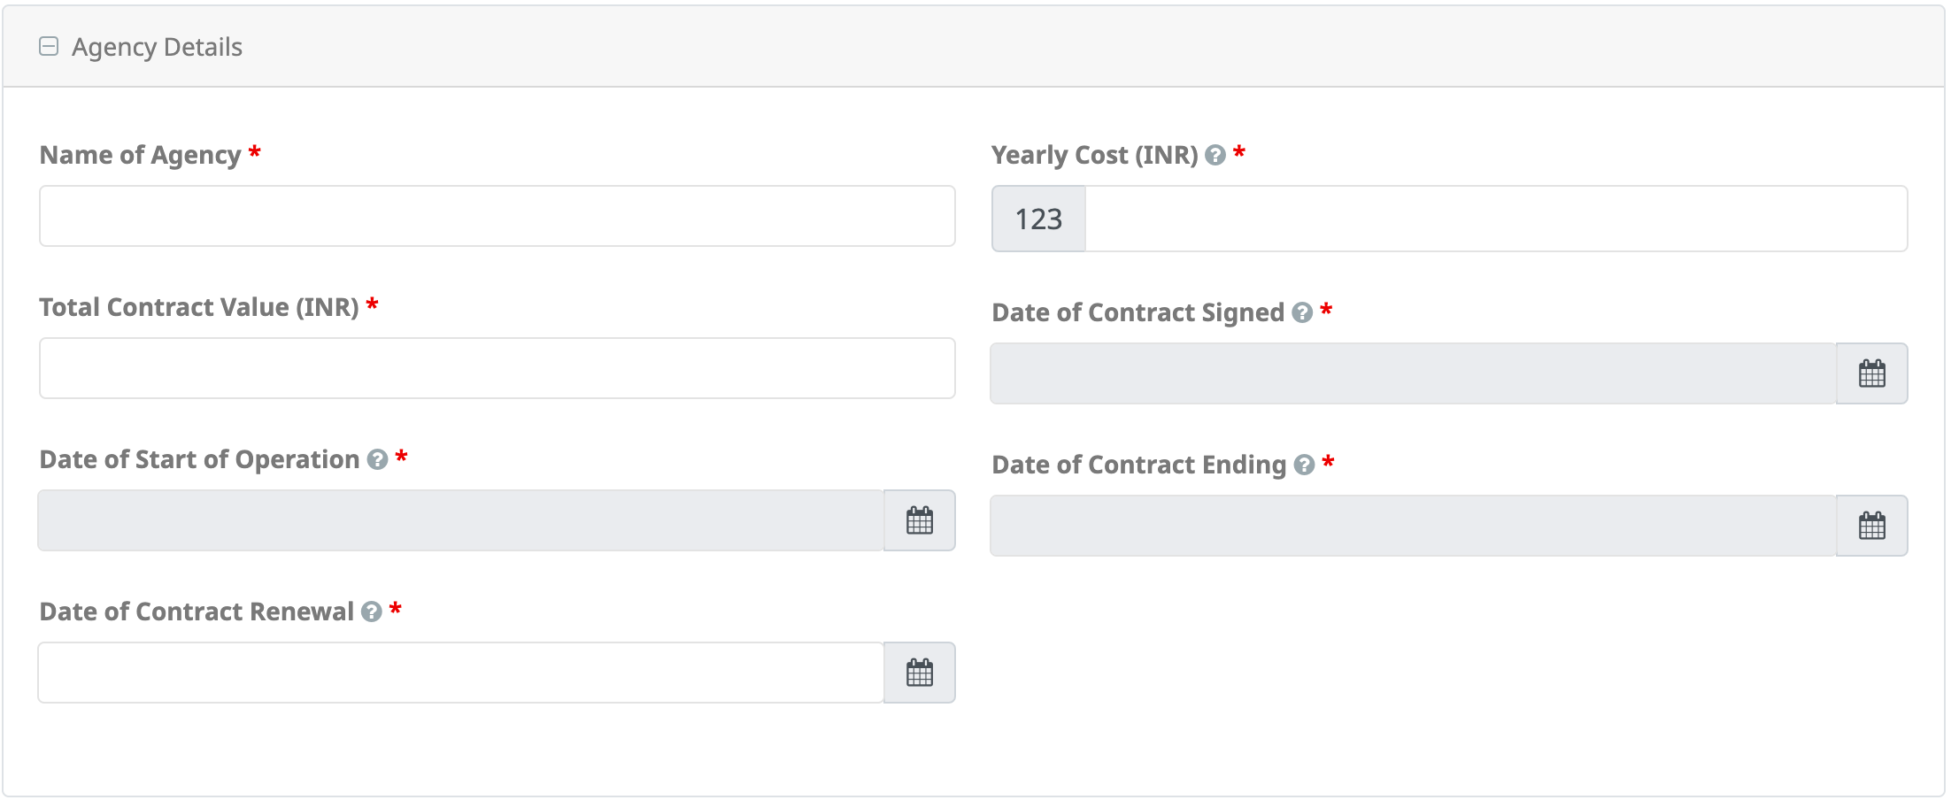
Contract Management & Tracking Tool– Background Data
Step 1
Step 2
Step 3
Click on Ni-kshay Reports
Select Contract Management Forms
Select the Background Data Form
Agency specific details to be added

Slide 8
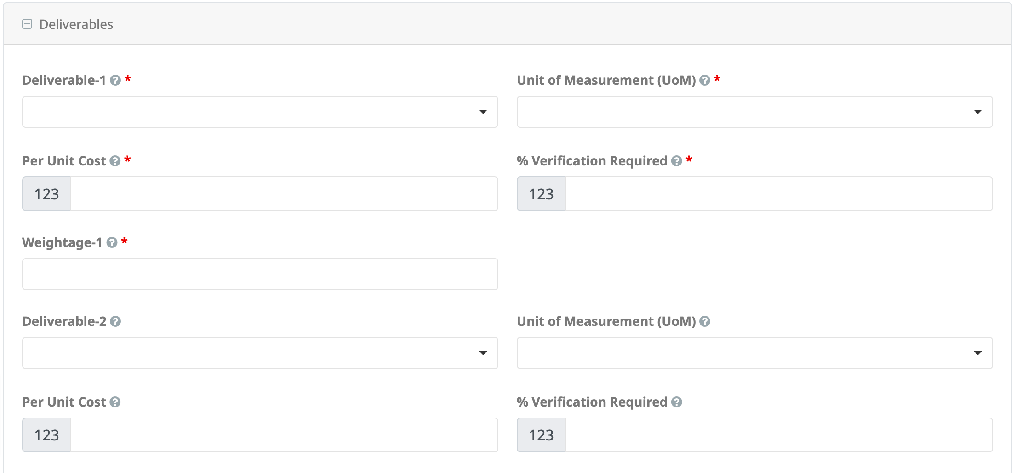
Contract Management & Tracking Tool– Background Data
Deliverables and associated variables to be added
Upto 15 deliverables can be added

Slide 9
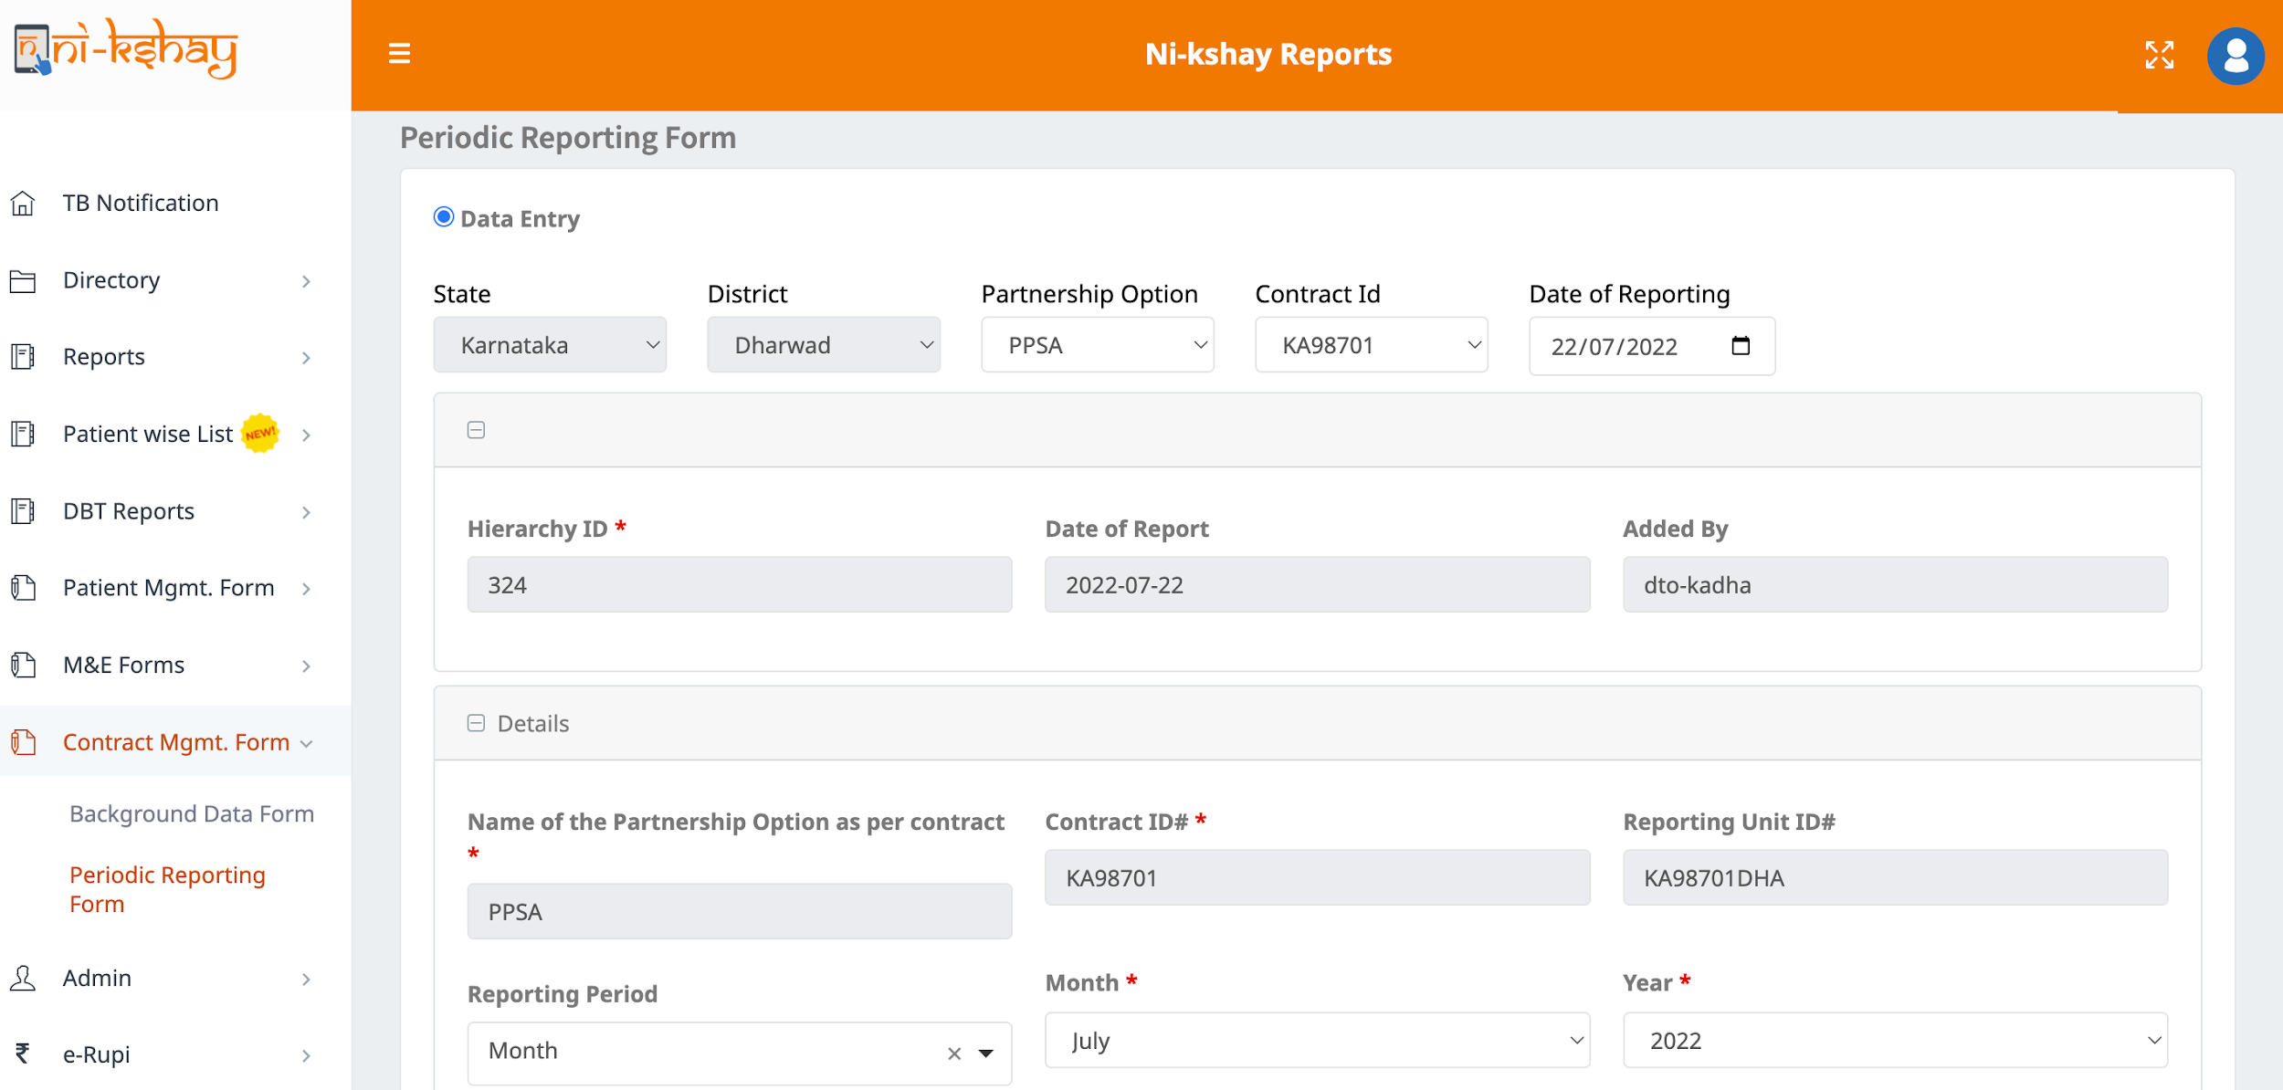
Contract Management & Tracking Tool– Periodic Entry Form
Step 1
Step 2
Step 3
Click on Ni-kshay Reports
Select Contract Management Forms
Click on Periodic Reporting Form
Select Partnership option
Select Contract ID
Select Reporting Period (Month/Quarter)
Select Month
Select Year

Slide 10
Contract Management & Tracking Tool– Periodic Entry Form
Step 1
Step 2
Step 3
Click on Ni-kshay Reports
Select Contract Management Forms
Click on Periodic Reporting Form
Agency specific details may be verified

Slide 11
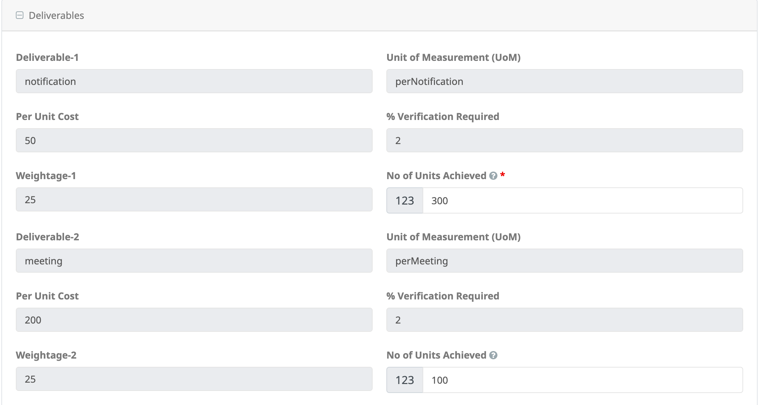
Contract Management & Tracking Tool– Periodic Entry Form
Step 1
Step 2
Step 3
Click on Ni-kshay Reports
Select Contract Management Forms
Click on Periodic Reporting Form
Agency deliverables-specific details may be verified (up to 15 deliverables) and No. of Units Achieved will be provided.

Slide 12
Contract Management & Tracking Tool– Periodic Entry Form
Step 1
Step 2
Step 3
Step 4
Click on Ni-kshay Reports
Select Contract Management Forms
Click on Periodic Reporting Form
Click on Bill submission details
Upon verification of deliverables and providing the No. of Units Achieved, Bill Submission Details will be available

Slide 13
Contract Management & Tracking Tool– Periodic Entry Form
Step 1
Step 2
Step 3
Step 4
Click on Ni-kshay Reports
Select Contract Management Forms
Click on Periodic Reporting Form
Click on Bill verification details
Upon submission of Bill details, Bill verification details will be available

Slide 14
Contract Management & Tracking Tool– Periodic Entry Form
Step 1
Step 2
Step 3
Step 4
Click on Ni-kshay Reports
Select Contract Management Forms
Click on Periodic Reporting Form
Click on Bill Payment details
Upon Bill verification, Payment details will be available.

Slide 15
THANK YOU

