Slide 1
Advanced Transfer Function
Transfer Request Response workflows

Slide 2
Introduction
This module enables transfer request of patients between health facilities across the country. Users make requests of two types - “Transfer In” and “Transfer Out”.
These request are made visible in the Transfer page with 3 tabs -
“Transfer In” - View list of all patients where requests for Transfer In are pending (with either the user logged in or someone else).
“Transfer Out” - View list of all patients where requests for Transfer out are pending. (The option to request transfer out is available in Patient Page>Health Facilities)
Request for Transfer In - In this tab, you can search a patient currently in any other geography or PHI using “Patient ID”/ “Episode Id” or “Patient Mobile Number” and initiate a request transfer in.
NOTE:
All transfer requests needs to be accepted by “District/TU/PHI” to where the transfer request is made to, in order for it to take effect.
Transfer requests can be made to even the District/TU level. However, it can be completed only once the “Transferred To PHI” has been assigned.

Slide 3
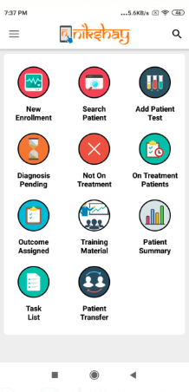
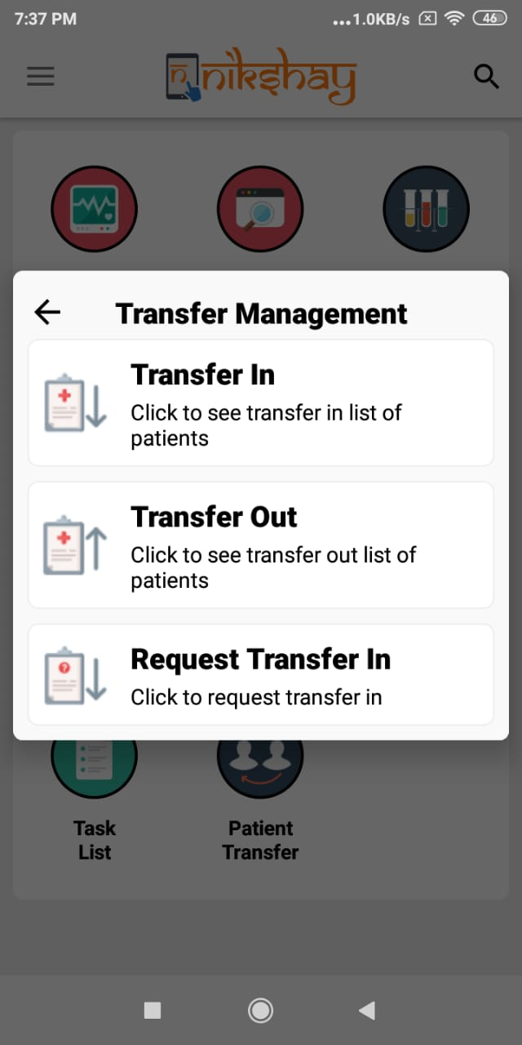
Transfer Management
List of Patients Transferred in from other District /TU/ PHI to your district that are pending acceptance
List of Patients Transferred out from your district to another district that are pending acceptance
Initiate a transfer in request for patients who are currently in another District / TU / PHI.
Click on ‘Patient Transfer’ to view the Transfer Module

Slide 4
Contents
Request Transfer Out
Initiate the Transfer out Request (by Source PHI/TU/District)
Accept Transfer in (by receiving PHI/TU/District)
Reject Transfer in (by receiving PHI/TU/District)
Request Transfer in
Initiate the Transfer in Request
Accept Transfer out (by Source PHI/TU/District)
Reject Transfer out (by Source PHI/TU/District)

Slide 5
1a. Request Transfer Out
Initiate move of patients to a PHI outside your geography

Slide 6
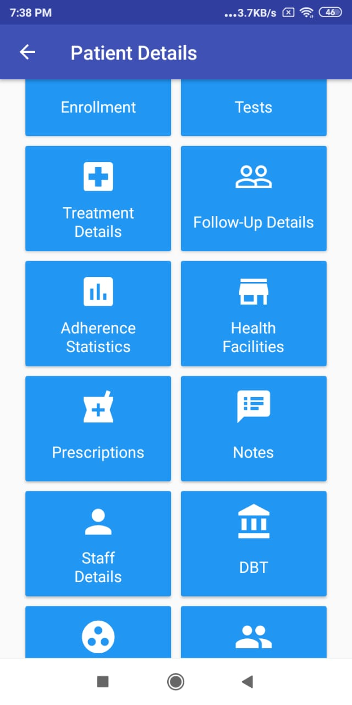
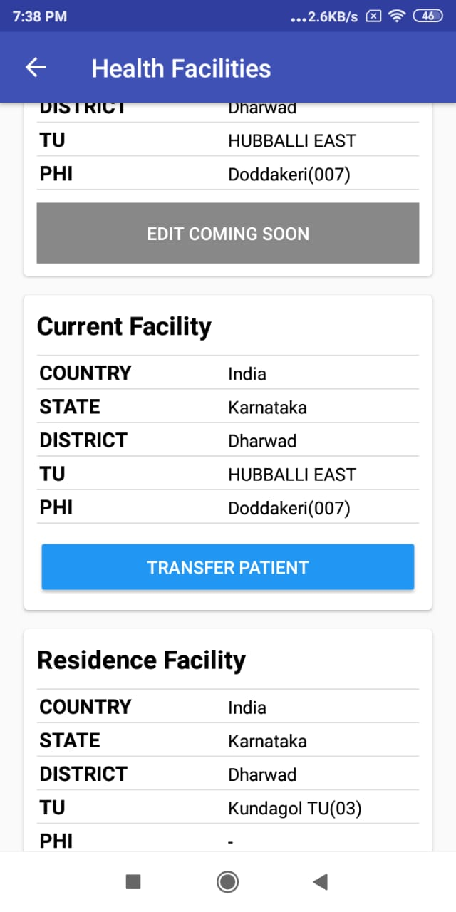
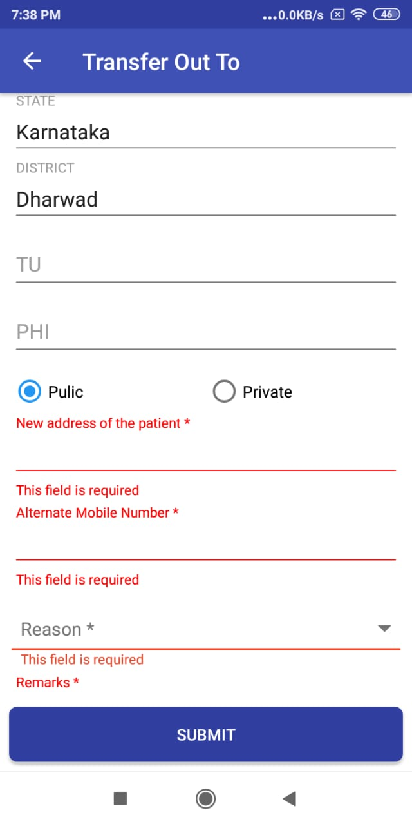
Initiate Transfer Out request-1
Step 1
Step 2
Step 3
Open Patient Record and click “Health Facilities”
Scroll down to “Current Facility” and click “Transfer Patient” Button
Fill in the necessary details and click “SUBMIT” button to initiate a transfer out

Slide 7
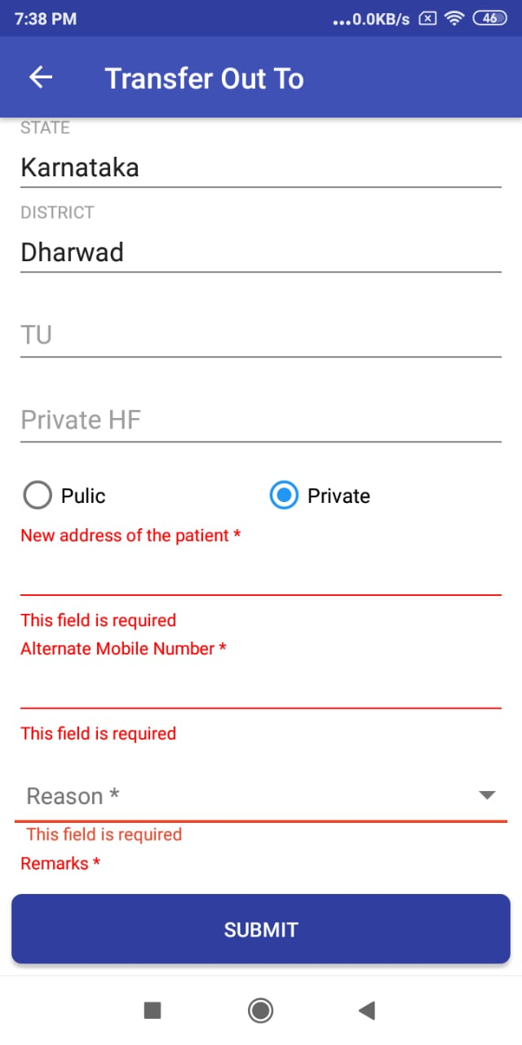
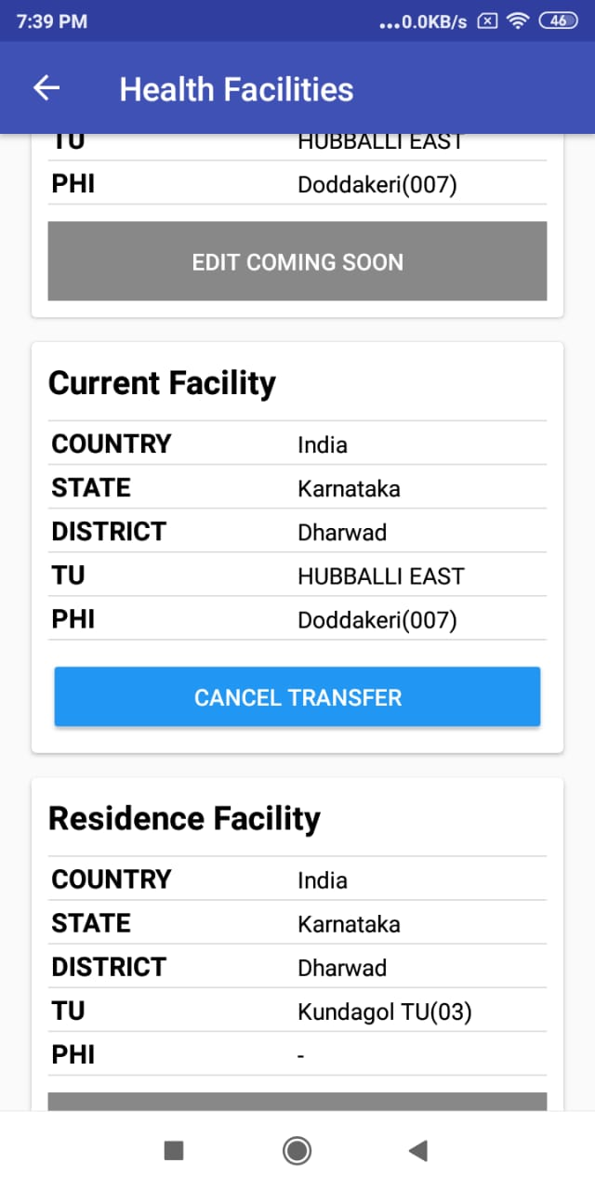
Initiate Transfer Out request-2
If required the user initiating the request can “Cancel Transfer”.
One can click “Private” and select the Private HF to transfer the patient

Slide 8
1b. Accept Transfer In
Take action where Transfer Out requests made by someone else, and transfer in are pending with you.

Slide 9
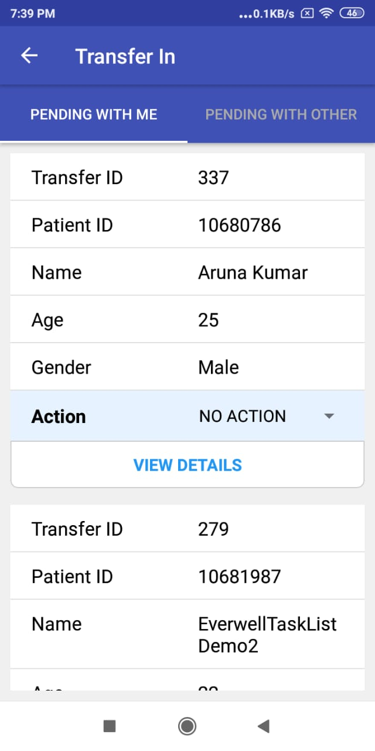
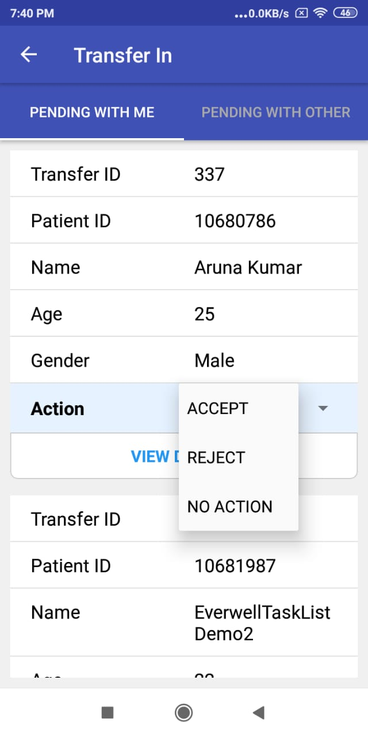
Accept Transfer In-1
Step 1
Step 2
Step 3
Step 1
Click “Transfer In”
One can see the list of Transfer in Patients to your jurisdiction
Under “Action” one can take action for the transfer record. Click “ACCEPT”.

Slide 10
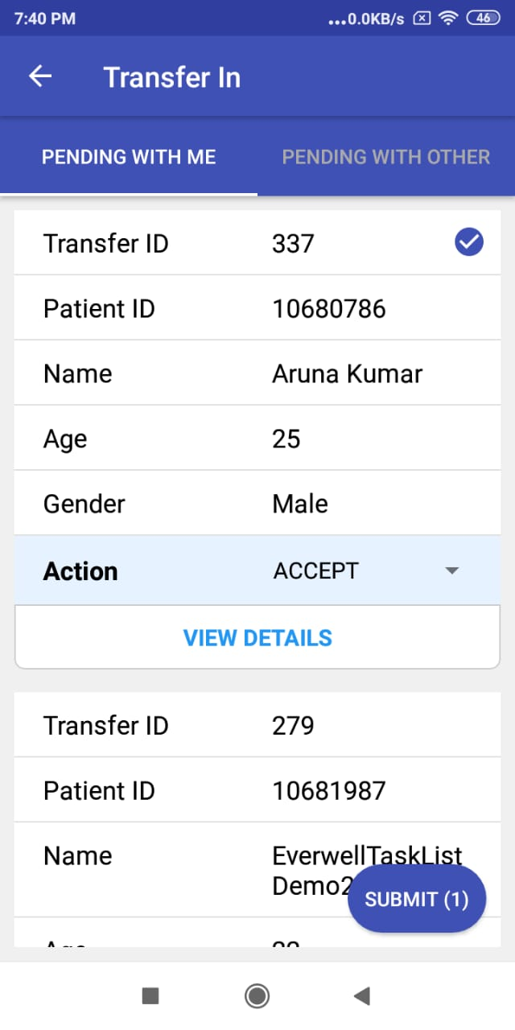
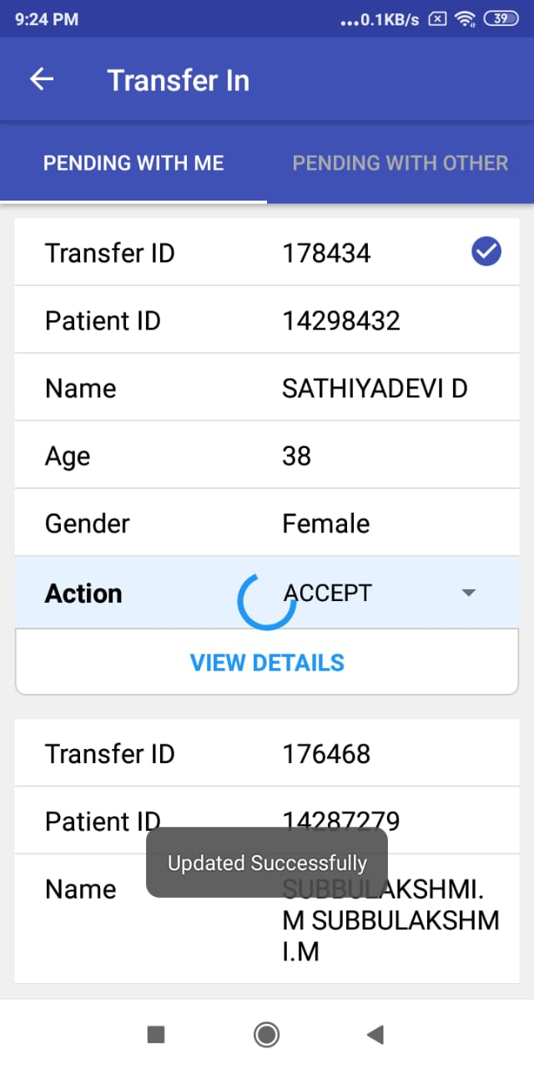
Accept Transfer In-1
Step 4
Step 5
Step 1
After Clicking submit it will appear “Updated Successfully”
After clicking “SUBMIT” you will see a confirmation that it got successfully updated.

Slide 11
1c. Reject Transfer In
Take action where Transfer In requests made by someone else, are pending with you.

Slide 12
Reject Transfer In-1
Step 1
Step 2
Step 3
Step 1
Click “Transfer In”
One can see the list of Transfer in Patients to your jurisdiction
Under “Action” one can take action for the transfer record. Click “REJECT”.

Slide 13
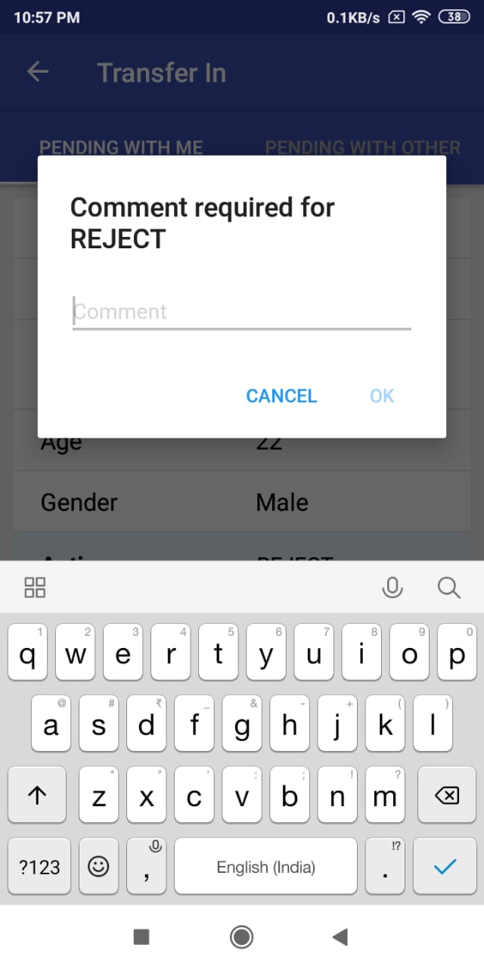
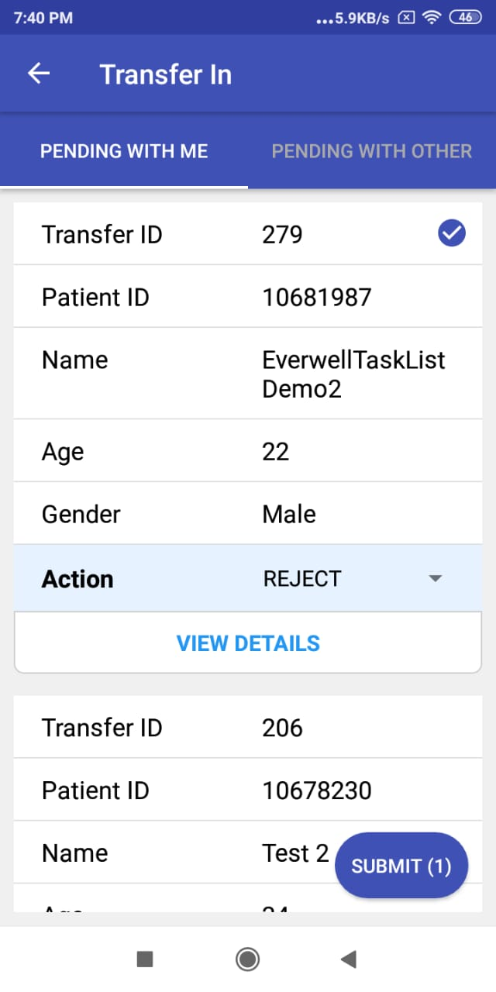
Reject Transfer In-1
Step 4
Step 5
Step 1
Enter the reason for Rejection and click “Ok”
After Clicking submit it will appear “Updated Successfully”

Slide 14
2a. Request Transfer In
In this tab, you can search a patient currently in any other geography or PHI using “Patient ID”/ “Episode Id” or “Patient Mobile Number” and request a transfer in.

Slide 15
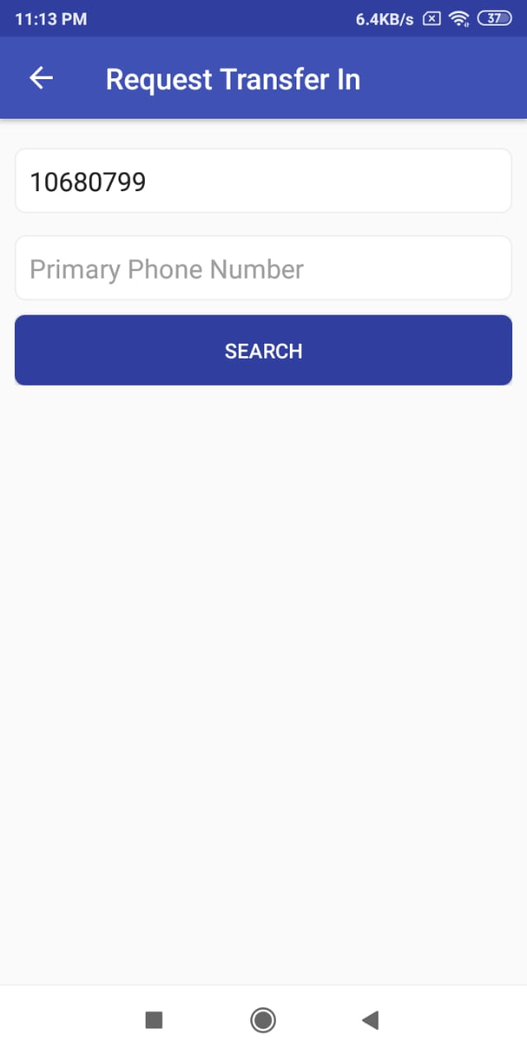
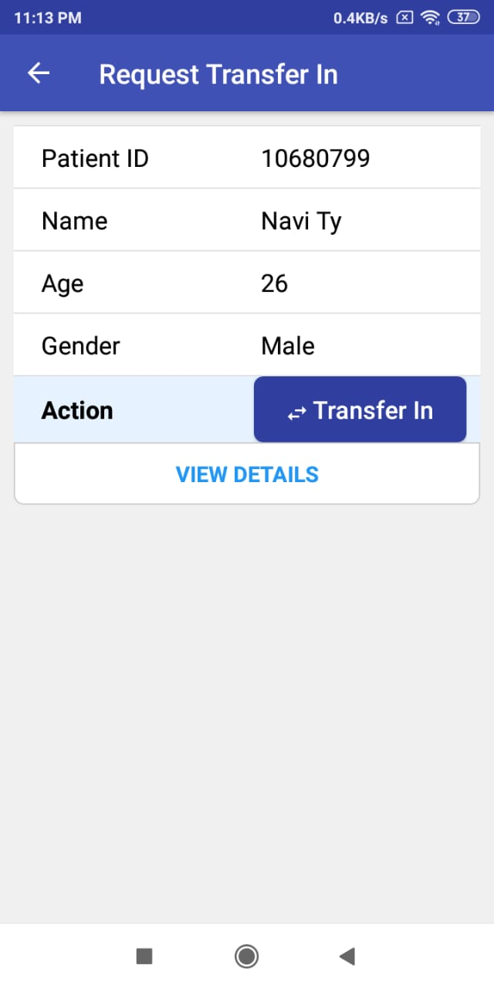
Request Transfer In-1
Step 1
Step 2
Step 3
Click “RequestTransfer In”
Search for the Patient using his Patient ID or Mobile Number
Click “Transfer In ” button to fill the transfer in details

Slide 16
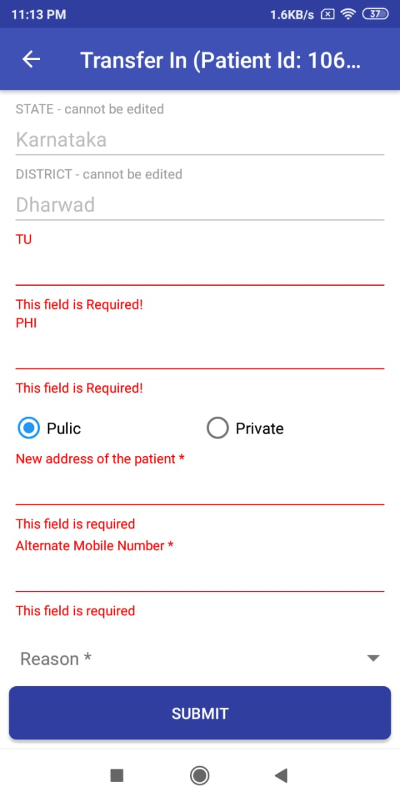
Request Transfer In-1
Step 4
Fill in the necessary details for Transfer In and click “Submit”

Slide 17
2b.Accept Transfer Out Request
A Transfer in Request initiated by you can be cancelled

Slide 18
Accept Transfer Out-1
Step 1
Step 2
Step 3
Step 1
Click “Transfer Out”
One can see the list of Transfer in Patients to your jurisdiction
Under “Action” one can take action for the transfer record. Click “ACCEPT”.

Slide 19
Accept Transfer Out-1
Step 4
Step 5
Step 1
After Clicking submit it will appear “Updated Successfully”
After clicking “SUBMIT” you will see a confirmation that it got successfully updated.

Slide 20
2c.Reject Transfer Out Request
A Transfer in Request initiated by you can be cancelled

Slide 21
Reject Transfer Out-1
Step 1
Step 2
Step 3
Step 1
Click “Transfer Out”
One can see the list of Transfer in Patients to your jurisdiction
Under “Action” one can take action for the transfer record. Click “REJECT”.

Slide 22
Reject Transfer Out-1
Step 4
Step 5
Step 1
Enter the reason for Rejection and click “Ok”
After Clicking submit it will appear “Updated Successfully”

Slide 23
Thank You

