Slide 1
Advanced Transfer Function
Transfer Request Response workflows

Slide 2
Introduction
This module enables transfer request of patients between health facilities across the country. Users make requests of two types - “Transfer In” and “Transfer Out”.
These request are made visible in the Transfer page with 3 tabs -
“Transfer In” - View list of all patients where requests for Transfer In are pending (with either the user logged in or someone else).
“Transfer Out” - View list of all patients where requests for Transfer out are pending. (The option to request transfer out is available in Patient Page>Health Facilities)
Request for Transfer In - In this tab, you can search a patient currently in any other geography or PHI using “Patient ID”/ “Episode Id” or “Patient Mobile Number” and initiate a request transfer in.
NOTE:
All transfer requests needs to be accepted by “District/TU/PHI” to where the transfer request is made to, in order for it to take effect.
Transfer requests can be made to even the District/TU level. However, it can be completed only once the “Transferred To PHI” has been assigned.

Slide 3
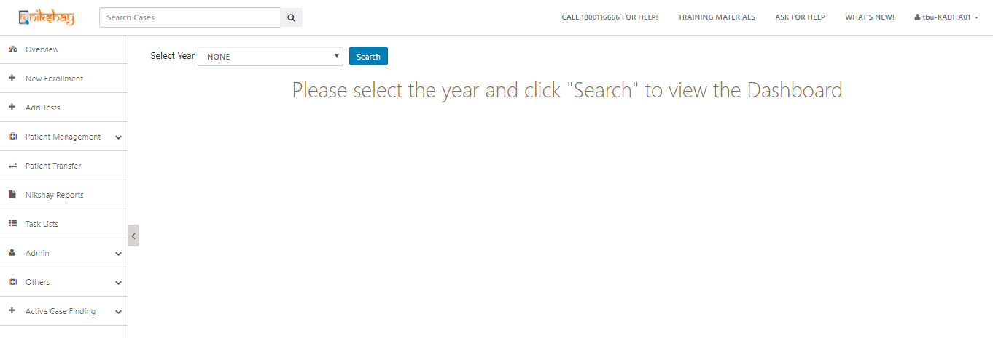
Transfer Management
Click on ‘Patient Transfer’ to view the Transfer Module

Slide 4
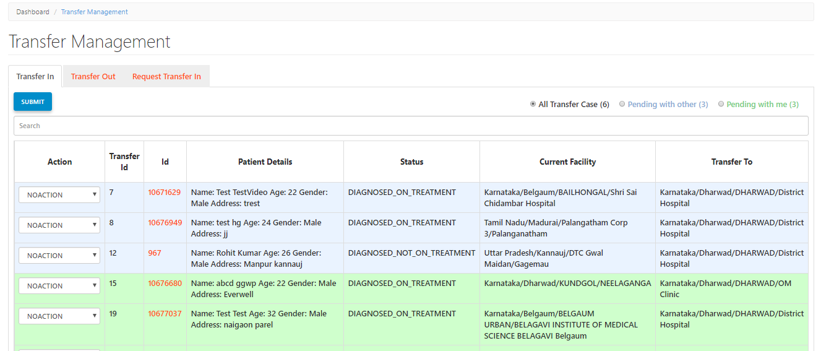
Transfer Management
List of Patients Transferred out from your district to another district that are pending acceptance
Summary to alert users of pending Transfer Requests with either you or others
Initiate a transfer in request for patients who are currently in another District / TU / PHI.
List of Patients Transferred in from other District /TU/ PHI to your district that are pending acceptance
Transfer approval is pending with other users
Transfer approval is pending with me

Slide 5
Contents
Request Transfer Out
Initiate the Transfer out Request (by Source PHI/TU/District)
Accept Transfer in (by receiving PHI/TU/District)
Reject Transfer in (by receiving PHI/TU/District)
Request Transfer in
Initiate the Transfer in Request
Accept Transfer out (by Source PHI/TU/District)
Reject Transfer out (by Source PHI/TU/District)
Cancel the transfer in request (By receiving PHI/TU/District)

Slide 6
1a. Request Transfer Out
Initiate move of patients to a PHI outside your geography

Slide 7
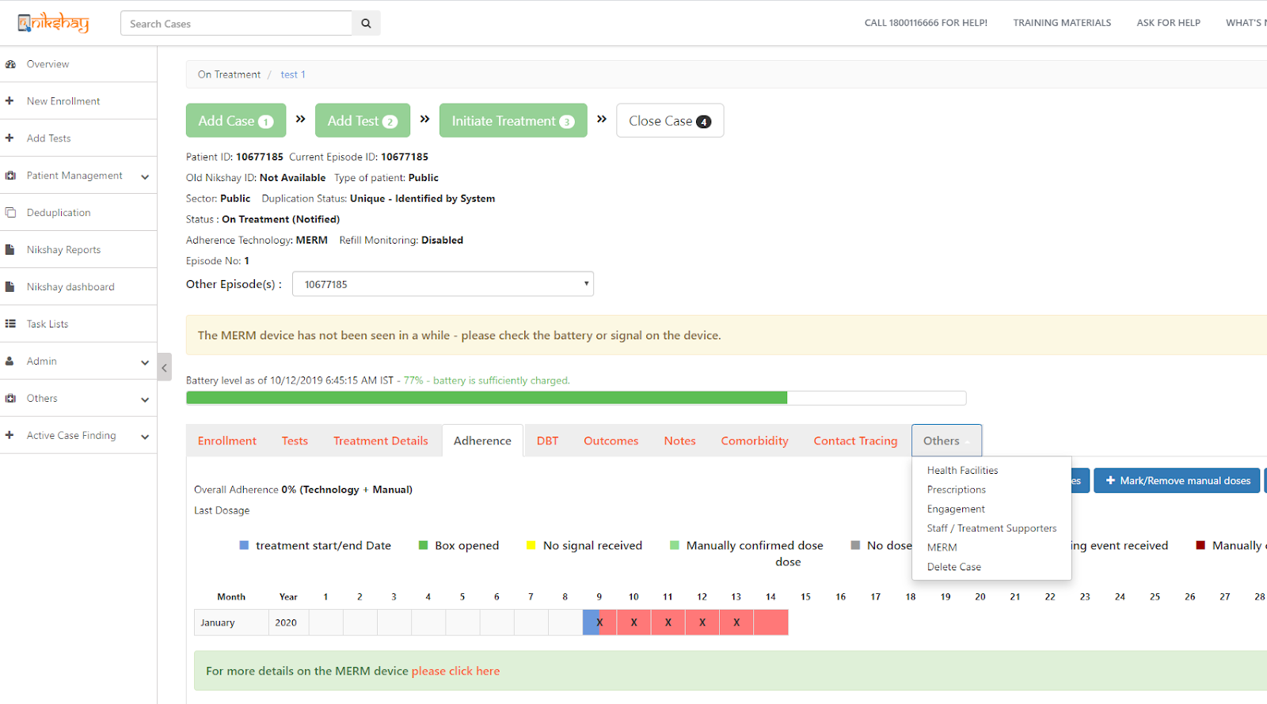
Initiate Transfer Out request-1
Step 1
Click on ‘Others’

Slide 8
Initiate Transfer Out request-2
Step 1
Step 2
Click on ‘Others’
Click on Health Facilities

Slide 9
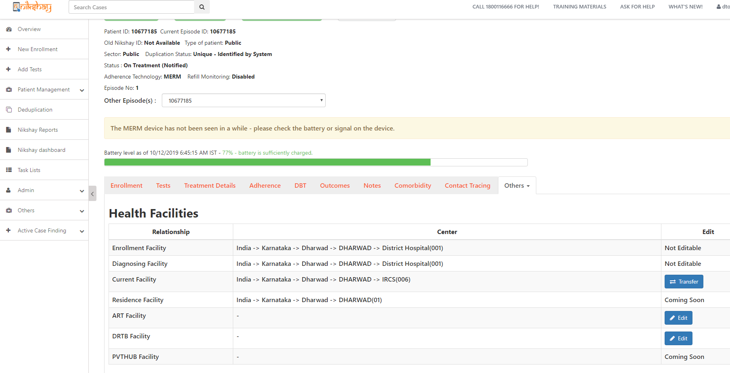
Initiate Transfer Out request-3
Step 1
Step 2
Step 3
Click on ‘Others’
Click on Health Facilities
Click on Transfer

Slide 10
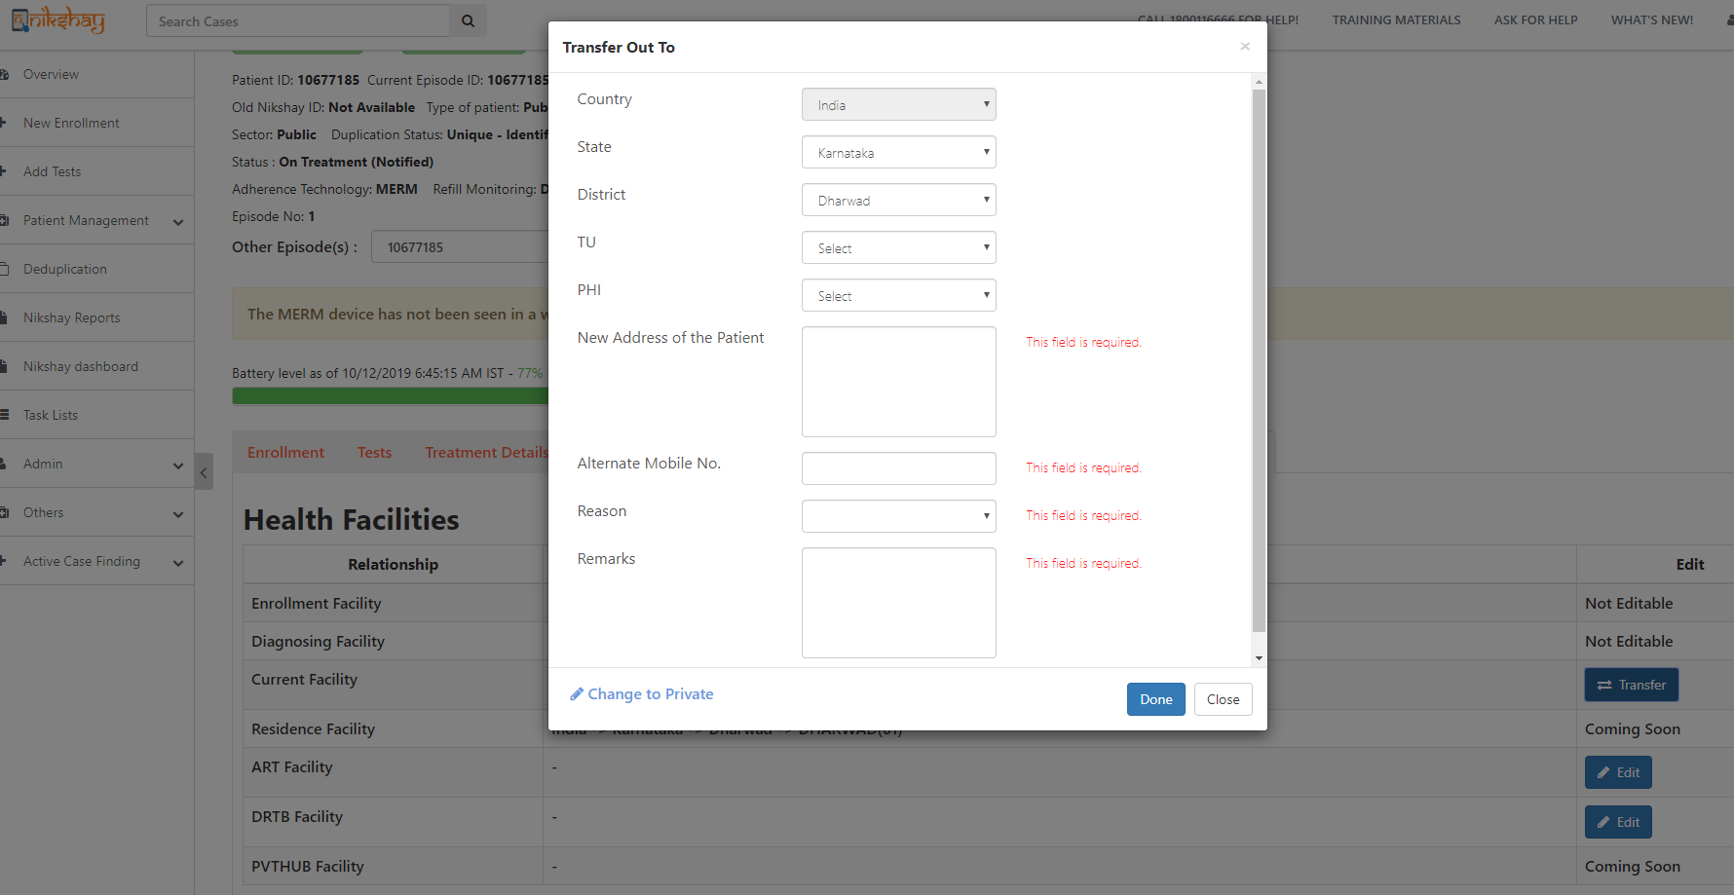
Initiate Transfer Out request-4
Step 1
Step 2
Step 3
Step 4
Click on ‘Others’
Click on Health Facilities
Click on Transfer
Enter the Details of the Hierarchy where the patient is being transferred

Slide 11
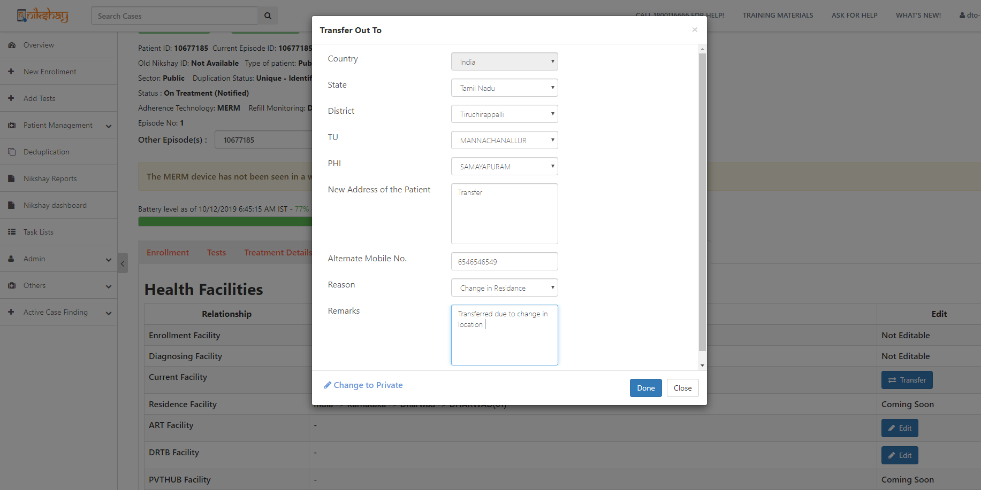
Initiate Transfer Out request-5
Step 1
Step 2
Step 3
Step 4
Step 5
Click on ‘Others’
Click on Health Facilities
Click on Transfer
Enter the Details of the Hierarchy where the patient is being transferred
Click on Done
Enter all the details required
Click here to complete the Transfer
If you are unaware of the destination PHI/ TU, you may still transfer to the district/TU who can then assign the required PHI

Slide 12
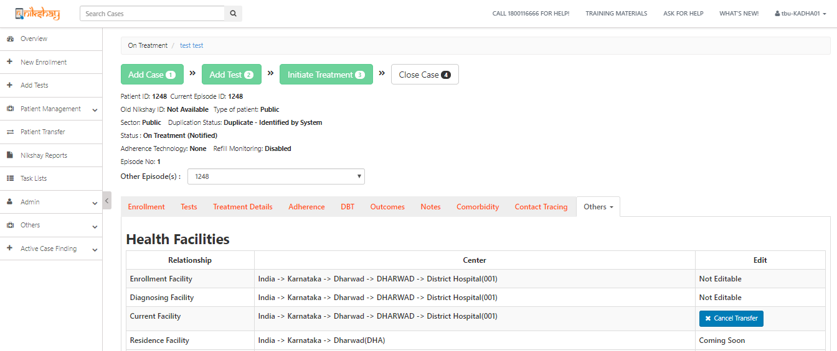
Initiate Transfer Out request-6
If required the user initiating the request can “Cancel Transfer”.
The patient now appears in the “Transfer In” tab where the patient has been transferred to .
Message displayed that Transfer Out request has been completed. Transfer ID is mentioned.
You can also access the transfer details via “Transfer Out” tab of your “Transfer Management” Page

Slide 13
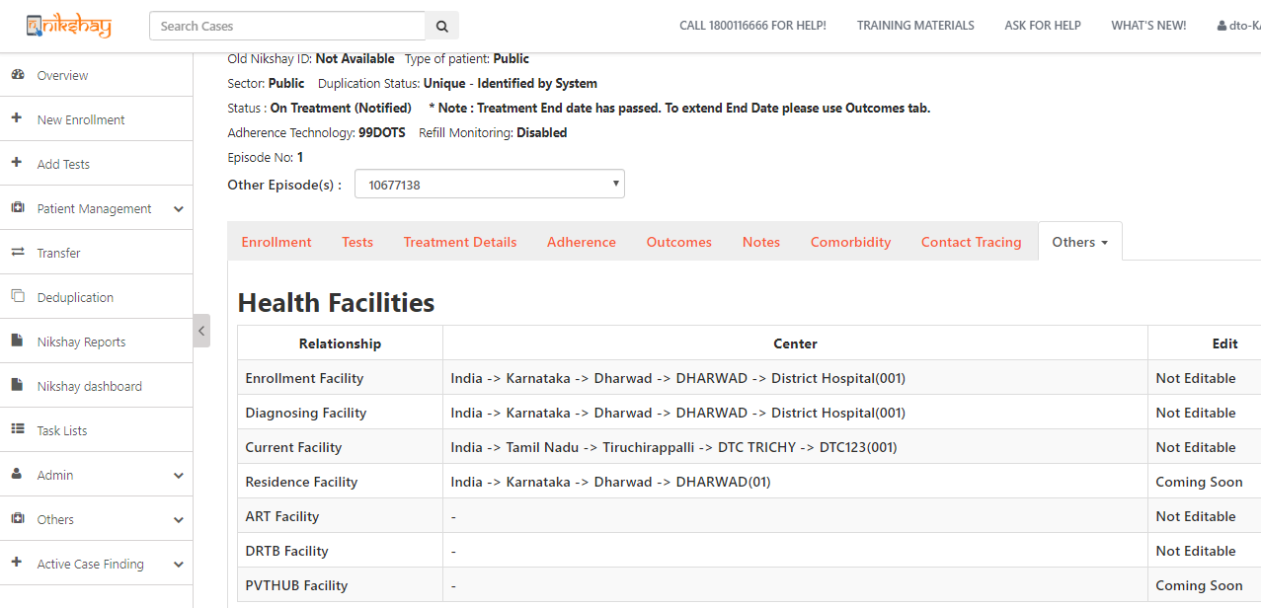
Initiate Transfer Out request-7
When the transfer out request has been accepted by the receiving District / TU/ PHI, then the current facility of the patient will be updated.

Slide 14
1b. Accept Transfer In
Take action where Transfer Out requests made by someone else, and transfer in are pending with you.

Slide 15
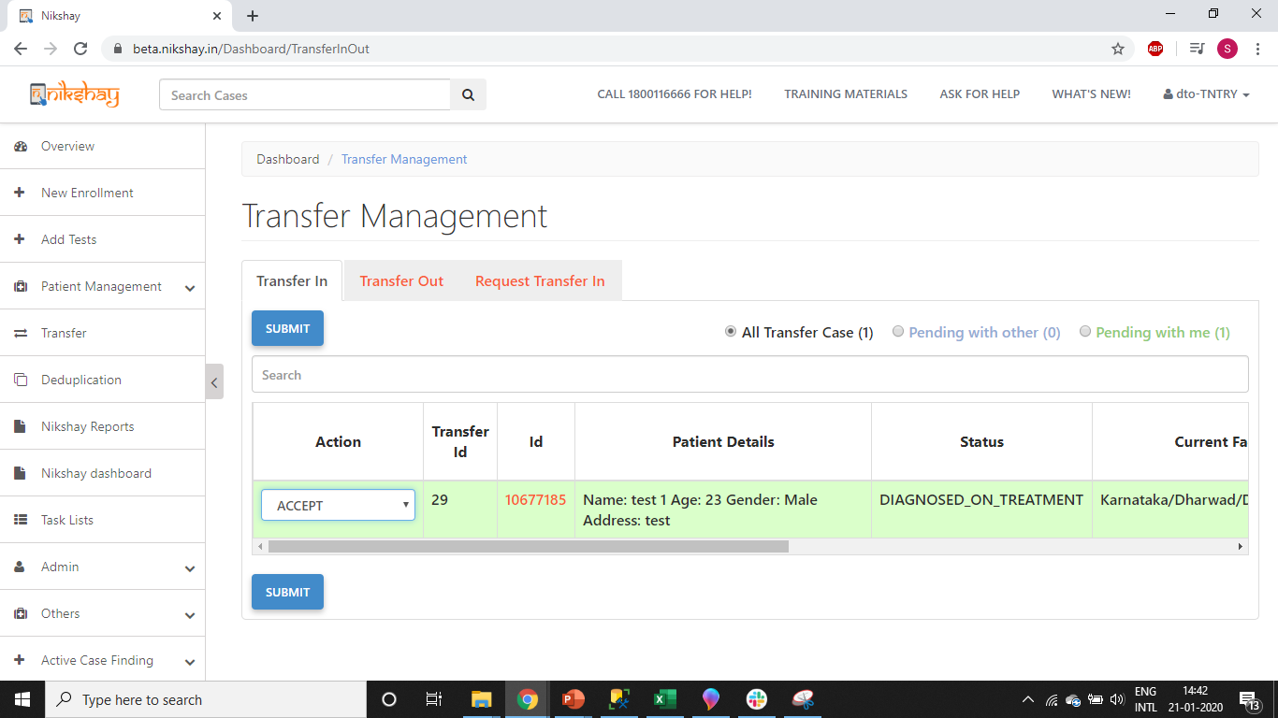
Accept Transfer In-1
Step 1
Select “Accept” in the Dropdown option

Slide 16
Accept Transfer In-2
Step 1
Step 2
Select “Accept” in the Dropdown option
Click on Submit

Slide 17
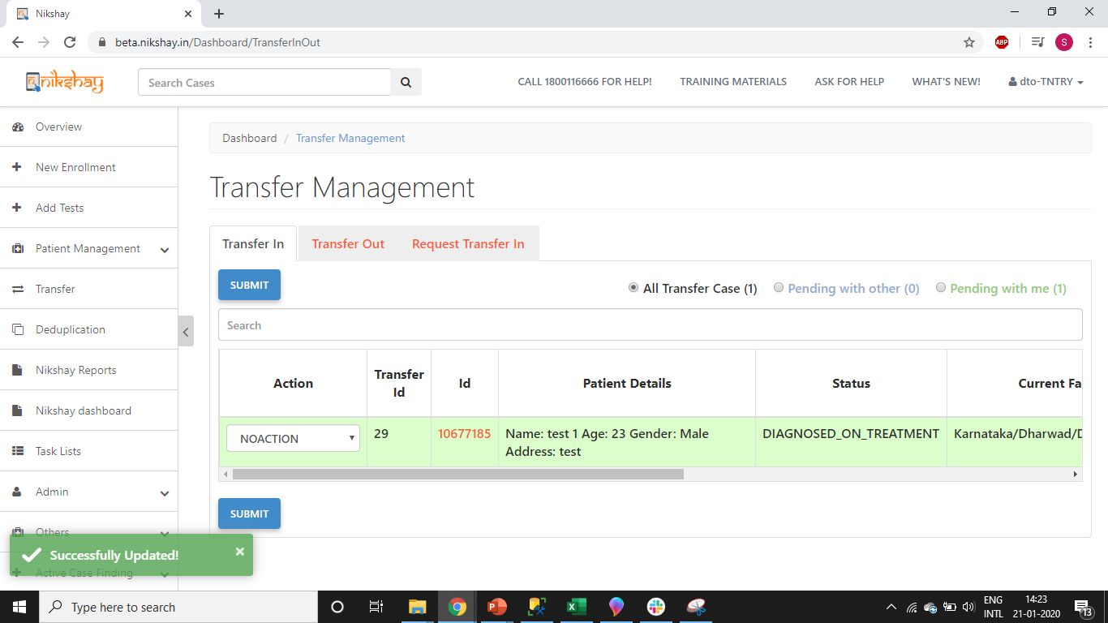
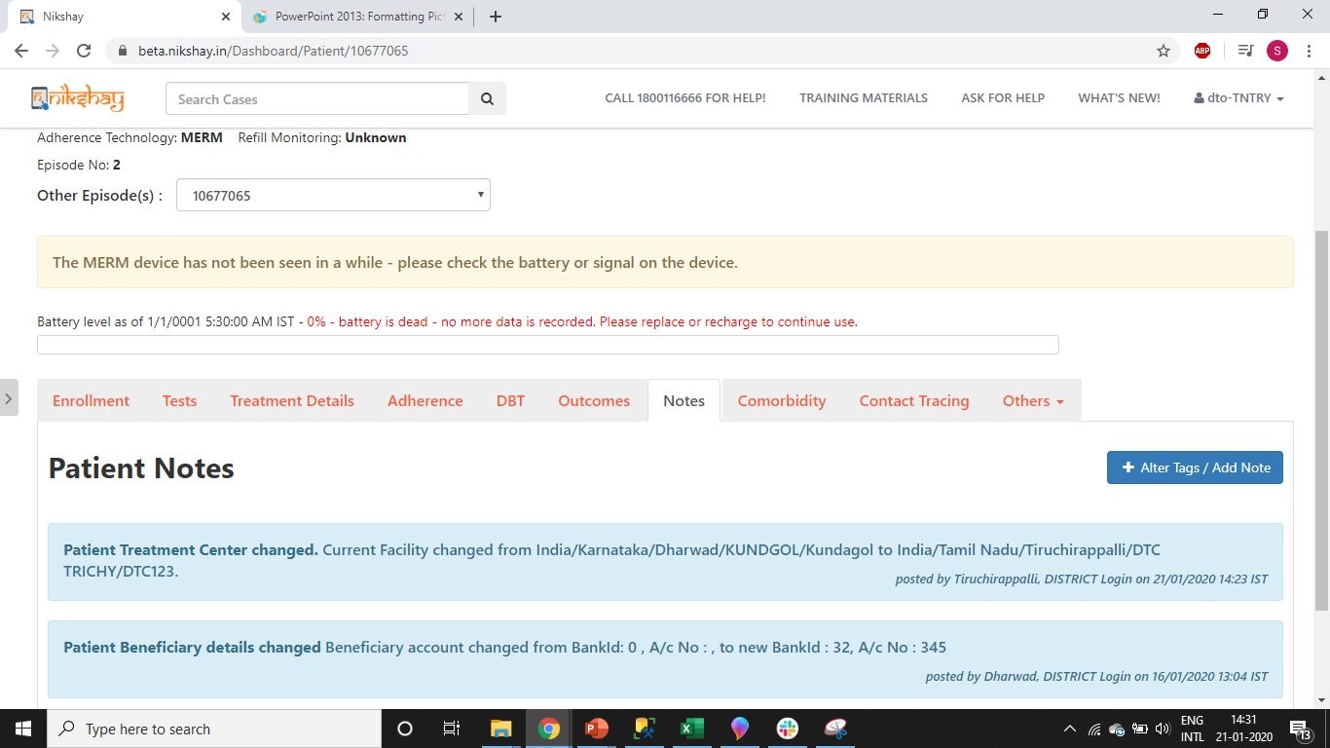
Accept Transfer In-3
Transfer In
Transfer details are displayed in the Notes tab of patient
Message displayed after successful Transfer

Slide 18
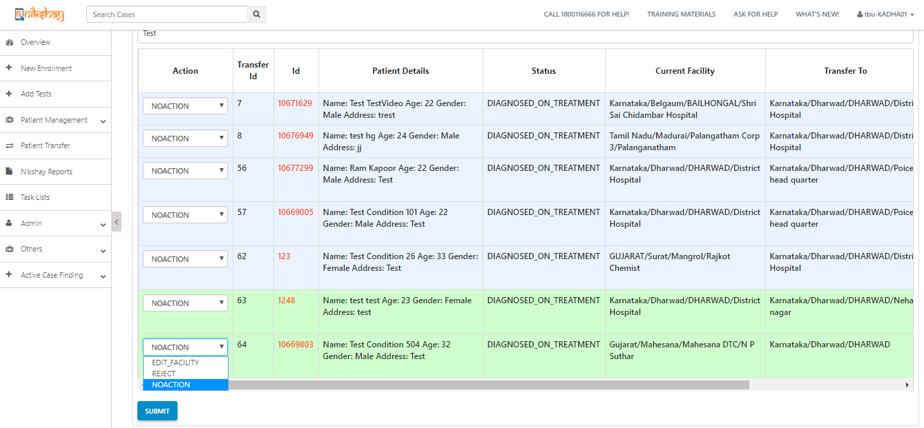
Accept Transfer In-4 (If PHI not assigned)
Step 1
Select ’Assign’ PHI’

Slide 19
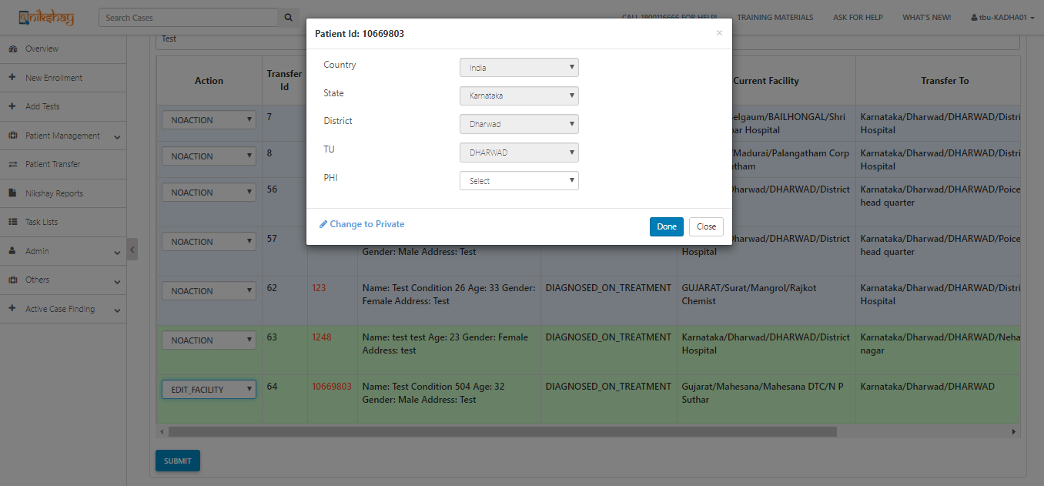
Accept Transfer In-4 (If PHI not assigned)
Step 1
Step 2
Select ’Assign PHI’
Enter the TU/PHI details (if not selected while patient transfer) and click on Done
To accept a patient, user will have to Click Edit Facility and select TU and PHI (if those details were not already entered by referring district). The users will also be able to change the TU/ PHI selected by the referring facility

Slide 20
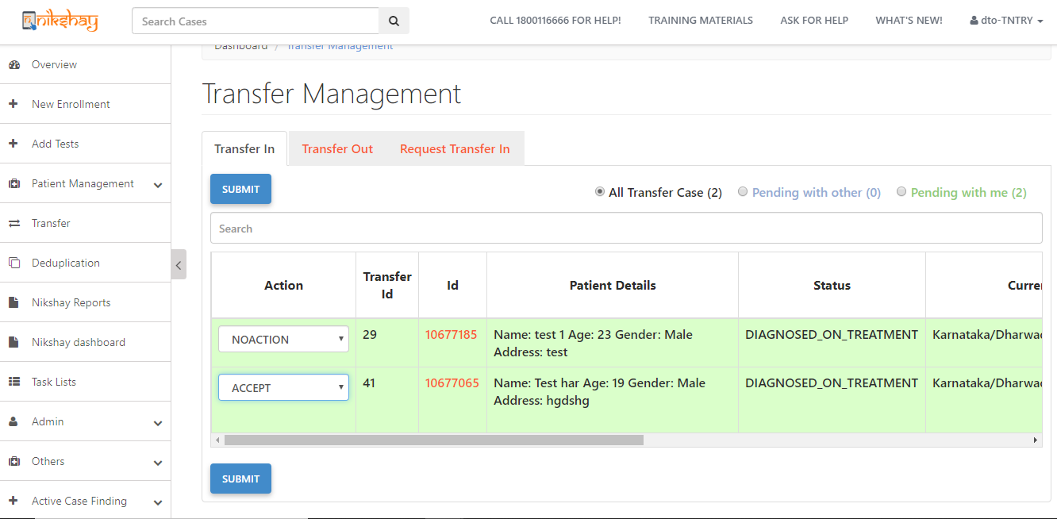
Accept Transfer In-5 (If PHI not assigned)
Step 1
Step 2
Step 3
Select ’Assign PHI’
Enter the TU/PHI details (if not selected while patient transfer) and click on Done
Follow normal accept transfer in process

Slide 21
1c. Reject Transfer In
Take action where Transfer In requests made by someone else, are pending with you.

Slide 22
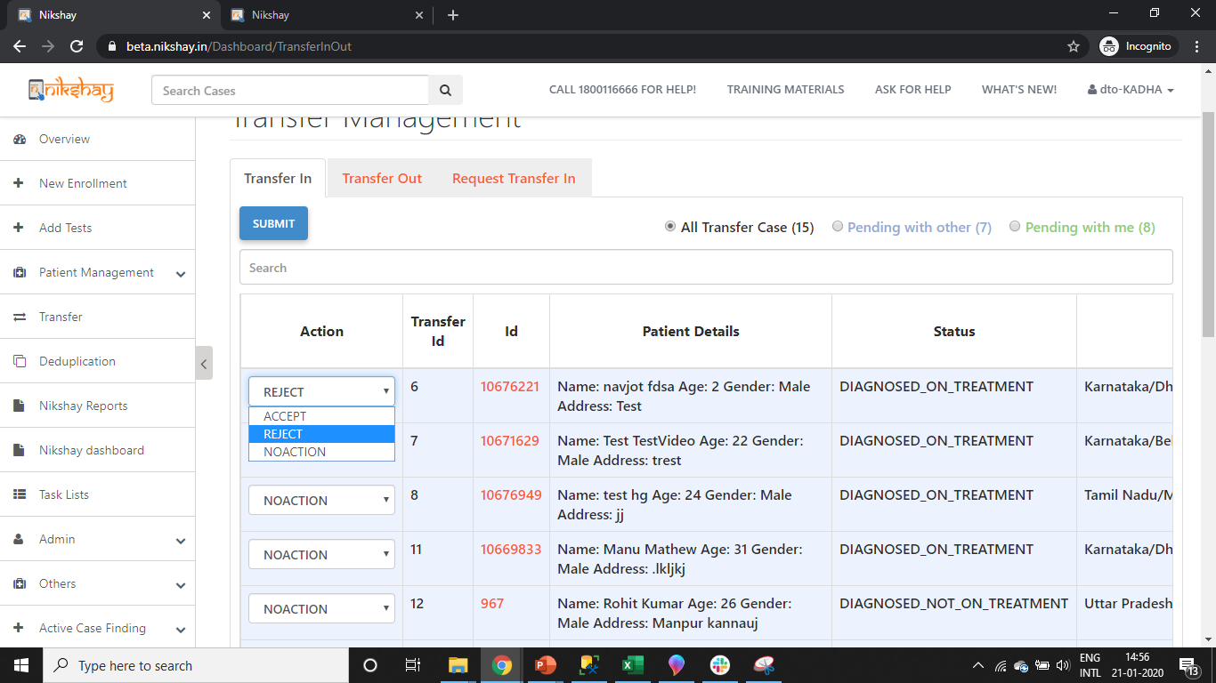
Reject Transfer In-1
Step 1
Select “Reject” in the Dropdown option

Slide 23
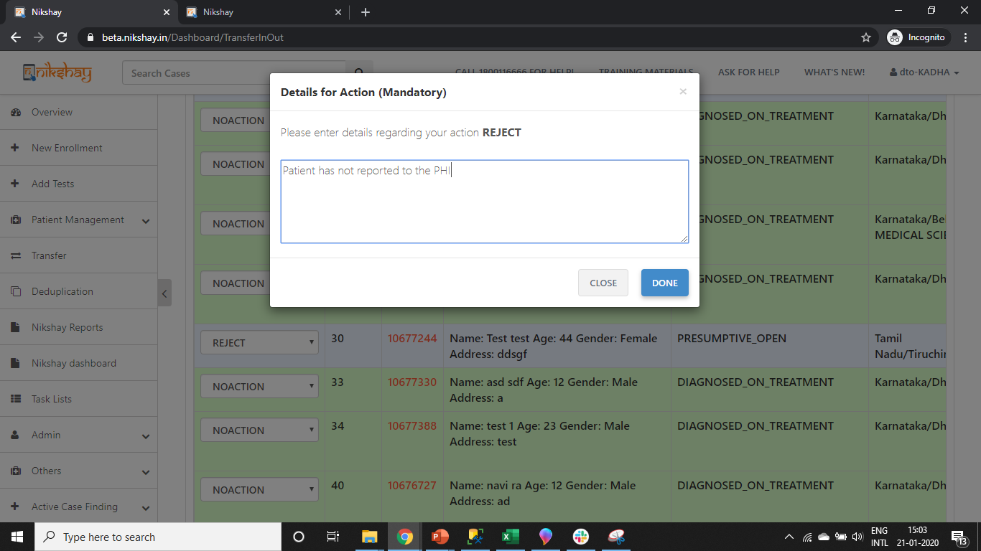
Reject Transfer In-2
Step 1
Step 2
Select “Reject” in the Dropdown option
Enter the reason for Rejection
Mandatory field, if transfer is rejected

Slide 24
Reject Transfer In-3
Step 1
Step 2
Step 3
Select “Reject” in the Dropdown option
Enter the reason for Rejection
Click on Done

Slide 25
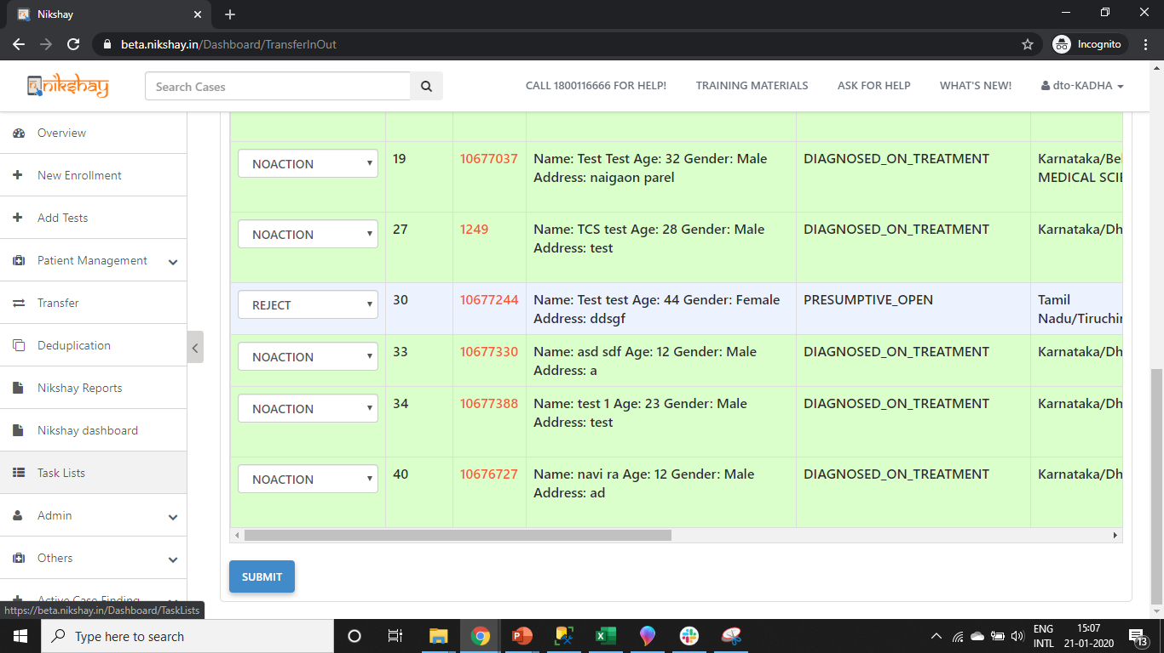
Reject Transfer In-4
Step 1
Step 2
Step 3
Step 4
Select “Reject” in the Dropdown option
Enter the reason for Rejection
Click on Done
Click on Submit

Slide 26
2a. Request Transfer In
In this tab, you can search a patient currently in any other geography or PHI using “Patient ID”/ “Episode Id” or “Patient Mobile Number” and request a transfer in.

Slide 27
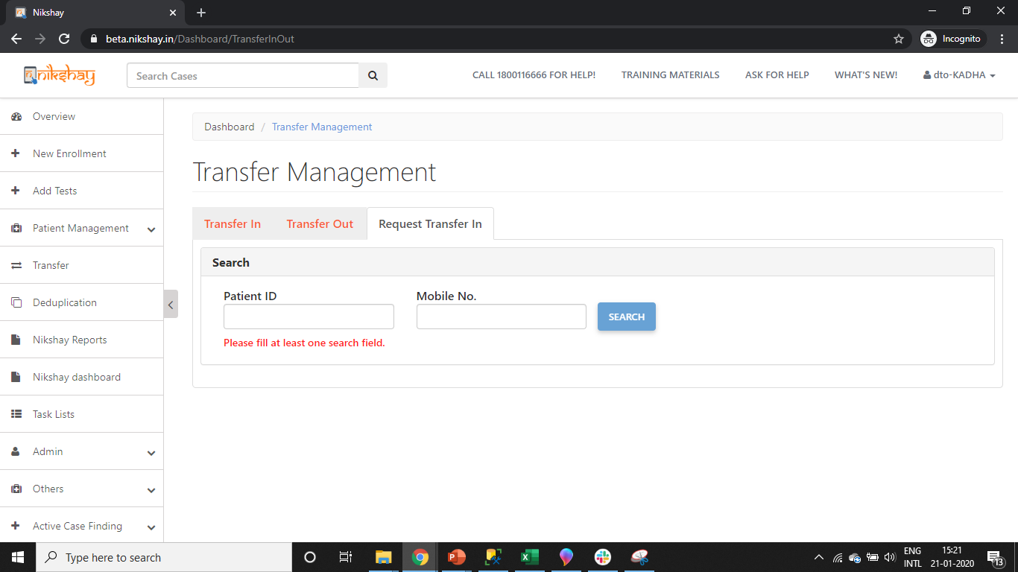
Request Transfer In-1
Step 1
Search for the Patient using his Patient ID or Mobile Number
Patients can be searched, and basic details will be visible to help users select the correct record

Slide 28
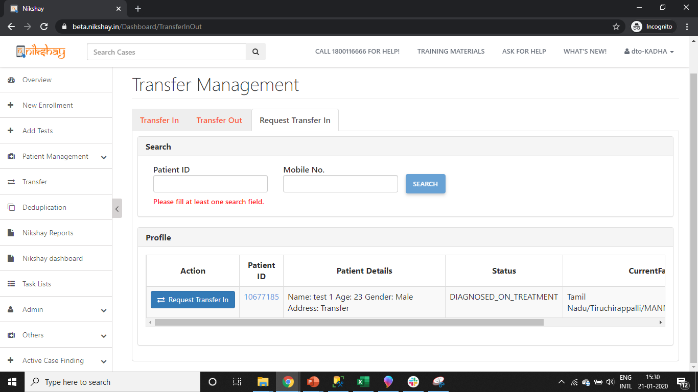
Request Transfer In-2
Step 1
Step 2
Search for the Patient using his Patient ID or Mobile Number
Click on ‘Request Transfer In’

Slide 29
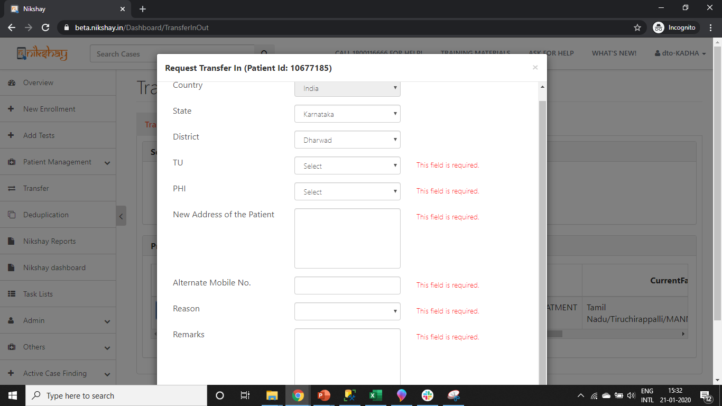
Request Transfer In-3
Step 1
Step 1
Step 2
Step 3
Search for the Patient using his Patient ID or Mobile Number
Search for the Patient using his Patient ID or Mobile Number
Click on ‘Request Transfer In’
Enter Mandatory Information

Slide 30
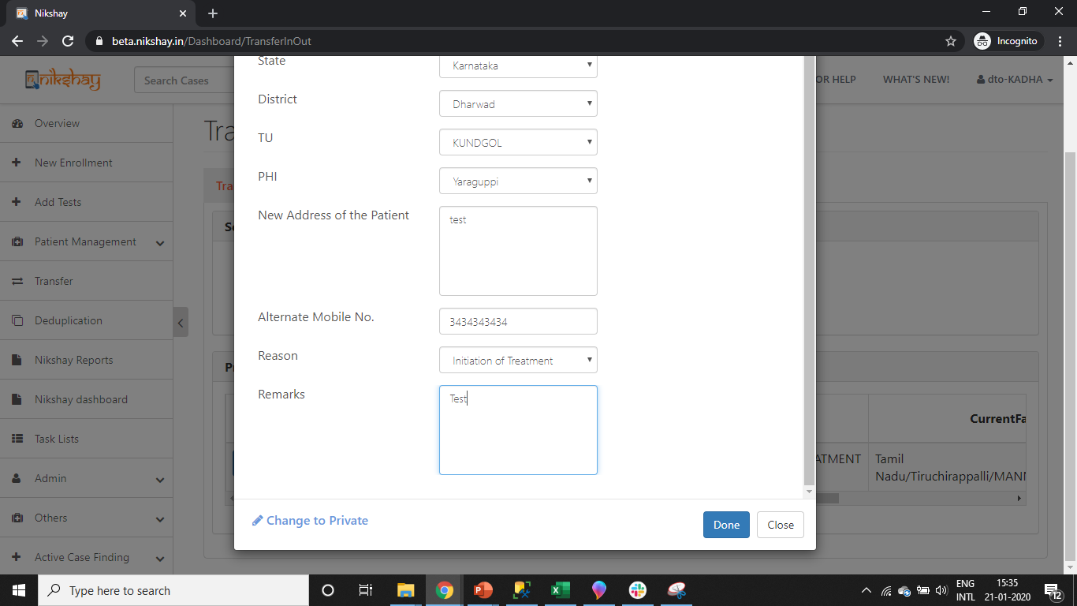
Request Transfer In-4
Step 1
Step 4
Step 1
Step 2
Step 3
Search for the Patient using his Patient ID or Mobile Number
Click on Done
Search for the Patient using his Patient ID or Mobile Number
Click on ‘Request Transfer In’
Enter Mandatory Information

Slide 31
Request Transfer In-5
Step 1
Step 4
Step 1
Step 2
Step 3
Search for the Patient using his Patient ID or Mobile Number
Click on Done
Search for the Patient using his Patient ID or Mobile Number
Click on ‘Request Transfer In’
Enter Mandatory Information
Only Initiated PHI / TU / District can “Cancel Transfer”
Action updated after successful Transfer
Message displayed after successful Request for Transfer IN

Slide 32
2b.Accept Transfer Out Request
A Transfer in Request initiated by you can be cancelled

Slide 33
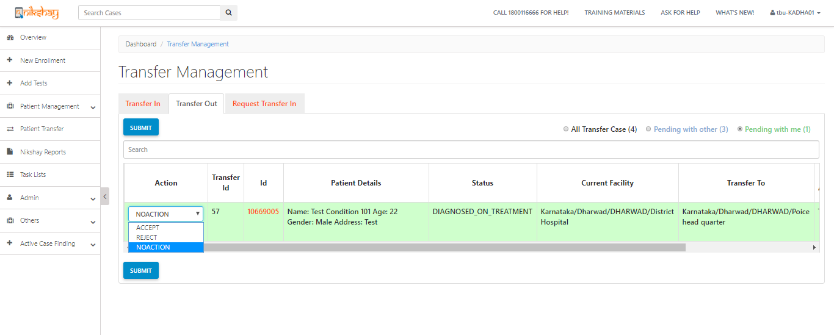
Accept Transfer Out Request-1
Step 1
Step 1
Search for the Patient using his Patient ID or Mobile Number
Click on Patient Transfer → Transfer Out
Click here to view those request that are pending with you

Slide 34
Accept Transfer Out Request-2
Step 1
Step 1
Step 2
Search for the Patient using his Patient ID or Mobile Number
Click on Patient Transfer → Transfer Out
Click on ‘Accept’
Message displayed after Transfer is accepted

Slide 35
2c.Reject Transfer Out Request
A Transfer in Request initiated by you can be cancelled

Slide 36
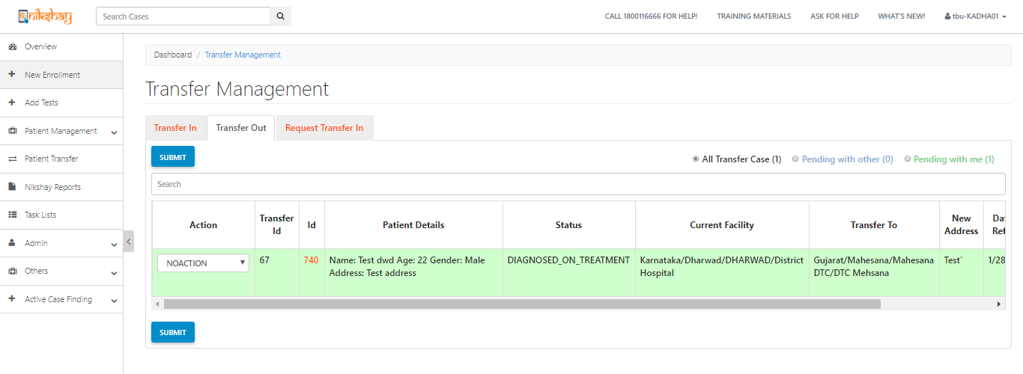
Reject Transfer Out Request-1
Step 1
Step 1
Search for the Patient using his Patient ID or Mobile Number
Click on Patient Transfer → Transfer Out
Click here to view those request that are pending with you

Slide 37
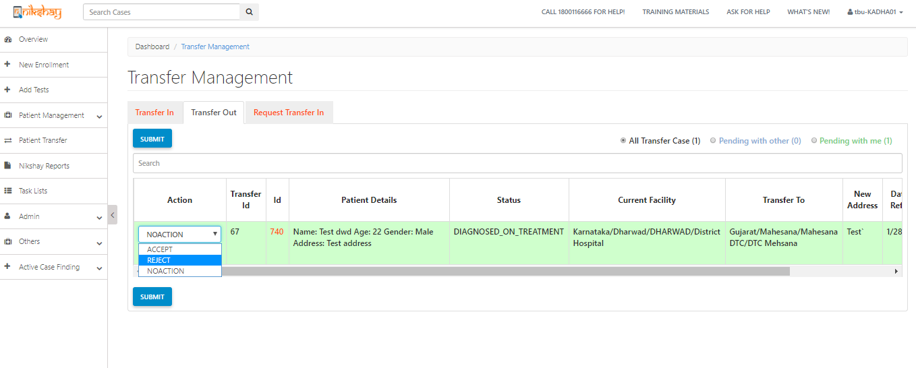
Reject Transfer Out Request-2
Step 1
Step 1
Step 2
Search for the Patient using his Patient ID or Mobile Number
Click on Patient Transfer → Transfer Out
Click on ‘Reject’

Slide 38
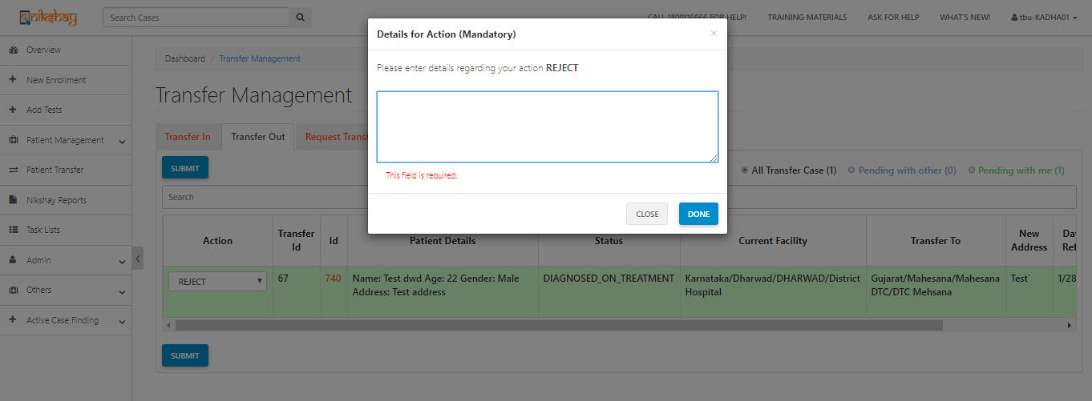
Reject Transfer Out Request-3
Step 1
Step 1
Step 2
Step 3
Search for the Patient using his Patient ID or Mobile Number
Click on Patient Transfer → Transfer Out
Click on ‘Reject’
Enter Mandatory Information
Mandatory field, if transfer is rejected

Slide 39
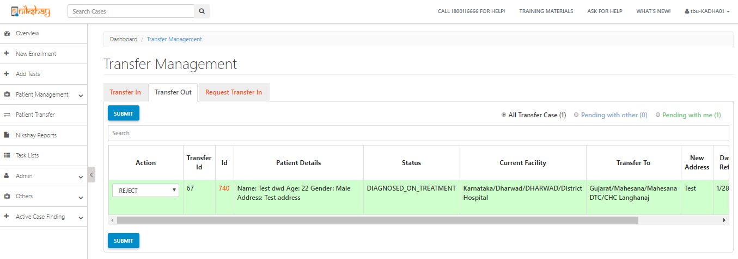
Reject Transfer Out Request-4
Step 1
Step 4
Step 1
Step 2
Step 3
Search for the Patient using his Patient ID or Mobile Number
Click on “Submit”
Click on Patient Transfer → Transfer Out
Click on ‘Reject’
Enter Mandatory Information
Message displayed after Transfer Request is Rejected

Slide 40
2d.Cancel Request Transfer In
A Transfer in Request initiated by you can be cancelled

Slide 41
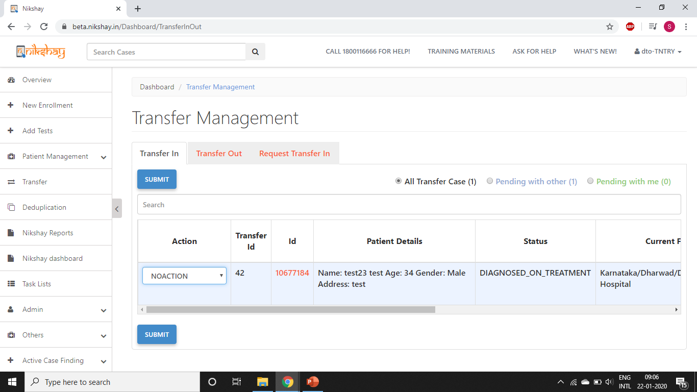
Cancel Transfer In Request
Step 1
Click on “Transfer In” Option

Slide 42
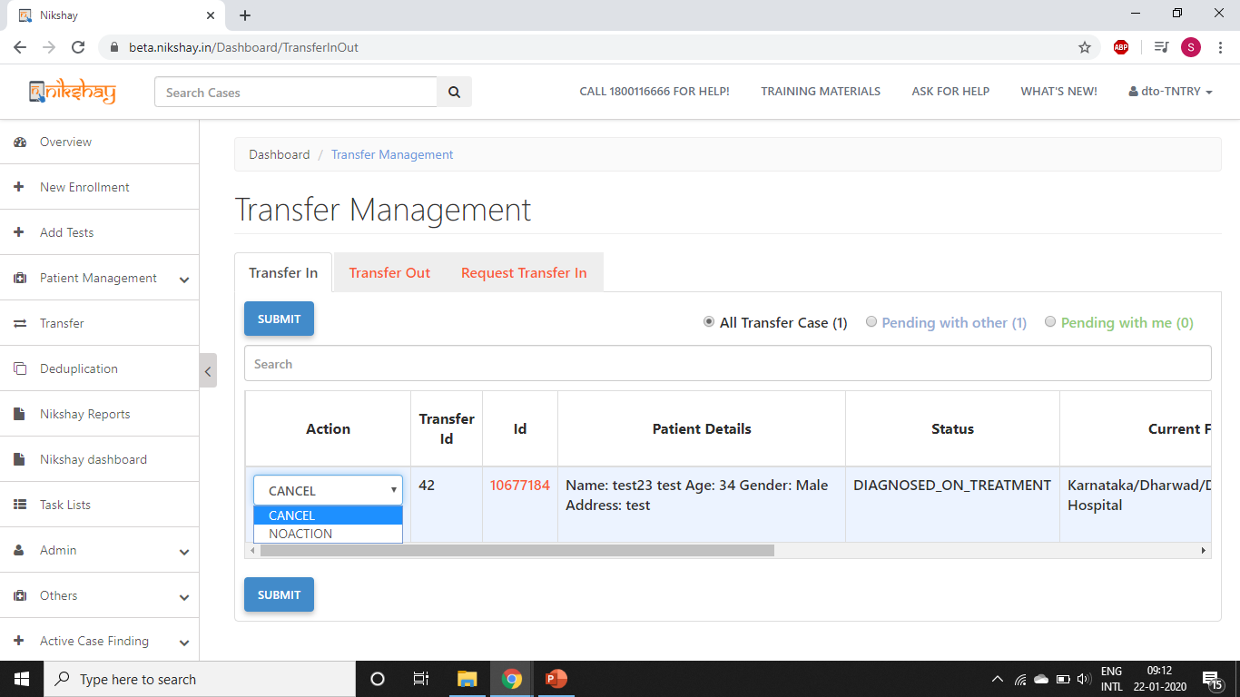
Cancel Transfer In Request
Step 1
Step 2
Click on “Transfer In” Option
Select ‘Cancel’

Slide 43
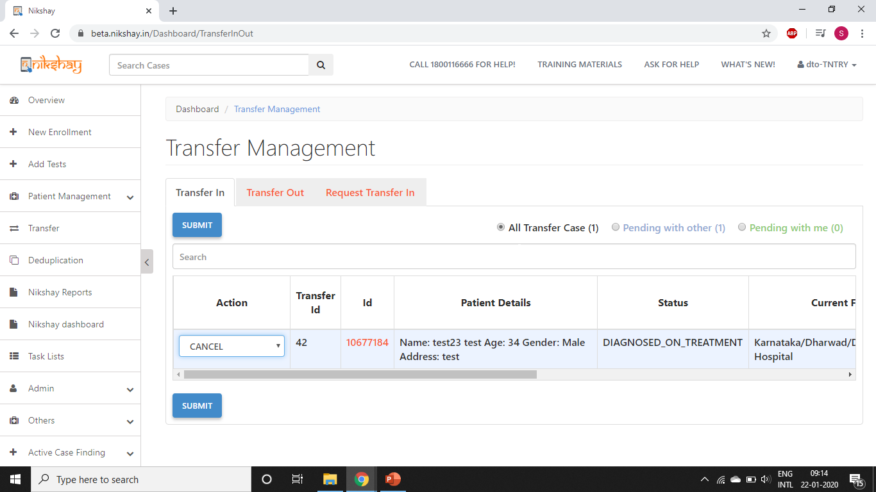
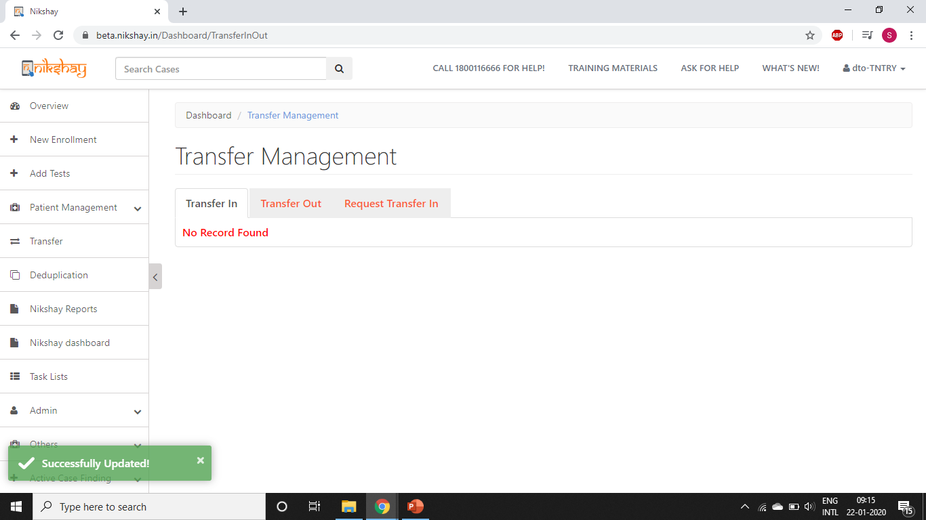
Cancel Transfer In Request
Step 1
Step 2
Step 3
Click on “Transfer In” Option
Select ‘Cancel’
Click on Submit Button
Message displayed after Cancellation of Transfer IN request

Slide 44
Thank You

