Slide 1
Adherence Summary View
Training Material

Slide 2
Overview of Adherence Summary View..1
The Adherence Summary Graph that was available earlier on the Nikshay App was widely used by the staff to monitor daily adherence of all patients. It had been removed some time back and this resulted in a lack of real time adherence data at the field level to monitor the daily adherence of all patients on treatment at once. Checking the Adherence calendar of each patient to monitor if they have taken the dose or not, was proving to be challenging.
To resolve this lack of real time data for adherence monitoring, the Adherence Summary view is designed primarily for treatment supporters and field staff to help them monitor the day to day adherence metrics for their patients and provide them an option to act on this data wherever required.

Slide 3
Overview of Adherence Summary View..2
The Adherence Summary View enables staff at District Level hierarchies and below (Level 3,4,5) to view real time adherence information of all ‘On Treatment Patients’. This view provides a summary of
The Number of Patients currently enrolled on various Digital Adherence Technologies(99DOTS, MERM, VOT)
The Average Adherence of all patients on treatment
The Digital Adherence of all patients on treatment
Real time update on the number of patients who have reported a dose(Digital+Manual) for the day and the number of patients who are yet to report a dose.
Adherence Task Lists

Slide 4
Adherence Dashboard vs Adherence Summary View
Differences between Adherence Dashboard and Adherence Summary View
 | Adherence Dashboard | Adherence Summary view
Primarily designed for | Administrative Staff and decision makers - CTD, WHO, DTO, STO | Field Staff - Treatment Supporter, STS, TBHV
Type | Analytical | Actionable
Aggregated across | Any level from PHI to national | PHI/TU/District
Data availability | T-1 | Real-time
Patients | Current + historical (on and off treatment) | Current (on treatment)

Slide 5
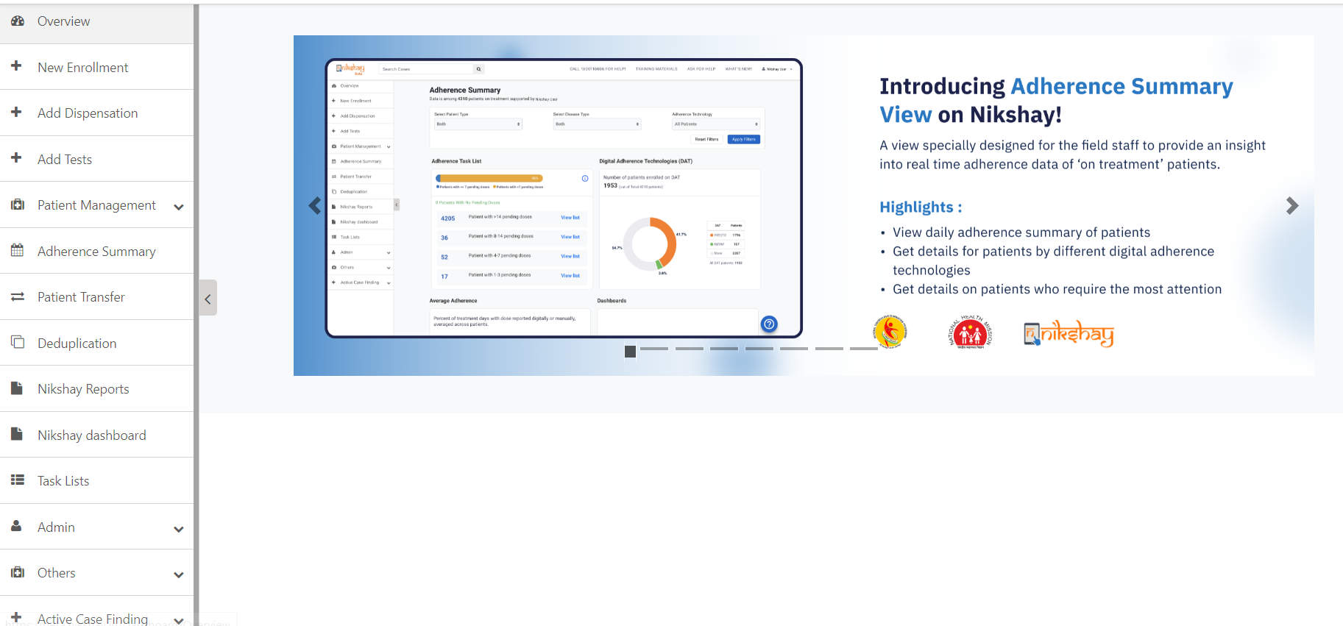
Adherence Summary View (Web)
Click here to view the Adherence Summary Page

Slide 6
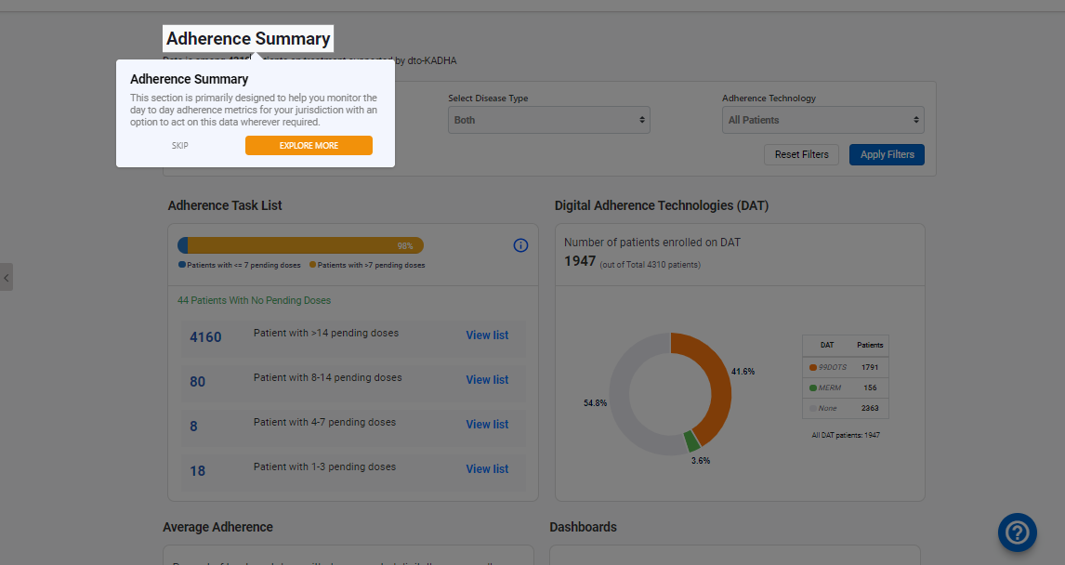
Adherence Summary View - Walkthrough
Click on the ‘Explore More’ button for a demo on how to use the Adherence Summary View.
Click ‘Skip’ if you do not wish to view the guided tour.
Click here to view the tutorial again.

Slide 7
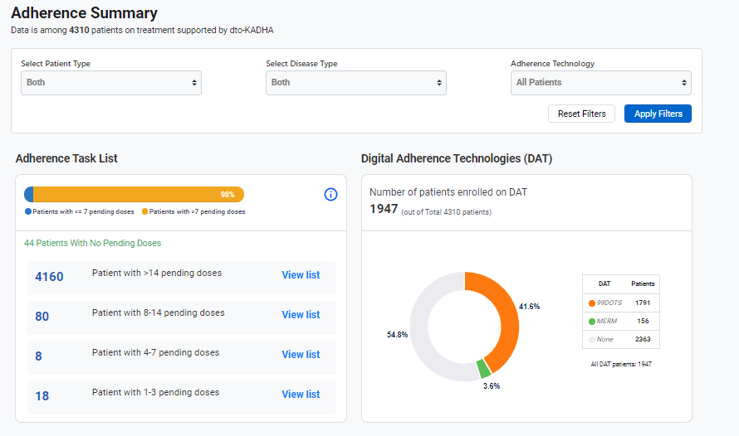
Adherence Summary View
This count represents the number of patients ‘On Treatment’ based on the filters selected.
Click here to select the Patient Type
Click here to select the Disease Type
Click here to select all patients or a subset of patients on a specific DAT

Slide 8
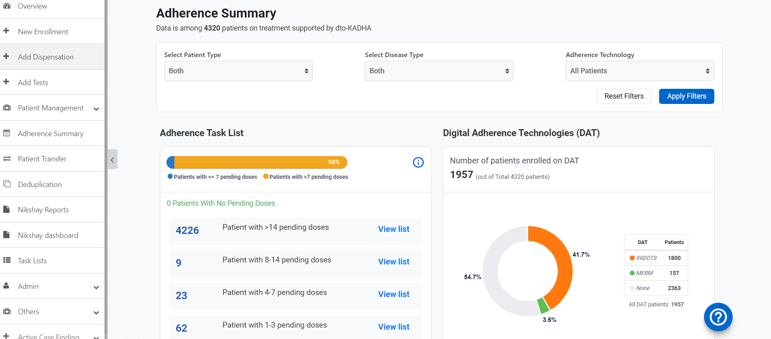
Adherence Summary View – All Patients
Step 1
Step 2
Select ‘All Patients’ in the Adherence Technology dropdown
Click on ‘Apply Filters’
Patients with <7 unreported (missing adherence or manually confirmed missed dose starting with yesterday's dose) appear in the blue bucket, patients with >7 unreported doses appear in the Yellow bucket.
Click here to view the list of patients appearing in the bucket
This graph displays the number of patients allocated on each adherence technology
This graph displays the number of patients who have missed consecutive doses in the following buckets.

Slide 9
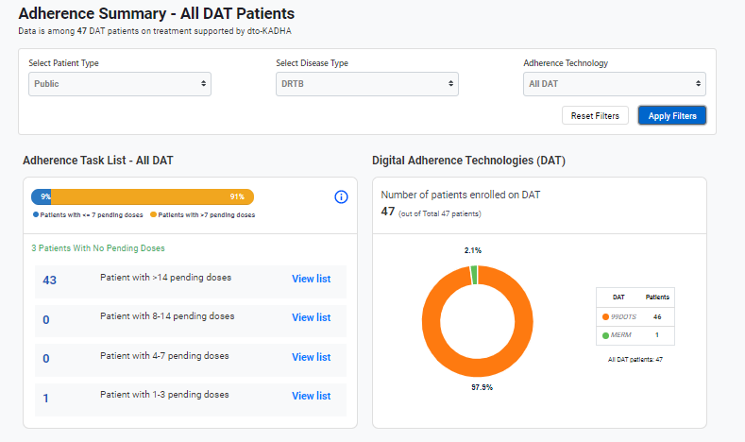
Adherence Summary View – DAT Patients
Step 1
Select ‘All DAT’ in the Adherence Technology dropdown
Step 2
Click on ‘Apply Filters’
This graph displays the number of patients allocated on each adherence technology

Slide 10
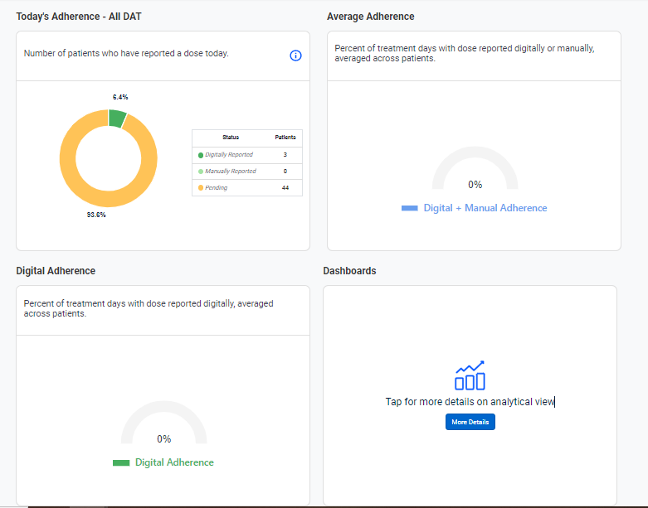
Adherence Summary View - DAT Patients
This graph displays the number of patients who have reported a dose today
This graph displays average adherence(digitally reported + manually marked doses) of the selected cohort
This graph displays average tech only adherence of the selected cohort
On Clicking here, you will be redirected to the ‘Adherence Dashboard’

Slide 11
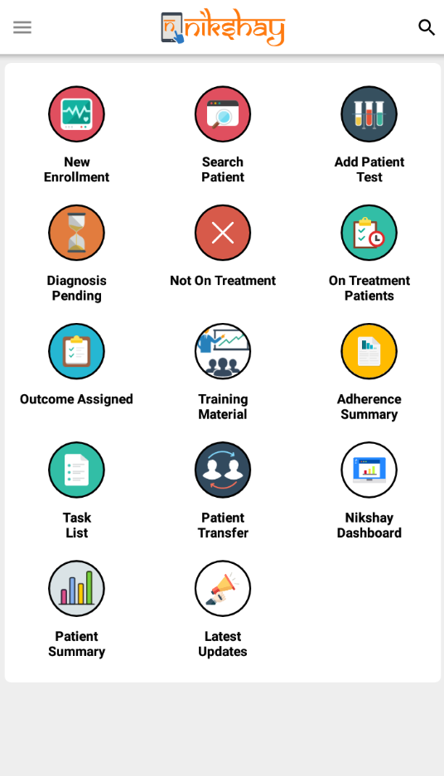
Adherence Summary View (App)
Click here to view the Adherence Summary Page

Slide 12
Adherence Summary View (Walkthrough)
Click the ‘X’ icon if you do not wish to view the guided tour.
Click the ‘?’ icon to view the instructions and click on the icon beside it ’ icon to share guided tour.
Click on the ‘Continue’ button for a demo on how to use the Adherence Summary View.

Slide 13
Adherence Summary View (App)
This count represents the number of patients ‘On Treatment’ based on the filters selected.
You will be able to select filters for the Patient Type(Public, Private, Both), Disease Type (DRTB, DSTB, Both) and the Adherence Technologies that are available based on the login.
Click here to set filters for the Adherence View

Slide 14
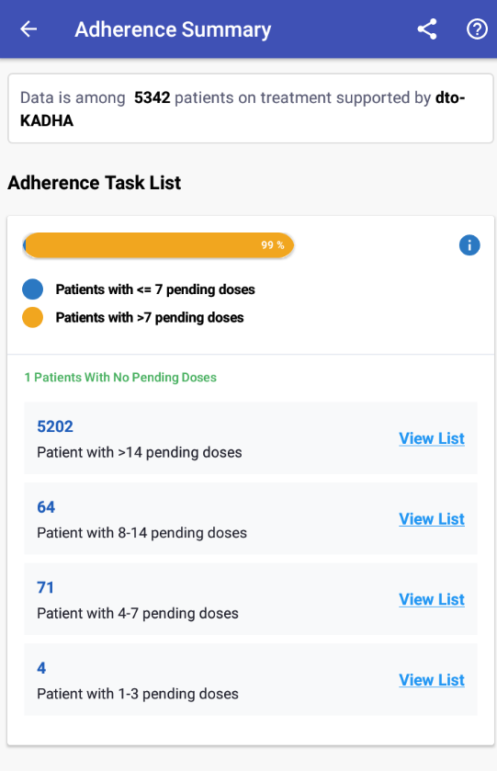
Adherence Summary View (All Patients)
Patients with <7 unreported (missing adherence or manually confirmed missed dose starting with yesterday's dose) appear in the blue bucket, patients with >7 unreported doses appear in the Yellow bucket.
Click here to view the list of patients appearing in the bucket
This graph displays the number of patients who have missed consecutive doses in the following buckets.

Slide 15
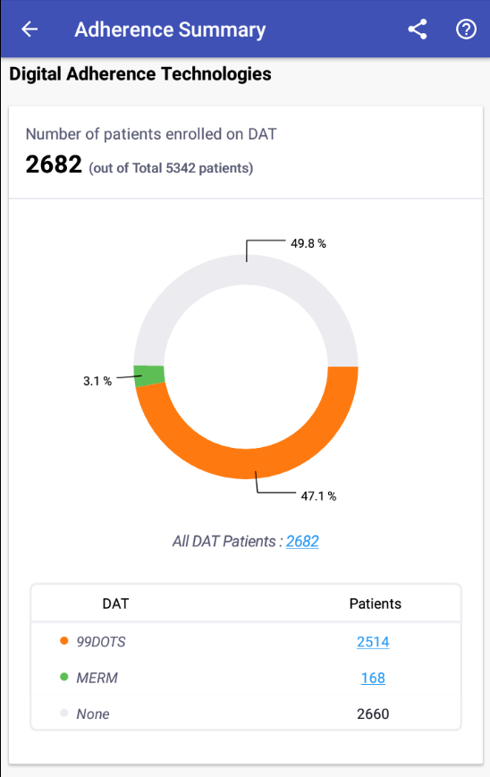
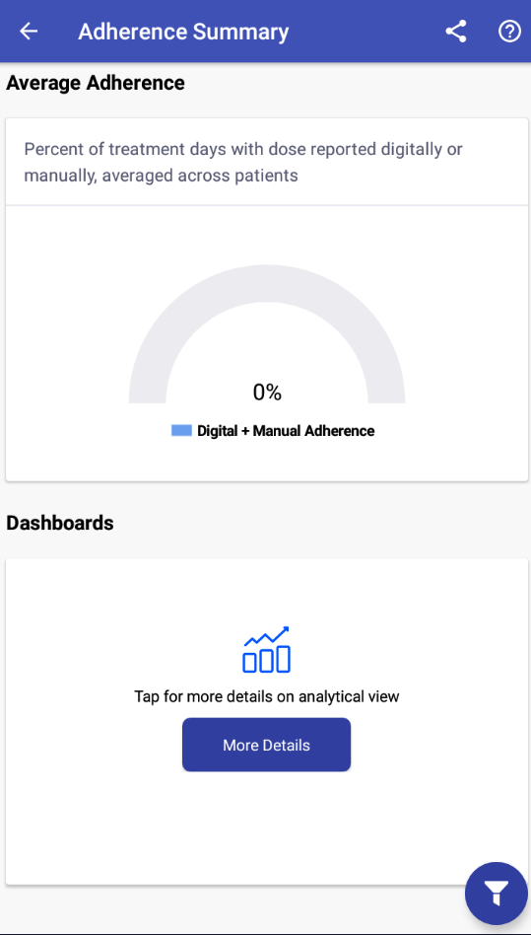
Adherence Summary View (App)
This graph displays average adherence(digitally reported + manually marked doses) of the selected cohort
This graph displays the number of patients allocated on each adherence technology and on NONE
On Clicking here, you will be redirected to the ‘Adherence Dashboard’

Slide 16
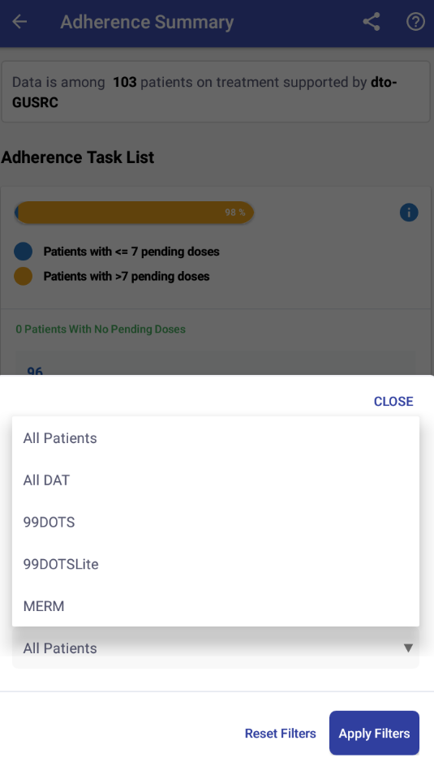
Adherence Summary View (All DAT Patients)
Select “All DAT” to view the adherence statistics of all patients enrolled on any of the Digital Adherence Technologies or select any of the available DATs and click on ‘Apply Filter’

Slide 17
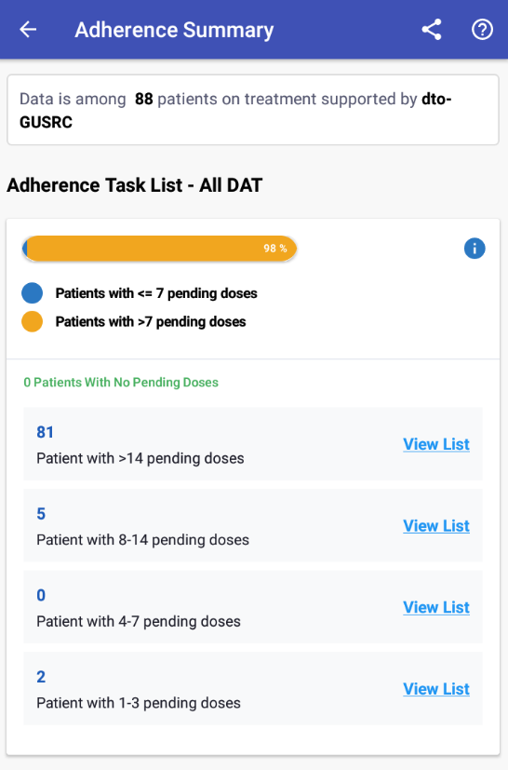
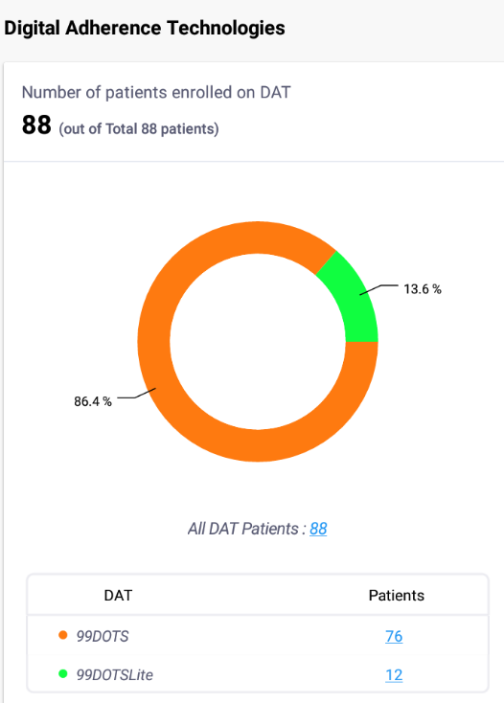
Adherence Summary View (All DAT Patients)
This count represents the number of patients ‘On Treatment’.
This graph displays the number of patients allocated on each adherence technology

Slide 18
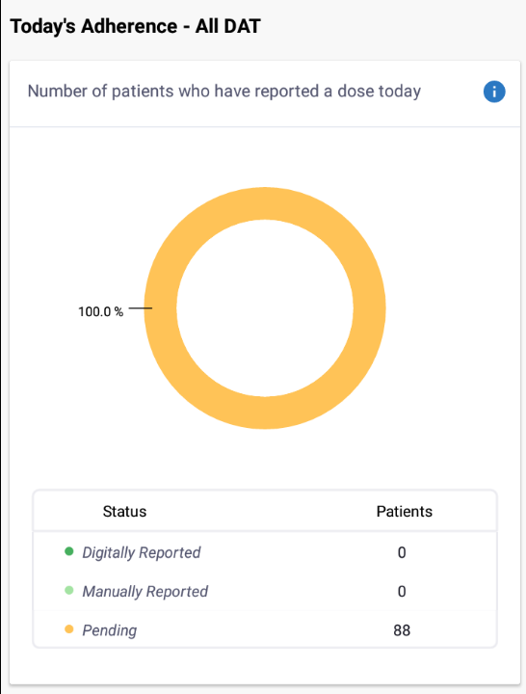
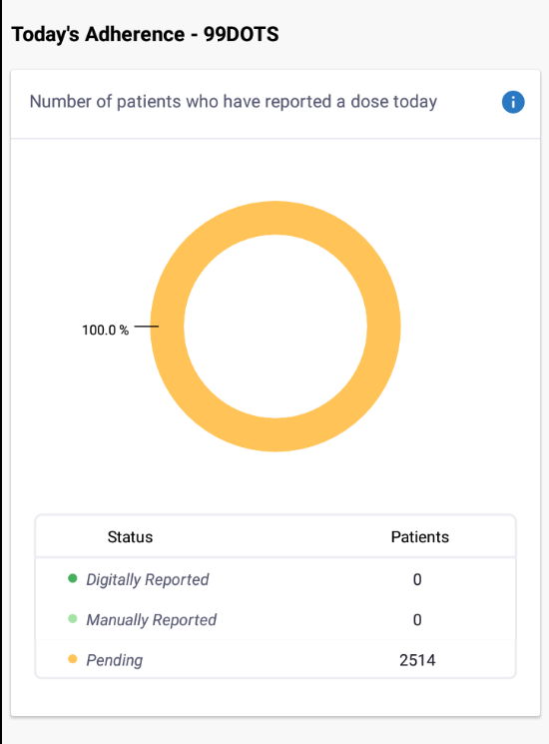
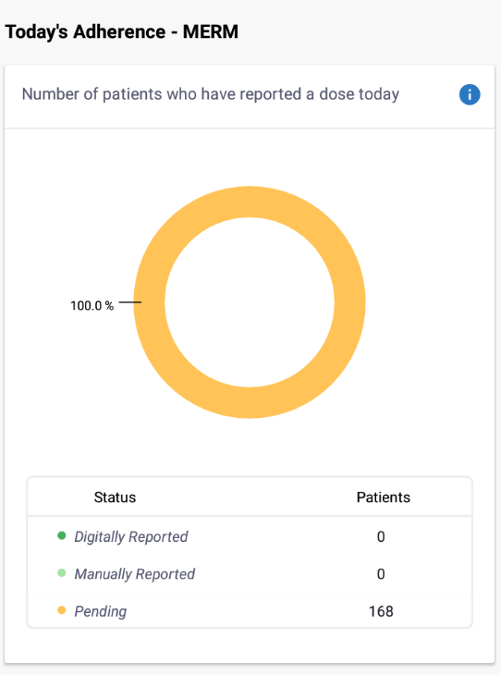
Adherence Summary View (App)
These graphs displays the number of patients who have reported a dose today based on the filters selected.

Slide 19
Thank you

