Slide 1
Addition of Cy-Tb test as a Diagnostic test for TB Infection

Slide 2
Cy-TB
In 2023-24, the program priority for TPT is institution-based mapping of other risk groups for TPT by districts. To ensure that all eligible individuals receive preventive treatment, a new test type ‘Cy-Tb’ has been made available in the test type options in addition to TST and IGRA which are already available.
This test will be visible if Reason for Testing is selected as ‘Diagnosis of TBI’
The test will be visible for all level 5 facilities.
On selection of ‘Positive’ as the final interpretation value, the stage of the patient will change to ‘Diagnosed But Pending Treatment (Notified)’’
TPT Workflows will be triggered upon addition of a positive Cy-TB test is added.

Slide 3
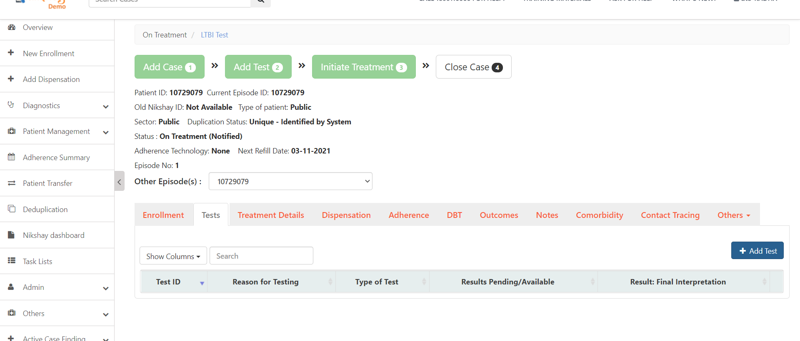
Adding Test for TBI Beneficiary ..1
Step 1
Click on Tests Tab and click on the ‘Add Test’ Button

Slide 4
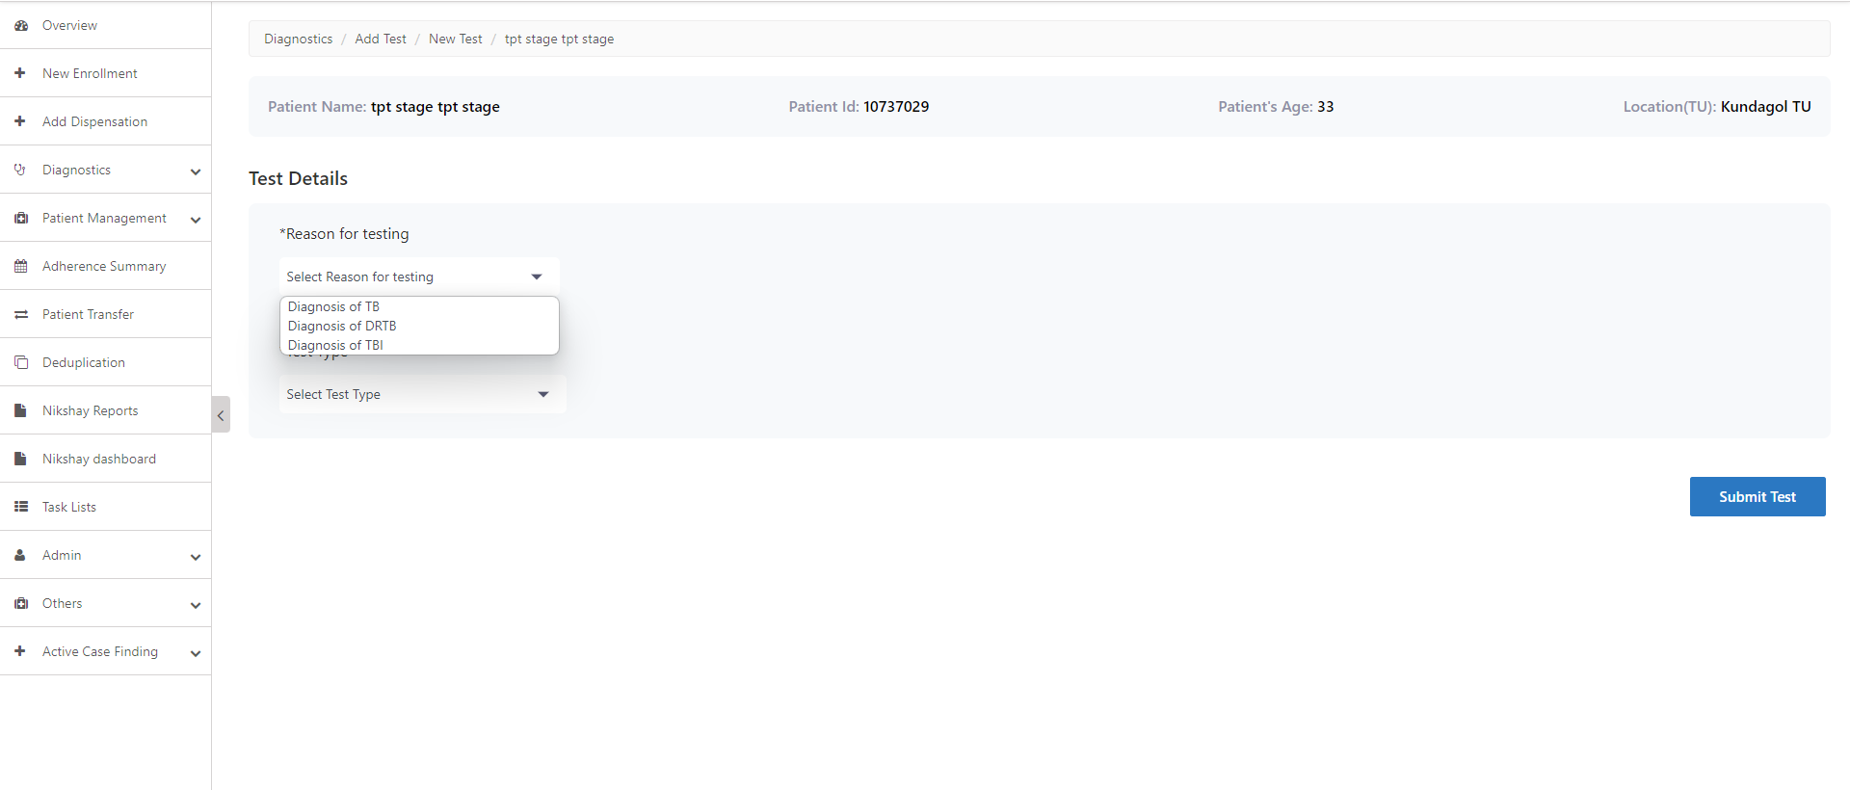
Adding Test for TBI Beneficiary..2
Step 1
Step 2
Click on Tests Tab and click on the ‘Add Test’ Button
Select Reason for Testing

Slide 5
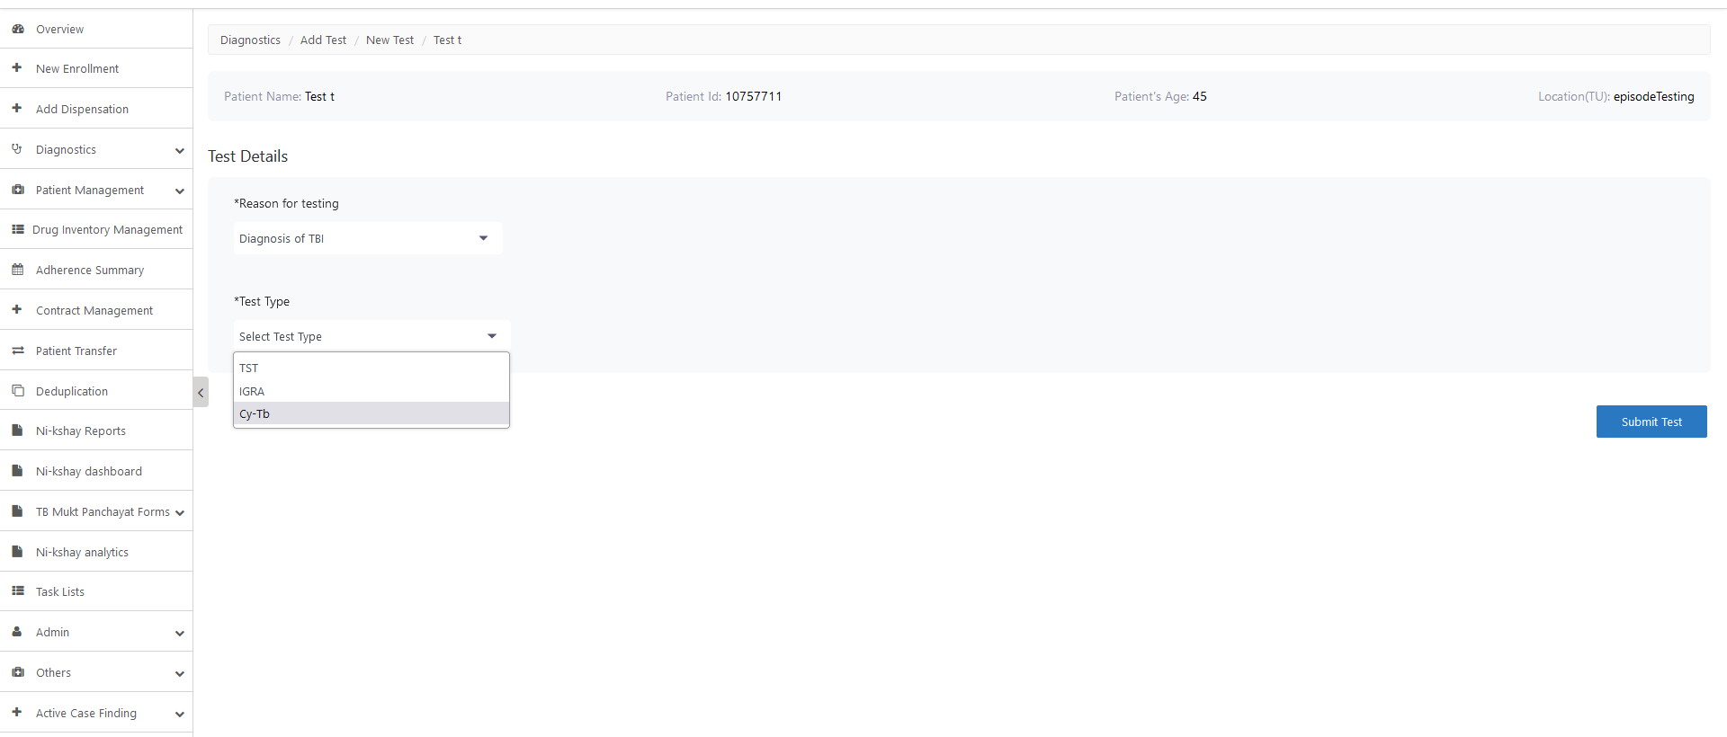
Adding Test for TBI Beneficiary..3
Step 1
Step 2
Step 3
Click on Tests Tab and click on the ‘Add Test’ Button
Select Reason for Testing
Select Cy-Tb

Slide 6
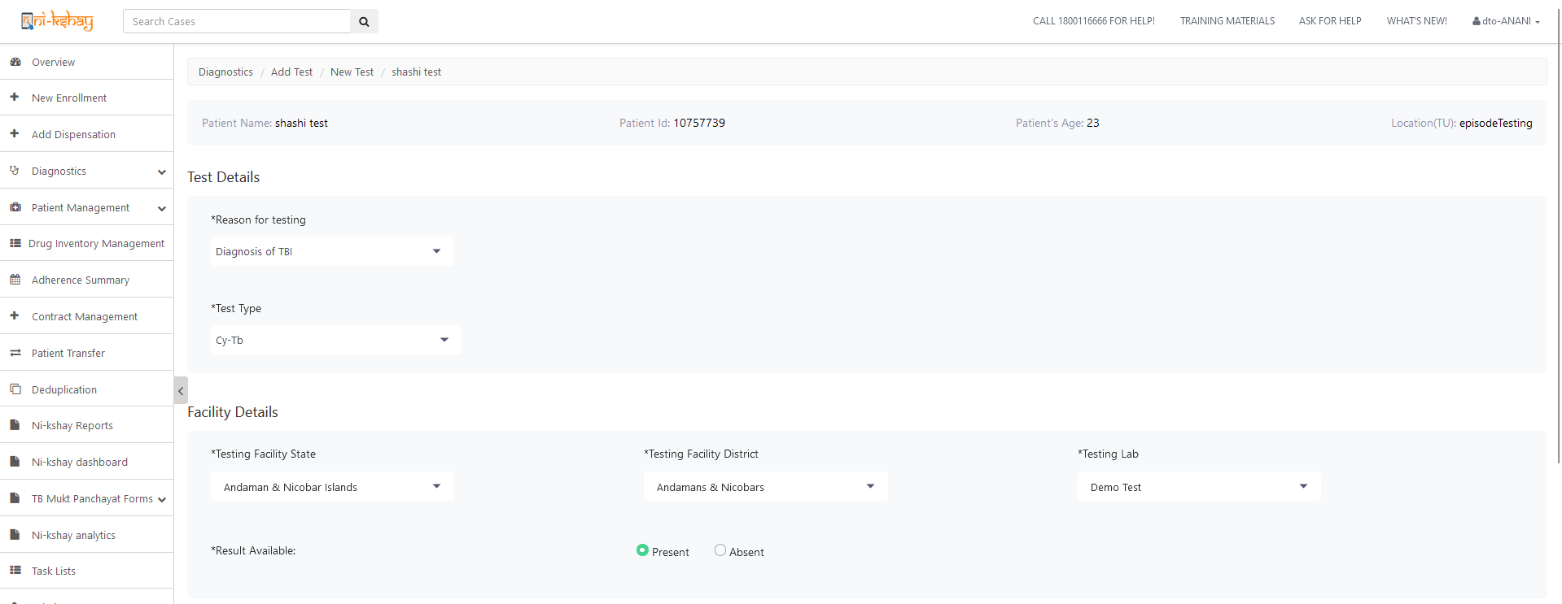
Adding Test for TBI Beneficiary..4
Step 1
Step 2
Step 3
Step 4
Click on Tests Tab and click on the ‘Add Test’ Button
Select Reason for Testing
Select Test Type
Select Facility Details
If results are available , select ‘Present’

Slide 7
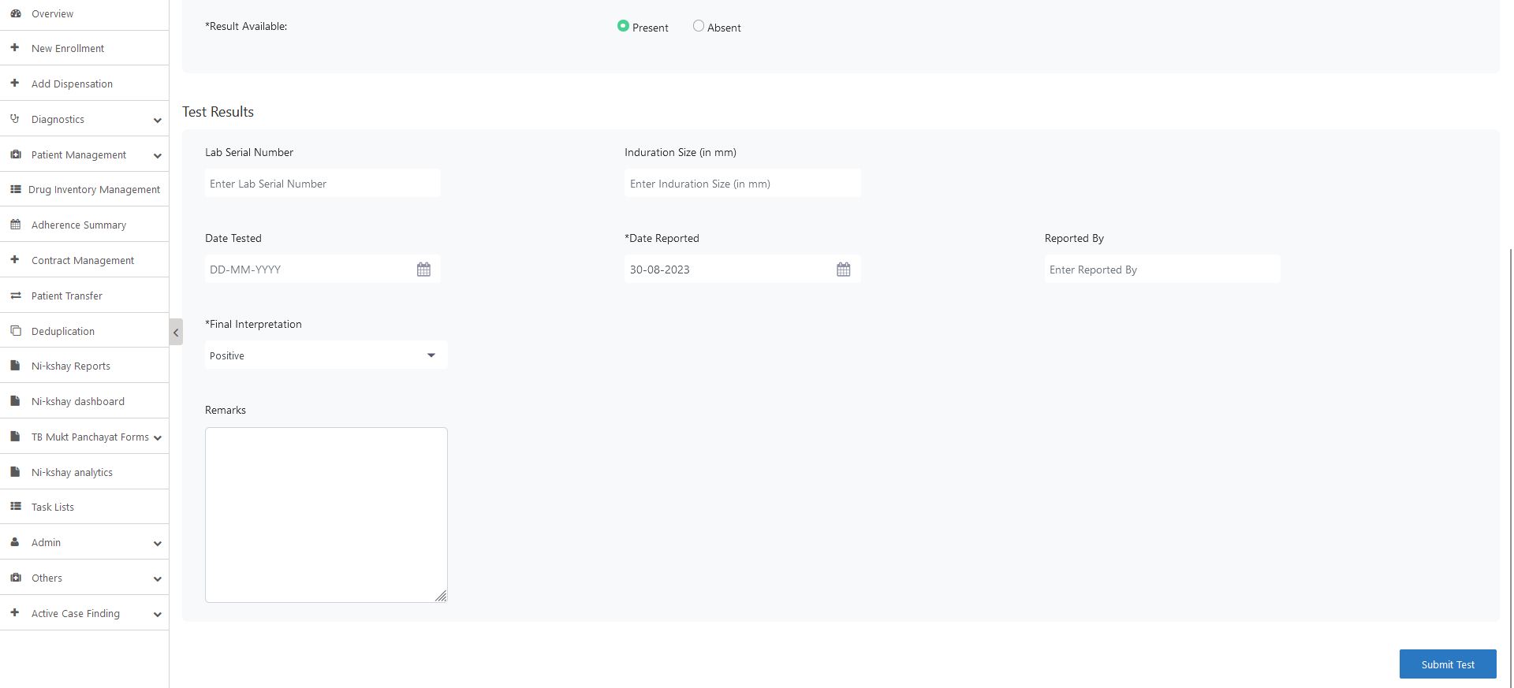
Adding Test for TBI Beneficiary..5
Step 5
Enter Test Results
Click here after entering the test details

Slide 8
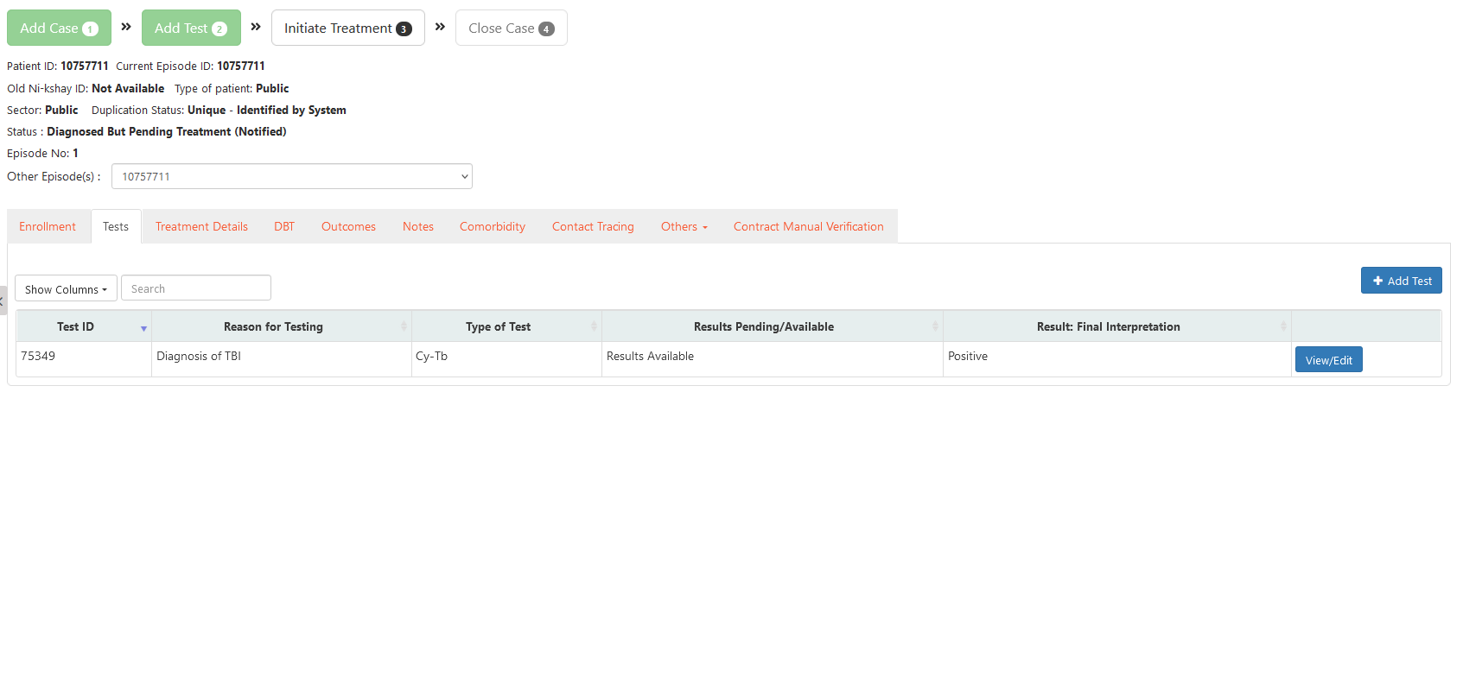
Adding Test for TBI Beneficiary..6
Test details are visible in the Tests Tab

Slide 9
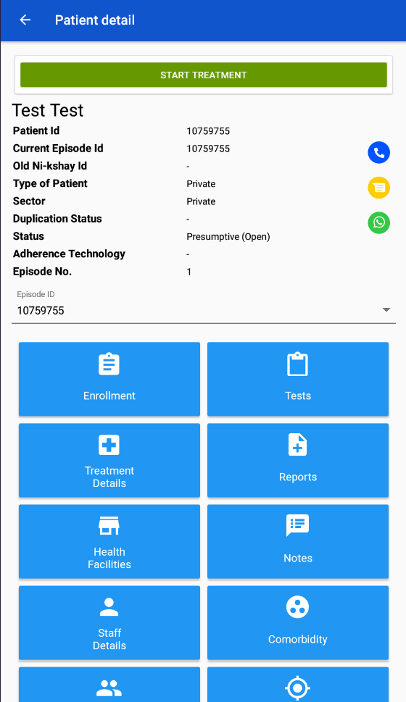
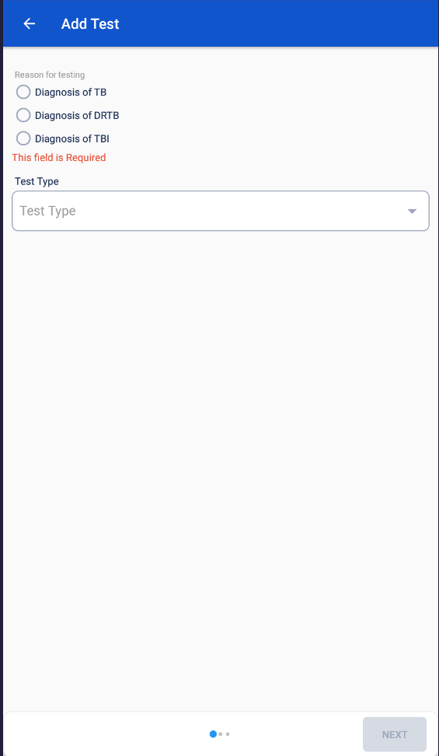
Adding Test for TBI Beneficiary - App
Step 1
Step 2
Step 3
Click on the ‘Tests’ button
Click on ‘+’ Button
Select ‘Diagnosis of TBI’

Slide 10
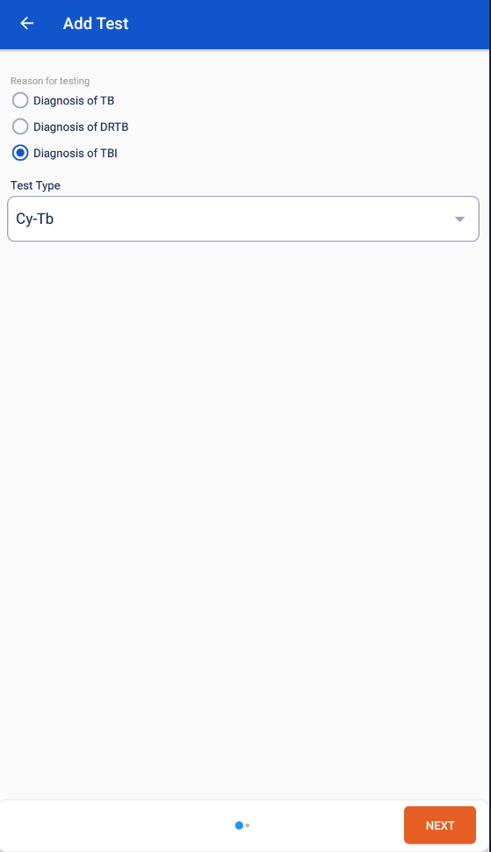
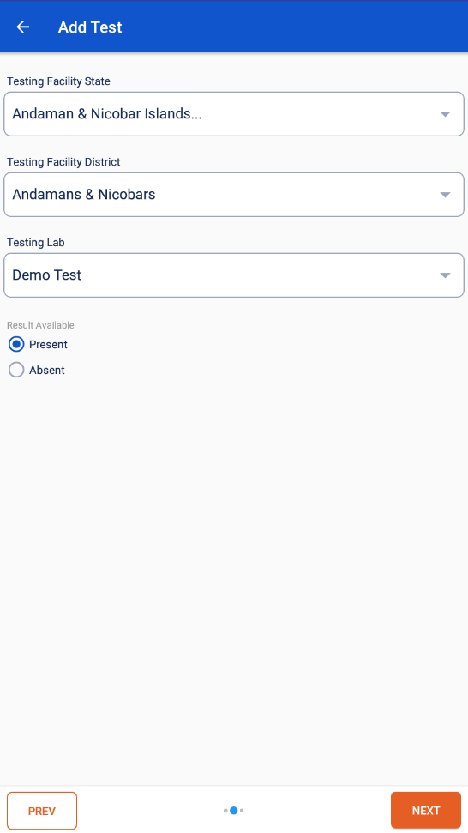
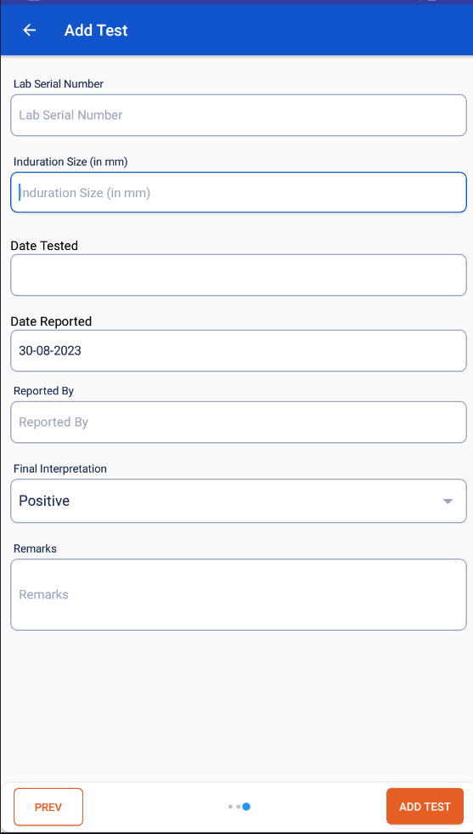
Adding Test for TBI Beneficiary - App
Step 4
Step 5
Step 6
Select ‘Cy-Tb’ as Test Type
Enter the Test Facility Details
Enter the Test Details
Click here after entering facility details
Click here after entering Test Type
Click here to add the test

Slide 11
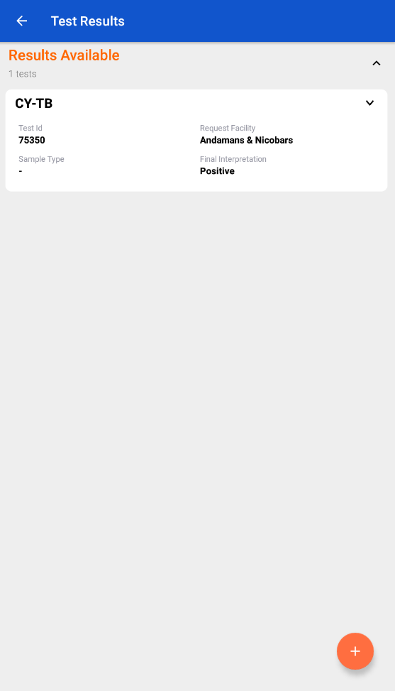
Adding Test for TBI Beneficiary - App
Test details added are visible in the Test Tab

Slide 12
Reports
Relevant update in the Ni-kshay Reports and registers will be undertaken to reflect
the changes that will be made because of adding Cy-TB as a Test Type for
diagnosis of TBI.

