Slide 1

Adding Village-level details in Ni-kshay Patient Enrollment Form

Slide 2
Introduction
Mapping of Ni-kshay hierarchies
Adding Village option in patient enrollment form
Editing Village option in Health Facilities Tab
Contents

Slide 3
Introduction
Earlier, the village variable was available in the address field but it was an open field and not mapped to LGD code and non-mandatory.
Mapping the village-level hierarchies will improve the tracking of patients and a it will also help the field staff to capture the patient's outcome status.
Hence, a drop-down of village names is made available as per census in Ni-kshay on patient enrollment form
This feature will help in tracking the patients at the village-level by the field staff.

Slide 4
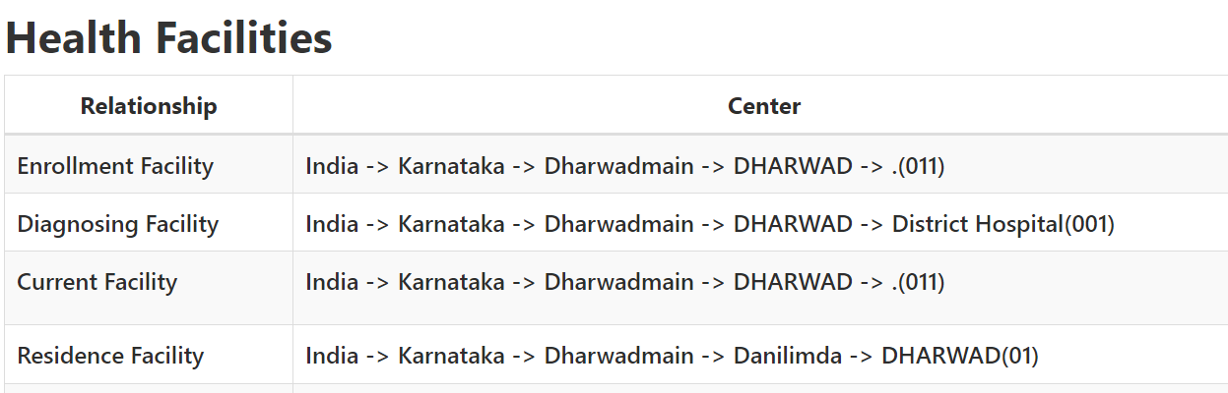
TYPES OF FACILITIES IN NIKSHAY

Slide 5
MAPPING FOR PROSPECTIVE PATIENTS
LOGIN VIA PHI LOGIN– ENROLMENT FACILITY IS AUTOSELECTED AND
1. ENROLMENT FACILITY DEFAULTED AS RESIDENTIAL FACILITY.
2. RESIDENTIAL FACILITY TO BE CHANGED AND VILLAGES MAPPED TO THE RESIDENTIAL FACILITY SHALL BE AVAILBALE FOR SELECTION IN DROP DOWN
LOGIN VIA TBU LOGIN – ENROLMENT FACILITY TO BE SELECTED MANUALLY

Slide 6
MAPPING FOR RETROSPECTIVE PATIENTS
Enrolment State and District considered for Residential State and District
The village nearest to the current facility will be defaulted as village for the patient
The Residential Facility will be an editable field.
1. The Residential TBU is mapped to the LGD blocks in the backend.
2. When a User wishes to modify the village, the residential state→District→TBU→ PHI/PVT HF needs to be selected and this will give a drop-down of all the villages nearest to the facility selected.
3. The User can then select the correct village.

Slide 7
Mapping of Ni-kshay Hierarchies
Steps performed:
Mapping of Ni-kshay hierarchies below district level with LGD code conducted and inserted in Ni-kshay backend.
PHI and village-level dropdown enabled in address sections/residence details in enrollment form in Ni-kshay.
The Village shall be shown below PHI and TU after they are selected.
State
District
TU
PHI
Village

Slide 8
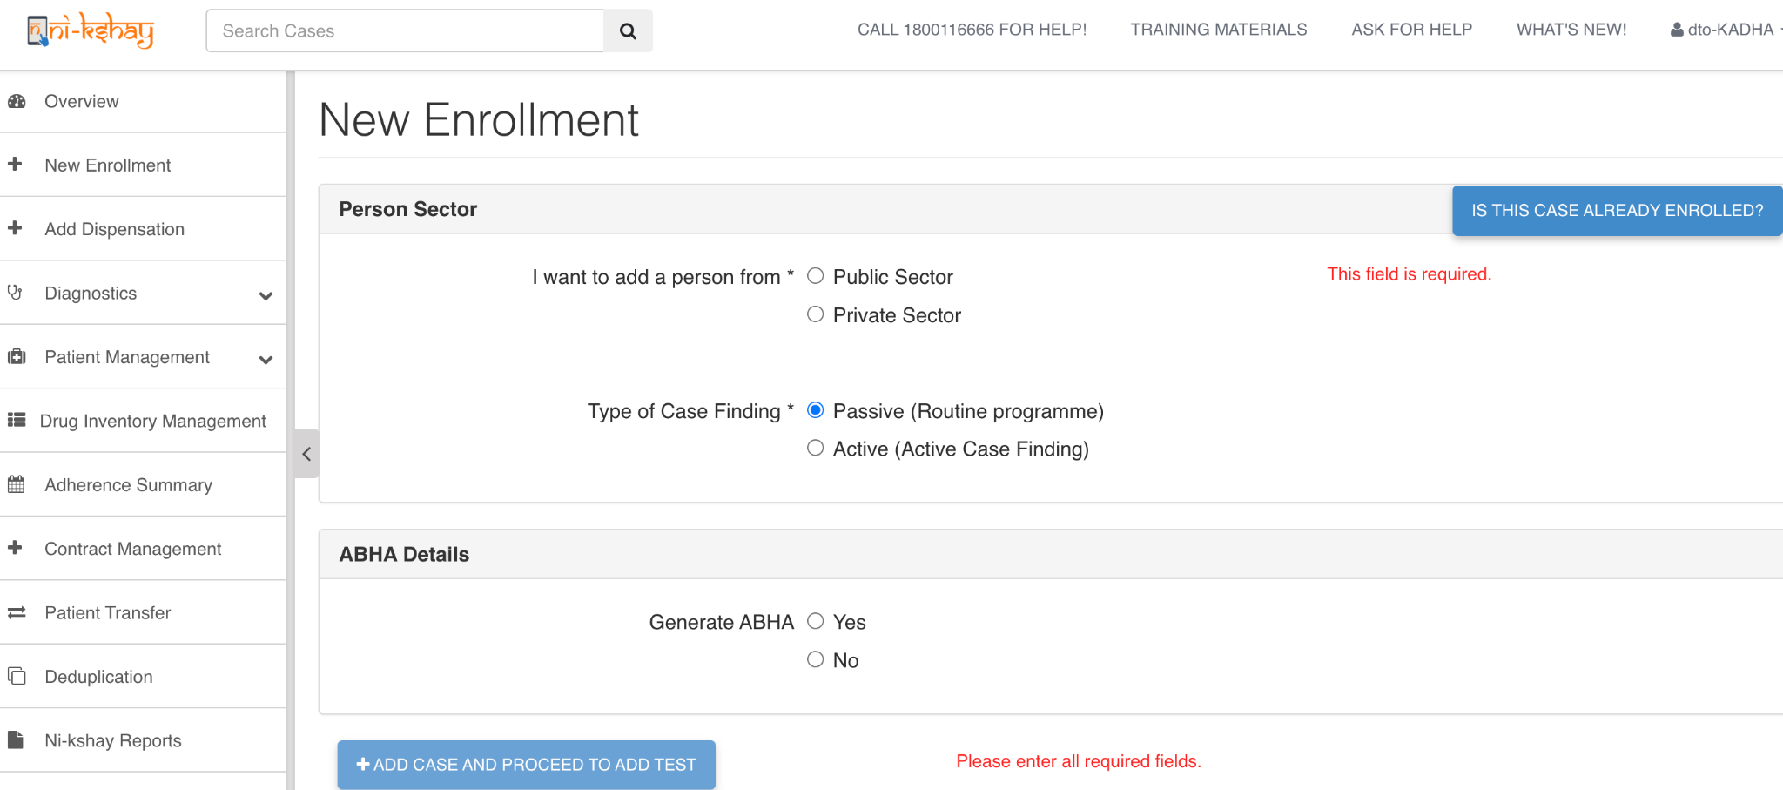
Adding Village option in patient enrollment form
Step 1
Step 2
Step 3
Click on ‘New Enrollment'
Select ‘Person Sector’ and other mandatory options
Available details shall be available

Slide 9
Adding Village option in patient enrollment form
Step 1
Step 2
Step 3
Click on ‘New Enrollment'
Select ‘Person Sector’ and other mandatory options
Available details shall be available

Slide 10
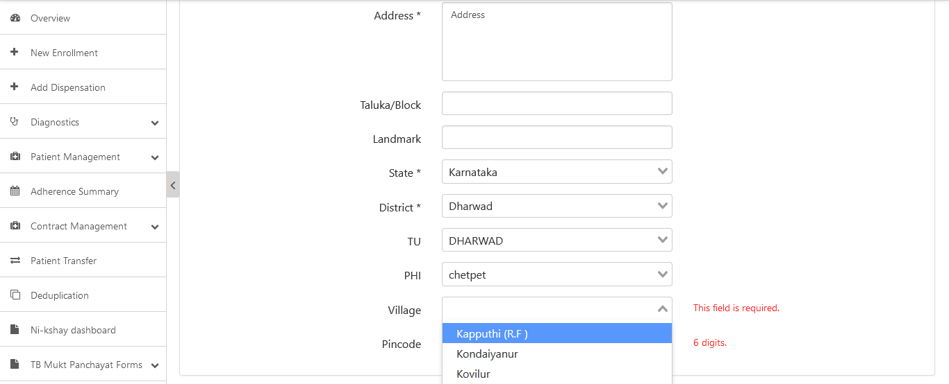
Adding Village option in patient enrollment form
Step 1
Step 2
Step 3
Step 4
Click on ‘New Enrollment'
Select ‘Person Sector’ and other mandatory options
Available details shall be available
Option available in the Residence details

Slide 11
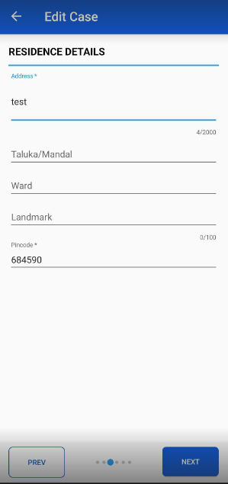
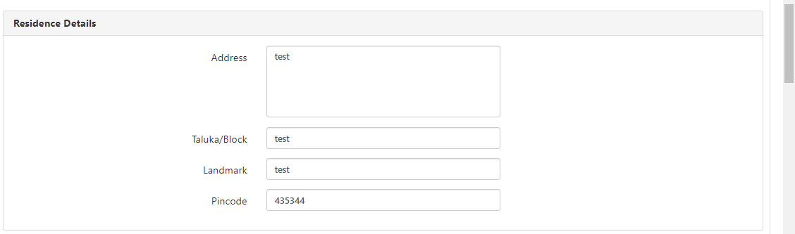
Edit Village option in Health Facilities Tab
The residence details in the Enrolment tab will only include Address, Taluk, Ward, Landmark and Pincode fields. The State, District, TU, PHI, Village fields will not be visible in the Enrolment tab, but users will be able to edit the residence hierarchy details from the Health Facilities Tab.

Slide 12
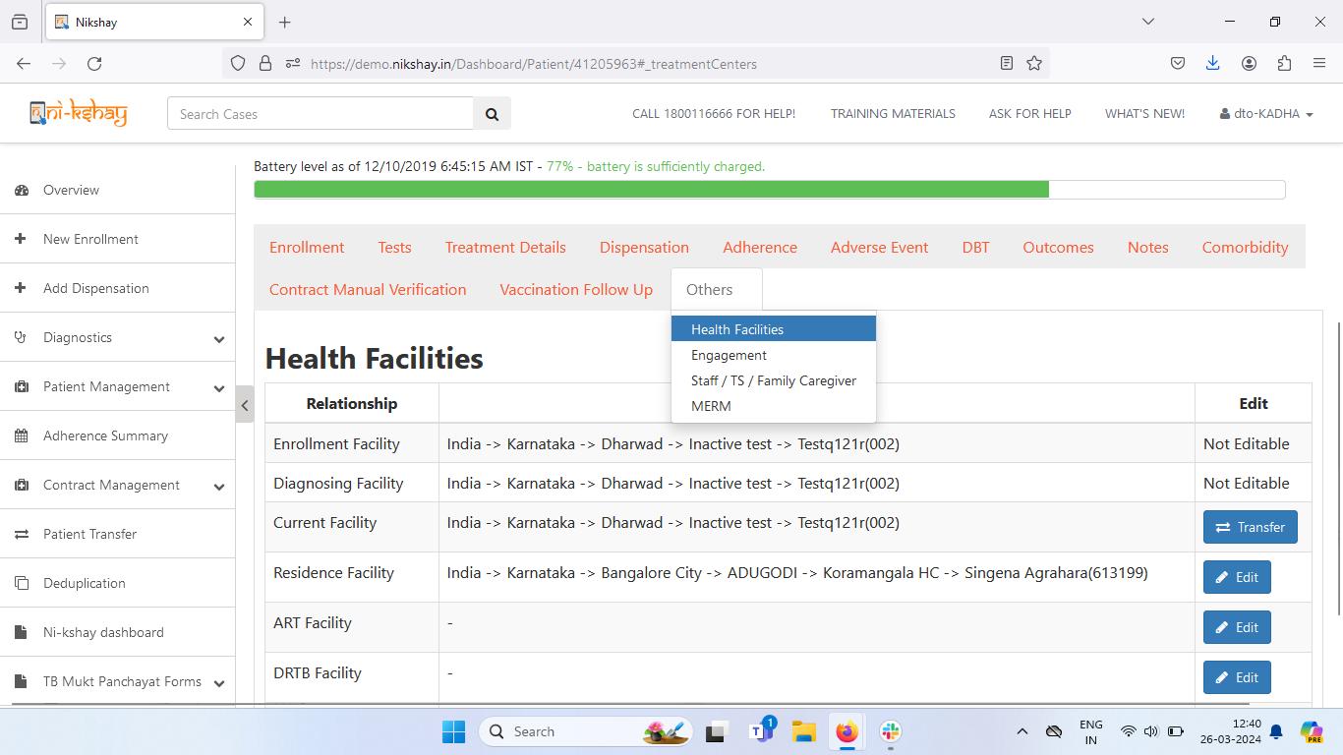
Edit Village option in Health Facilities Tab - Web
Step 1
Step 2
Click on ‘’Others’ -> ‘Health Facilities’
Click on ‘Edit’ beside Residence Facility Section

Slide 13
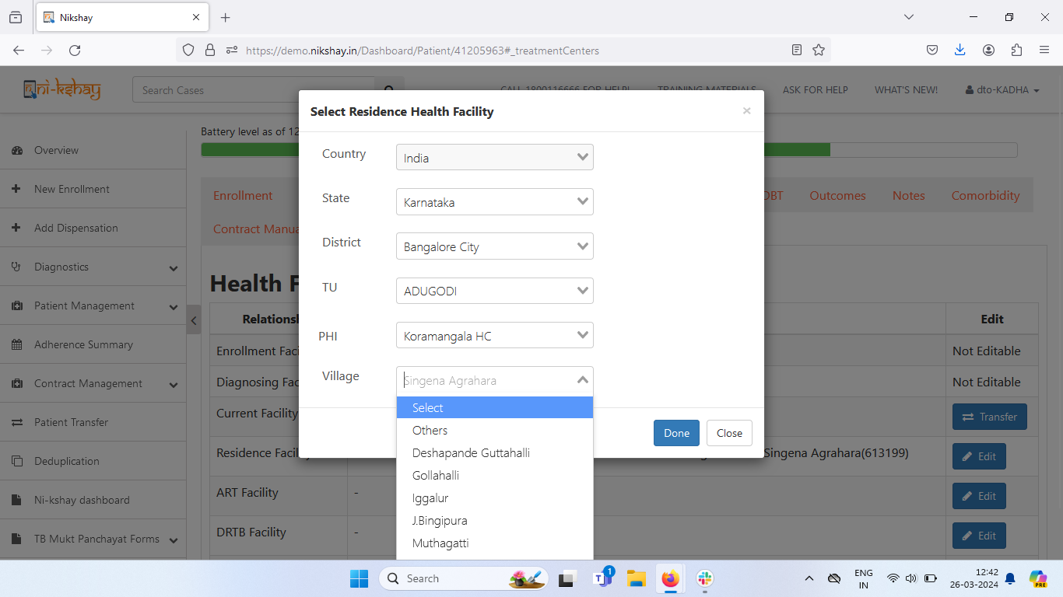
Edit Village option in Health Facilities Tab - Web
Step 1
Step 2
Step 3
Click on ‘’Others’ -> ‘Health Facilities’
Click on ‘Edit’ beside Residence Facility Section
Select Village and click on Done

Slide 14
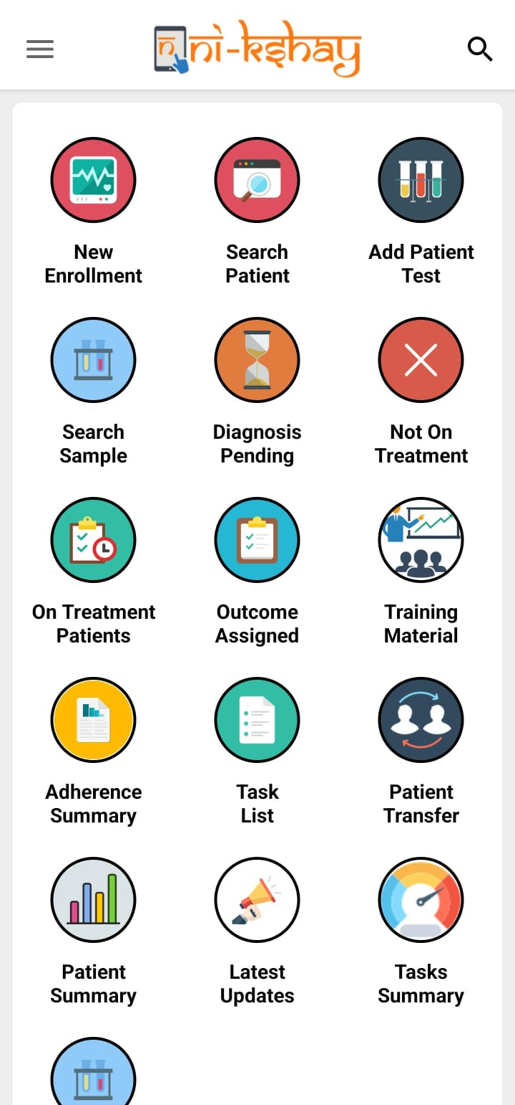
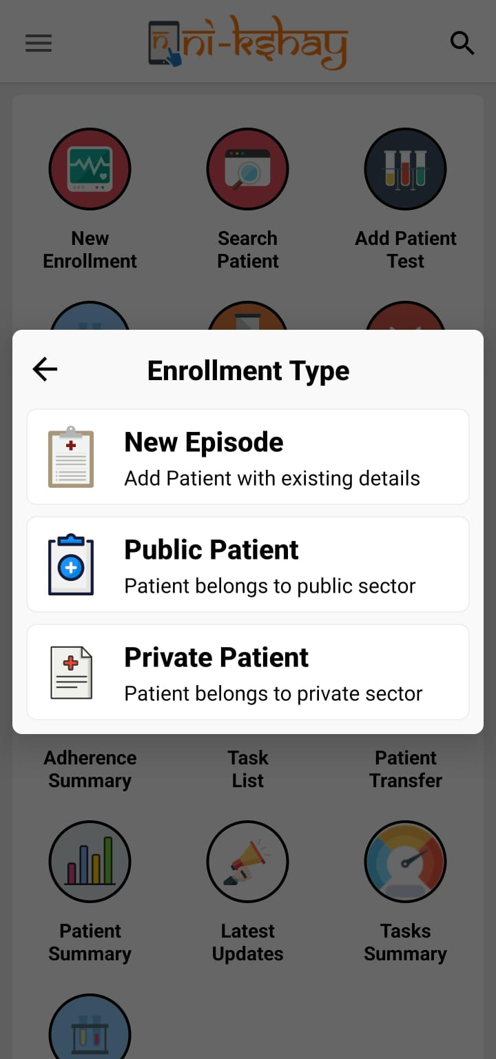
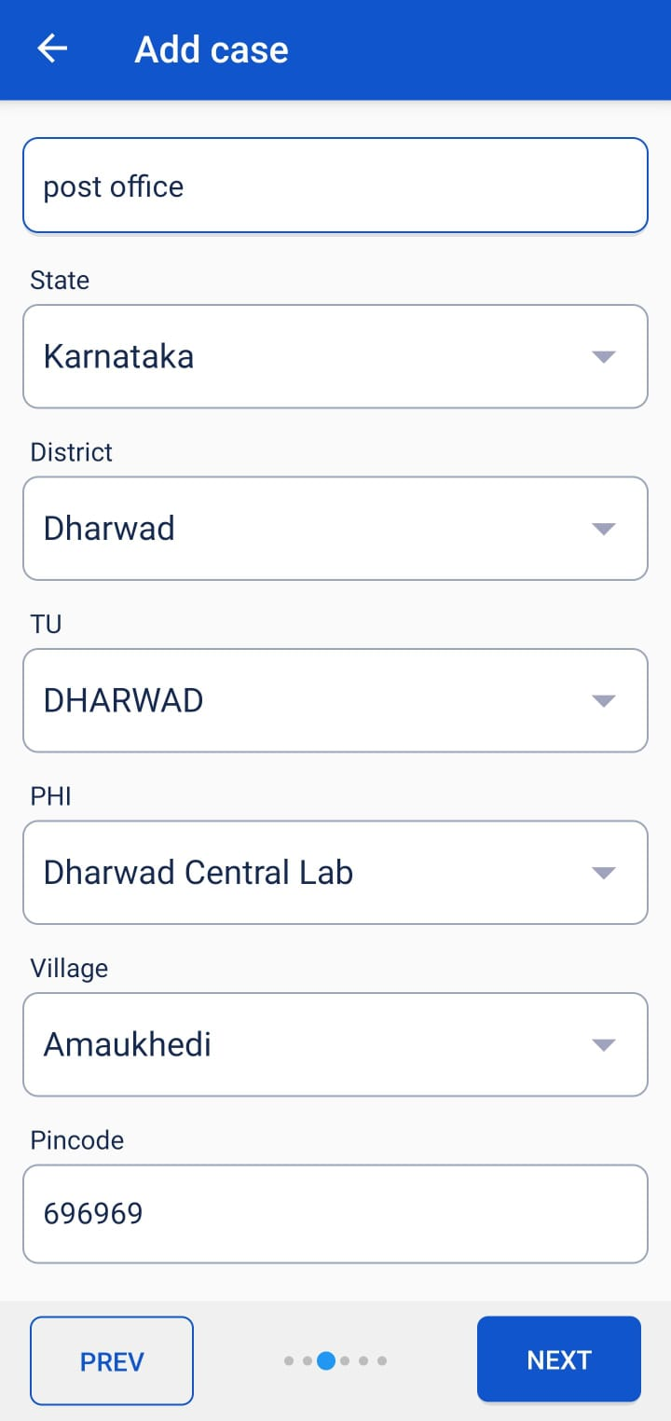
Adding Village option in patient enrollment form - App
Step 1
Step 2
Step 3
Click on ‘New Enrollment'
Select ‘Person Sector’ and other mandatory options
Option available in the Residence details

Slide 15
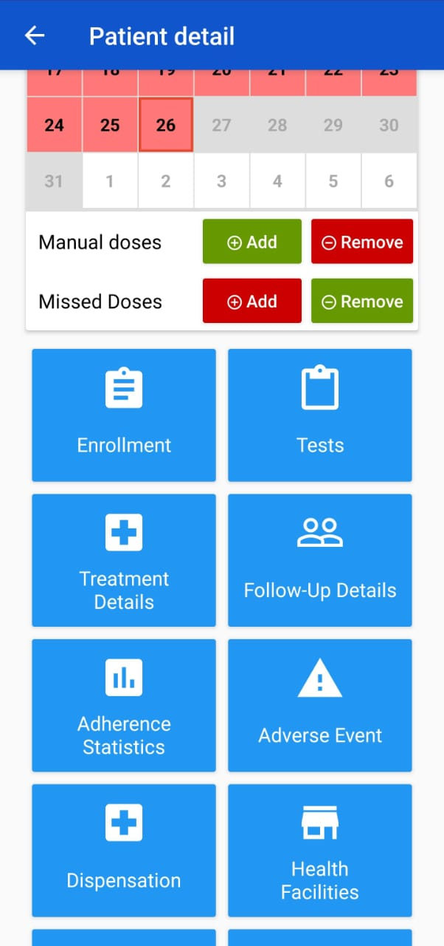
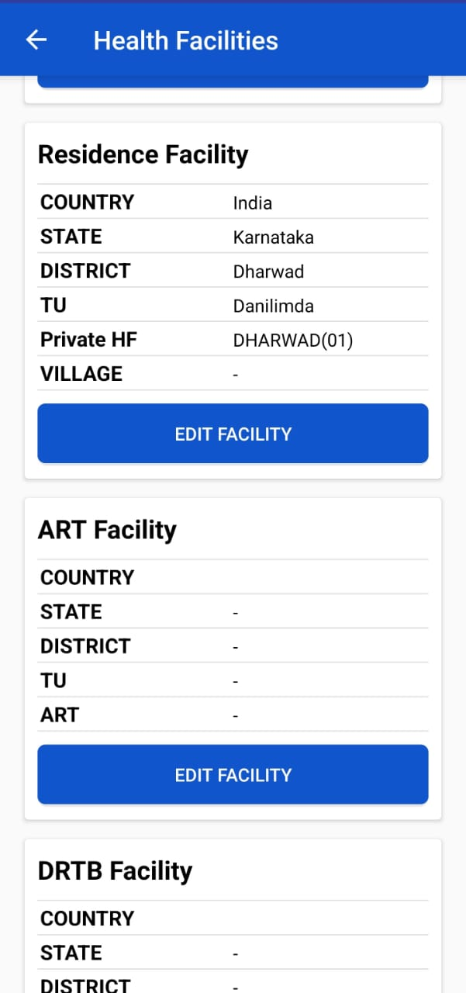
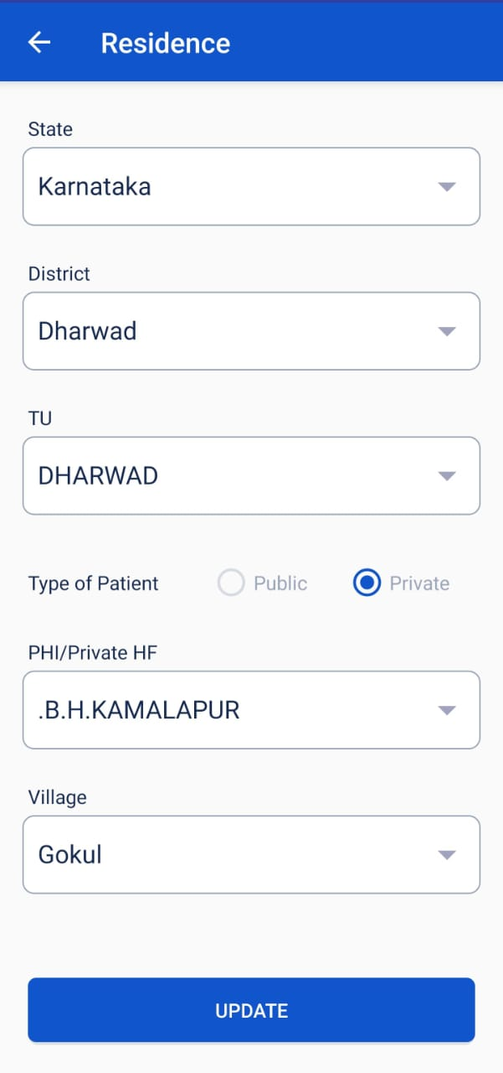
Edit Village option in Health Facilities Tab - App
Step 1
Step 2
Step 3
Click on ‘’Others’ -> ‘Health Facilities’
Click on ‘Edit’ beside Residence Facility Section
Select Village and click on Update

Slide 16
THANK YOU

