Slide 1
Adverse Event Reporting System

Slide 2
Contents
Overview
Add Adverse Event for Patients
Add Causality
Declare Outcomes for Adverse Events
Edit Adverse Events added
AERS Walkthrough for the Mobile App
FAQs

Slide 3

Overview
An adverse event is any unfavorable and unintended sign (including an abnormal laboratory finding), symptom, or disease that presents in a patient during treatment or procedure, regardless of whether it is considered related to the medical treatment or procedure.
This Module provides an option to record adverse events, add causality and declare outcomes for the adverse events.
The Module will be available for Patients who have been initiated on treatment (Status: On Treatment - Notified).

Slide 4
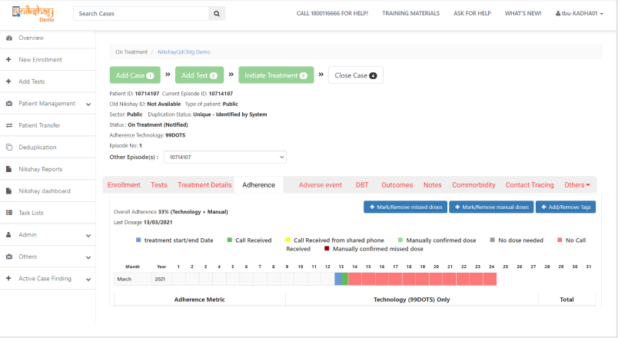
Add Adverse Event
Step 1
Click on ‘Adverse Event’

Slide 5
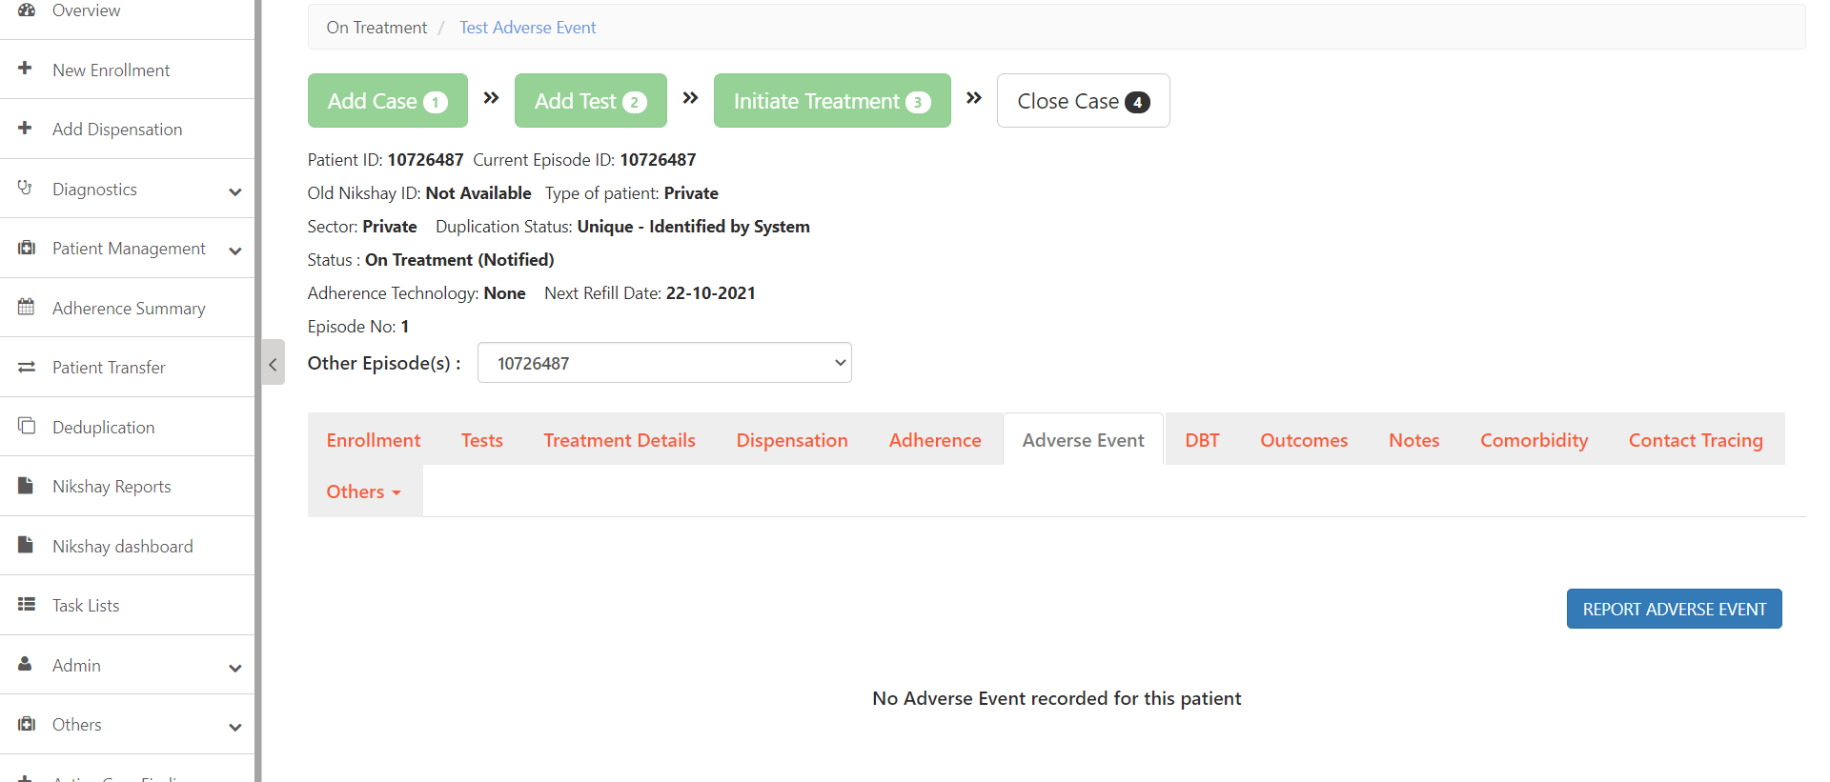
Add Adverse Event
Step 1
Step 2
Click on ‘Adverse Event’
Click on ‘Report Adverse Event’ button

Slide 6
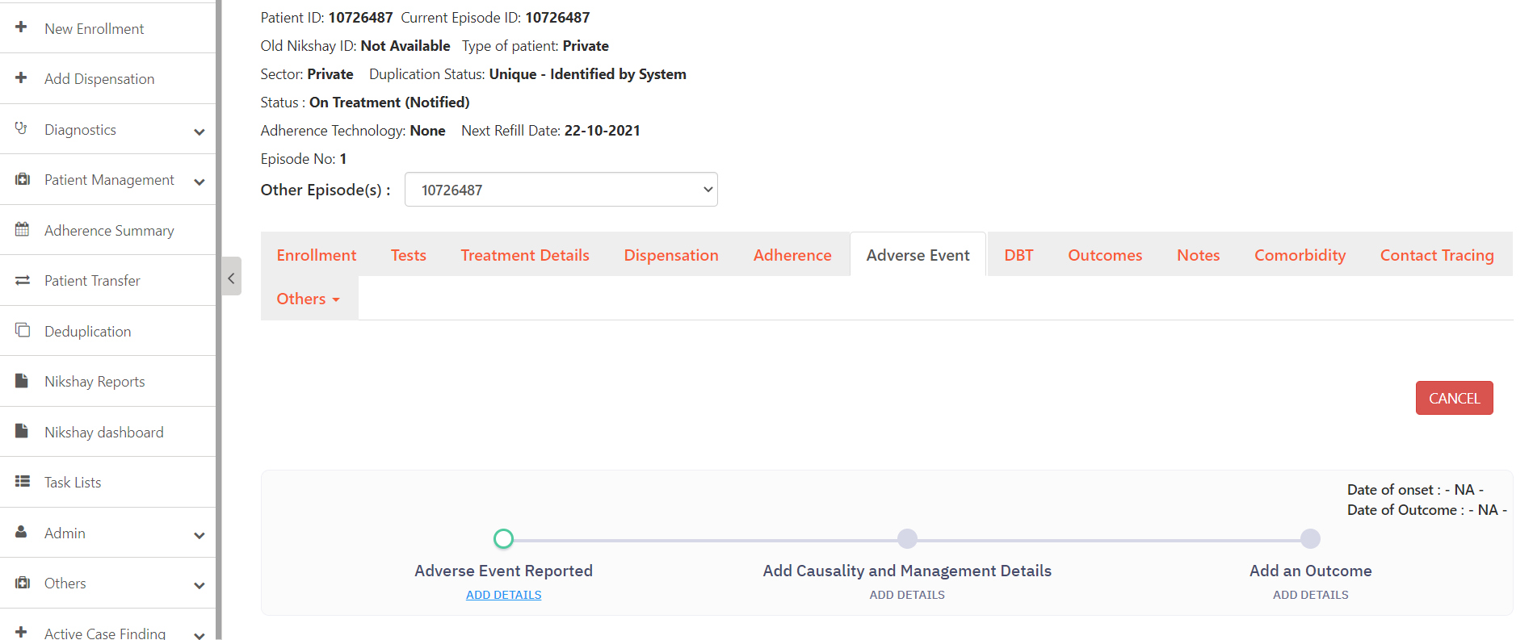
Add Adverse Event
Step 1
Step 2
Step 3
Click on ‘Adverse Event’
Click on ‘Report Adverse Event’ button
Click on ‘Add Details’

Slide 7
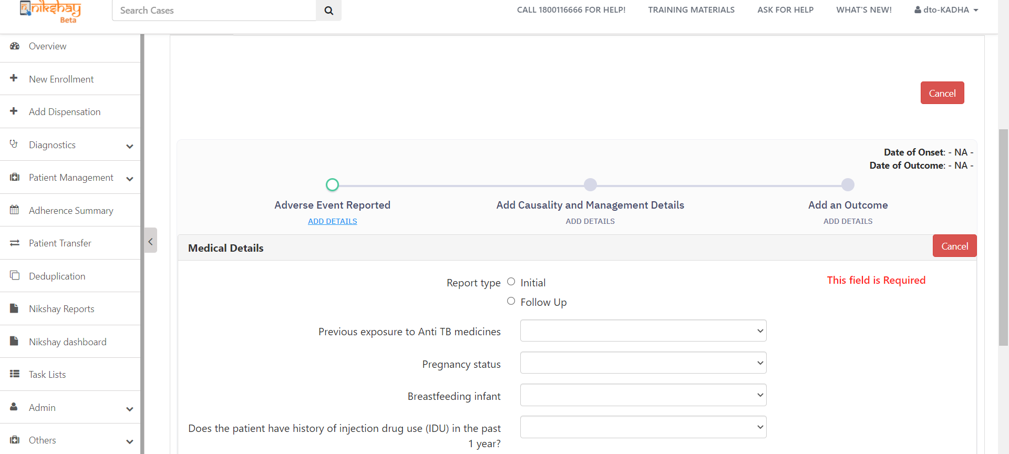
Add Adverse Event
Step 1
Step 2
Step 3
Step 4
Click on ‘Adverse Event’
Click on ‘Report Adverse Event’ button
Click on ‘Add Details’
Enter Medical Details
Additional Medical details that were previously available such as weight, Patient Type, exposure to certain drugs etc, have now been removed in the updated form
Enter all Medical Details here

Slide 8
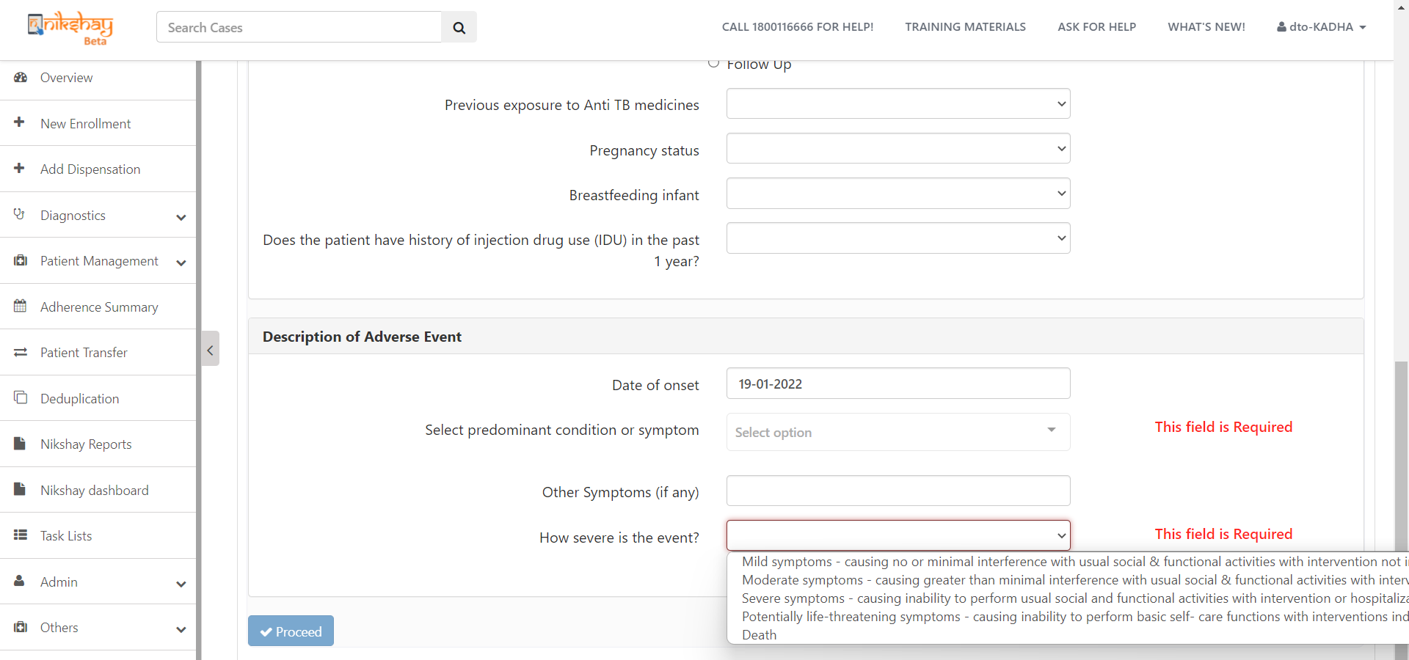
Add Adverse Event
Step 5
Enter Details of Adverse Event
Enter all details of the Adverse Event here

Slide 9
Add Adverse Event
Step 5
Step 6.a
Enter Details of Adverse Event
Enter Additional Details of Adverse Event
Depending on the severity of the event selected, additional data fields will be available to capture information. (Screenshot in the next slide)

Slide 10
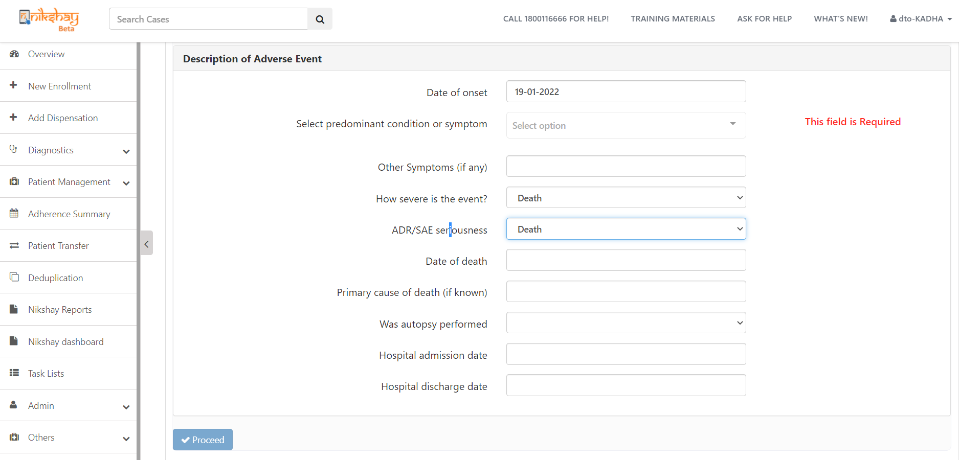
Add Adverse Event
Step 5
Step 6.b
Enter Details of Adverse Event
Enter Additional Details of Adverse Event

Slide 11
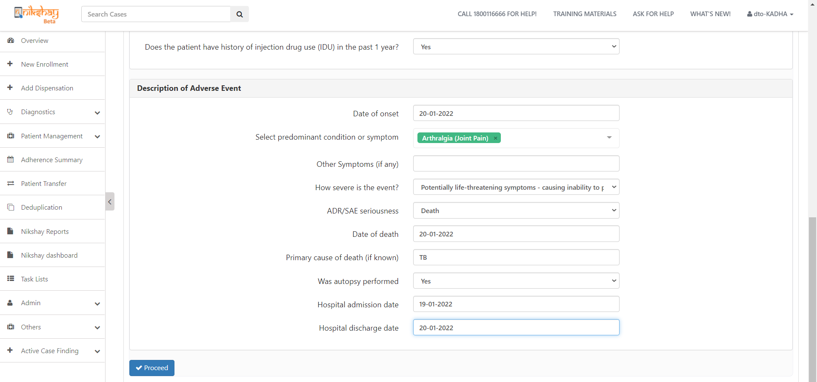
Add Adverse Event
Step 5
Step 6
Step 7
Click Details of Adverse Event
Enter Additional Details if relevant
Click on Proceed Button

Slide 12
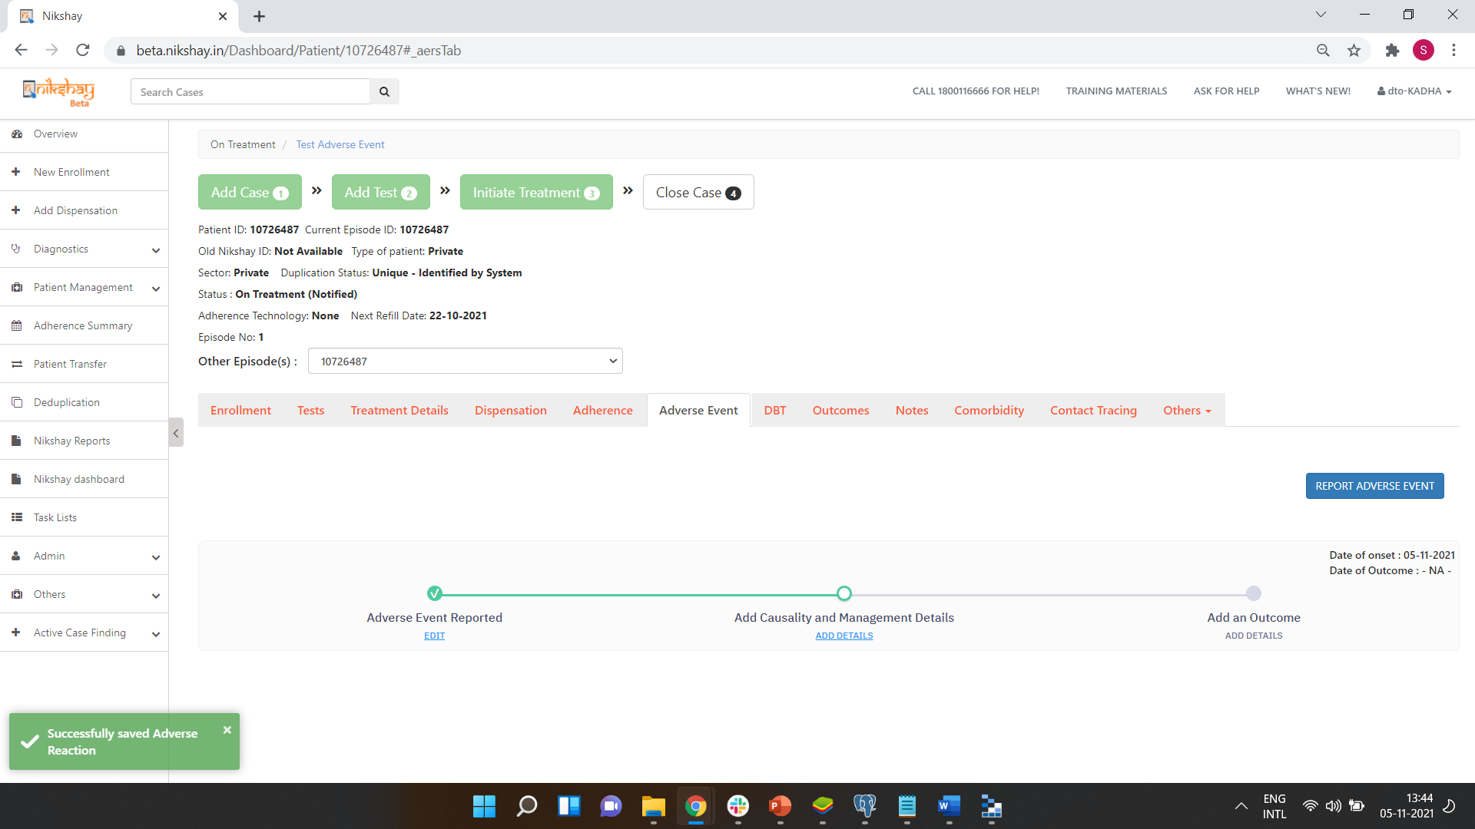
Add Adverse Event
Date of Onset of the Adverse Event is visible here
Message displayed on successful addition of the Adverse Event

Slide 13
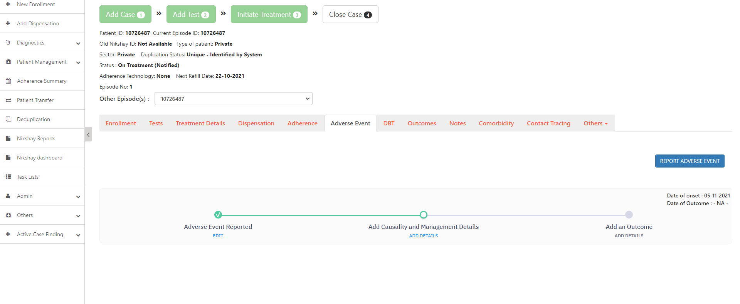
Add Causality
Step 1
Click on ‘Add Details’

Slide 14
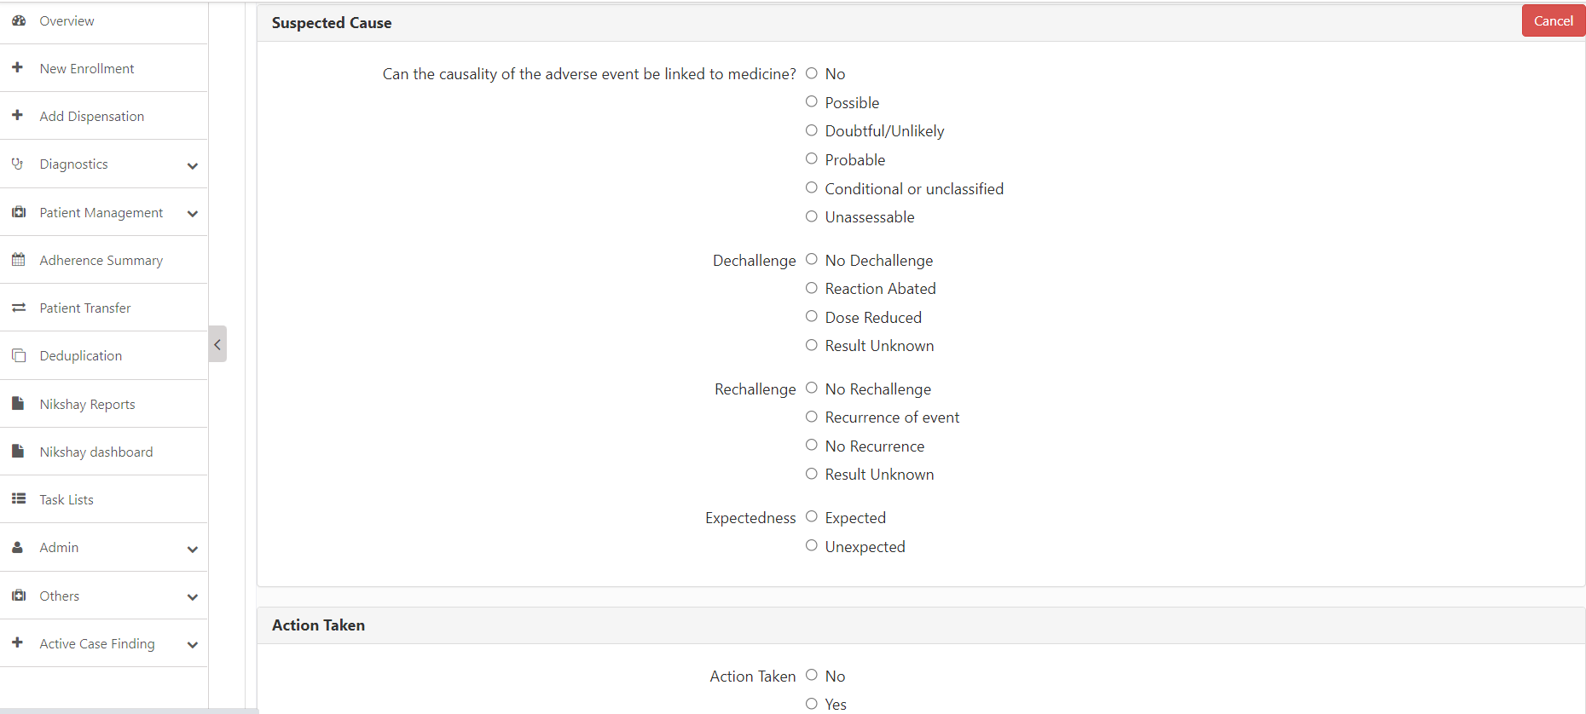
Add Causality
Step 1
Step 2
Click on ‘Add Details’
Enter the Suspected Cause and the Action Taken
Depending on the option selection, additional data fields will be displayed.

Slide 15
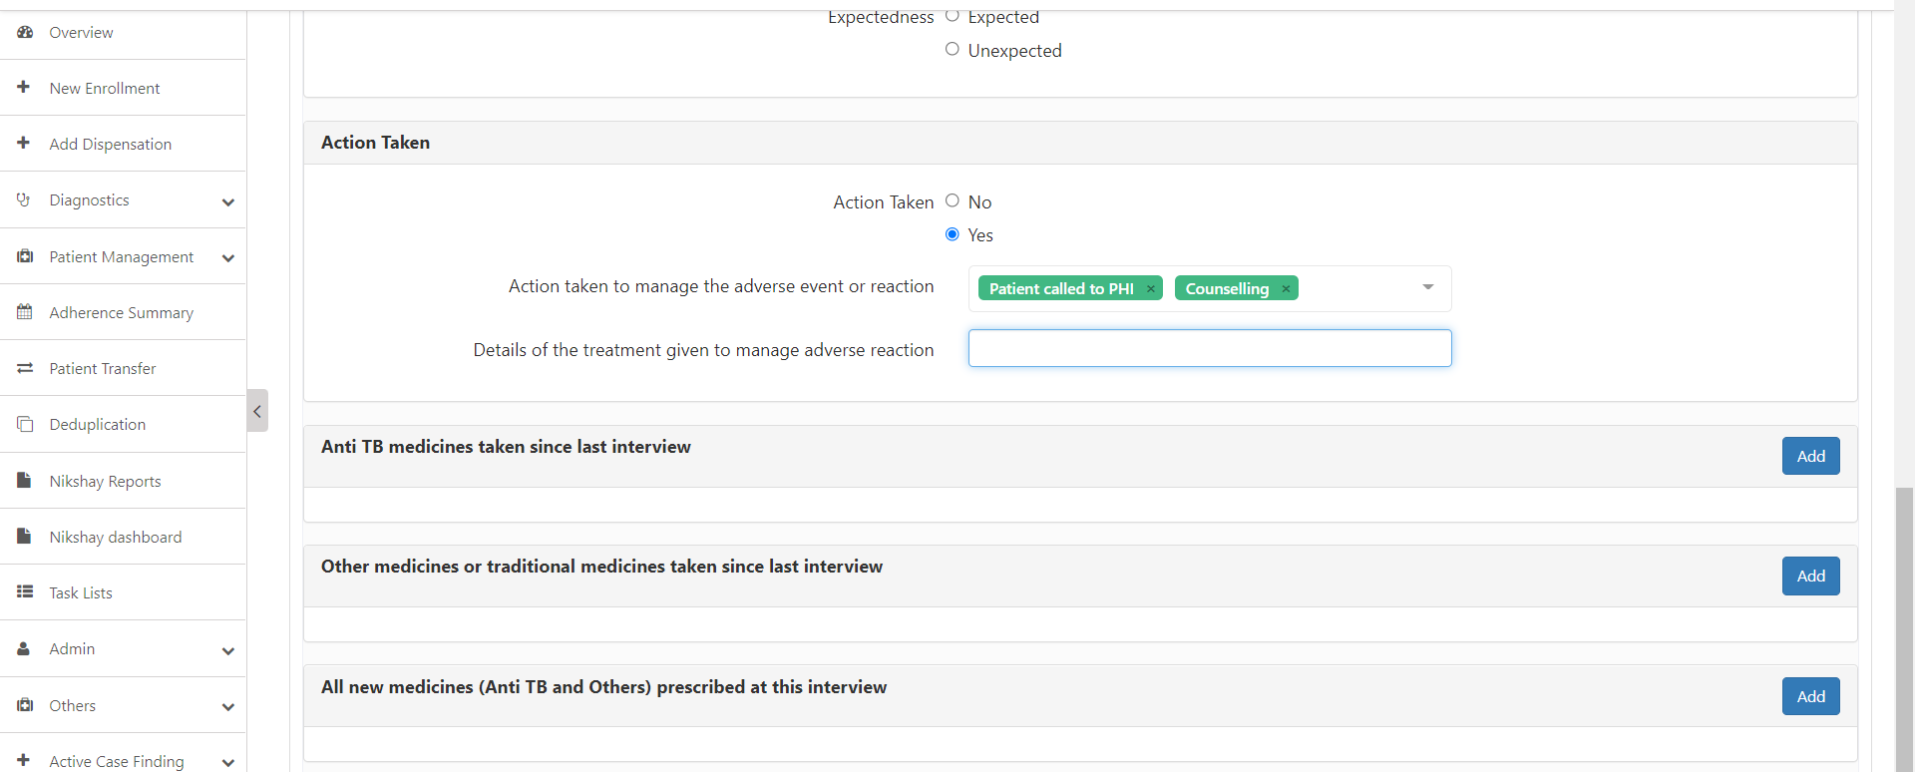
Add Causality
Step 1
Step 2
Step 3
Click on ‘Add Details’
Enter the Suspected Cause and the Action Taken
Enter details of the Action Taken

Slide 16
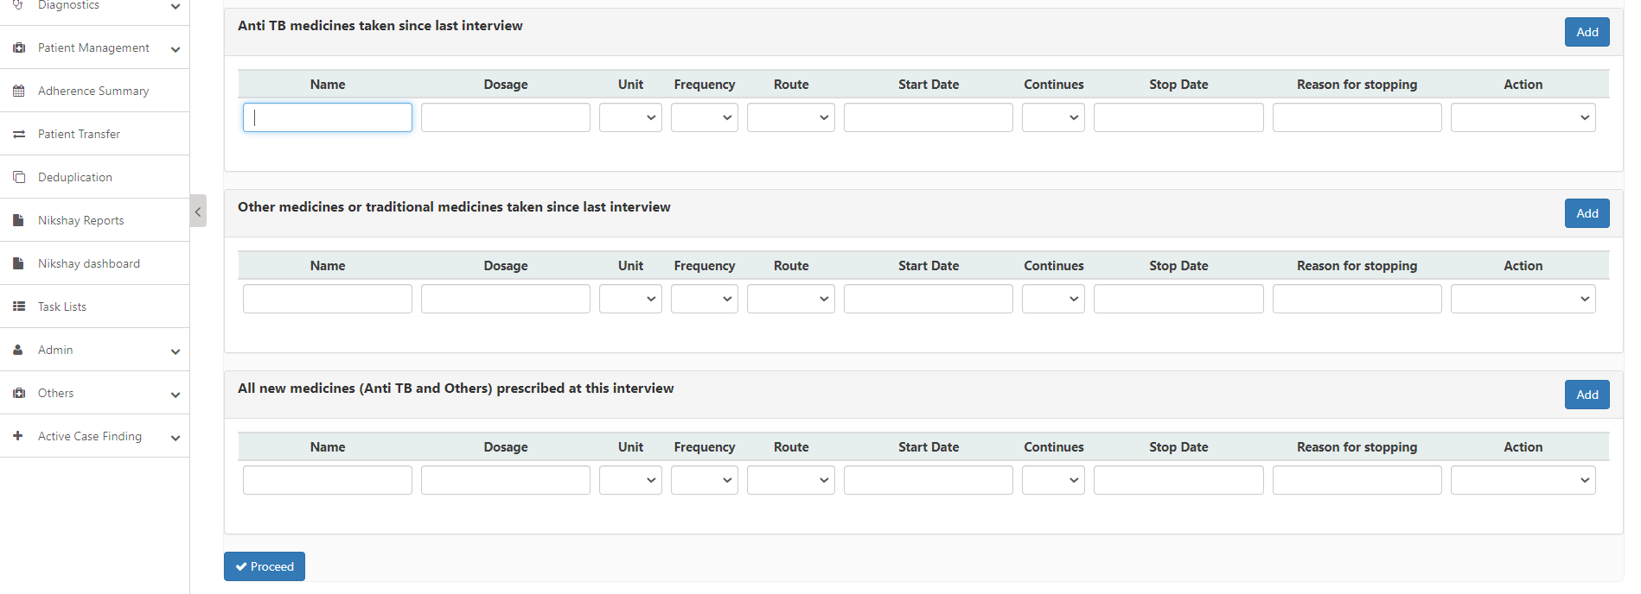
Add Causality
Step 1
Step 2
Step 3
Step 4
Click on ‘Add Details’
Enter the Suspected Cause and the Action Taken
Enter details of the Action Taken
Enter other relevant information and click on the ‘Proceed’ button

Slide 17
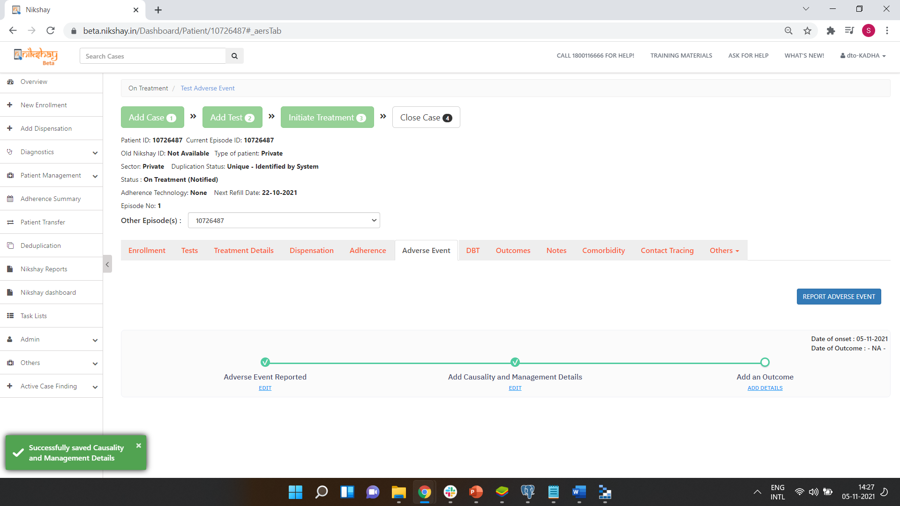
Add Causality
Message displayed on successful addition of the Causality details.

Slide 18
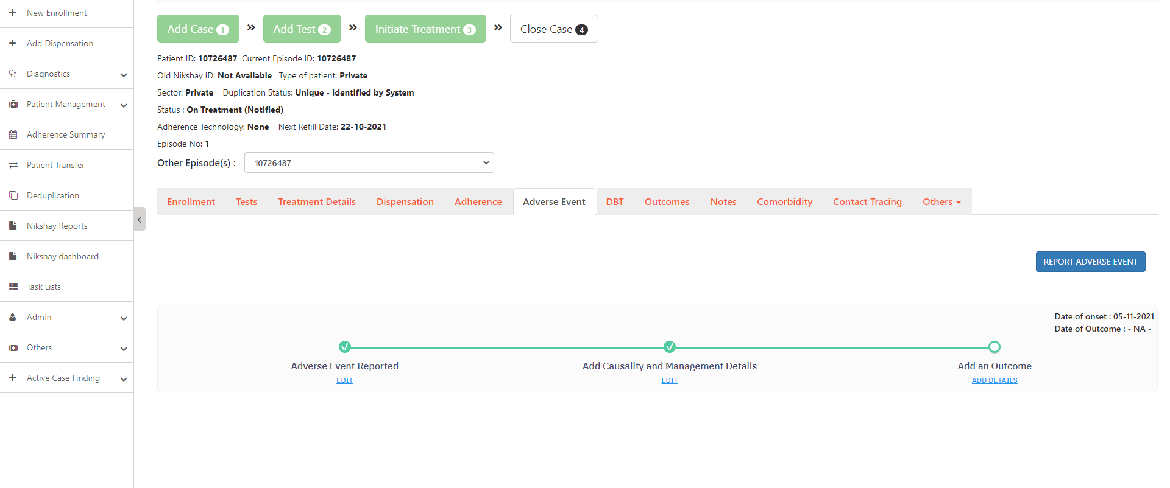
Add Outcomes to Adverse Events
Step 1
Click on ‘Add Details’

Slide 19
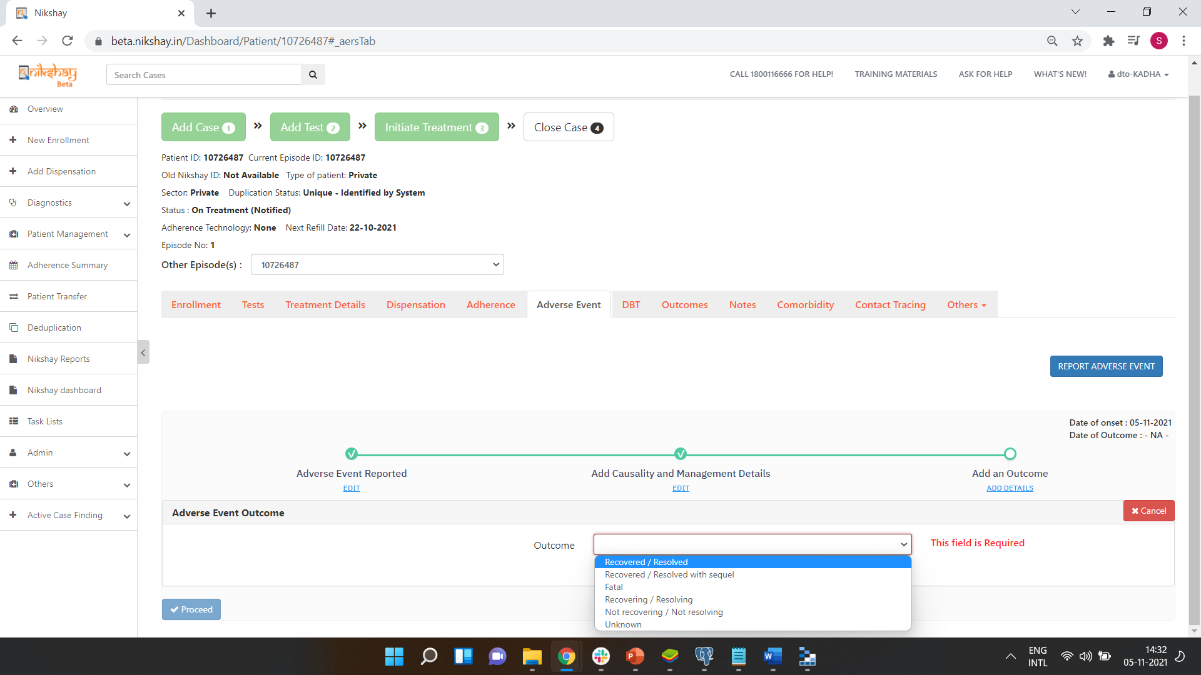
Add Outcomes to Adverse Events
Step 1
Step 2
Click on ‘Add Details’
Select the Outcome of the Adverse Event

Slide 20
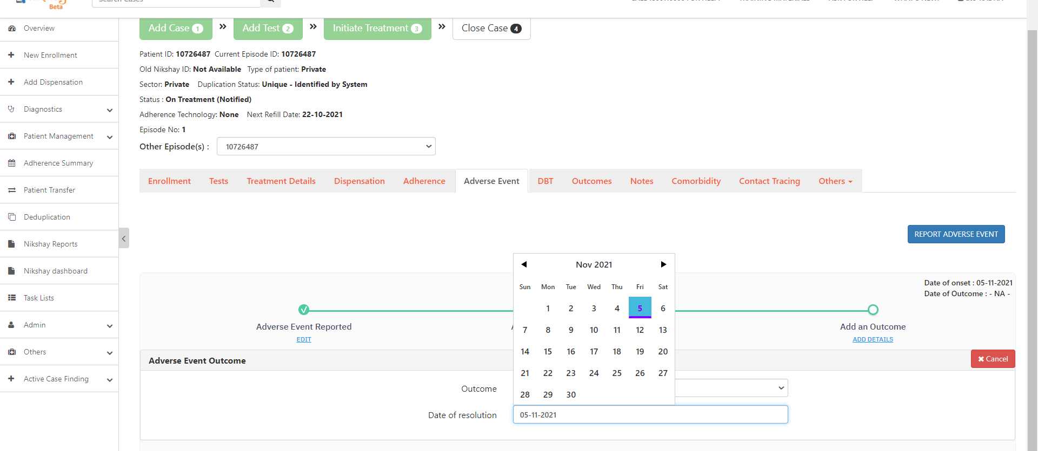
Add Outcomes to Adverse Events
Step 1
Step 2
Step 3
Click on ‘Add Details’
Select the Outcome of the Adverse Event
Select the Date of Resolution

Slide 21
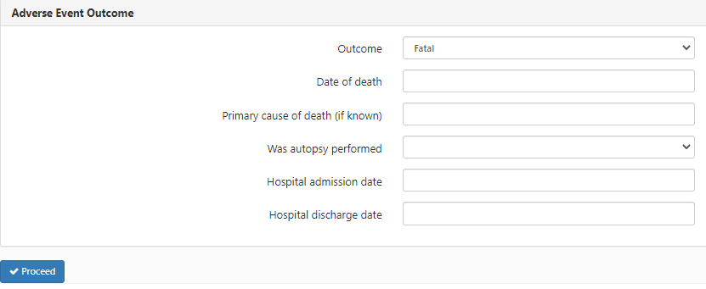
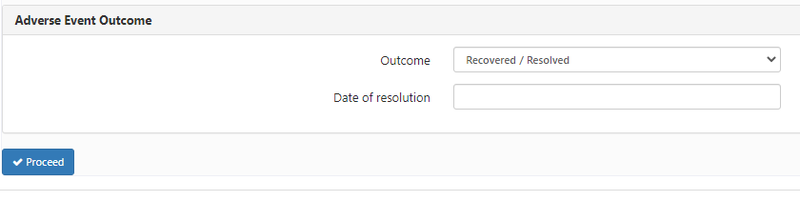
Additional Options for Outcomes
When ‘Fatal’ and ‘Recovered/Resolved’ are selected as the outcomes for the Adverse Events, then the user will have to enter additional details for the respective outcomes.

Slide 22
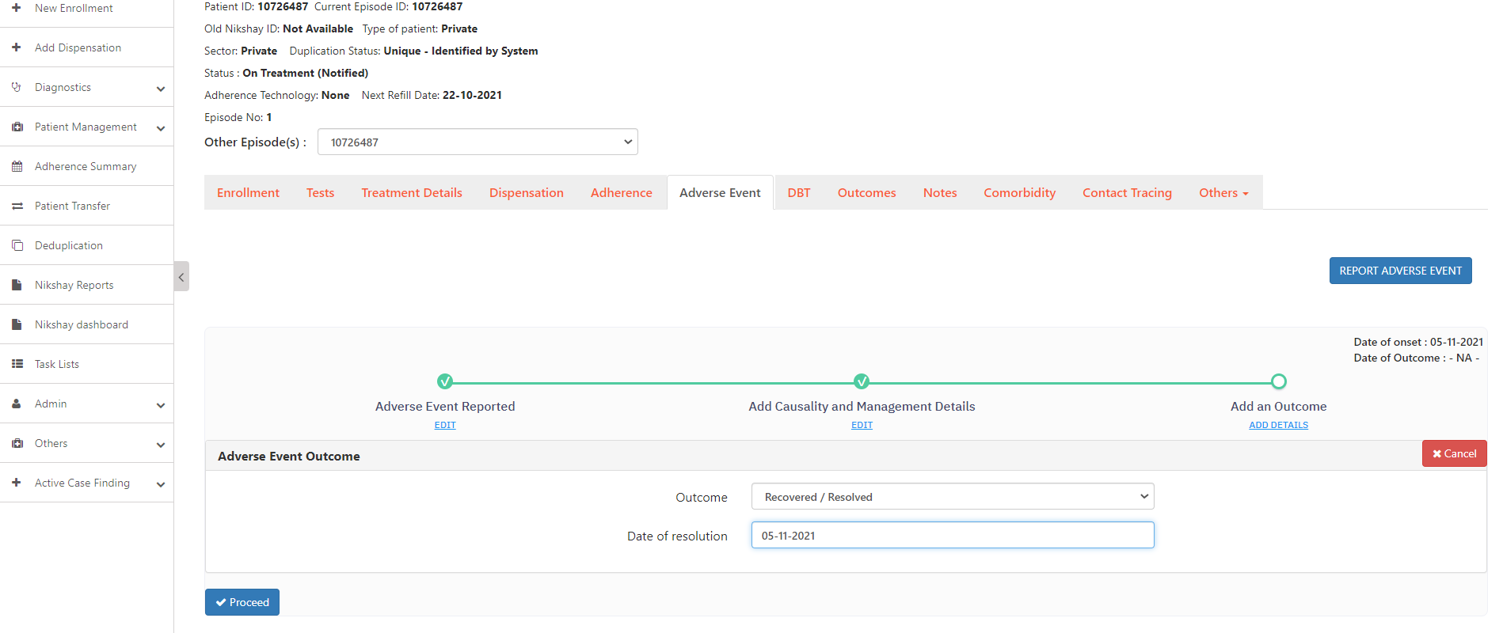
Add Outcomes to Adverse Events
Step 1
Step 2
Step 3
Step 4
Click on ‘Add Details’
Select the Outcome of the Adverse Event
Select the Date of Resolution
Click on the ‘Proceed’ button

Slide 23

Add Outcomes to Adverse Events
Date of Onset and Outcome of the Adverse Event is visible here
Message displayed on successful declaration of outcome

Slide 24

Editing Adverse Events
Click on the Edit Buttons to edit the Adverse Events, Causality and Outcomes that have been added for a patient

Slide 25
AERS Workflow on Nikshay App

Slide 26
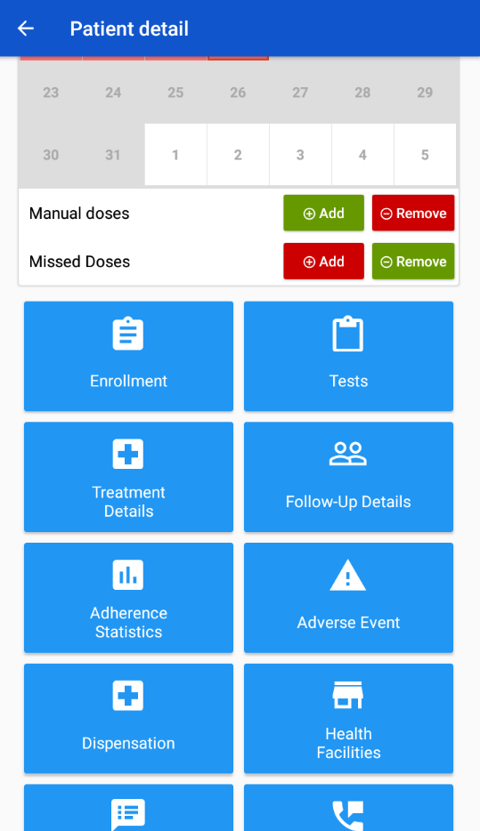
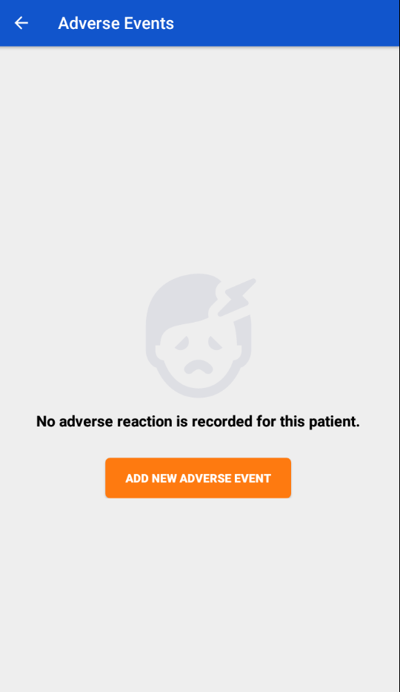
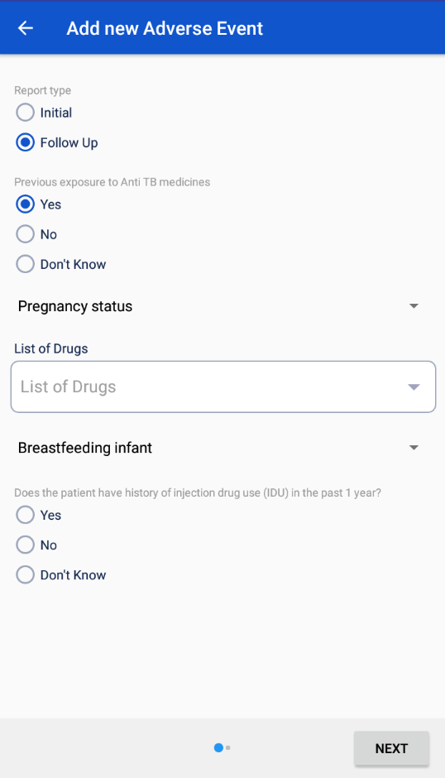
Add Adverse Event
Step 1
Step 2
Step 3
Click on ‘Adverse Event’ Tab
Click on ‘Add New Adverse Event’
Enter Details and Click Next

Slide 27
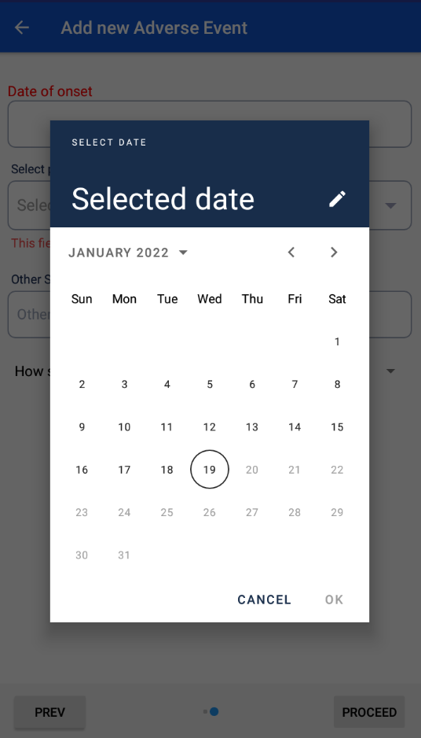
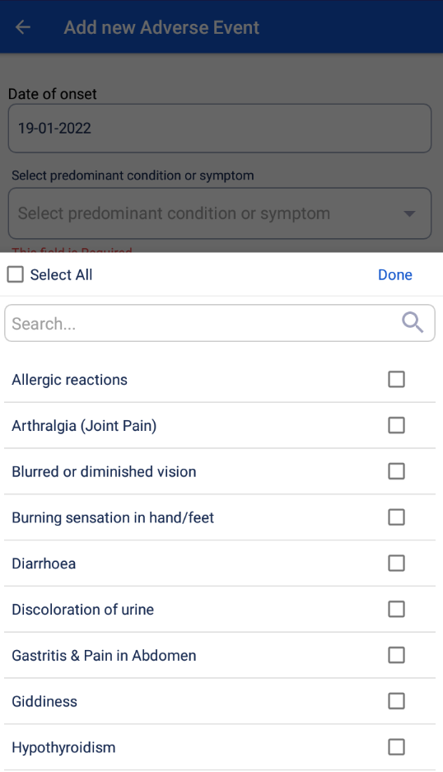
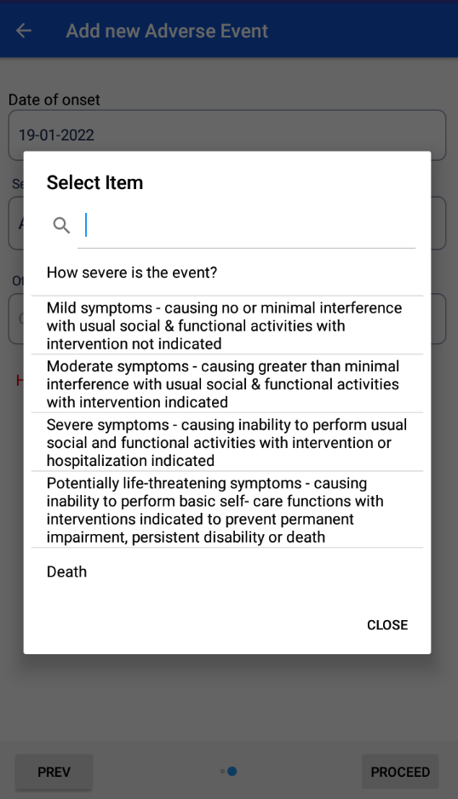
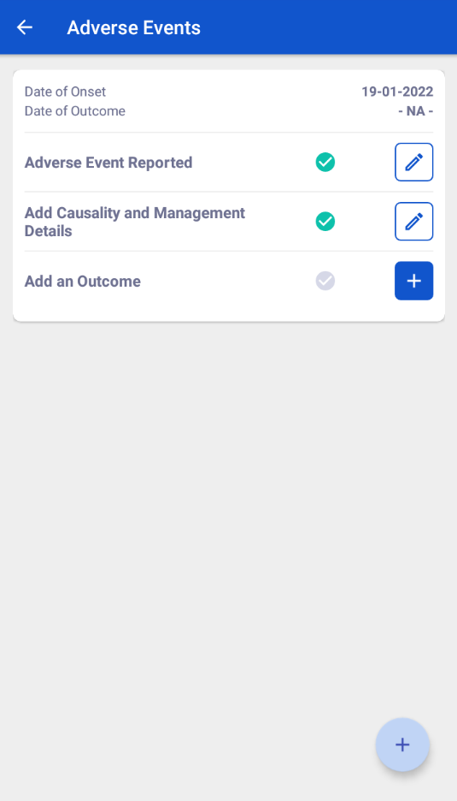
Add Adverse Event
Step 4
Step 5
Step 6
Select Date of Onset
Select Predominant symptom
Enter Event Severity and click on ‘Proceed’ button
Date of Onset is updated and the form to Add Causality Details will now be visible
Depending on the severity selected, additional fields will be available

Slide 28
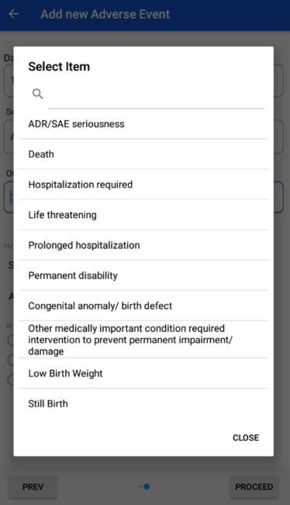
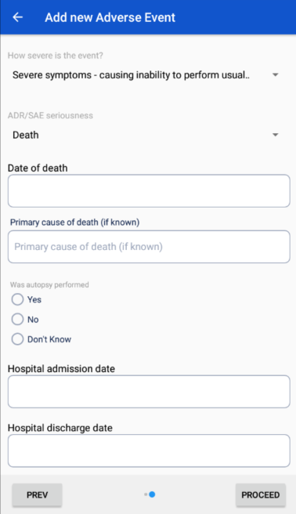
Additional Options on selecting Severity
When ‘Severe symptoms’ , ‘Potentially Life threating symptoms’ or ‘Death’ are selected
When ‘Death’ is selected as ADR/SAE Seriousness

Slide 29
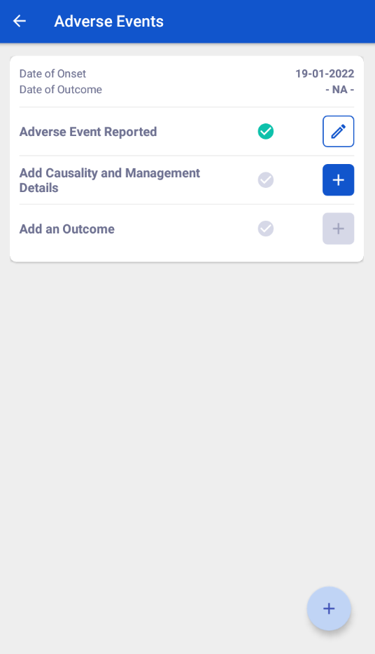
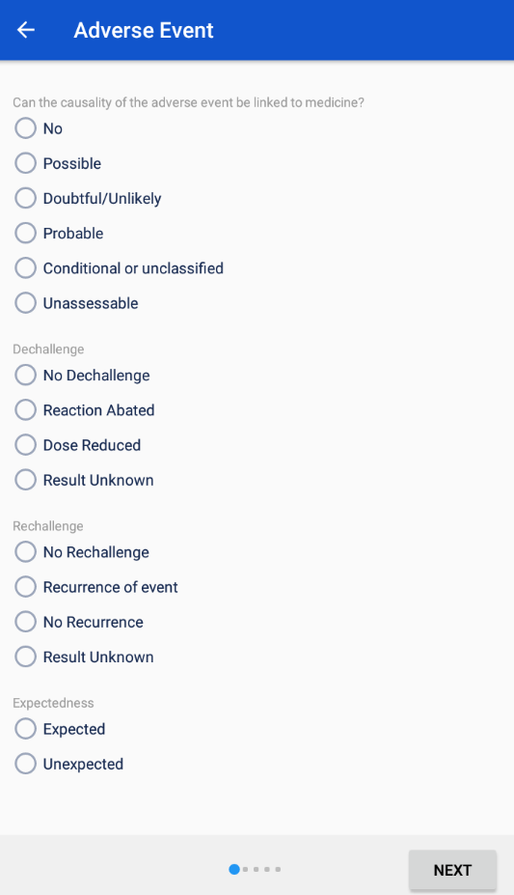
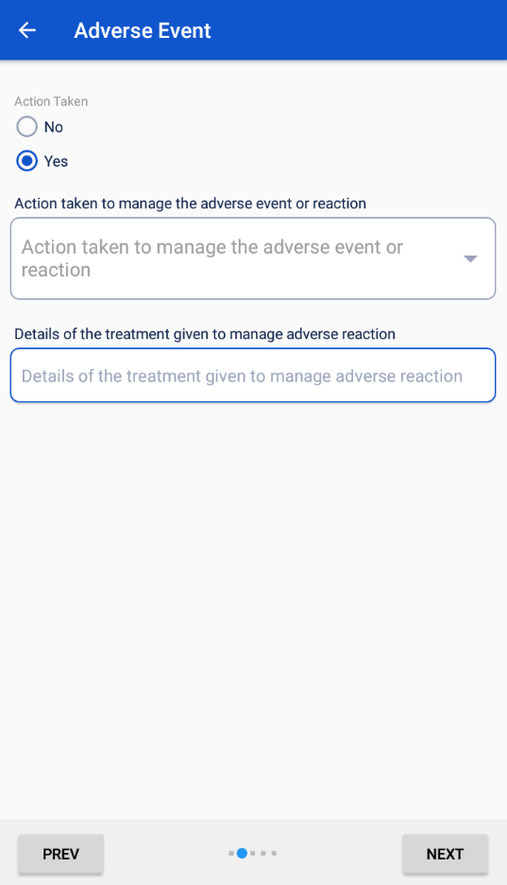
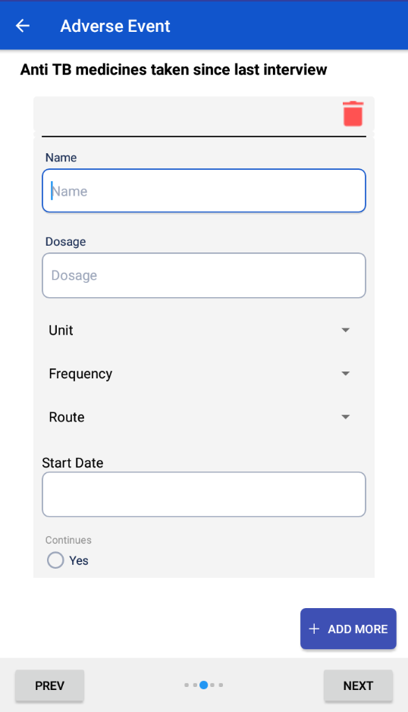
Add Causality and Management Details
Step 1
Step 2
Step 3
Step 4
Click on the ‘+’ Icon
Select Causality Details and Click Next
Enter details of Action Taken
Enter details of Anti TB medicines taken

Slide 30
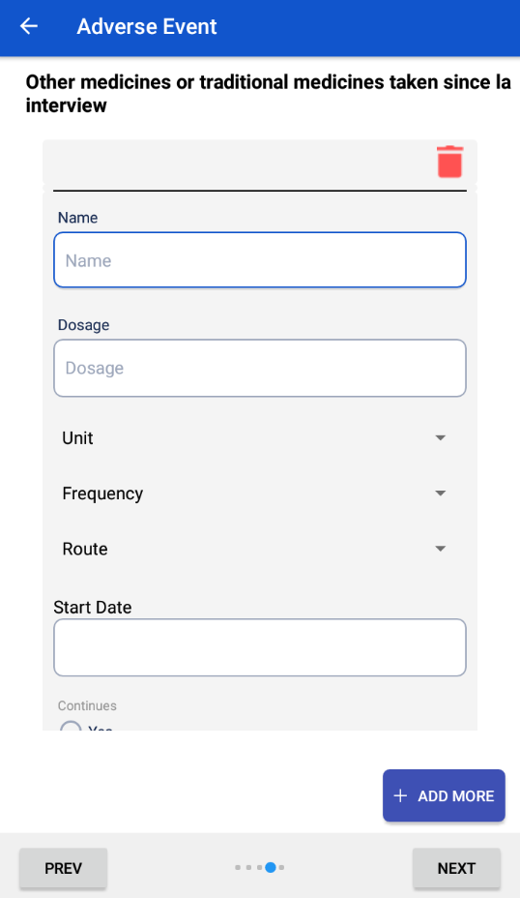
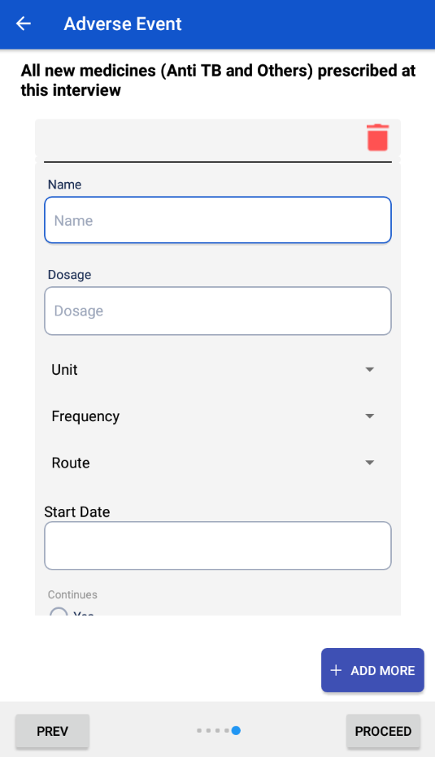
Add Causality and Management Details
Step 5
Step 6
Enter details of other medicines taken
Select Causality Details and Click Next
Click ‘ADD MORE’ to add multiple drug details
Click Proceed to complete adding Causality Details

Slide 31
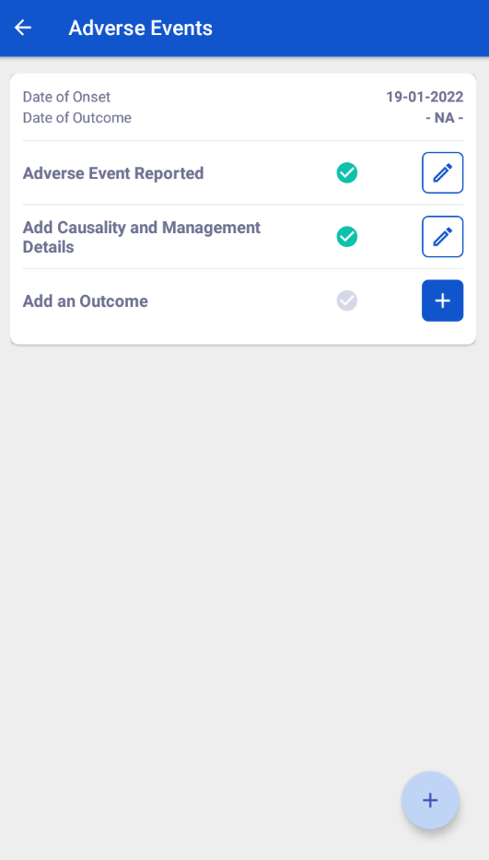
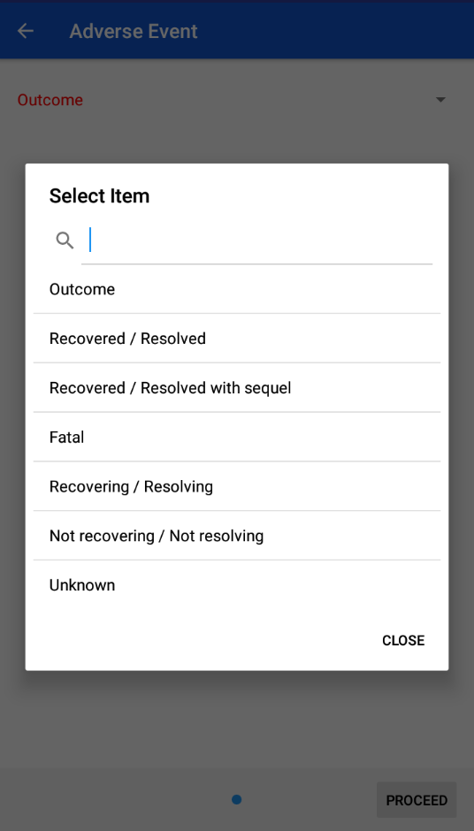
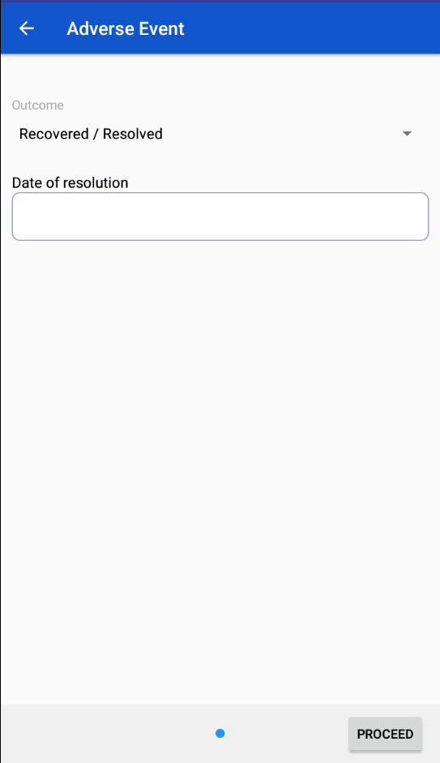
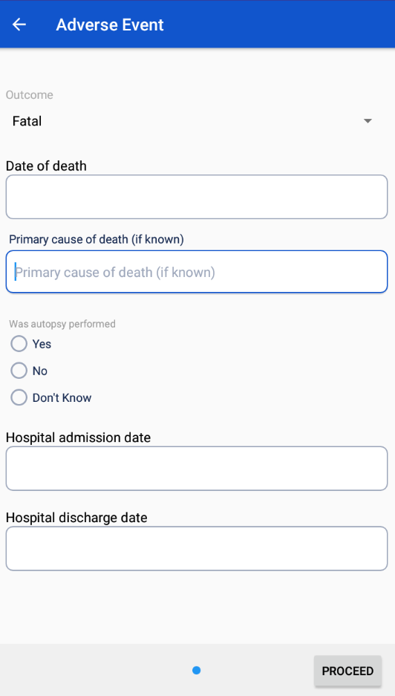
Add Outcomes to Adverse Events
Step 1
Step 2
Step 3
Step 4
Click on the ‘+’ Icon
Select the Outcome
Enter Additional details if necessary
Click Proceed to Submit Form

Slide 32
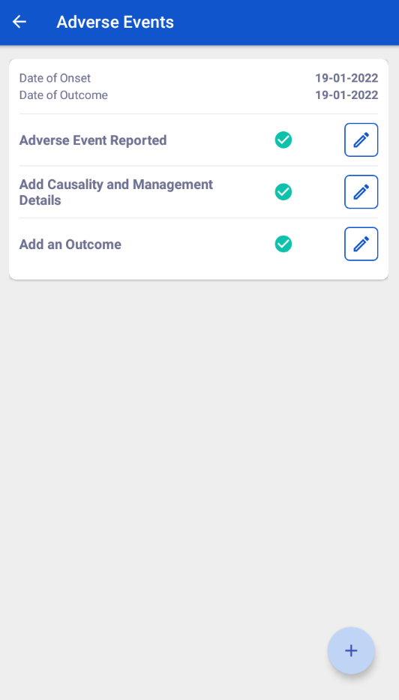
Edit Adverse Events
Step 1
Click on the Icon to edit details
Click here to add additional adverse events

Slide 33
Frequently Asked Questions
What all events can be reported through this module
  All events relating to an Adverse Drug Reaction and any other kind of adverse event can be reported through the module.
2. What type of Patients can Adverse Events be added for
  Adverse Events can be added by both DS-TB, DR-TB/PMDT and TPT Patients
Can more than one Adverse Events be added to a patient ?
  Yes, multiple Adverse Events can be added to a patient record
4. Are the Adverse Events added editable ?
  Yes, the Adverse Events reported, the Causality details and the Outcome details are editable. These details can be edited even after newer adverse events have been added.

