Slide 1
ACSM Monthly Report (State)

Slide 2
Introduction
State ACSM Monthly Report in Ni-kshay
State ACSM Report in Ni-kshay Analytics
FAQ
Contents

Slide 3
Overview
A state ACSM report has been developed to capture information on activity related to ACSM undertaken under NTEP at the State level in Ni-kshay.
ACSM Monthly reporting formats have been developed for routine monitoring processes at the State level.
Indicators for each Advocacy, Communication, and Social Mobilization have been identified, based on the activities planned in PIP.
The report would be accessible via Web and Mobile browsers.
The output reports for the entry forms would be made available subsequently.

Slide 4
State ACSM Monthly Forms and Reports
The following indicators are available in the form-
Advocacy
Communications
Social Mobilization
Finance
The access shall be available to the below users-
CTD users
State TB Officers (STO)
WHO Consultants

Slide 5
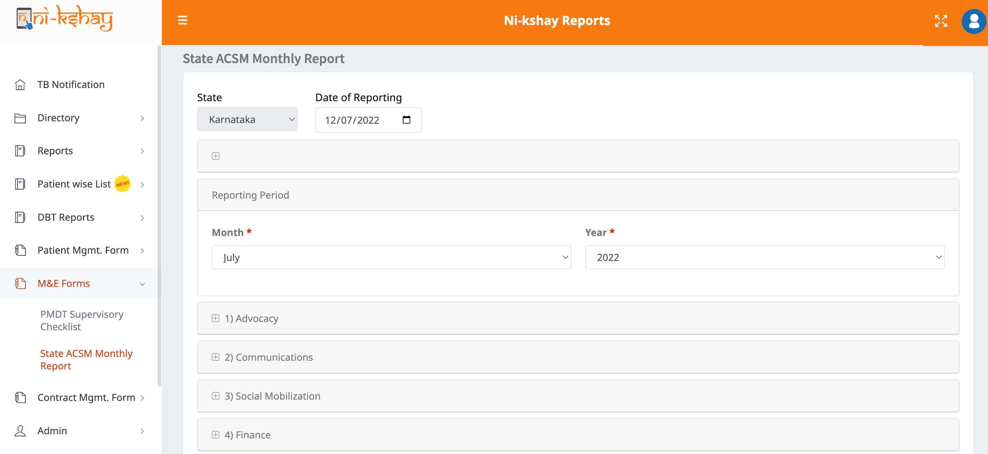
State ACSM Monthly Report
Step 1
Step 2
Click on ‘M&E Forms’
Click on ‘State ACSM Monthly Report’
Select reporting month
Select reporting year

Slide 6
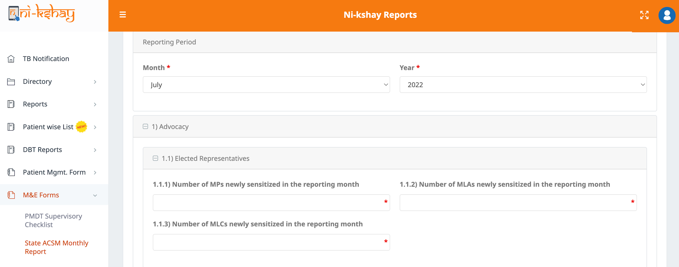
State ACSM Monthly Report…Advocacy
Step 1
Step 2
Step 3
Step 4
Click on ‘M&E Forms’
Click on ‘State ACSM Monthly Report’
Click on ‘Advocacy’
Click on ‘Elected Representatives’
Click on “Elected Representatives” to enter values for the KPIs

Slide 7
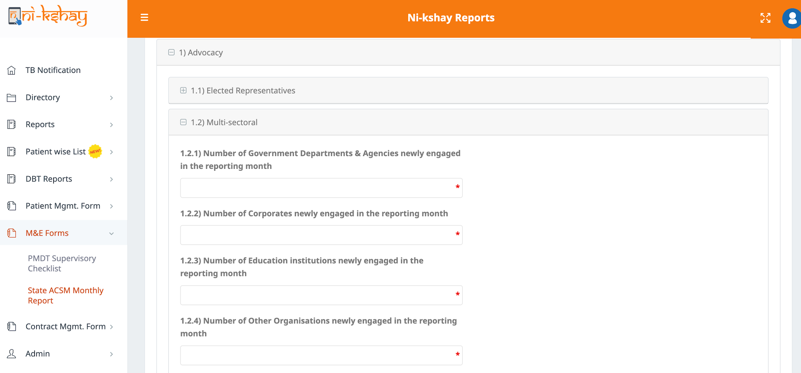
State ACSM Monthly Report…Advocacy
Step 1
Step 2
Step 3
Step 4
Click on ‘M&E Forms’
Click on ‘State ACSM Monthly Report’
Click on ‘Advocacy’
Click on ‘Multi-sectoral’
Click on “Multi-sectoral” to enter values for the KPIs

Slide 8
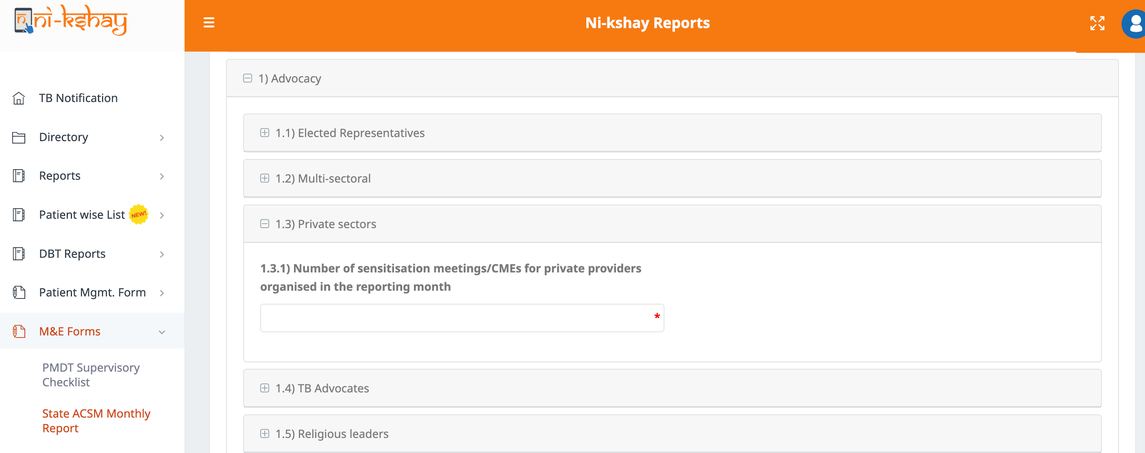
State ACSM Monthly Report…Advocacy
Step 1
Step 2
Step 3
Step 4
Click on ‘M&E Forms’
Click on ‘State ACSM Monthly Report’
Click on ‘Advocacy’
Click on ‘Private sectors’
Click on “Private sectors” to enter a value for the KPI

Slide 9
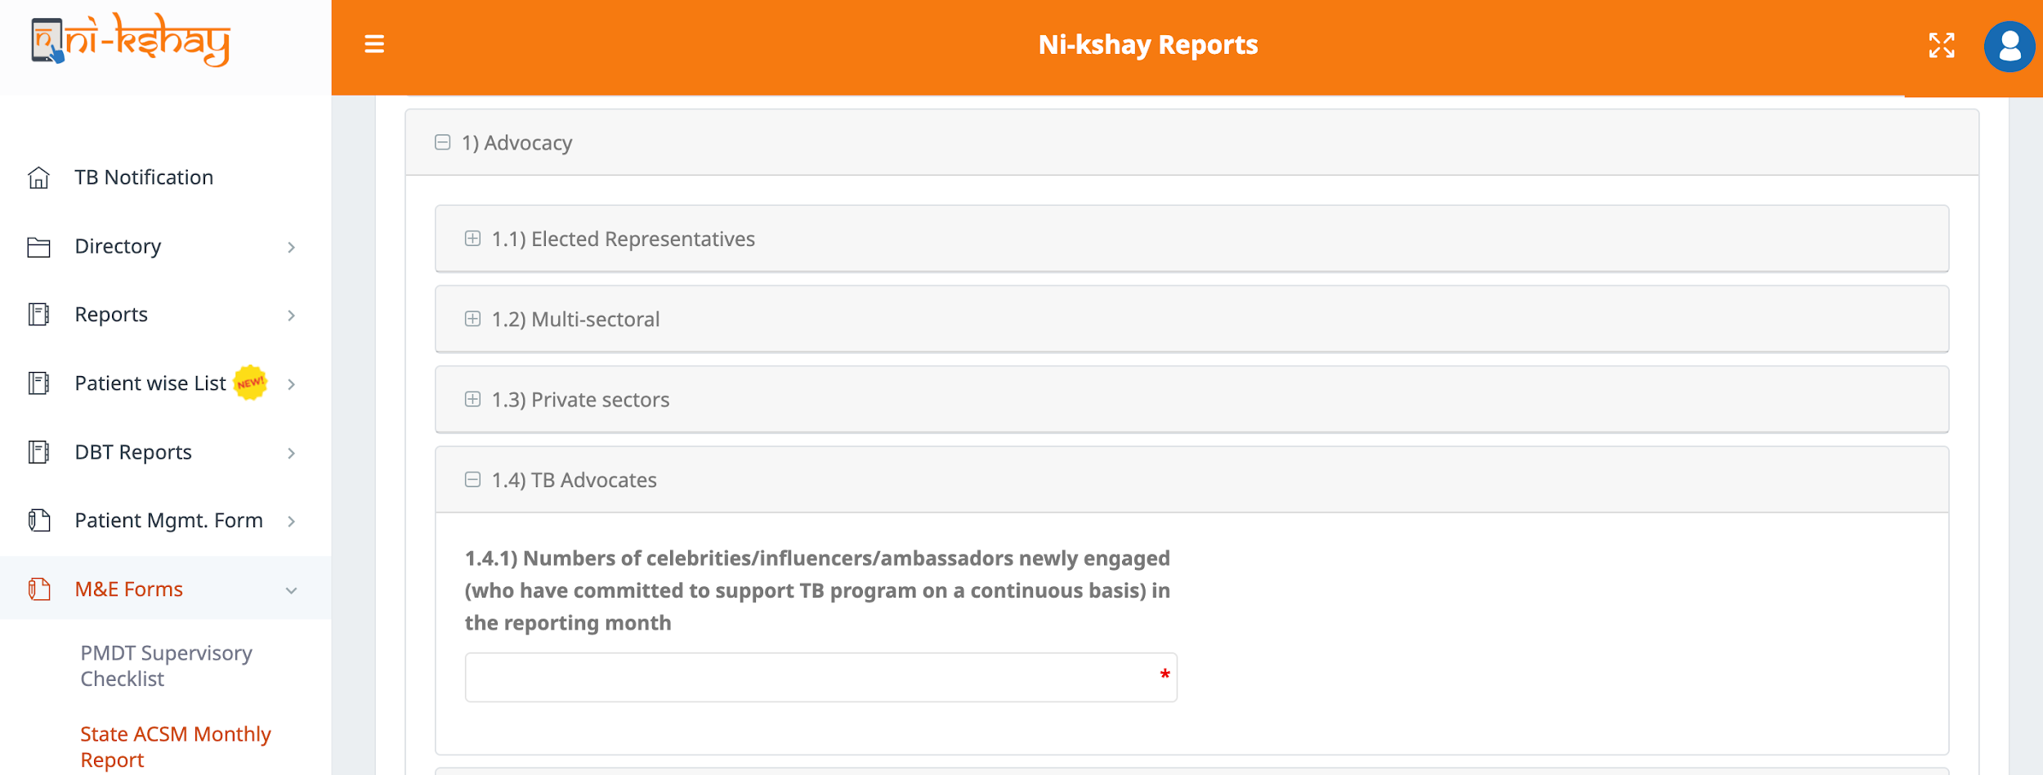
State ACSM Monthly Report…Advocacy
Step 1
Step 2
Step 3
Step 4
Click on ‘M&E Forms’
Click on ‘State ACSM Monthly Report’
Click on ‘Advocacy’
Click on ‘TB Advocates’
Click on “TB Advocates” to enter a value for the KPI

Slide 10
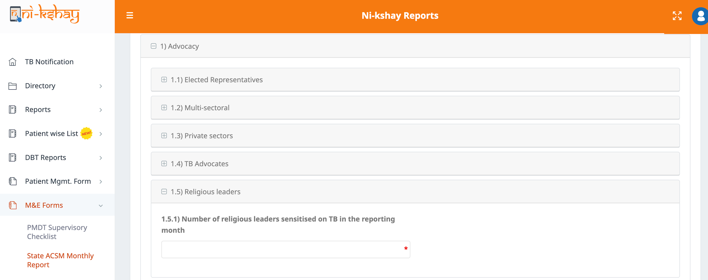
State ACSM Monthly Report…Advocacy
Step 1
Step 2
Step 3
Step 4
Click on ‘M&E Forms’
Click on ‘State ACSM Monthly Report’
Click on ‘Advocacy’
Click on ‘Religious Leaders’
Click on “Religious Leaders” to enter a value for the KPIs

Slide 11
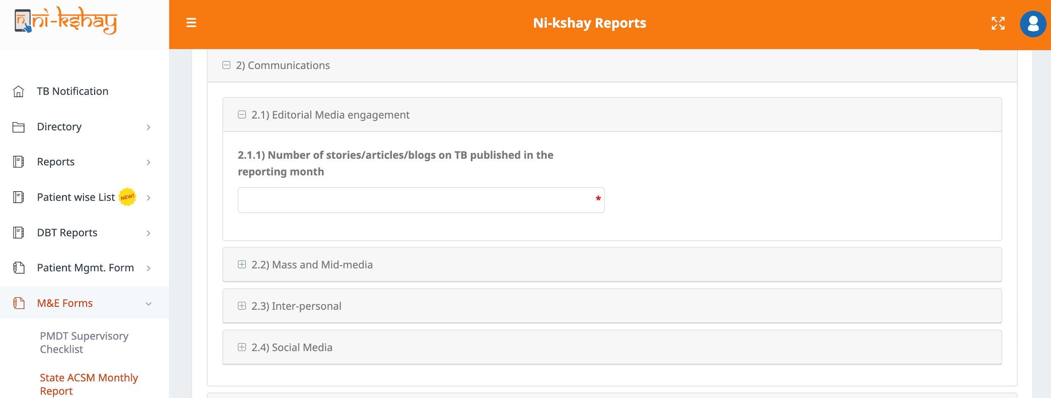
State ACSM Monthly Report…Communications
Step 1
Step 2
Step 3
Step 4
Click on ‘M&E Forms’
Click on ‘State ACSM Monthly Report’
Click on ‘Communications’
Click on ‘Editorial Media Engagement’
Click on “Editorial Media Engagement” to enter a value for the KPIs

Slide 12
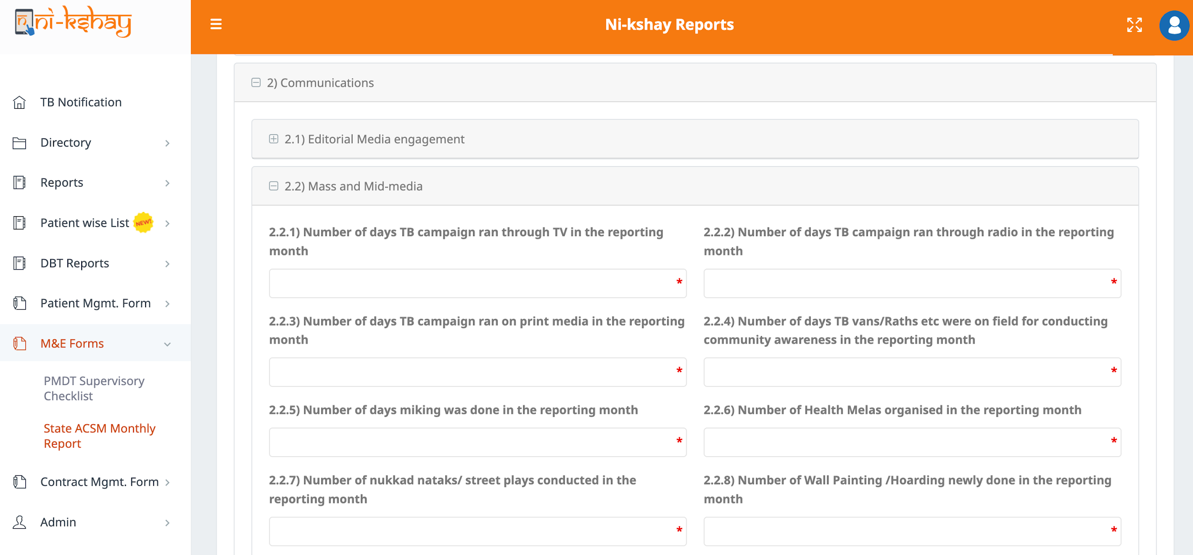
State ACSM Monthly Report…Communications
Step 1
Step 2
Step 3
Step 4
Click on ‘M&E Forms’
Click on ‘State ACSM Monthly Report’
Click on ‘Communications’
Click on ‘Mass and Mid-media’
Click on “Mass and Mid-media” to enter values for the KPIs

Slide 13
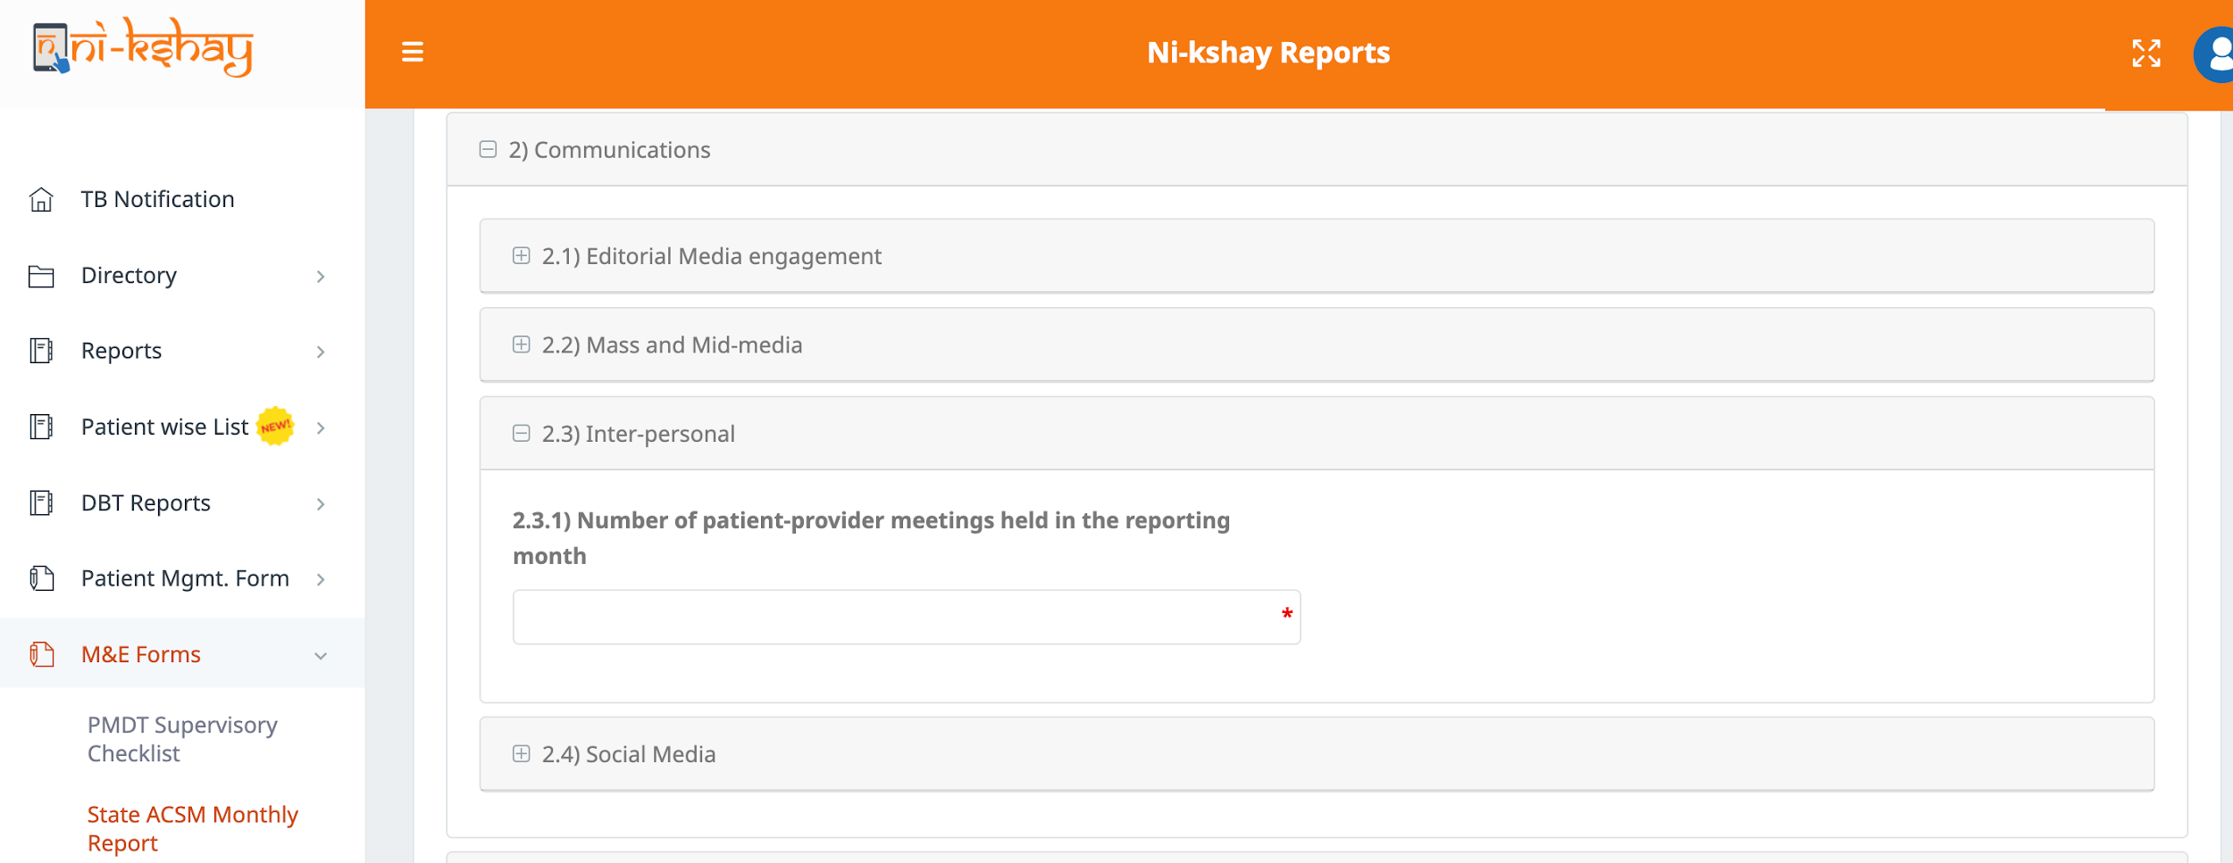
State ACSM Monthly Report…Communications
Step 1
Step 2
Step 3
Step 4
Click on ‘M&E Forms’
Click on ‘State ACSM Monthly Report’
Click on ‘Communications’
Click on ‘Inter-personal’
Click on “Inter-personal” to enter a value for the KPIs

Slide 14
State ACSM Monthly Report…Communications
Step 1
Step 2
Step 3
Step 4
Click on ‘M&E Forms’
Click on ‘State ACSM Monthly Report’
Click on ‘Communications’
Click on ‘Social Media’
Click on “Social Media” to enter values for the KPIs

Slide 15
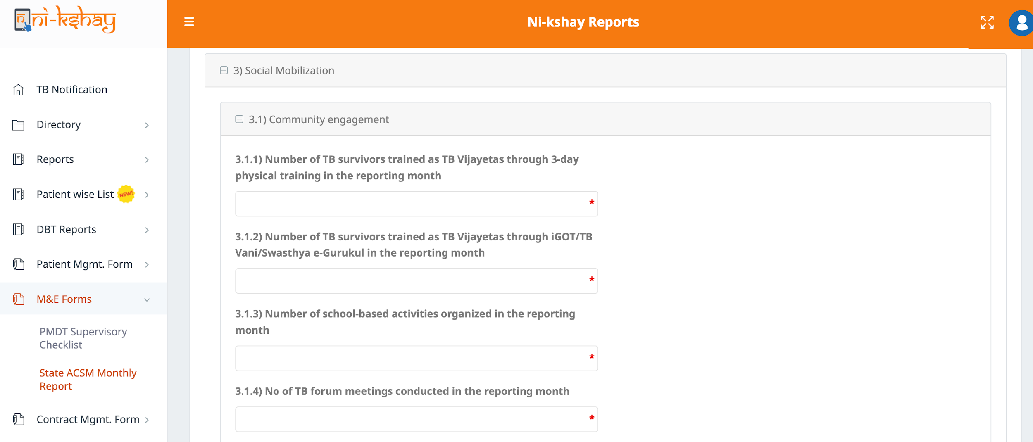
State ACSM Monthly Report…Social Mobilization
Step 1
Step 2
Step 3
Step 4
Click on ‘M&E Forms’
Click on ‘State ACSM Monthly Report’
Click on ‘Social Mobilization’
Click on ‘Community Engagement’
Click on “Community Engagement” to enter values for the KPIs

Slide 16
State ACSM Monthly Report…Social Mobilization
Step 1
Step 2
Step 3
Step 4
Click on ‘M&E Forms’
Click on ‘State ACSM Monthly Report’
Click on ‘Social Mobilization’
Click on ‘Provider Trainings’
Click on “Provider Trainings” to enter values for the KPIs

Slide 17
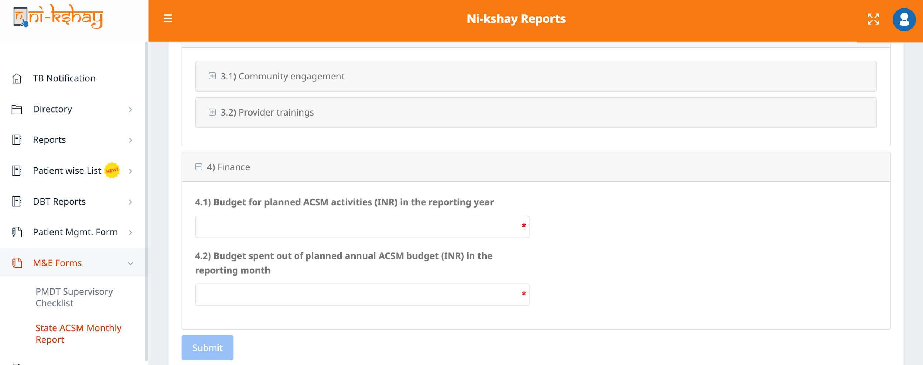
State ACSM Monthly Report…Finance
Step 1
Step 2
Step 3
Step 4
Step 5
Click on ‘M&E Forms’
Click on ‘State ACSM Monthly Report’
Click on ‘Finance’
Check and verify all the mandatory fields
Click on ‘Submit’ for the final submission
Click on “Finance” to enter values for the KPIs

Slide 18
ACSM Reports in Ni-kshay Analytics
The NTEP staff at the State level can access the Ni-kshay Analytics using the same Ni-kshay credentials on Ni-kshay Analytics.
The reports can be downloaded directly from Ni-kshay Analytics in CSV formats.
The user can choose the District, Year and Month to extract data from the available filters.
URL to direct access the report in Ni-kshay Analytics:
https://analytics.nikshay.in/superset/dashboard/p/AKoynNbyLmR/

Slide 19
ACSM Reports in Ni-kshay Analytics

Slide 20
FAQ
In case case of any issues with the form, please raise a ticket on Ni-kshay HelpDesk (https://nikshay-support.atlassian.net/servicedesk/customer/portal/1/group/7/create/20)
In case of any duplicate/erroneous entries in the forms, the ticket may be raised in Ni-kshay HelpDesk for deletion

Slide 21
Thank You

