Slide 1
ABDM Milestone 2 Building Health Information Provider (HIP) services to share digital records via Personal Health Records (ABHA) app.

Slide 2
Introduction
ABDM Milestone 2 will enable Ni-kshay to share consented digital health records(prescription and diagnostic) via PHR Mobile Applications. As a part of this feature, the following changes have been made in Ni-kshay
Creation of care contexts to be associated with the beneficiary
Ability to respond to discovery requests against ABHA Number
Support patient-initiated linking of old medical reports
Acknowledge Consent Manager requests for health data and save the consent artifact
Facilitate flow of medical data against consent artifact as per specified format (FHIR, encrypted)
Notifications to the PHR app
Deep Link SMS
Staff and Treatment Supporters

Slide 3
HIP Initiated Linking
HIP initiated linking is the process through which a HIP(Ni-kshay) links the patients care contexts (diagnostic and prescription) records with the patients ABHA Address.
HIP Initiated Linking will be done for all records that have an ABHA ID tagged to the Ni-kshay record.

Slide 4
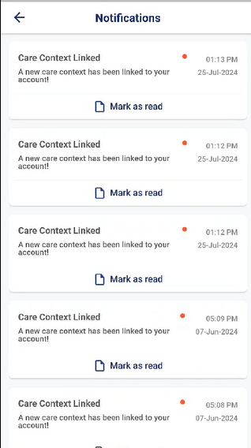
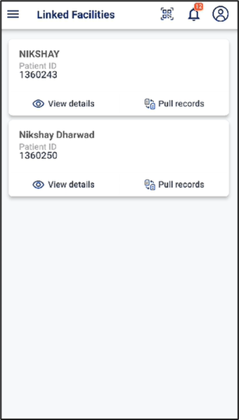
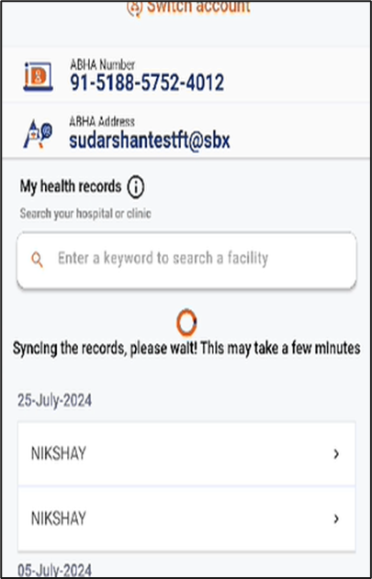
HIP Initiated Linking
Step 1
Step 2
Step 1
Step 3
Enroll the patient through New Enrollment
Click on Pull Records
Click on the record
Click on notification received on PHR App
Enroll the patient through New Enrollment

Slide 5
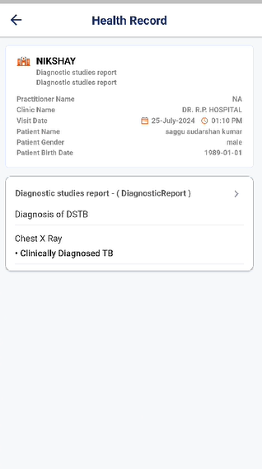
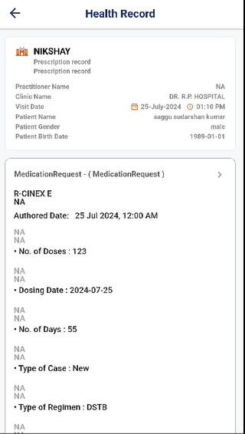
HIP Initiated Linking
Prescription record.
Diagnostic (Test) record.

Slide 6
User Initiated Linking
User initiated linking is the process through which a user initiates the process to search and link their care contexts (diagnostic and prescription) records with their demographic details.
If records matching their name, gender, year of birth, ABHA Address are available in Ni-kshay, the list of such records are presented to the user in the PHR app.
Upon approval of the user, the selected records are linked to their ABHA ID, and they will be able to view their Diagnostic and Prescription records.

Slide 7
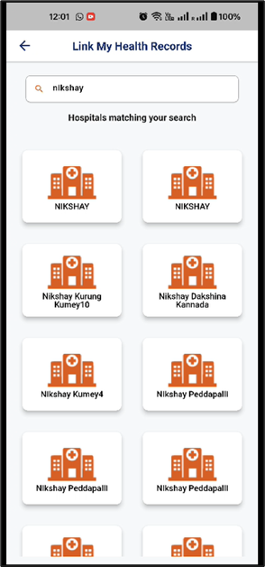
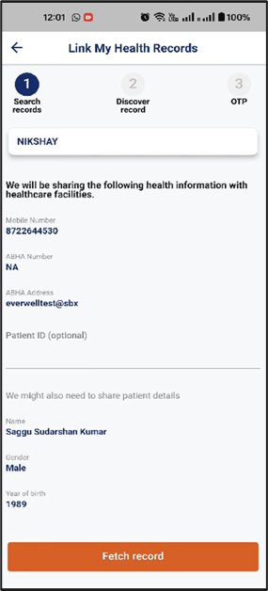
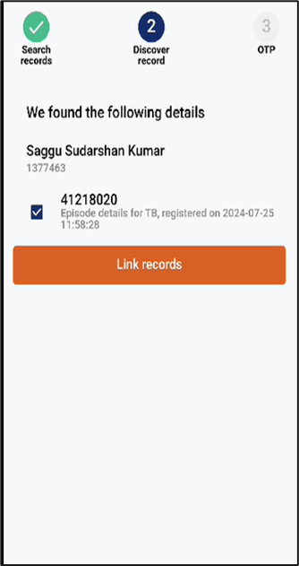
User Initiated Linking
Step 1
Step 2
Step 3
Step 1
Step 3
Enroll the patient through New Enrollment
Enter Nikshay in the search box
Click on fetch record
Click on Link Record
Click on Link New Facility
Enroll the patient through New Enrollment

Slide 8
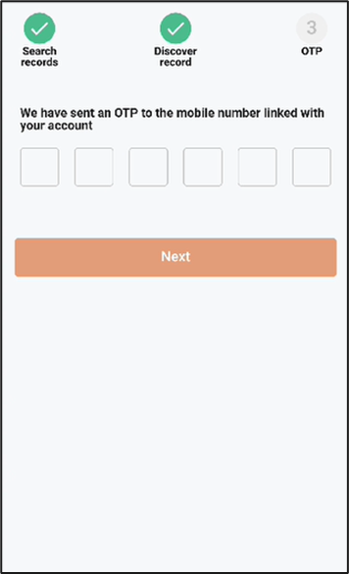
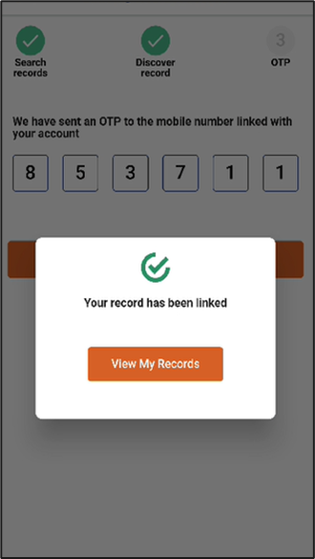
User Initiated Linking
Step 1
Step 6
Step 5
Enroll the patient through New Enrollment
Click on View my Records
Enter the OTP
Enroll the patient through New Enrollment

Slide 9
User Initiated Linking
Prescription record.
Diagnostic (Test) record.

Slide 10
Deep Link SMS
1. Upon creation of a new record on Ni-kshay, ABDM will send an SMS to the user with a deep link. The content of the message will be
Your NIKSHAY reports are now ready. Bring all your health records together for safekeeping and sharing by you with any Doctor. Click https://phrsbx.abdm.gov.in/uhi/NIKSHAY-HIPABDM,NHA
2. Clicking on the link will show the list of all ABHA Mobile applications (PHR apps) that have been approved by ABDM.

Slide 11
THANK YOU

