Slide 1
Informant DBT module under NTEP -
Ni-kshay workflows
Last Updated on 20th October,2022

Slide 2
Contents
Introduction
Informant registration
Presumptive TB registration
Enroll a patient through TB Screening tool
Informant tag for PHI/other users
DBT maker workflow
DBT Checker workflow
Ni-kshay DBT Dashboard
Staff and Treatment Supporters

Slide 3
Introduction
Informant can facilitate referral of a presumptive TB patient to any Designated Microscopy Center or a molecular testing laboratory in the public sector; and if the person is diagnosed as confirmed TB patient at such center, and has not been notified earlier by the public/private sector in Ni-kshay, the informant would be eligible to get an incentive of Rs.500/- for notification.
Ni-kshay portal enables a beneficiary to register as an informant and facilitate registration of a presumptive TB patient within the system.
Incentives of Rs. 500 for Informant, Notification and Outcome Declaration will be provided to Private Provider (HF) & Staff get informant incentive.
Staff who have the following designations can be added as Informants - Asha, NGO Volunteer, Other Community Volunteer, Private practitioner, Citizen, Informal Provider
Staff and Treatment Supporters

Slide 4
Informant user flow
Staff and Treatment Supporters

Slide 5
Step 1- Informant Registration
New Informant Registration Page is accessible to anyone who visits the website www.Nikshay.in

Slide 6
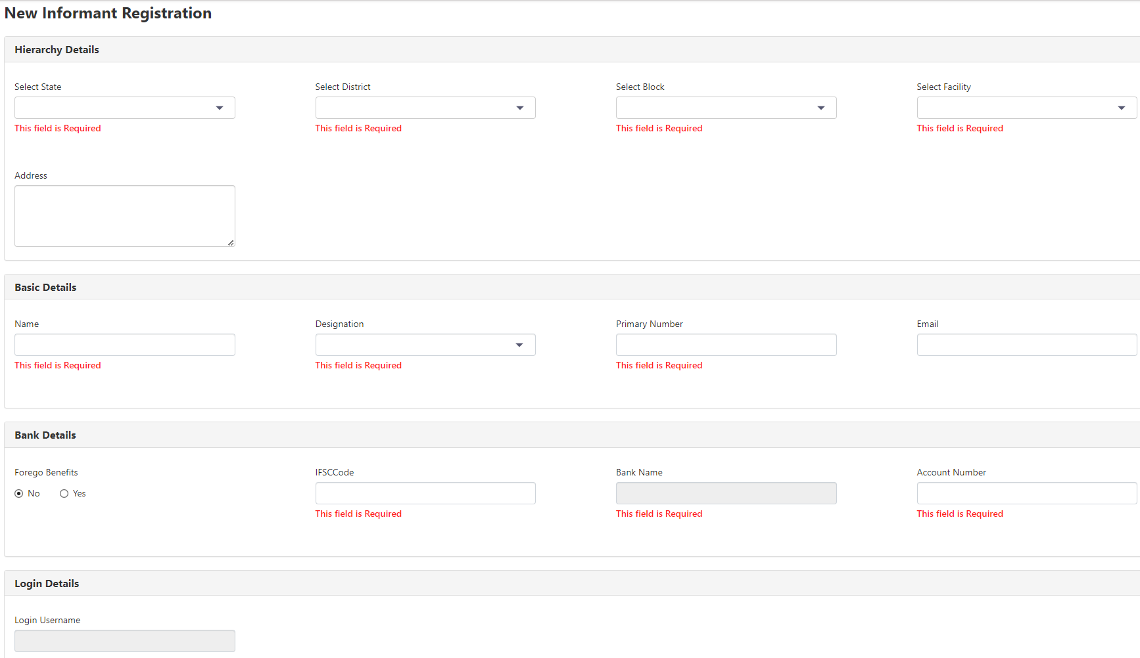
Informant registration page
Enter all fields that are required.
Duplication check is there on Primary Number and Bank account details
Mobile No. must be unique
Bank details must be unique

Slide 7
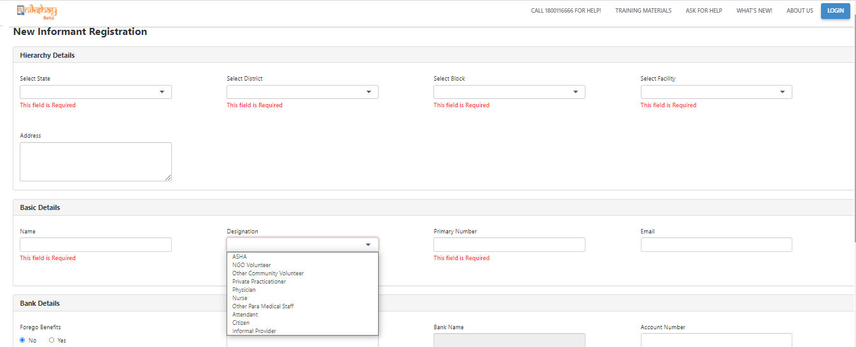
Informant registration page
Different designations of the Informant

Slide 8
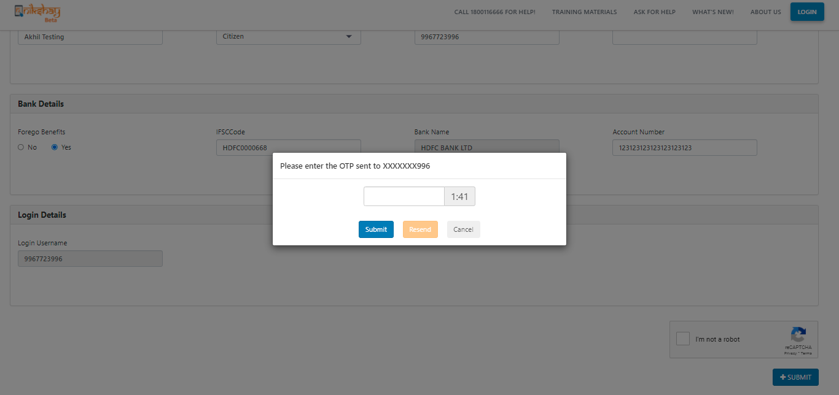
OTP verification
Enter OTP received on phone number that is valid for 2 mins
A Resend OTP option can be used twice to get a valid OTP
On successful confirmation, the staff is created in Ni-kshay.
The username will be the phone number and an auto generated password will be sent to the phone number entered

Slide 9
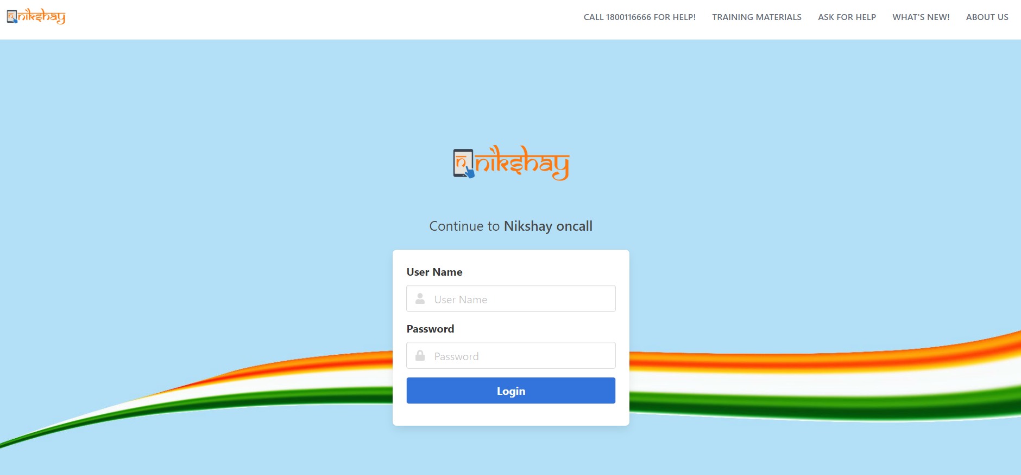
Step 2- Informant Login
Login using the username and password. User will be asked to reset the password.
Please reset the password in order to login in Ni-kshay

Slide 10
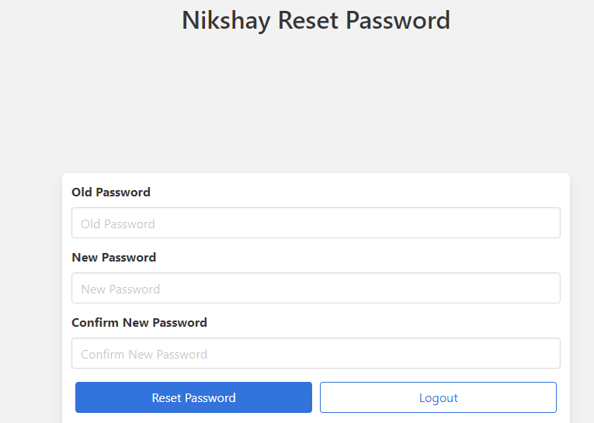
Reset password page

Slide 11
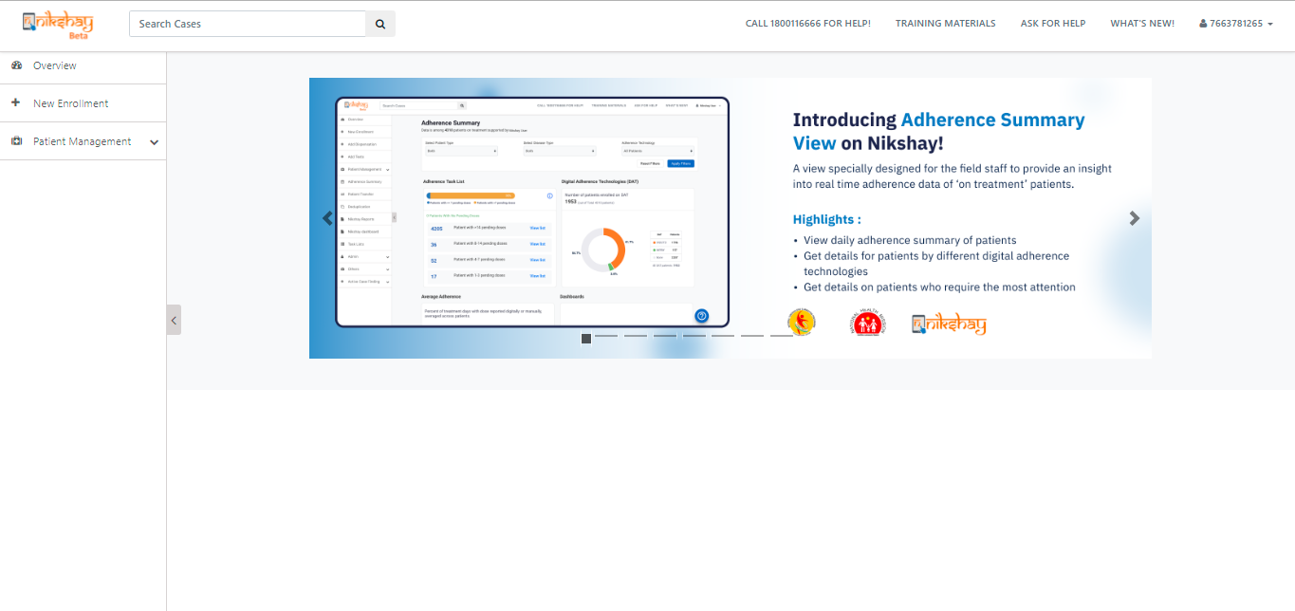
Step 3- Access in Ni-kshay
After login, only Overview, Patient Management and New Enrollment would be shown for Citizen and informal providers

Slide 12
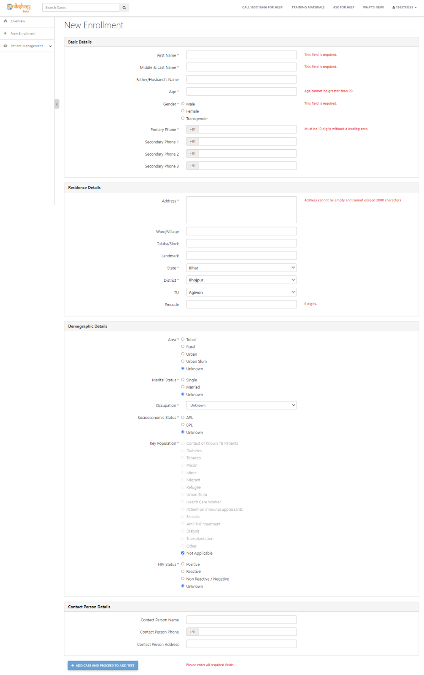
Step 4: Enrolling a Presumptive patient
On Clicking on New Enrollment, the user can enroll a presumptive patient.
On successful completion of enrollment form, the presumptive patient gets added to Ni-kshay

Slide 13
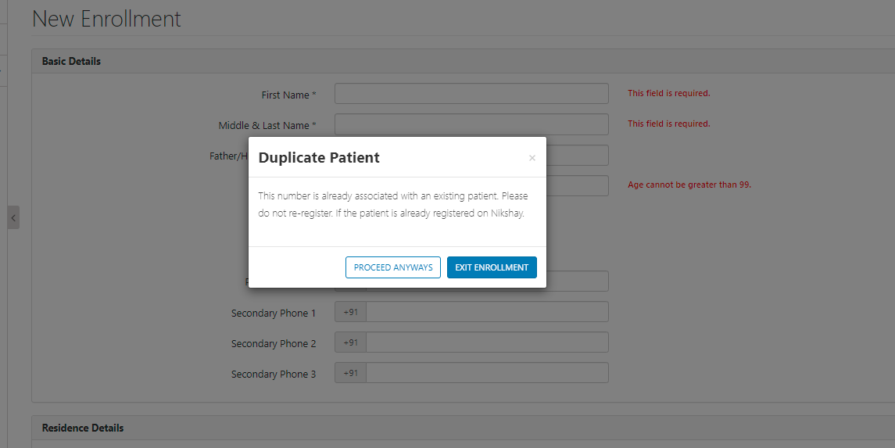
Deduplication check for Presumptive patients
In case there are duplicate patients (patients with same phone number and gender) we will show a message to reduce the duplicates. However we will allow only upto 5 patients to be registered using the same phone number.

Slide 14
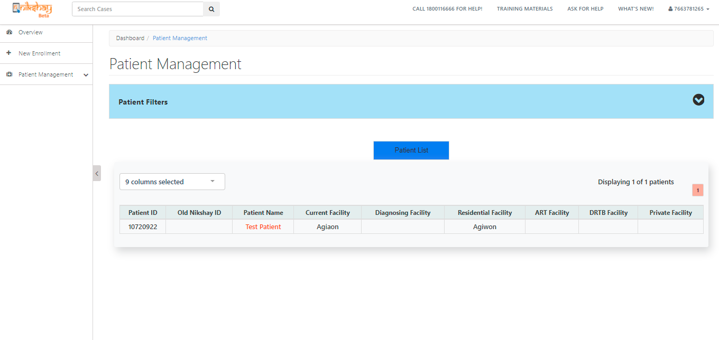
Added patient visible in the patient management module

Slide 15
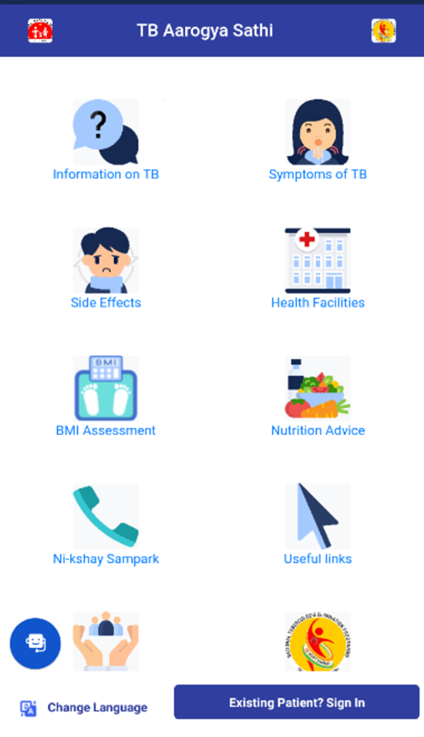
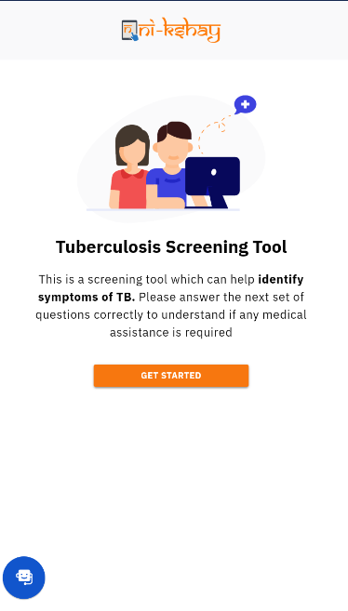
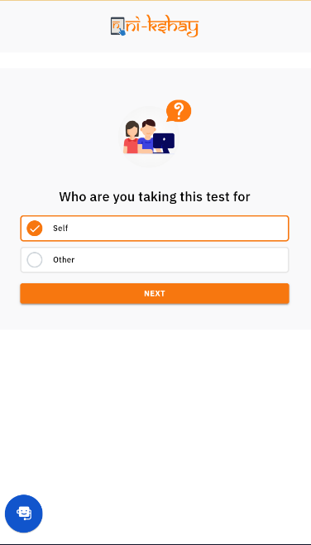
Enroll a patient through TB Screening tool
>>Click on Symptoms of TB
>> click on Get Started
>>select Self option for enrollment

Slide 16
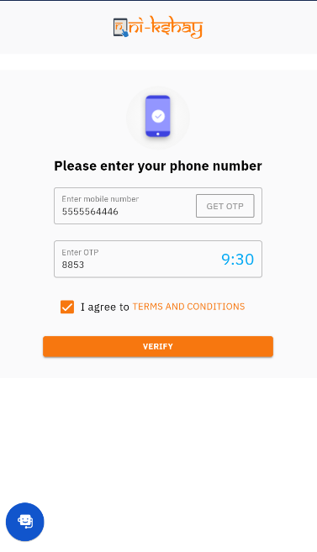
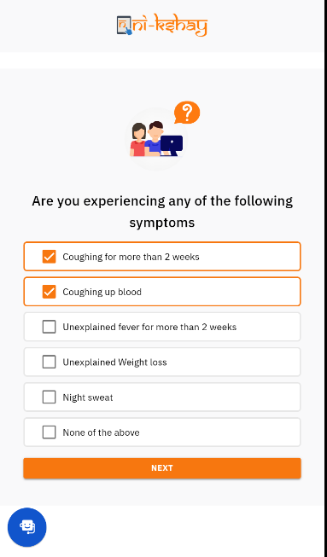
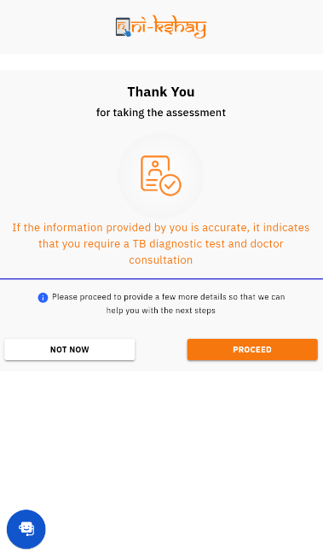
Enroll a patient through TB Screening tool
> Enter Mobile number
> Verify the OTP
> Select the symptoms
> Click on proceed for next step

Slide 17
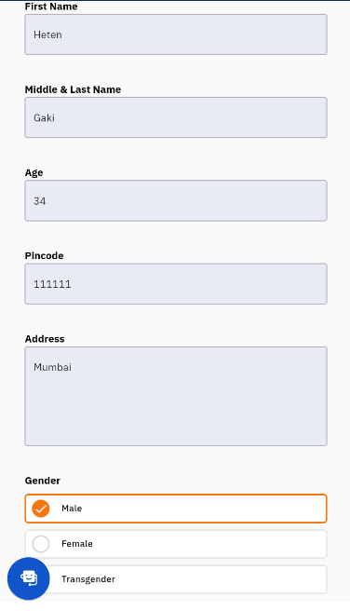
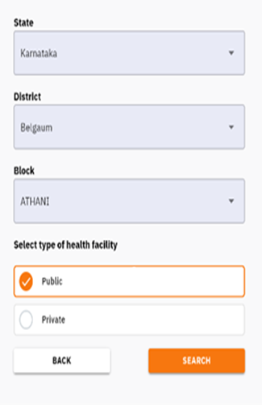
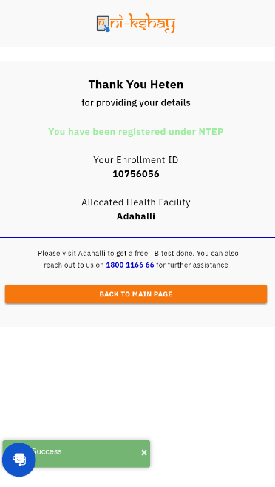
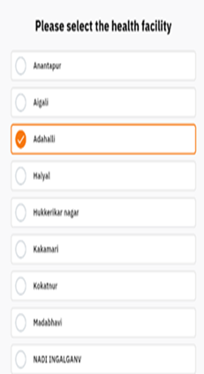
Enroll a patient through TB Screening tool
>> Fill Basic details
>> Select State, District & TBU
>> Select public sector health facility
>>Now patient is enroll as presumptive
patient

Slide 18
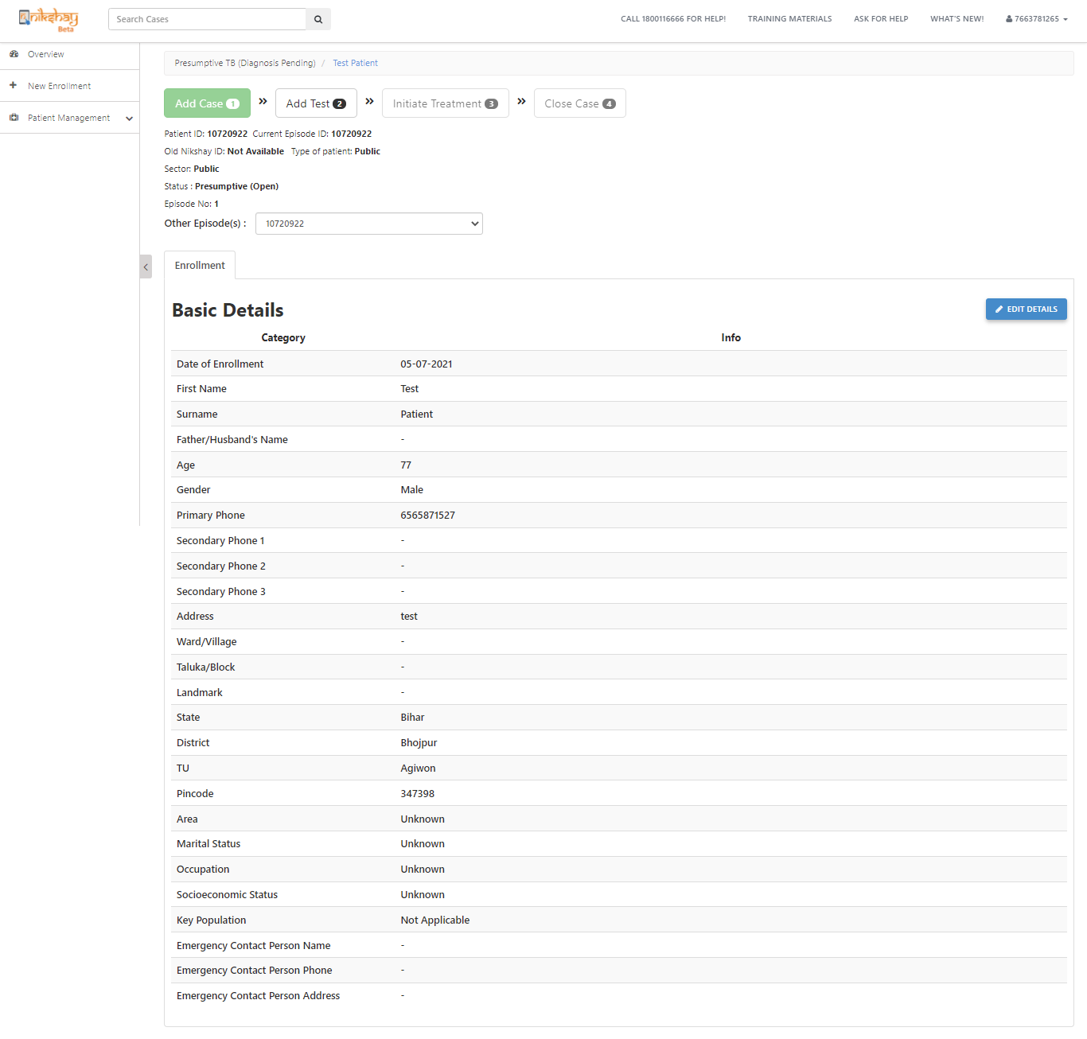
Basic details of added patients
Added patient is visible however, the informal provider/citizen will only be able to edit the basic details of the patient.
No other action can be taken for the added patient.

Slide 19
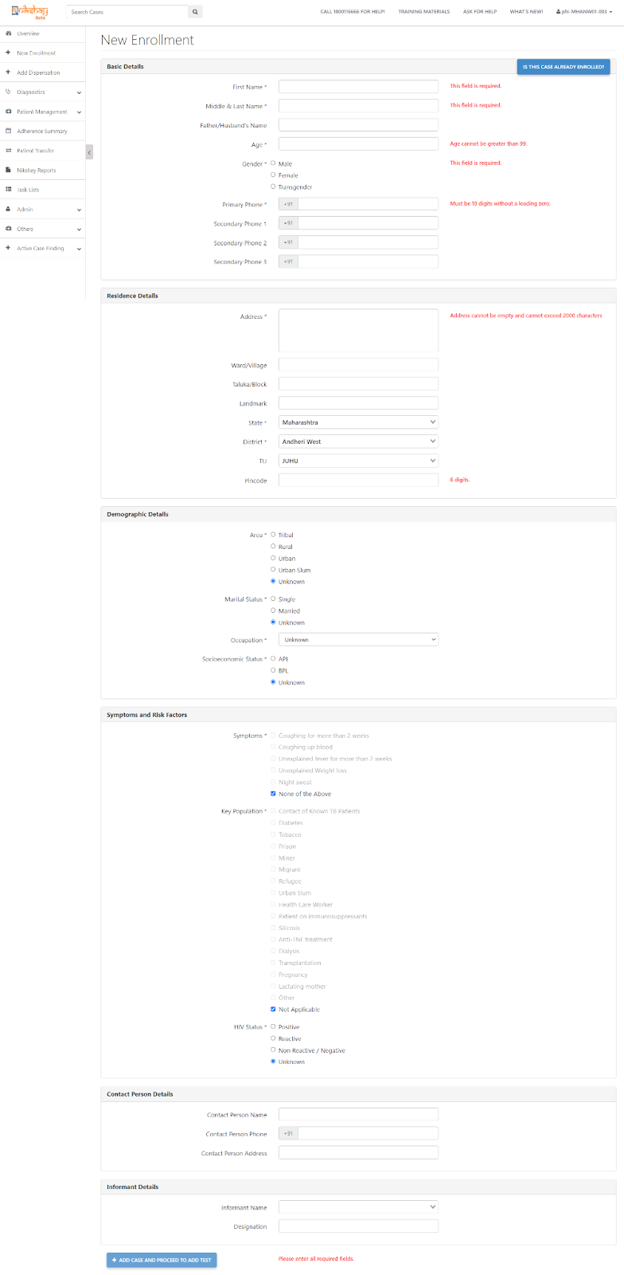
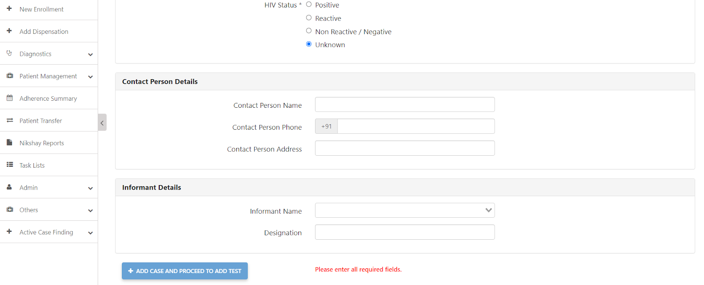
Informant entry through PHI logins
For PHI logins, add informant details is part of the registration page.

Slide 20
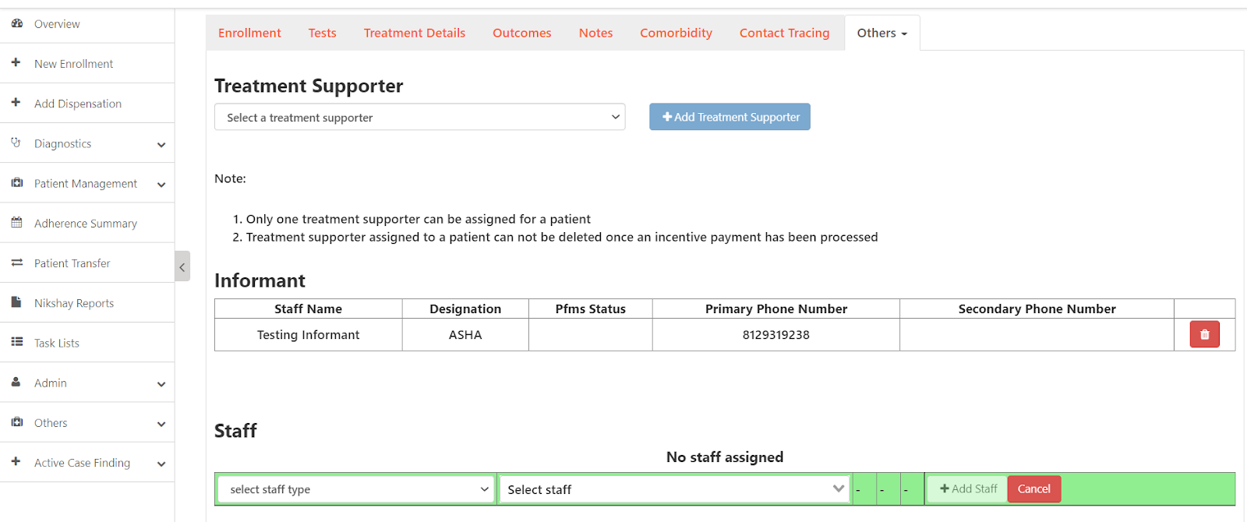
Informant can be added/removed in Staff/Treatment Supporter page
PHI/ TBU/ District can add/remove Informant in the Staff/Treatment Supporter page

Slide 21
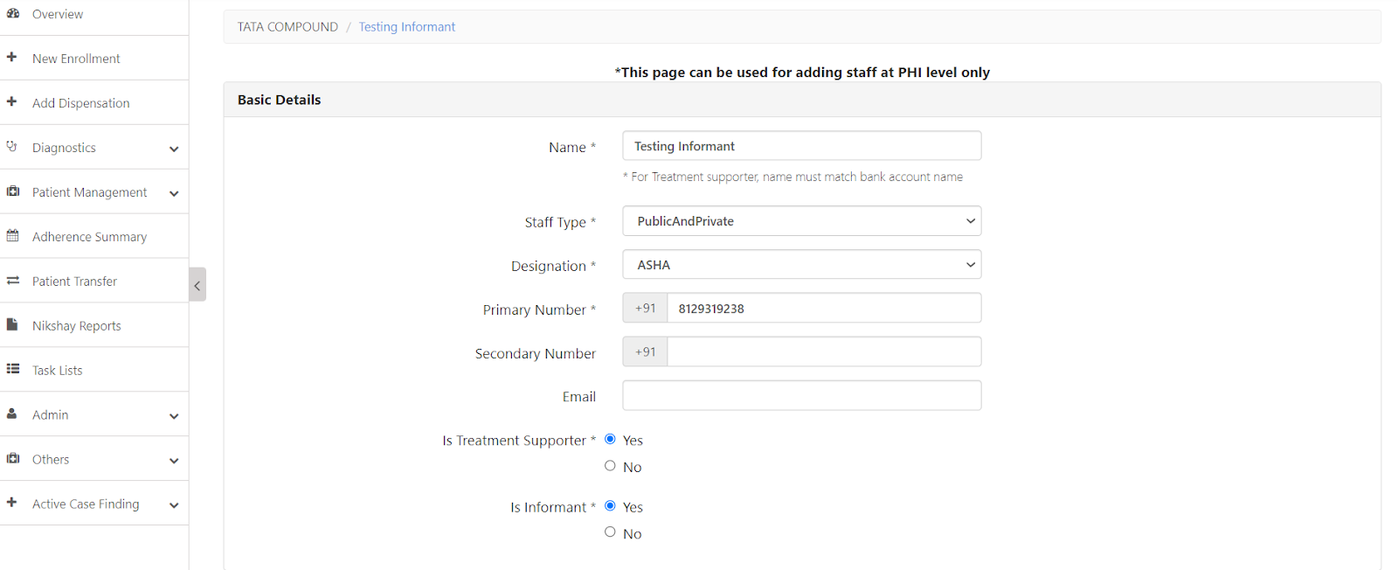
Addition of staff as Informants
Staff who have the following designations can be added as Informants-
Asha, NGO Volunteer, Other Community Volunteer, Private practitioner, Citizen, Informal Provider

Slide 22
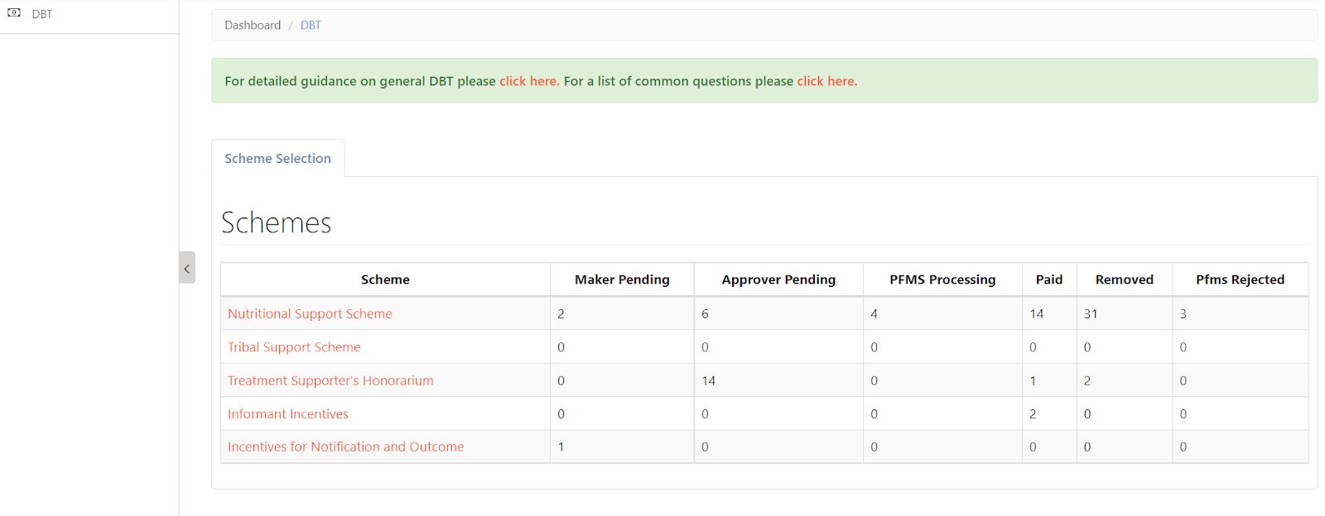
DBT Maker page for Informant incentives
New section introduced for informant incentives

Slide 23
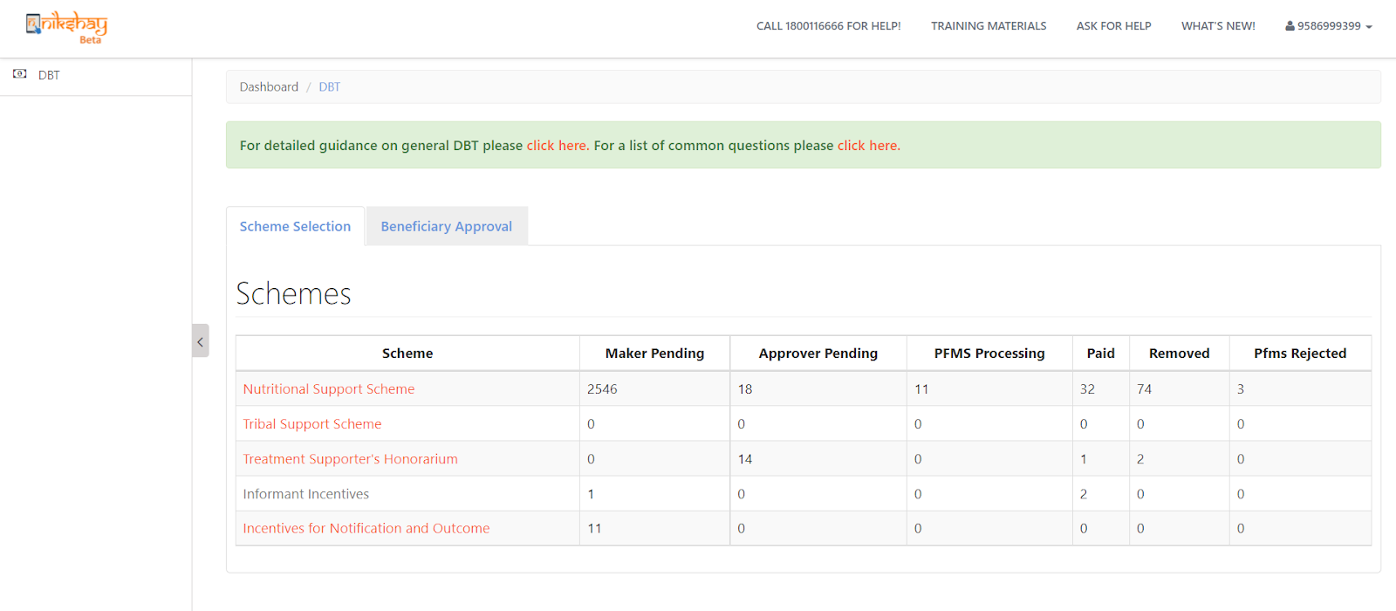
DBT Checker page for Informant incentives
New section introduced for informant incentives

Slide 24
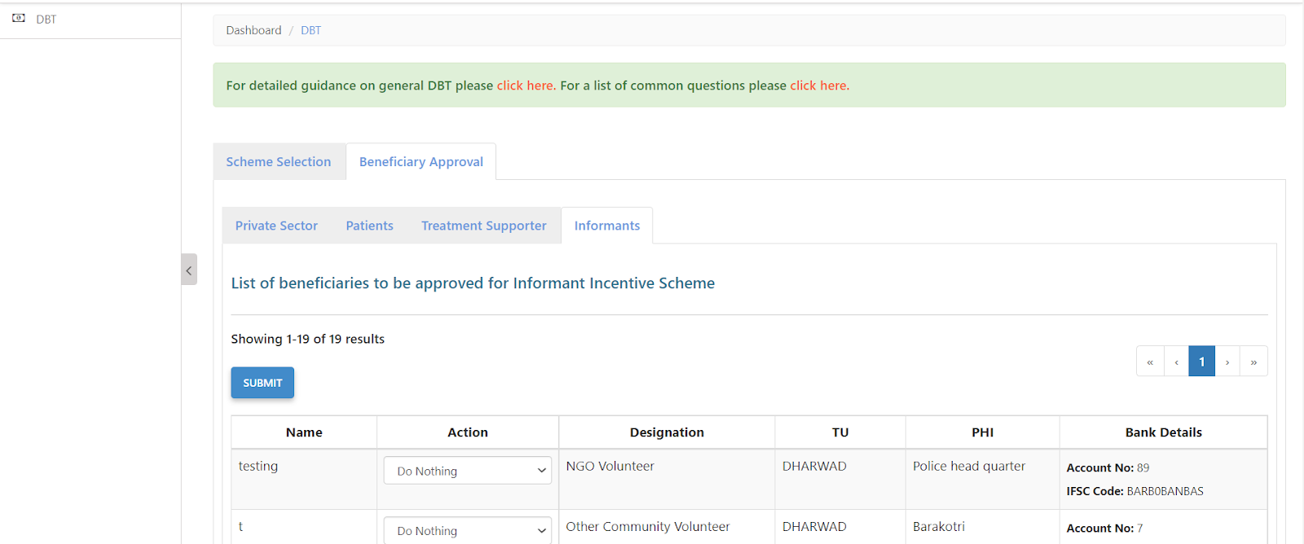
DBT Checker - Beneficiary workflow

Slide 25
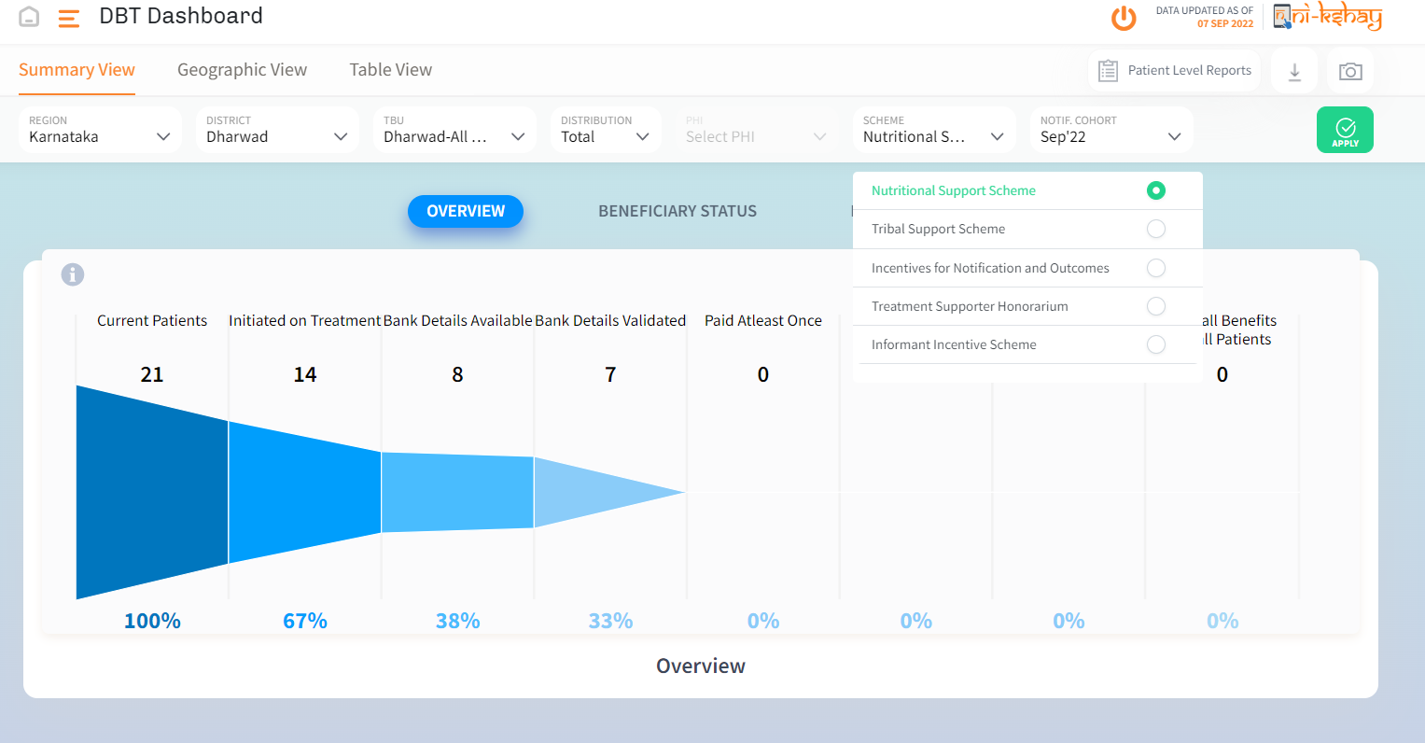
Ni-kshay DBT Dashboard

Slide 26
Scenarios where Informant incentive would be applicable
Added by | Enrolment by (i.e. Login used) | Diagnosis | Beneficiary | Incentive Type
HUB | HUB | PHI | HUB | Informant
PHI | PHI | PHI | INFORMANT/PATIENT | Informant
PVTCHEM | PVTCHEM | PHI | PVTCHEM | Informant
PVTLAB | PVTLAB | PHI | PVTLAB | Informant
PVTHUB / State Jeet / District Jeet | HUB | PHI | HUB | Informant
TU | PHI | PHI | INFORMANT/PATIENT | Informant
TU | HUB | PHI | HUB | Informant
DISTRICT | PHI | PHI | INFORMANT/PATIENT | Informant
DISTRICT | HUB | PHI | HUB | Informant
INFORMANT | PHI | PHI | INFORMANT | Informant

Slide 27
FAQs
1.What is the benefit generation timeline for Informant scheme?
>>The Informant Incentive should be generated to the informant only after 7 days from date of diagnosis.
2.This form seems to be quite complex. Is there any way of simplifying it or reducing some non- mandatory indicators?
>>Currently users need to fill the basic & residentials fields which are mandatory in enrollment form. Total mandatory fields are 7 in enrollment form.
Staff and Treatment Supporters

Slide 28
Thank you

