Slide 1
Module 7: Private Provider (HF) incentives scheme

Slide 2
How are PSN Benefits generated by Ni-kshay
Incentives of Rs. 500 for Notification and Outcome Declaration will be provided to Private Provider (HF)
Presently, Ni-kshay enables users to pay only the ‘Private Health Facilities’ for Notification of TB patients and also for referring cases (informing) to Public Sector laboratories for diagnosis.
The ability to pay other informants for referral for diagnosis and to TB patients for self-notification will be added subsequently within the same scheme. For the time being these need to be paid manually by PFMS.

Slide 3
DBT processing via Ni-kshay
Following are the 6 steps to be followed for processing payments in Ni-kshay under this scheme.
1
Registration of Private Provider
2
Update Bank details of Private Provider
(Once per Private provider)
3
Approval of Bank Details by DBT Checker
4
Auto generation of benefits by Ni-kshay
5
Approval of Benefit by DBT Maker
(Once per benefit)
6
Approval of Benefit by DBT Checker
As this benefits are accepted in PFMS, they have to be approved in PFMS via DA Login

Slide 4
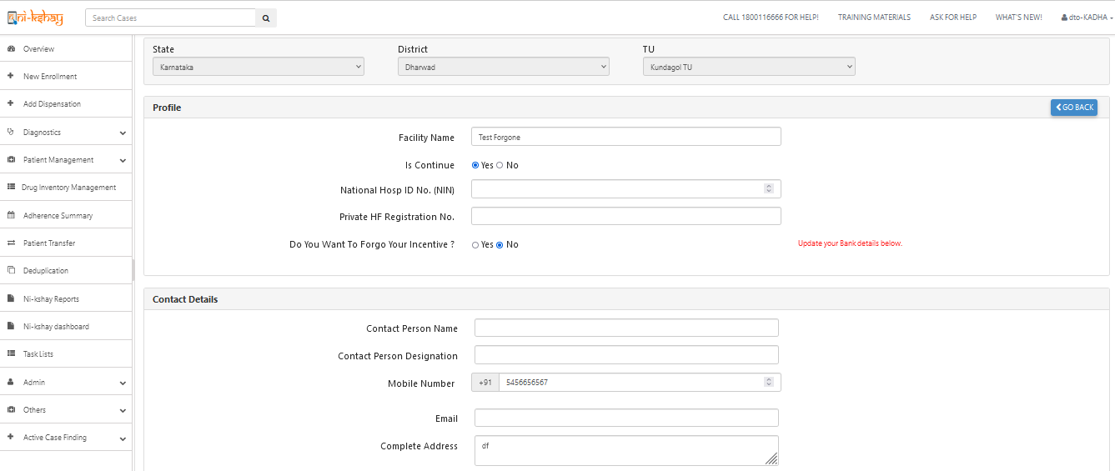
Step 1: Registration of Private Provider (HF) in Ni-kshay
Private Provider (HF) can be registered by a DTO or TU Login or by a Open form available in Ni-kshay Home Page and Default value for forgone as “NO”
If Provider is active, select ‘Yes’
Default value is selected “NO” & enter Bank details
Mobile No. must be unique

Slide 5
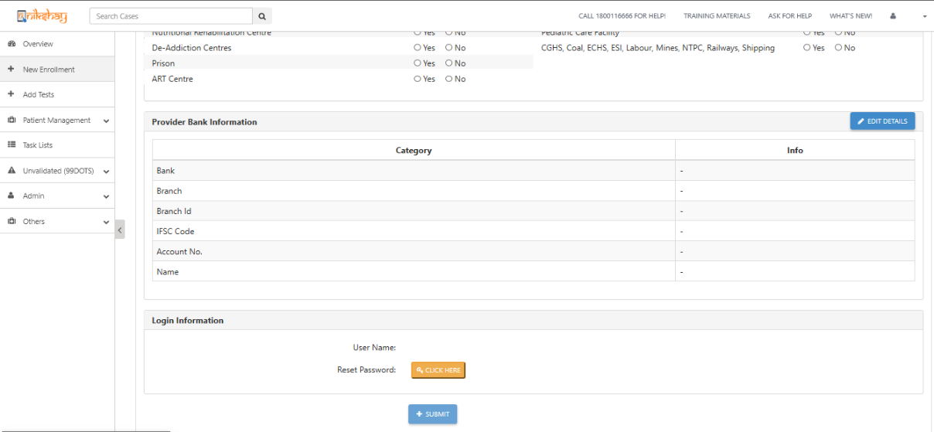
Step 2a: Update Bank details of Private Provider (HF)
Click on Edit details for update bank

Slide 6
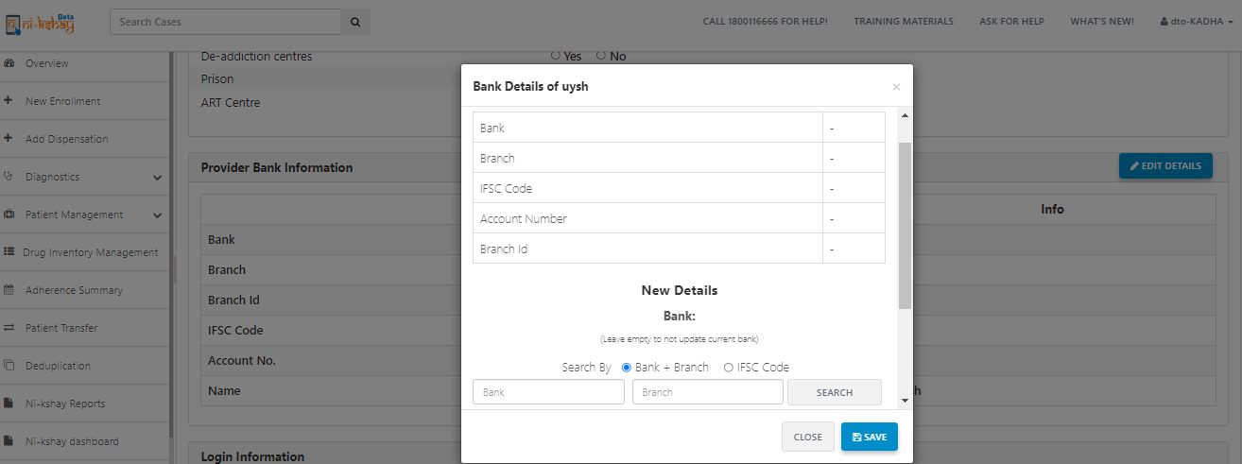
Step 2b: Update Bank details of Private Provider (HF)
Click on Edit details for update bank

Slide 7
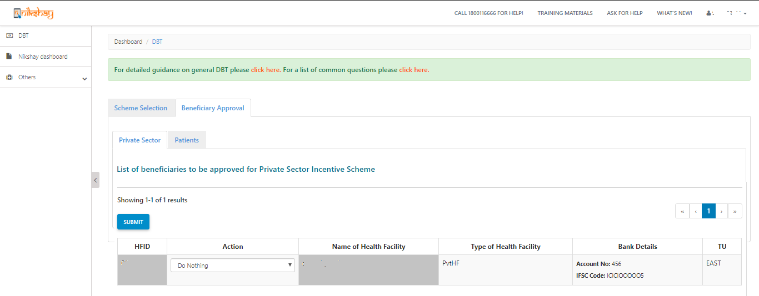
Step 3: to be taken in Ni-kshay at DBT Checker
As the Bank details of a Private Health Facility are entered, it is sent to DBT Checker for Approval. Such records are seen in “Beneficiary Approval” 🡪 “Private Sector” page.
If any Private Health Facilities Bank details are pending approval with DBT Checker, its Beneficiary Status will be “Not Validated”

Slide 8
Pre-requisites for Benefit generation under the scheme
The Private Health Facility should be in Active Status i.e.. “is Continue” should be selected as “Yes”
For the Private Health Facility “Do you want to forego incentive” should be selected as “No”
The Bank Account details of the Private Health Facility should be approved by DBT Checker and its Status should be “Validated”
Ni-kshay will generate Benefits only for episodes notified after “30th July 2019”. For all prior notifications, benefits may be paid directly through PFMS
Benefit will only be generated if the notified episode is “System identified Unique” or “Unique marked by users”.
Benefit will NOT be generated if episodes are marked as “System identified – Duplicates” and pending approval by user or “User marked - Duplicates”.

Slide 9
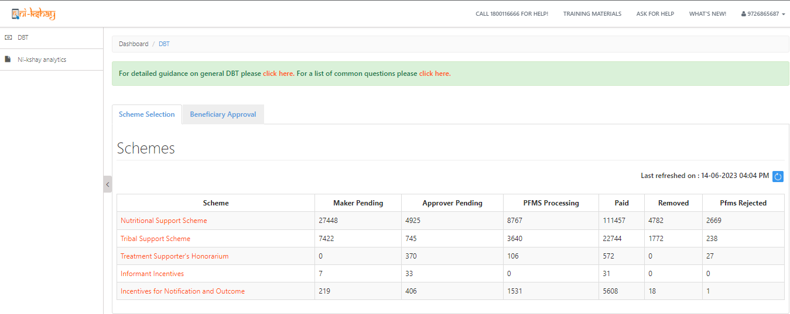
Step 4: Auto generation of benefit via Ni-kshay
Step 1
Step 2
Login with DBT Maker – staff ID
Click on Scheme
Login from “DBT Maker – Staff ID”
Scheme wise, Benefit Payment status

Slide 10
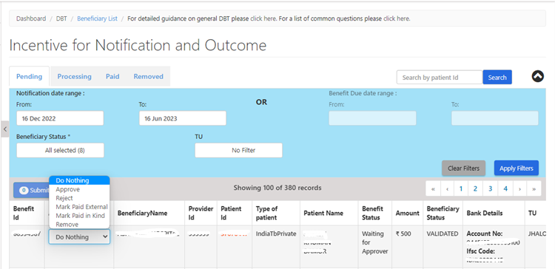
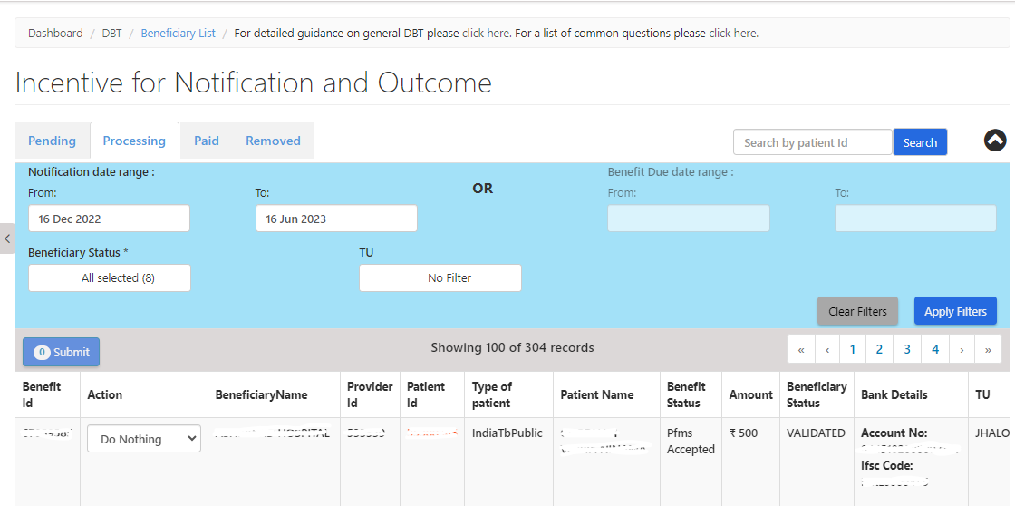
Steps to be taken in Ni-kshay at TU Level…
Step 1
Step 2
Step 3
Step 4
Step 5
Login with DBT Maker – staff ID
Click on Scheme
Apply DBT Search Filter
View the List of Eligible Benefits
Processing Benefits

Slide 11
Steps to be taken in Ni-kshay at DTO Level
Step 1
Login with DBT Checker– staff ID

Slide 12
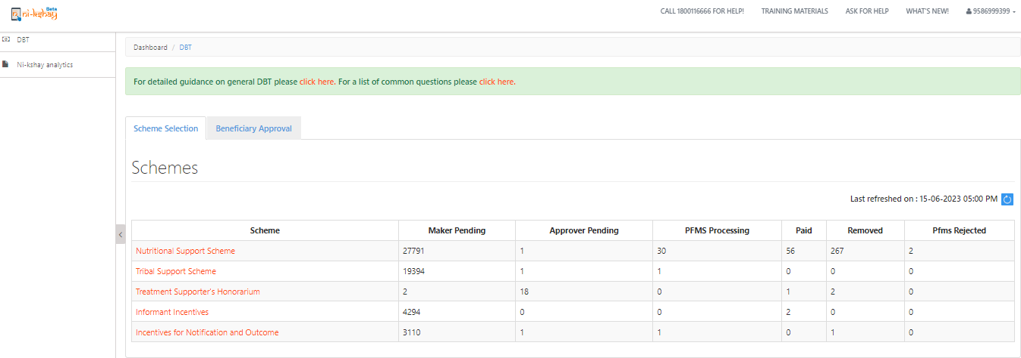
Steps to be taken in Ni-kshay at DTO Level
Step 1
Step 2
Login with DBT Checker – staff ID
Click on Scheme

Slide 13
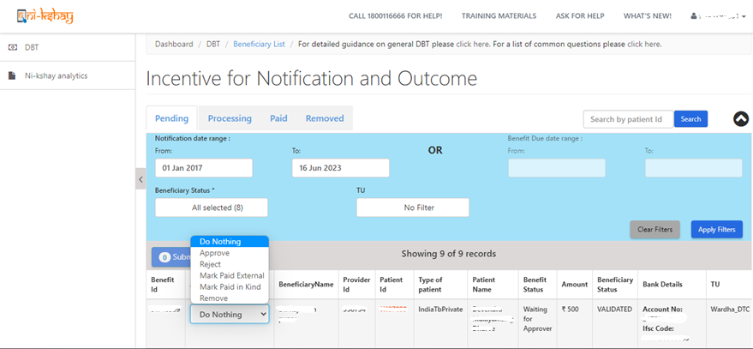
Steps to be taken in Ni-kshay at DTO Level
Step 1
Step 2
Step 3
Step 4
Login with DBT Checker – staff ID
Click on Scheme
Apply DBT Search Filter
View & Process Benefits

Slide 14
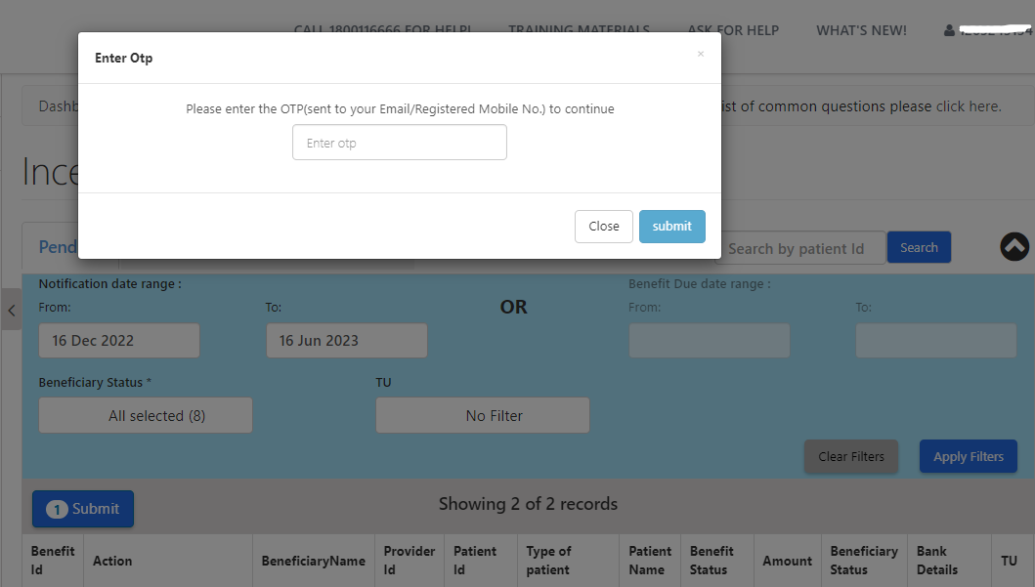
Steps to be taken in Ni-kshay at DTO Level
Step 1
Step 2
Step 3
Step 4
Login with DBT Checker – staff ID
Click on Scheme
Apply DBT Search Filter
View & Process Benefits
Enters OTP received on DTO’s registered mobile no.

Slide 15
Scenarios where Private facilities will be getting benefits
AddedBy | Level | HierarchyMapping_Enrollment | HierarchyMapping_Diagnosed | Eligible Beneficiary | Incentive Type
HUB | 5 | HUB | PVTLAB | HUB | NOTIFICATION
PVTCHEM | 5 | PVTCHEM | PVTLAB | PVTCHEM | NOTIFICATION
PVTLAB | 5 | PVTLAB | PVTLAB | Enrollment PVTLAB | NOTIFICATION
PVTHUB / State Jeet / District Jeet | 4 | HUB | PVTLAB | HUB | NOTIFICATION
TU | 4 | HUB | PVTLAB | HUB | NOTIFICATION
DISTRICT | 3 | HUB | PVTLAB | HUB | NOTIFICATION
PVTCHEM | 5 | PVTCHEM | PVTCHEM | PVTCHEM | NOTIFICATION
HUB | 5 | HUB | HUB | Enrollment HUB | NOTIFICATION
PVTHUB / State Jeet / District Jeet | 4 | HUB | HUB | Enrollment HUB | NOTIFICATION
TU | 4 | HUB | HUB | Enrollment HUB | NOTIFICATION
DISTRICT | 3 | HUB | HUB | Enrollment HUB | NOTIFICATION
Note:
Where there are two HFs involved, Informant (i.e. Enrolling HF facility) gets priority over Diagnostic facility
Benefits will be created in districts where private health facility is registered.
If a TU and above (Including JEET/ CC) enrolls a case on behalf of private health facility, and then refers a case for diagnosis to a public sector lab, then private health facility is not eligible for “Informant Incentive” i.e. Private Health facility has to login and refer cases for diagnosis to public sector to be eligible for “Informant Incentive”

Slide 16
Outcome benefit generation conditions
This incentive will be generated when a patient’s Treatment Outcome is declared.
Benefit will be generated only if Outcome is declared from “Private Practitioner/Clinic etc. (Single)” and “Hospital/ Clinic/ Nursing Home etc. (Multi)” irrespective of notification done.

Slide 17
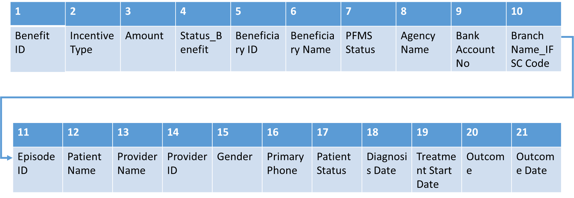
Report available to Private Provider (HF)

Slide 18
Thank You

