Slide 1
Module 6: Treatment Supporter Scheme - DSTB and DRTB beneficiaries

Slide 2
Who can be a Treatment Supporter
A Treatment Supporter can be any person such as a Medical Officer, MPWs, community volunteers working with the program etc.. Even a patient’s relative can be a Treatment Supporter.
As per NTEP guidelines, salaried NTEP/ General Health System staff may also be assigned as treatment supporters for a patient. However, they will not be eligible for any honorarium.
A patient can only be linked to one treatment supporter at a time.
Staff and Treatment Supporters

Slide 3
Role of a Treatment Supporter
The Treatment Supporter is a person who helps a TB patient to complete his treatment
They explain the patients about TB treatment and inform them about the treatment facilities provided by the government
They encourage patients to take the prescribed TB medication regularly, on schedule, for the full duration of the treatment
They record the patient’s treatment adherence details on the treatment card
They help the patients to visit nearest health facility for regular health check ups and conduct the follow-up tests on time
If the patient faces any health issues such as ADR, refers the patient to the health facility
Staff and Treatment Supporters

Slide 4
About the Treatment Supporter Honorarium Scheme
Eligibility: Honorarium to be disbursed upon completion or cure of TB patient as below
For DSTB cases, Rs. 1,000
For DRTB cases, Rs. 5,000
Rs. 2,000 at end of IP (6 months)
Rs. 3,000 on Treatment completion
Treatment Supporter’s Honorarium

Slide 5
DBT processing via Ni-kshay
Following are the 5 steps to be followed for processing payments under this scheme. This is the only scheme in Ni-kshay in which the benefits must be generated manually by TU User.
1
Registration of Treatment Supporter
(Once per treatment supporter)
2
Update Bank details of Treatment Supporter
3
Assign Treatment Supporter to a patient
(Once per benefit)
4
Manually create Benefits
(Once per DS TB patient and twice per DR TB Patient)
5
Approval of Benefit by DBT Checker
(Once per benefit)

Slide 6
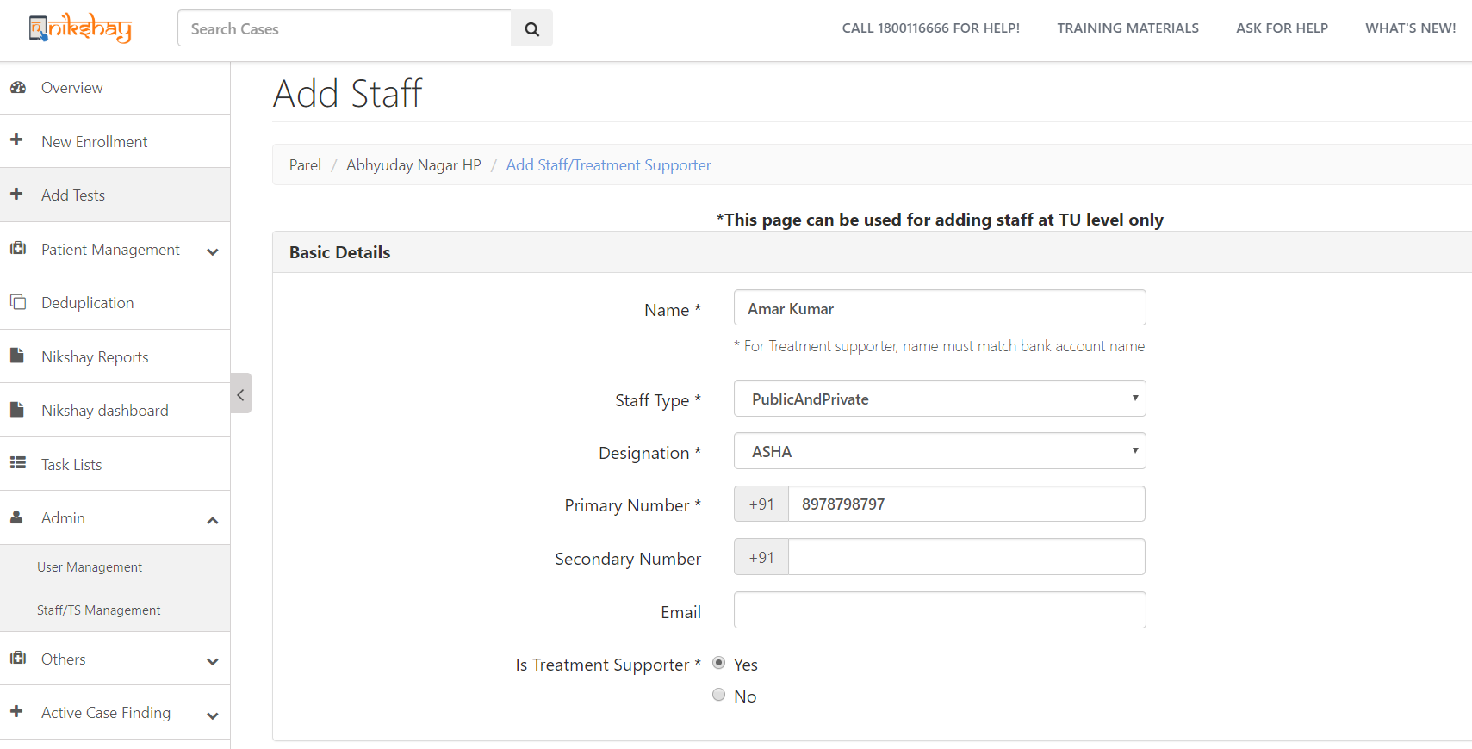
Step 1: Registration of Treatment Supporter in Ni-kshay
Go to Admin 🡪 Staff/TS Management
Note: Treatment Supporters can be created only at TU and PHI levels
Select “PublicAndPrivate”
Mobile No. must be unique
Select “Yes”

Slide 7
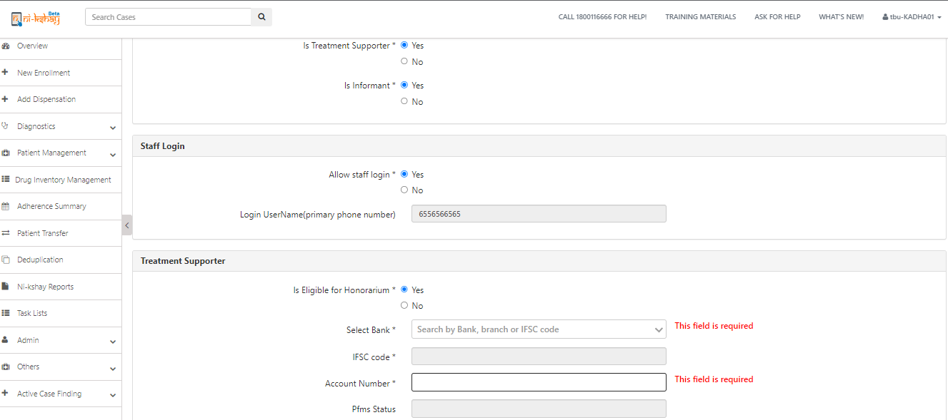
Step 2: Update Bank details of Treatment Supporter
Select Yes
Select Yes
If same staff is Informant then select Yes
Treatment Supporter can login into Ni-kshay and view /edit details of patients assigned
Enter Bank details
As Bank details are entered, its sent to PFMS for validation

Slide 8
Step 3: Assign Treatment Supporter to patient
Open the Patient’s record, Go to “Others” 🡪 “Staff/Treatment Supporter”
Click here to Add

Slide 9
Step 3: Assign Treatment Supporter to patient
Select Treatment Supporter’s Name
Note: The Treatment Supporters of Patient’s current TUs will appear in this drop down

Slide 10
2. Assigning a Treatment Supporter to a Patient
Step 3: Assign Treatment Supporter to patient
Treatment Supporter cannot be unassigned if a benefit has been sent to PFMS or paid
A Treatment Supporter can be unassigned by clicking the delete button

Slide 11
Step 4: Manually create Benefits
Benefit can be created only if the following conditions are met:
A staff (Treatment supporter = Yes) is assigned as Treatment supporter to the patient
The assigned staff has Eligible for Honorarium = Yes
Treatment Supporter’s Bank details are validated by PFMS
Treatment Status of patient:
For DS TB patient, one benefit of maximum amount of Rs. 1,000 can be created if outcome is updated as “Cured” or “Treatment Completed
For DR TB patients two benefits can be generated:
First benefit of maximum amount Rs. 2000 can be created at end IP ( i.e.. Initiation Date + 6 months)
Second benefit of maximum amount Rs.3000 can be created if Outcome is updated as “Cured” or “Treatment Completed”
If all the above conditions are met, TU user can create Benefit for Treatment Supporter

Slide 12
3. Creation of Benefits by TU
Step 4: Manually create Benefits
Login as TU User, open Patient’s Record for which Treatment Supporter Honorarium is to be paid, and Go to ‘DBT’ Tab
If eligibility conditions are met, benefit can be generated by clicking here

Slide 13
Step 4: Manually create Benefits
Enter amount and click on Save

Slide 14
3. Creation of Benefits by TU
Step 4: Manually create Benefits
As user clicks on Save, Benefit will get created and notification displayed
Note:
1. A patient’s episode record cannot be deleted if benefit to the Treatment Supporter has already been sent to PFMS or paid
2. Edit of Case type (DSTB to DRTB/ DRTB to DSTB) will not be possible once benefit is generated under this scheme

Slide 15
Step 5: Approval of Benefit by DBT Checker
Benefit will be available at DBT Checker login for approval.
Benefit Status can be seen here

Slide 16
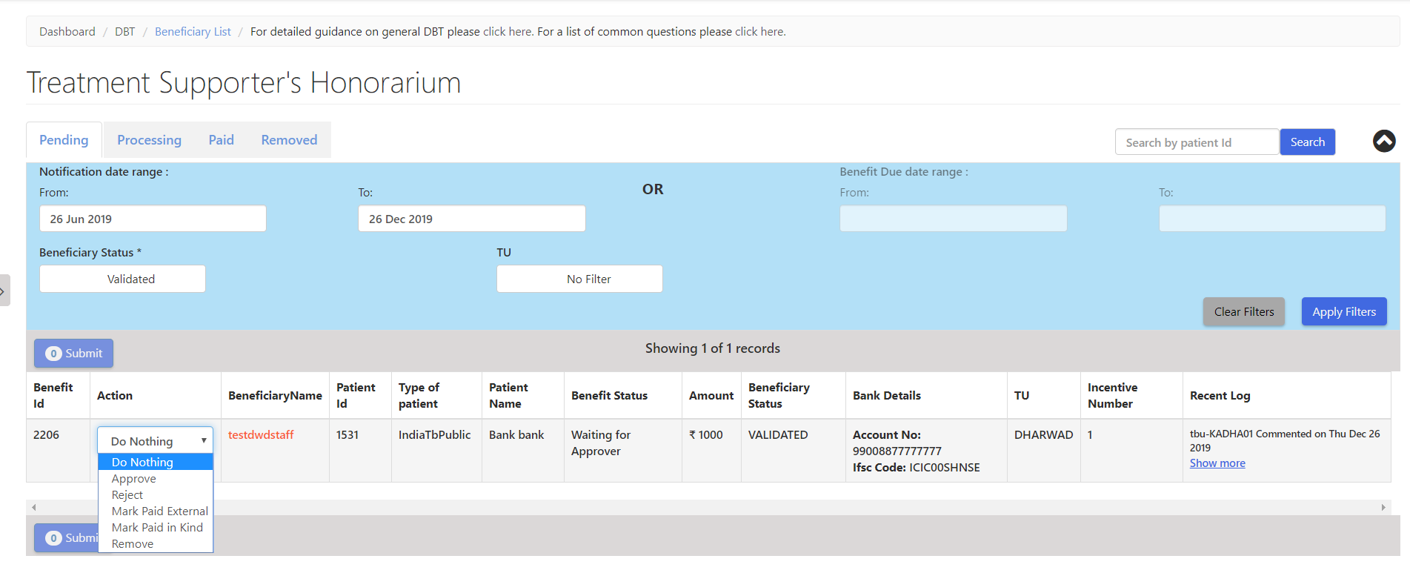
Step 5: Approval of Benefit by DBT Checker
The DBT Checker User will be able to process the Benefits

Slide 17
Staff Transfer Impact on DBT benefits and beneficiaries
Users can register a staff with new bank details and generate a TSS benefit
We will delete all beneficiary bank account number in database which are in old hierarchy to avoid the duplicate pop message while entering bank account details in new hierarchy to same staffs
Processed & Unprocessed benefit will not move with patient to new hierarchy
Users have the option to pay the old hierarchy benefits which are in status “Approver_Pening”.
Kindly follow below steps for payment where benefit under “Approver_Pening” in old hierarchy.
a. users can remove the treatment supporter from other tab where benefits is not processed
b. After removing the treatment supporter system will delete the TSS benefit which are under “Approver_pending” in backend.

Slide 18
Staff Transfer Impact on DBT benefits and beneficiaries
c. User need re-register same treatment supporter with bank details in new hierarchy
d. User can use the same bank details for payment since we have deleted old beneficiary (Isdeleted= 1)
e. Once beneficiary is validated by PFMS for new staff then you can assign the treatment supporter and create a TSS benefit by TU logins
f. After all this process, user can reassign the same Treatment supporter to patient for further process
g. Create a TSS benefit manually from patient DBT page by TU logins
h. Clear all backlogs benefits which are already under PFMS process to avoid the future rejection

Slide 19
Thank You

