Slide 1

NTEP 100 Days TB Campaign
Training Material

Slide 2
Key population additions in Ni-kshay enrolment form
Forms
  Form 1: Vulnerable mapping form
  Form 2: Facility-level reporting form
  Form 3: DTO level daily reporting form
  Form 4: District-level activities
Dashboards & Reports
Field data updating, verification, and synchronization in Ni-kshay

Slide 3
The Key Population demographics in Ni-kshay need to be updated with the following additional categories relevant to TB Preventive Treatment (TPT) eligibility:
Key population additions in Ni-kshay enrolment form
New Key Population Categories:
Undernourished / Malnourished (BMI <18.5 kg/m2)
Elderly (age >60 years)
Workplace settings (coal, sandblasting, brick kiln)
Tea garden worker
Construction site worker
Congregate settings
Attendees of de-addiction centers
Person exposed to indoor air pollution
Marginalized populations at risk of HIV
LGBTQAI++
Substance abuse (alcoholic, intravenous drug users)
Tobacco/smoker (new category: Tobacco/Smoker)
Silica exposure/silicosis
Pregnancy/antenatal mother)
Tribal
  Particularly Vulnerable Tribal Group (PVTG)
  Non-PVTG

Slide 4
Form 1:
Vulnerable Mapping Form

Slide 5
Form 1: Vulnerable Mapping Form…1
This static form is to be filled out at the PHI (Primary Health Institution) level once or updated when changes occur. The most recent submission will be used for monitoring purposes.
The following fields are required:
No. of vulnerable individuals mapped in the geography
No. of diabetics mapped in the geography
No. of undernourished individuals / BMI under 18.5 mapped in the geography
No. of individuals >60 years of age mapped in the geography
No. of individuals who are smokers and mapped in the geography
No. of individuals who are alcoholic and mapped in the geography
Contacts of TB Patients (in Last three years)
Past TB Patients (last 5 years)
Notes:
Undernutrition (BMI <18.5) Population in the geography

Slide 6
Form 1: Vulnerable Mapping Form…2
This static form is to be filled out at the PHI (Primary Health Institution) level once or updated when changes occur. The most recent submission will be used for monitoring purposes.
The following fields are required:
No. of individuals in congregate settings mapped in the geography
Total No. of Prison Inmates
Total no. of residents in the Old age homes
Total No of residents in Orphanage
Population of Destitute homes
Population of Night shelters
Total no. of students in residential schools
No. of workers in the industry or make-shift residential Setting
Total Tribal Population of the geography
Total Slum Population of the geography
Total Other vulnerable population (from the above categories)

Slide 7
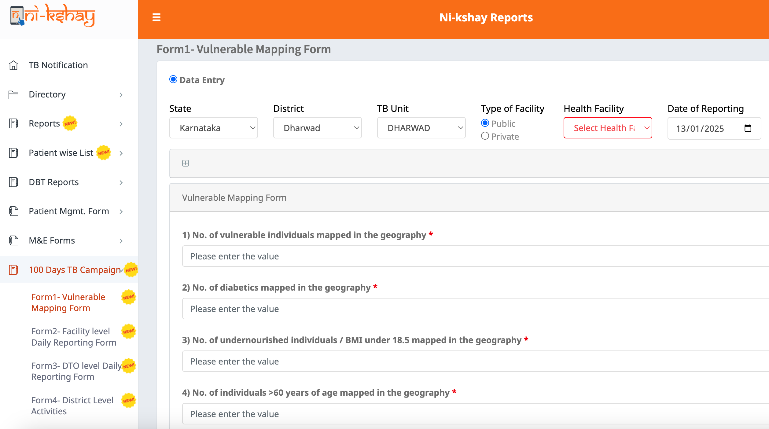
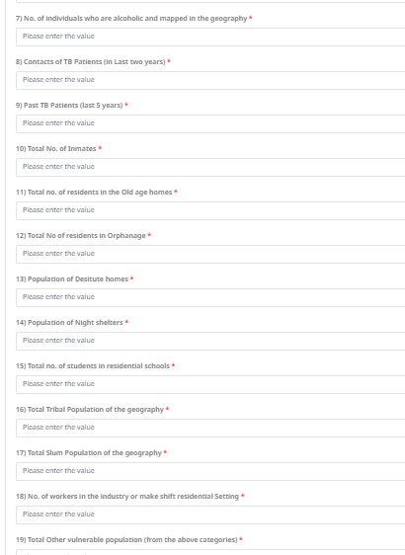
Form 1: Vulnerable Mapping Form
Step 1
Click on Ni-kshay Reports
Step 2
Select ‘100 Days TB Campaign’
Step 3
Select Form1:
Vulnerable Mapping Form
Once filled the required information, click on ‘Submit’
Submit

Slide 8
Form 2:
Facility level daily reporting form

Slide 9
Form 2: Facility level daily reporting form
This form will be filled in daily by facility-level users during the entire campaign.
The following fields are required:
No. of vulnerable individuals screened in that geography during the campaign.
No. of individuals with past history of TB screened.
No. of household contact screened.
No. of diabetics screened in that geography during the campaign.
No. of undernourished individuals / BMI <18.5 screened in that geography during the campaign.
No. of individuals >60 years of age screened in that geography during the campaign.
No. of individuals who are smokers and screened in that geography during the campaign.
No. of individuals who are alcoholic and screened in that geography during the campaign.
No. of vulnerable individuals identified as presumptive using symptom screening or X-ray.
No. of individuals in congregate settings screened in that geography during the campaign.
Total no. of individuals (vulnerable + general) screened during the campaign.
Total no. of individuals (vulnerable + general) identified as presumptive using symptom screening or X-ray.
No. of individuals referred for X-Ray.
No. of individuals referred for NAAT.
No. of individuals referred for Microscopy.
No. of Ni-kshay Shivirs held
No. of Ni-kshay Vahans deployed

Slide 10
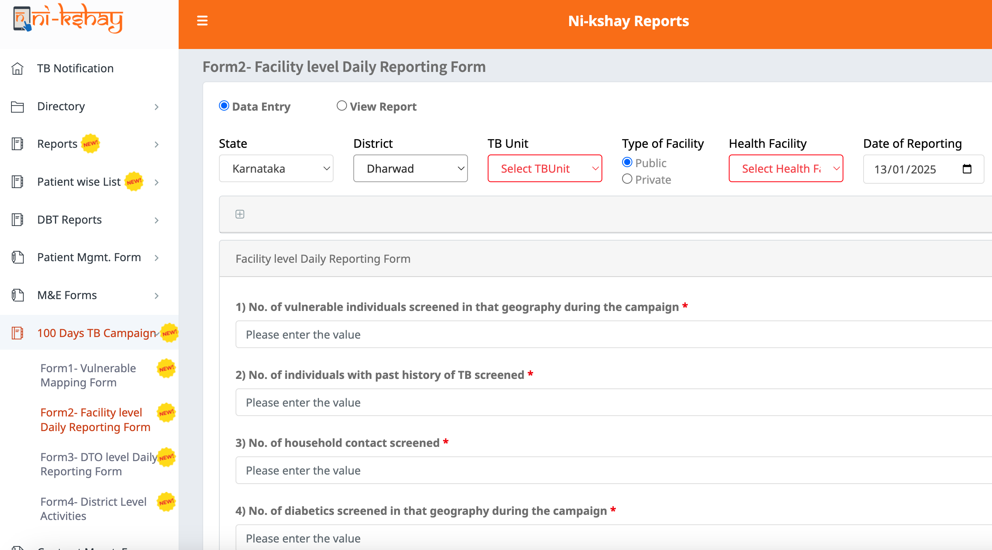
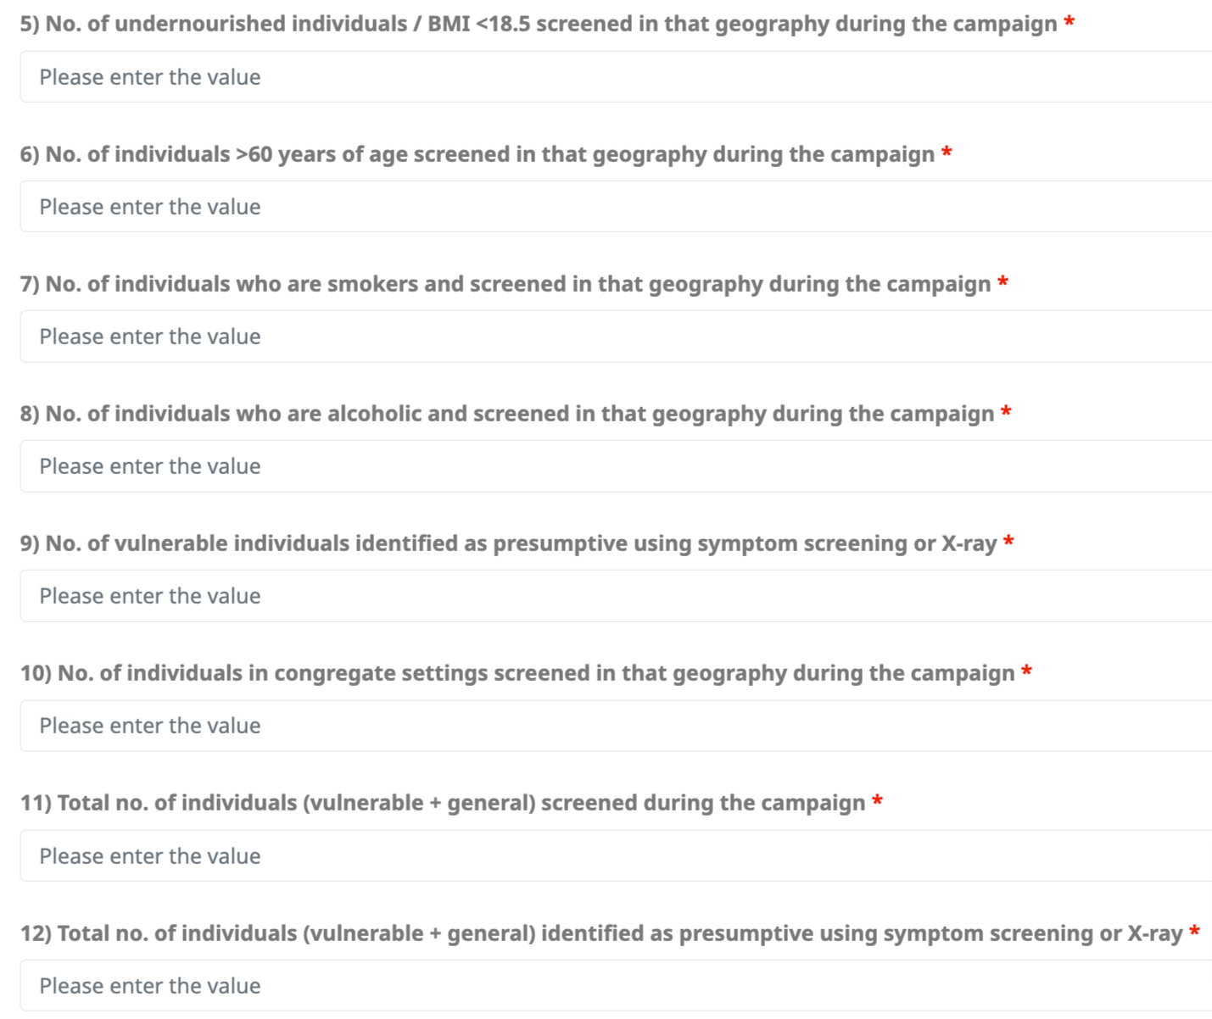
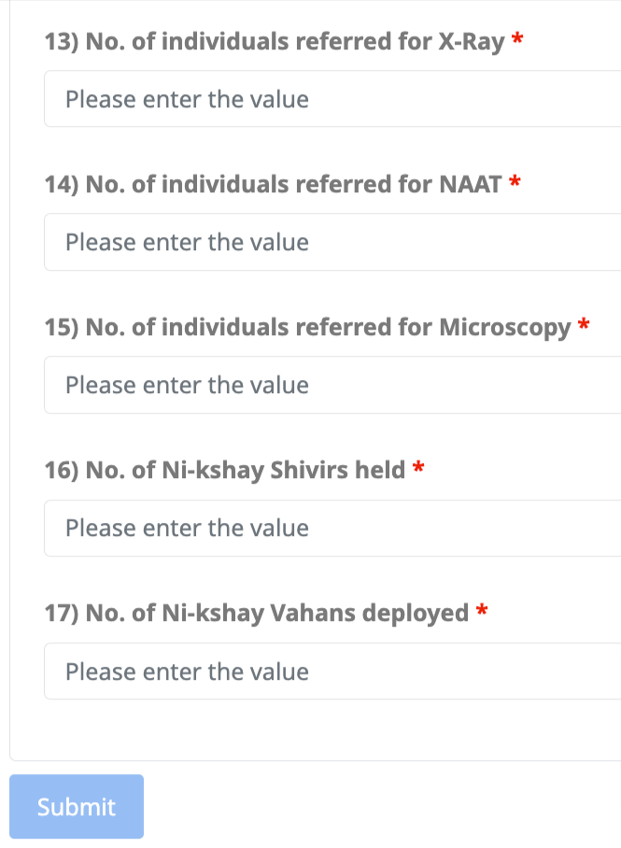
Form 2: Facility level daily reporting form
Step 1
Step 2
Step 3
Click on Ni-kshay Reports
Select ‘100 Days TB Campaign’
Select Form 2:
Facility level daily reporting form
Once filled in the required information, click on ‘Submit’

Slide 11
Form 3:
DTO level daily reporting form

Slide 12
Form 3: DTO level daily reporting form
This form will be verified daily by district-level users during the entire campaign.
The following fields are required:
No. of vulnerable individuals screened in that geography during the campaign.
No. of individuals with past history of TB screened.
No. of household contact screened.
No. of diabetics screened in that geography during the campaign.
No. of undernourished individuals / BMI <18.5 screened in that geography during the campaign.
No. of individuals >60 years of age screened in that geography during the campaign.
No. of individuals who are smokers and screened in that geography during the campaign.
No. of individuals who are alcoholic and screened in that geography during the campaign.
No. of vulnerable individuals identified as presumptive using symptom screening or X-ray.
No. of individuals in congregate settings screened in that geography during the campaign.
Total no. of individuals (vulnerable + general) screened during the campaign.
Total no. of individuals (vulnerable+general) identified as presumptive using symptom screening or X-ray.
No. of individuals referred for X-Ray.
No. of individuals referred for NAAT
No. of individuals referred for Microscopy.
No. of Ni-kshay Shivirs held
No. of Ni-kshay Vahans deployed

Slide 13
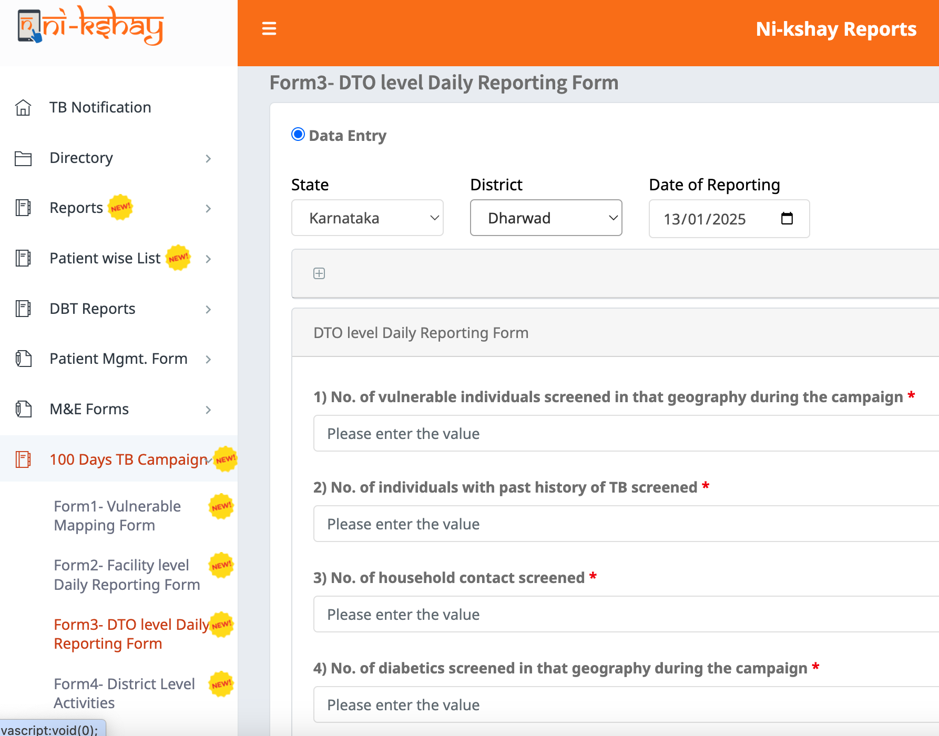
Form 3: DTO level daily reporting form
Step 1
Step 2
Step 3
Click on Ni-kshay Reports
Select ‘100 Days TB Campaign’
Select Form 3:
DTO level daily reporting form
Once filled in the required information, click on ‘Submit’

Slide 14
Form 4:
District-level activities

Slide 15
Form 4: District Level Activities
This form is to be filled out by the district-level users during the entire campaign.
The following fields are required:
Jan Bhagidari Activities Reporting-
Number of activities conducted in the presence of elected representative.
Number of activities supported by PRI/ULB members
Number of activities conducted in the schools/colleges
Number of activities conducted in Mines, Prisons other congregation sites
Number of activities conducted in partnership with industries(trade associations/business associations/public sector units)
Number of private sector CME conducted
Number of activities conducted by other departments
Number of activities conducted by the religious leaders/organisations
Number of activities carried out by the opinion leader/community influencer
Number of activities carried out by NGOs/CSOs
Number of media reported activities(except social media)
Number of activities carried out by community groups(Self Help Groups, Anganwadi, etc)
Number of activities carried out by youth volunteer(NCC, NSS, etc)
Number of activities carried out by TB Champions

Slide 16
Dashboards & Reports

Slide 17
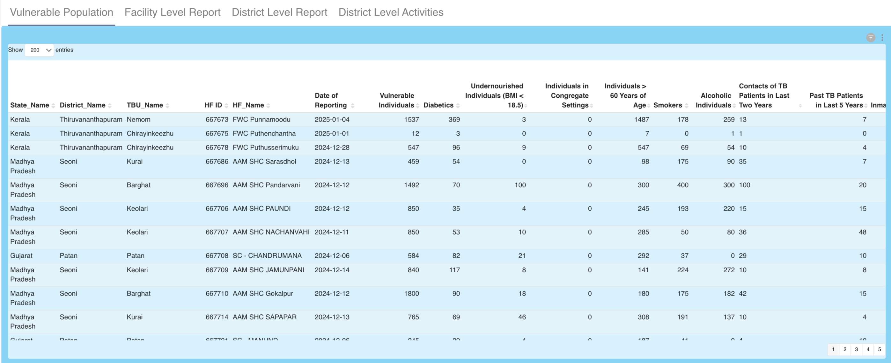
Dashboard 1: Vulnerable Mapping
This dashboard visualizes data from the Vulnerable Mapping form that is to be filled out at the PHI (Primary Health Institution) level once or updated when changes occur.
URL to access this dashboard: https://analytics.nikshay.in/superset/dashboard/5231
Refresh interval: 3 times a day at 12:30 PM, 06:30 PM, and 02:30 AM

Slide 18
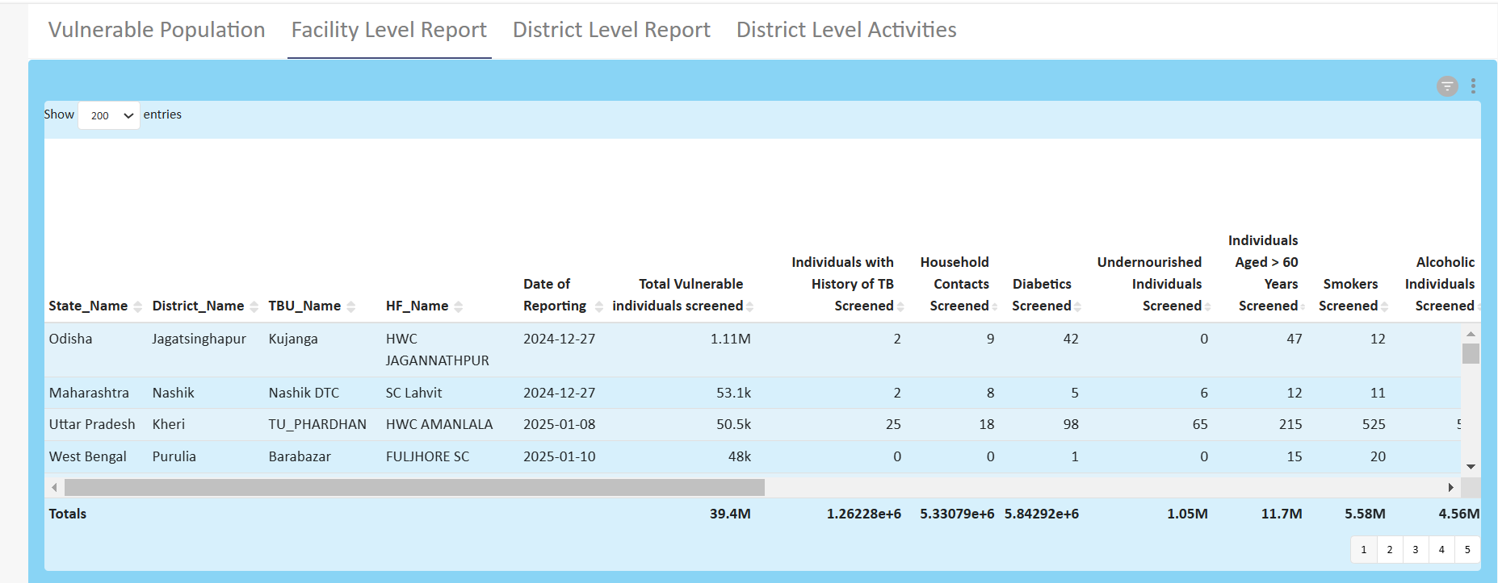
Dashboard 2: Facility level daily reporting
This dashboard visualizes data that will be filled in daily by facility-level users during the entire campaign.
URL to access this dashboard: https://analytics.nikshay.in/superset/dashboard/5231
Refresh interval: 3 times a day at 12:30 PM, 06:30 PM, and 02:30 AM

Slide 19
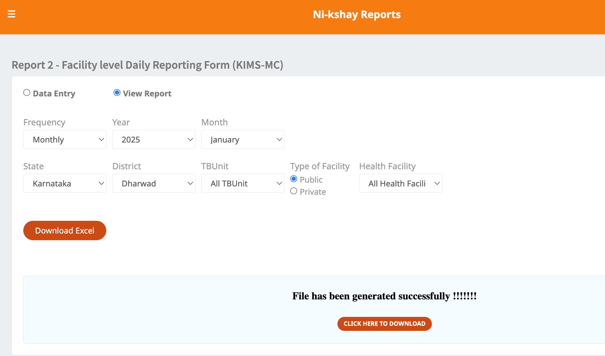
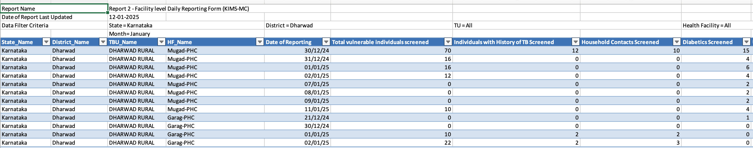
(Ni-kshay Reports) Form 2: Facility level daily reporting
Step 1
Step 2
Step 3
Step 4
Click on Ni-kshay Reports
Select ‘100 Days TB Campaign’
Select Form 2:
Facility level daily reporting form
Select Form 2:
View Report

Slide 20
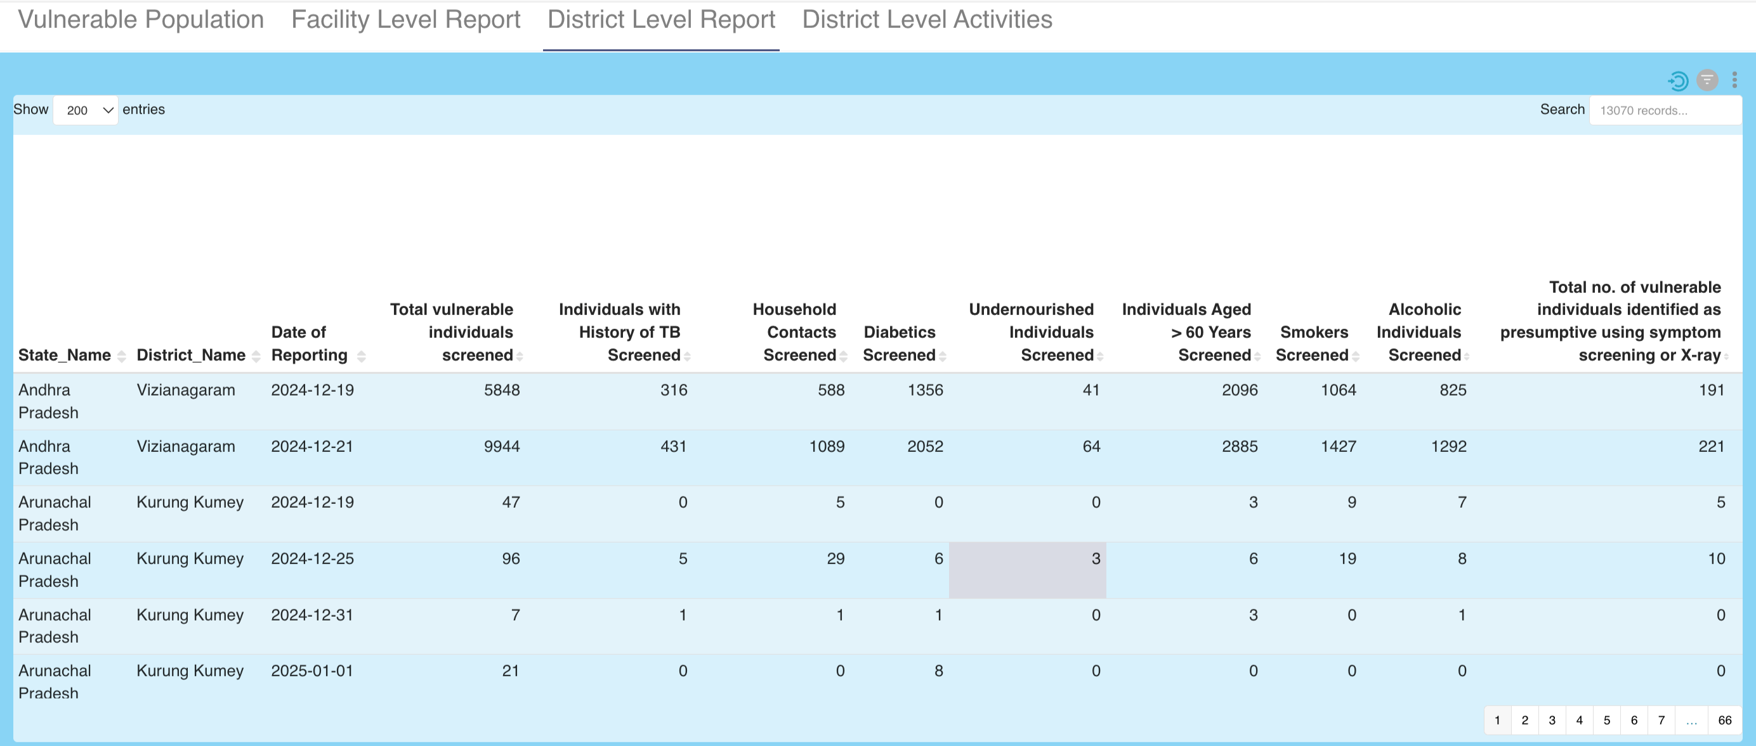
Dashboard 3: DTO level daily reporting Report
This dashboard visualizes data that will be verified daily by district-level users during the entire campaign.
URL to access this dashboard: https://analytics.nikshay.in/superset/dashboard/5231
Refresh interval: 3 times a day at 12:30 PM, 06:30 PM, and 02:30 AM

Slide 21
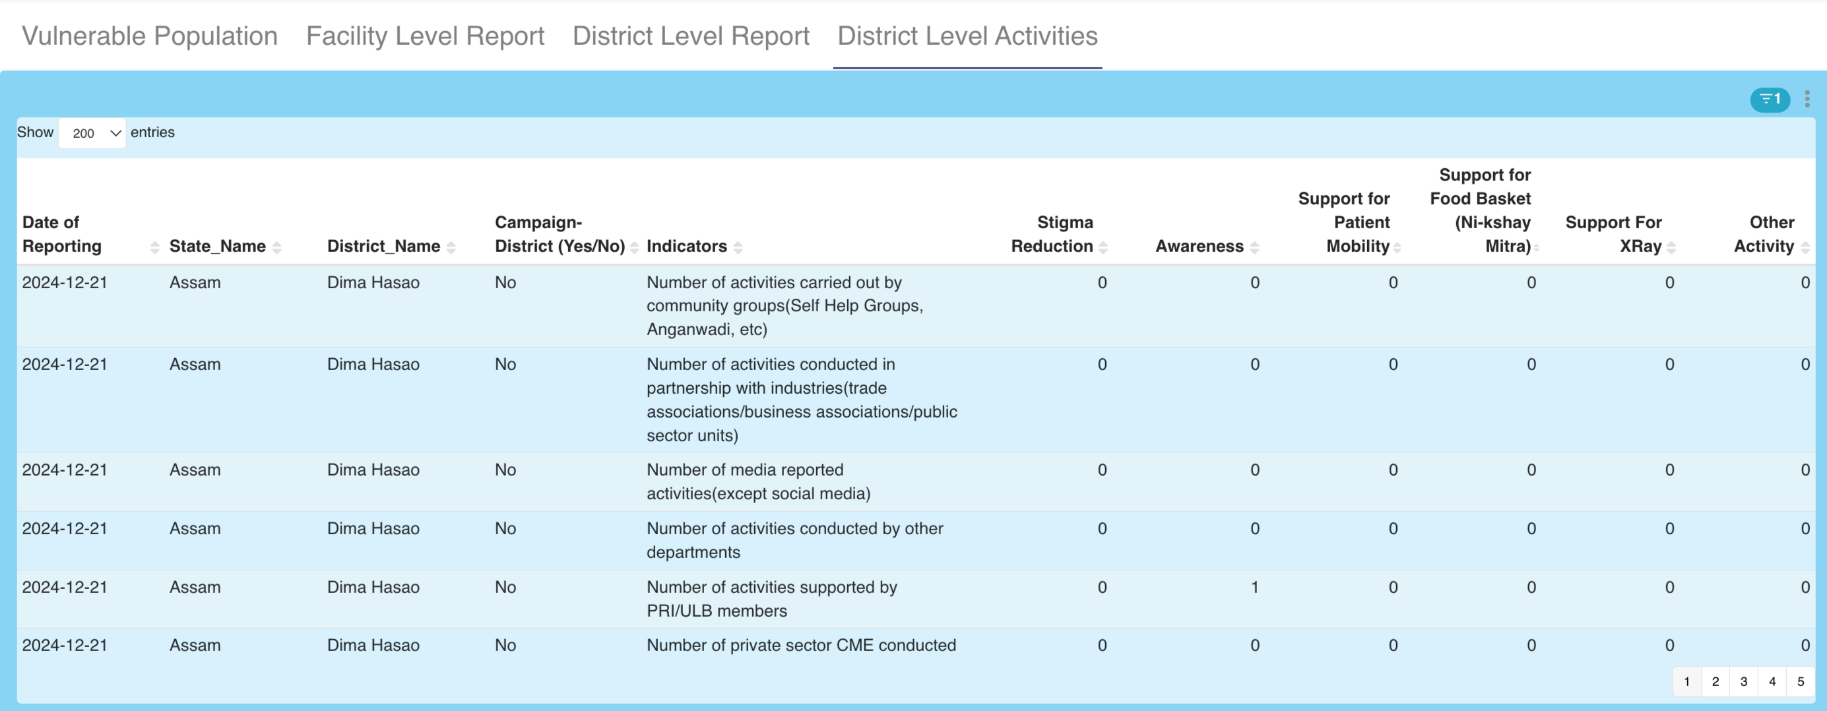
Dashboard 4: District-level activities
This dashboard visualizes data that will be filled out by the district-level users during the entire campaign.
URL to access this dashboard: https://analytics.nikshay.in/superset/dashboard/5231
Refresh interval: 3 times a day at 12:30 PM, 06:30 PM, and 02:30 AM

Slide 22
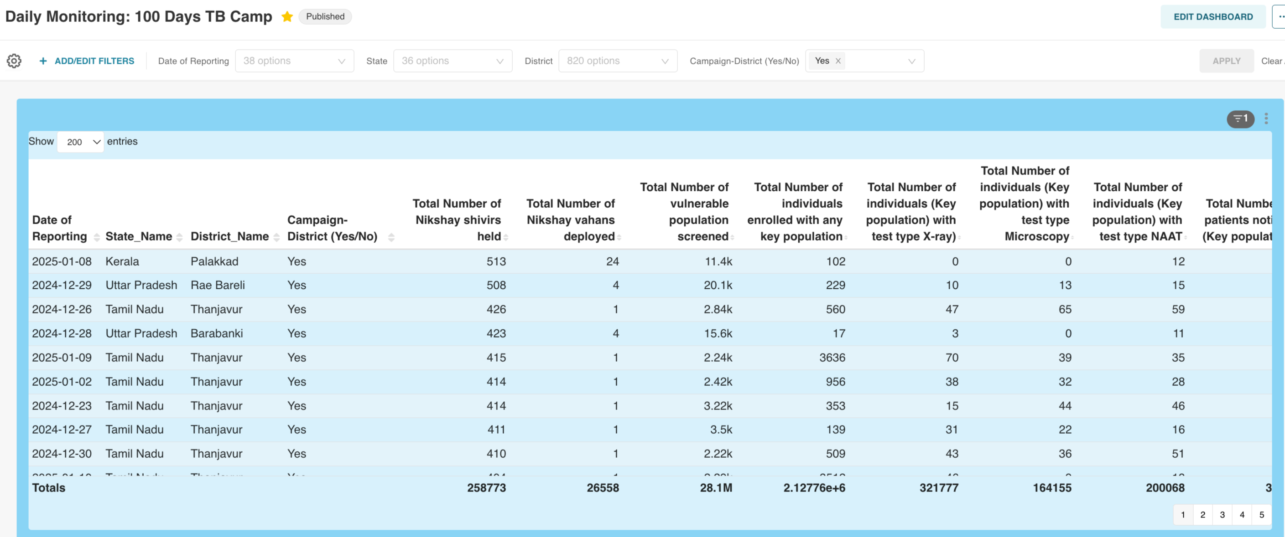
Daily Monitoring Dashboard
This dashboard visualizes data that will be filled out by the district-level users (aggregated data) in FORM 3 with major Ni-kshay Key Performance Indicators (KPIs) such as Notifications, Enrolment, DBT, Test, etc.
URL to access this dashboard: https://analytics.nikshay.in/superset/dashboard/5381
Refresh interval: 3 times a day at 12:30 PM, 06:30 PM, and 02:30 AM

Slide 23
Field data updating, verification, and synchronization in Ni-kshay

Slide 24
Daily entry of data in Form 2 by Health Facility BEFORE 6PM
Data to be checked for inconsistencies and correct data to be compiled by District TB Office
District TB Office to enter the validated data in Form 3 BEFORE 8PM
Master KPI report to be used for monitoring the key activities of the campaign
Field data updation and verification
Compiled HF-wise Data available as Report in Ni-kshay Reports and Ni-kshay Analytics
Compiled district-wise Data report as well as Master KPI Report available in Ni-kshay Analytics next day

Slide 25
Field data updation and verification
Frequency for filling, verification, and synchronization of data in Ni-kshay - Daily
DATA ENTRY | LEVEL OF DATA ENTRY | OUTPUT FORMAT | OUTPUT AVAILABLE IN | OUTPUT REPORT AVAILABLE BY
FORM 1 - Vulnerable Mapping Form | HEALTH FACILITY | Health facility wise aggregates of mapped vulnerable population | Ni-kshay Analytics | Same day at 6.30PM (for data entered before 6PM)
FORM 2 - Facility level daily reporting form | HEALTH FACILITY | Health facility wise aggregates of daily data reported in the form | Ni-kshay Reports and Ni-kshay Analytics | Same day at 6.30PM (for data entered before 6PM)
FORM 3 - DTO level daily reporting form | DISTRICT TB OFFICE | District–wise aggregate of daily data reported | Ni-kshay Analytics | Next day morning
 |  | Master KPI Monitoring Report | Ni-kshay Analytics | Next day morning
FORM 4 – District level activities | DISTRICT TB OFFICE | District–wise aggregate of daily data reported | Ni-kshay Analytics | Next day morning

Slide 26
THANK YOU

