Slide 1
Module 4: Module 5: User Management, Merge functionality and SOP for Move functionality

Slide 2
Overview
NTEP now has registered cumulatively following hierarchies in Ni-kshay
830Districts
7783TUs
200107 PHIs
233158 Private HFs
33818 Private labs
85582 Private Chemists
Different Health Facilities have different profiles and may change over time.

Slide 3
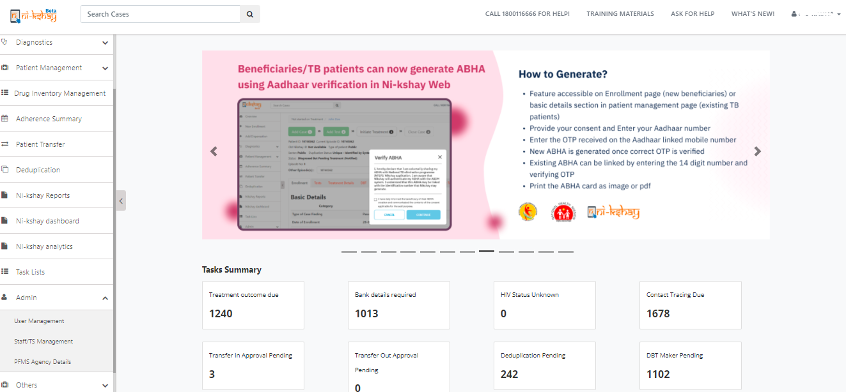
Steps to be taken in Ni-kshay at TU Level
User Management option available under Admin Menu

Slide 4
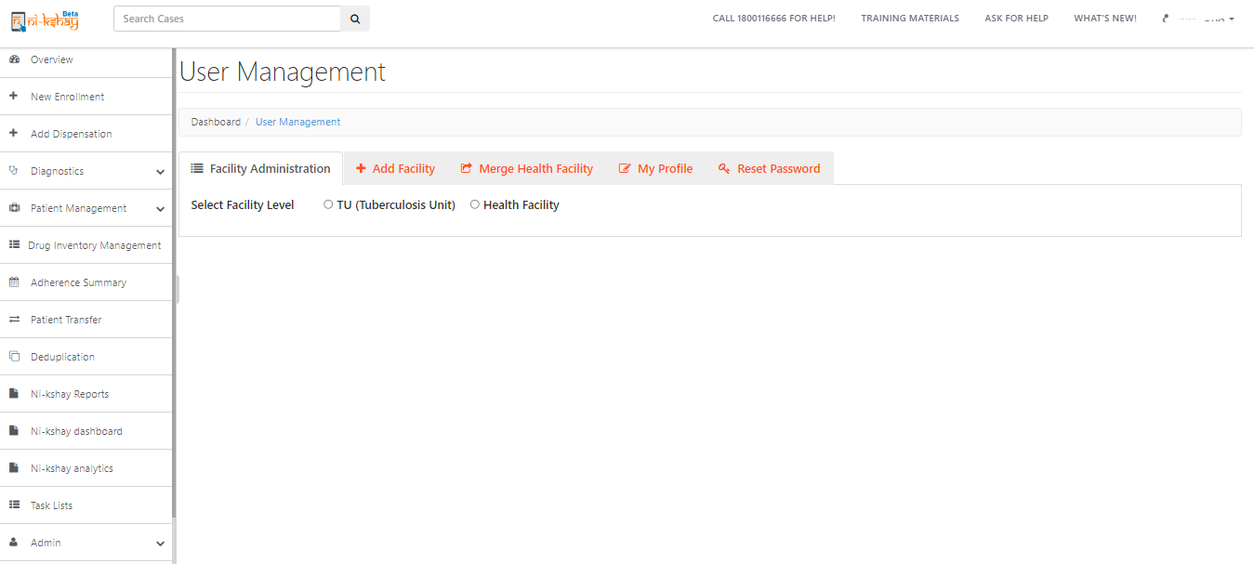
User Management…
Create New Facilities
Merge if health facilities are duplicate
Update Your Password
Modify Your own profile
Modify Facilities

Slide 5
Editing TU Profile
Select TU

Slide 6
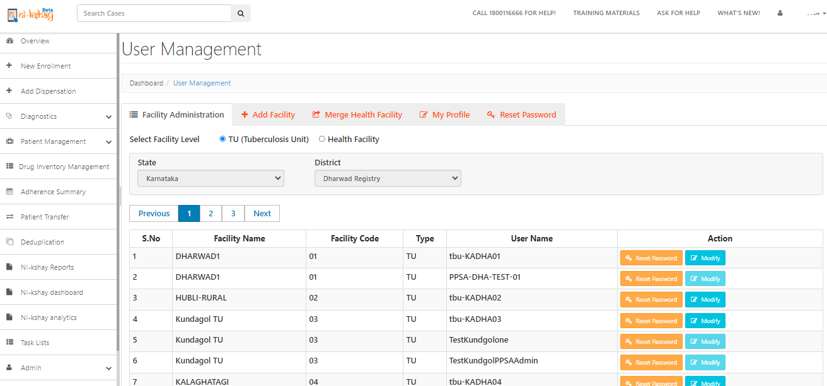
Editing TU Profile…
Select Action to be performed for the TU

Slide 7
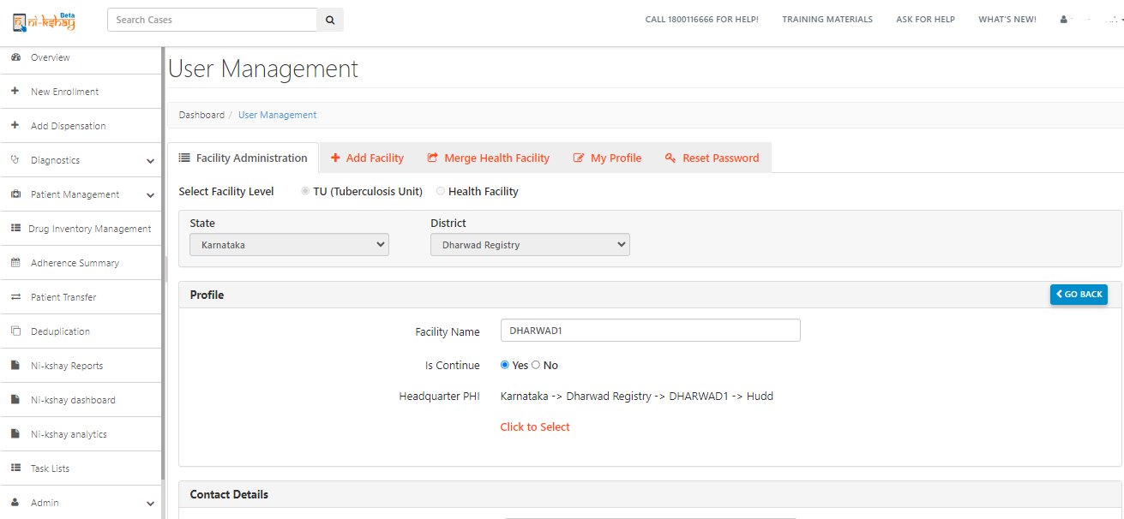
Editing TU Profile…
Edit as necessary
Inorder to inactivate a hierarchy, select “No” in IsContinue
Edit/Update headquarter PHI - This is essential to ensure patients are transferred to appropriate hiearchy

Slide 8
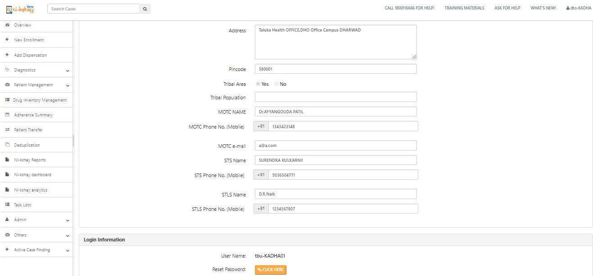
Editing TU Profile…
Any phone number updates may be done from here
Any phone number updates may be done from here
Any phone number updates may be done from here
View/ edit User Credentials

Slide 9
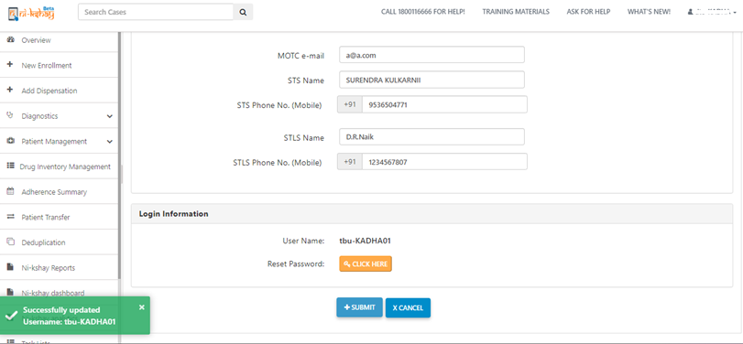
Editing TU Profile…
Click submit to save changes
Wait for confirmation message

Slide 10
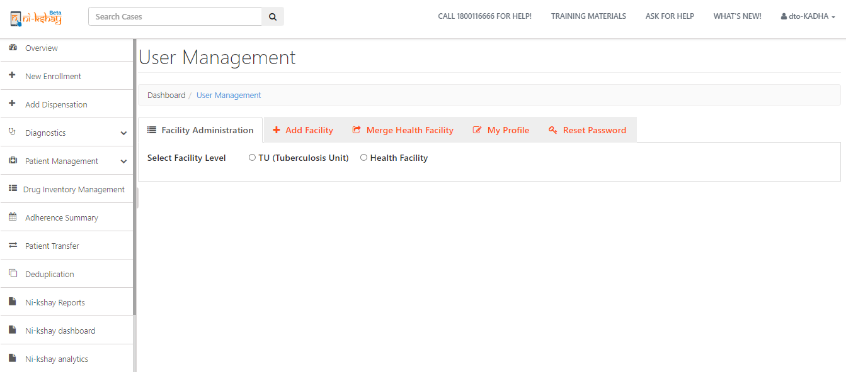
Edit PHI/ Pvt HF Profile…
Select Health Facility

Slide 11
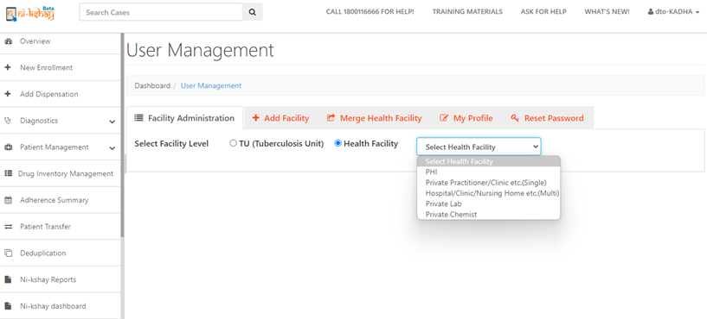
Edit PHI/ Pvt HF Profile…
Select Health Facility type to be edited

Slide 12
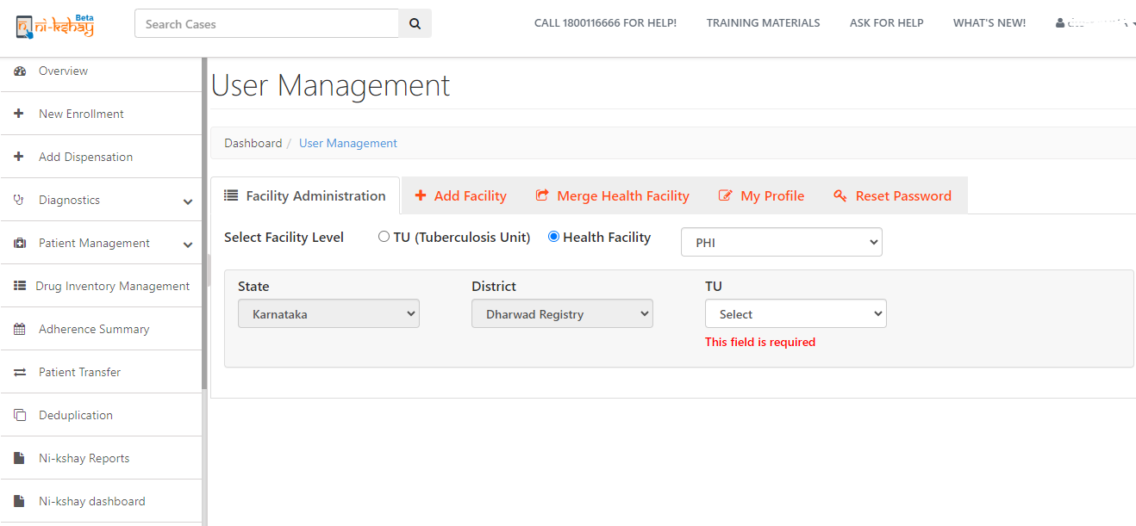
Edit PHI/ Pvt HF Profile…
Select State District & TU

Slide 13
Edit PHI/ Pvt HF Profile…
Click Modify on the PHI for which profile need to be edited

Slide 14
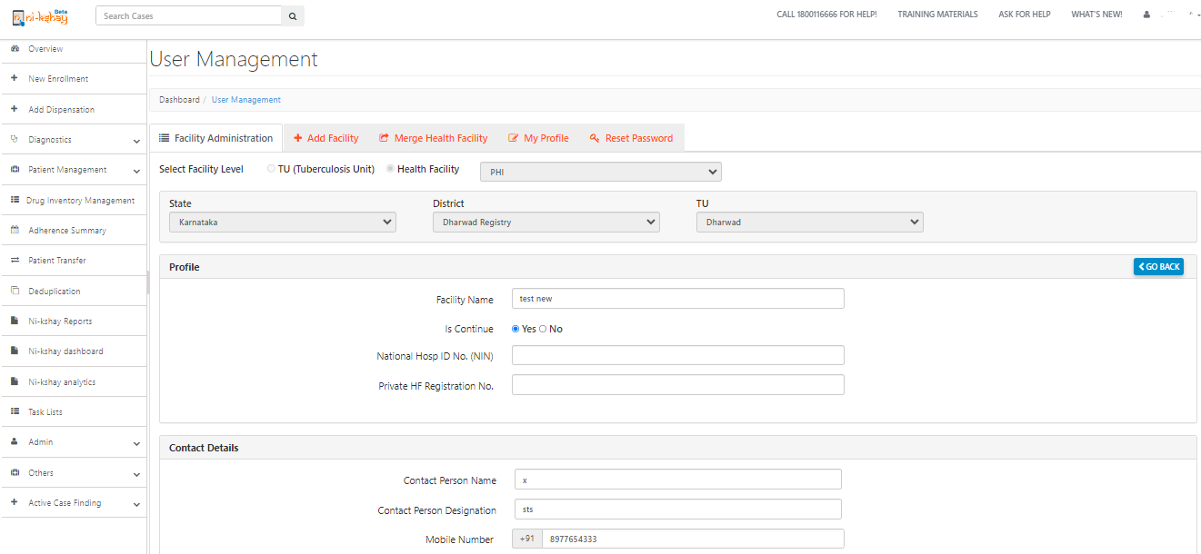
Edit PHI/ Pvt HF Profile…
Edit Auto filled information
Edit Auto filled information

Slide 15
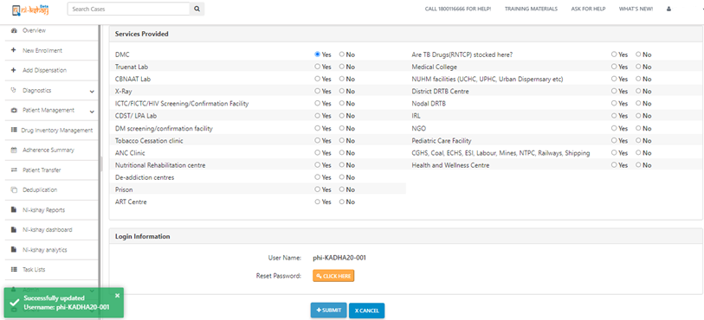
Edit PHI/ Pvt HF Profile…
Edit the Services provided
Based on this selection various dropdown menus will be adjusted and click on submit to proceed
Wait for confirmation message
Click submit to save changes

Slide 16
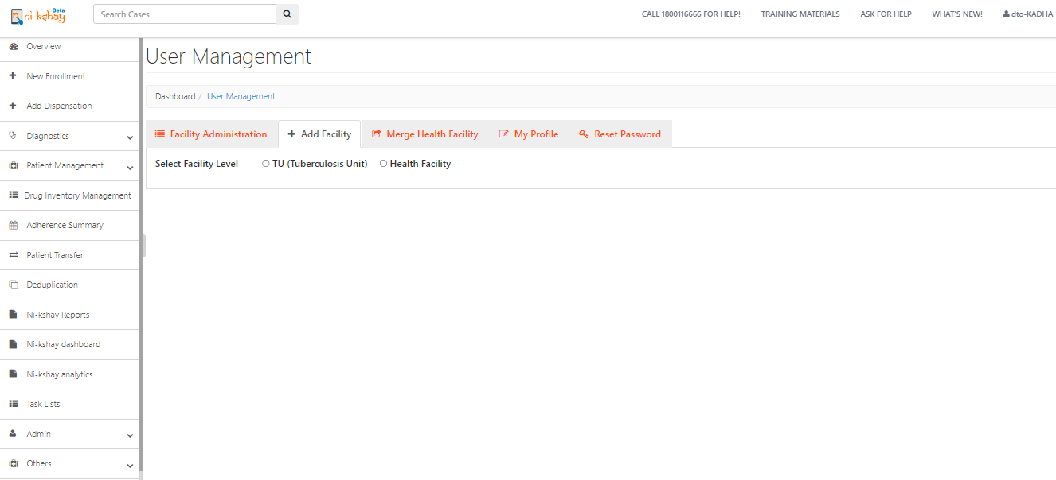
Add TU Healt facility by DTO ID…
Select TU/ Health Facility as required

Slide 17
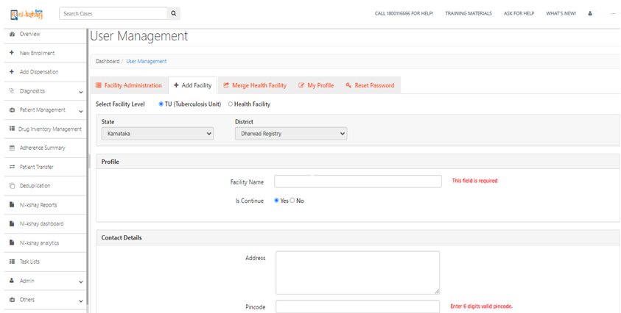
Add TU Healt facility by DTO ID…
Fill in the necessary details
Fill in the necessary details

Slide 18
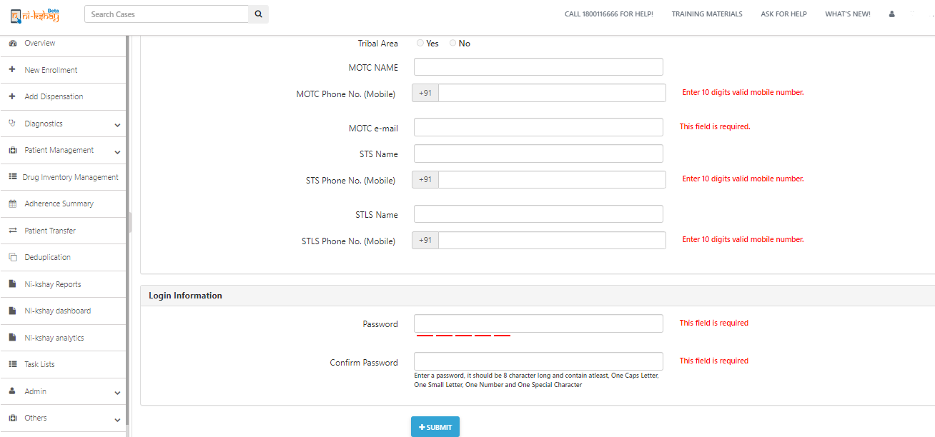
Add TU Healt facility by DTO ID…
Fill in the necessary details
Enter Password
Note the password being entered
Click Submit and wait for confirmation message

Slide 19
Edit/Update Health facilities Self Profile
Click on My Profile tab

Slide 20
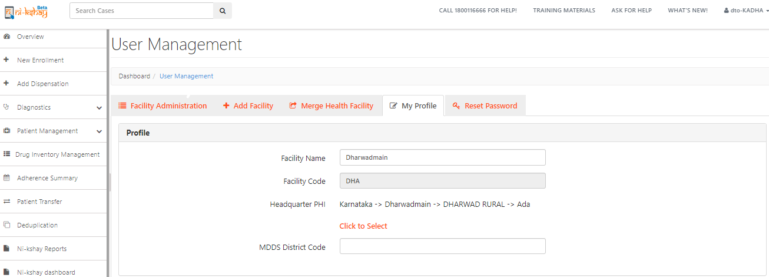
Edit/Update Health facilities Self Profile
Edit as necessary
Edit/Update headquarter PHI - This is essential to ensure patients are transferred to appropriate hierarchy

Slide 21
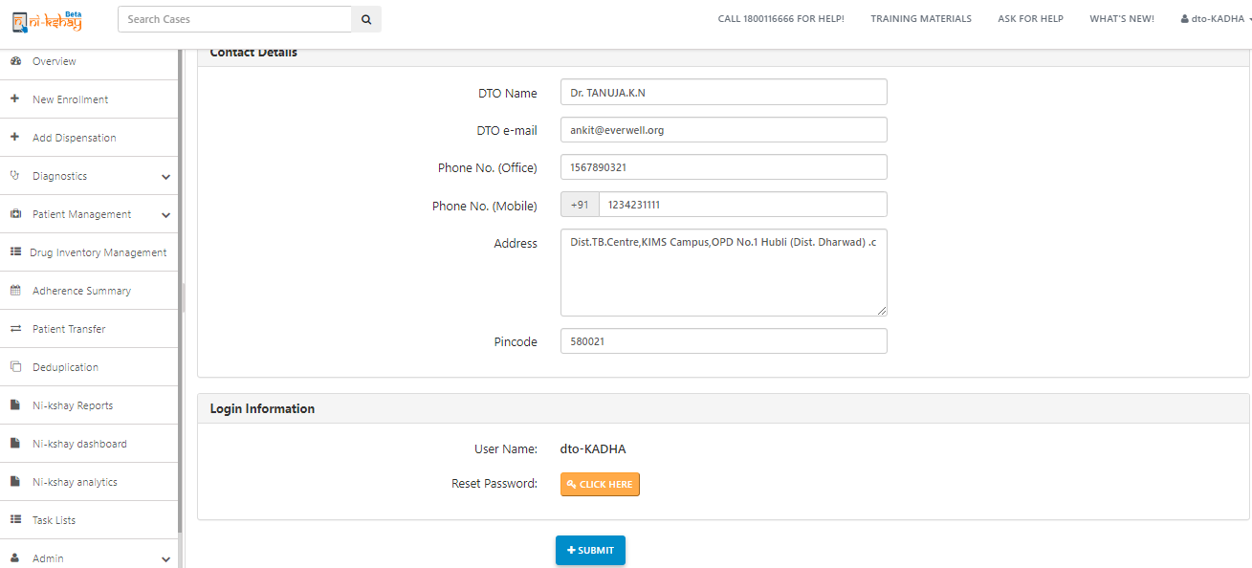
Edit/Update Health facilities Self Profile
Update if any changes in DTO’s profile
Click on submit tab to update changes

Slide 22
Reset Self Login password
Click on My Reset Password

Slide 23
Reset Self Login password
Update new password
Click on submit to reset new password

Slide 24
Reset Self Login password
Click on ok

Slide 25
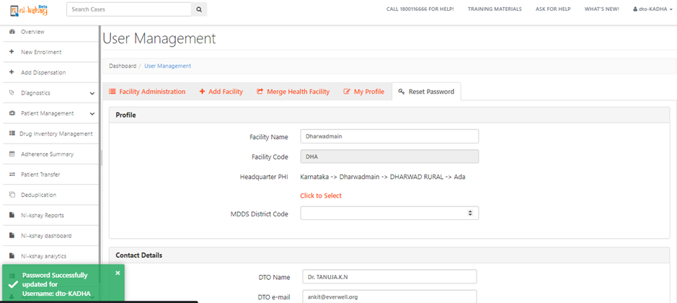
Reset Self Login password
Wait for confirmation message

Slide 26
Note..1
The designated in-charge personnel of the facility is required to maintain their own usernames and passwords and of those below their level in a secure manner.
If a password is created/changed, it has to be maintained securely by the user changing it and communicated to the relevant authority.
Password reset for any facility is available at the same and higher hierarchy (TBU/District/State) and should only be done with the concurrence of the competent authority.

Slide 27
Note..2
Currently we have state and district are mapped with LGD codes in Ni-kshay
The LGD codes for District Panchayat, Census blocks, Gram Panchayat, village level, Assembly/parliamentary mapping would also be available in Ni-kshay
Inorder to update the LGD code, Tribal TBU status and PFMS agency code , user needs to create a ticket on Ni-kshay HelpDesk (https://nikshay-support.atlassian.net/servicedesk/customer/portal/1)

Slide 28
Geo Location mapping for PHIs/Private Health Facilities
In Mobile version of User Management module, user should be able to access the following details:
Facility Location- Capture Geolocation of Level 5 Health Facility only by DTO/TU/level 5 hierarchies it selfs

Slide 29
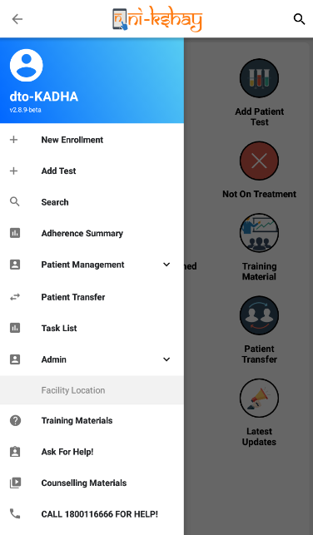
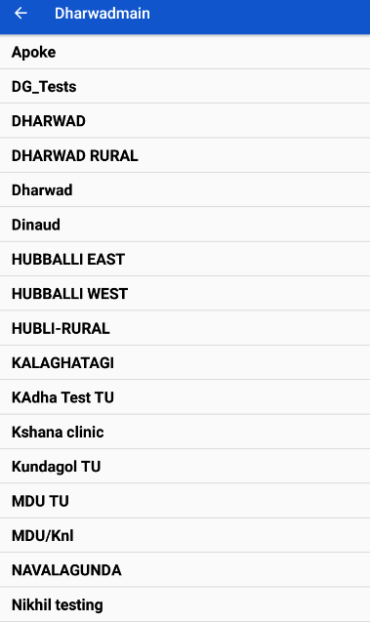
Geo- Location mapping of PHI/Private Health facilities
Create a new tab as “Admin” → Facility Location>> Select TU
Select TU
Click on facility location

Slide 30
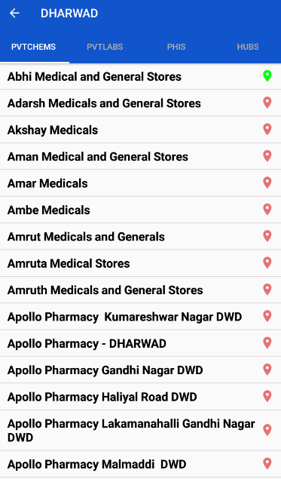
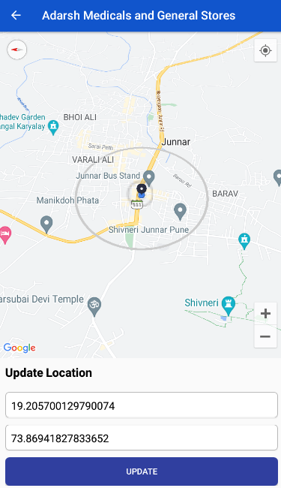
Geo- Location mapping of PHI/Private Health facilities
Create a new tab as “Admin” → Facility Location>> Select TU >> Select Health Facility
Select Health facility
Click on Update tab

Slide 31
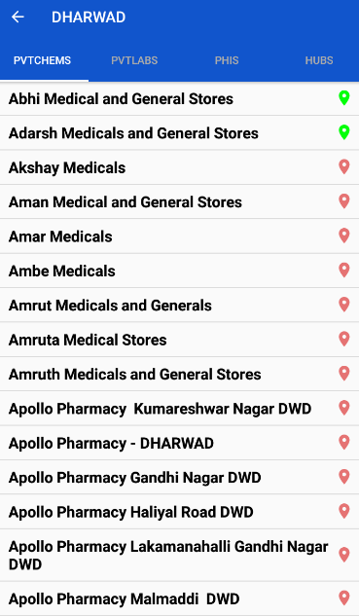
Geo- Location mapping of PHI/Private Health facilities
Create a new tab as “Admin” → Facility Location>> Select TU >> Select Health Facility
Now Geo- location mapping is updated successfully and highlighted in green colour
Note:
“Add Facility” option in User Management module should only be available from Web version of Ni-kshay
In this version of User Management Module in app will allow users to capture only Geo location

Slide 32
Description of Changes
Existing Problem:
Currently in Ni-kshay there are Health Facility records duplicated for various reasons. These erroneous records need to be cleaned by merging all related patient notifications, lab records and users into the original Health facility.
The new feature:
Merge a duplicate Health Facility record into the original record that need to be maintained
User can select the type of Health Facilities that they choose to merge.
When a Health Facility is merged, all linkages with patients, tests, staff, DBT records etc of the Merged Health Facility are relinked to the retained Health Facility. After merging the merged HF will no longer be visible in User Management.
Whenever a Health facility gets merged, a notification is sent to the parent hierarchies (State, District, TU and concerned Health Facilities)

Slide 33
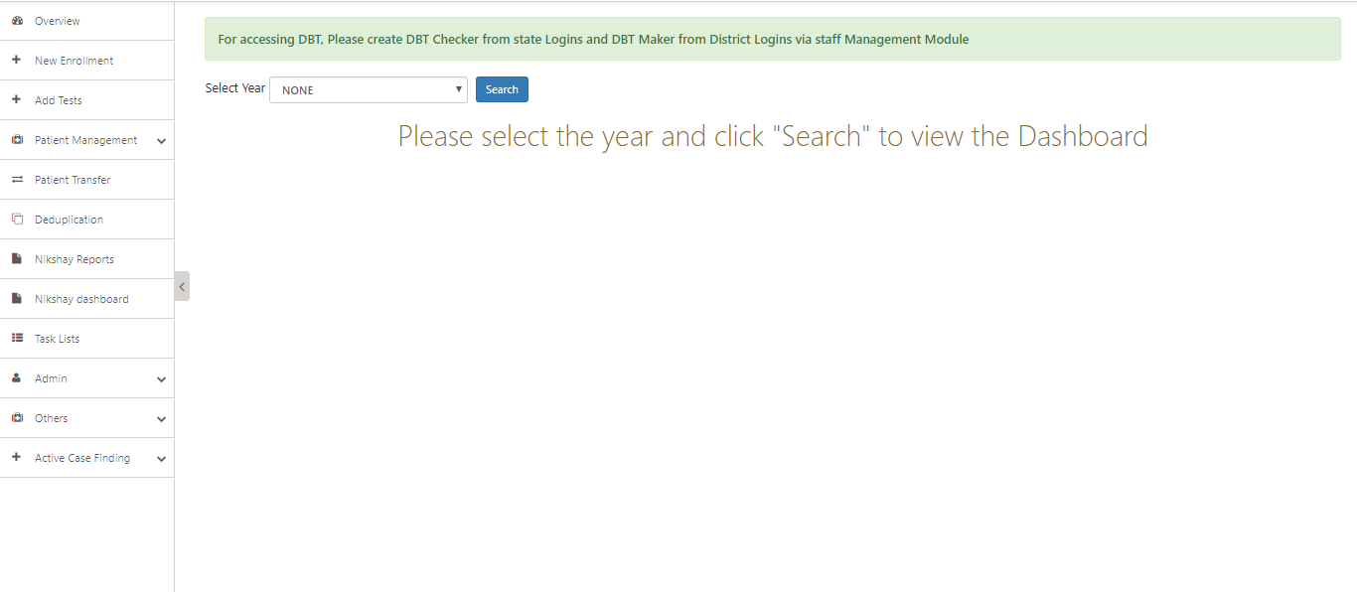
Description of Changes
Step 1
Click on Admin

Slide 34
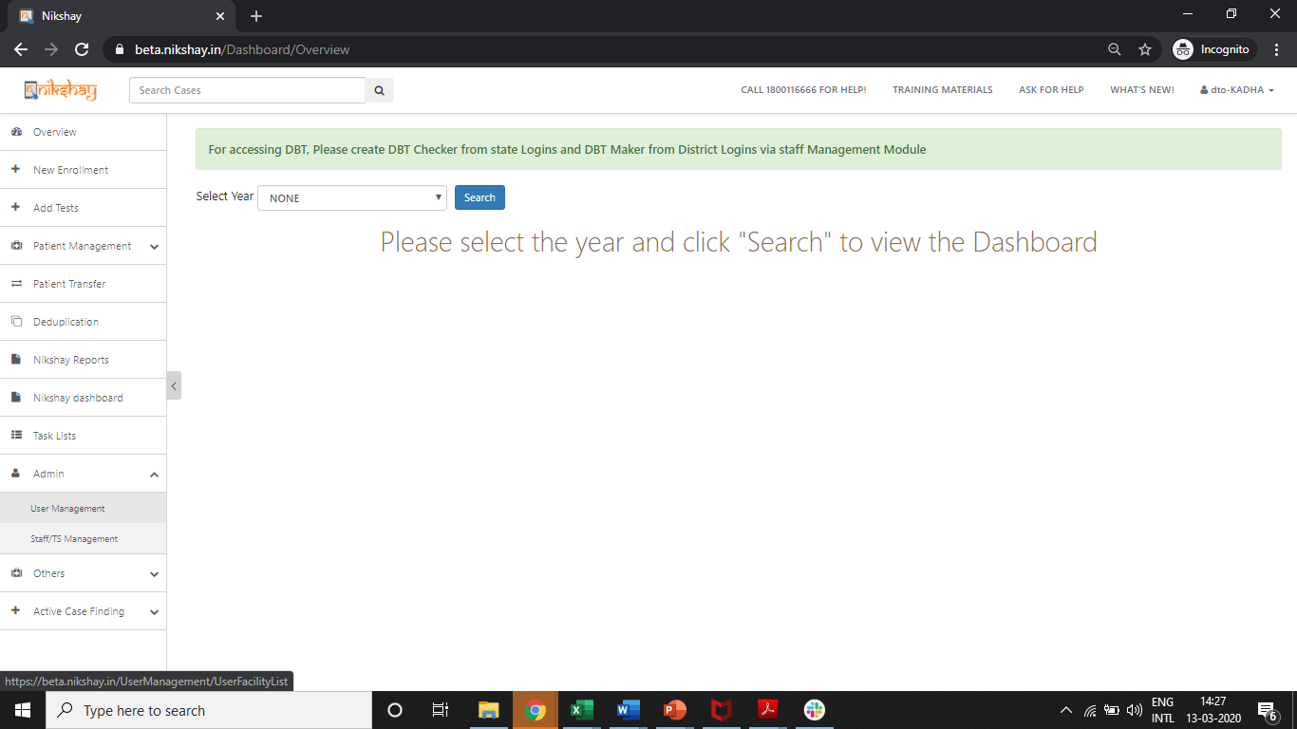
User Management – Merge Health Facility
Step 1
Step 2
Click on Admin
Click on User Management

Slide 35
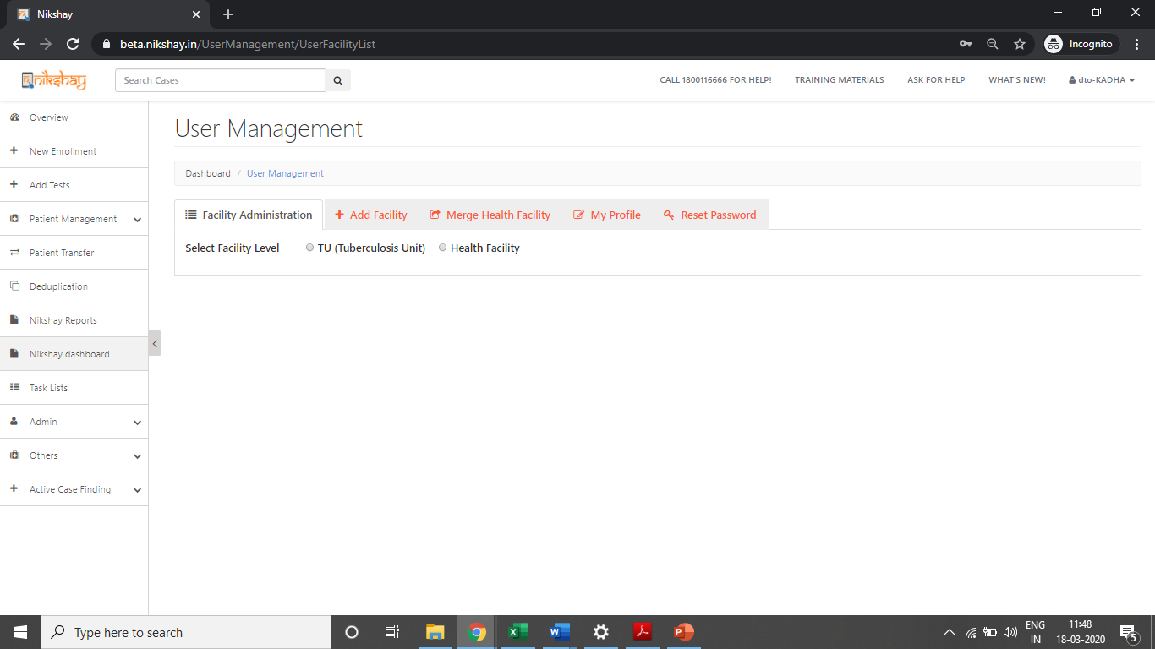
User Management – Merge Health Facility
Step 1
Step 2
Step 3
Click on Admin
Click on User Management
Click on Merge Health Facility

Slide 36
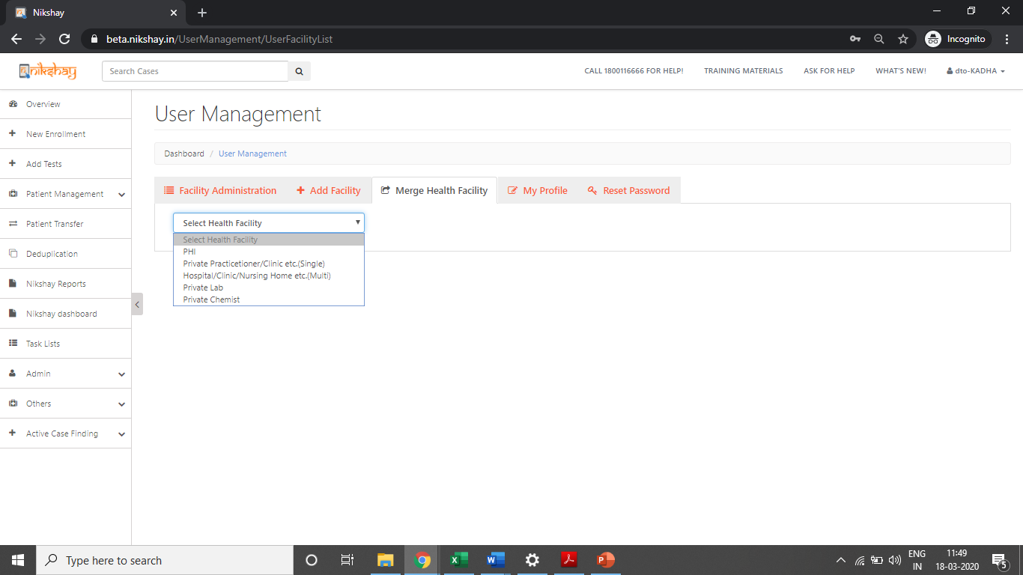
User Management – Merge Health Facility
Step 1
Step 2
Step 3
Step 4
Click on Admin
Click on User Management
Click on Health Facility Merge
Select the Type of Health Facility that is to be Merged

Slide 37
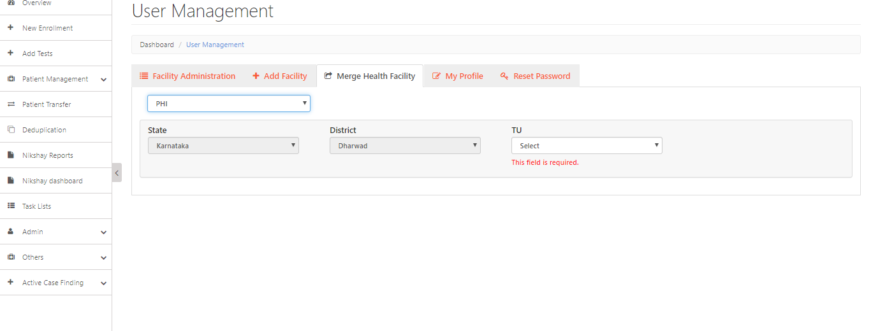
User Management – Merge Health Facility
Step 1
Step 2
Step 3
Step 4
Step 5
Click on Admin
Click on User Management
Click on Health Facility Merge
Select the Type of Health Facility that is to be Merged
Select the TU

Slide 38
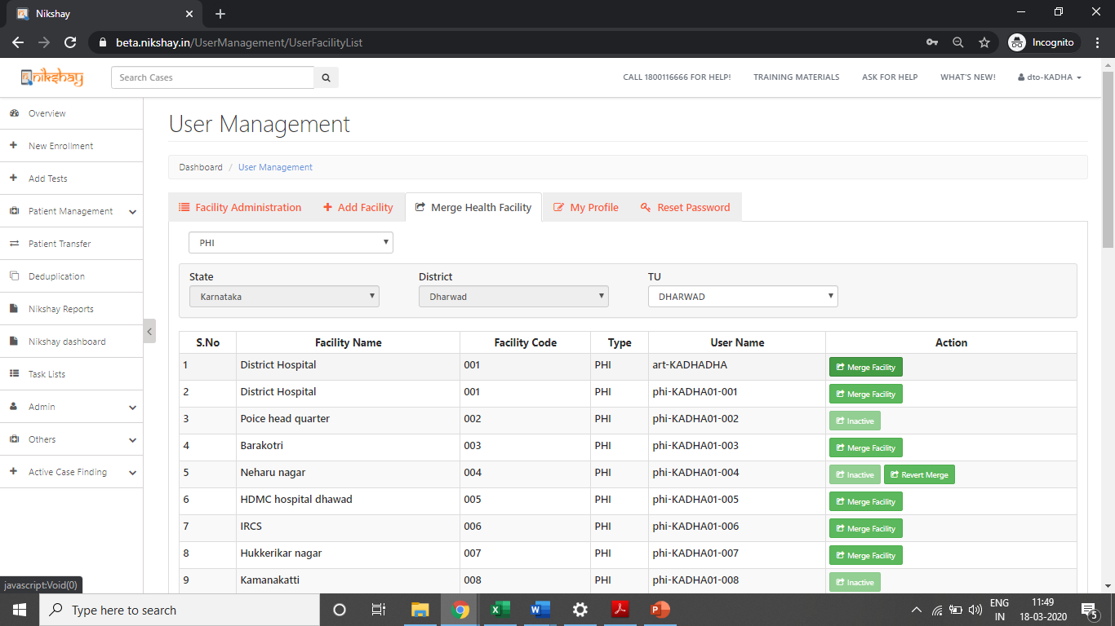
User Management – Merge Health Facility
Step 6
Click on Merge Facility
Select the facility that needs to be merged with another facility. This facility will disappear after the merge is completed
Duplicated record
On Selecting the TU, the list of PHIs that are under the TU are displayed.

Slide 39
User Management – Merge Health Facility
Step 6
Click on Merge Facility
Select the facility that needs to be merged with another facility. This facility will disappear after the merge is completed
Duplicated record
On Selecting the TU, the list of PHIs that are under the TU are displayed.

Slide 40
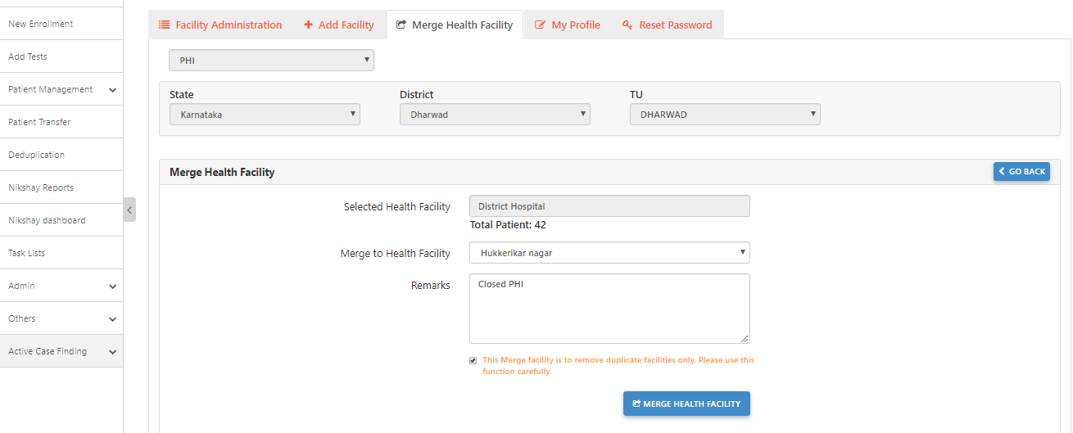
User Management – Merge Health Facility
Step 6
Step 7
Click on Merge Facility
Enter details required and click on Merge Health Facility
Note the number of patient records that this will affect
Select the Health Facility, Enter Remarks and tick the Check Box
Select the Health Facility where the previously selected PHI will be merged into.
This facility will be retained
Click here to process the Merge Request

Slide 41
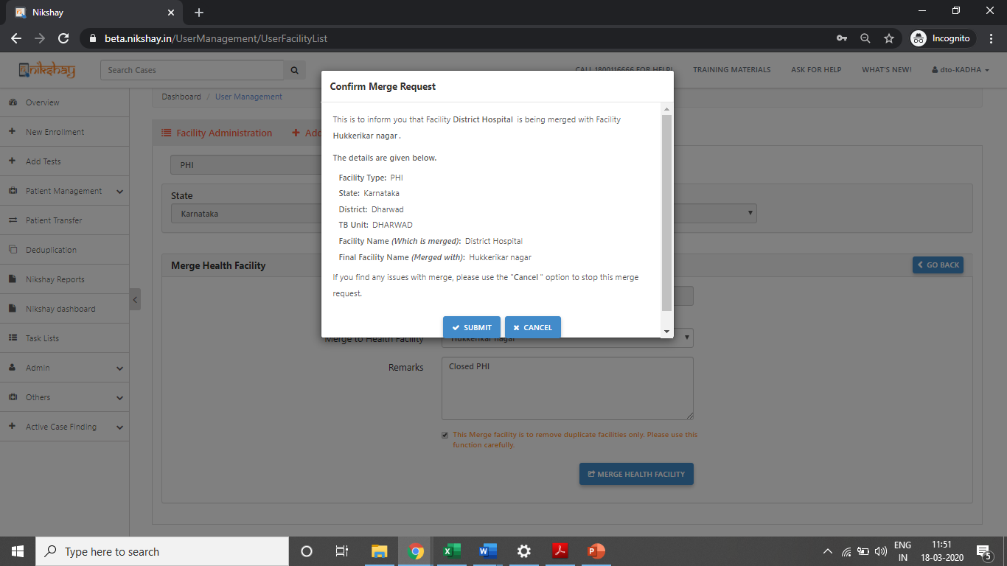
User Management – Merge Health Facility
Step 6
Step 7
Step 8
Click on Merge Facility
Enter details required and click on Merge Health Facility
Click on Submit Button
Review the information before submitting the Merge Request

Slide 42
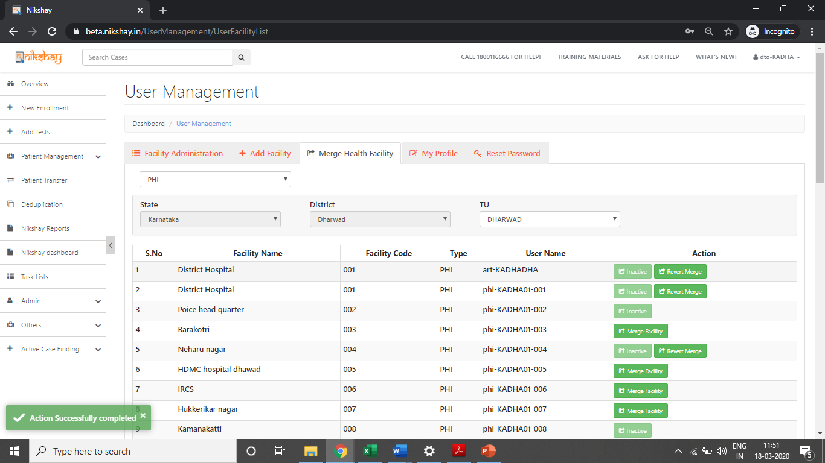
User Management – Merge Health Facility
Message displayed after successful submission of Merge Request
NOTE:
- This is a time-consuming process and may take a few seconds to a few minutes to complete. Please do not refresh or close the page before the success message.
- For merging PHI’s within a TU, with more than 500 patients, Please reach out to Ni-kshay Helpdesk by raising a service request via “Ask for Help” section.

Slide 43
User Management-Revert Merge Health Facility
Step 1
Click on Revert Merge
Facility to Revert Merge appears for 7 days after Merge
NOTE: Please use this function sparingly and cautiously. This may result in errors in data.

Slide 44
Merging Private Health Facilities
In cases, where the Health Facility Type is different, then the base of the Health Facility Merge must be a “Hub”. Eg: If a Hub and Lab is being merged merge, then a Lab can merge into Hub, but a Hub cannot merge into a Lab.
Implications on DBT:
Beneficiary details will be retained, based on the beneficiary status of the merged and retained health facility.
Beneficiary status of the retained health facility will be given a high priority and the corresponding merged health facility beneficiary status will be made inactive.
If the beneficiary status is “Validated” for both the health facilities, then the beneficiary details of the Health Facility that is retained will be kept.

Slide 45
User Management – Merge Private Health Facility
Step 1
Click on Admin

Slide 46
User Management – Merge Private Health Facility
Step 1
Step 2
Click on Admin
Click on User Management

Slide 47
User Management – Merge Private Health Facility
Step 1
Step 2
Step 3
Click on Admin
Click on User Management
Click on Health Facility Merge

Slide 48
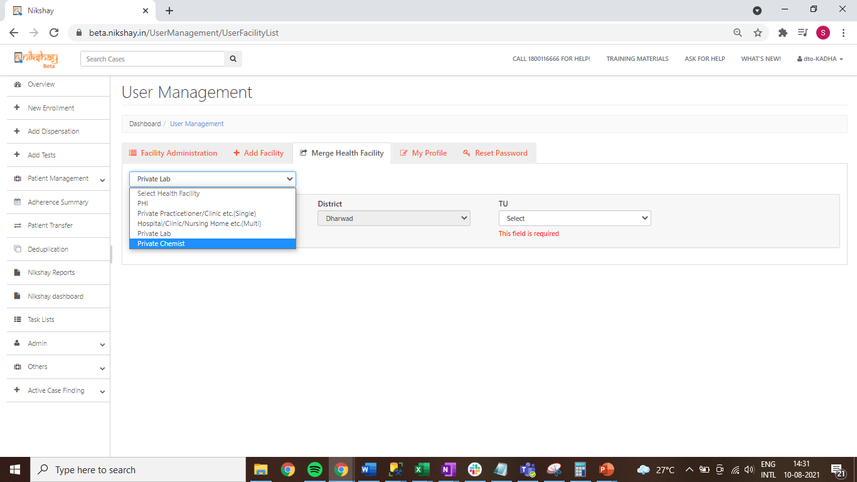
User Management – Merge Private Health Facility
Step 1
Step 2
Step 3
Step 4
Click on Admin
Click on User Management
Click on Health Facility Merge
Select the Type of Private Health Facility that is to be Merged

Slide 49
User Management – Merge Private Health Facility
Click on Admin
Click on User Management
Click on Health Facility Merge
Select the Type of Private Health Facility that is to be Merged
Select the TU
Note: In cases, where the Health Facility Type is different, then the base of the Health Facility Merge must be a “Hub”. Eg: If a Hub and Lab is being merged merge, then a Lab can merge into Hub, but a Hub cannot merge into a Lab.

Slide 50
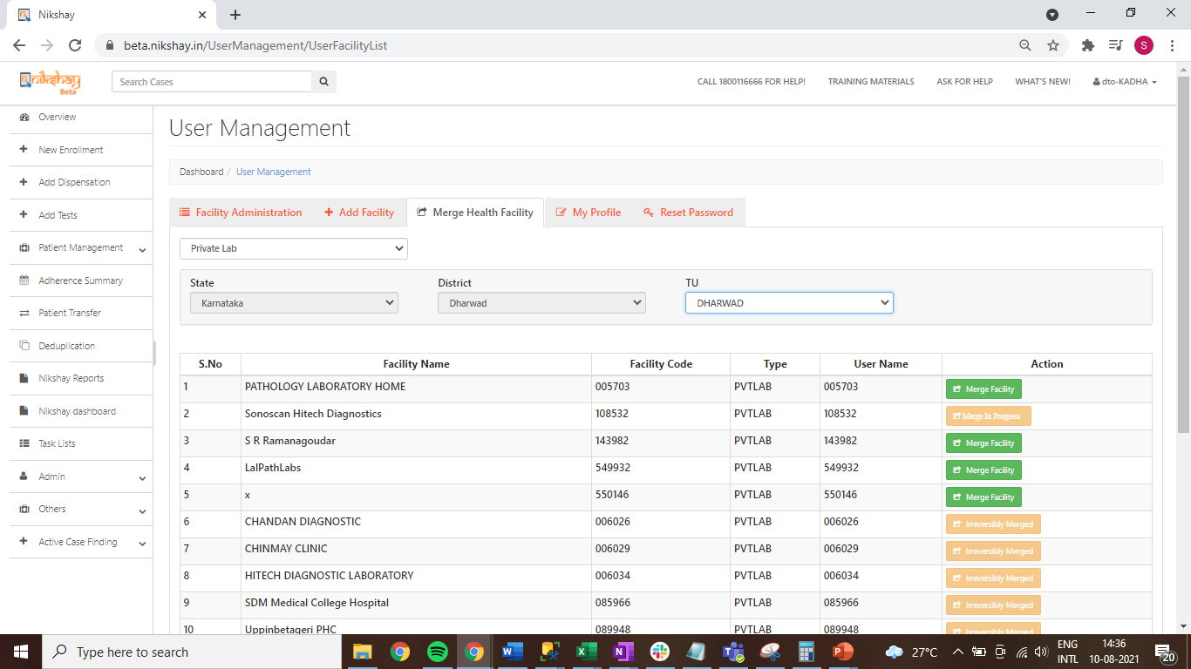
User Management – Merge Private Health Facility
Step 6
Click on Merge Facility
Select the facility that needs to be merged with another facility. This facility will disappear after the merge is completed
On Selecting Private Lab, the list of Labs that are under the TU are displayed.

Slide 51
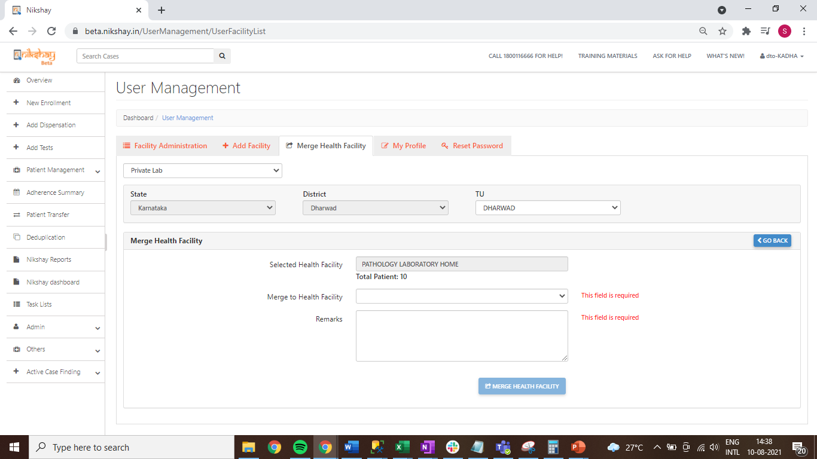
User Management – Merge Private Health Facility
Step 6
Step 7
Click on Merge Facility
Enter details required and click on Merge Health Facility
Note the number of patient records that this will affect
Select the Health Facility, Enter Remarks and tick the Check Box
Select the Health Facility where the previously selected Private facility will be merged into.
This facility will be retained
Click here to process the Merge Request

Slide 52
User Management – Merge Private Health Facility
Step 6
Step 7
Click on Merge Facility
Enter details required and click on Merge Health Facility
Note the number of patient records that this will affect
Select the Health Facility, Enter Remarks and tick the Check Box
Select the Health Facility where the previously selected Private facility will be merged into.
This facility will be retained
Click here to process the Merge Request

Slide 53
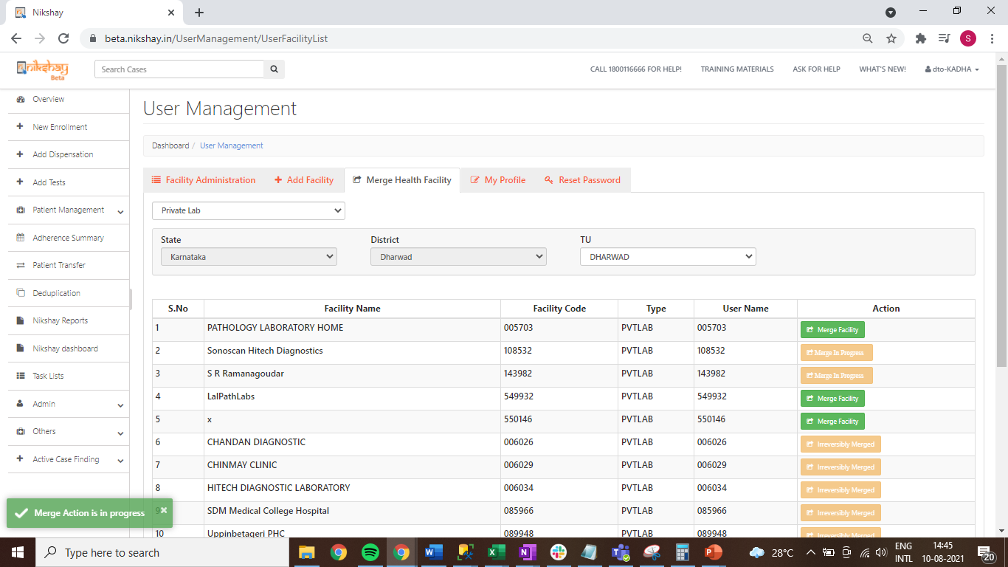
User Management – Merge Private Health Facility
Message displayed after successful submission of Merge Request
NOTE:
- This is a time-consuming process and may take a few seconds to a few minutes to complete. Please do not refresh or close the page before the success message.
- For merging health facilities within a TU, with more than 500 patients, Please reach out to Ni-kshay Helpdesk by raising a service request via “Ask for Help” section.

Slide 54
Standard Operating procedure for Move functionality
- The SOP would be applicable for Health facilities, patients, and staff in Public and Private sector.
- These need to be followed in a sequential manner.
HIERARCHIES:
o The NTEP staff would create the District, TBU, PHI and Private Health facility from the front-end using the User management module in District and TBU Ni-kshay logins.
o The phone number to be used should be different from the one used in the earlier hierarchy, in order to skip the deduplication check. In case a different number is not available, the phone number registered in the earlier hierarchy may be modified to a dummy number and subsequently the phone number may be used for new hierarchy registration.
o The Navigation in Ni-kshay is as below - Select Admin option in left menu 🡪 User Management 🡪 Select District 🡪 Select TU (Same as old hierarchy name) 🡪 Create PHI (Same as old hierarchy name) o Remove/re-assign the HQ PHI if any exists

Slide 55
Standard Operating procedure for Move functionality
o After all the patients are transferred to new hierarchy then users need inactivate the old PHI/PVT HF
o The PFMS Agency code and Tribal status of the hierarchy should be shared with State/CTD for approval and a ticket created on Ni-kshay HelpDesk with all necessary details. (Wherever Applicable
STAFF:
o Users need to register a new staff from the front-end using the Admin module with new mobile numbers for staff migration.(Wherever Applicable)
o The phone number to be used should be different from the one used by the staff in the earlier hierarchy, in order to skip the deduplication check. In case a different number is not available, the phone number registered in the earlier hierarchy may be modified to a dummy number and subsequently the phone number may be used for new hierarchy registration.

Slide 56
Standard Operating procedure for Move functionality
PATIENTS:
o They can transfer the Active TB patients (Diagnosed On treatment & Diagnosed not on treatment patients) from old hierarchy to new hierarchy. Patients who are not active - Diagnosed Closed, Diagnosed Outcome Assigned, Presumptive Closed would not be transferred.
o Users need to login by newly created PHI and follow below steps to request a patient from old hierarchy
o The Navigation in Ni-kshay is as below - Select Patient Transfer option in left menu 🡪 Request in Transfer 🡪 Search Patient ID🡪 Click on Request Transfer In 🡪 Search check the TU & PHI details 🡪 fill the form and click on done tab for requesting a patient.
o After requesting a patient transfer from the old hierarchy the users need to accept the transfer request from the destination hierarchy (From Transfer module).

Slide 57
Scheme wise DBT Impact Under Move Process
Ni-kshay Poshan Yojana Scheme:-
1. Unprocessed benefits will transfer to the new hierarchy.
2. Processed benefit will not move to new hierarchy if benefit under PFMS processing.
3. User should be instructed to clear all backlogs benefits which are already under PFMS process to avoid the rejection.
4. Beneficiary status will change if agency code is different and beneficiary status will change from validated to entered mode, So user should wait for sometime to validate the beneficiary to process the benefits which are coming on to new hierarchy

Slide 58
Scheme wise DBT Impact Under Move Process
Tribal Support Scheme:-
1. Unprocessed benefits will transfer to the new hierarchy if destination TU marked as Tribal area in N-ikshay
2. Processed benefit will not move to new hierarchy if benefit under PFMS processing
3. User should be instructed to clear all backlogs benefits which are already under PFMS process to avoid the rejection.
4. Beneficiary status will change if agency code is different and beneficiary status will change from validated to enter mode, So user should wait for sometime to validate the beneficiary to process the benefits which are coming on new hierarchy

Slide 59
Scheme wise DBT Impact Under Move Process
Treatment Supporter Scheme Impact:-
1. Users can register a staff with new bank details and generate a TSS benefit
2. We will delete all beneficiary bank account number in database which are in old hierarchy to avoid the duplicate pop message while entering bank account details in new hierarchy to same staffs
3. Processed & Unprocessed benefit will not move with patient to new hierarchy
4. Users have the option to pay the old hierarchy benefits which are in status “Approver_Pening”.
5. Kindly follow below steps for payment where benefit under “Approver_Pening” in old hierarchy.
a. users can remove the treatment supporter from other tab where benefits is not processed b. After removing the treatment supporter system will delete the TSS benefit which are under “Approver_pending” in backend

Slide 60
Scheme wise DBT Impact Under Move Process
Treatment Supporter Scheme Impact:-
c. User need re-register same treatment supporter with bank details in new hierarchy
d. User can use the same bank details for payment since we have deleted old beneficiary (Isdeleted= 1)
e. Once beneficiary is validated by PFMS for new staff then you can assign the treatment supporter and create a TSS benefit by TU logins
f. After all this process, user can reassign the same Treatment supporter to patient for further process
g. Create a TSS benefit manually from patient DBT page by TU logins
h. Clear all backlogs benefits which are already under PFMS process to avoid the future rejection.

Slide 61
Scheme wise DBT Impact Under Move Process
Private Sector Notification Scheme:-
1. Processed & unprocessed benefit will remain in old hierarchy
2. Users can register a Private HF with same bank details
3. User will not get the duplicate pop error as we will delete all beneficiary bank account number in database which are in old hierarchy to avoid the duplicate pop message while entering bank account details in new private HF
4. System will generate benefit for Outcome declaration in new hierarchy if patient outcome was not assigned in old hierarchy
5. Clear all backlogs benefits which are already under PFMS process to avoid the future rejection.

Slide 62
Scheme wise DBT Impact Under Move Process
Important key points before creation of new PHI/PVT HF & STAFF in new hierarchy & transfer of the patient.
o Payment should be done where benefits are already in PFMS under process for patient & staff (Treatment supporter) and don't send/Approve newly created benefits to the Maker level (TU)/Checker level (district) for payment while transferring the patient.
o For the patient & staffs beneficiary status which are under sent mode need to be validated before transfer request.

Slide 63
Thank You

