Slide 1
Update of TB Preventive Treatment (TPT) Enrolment Form

Slide 2
Background
. The TB Preventive Treatment (TPT) Module went live on Ni-kshay on 24th March 2022. Through the module users were able to register and track the management and add Dispensation, Adherence, and Comorbidity details for the TPT beneficiaries.
In 2023-24, the program priority for TPT is institution-based mapping of other risk groups for TPT by districts. To ensure that all eligible individuals receive preventive treatment, and to ensure that the form caters to all sections of society, relevant changes are to be made to the TPT Enrolment Form.

Slide 3
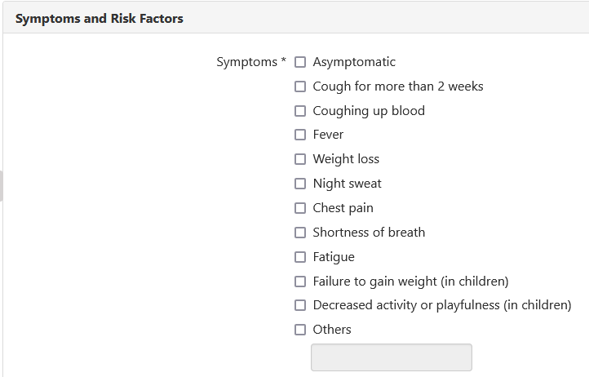
Updating of Symptom Options
Current Symptoms | Task | Proposed Symptoms
None of the Above | Renamed | Asymptomatic
Coughing for more than 2 weeks | Renamed | Cough for more than 2 weeks
Coughing up blood | Retained | Coughing up blood
Unexplained fever for more than 2 weeks | Renamed | Fever
Night sweat | Retained | Night sweat
Unexplained Weight loss | Renamed | Weight loss
 | New | Chest pain
 | New | Shortness of breath
 | New | Fatigue
 | New | Failure to gain weight (in children)
 | New | Decreased activity or playfulness (in children)
 | New | Others
Updated list of Symptoms

Slide 4
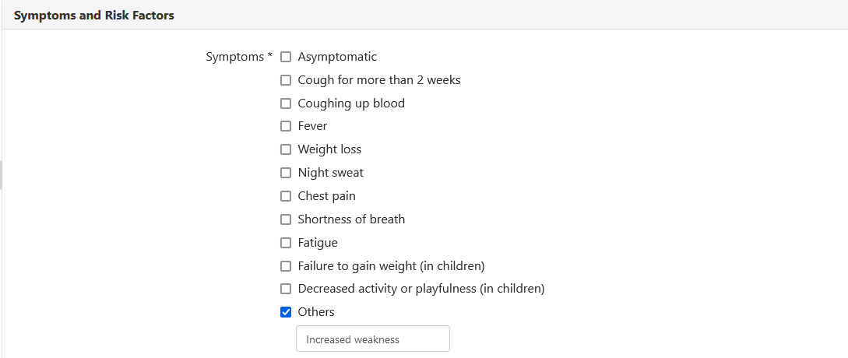
Option to enter additional Symptoms

Slide 5
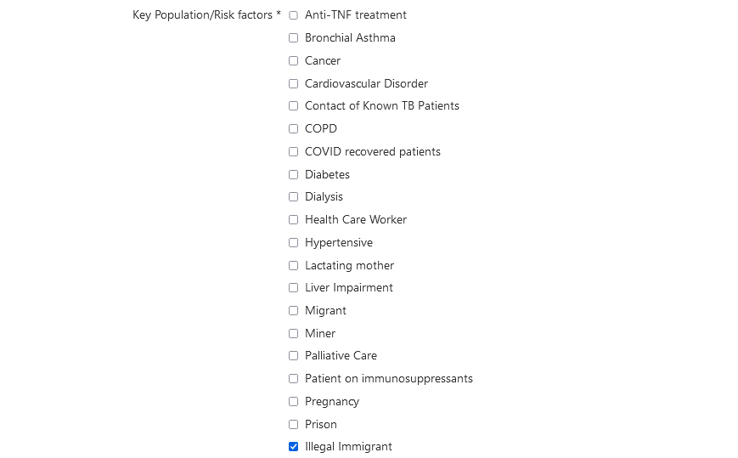
Refugee replaced to Illegal immigrants

Slide 6
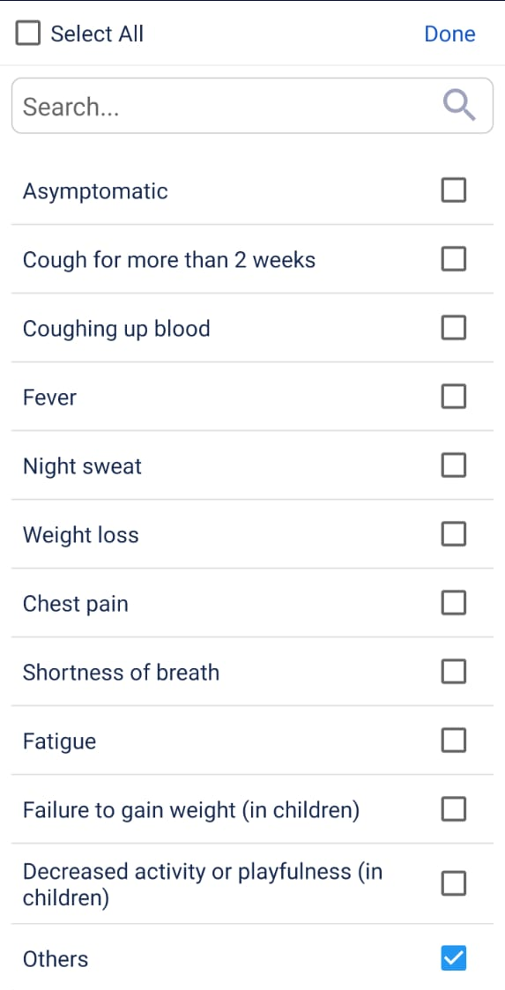
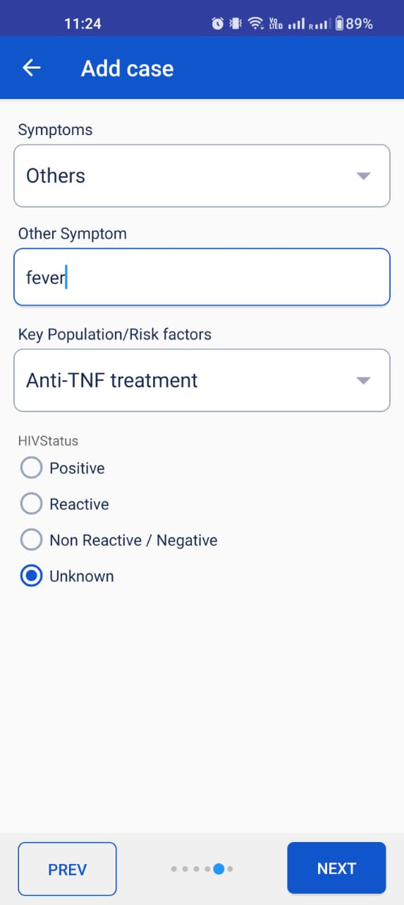
Updating of Symptom Options - APP
To enter ‘Other’ Symptom, select the ‘Others’ checkbox and click on ‘Done’ to view the textbox to enter other symptoms not present in the lsit
Updated list of Symptoms

Slide 7
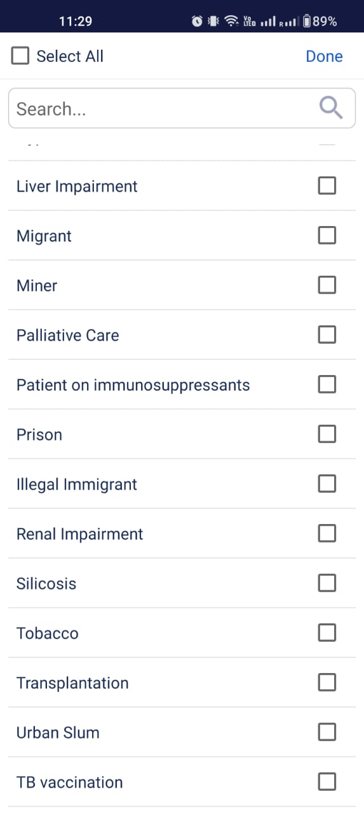
Refugee replaced to Illegal immigrants - App

